Slide 1
Input from JLab Management and Physics Division
Cynthia Keppel
SoLID Collaboration Meeting
December 7,8, 2023
Jefferson Lab

Slide 2
Highlights from the Lab
12 GeV scientific era is going strong
– ~30 weeks operation in FY23 and FY24 (planned), enabled by supportive Operations budget
– High-profile results emerging from 12 GeV program
– Progressing on CPP with CM refurbishments, C75 CM construction and spares purchased, accelerator uptime improved!
Successful partnership with BNL in management, design, construction of EIC Project
MOLLER Project well underway
Exploring exciting scientific opportunities enabled by cost-effective and technically innovative CEBAF upgrade concept
Joint JLab/User committee formed, accelerator/theory/physics
Expect invites to talk, workshops,….
HPDF approved for Jefferson Lab site!
Other initial steps toward diversifying Jefferson Lab’s scientific mission – BES, HEP,…
2

Slide 3
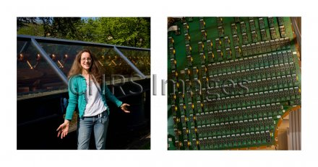
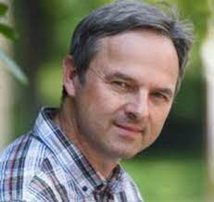
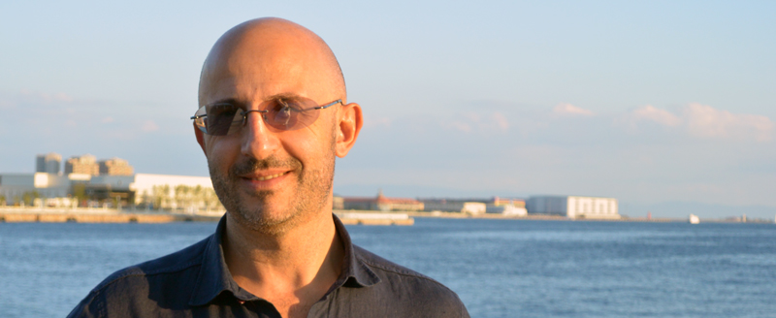
Program Advisory Committee - PAC52 will be held during the week of July 8, 2024 - The deadline for submission of proposals will be sent out in early 2024 Committee Member Changes - Barbara Erasmus and Matthias Grosse Perdekamp to rotate off - New Incoming Chair (one year overlap, Markus Diehl still Chair) Pasquale DiNezza (INFN) - Also Krešimir Kumerički (University of Zagreb), Cynthia Hadjidakis (Université Paris-Saclay/CNRS)

Slide 4
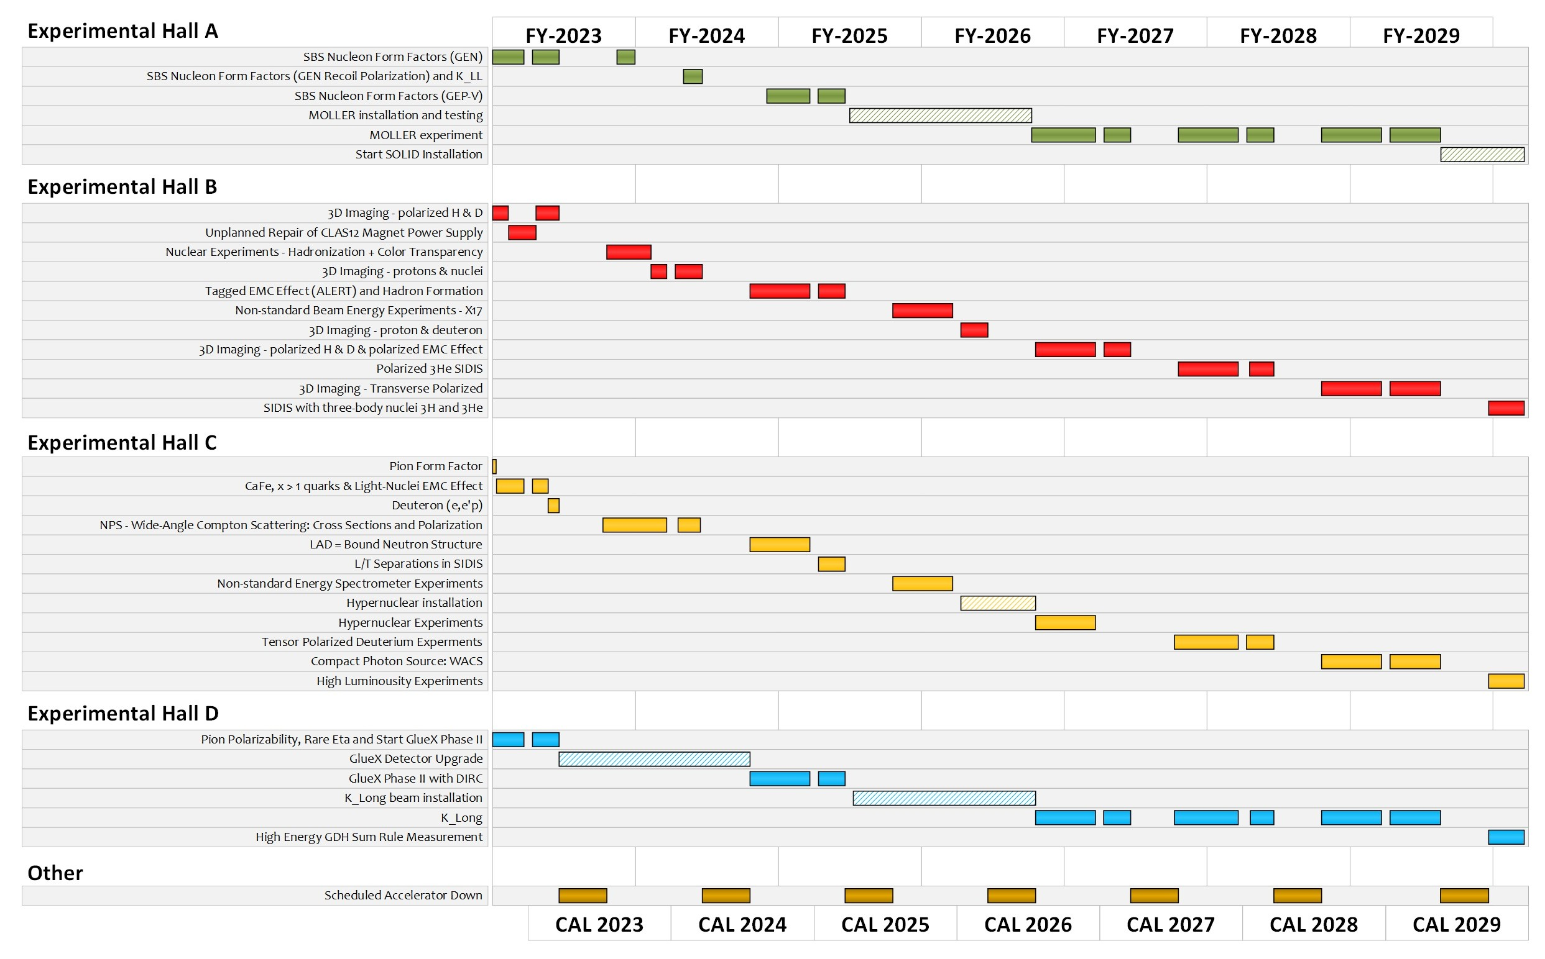
Extended Experimental Schedule – less certain! planning!
SoLID installation
could start ~mid-FY29
86% complete in
FY29 without SoLID, 70% complete with
SoLID (assuming optimal running operation)
…not including new proposals
May move into upgrade era
4

Slide 5
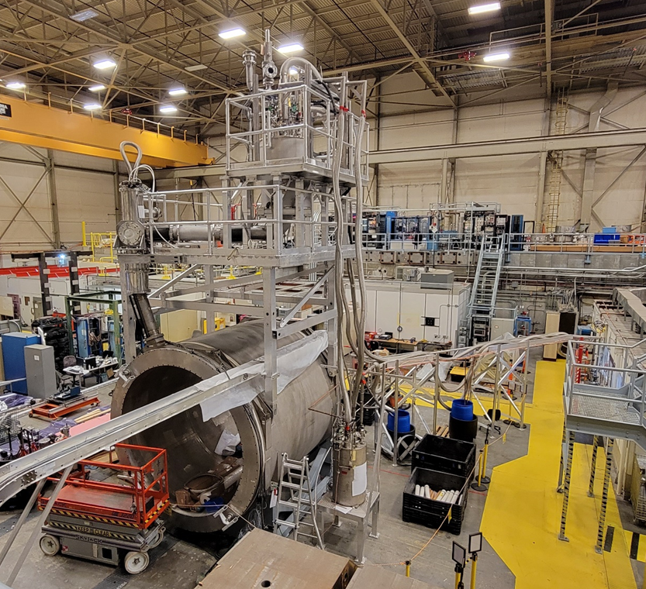
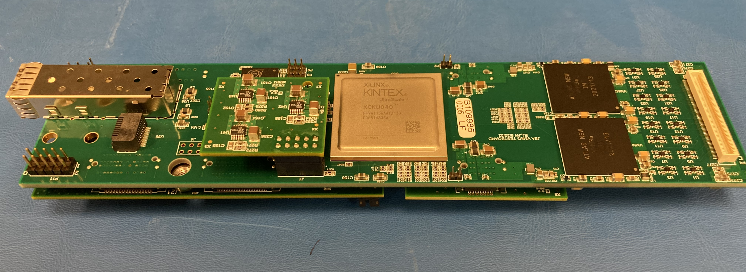
For SoLID specifically…. Capital and preR&D support thus far
Instrumentation and testing of CLEO magnet
Data Acquisition Development
Warmup began early this year
Can test (low fields) as possible
1st DOE funded SoLID pre-R&D project completed
- $400K for DAQ@JLab, $600K for detector @ user groups (ANL, Duke, Temple, UVa)
2nd DOE funded pre-R&D for 2022/2023
- $140K for DAQ @ JLab, >$200K for detector test through user groups (UVa for ECal beam test, NMSU for Cherenkov Mirror test)
VMME prototype

Slide 6
Recently, DOE NP suggested that the laboratory look at ways to “redirect” additional funds to SoLID
Even with SoLID well supported by the Long Range Plan, the office is not encouraging about new projects at this time
”Redirect” is a possible way to reduce project ask (can’t change total project cost), continue development, and keep SoLID moving
But, it’s a tricky path…
SFP+ (Ethernet)
Base board
VMM
FPGA
To GEM
VMM
FPGA power mezzanine
MGT power mezzanine
VMM power mezzanine
Can’t look like we have extra funds sitting around – risk budget reduction
We DON’T have extra funds sitting around – so other efforts will suffer
There are “color of money” as well as project rules what we can and can’t spend on

Slide 7
We’re working on a plan, have two sources to use….
1. Capital Equipment: MUST be “piece” of equipment for general experimental use
2. Operations Support: Comes from Hall A budget, need to support MOLLER and SoLID
Data Acquisition “System”
－ Just approved this DAQ capital project, synergistic with multiple efforts at the laboratory, ~$2.6M total over a couple years, can possibly expand
Other ideas
－ Continue magnet testing and preparations under operations – can redirect some salaries that are already planned for Physics (reduce project ask and impact Hall A resources)
GEM development, part of laboratory strategic planning (MPGD expertise, Center development), likely largely capital (must negatively impact some future developments in other Halls such as Hall B high lumi, Hall D Klong, Hall C TDIS, positron program development,…)
Calorimeter development – same concerns but even less general
Hall Infrastructure – can redirect some salaries that are already planned for Physics (reduce project ask and impact Hall A resources)
7

Slide 8
US-based MicroPattern Gaseous Detector Center
- a Proposed National User Facility
Need for US-MPGD center for NP, HEP, Applications,…
Large number of US institutions engaged in MPGD activities
limited inter-disciplinary interaction between the institutions
The community needs a dedicated US-based MPGD User Facility with a:
Production workshop like to the SiDet Facility for at FNAL
Detector R&D Lab like the RD51 / GDD Lab at CERN
US-MPGD center will be greatly beneficial for EIC detector development
Jefferson Lab is an excellent place for an MPGD center in the US
At the forefront in the deployment of large MPGDs in NP experiments
In-house MPGD expertise and beam test capabilities for MPGD tests
MPGD Center @ JLab: RD51 / GDD-like R&D Lab
GDD-RD51 Lab @ CERN
MPGD Production Workshop
Similar to SiDet Facility at FNAL, or MPT workshop at CERN
Fabrication of large MPGDs (µRWELLs, GEMs, flexible PCBs…)
MPGDs production for detector R&D and prototyping for the community
MPGD Detector R&D Lab
Similar to the RD51 / GDD Lab at CERN ➔ in-house and external users' space with local technical and scientific support team
Equipment and Instrumentation for detector assembly, testing, irradiation, high-rate and aging studies..
Exchange of ideas between MPGD detector development groups
MPGD Center @ JLab: MPGD Production Facility
Large area resistive MPGD
Magnetron sputtering machine

Slide 9
How best to move SoLID forward?
Keep highest priority in Long Range Plan (LRP) – very important!
The DOE is thinking how to fund SoLID, which may require some laboratory support
Looking at how to stage project, request some initial step?
Looking at items to perhaps remove from project and fund on Operations
Look at NSF and foreign contributions
Will work with Collaboration on the above AFTER the LRP resolution meeting
Will continue to support pre-R&D
But, be careful – we are at “no showstopper stage”, nothing can be necessary
Can propose risk or cost reduction tests
Consider bonding with EIC for streaming, ML, heterogenous computing
Slide from last Collaboration meeting – we’re making progress!!
9

Slide 10
How best to move SoLID forward?
Keep highest priority in Long Range Plan (LRP) – DONE!!!
The DOE is thinking how to fund SoLID, which WILL require some laboratory support
Looking at items to perhaps remove from project ask and fund on Operations, Capital – aiming to submit a draft plan to DOE in December
Not just funds, this planning takes Director support, budget office, Division resources
NSF and foreign contributions will help!!!
Will work with Collaboration on the above AFTER the LRP resolution meeting
Will continue to support pre-R&D
But, be careful – we are at “no showstopper stage”, nothing can be necessary
Can propose risk or cost reduction tests
Collaboration should strongly consider bonding with EIC for streaming, ML, heterogenous computing
NOW!!!
10

Slide 11
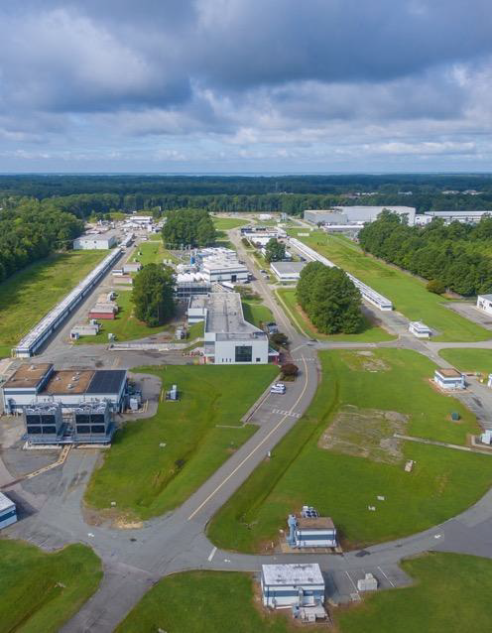
Summary
The Lab is in a strong position moving forward
Supportive funding for CEBAF Operations
Our priorities are clear:
Ensuring that the 12 GeV program is successful in all facets – including SoLID!*
Moving EIC forward
HPDF approved
Laying the groundwork for an exciting role for CEBAF in the EIC era – positrons and 22 GeV
Diversifying Jefferson Lab’s scientific mission
11

