Slide 1
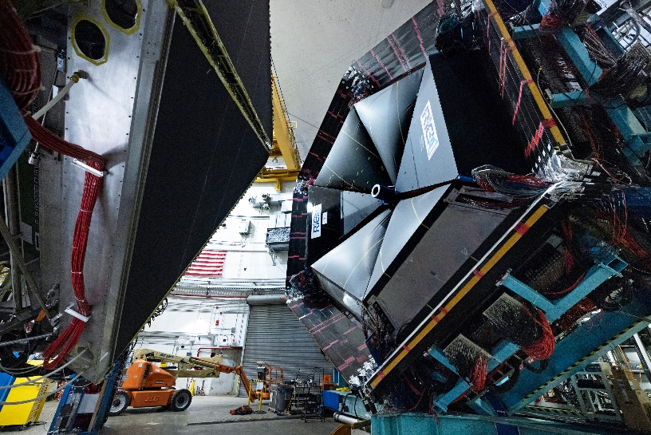
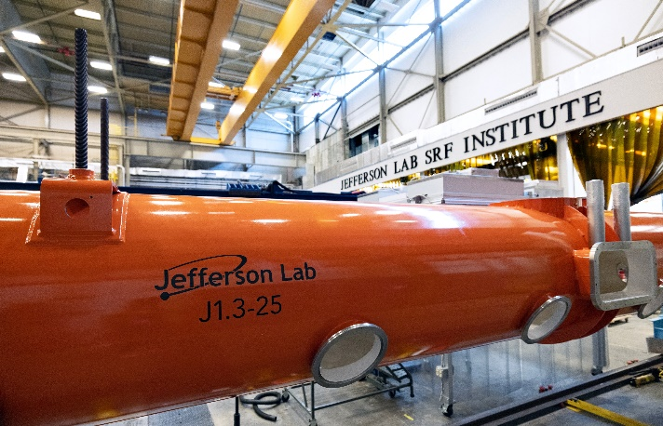
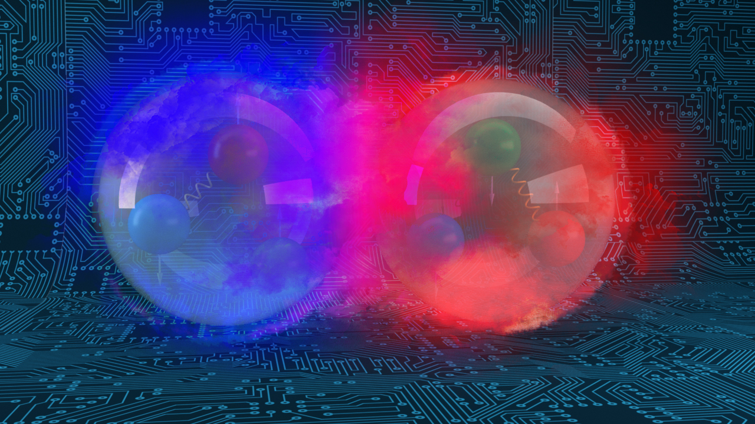
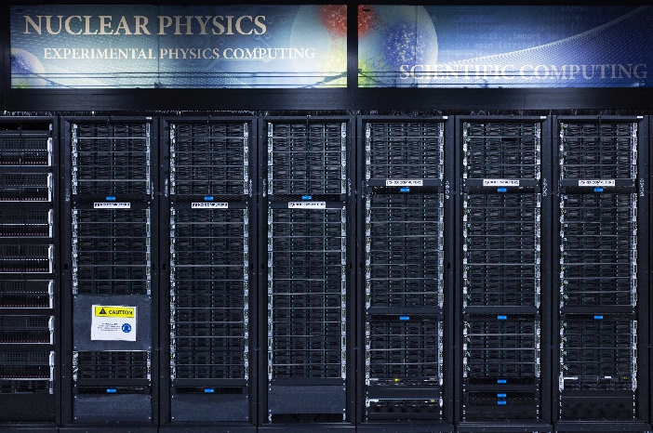
Jefferson Laboratory Overview
David Dean
Deputy Director
Presented To:
CLAS Collaboration
November 7, 2023

Slide 2
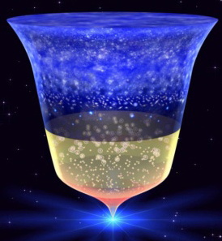
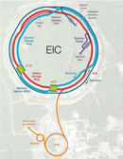
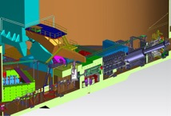

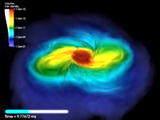
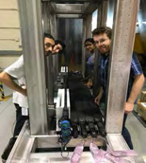
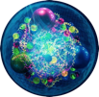
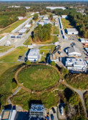

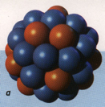

Nuclear Physics: From Small-x to Heavy Nuclei
2023 LRP Science Questions
How do quarks and gluons make up protons, neutrons, and, ultimately, atomic nuclei?
How do the rich patterns observed in the structure and reactions of nuclei emerge from the interactions between neutrons and protons?
What are the nuclear processes that drive the birth, life, and death of stars?
How do we use atomic nuclei to uncover physics beyond the Standard Model?
Gluons
Fundamental Symmetries
Neutron Star Mergers
Quarks
Nuclear Properties
It takes facilities, people, and funding to tackle these challenging questions

Slide 3
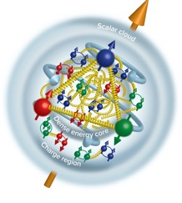
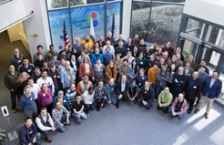
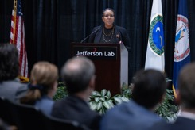
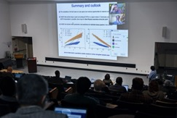
News and highlights
High-impact scientific results are flowing from CEBAF 12 GeV Program
Very extensive upgrades and improvements carried out in complex Scheduled Accelerator Downs
  Installation of the C100-9R/2L26 C100-5R
  Implementation of plasma processing for cryomodules
January 9-11 EPIC Collaboration meeting (EIC detector)
Electron-Ion Collider OPA Status Review held January 31-February 2 at JLab
MOLLER CD-3A/Status review January 10-12, 2023. CD-3A approved on March 27, 2023; CD-2/3 review (October 3-5, 2023)
Dr. Berhe visits the Laboratory and kicks of the BRIC
Actively pursuing diversification of Jefferson Lab’s mission and planning for the CEBAF future
  CEBAF Science at the Luminosity Frontier, January 23-25, 2023
  HPDF Proposal Submitted
Active participation in the NSAC Long Range Plan (LRP)
EPIC Collaboration meeting
SC Director Berhe Visit
Science of 22 GeV

Slide 4
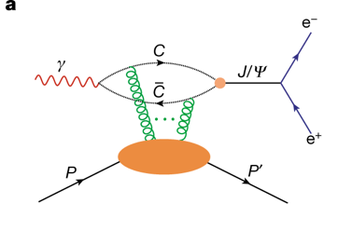

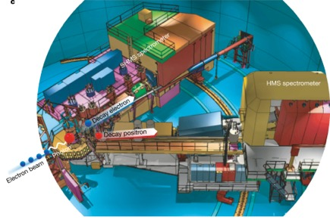
CEBAF Experiment Finds Gluon Mass in the Proton
Near threshold J/psi photoproduction experiment
Inner Gluon radius: 0.52 +/- 0.03 fm
Charge radius: ~0.84-0.88 fm
Scalar gluon rad: 1.069+/-0.056 fm
Measured in Hall C
“Determining the gluonic gravitational form factors of the proton," Duran et al, Nature 615, 813 (2023)

Slide 5
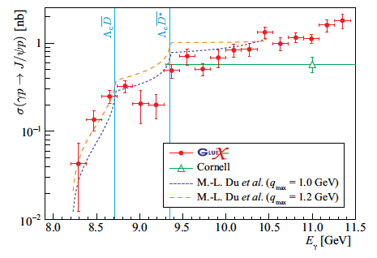
Measuring J/Psi Production
Photoproduction of γp→J/ψp close to threshold
Large theoretical interest!
2-gluon exchange probes the gluonic structure of the nucleon
Relation of dσ/dt to gravitational form factors of the nucleon
Relation to the EMT trace anomaly and nucleon mass
Probing the nature of LHCb Pentaquark (P →J/ψp): BR<few %
1st paper: Ali et al, PRL 123 (2019) >160 citations
2nd paper Phys. Rev. C108, 025201 (2023) (4x data)
Presented by Lubomir Pentchevat QNP18, QNP22, DIS23; by E.Ch. At SPIN18, HADRON23
Hall D

Slide 6
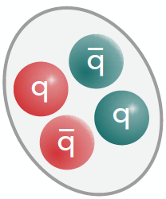

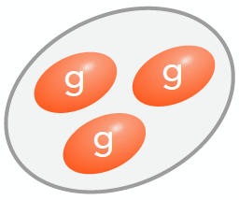
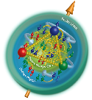
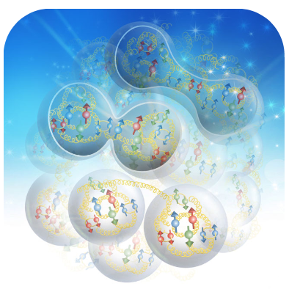
Theory guides and supports the experimental program
Research aligns with the JLab Agenda focusing on:
Nuclear Physics at CEBAF
Electron-Ion Collider
Computation for NP
DEI, Outreach & Training
Hadron Spectrum:
JLAB
COMPASS
BESIII
LHCb
EIC
…
Lattice QCD
Experimental
data
Amplitude
Analysis
Amplitude
Analysis
Thrust area 1:
Hadron Spectrum - LQCD
Resonances & exotic/hybrid hadrons
Thrust area 2: Hadron Spectrum - JPAC
Hadron Structure - Partonic:
Global analysis
JLAB
COMPASS
RHIC
LHC
EIC
…
Lattice QCD
Experimental
data
Thrust area 3:
Hadron Structure - LQCD
Factorization
Factorization
3D partonic structure PDFs, TMDs, GPDs, …
Thrust area 4: Hadron Structure – Partonic analysis
Hadron & Nuclear Structure - Effective:
HUGS-2023
HUGS-2023
Thrust area 5: Hadron Structure
– Low energy properties & EFTs
Low energy properties
Mass, spin, …
Low energy
EFTs
Nuclear few body
systems
Nuclear Properties & Structure
Thrust area 6:
Nuclear Few Body Systems
Data, LQCD

Slide 7
FY23 Scheduled accelerator Down
New Injector will reduce helicity correlated asymmetries for MOLLER.
Installed cryomodules and plasma processing will increase energy reach.
Upgrade of Personnel Safety System in South Linac. Certification once per year is considered.
All SAD-scheduled major activities are completed; hot checkout is in progress.
Booster
C100-10R
98 MV
PSS Upgrade in South Linac
North Linac
energy gain +98 MV
0L02
1L26
Drift tube
New Injector Phase 2
Installed
2L26
C100
76 MeV
2L25
C100
84 MeV
2L24
C100
80 MeV
2L23
C100
82 MeV
2L22
C100
90 MeV
South Linac
energy gain +50-60 MV
C100-05R
98 MV
Plasma processing

Slide 8
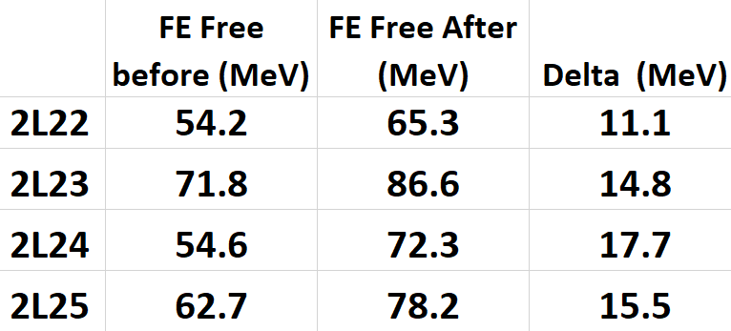
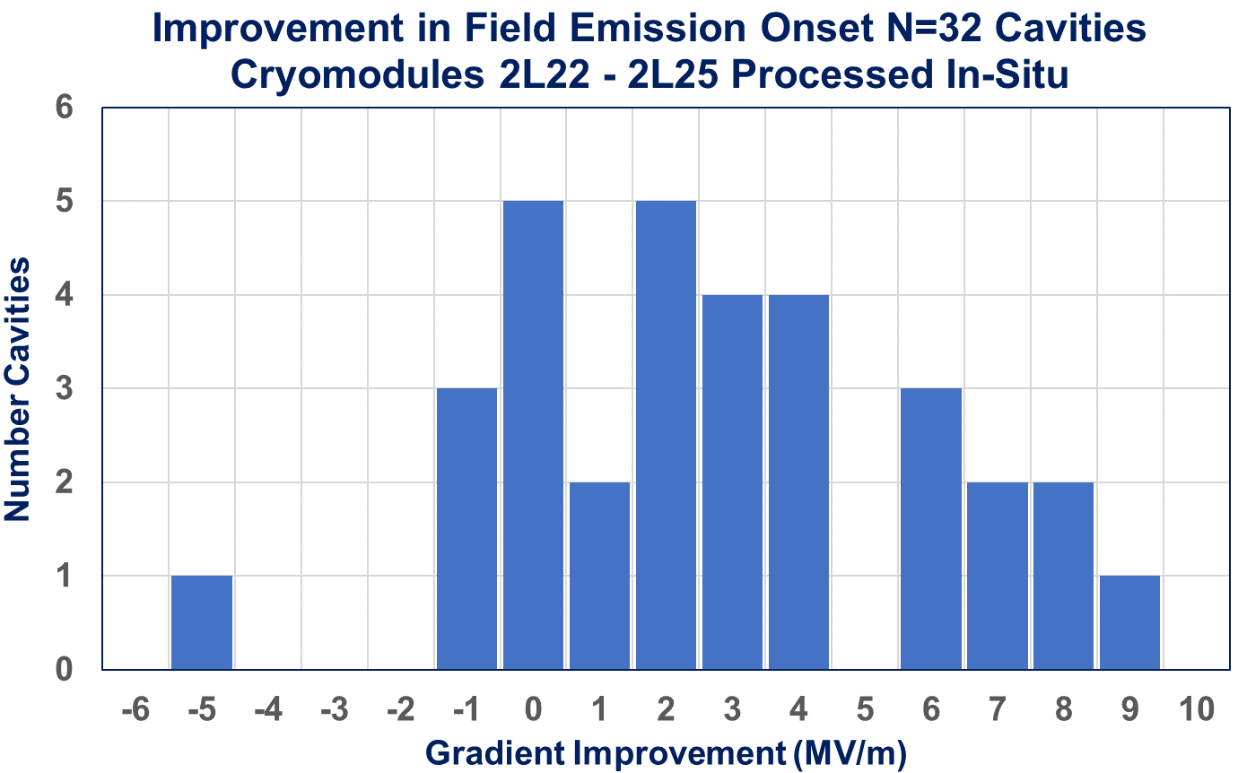
In-situ plasma processing increased gradient by 2.7 MV/m
Average Increase
is 2.7 MV/m
Field emission free operation was improved by 59.1 MeV (24%)
An average improvement of 2.7 MV/m
5 cavities were field emission free after processing
Successful demonstration of plasma processing will speed up growth of the CEBAF energy

Slide 9
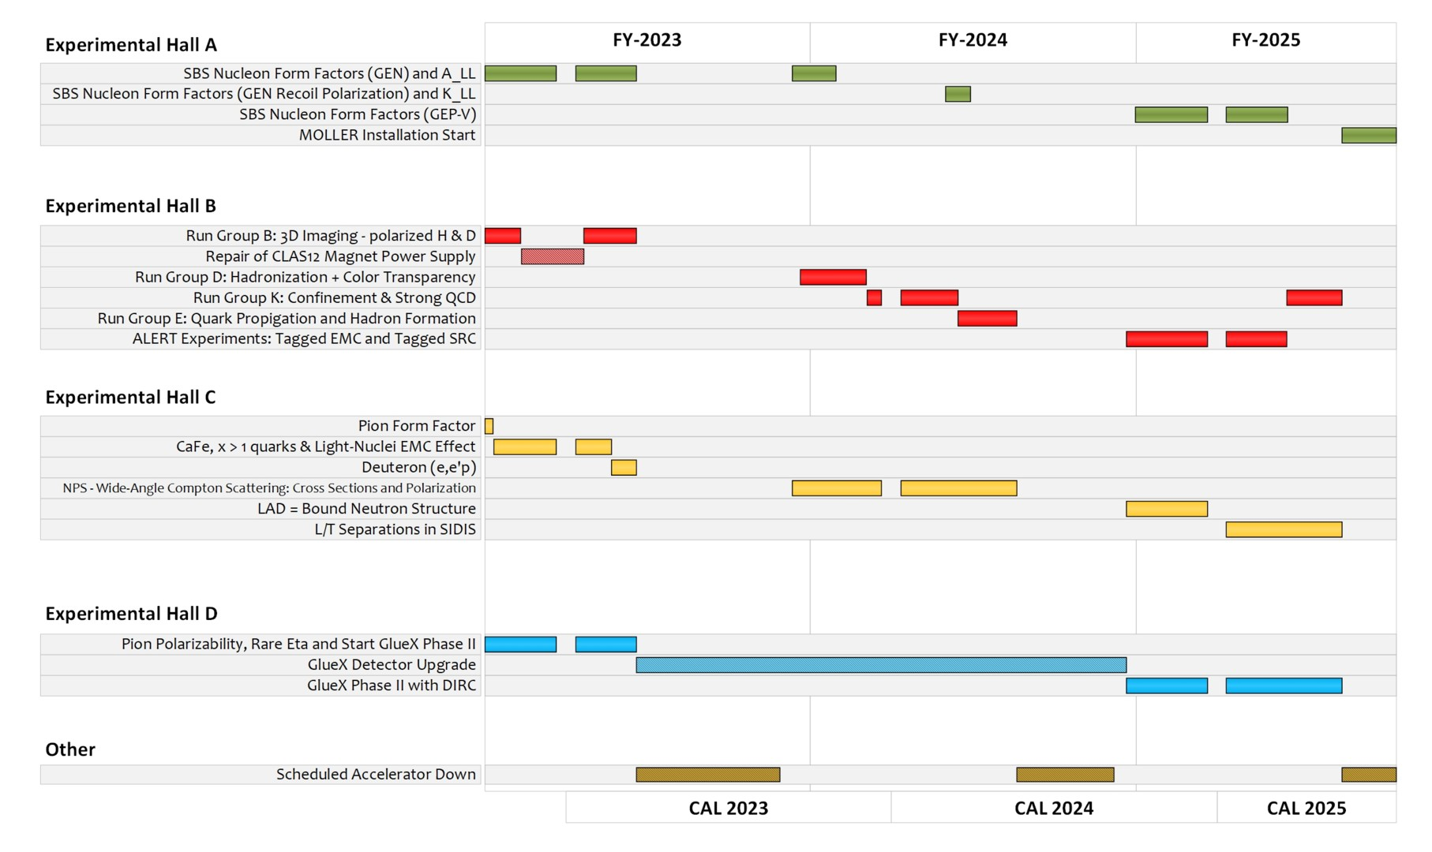
Extended experimental schedule
205 completed experiments to-date (28 full; 28 partial in 12 GeV era)
51 experiments remaining
~7 years at ~30 weeks/year
…not including SoLID
…not including new proposals
9

Slide 10
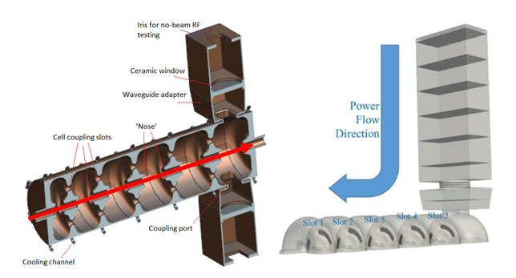
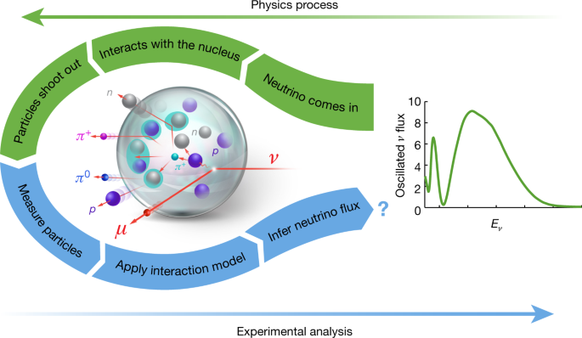
TJNAF Capabilities Enable Other Opportunities
Compact, Efficient Continuous-Wave Normal Conducting Accelerator for Industrial Sterilization. Develop and demonstrate a novel high-efficiency, CW electron LINAC using low-cost, commercial (domestic) RF sources for direct radiological source replacement. (NNSA/NA-22: $1.5M, FY24-FY26)
Spin Polarized Nuclei for Injection into DIII-D. Polarized fuels can lead up to 75% power gain in the large fusion power reactor. (SC/FES: $1.2M, FY23-FY25)
Lepton-nucleus scattering in the pion production region. Accurate modeling of GeV neutrino interactions on ⁴⁰Ar (DUNE experiment). (SC/HEP: $0.5M FY23-FY25)
Integrated Research Infrastructure Architecture Demonstrator Project (IRIAD). Demonstrate that edge and core computing can be seamlessly integrated to support processing of data directly from an experiment in a way that can support future use of AI/ML for data steering. (SC/ASCR: $1M FY22-FY25)
Nature 599, 565 (2021)

Slide 11
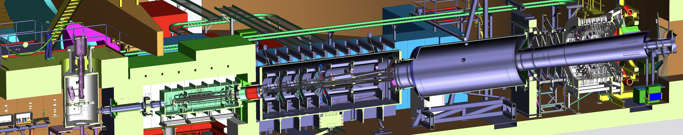
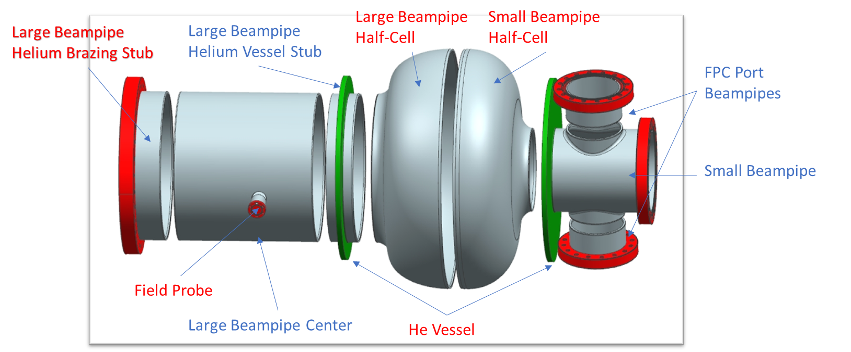
Moving science projects forward
MOLLER: State of the art, sub-part per billion statistical reach and systematic control to measure parity violation. Ready for CD-2/3.
30 m
EIC is moving:
$2.8B project with JLab a full partner and ~25% of funding
On track for CD-3A review in November (next week)
Detector and accelerator design ongoing at JLab
Notable changes this FY:
  Jim Fast appointed JLab Project Manager for EIC
  Sergei Nagaitsev, EIC Chief Scientist for Accelerators
  David Dean, rotational chair of the RRB (with Haiyan Gao at BNL)
Prototype 591MHz Crab Cavity

Slide 12
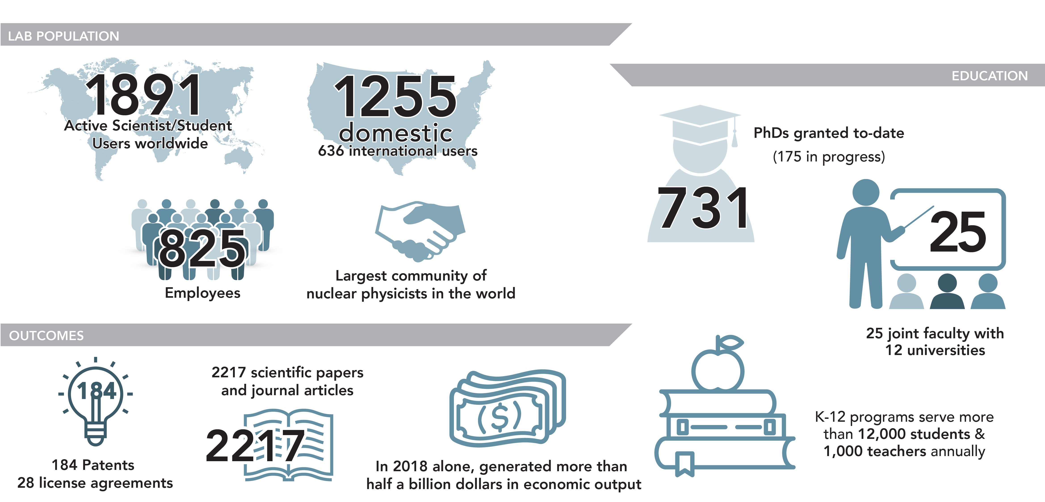
JLab Metrics of Interest

Slide 13
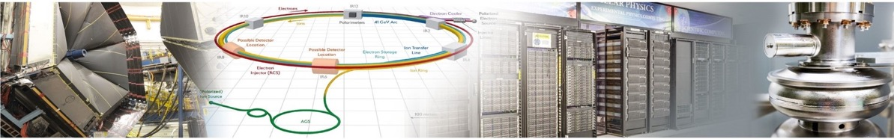

Expanding Jlab’s science and technology mission
Physics at CEBAF
Collider R&D
Computational & Data Science
Applied Research & Technology
Vibrant physics research program at CEBAF with optimal 34 weeks/yr supporting ~1,900 annual users
MOLLER Project
BSM Physics – BDX
High precision pictures of the quarks and gluons inside hadrons
Developing CEBAF upgrade paths including positrons and energy doubling
Partnering with BNL in the management, design, and construction of the Electron-Ion Collider Project
Leadership in the design and construction of SRF accelerator capability for the Office of Science
Leadership in energy recovery, polarized e- beams, emerging expertise in polarized e+ and FFA
Among the leaders in Lattice QCD
Pioneers in multi-facility streaming data and fast data transfer and analysis
Vision for world-leading first-of-its-kind Data specific scientific computing facility: High Performance Data Facility
R&D in accelerator, detectors and applications in nuclear imaging and medicine
Compact accelerator technology for industrial applications
Industrial partnerships on lithographic technology
Advanced detector development (MPGD)
S&T thrusts are synergistic and mutually supportive
Build on our core capabilities to pursue a diverse scientific portfolio

Slide 14

We are opening a new era in data rich scientific computing

Slide 15
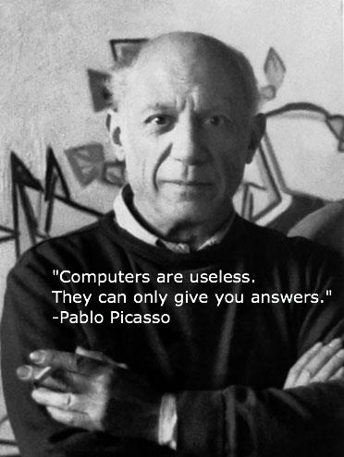
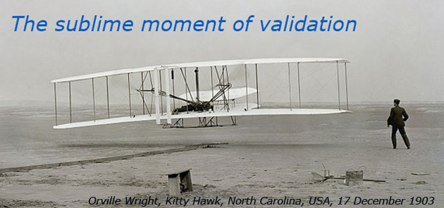
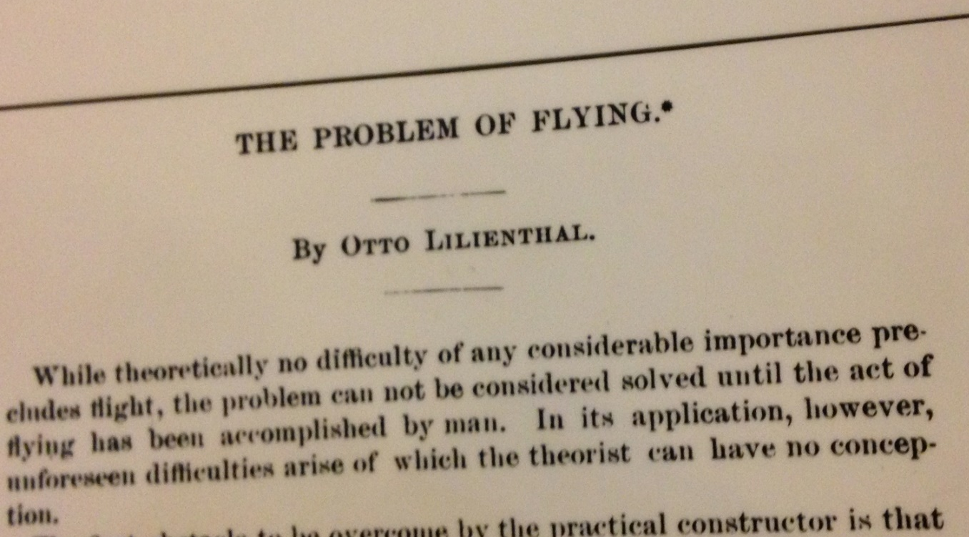
Questions drive science…and lead to discovery tools

Slide 16
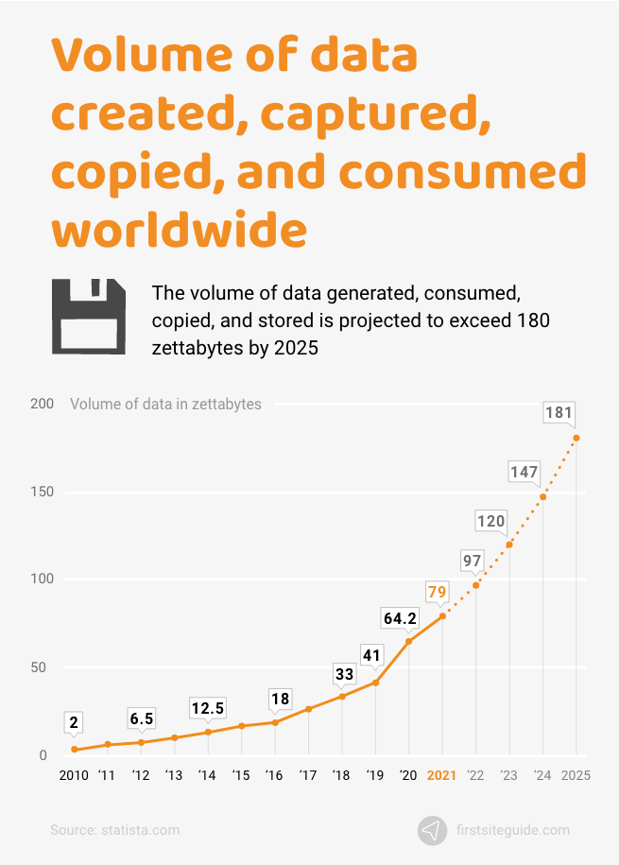
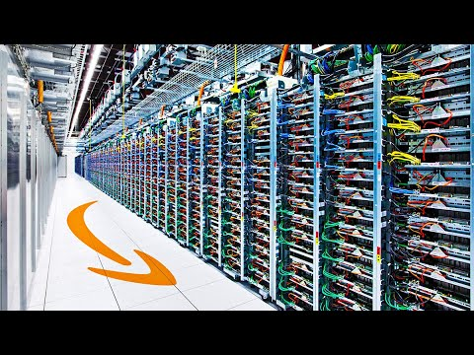
Data movement growth and data storage growth are different
2% of data produced and consumed in 2020 was retained into 2021
2020 installed base of storage capacity: 6.7 zettabytes
Growth anticipated at 19.2% per year (2020-2025)
statista.com

Slide 17
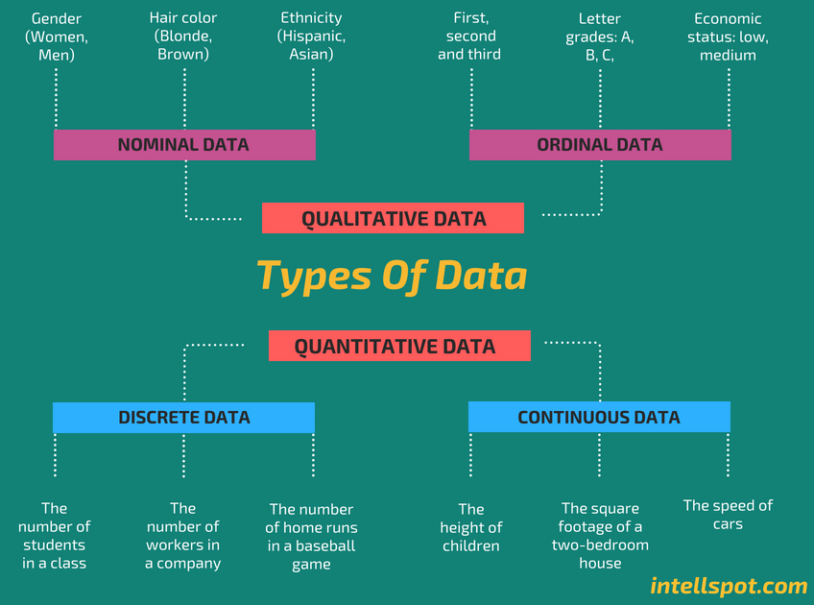
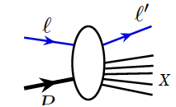
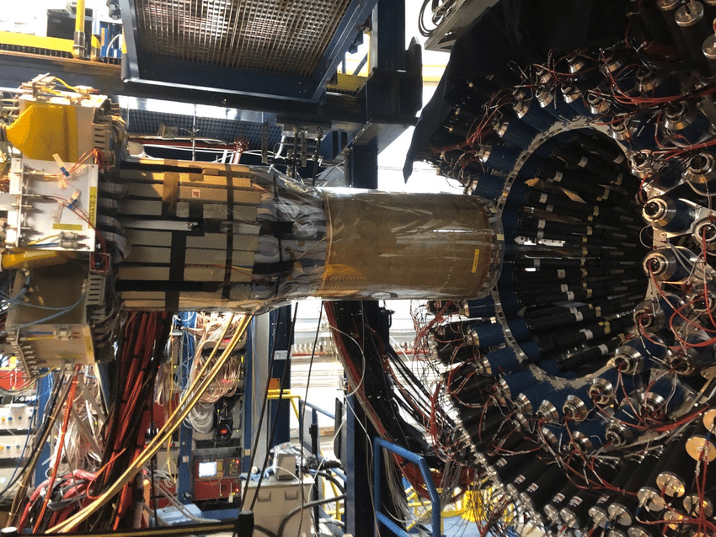
HPDF will focus on scientific data
Scattering data is discrete (digitized)
It is also similar (splat-on-splat, Venton Cerf)
It is usually not complete

Slide 18
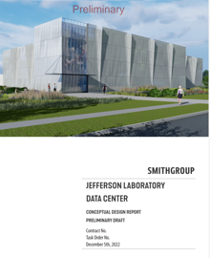


Some facts from the DOE announcement
HPDF is set to become the newest capability in high-performance computing provided through the U.S. Department of Energy’s Advanced Scientific Computing Research program
A resource designed for data intensive computing.
A distributed facility with a hub-and-spoke architecture.
  Time-critical and integrative data intensive experiments
In Partnership with LBNL
Jefferson Lab Data Center

Slide 19
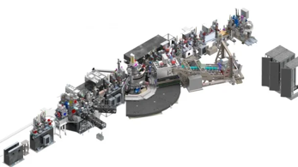

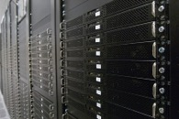
HPDF Will Provide Frictionless Access to Data Capabilities
The Hub enables:
  Driving experiments in real time
  Data combination and analysis from different sources.
  Sustained long-term data campaigns
  Spokes as the data sites (to be defined later)
qRIXS@LCLS II

Slide 20
partnerships will establish the HPDF ecosystem
HPDF Hub
In partnership with the DOE Office of Science ASCR Program and LBNL
National Laboratory Partners
Virginia Partnership
University/Industry Partners
Create the Student pipeline
Create joint research faculty in Data Science with JLab
Develop the workforce
Computational facility partners provide valuable technical and management resources in initial growth phase of project
Early access testbed system
Building the JLab Data Center (JLDC)
Laboratory Directed R&D to establish new R&D positions
Industrial partners for the hardware
Continued support from the Commonwealth to generate positions for HPDF as appropriate
Continued support of the Commonwealth toward the Virginia Data Science Ecosystem
Partnerships with HBCUs to drive diversity in Data Science
Identify industrial partnering mechanisms for HPDF
Early ‘spoke’ partnerships to build the facility
HPDF Ecosystem

Slide 21
HPDF: a 21st century facility for 21st century challenges
HPDF is the platform for the Integrated Research Infrastructure (IRI) at DOE.
HPDF will give researchers frictionless access to a seamlessly integrated system of computing, networking, instruments, and experimental facilities.
The HPDF Hub (HPDF-H) at JLab will advance the state of the art, unleashing the revolutionary potential of data science to power scientific discovery.
Now for the exciting work of establishing the HPDF

