Slide 1
CLAS Collaboration Meeting 11/7/23
TORRI JESKE
THOMAS BRITTON
DAVID LAWRENCE
KISHANSINGH RAJPUT
roark@jlab.org
tbritton@jlab.org
davidl@jlab.org

Slide 2
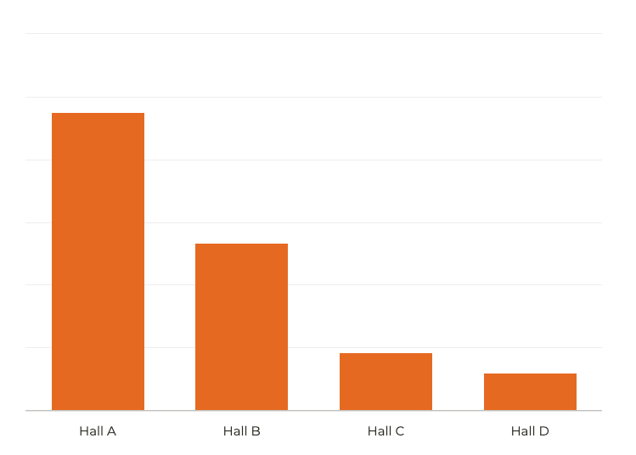
Online monitoring is tedious.
714
Problem: varying levels of expertise, inconsistent monitoring, too many plots
400
Problem: Images are good most of the time. Rare "bad" instances are easily missed.
138
90
Use computer vision to aid shift crew in all 4 experimental halls.
Approximate number of individual histograms per experiment per run, monitored by the shift crew for each experimental hall.

Slide 3
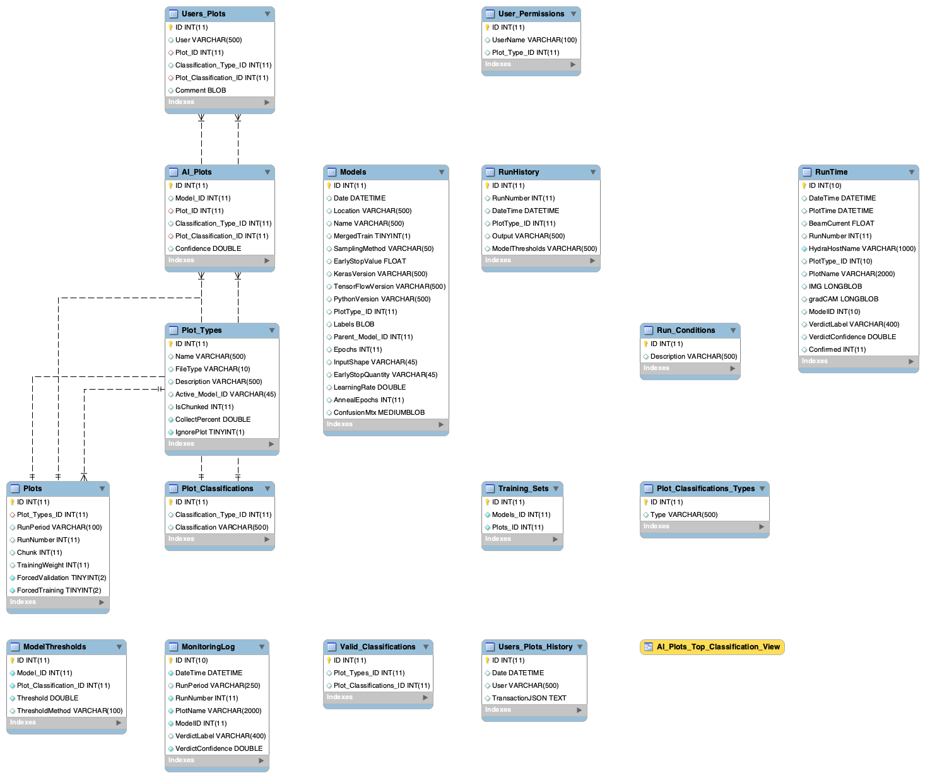
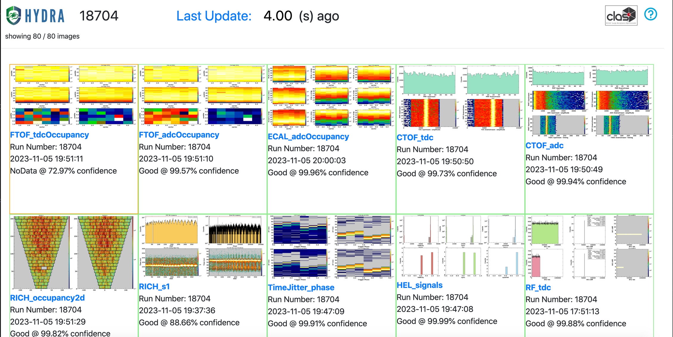
Online Data Quality Monitoring with HYDRA
An extensible framework for training, managing, and evaluating AI for real time data quality monitoring.
1/ MySQL back end
2/ Web based front end
Unique plot identifiers, model training parameters, classifications, user permissions, labels, and more are all stored in MySQL database.
Web based front end for labeling, monitoring, and model validation.
EPSCI develops and maintains Hydra in all Halls in collaboration with Users

Slide 4
Online Data Quality Monitoring with HYDRA
Correct, frequent classifications
Train InceptionV3 (default) for each image using a labeled data set
Explainable predictions
Can the model tell us about its predictions?
Generate Gradient Weighted Class Activation Maps (GradCAM) to highlight regions of image important for classification
NOT Replacing shift crew duties
The shift crew should still be following standard monitoring procedures.
shift crew AI

Slide 5
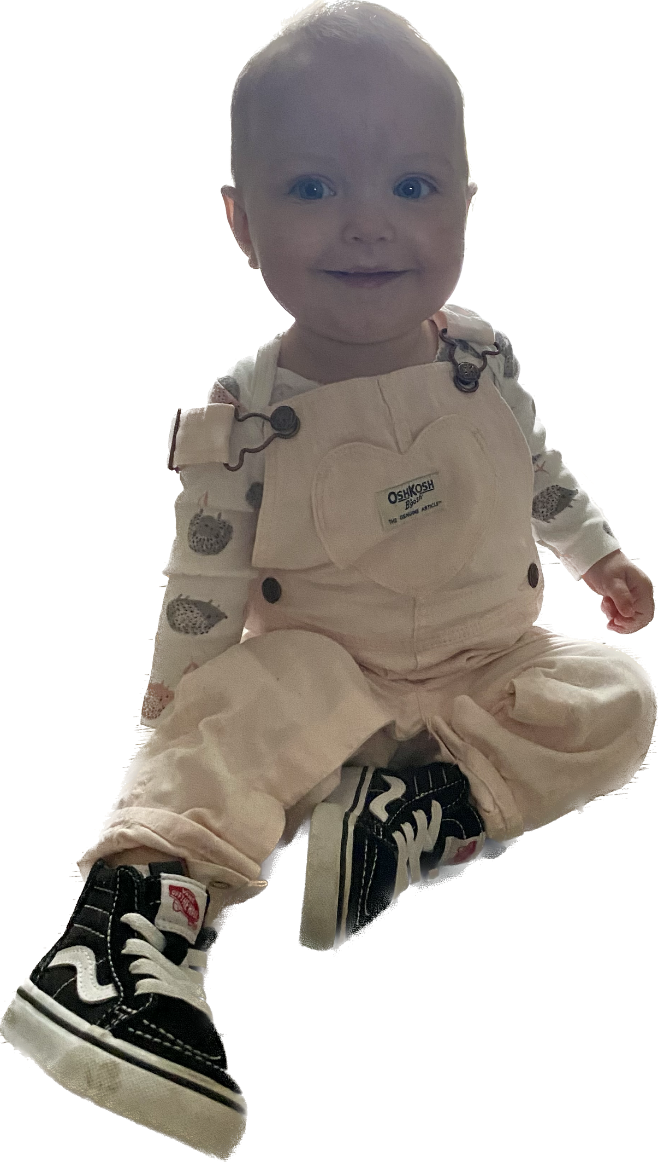
Updates from last year
Hydra has undergone a lot of changes!
2022:
2023:
Images sent to labeler when shift crew submits to logbook via mon12
Images are automatically sent every N electron triggers.
Models trained with ~100s of images
Some models trained with ~1000s of images
Hydra "walked" over input directory
GradCAM heat maps available for Bad images online
Hydra now listens for images
Unified front end
Parallel predicts coming very soon
80 images every 5 minutes >> GlueX

Slide 6
80 total plot types
35 images with active model in production
Remaining either have no bad examples and/or no active model.
Models with no bad examples for training were pulled from production to avoid the scenario where Hydra cannot classify an image as bad.
Images are "chunked"
Hydra looks every 10k electron triggers, which is about every 5 minutes
Events in one chunk are NOT in another
Hydra keeps most images for labeling
This is on purpose - most models are over fit and need a lot more training data. Eventually the percentage of images kept will be reduced.
Hydra for CLAS12

Slide 7
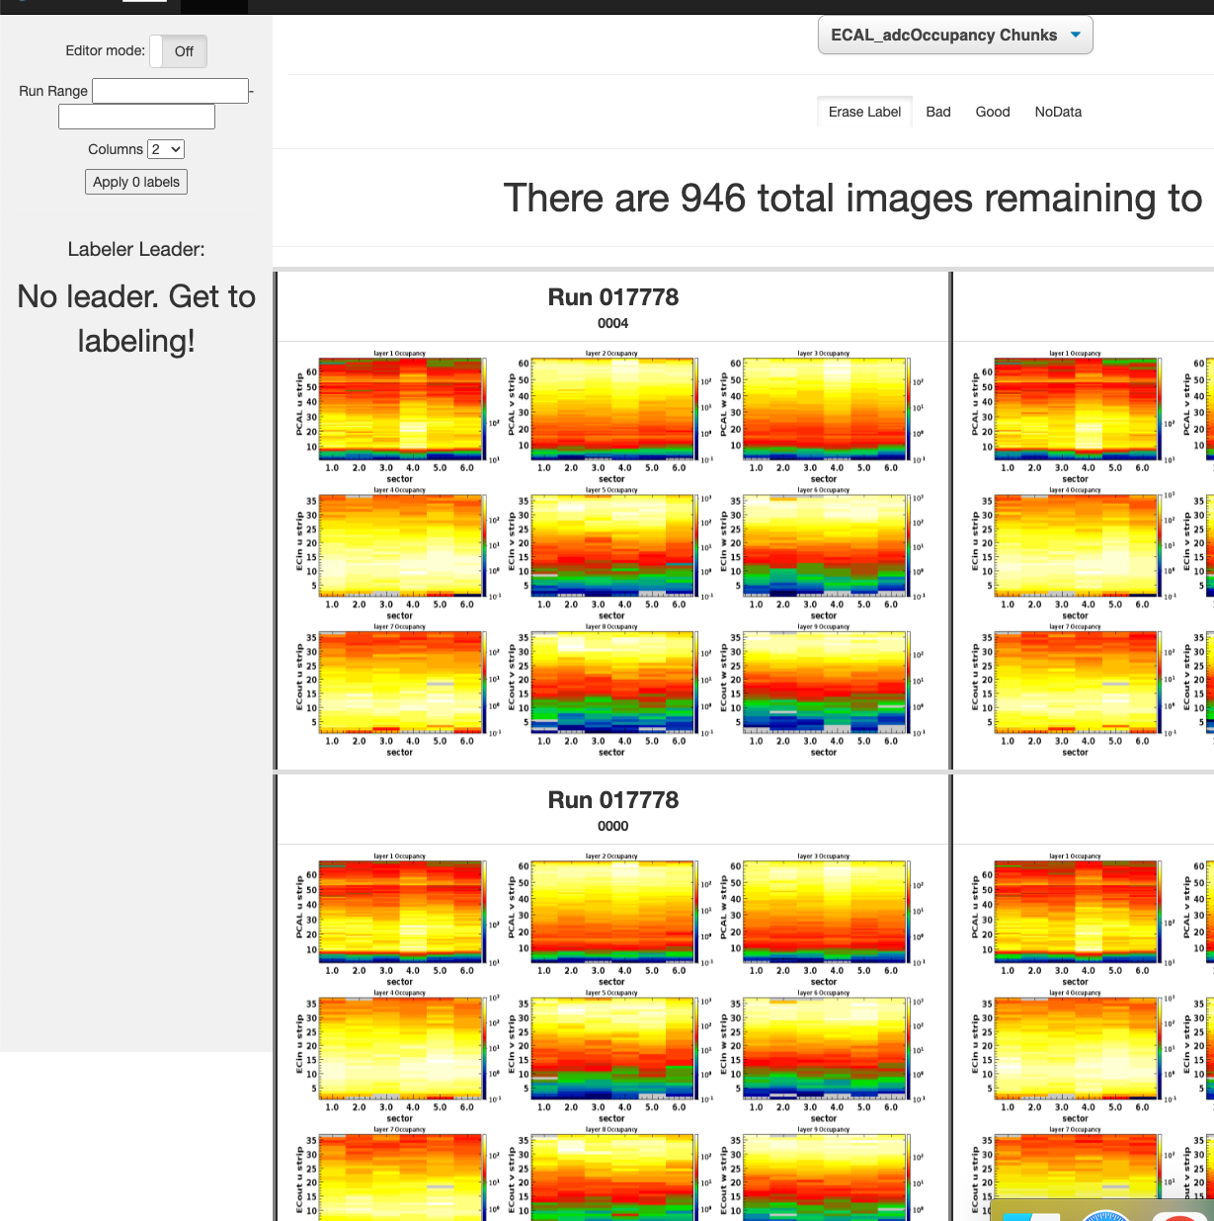
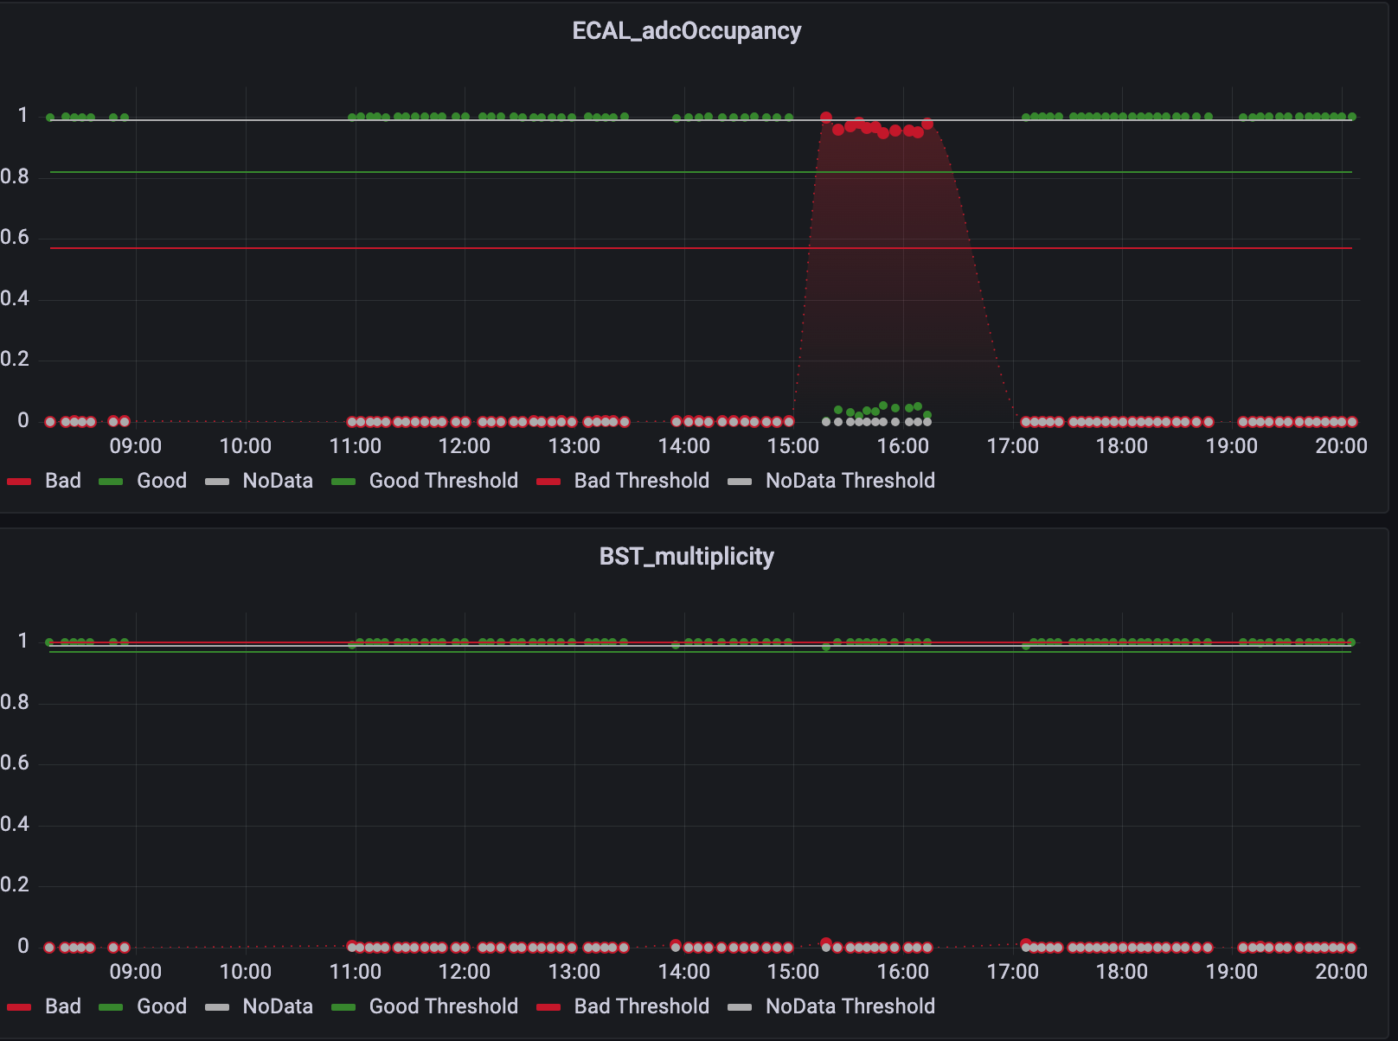
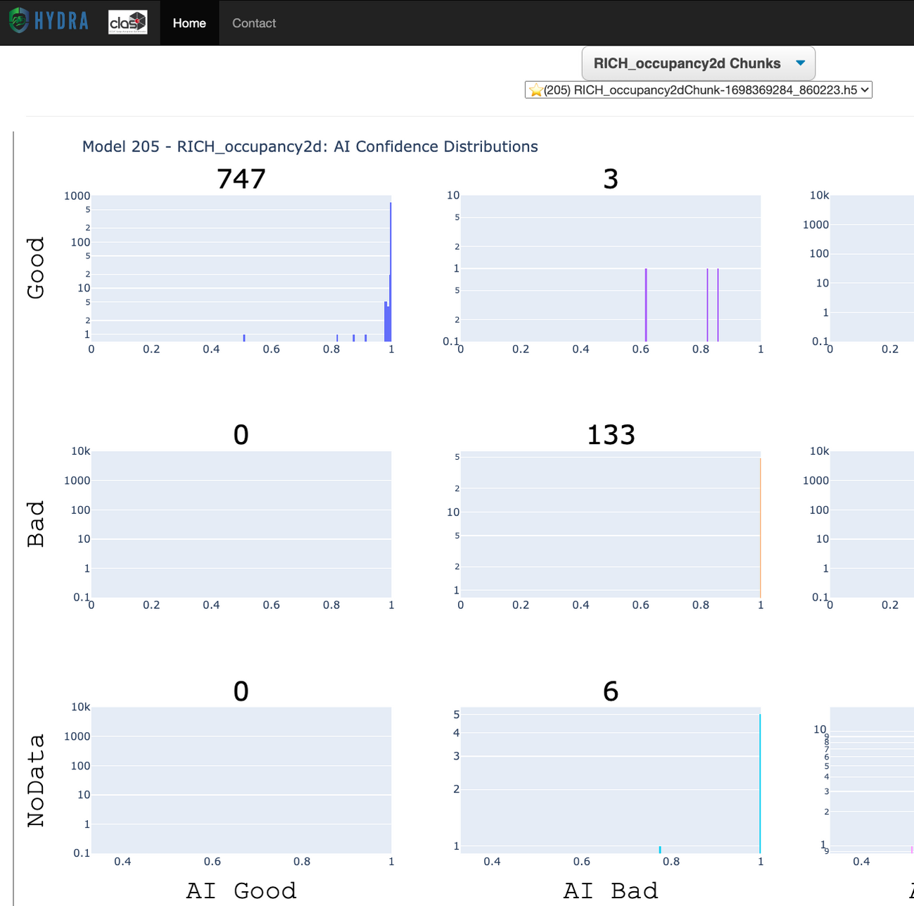
Offline Tools
Labeler
Grafana
Library
Keep labeling images please :)
See output from model over time. Dots correspond to softmax probability per class.
Confusion matrix about each trained model, adjust thresholds, etc

Slide 8
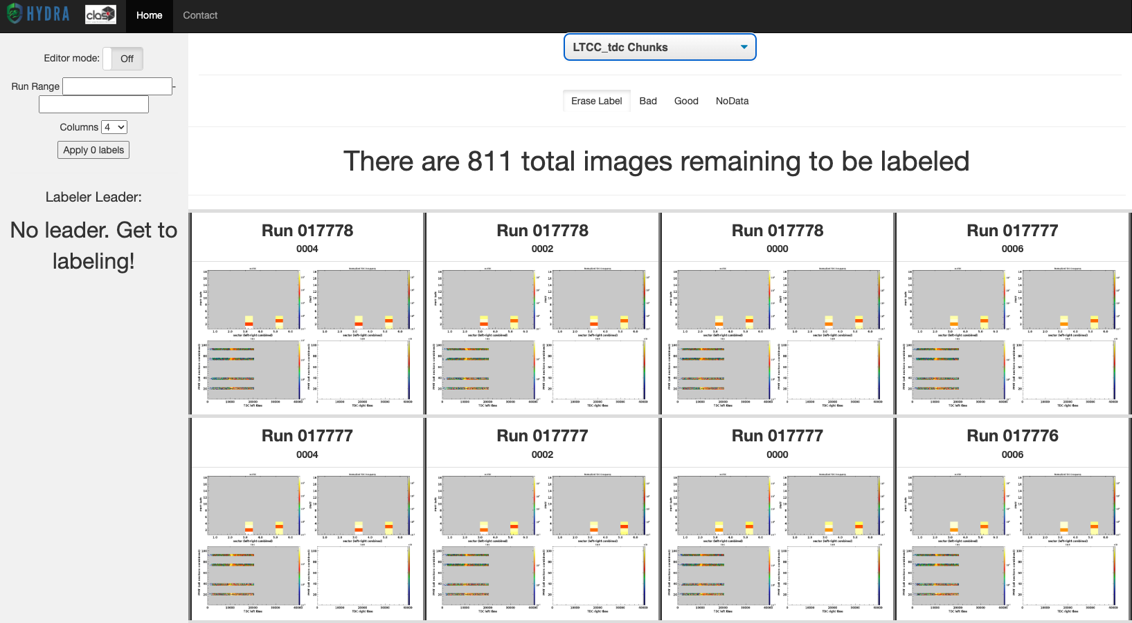
HYDRA: Data Labeler
Efficiently label multiple monitoring plots. Labels and images are automatically uploaded to database.
Most plot types have ~1000s of images to label.
Please label ☺

Slide 9
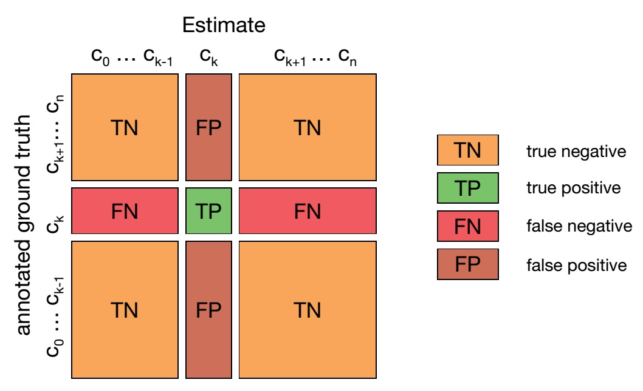
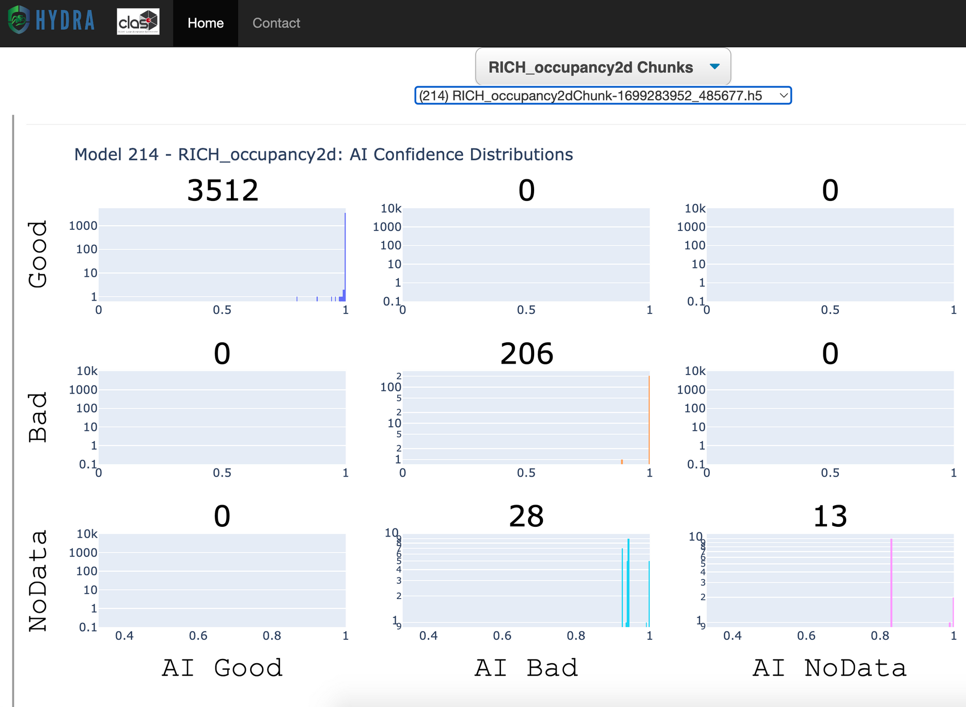
HYDRA: Library
Visualize model performance, thresholds, active models, etc.
Threshold: based on max f1 score per class by default.

Slide 10
HYDRA: Grafana Dashboard
Look at any prediction over time.
Y axis: ”Confidence” – output from model inference
Points per inference correspond to number of labels
Lines correspond to threshold values

Slide 11
Online Tools
Run
Log
Status
Real time classifications. Should be up in counting house!
Bad or potentially concerning plots for the previous 24 hours
See if back end processes are running, time it takes for an image to go through Hydra, etc

Slide 12
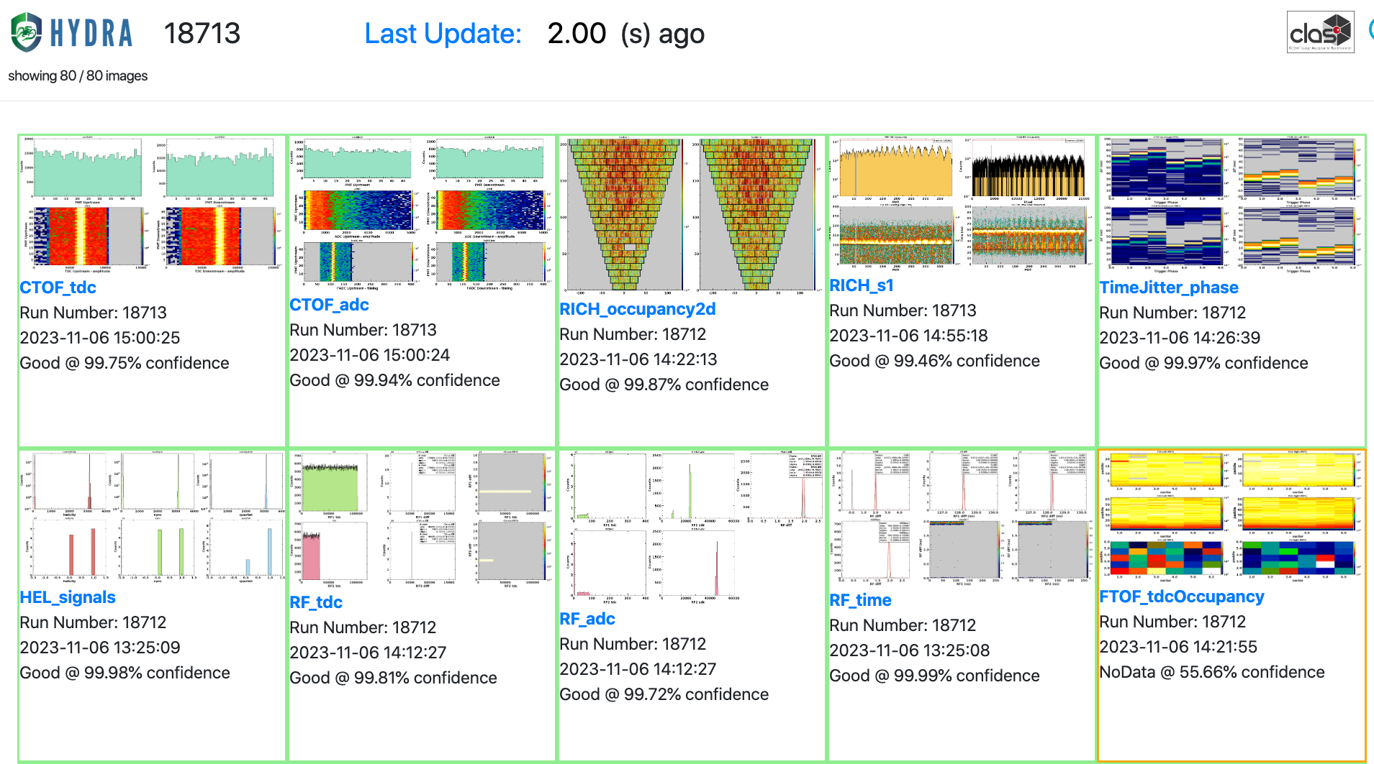
HYDRA: Run
Watch predictions in real time from anywhere
GradCAM visualizations are available for Bad images

Slide 13
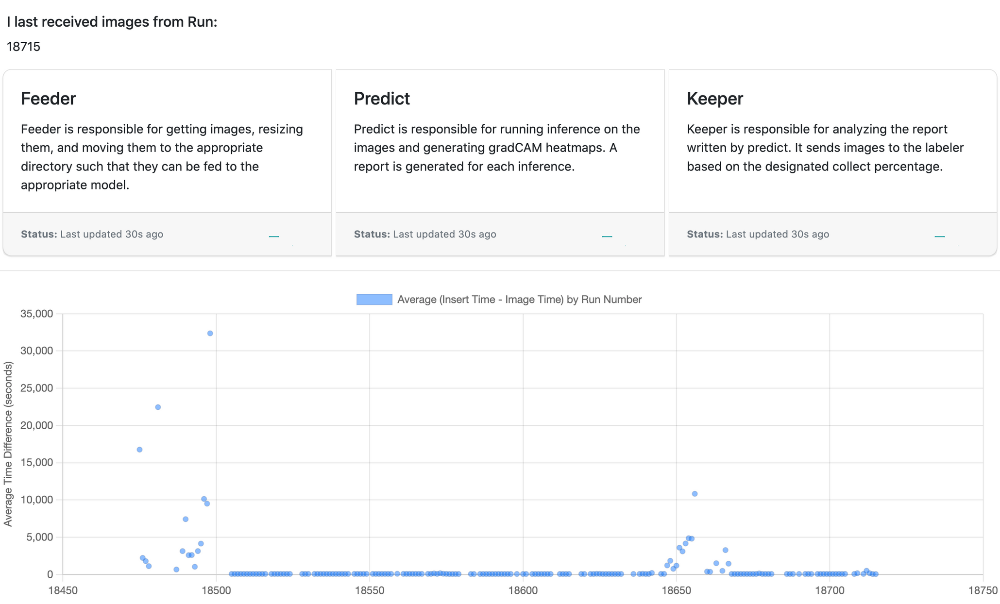
Dashboard
Shows status indicators for Hydra
Preliminary benchmark: Average time (by run number) for each image to flow through Hydra
Database Issues
Mystery problem here
More tests here

Slide 14
HYDRA: Log
See 'Bad' or 'Unconfirmed' images from previous runs, separated by detector.
Easily identify when a particular problem started

Slide 15
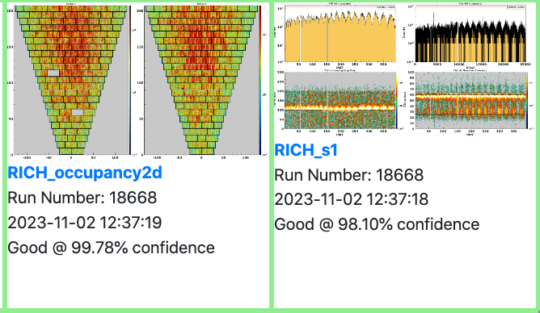
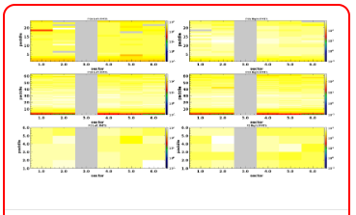
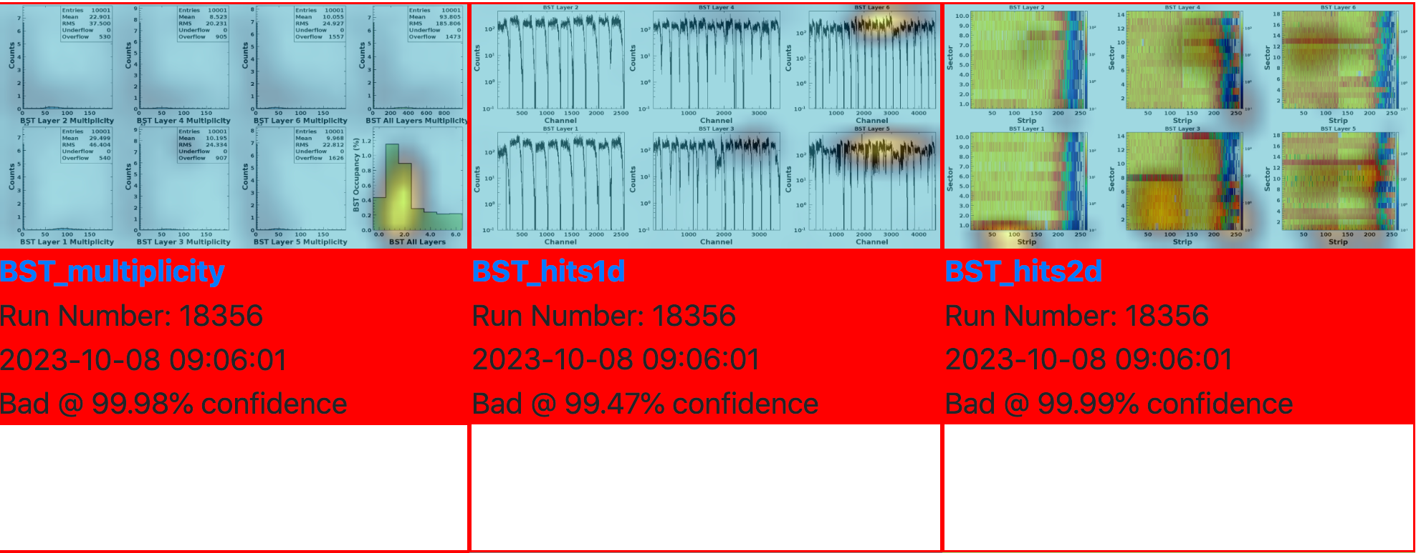
Performance so far
Issues Hydra has caught AND missed
I am *actively* working on this.

Slide 16
To Do
In Progress
Visual Indications of Hydra health
Retraining!
As we get more labels, I retrain models.
Give feedback for common errors
Tutorials
Parallel Hydra
I'm a new graduate student/shift taker, how do I use Hydra?
Multiple "copies" of back end processes running at the same time
Playground
Have a place to train a model on labeled data set
Test different models, training methods

Slide 17
Conclusions + Acknowledgements
Hydra is under active development!
Hydra is healthy overall!
Parallel Hydra will be deployed next maintenance day!
Models still need considerable training. Please label.
Thanks to Nathan Baltzell, Dan Carman, and labelers for being a part of getting Hydra implemented.
We would love your feedback!
all web pages can be found at clasweb.jlab.org/hydra/

Slide 18
How can I delegate labeling responsibilities?
Just send Thomas (tbritton@jlab.org) or myself (roark@jlab.org) an email with the appropriate JLab username.
Can we train our own model?
Sure! InceptionV3 is the default. We can experiment with different models.
Why didn't Hydra catch this problem?
Has it seen similar problems before?
Did the model have a "bad" label available?
Did the confidence for the classification drop?
Can we contribute to Hydra?
Absolutely.
FAQs

Slide 19
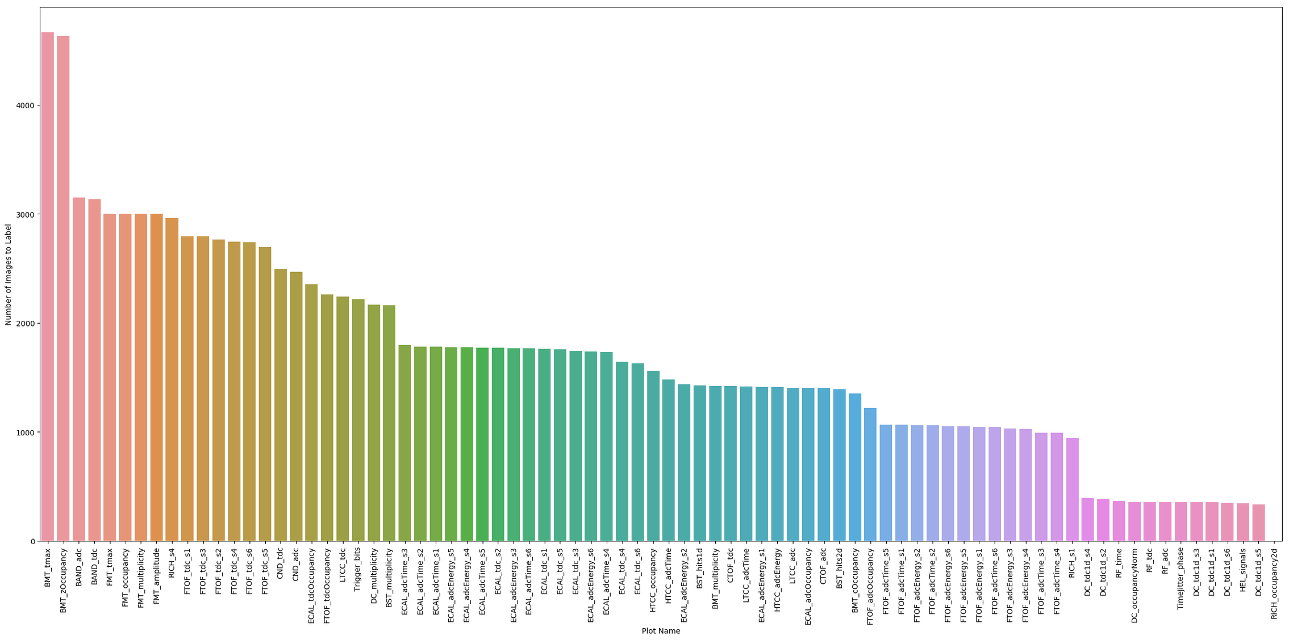
Current Labeling Stats

