Slide 1
Many Proton Knock-Out From Nuclear Targets Using Real Photon Beams
Rhidian Williams
November 8th , 2023
Rhidian Williams
November 8th, 2023 1/18

Slide 2
Preview
P₁
¹²C
P₂
ᵞ
¹⁰Be
Rhidian Williams
November 8th, 2023 2/18

Slide 3
Introduction
Explore suitability of next generation compact photon sources
Produce isotopes currently out of reach
Neutron rich, produced by photoinduced many proton knockout
GiBUU predicts photoinduced nucleon knockout processes…but
Needs benchmarking
CLAS well suited for this
Benchmarked model can be used to assess isotope production rate
Rhidian Williams
November 8th, 2023 3/18

Slide 4
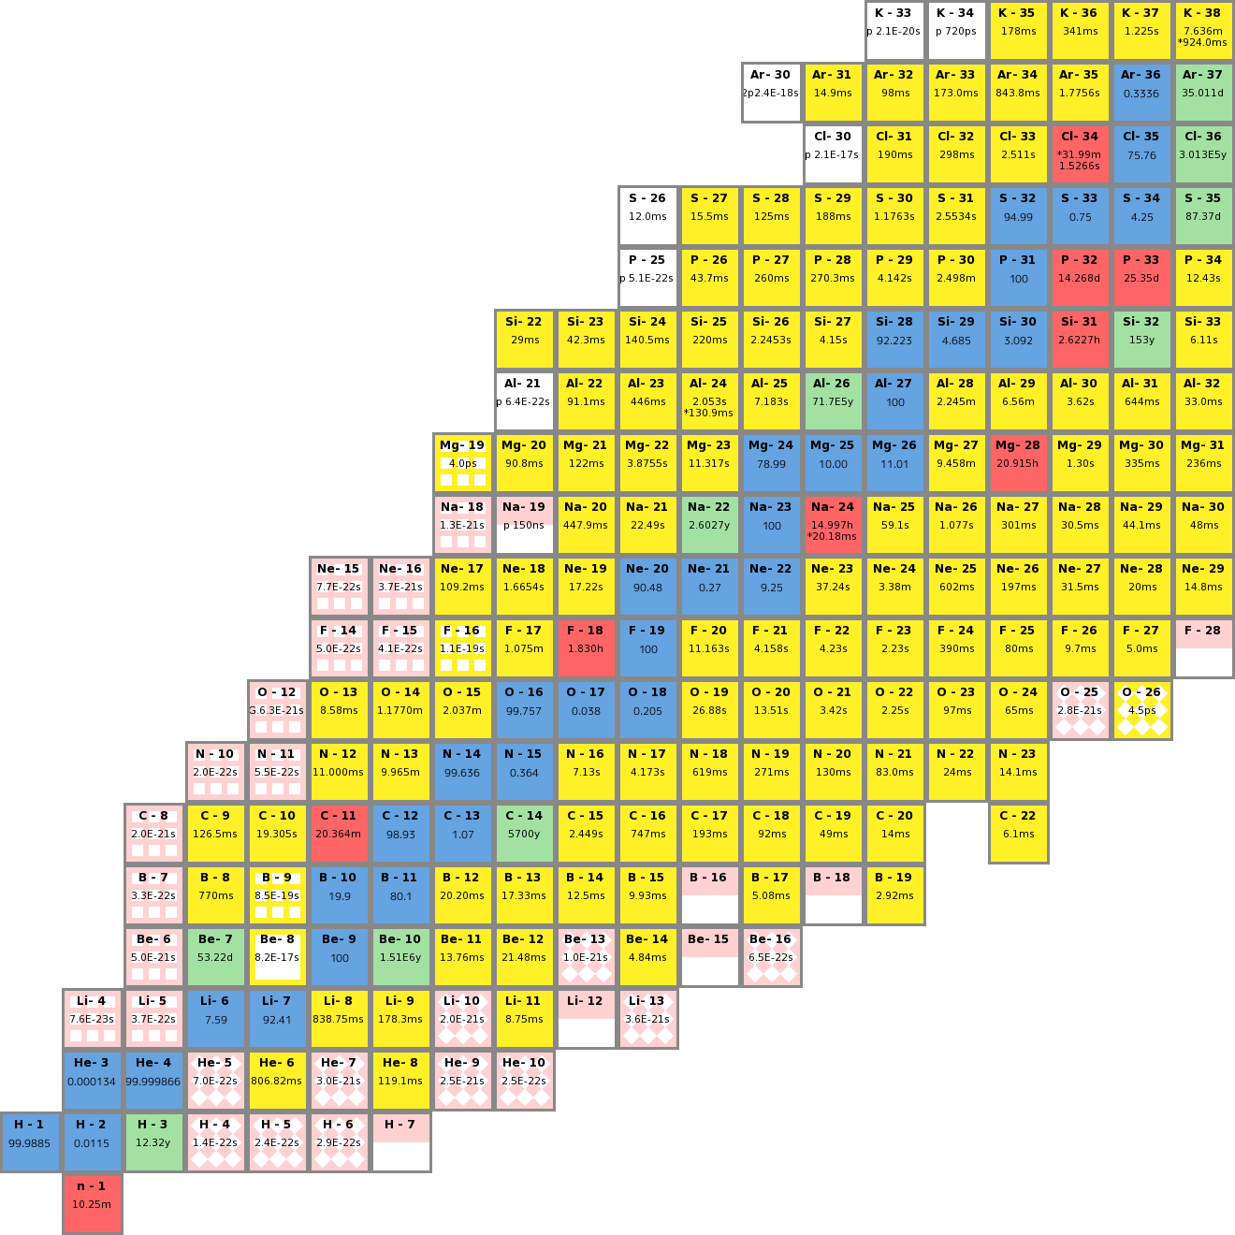
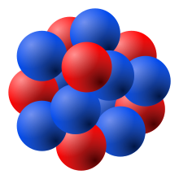
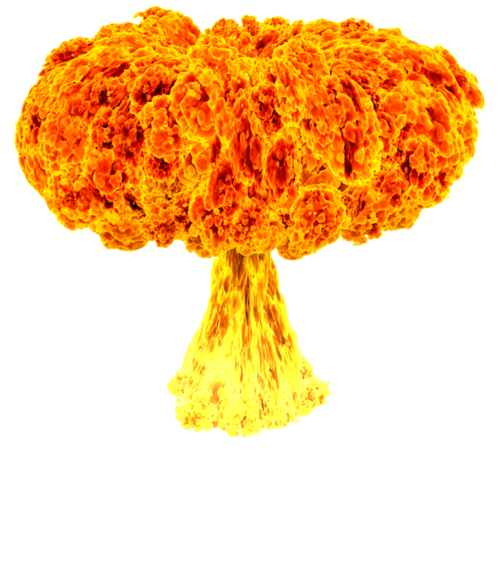
Motivation
Photon beams as a spallation source
Reach exotic nuclei
Comparison with simulation
Many body physics
Interpret dominant interactions
Number of protons
Number of protons
²⁰⁸Pb
Number of neutrons
Number of neutrons
Rhidian Williams
November 8th, 2023 4/18
Notes:
4

Slide 5
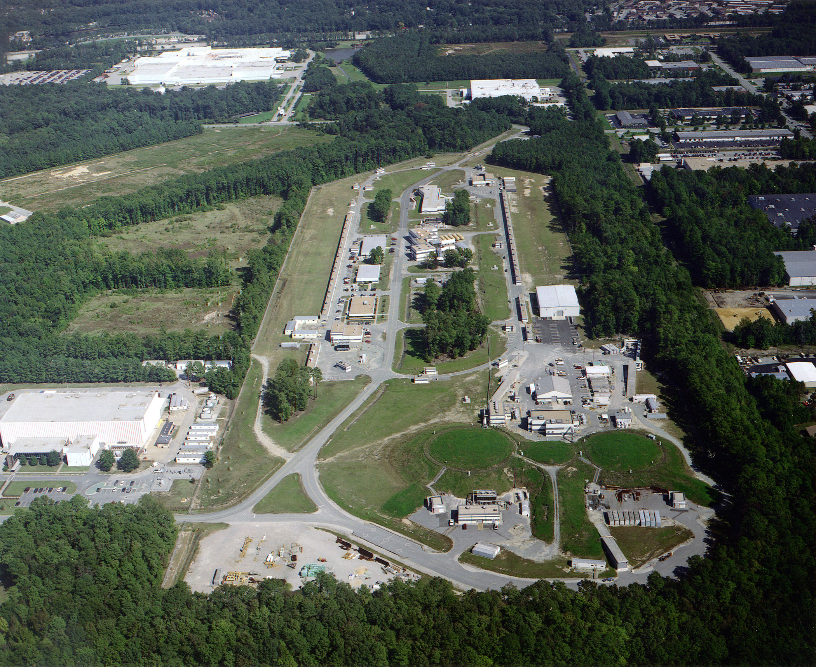
Thomas Jefferson National Laboratory
e⁻
A
B
C
Rhidian Williams
November 8th, 2023 5/18
Notes:
5

Slide 6
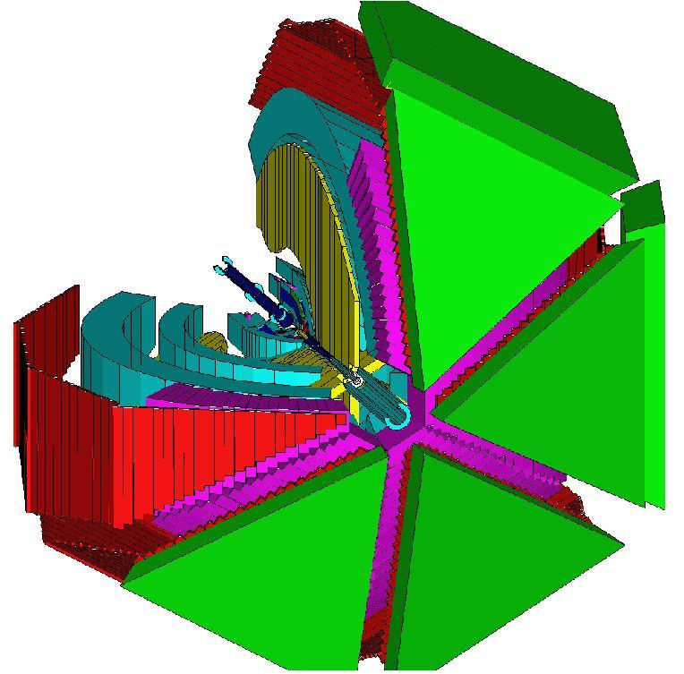
Experimental Details – FROST
Tagging Spectrometer
e⁻
ᵞ
Tagged real photons
0.6 – 4.3 GeV beams
Nuclear targets
Lin pol data
Diamond Radiator
Rhidian Williams
November 8th, 2023 6/18
Notes:
6

Slide 7
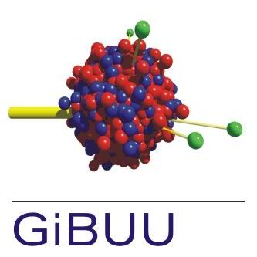
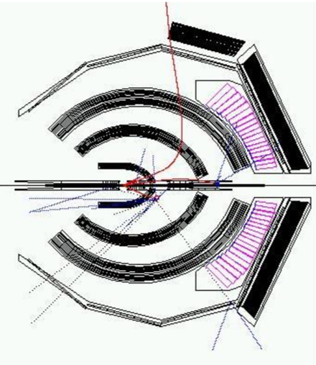
Simulation
Rhidian Williams
November 8th, 2023 7/18
Notes:
7

Slide 8
Scaled Photon Energy Spectrum
Rhidian Williams
November 8th, 2023 8/18

Slide 9
Photon Flux
Assume GiBUU models $γp→pπ^{0}$ well for $E_{γ}=(0.6, 0.8)$ GeV
$$\frac{Y_{Sim}}{Y_{Exp}}=\frac{L_{Sim}×ϵ×A×σ_{Sim}}{L_{Exp}×ϵ×A×σ_{Exp}×Φ_{γ}}$$
$$\frac{Y_{Sim}}{Y_{Exp}}=\frac{σ_{Sim}}{σ_{Exp}}$$
Rhidian Williams
November 2nd, 2022 9/18

Slide 10
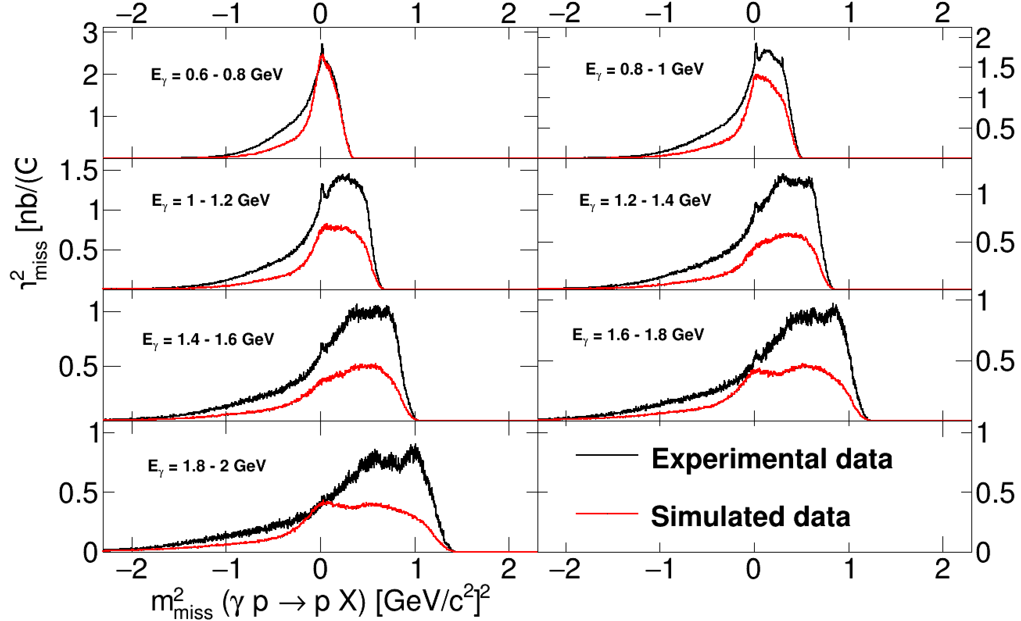
Scaled Missing Mass Assuming Proton Target
$$P_{Miss} = P_{Beam} +P−p_{1}$$
Rhidian Williams
November 8th, 2023 10/18

Slide 11
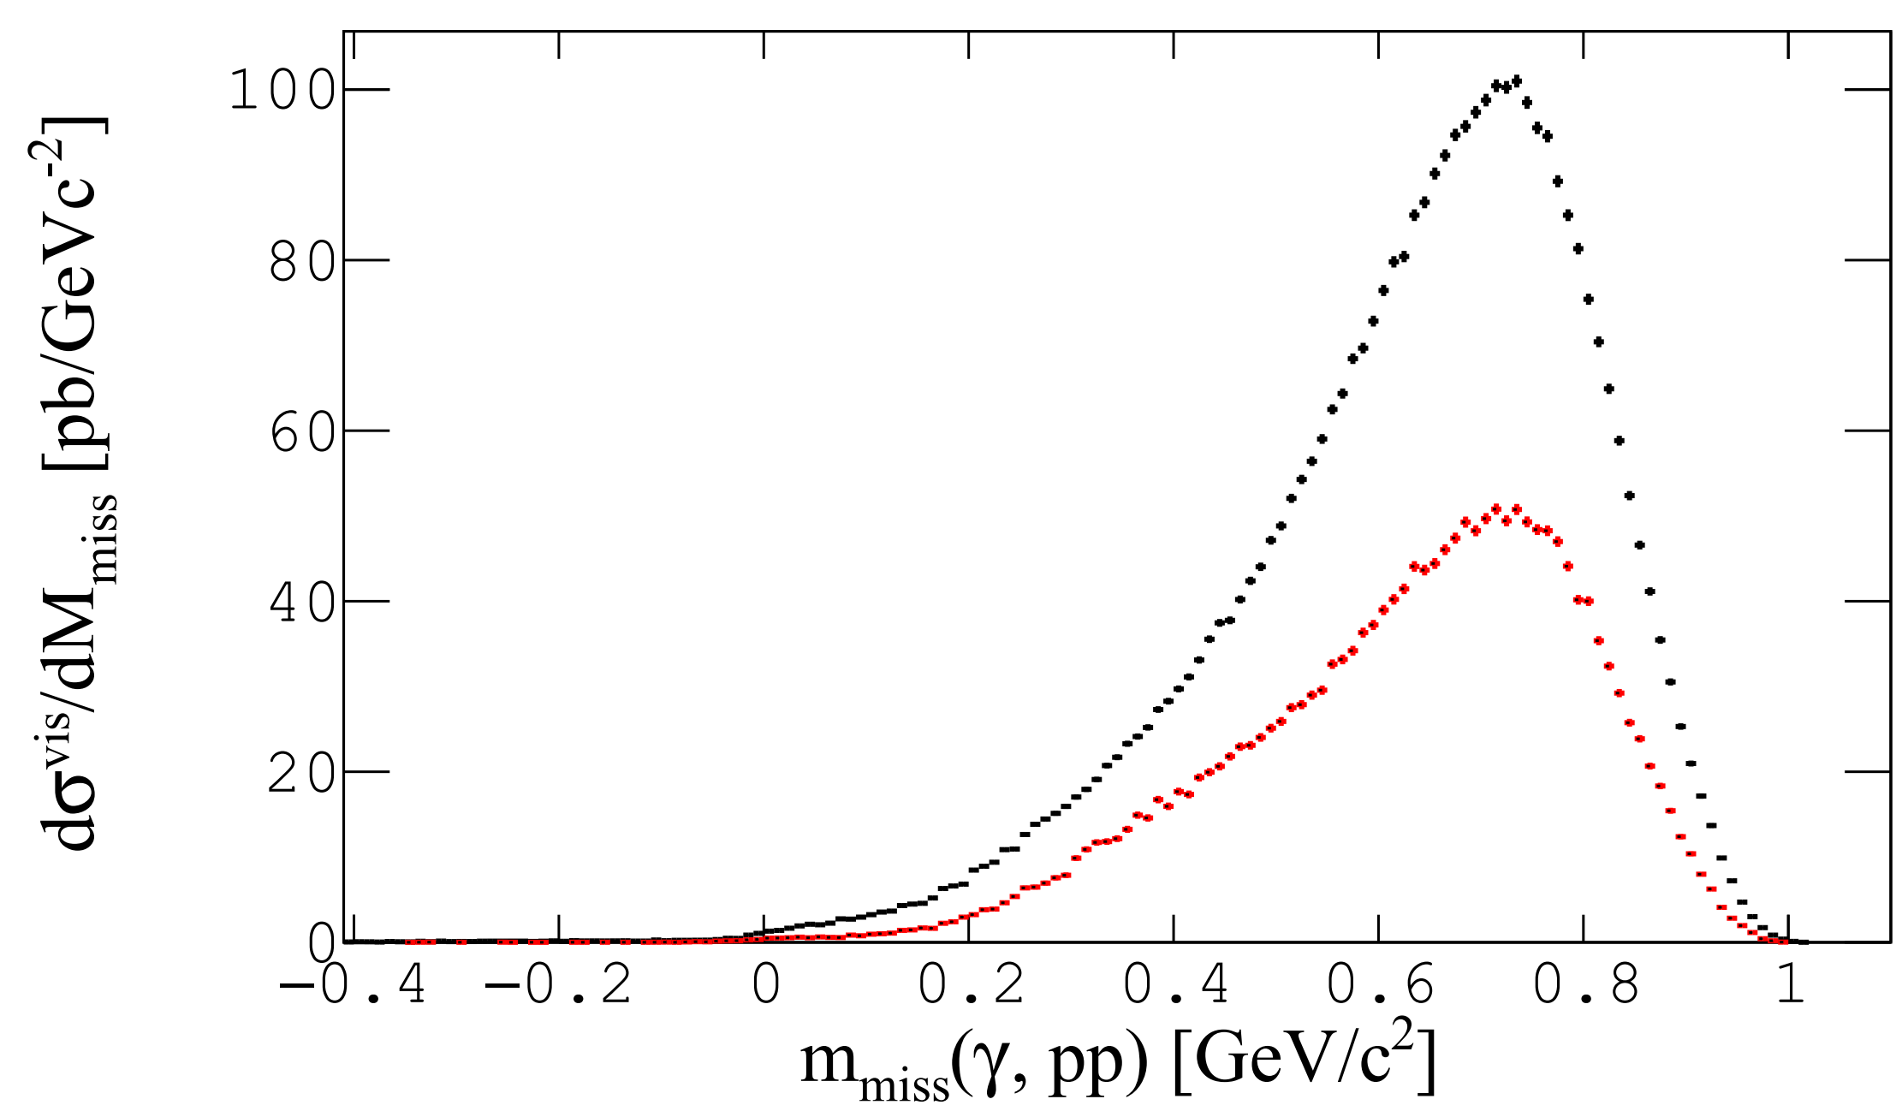
Scaled Missing Mass 2 Proton Knock-Out
$$P_{Miss} = P_{Beam} + P_{C_{12}} − \sum_{i=1}^{n}{P_{p_{i}}}$$
$E_{γ}=(1.0, 1.2)$GeV
Rhidian Williams
November 8th, 2023 11/18

Slide 12
Multiplicity Ratios
Rhidian Williams
November 8th, 2023 12/18

Slide 13
Can We Isolate/Enhance Direct Knock-Outs?
Rhidian Williams
November 8th, 2023 13/18

Slide 14
Answer: Yes!
$$P_{Miss} = P_{Beam} + P_{C_{12}} − \sum_{i=1}^{n}{P_{p_{i}}}$$
$E_{γ}=(1.0, 1.2)$GeV
Rhidian Williams
November 8th, 2023 14/18

Slide 15
Multiplicity Ratios With $P_{⊥}$ cut
Rhidian Williams
November 8th, 2023 15/18

Slide 16
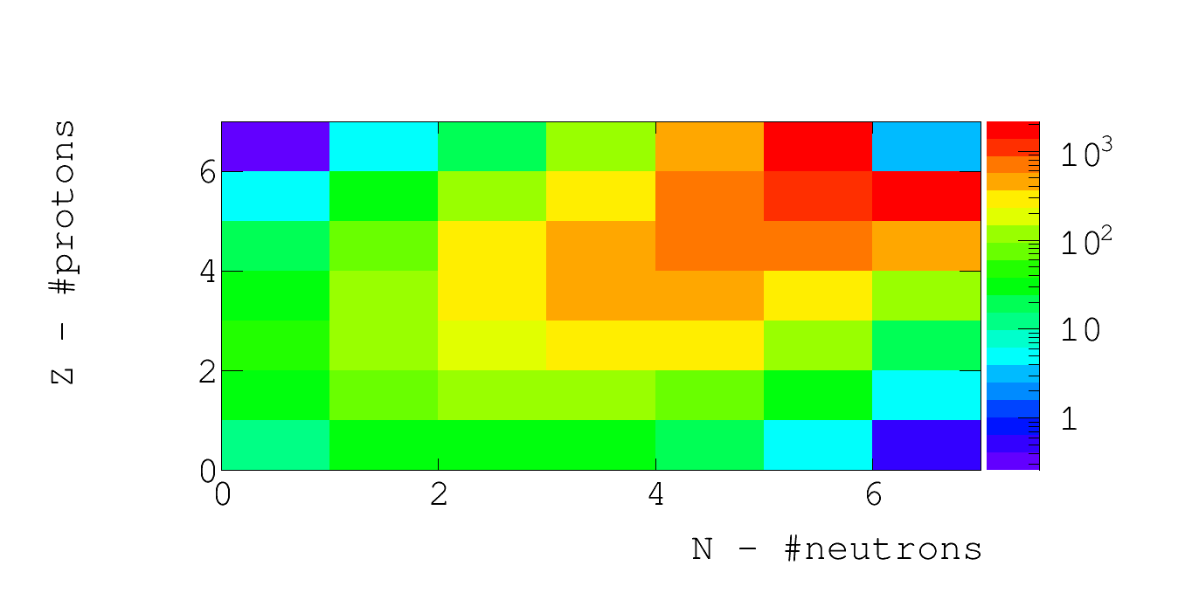
C₁₂ Nuclear Chart
¹⁰Be
⁷Li
⁹Li
⁸He
¹H
⁷H
Rhidian Williams
November 8th, 2023 16/18

Slide 17
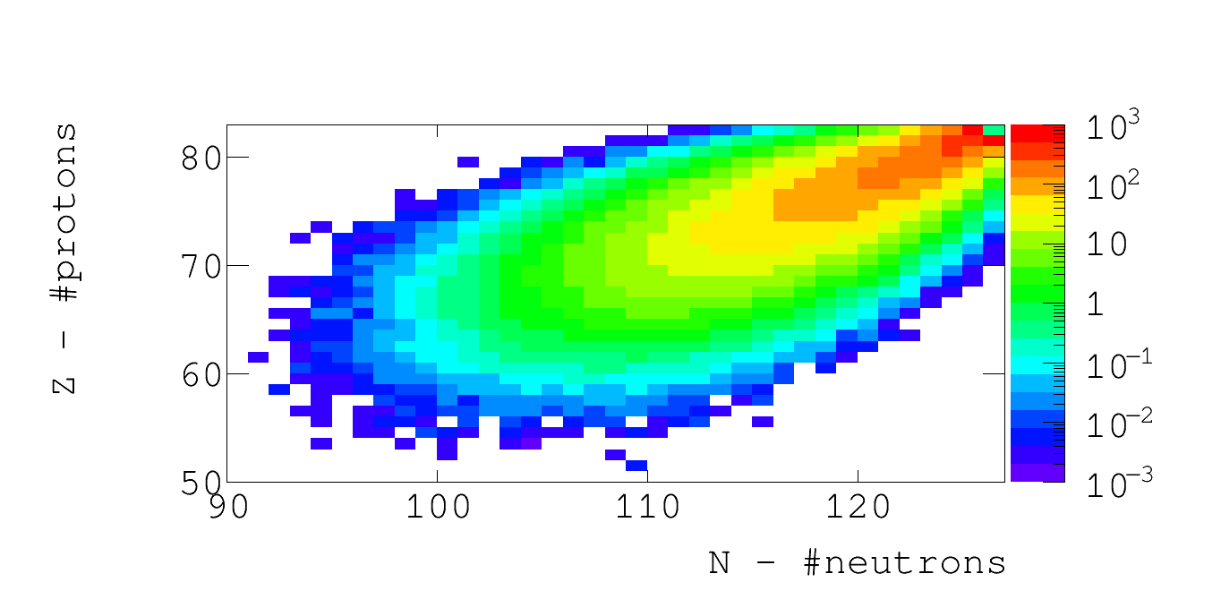
Pb₂₀₈ Nuclear Chart
Simulations show many neutron knock-out also possible!
Estimated Lifetime – Not measured
New Isotope
Exotic Nuclei
Rhidian Williams
November 8th, 2023 17/18

Slide 18
Conclusion + Future Work
First test of feasibility shows promising results
Future experiments exploiting mass spectrometers could be used
Compact photon source
Theorists adapting model based on our results
Simulations show method applicable to neutrons
Nuclear physics community take great interest
Expand physics learnt to enhance models for photon beam experiments
Rhidian Williams
November 8th, 2023 18/18

