Slide 1
Accelerator Operations Update
Eduard Pozdeyev
Director of Accelerator Operations
Presented to:
CLAS Collaboration Meeting
November 7, 2023

Slide 2
Outline
Priorities of CEBAF Operations
Status of Accelerator Operations
Beam availability and downtime mitigation
CEBAF Performance Plan (CPP)
Accelerator Improvement Projects (AIPs) and R&D portfolio
Accelerator Division reorganization
Conclusions

Slide 3
Mission of Accelerator Operations
Adapted from S. Henderson’s
all-hands presentation 07/2023
Operate CEBAF for Nuclear Physics for >30 week/yr. for >1800 users
Ensure CEBAF ready for upcoming 12 GeV experimental program (MOLLER, SoLID, K-Long)
Support future upgrades providing new experimental capabilities (22 GeV and e+)

Slide 4
Priorities of CEBAF Operations
Deliver beam (up) to four halls for nuclear physics program safely and reliably
Increase beam availability, reduce unscheduled downtime and frequency of trips
Improve CEBAF multi-hall performance with a high intensity beam.
Prepare for upcoming experiments to meet users’ requirements
Execute CEBAF Performance Plan
Extend CEBAF energy reach up to 12 GeV after 5.5 passes with margin
Improve hardware reliability through acquisition of critical components and spares
Address hardware obsolescence
Enhance CEBAF capabilities through AIPs, upgrades, and R&D
Maintain strong operations team capable of meeting operational challenges

Slide 5
FY24 and FY25 Operations
FY24 Run
34 weeks of beam operations, ~31 weeks physics
Expected challenges
Increasing reliability and beam availability
Scheduled Accelerator Down starts on May 20th
FY25 Run
33 weeks of beam operations, ~31 weeks physics
Expected challenges
Physics requests CEBAF to operate at full design energy (12 GeV) and high beam power (1.1 MW)
Increasing CEBAF energy reach will be critical
Now
 | FY23 |  |  | FY24 |  |  |  | FY25
 | Q2 | Q3 | Q4 | Q1 | Q2 | Q3 | Q4 | Q1 | Q2
Hall A
Hall B
Hall C
Hall D
SAD
Energy/linac
1047 MeV
1047 MeV
1100 MeV

Slide 6
FY23 Scheduled Accelerator Downtime (SAD) Completed
New injector will reduce helicity correlated asymmetries for MOLLER.
Installed cryomodules and plasma processing increased the energy reach.
Upgrade of Personnel Safety System in South Linac. Certification once per year is considered.
Booster
C100-10R
98 MV
PSS Upgrade in South Linac
North linac
energy gain +72 MV
0L02
Lost 1L09
helium leak
1L26
Drift tube
New Injector Phase 2
Installed
2L26
C100
76 MeV
2L25
C100
84 MeV
2L24
C100
80 MeV
2L23
C100
82 MeV
2L22
C100
90 MeV
South linac
energy gain +65-70 MV
C100-05R
98 MV
Plasma processing

Slide 7
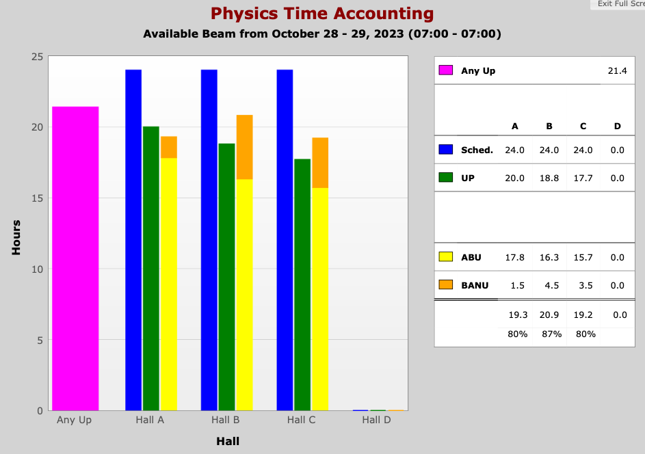
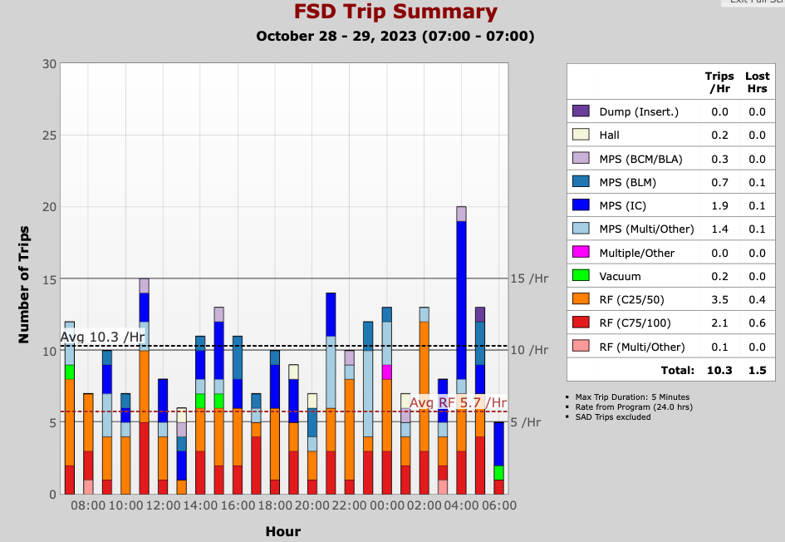
Status of CEBAF Beam Operations
Beam parameters on target
Hall A: ~40 uA, 4 pass
Hall B: 5 – 100 nA, 5 pass
Hall C: 10 – 30 uA, 5 pass
More stable beam than last year
Reduced number of RF trips
Longer uninterrupted runs
Likely, due to increased energy reach, smaller number of Halls

Slide 8
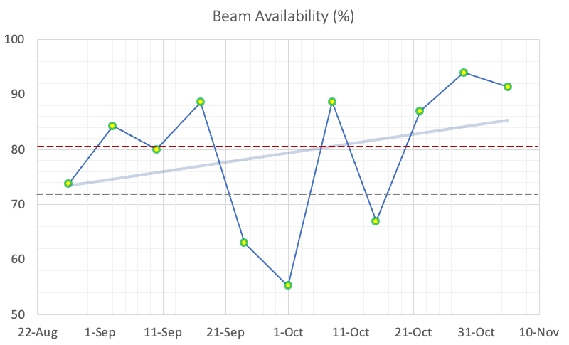
Status of CEBAF Beam Operations: Beam Availability
Average beam availability for this run is 81%
81% - This Run Average
72% - Previous Run Average
As of 11/05/2023
Data shows average
beam availability over a week
ending on the shown date

Slide 9
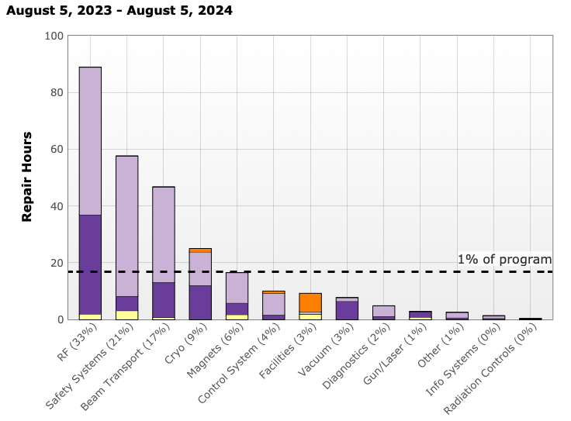
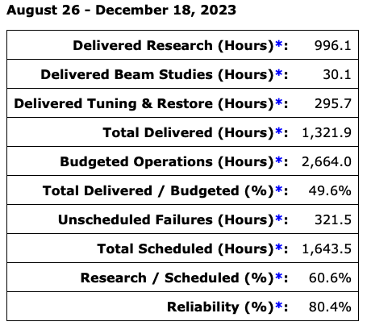
Beam Availability and Reliability, This Run (08/26/2023 – now)

Slide 10
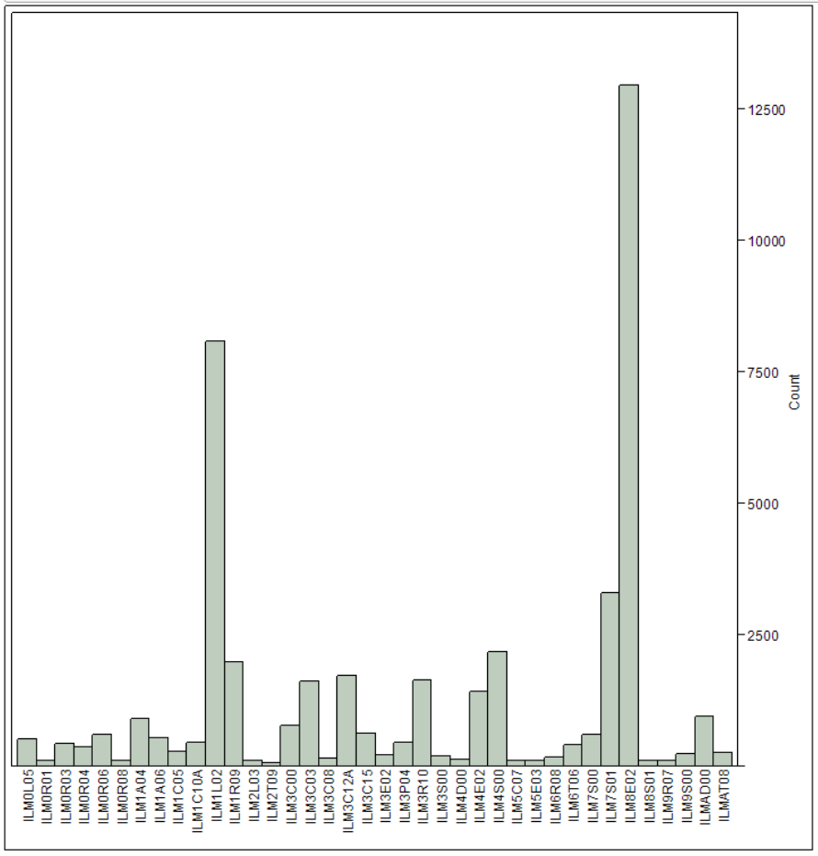
Main Sources of Downtime and Their Mitigation
RF/SRF failures are the largest contribution to downtime
CEBAF Performance Plan (see following slides)
CEBAF Gradient Team formed to address immediate SRF/RF performance issues and identify opportunities for improvement
SRF/RF/Operations meeting to address to issues common for SRF/RF/Ops
Q_{ext} reduced 3e7 to 1.6e7 due to lower field and higher microphonics
Beam losses and unscheduled tuning is a consistently high contribution
Improve and automate beam measurement and tuning procedures
Ongoing effort to Re-calibrate most offending beam loss monitors
Conduct a mini-workshop to develop path forward with BLM system upgrade
Number of MPS fast trips caused by BLMs
60% of all trips are caused
by four BLMs

Slide 11
Improving Reliability Is High Priority
Last run beam availability was 72%. DOE wants to see 80% at least.
Accelerator Ops are hiring Operability Deputy with a focus on reliability.
Need a cultural change to shift from reactive approach to proactive/preventive maintenance.
Identify immediate opportunities to improve reliability
Long term planning to address aging CEBAF systems
SMEs must be fully engaged in the process, understand failure modes of their systems, proactively think how to improve reliability, and plan for upgrades
CEBAF Performance Plan addresses critical spares and obsolescence
Procurement of critical spares and maintaining spares inventory
Replacement of obsolete systems

Slide 12
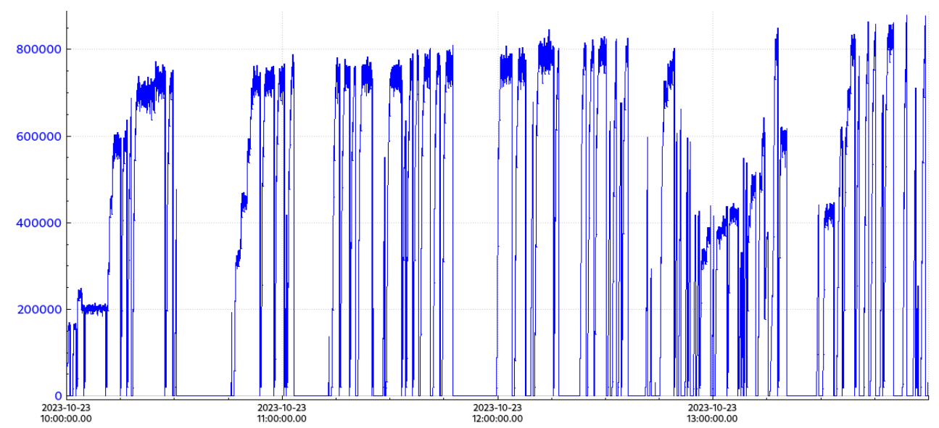
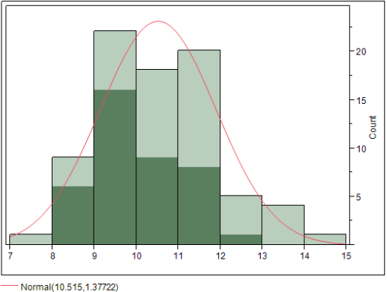
Probing CEBAF Performance Limits Increased Intensity Run in 10/2023
High intensity run to identify CEBAF limitations in anticipation of the high-power run in FY 2025 (1.1 MW).
RF Klystron Power Distribution
Absolutely needed 10 kW RF power output
Klystrons are specified at 11 kW linear regime.
Beam power as function of time
850 kW (395 uA)

Slide 13
CEBAF Performance Plan (CPP)
Goal: ensure CEBAF reaches 12 GeV in 5.5 passes and sustains reliable operations to meet physics program requirements
Energy Reach Project, manager – Tony Reilly
Reliability Project, manager – Randy Michaud
Cryomodule Installation Plan
 | Cryomodules Installed | Cryomodules Removed | Energy Gain (NL/SL), MV
FY23 | C100, C100 | C100 | 98 / 22
FY24 | C100, C75, C75 | F100, C20, C20 | 24 / 97
FY25 | C100, C75 | C100, C20 | 75 / 0
FY26 | C100, C75 | C100, C20 | 0 / 75
FY27 | C100, C75 | C100, C20 | 75 / 0
FY28 | C100, C75 | C100, C20 | 0 / 75
FY29 | C100, C75 | C100, C20 | 75 / 0
FY30 | C100, C75 | C100, C20 | 0 / 75

Slide 14
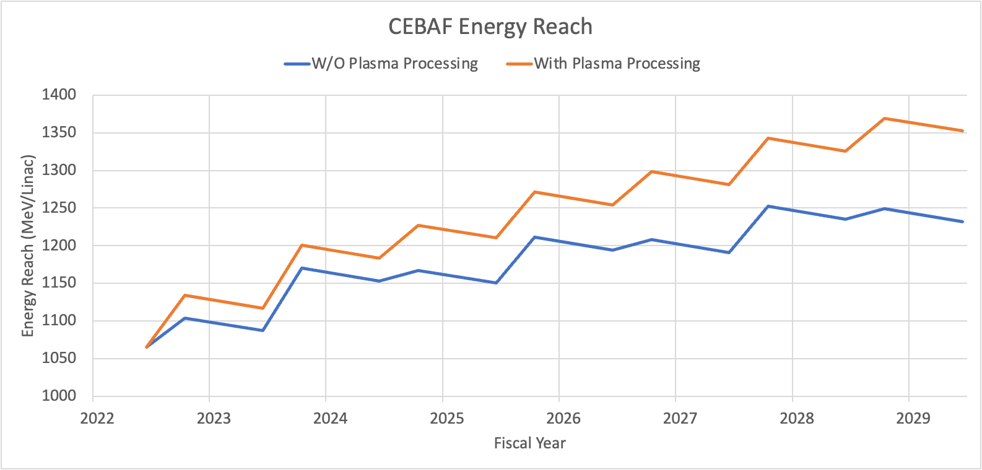
CPP: Energy Reach Projection
1090+100
CEBAF
energy reach
in 03/2023
✽
1090 (12 GeV)
FY23
FY24
FY25
FY26
FY27
FY28
FY29
FY30
Requested Physics
Energy (per linac)
Energy reach is the energy gain per linac corresponding to 10 RF trips/hour
Available RF power and beam current can dictate linac voltage profile and frequency of RF trips

Slide 15
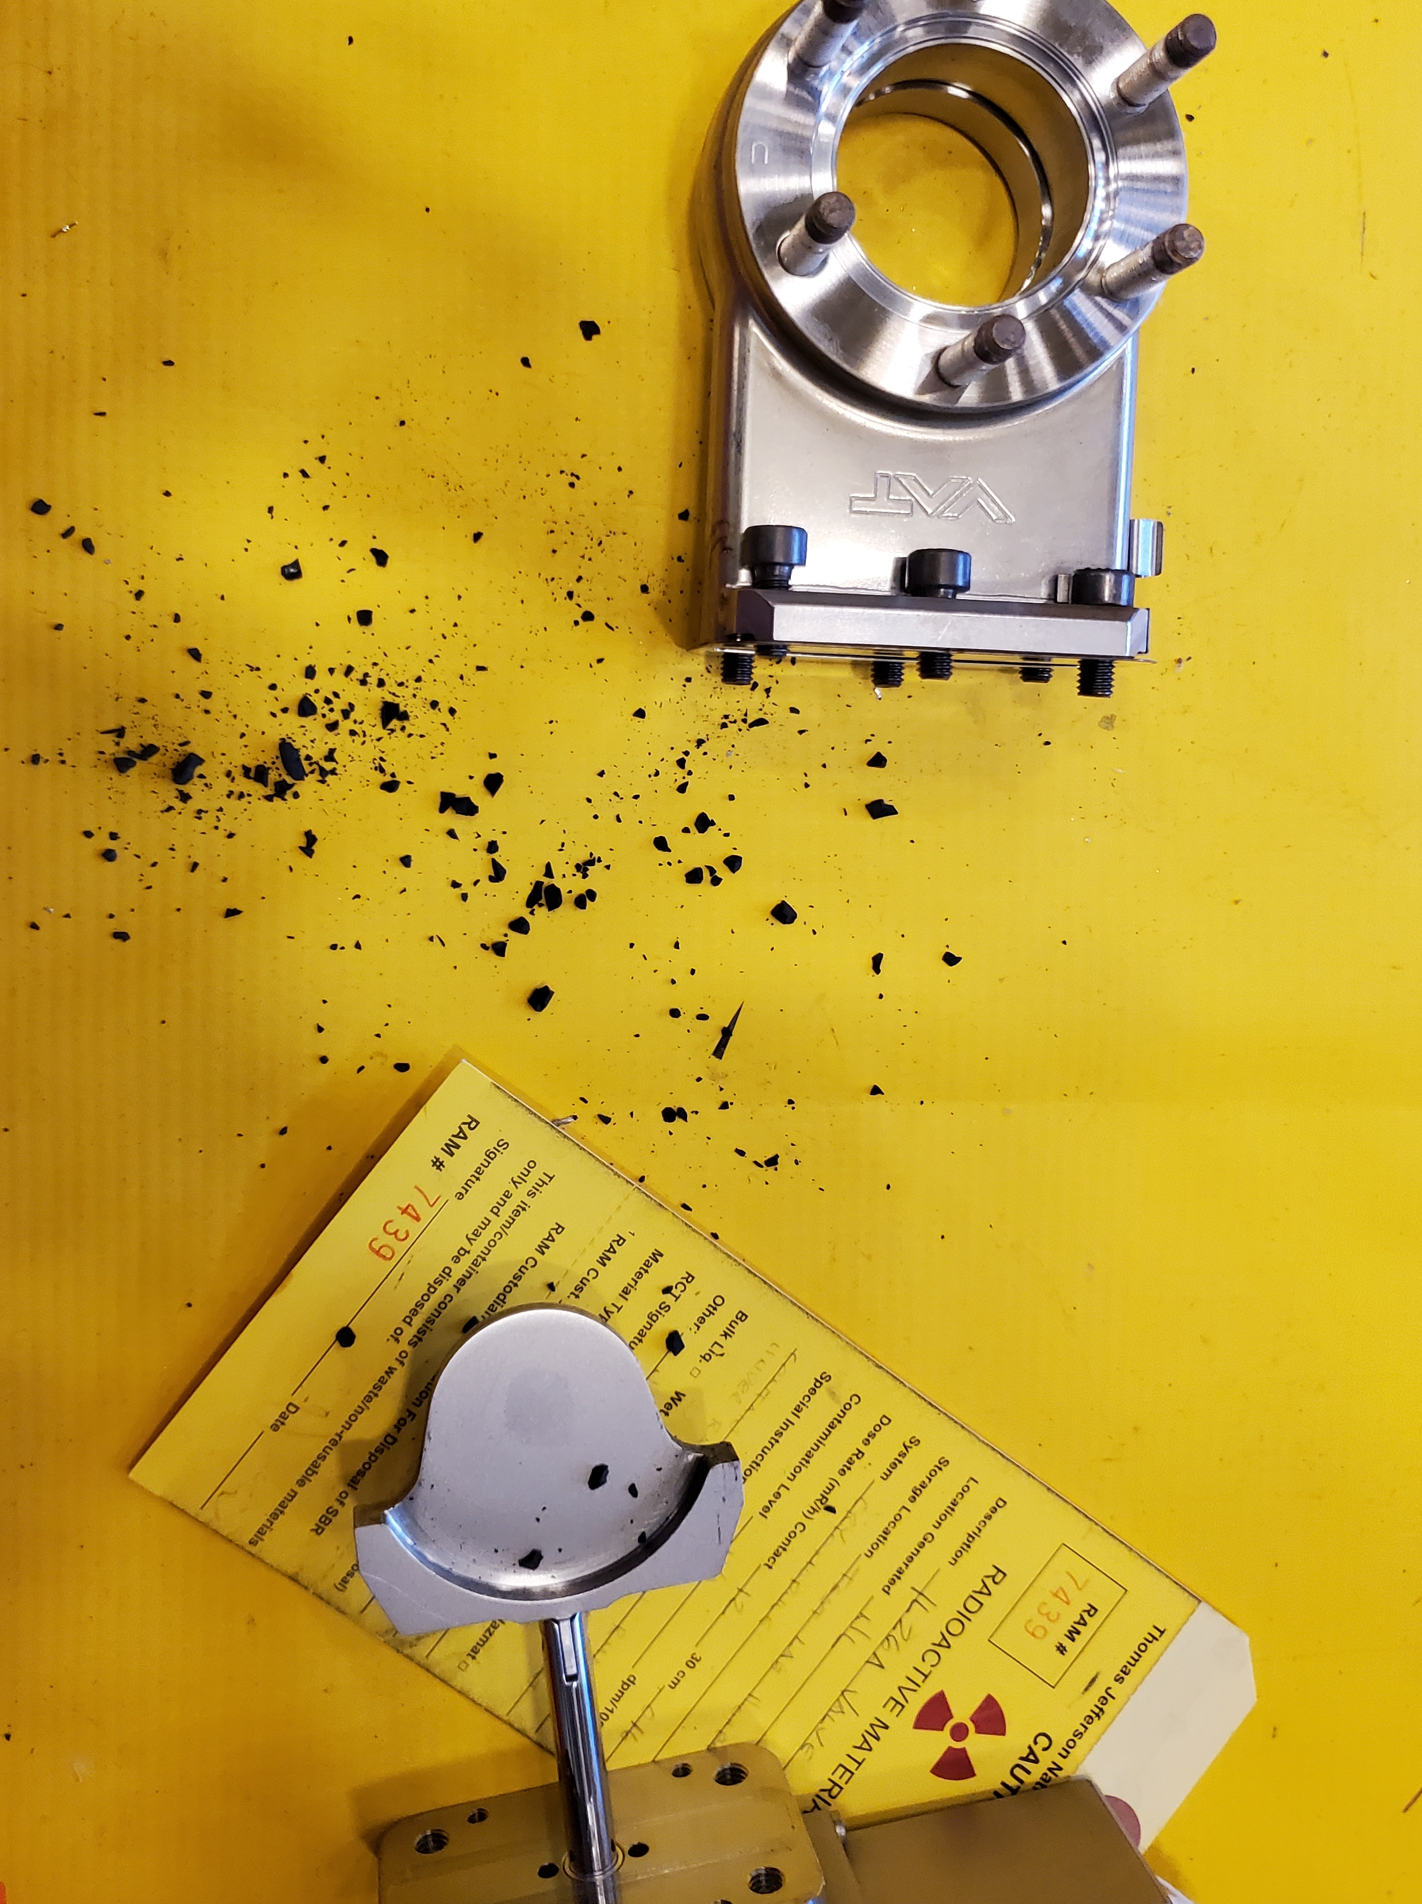
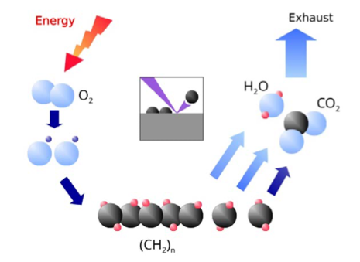
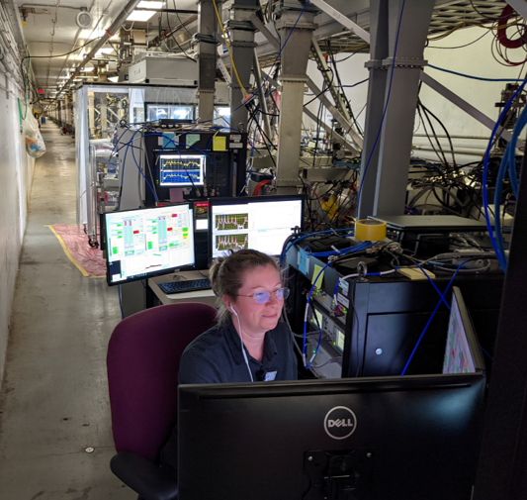
Successful In-Situ Plasma Processing Of CEBAF CMs
Four cryomodules, 2L22 - 2L25 (all cavities), were plasma-processed in the tunnel during last SAD
Path Forward
Process 3 to 4 C100 and C75 cryomodules during accelerator shutdowns.
Extend plasma processing to C75 cavities.

Slide 16
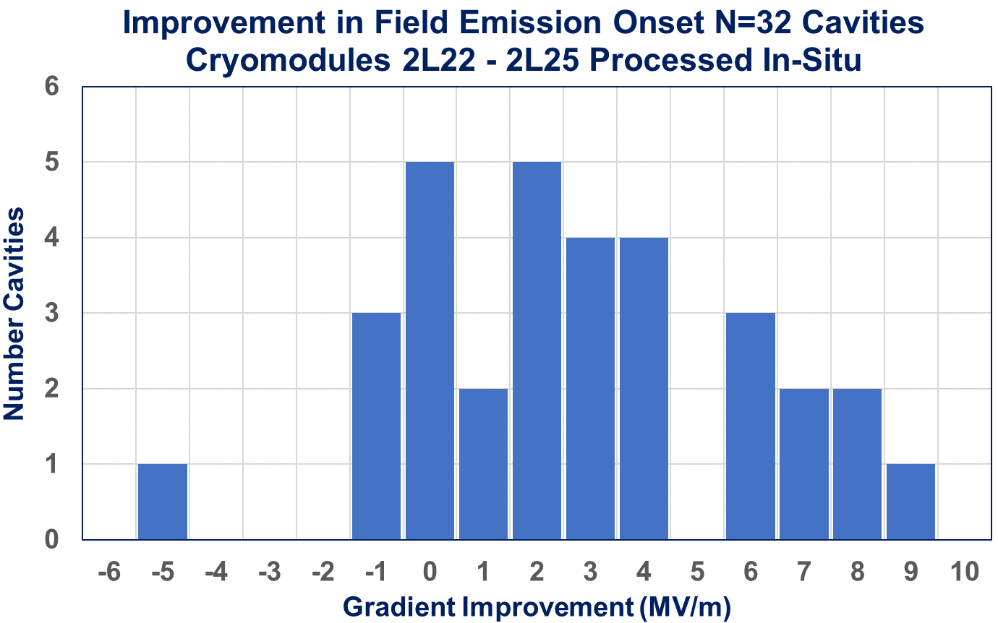
In-Situ Plasma Processing Increased Gradient by 2.7 MV/m
Average Increase
is 2.7 MV/m
Field emission free operation was improved by 59.1 MeV (24%).
An average improvement of 2.7 MV/m.
5 cavities were field emission free after processing.
Success of plasma processing supports more aggressive curve for CEBAF energy reach

Slide 17
Accelerator Improvement Projects
AIPs are used to upgrade existing system and bring new functionality
AIP | Status
Full Energy Injector - Integration | Completed
LLRF Digital Upgrades - C75 LLRF | On-going
Next Gen BPM Upgrade | Prototyping
Global Timing System | Not started
Spare CEBAF Booster | Not started
Waveguide Stub Tuners | Not started
BLM system upgrade (New) | Not started
RF one zone upgrade (New) | Not started

Slide 18
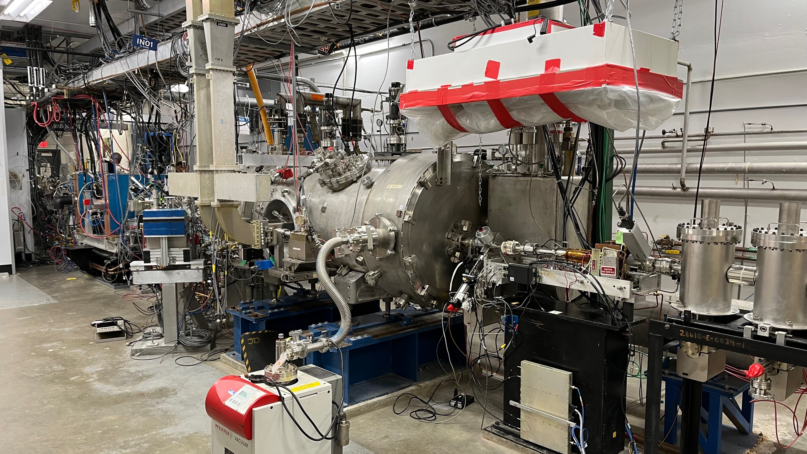
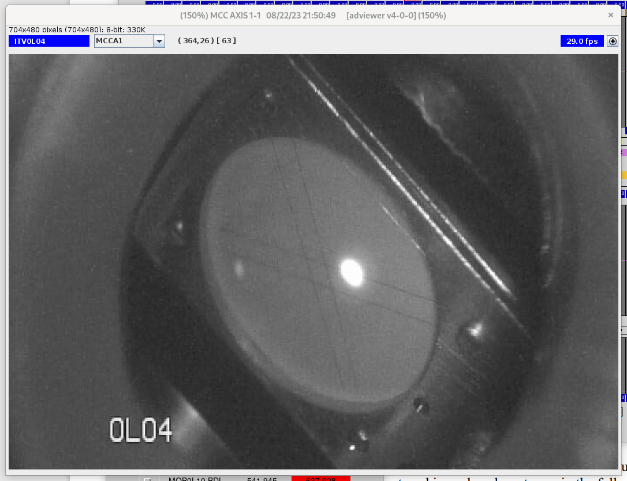
AIPs: Injector Upgrade Completed
The injector upgrade reduces helicity correlated asymmetries for the Parity Quality program (MOLLER).
Scope
Increased gun voltage from 130 to 180 keV.
Upgraded Wien filters.
Solenoids with a larger aperture.
New SRF Booster cryomodule with reduced deflection and coupling.
Injector is successfully used for this beam run
Beam tests to quantify beam Parity Quality and fully evaluate the injector are on-going
180 kV photogun
booster
New injector and Booster CM
In the CEBAF tunnel
Beam in the injector

Slide 19
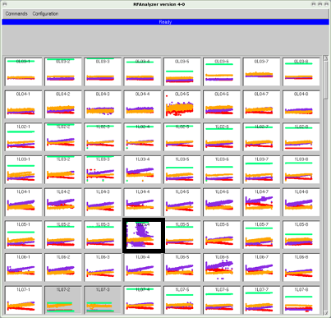
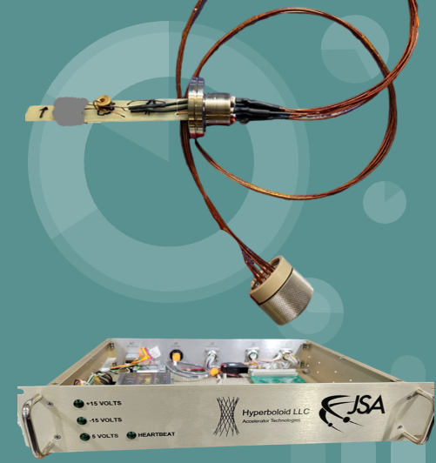
Portfolio of R&D and SBIR-Funded Projects
Detection of anomalies in cavity field
Three AI/ML DOE funded projects (FOA-LAB-20-2261)
Automate identification of unstable SRF cavities.
C100 Cavity Fault Prediction.
CEBAF cavity field emission management using neutron detectors and surrogate models (ML)
Reduce field emission, increase lifetime of components
He flowmeter (SBIR, Hyperboloid LLC)
Allows for fast and accurate measurement of cavity heat and Q₀
1497 MHz Magnetron RF source (SBIR, Muon Inc)
Demonstrate feasibility of magnetron as alternative, efficient RF source for CEBAF
Helium Mass
Flow Monitor​
First L-Band tube at
Richardson Electronics

Slide 20
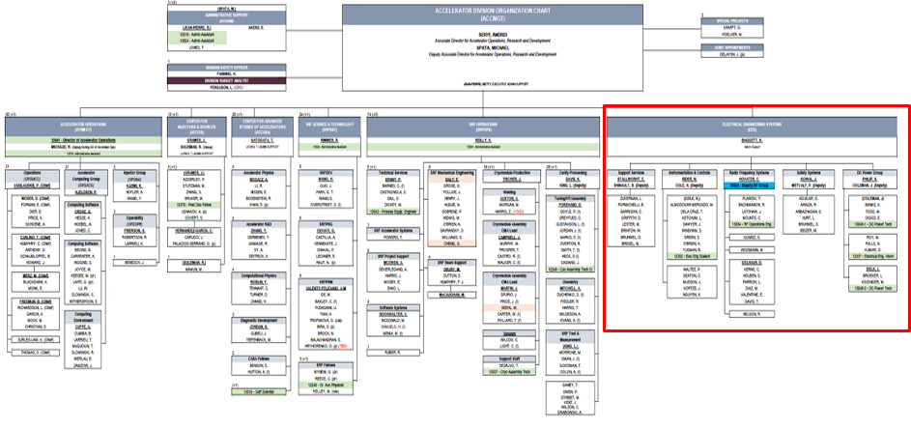
Accelerator Division Reorganization
Effective October 1, 2023, DC Power, RF, I&C, Safety Systems, Support Services, Vacuum Technicians, Specific Mechanical Engineering personnel moved from Engineering Division to Accelerator Division
Goal: align resources, responsibility and accountability for CEBAF operations, maintenance and improvements within a single organization

Slide 21
FY24 SAD Planning Started
Dates (preliminary) 5/19/2024 – 9/5/2024
SRF
Install 2xC75 CM and swap one C100 CM
Plasma-process 3-4 C100 and C75 CMs
Change gate valves around these CMs, girders?
RF
Keep installing LLRF 3.0
Install fiber links for Master Oscillator to North and South Linacs to reduce EMI induced trips
…

Slide 22
How Do CEBAF Operations Compare To Other Facilities
The Good
Close interaction with experimental halls
Strong CEBAF operator group and training
Work release system (ATLis)
The Bad
Culture of reactive approach to hardware maintenance results in low reliability
In-consistent use of best engineering practices and processes and lack of ownership
And we really need to think about it…
How are we going to upgrade aging infrastructure under present funding and schedule boundary conditions
Succession planning

Slide 23
Conclusions
Beam run in CEBAF is in full progress. Average reliability for the run is 81%.
Focus on improvement of communication between Ops and SMEs and performance and reliability issues
Energy reach will meet 12 GeV requirements with the required margin in FY 25-27. Successful demonstration of in-situ plasma processing will speed up growth of the CEBAF energy.
Accelerator Division reorganization will align resources with CEBAF operations
Looking forward to another successful year of delivering beam to NP users.

Slide 24
Thank you!

Slide 25
