Slide 1









Continuation of KLM R&D for the EIC
Anselm Vossen for the collaboration

Slide 2
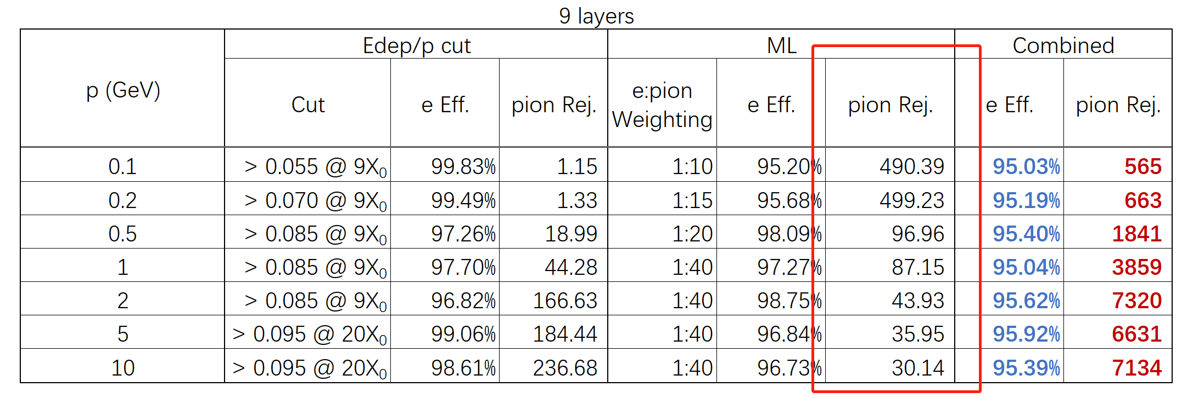
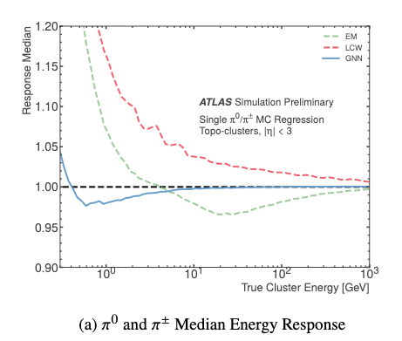
AI/ML is mentioned a number of times in the proposal, but did not surface in the deliverables explicitly. What is the connection?
AI/ML is not a deliverable per se, but a tool to optimize the deliverables.
We see two potential uses of ML/AI
  Energy reconstruction and PID
    Established
    Make use of longitudinal and lateral segmentation
    Well established (e.g. ATLAS, ePIC), in particular for non-compensating calorimeters
  Detector design
    2nd detector design optimization is one potential goal of the AIDE collaboration (Vossen co-PI)
Impact of ML/AI on ePIC barrel calorimeter performance (courtesy of C. Peng)
Performance of GNN based Steel/Scintillator tile
HCAL recATL-PHYS-PUB-2022-040

Slide 3
Some context, or comparison, of this proposal’s device relative to the HCals of the LEP detectors, DELPHI, OPAL and ALEPH, would be useful. These were multi-plate steel-sensor stacks that served as magnet-barrel flux returns, hadronic calorimeters, and first stages of muon taggers.

Slide 4
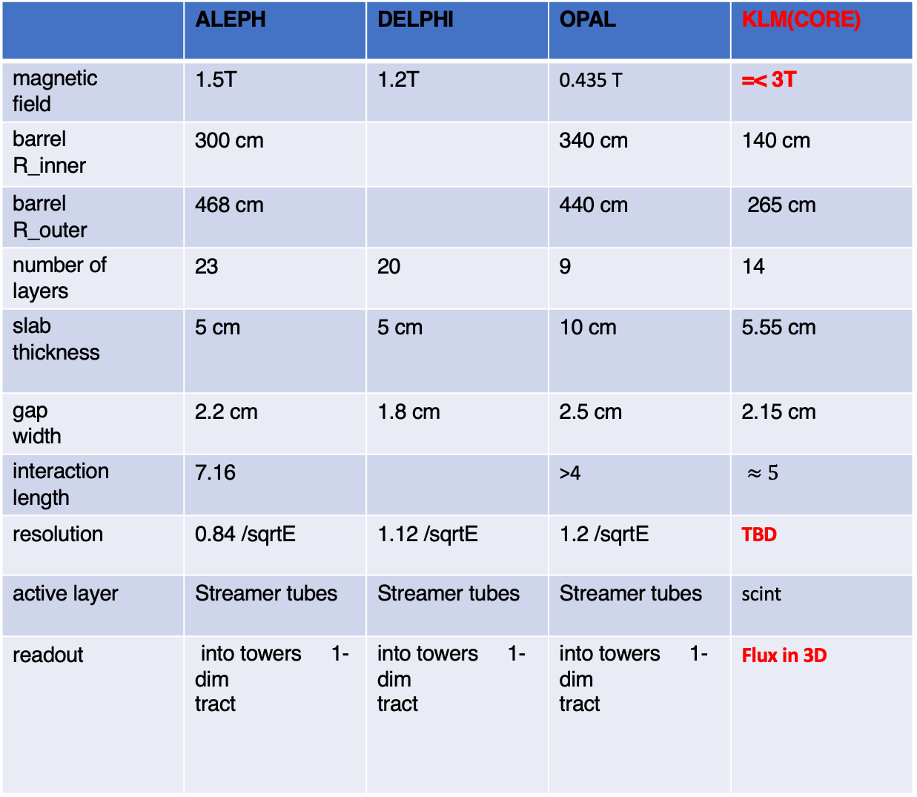
 | ALEPH | DELPHI | OPAL | KLM(CORE)
magnetic field | 1.5T | 1.2T | 0.435 T | =< 3T
barrel R_inner | 300 cm |  | 340 cm | 140 cm
barrel R_outer | 468 cm |  | 440 cm | 265 cm
number of layers | 23 | 20 | 9 | 14
slab thickness | 5 cm | 5 cm | 10 cm | 5.55 cm
gap width | 2.2 cm | 1.8 cm | 2.5 cm | 2.15 cm
interaction length | 7.16 |  | >4 | $≈5$
resolution | 0.84 /sqrtE | 1.12 /sqrtE | 1.2 /sqrtE | TBD
active layer | Streamer tubes | Streamer tubes | Streamer tubes | scint
readout | into towers 1-dim tract | into towers 1-dim tract | into towers 1-dim tract | Flux in 3D

Slide 5
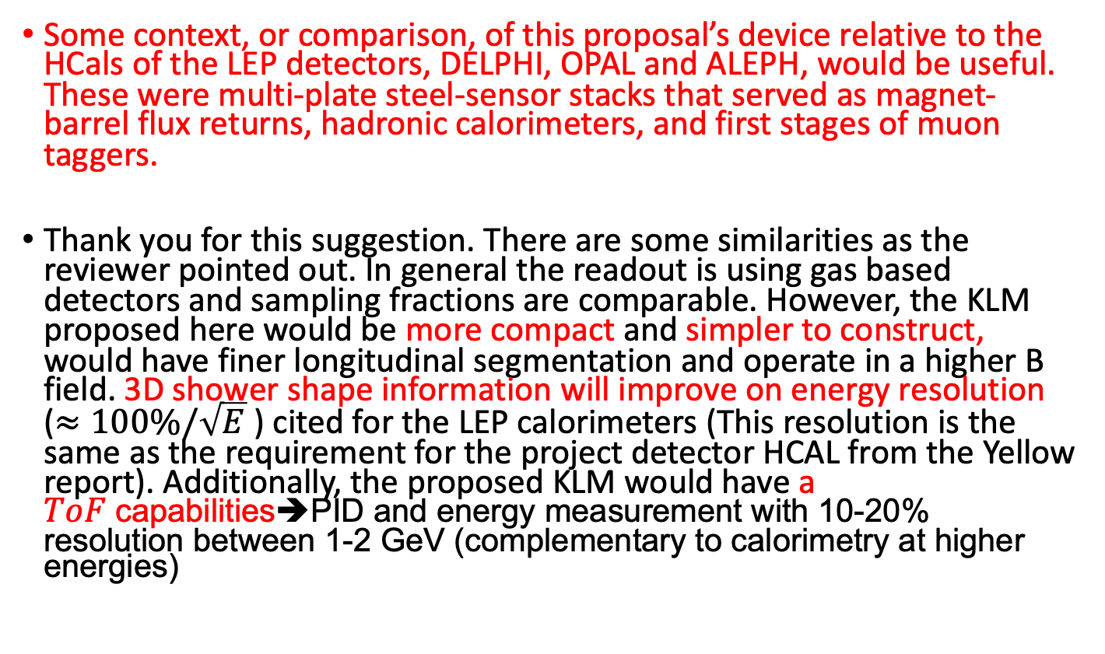
Some context, or comparison, of this proposal’s device relative to the HCals of the LEP detectors, DELPHI, OPAL and ALEPH, would be useful. These were multi-plate steel-sensor stacks that served as magnet-barrel flux returns, hadronic calorimeters, and first stages of muon taggers.
Thank you for this suggestion. There are some similarities as the reviewer pointed out. In general the readout is using gas based detectors and sampling fractions are comparable. However, the KLM proposed here would be more compact and simpler to construct, would have finer longitudinal segmentation and operate in a higher B field. 3D shower shape information will improve on energy resolution ($≈100\%/\sqrt{E}$ ) cited for the LEP calorimeters (This resolution is the same as the requirement for the project detector HCAL from the Yellow report). Additionally, the proposed KLM would have a $ToF$capabilities➔PID and energy measurement with 10-20% resolution between 1-2 GeV (complementary to calorimetry at higher energies)

Slide 6
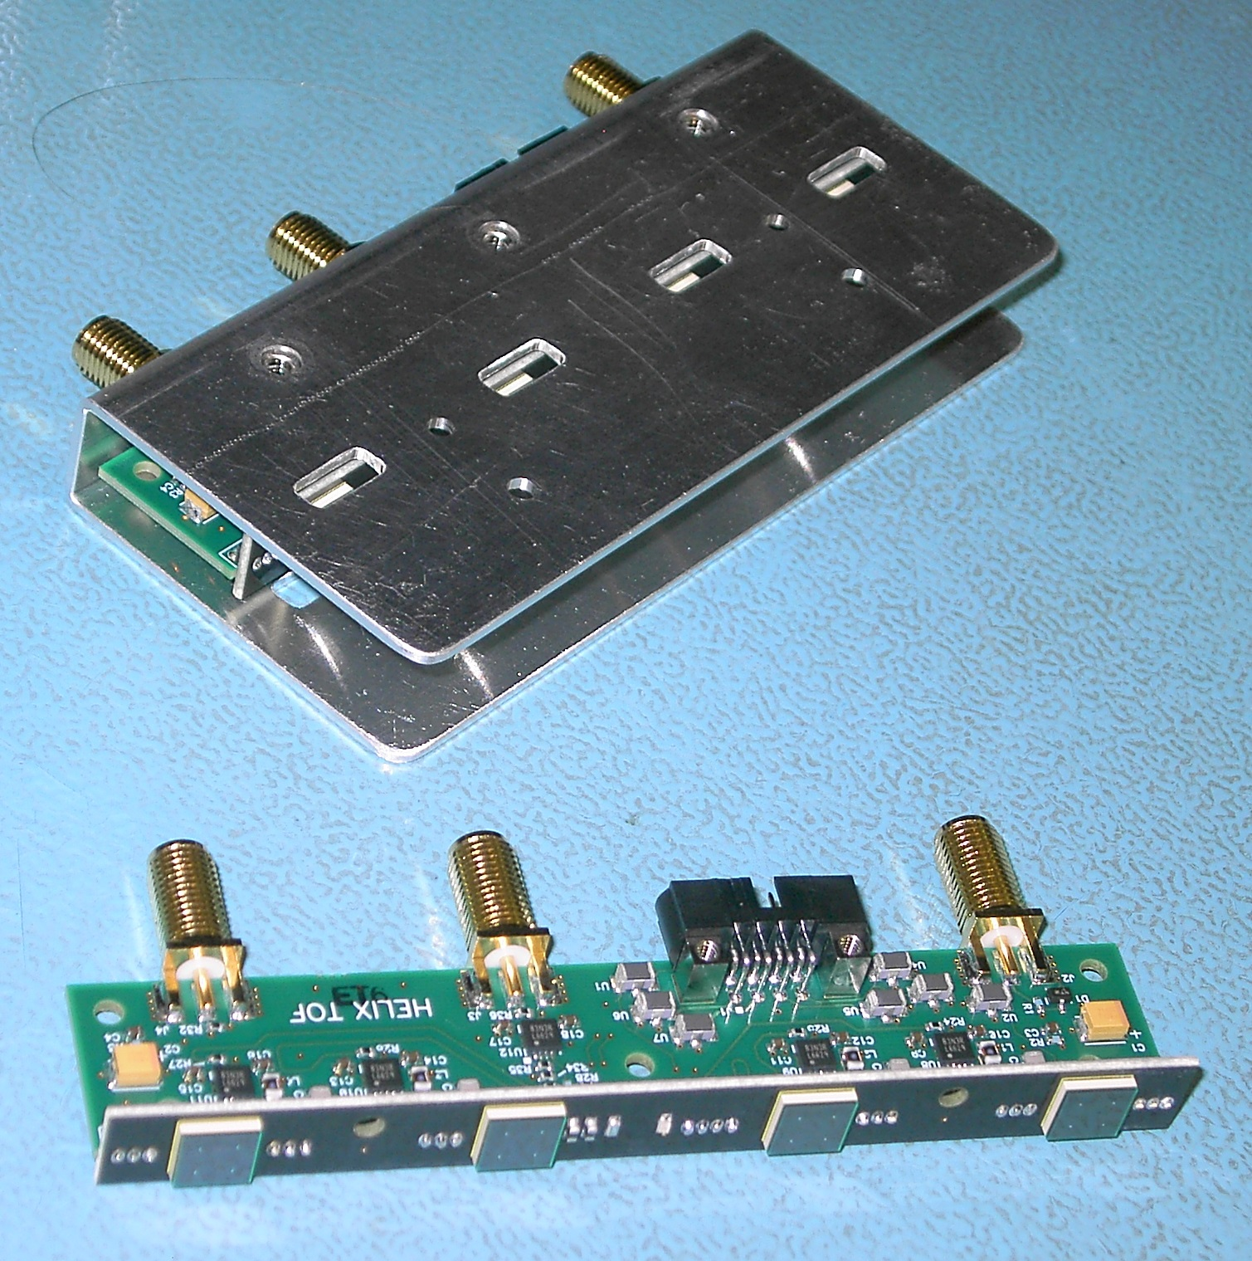
Some detail about the HELIX experiment electronics would be helpful.
A description of the full HELIX readout can be found in the reference: Nahee Park et al., “Cosmic-ray isotope measurements
with HELIX,” PoS ICRC2021, 091
Depending on particles, ToF has up to 50ps
resolution.
For KLM, plan to adapt carrier+preamp
Slow and fast outputs (timing and charge)

Slide 7
Does ELJEN have access to needed chemicals to manufacture the required scintillators or are there any known supply chain issues? What type of scintillator is planned?
According to their representative, there are no supply chain problems and they could deliver 30k scintillator bars if we were to order them.

Slide 8
Is Fig.2 right hand panel 1.5 T (text) or 2.0 T (legend on figure)?
The correct value is 1.5 T, the labelling of the figure of 2. T is not correct.

Slide 9
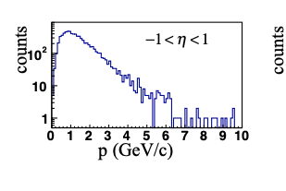
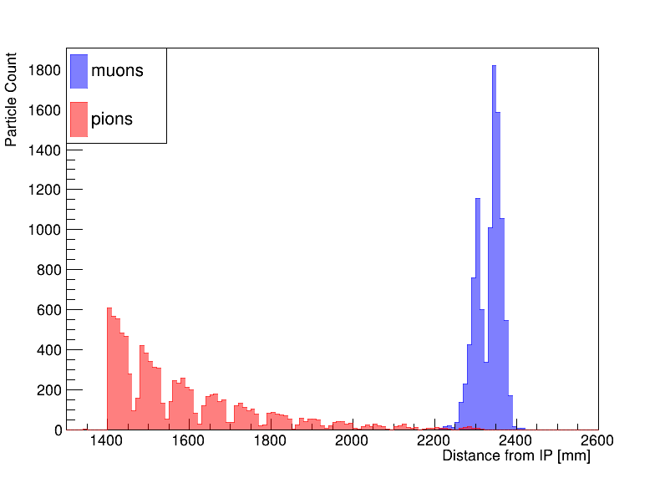
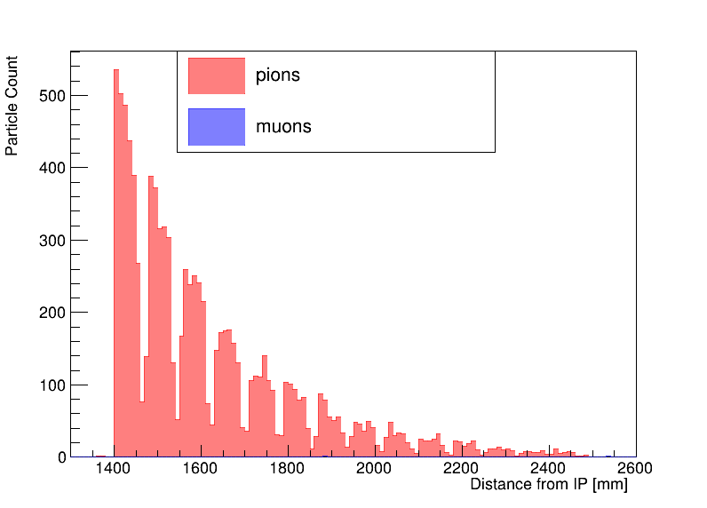
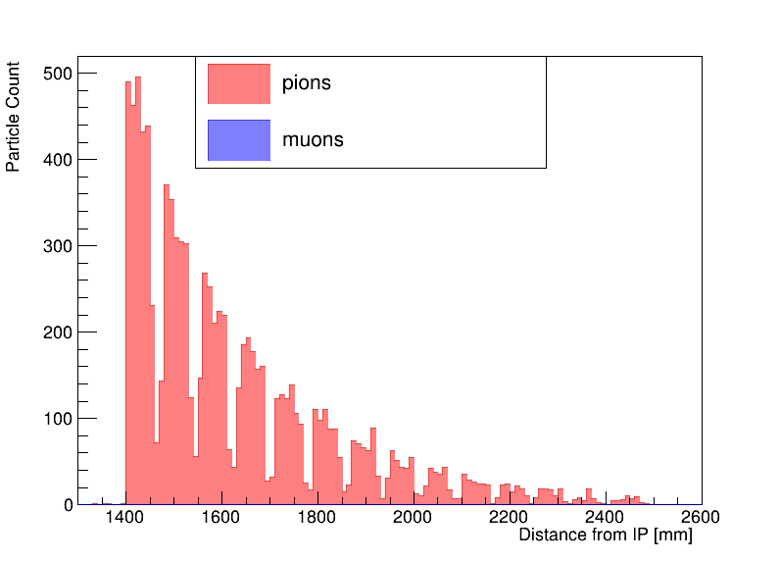
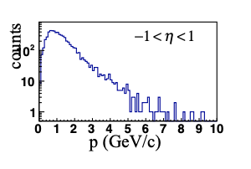




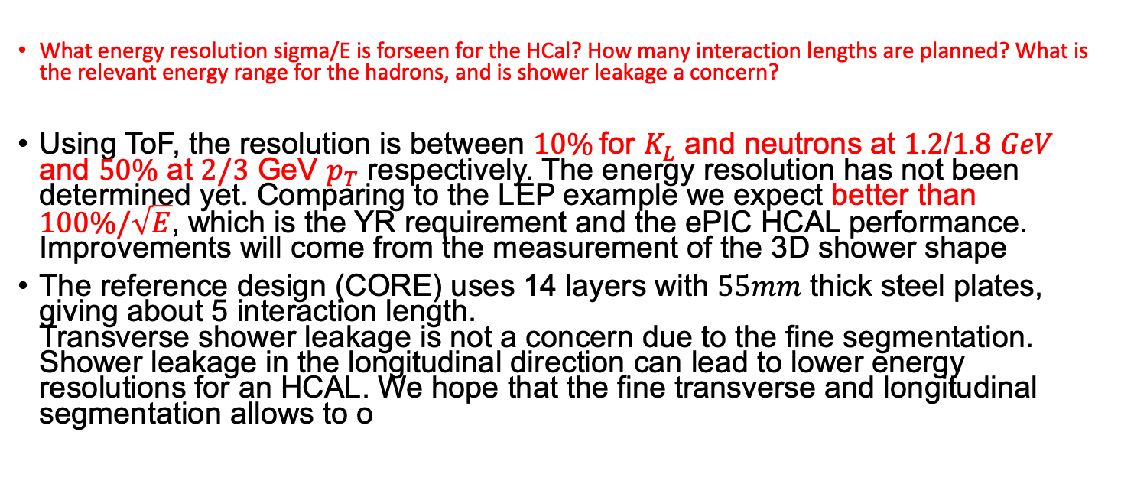


What energy resolution sigma/E is forseen for the HCal? How many interaction lengths are planned? What is the relevant energy range for the hadrons, and is shower leakage a concern?
Using ToF, the resolution is between $10\%$for $K_{L}$ and neutrons at $1.2$/$1.8$ $GeV$ and $50\%$ at $2/3$ GeV $p_{T}$ respectively. The energy resolution has not been determined yet. Comparing to the LEP example we expect better than $100\%/\sqrt{E}$, which is the YR requirement and the ePIC HCAL performance. Improvements will come from the measurement of the 3D shower shape
The reference design (CORE) uses 14 layers with $55mm$ thick steel plates, giving about 5 interaction length.
Transverse shower leakage is not a concern due to the fine segmentation. Shower leakage in the longitudinal direction can lead to lower energy resolutions for an HCAL. We hope that the fine transverse and longitudinal segmentation allows to o
$$18×275$$
$$K_{L}$$
$$p_{T}=1 GeV$$
$$p_{T}=5 GeV$$
$$p_{T}=10 GeV$$
$$n$$
Last energy deposit in KLM for different $p_{T}$ ➔Shower is largely contained even at the highest
momenta expected in the barrel

Slide 10
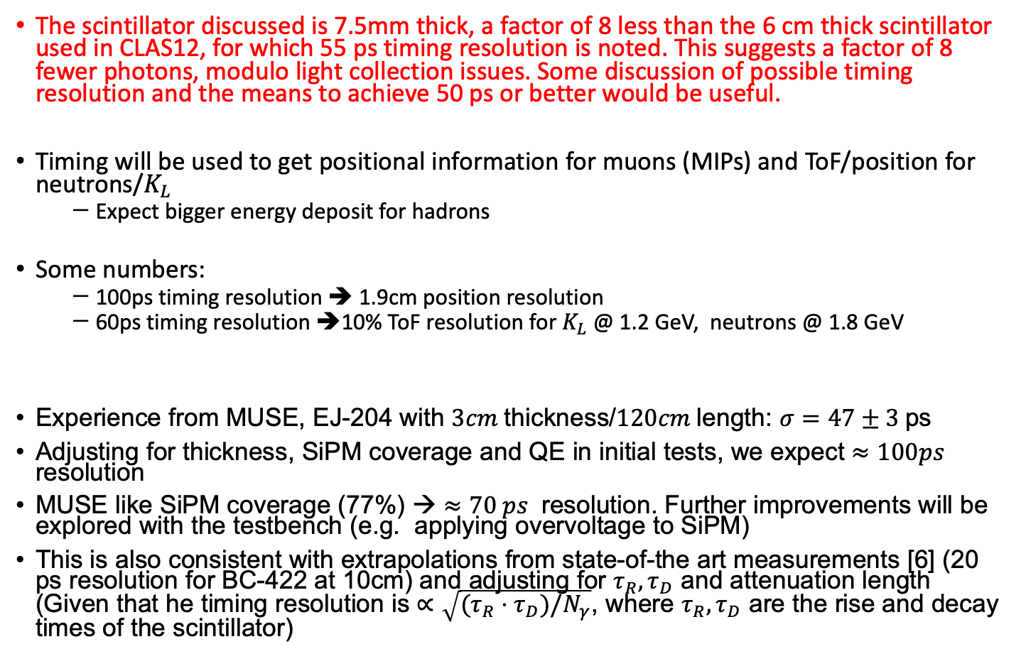
The scintillator discussed is 7.5mm thick, a factor of 8 less than the 6 cm thick scintillator used in CLAS12, for which 55 ps timing resolution is noted. This suggests a factor of 8 fewer photons, modulo light collection issues. Some discussion of possible timing resolution and the means to achieve 50 ps or better would be useful.
Timing will be used to get positional information for muons (MIPs) and ToF/position for neutrons/$K_{L}$
  Expect bigger energy deposit for hadrons
Some numbers:
  100ps timing resolution ➔ 1.9cm position resolution
  60ps timing resolution ➔10% ToF resolution for $K_{L}$ @ 1.2 GeV, neutrons @ 1.8 GeV
Experience from MUSE, EJ-204 with $3cm$thickness/$120cm$length: $σ=47±3$ps
Adjusting for thickness, SiPM coverage and QE in initial tests, we expect $≈100ps$ resolution
MUSE like SiPM coverage (77%) → $≈70 ps$ resolution. Further improvements will be explored with the testbench (e.g. applying overvoltage to SiPM)
This is also consistent with extrapolations from state-of-the art measurements [6] (20 ps resolution for BC-422 at 10cm) and adjusting for $τ_{R}, τ_{D}$ and attenuation length (Given that he timing resolution is $∝\sqrt{(τ_{R}⋅τ_{D})/N_{γ}}$, where $τ_{R}, τ_{D}$ are the rise and decay times of the scintillator)
[6] IEEE Trans.Nucl.Sci. 68 (2021) 7, 1487-1494, e-Print: 2103.11391 [physics.ins-det]

Slide 11
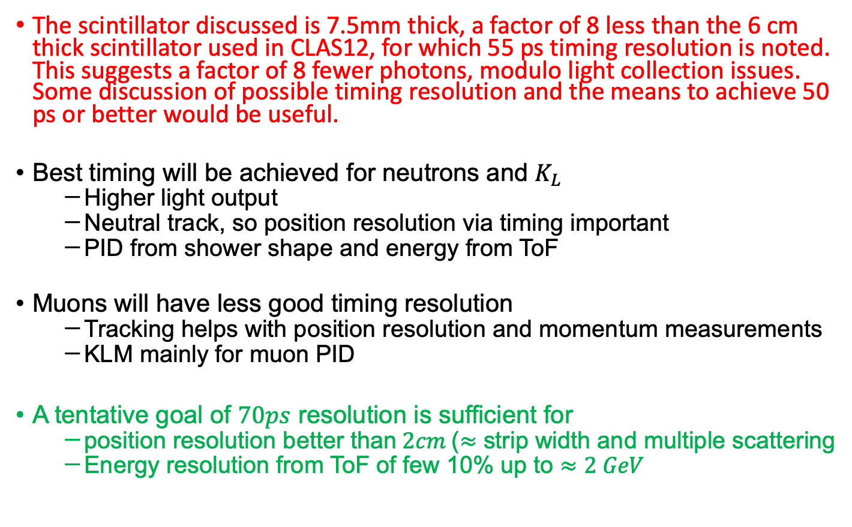
Cont
The scintillator discussed is 7.5mm thick, a factor of 8 less than the 6 cm thick scintillator used in CLAS12, for which 55 ps timing resolution is noted. This suggests a factor of 8 fewer photons, modulo light collection issues. Some discussion of possible timing resolution and the means to achieve 50 ps or better would be useful.
Best timing will be achieved for neutrons and $K_{L}$
  Higher light output
  Neutral track, so position resolution via timing important
  PID from shower shape and energy from ToF
Muons will have less good timing resolution
  Tracking helps with position resolution and momentum measurements
  KLM mainly for muon PID
A tentative goal of $70ps$ resolution is sufficient for
  position resolution better than$2cm$($≈$ strip width and multiple scattering
  Energy resolution from ToF of few 10% up to $≈2 GeV$
[6] IEEE Trans.Nucl.Sci. 68 (2021) 7, 1487-1494, e-Print: 2103.11391 [physics.ins-det]

Slide 12
Will larger-area SiPMs than exhibited for HELIX in Figure 6 be tested? Some larger SiPMs were tested by C. Woody of BNL as part of prior R&D, in that case for reading out EMCal modules. Has contact with him been made?
For the tests, we are considering to use 6x6 mm^2 SiPMs (max size from Hamamatsu). Depending on the results of the tests, we may need to consider potentially, further options that lead to a larger coverage of the area of the bar, where the light is collected, Contact with C. Woody is to be established.

Slide 13
Are there any representative waveforms already recorded for the signals from SiPMs coupled to the proposed scintillator(s), or is that part of this R&D?
This is part of the proposed activities for FY24

Slide 14
Have you calculated the threshold for a constant field by hand? Is this broadly consistent (within the deliberate choice of 0.5 for the efficiency)?
Yes, we have and not accounting for energy loss in the material prior to the KLM. For example, the minimum momentum a muon would need to just reach the KLM in a 3-T field is 0.642 MeV/c. In a 1.5-T field, this momentum is 300 MeV/c. Due to energy loss, such muons do not make it to the detector. The 50% cutoff was chosen arbitrarily.

Slide 15
The proposal reports on some test bench measurements from Belle-II. It seems that the numbers are not completely consistent between sections II-A-3 and IV-B-2. Can you summarize this and explain the purpose of the new scintillator sizes? Can you explain in more detail the plans to directly couple the SiPM to the scintillator? (Other experiments may still have some leftover spares with other dimensions, although details about the light collection may be helpful.)
We could not quite follow this comment. The dimensions of the scintillators given in the two referenced sections are the same.
There are no testbench measurements with Scintillators+SiPMs from Belle reported in the proposal.
The dimensions of the scintillators are driven by the tradeoff between a compact design and sufficient photon yield for the target timing resolution.
Coupling of the SiPMs: optical grease (likely for teststand) or cement (final detector)

Slide 16
Is the delayed funding an independent problem to the workforce recruitment?
Since only partial funding is provided recruitment has to be somewhat independent of the arrival of funds. However, work scheduling depends on the availability of funds.

Slide 17
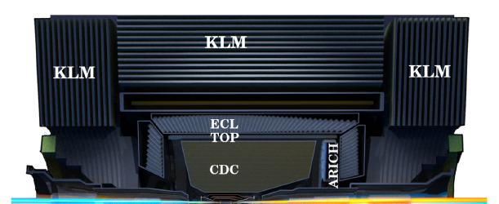
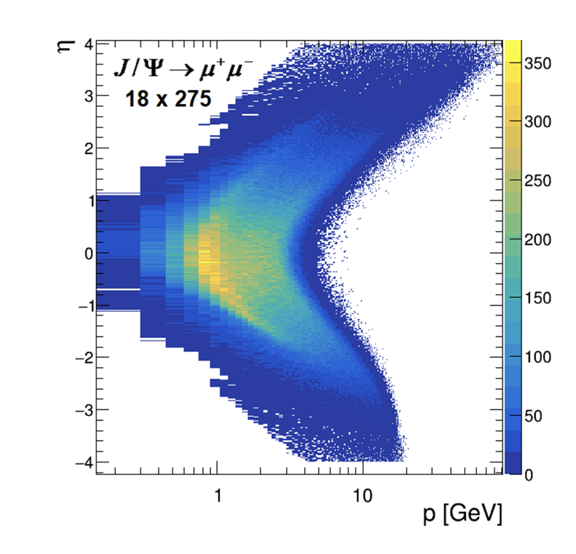
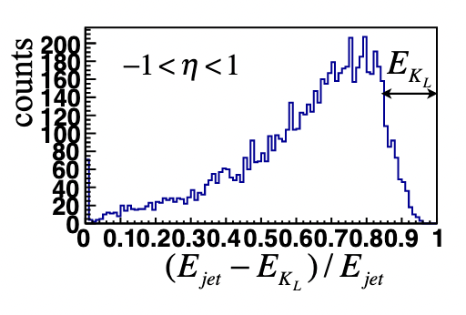
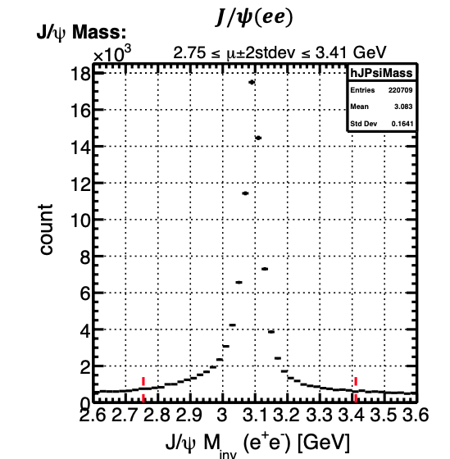
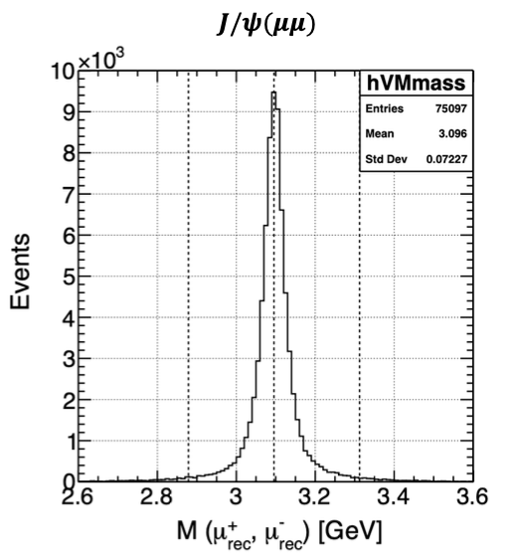

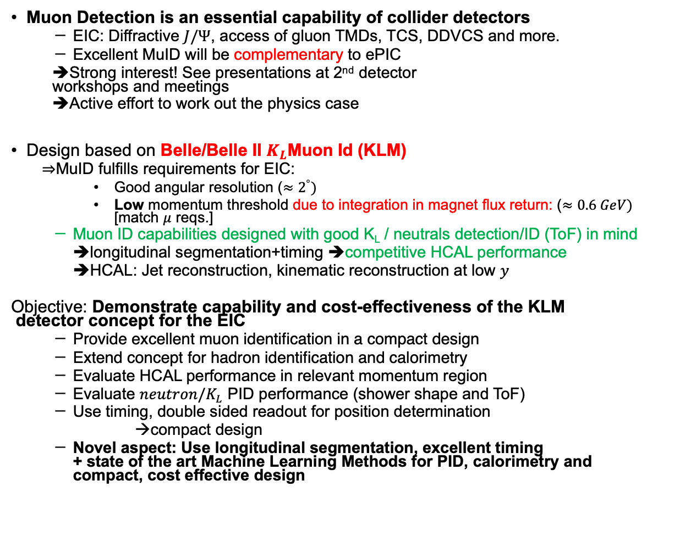
Project Motivation and Objectives
Muon Detection is an essential capability of collider detectors
  EIC: Diffractive $J/Ψ$, access of gluon TMDs, TCS, DDVCS and more.
  Excellent MuID will be complementary to ePIC
  ➔Strong interest! See presentations at 2nd detector
  workshops and meetings
  ➔Active effort to work out the physics case
Design based on Belle/Belle II $K_{L}$Muon Id (KLM)
  $⇒$MuID fulfills requirements for EIC:
    Good angular resolution ($≈2^{°})$
    Low momentum threshold due to integration in magnet flux return: ($≈0.6 GeV)$ [match $μ$ reqs.]
  Muon ID capabilities designed with good K_{L} / neutrals detection/ID (ToF) in mind
  ➔longitudinal segmentation+timing ➔competitive HCAL performance
  ➔HCAL: Jet reconstruction, kinematic reconstruction at low $y$
Objective: Demonstrate capability and cost-effectiveness of the KLM
detector concept for the EIC
  Provide excellent muon identification in a compact design
  Extend concept for hadron identification and calorimetry
  Evaluate HCAL performance in relevant momentum region
  Evaluate $neutron/K_{L}$ PID performance (shower shape and ToF)
  Use timing, double sided readout for position determination
  →compact design
  Novel aspect: Use longitudinal segmentation, excellent timing
  + state of the art Machine Learning Methods for PID, calorimetry and
  compact, cost effective design
arXiv:2209.00496
$$p<1 GeV$$
In barrel

Slide 18
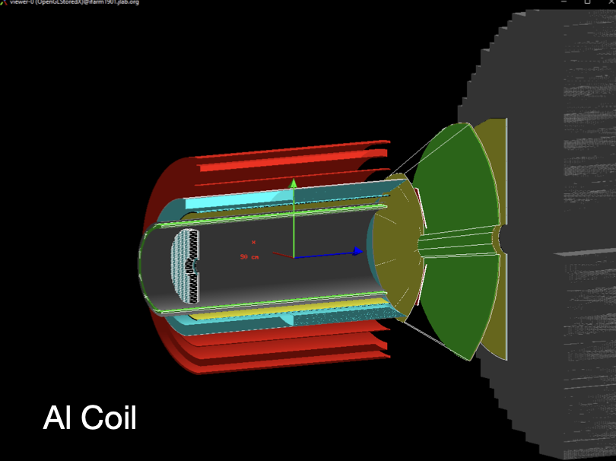
Project Scope
Implementation of Barrel KLM in Simulation to
  Study optimization of field, det radius and layer topology for best muon efficiency vs. threshold and desired range.
  Achieve a KLM baseline integrated design (with magnet and tracker)
  Study hadronic response (energy, PID)
  Adapt ML algorithms to KLM geometry
  Interplay of geometry/ML performance
R&D on thin scintillators
  Demonstrate feasibility of compact design with direct readout
  Timing (strive for 10s of picoseconds) for TOF info for hadron ID and momentum measurement
  w/ double-sided readout of strip, evaluate timing for position determination
  ➔more compact design.
Implementation of fast readout chain using SiPMs
Integration of R&D results into simulations
Beam test to verify hadronic response
CORE magnet system simulations
Performance of GNN based HCAL rec
ATL-PHYS-PUB-2022-040

Slide 19
Previous Year 1 Activities and Budget Request
Simulation + Reconstruction work at Duke
  Deliverables
    MuID reconstruction/MuID
    Study of hadronic shower shape
    Clustering, hadronic reconstruction algorithms
  Milestone: Initial characterization of MuonID, hadron reconstruction/ID
Readout teststand at Duke (+ in kind contributions/REU)
Teststand for Scintillator R&D, UofSC
  Deliverable:
    Procurement of material
    Preparation of teststand (including DAQ)
  Milestone: Teststand ready
  EE support by IU
Simulation work at UofSC/SBU
  Deliverables/Milestone: Implemented KLM layer structure

Slide 20
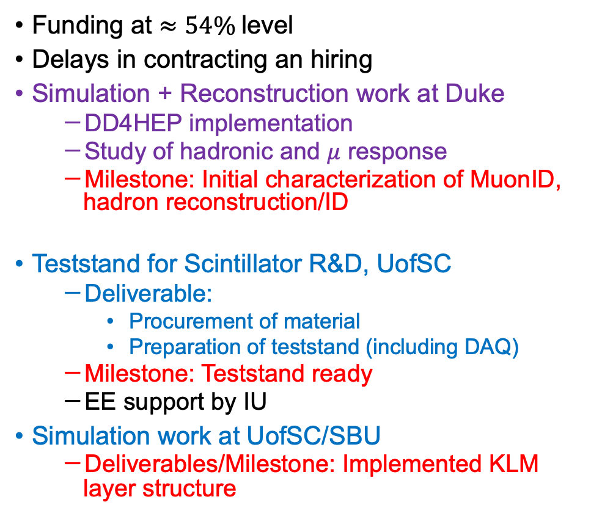
Current Status
Funding at $≈54\%$level
Delays in contracting an hiring
Simulation + Reconstruction work at Duke
  DD4HEP implementation
  Study of hadronic and $μ$ response
  Milestone: Initial characterization of MuonID, hadron reconstruction/ID
Teststand for Scintillator R&D, UofSC
  Deliverable:
    Procurement of material
    Preparation of teststand (including DAQ)
  Milestone: Teststand ready
  EE support by IU
Simulation work at UofSC/SBU
  Deliverables/Milestone: Implemented KLM layer structure

Slide 21
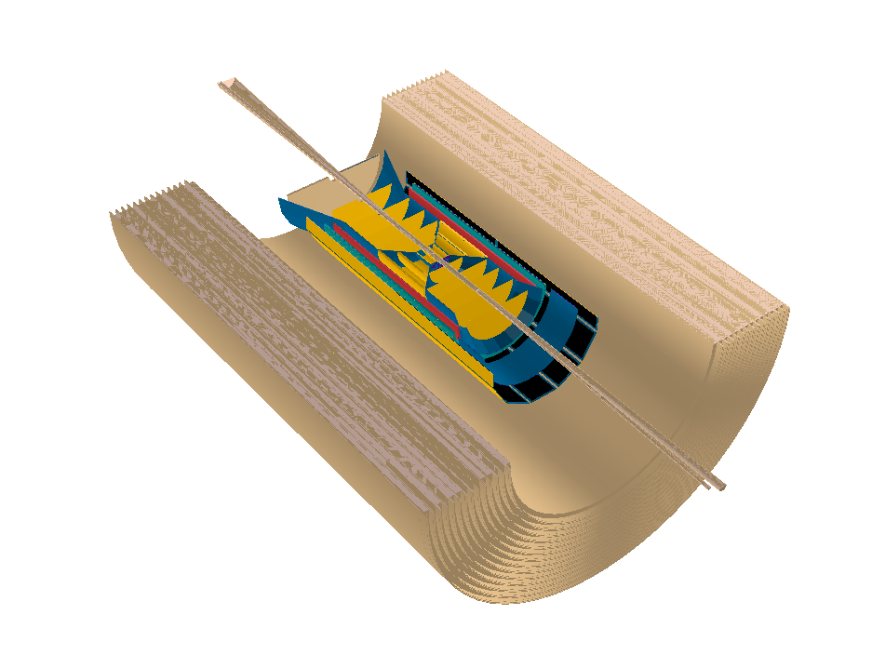
Simulations
Implementation in DD4HEP
  Synergy with 2nd detector and ePIC
    E.g. 2nd IP implementation, study of muon physics
55.5 mm steel
with a 21.5 mm gap
14 layers
Implementation in Fun4All
  Existing CORE implementation
  Minimal initial effort
  Ways to export to DD4HEP

Slide 22
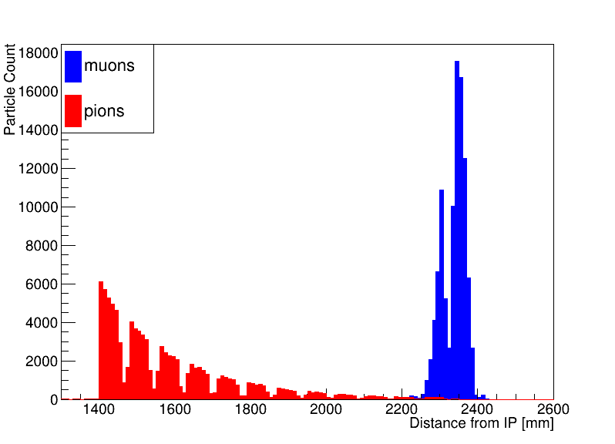
Simulations, Cont
1.5T
Minimum Muon momentum for CORE configuration
  600 MeV is reached for lower central B field
Muon vs pion response from DD4HEP simulation

Slide 23
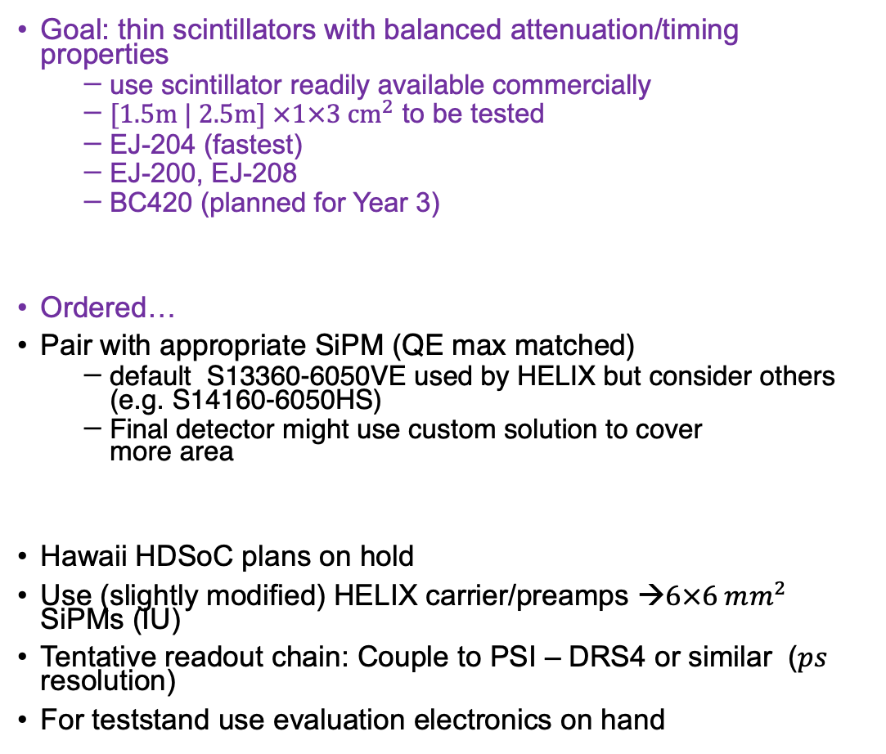
Scintillator test and electronics
Goal: thin scintillators with balanced attenuation/timing properties
  use scintillator readily available commercially
  $[1.5m | 2.5m] ×1×3 {cm}^{2}$ to be tested
  EJ-204 (fastest)
  EJ-200, EJ-208
  BC420 (planned for Year 3)
Ordered…
Pair with appropriate SiPM (QE max matched)
  default S13360-6050VE used by HELIX but consider others
  (e.g. S14160-6050HS)
  Final detector might use custom solution to cover
  more area
Hawaii HDSoC plans on hold
Use (slightly modified) HELIX carrier/preamps →$6×6 mm^{2}$ SiPMs (IU)
Tentative readout chain: Couple to PSI – DRS4 or similar ($ps$ resolution)
For teststand use evaluation electronics on hand
HELIX carrier/preamp board
Setup at USC

Slide 24
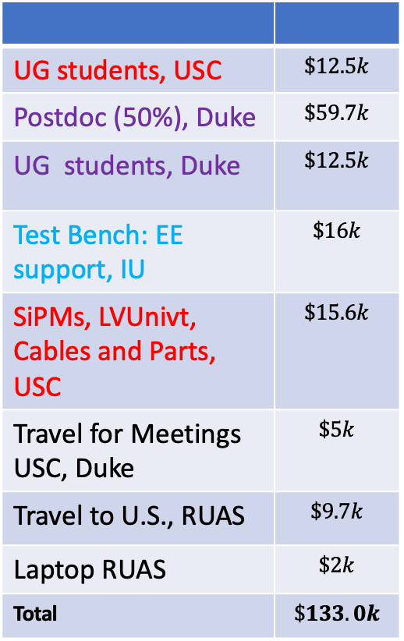
Year 2 Activities and money matrix
UG students, USC | $$\$12.5k$$
Postdoc (50%), Duke | $$\$59.7k$$
UG students, Duke | $$\$12.5k$$
Test Bench: EE support, IU | $$\$16k$$
SiPMs, LVUnivt, Cables and Parts, USC | $$\$15.6k$$
Travel for Meetings USC, Duke | $$\$5k$$
Travel to U.S., RUAS | $$\$9.7k$$
Laptop RUAS | $$\$2k$$
Total | $$\$133.0k$$
Refinement of MuID Algorithm
  Include in fast simulations, physics impact
Further study of KLM response to hadrons
  Energy resolution, PID
Clustering & MuID, track matching
SiPM carrier/preamp assembled at IU
Bench test HELIX and simple readout
➔feed back into simulations
Readout chain test at Duke
Optimization of buildable configurations
Prioritize engineering/hardware in the budget

Slide 25
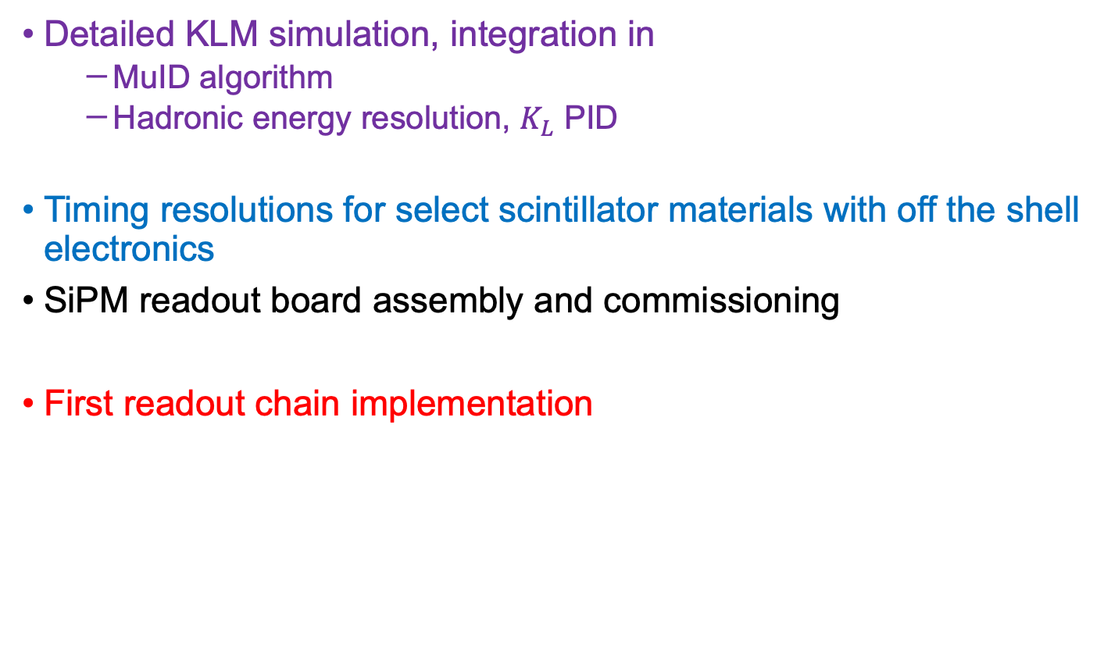
Milestones Year 2
Detailed KLM simulation, integration in
  MuID algorithm
  Hadronic energy resolution, $K_{L}$ PID
Timing resolutions for select scintillator materials with off the shell electronics
SiPM readout board assembly and commissioning
First readout chain implementation

Slide 26
Year 3 Activities
Full simulation of final configuration
Compare single/two strip in simulation
Integrating in (final?) magnet return yoke
Position resolution determined in test bench
  Implement in simulations if better than 30mm
PID performance from full simulations
Optimization of readout chain
Beam test to evaluate hadronic response
Milestones
  Quantified detector performance for muons & hadrons in simulation
  Position resolution from test stand with HELIX electronics and simple digitizer
  SiPM carrier/preamp assemblies
  Optimized readout chain (HDSoC still on the table maybe for year 4)
  Timing and position of optimized readout

Slide 27
Backup

Slide 28
Scintillator Tests at the University of South Carolina
Objective: To measure timing and position resolution of scintillator bars with design length, width, and thickness; and with SiPM readout on both ends.
Measurements will provide information about:
The best scintillation material (fast response vs attenuation length) for various-length KLM bars
Timing resolution with an initial SiPM readout
    Can we reach the desired timing resolution to measure hadron momentum via time of flight and what minimum SiPM coverage is needed?
    Do we need wave-form analysis electronics?
Position resolution - can we use only one plane of scintillators per layer - cost and space budget

Slide 29
Scintillators Acquired in FY23: side area of 1cm x 3cm
Material | Rise Time (ns) | Decay Time (ns) | Photons/1MeV e⁻ | Attenuation Length (cm) | Wavelength of Max. Emission (nm) | Scintillator Length (cm)
EJ-200 | 0.9 | 2.1 | 10,000 | 380 | 425 | 150, 250
EJ-204 | 0.7 | 1.8 | 10,400 | 160 | 408 | 150
EJ-208 | 1.0 | 3.3 | 9,200 | 400 | 435 | 150, 250
KLM Scintillator Bars Design (2023): side area of 0.75cm x 3 cm; Variable Length: 120 cm — <300 cm

Slide 30
SiPM Options (FY24)
The timing resolution depends on the amount of light collected by the photocathode area of the photomultiplier. Ideally, we want to collect all the light at each of a bar, i.e., in a 1x3 cm² area.
The largest-photosensitive area SiPMs Hamamatsu offers are 0.6x0.6 cm².
S14160-6050HS
S13360-6050VE
SiPM | Peak Sensitivity Wavelength (nm) | PDE at PSW | Gain | Recommended Operating Voltage (V)
S14160-6050HS | 450 | 50% | 2.5x10⁶ | 38+2.7
S13360-6050VE | 450 | 40% | 1.7x10⁶ | 53+3
S14160-6050HS is a preferred choice due to its higher PDE and lower operating voltage

Slide 31
Scintillator Tests at USC: Infrastructure
A state-of-the-art laboratory has been fully equipped to mount and test more than 500 large scintillators for the CLAS12 and MUSE projects.
Scintillators are wrapped in Aluminized Mylar; Light tight DuPont Tedlar encases the entire counter.
Electronics:
Leading-edge discriminators: LeCroy 623B
TDC (25 ps): CAEN V1290N
QDC for time-walk correction: CAEN V792N
Scintillation bars for the CLAS12 FTOF detector under cosmic ray tests at USC
R. Gothe and E. Phelps, private communication.

Slide 32
Simulations, Cont
Minimum Muon momentum for CORE configuration
  600 MeV is reached for lower B field central
Muon vs pion response from DD4HEP simulation

Slide 33
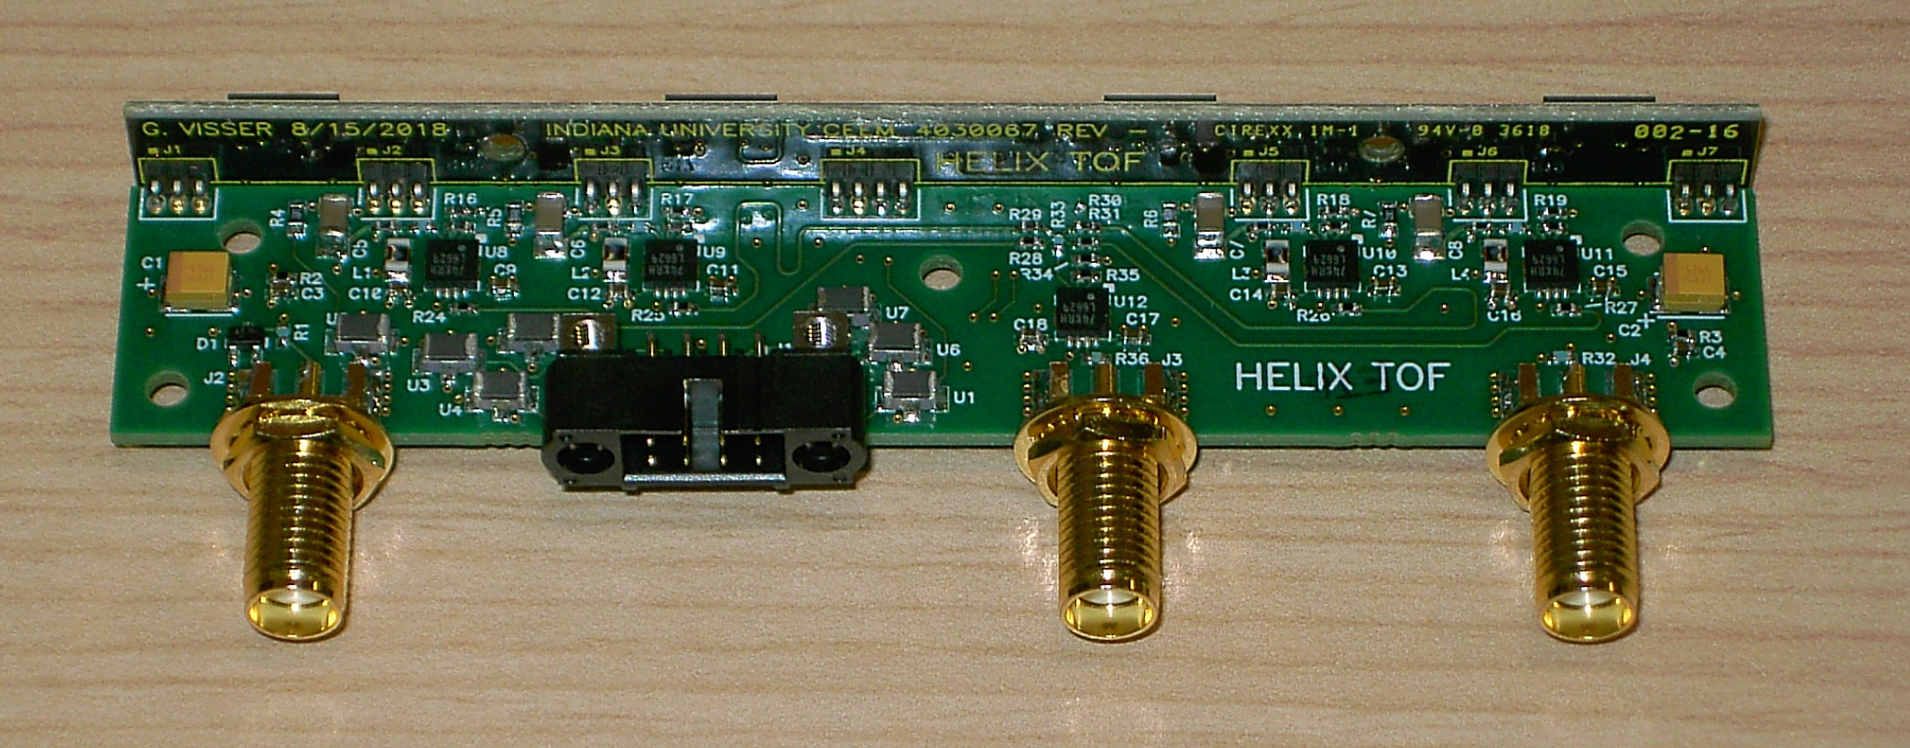

This is also consistent with extrapolations from state-of-the art measurements [6] (20 ps resolution for BC-422 at 10cm) and adjusting for $τ_{R}, τ_{D}$ and attenuation length (Given that he timing resolution is $∝\sqrt{(τ_{R}⋅τ_{D})/N_{γ}}$, where $τ_{R}, τ_{D}$ are the rise and decay times of the scintillator)

Slide 34
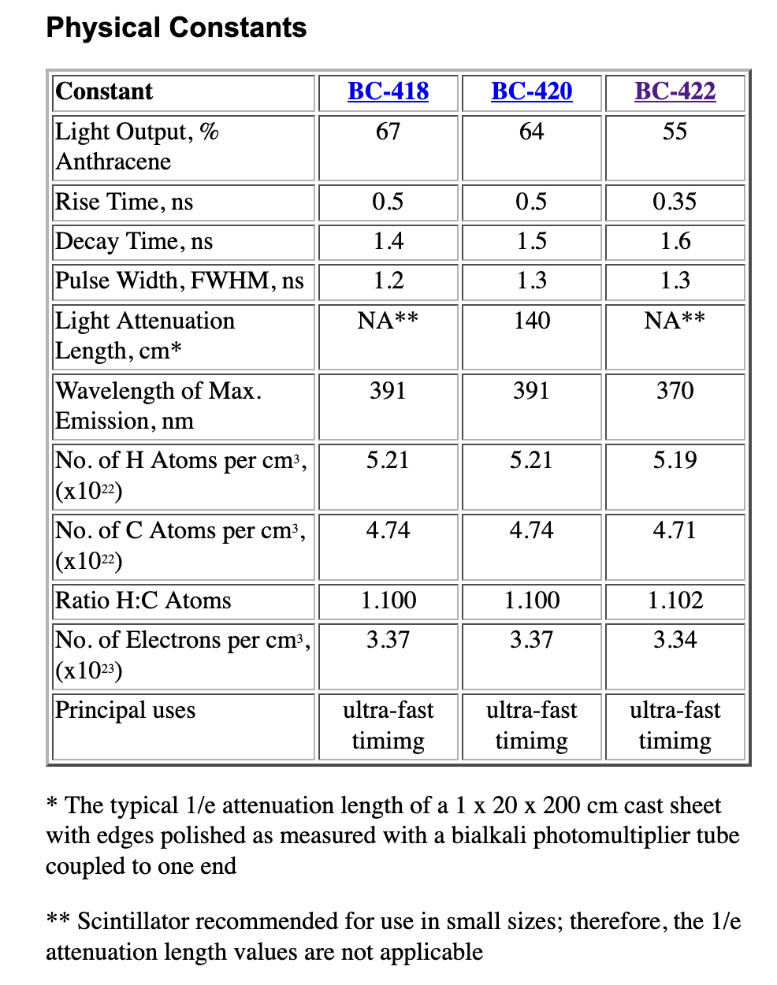

Slide 35
