Slide 1
Feasibility of Organic Glass Scintillators (OGS) for EIC
Aleksey Bolotnikov, Erik Muller, James Kierstead, Ivan Kotov, Milind Diwan, Sean Stoll, and Craig Woody
Brookhaven National Laboratory
EIC-Related Generic Detector R&D Proposal Review Meeting
October 30-31, 2023

Slide 2
Q1: This is an expensive yet interesting proposal. Since labor will dominate the budget, the committee requests more detail about the proposed time commitments for scientists, technicians, and students. BNL proposals often include a very useful “blue table” which summarizes labor, overhead, etc.?
The budget tables (at three funding levels) are attached at the end of the presentation

Slide 3
Q2: What energy range do we expect the neutrons to be and how does that change as they travel through the calorimeter? How 'straight' do the neutrons travel?
Neutrons with energies up to several 100 GeV are expected
OGS cannot stop high-energy neutrons. Therefore, a high-density absorber, e.g., tungsten, needs to be placed between layers of OGS to achieve sufficient stopping power
Neutrons produce hadronic showers in the calorimeter that include mixtures of hadrons. In turn, the hadrons cascade eventually leads to low-energy neutrons in the MeV range that can undergo multiple elastic scattering in OGS (primarily from ¹H and ¹²C)
In contrast to ¹²C, proton recoils generate strong light signals that can be detected with PMTs or SiPMs
We expect that OGS will be able to distinguish between hadrons and high-energy electron

Slide 4
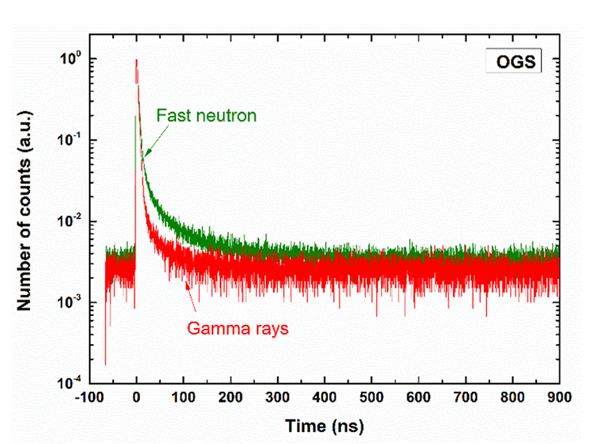
Q3: What PSD algorithm has been used to give the FoM? How will that be integrated into a potential application?
There are fast and slow components in the light signals generated in OGS
The intensity of the slow component depends on the ionization density which allows to distinguish between proton and electron recoils
FoM (or PSD) is defined as a ratio of the charge in the tail (slow component) to the total charge in the pulse
Signal waveforms will be captured and digitally processed: integrated over two time windows (head and tail)
Head area
Total area
Current signal
FoM=1-Head/Total

Slide 5
Q3: Do you expect the Cherenkov light will affect the PSD?
Yes, Cherenkov light can potentially interfere with PSD
The contribution of the Cherenkov light will depend on the UV light transmission in OGS
Scintillation light generated in OGS peaks around 430 nm which overlaps with the Cherenkov spectrum tail
Fast Cherenkov signals will contribute to the fast component
We propose to investigate these effects and develop correction techniques if necessary

Slide 6
Q4: What photon sensor do you envisage and do you expect it to have effect on the PSD?
We propose PMTs or SiPMs with fast responses
Q5: Can the shape studies be performed in ray-tracing Monte Carlo?
It is possible
Q6: Is the planned beam time secured?
Not yet

Slide 7
Project goals
The goal of this proposal is to evaluate the feasibility of novel organic glass scintillators (OGS) for high-energy calorimetry
  OGS was originally developed for nuclear physics experiments: detection of neutrons in the presence of high gamma-ray flux, e.g., in the Facility for Rare Isotope Beams (FRIB) at Michigan State University
  The most important feature of OGS is the possibility to discriminate proton and electron signals using the Pulse Shape Discrimination technique (PSD)
  Detection of Cherenkov light is another potentially useful feature of OGS (has yet to be demonstrated) – this will depend on the UV light transparency in OGS
The objectives of this project
  Prototype in the lab and carry out beam tests to investigate if OGS can be used to discriminate hadron and electromagnetic signals
  Investigate the Cherenkov light in OGS -- can it be detected?
Samples of different shapes and compositions will be acquired from Radiation Monitoring Devices Inc. (RMD) and characterized first in the lab and then in the beam

Slide 8
OGS properties
OGS is a novel scintillator recently developed by Sandia National Laboratory (SNL) to replace conventional plastic scintillators used for fast neutrons at high gamma-ray backgrounds
Its mechanical properties are similar to the conventional plastics, but it has several advantages as a scintillator:
  High light output in comparison to plastics scintillators, ~20,000 ph/MeV
  Emission spectrum peaks around 450 nm matching available photodetectors
  Fast decays: 2 and 150 ns (fast and slow components)
  Pulse shape discrimination (PSD) capability for particle identification
  Better radiation hardness (no degradation was observed up to 50 kRad gamma-ray exposure)
  Use commercial manufacturing technologies, including injection molding of thin tiles, sheets, and possibly rods
  Timing resolution of < 300 ps was reported by OGS producers

Slide 9
OGS comparison with plastic scintillators
We note that most conventional plastic scintillators cannot efficiently discriminate between proton and electron recoil signals

Slide 10
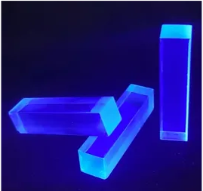
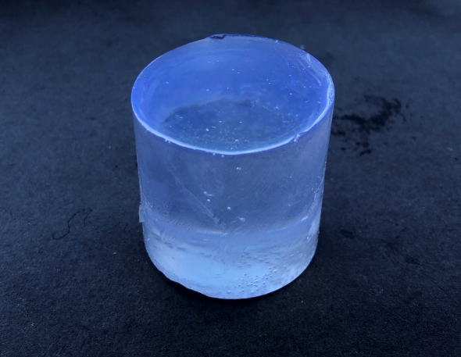
OGS is available from two vendors: RMD, Inc. and Blueshift Optics, LLC
Samples of 20-cm long OGS bars (left) and 38 ID mm x 38 mm OGS cylinder
RMD is interested in supporting this project by providing samples of different shapes and optimizing the plastic formulations
blueshiftoptics.com/org-glass-scintillator & rmdinc.com/product-category/organic-glass-scintillator

Slide 11
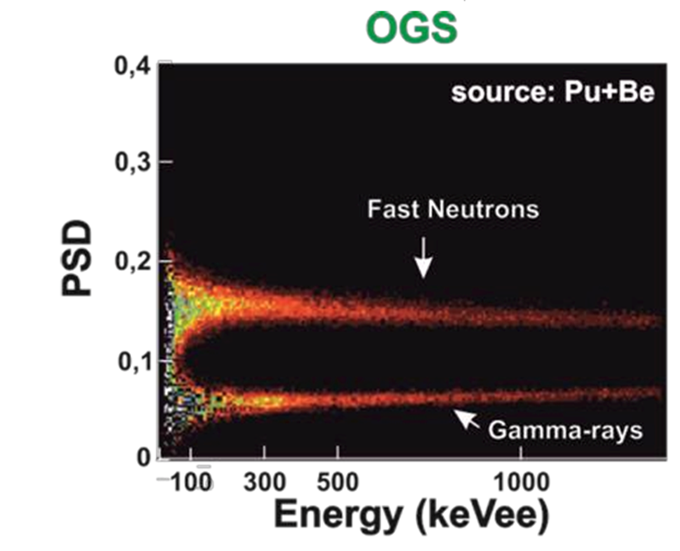
Pulse shape discrimination
Current signals in OGS from recoil protons and gamma rays
In many organic and some inorganic scintillators, the fraction of the light in the slow component depends on ionization density, dE/dx.
This dependence can be used to differentiate between weakly and strongly ionizing particles, e.g., proton and electron recoils
PSD is defined as a difference in the ratio of the charge in the tail to the total integrated charge in the pulse
Time windows should be optimized, e.g., (0-30) ns and (30-190) ns
PSD in OGS
The main question is whether we can use the pulse shape discrimination capability to distinguish between hadronic and electromagnetic showers
M. Grodzicka-Kobylka, et al., “2-inch molecular organic glass scintillator for neutron–gamma discrimination”, Nucl. Instr. and Meth., A1047 (2023) 167702.

Slide 12
Is detection of Cherenkov light possible?
Currently, there is no data in the literature on the Cherenkov light detection in OGS
Cherenkov light generated in OGS is expected to be similar to the Cherenkov light in quartz (the refractive indices are nearly the same for both materials)
In the past, Cherenkov light has been studied in PMMA and some plastic scintillation fibers [1,2]
One of the proposed tasks is to investigate the possibility of the Cherenkov light detection in OGS
[1] Alekseev et al., “The Yield of Cherenkov and Scintillation Radiation Generated
by the 2.7 MeV Electron Beam in Plate PMMA Samples”, Micro 2022, 2(4), 663-669
[2] C. Adler et al., “The RHIC zero-degree calorimeters” NIMA 470 (2001) 488–499

Slide 13
Radiation hardness of OGS
The long-term irradiation effects on the light output and particle-discriminating capabilities of OGS have been tested for space applications[1]
No light output reduction or PSD changes were observed after gamma-ray irradiation up to 50 kRad
Damage due to neutrons was not observed up to 2.5x 10¹¹ n/cm²
For experiments at the EIC, moderate radiation hardness up to ~3 kRad/year electromagnetic and 10¹⁰ n/cm² hadronic are expected
The results reported in the literature suggest that OGS should be able to meet these requirements
We propose to use the high-intensity ⁶⁰Co source, Tandem, or NSRL facilities for testing OGS
[1] M.I. Pinilla-Orjuela, et al. “Performance evaluation of pulse shape discrimination capable organic scintillators for space applications”, Nucl. Instr. Meth., A1053 (2023) 168309.

Slide 14
Proposed tasks for Year 1
OGS characterization and testing:
Optical transmittance, checking the absorption length
Scintillation properties – with radioactive sources and cosmic rays using PMTs and SiPMs.
Decay times -- using a pulsed laser fluorescence spectrometer and single photon counting
PSD -- measure with Cf-252, Sr-90 sources, Am-241, and proton beam
Investigate the Cherenkov light -- with radioactive sources
Radiation hardness to gammas -- measured at BNL using the 300 Ci ⁶⁰Co source
Radiation hardness to protons – at NSRL or Tandem
We will provide the feedback to RMD with potential formulations refining

Slide 15
Proposed tasks for Year 2
Prototype designing and testing -- this task will depend on the results obtained during Year 1
We design and integrate a prototype
We consider a thin detecting plane made up of small-area tiles, bars, or fibers; specific dimensions of the tiles and the type of photodetectors will be optimized based on the previous studies
Testing the prototype at the Fermilab test beam. This task is subject to the fund availability

Slide 16
Nominal budget (PIMS # 7120)

Slide 17
20% cut budget

Slide 18
40% cut budget

