Slide 1
Large-Area Monolithic Active Pixel Sensors Combining High Spatial and Temporal Resolution – committee presentation meeting
Dominik Gorni
10/30/2023

Slide 2
PART 1
Committee comments

Slide 3
Question #1
Are there engineering, physics, or computer science faculty at universities who would be interested in collaborating on some aspects of this R&D? In general, this would seem like a way to increase the number of senior person-months per year devoted to arguably important generic R&D without increasing the cost so much that it is out of reach of the current program.

Slide 4
Answer
We are open for collaboration. Instrumentation Division has a long tradition of collaboration with the universities around the US, e.g.:
- Yale University (Photon Detector Readout Electronics for nEXO)
- Yale and Princeton Universities (Co-design Center for Quantum Advantage C2QA)
- Columbia University / Nevis Lab (ATLAS lAr Calorimeter ALFE ASIC-COLUTA ADC)
- University of Pennsylvania (Rubin Observatory - LSST)
Some ad-hoc ideas for shared, supplemental efforts, while more can emerge:
- Simulation of whole sensors latency with event-driven readout using physics data generators;
- Investigation of the original data grabber and RSU-to-StaveEnd transmission, existing for framed-readout, and its adequacy for the event-driven readout, and potential redesign;
- Happy to host grad, PhD students and postdocs on-site in ASIC design (process specific) and testing work.
Note: Good communication between BNL and potential collaborators is required due to utilization of IPs, created at BNL, fabrication process requiring NDA;

Slide 5
Question #2
It is not clear to me how a person with 0.02 FTE can be effective. The highest FTE in this project is <0.2 which is also low. Which tasks does each person do? This breakdown would be necessary to judge if the required task could be performed with the assigned FTE value.

Slide 6
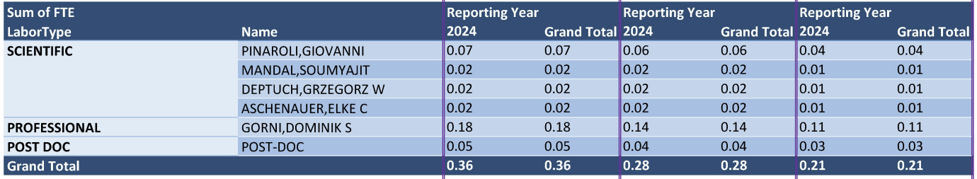
Answer
While generic R&D aims at demonstrations of feasibility and suitability of the proposed technologies, it is constrained in the total distributable budget for all projects, so we adjusted to the expectations and plan to achieve the initial stages of the R&D efforts.
To advance to a manufacturability readiness level, more funding should be requested, but we do not see ability of getting such a chunk from the generic R&D portfolio, therefore follow-up on this “actual seed” will need to be requested in the upgrades-time, but we hope to start the project, gain tracking and visibility.
This concept is beyond the ePIC SVT baseline, nevertheless the team possess momentum and the same fabrication process is used, so less overhead than in starting from scratch.
Responsible for design and simulations of the analog part
Supervision of the design, technical assistance
Supervision of the physics side
Responsible for design and simulations of the digital part
Note: funds are limited, thus allocations aims at covering, even shallowly, the most critical tasks needed to achieve technology demonstration; individual names may change.
Responsible for simulations on the physics side

Slide 7
Question #3
How does the proposed solution compare with other event-driven readout designs such as the MuPix chip (https://arxiv.org/abs/2002.07253) which achieves timing < 10ns ?

Slide 8
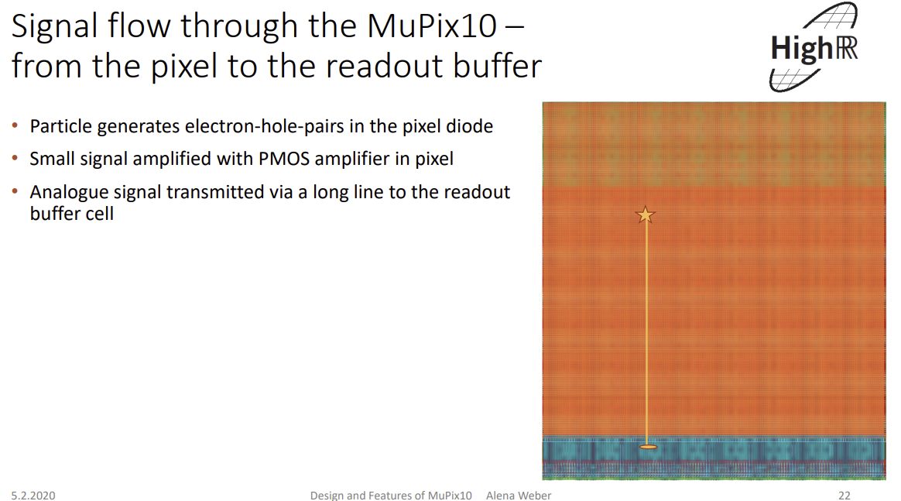
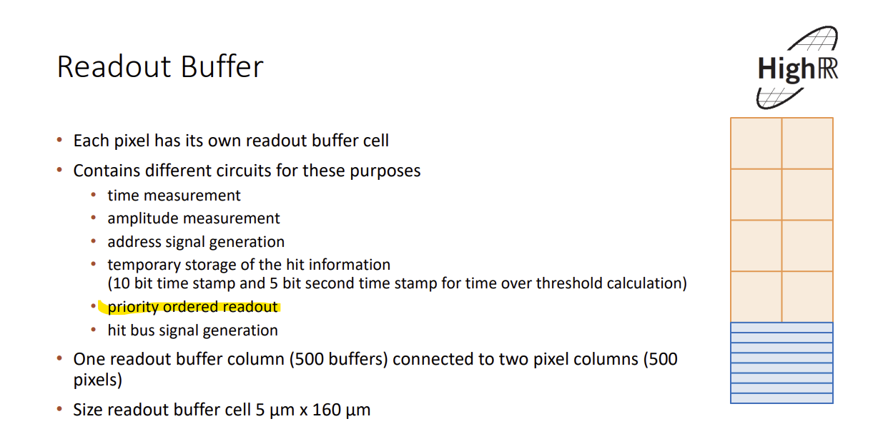
Answer
MuPix is not even driven; it only stores hit is peripheral cells, measures time of arrival and amplitude and cells wait for being scanned.
MuPix still utilizes priority encoding at the end for readout of the cells
the readout circuitry is spatially separated from the active pixel matrix and there is one readout cell for every pixel in double column structure (old scheme), resulting in big periphery circuit – highly disqualifying for EIC SVT!
MuPix10 (cern.ch)
Every pixel individually routed to periphery, that is feasible for O(50um-80un) but impossible at O(20um) and with process with 6 metal layers
Alone readout cells are >2um in height each, occupying all more area than entire readout in ALICE-ITS3 sensors

Slide 9
Answer cont.
Definition of Event-Driven Readout:
Event-Driven Readout is a data processing approach and transmission method, where data is automatically localized and forwarded to the output in an automated manner without the need for manual prioritization, intervention or intermediate storage. This approach ensures that data is transmitted without corruption or delay caused by collisions with other data, transfer of which was either previously initiated or during the transmission pf the data in question. This method guarantees efficient, seamless data transmission without explicit, hidden, or apparent priority assignments.
Readout, in which sources of data report to external storage cells (and these cells extract time-of arrival and amplitude information thanks to locally running clocks, data converters, etc.) and, then, these cells are scanned for presence of data is not Event-Driven.
Currently in HEP or NP community there is no Event-Driven Readout developed or used other than here presented EDWARD protocol.
X-Y reporting is prone to ambiguities
Token Passing is polling readout method with unpredictable time to localize data
Priority-encoder based methods require snapshotting of frames
Time-encoded methods, such as CERN-proposed DPTS, are prone to ambiguities, prone to process dispersions and biases changing timing and require time-to-digital converters for obtaining position from time or delay information

Slide 10
Question #4
Funding this proposal will not produce a working prototype. What is the path forward in subsequent years?

Slide 11
Answer
Yes, the requested funding is insufficient to complete the design and prototyping;
We know that:
  the concept's general viability has been demonstrated in X-ray hybrid pixel detector prototypes at BNL;
  how to successfully transition to O(20um) monolithic pixels needs to be undertaken;
Within the scope of this proposal, our intention is to work on:
  tailoring of the concept for implementation together with AFE in O(20um) monolithic pixels
  setting up methodology and CAD/EDA flow to match the needs, e.g., evenly distribute resources of the event-driven protocol in the matrix of O(20um) pixels,
  developing scalable readout skeleton and building blocks (FE, configuration, etc.) in TPSCo65nm process,
  forging understanding of the proposed technology among potential users,
  sharing the findings and form collaborations, even with other groups who may be preferring working on other then TSPCo65nm process;
Universality of the planned development will allow flexible and independent of specific form factor and manufacturing process use in the future.

Slide 12
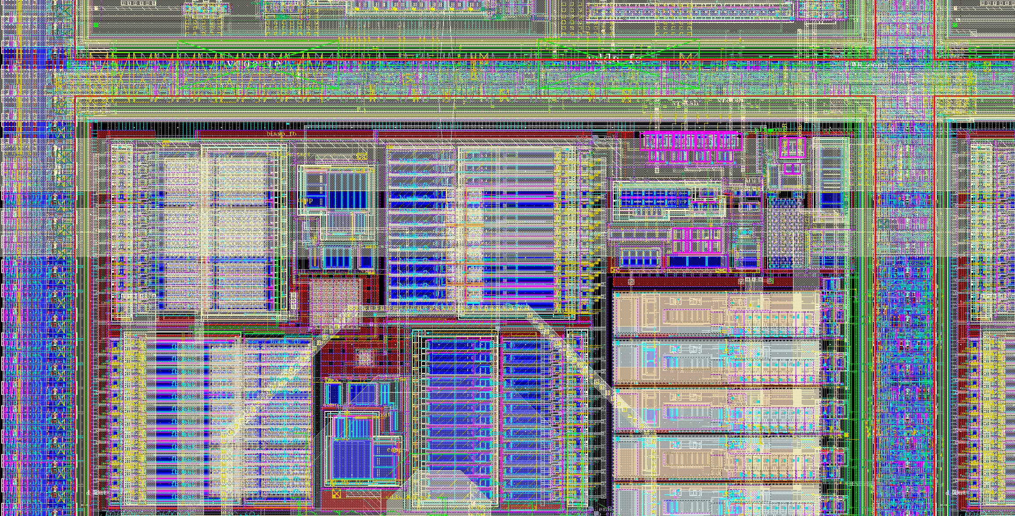
Answer cont.
Flash view of implementation in X-ray pixel Readout ASIC, challenge of translation to monolithic O(20um) pixels
Readout and configuration implemented in digital gates
90 μm
Analog Front-end
CMOS 65 nm
about 4,000 transistors / pixel (100 ×100 μm²), 20 : 80 analog : digital

Slide 13
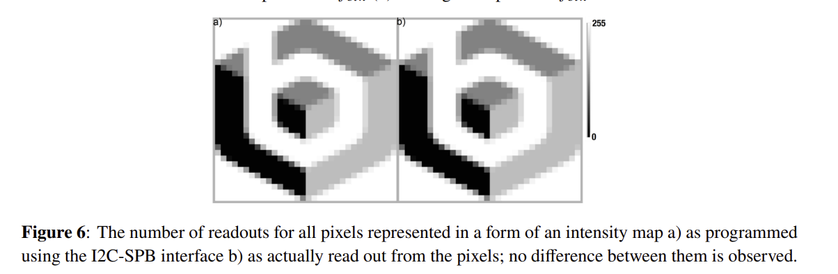
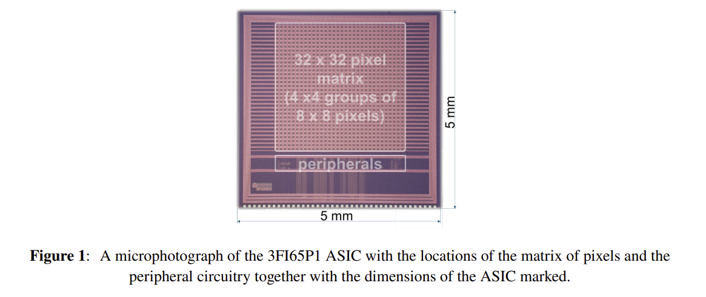
Answer cont.

Slide 14
PART 2
Proposal overview

Slide 15

Motivation
Improve design to the EIC requirements based on the existing ALICE ITS3 design – baseline for ePIC SVT inner layers:
improved timing resolution (sub-microsecond, on the order of ∼100 ns),
low mass,
low power

Slide 16
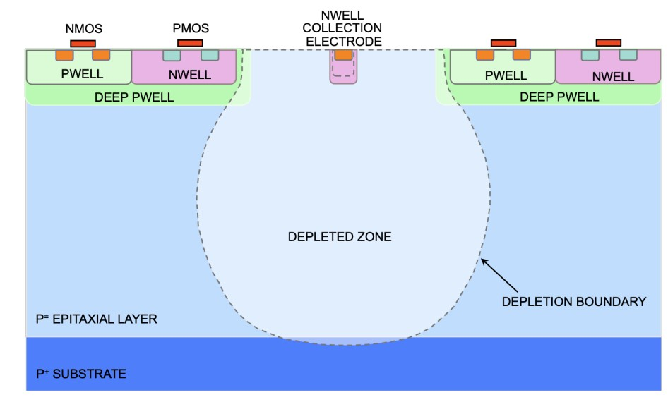
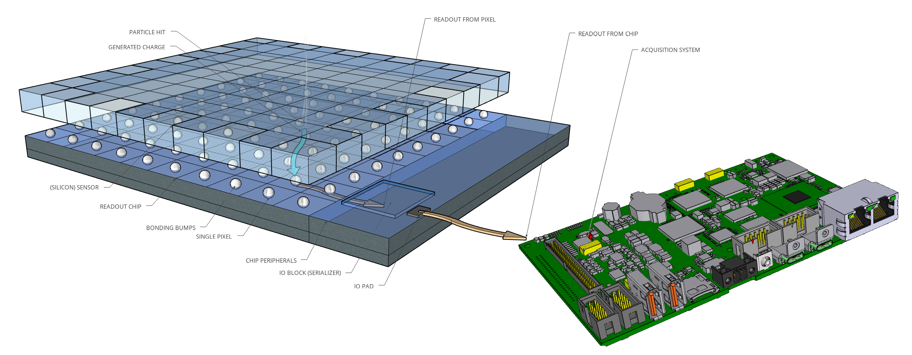
MAPS
The material budget and spatial resolution requirements of the EIC Vertex and Tracking Detector are only fulfillable by the Monolithic Active Pixel Sensors (MAPS), built as Si large-scale chips;
MAPS combine the sensor matrix and readout circuitry in one silicon substrate, unlike the hybrid sensors, where the sensor matrix and readout circuitry are split in two separate silicon pieces;
MAPS example https://doi.org/10.1016/j.nima.2017.07.046
Hybrid pixel sensor example

Slide 17
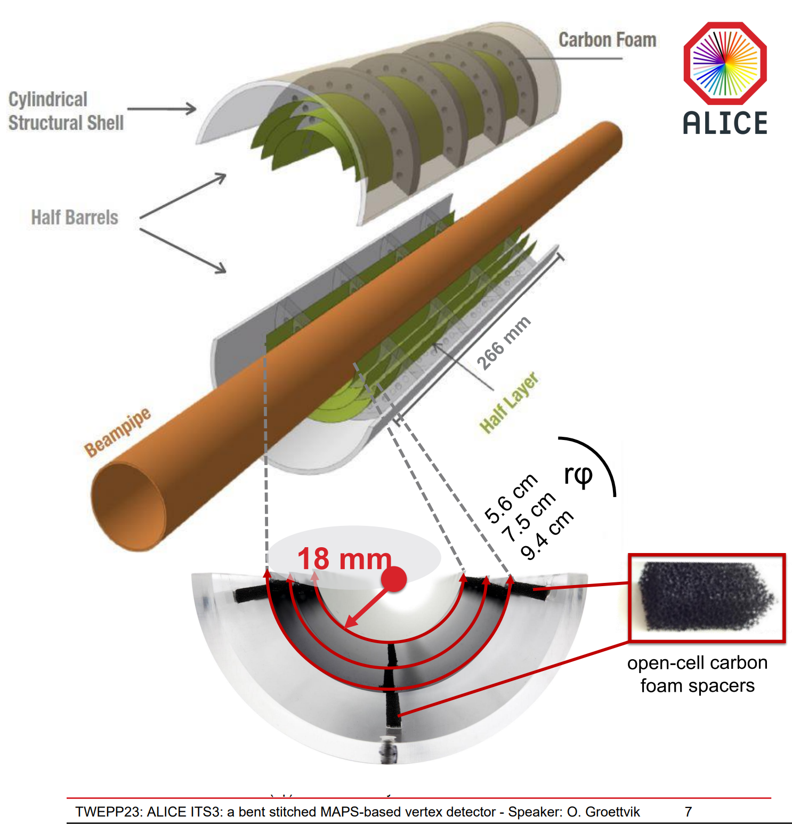
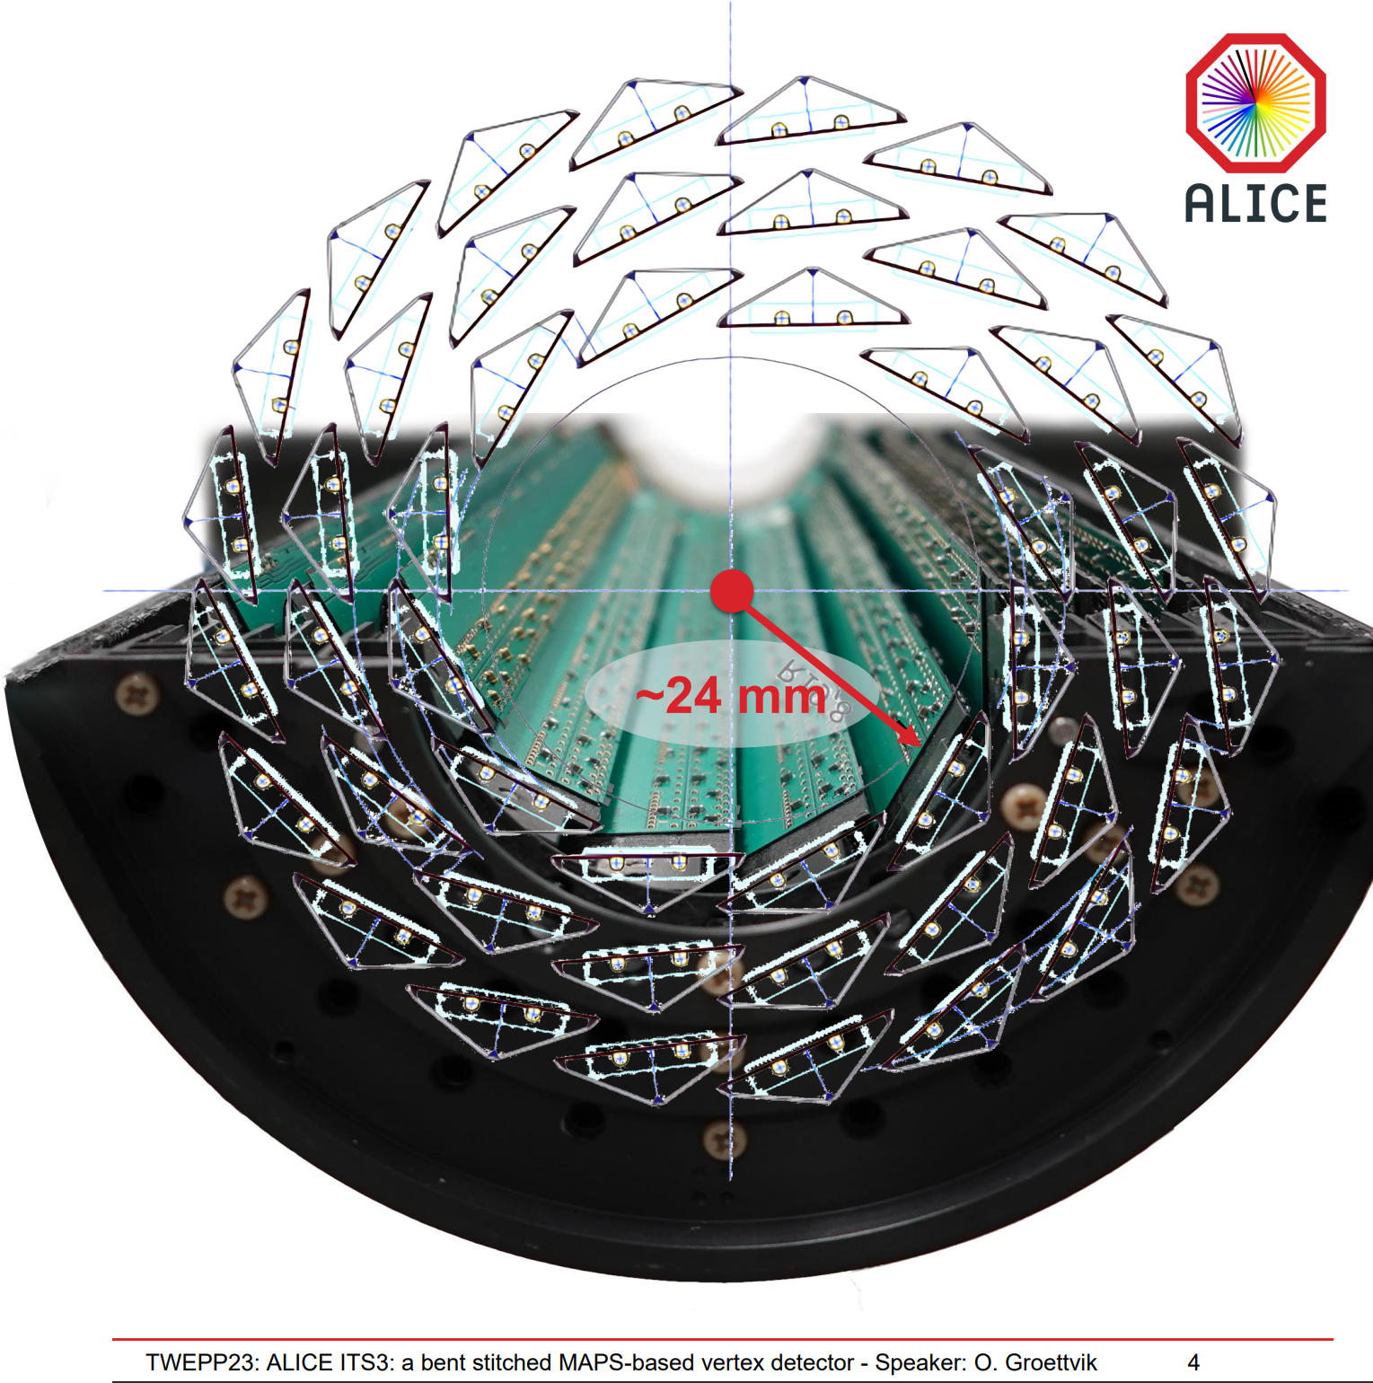
ALICE-ITS3
Main goals:
reduction of power consumption,
coverage by multiple layers
reduction of material budget
elimination of water cooling (in favor of air cooling)
ITS2
ITS3 → ePIC SVT fork

Slide 18
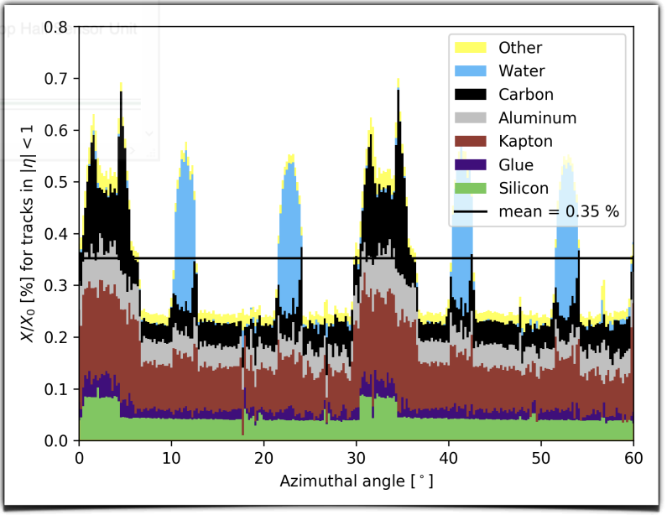
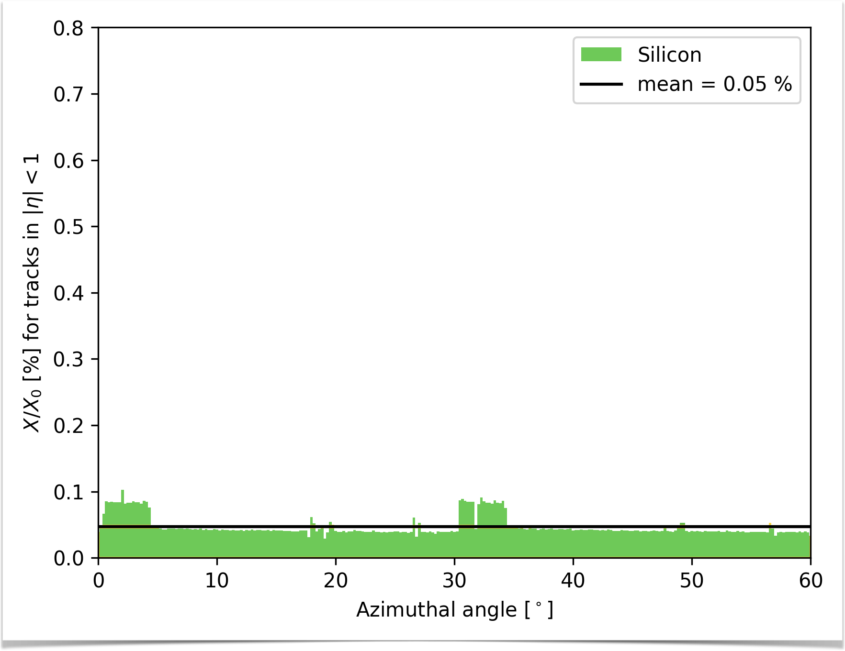
ALICE-ITS3
Remove water cooling
Remove the circuit boards
Reduction of cabling
Reduction of mechanical support
ITS2
ITS3 → ePIC SVT fork
TWEPP 2023 Topical Workshop on Electronics for Particle Physics (1-October 6, 2023): ALICE ITS3: a bent stitched MAPS-based vertex detector · Indico (cern.ch)

Slide 19
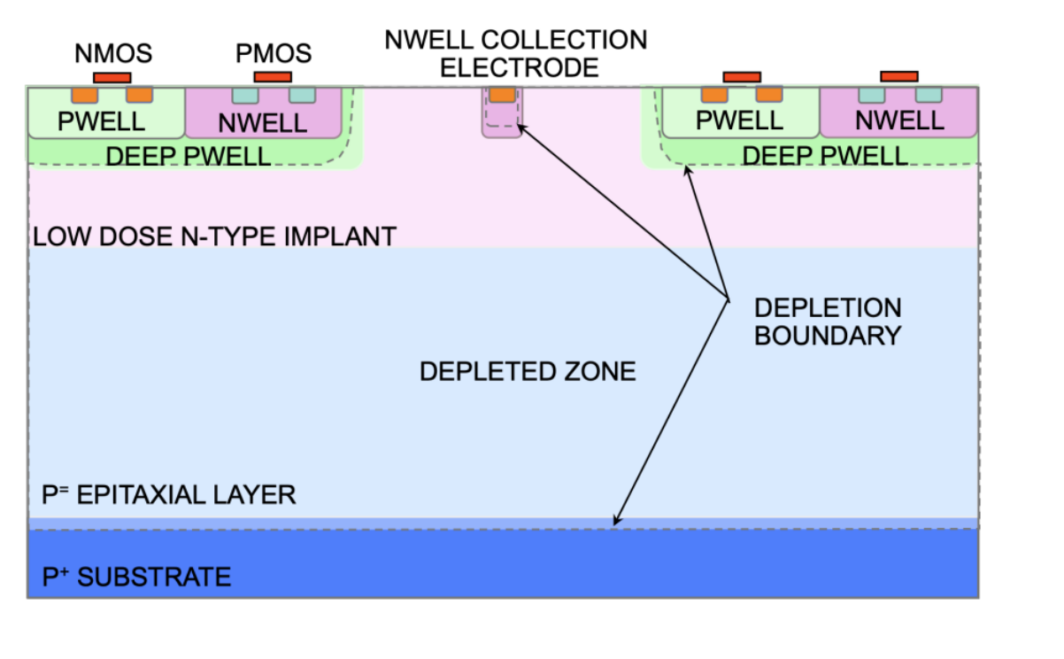
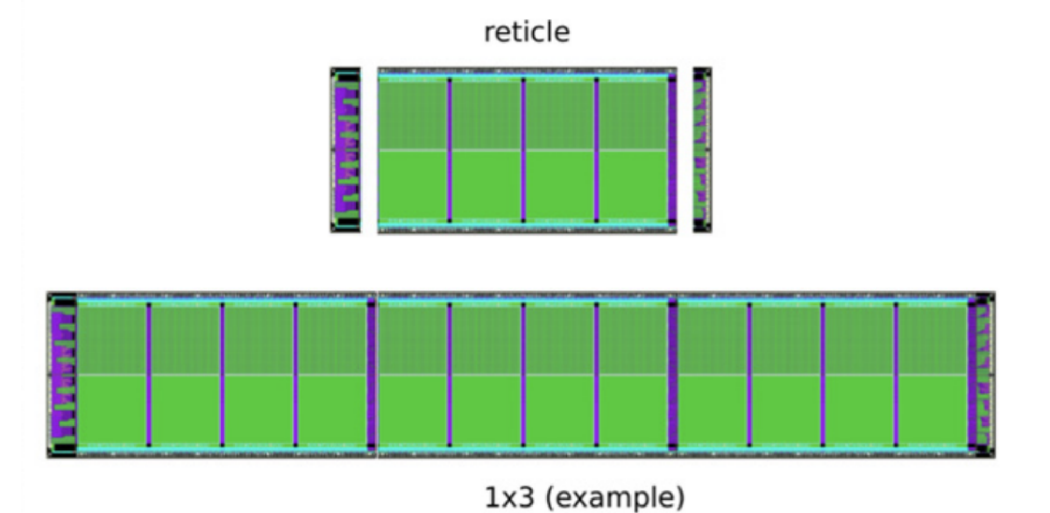
TPSCo 65nm
The TPSCo (Tower Partners Semiconductor Co.) 65 nm process is the state-of-the-art CMOS process for image sensors.
TPSCo65nm is continuation of Tower-Jazz 180nm, which was successfully used for all layers of the ALICE-ITS2.
Stitched sensors (wafer size)
Example of modification of standard proces allowed in TPSCo 65nm
https://doi.org/10.1016/j.nima.2017.07.046
Stiching example

Slide 20
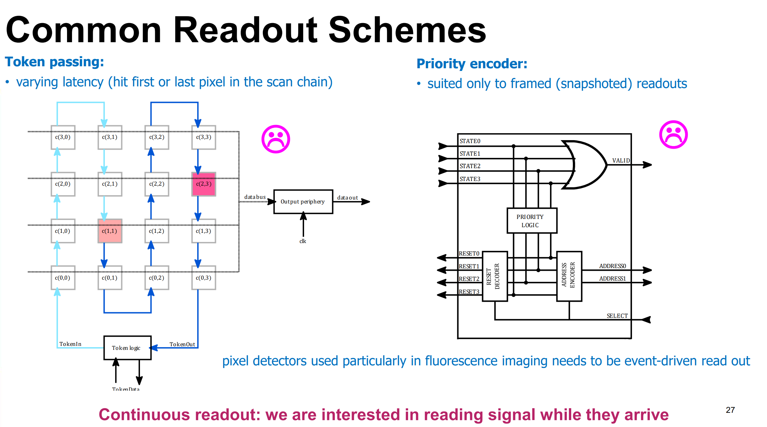

Slide 21
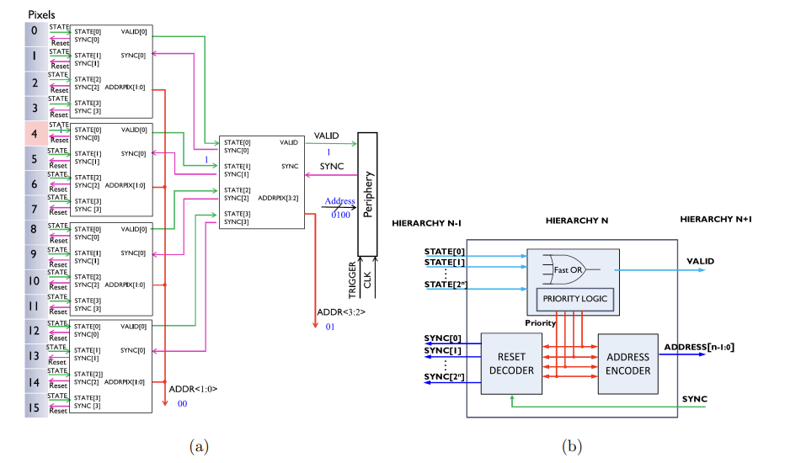
ALICE readout - AERD
Priority encoder
Frame snapshots (2 us – 10 us)
Improvement is not anticipated due to operational mode limitations.

Slide 22
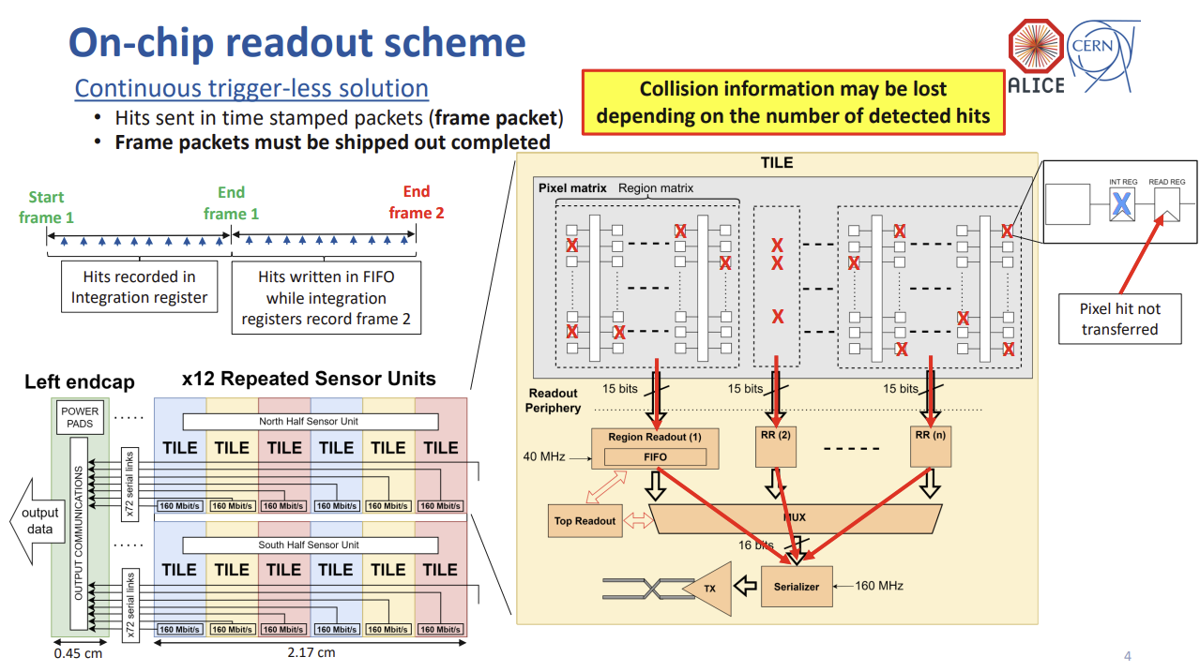
AERD in ALICE-ITS3
Utilizable platform with readout periphery largely agnostic of how data from pixels is flowing in;
TWEPP 2023 Topical Workshop on Electronics for Particle Physics (1-October 6, 2023): Model and analysis of the data readout architecture for the ITS3 ALICE Inner Tracker System · Indico (cern.ch)

Slide 23

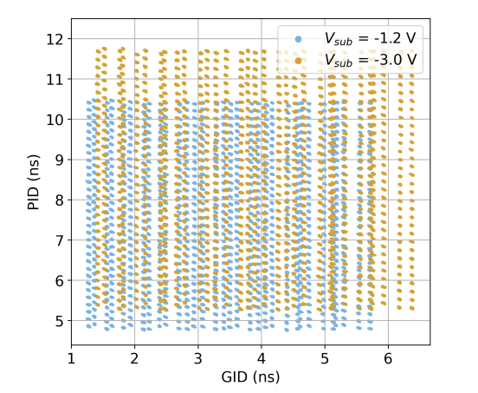
DPTS idea
Awareness of the limits of the priority-encoder-based readout is apparent and research on event-driven readouts is commonly carried out, but no success so far, e.g.:
The Digital Pixel Test Structure (DPTS) is CERN’s MAPS prototype MAPS in TPSCo65 nm process by CERN. DPTS encodes position in the time-domain position:
in-pixel discriminators trigger address generators to send two consecutive pulses on the CML outputs with a duration based on the pixel position;
duration of the first pulse is fixed,
time distance between the two pulses encodes the pixel position in a group of columns (PID);
duration of the second pulse encodes the column group position in the matrix (GID).
VERY SENSITIVE to any differences (including ageing) of operation points, biases, etc.
Digital Pixel Test Structures implemented in a 65 nm CMOS process (arxiv.org)

Slide 24
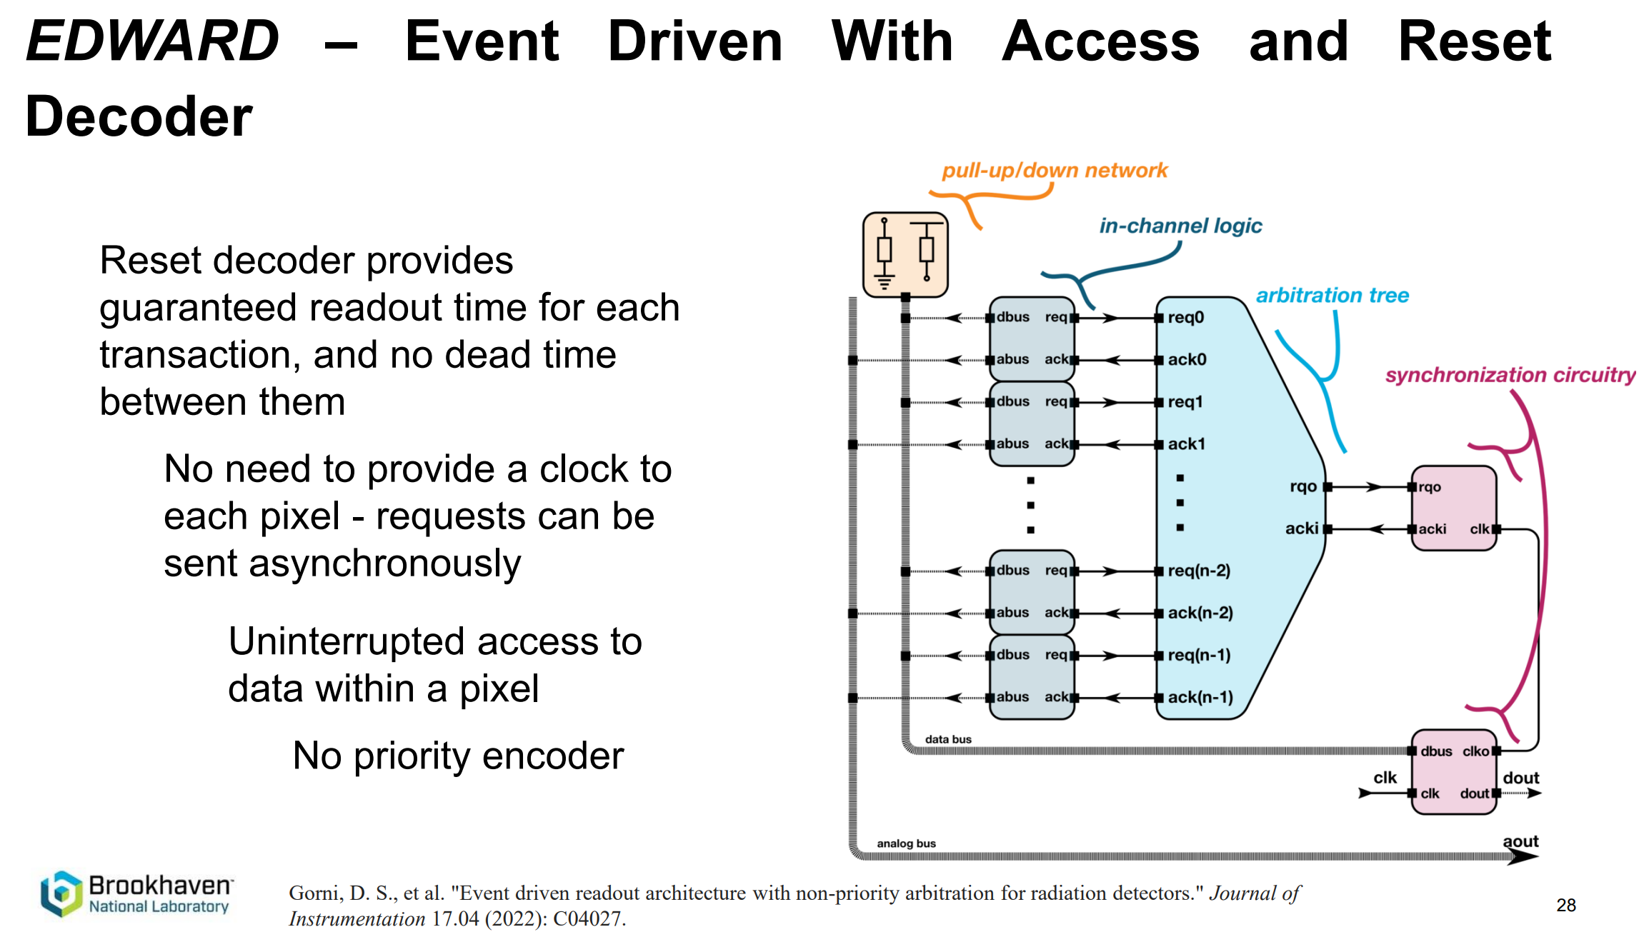
no success so far, except BNL’s EDWARD

Slide 25
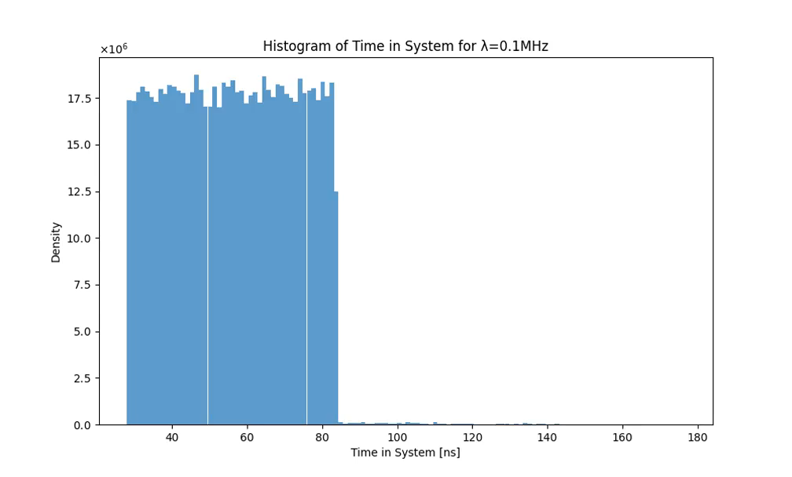
Readout latency in EDWARD (delay) -1
Assumptions in the example:
1024 independent pixels with Poisson process generator (rate λ);
readout clock equal to 250 MHz/14 = 17.86 MHz
Readout latency – time passed from generating the event to latching data in the periphery

Slide 26
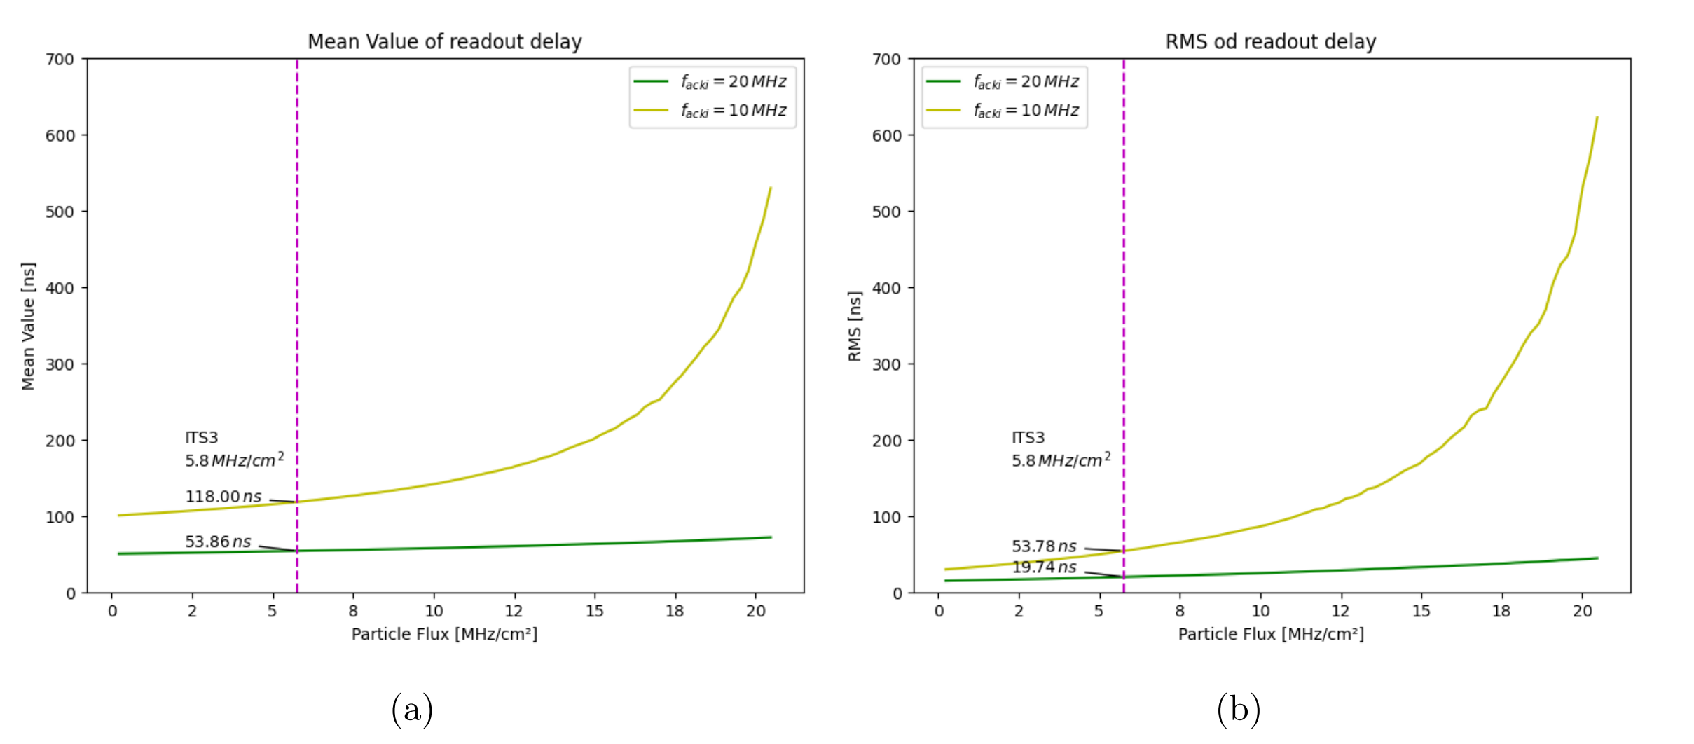
Readout latency (delay) – 2
The mean and RMS of readout latency as a function of particle flux (~event generation) for different readout clock speeds.

Slide 27
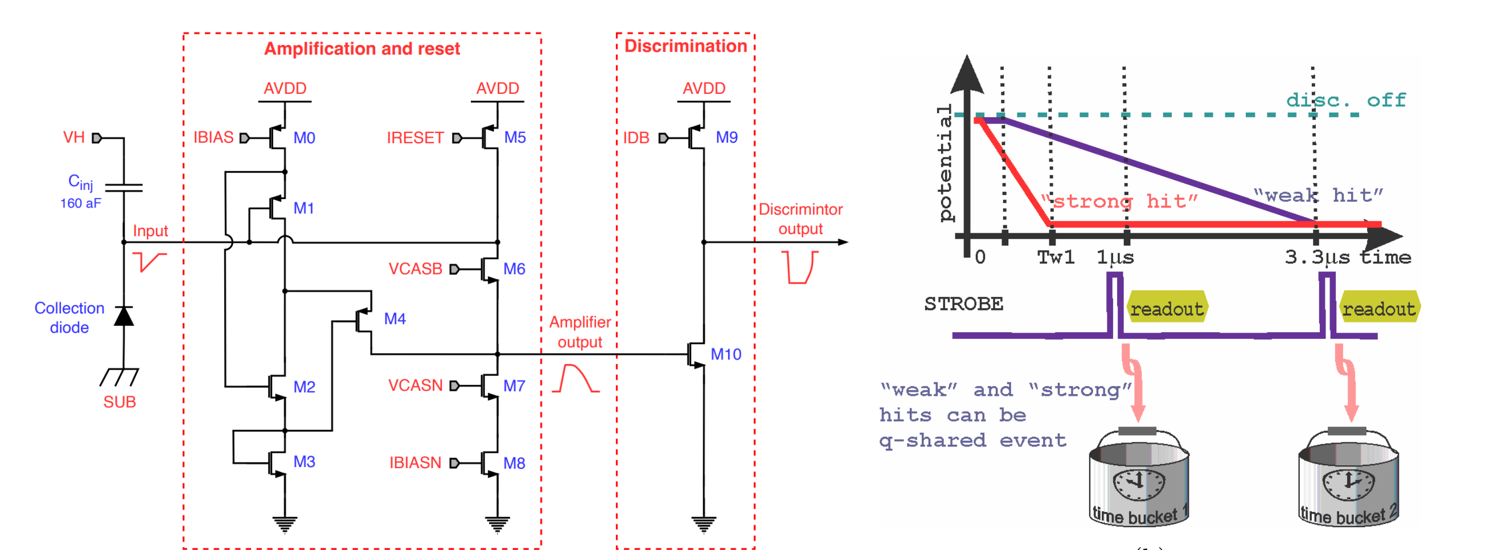
Low-Power Front-End Design
ALICE-ITS3 – modified ALPIDE FE
ALPIDE’s Front-End is suitable for framed readout but it is not enough beyond:
Time-Walk is shaded by frame durations;
hand-shake with priority-encoder-based readout uses global STROBE;
does not amplify input charge;
needs directly maximizing charge-to-voltage conversion what is slow.
Notes:
Pochwal ALPIDE – szybszy czas odczytu się nie nadaje jednak
Zamiast z małego ladungu (wolnego) generacje skoku napięcia mamy wzmacniacz ladunkowy (poprawa czasowa)
Tylko 3 stopnie (tak samo)
Moc – optymalizacja, kilkadziesiąt nw ~50nW, mniej biasow
Rozsmarowanie resourcow

Slide 28
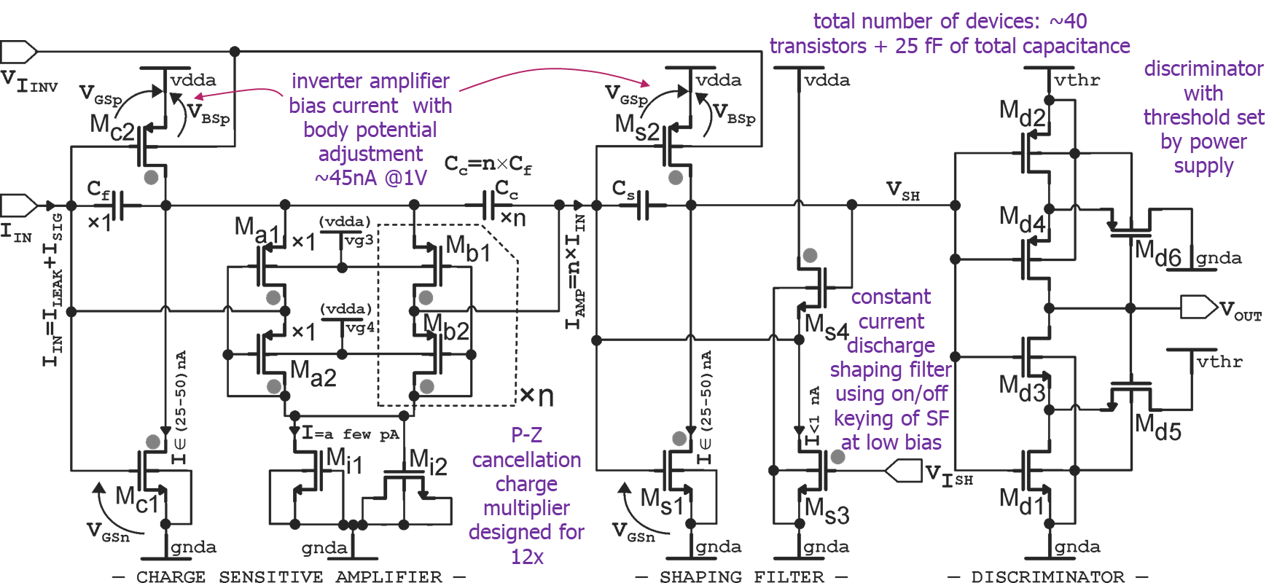
Low-Power Front-End Design
ALPIDE Æ ALICE-ITS3 Front End:
does not amplify charge but needs to create voltage amplitude large enough to discriminate;
high-gain stage operates at low current but does not allow increase of transconductance with signal;
It is still composed of three stages.
Direction for proposed FE paved by Electron Microscopy MAPS LDRD at BNL using SCFET amplifier for charge multiplication:
Low DC bias with signal-dependent increase (low power X0 nW),
Capacitive arithmetic charge multiplication;
Fast rise time and constant current discharge,
Discriminator with hysteresis and threshold applied as power supply
Minimal (2) number of biases,
Q-amplifying FE developed in Electron Microscopy LDRD at BNL
Q-amplification
I-const. discharge
discriminator

Slide 29
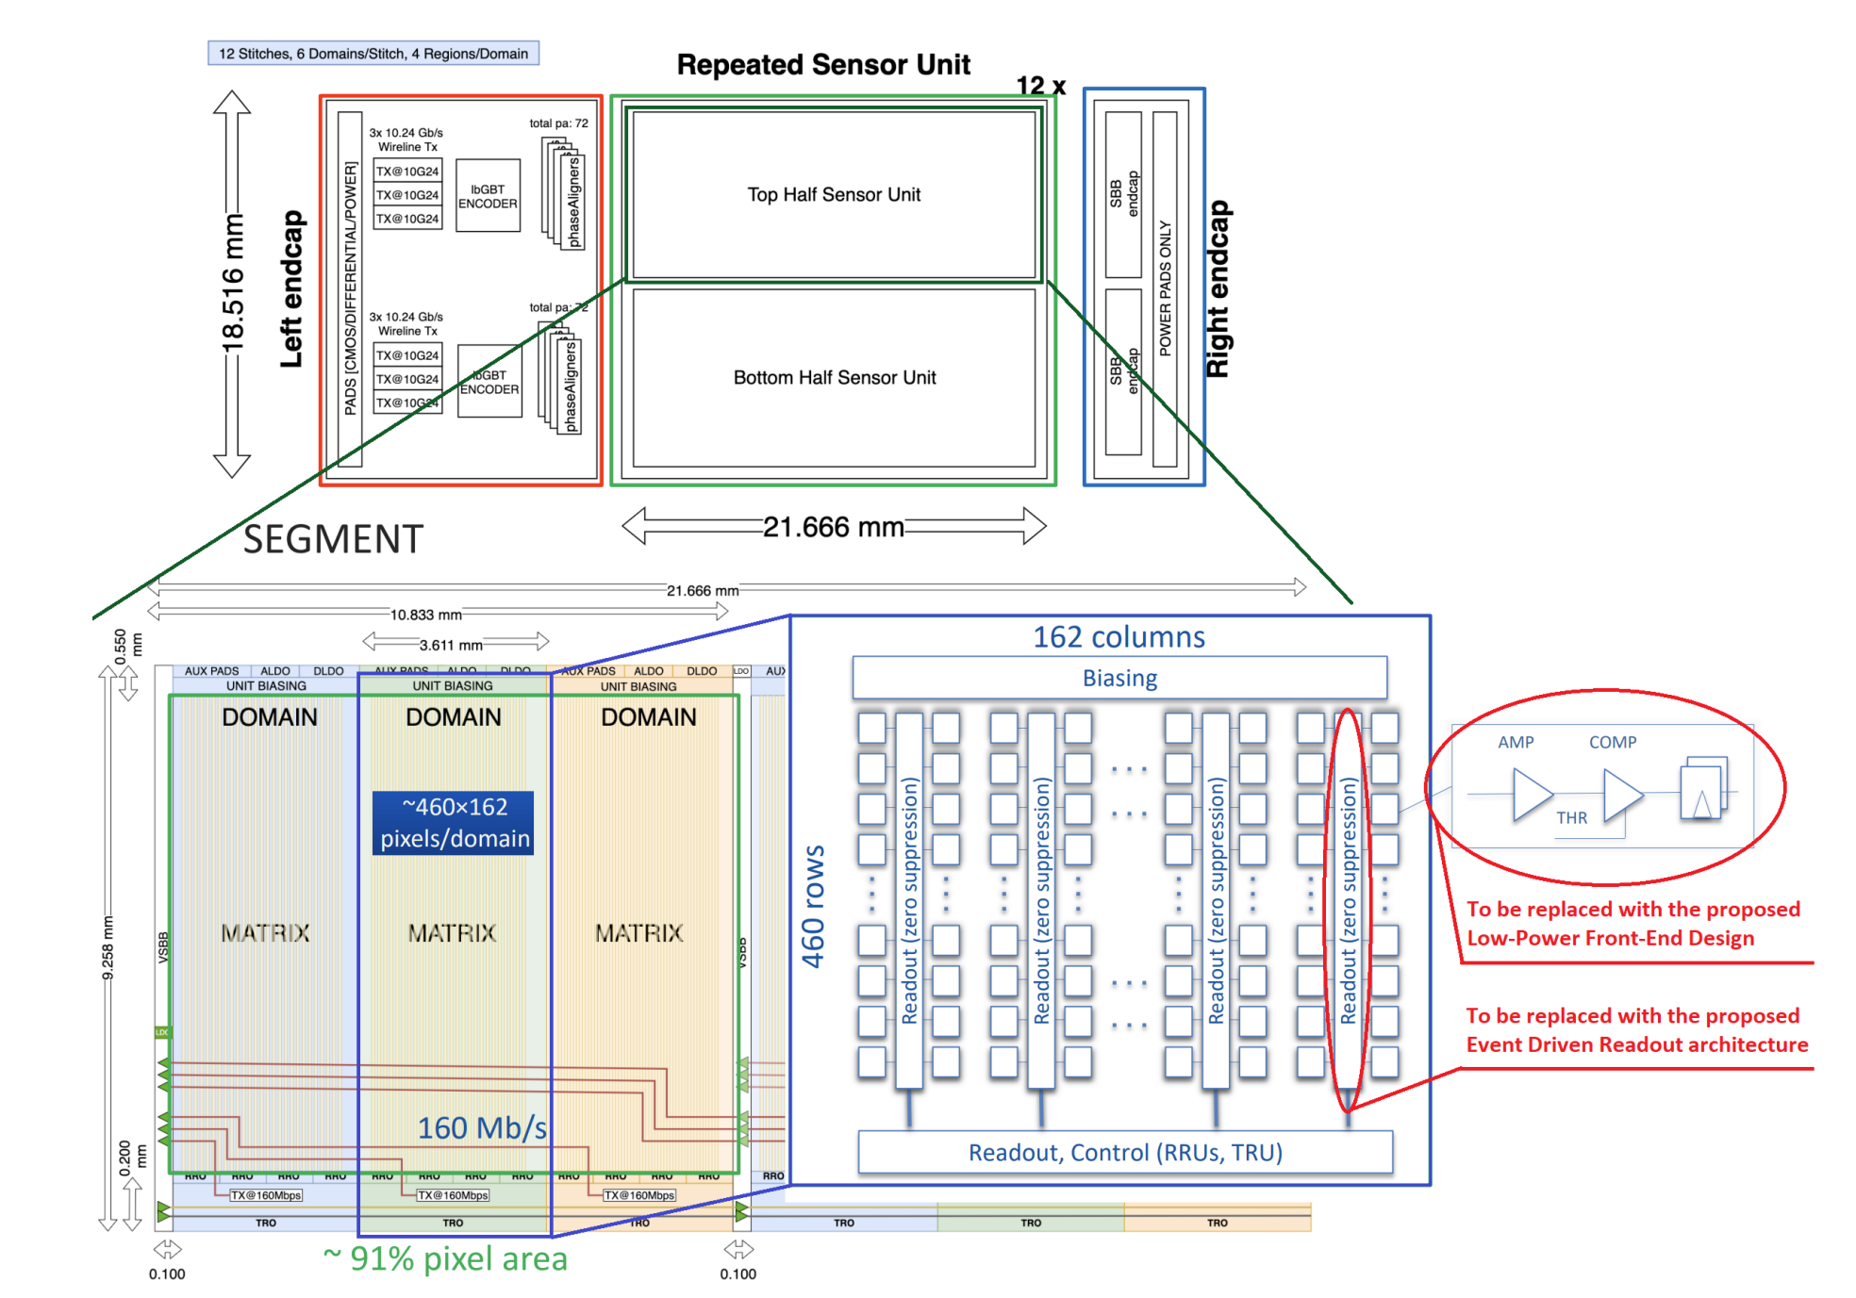
Plan for substituting ALICE ITS3 RSU
ALICE ITS3 sensors – baseline for ePIC SVT:
Evolutionary development of ALICE-ITS2 / ITS3 sensors spans more than a decade and carries degree of legacy;
ITS3 sensors are not finalized and efforts of getting large-area sensors operational are significant.
We favor risk and effort minimization:
Repeated Sensor Unit (RSU) plug to peripheral transmission blocks (@160Mbps/domain);
Priority-Encoder and EDWARD both produce addresses of hit pixels and minimal effort should be required to substitute RSU with priority-encoder-based readout by RSU with EDWARD – this will be studied!
Adaptation of the interface is good ground to work with the universities
Completion with Front-End and interface:
LP charge amplification and simple discrimination

Slide 30
Tasks overview
4. Development of asynchronous, event-driven readout implementation methodology
7. Extraction of performance matrix
1. Define requirements and confirm with Physics needs
6. Integration and functional simulation verification
3. Define interface
2. Explore ALICE-ITS3 database for compatibility
5. Development of Low-Power, small footprint AFE
8. Results and conclusions
EDWARD and CSA with SCFET are BNL’s patent pending technologies

Slide 31
PART 3
Q&A

Slide 32
Backup

Slide 33
Tasks overview
Quoted as in proposal:
Task 1: Determine detector operating conditions, requirements and needs to compare the capabilities of the ITS3 detector with the proposed new solution.
Task 2: ITS3 database exploration and environment configuration.
Task 3: Development of architectural adaptations in the detector database.
Task 4: Integration of EDWARD readout architecture into the database.
Task 5: Incorporating Low Power AFE into the database.
Task 6: Functional verification of the detector with the new circuits.
Task 7: Comparison of the performance obtained with the assumptions made.
Task 8: Creating the proposal of the new SVT detector which exploits the advantages of the increased timing resolution and low power design.

Slide 34
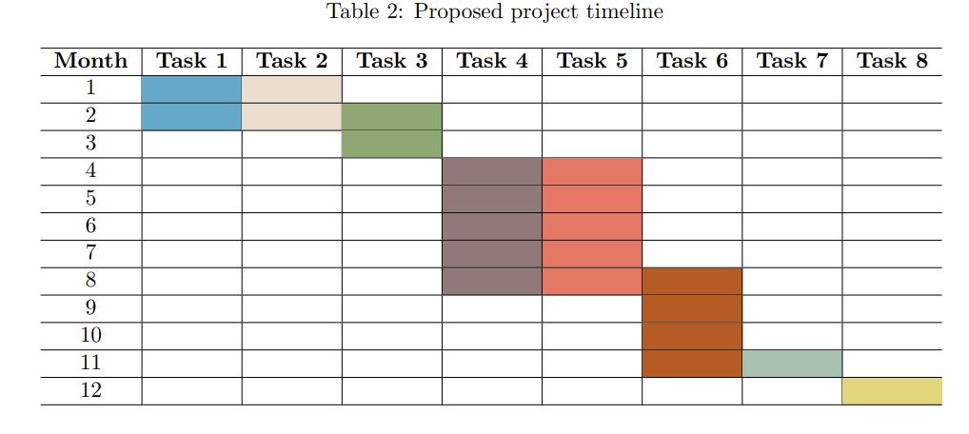
Tasks overview cont.

Slide 35
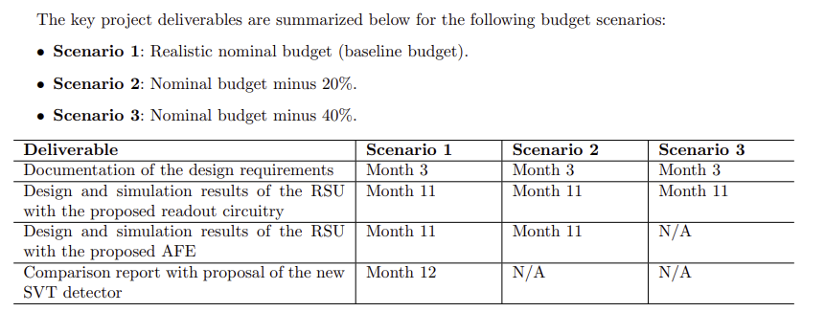
Deliverables

Slide 36
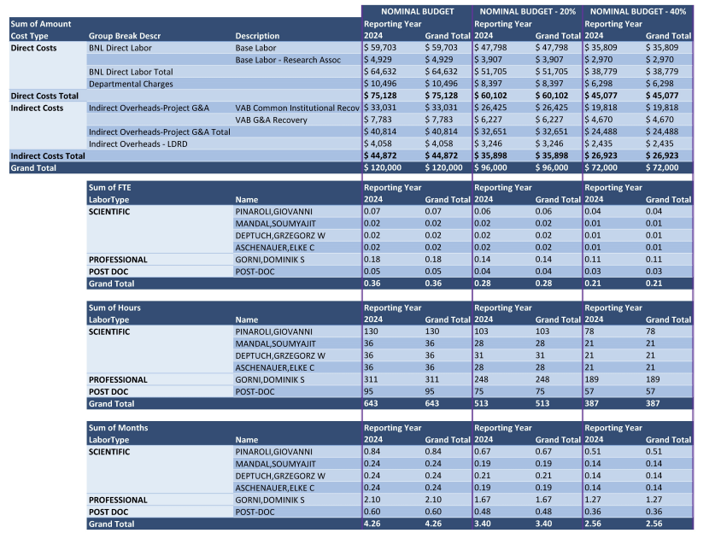
Budget

