Slide 1
Slim Edge for LGADs
Gabriele Giacomini
EIC-Related Generic Detector R&D Proposal Review Meeting
October 20th 2023

Slide 2
Answers to reviewers’ questions - 1
Explain in more detail the designs of the edges.
Modified termination:
(several variants will be designed):
- termination down to 1 floating guard Ring
- shrinking (or elimination) of grounded GR
- Substrate contact smaller and closer
Substrate contact
trench
cutline
Termination
50um
GND Guard Ring
Pad contact
800 um
Active area
Trench will go here
Guard Ring
Standard termination,
even for a 20um thick substrate

Slide 3
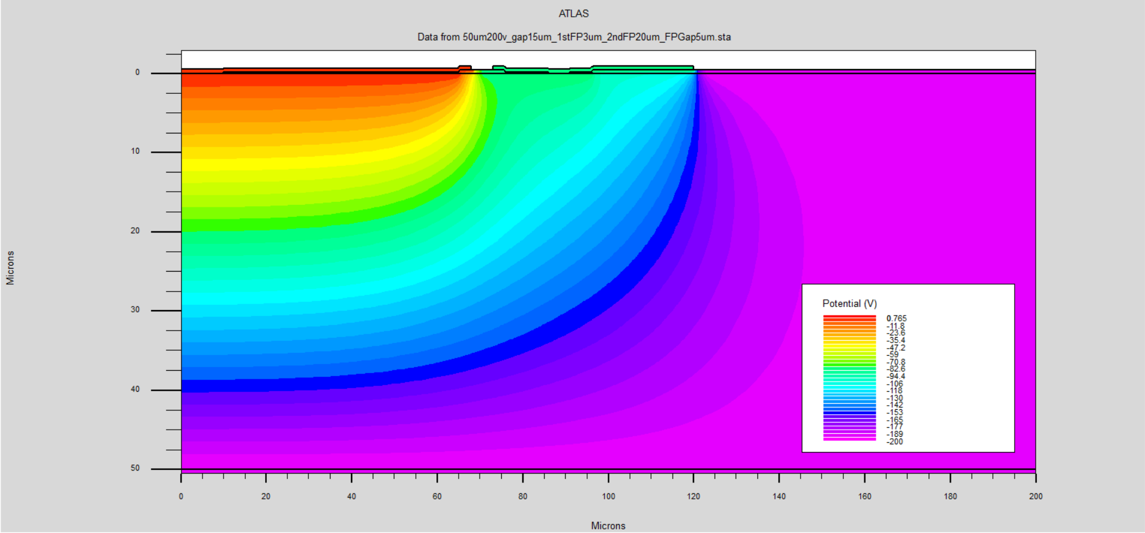
Answers to reviewers’ questions - 2
Is simulation supporting your choices?
Yes, a great deal of TCAD simulations was already carried out by a SULI student this summer (J. Duncan, U, Memphis).
Depletion region hardly extend beyond one GR which is within 50 um from grounded area, even at high voltages.
Diode @ GND
Region equipotential with back
(200V)
20um thick substrate
Region equipotential with back
(80V)
50um thick substrate
Back @ -200V

Slide 4
Answers to reviewers’ questions - 3
What designs won’t be implemented between 100% and 60% financing?
The 4” wafers will be populated with many different designs, to push the limits of the different technologies.
The wafers will have a common lithographic mask set, so all designs that we can think of will be implemented.
However, the number of techniques that will be explored to have slim edges will be reduced accordingly.
100% : KOH etch w and w/o alumina deposition, RIE w and w/o alumina deposition, DRIE, …
60%: no DRIE or other ideas which will mature during the projects

Slide 5
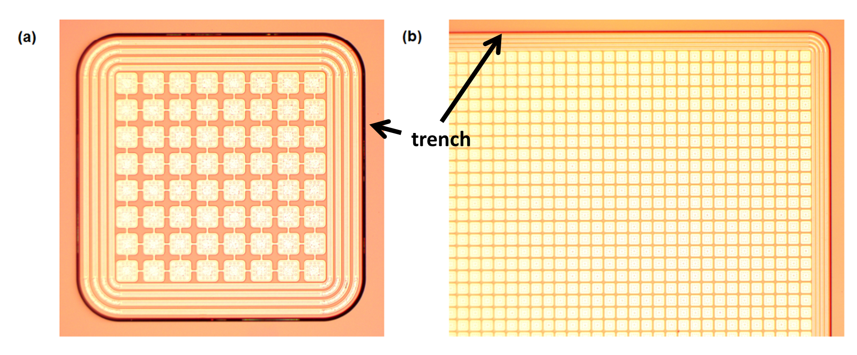
Answers to reviewers’ questions - 4
Why do you not include DRIE (Deep Reactive Ion Etching) in the program? Such a machine may not be available at BNL but they are widely available at University fabs. Inclusion would make the project more complete.
Although we don’t have experience in DRIE, we can certainly profit from this project to gain some.
DRIE will require – beside the facility – a furnace for boron diffusion (not a BNL either, but we are users of, for example, Cornell Nanoscale Facility https://www.cnf.cornell.edu/ - so the process can be carried out at Cornell), and PECVD filling to planarize the surface and allow several other lithographies (contact opening, metal, passivation opening).
It is certainly a very elegant and working solution, but it takes some effort (need 100% of funding).
[1] L. Pancheri et al 2016 JINST 11 C12018, https://iopscience.iop.org/article/10.1088/1748-0221/11/12/C12018

Slide 6
Answers to reviewers’ questions - 5
What lithography is needed after the trench etch? Can it be the last step?
Yes, passivation opening will be the last step.
To resist the KOH attack, a layer of nitride (~ 100nm – already tested) will be deposited. Then we have to open the nitride in the pads area, for testing and contacting. This requires litho.
Example of process
nitride
nitride
P- epitaxial layer
P- epitaxial layer
P- epitaxial layer
P+ CZ wafer
P+ CZ wafer
P+ CZ wafer

Slide 7
Answers to reviewers’ questions - 6
What guard ring geometry do you plan to use? How much space does it take?
In the wafer, there will be placed many design variants, however we’ll focus on few GRs, closely spaced, order of ~ 50um or less.
TCAD simulations suggests that, if the substrate is thin, GRs are hardly biased at all.
Measurements on test structures tell that 1 GR is enough to sustain very high voltage.
20 um thick substrate.
Back at 80V
GR stays at ~ 60V.
TCAD and I-V by J. Duncan, U. Memphis, SULI 2023

Slide 8
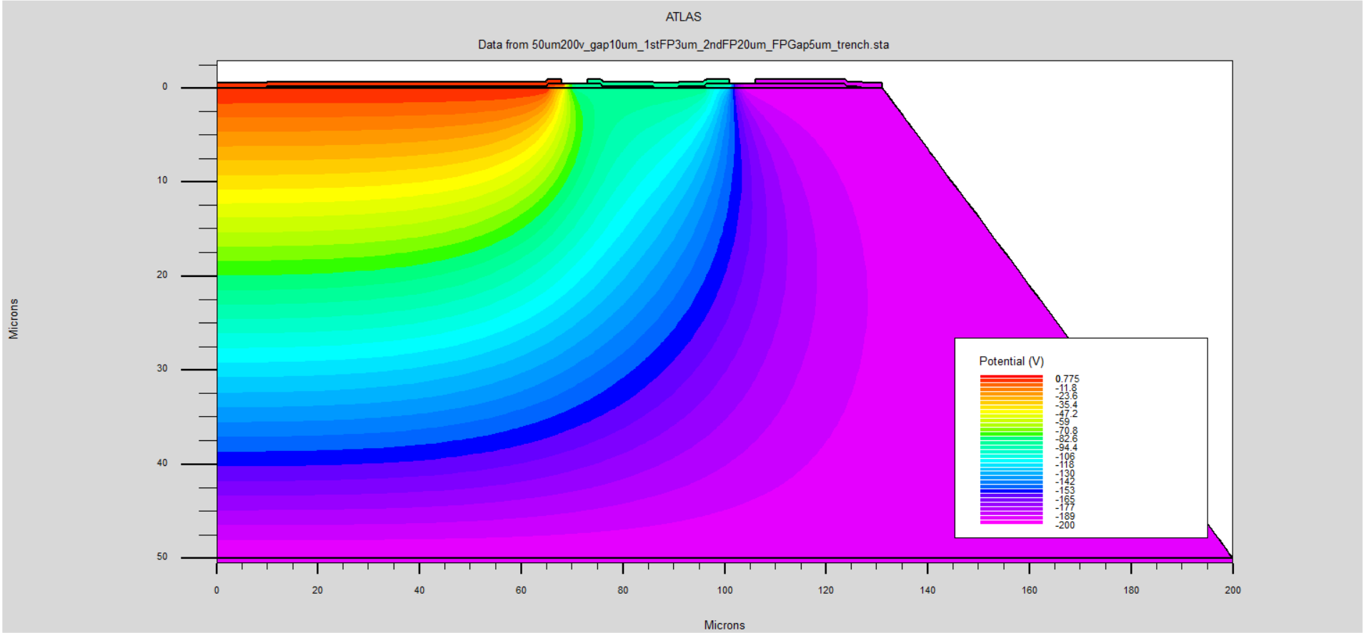
Answers to reviewers’ questions - 7
Can the trench be used to isolate the backside from the front so that the front side is at ground potential?
Not in the present plan: both the substrate and the epitaxial active layer are p-type.
The voltage applied to the back propagate to the front side because of:
the etched/diced wall of the scribeline/trench due to defects
by the hole accumulation layer induced by the alumina passivation layer.
by the undepleted region at the border (equipotential to the back).
at the top surface, at the edge of the device, a p+ layer terminate the surface and is equipotential to the back.
P+ implant
Pad @ GND
Undepleted region
60μm
Defects or alumina layer
Map of the electrostatic potential

Slide 9
Project description

Slide 10
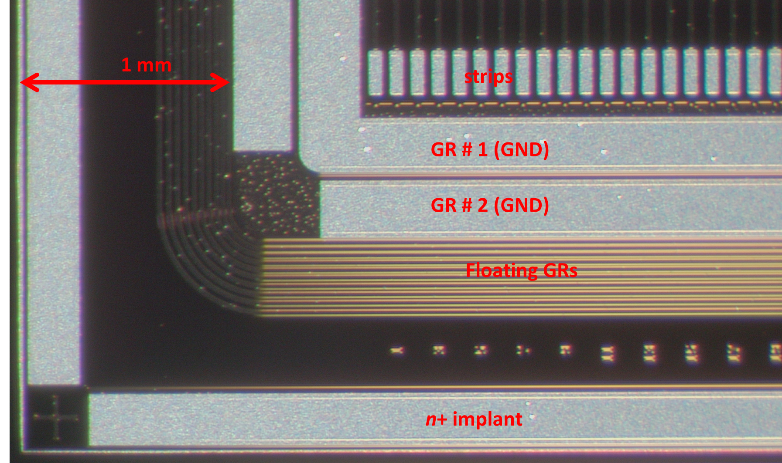
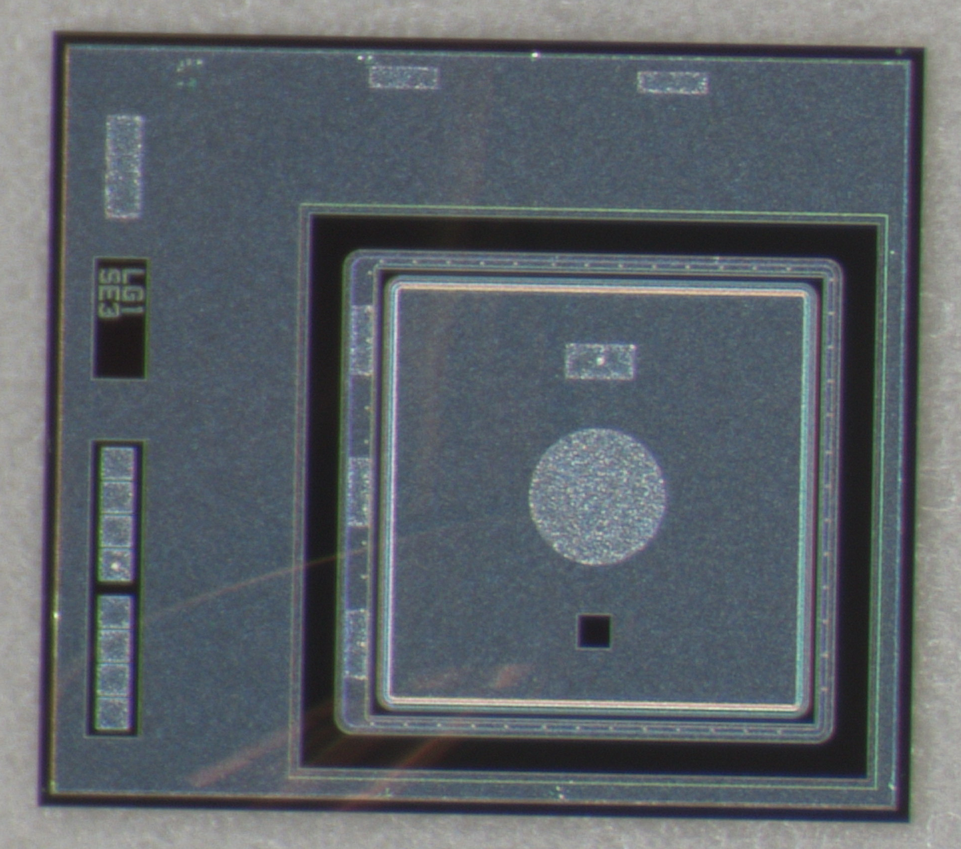
Standard Termination for silicon sensors
Strip sensor on 300-um thick substrate
Low-Gain Avalanche Diode on 20um thick
Substrate contact
cutline
Termination
GND Guard Ring
800 um
Pad contact
Scribeline/Cutline placed at 3x (substrate thickness) to avoid depletion region touching defect-full cut.
→ 1mm from active area
While LGADs are built on thin substrates, the 1mm “rule-of-thumb” is present in all devices by all manufacturers.
Can we cut-down the distance?
HPK not that different

Slide 11
Active edge
Depletion region must stay away from the defect-full scribeline, or a large current injected into the device.
If cutline are “passivated”, defects are shut down and they do not act as generation center → no leakage current even if depletion region extends up to the cutline
The standard way to passivate is by etching a vertical trench
(Deep Reactive Ion Etching – DRIE) and doping.

Slide 12
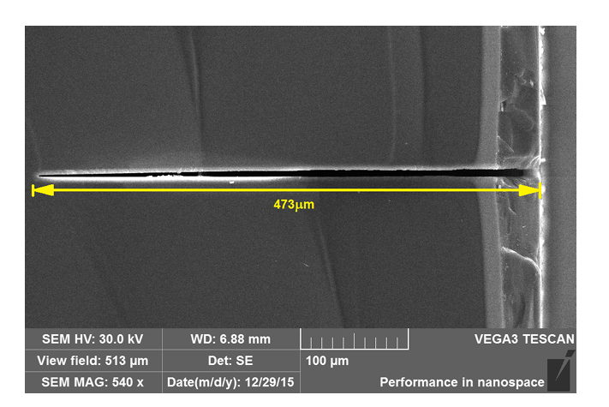
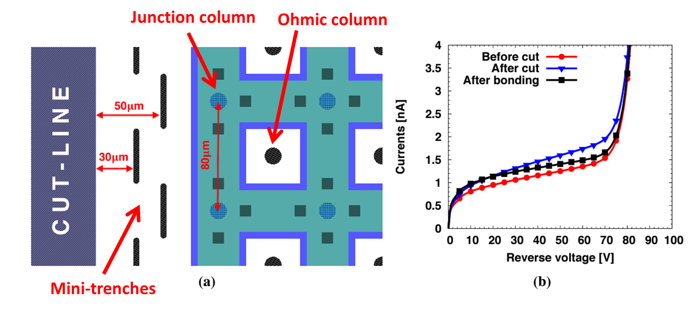
Trench etching by DRIE
Classical method, used for a few PS/HEP experiments
on thick wafers (~ 500 – 100 um )
For XFEL
L. Pancheri et al 2016 JINST 11 C12018
R&D at FBK(Trento , Italy) towards ATLAS IBL, M Povoli et al 2013 JINST 8 C11022

Slide 13
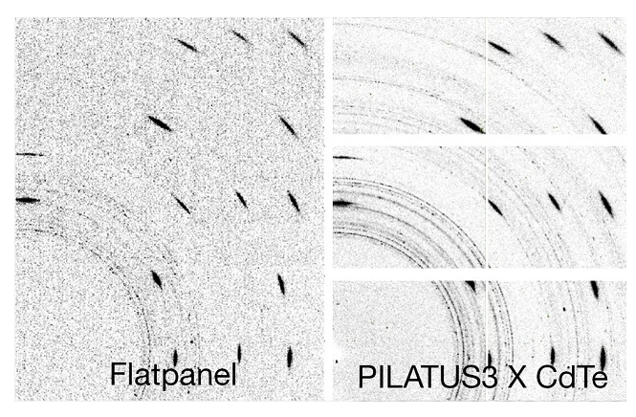
Why go with Slim Edge?
When tiling sensors, dead areas appear w/o slim edges
Powder diffraction experiment
Slim edges for:
Minimize dead areas
Facilitating tiling
Smaller devices for the same Fill Factor
(particularly critical for LGADs, which suffer from low yield)

Slide 14
Case for thin substrates
In thin (20-50um thick) substrates, depletion region extends ~ 50um, as space is needed to allocate the GR (lithographic constrains).
In the undepleted region, a cutline can be placed.
No need of any treatment (to be tested)?
Most likely, need to produce a clean cut and passivation.
Active area
Floating GR
Undepleted substrate
70 um
DRIE is the standard option (known to work) but other means may be good enough to achieve the same result.

Slide 15
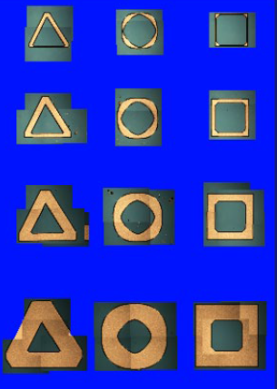
Trench etching
Chemical etching (KOH)
+ alumina passivation
RIE silicon etching
proved to be enough for thin substrates.
Cleaving, laser dicing, …
Passivation of Atomic Layer Deposition of aluminum oxide available at BNL.
Used to induce a hole accumulation layer at the Si/AlO interface.

Slide 16
Fabrication
All fabrication carried out in class-100 clean room at BNL, except for:
nitride/alumina deposition (CFN at BNL)
DRIE + boron diffusion – if funds allow – at Cornell
Ion implantation
4” wafer populated with a large number of (small area, ~ mm²) test structures, differing for number of Guard Rings, distance from the scribeline, termination structure, trench etching method, …
Testing
Current-voltage at the probe station for basic functionality
Transient Current Technique to assure charge collection efficiency.

Slide 17
Budget
one year project
100% budget is 130k (overhead included),
mainly labor (2 weeks PI, 1 month clean-rom engineer, 2 months tech)
80-60% scenario:
work reduced accordingly to fit the budget
less exploration of slim edge techniques
month 1-2: production of photolithographic masks and definition of the clean-room process
month 3-4: silicon substrates ready for trench etching
month 5-6. first wafers completed with trenches
month 7. static characterization of device and next plans laid down
month 8-9. Deliverables: method #2 for trench etching/passivation
month 10. static characterization of device
month 11 -12. additional methods for trenching, reports/papers.

