Slide 1
Outline
Brief description of the physics program
List of experiments and spokespersons
List any new idea of CAA
List of Ph.D. students and subject of thesis topic completed and in progress
Analyses based on pass-1 data
Completed analysis and published articles
Status of analysis notes and articles in preparation based on pass1
Current analysis with pass-2 data and FY2024 plans
First look at spring 2019 data comparing pass-1 and pass-2 highlights
Physics requirements
Resources FY2024
Publication plans for FY2024 with timeline
Collaboration with theorists and high-level analysis
Summary including challenges and questions

Slide 2
RGA – Deep Exclusive Science Program
Generalized Parton Distributions (GPDs), and 3 dimensions (3D) imaging of the proton, 2 in transverse coordinate space and 1 in longitudinal momentum space.
Mechanical Structure of the Nucleon, a novel way to describe the nucleon structure, access to the pressure, strong force distribution and the mechanical radius of the proton
The program requires the measurements with high precisions of deep exclusive processes, both BSA and cross sections.

Slide 3
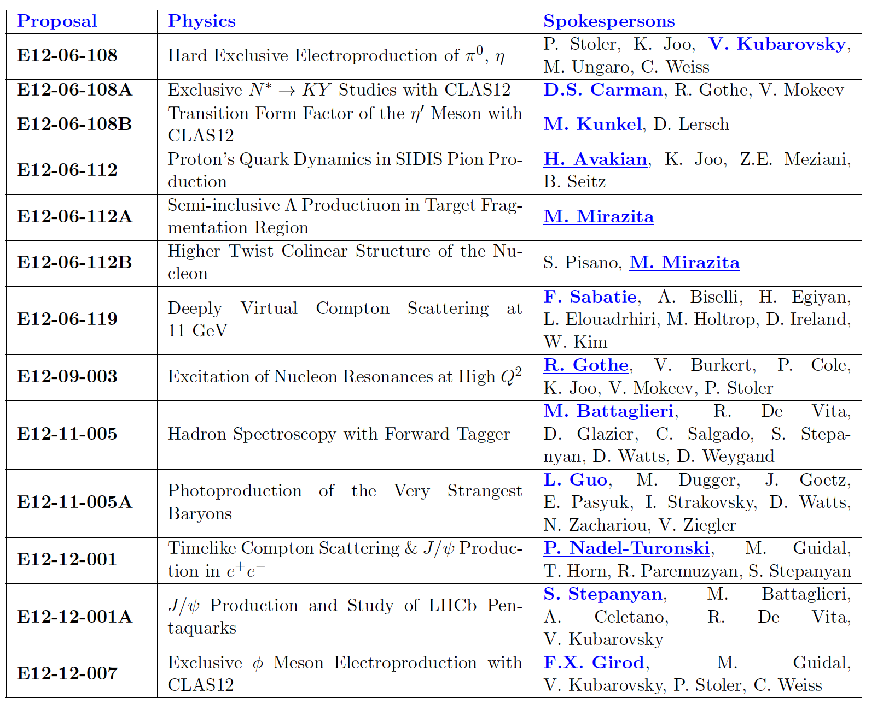
List of experiments

Slide 4
Completed analyses and published articles based on pass1 data
G. Christiaens et al. (CLAS Collaboration) First CLAS12 Measurement of Deeply Virtual Compton Scattering Beam-Spin Asymmetries in the Extended Valence Region Phys. Rev. Lett. 130, 211902 – Published 25 May 2023
S. Diehl et al., "First Measurement of Hard Exclusive π⁻ Δ⁺⁺ Electroproduction Beam Spin Asymmetries off the Proton", Phys. Rev. Lett. 131, 021901 (2023).
S. Diehl et al., "A Multidimensional Study of the Structure Function Ratio σ_{LT′}/σ₀ from Hard Exclusive π⁺ Electroproduction off Protons in the GPD Regime", Phys. Lett. B 839, 137761 (2023).
A. Kim et al. (CLAS Collaboration), "Beam Spin Asymmetry Measurements of Deeply Virtual π⁰ Production with CLAS12", arXiv:2307.07874, submitted to Phys. Lett. B.

Slide 5
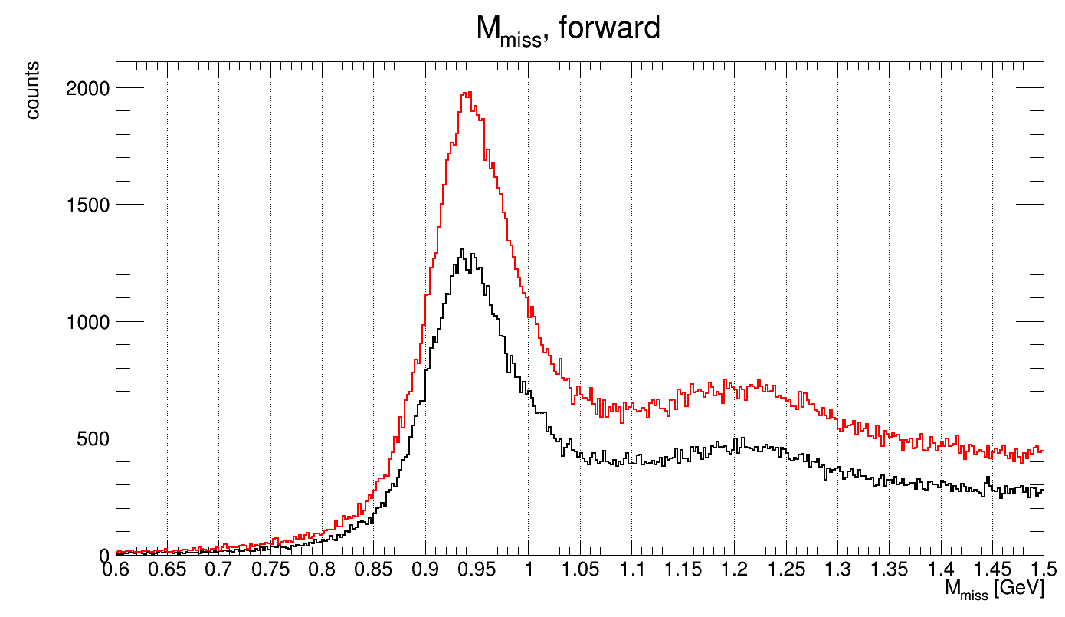
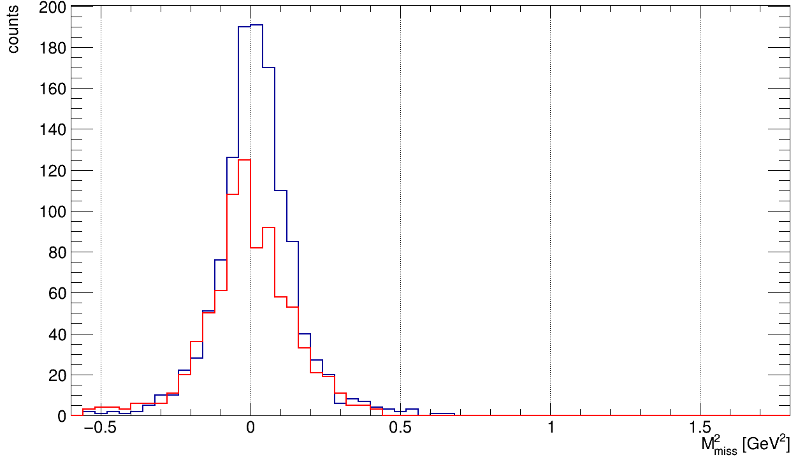
pass1/pass2 Comparison for Exclusive Channels
➔ Pass 2 provides significant improvements for exclusive reactions
e p → e π⁺ X missing neutron
e p π⁺ (π⁻) missing π⁻
Q² > 1.0 GeV² W > 2 GeV -t < 1.5 GeV²
all particles in the FD
π⁺ in the CD!
pass 2
pass 2
pass 1
pass 1
signal gain: + 60 %
in addition, significant resolution
improvement for particles in the CD

Slide 6
List of PhD students and subject of thesis topic completed and in progress
Brandon Clary (Ph.D. in 2020, no publication yet): Exclusive φ Production Beam Spin Asymmetry Measurements with CLAS12 (pass1 data) (Uconn)
G. Christiaens (Ph. D. in 2020) First CLAS12 measurement of DVCS beam-spin asymmetries in the extended valence region (pass1 data) (Saclay)
S. Lee (Ph. D. in 2021) DVCS cross sections (pass1 data) (MIT)
D. Bulumulla (Ph.D. in 2023) Deep Virtual Pion Pair Production (pass1 data) (ODU)
R. Johnston (Ph.D. in 2023) Deep Virtual exclusive pi0 cross section (pass1 data) (MIT)
P. Moran (Ph.D. Expected in 2024): Deep Exclusive Phi cross section (pass1 data) (MIT)
Nicholas Trotta (Ph.D. Expected in 2024): Beam Spin Asymmetries and Spin Density Matrix Elements from Deeply Exclusive rho^0 production (pass1 data and pass2 data in progress) (UConn)
Ricardo Santos (Ph.D. Expected in 2025): Differential Cross Sections of Deeply Virtual \pi+ production (pass2 data) (Uconn)
Gursimran Kaines (Ph.D. Expected in 2026): Beam Spin Asymmetries of Deeply Virtual omega production (pass2 data) (Uconn)

Slide 7
PAC Proposal, CLAS Approved Analysis (CAA), and Analyses based on pass2 data in FY24
Stefan Diehl and Kyungseon Joo, “The Studies of the N->N* Transition GPDs with CLAS12,” to be submitted to PAC 52 in 2024.
Stefan Diehl and Kyungseon Joo, “Beam spin asymmetry measurements of deeply virtual exclusive pi+ production in the backward angle with CLAS12.
Utsav Shrestha, “Beam Spin Asymmetries from deeply virtual exclusive ep->K Lambda(1520).”

Slide 8
Summary and Next step
Excellent progress based on pass1 data processing (Common analysis note)
Excellent team in place for the deep meson exclusive processes from University of Connecticut
How to proceed with DVCS cross section current analysis note towards publication this year?
No dedicated manpower for DVCS analysis from Pass2
Recruiting additional manpower and involving other institutions to enhance our research capabilities.
Develop common tools & procedures for understanding the detector efficiency for each configuration.
Better coordination with other run groups, especially with RGB and RGK teams, to exchange insights and data analysis techniques.
Collaborate with theoretical physicists and phenomenologists to refine the extraction of physics observables in the current stage of our analysis.

Slide 9
Summary and Next step
Excellent progress based on pass1 data processing (Common analysis note)
Excellent team in place for the deep meson exclusive processes from University of Connecticut
How to proceed with DVCS cross section current analysis note towards publication this year?
No dedicated manpower for DVCS analysis from Pass2
Recruiting additional manpower and involving other institutions to enhance our research capabilities.
Develop common tools & procedures for understanding the detector efficiency for each configuration.
Better coordination with other run groups, especially with RGB and RGK teams, to exchange insights and data analysis techniques.
Collaborate with theoretical physicists and phenomenologists to refine the extraction of physics observables in the current stage of our analysis.

Slide 10
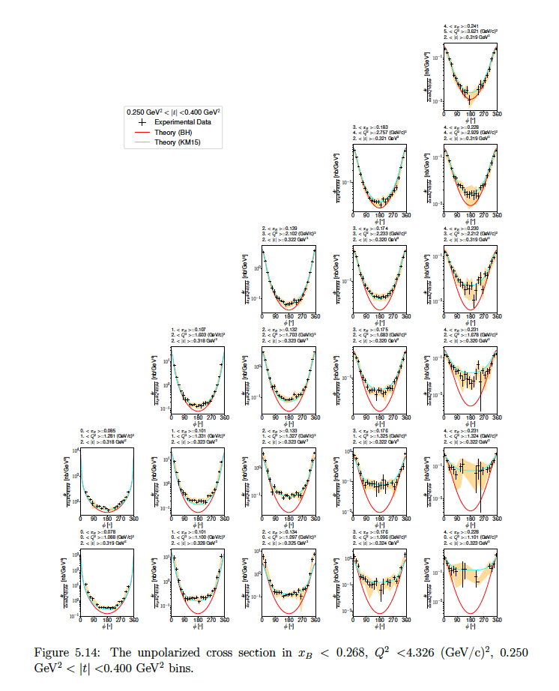
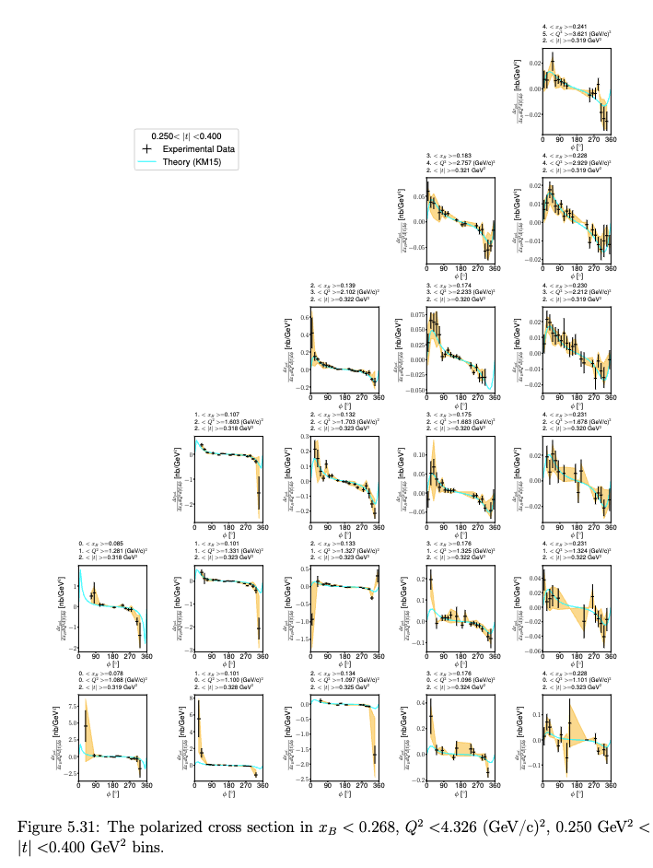
DVCS Cross Section Measurement Analysis-note under review
DVCS Cross sections
Impacts
New inputs for global fitting
Unprecedentedly wide phase space
Full final state measurement
Access to further studies

