Slide 1
Short History and a Non-Project Person’s View of the Project Status
( along with a few slides on JLab Positrons and 22GeV Upgrade )
Election-Ion Collider Update
Douglas W. Higinbotham
16 January 2024

Slide 2
Fixed Target and Collider Electron Beam Scattering Facilities
CEBAF at Jefferson Lab
  Decade+ long physics program with 12GeV beams
    Lots of exciting new results and fantastic new experiments
    Outstanding new ideas still being developed.
    At PAC51 in July 2023
      Five Electron Experiments Fully Approved
      Five Positron Experiments Approved (C1)
  Very exciting ideas for increasing Jefferson Lab’s energy to 22GeV
EIC at Brookhaven
  Cutting edge electron-ion collider (amazing accelerator physics)
  World class physics program to start in the 2030’s
In general, the fixed target program’s focus is on the valence quark region (medium to high x_{B}) while with the EIC collider one can easily access the sea quarks (low to medium x_{B}).

Slide 3
PAC51 Positron Results
NUMBER | TITLE | CONTACT PERSON | HALL | DAYS REQUESTED | DAYS AWARDED | SCIENTIFIC RATING | PAC DECISION
PR12+23-002 | Beam Charge Asymmetries for Deeply Virtual Compton Scattering on the Proton at CLAS12 | Eric Voutier | B | 100 | 100 | A- | C1
PR12+23-003 | Measurement of Deep Inelastic Scattering from Nuclei with Electron and Positron Beams to Constrain the Impact of Coulomb Corrections in DIS | Dave Gaskell | C | 9.3 | 9.3 | A- | C1
PR12+23-005 | A Dark Photon Search with a JLab positron beam | Bogdan Wojtsekhowski | B | 60 |  |  | Deferred
PR12+23-006 | Deeply Virtual Compton Scattering using a positron beam in Hall C | Carlos Munoz Camacho | C | 137 | 137 | A- | C1
PR12+23-008 | A Direct Measurement of Hard Two-Photon Exchange with Electrons and Positrons at CLAS12 | Axel Schmidt | B | 55 | 55 | A | C1
PR12+23-012 | A measurement of two-photon exchange in unpolarized elastic positron–proton and electron–proton scattering | Michael Nycz | C | 56 | 56 | A- | C1
C1 = Conditionally Approved w/Technical Review by the Lab
Approved 155 days Hall B & 202 days in Hall C for 357 total PAC days!
Three years of running at 34 weeks per year. ( PAC day = two calendar day)

Slide 4
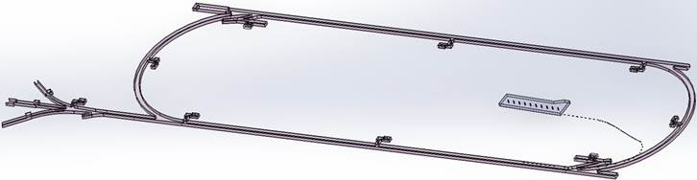

Low Energy Recirculator Facility (LEFRF) As The New Injector Facility for CEBAF
123 MeV e+
(650 MeV e-)
Inject e⁺ into North Linac to usual 12 GeV (w/ magnets reversed)
Build e⁺ injector at the LERF
Build new LERF to CEBAF tunnel
123 MeV e+
(650 MeV e-)
Build new transport line along South Linac and West Arc

Slide 5
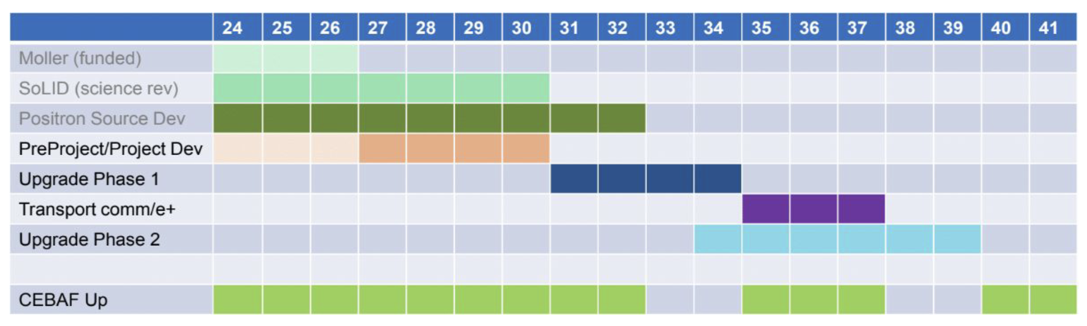
VERY ROUGH Timeline for Positrons and the 22 GeV Upgrade
Gantt chart to give a rough idea when these project could become a reality.
Phase 1 includes building the positron source and the tunnel & beamline connecting the source to main machine.
Phase 2 includes the new permanent magnets to allow 22 GeV within current CEBAF footprint.
NOTE: Plan was formulated so that these projects are ramping up as the EIC project cost is ramping down.

Slide 6
DOE Fixed Target and Collider Electron Beam Scattering Facilities
CEBAF at Jefferson Lab
  Decade+ long physics program with 12GeV beams
    Lots of exciting new results and fantastic new experiments
    Outstanding new ideas still being developed.
    At PAC51 in July 2023
      Five Electron Experiments Fully Approved
      Five Positron Experiments Approved (C1)
  Very exciting ideas for increasing Jefferson Lab’s energy to 22GeV
EIC at Brookhaven
  Cutting edge electron-ion collider (amazing accelerator physics)
  World class physics program to start in the 2030’s
In general, the fixed target program’s focus is on the valence quark region (medium to high x_{B}) while with the EIC collider one can easily access the sea quarks (low to medium x_{B}).

Slide 7
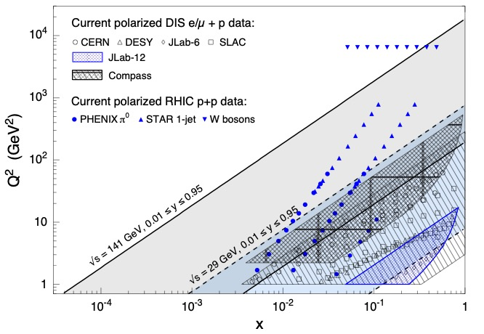
Kinematic Coverage Of The Electron Ion Collider
NOTE: Jefferson Lab is also very high luminosity >10³⁸ cm⁻²s⁻¹ while the proposed
EIC would be ~10³³ to 10³⁴ cm⁻²s⁻¹ so kinematic coverage alone isn’t the whole story.

Slide 8
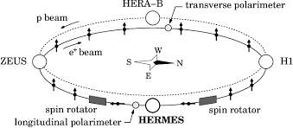
HERA
HERA (German: Hadron-Elektron-Ringanlage, English: Hadron-Electron Ring Accelerator) was a particle accelerator at DESY in Hamburg.
318 GeV center of mass energies: 27.5 GeV e, 920 GeV p
Electron-proton collider ran from 1992 – 2007
Electron polarization by Sokolov – Ternov effect.
Amazing machine and publications are still coming out from the data.
Luminosity (~10³¹ cm⁻²s⁻¹) and design choices limited the physics reach which now naturally lead to next generation machine: the EIC.

Slide 9
Key Science Questions For The EIC To Answer
How do the nucleonic properties such as mass and spin emerge from partons?
How are partons inside the nucleon distributed in both momentum and position space?
How do color-charged quarks and gluons, and jets, interact with a nuclear medium?
How does a dense nuclear environment affect the quarks and gluons, their correlations, and their interactions?
See National Academy of Science Report for details:
https://www.nap.edu/login.php?record_id=25171&page=https%3A%2F%2Fwww.nap.edu%2Fdownload%2F25171

Slide 10
October 2019 Review of Two Competing EIC Designs
For e-N collisions:
  Polarized beams: e, p, d/³He
  e beam 5-20 GeV
  Luminosity ~ 10³³⁻³⁴ cm⁻²sec⁻¹
  100-1000 times HERA
  20-140 GeV variable center of mass energy
For e-A collisions:
  Wide range in nuclei
  Luminosity per nucleon same as e-p
  Variable center of mass energy
Key Supporting Documents
  EIC White Paper
  National Academy of Science Report
JLEIC

Slide 11
Site Selection & Intellectual Ownership of the Physics
CD0 (statement of need by DOE) was approved 19 Dec. 2019 with an announcement from the DOE department of energy on 9 Jan. 2020 https://www.energy.gov/articles/us-department-energy-selects-brookhaven-national-laboratory-host-major-new-nuclear-physics
While JLab scientists were understandably disappointed, Tim Hallman (Associate Director of Science for Nuclear Physics) came here after site selection and encouraged the Jefferson Lab community to continue to develop their intellectual ownership of the physics.
This idea really resonated with many and a very positive BNL-JLab partnership started.
This commitment to the EIC was formalized with the BNL-JLAB Partnering Agreement, signed May 7, 2020.
This partnership has been flourishing ever since!

Slide 12
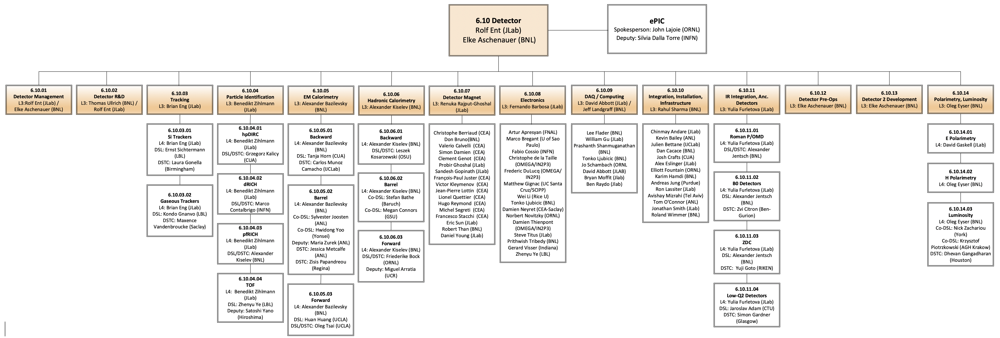
Integration of BNL & JLab into the Project

Slide 13
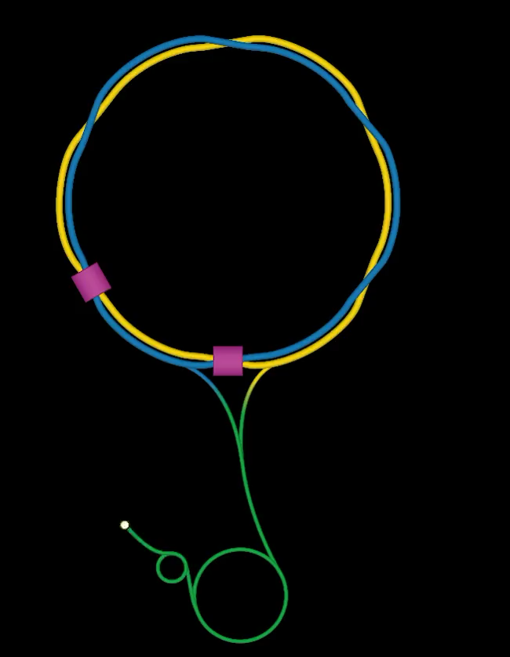
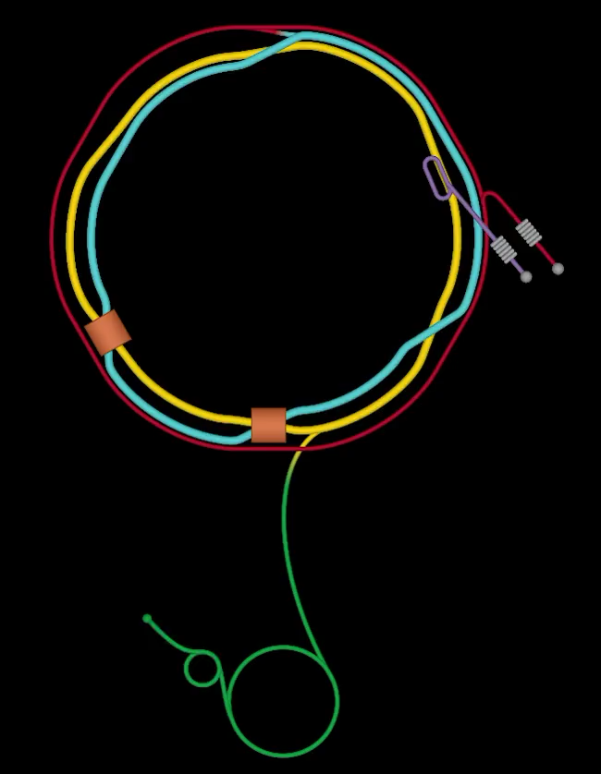
From RHIC to Electron Ion Collider ( circa 2021 )

Slide 14
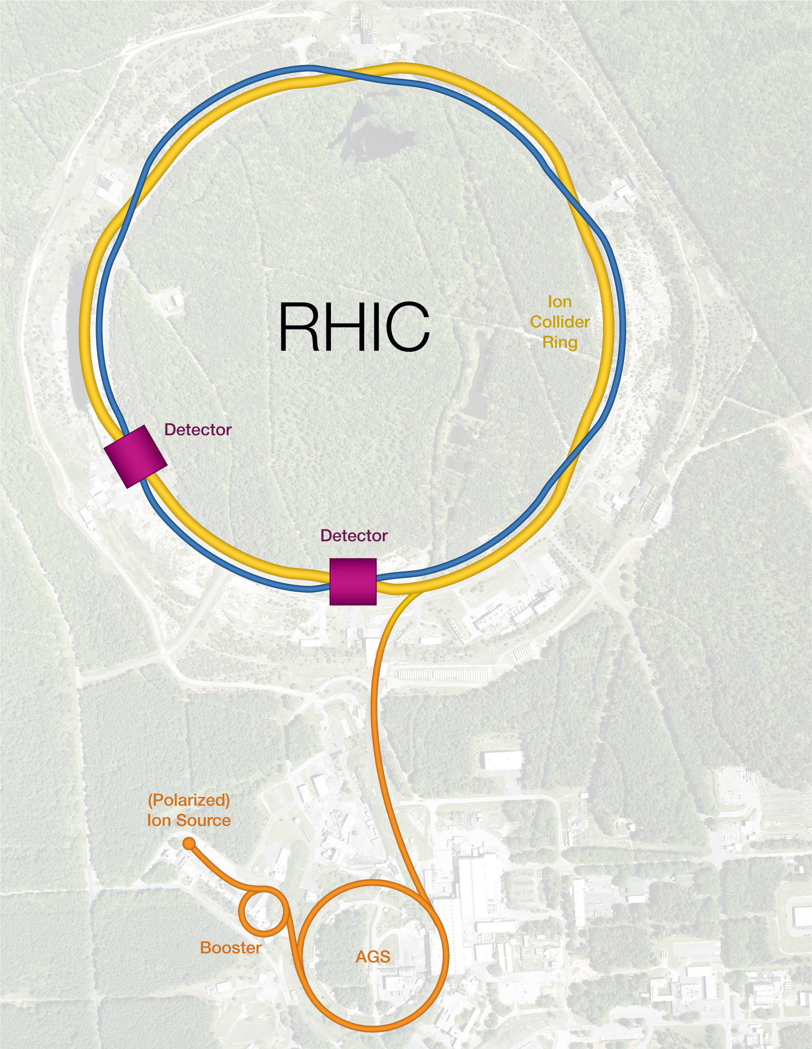
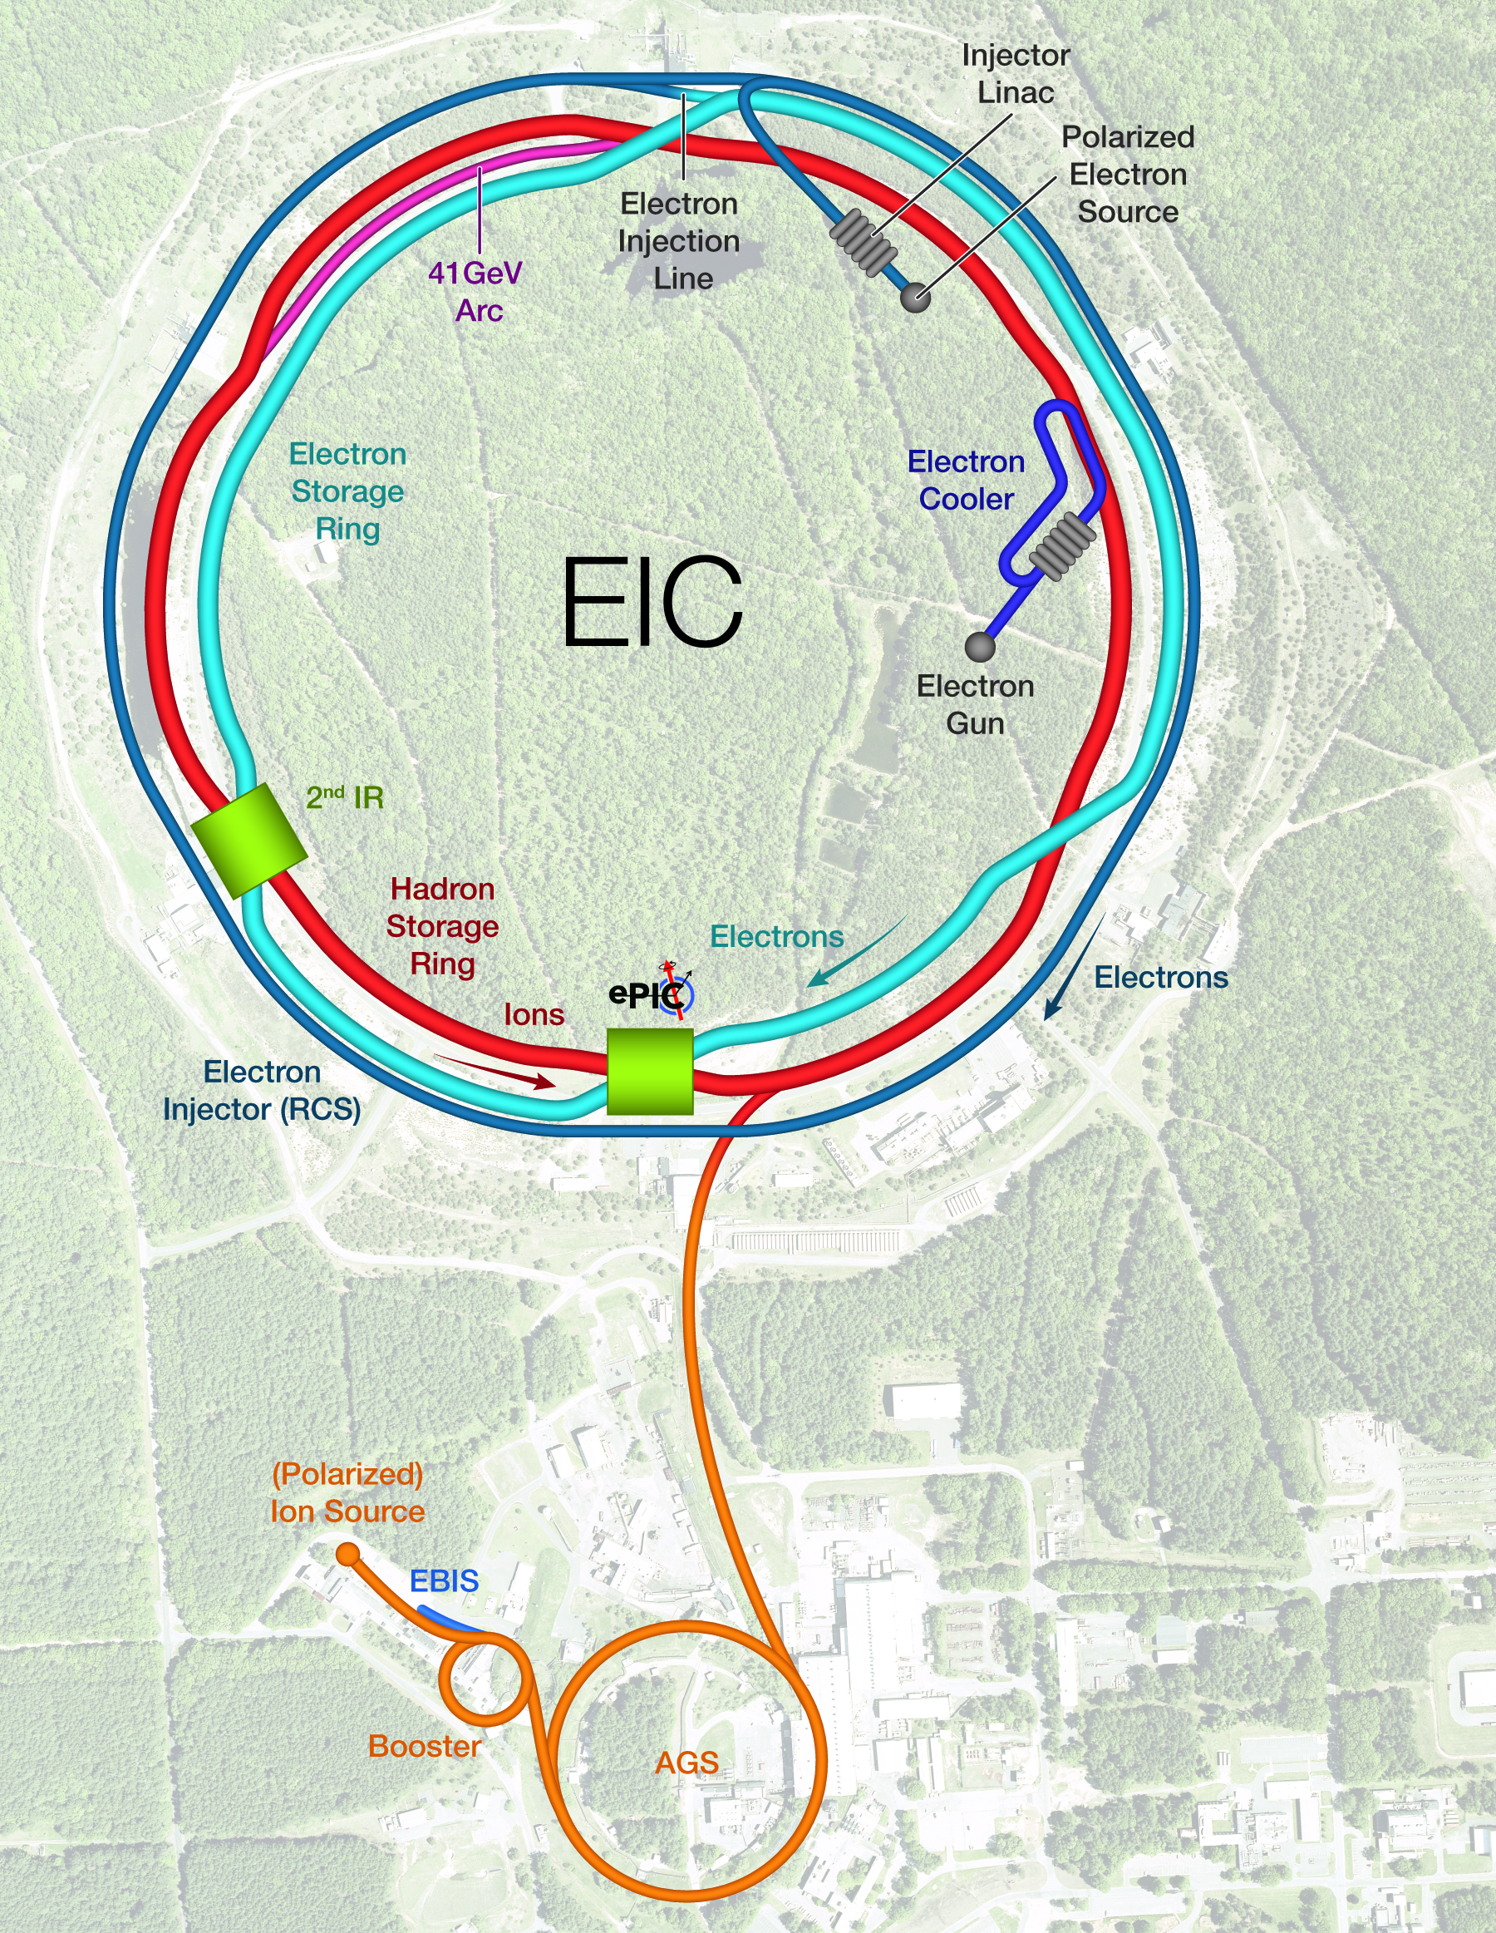
From RHIC to EIC as of January 2024

Slide 15
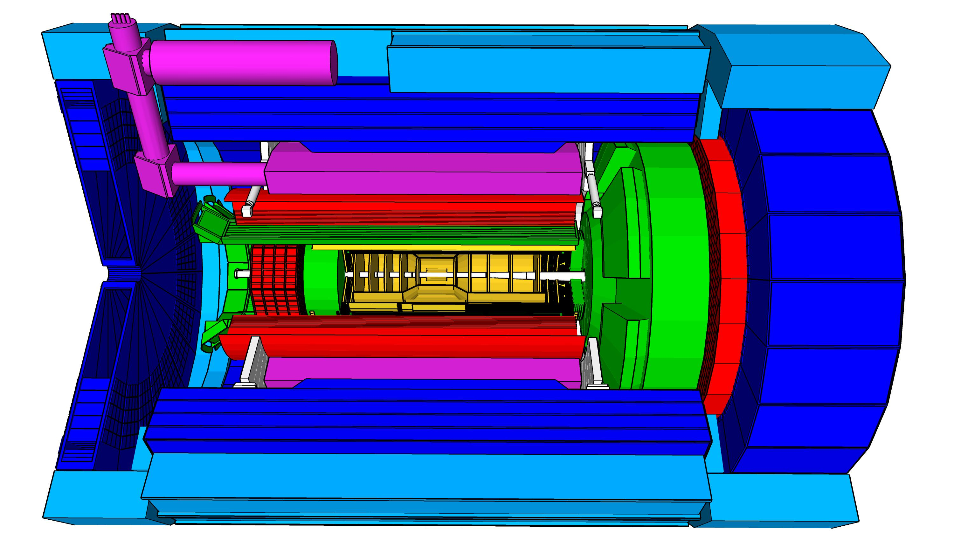
Project Scope for detector at IP6
High Luminosity: L= 10³³ – 10³⁴cm⁻²sec⁻¹,
10 – 100 fb⁻¹/year
Highly Polarized Beams: 70%
→ requires high precision electron and hadron polarimetry
Large Center of Mass Energy Range:
E_{cm} = 29 – 140 GeV
→ Large Detector Acceptance
Asymmetric beam energies
→ require an asymmetric detector Barrel
with electron and hadron endcap
→ equal coverage (-4 < η < 4) Tracking, particle dentification,
electromagnetic and hadronic calorimetry
  High precision low mass tracking
  good e/h separation critical for scattered electron identification
  separate e, π, K, p on track level
Science program required momentum resolution
→ requires a large bore 2T magnet
(1.7 T magnet operation point, stretch goal 2T)
that has same geometry as the BaBAR magnet.
Imaging science program → Large Ion Species Range:
protons to Uranium
→ requires specialized detectors integrated in the Interaction Region over 80 m
Streaming readout electronics model
→ highest scientific flexibility
very compact Detector → Integration is key
Good Background Conditions
local hadron polarimeter
hadronic calorimeters
Time.of.Flight,
DIRC,
RICH detectors
MPGD trackers
Solenoidal Magnet
MAPS tracker
e/m calorimeters
Luminosity
Monitor
low Q² electron-tagger
off-Momentum
taggers
Roman
Pots
Zero-Degree
Calorimeter
p: 41 GeV, 100 to 275 GeV
p/A beam
e beam
e: 5 GeV to 18 GeV
lepton and hadron polarimeters not shown

Slide 16
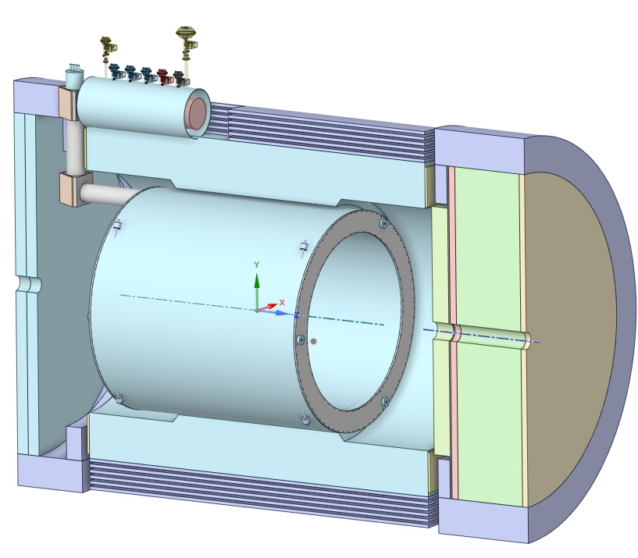
ePIC Detector Solenoid (MARCO) Overview
Superconducting Detector Solenoid
3.5 m long coil, 2.84 m room temperature bore diameter
2 T on-axis field
Operating Temperature 4.5 K
Conductor: Copper Cladded, Rutherford Cable made with NbTi superconducting strands

Slide 17
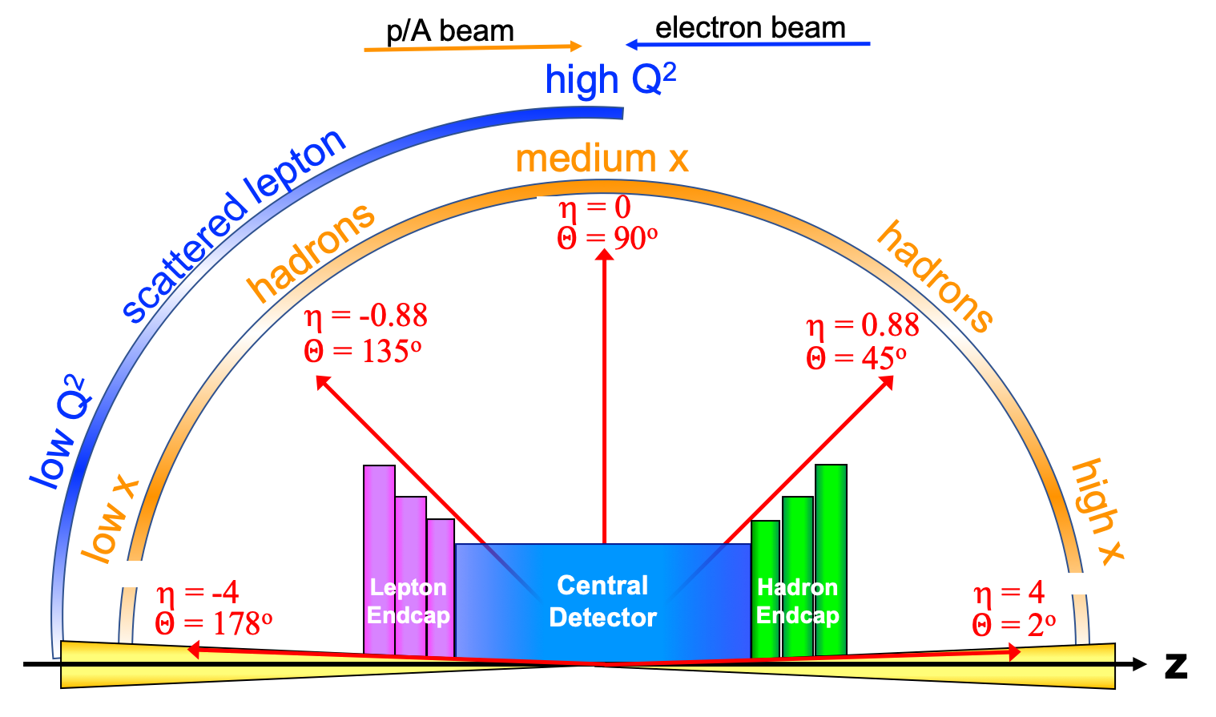
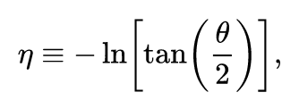
Detector polar angle / pseudo-rapidity coverage

Slide 18



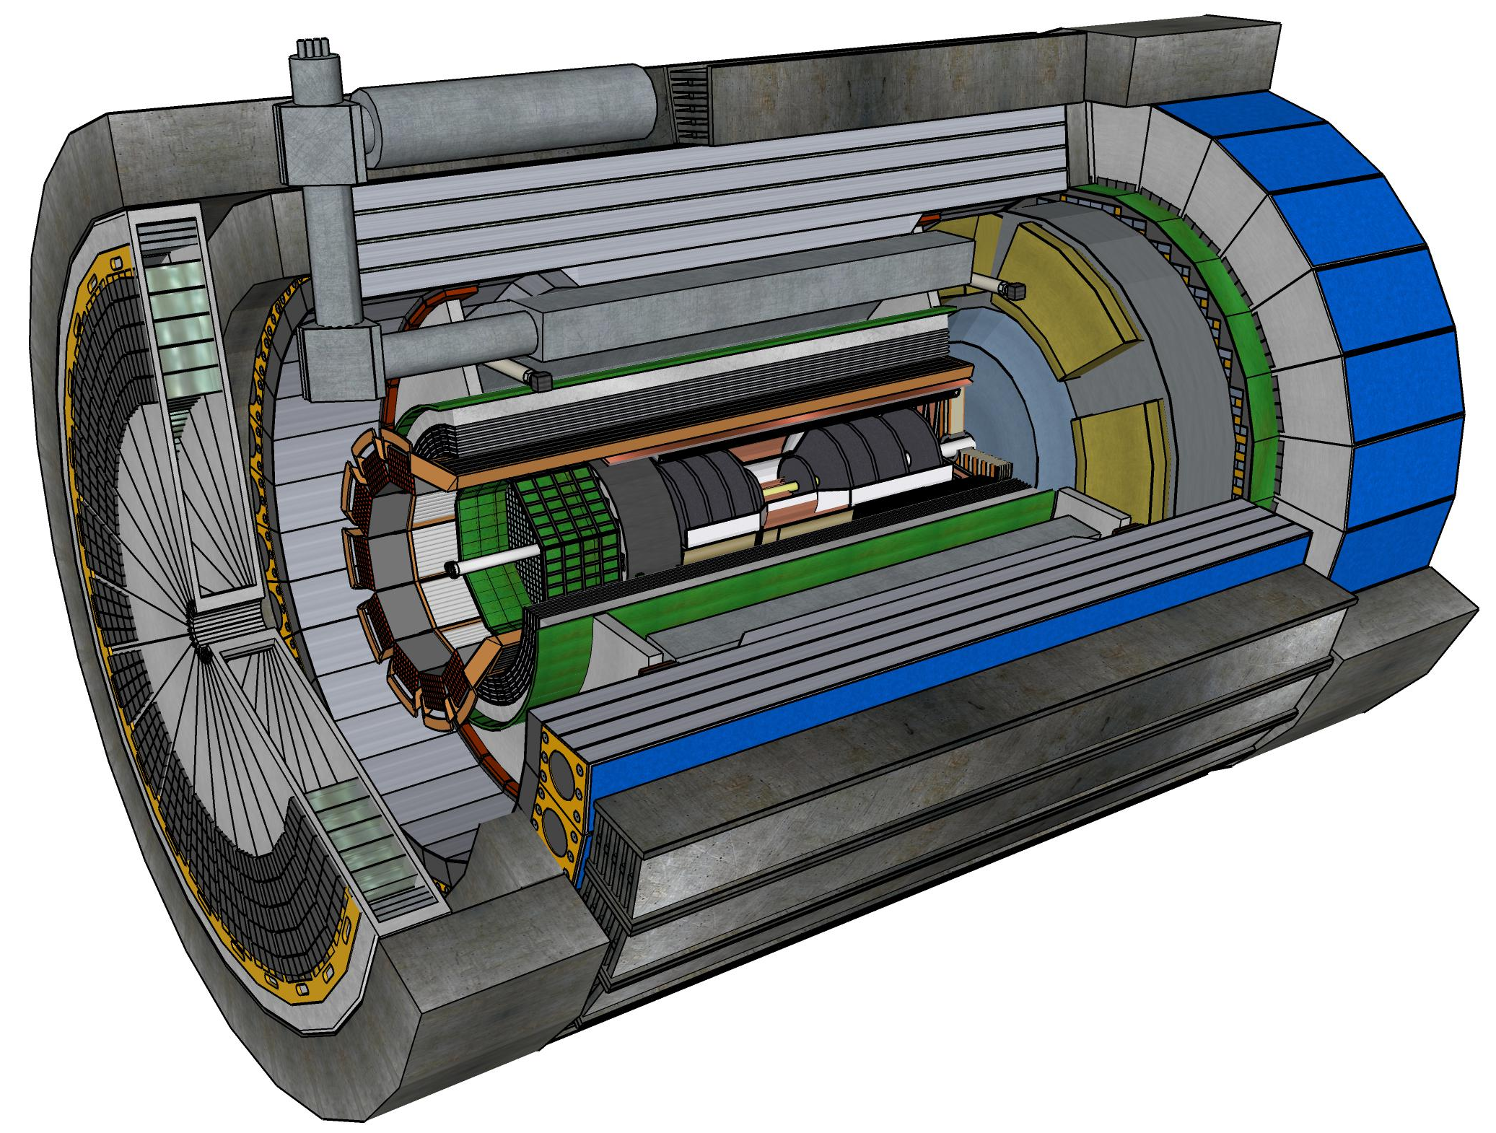










Central Detector Non-DOE Interest & In-Kind
Superconducting
Solenoid
Dual-radiator
RICH
Forward Electromagnetic
Calorimeter
Barrel
Electromagnetic
Calorimeter
Tracking
Detectors
Backward
Electromagnetic
Calorimeter
Time-of-Flight
Backward Hadronic
Calorimeter
Data-Acquisition
Electronics

Slide 19
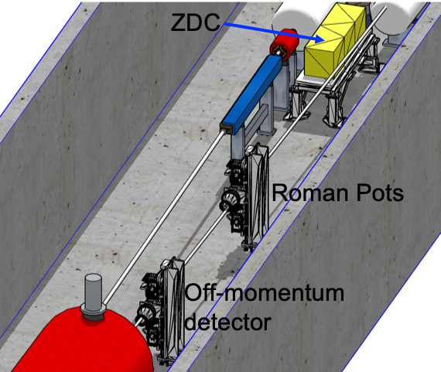
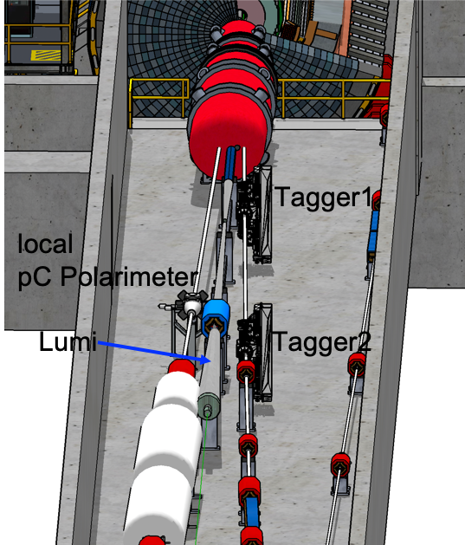

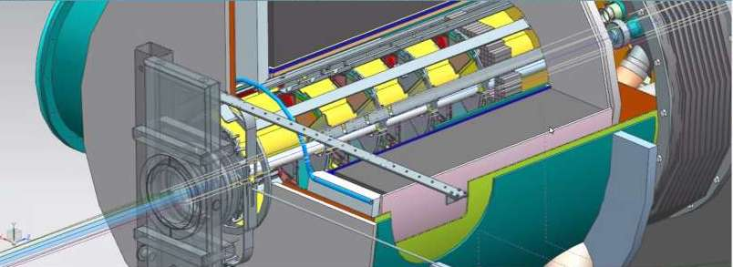

Far-Forward/Far-Backward Detectors Non-DOE Interest & In-kind
Detectors along the hadron and electron beam-lines
B0-Tracker & Electromagnetic Calorimeter

Slide 20
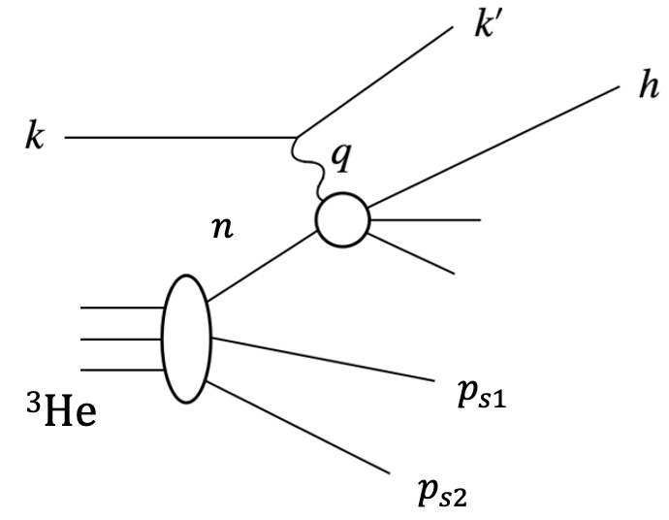
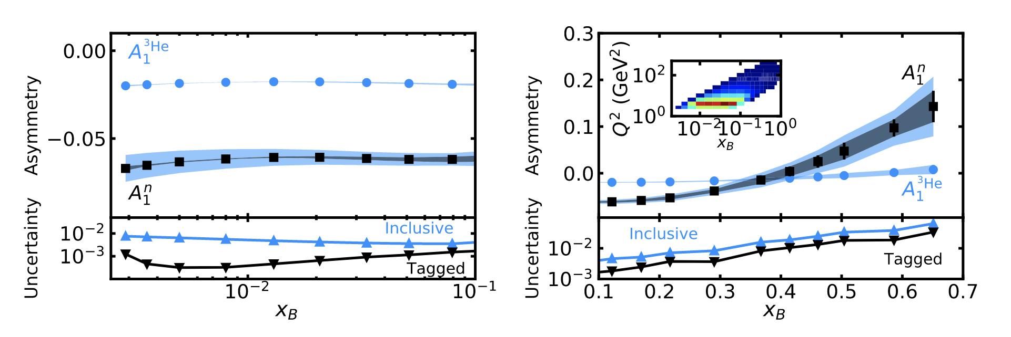
EIC ³He Physics with Tagging
Frišcic, D. Nguyen, J.R. Pybus, A. Jentsch, E.P. Segarra, M.D. Baker, O. Hen, D.W.H., R. Milner, A.S. Tadepalli, Z. Tu, J. Rittenhouse West,
Phys. Lett. B (2021) 136726 https://doi.org/10.1016/j.physletb.2021.136726
Physics Goals:
Nucleon structure function F₂^{n}, F₂^{p} and study medium modifications
Neutron spin structure study on A₁^{n}, g₁^{n} for polarized PDFs
TMD measurements: Flavor and spin dependence of the Transverse Momentum Distribution.
DIS & SIDIS
Tagging

Slide 21
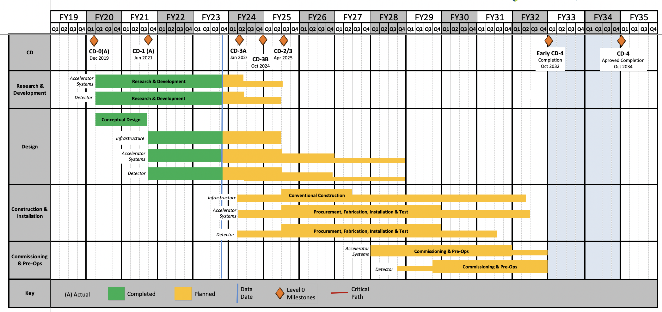
Schedule as Shown at 2024 Jan. ePIC Meeting
Conclusion of
RHIC Operation

Slide 22
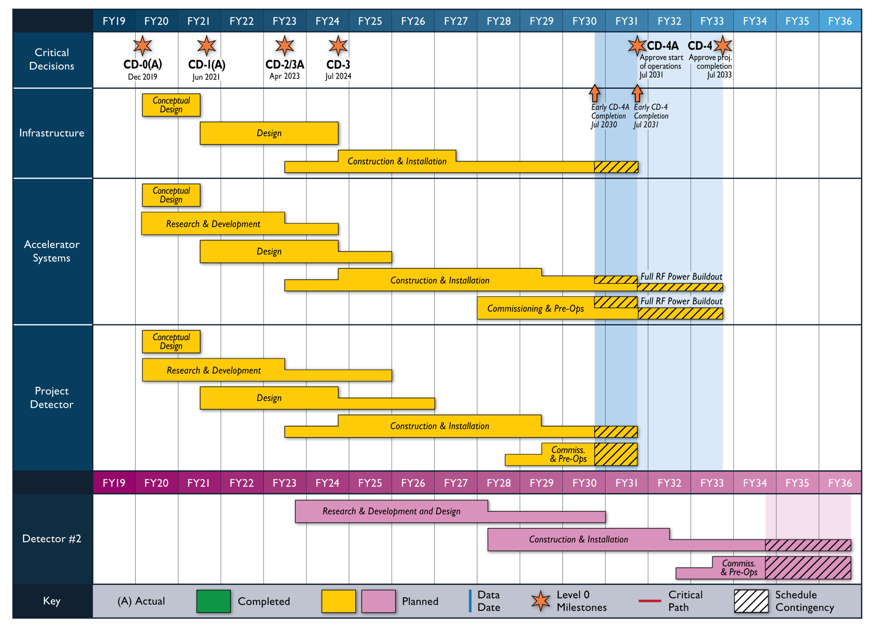
Reference Schedule (Oct. 2021)
Notional Schedule
2nd IR and
Schedule
Generic Detector R&D

Slide 23
Transition to Operations
This funding profile, V4 (Version 4), is based on actuals through FY23 and forecasts.
V5 will use FY24 actual and revised forecasts.
V6 will be the CD-2 Performance Baseline.
23

Slide 24
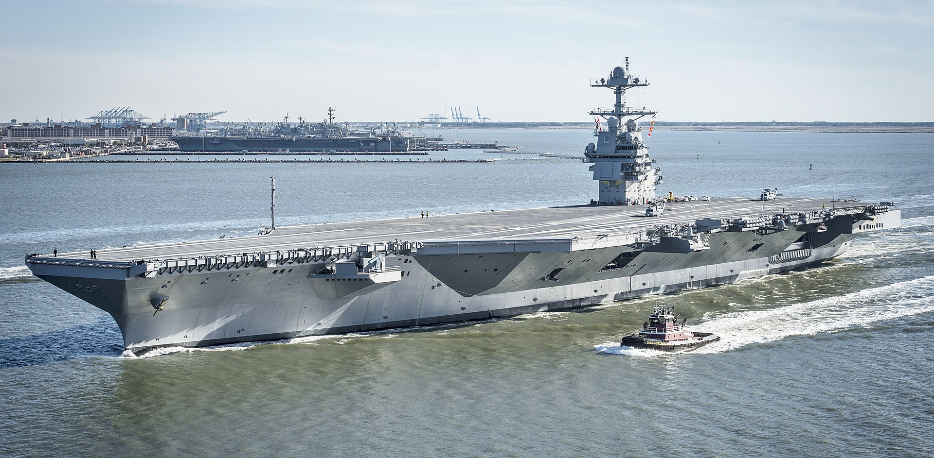
~10% Cost of A US Aircraft Carrier which are all built here in Newport News
Gerald R. Ford-class aircraft carrier
3 billion dollars is a very large amount for a DOE nuclear physics project and budgets in the US are annual so we can expect good years and bad years along the way.

Slide 25
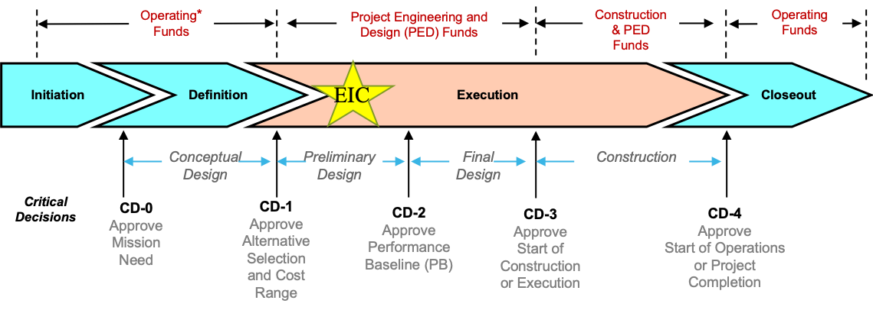
EIC Schedule
    EIC Critical Decision Plan
    CD-0/Site Selection December 2019 ✓
    CD-1 June 2021 ✓
    CD-3A January 2024
    CD-3B October 2024
    CD-2/3 April 2025
    early CD-4 October 2032
    CD-4 October 2034
CD-2:
Approve preliminary design for all subdetectors
Design Maturity: >60%
Need “pre-”TDR
Baseline project in scope, cost, schedule
CD-3:
Approve final design for all subdetectors
Design Maturity: ~90%
Need full TDR
25

Slide 26
From EIC Yellow Report to pre-TDR
Posted to the arXiv on 8 March 2021:
https://arxiv.org/abs/2103.05419
902 pages, 415 authors, and 151 institutions
LaTeX Source Code On The arXiv
Now also published in a refereed journal:
Nucl.Phys.A 1026 (2022) 122447
As of 16 January 2024 has 714 citations
The document is broken into three volumes:
Executive Summary
Physics
Detectors
NOW we starting to get organized to write a pre Technical Design Report
26

Slide 27
Summary
Due to a very strong overlap in the physics interests, the EIC project has turned into a very nice joint project with BNL and JLab. (note: in an ideal world this is how science should always be done!)
Project is making good progress and with the requested funding, the EIC machine will turn on for science in the 2030’s, so the young people in this room will be part of the scientific team running the experiments and analyzing the exclusive physics channels!
If you have no idea where you as a form factor person fit in, Barak, Andrew, myself are working getting our Yellow Report elastic scattering team going again: ePIC interest both for luminosity checks and for high Q² physics.
MANY other opportunities available to you from within the Hall A collaboration!

