Slide 1
CEBAF Operations Overview
Eduard Pozdeyev,
Director of Accelerator Operations
2024 JLAAC Review

Slide 2
Outline
Introduction
Status of Accelerator Operations
Sources of beam downtime and performance limitations
CEBAF Performance Plan
Accelerator Improvement Projects (AIPs) and R&D portfolio
Operations staffing
Accelerator Operations risks
Summary
This presentation answers charge questions 1 and 3

Slide 3
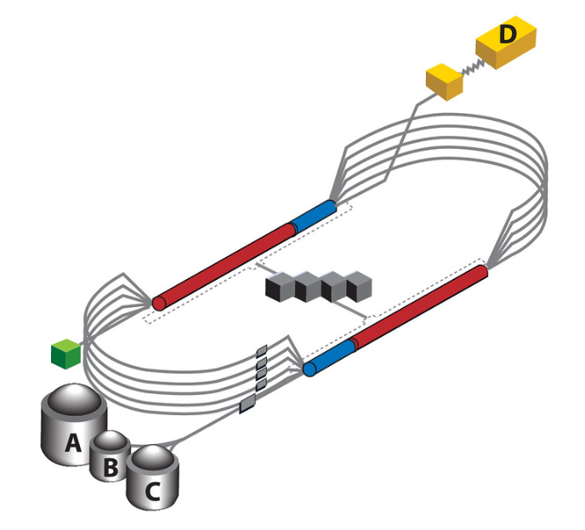
CEBAF Accelerator
Experimental Hall D
12 GeV after 5.5 passes
SRF, recirculating, 5.5 pass, 12 GeV Linac
Beam power up to 900 kW
Total recirculated beam current in the linac up to 450 uA
CEBAF can provide beam up to 4 Halls simultaneously
Beam can be extracted to a specific Hall at any selected pass
e.g., Hall A can operate at pass 4, Hall B can operate at pass 5, and Hall C can operate at pass 3
5 magnetic
Arcs
C100 (new) CMs
1.1 GeV linac
C20 (old) CMs
C20 (old) CMs
Injector
1.1 GeV linac
C100 (new) CMs
Experimental Halls A,B, C
2.2-11 GeV after 1-5 passes

Slide 4
Alignment with Lab’s Mission and Long-Range Plan (LRP)
LRP Recommendation 1: Capitalize on the extraordinary opportunities for scientific discovery made possible by the substantial and sustained investments. Continue effective operation of national user facilities, including CEBAF at TJNAF
Adapted from S. Henderson’s
all-hands presentation 07/2023
Operate CEBAF for Nuclear Physics for >30 week/yr. for >1800 users
Support upcoming 12 GeV experimental program (MOLLER, SoLID, K-Long)

Slide 5
Scope of Accelerator Operations
Operations of CEBAF Accelerator, Real Time Support and Repair (RSR)
MCC (control room operator) group
Software/EPICS controls group
Labor and material required to operate and maintain CEBAF accelerator systems, e.g., RF, magnets, instrumentation. It can include some development.
Scope and budget are planned by system owners yearly in collaboration with Operations.
Does not include power and other utilities
FY2024 Budget $18.8M, labor 121 FTE, material $2.24M
CEBAF Performance Plan
CPP Reliability, critical spares, obsolescence. FY2024 Budget is $2.76M.
CPP Energy Reach (cryomodule upgrade and refurbishment). Budget is in SRF-Ops.
AIPs
$1.05M/year
Budget presently is not in Accelerator Operations

Slide 6
Program Requirements and Performance Limitations
Operational time (weeks/year) is determined by DOE. Goal is 33-34 weeks/year.
DOE metric for reliability is $≥$80%
Scheduled program includes 100% margin (1 experiment day mapped to 2 calendar days)
Beam energy:
CEBAF is operated at 11.5 GeV (after 5.5 pass) in FY2024. 12 GeV requested in FY2025.
Many experiments, including MOLLER, can trade energy for reduced RF fault rate
Beam power and intensity:
CEBAF 12 GeV upgrade performance optimized for up to 1 MW, 450 uA recirculated current
CEBAF is operated at <800 kW. Beam power of 1.1 MW requested in FY2025
Some experiments do not require maximum energy allowing for program optimization
Accelerator performance limitations (presently):
Accelerator systems ~850 kW Klystron performance below spec
Operational Envelope 1.1 MW Determined by the dump cooling system
Environmental Assessment: 2 MW

Slide 7
FY24 and FY25 Operations
FY24 Run
34 weeks of beam operations, ~31 weeks physics
Three Halls: A (2-5), B (3-5), C (3-5)
E = 11.5 GeV (1047 MeV/linac), P = 900 kW
FY25 Run
33 weeks of beam operations, ~31 weeks physics
Four Halls: A (3-5) , B (1-5), C (3-5), D (5.5)
E = 12 GeV (1100 MeV/linac), P = 1.1 MW
Increasing CEBAF energy reach will be critical

Slide 8
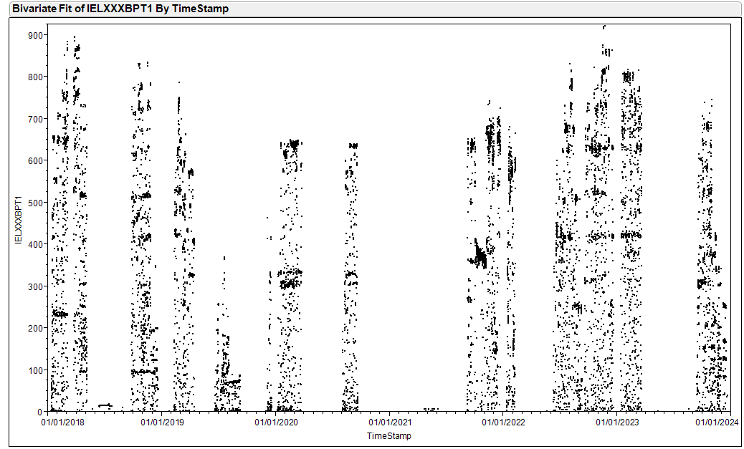
CEBAF Beam Power For 5 Last Years
CEBAF typically operates at <800 kW
Power is lower in FY2024 run due to
Hall A shutdown from Nov to Apr
Hall C reduced power requirements
Runs above 800 kW (e.g., in 2022) were difficult due to frequent RF trips

Slide 9
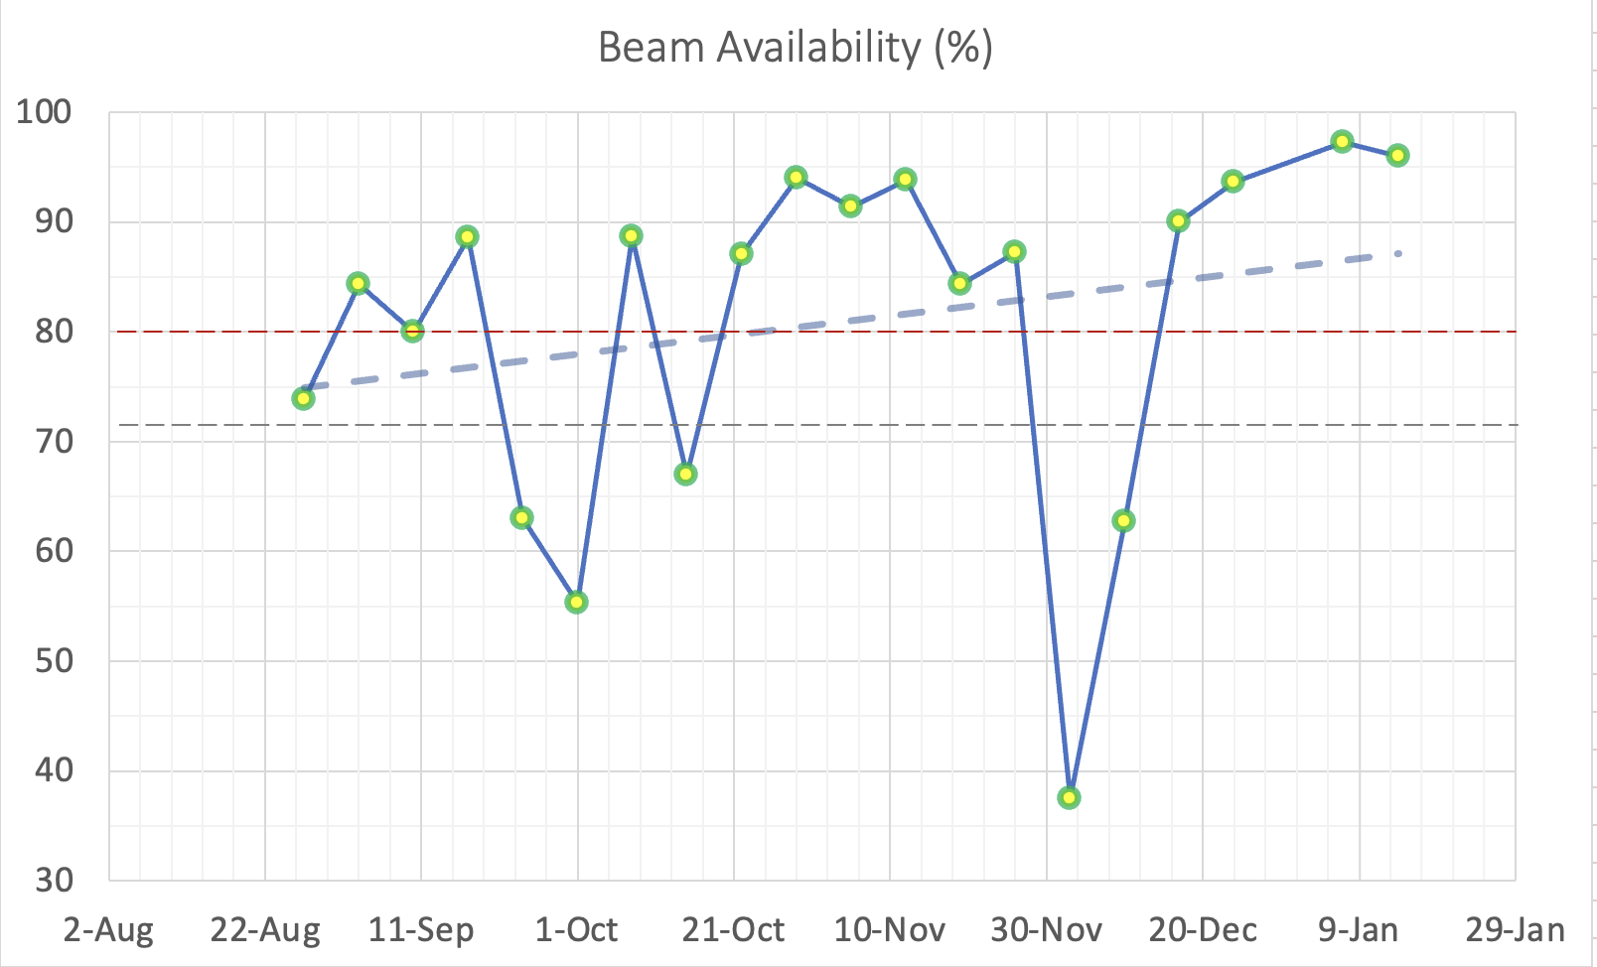
Status of CEBAF Beam Operations: Beam Availability
Average beam availability for this run (08/26/2023 – now) is 80%
DOE metric is $≥$80%
80% - This Run Average
72% - Previous Run Average
Safety Interlock
Systems Failure
CEBAF Gun Failure
Data shows average
beam availability over a week
ending on the shown date

Slide 10
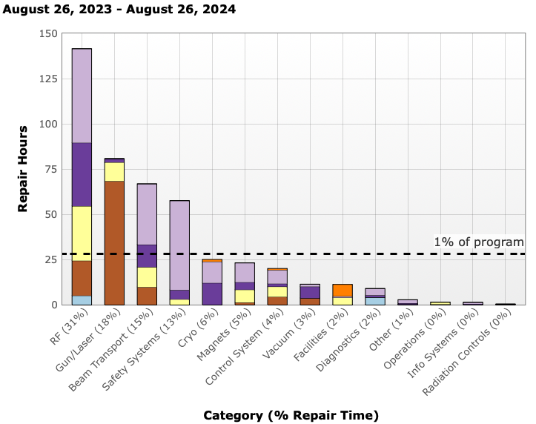
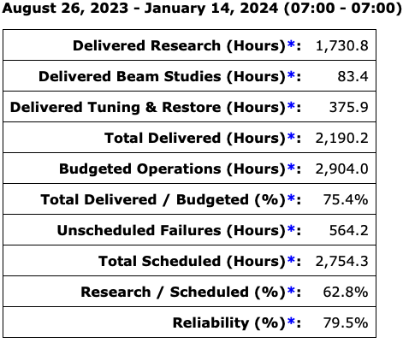
Beam Availability and Reliability, This Run (08/26/2023 – now)

Slide 11
Main Sources of Downtime
RF failures are consistently the largest contribution to downtime, >30%
Klystron HV PS and control boards
High power components (transformers, breakers, etc.)
Cooling
Beam transport consistently is a high contribution, ~15%-25%
Beam losses due to optics and orbit drifts
Unscheduled tuning to reduce beam losses
Other noticeable contributions to downtime
Magnet cooling channels clogging
Power supply failures
Facilities: LCW, HVAC
Gun is a single point failure. Although mostly reliable, it’s failure causes significant downtime.

Slide 12
Accelerator Performance Limitations
SRF
C100 cavity gradient degradation.
Contamination due to degrading Viton seals, field emission, and high radiation
Possibly, dark current due to field emission
Loss of cryomodules and cavities to vacuum leaks and other events.
Cavity faults caused by microphonics and other effects.
RF
RF station power lags performance requirement
Outdated and inadequate accelerator systems, including data acquisition and post-mortem capabilities, limit understanding of the machine and application of advanced techniques such as AI/ML
LLRF, earlier, analog versions are still prevalent at CEBAF
BPMs, slow DAQ (most), no buffering for postmortem processing
BLMs, slow DAQ
(No) Global timing system, no synchronization between different systems
See slide 25

Slide 13
CEBAF Performance Plan (CPP)
Established in 2017 with goal of achieving 12 GeV in 5.5 passes with good reliability.
Reliability Project, manager: Randy Michaud
Critical Spares
Klystrons
Obsolescence
Optimal Weeks Hardware
Energy Reach Project, manager: Tony Reilly
C75 program
C100 refurbishment program
Plasma processing
CPP funding vs FY. The total is $60.1M.

Slide 14
CPP Reliability
Critical Spares, No scope in FY24.
Klystrons
Supply chain crisis increased service cost by 60%. Supplier business has a new owner.
We evaluate an alternative supplier to mitigate risk
FY24 plan: 10 rebuilds and 10 new klystrons
Obsolescence
SSG – 5 items @ $79K: ODH UPSs ordered for SAD24.
DC – 4 items @ $515K : New DC PM coming up to speed on CPP plans.
I&C – 3 items @ $360K: VME Crates awaiting PO, 15 units for SAD24
RF – 5 items @ $666K : Work planning for Sep SSA install SAD24.
ACE – 2 items @ $60K: UPS/Line Switches ordered.
Optimal Weeks, No scope in FY24.

Slide 15
CPP Energy Reach
T. Reilly
Scope
C75 program
C100 refurbishment program
Plasma processing
Cryomodules refurbished and installed at CEBAF to date: C75 x 2, C100 x 4, C50 x 1, 7-cell P1 x 1
Four cryomodules in south linac were plasma processed in situ.
Cryomodule Installation Plan
 | Cryomodules Installed | Cryomodules Removed
FY23 | C100, C100 | C100
FY24 | C100, C75, C75 | F100, C20, C20
FY25 | C100, C75 | C100, C20
FY26 | C100, C75 | C100, C20
FY27 | C100, C75 | C100, C20
FY28 | C100, C75 | C100, C20
FY29 | C100, C75 | C100, C20
FY30 | C100, C75 | C100, C20

Slide 16
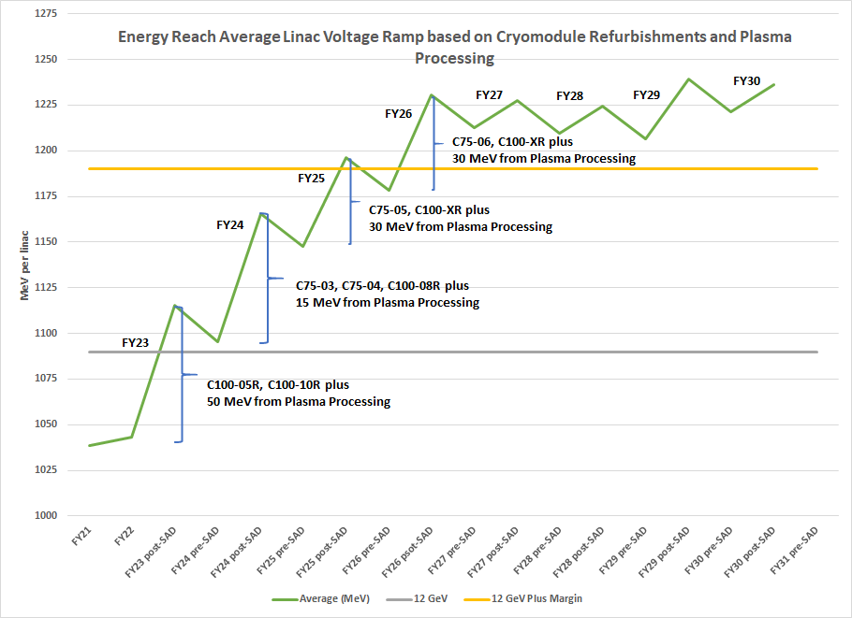
CEBAF Energy Reach Projection
T. Reilly
Jay adds: TN-24-001 has energy reach history 2016-2024
now
- measured
- projected for FY25 run

Slide 17
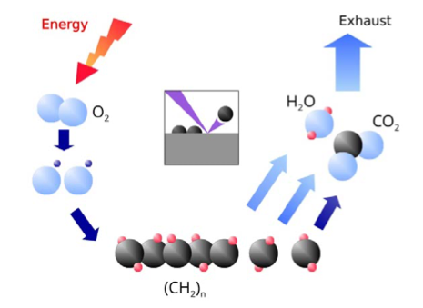
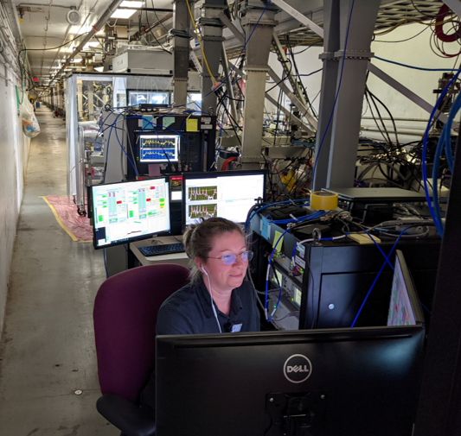
Successful In-Situ Plasma Processing Of CEBAF CMs
T. Powers
Four cryomodules, 2L22 - 2L25 (all cavities), were plasma-processed in the tunnel during last SAD
Path Forward
Process 3 to 4 C100 and C75 cryomodules during accelerator shutdowns.
Extend plasma processing to C75 cavities.

Slide 18
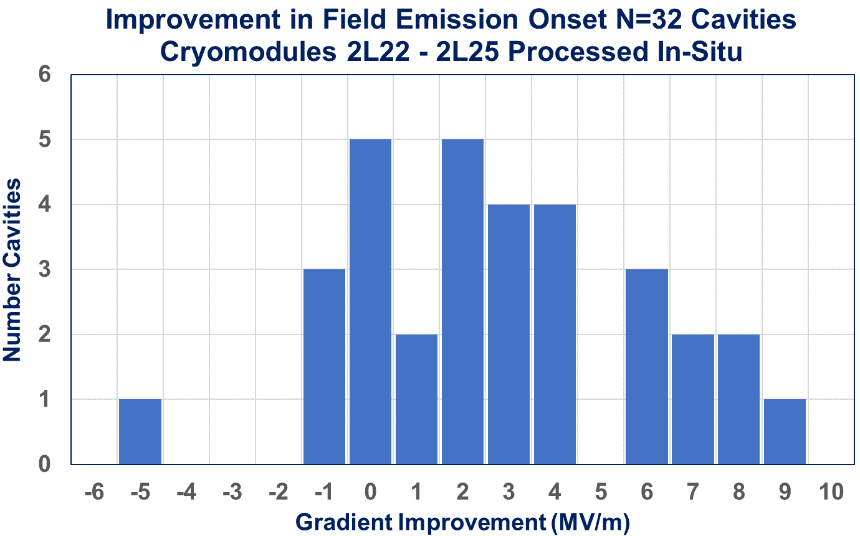
In-Situ Plasma Processing Increased Gradient by 2.7 MV/m
T. Powers
Average Increase
is 2.7 MV/m
Field emission free operation was improved by 59.1 MeV (24%).
An average improvement of 2.7 MV/m.
5 cavities were field emission free after processing.
Success of plasma processing supports more aggressive curve for CEBAF energy reach

Slide 19
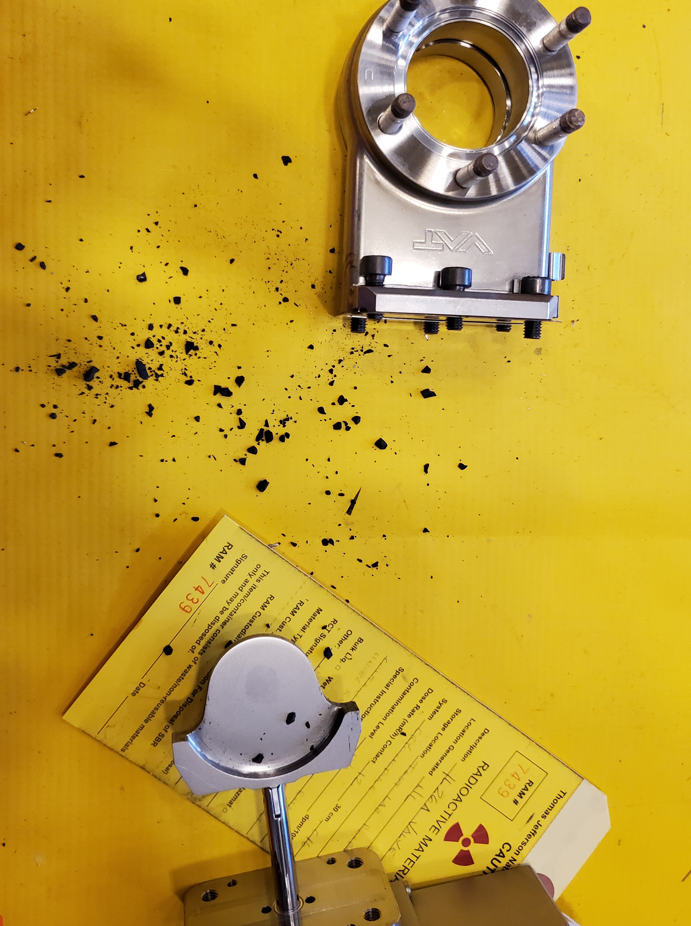
All-Metal Gate Valves
Contamination of CEBAF linac causes degradation of cavity performance, requires cryomodule refurbishment, plasma processing.
One of contamination sources was attributed to radiation damage of elastomer (Viton) seals around C100 and C75 CMs
Viton seals can reach its lifetime in a single run
All-metal gate valves are a viable alternative
All-metal valves are used in SRF accelerators: X-FEL, LCLS-II, PIP-II (future)
Risk – production of metallic particulates
Some gate valves cycle a dozen times a run, some not at all
We are considering installing all-metal gate valves in CEBAF next shutdown. Exact scope of installation is under discussion (3 to 7 CMs).
We solicit comments on viability of this approach from JLAAC

Slide 20
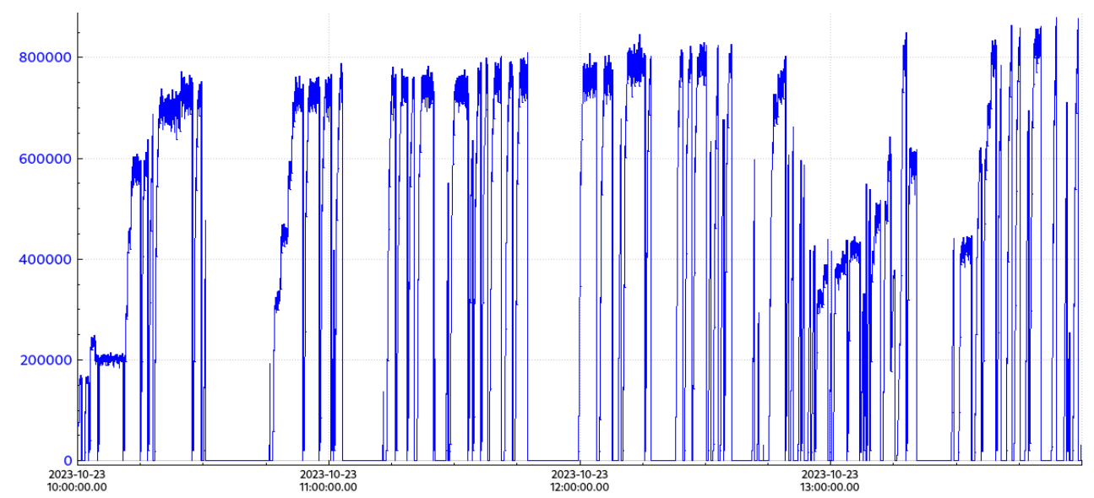
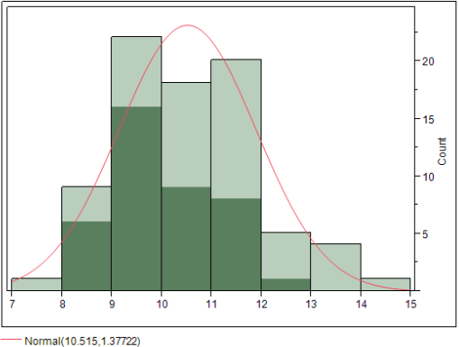
Probing CEBAF Performance Limits
High intensity run in 10/2023 to identify CEBAF intensity limitations.
Performance is limited by available RF power. C100 CM klystrons are underperforming.
Need at least 10 kW for 1.1 MW
Klystrons specified at 13 kW max and 11 kW linear regime
Maximum achieved power
850 kW (395 uA)
Measured RF Klystron Power Distribution
Need 10 kW RF for 1.1 MW beam power.
Klystrons are specified at 13 kW max and 11 kW linear.
Beam power as function of time

Slide 21
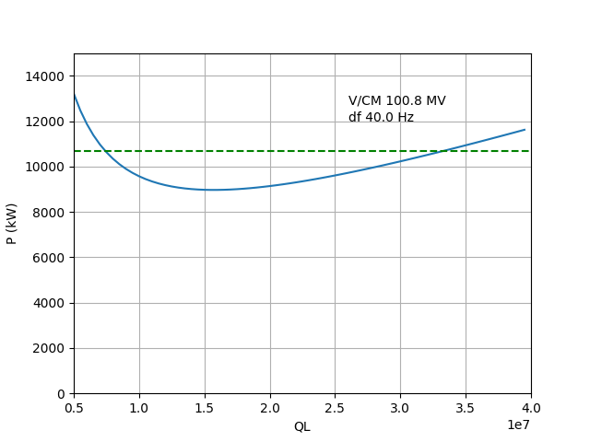
Optimization of Q_{L} of C100 Cryomodules
C100 cavities were designed with Q_{L} of 3e7 in anticipation of high operating field and low microphonics
Reality:
Microphonics is higher than specified
Operating field is lower than expected
Impact:
C100 cavities trip due to insufficient RF power with high beam current and high microphonics
Difficult to control narrow-bandwidth C100 cavities
Mitigation: Q_{L} of C100 cavities was reduced to optimal 1.5-1.7e7 during this SAD
Impact to be tested during this and next runs
Required RF power as function of QL
100 MV/CM and 40 Hz detuning
Average Klystron power
available at cavities
Design QL=3e7
Adjustment goal
QL=1.5e7 – 1.7e7
QL after
adjustment
QL before adjustment
Measured QL of C100 cavities before and after adjustment

Slide 22
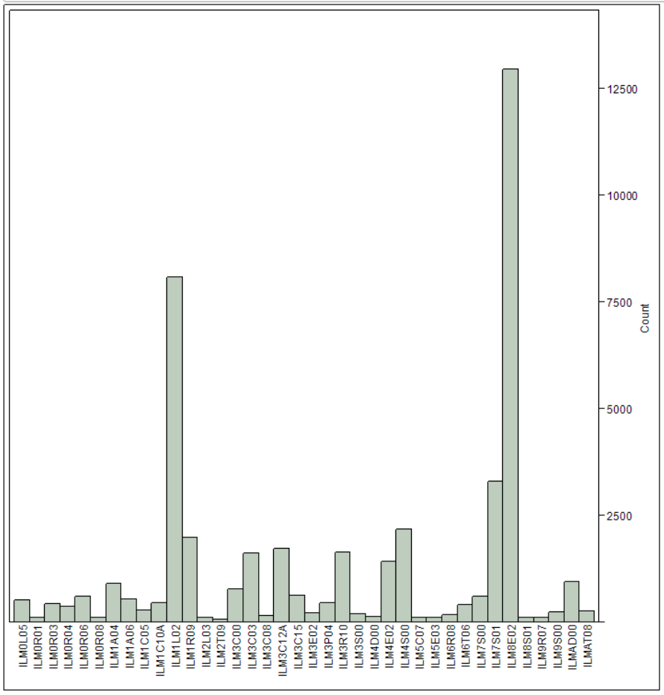
Improving Understanding of Beam Losses
CEBAF employs original 30-year-old analog BLM system to detect beam losses
System adequately protects the machine but is not well suited for understanding or optimization of beam losses
PMT voltage settings are likely too conservative
Near-term approach
Procured 8 ion chambers with fast DAQs and installed them at the location of highest losses (see figure)
Ion chambers are used to study beam losses and cross-calibrate existing BLMs
Long-term approach: Conduct a mini-workshop with subject matter experts to develop path forward with the upgrade of the BLM system
Frequency of MPS fast trips pulled by BLMs
60% of all trips are caused by four BLMs
Beam losses are responsible for ~27%
of all downtime.

Slide 23
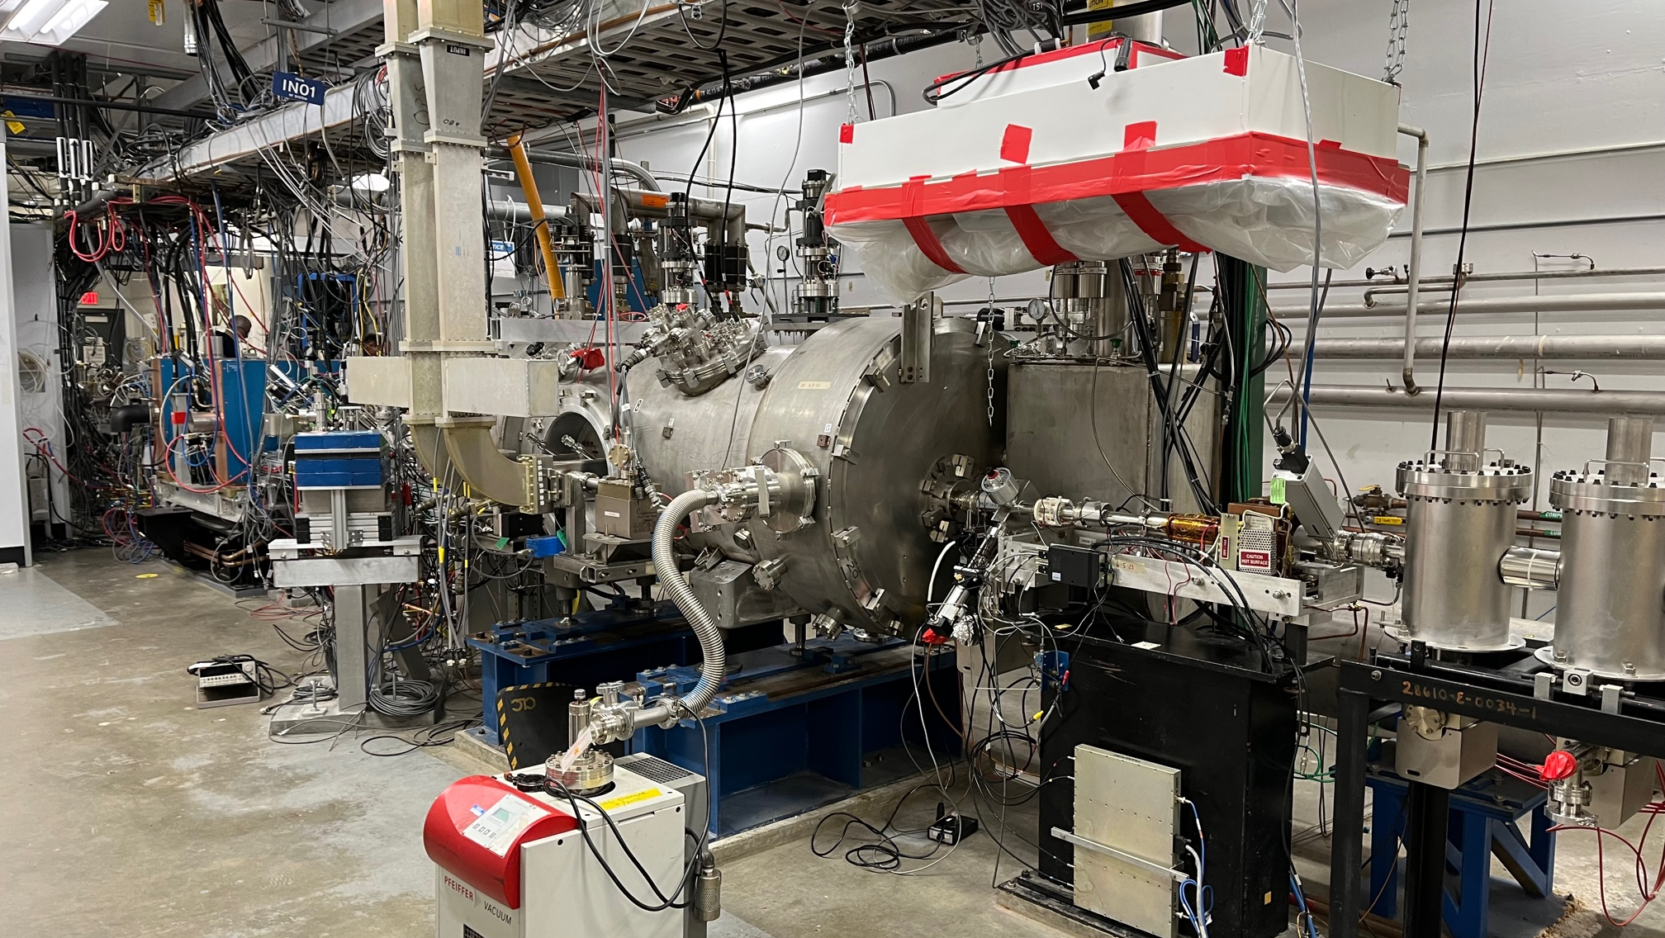
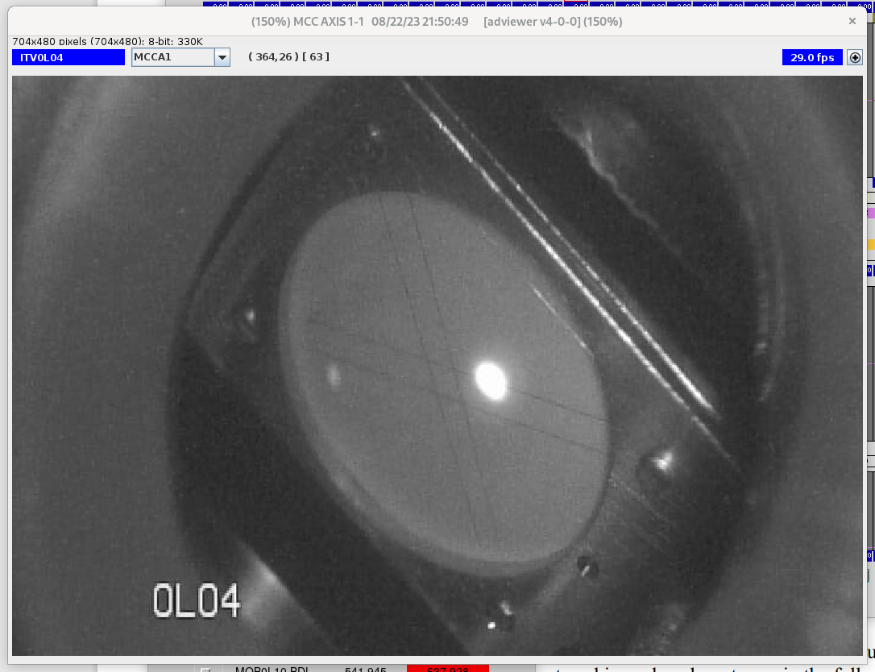
Injector Upgrade Completed
The injector upgrade reduces helicity correlated asymmetry for the Parity Quality program (MOLLER) and improves beam quality for high charge/bunch beam (K-Long).
Scope
Increased gun voltage from 130 to 180 keV.
Upgraded Wien filters.
Solenoids with a larger aperture.
New SRF Booster cryomodule with reduced deflection and coupling.
Injector is used successfully for this beam run.
Increased beam energy improved beam stability significantly.
Beam tests to quantify beam Parity Quality and fully evaluate the injector are on-going
180 kV photogun
booster
New injector and Booster CM
In the CEBAF tunnel
Beam in the injector

Slide 24
Accelerator Improvement Projects (AIPs)
 | Total cost | Past Years | FY22 | FY23 | FY24 | FY25 | FY26 | FY27 | FY28 | FY29
LLRF Digital Upgrades | 3,739 | 1,789 | 660 | 266 | 905 | 40 | 40 | 40
Next Gen BPM Upgrade | 4,580 |  |  |  | 190 | 1,088 | 1,122 | 1,157 | 1,023
Global Timing System | 1,480 |  |  |  |  |  |  |  | 210 | 1,270
Beam Loss Monitoring System | TBD
TOTAL ( = Funding) | 9799+ |  | 1,052 | 1,063 | 1,095 | 1,128 | 1,162 | 1,197 | 1,233 | 1,270
Challenges
Cost-Of-Living funding does not allow acquisition of critical systems before FY30.
Incremental production and installation spread over multiple years is costly and inefficient.
LLRF, BPMs, BLMs, and Timing together provide complementary, synchronized data.
Focused funding and construction of these systems will provide maximum benefit for CEBAF Operations.
See next slide

Slide 25
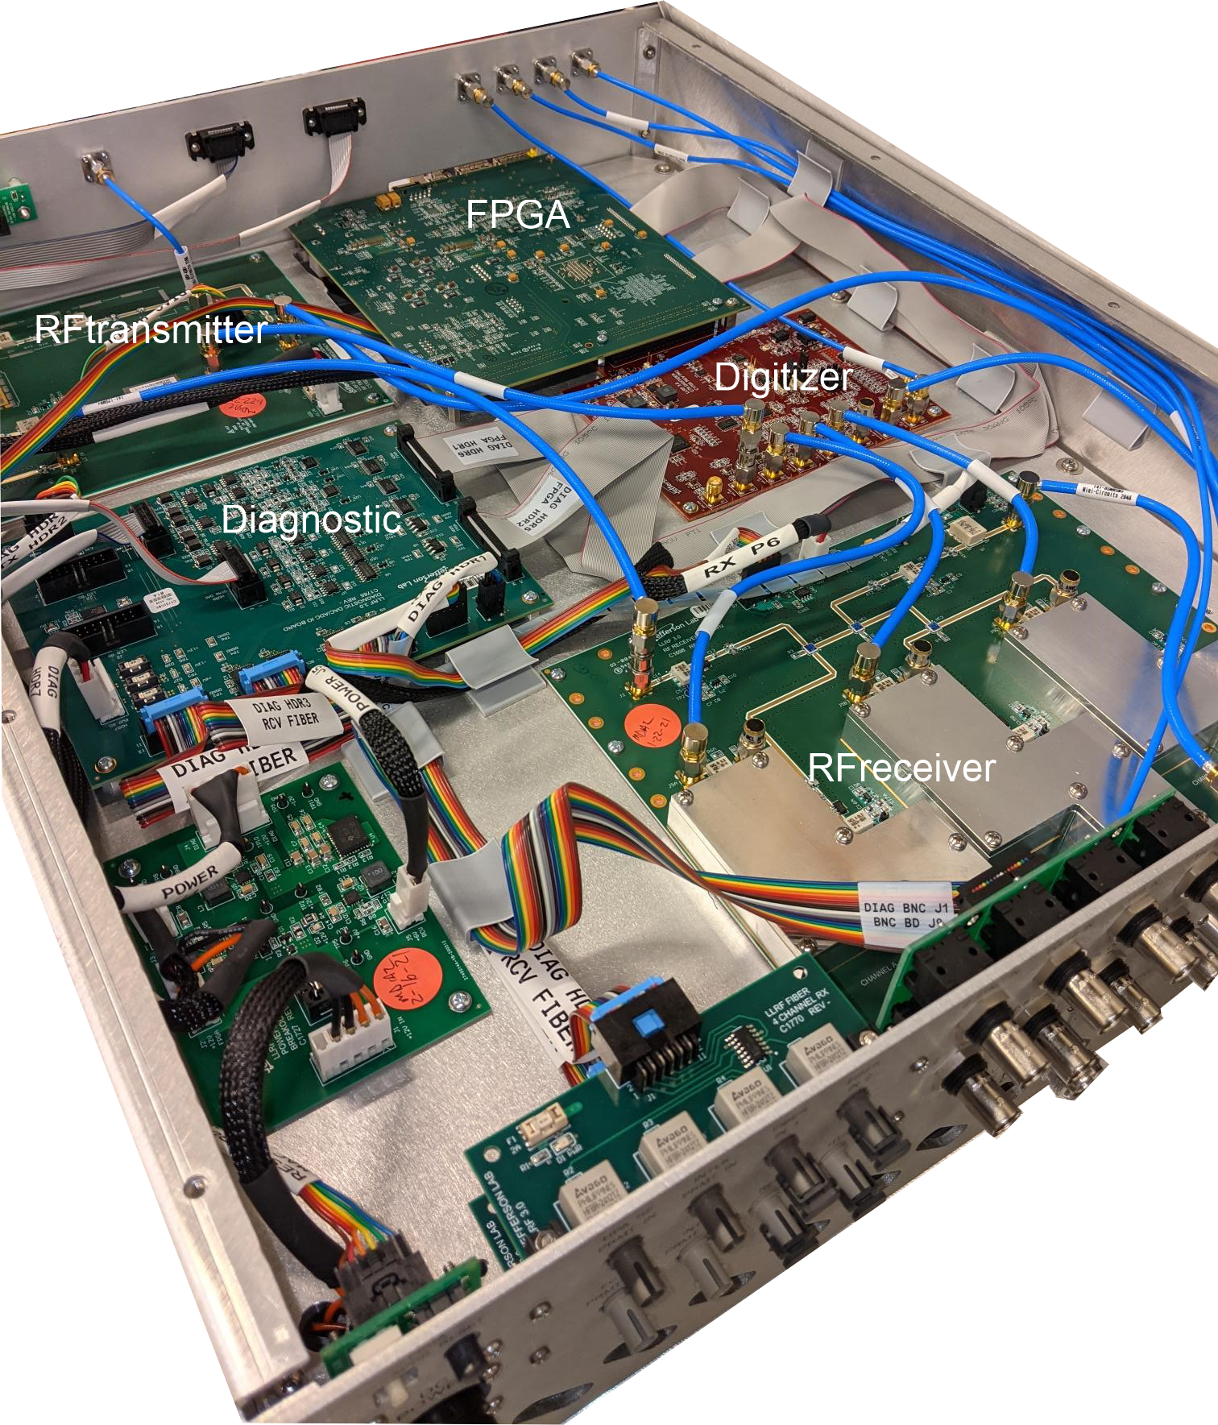
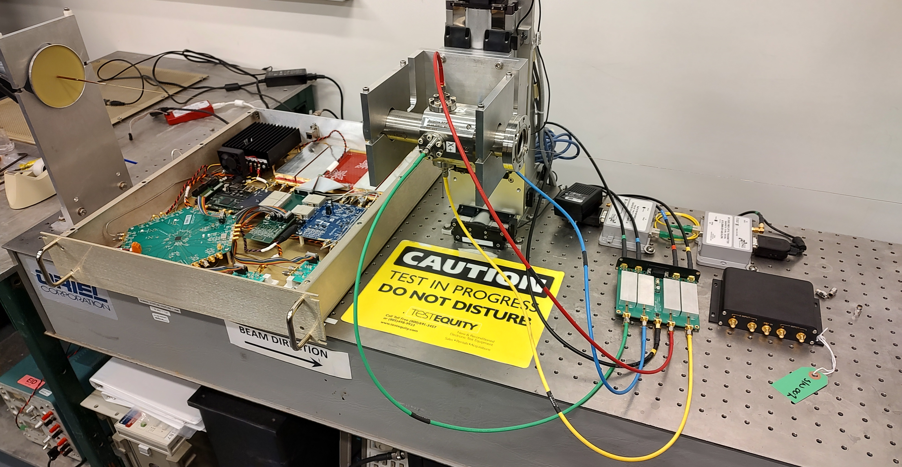
Benefits Of Advancing LLRF, BPM, BLM, and Timing System
LLRF Upgrade
Provides advanced functionality for field control and diagnostics capabilities.
Upgrade in progress. Installation to proceed until 2027.
Next Generation BPMs
Addresses obsolescence. Provides new functionality: high bandwidth DAQ, buffering, interface to global timing system, suitable for capturing fast transients.
Porotype construction in progress. Plan to install by 2028.
BLM System Upgrade
Provides new functionality (faster DAQ, buffering, interface to timing system). Total loss monitors can extend area coverage.
Global Timing System
Synchronizes instrumentation and allows correlating their response to beam events
These systems will benefit CEBAF the most if they are treated as parts of an integrated system, complementing each other.
Advanced functionality and global timing will provide insight into machine behavior and allow us to use modern tools such as ML/AI.
We ask JLAAC to comment on this concept and usefulness of advancing procurement of these systems.
N. Rider
LLRF v3
New gen. BPM prototype
Global timing system concept

Slide 26
Next Generation CEBAF High Power RF
Klystron has been a reliable RF source at CEBAF for almost 30 years
Industry is changing
Design experience is aging out.
Solid State became much more prevalent in the last 10 years.
Cost of Klystrons surpassed cost of Solid-State Amplifiers.
It becomes difficult to find klystron vendors.
Aging CEBAF HP RF system is the main source of downtime: HV PS, Transformers, Klystron control electronics.
We need to think about next generation RF solution for CEBAF
$10/Watt

Slide 27
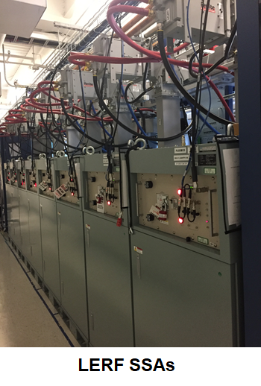
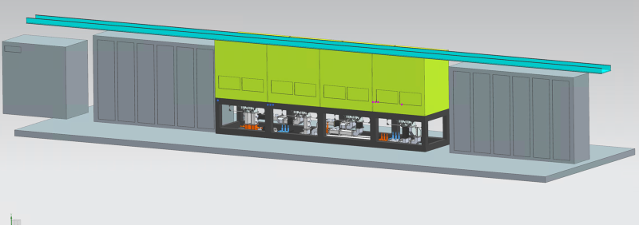
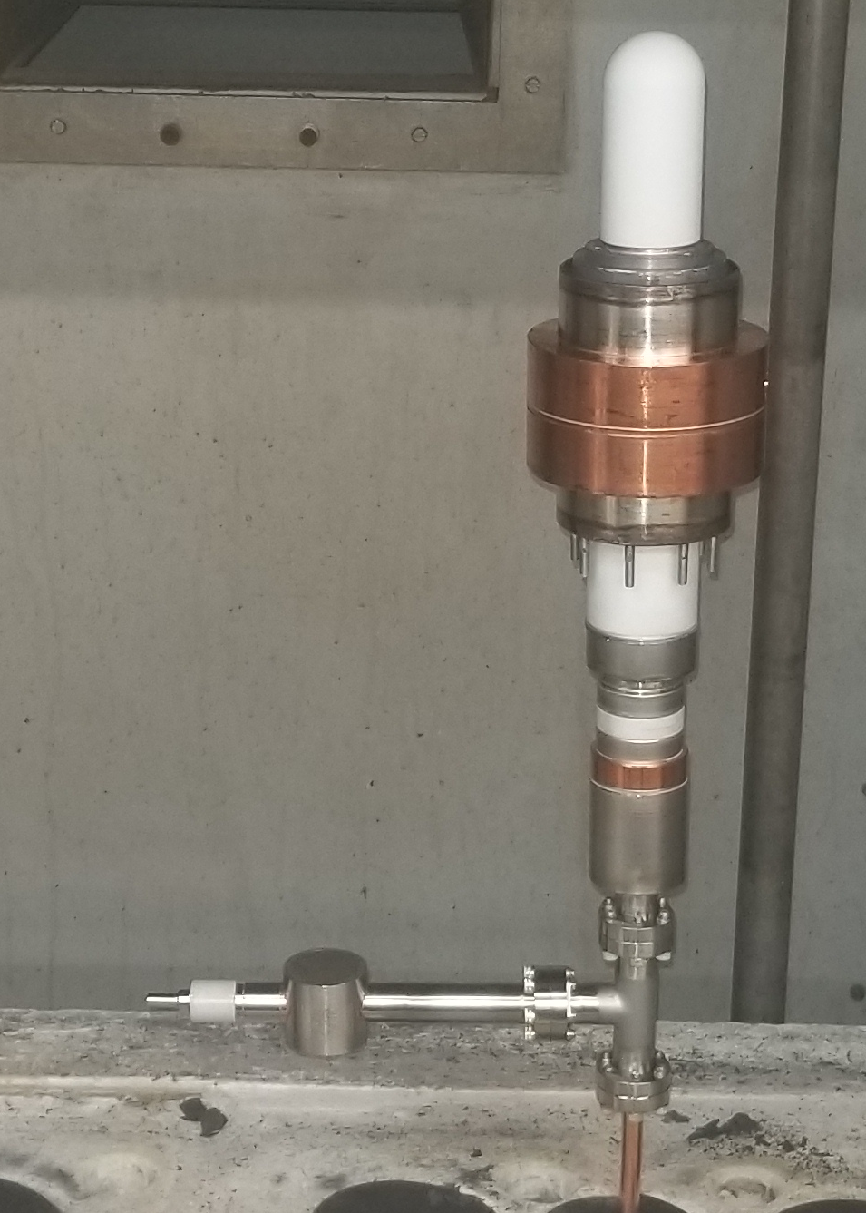
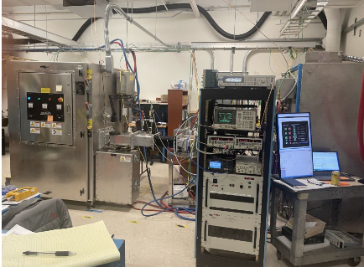
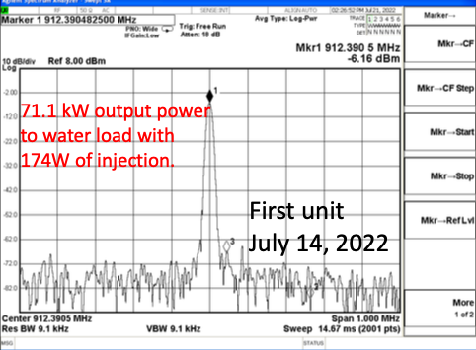
Next Generation CEBAF High Power RF: Alternatives
Solid State Amplifiers (SSA)
Solid State Amplifiers are widely accepted technology that matured over last 20 years.
Viable alternative to tubes between 100 MHz – 2 GHz.
SSA efficiency > 40% for class A/B…more for class F.
SSA is technology of choice for LCLS-II, FRIB, PIP-II.
Status: requirements for CEBAF 8 kW SSA developed. Ready to contact vendors to get proposals for one CEBAF cryomodule. Project will be funded as AIP.
H. Wang
Magnetrons
Promise of high-efficiency, high power, and, possibly, lower cost.
Widely used technology for industrial applications but not accelerators.
R&D is conducted to demonstrate required phase and amplitude stability and address short lifetime.
75 kW, 915 MHz AMTek magnetron funded by DOE Accelerator Stewardship award
SBIR with Muons, Inc. for 1497 MHz magnetron
One zone at CEBAF (design)
We request and will appreciate comments from JLAAC

Slide 28
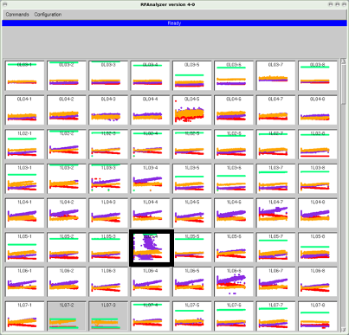
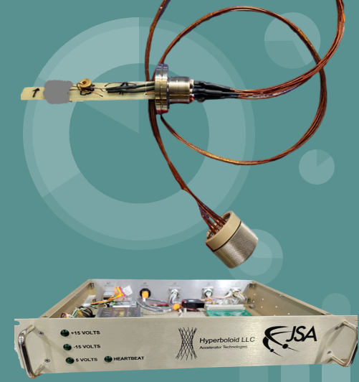
Portfolio of R&D and SBIR-Funded Projects
Detection of anomalies in cavity field
Three AI/ML DOE funded projects (FOA-LAB-20-2261)
Automate identification of unstable SRF cavities.
C100 Cavity Fault Prediction.
CEBAF cavity field emission management using neutron detectors and surrogate models (ML)
Reduce field emission, increase lifetime of components
He flowmeter (SBIR, Hyperboloid LLC)
Allows for fast and accurate measurement of cavity heat and Q₀
1497 MHz Magnetron RF source (SBIR, Muon Inc)
Demonstrate feasibility of magnetron as alternative, efficient RF source for CEBAF
C. Tennant
D. Turner
M. Spata
Helium Mass
Flow Monitor​
First L-Band tube at
Richardson Electronics

Slide 29
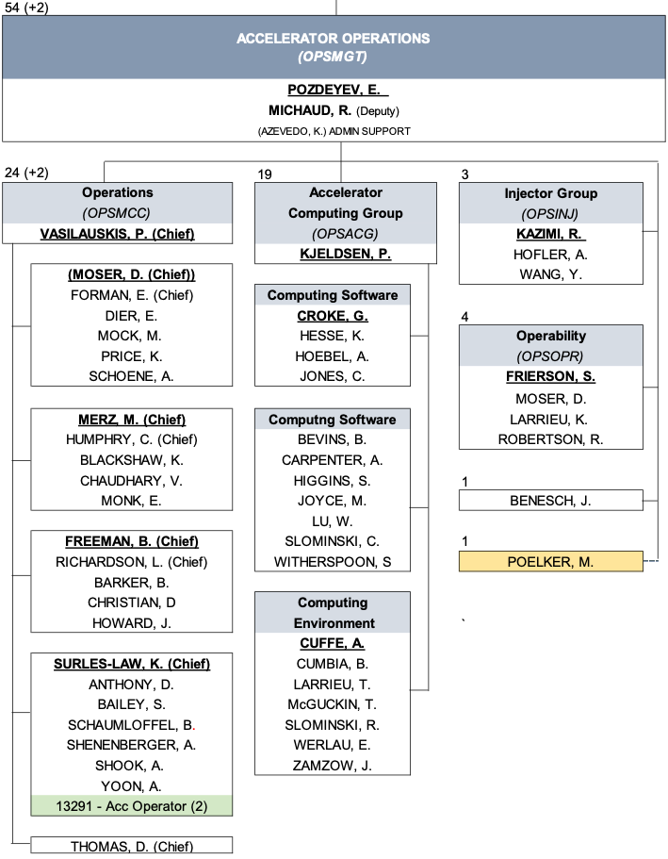
Accelerator Operations Staffing
Personnel of operator group increased to 25, bringing Ops staffing to adequate level.
7 new operators hired with a loss of 2 operators over the last year.
Operability deputy hired to focus on improving reliability and failure analysis
Competition for technical expertise with EIC and other projects is a concern
Projects will compete for expert knowledge (e.g., SRF/RF/LLRF) required to support CEBAF

Slide 30
CEBAF Operations Risks And Their Mitigation
Top risks
Loss of experienced personnel supporting CEBAF Operations
Aging linac systems and infrastructure affect CEBAF performance and increase rate of component failures to unacceptable level (e.g., loss of CMs, RF failures, CF failures)
Changing market conditions and industry can cause obsolescence of accelerator components and/or increase cost of maintenance
Energy reach fails to meet goals
Funding after CPP ends is insufficient to maintain CEBAF performance and reliability
CPP and AIPs are examples of Risk Mitigation
We will benefit from pulling AIPs ahead and combining them to take full advantage of provided capabilities
Formal risk registry exists for CPP. No formal risk registry for Operations exists yet. We plan to develop it.

Slide 31
Summary
CEBAF usefully delivers beam to experimental halls in support of DOE NP mission.
Beam run is in progress. Average reliability for the current run is 80%.
We are actively addressing sources of downtime and performance limitations and managing future risks.
CEBAF Performance Plan and AIPs are used to improve performance of the machine, improve reliability, and address risks.
Looking forward to another successful year of delivering beam to NP users.

Slide 32
Thank You!

Slide 33
Current Priorities of CEBAF Operations
Deliver beam (up) to four halls for nuclear physics program safely and reliably, meeting program’s requirements
Execute CEBAF Performance Plan to extend CEBAF energy reach up to 12 GeV after 5.5 passes with margin.
Increase beam availability, reduce unscheduled downtime and frequency of trips
Improve hardware reliability through acquisition of critical components and spares. Address hardware obsolescence
Enhance CEBAF capabilities through AIPs, upgrades, and R&D
Prepare for upcoming experiments
Maintain strong operations team capable of meeting operational challenges

Slide 34
Machine Studies And Operator Training
Y. Roblin
D. Turner
Machine Studies
Systematic beam studies to improve performance of the machine, understand performance limitations, and conduct R&D for future experiments are conducted bi-weekly (1 shift) and when opportunity presents itself
Beam studies are managed by CASA in coordination with Ops and other departments
Study plans are approved, prioritized, and scheduled at a weekly BTEAM meeting
Operator Training
Senior crew chiefs conduct hands-on operator training of junior operators on a live machine when either opportunity presents or during machine studies
These sessions provide unique opportunity to train young operators
Junior operators execute beam tuning procedures and operate hardware

Slide 35
FY23 Scheduled Accelerator Downtime (SAD) Completed
New injector will reduce helicity correlated asymmetries for MOLLER.
Installed cryomodules and plasma processing increased the energy reach.
Upgrade of Personnel Safety System in South Linac. Certification once per year is considered.

Slide 36
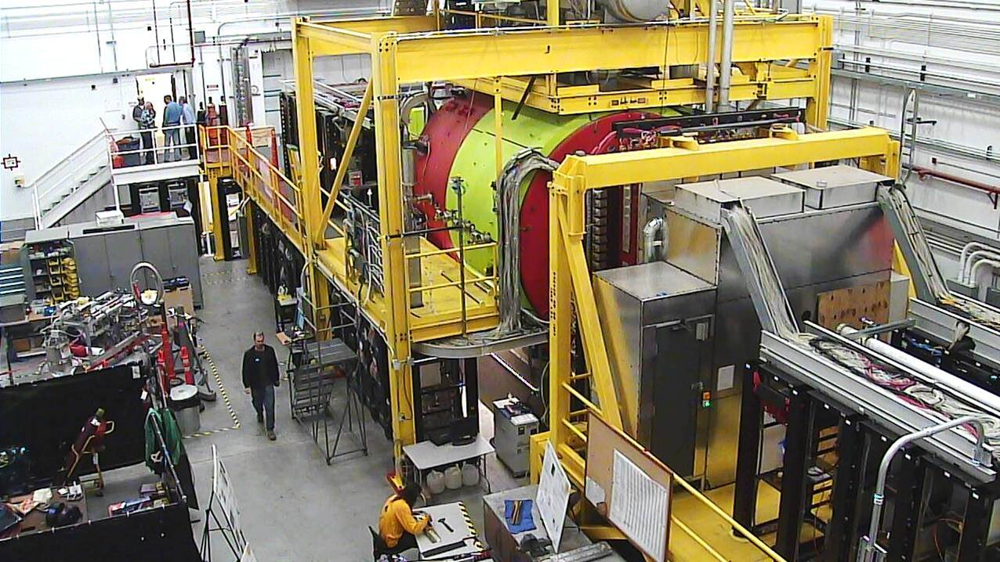
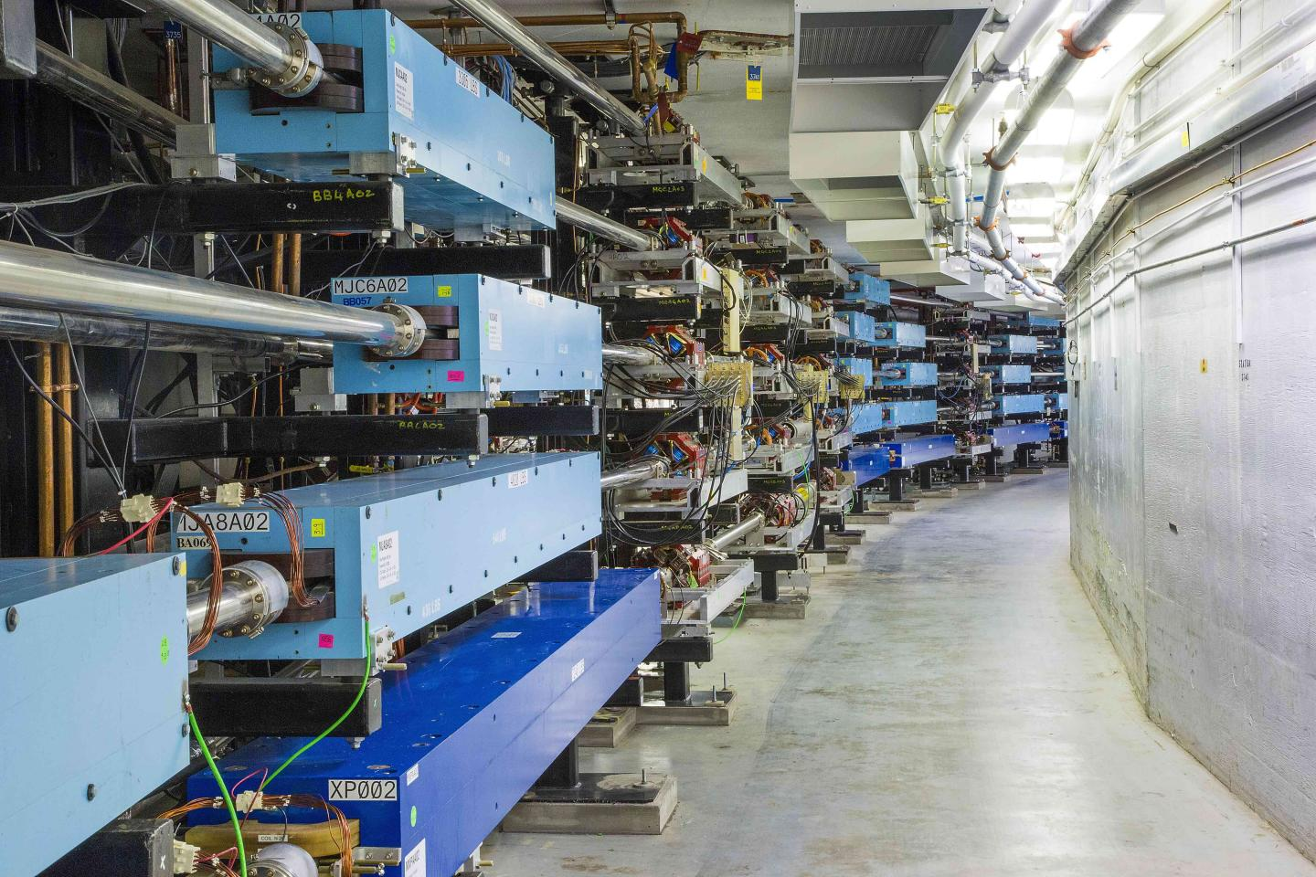
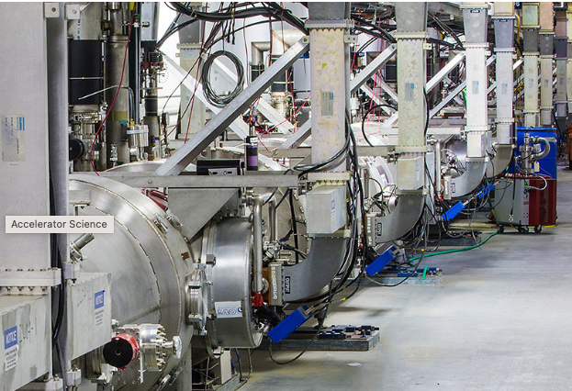
CEBAF Accelerator
Hall D
Injector
5 Magnetic Arcs
Halls A, B, C
1.1 GeV Linac

