Slide 1
Jefferson Lab Status
Cynthia Keppel
Hall A Collaboration Meeting
January 16, 2024
Jefferson Lab

Slide 2
Highlights from the Lab
12 GeV scientific era is going strong
– ~30 weeks operation in FY23 and FY24 (planned), enabled by supportive Operations budget
– High-profile results emerging from 12 GeV program – thank you all!
– Progressing on CPP with CM refurbishments, accelerator uptime improved!
Successful partnership with BNL in management, design, construction of EIC Project
MOLLER Project well underway
Exploring exciting scientific opportunities enabled by cost-effective and technically innovative CEBAF upgrade concept
Joint JLab/User committee formed, accelerator/theory/physics
Expect invites to talk, workshops,….
HPDF approved for Jefferson Lab site!
Other initial steps toward diversifying Jefferson Lab’s scientific mission – BES, HEP,…
2

Slide 3
Science at Jefferson Lab: Studying Hadronic Structure at the Luminosity Frontier
I thought you would be interested in excerpts from this presentation – commentary in green
Presented to the Comparative Review Committee
Cynthia Keppel Associate Director for Physics

Slide 4
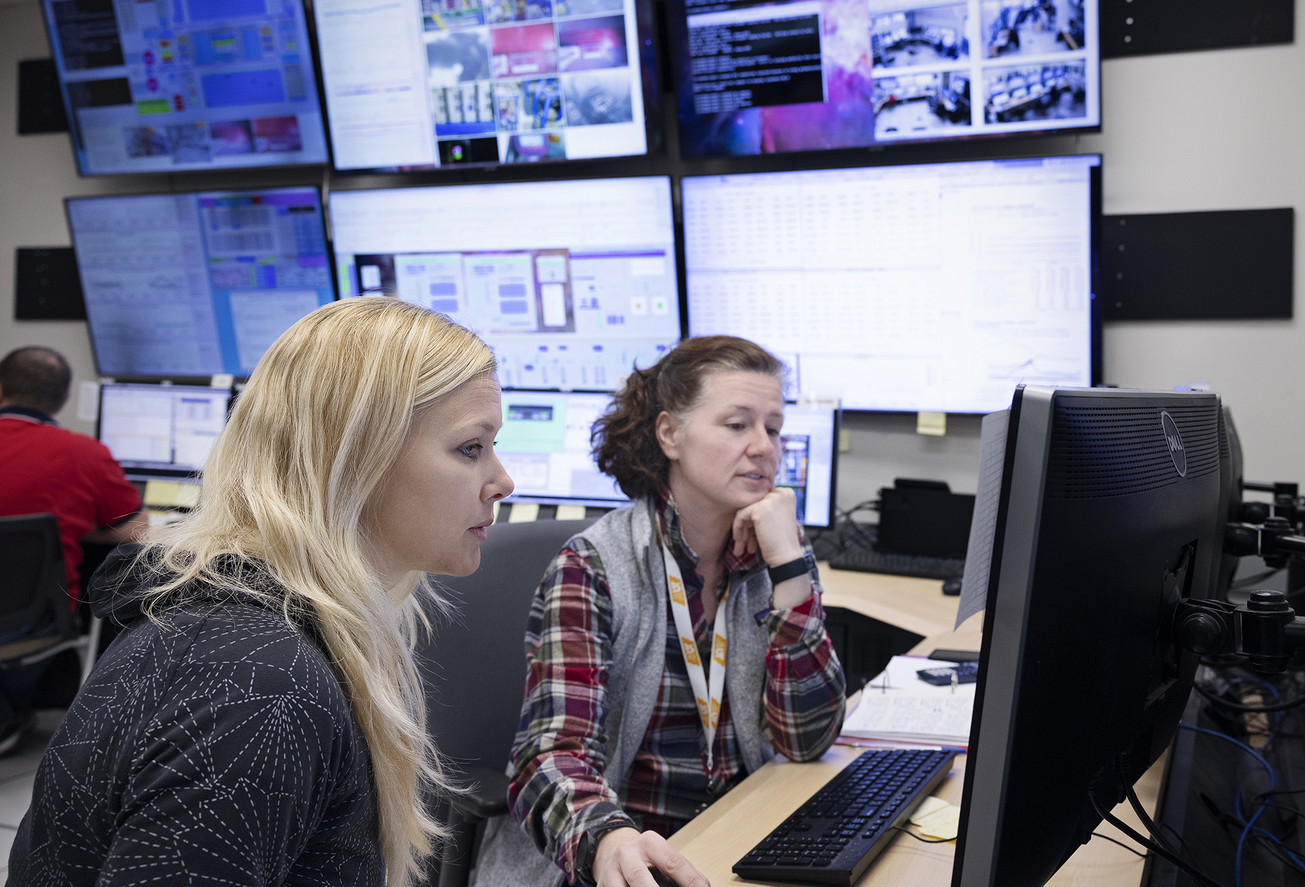
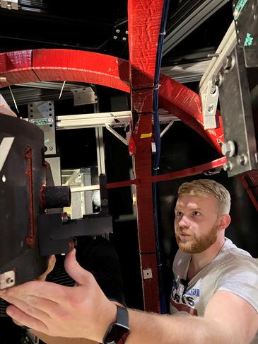
PHYSICS BEING ADDRESSED/GOALS
Laboratory Comparative Review of Research – requested a focus on individuals supported
Work in coordination with the JLab user community to:
(1) Propose, analyze, present, and publish data leveraging electron scattering experiments to address fundamental questions such as:
How are the spectrum, structure and dynamics of hadrons determined by QCD, and in turn how do these build nuclei with the properties observed in nature?
Is there physics beyond the Standard Model?
(2) Prepare next generation scientists to further unravel the complex puzzles of hadronic physics.

Slide 5
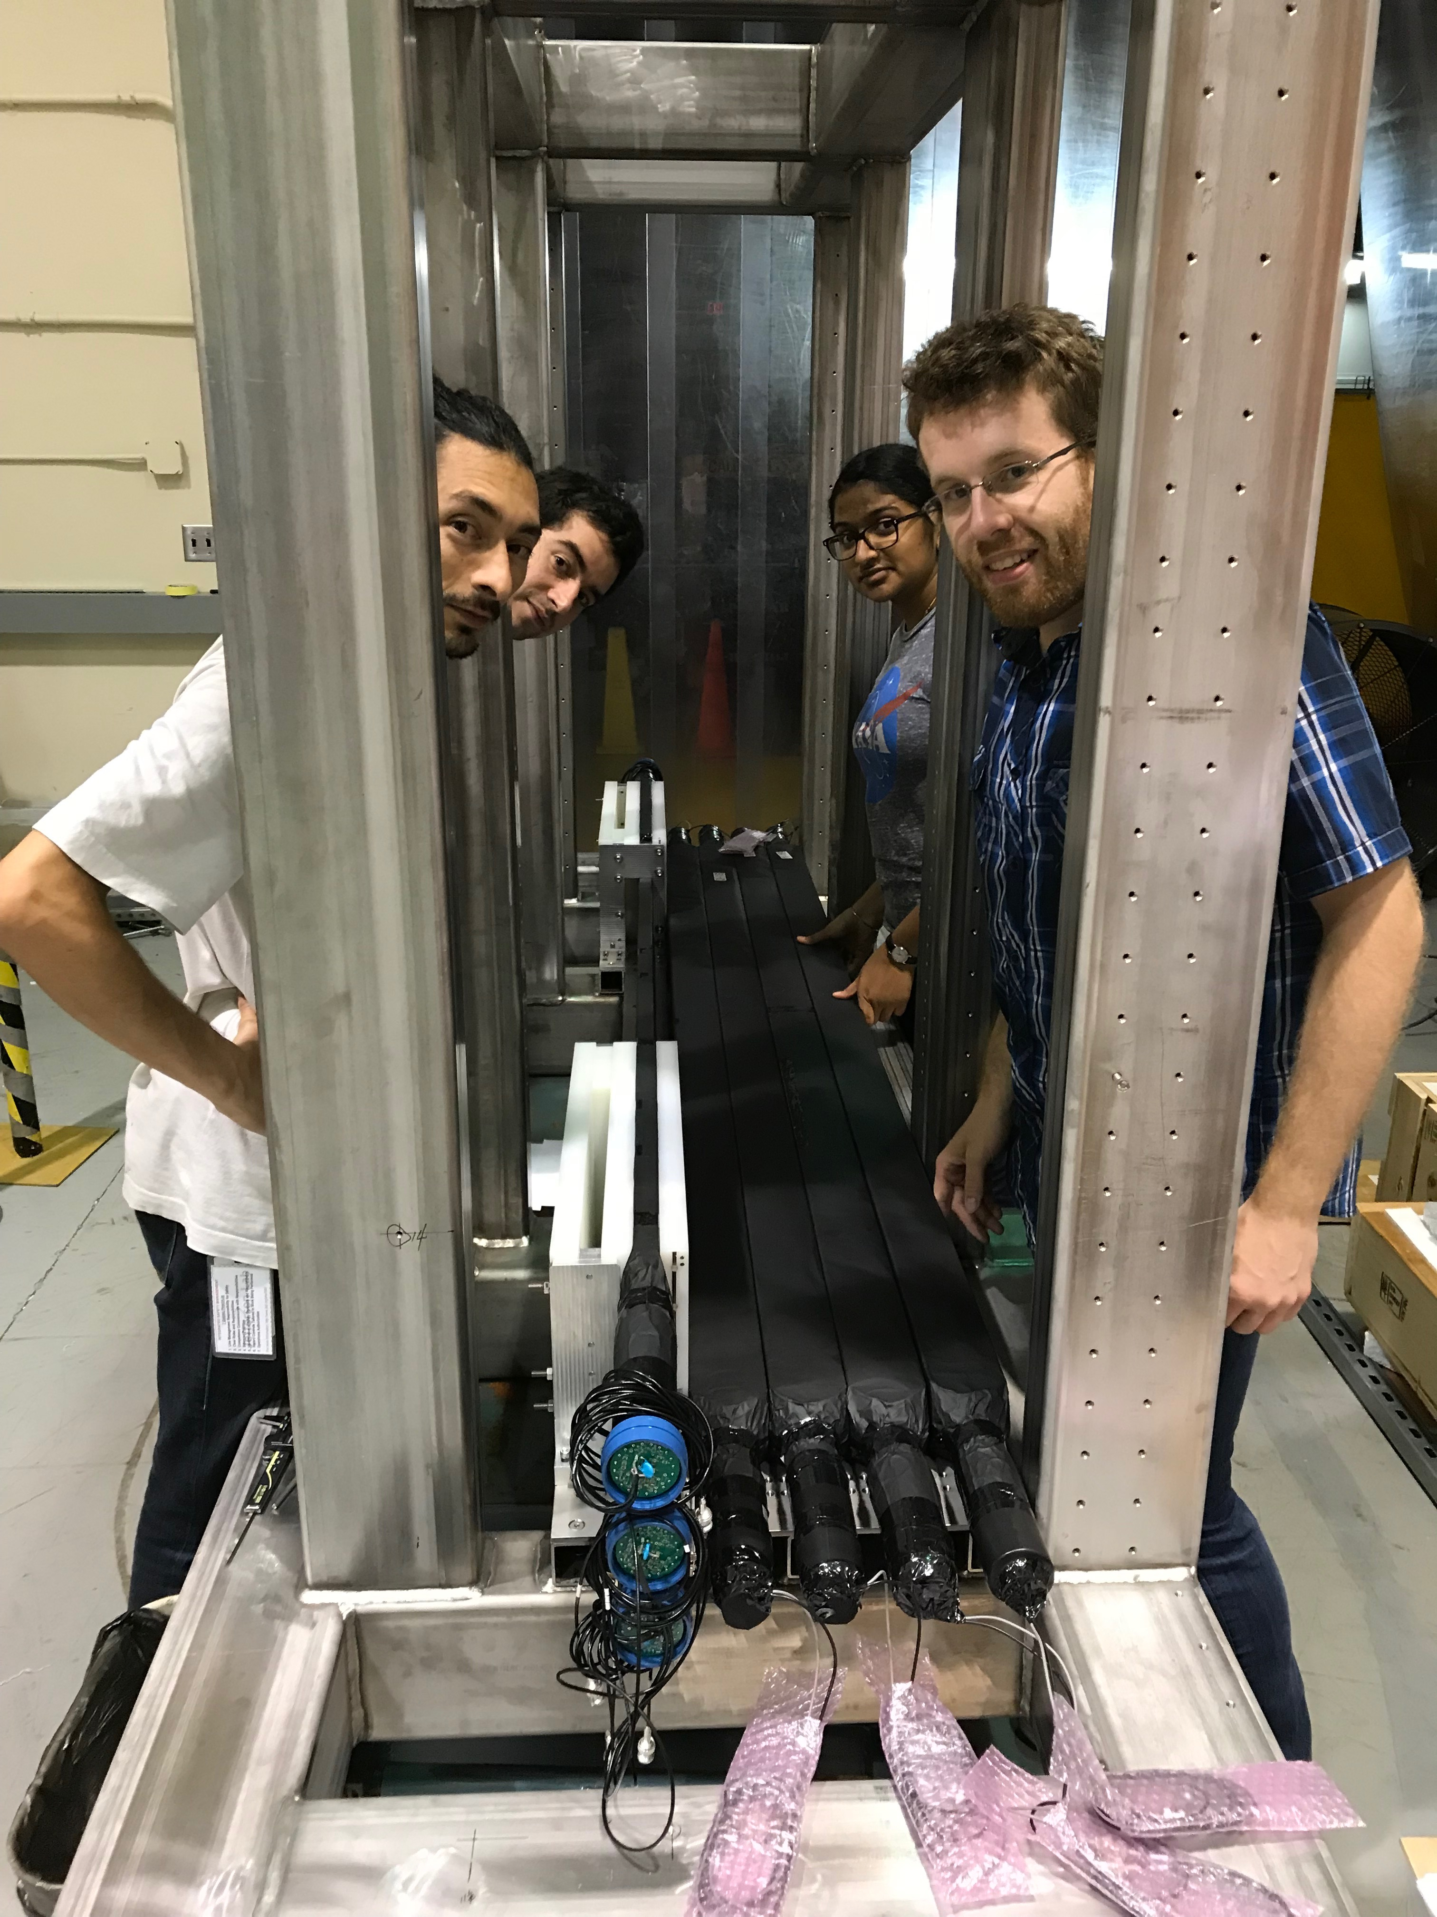
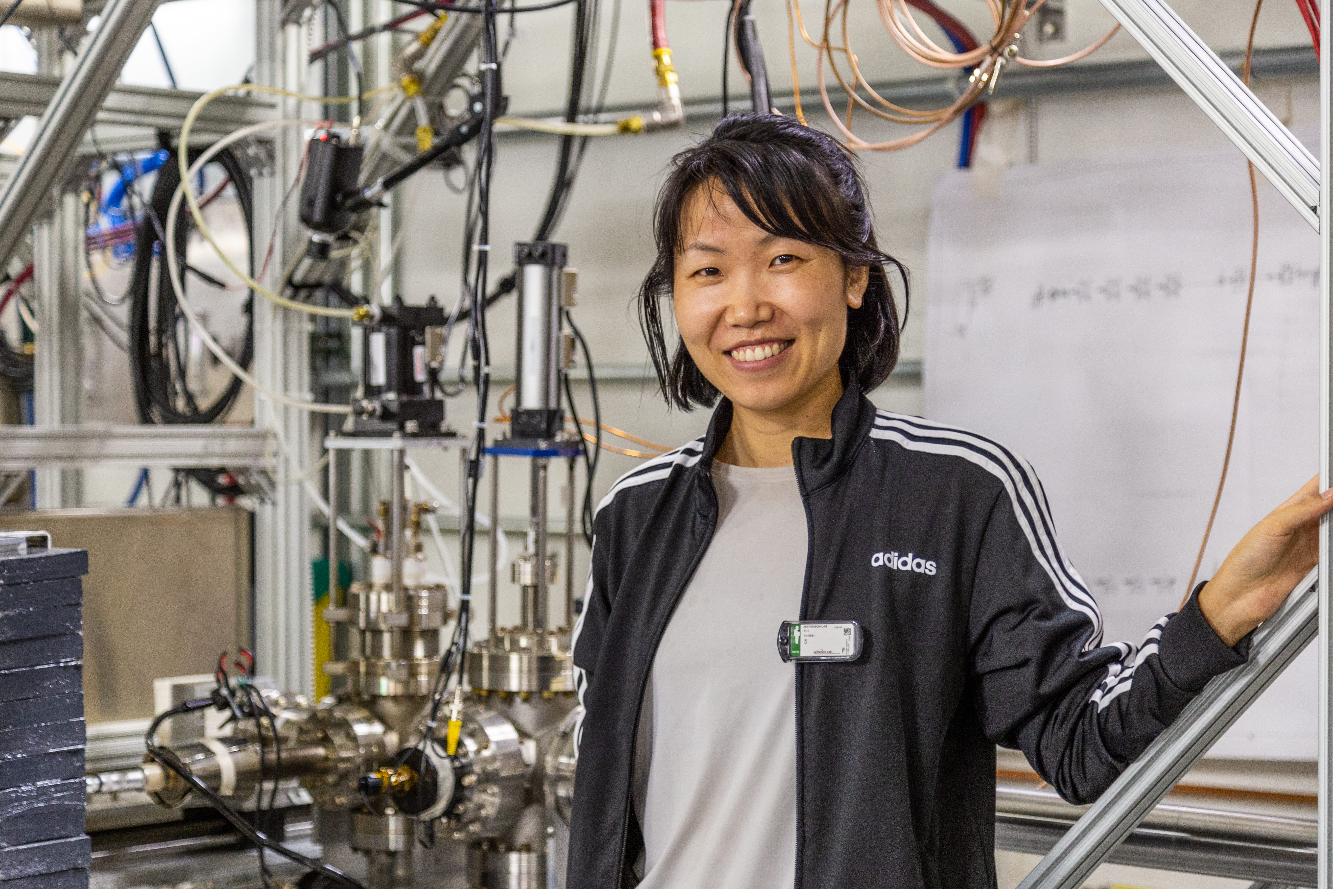
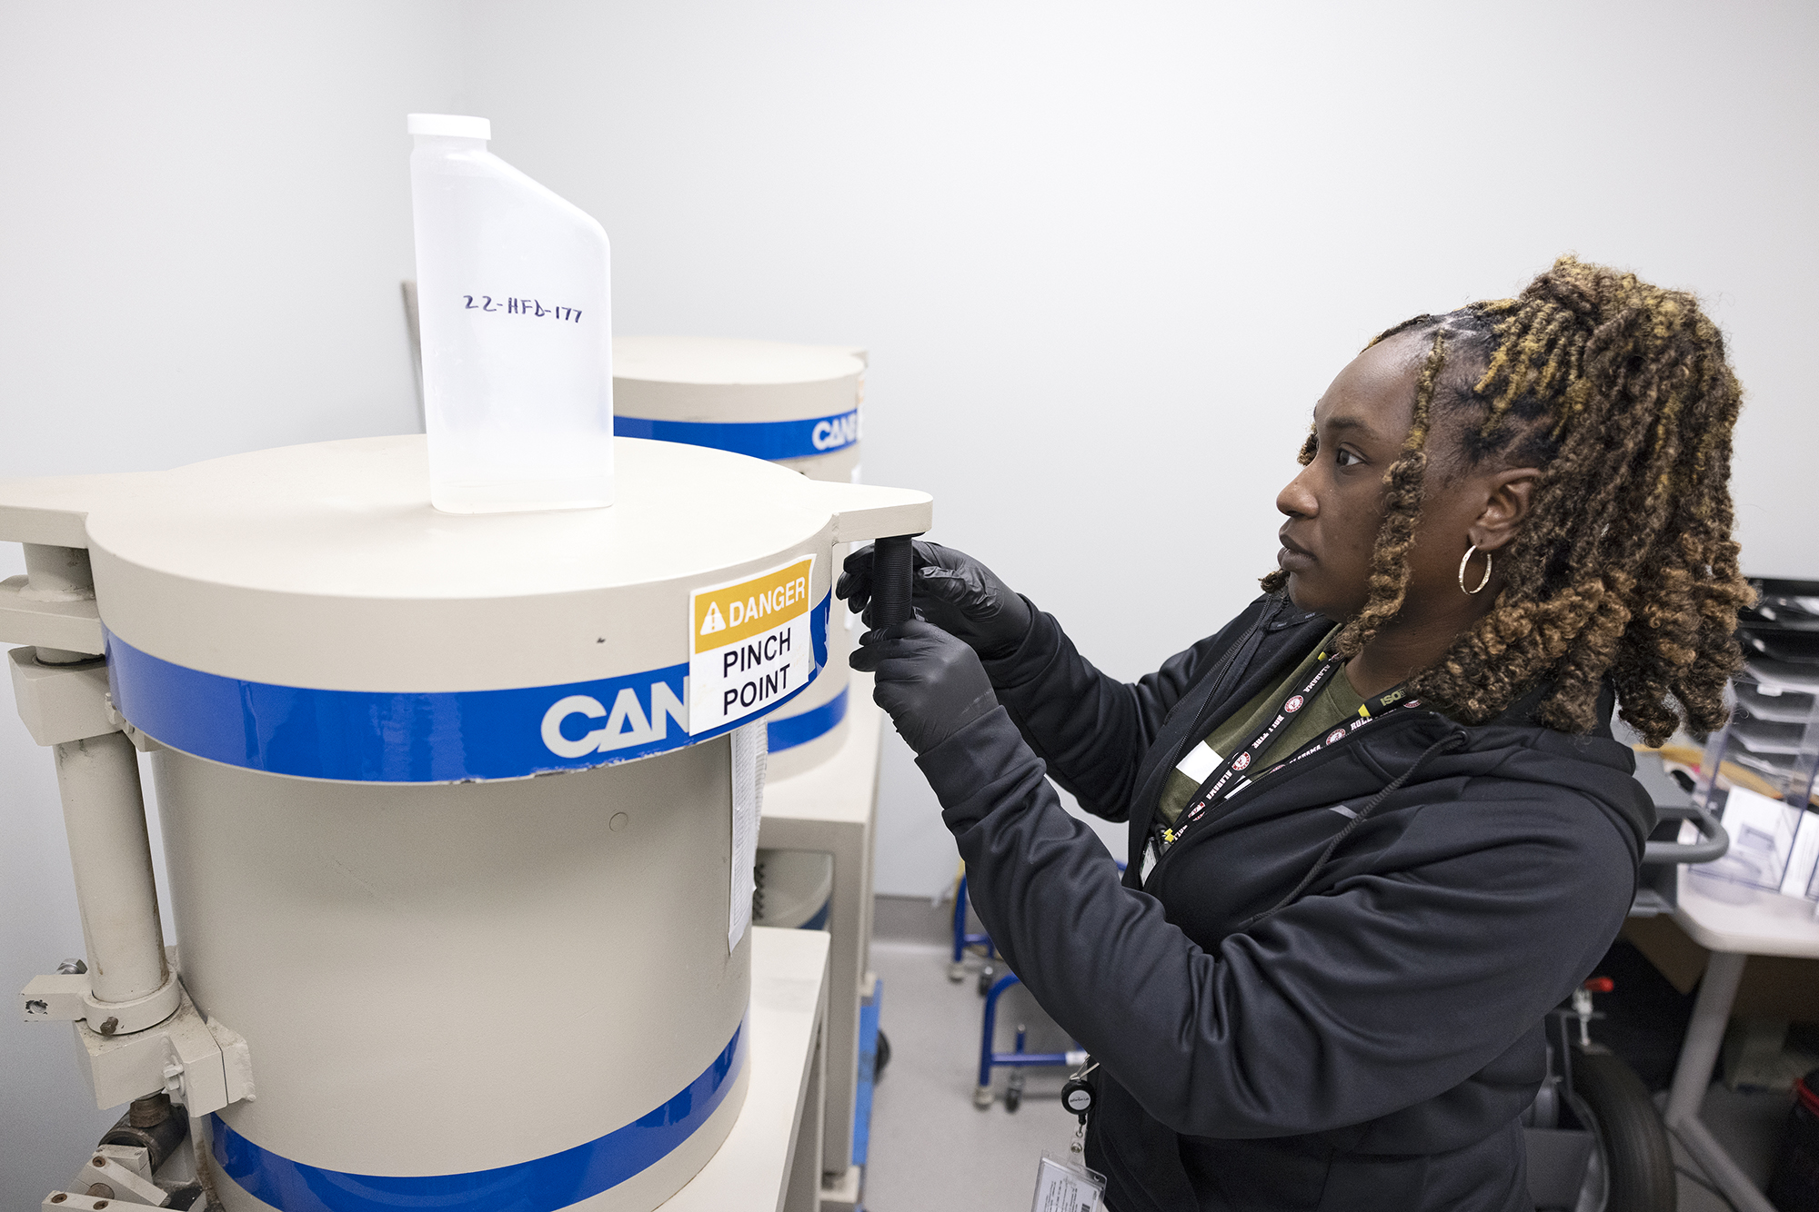
ACCOMPLISHMENTS/HIGHLIGHTS (last 5 years)
Just under 300 publications, including
48 Physical Review Letters
15 Nature articles
22 (Inter)national awards recognizing work of outstanding scientific merit, including:
2 DOE Early Career Awards
3 APS Fellows
DOE Office of Science Distinguished Scientist Fellow
107 doctoral theses awarded based on experimental research mentored, led, or both
JLab totals 743 PhDs granted to-date, 175 in progress: ~1/3 of US PhDs in Nuclear Physics

Slide 6
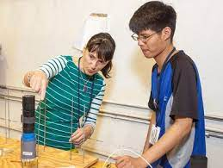
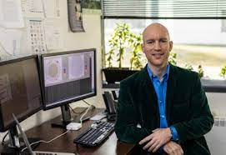
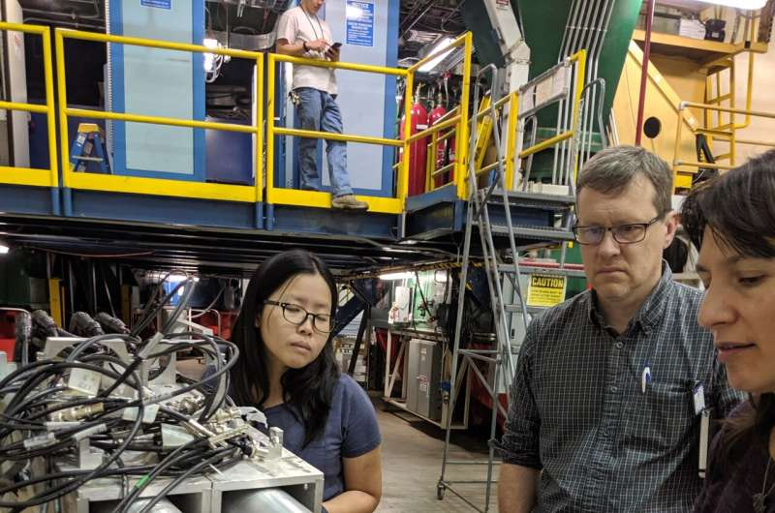
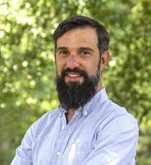
Vibrant Experimental Scientists
Over 500 invited talks at international conferences and workshops in last five years
Over 100 university colloquia and seminars
Organize, advise over 20 international conferences and workshops annually (NOT including collaboration meetings, schools, etc.)
High level scientific activities beyond the reach of regular JLab operations

Slide 7
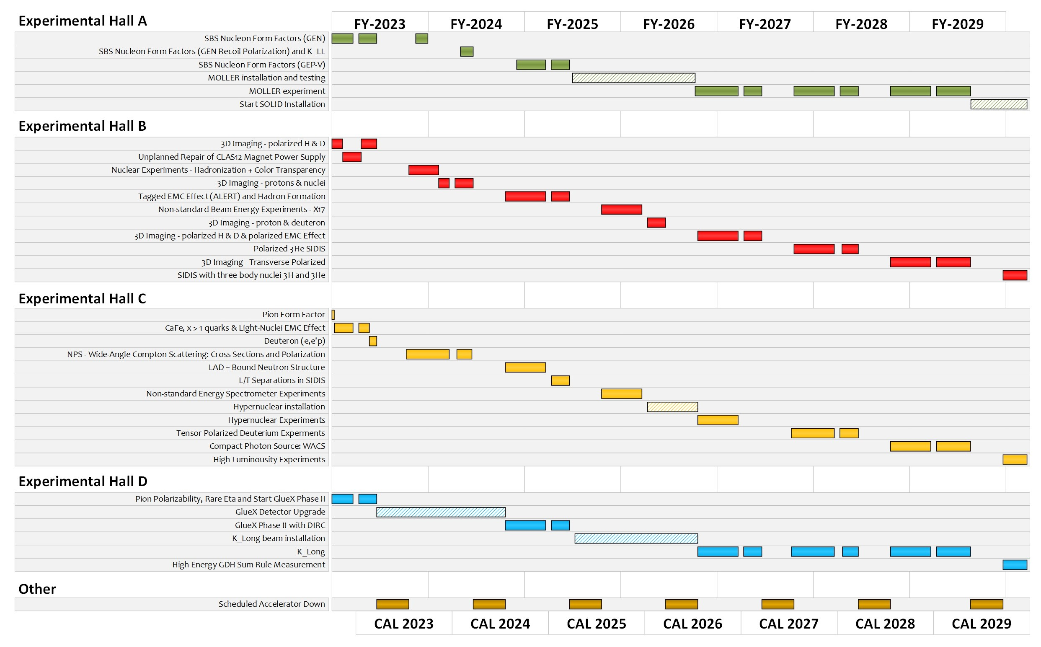
Management of Prioritized Program
The MEP scientific staff prioritize activities in accordance with the laboratory experimental schedule.
75% operations duties and 25% research support are balanced by individuals and tracked by Hall Leaders and Associate Director – formalized, annual expectations as part of performance review.
Scientific priority determined by the Program Advisory Committee
Readiness determined by Division Readiness Review process
Nuclear Physics Experimental Scheduling Committee optimizes running for scientific output

Slide 8
Note: Extended Experimental Schedule – less certain! In planning!
SoLID installation
could start ~mid-FY29
86% complete in
FY29 without SoLID, 70% complete with
SoLID (assuming optimal running operation)
…not including new proposals
May move into upgrade era
8

Slide 9
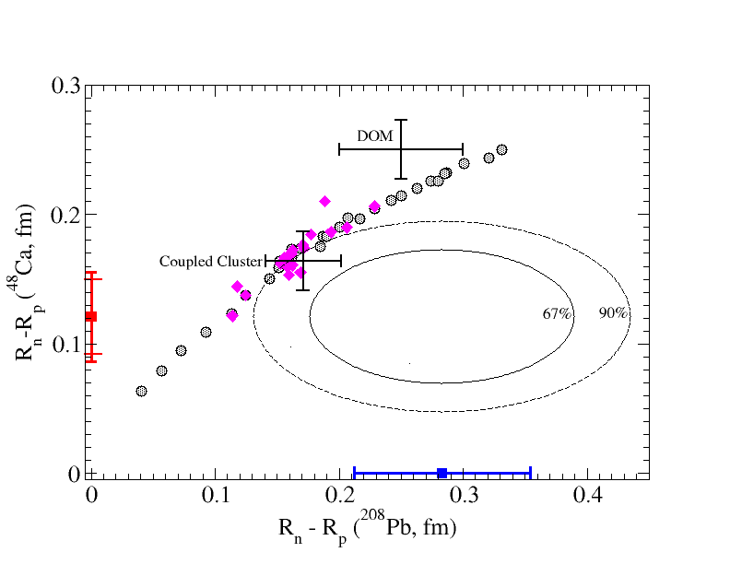
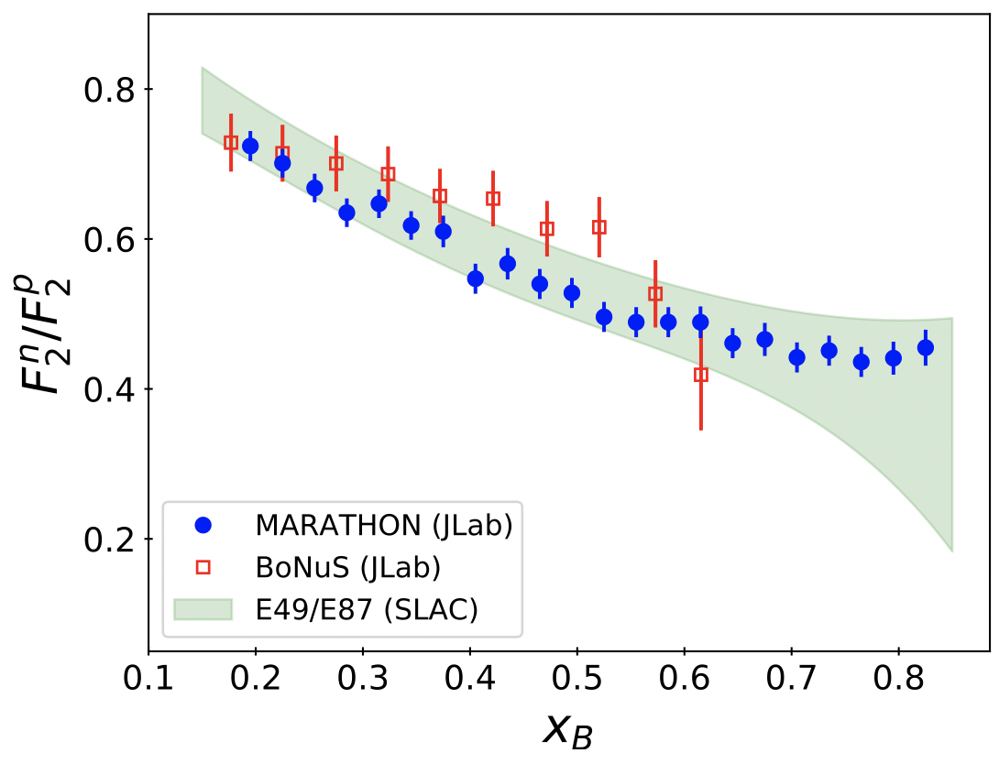
Hall A: Recent Results
Precise Determination of the Nucleon F₂^{n}/F₂^{p} at Large x_{B}
From Nuclei to Neutron Stars
Electron DIS from the mirror nuclei ³H and ³He gives unique access to the neutron/proton ratio.
Tests fundamental QCD models of nucleon d/u structure Critical input to parton distribution functions, also relevant for high-energy collider data.
Parity-violating electron scattering measurement of neutron skins in comparison to nuclear models, ab-initio calculations.
Models used in calculation of neutron star mass limits.
Published in PRL (3 letters 2021-22) – 309 (PREX), 82 (CREX) citations
Robert Michaels (PREX) and Silviu Covrig (CREX) are co-spokespersons.
15 graduate students, 12 postdocs involved.
Major presentations by staff members Ciprian Gal*, Robert Michaels, and Sanghwa Park*.
Phys. Rev. Lett. 128, 132003
Javier Gomez, Co-Spokesperson
Along with Physics Division liaison Doug Higinbotham, they provided scientific guidance for the run planning, analysis and publication, along with mentoring six doctoral theses

Slide 10
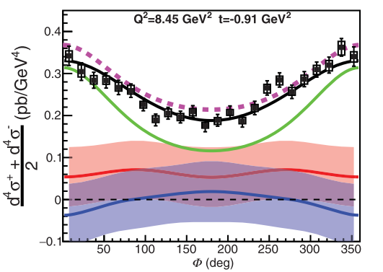
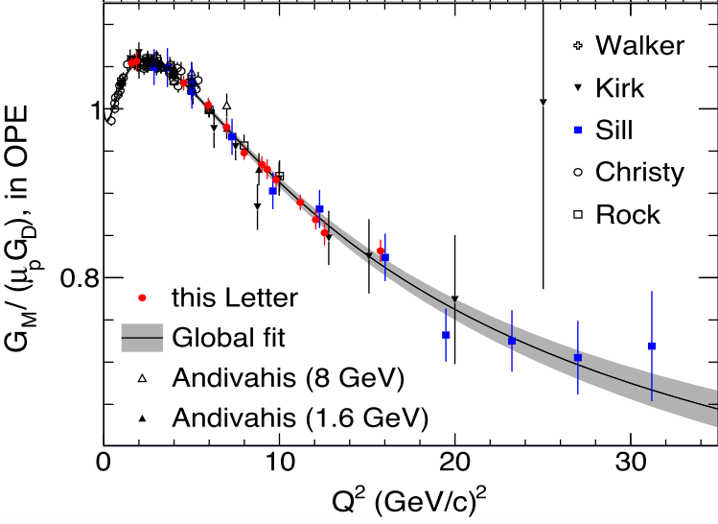
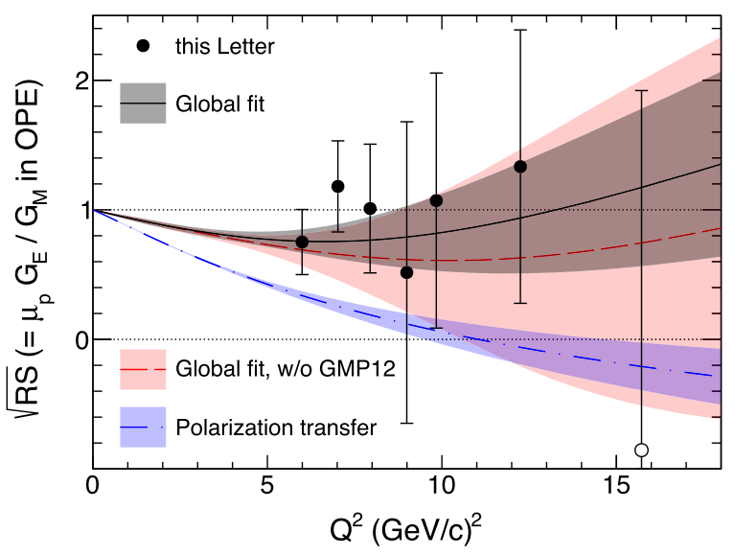
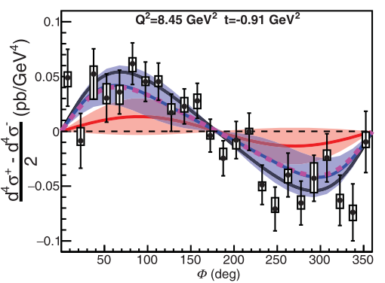
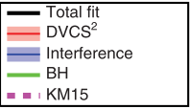
Hall A: Recent Results
First Experimental Extraction of All Four Helicity-Conserving Compton Form Factors (CFF)
Proton magnetic form factor, G_{M}, at Q² = 15.75
High luminosity needed to do longitudinal-transverse separation. Electric form factor has small contribution to cross section at large Q²
Hard two-photon exchange effects at large Q² quantified
DVCS is the prime reaction to determine CFFs which are convolutions of Generalized Parton Distributions (GPDs).
Fit cross section data over large range of x_{B}, Q² and t.
Determined some poorly known CFFs.
Phys. Rev. Lett. (2021) , Phys. Rev. Lett. (2022).
Alexandre Camsonne is a Co-Spokesperson
He worked closely with five graduate students on the data analysis and publications
Published in Phys. Rev. Lett. 128 (2022)
Bogdan Wojtsekhowski and Eric Christy are Co-Spokespeople
They mentored 5 graduate students through their thesis analyses and publication.

Slide 11
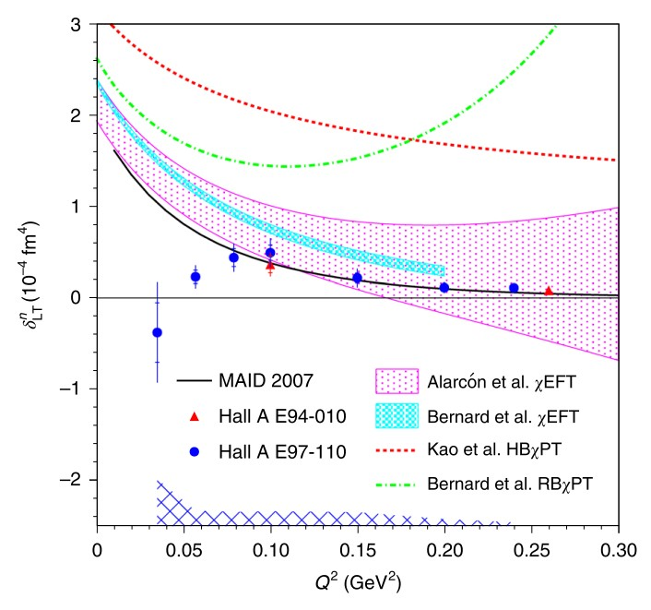
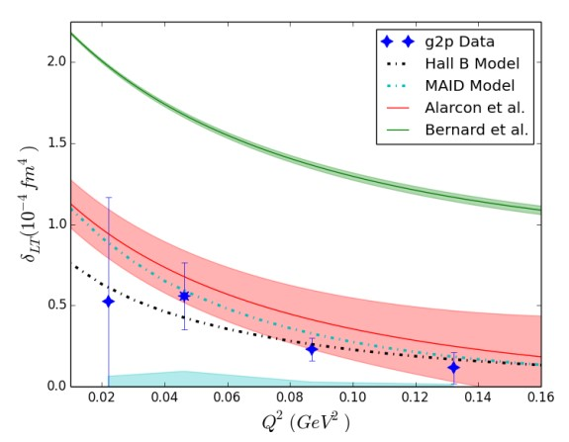
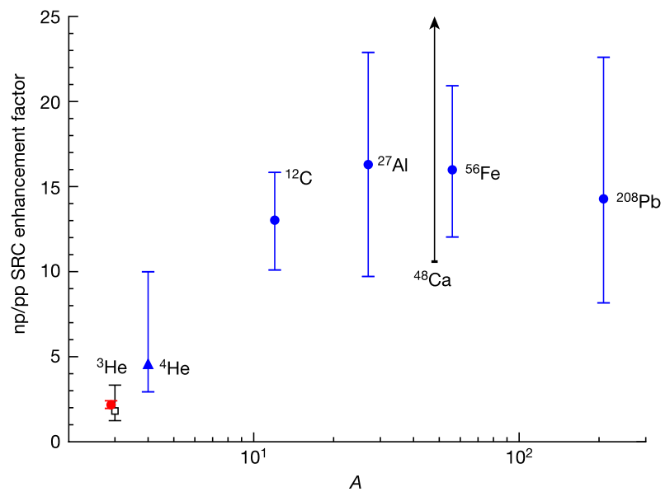
Hall A: Recent Results
Test of Chiral Effective Field Theory at Low Q²
Nuclear Studies of Light Mirror Nuclei
Spin observables to test QCD-based theories.
Different models predict different neutron and proton transverse-longitudinal spin polarizabilities, δ_{LT}
In heavy nuclei, np pairs dominant Short Range Correlations over pp pairs.
Inclusive electron scattering on 3H and 3He to determine the mass-3 SRC and find the np/pp SRC enhancement is much smaller ( red data point) compared to heavy nuclei.
Polarized Neutron
Polarized Proton
Nature (2022)
Doug Higinbotham mentored the graduate students on their analysis and publications.
He also mentored the postdoc, Florian Hauenstein, who took over a lead role in the analysis of the experiments and eventually was hired as a JLab Hall B staff scientist.
Nature Physics (2021) for neutron (E97-110 data)
Nature Physics (2022) for proton (g2p data)
Jian-ping Chen was a Co-Spokesperson on both experiments
He worked closely with 5 graduate students on E97-110, 8 graduate students on g2p and 2 postdocs on the analysis to publications.

Slide 12
Hall A: Proposed Science
Neutron Magnet Form Factor to Q² = 13.5
Neutron Electric Form Factor to Q² = 10
New Super BigBite Spectrometer with large acceptance which makes high Q² elastic measurements possible
Ratio of D(e,e’n)/D(e,e’p) yield sensitive to G_{M}^{n}
At Q²= 4.5, data at two beam energies to measure two-photon exchange in neutron.
Polarized helium target with L=60cm, P =50% at 45uA.
Beam-target asymmetries measured G_{E}^{n} to Q²= 10.
Recoil polarization by charge exchange to measure G_{E}^{n} at Q² = 4.5 . Cross check with separate technique.
Red points projected errors
Arun Tadepalli and Jian-Ping Chen are mentoring two graduate students on the analysis of the polarized helium polarimetry.
Don Jones is supervising a grad student and postdoc on the analysis of the beam polarization data.
Jiwan Poudel will analyze the data and mentor a graduate student.
Bill Henry will mentor a grad student on the recoil polarization experiment.
Bogdan Wojtsekhowski is Co-Spokesperson on all SBS form factor experiments
Holly Szumila-Vance and Arun Tadepalli are mentoring 7 graduate students on analysis.
Ole Hansen is advising grad students on SBS software for all SBS experiments

Slide 13
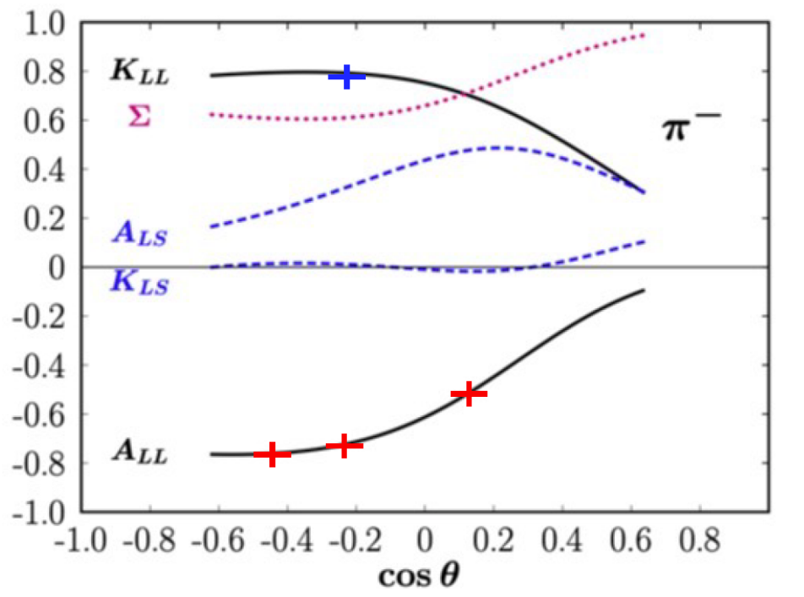
Hall A: Proposed Science
Test of twist-3 contribution
Proton Electric Form Factor to Q² = 12
π⁻ photoproduction on neutron
Two experiments: Measure the Beam-Target asymmetry, A_{LL} with 3He and another to measure the recoil polarization of proton, K_{LL}
GPD based model which agrees with cross sections predicts opposite sign between two spin observables.
Combining all 4 form factors, can determine the up and down quark form factors to Q² = 10
Red points projected errors
Bogdan Wojtsekhowski and Arun Tadepalli are Co-Spokespeople.
Bogdan Wojtsekhowski and Mark Jones are Co-Spokespersons
They along with Holly Szumila-Vance, Don Jones will mentor the graduate students on the analysis and publication preparation.

Slide 14
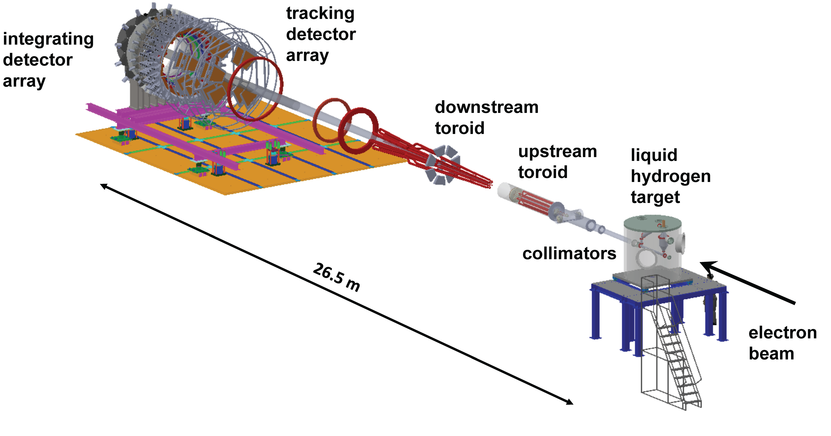
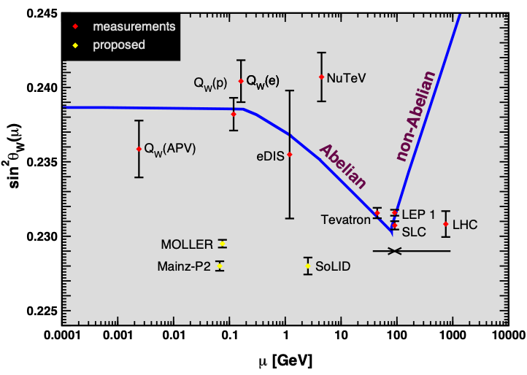
MOLLER: Proposed Science
Major new apparatus to measure fundamental electroweak couplings in electron-electron scattering, with unique new physics reach.
Precision measurement of the weak mixing angle off the Z-pole, competitive with high-energy searches for physics beyond the Standard Model.
James Fast (Project Manager), Ruben Fair (incoming Project Panager)
CAMS are Jefferson Lab staff: Vladimir Berdnikov, Silviu Covrig*, Michael Dion, Ciprian Gal*, Robert Michaels*, Carl Zorn.
About half of the A/C staff will be involved scientifically!
42 institutions, estimated to produce ~20 PhD students and to involve ~15 postdocs.

Slide 15
SoLID: Recent Results
Currently working on a laboratory redirect to support SoLID
SoLID Whitepaper
accepted for publication in J. Phys. G, 2023
Highlights of SoLID scientific programs and instrumentation
Electromagnetic Calorimeter Prototype for the SoLID Project at Jefferson Lab
TIPP, SPRINGER NATURE (2018).
J. P. Chen led the effort in organizing the writing and editing
Mentored several postdocs in working on the SoLID whitepaper and science case(s).
The SoLID science cases were widely presented in a number of conferences/workshops, including some by J. P. Chen.
J. P. Chen and Simona Malace worked closely in collaboration with university groups in scientific development and testing of detector prototype

Slide 16
Recently, DOE NP suggested that the laboratory look at ways to “redirect” some support to SoLID
Even with SoLID well supported by the Long Range Plan, NP is not encouraging about new projects at this time
”Redirect” is a possible way to reduce project ask (can’t change total project cost), continue development, and keep SoLID moving
But, it’s a tricky path…
The Office of Science has called for a review of all proposals – NSAC submitted SoLID for consideration, as well as EIC, HRS, neutrinoless double beta decay,…
Can’t look like we have extra funds sitting around – risk budget reduction
We DON’T have extra funds sitting around – so other efforts will suffer
There are “color of money” as well as project rules what we can and can’t spend on

Slide 17
Summary
Also discussed EIC science, 12 GeV positron, 22 GeV electron upgrade development
Due critically to Medium Energy support, Jefferson Lab has significantly advanced the understanding of the structure of matter – and will continue to do so into the 2030s Only a sample presented Large and growing Nuclear Physics user community (~1900 users) JLab science staff provide necessary scientific guidance, training, mentorship to students and postdocs on site Jefferson Lab will remain a critical facility for fixed target electron scattering at high luminosity – fundamental studies of the valence regime Developing the science of the EIC There are emerging scientific opportunities with positrons and a higher energy CEBAF

Slide 18
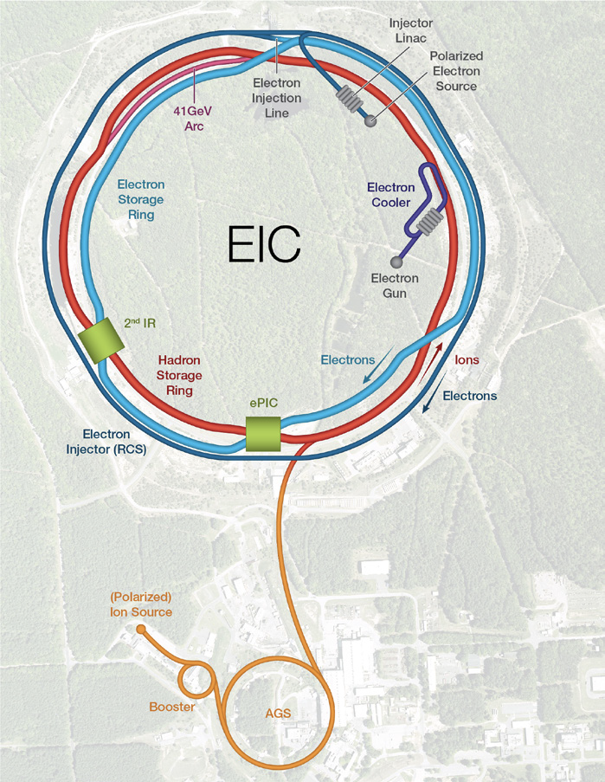
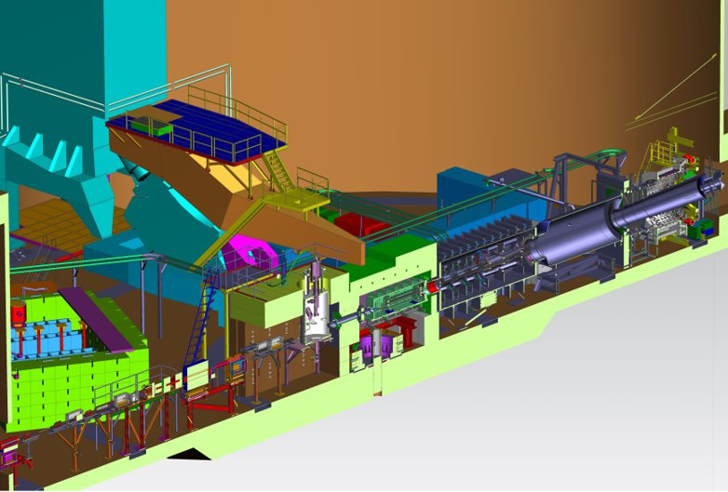
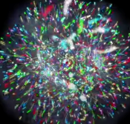
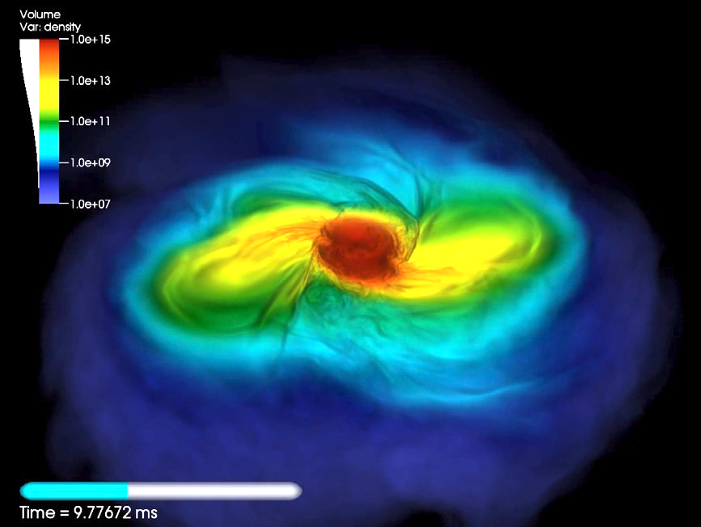
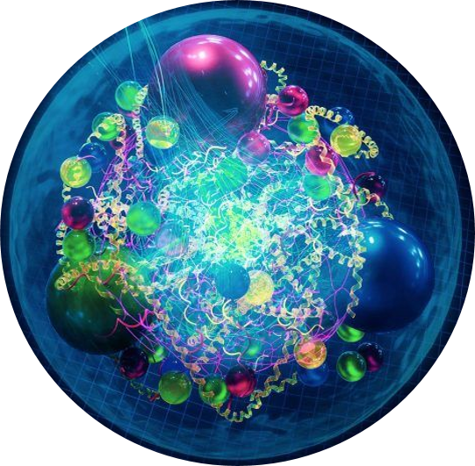
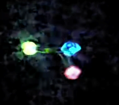
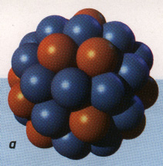
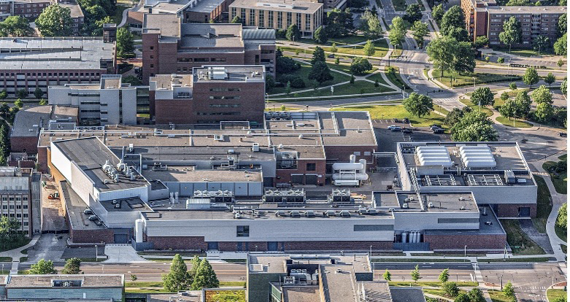
JLab in the Long Range Plan
2023 LRP Science Questions
How do quarks and gluons make up protons, neutrons, and, ultimately, atomic nuclei?
How do the rich patterns observed in the structure and reactions of nuclei emerge from the interactions between neutrons and protons?
What are the nuclear processes that drive the birth, life, and death of stars?
How do we use atomic nuclei to uncover physics beyond the Standard Model?
Gluons
Fundamental Symmetries
Neutron Star Mergers
Quarks
Nuclear Properties
It takes facilities, people, and funding to tackle these challenging questions

Slide 19
The Recommendations: I
The highest priority of the nuclear science community is to capitalize on the extraordinary opportunities for scientific discovery made possible by the substantial and sustained investments of the United States. We must draw on the talents of all in the nation to achieve this goal.
This recommendation requires:
Increasing the research budget that advances the science program through support of theoretical and experimental research across the country, thereby expanding discovery potential, technological innovation, and workforce development to the benefit of society.
Continuing effective operation of the national user facilities ATLAS, CEBAF, and FRIB, and completing the RHIC science program, pushing the frontiers of human knowledge.
Raising the compensation of graduate researchers to levels commensurate with their cost of living—without contraction of the workforce—lowering barriers and expanding opportunities in STEM for all, and so boosting national competitiveness.
Expanding policy and resources to ensure a safe and respectful environment for everyone, realizing the full potential of the US nuclear workforce.
Nuclear science is an ecosystem in which facility operations and research at laboratories and universities by senior investigators, technical staff, postdocs, and students work together to drive progress on the forefront science questions discussed above and throughout this Long Range Plan. A healthy workforce is central not only to these scientific goals but also to the nation’s security, technological innovation, and prosperity.

Slide 20
The Recommendations: II & III
Next, we reaffirm the exceptionally high priority of the following two investments in new capabilities for nuclear physics. The Electron–Ion Collider (EIC), to be built in the United States, will elucidate the origin of visible matter in the universe and significantly advance accelerator technology as the first new particle collider to be constructed since the LHC. Neutrinoless double beta decay experiments have the potential to dramatically change our understanding of the physical laws governing the universe.
As the highest priority for new experiment construction, we recommend that the United States lead an international consortium that will undertake a neutrinoless double beta decay campaign, featuring the expeditious construction of ton-scale experiments, using different isotopes and complementary techniques.
We recommend the expeditious completion of the EIC as the highest priority for facility construction.

Slide 21
The Recommendations: IV
We recommend capitalizing on the unique ways in which nuclear physics can advance discovery science and applications for society by investing in additional projects and new strategic opportunities.
Today’s investments enable tomorrow’s discoveries, with corresponding benefits to society. We underscore the importance of innovative projects and emerging technologies to extend discovery science, which plays a unique role in supporting national needs.

Slide 22
Section 1.3: Strategic Opportunities
1.3.1 Opportunities to Advance Discovery
Strategic opportunities exist to realize a range of projects that lay the foundation for the discovery science of tomorrow. These projects include the 400 MeV/u energy upgrade to FRIB (FRIB400), the Solenoidal Large Intensity Device (SoLID) at Jefferson Lab, targeted upgrades for the LHC heavy ion program, emerging technologies for measurements of neutrino mass and electric dipole moments, and other initiatives that are presented in the body of this report.
Future advances in nuclear physics rely upon a vibrant program of detector and accelerator R&D, pushing for instance the current limits on detector sensitivity and on accelerator beam transport technology. R&D for novel nuclear physics detector and accelerator ideas influence fields such as medicine and national security. Such developments must continue.
1.3.2 Cross-cutting Opportunities
Computing and sensing – Quantum, AI/ML, HPC
Multidisciplinary Centers – Collaborative centers built around experiment and theory
Nuclear Data – collaboratively funded projects

Slide 23
CEBAF in the LRP
Recent first measurements of production of a charm–anticharm bound state at Jefferson Lab suggest that the matter radius appears to be smaller than the charge radius. More detailed measurements are planned, and eventually we will be able to access gluons by detecting the production of heavier bottom–antibottom bound states at the EIC.
A model-independent extraction of the ratio in Figure 3.2 (ubar/dbar) can also be obtained in parity-violating DIS (PVDIS) with the proposed SoLID experiment at Jefferson Lab, where the strange-quark PDF in the valence regime can also be accessed.
Significant progress has been made since the last Long Range Plan: the valence quark spin contribution was measured using polarized electron beams scattering off polarized proton and nuclear targets at Jefferson Lab…Further investigation of the proton spin puzzle will be a major part of the EIC program and is discussed in greater detail in section 3.4.1.1.

Slide 24
CEBAF in the LRP
The possible addition of a polarized positron beam to CEBAF would enable precise separation of signal and background for one of the relevant processes to access GPDs. The future EIC will enable a complementary program to perform spatial imaging for quarks and gluons carrying smaller momentum fractions of the nucleon.
The origin of these large opposing spin-spin correlations is not yet understood. Proposed measurements at the Jefferson Lab SoLID detector and the future EIC will significantly improve our knowledge of these correlations.

Slide 25
CEBAF in the LRP
To investigate the other XYZP states, higher beam energy is required; the tetraquark candidate Z_{c} states would Z_{c} be copiously produced at a high-luminosity, fixed-target electron machine operating above 20 GeV.
Future high-resolution hyper-nuclear experiments at Jefferson Lab in Halls A and C and efforts to isolate hyperon–nucleon scattering in Hall B provide critical measurements to help solve this interdisciplinary problem.
Moller and SoLID also have good visibility in the fundamental symmetries section of the document
SOLID – mentioned 22 times

Slide 26
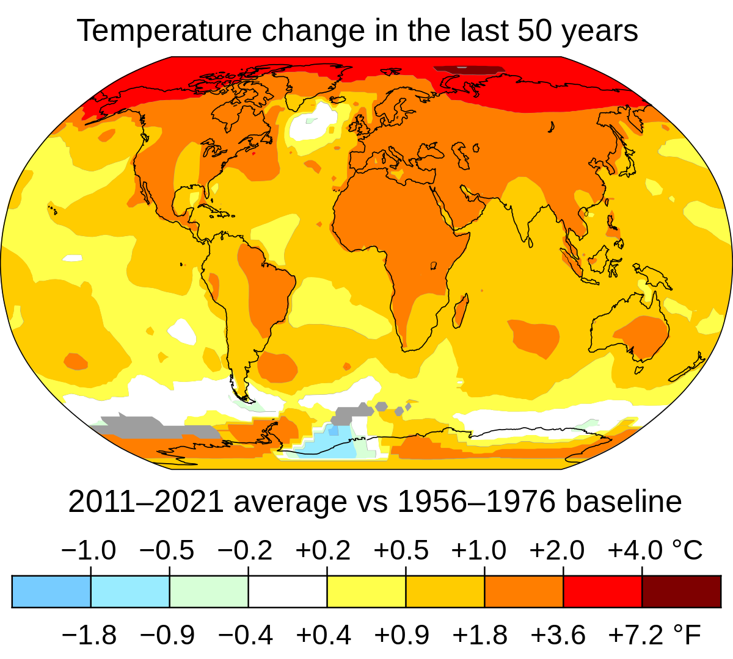
Concluding Thoughts: We Must BE Aggressive SCIENCE PROPONENTS
The laboratory did relatively well, and all priorities were met, but….
Budgets may be flat for at least 5 years (a prediction)
FY2023 Budget Agreement implies a flat at best FY24 and FY25 (that’s 3 years at the same level)
The federal budget deficit combined with high interest rates are starting to take a toll on federal spending
Two wars may realign priorities
Increased competition for budget, for instance climate change mitigation
https://data.giss.nasa.gov/gistemp/maps/index_v4.html

Slide 27
Moving Forward
Avoiding downward pressure on CEBAF operations requires us to be active:
Pursue discoveries
Ask interesting and important scientific questions; and figure out how to answer them…
Stay engaged
Go to meetings; tell others about your great science; advocate for the science; develop and propagate the “elevator speech”
Pursue the Future
Help us to hone the upgrade science case…what is the best science that can come from the upgrade? What is your favorite, and what really pushes the community forward?
We need to get to a pre-CDR (small group beginning to work on this – stay tuned!)

Slide 28
US-based MicroPattern Gaseous Detector Center
- a Proposed National User Facility
Need for US-MPGD center for NP, HEP, Applications,…
Large number of US institutions engaged in MPGD activities
limited inter-disciplinary interaction between the institutions
The community needs a dedicated US-based MPGD User Facility with a:
Production workshop like to the SiDet Facility for at FNAL
Detector R&D Lab like the RD51 / GDD Lab at CERN
US-MPGD center will be greatly beneficial for EIC detector development
Jefferson Lab is an excellent place for an MPGD center in the US
At the forefront in the deployment of large MPGDs in NP experiments
In-house MPGD expertise and beam test capabilities for MPGD tests
MPGD Center @ JLab: RD51 / GDD-like R&D Lab
GDD-RD51 Lab @ CERN
MPGD Production Workshop
Similar to SiDet Facility at FNAL, or MPT workshop at CERN
Fabrication of large MPGDs (µRWELLs, GEMs, flexible PCBs…)
MPGDs production for detector R&D and prototyping for the community
MPGD Detector R&D Lab
Similar to the RD51 / GDD Lab at CERN ➔ in-house and external users' space with local technical and scientific support team
Equipment and Instrumentation for detector assembly, testing, irradiation, high-rate and aging studies..
Exchange of ideas between MPGD detector development groups
MPGD Center @ JLab: MPGD Production Facility
Large area resistive MPGD
Magnetron sputtering machine

Slide 29
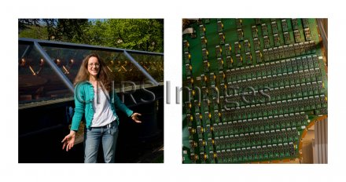
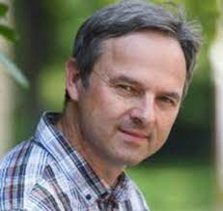
Program Advisory Committee - PAC52 will be held during the week of July 8, 2024 - The deadline for submission of proposals will be sent out in early 2024 Committee Member Changes - Barbara Erasmus and Matthias Grosse Perdekamp to rotate off - New Incoming Chair (one year overlap, Markus Diehl still Chair) Pasquale DiNezza (INFN) - Also Krešimir Kumerički (University of Zagreb), Cynthia Hadjidakis (Université Paris-Saclay/CNRS)

Slide 30
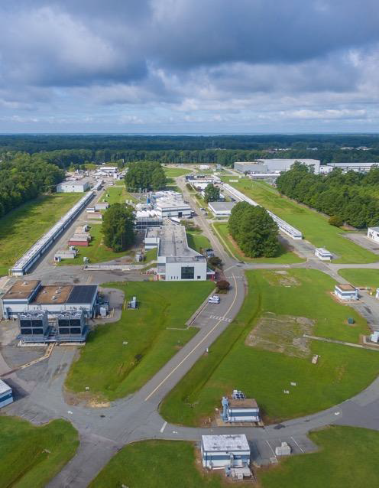
Summary
The Lab is in a strong position moving forward
Supportive funding for CEBAF Operations
Our priorities are clear:
Ensuring that the 12 GeV program is successful in all facets
Moving EIC forward
HPDF approved
Laying the groundwork for an exciting role for CEBAF in the EIC era – positrons and 22 GeV
Encourage you to get engaged, perhaps a Hall A working group and certainly request a talk or two at the Summer meeting!
30

