Slide 1

Exclusive η Electroproduction Beam Spin Asymmetry Measurements using CLAS12 at Jefferson Lab
IZZY ILLARI
PWA13/ATHOS8
29 May 2024

Slide 2
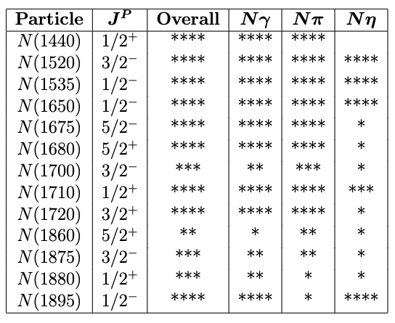
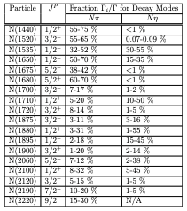
Unique Opportunity of Nη Final States
Key Idea: Nη final states provide a cleaner probe of nucleon resonances compared to Nπ final states
η is isospin singlet (I = 0) → “isospin filter” (Nη final states access only I = 1/2 nucleon resonances)
Reduces # of contributing resonances → cleaner extraction of resonance properties
Complements Nπ studies in a coupled-channel approach
Notes:
First, let's start the talk by discussing why we use eta mesons in our research. Eta is a convenient tool because it acts as an isospin filter. This means that eta only accesses specific nucleon resonances with isospin 1/2, which are the N* resonances. However, when we study the eta decay channel, it knocks out all the Delta* resonances, leaving only the N* resonances in the spectrum. This is advantageous because it helps to reduce the complexity of the spectrum and enhance the extraction of resonance properties.
Most of the world database focuses on pion decays, which have access to both N* and Delta* resonances. While this is useful for studying the complete resonance spectrum, it can sometimes make it difficult to disentangle specific resonances due to their complicated overlapping behavior.
Eta, on the other hand, not only eliminates the Delta* resonances but also doesn't decay strongly to all nucleon resonances. As shown in this table, the channels with large decay rates for eta are the N(1535), N(1650), N(1710), and N(1895) resonances. This allows us to focus on these specific resonances, as eta preferentially decays to them.
By using eta as a probe, we can effectively reduce the complexity of the resonance spectrum and simplify the process of extracting the properties of individual resonances. However, it's important to note that studying eta decays alone is not sufficient for a comprehensive understanding of nucleon resonances. To achieve a complete picture, we need to complement eta studies with pion studies in a coupled-channel approach.
By combining information from multiple decay channels, we can disentangle the contributions of individual resonances and extract reliable information about their properties. This is why our research on eta electroproduction plays a crucial role in the broader context of nucleon resonance studies.
In summary, the unique properties of eta as an isospin filter make it a valuable tool for studying nucleon resonances. It reduces complexity, enhances resonance extraction, and complements pion studies in a coupled-channel approach. This is the main reason why we have chosen to focus on eta electroproduction in our research.
########################################
Using CLAS12 data we can investigate the electroproduction of the η mesons, which will provide a useful tool to study nucleon resonances N*. Due to the fact that η has isospin I = 0 this provides an “isospin filter” that allows us to access nucleon resonances where I = ½. This work is in contrast to the bulk of the current world database, which focuses on πN final states.
Outside of the S11(1535) I’d like to highlight N(1710), which is listed in the PDG as having a branching ratio of
“A prominent peak in the total cross section is seen for η production at W = 1.535 GeV in both γN and πN experiments…This state has a branching ratio to ηN of 45-60% compared to at most a few percent [9, 10] for other states. This is a very interesting and unusual pattern.” (Denizli, 2007) Threshold for eta at ~1.49(1.4856) GeV and threshold for eta’ at ~1.75 GeV
There is only one resonance N(1895) that has possibly a large Eta' coupling. The science could then be to extract the transition form factor for that resonance by isolating this state in N-eta' decay.
Re N(1895) not strongly coupled to the pion, only 1 star
N*: Nucleon excited states with isospin I = 1/2
Δ*: Delta excited states with isospin I = 3/2

Slide 3
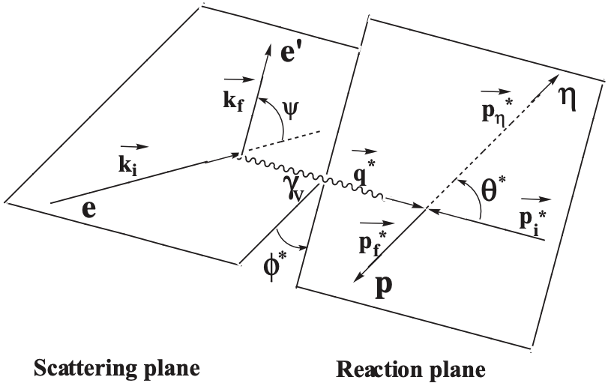
η Electroproduction Kinematics
Key Idea: The η electroproduction reaction is studied in the center-of-mass frame, with key kinematic variables W, Q², cos(θ*), and φ*.
Center-of-mass frame: resonance is at rest
ep → e'p'η
Notes:
In this slide, we introduce the key kinematic variables and the reaction framework for studying eta electroproduction. It's crucial to establish a common language and understanding of these variables as they form the basis for our analysis.
The reaction we are studying is ep → e'p'η, where an electron (e) interacts with a proton (p) target, resulting in a scattered electron (e'), a recoil proton (p'), and an eta meson (η). To simplify the analysis, we work in the center-of-mass frame, where the resonance is at rest.
The diagram on the slide illustrates the geometry of the reaction. The electron beam and the scattered electron define the scattering plane, while the virtual photon, the target proton, the recoil proton, and the produced eta meson define the reaction plane.
Now, let's discuss the key kinematic variables:
W is the center-of-mass energy, which is the invariant mass of the virtual photon and the target proton system. It is calculated as the magnitude of the sum of the four-momenta of the virtual photon and the target proton.
Q^2, often referred to as the photon virtuality, represents the negative square of the four-momentum transfer from the electron to the proton. It quantifies the energy and momentum carried by the virtual photon.
cos(θ*) is the cosine of the polar angle of the eta meson in the center-of-mass frame, defined relative to the virtual photon momentum direction.
φ* is the azimuthal angle of the eta meson in the center-of-mass frame, defined relative to the electron scattering plane.
These four variables—W, Q^2, cos(θ*), and φ*—fully describe the kinematics of the eta electroproduction reaction. They allow us to probe different aspects of the reaction and extract information about the underlying physics, such as the structure of the proton and the properties of nucleon resonances.
########################################
Q2 photon virtuality
W sqrt(s) center of mass energy
The reaction is depicted in the center of mass system, where the resonance is at rest. The meson decay polar angle (theta) is defined relative to the virtual photon momentum, and the azimuthal angle (phi) is defined relative to the the electron scattering plane.

Slide 4
Objective: Measuring Beam Spin Asymmetry (A_{LU}) in η Electroproduction
Key Idea: First ever measurement of the beam spin asymmetry in exclusive η electroproduction in a previously unexplored kinematic region (1.6 ≤ W ≤ 2.2 GeV).
Longitudinally polarized electron beam on unpolarized stationary proton target
Complements existing cross section and polarization observable measurements
Polarized cross sections:
Beam Spin Asymmetry A_{LU}:
Sin φ* Moment:
A_{LU}
N± = η signal yield for (±1) helicity
P_{b} = beam polarization (0.8517)
Notes:
Now that we've established the importance of using eta mesons in our research, let's dive into the specific objective of our study. Our goal is to measure the beam spin asymmetry, denoted as ALU, in exclusive eta electroproduction in a previously unexplored kinematic region.
This is the first-ever measurement of ALU in eta electroproduction for the W range between 1.6 and 2.2 GeV. By focusing on this specific kinematic region, we aim to complement existing cross section and polarization observable measurements, providing new insights into nucleon resonances in this energy range.
To achieve this, we utilize a longitudinally polarized electron beam incident on an unpolarized stationary proton target. The beam spin asymmetry, ALU, is defined as the ratio of the difference and sum of the eta signal yields for positive and negative beam helicities, normalized by the beam polarization.
As shown in the equation, ALU is proportional to the sine moment of the differential cross section, which is expressed as the difference between the eta signal yields for positive and negative helicities, divided by their sum and the beam polarization factor.
In our experiment, the beam polarization, Pb, is 0.8517, which is taken into account when calculating the beam spin asymmetry.
By measuring ALU in this unexplored kinematic region, we aim to shed light on the contributions of specific nucleon resonances, such as the N(1710) and N(1895), which have significant branching ratios to the eta decay channel.
These measurements will provide valuable data to constrain theoretical models and improve our understanding of the nucleon resonance spectrum and their properties. The results of this study will contribute to the ongoing efforts in the field of hadron spectroscopy and the exploration of the strong interaction dynamics in the non-perturbative regime.

Slide 5
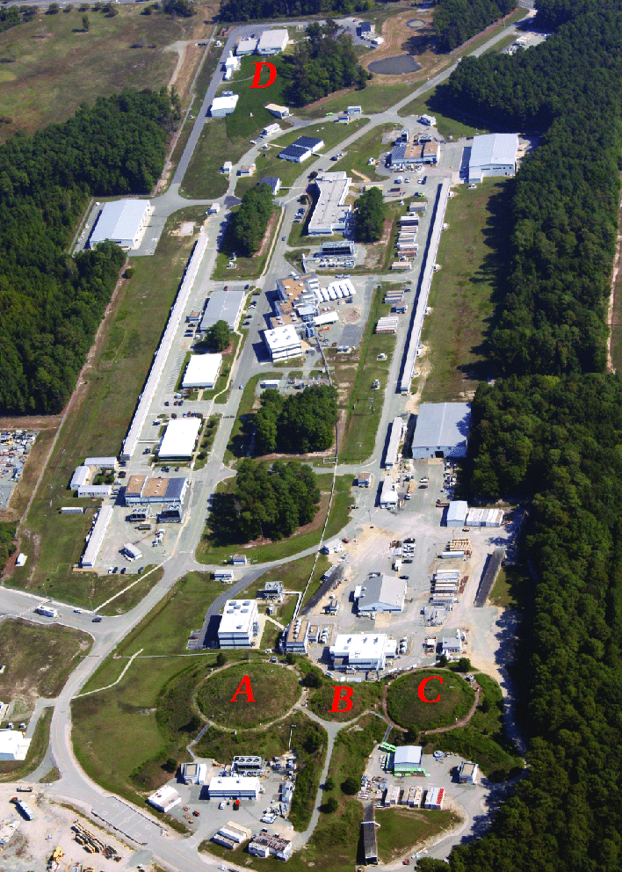
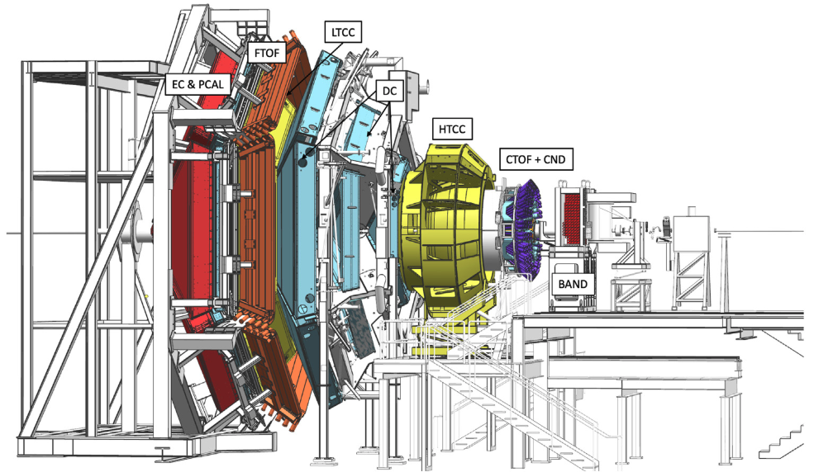
CEBAF and CLAS12 at Jefferson Lab
Key Idea: The 12 GeV upgrade of the Continuous Electron Beam Accelerator Facility (CEBAF) and the CLAS12 spectrometer enable high-precision studies of nucleon structure and resonances.
CEBAF delivers high-energy, longitudinally polarized electron beams
  Up to 11 GeV to Hall B after 5 passes
  Beam polarization is measured using the Møller polarimeter in Hall B
Notes:
The Continuous Electron Beam Accelerator Facility, or CEBAF, at Jefferson Lab delivers high-energy, longitudinally polarized electron beams to four experimental halls. After undergoing a 12 GeV upgrade, CEBAF can now deliver beam energies up to 11 GeV to Hall B after 5 passes, which houses the CLAS12 spectrometer.
CLAS12, a large acceptance spectrometer, was also upgraded to accommodate the higher beam energies. The CLAS12 physics program focuses on studying the nucleon resonance spectrum and structure through electroproduction of various final states.
The CLAS12 detector consists of two main parts: the Forward Detector, or FD, and the Central Detector, or CD. The FD covers polar angles from 5 to 35 degrees and is designed to detect scattered electrons and forward-going particles. The CD, on the other hand, covers polar angles from 35 to 125 degrees.
In my research, I focus on final states where the proton is detected in the FD. This allows for a cleaner separation of the proton from other particles and reduces background contributions.
To measure the beam polarization delivered to CLAS12, we use a Møller polarimeter located in Hall B. The Møller polarimeter operates by scattering polarized electrons from the beam off a polarized iron-cobalt alloy target. The polarization is determined from the asymmetry in the scattering cross-section for opposite electron helicities.
During the time period of my analysis, the beam polarization was measured to be approximately 85% using the Møller polarimeter. This high degree of polarization is crucial for studying spin-dependent observables, such as the beam spin asymmetry.
The combination of the upgraded CEBAF accelerator and the CLAS12 spectrometer provides a powerful tool for studying nucleon resonances and their properties with unprecedented precision.
#############################################
CEBAF delivers high-energy, polarized electron beams up to 12 GeV
CLAS12 physics program focuses on studying nucleon resonance spectrum and structure through electroproduction of various final states
Differences between Forward Detector (FD) and Central Detector (CD)
CEBAF Large Acceptance Spectrometer 12 GeV upgrade
Completed September 2017 https://www.jlab.org/news/releases/jefferson-lab-accelerator-delivers-its-first-12-gev-electrons
The CLAS12 detector systems were commissioned in the period from December 2017 through February 2018, using beam energies of 2.2, 6.4, and 10.6 GeV.
5 loops to reach a maximum energy of 11 GeV
The CLAS12 physics program is involved in the studies of the nucleon resonance spectrum and structure in electroproduction of a large variety of final states.
proton in FD vs CD
different backgrounds in MM2 distribution, different subsystems and resolutions
point out HTCC
The Møller polarimeter in Hall B is crucial for measuring the longitudinal beam polarization. It operates by scattering polarized electrons from the beam off a polarized permendur (iron-cobalt alloy) foil target. The polarization is determined from the asymmetry in the scattering cross-section for opposite electron helicities. The Møller polarimeter achieves an absolute precision of about 2.5% [cite BALTZELL2020163421].

Slide 6
Analysis Roadmap
Key Idea: A systematic approach to extract the beam spin asymmetry (BSA or A_{LU}) and the sin φ* moment of the asymmetry (A_{LU}^{sinφ*}) from the data.
Step 1:
Event Selection:
Skim data for relevant final states and apply fiducial and analysis cuts
Step 2
Kinematic Binning:
Determine the physics of the final state
Step 3:
Signal Extraction:
Fit data to extract the η signal yield
Step 4:
Step 5:
Uncertainties:
Polarization Observables:
Beam Spin Asymmetry (A_{LU}) and sine moment (A_{LU}^{sinφ*})
Step 6:
Present Results
Statistical and Systematic

Slide 7
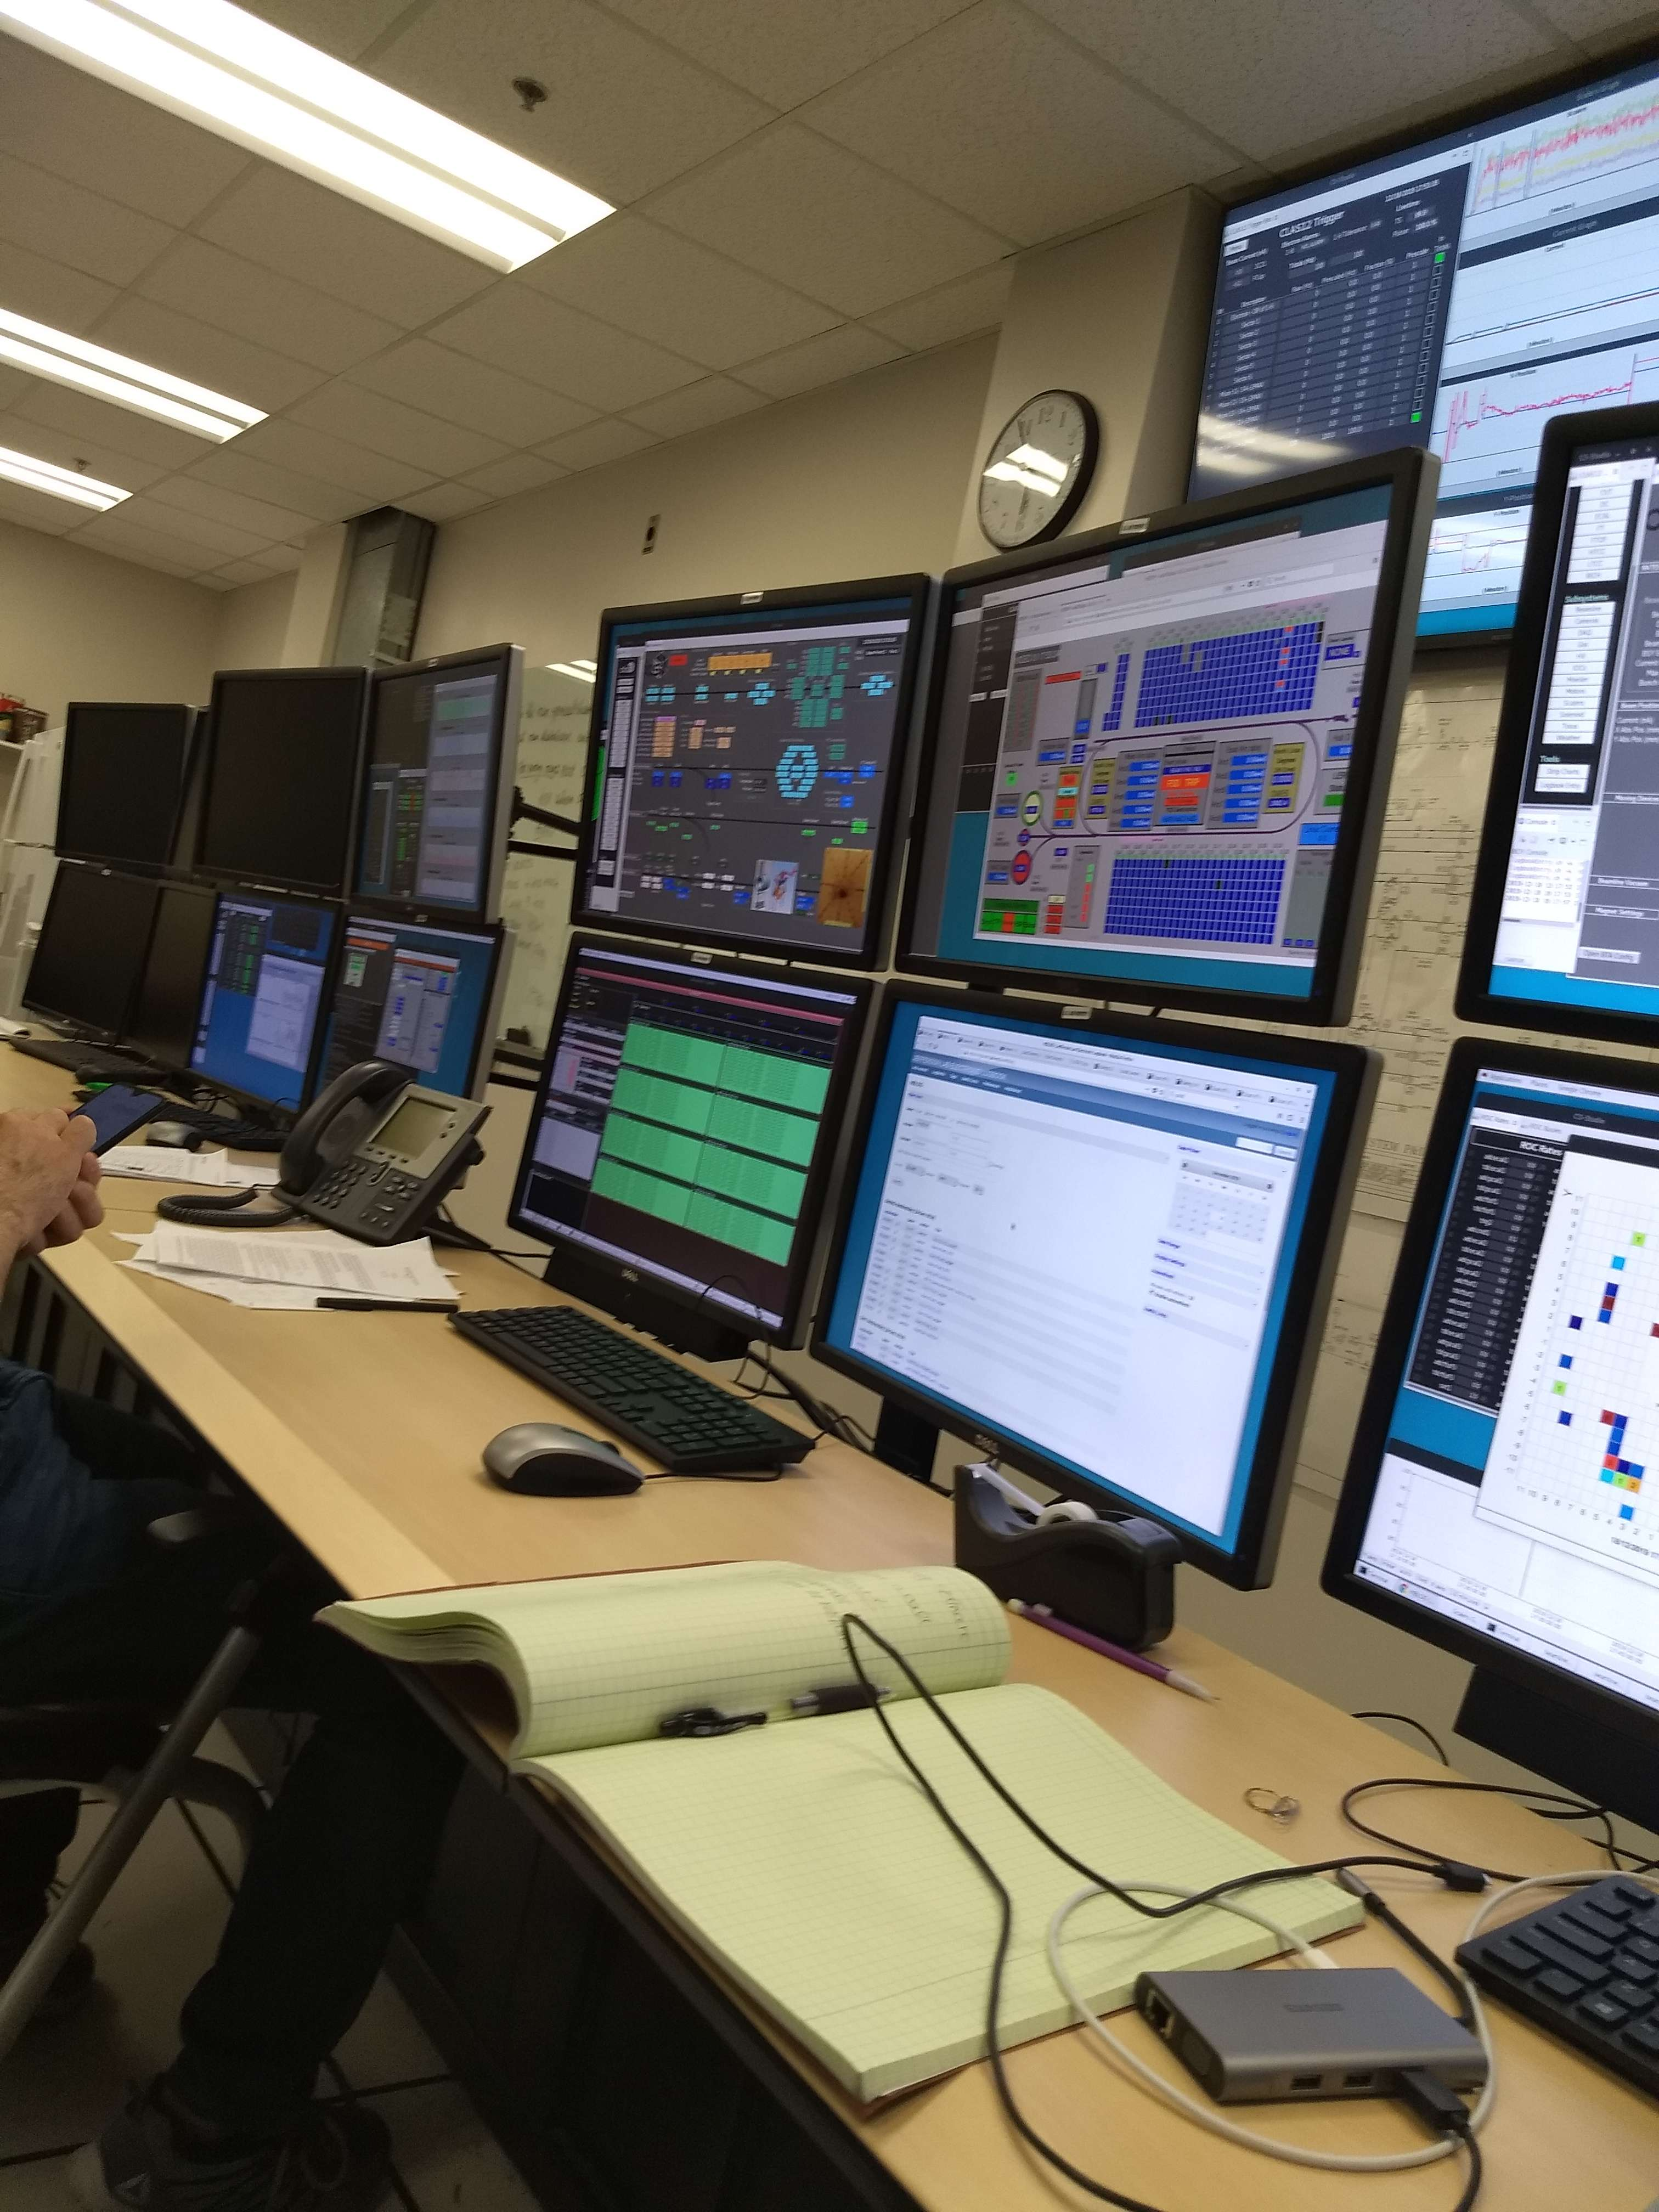
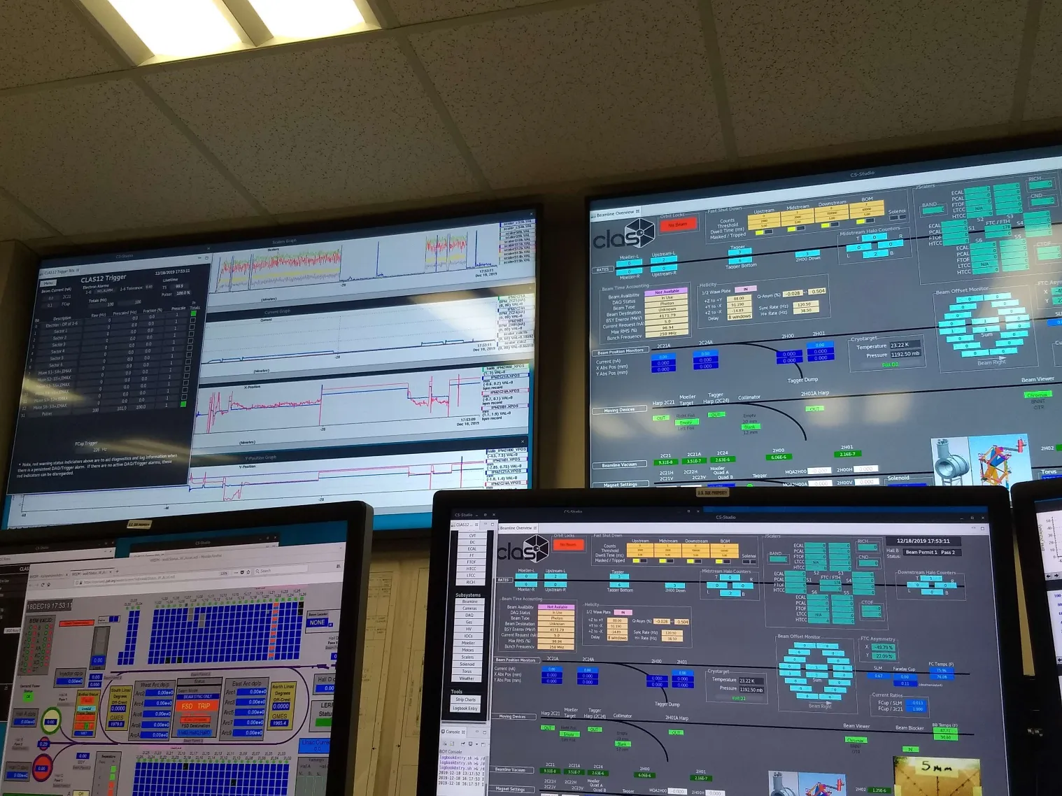
CLAS12 Run Group K Dataset
Key Idea: This work utilizes a subset of the RG-K dataset
Data collected from Nov. 28 to Dec. 20, 2018 as a short "opportunistic" run
  ~10% of the approved RG-K beam time
Beam energy: 6.5 GeV
Longitudinally polarized electron beam (P_{b} ≥ 85%) on unpolarized liquid hydrogen (LH₂) target
High luminosity: 10³⁵ cm⁻² s⁻¹
Total events collected: 7.8 billion

Slide 8
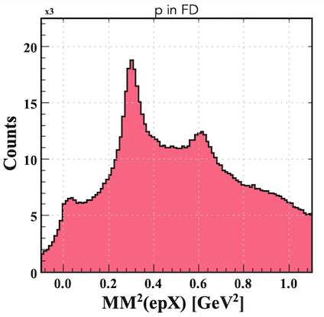
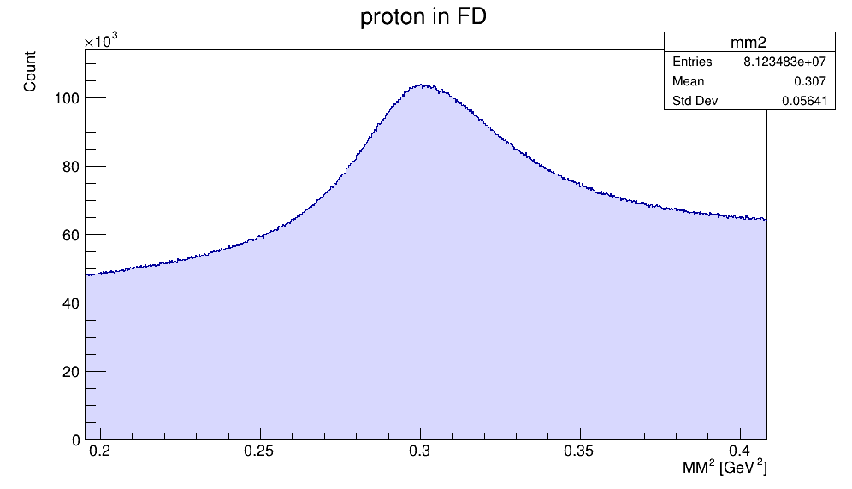
Event Selection and η Identification
Key Idea: η mesons are identified using the missing mass technique in the ep → e'p'X reaction.
Detect scattered electron and proton in the Forward Detector
Reconstruct the missing mass squared (MM²) of the undetected particle X
η signal appears as a peak around MM² = 0.3 GeV²
Apply analysis cuts:
  W < 2 GeV (nucleon resonance region)
  0.15 GeV² < MM² < 0.45 GeV² (η peak region)
Implement standard RGK fiducial cuts and cuts developed for analysis
Proton in FD
η
Event Selection
ω/ρ⁰
π⁰
PRELIMINARY
PRELIMINARY
Missing Mass² of X [GeV²]
Missing Mass² of X [GeV²]

Slide 9
Kinematic Binning: Stepwise Methodology
Key Idea: A strategic, adaptive approach to binning is employed to balance kinematic resolution and statistical power.
Step 1
Begin with binning over W
Identify nucleon resonances
Step 2
Bin over φ*
Enable fitting of the BSA
Step 3
Bin over Q²
Variable bin widths → equal Nevent per bin
Step 4
Bin over cosθ*
Wide bins to explore this parameter space

Slide 10
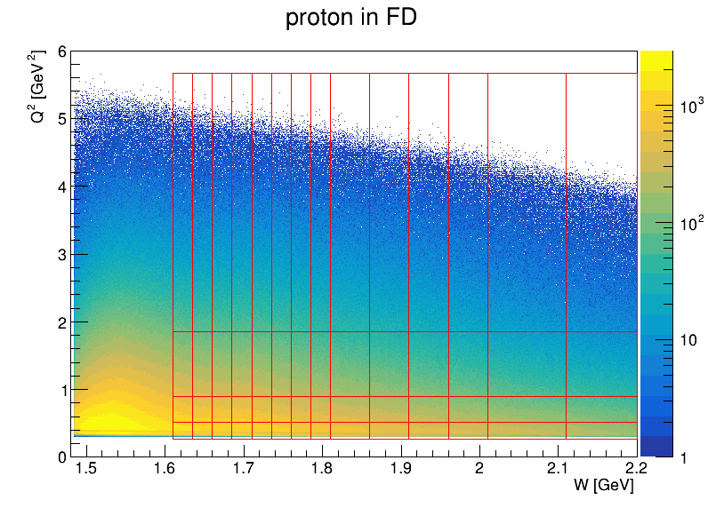
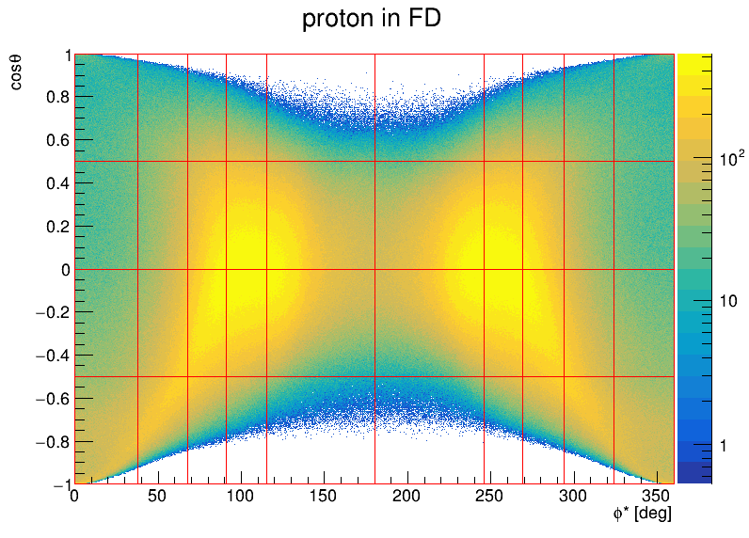
Kinematic Binning: Phase Space Coverage
Key Idea: The multi-dimensional kinematic phase space is partitioned into discrete bins for detailed analysis.
W [GeV] | ϕ* [deg] | Q² [GeV²] | cos(θ*)
1.610 to 1.635 | 0 to 38 | 0.300 to 0.521 | -1.0 to -0.5
1.635 to 1.660 | 38 to 68 | 0.521 to 0.896 | -0.5 to 0.0
1.660 to 1.685 | 68 to 91 | 0.896 to 1.850 | 0.0 to 0.5
1.685 to 1.710 | 91 to 115 | 1.850 to 5.671 | 0.5 to 1.0
1.710 to 1.735 | 115 to 180
1.735 to 1.760 | 180 to 246
1.760 to 1.785 | 246 to 269
1.785 to 1.810 | 269 to 294
1.810 to 1.860 | 294 to 324
1.860 to 1.910 | 324 to 360
1.910 to 1.960
1.960 to 2.010
2.010 to 2.110
2.110 to 2.210
PRELIMINARY
PRELIMINARY

Slide 11
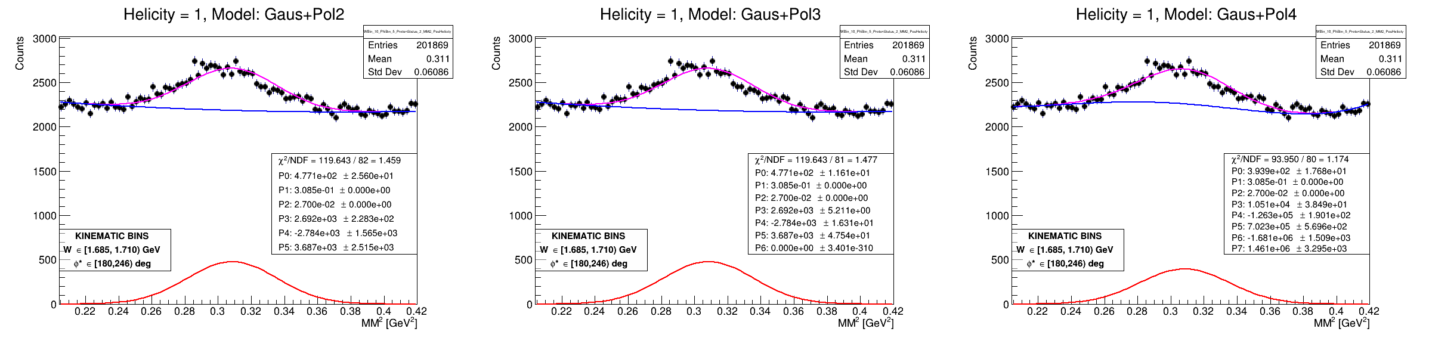
Signal Extraction and Background Fit
Key Idea: Extracting the η signal yield requires fitting the missing mass squared distribution with a combination of signal and background fits.
Signal: Fitted using a Gaussian function
Background: Fitted using polynomial functions of various orders (pol2, pol3, pol4)
pol3 chosen as the "benchmark" fits, balancing bias and variance
Systematic uncertainty analysis is preliminary
  Dominant source considered is the yield extraction procedure, estimated by comparing different background fits (pol2, pol3, pol4)
pol3 as “benchmark”
PRELIMINARY
PRELIMINARY
PRELIMINARY

Slide 12
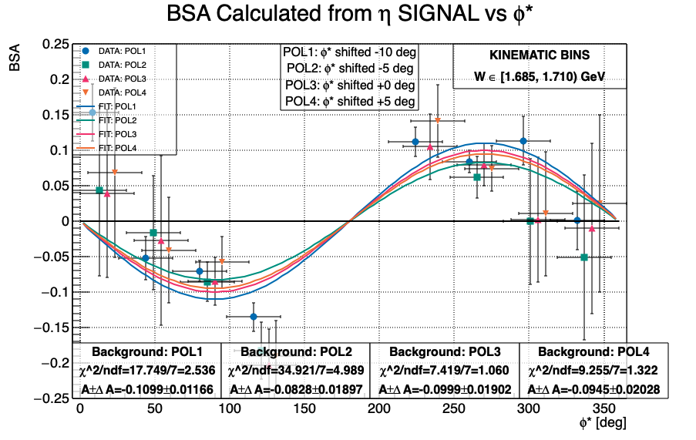
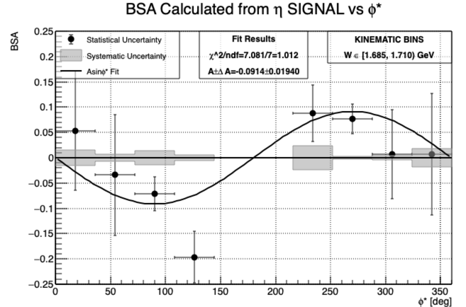
Representative Fit to Beam Spin Asymmetry
Key Idea: The BSA is extracted by fitting the asymmetry as a function of φ* with a sine function.
Data binned over W and φ*, integrated over Q² and cosθ*
A_{LU}
A_{LU}
PRELIMINARY
PRELIMINARY
PRELIMINARY
PRELIMINARY
A_{LU}
A_{LU}

Slide 13
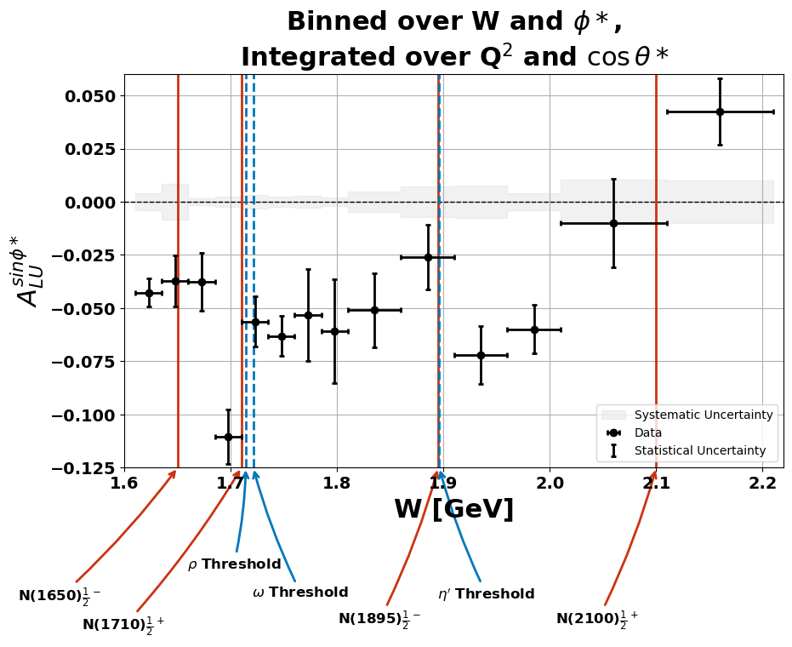
Sine Moment of the Beam Spin Asymmetry (A_{LU}^{sinφ*})
Key Idea: The sine moment of the asymmetry, A_{LU}^{sinφ*}, is extracted to study the dependence on the center-of-mass energy W.
Data binned over W and φ*, integrated over Q2 and cosθ*
Error bars represent statistical uncertainties
Grey histograms around zero line indicate systematic uncertainties
Red lines: selected nucleon resonances
Blue lines: selected meson production thresholds
Vertical lines suggest interesting physics at specific W values but do not definitively explain the observed behavior
PRELIMINARY
PRELIMINARY

Slide 14
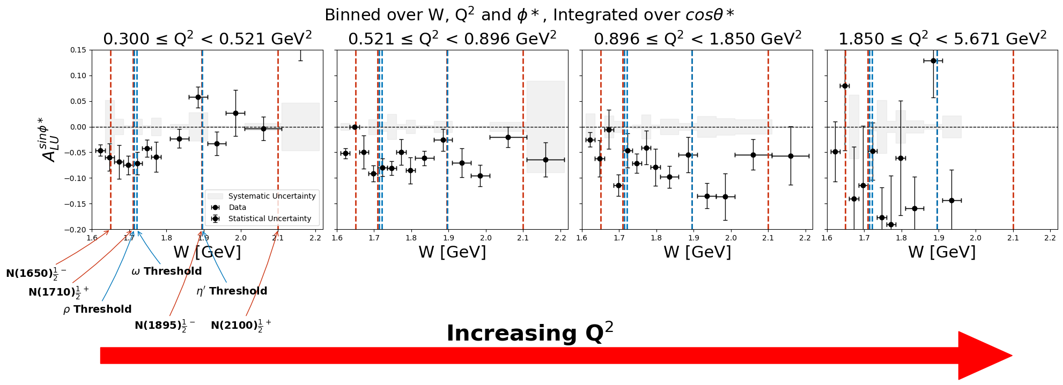
Q² Dependence of the Sine Moment (A_{LU}^{sinφ*})
Key Idea: Binning the data over Q² allows for investigating the dependence of A_{LU}^{sinφ*} on the four-momentum transfer squared.
PRELIMINARY
PRELIMINARY
PRELIMINARY
PRELIMINARY
PRELIMINARY
PRELIMINARY

Slide 15
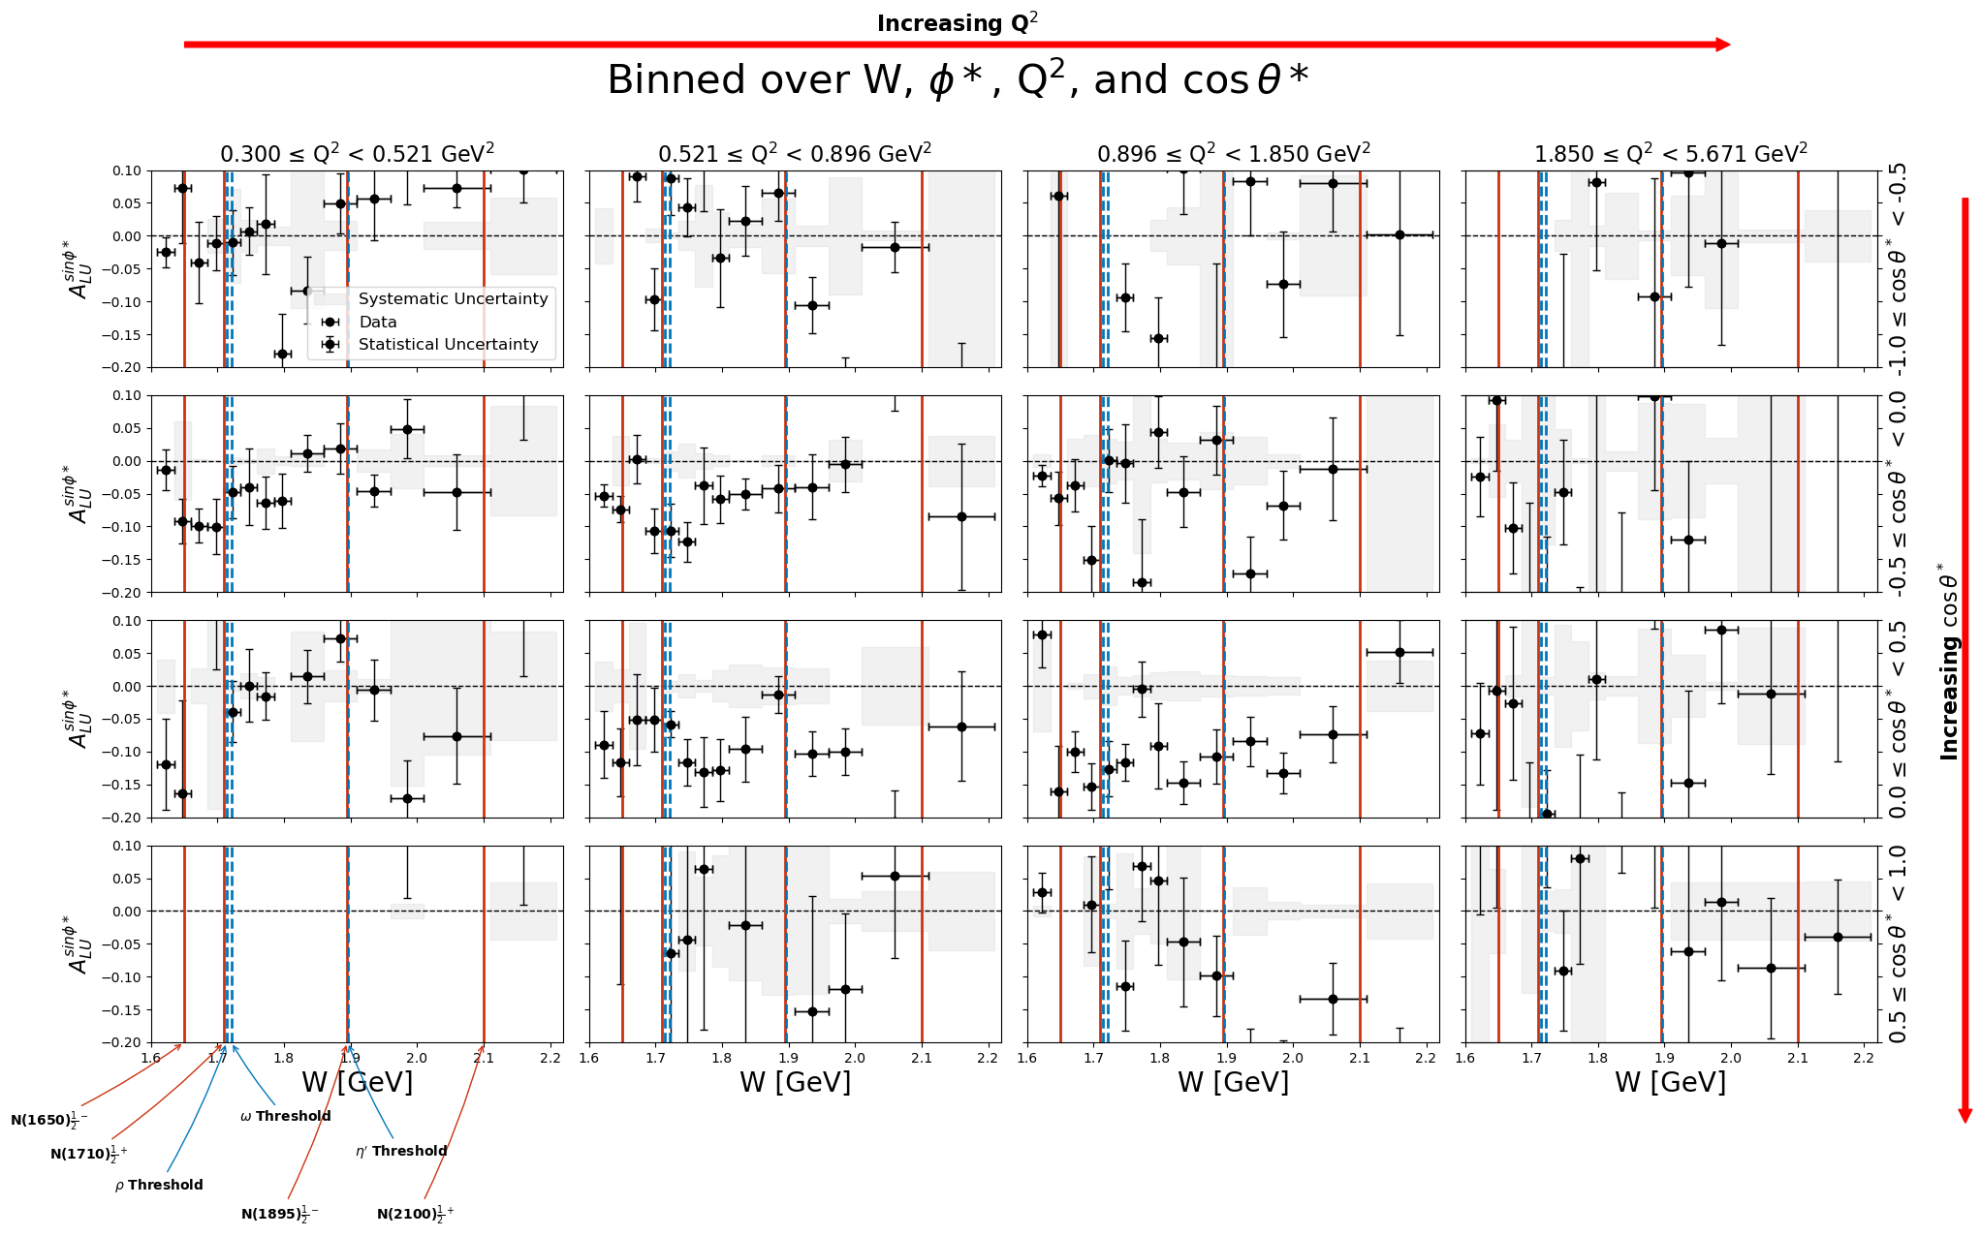
Full Kinematic Dependence of the Sine Moment
PRELIMINARY
PRELIMINARY
PRELIMINARY
PRELIMINARY
PRELIMINARY
PRELIMINARY
PRELIMINARY
PRELIMINARY
PRELIMINARY
PRELIMINARY
PRELIMINARY
PRELIMINARY
PRELIMINARY
PRELIMINARY
PRELIMINARY
PRELIMINARY
Key Idea: A comprehensive study of the sine moment's dependence on the kinematic phase space.

Slide 16
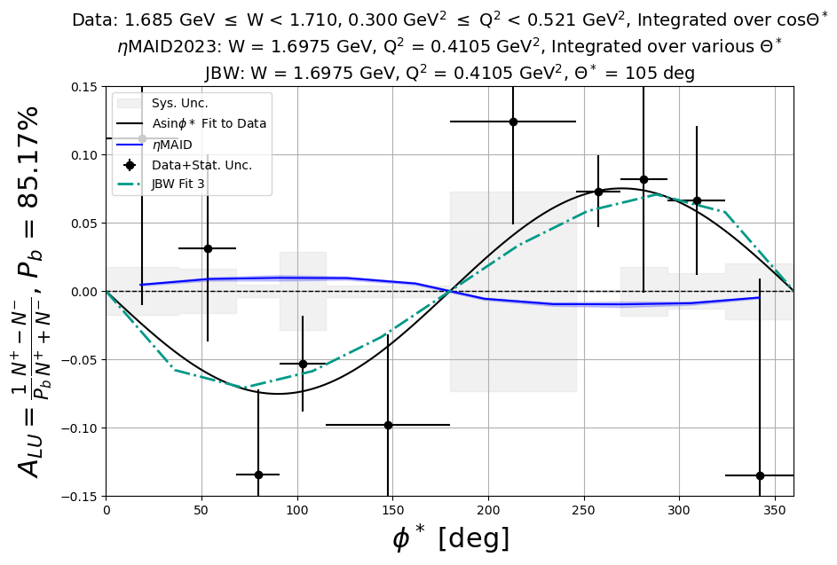
Comparison with Theoretical Models: An Illustrative Example
Key Idea: The beam spin asymmetry data has the potential to constrain and improve theoretical models of η electroproduction.
Data binned over W, φ*, and Q² and integrated over cosθ*
Jülich-Bonn-Washington (JBW)
EtaMAID
Illustrative example of the potential for this data to constrain and improve theoretical models
Limitations in the models (small Nη datasets, lack of polarization observables) prevent definitive conclusions at this stage
PRELIMINARY
PRELIMINARY

Slide 17
Summary of Key Findings and Impact
Key Idea: The beam spin asymmetry measurements in η electroproduction offer valuable data for theoretical models and could be provide new insights into nucleon resonances.
Findings:
  Consistently negative A_{LU}^{sinφ*} values across the W range
  Dip-like structure near N(1710)
  Cusp-like behavior near N(1895)
Impact:
  Expands kinematic reach in η electroproduction BSA measurements
  Provides new data to evaluate and constrain theoretical models
Next Steps and Path to Publication:
  Perform Fast MC simulations to determine acceptances
  Prepare a CLAS12 Analysis Note
  Explore collaborations with EtaMAID and JBW
PRELIMINARY
PRELIMINARY

Slide 18


THANK YOU
FOR
LISTENING!

Slide 19
Any Questions?

Slide 20
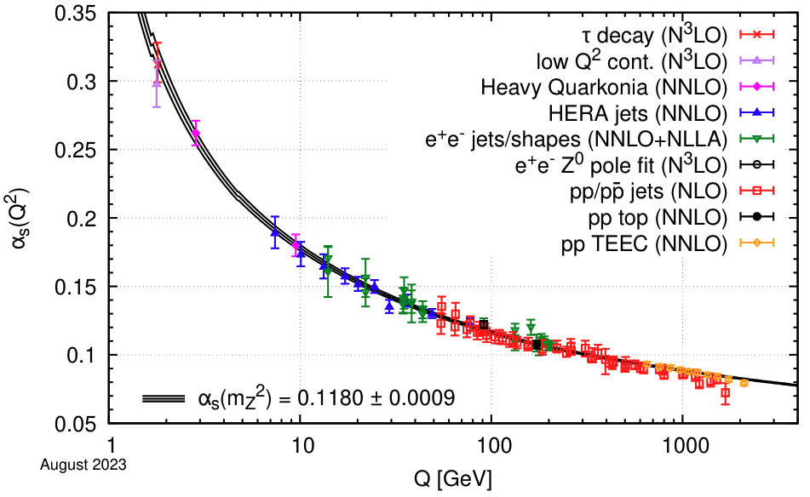
QCD and the Role of Hadron Spectroscopy
 | Non-Perturbative | Perturbative
α_{s} | Large | Small
Q² | Low | High
Distance | Long (confinement) | Short (asymptotic freedom)
Experiments | Hadron Spectroscopy, Resonance Experiments | Deep Inelastic Scattering
Theory | LQCD, Phenomenological Models | Perturbative QCD
Notes:
Today, I would like to introduce you to the field of hadron spectroscopy, as the research I conducted falls under this umbrella. Hadron spectroscopy is the study of hadrons and their excited spectrum, which includes nucleon resonances.
However, there are unique complications associated with hadron spectroscopy due to the low energy regime in which it operates. In this regime, the strong coupling constant, alpha_s, is large, leading to a non-perturbative nature of the interactions. As a result, we cannot directly probe the internal dynamics of quarks and gluons using perturbative QCD calculations.
This is where the concept of confinement comes into play. Quarks and gluons are confined within hadrons, and we cannot observe them as free particles. Consequently, we must rely on indirect methods to study their behavior and interactions within hadrons.
This is where the importance of hadron spectroscopy becomes evident. By studying the excited spectrum of hadrons, we can gain insights into the internal dynamics of quarks and gluons, even in the non-perturbative regime. This allows us to explore the rich structure of nucleon resonances and their properties.
In the next slide, I will delve deeper into the concept of nucleon resonances and how they relate to my research on the beam spin asymmetry using eta electroproduction.
########################################
The running coupling constant, denoted as αs, quantifies the strength of the strong interaction. It is analogous to the fine-structure constant in Quantum Electrodynamics (QED). However, unlike QED, the running coupling constant in QCD changes with the energy scale, Q, which is related to the four-momentum transfer squared, Q². This unique feature of QCD is known as asymptotic freedom.
The plot shows how αs varies with Q. At high energies (large Q), the coupling constant becomes small, and perturbative calculations can be applied. This is the perturbative regime of QCD. Conversely, at low energies (small Q), the coupling constant becomes large, leading to the confinement of quarks and gluons within hadrons. This is the non-perturbative regime of QCD.
The table summarizes the key characteristics of the perturbative and non-perturbative regimes. In the non-perturbative regime, confinement prevents the direct experimental study of quark and gluon dynamics. This is where hadron spectroscopy becomes an indispensable tool for investigating nucleon structure.
Hadron spectroscopy involves studying the spectrum of hadrons and their excited states. By measuring various observables, such as cross sections and polarization asymmetries, in hadron spectroscopy experiments, we can indirectly probe the internal dynamics of quarks and gluons within nucleons. These experiments provide crucial data for understanding the complex interplay between quarks and gluons in the non-perturbative regime, where QCD calculations become highly challenging.
The experimental results from hadron spectroscopy can be compared with theoretical approaches like lattice QCD and phenomenological models. These comparisons help to constrain and refine our understanding of nucleon structure in the non-perturbative regime, where direct calculations are not possible due to confinement.

Slide 21
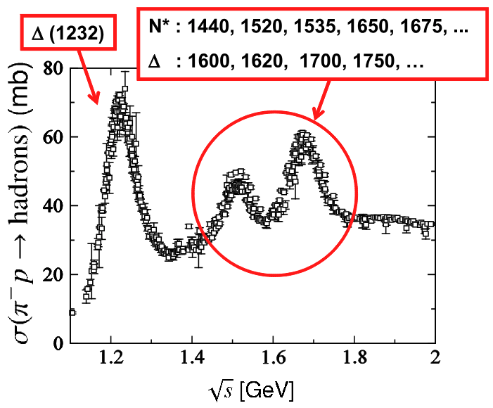
Complexity of the Nucleon Resonance Spectrum
Key Idea: The nucleon resonance spectrum is complex, with overlapping states that are difficult to isolate using a single reaction channel.
Notes:
Figure: “Peaks in the π −p reaction total cross sections. The first peak at √ s ∼ 1.2 GeV is known to be produced by ∆(1232), the first P33 nucleon resonance, while the second and third peaks contain more than 10 N ∗ states, which indicates that those are highly overlapping with each other in energy”
As I mentioned earlier, hadron spectroscopy is the study of hadrons and their excited spectrum. This brings us to the concept of nucleon resonances. Nucleons, which include protons and neutrons, have excited states known as nucleon resonances. The nucleon resonance spectrum is what we measure in hadron spectroscopy.
This slide shows the total cross section of pi-p as a function of the square root of s, which is the center-of-mass energy, denoted as W. We can associate a resonance with a particular value of W.
For example, the first peak at around 1.2 GeV is known to be produced by the Delta(1232) baryon, which is the first P33 nucleon resonance. However, as we move to higher energies, the spectrum becomes more complicated. The second and third peaks contain more than 10 N* states, indicating that these resonances are highly overlapping in energy.
This complexity in the resonance spectrum makes it challenging to disentangle individual resonances by simply looking at these "bumps." It's a complicated question of what's going on here, and that's where the study of specific decay channels becomes important.
########################################
Isolating individual resonances is challenging due to the overlapping nature of these states. A coupled-channel approach, which combines information from multiple reaction channels (e.g., Nπ, Nη, Nω), is necessary to disentangle the contributions of individual resonances.
In this slide, we delve into the complexity of the nucleon resonance spectrum. The figure presented here shows the total cross section of π−p scattering as a function of the center-of-mass energy, √s. The peaks in the cross section correspond to various nucleon resonances, which are excited states of the nucleon.
The first peak, located at around √s ∼ 1.2 GeV, is primarily due to the Δ(1232) resonance, which is the first excited state of the Δ baryon. However, as we move to higher energies, the second and third peaks reveal a more complex structure. These peaks contain contributions from more than 10 overlapping nucleon resonances, known as N* states.
Nucleon resonances, denoted as N*, are excited states of the nucleon with isospin I = 1/2. They have higher masses than the ground state nucleon and can decay into various final states, such as Nπ, Nη, and Nω. On the other hand, Δ resonances, denoted as Δ*, are excited states of the Δ baryon with isospin I = 3/2. They also have higher masses than the ground state Δ and can decay into similar final states.
The presence of overlapping resonances in the higher-energy peaks poses a significant challenge in understanding the nucleon resonance spectrum. It becomes difficult to isolate the contributions of individual resonances using a single reaction channel, such as π−p scattering.
To overcome this challenge, a coupled-channel approach is employed. This approach involves measuring experimental observables from multiple reaction channels, such as Nπ, Nη, and Nω, and combining the information to disentangle the contributions of individual resonances. By studying various final states, we can gain a more comprehensive understanding of the nucleon resonance spectrum and the properties of individual resonances.
The coupled-channel approach is crucial for unraveling the complex structure of the nucleon resonance spectrum and extracting reliable information about the properties of individual resonances. In the next slide, we will discuss how the η meson, in particular, can serve as a valuable tool in this endeavor through its isospin filtering properties.

Slide 22
Connecting Experiment and Theory
Key Idea: The study of nucleon resonances requires a collaborative effort between experiment and theory, with various observables and theoretical approaches.
Experimental Observables
  Cross Section
  Polarization
Partial Wave Analysis (PWA)
  Multipoles
  EtaMaid
  Jülich-Bonn-Washington (JBW)
  Chiral Perturbation Theory (ChPT)
Transition Form Factors
  ChPT (Unitary Extension)
  Lattice QCD (LQCD)
  Quark Models
  Dyson-Schwinger Equations (DSEs)
Notes:
Now that we've discussed the advantages of using eta to isolate specific resonances for better study, it's important to understand that experimental data alone cannot provide all the answers. To gain a full understanding of resonances and connect them to theories, we need a collaborative effort between experiment and theory.
Theories aim to explain what's happening in the resonance spectrum. They predict the presence of partial waves from specific resonances and attempt to describe the underlying physics. However, from the experimental side, we cannot offer definitive explanations of what's going on without the help of theories or models.
The challenge lies in the fact that these theories don't directly predict the experimental observables we measure, such as cross sections and polarization. Instead, they often predict quantities like multipoles or transition form factors. To compare the theoretical predictions with experimental data, we need to perform a partial wave analysis using the experimental observables to extract multipoles that can be compared to the theories.
For example, in my research, I obtained predictions from EtaMaid and Jülich-Bonn-Washington (JBW) theorists. They used their multipole predictions to calculate structure functions, which we then used to calculate the beam spin asymmetry. So, we had to massage the results from the theories to obtain the beam spin asymmetry, which is an observable we can measure experimentally.
Moving from multipoles, we can further connect to transition form factors, which are predicted by various theoretical approaches such as Lattice QCD (LQCD), Quark Models, and Dyson-Schwinger Equations (DSEs). These theories predict transition form factors, but they don't directly predict the experimental observables. To compare the predictions to the data, we need to transform the data and get them to speak the same language, so to speak. We need to compare apples to apples, or in this case, multipoles to multipoles, or beam spin asymmetry to beam spin asymmetry.
This slide emphasizes the importance of connecting experiment and theory, but it also highlights the complexity of the process. It's not a straightforward comparison, and it requires a lot of effort from theorists to interpret the experimental data and provide explanations for what's happening in the resonance spectrum.
########################################
In this slide, we present a streamlined workflow diagram that illustrates the connection between experimental observables and theoretical approaches in the study of nucleon resonances. This diagram highlights the collaborative nature of this research and shows how our work on the beam spin asymmetry in η electroproduction fits into the larger context.
The workflow begins with experimental observables, such as cross sections and polarization measurements. In our case, we focus on the beam spin asymmetry in η electroproduction, which provides valuable information about the reaction dynamics and the contributing resonances.
The next step in the workflow is partial wave analysis (PWA). PWA is a technique that decomposes the experimental data into components associated with different angular momenta. This decomposition allows us to extract detailed information about the interaction processes and the resonances involved in η electroproduction.
From the partial wave analysis, we obtain multipole amplitudes. These amplitudes provide an additional perspective on the interaction dynamics and serve as a bridge to understanding the electromagnetic properties of the resonances. Theoretical models, such as EtaMAID and JBW, calculate these multipoles and use them to predict experimental observables, like the beam spin asymmetry.
Moving further along the workflow, we encounter transition form factors. These form factors quantify the changes in the nucleon's internal structure as it transitions to different resonance states. They are derived from the multipole amplitudes and are crucial for understanding the behavior of resonances at different energy scales.
Various theoretical approaches, such as Lattice QCD (LQCD), Dyson-Schwinger Equations (DSEs), and Chiral Perturbation Theory (ChPT), play essential roles in calculating these transition form factors and providing insights into the underlying physics.
Our work on the beam spin asymmetry in η electroproduction, highlighted in the red box, contributes to this collaborative effort by providing experimental data that can be compared to theoretical predictions. The dashed lines in the diagram indicate the comparison of our results with the JBW and EtaMAID models.
It's important to emphasize that the interaction between experiment and theory is a two-way street. Experimental results, like our beam spin asymmetry measurements, provide valuable constraints for theoretical models and guide their development. In turn, improved theoretical predictions can inform future experimental efforts, leading to a deeper understanding of nucleon resonances and their properties.

Slide 23
The Power of Polarization Observables
Key idea: Polarization observables provide crucial information for disentangling the contributions of individual nucleon resonances, complementing the information obtained from unpolarized cross sections.
Combining unpolarized cross sections and polarization observables is crucial for a comprehensive understanding of nucleon structure and reaction dynamics.
Unpolarized Cross Section | Polarization Observables
Overall strength of the reaction | Interference between helicity amplitudes
Total contribution of all resonances | Relative phases and magnitudes of amplitudes
Cannot distinguish individual resonances | Separation of individual resonance contributions
Limited in probing nucleon structure | Detailed probe of nucleon structure and dynamics
Notes:
Now that we've discussed the connection between experiment and theory, and mentioned cross sections and polarization observables, let's delve into the research I'm presenting today. Before we get there, I want to compare unpolarized cross sections to polarization observables to motivate why we would want to study polarization observables, especially since I'm presenting a polarization observable in this work.
Unpolarized cross sections provide a baseline measurement of the reaction's overall strength. They give us a sense of the total probability for the reaction to occur, which is essential for understanding the general behavior of the reaction and for comparing different reactions. Additionally, unpolarized cross sections can help identify energy regions where resonances are likely to occur. By looking for peaks or enhancements in the cross section, we can pinpoint areas of interest for further investigation with polarization observables.
Furthermore, the total contribution of all resonances, as measured by unpolarized cross sections, helps to constrain theoretical models. Models must be able to reproduce the overall strength of the reaction before delving into the details of individual resonance contributions. Unpolarized cross sections set the foundation for building accurate models.
However, unpolarized cross sections have limitations. They cannot distinguish between individual resonances, and it's difficult to probe the internal structure of nucleons using only unpolarized data. This is where polarization observables come into play.
Polarization observables offer unique insights by being sensitive to the interference between different helicity amplitudes. They access information about the relative phases and magnitudes of these amplitudes, enabling the separation of individual resonance contributions in a way that you can't achieve with unpolarized cross sections alone.
It's important to note that we need to combine both unpolarized cross sections and polarization observables for a full picture of the reaction dynamics and nucleon structure. That's why measuring polarization observables is crucial, and it's the focus of my research.
########################################
In this slide, we highlight the power of polarization observables and their complementary role to unpolarized cross sections in understanding nucleon structure and reaction dynamics.
Unpolarized cross sections provide valuable information about the overall strength of the reaction and the total contribution of all resonances. However, they have limitations in distinguishing individual resonance contributions and probing the underlying nucleon structure.
On the other hand, polarization observables offer unique insights by being sensitive to the interference between different helicity amplitudes. They access information about the relative phases and magnitudes of these amplitudes, enabling the separation of individual resonance contributions. This makes polarization observables a powerful tool for obtaining a more detailed understanding of nucleon structure and reaction dynamics.
It is important to emphasize that combining unpolarized cross sections with polarization observables is essential for developing a comprehensive picture of nucleon structure and the role of individual resonances in the reaction dynamics. By measuring both types of observables, we can gain a more complete understanding of the underlying physics.
In our work, we focus on measuring the beam spin asymmetry, a specific type of polarization observable, to access this valuable information and contribute to the larger goal of unraveling the complexities of nucleon structure.
In the next slide, we will delve into the different types of polarization observables and their relation to the polarization states of the beam, target, and recoiling nucleon.

Slide 24
The Types of Polarization Observables
Key Idea: Polarization observables arise from the polarization states of the beam, target, and recoiling nucleon, and can be classified based on the number of polarized particles involved.
Polarization:
Longitudinal (L):
  Spin oriented along the direction of motion
Transverse (T):
  Spin oriented perpendicular to the direction of motion
Unpolarized (U):
  No net polarization; spins randomly oriented
Polarization observables:
Single Spin Asymmetries (SSAs):
  One polarized particle (e.g., beam, target, or recoil nucleon)
Double Spin Asymmetries (DSAs):
  Two polarized particles (e.g., beam and target, beam and recoil, or target and recoil)
Triple Spin Asymmetries (TSAs):
  All three particles polarized (beam, target, and recoil nucleon)
Beam Spin Asymmetry (A_{LU}/BSA): longitudinally polarized electron beam incident on an unpolarized proton target
Notes:
Now, let's discuss what polarization observables actually are. First, let's define the types of polarizations:
Longitudinal (L): Spin oriented along the direction of motion
Transverse (T): Spin oriented perpendicular to the direction of motion
Unpolarized (U): No net polarization; spins randomly oriented
Polarization observables can be classified based on the number of polarized particles involved in the reaction:
Single Spin Asymmetries (SSAs): One polarized particle (e.g., beam, target, or recoil nucleon)
Double Spin Asymmetries (DSAs): Two polarized particles (e.g., beam and target, beam and recoil, or target and recoil)
Triple Spin Asymmetries (TSAs): All three particles polarized (beam, target, and recoil nucleon)
In my research, I am measuring the Beam Spin Asymmetry (BSA), also denoted as ALU. The subscript "LU" indicates that the beam is longitudinally polarized (L), and the target is unpolarized (U). Specifically, I am using a longitudinally polarized electron beam incident on an unpolarized proton target.
This is the key point of this slide: to highlight the specific polarization observable I am measuring, the Beam Spin Asymmetry, and to provide context for its role in the broader landscape of polarization observables.

Slide 25
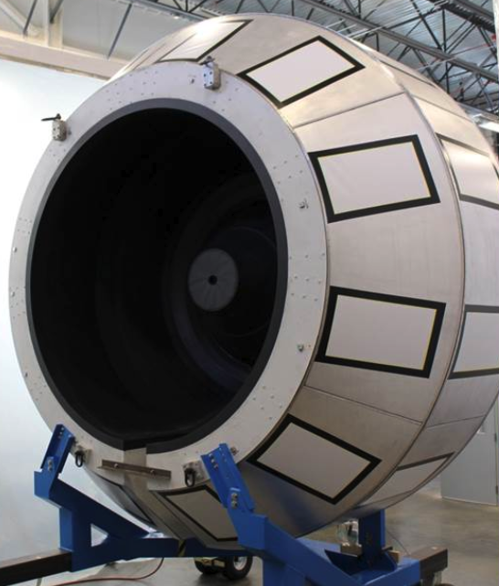
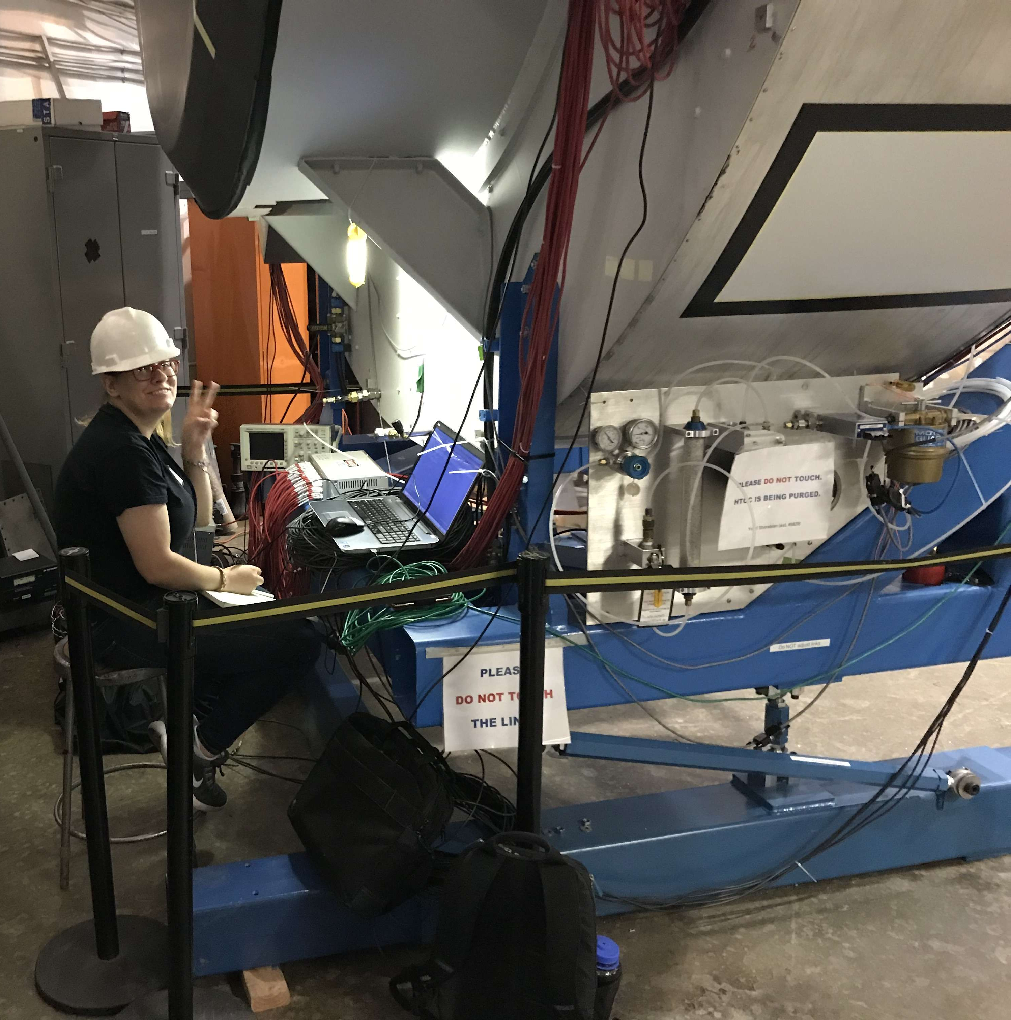
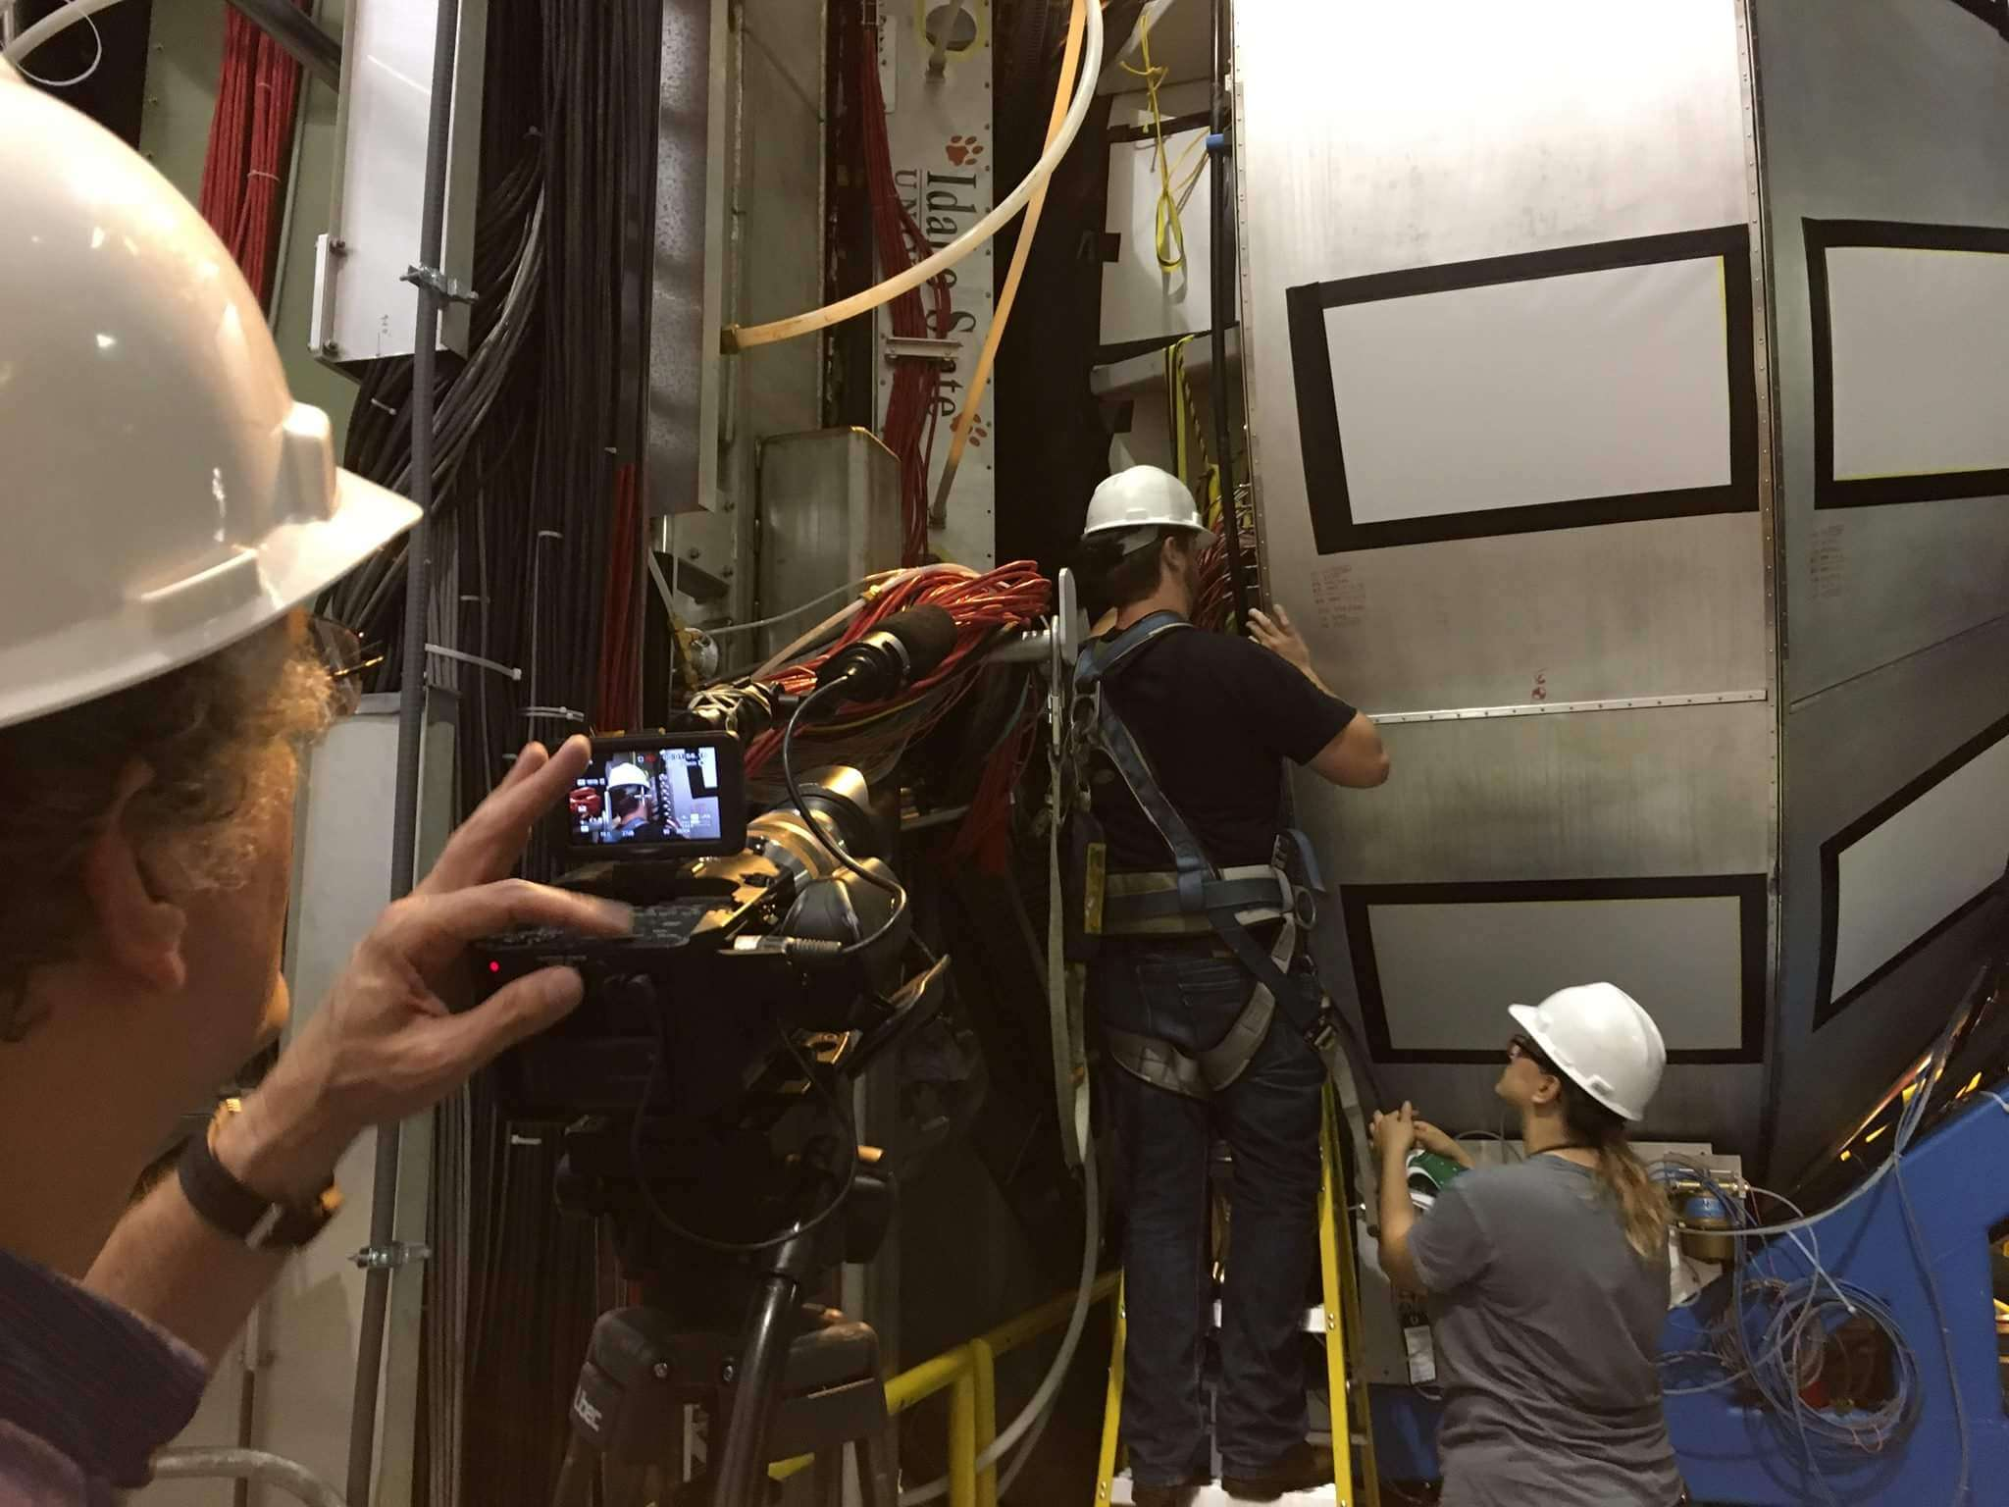
High Threshold Cherenkov Counter (HTCC)
Key Idea: The HTCC is essential for identifying scattered electrons and generating fast trigger signals in CLAS12 experiments.
Helps distinguish electrons from other particles, such as pions
I am in charge of online calibrations
Notes:
used to generate a fast trigger signal in electron scattering experiments => HTCC quickly detects the presence of scattered electrons and sends a signal to the trigger system to initiate the recording of the event. This fast trigger helps in selecting events of interest and reduces the amount of unwanted data recorded
polar angle range from 5◦ to 35◦
rejection of charged π with momenta below 4.8 GeV

Slide 26
Calculating Systematic Uncertainties
Vary background model in missing mass fits
  Polynomial orders: linear to quartic
  Pol1 for special background but started failing to fit background when binning across Q²
  Reliable models chosen (pol3&pol4)
Compare beam spin asymmetry (BSA) values
  Benchmark: cubic polynomial
Systematic uncertainty
  Half the difference between BSA values
Statistical uncertainty
  From benchmark cubic fit
Total uncertainty
  Add systematic and statistical in quadrature
Final BSA value
  Average between cubic and quartic fits
Assess stability of signal extraction
  Sensitivity to background model assumptions
Select appropriate model for data
  Avoid under/overfitting backgrounds
Notes:
The goal is to quantify uncertainty in BSA from model dependence
Compare BSA values from two fits - cubic (benchmark) and quartic polynomials
Take the absolute difference between BSA values from each model fit
Divide difference by two (number of models)
Why divide by two?
Assumes both models could be equally valid representations of background shape
So the "true" BSA value lies somewhere between the two estimates
Taking half their difference gives an uncertainty range around the mean
Similar to statistical uncertainty - quantity to capture range of values
So in essence:
Systematic uncertainty ≈ measurement of dispersion between models
Captures potential bias/variability from model assumptions
Final BSA = average, systematics = "error bar"
The division by two places the uncertainty symmetrically around the mean BSA, reflecting model ambiguity.

Slide 27
Systematic Uncertainty Calculation
Use results from pol3 as “benchmark”
Calculate Mean Absolute Error (MAE)
  Average absolute difference between predicted and observed values
  Evaluate the average absolute deviation of data points from different fitting models (pol2, pol3, pol4) against the benchmark model (pol3)
  Focuses on the average magnitude of errors
  Less sensitive to outliers than (R)MSE (Root Mean Squared Error)

Slide 28
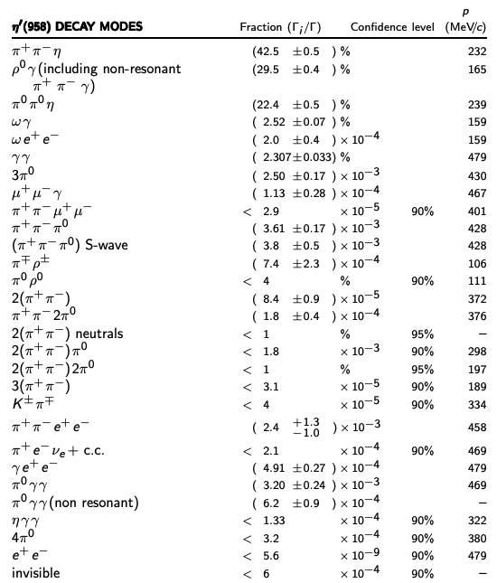
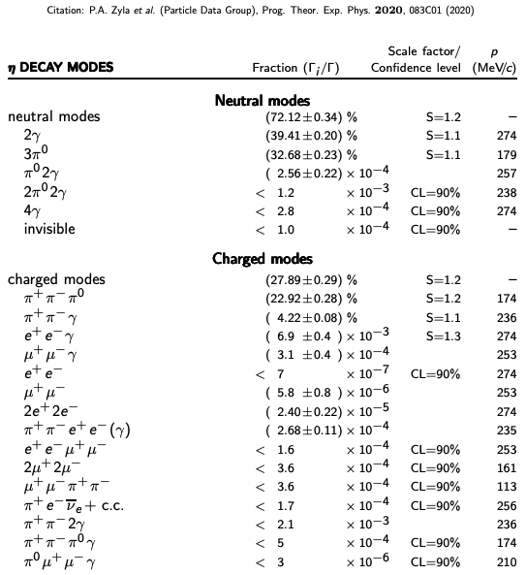
Decay Channels
Update
Notes:
If you wanted all the details but we've mentioned some channels today with Olga's talk with GLUEX and then I believe John Price mentioned mu+mu- channel but thats not my focus

Slide 29
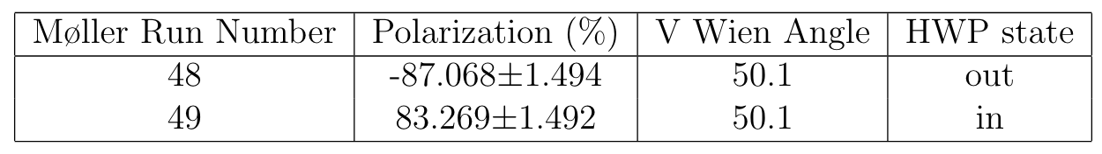
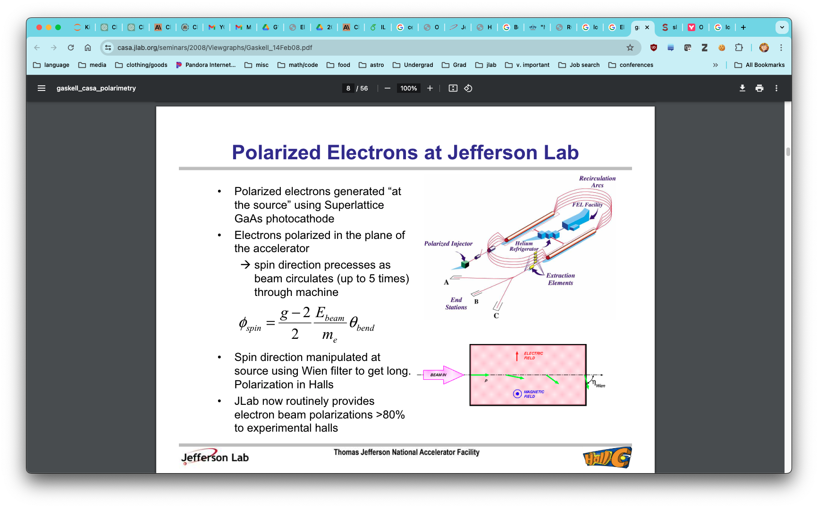
Polarization Observables in Electron Scattering
Polarized electrons generated “at the source” using Superlattice GaAs photocathode
Electrons polarized in the plane of the accelerator
Spin direction precesses as beam circulates (up to 5 times) through machine
Spin direction manipulated at source using Wien filter to get longitudinal polarization in Halls
JLab now routinely provides electron beam polarizations >80% to experimental halls
Notes:
To achieve longitudinal polarization in the experimental halls, the spin direction 1815 is manipulated at the source using a Wien filter. A Wien filter is a device that pro1816 duces crossed electric and magnetic fields, allowing the manipulation of the electron 1817 spin without affecting its trajectory. By adjusting the Wien filter, the electron spin 1818 can be oriented parallel or anti-parallel to the beam direction, resulting in longitu1819 dinally polarized electrons. An electron beam can indeed be polarized in directions 1820 other than longitudinal. Transverse polarization, where the electron spins are ori1821 ented perpendicular to the beam direction, is also possible. However, maintaining transverse polarization throughout the acceleration process is more challenging due 1823 to spin precession, and, as a result, most experiments requiring polarized electrons 1824 opt for longitudinal polarization, which is easier to produce and maintain.

Slide 30
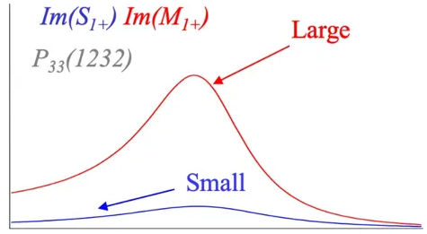
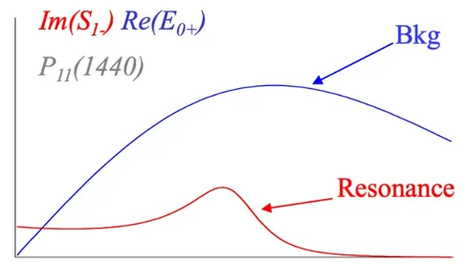
Structure Functions and Interference in η Electroproduction
Key Idea: Structure functions encode information about resonance excitation and decay processes, and their interference terms enhance sensitivity to small resonance contributions.
Structure functions are related to the electromagnetic multipoles (El±, Ml±, Sl±)
Interference structure functions, such as σLT and σLT', are sensitive to the relative phases and magnitudes of the multipoles
σLT (unpolarized): Interference between resonant and non-resonant multipoles Example: P33(1232) resonance - interference between small S1+ and dominant M1+ multipoles
σLT' (polarized): Interference between resonant and background amplitudes Example: P11(1440) resonance (Roper) - interference between weak resonance strength (Im(S1-)) and large non-resonant background (Re(E0+))

Slide 31
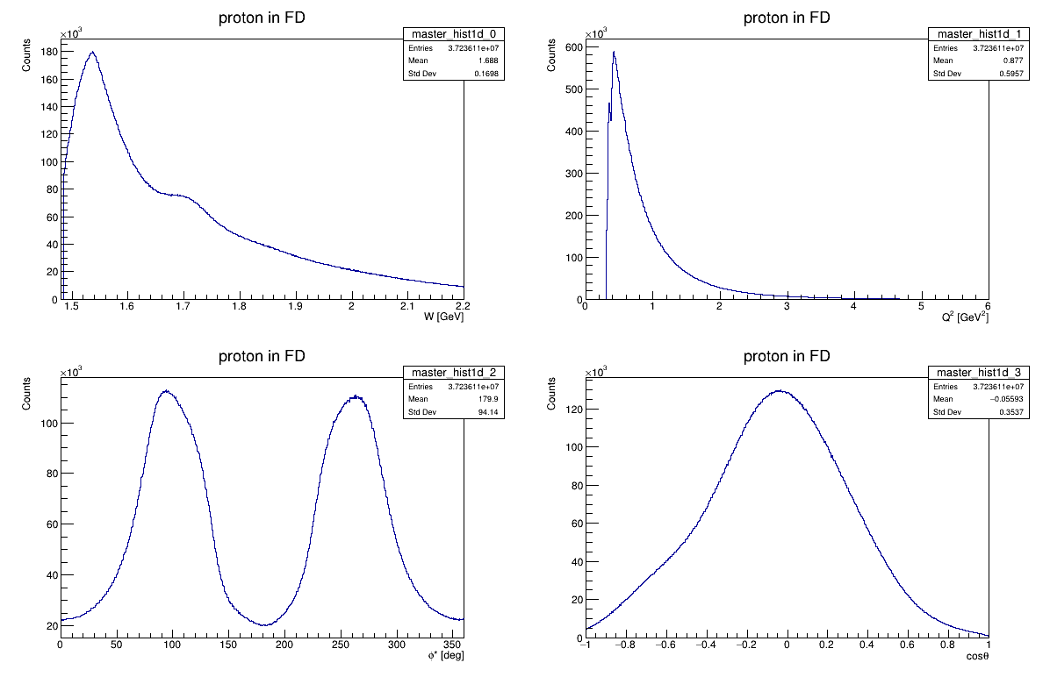
Info: Kinematics

Slide 32
 | Beam | Target | Recoil Nucleon | Example
Single Spin Asymmetries (SSAs) | Polarized (L or T) | Unpolarized | - | A_{LU} (BSA)
 | Unpolarized | Polarized (L or T) | - | A_{UL}
 | Unpolarized | Unpolarized | Polarized | Py
Double Spin Asymmetries (DSAs) | Polarized (L or T) | Polarized (L or T) | - | A_{LL}
 | Polarized (L or T) | Unpolarized | Polarized | C_{LX}, C_{LZ}
 | Unpolarized | Polarized (L or T) | Polarized | C_{XL}, C_{ZL}
Triple Spin Asymmetries (TSAs) | Polarized (L or T) | Polarized (L or T) | Polarized | C_{LXL}, C_{LZL}

Slide 33
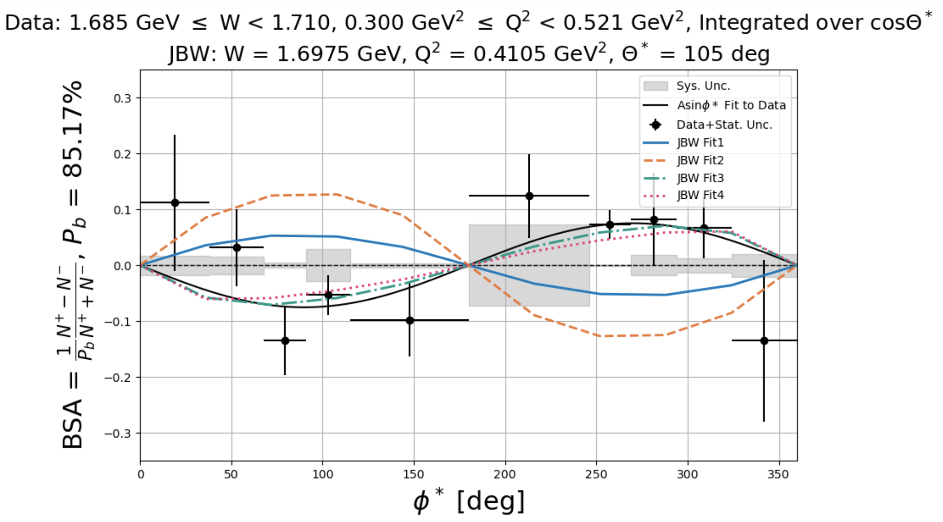
Comparison with JBW
hello

Slide 34
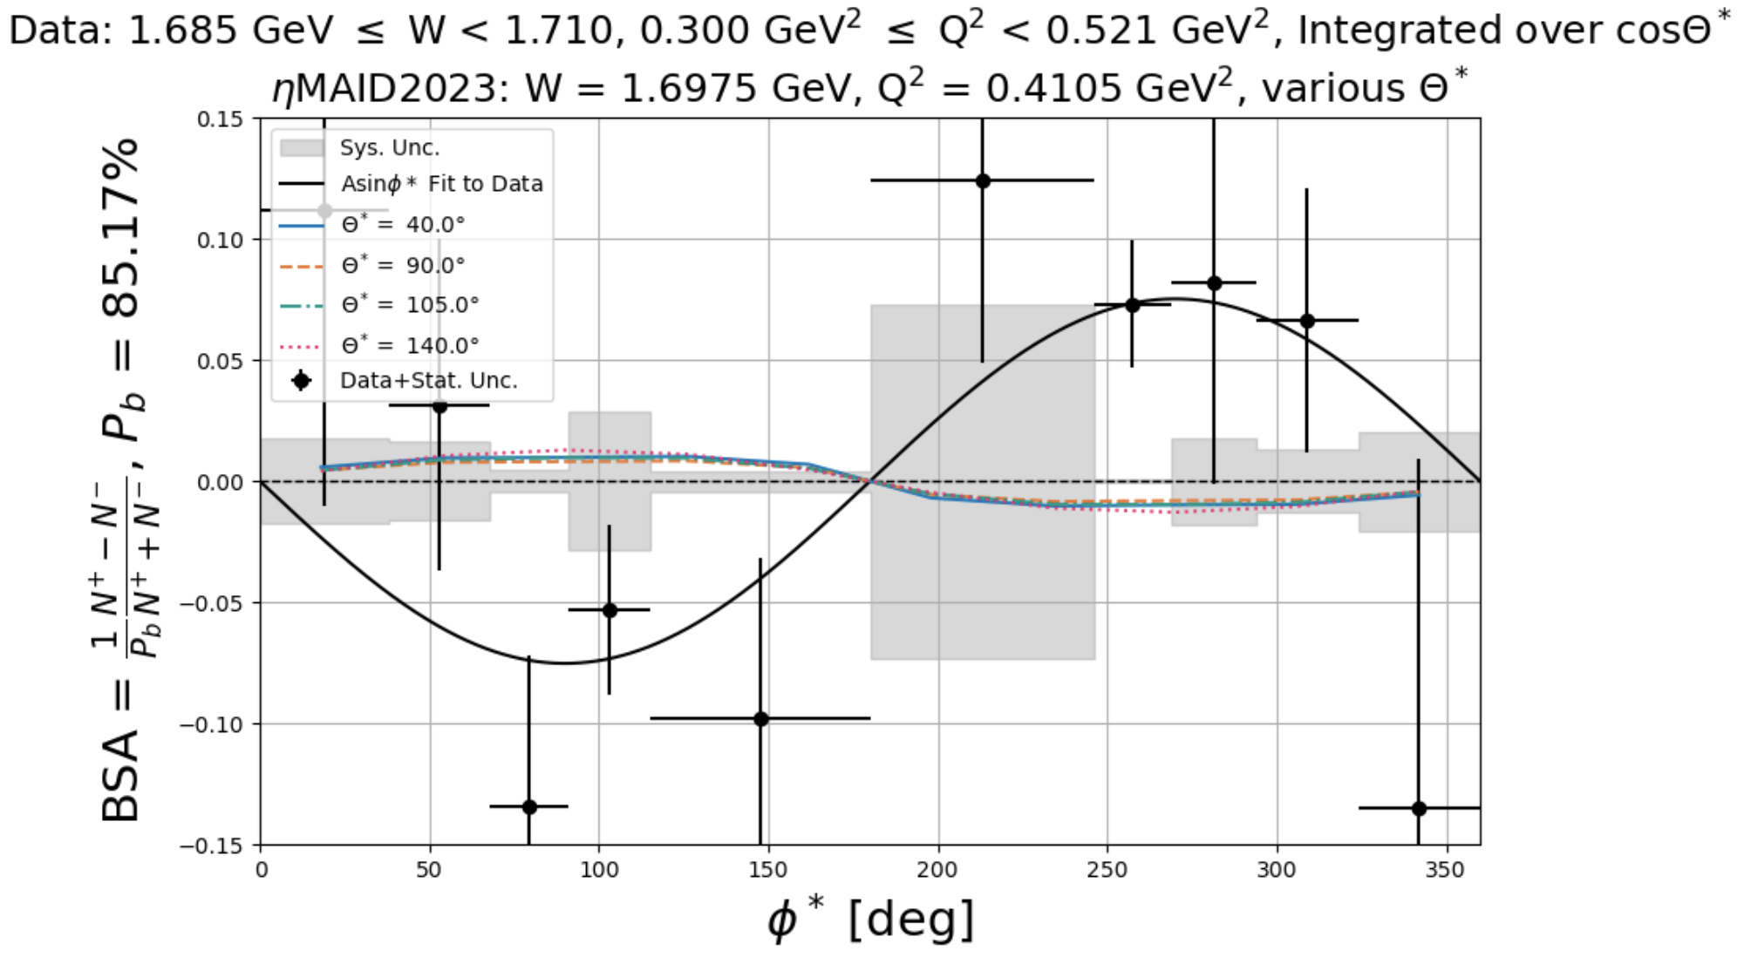
Comparison with EtaMaid
hello

Slide 35
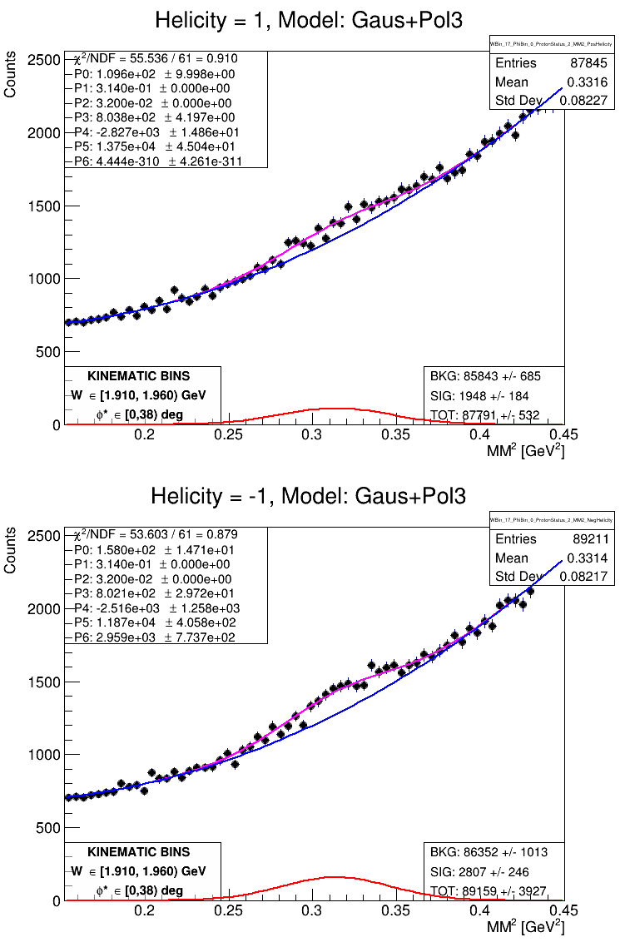
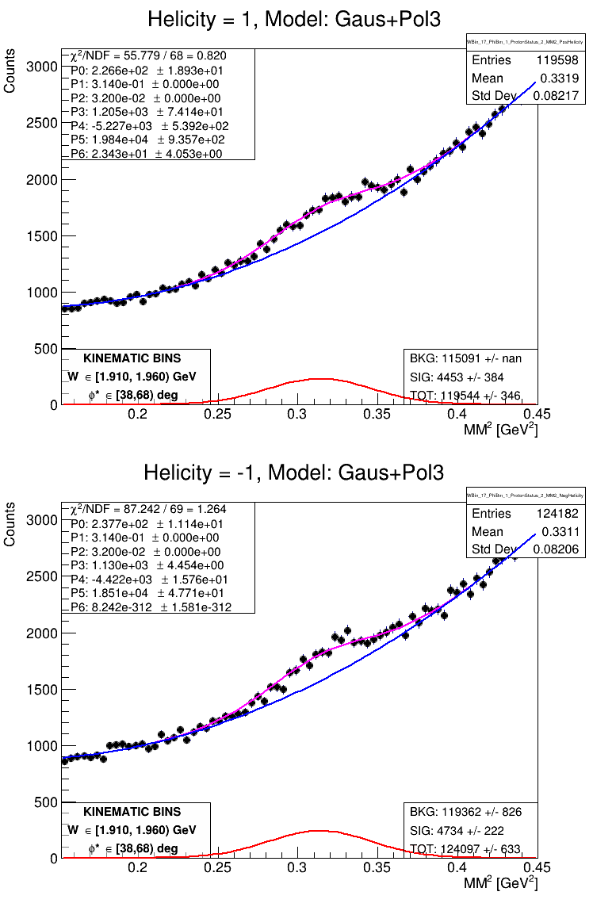
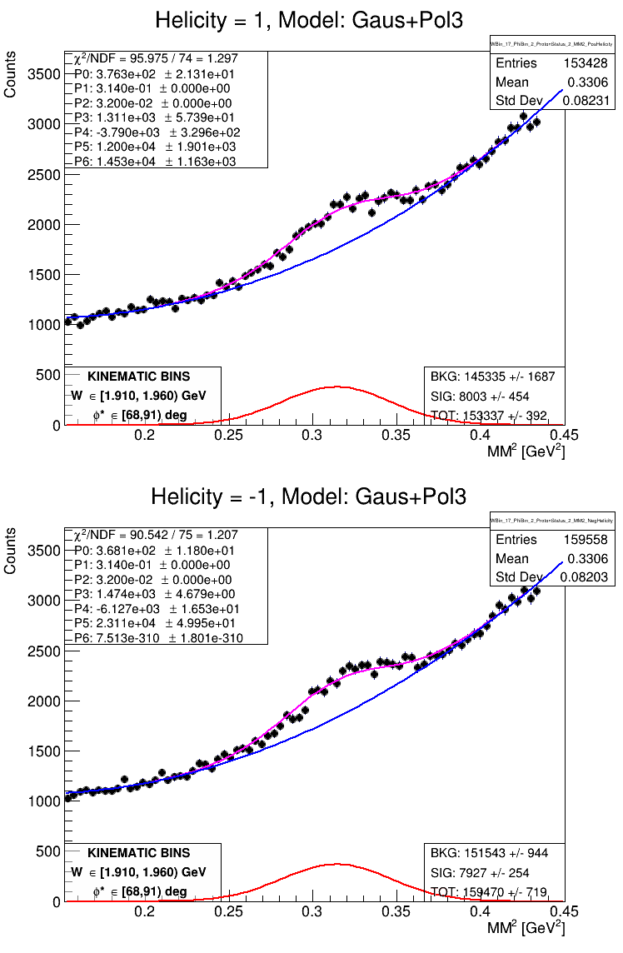
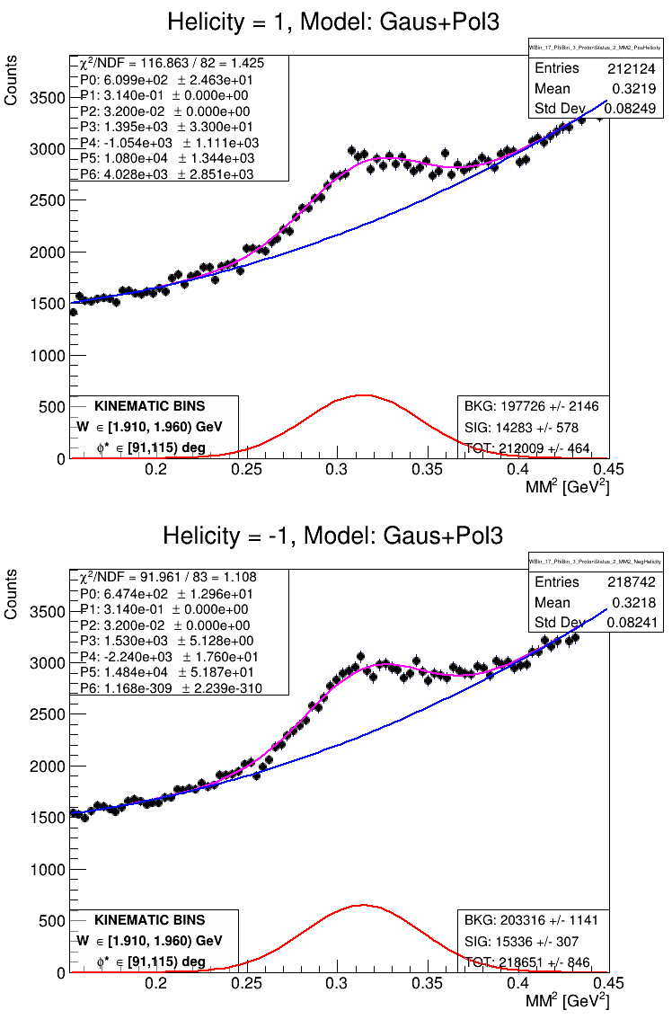
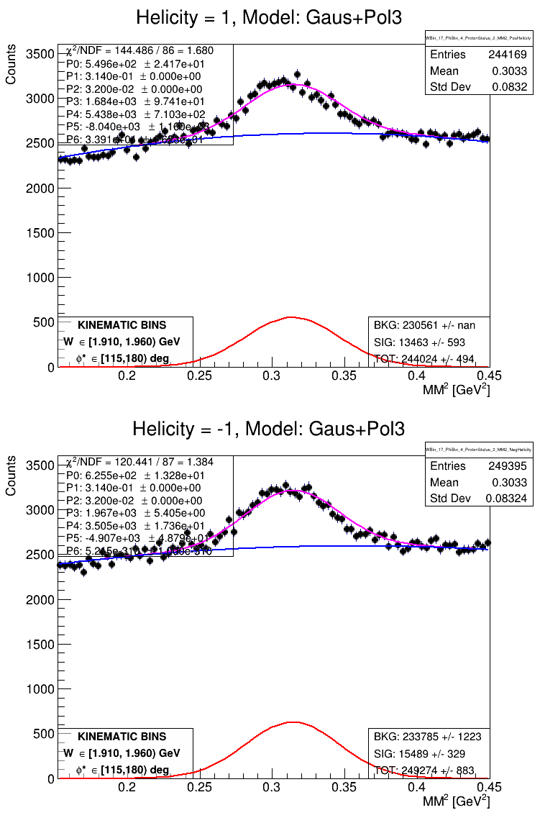
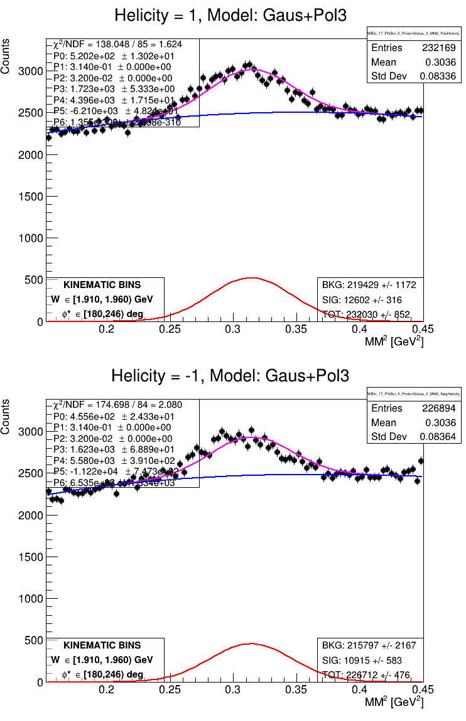
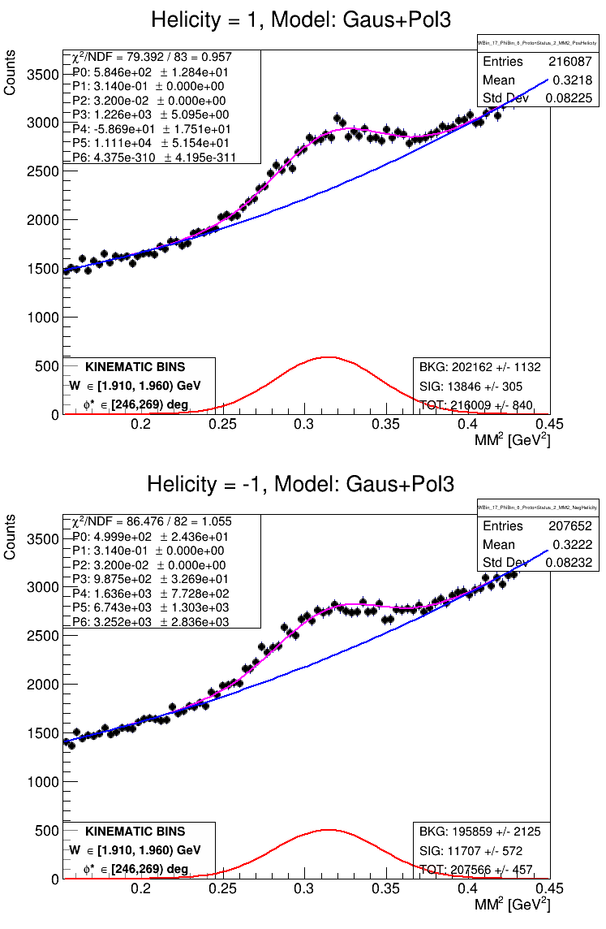
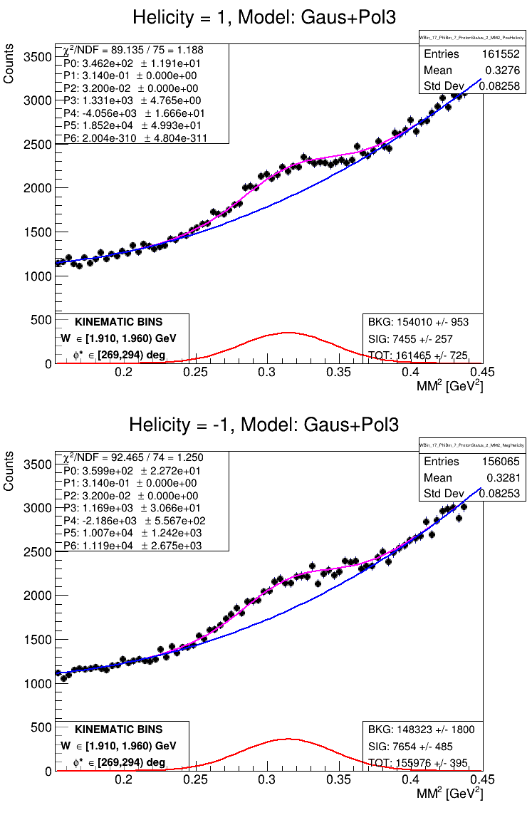
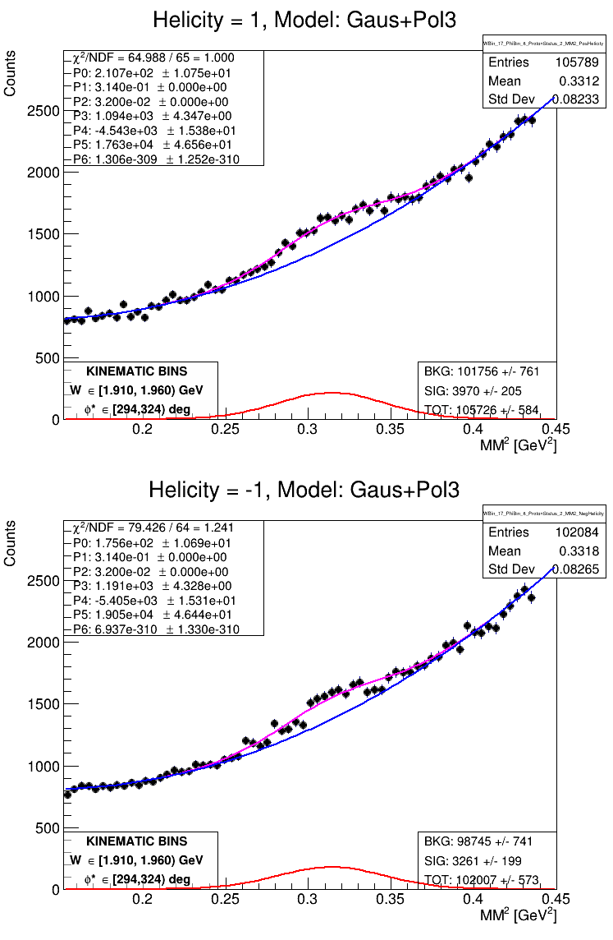
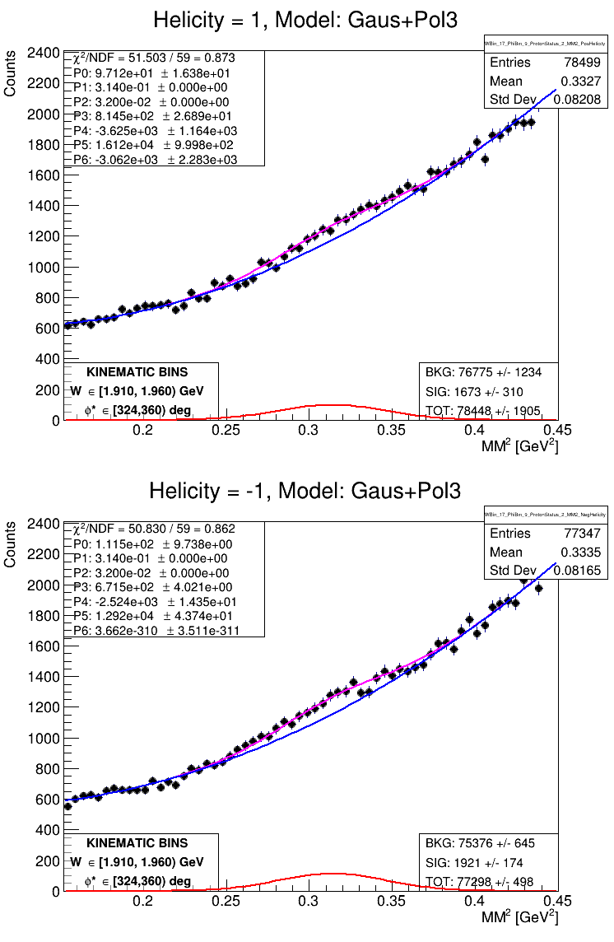
MM2 fit to φ* bins
W in [1.685, 1.710) GeV
hello
[0, 38) deg [38, 68) deg [68, 91) deg [91, 115) deg [115, 180) deg
φ*
[180, 246) deg [246, 269) deg [269, 294) deg [294, 324) deg [324, 360) deg

Slide 36
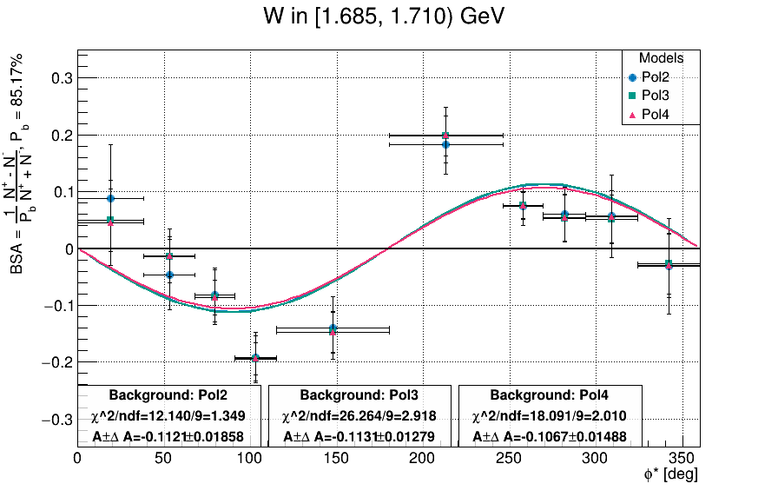
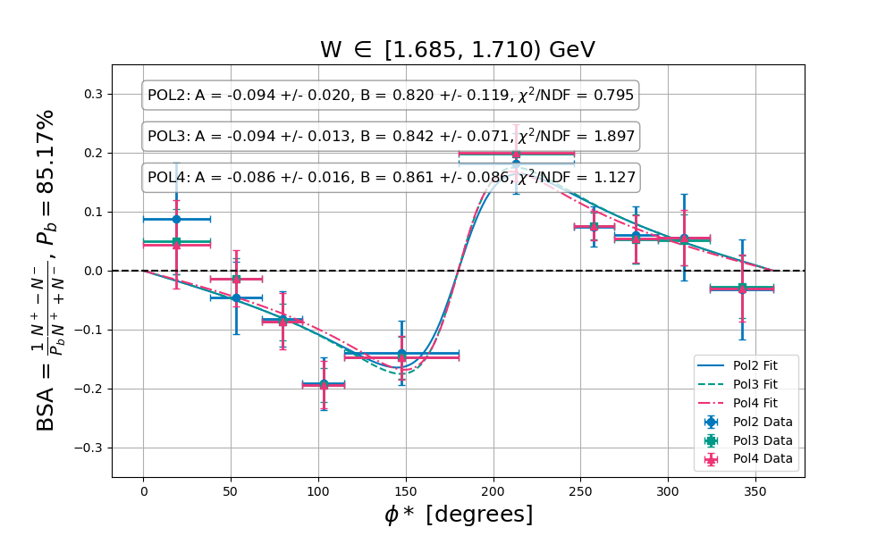
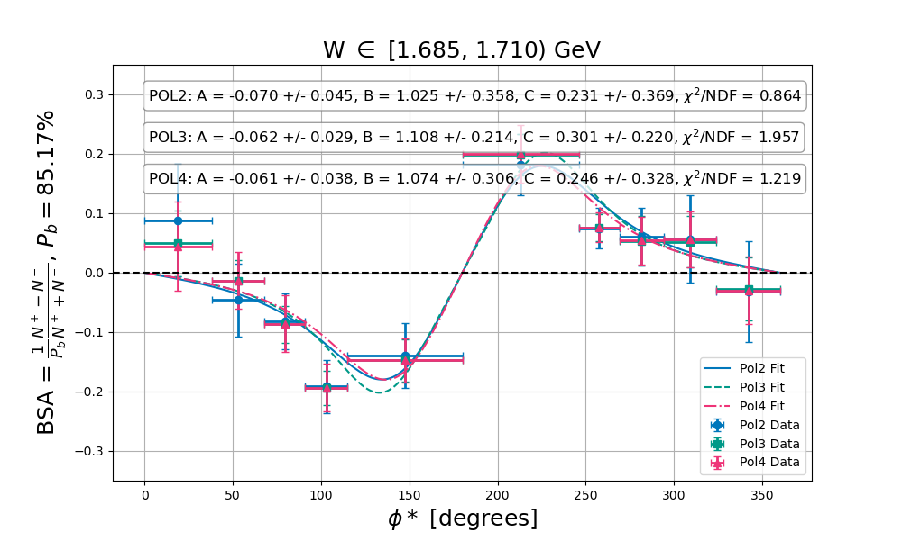
Results of adding cosφ* moments
Asinφ* fit
Binned over W and φ*
Integrated over Q2 and cosθ*

Slide 37
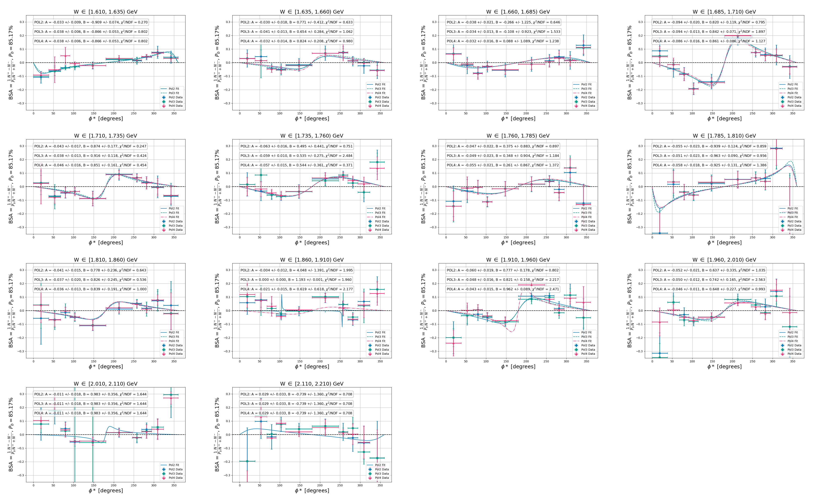
Fits to BSA
hello
BSA y range ±0.35
Binned over W and φ*
Integrated over Q2 and cosθ*
Unconstrained B

Slide 38
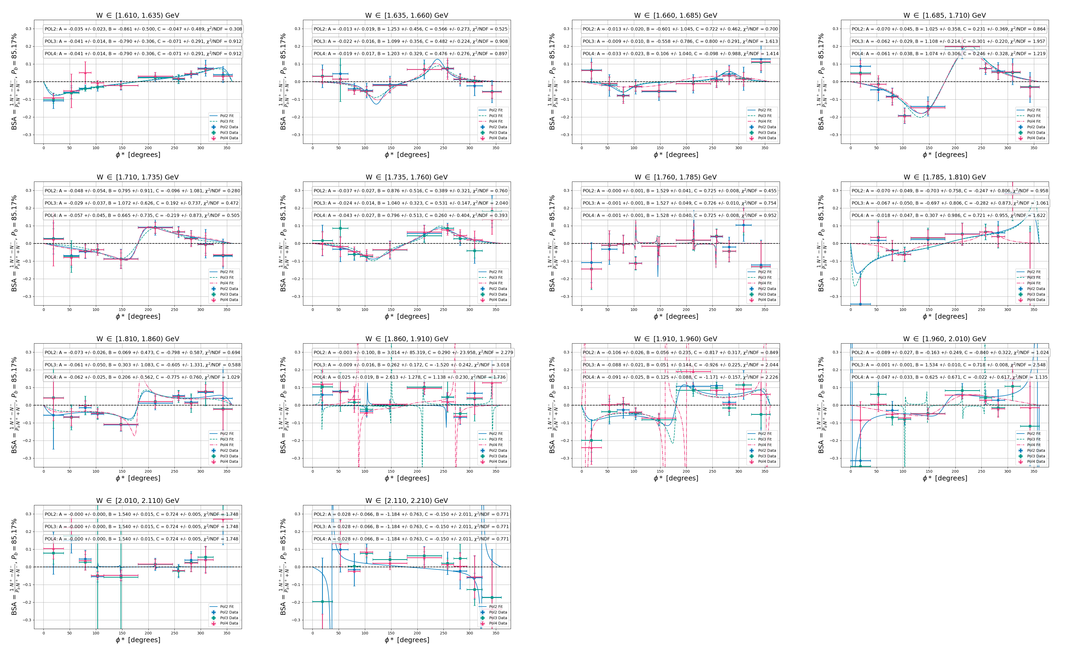
Fits to BSA
hello
BSA y range ±0.35
Binned over W and φ*
Integrated over Q2 and cosθ*
Unconstrained B and C

Slide 39
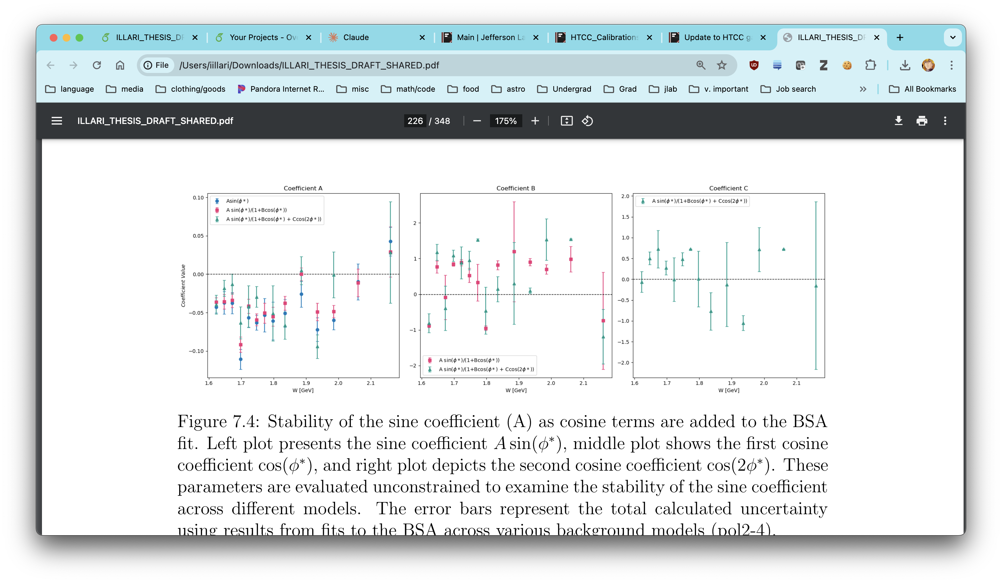
Comparison of A, B, C from full fit to BSA
Blue: shown in this work
Red: Including cos term
Green: Include 2 cos terms

Slide 40
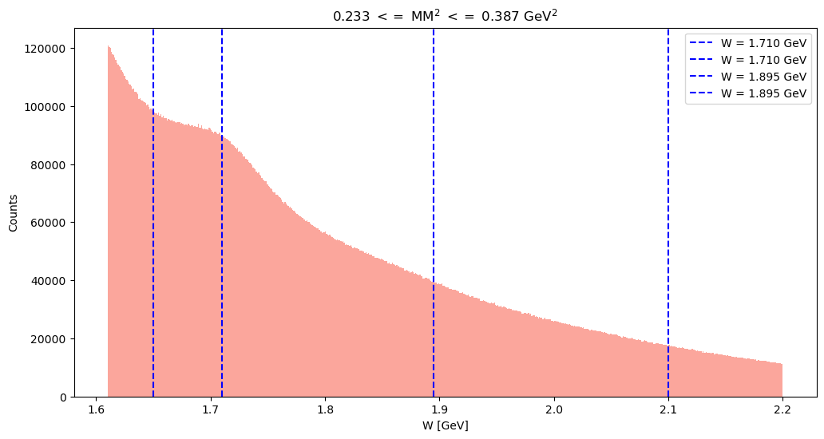
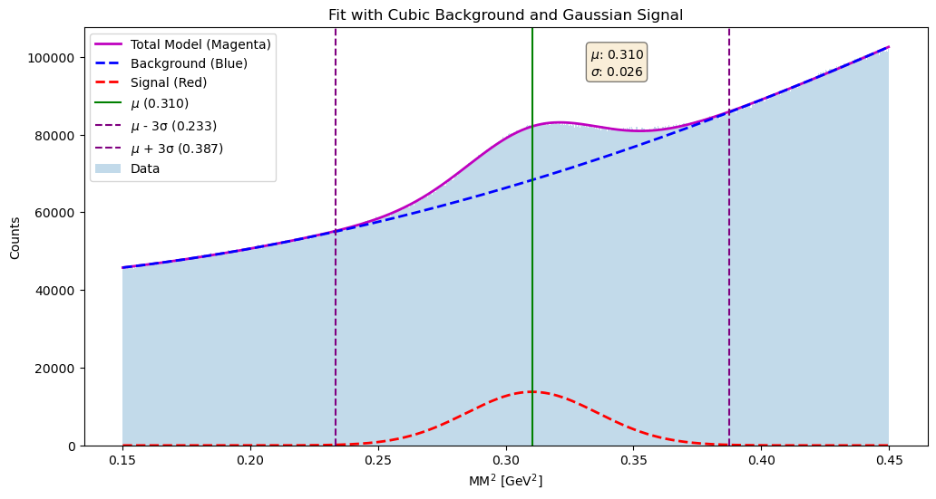
W Distribution after MM2 Cut around peak region
hello
Cut for peak region

Slide 41

Phi bin “center”
Key idea: check if the geometric center of the bin differs from the weighted mean of the histogram

Slide 42

Phi bin weighted mean as a function of W
Key idea: the weighted mean of the phi distribution for each phi bin appears to have some dependence on the W bin

