Slide 1


The strangest non-strange meson is not so strange after all
Saša Ceci
Ruđer Bošković Institute

Slide 2
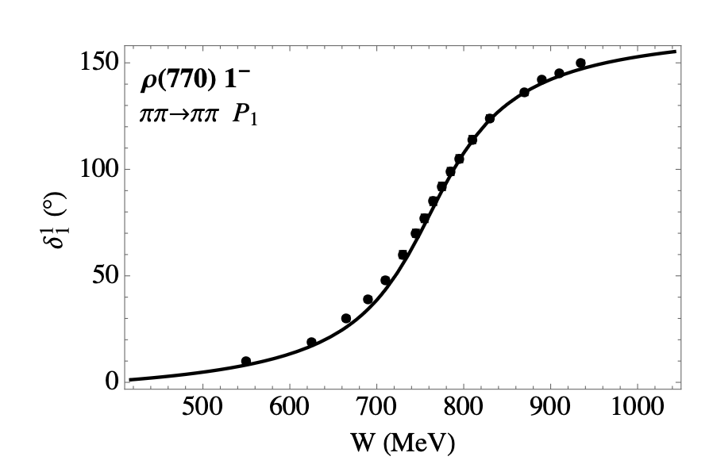
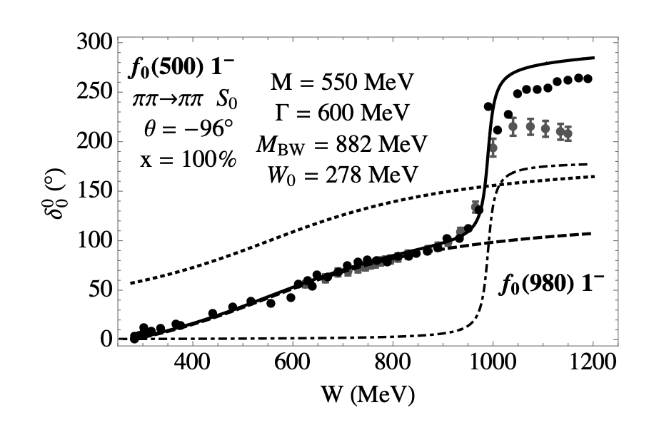

Slide 5
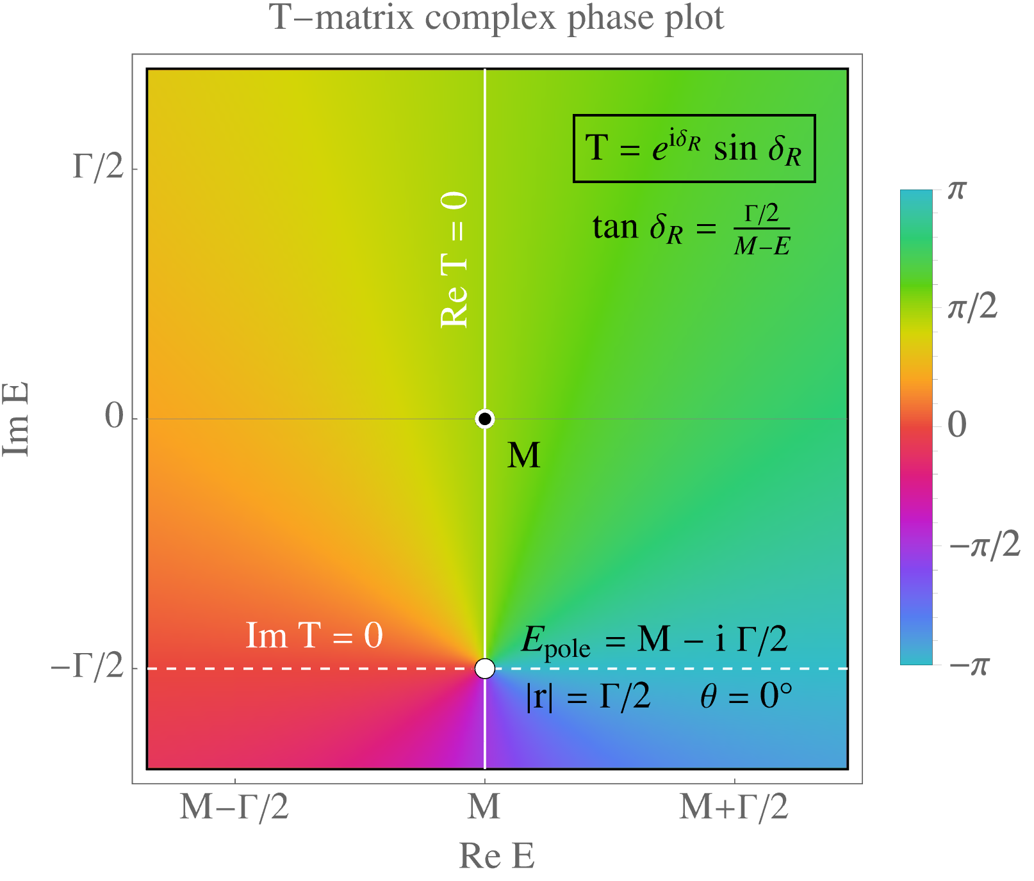

Slide 6
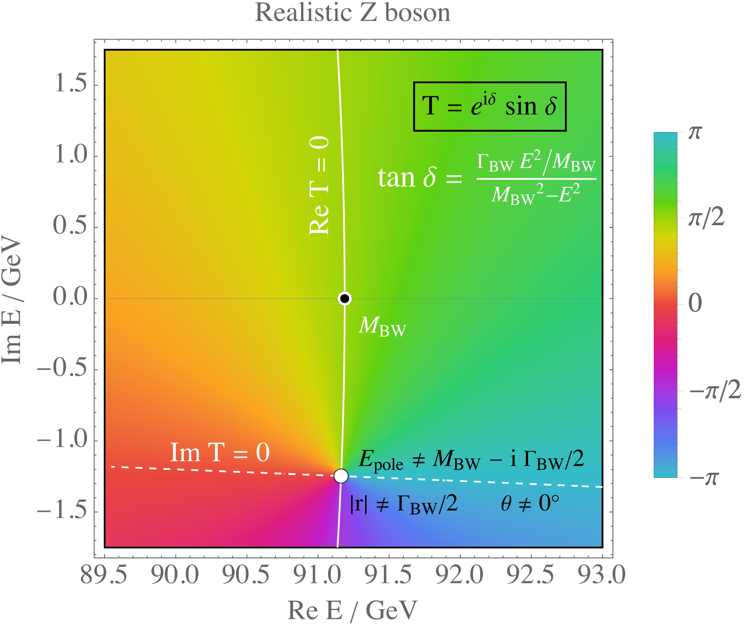

Slide 7
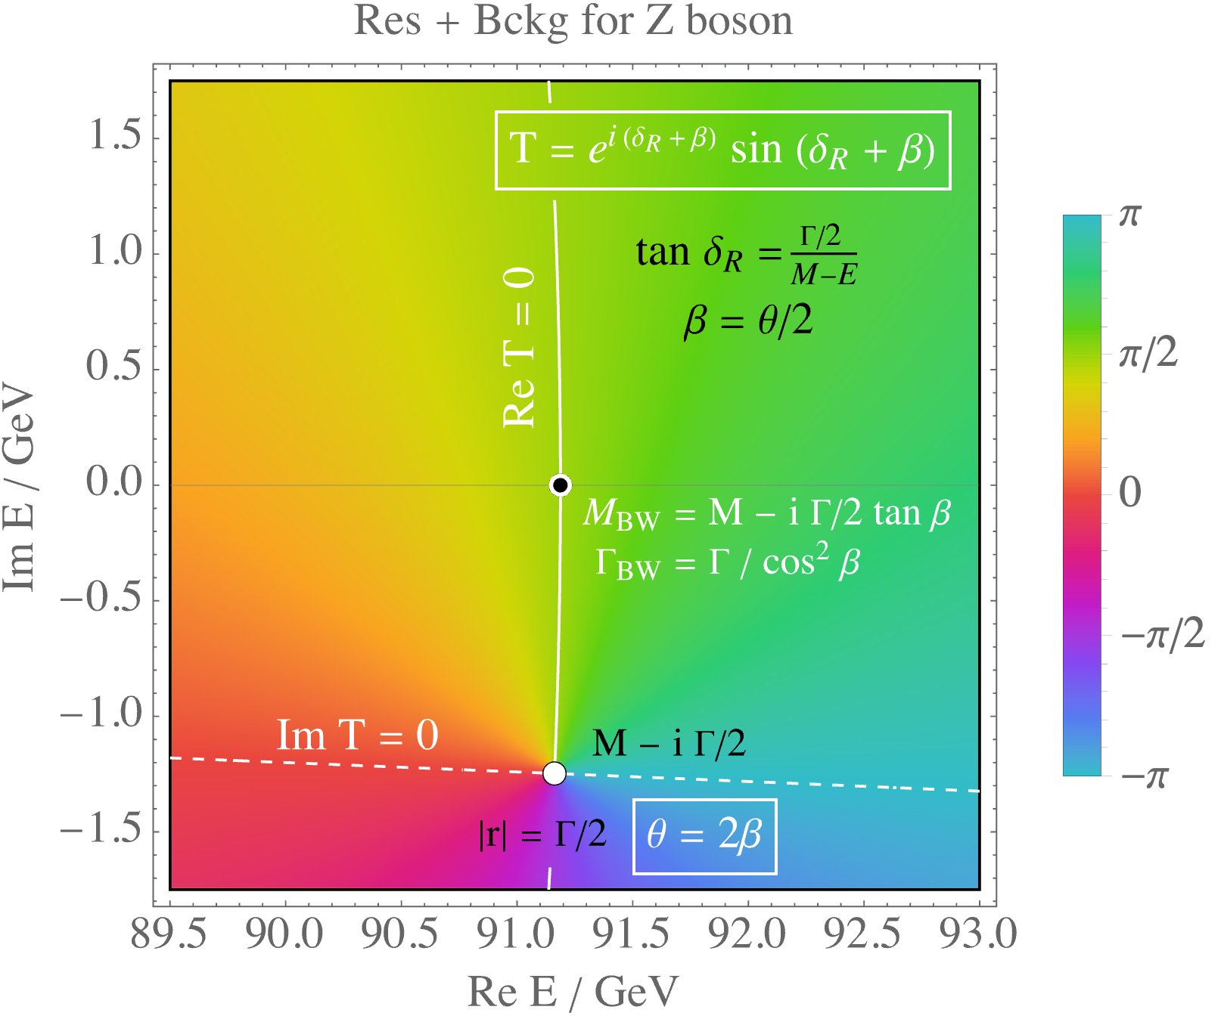

Slide 9
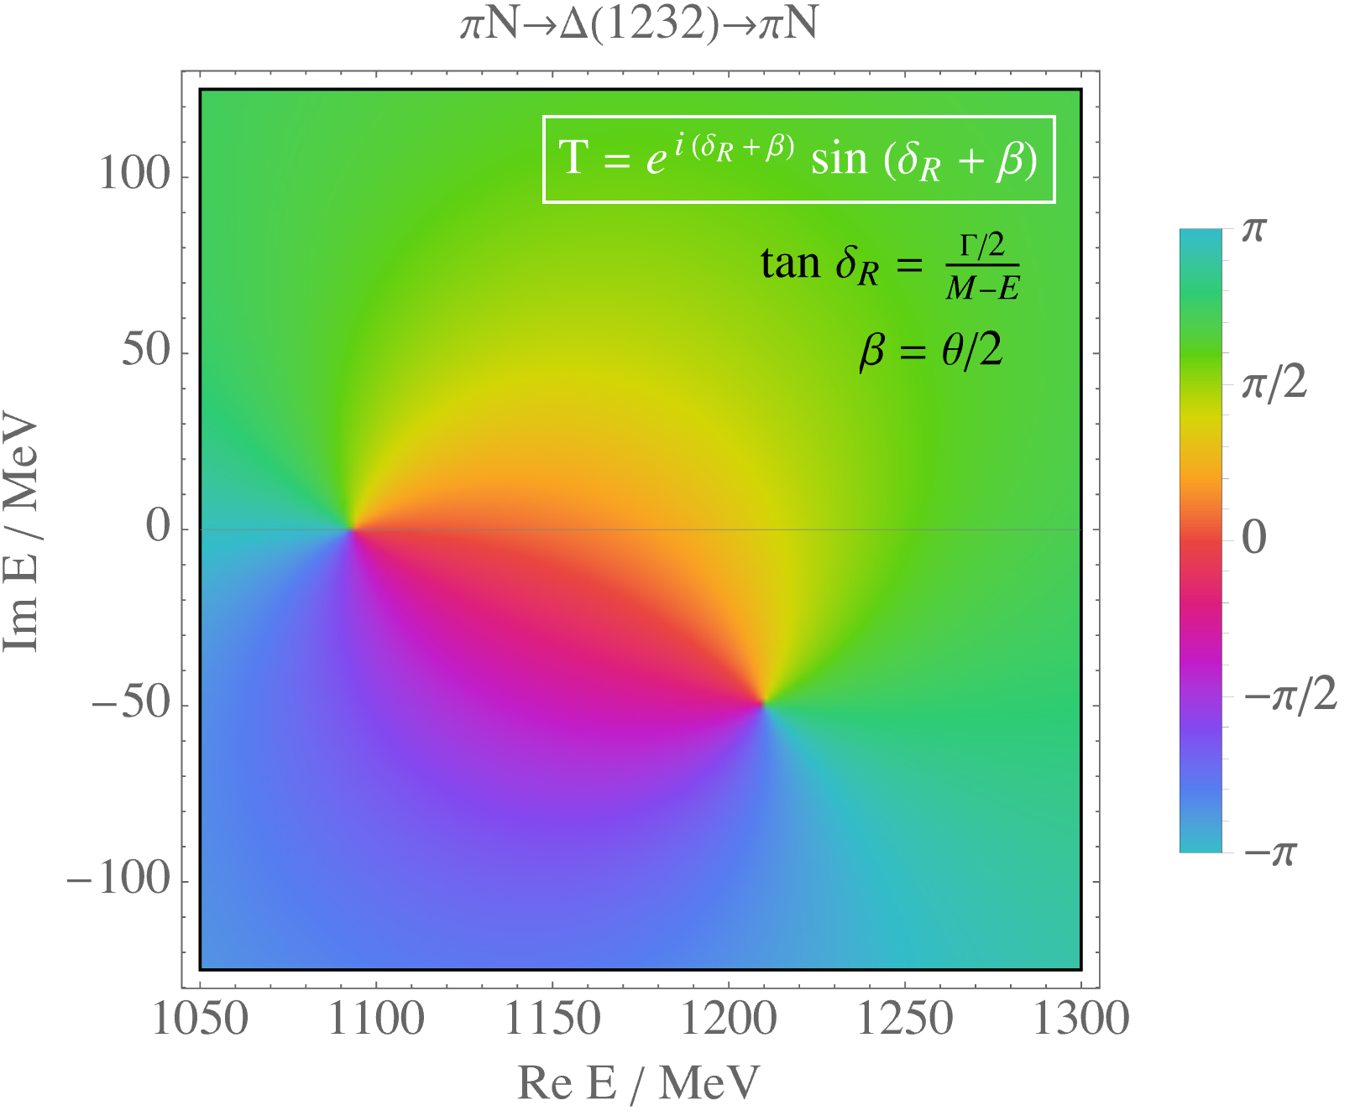

Slide 10


Slide 11
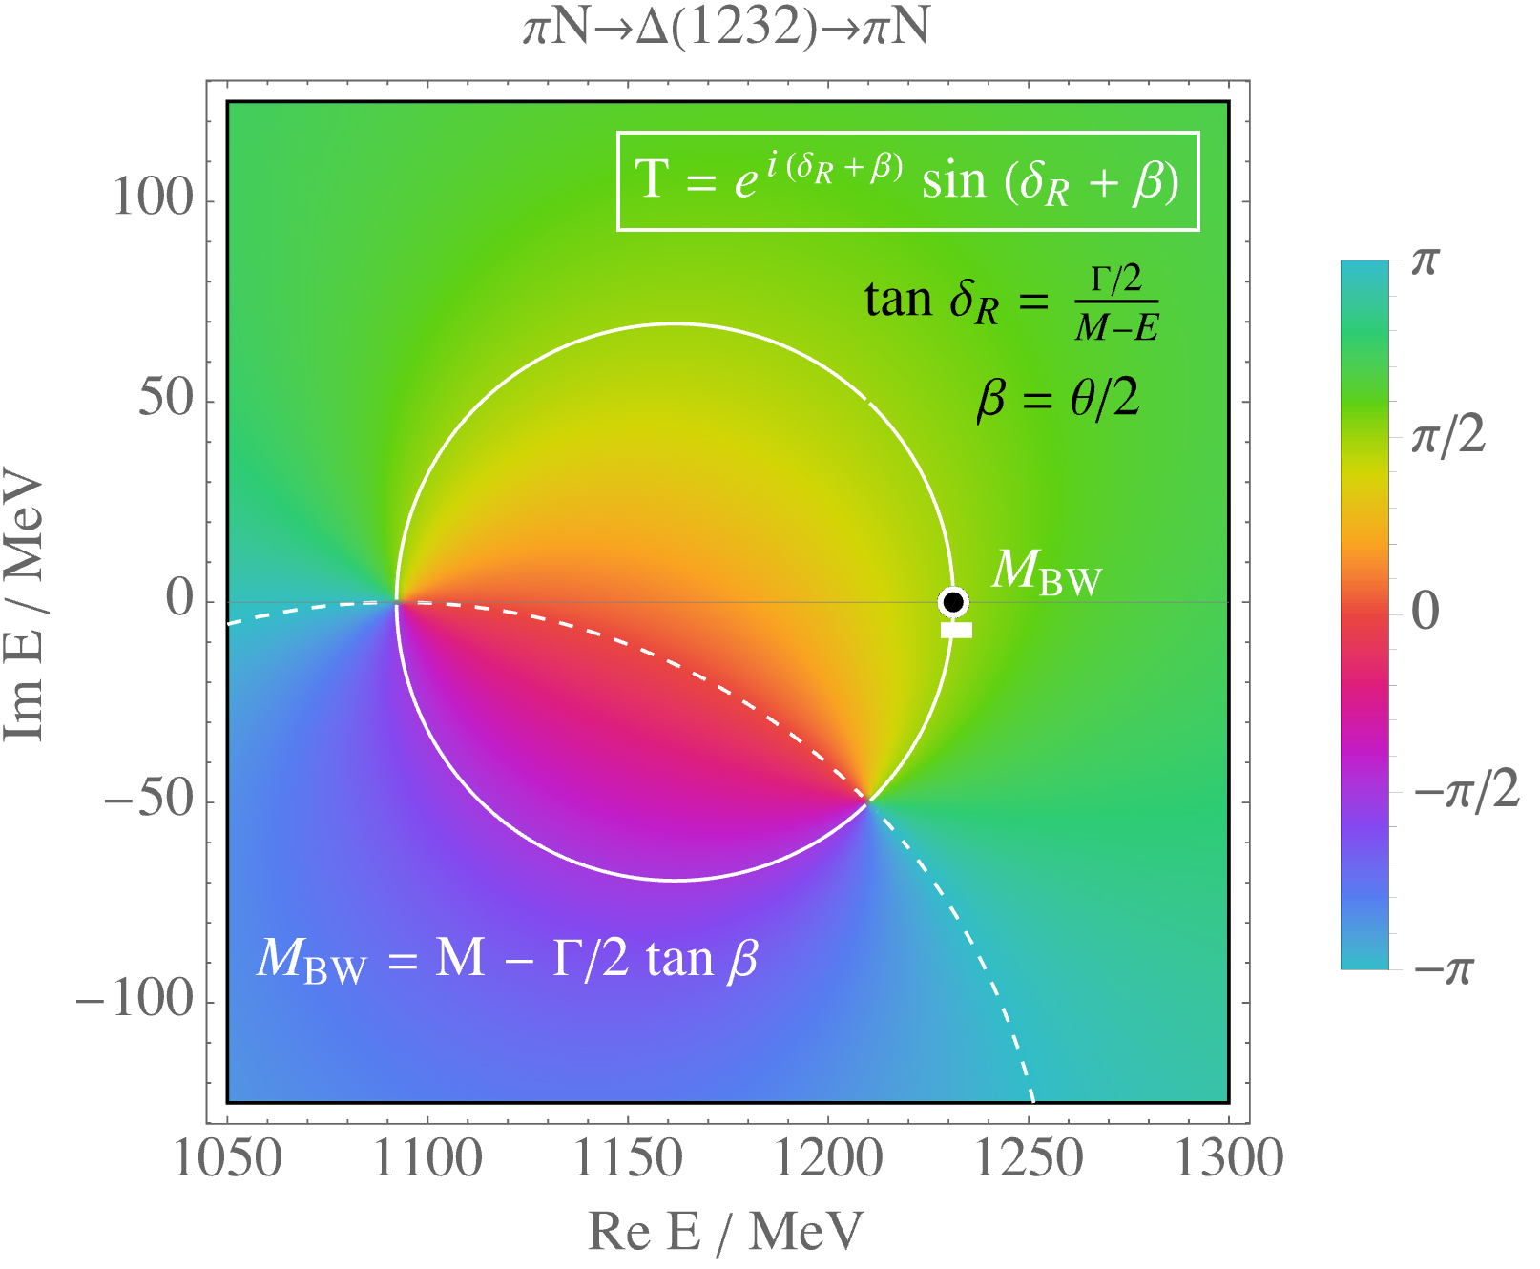

Slide 12
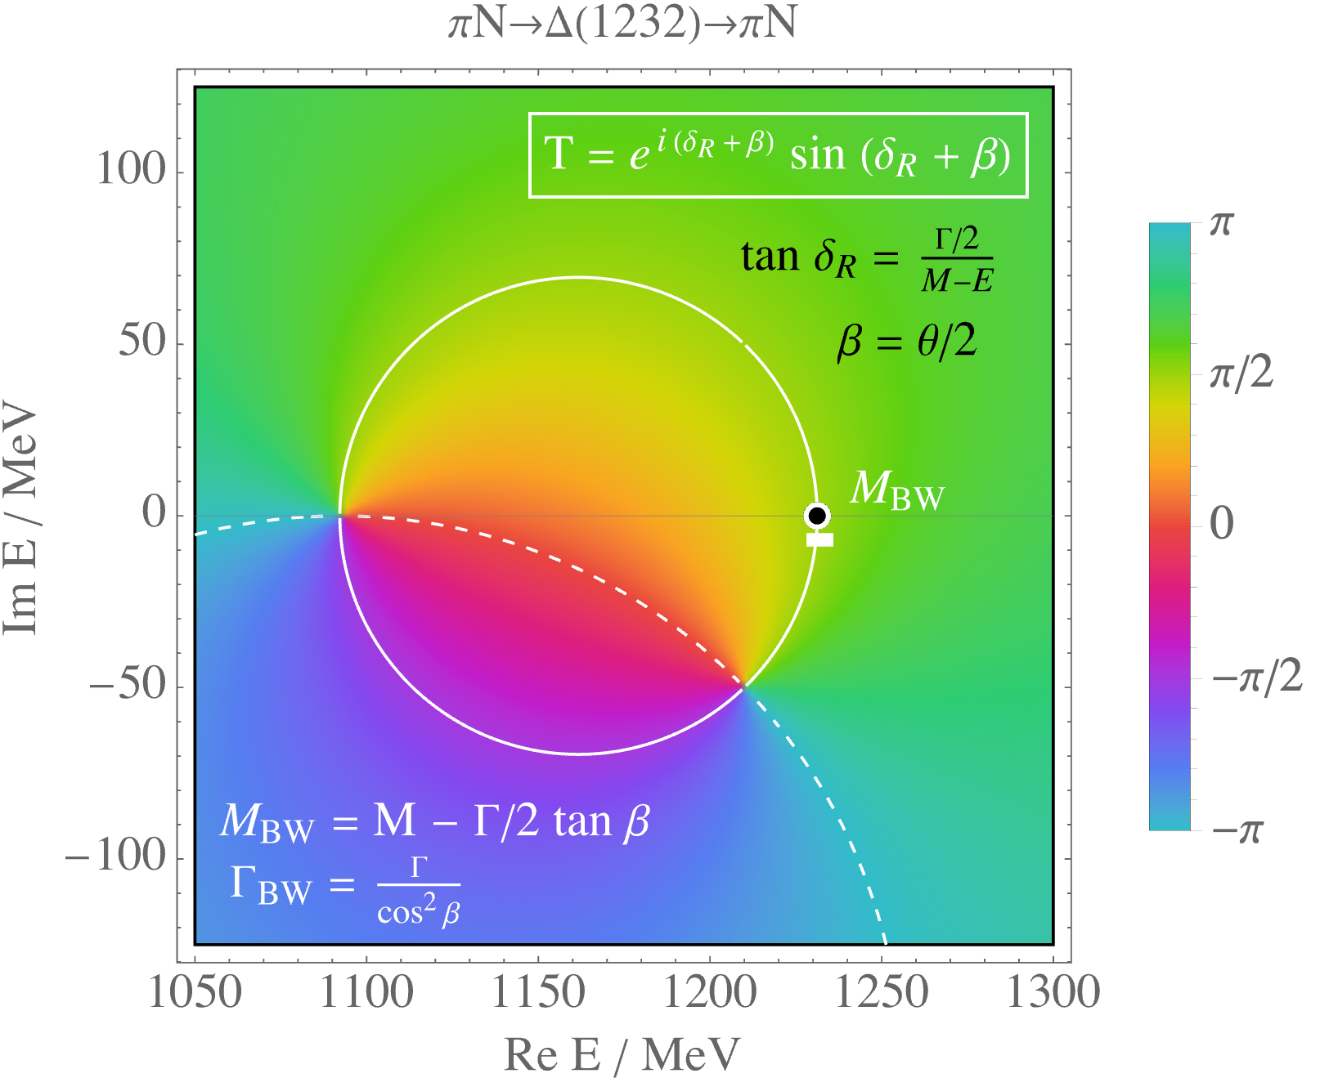

Slide 13
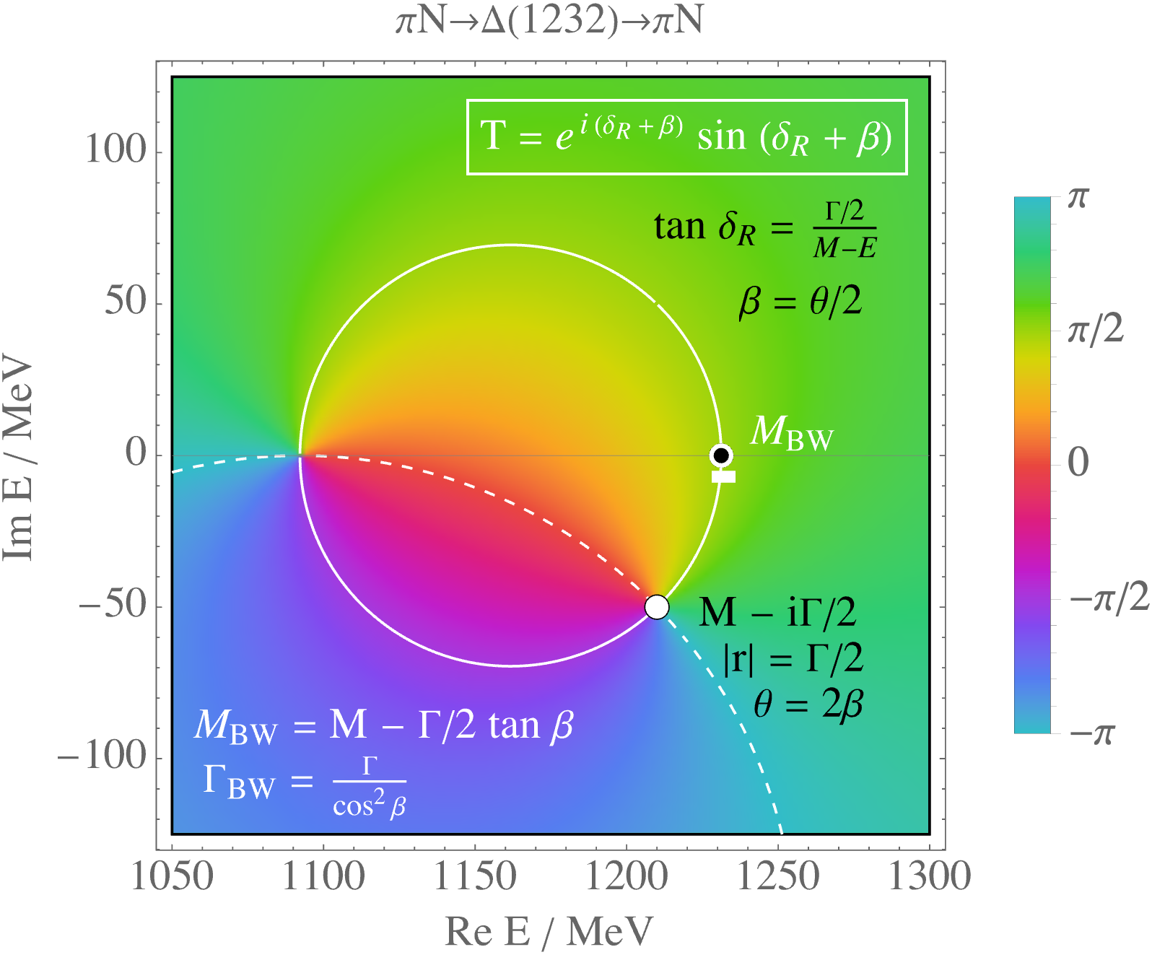

Slide 14
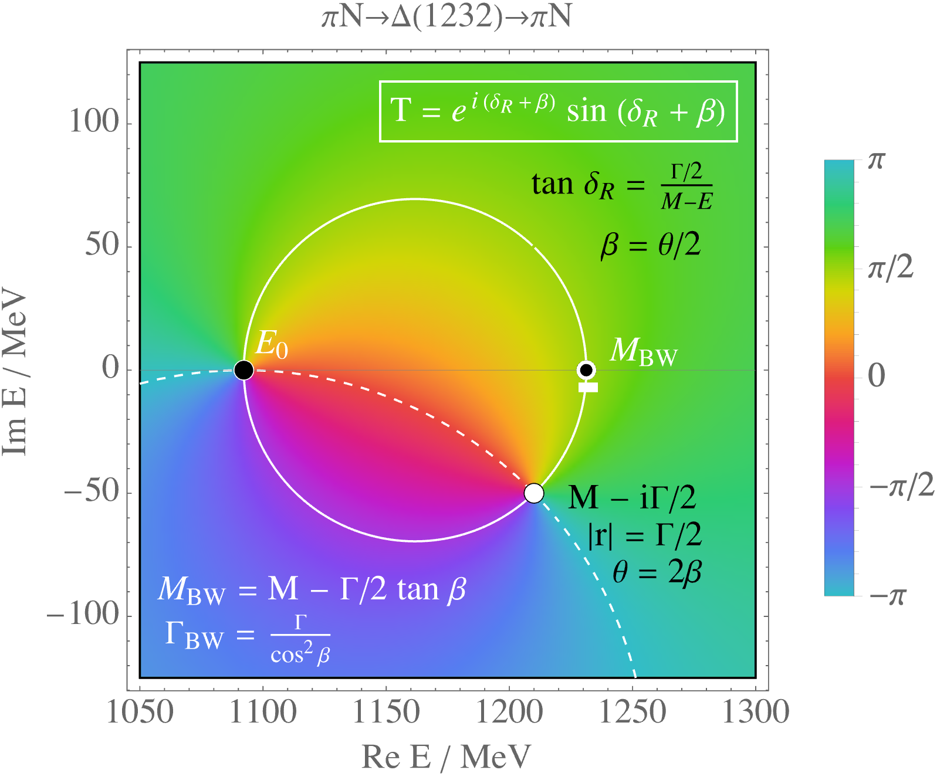

Slide 15
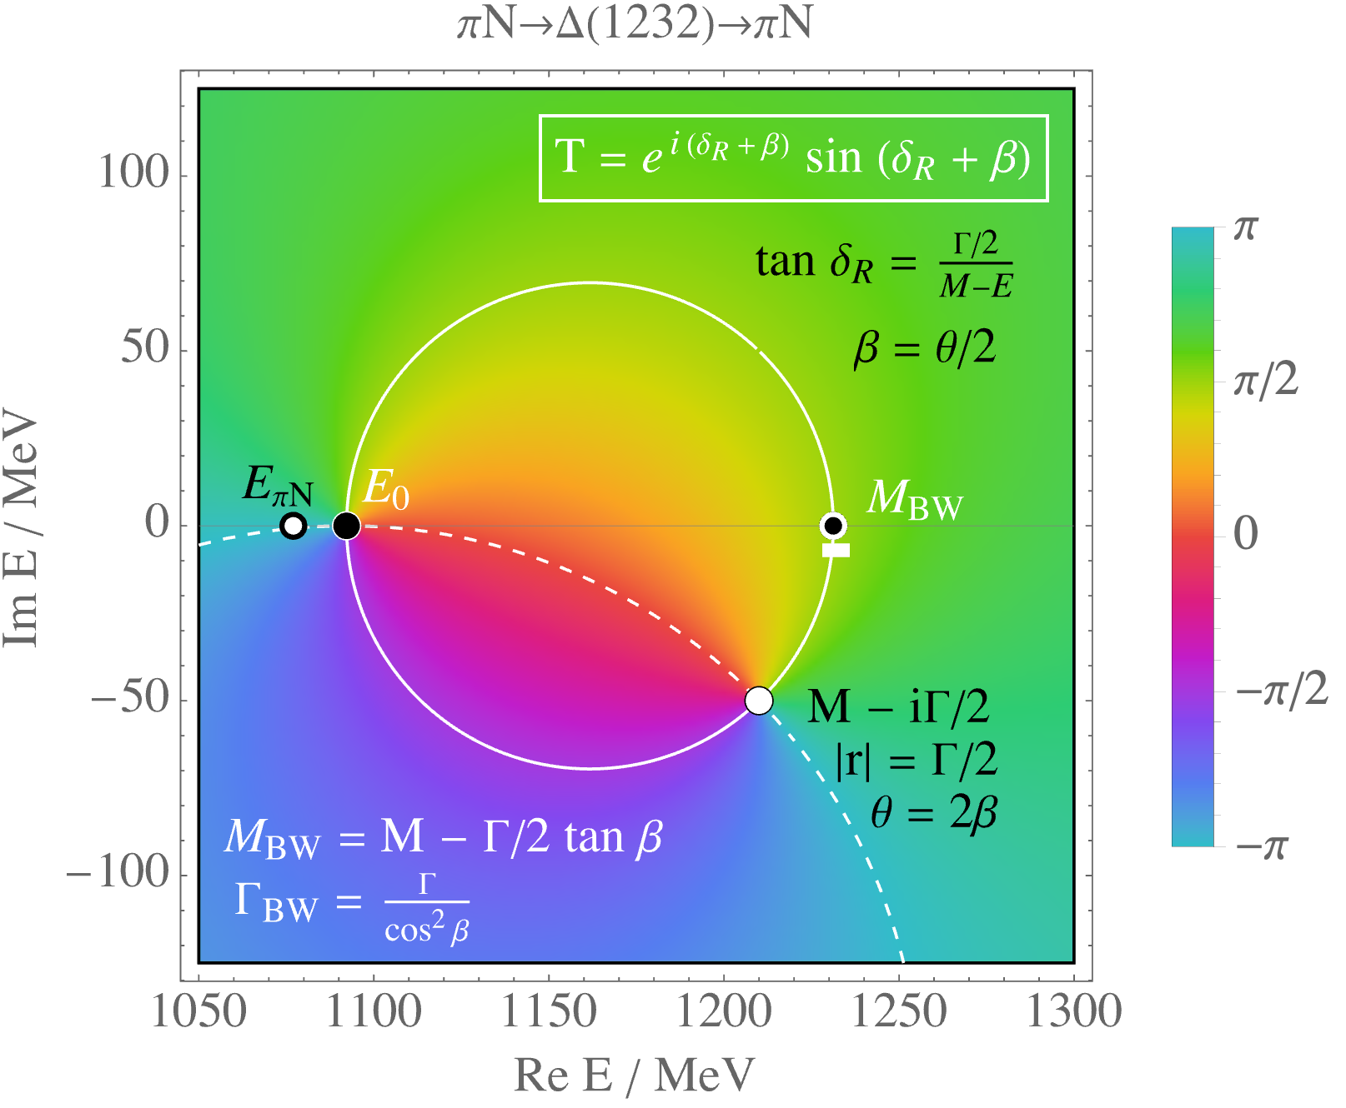

Slide 16
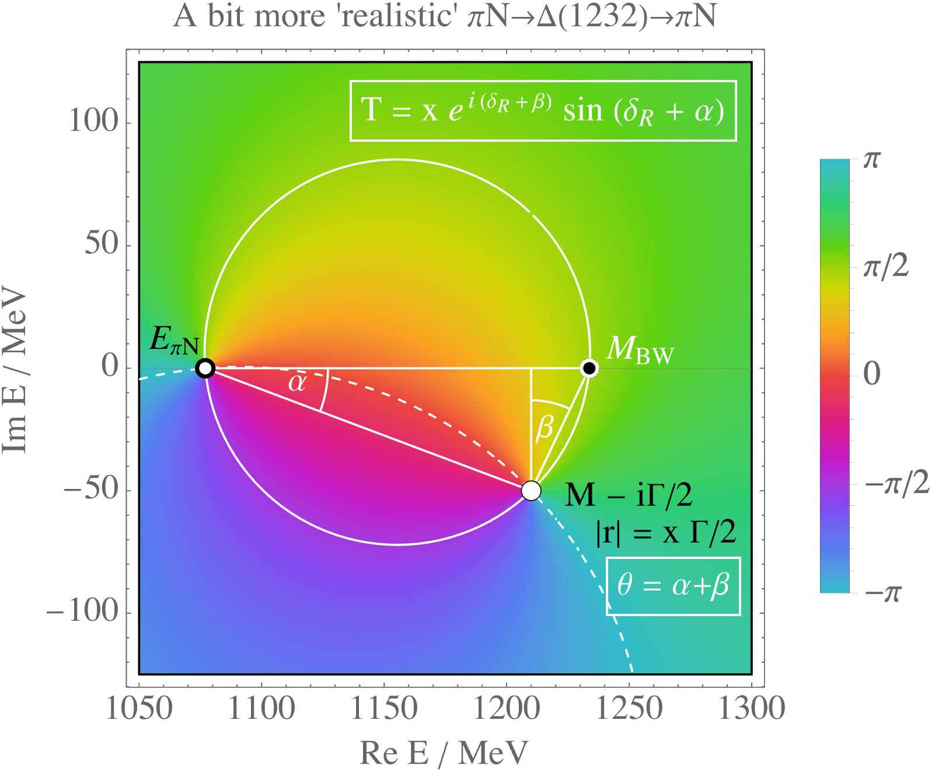

Slide 17
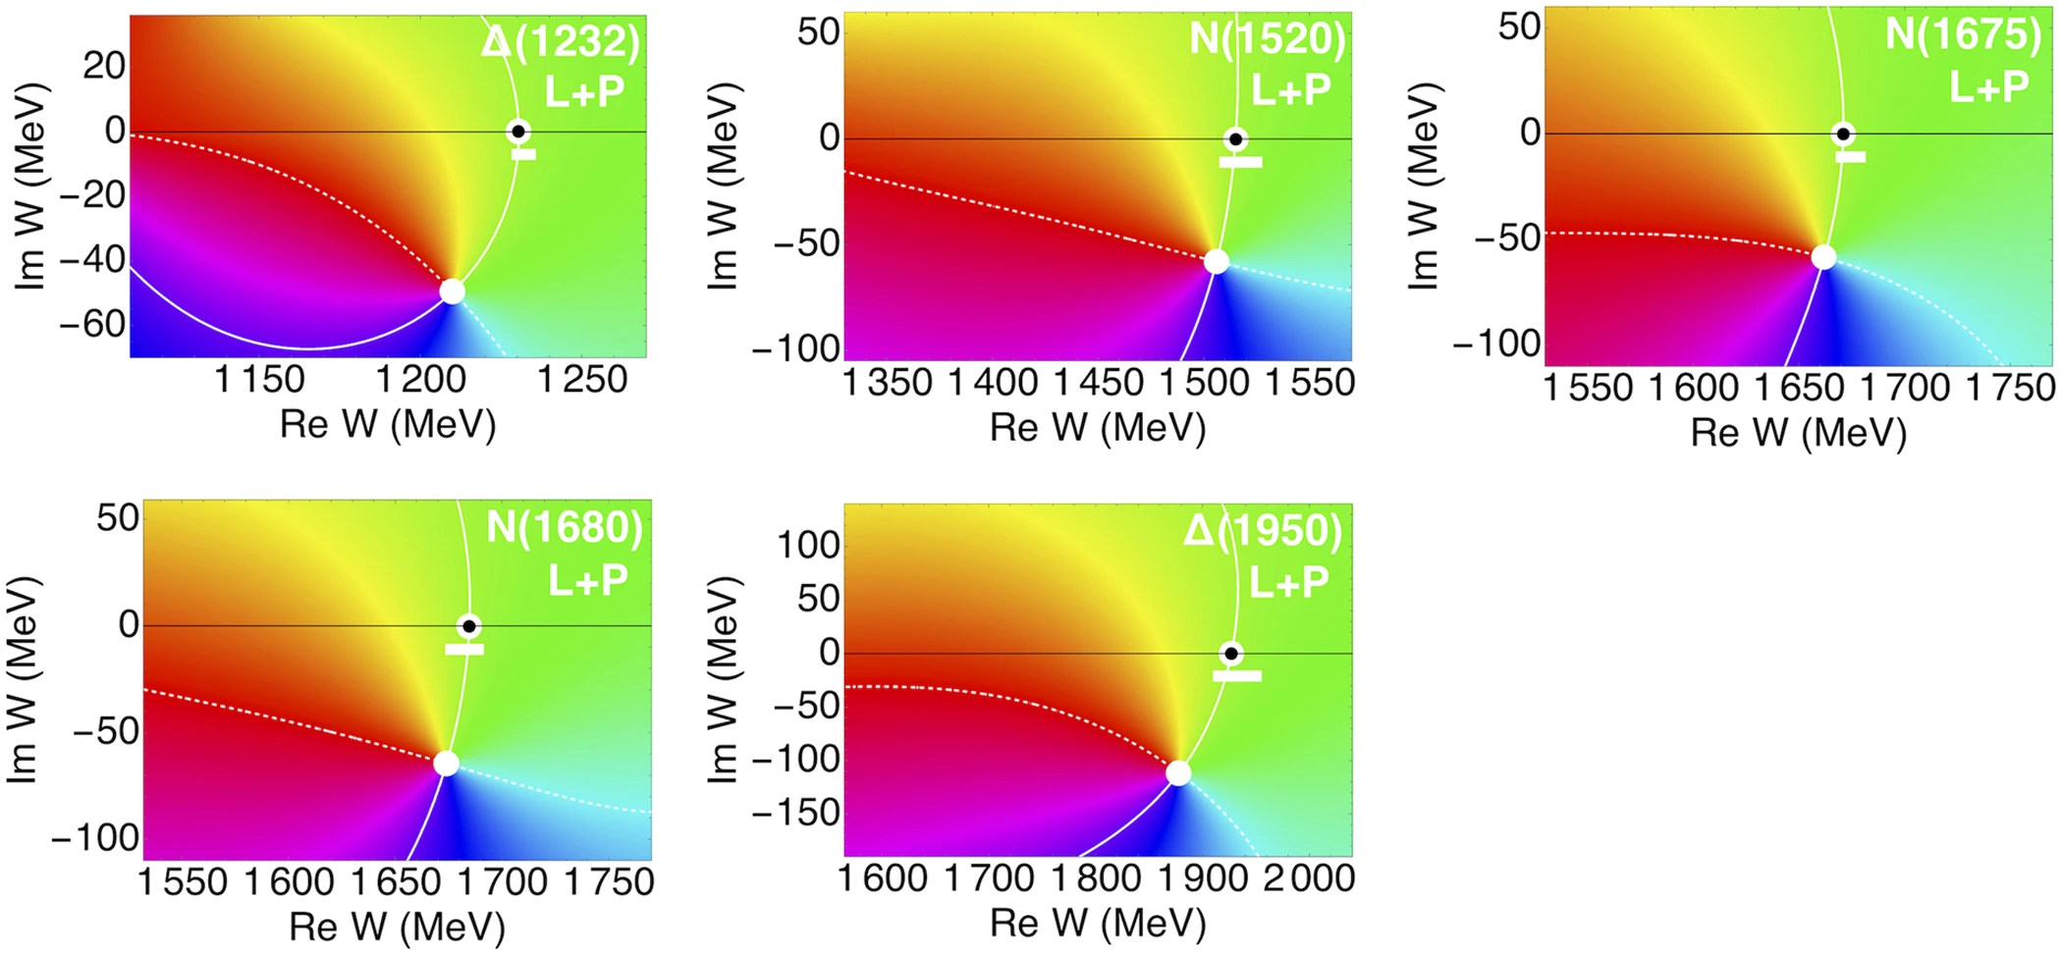

Slide 18
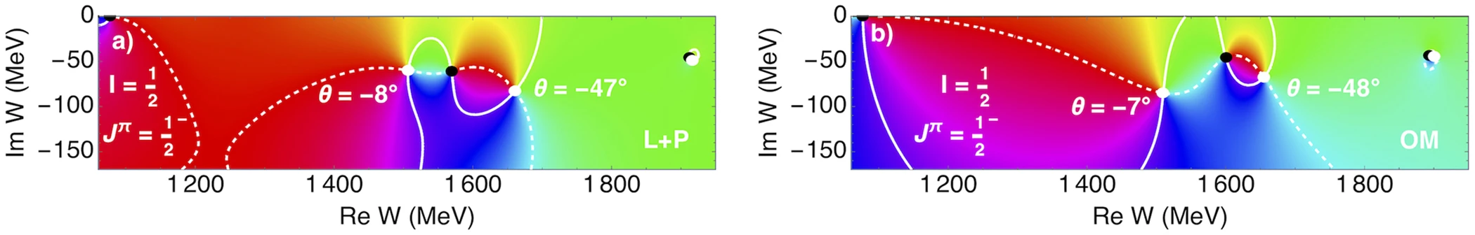

Slide 19
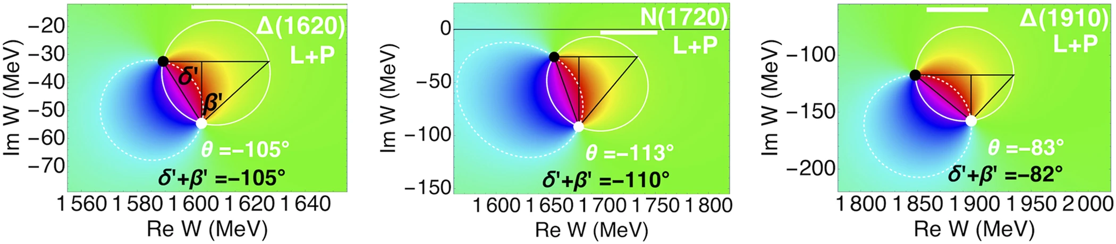

Slide 20
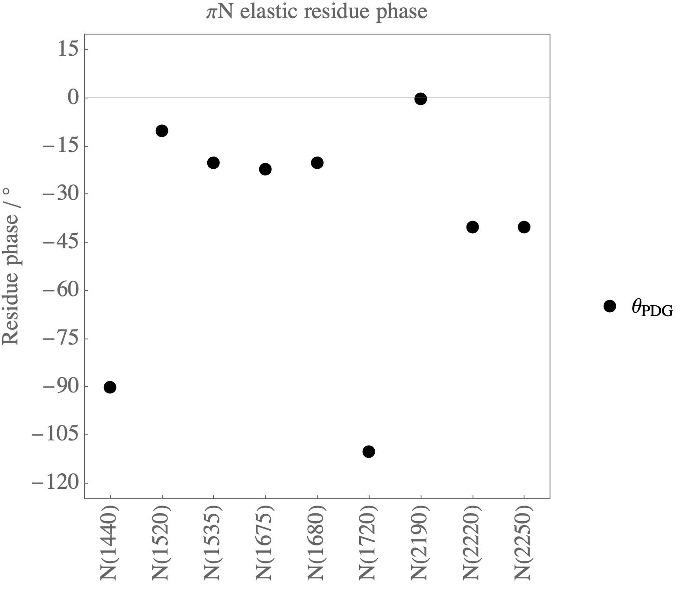
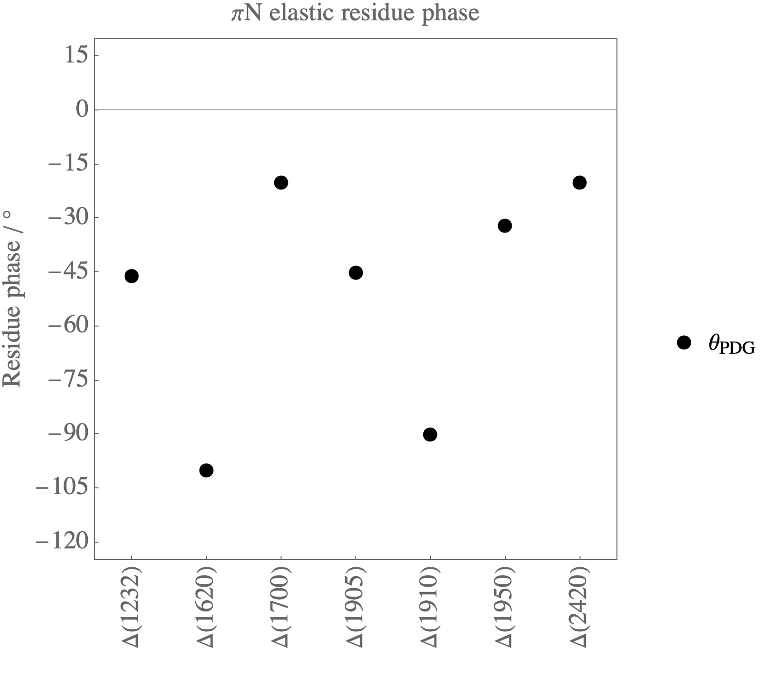

Slide 21
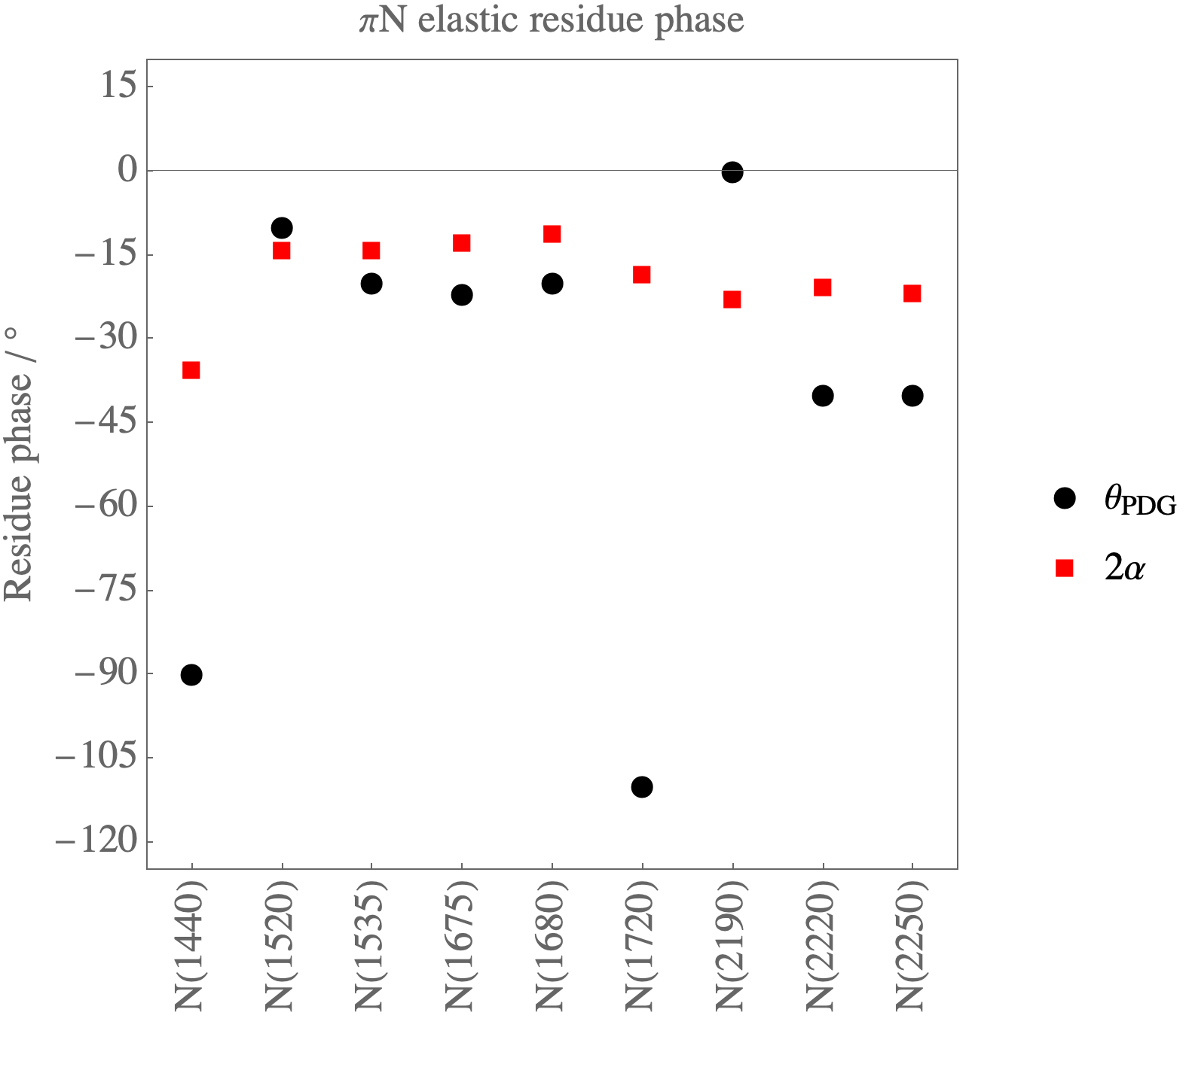
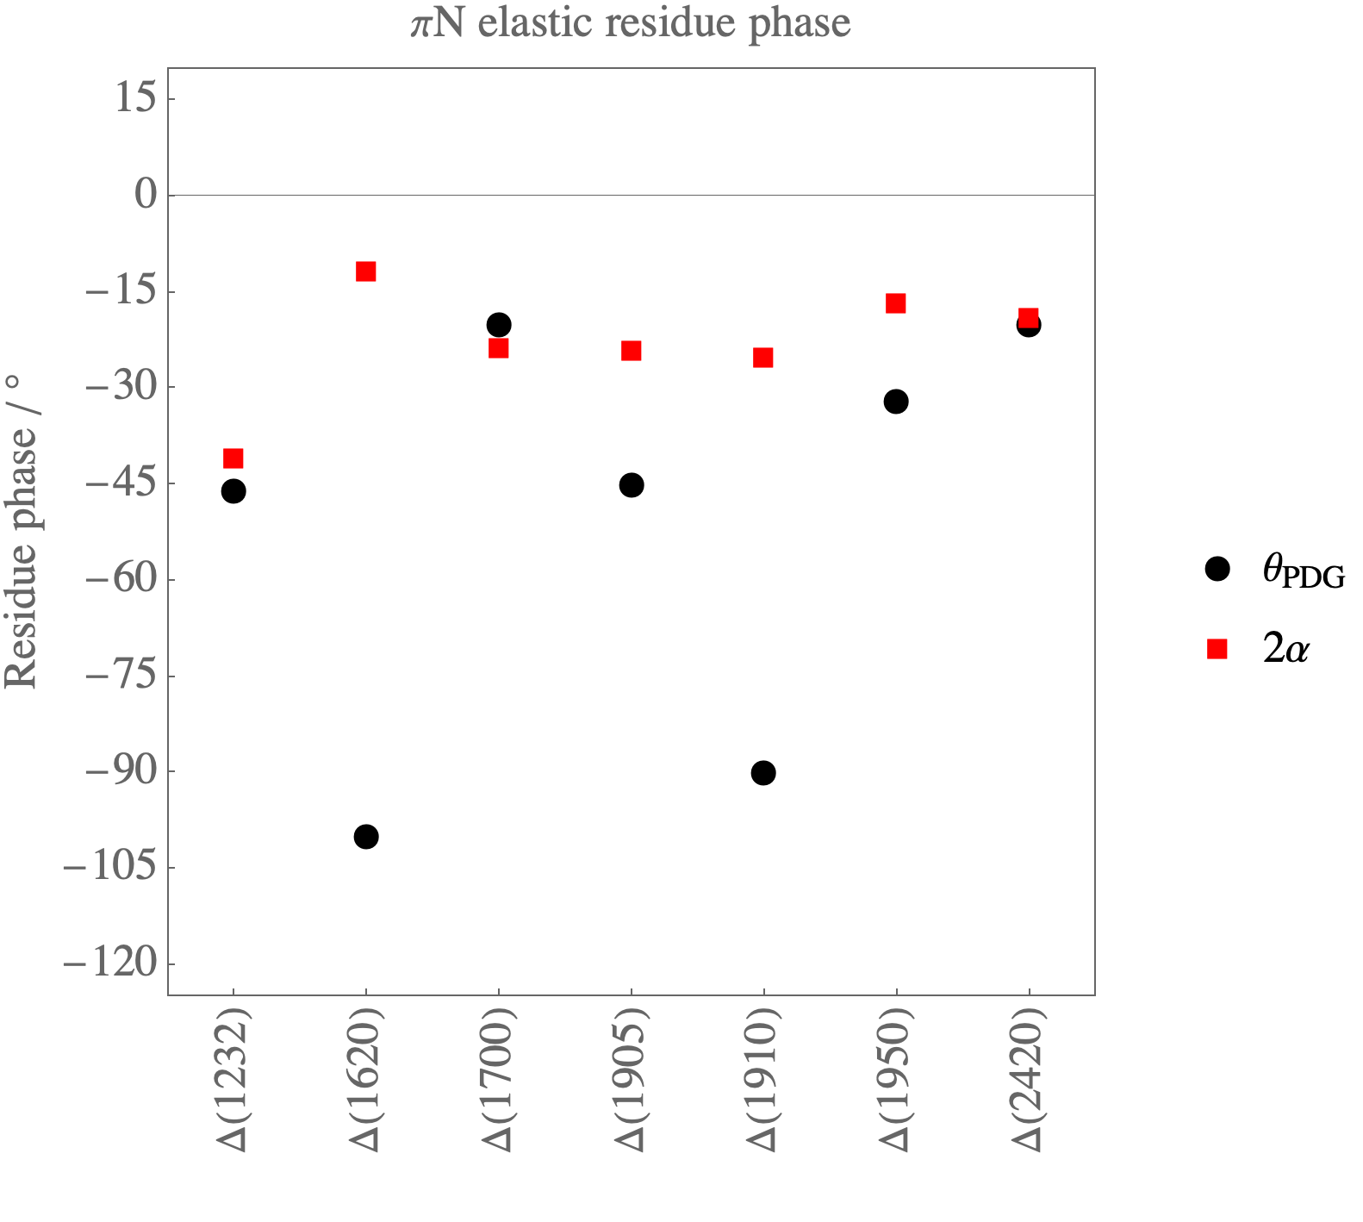

Slide 22
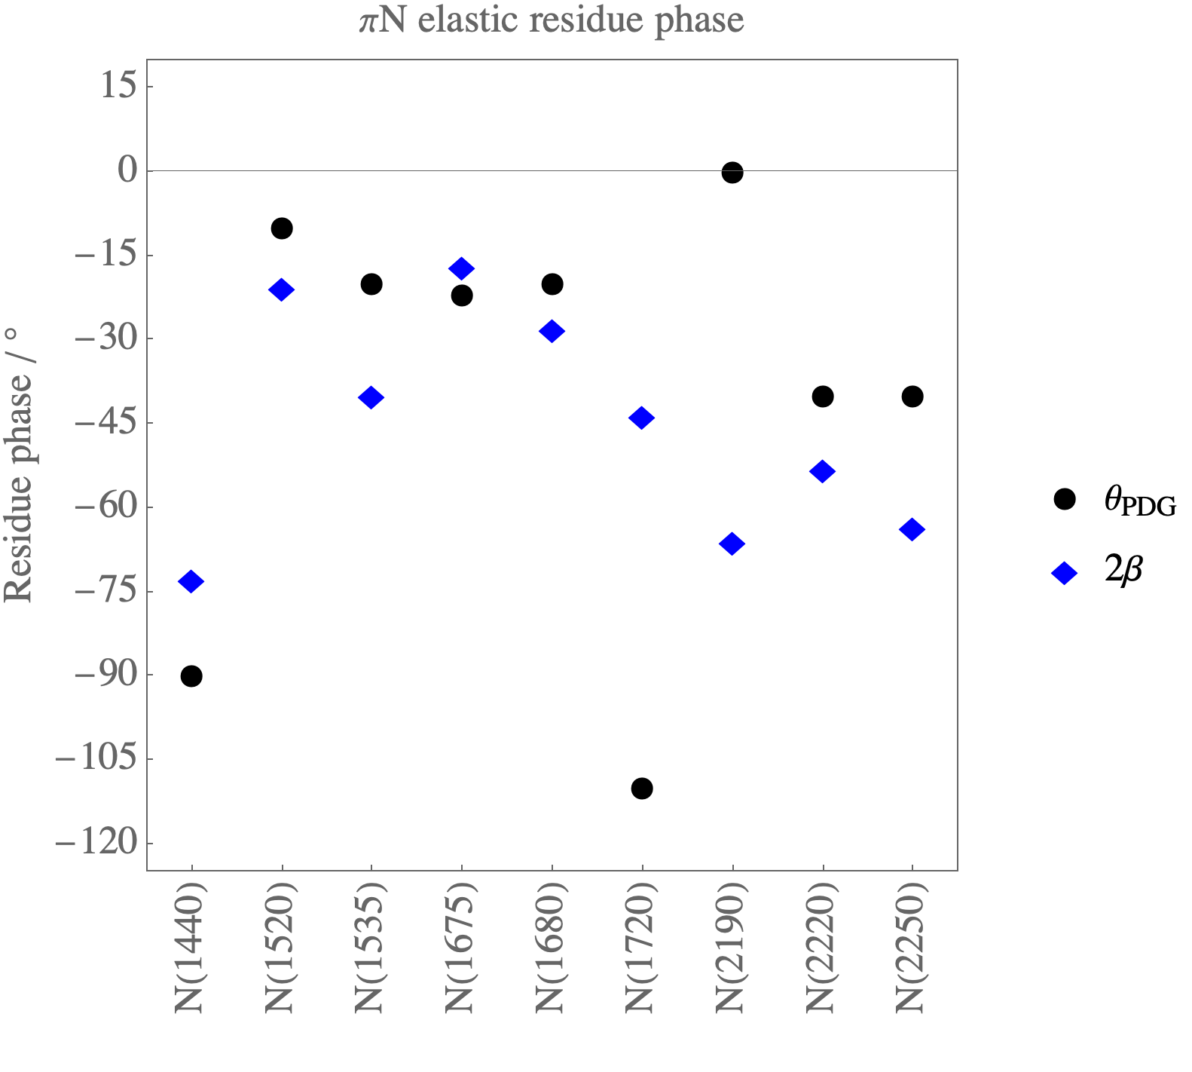
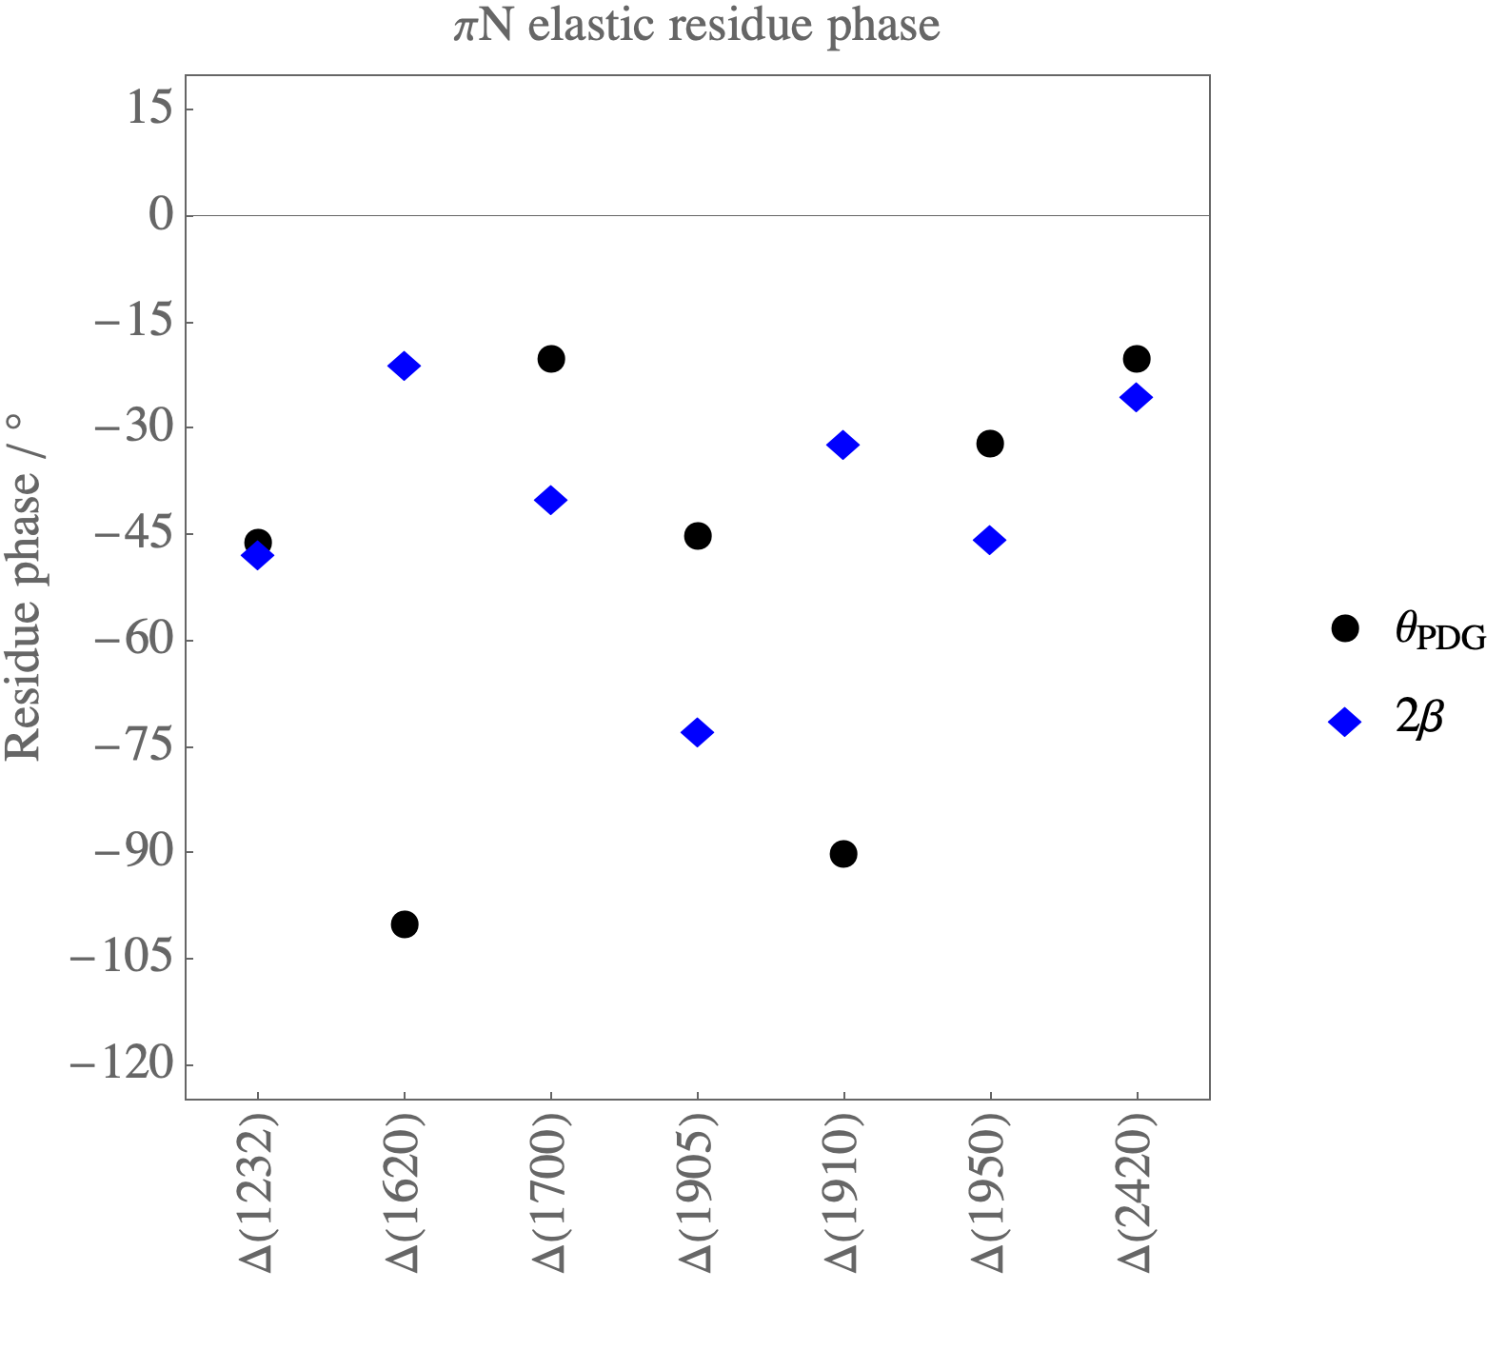

Slide 23
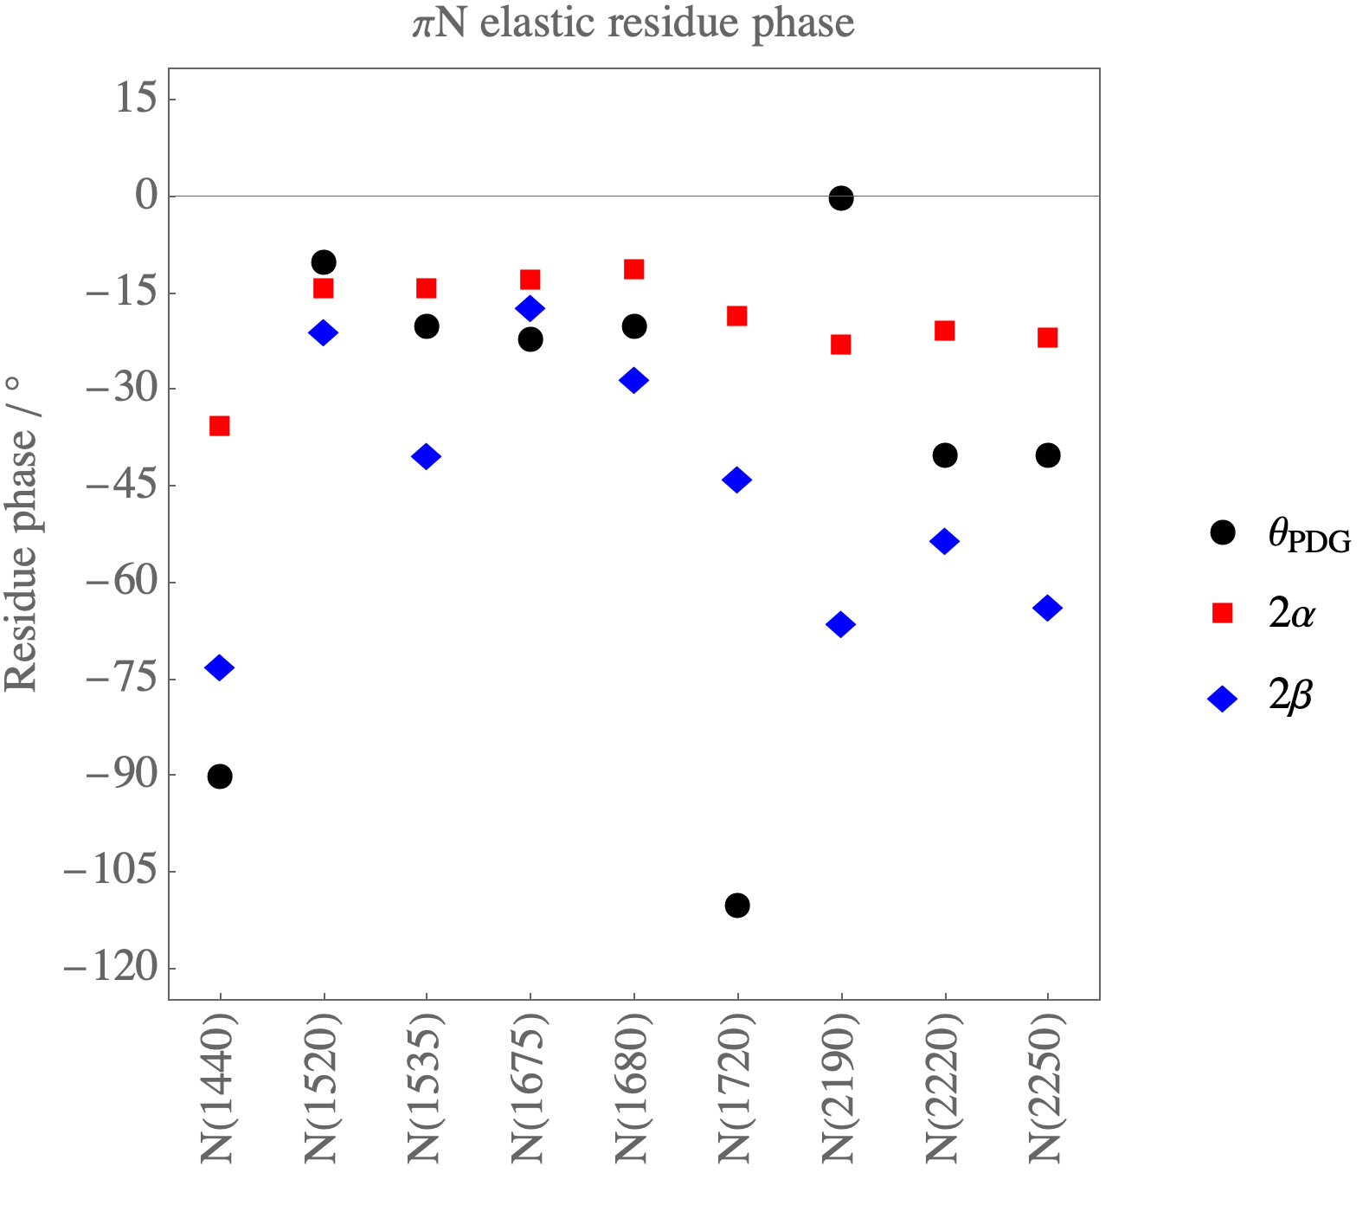
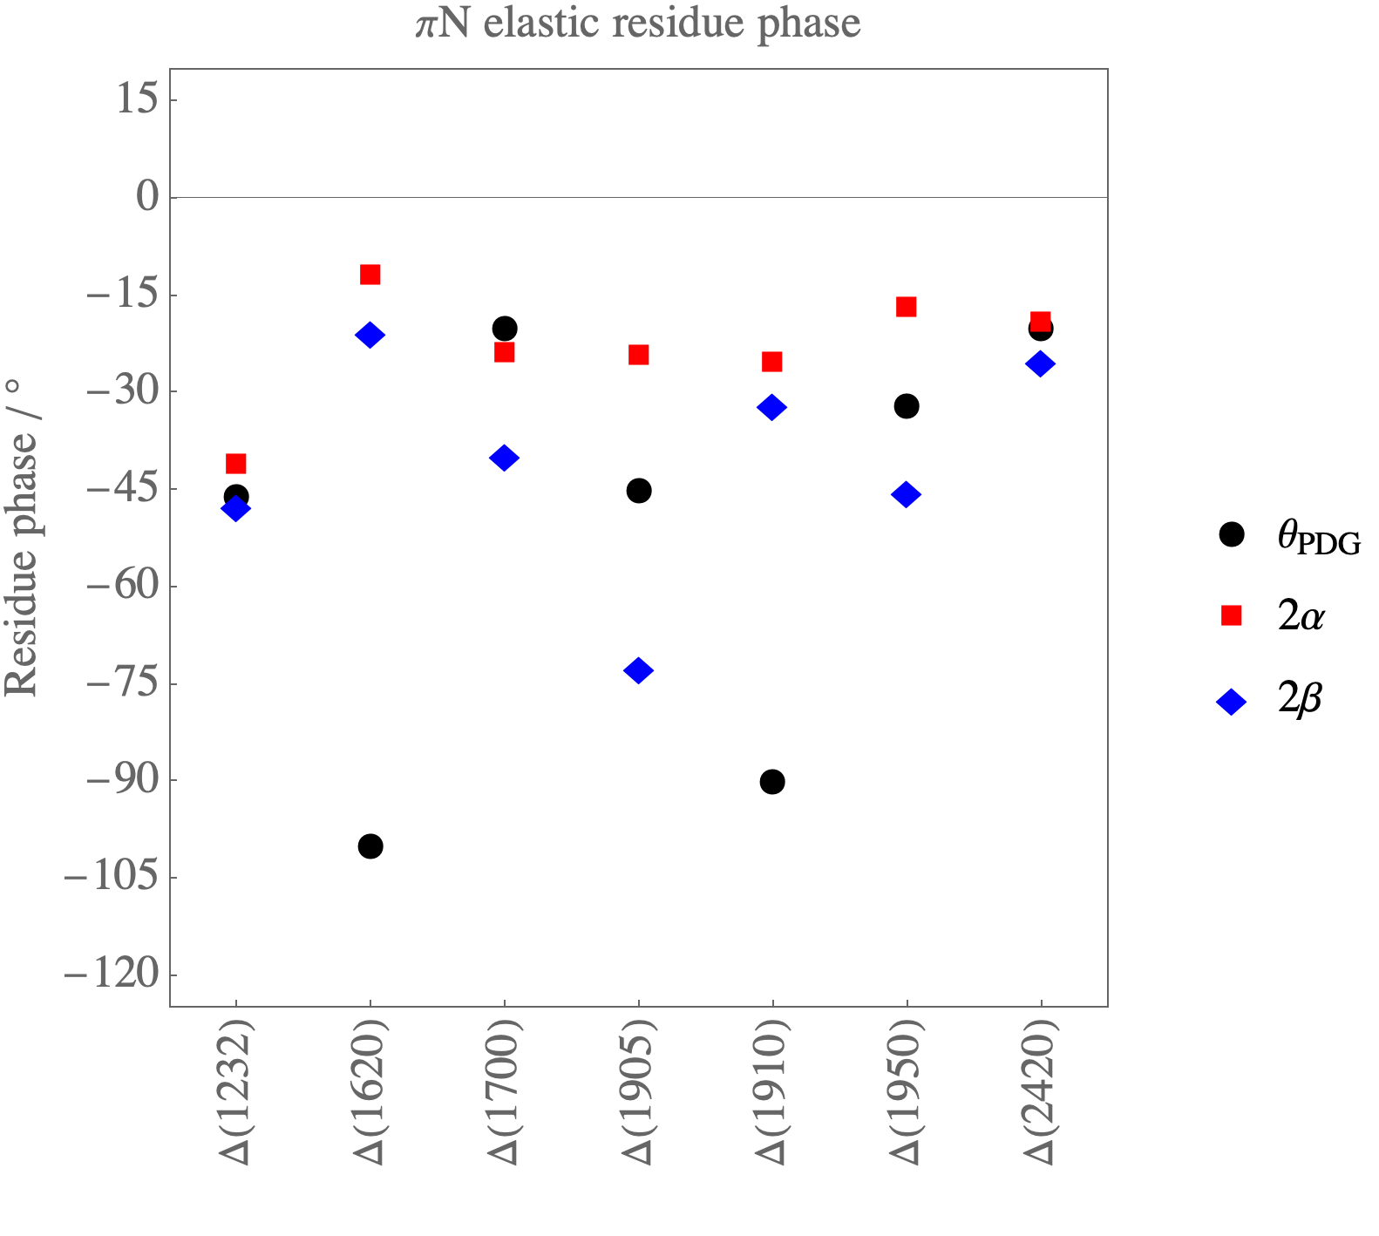

Slide 24
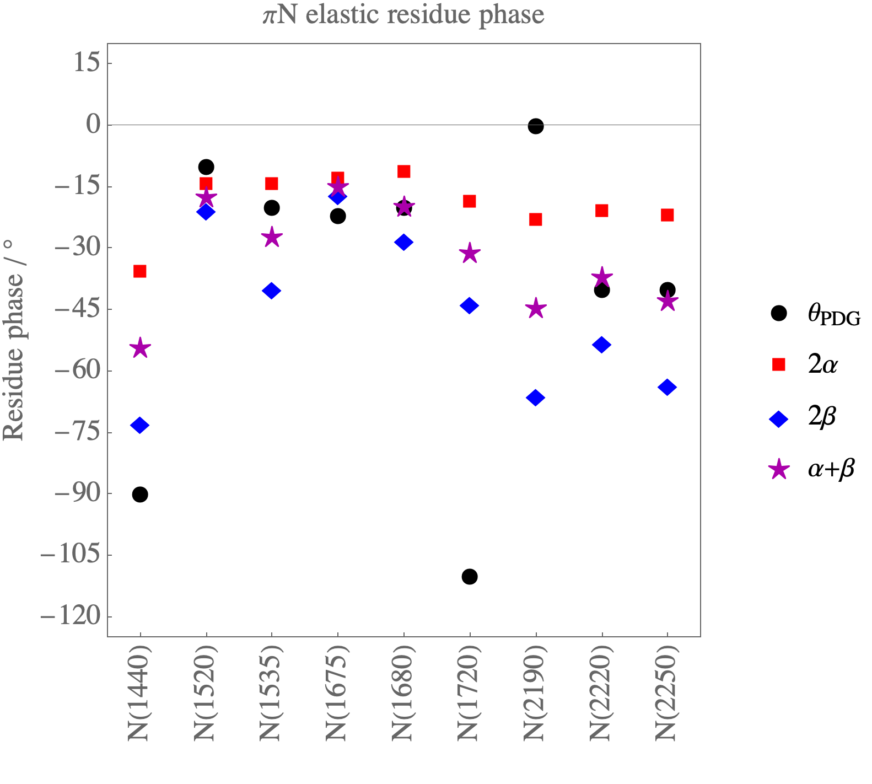
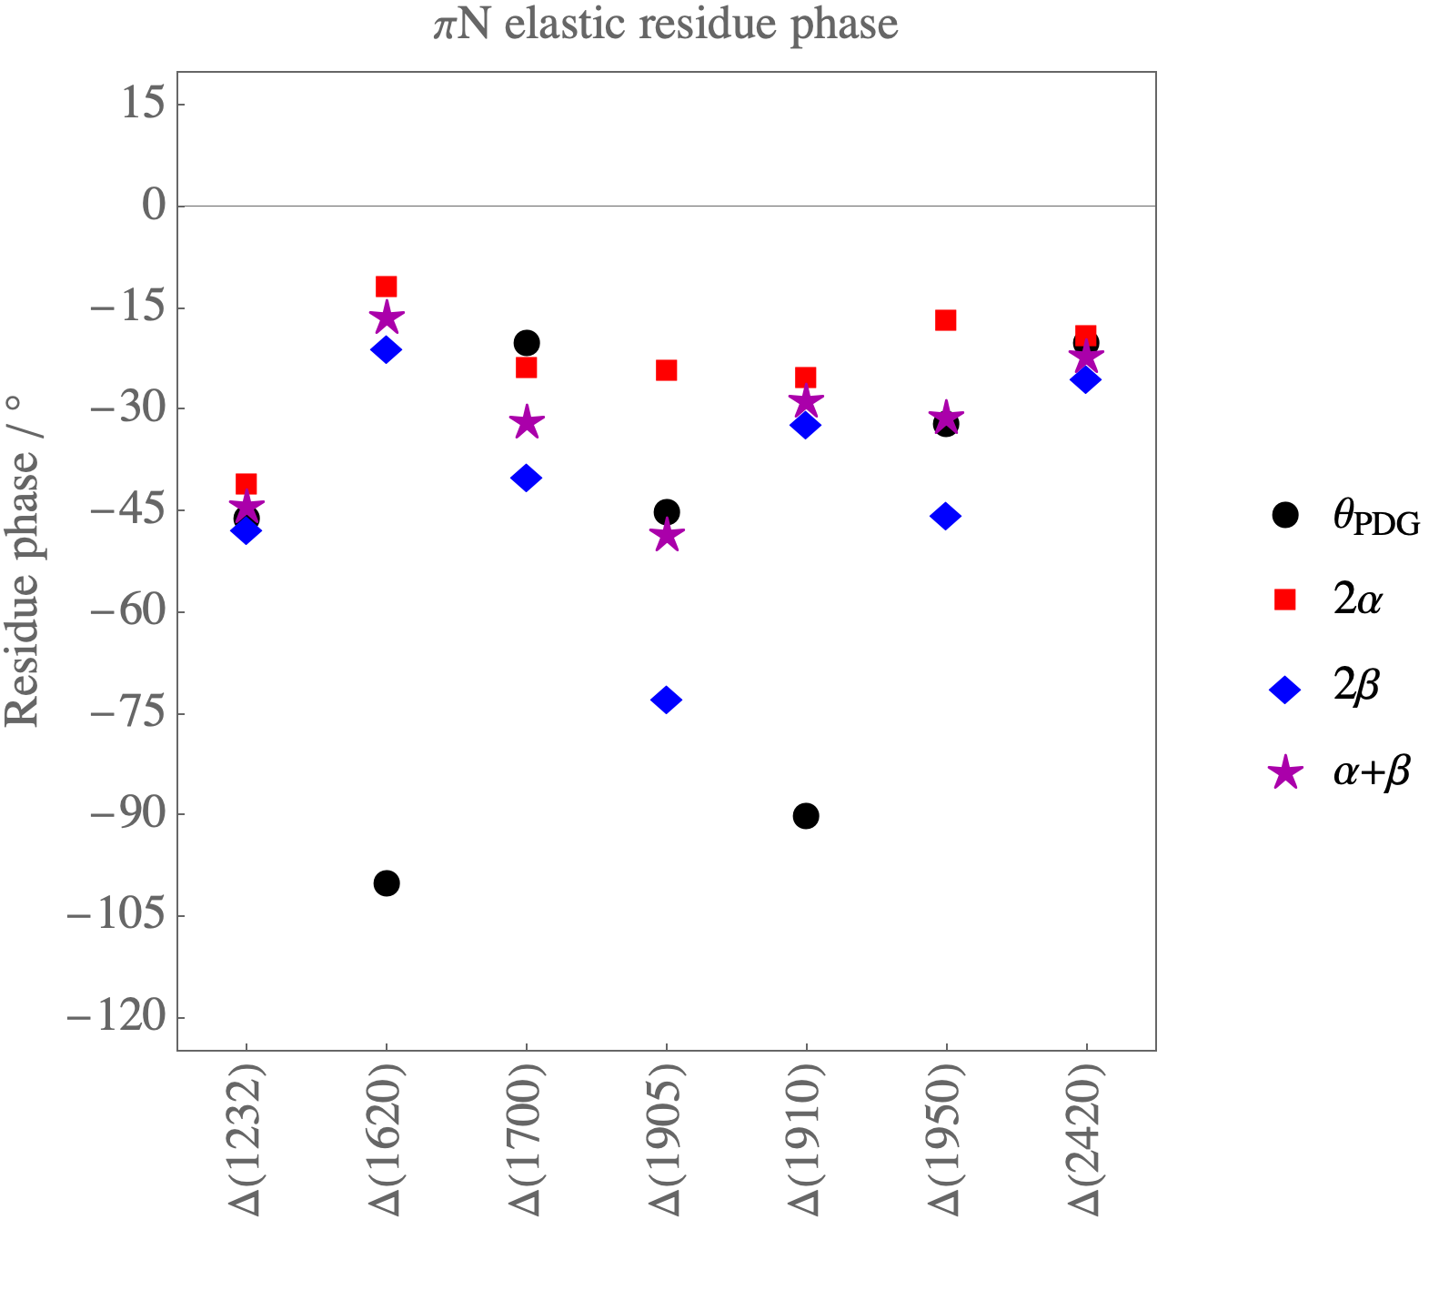

Slide 25
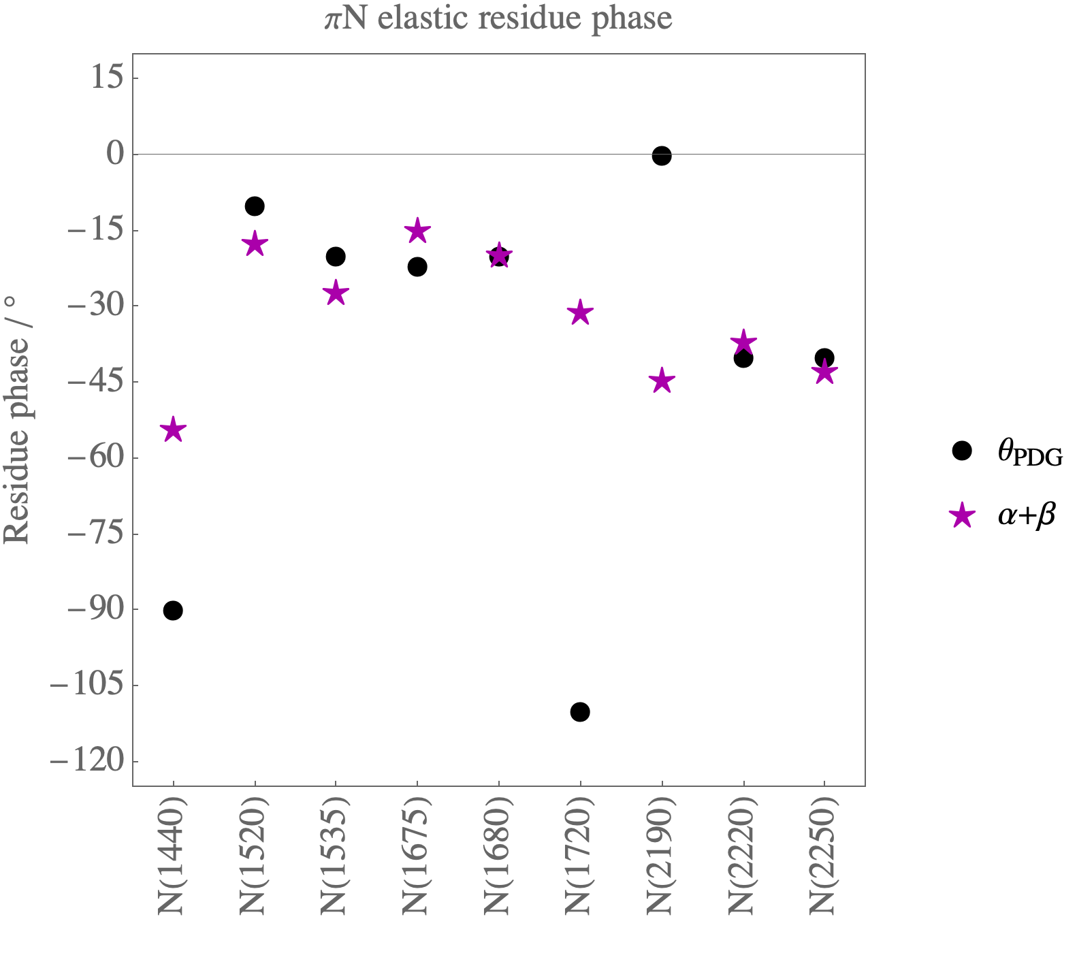
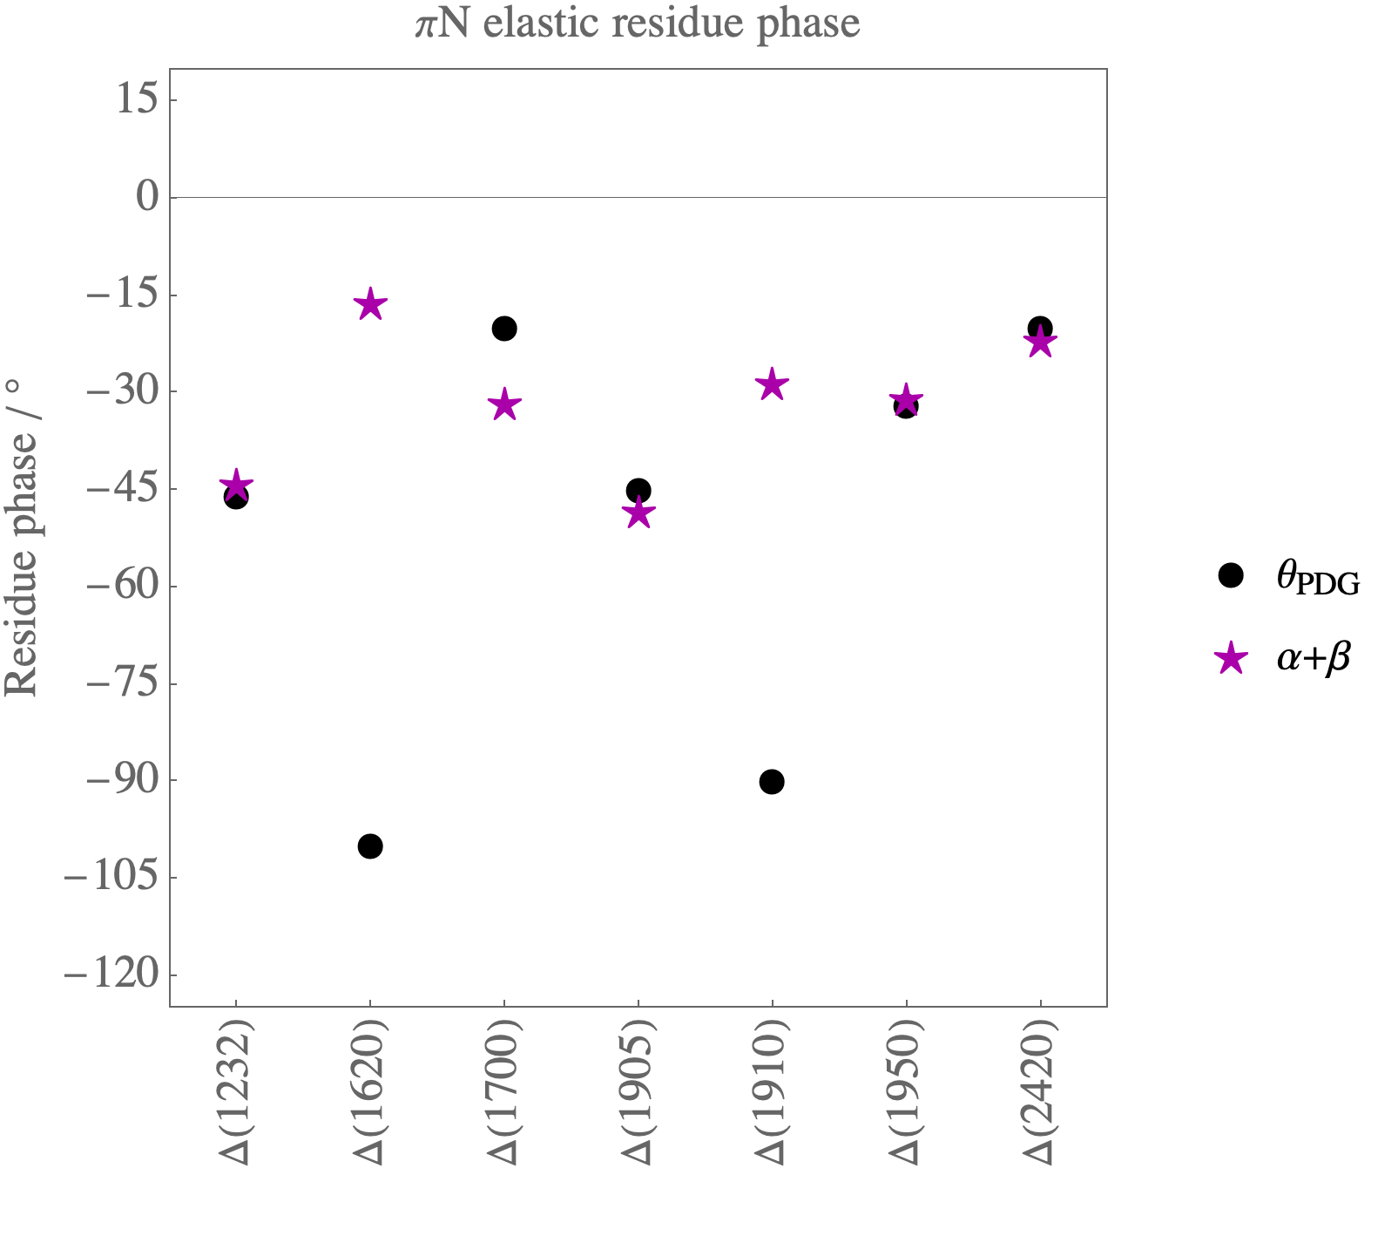

Slide 27
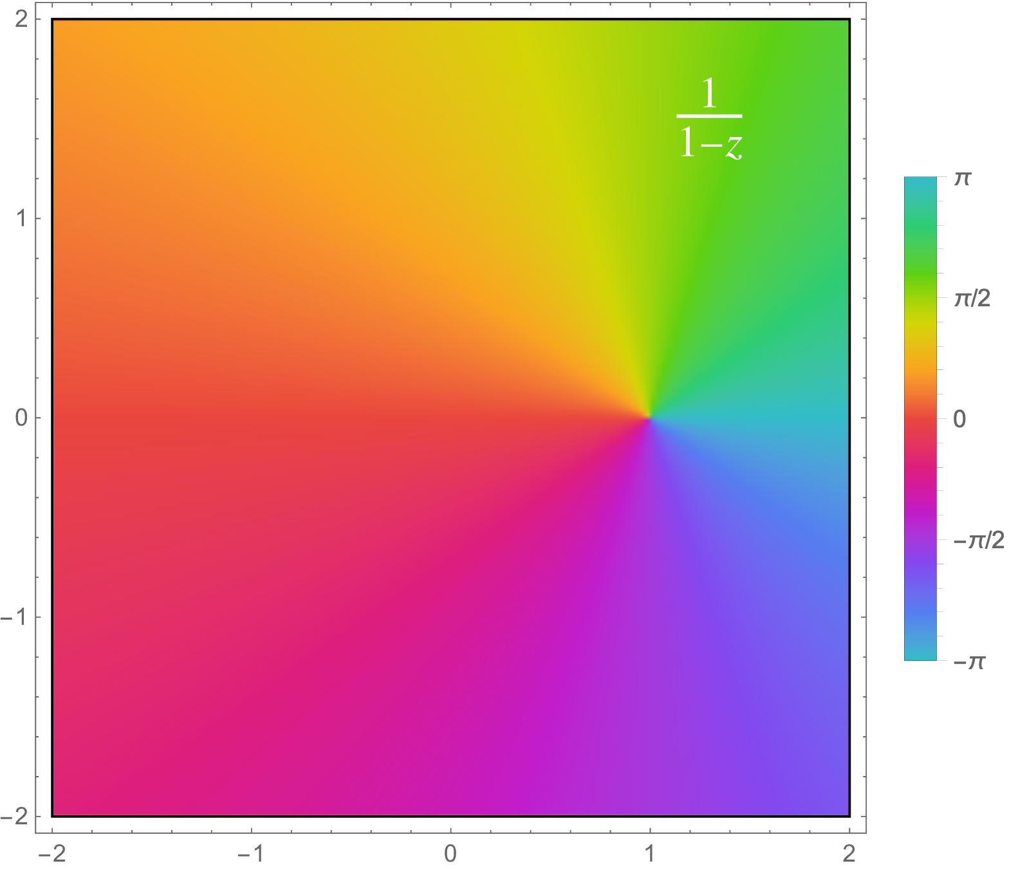
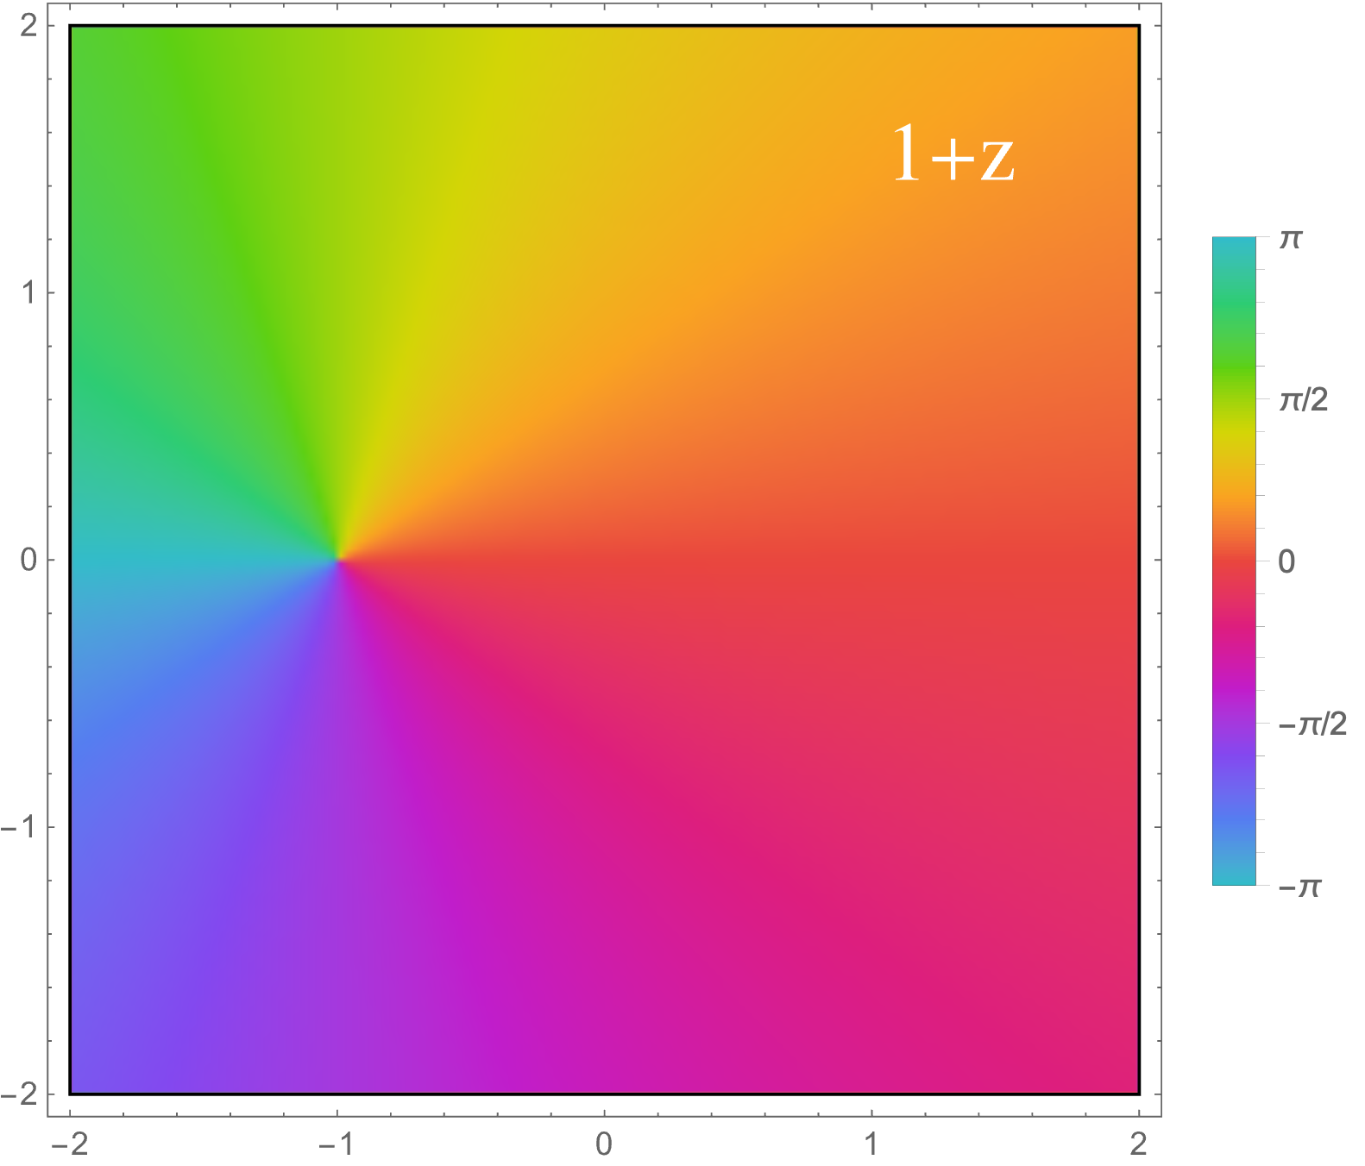

Slide 28
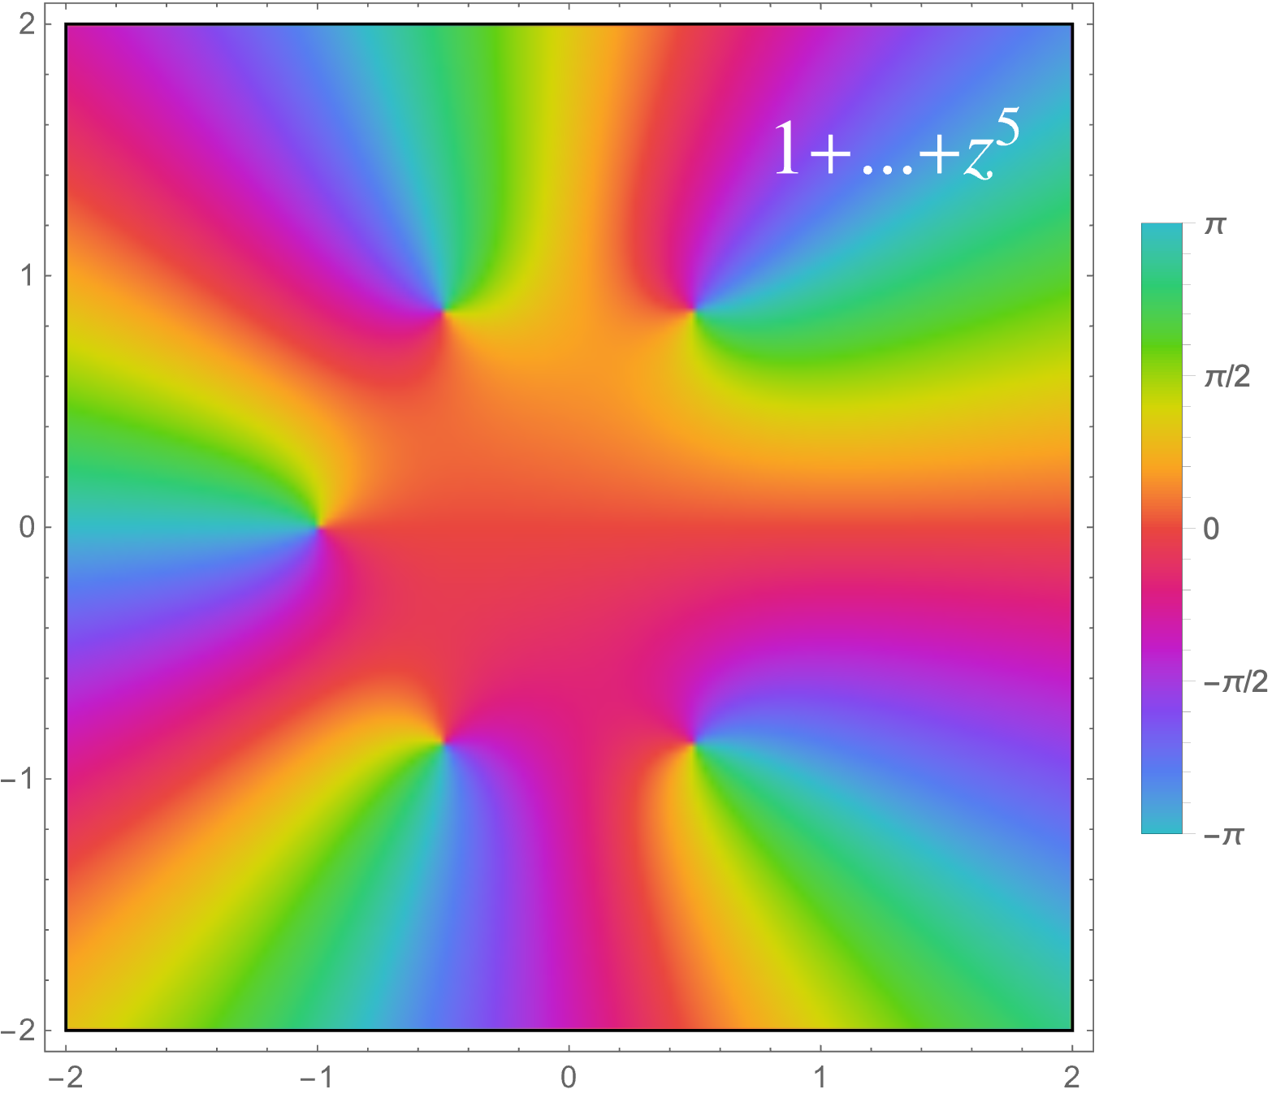

Slide 29
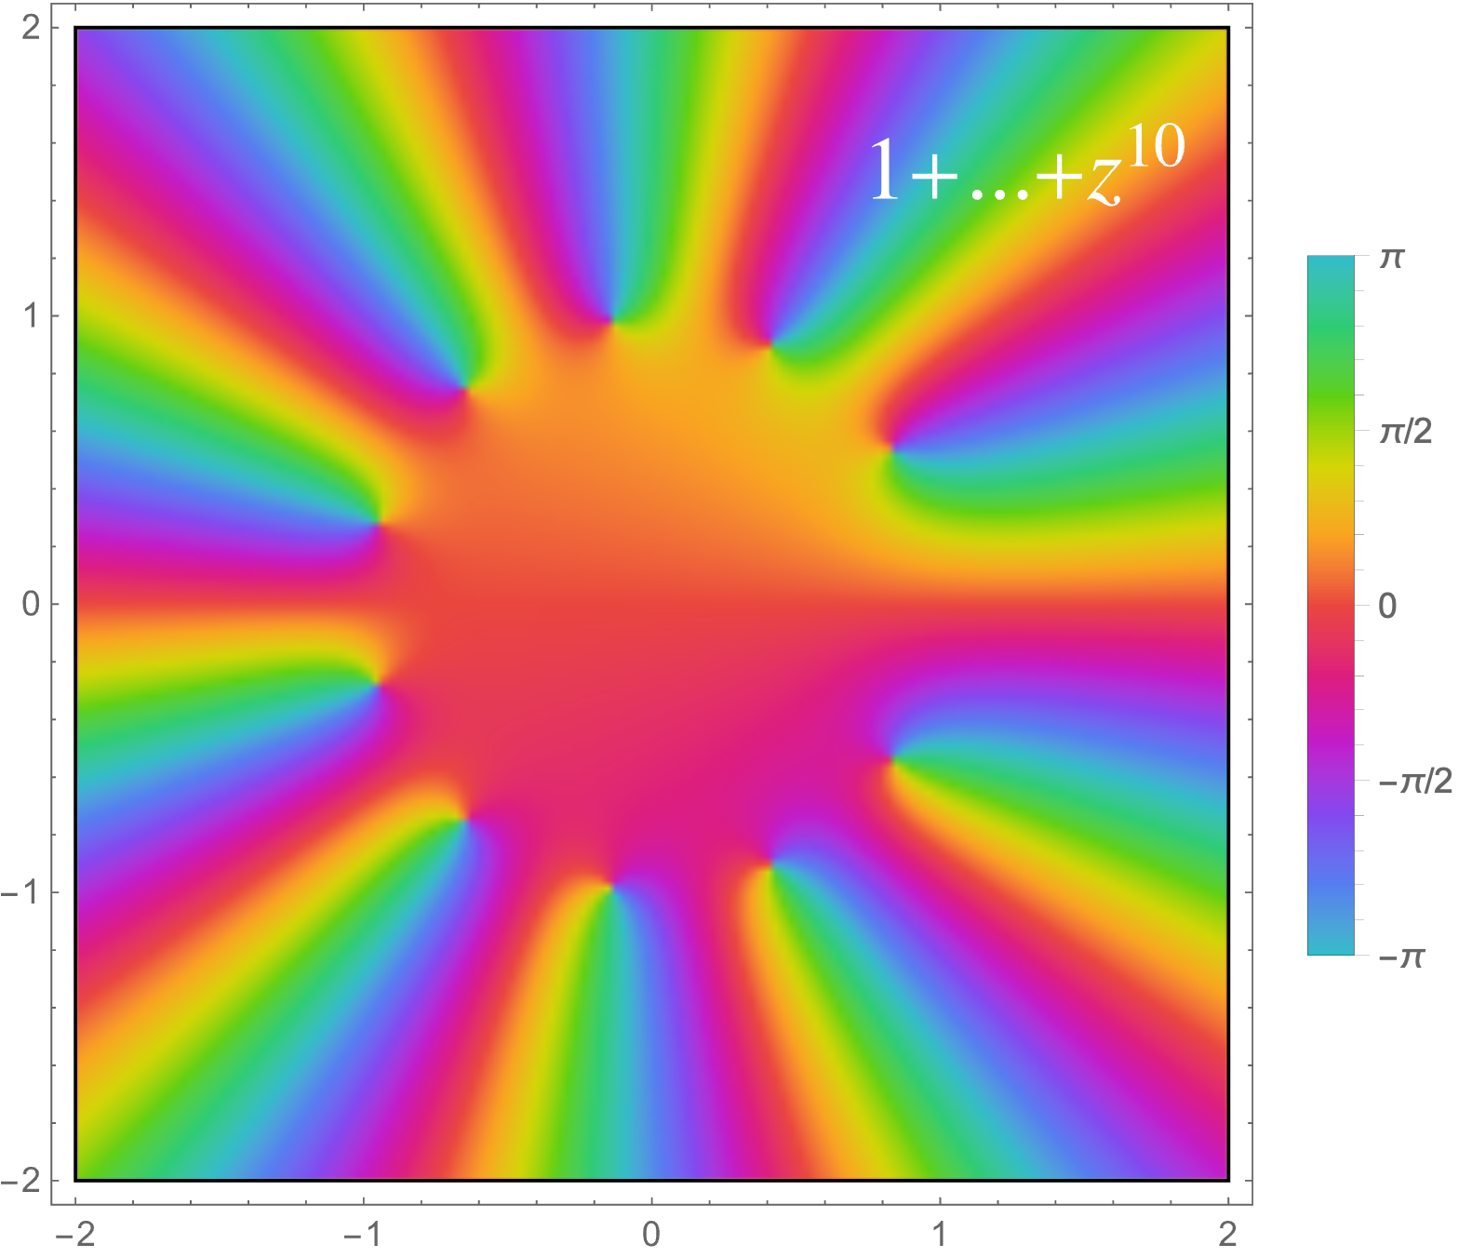

Slide 31
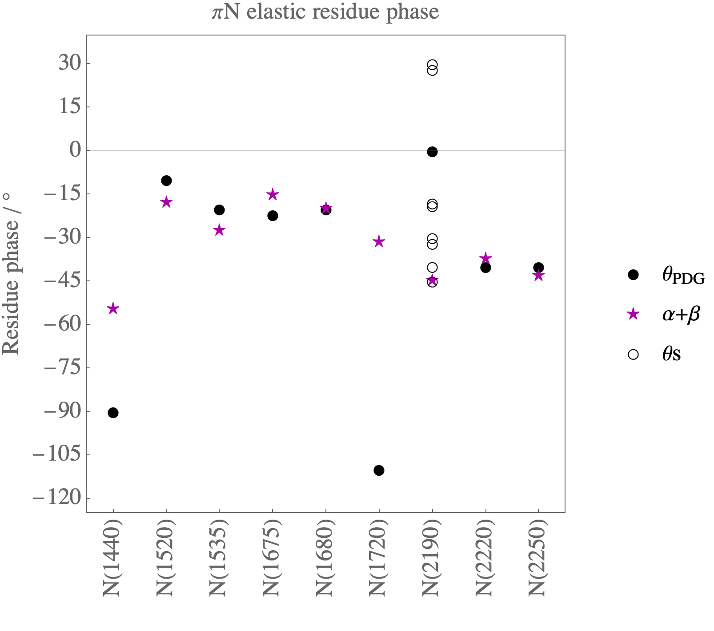
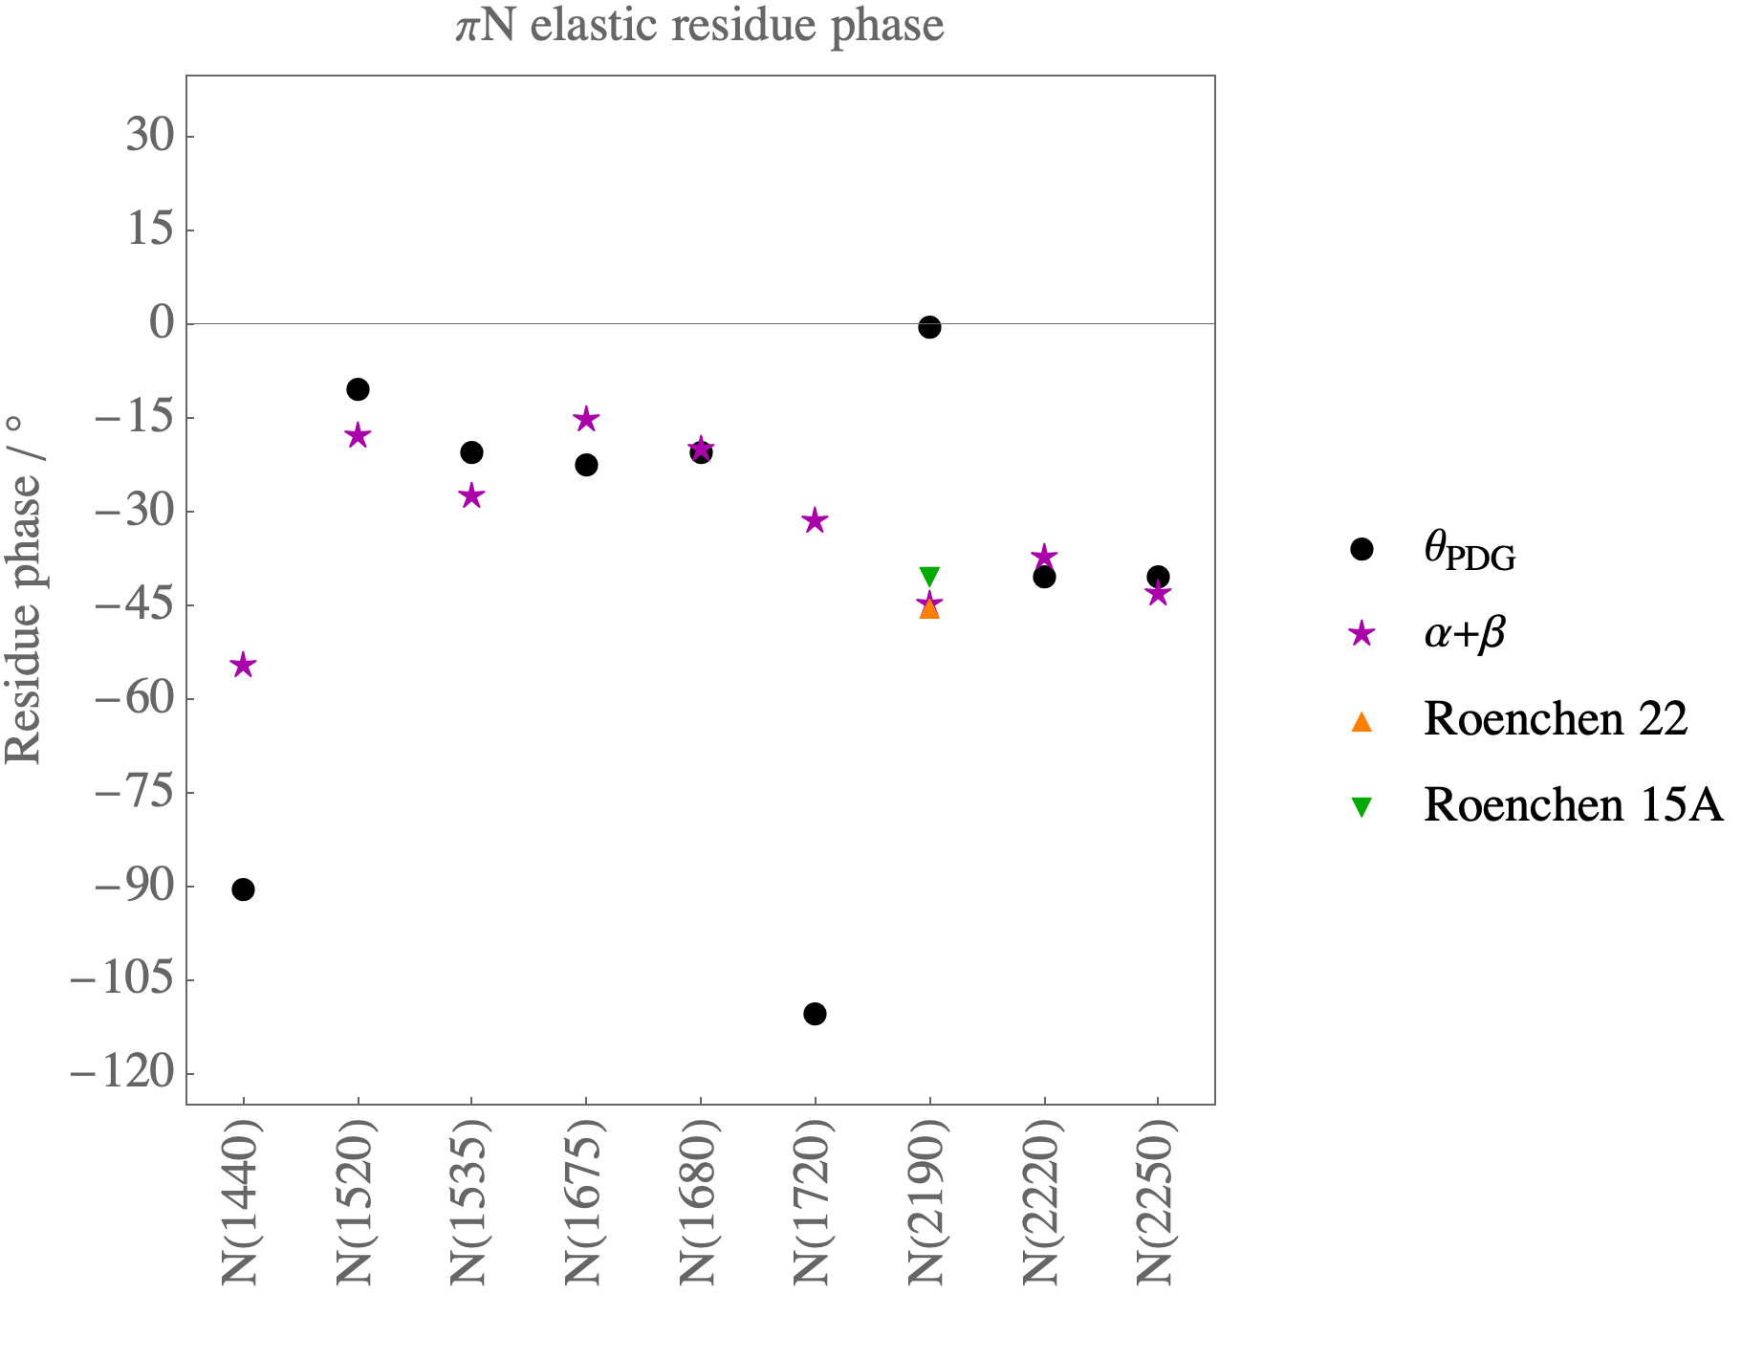

Slide 32

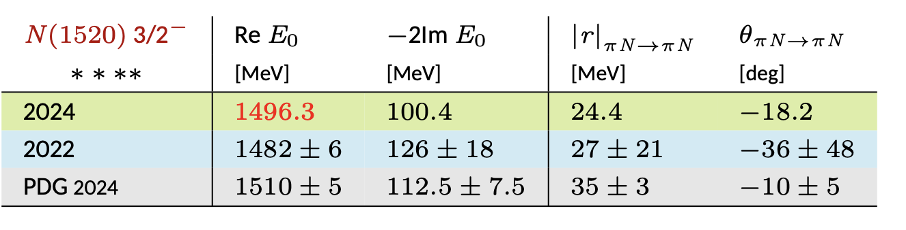
Our (purple) result for N(1520): -17.5 deg
Particle Data Group: from -5 to -15 deg
Wednesday morning talk:
The Jülich-Bonn dynamical coupled-channel approach
Given by: Christian Schneider

Slide 33
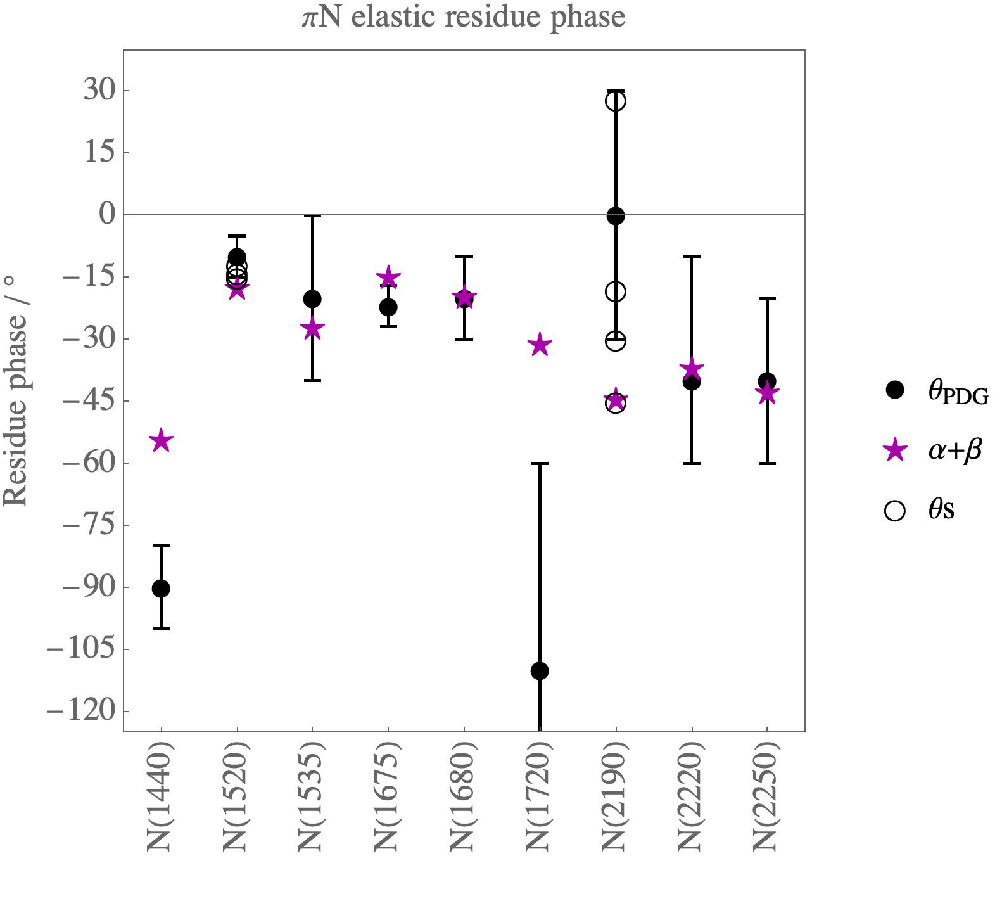
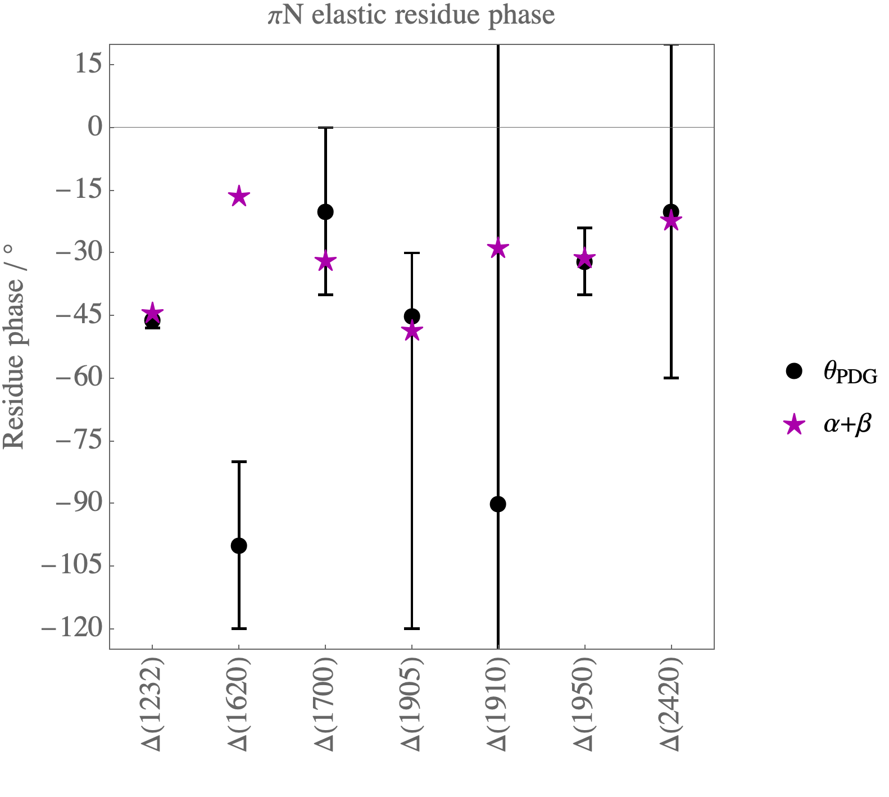

Slide 35
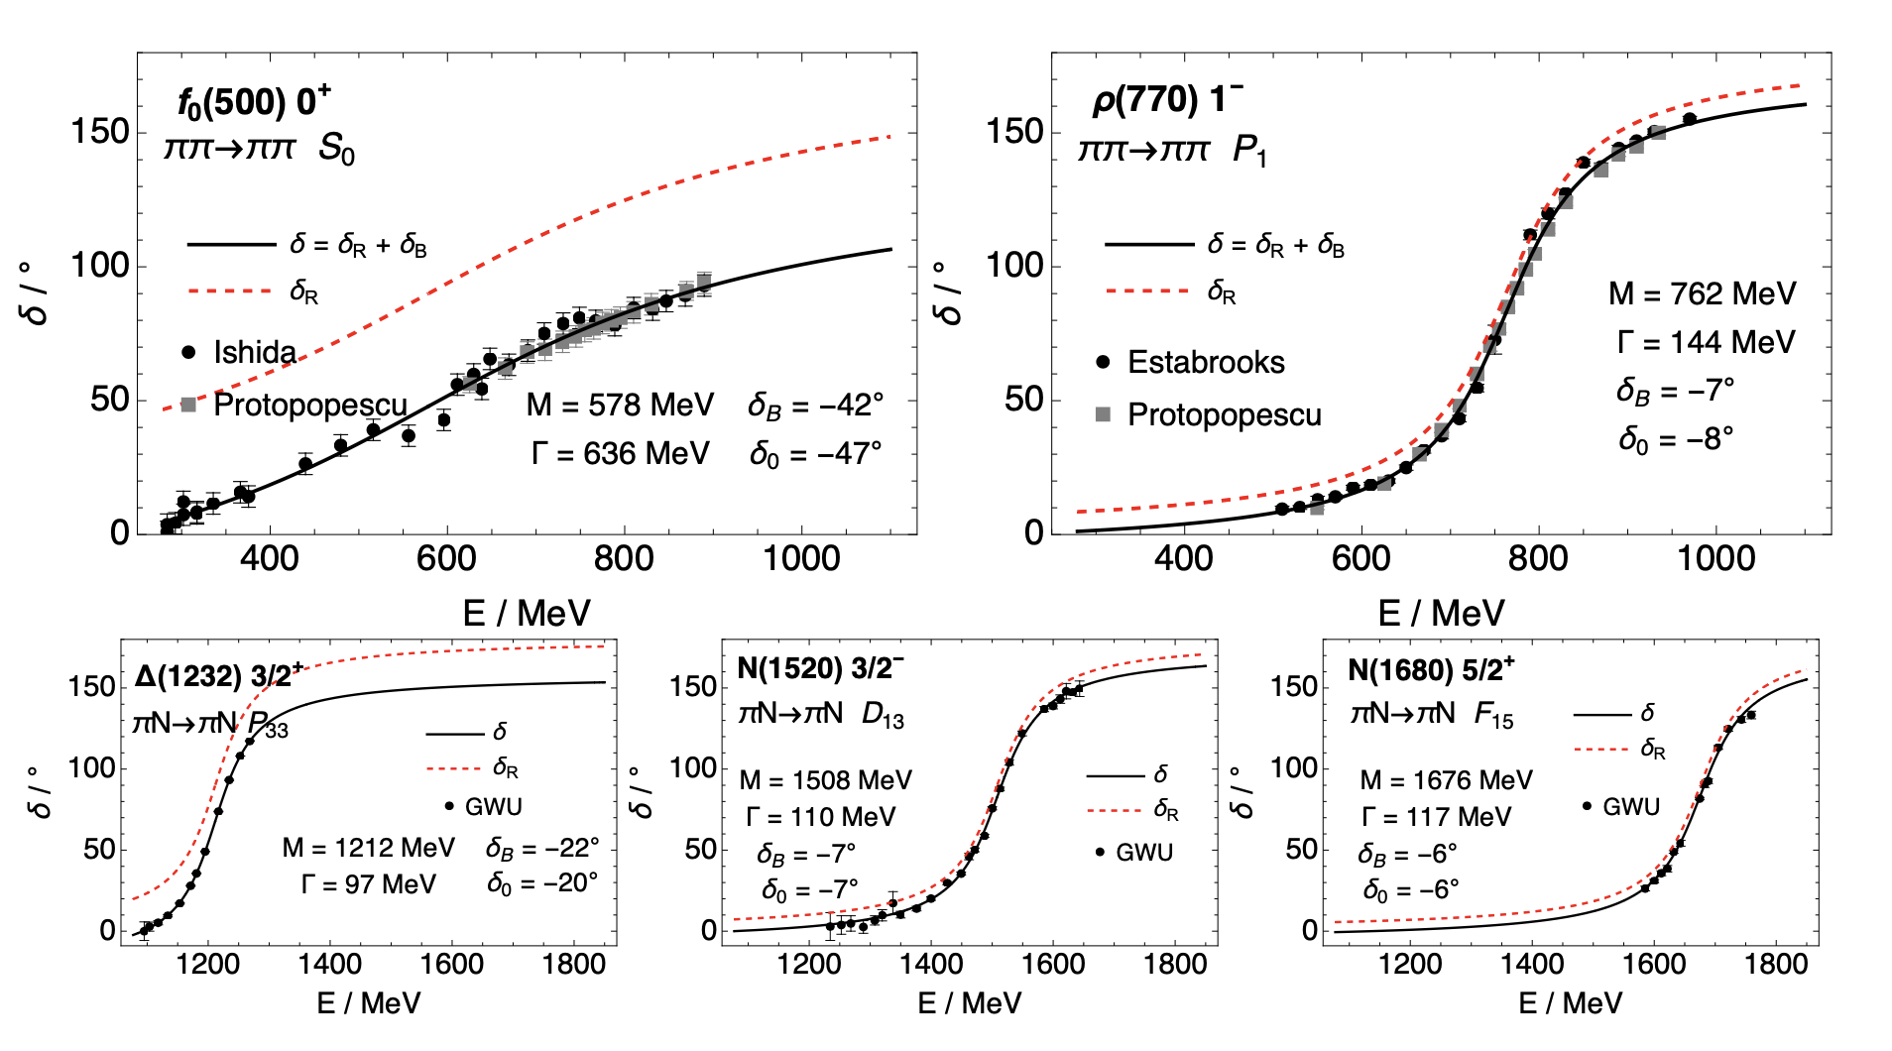

Slide 36
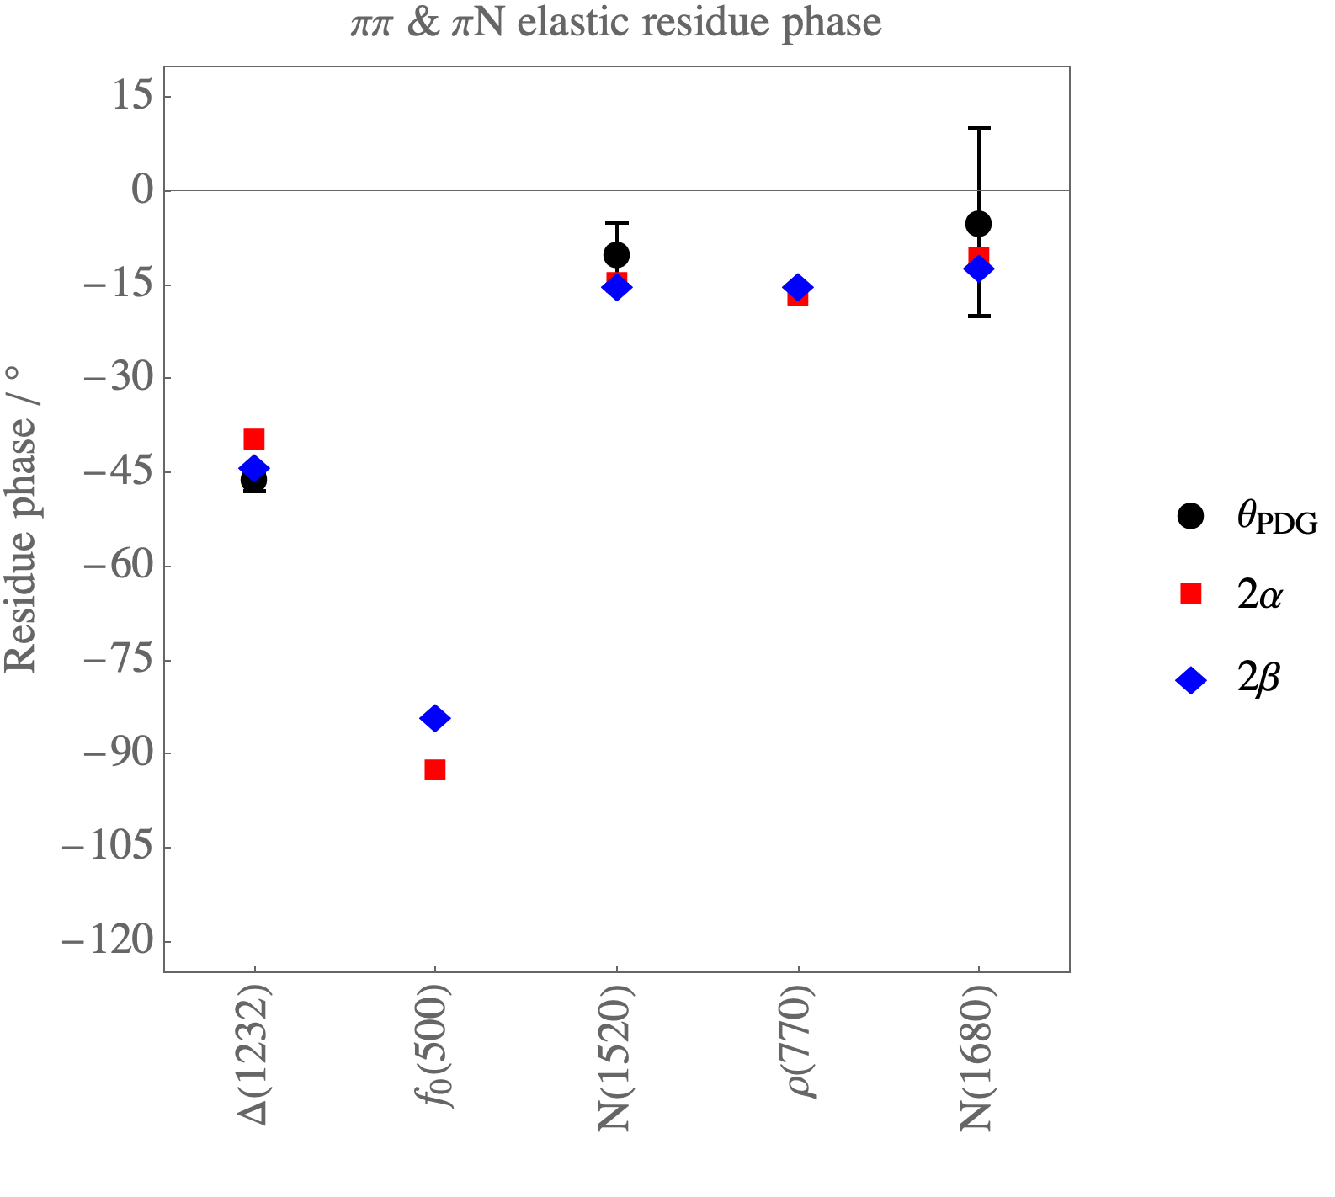

Slide 38
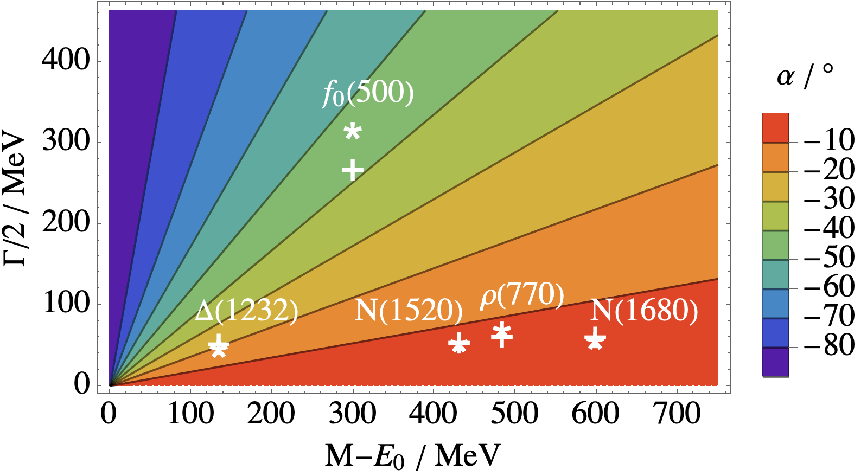

Slide 39
Summary
θ is a useful parameter and better estimates are needed
Its relationship with the threshold (α) and the BW mass (β) is curious
Do calculate T matrix in the complex plane, even far from resonant poles
Beware not only (unnecessary) poles, but also zeros
What we call a non-BW resonance can in fact be a good BW resonance
f₀(500) is strange for a similar reason why Δ(1232) is strange
It is too close to the threshold (and too broad)…
(broadness, by itself, is not a problem, see e.g. the Z boson)
…but it is describable by nearly simplest BW parameterization (M, Γ, and β)

Slide 40

Purple phase…
…all in my brain.
Lately, things just don’t seem the same.
Thank you ☺

Slide 41
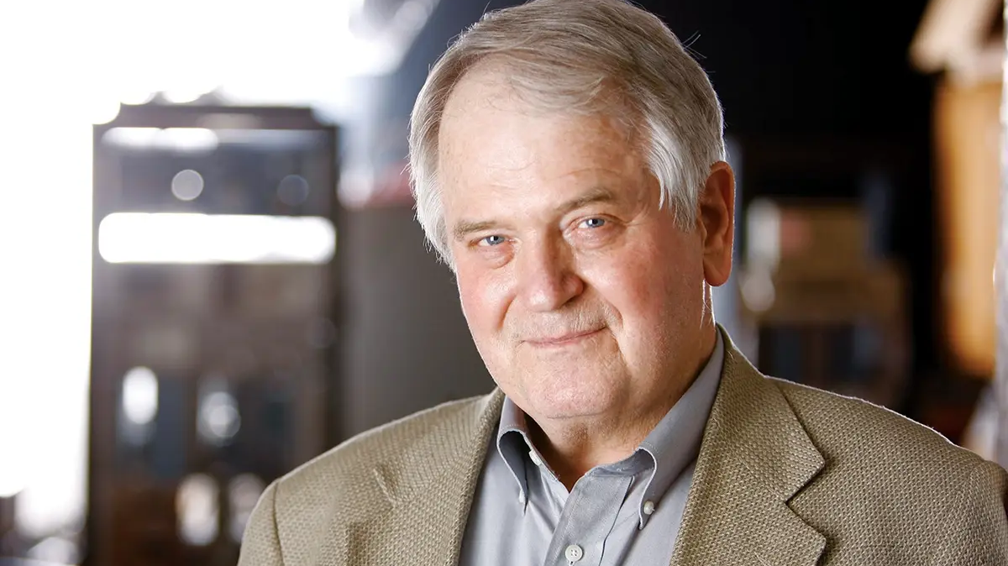
Mike E. Sadler
(1948-2021)
Founding father of
the PWA conference

