Slide 1
Frederike Hanisch
Co-Authors: Ulrich Wiedner, Fritz-Herbert Heinsius, Bertram Kopf, Meike Küßner
PWA13/ATHOS8
29.05.2024

Slide 2
Partial Wave Analysis (PWA) – Current Challenges
Era of high statistics
Event based PWA fits use lots of computing resources
Will be even more problematic in future
Currently fits take up to two weeks, even on multiple CPUs
What do we want to achieve?
More sustainable use of resources
Faster and more efficient PWA
Especially problematic in event based analyses
Fit time depends on:
AUTODIFF
ADAM
Computation
gradient per iteration
Number of Iterations
Number of data events
SNN

Slide 3
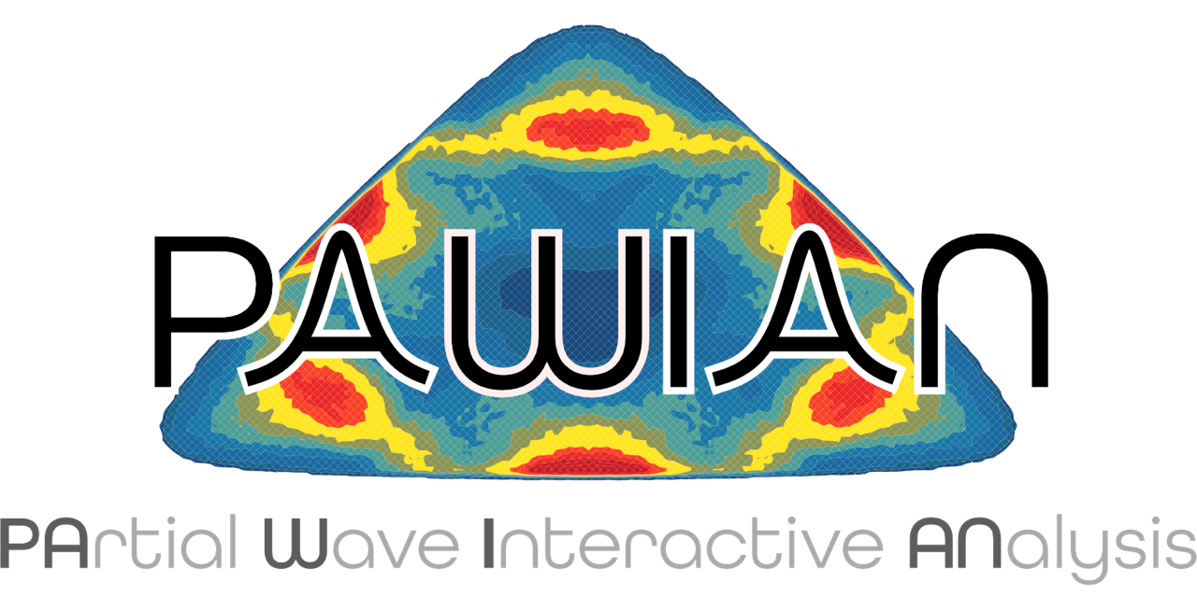
PAWIAN
PArtial Wave Interactive ANalysis Software: https://gitlab.ep1.rub.de/pwa/Pawian
Hypothesis and other settings defined via configuration files
Channels with arbitrary number of final state particles
Event based maximum likelihood fit using e.g. MINUIT2
Support for server-client mode and cluster submission
Analysis tools: Extraction of pole positions and residues
Event generation, histogramming, efficiency correction,…
Production Mechanism
Dynamical Models
Spin Formalisms
Annihilation $\overline{p}p,e^{+}e^{−},γγ$ fusion
Scattering $πp, ππ, …$
K-Matrix
Two-potential
Tensor
Breit-Wigner
…
Helicity
Canonical amplitudes
…

Slide 4
Automatic Differentiation
(Autodiff)

Slide 5
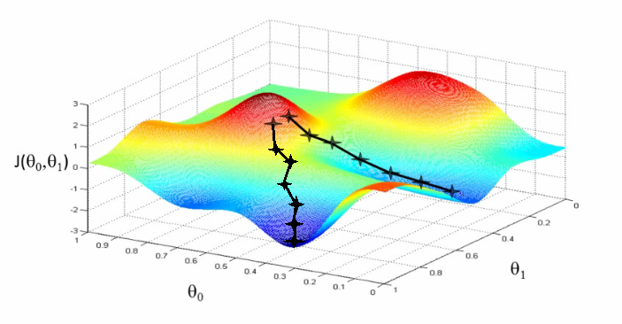
Minimization Tools for PWA – Status Quo
Numerical Minimization:
The derivatives are calculated numerically
$\underset{ h→0 }{f^{′}\left(x\right)=lim}{\frac{f\left(x+h\right)−f(x)}{h}}$
Problems:
Calculations with many parameters require a lot of time
Rounding errors occur → affects stability and convergence
https://miro.medium.com/max/1100/1*ZfdJDpJ8prZVJVDb2gaqRA.png

Slide 6
Automatic Differentiation (Autodiff) - Basics
Automatic differentiation can calculate derivatives efficiently
Computes the derivative as a concatenation of partial derivatives based on chain rule
Example:
We would like to optimize a function J(a,b,c) = $5(a+bc)$
u
v
a
J
b
v = a + u
J = 5v
u = bc
c
Computation Graph

Slide 7
Autodiff - Modes
Forward mode: Calculates the derivative of a function by successively applying the chain rule to the elementary function
Reverse mode: Calculates the derivative of a function by applying the chain rule to the output of the function (backpropagation)
→ Suitable for PWA → a lot of free parameters
a
b
v = a + u
J = 5v
u = bc
c
Computation Graph

Slide 8
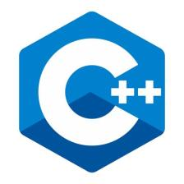
What are we currently working on?
Goal: Implementing Autodiff in PAWIAN
Major refactorisation of the code utilizing templates
We tested different C++-Packages for Autodiff
CoDiPack was best suited for our requirements
CoDiPack (Code Differentiation Package): Tool for gradient evaluation in computer programs developed by TU Kaiserslautern
Header only
Forward mode
Reverse mode
Different tape implementations
Higher order derivatives
Less memory consumption in comparison to other AD packages
Studies on the various Autodiff packages are ongoing (Clang + Clad)

Slide 9
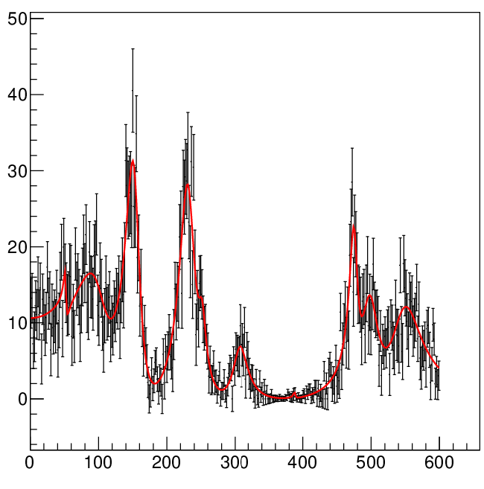
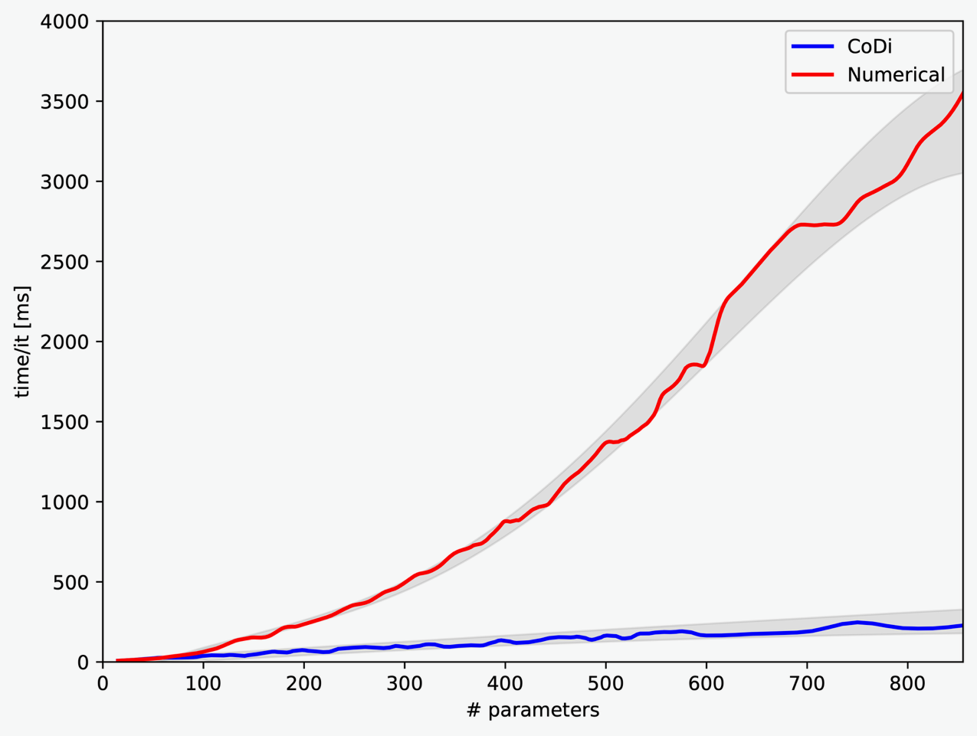
What we have achieved…
PAWIAN test application
~100k generated events
10 – 300 Breit-Wigner functions (30 – 900 parameters)
Comparison between numerical and automatic differentiation (reverse mode)
Autodiff is faster (up to 10 times!!!!) and more stable than numerical differentiation with a higher number of parameters

Slide 10
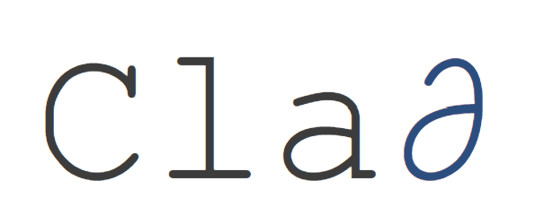
Outlook: Autodiff
Future Tasks:
Extending our tests to more complex models like K-Matrix
Performance tests with Forward-Mode
Testing different AD packages (Clang + Clad) 2203.06139 (arxiv.org)
Further Performance Tests
CPU-Tests
Autodiff in PAWIAN: Sever-Client-Mode
https://github.com/vgvassilev/clad
Clang: https://clang.llvm.org/

Slide 11
Sorting-Based Nearest Neighbour Search (SNN)

Slide 12
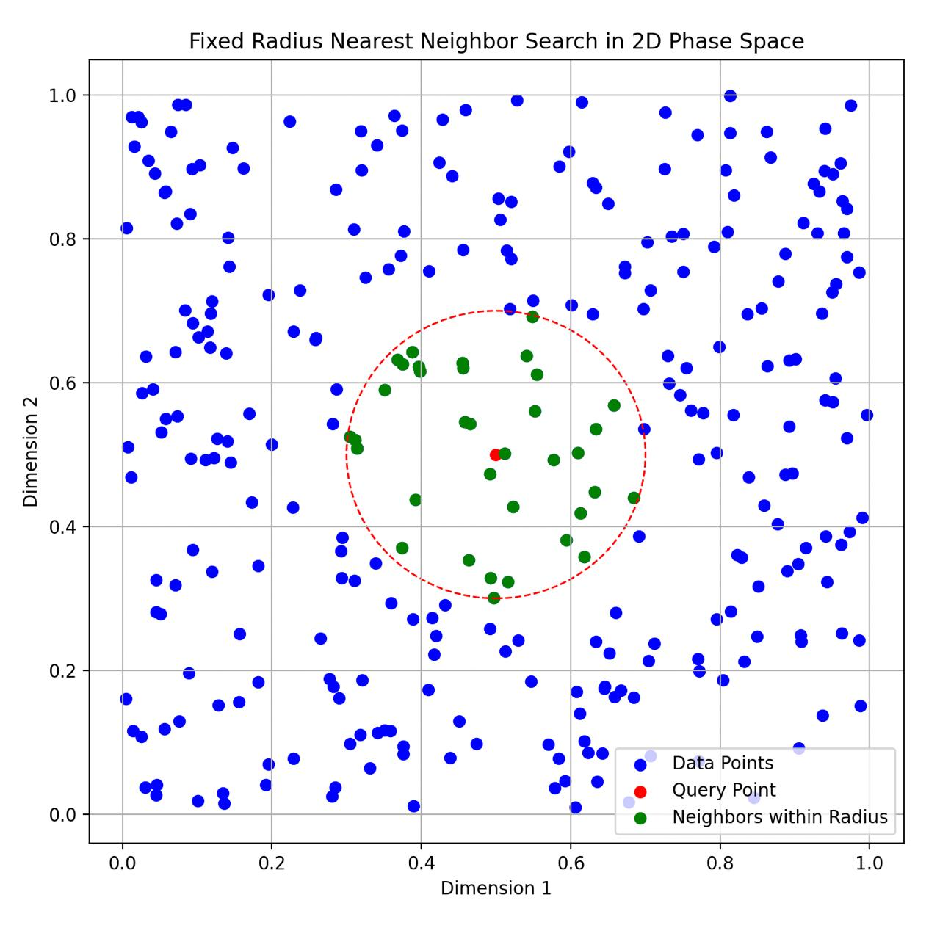
Sorting-Based Nearest Neighbour Search (SNN)
In times of high statistic data samples events can become indistinguishable within detector resolution
Idea: Combine events within the detector resolution without losing information
12

Slide 13
Sorting-Based Nearest Neighbour Search (SNN)
Problem:
Traditional methods include k-nearest neighbor (k-NN) and fixed-radius near neighbor (FRNN) search
Existing methods face challenges in balancing speed and accuracy, particularly for high-dimensional data
Need for a method that is fast and exact without requiring complex parameter tuning
SNN algorithm based on arXiv:2212.07679v6 solves these problems

Slide 14
SNN
Advantages:
Simplicity: No parameters except the search radius
Exactness: Guarantees all data points within the search radius are found
Speed: Outperforms brute force and tree-based methods
Flexibility: Low indexing time
Requirements:
NN search is performed before the fit to prepare the data and reassign event weights
Channel specific information need to be roughly known:
Detector resolution
Relevant PHSP dimensions and utilisation of symmetries
It is possible to assign individual radii depending on resolution in the specific PHSP volume

Slide 15
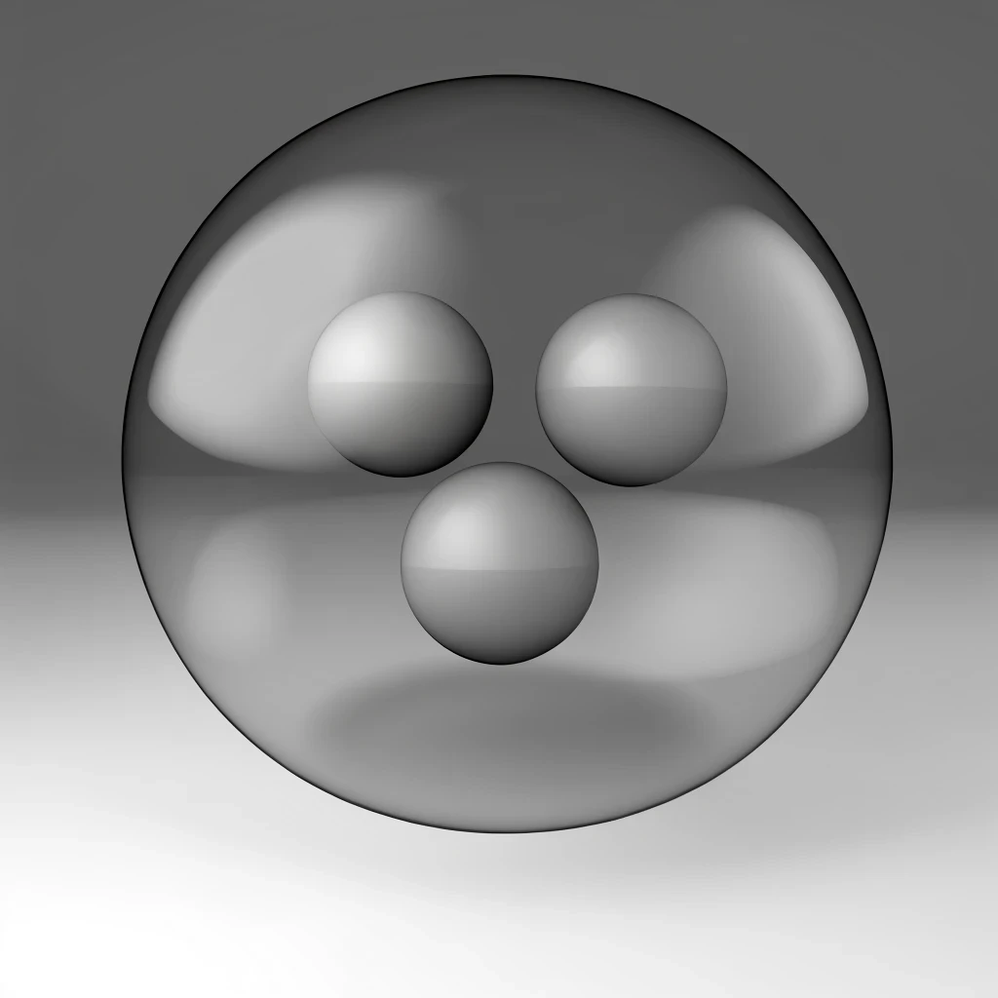
SNN – Example from radiative $J/ψ$ data
Example:
Radiative $J/ψ$ decay channels at BESIII (10 billion events)
~ 0.5 – 3 million reconstructed data events and 5–10 times more MC events
Idea: Combine events without losing to much information
~ 5 relevant PHSP dimensions
Preliminary results show:
Compression:
20% for MC
10% for data events
Directly proportional to computing time savings
Fit results are comparable within precision
Procedure more effective for lower PHSP dimensions
Especially valuable for pre fits and hypothesis studies
Generated with ChatGPT
15

Slide 16
Adaptive Movement Estimation Algorithm (ADAM)

Slide 17
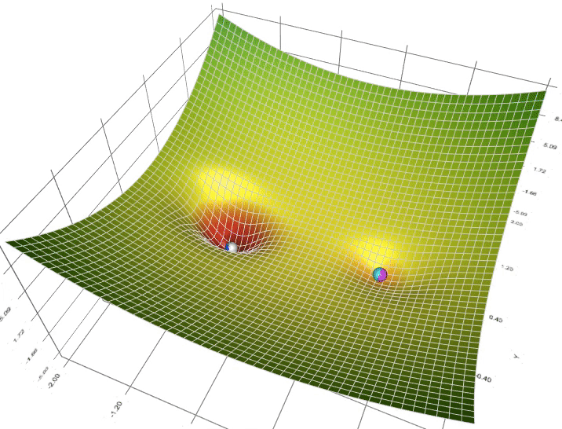
ADAM (Adaptive Movement Estimation Algorithm)
Adam optimisation is a gradient descent method based on adaptive estimation of first-order and second-order moments
Animation of 5 gradient descent methods on a surface: gradient descent (cyan), momentum (magenta), AdaGrad (white), RMSProp (green), Adam (blue).
A Visual Explanation of Gradient Descent Methods (Momentum, AdaGrad, RMSProp, Adam) | by Lili Jiang | Towards Data Science
17

Slide 18
ADAM – Basics
Input
$g_{t}$ : Gradient
$α$ : Learning Rate
$β_{1},{ β}_{2}, ε :$ Hyperparameters
$$m_{t}=β_{1}⋅m_{t−1}+\left(1−β_{1}\right)⋅g_{t}$$
$${\hat{m}}_{t}=\frac{m_{t}}{1−β_{1}^{t}}$$
$$v_{t}=β_{2}⋅v_{t−1}+\left(1−β_{2}\right)⋅g_{t}^{2}$$
$${\hat{v}}_{t}=\frac{v_{t}}{1−β_{2}^{t}}$$
First- and second moment average of gradients along $θ^{j}$
Bias-Correction
$$θ_{t+1}=θ_{t}−\frac{α⋅{\hat{m}}_{t}}{\sqrt{{\hat{v}}_{t}+ε}}$$
Corrected Parameters
Output

Slide 19
ADAM – Evaluation
Advantages:
Adaptive Learning Rates: Individual learning rates for different parameters
Fast and efficient: Performs well for computational efficiency and memory usage
Versatility: Suitable for a wide range of optimization problems
Disadvantages:
Non-Convergence in Some Cases: Slower convergence near minimum → Idea: L-BFGS https://doi.org/10.48550/arXiv.1802.05374
Tuning of Hyperparameters: Not straight-forward
Future Tasks:
Technically difficult merging Minuit and ADAM
Idea: Replace Minuit by ADAM
Test other optimizers
19

Slide 20
Summary and Outlook
ADAM:
Merging Minuit and ADAM is inefficent
Future Tasks:
Replacing Minuit with ADAM
SNN:
Testing various radii and estimate general critical turnover point
Autodiff:
CoDiPack: faster and more stable than the numerical method!!!
Future Tasks:
Extending our tests to more complex models like K-Matrix
Testing other autodiff packages e.g. Clang and CLAD
20

Slide 21
Thanks for your Attention!

Slide 22
Differentiation Methods
Stable
SYMBOLIC
AUTOMATIC
Slow
Fast
NUMERICAL
ANALYTICAL
In general not possible
Unstable
https://fmin.xyz/docs/methods/Autograd/

Slide 23
SNN - Methodology
Indexing Phase:
Sort data points based on their projection on the first principal component
Center the data points by subtracting the mean
Compute the first principal component to capture the largest variance
Precompute and store the squared norms of data points
Query Phase:
Center the query point and compute its projection score
Use binary search to find candidate points within the search radius
Efficiently compute distances using precomputed norms and BLAS operations
Filter candidates to ensure exact results
23

Slide 24
SNN-Backup
Computational Considerations
Arithmetic complexity is reduced by using precomputed dot products and matrix operations
BLAS (Basic Linear Algebra Subprograms) for fast computation on modern architectures
Handling of floating-point arithmetic ensures high accuracy
Theoretical Analysis
Efficiency of SNN depends on the number of distance computations
Analysis shows that the algorithm is more efficient with increasing query radius
SNN balances between exhaustive search and efficient pruning of search space

