Slide 1
Partial-Wave Analysis of the $K_{S}^{0}K^{−}$ Final State: Ambiguities and Physics Results
Julien Beckers for the COMPASS Collaboration
julien.beckers@tum.de
PWA/ATHOS 2024
May 28th, 2024

Slide 2
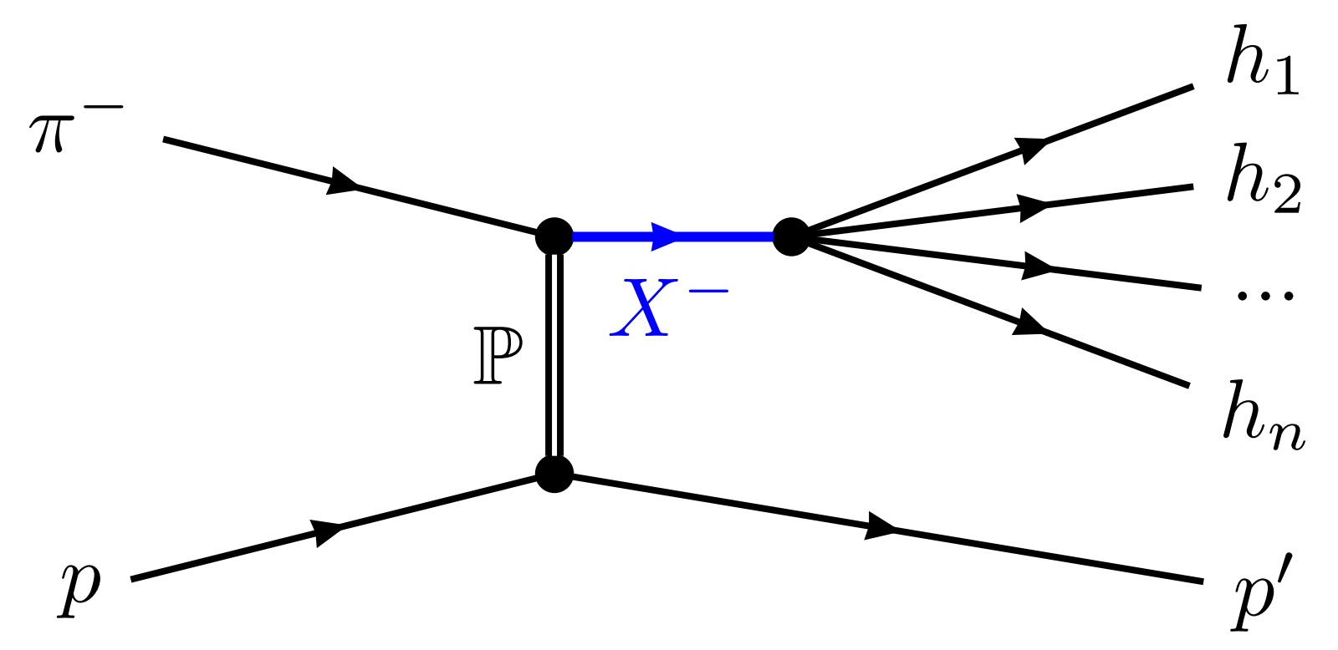
Excited Light Mesons at COMPASS
Inelastic scattering reactions of high-energetic meson beam
Strong interaction (Pomeron exchange) between beam meson and target proton
Intermediate hadronic resonances $X^{−}$ are created, then decay into $n$-body final state
$→$ wide range of allowed (spin) quantum numbers
Final-state particles measured in the COMPASS spectrometer

Slide 3
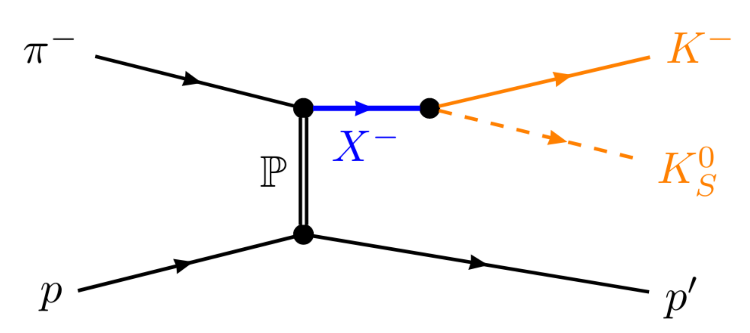
Excited Light Mesons at COMPASS
Inelastic scattering reactions of high-energetic meson beam
Strong interaction (Pomeron exchange) between beam meson and target proton
Intermediate hadronic resonances $X^{−}$ are created, then decay into $n$-body final state
$→$ wide range of allowed (spin) quantum numbers
Final-state particles measured in the COMPASS spectrometer

Slide 4
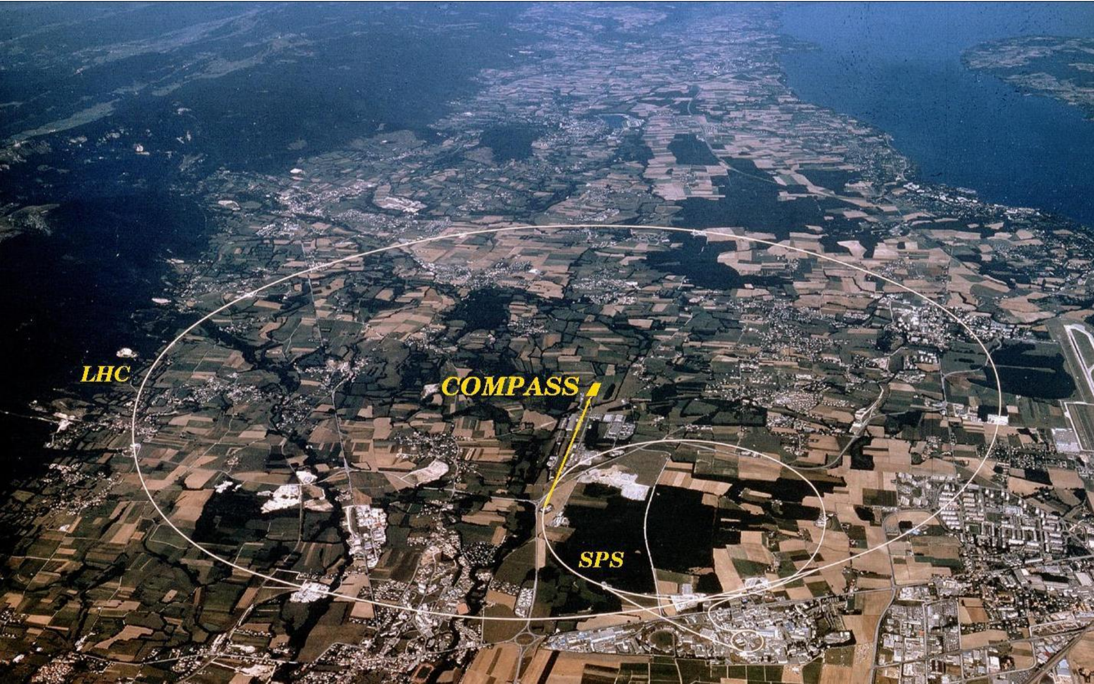
The COMPASS Experiment
Large-acceptance magnetic spectrometer @ CERN-SPS
Beam:
Secondary hadrons ($π^{−}, K^{−}$) at $190 GeV/c$
produced via primary proton beam from SPS

Slide 5
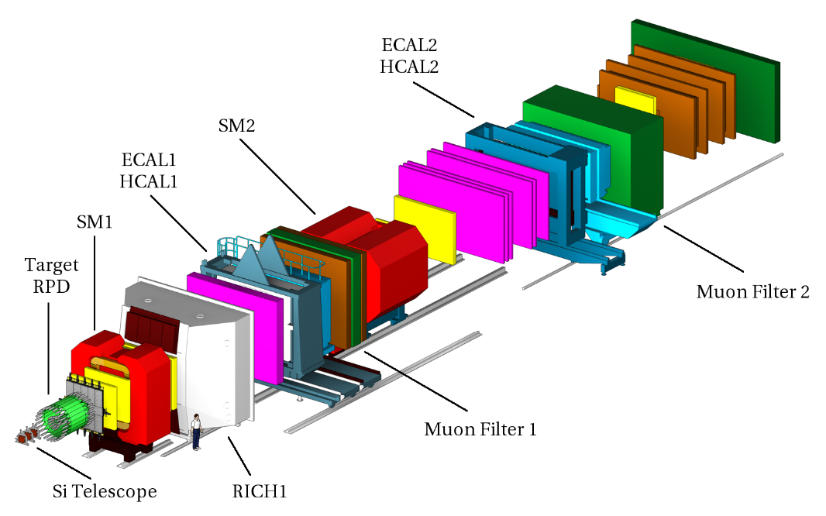
The COMPASS Experiment
Large-acceptance magnetic spectrometer @ CERN-SPS
Beam:
Secondary hadrons ($π^{−}, K^{−}$) at $190 GeV/c$
produced via primary proton beam from SPS
Spectrometer:
Liquid-hydrogen target
Two-stage spectrometer setup around two dipole magnets SM1/2
From COMPASS Collab., The COMPASS Setup for Physics with Hadron Beams (Nucl. Instrum. Methods Phys. Res. A 779 (2014), pp. 69–115)

Slide 6
Quantum Numbers of the $K_{S}^{0}K^{−}$ Final State
Quantum numbers of a $K_{S}^{0}K^{−}$ system
$$J=L$$
$$I=1$$
$$J=L$$
$$G={\left(−1\right)}^{L+1}$$
all given by $L$!
$$P={\left(−1\right)}^{L}$$
$$C={G\left(−1\right)}^{I}={\left(−1\right)}^{L}$$
$$I^{G}J^{PC}=1^{+}1^{−−}, 1^{−}2^{++}, 1^{+}3^{−−},1^{−}4^{++},…$$
S. U. Chung. C- and G-parity: A New Definition and Applications. https://suchung.web.cern.ch/Cparity7b.pdf.

Slide 7
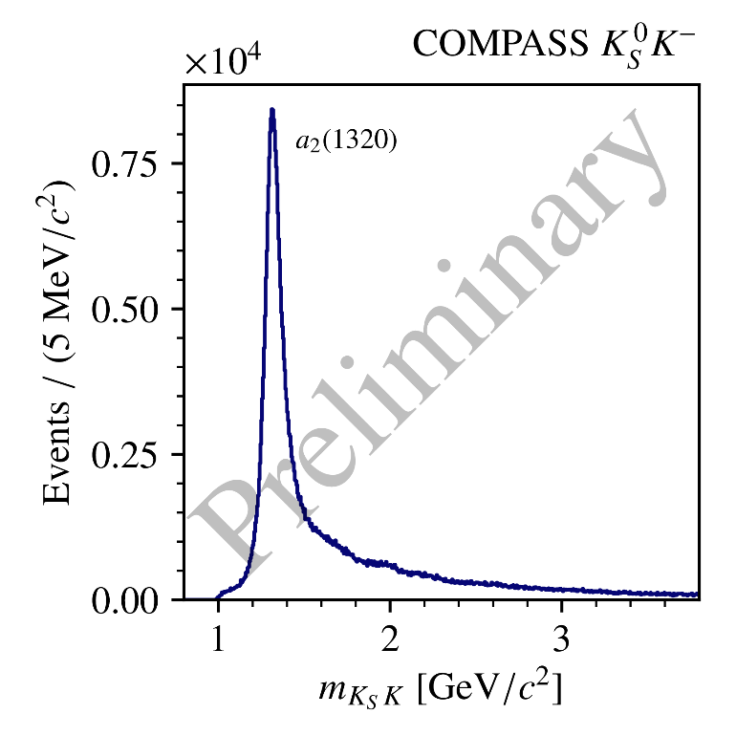
Quantum Numbers of the $K_{S}^{0}K^{−}$ Final State
Quantum numbers of a $K_{S}^{0}K^{−}$ system
Quantum numbers of the produced $X^{−}$:
$→$ odd spins $J$ are suppressed!
$$J=L$$
$$I=1$$
$$G={\left(−1\right)}^{L+1}$$
all given by $L$!
$$P={\left(−1\right)}^{L}$$
$$C={G\left(−1\right)}^{I}={\left(−1\right)}^{L}$$
$I^{G}=1^{−}$ for Pomeron ($I^{G}=0^{+}$ ) exchange
$$I^{G}J^{PC}=1^{+}1^{−−}, 1^{−}2^{++}, 1^{+}3^{−−},1^{−}4^{++},…$$
S. U. Chung. C- and G-parity: A New Definition and Applications. https://suchung.web.cern.ch/Cparity7b.pdf

Slide 8
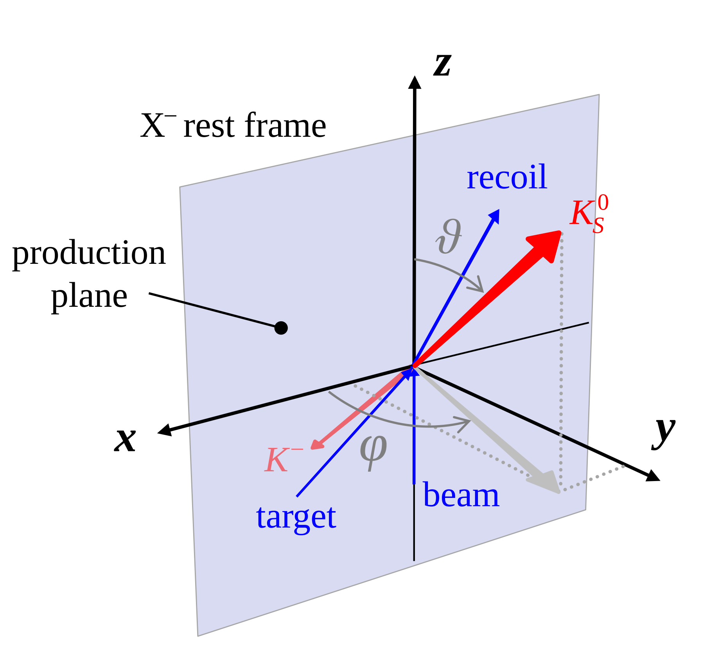
Partial-Wave Analysis Procedure
$$A\left(m_{KK},t^{′};θ,φ\right)=\sum_{J,M}{T_{J,M}\left(m_{KK},t^{′}\right) ψ_{J,M}(θ,φ)}$$
$$J=L$$
Decompose total process amplitude into partial waves
Depend on spin $J$ and spin-projection $M$
Other quantum numbers fixed by $J, M$

Slide 9
Partial-Wave Analysis Procedure
$$A\left(m_{KK},t^{′};θ,φ\right)=\sum_{J,M}{T_{J,M}\left(m_{KK},t^{′}\right) ψ_{J,M}(θ,φ)}$$
$$J=L$$
Decompose total process amplitude into partial waves
Partial-wave amplitudes split into
production and propagation $→$ $T_{J,M}\left(m_{KK},t^{′}\right)$
and
decay of $X^{−}$ $→$ $ψ_{J,M}\left(θ,φ\right)=Y_{J}^{M}(θ,φ)$

Slide 10
Partial-Wave Analysis Procedure
$$A\left(m_{KK},t^{′};θ,φ\right)=\sum_{J,M}{T_{J,M}\left(m_{KK},t^{′}\right) Y_{J}^{M}(θ,φ) }$$
$$J=L$$
Decompose total process amplitude into partial waves
Partial-wave amplitudes split into
production and propagation $→$ $T_{J,M}\left(m_{KK},t^{′}\right)$
and
decay of $X^{−}$ $→$ $ψ_{J,M}\left(θ,φ\right)=Y_{J}^{M}(θ,φ)$

Slide 11
Partial-Wave Analysis Procedure
$$I\left(m_{KK},t^{′};θ,φ\right)={\left|\sum_{J,M}{T_{J,M}\left(m_{KK},t^{′}\right) Y_{J}^{M}\left(θ,φ\right)}\right|}^{2}$$
$$\frac{dN}{dΦ(θ,φ)}\sim$$
$$J=L$$
Decompose total process amplitude into partial waves
Amplitudes split into production/propagation and decay of $X^{−}$
Dependence on $\left(m_{KK},t^{′}\right)$ unknown
$→$ fit $I\left(m_{KK},t^{′};θ,φ\right)$ to data in $\left(m_{KK},t^{′}\right)$ bins
$→$ extract constant $\{T_{J,M}\}$ in each bin

Slide 12
Partial-Wave Analysis Procedure
$$I\left(θ,φ\right)={\left|\sum_{J,M}{T_{J,M} Y_{J}^{M}\left(θ,φ\right)}\right|}^{2}$$
$$\frac{dN}{dΦ(θ,φ)}\sim$$
$$J=L$$
Decompose total process amplitude into partial waves
Amplitudes split into production/propagation and decay of $X^{−}$
Dependence on $\left(m_{KK},t^{′}\right)$ unknown
$→$ fit $I\left(m_{KK},t^{′};θ,φ\right)$ to data in $\left(m_{KK},t^{′}\right)$ bins
$→$ extract constant $\{T_{J,M}\}$ in each bin

Slide 13
Ambiguities in the Partial-Wave Decomposition
For any final state with two spinless particles ($ππ,KK,ηπ,…$):
Decomposition of intensity into $\{T_{J,M}^{ }\}$ is not unique
The fit cannot distinguish between the mathematically equivalent solutions!
$→$ Several sets of $\{T_{J,M}^{ }\}$ lead to the same $I\left(θ,φ\right)$ in each $(m_{KK},t′)$ bin
$$I\left(θ,φ\right)={\left|\sum_{J,M}{T_{J,M}^{(1)} Y_{J}^{M}\left(θ,φ\right)}\right|}^{2}={\left|\sum_{J,M}{T_{J,M}^{(2)} Y_{J}^{M}\left(θ,φ\right)}\right|}^{2}$$
Chung, PRD 56 7299–7316 (1997)
Barrelet, Nuov Cim A 8, 331–371 (1972)

Slide 14
Ambiguities in the Partial-Wave Decomposition
$$I\left(θ,φ\right)={\left|\sum_{J,M}{T_{J,M} Y_{J}^{M}\left(θ,φ\right)}\right|}^{2}$$
Assume strong dominance of $\left|M\right|=1$ *
Pomeron exchange dominant
$$→M≠0$$
Higher $\left|M\right|$ suppressed
*using reflectivity basis for $ψ_{JM}$ :
doi.org/10.1103/PhysRevD.11.633

Slide 15
Ambiguities in the Partial-Wave Decomposition
$$I\left(θ,φ\right)={\left|\sum_{J}{T_{J} Y_{J}^{1}\left(θ,φ\right)}\right|}^{2}$$
Assume strong dominance of $\left|M\right|=1$ *
Pomeron exchange dominant
$$→M≠0$$
Higher $\left|M\right|$ suppressed
*using reflectivity basis for $ψ_{JM}$ :
doi.org/10.1103/PhysRevD.11.633

Slide 16
Ambiguities in the Partial-Wave Decomposition
$$I\left(θ,φ\right)={\left|\sum_{J}{T_{J} Y_{J}^{1}(θ,φ)}\right|}^{2}$$
$$={\left|\sum_{J}{T_{J} Y_{J}^{1}(θ,0)}\right|}^{2} {\left|\sin{φ}\right|}^{2}$$
$$Y_{J}^{1}\left(θ,0\right)=\sum_{j=0}^{J−1}{y_{j}\tan^{2j}{θ}}$$
Polynomial in $\tan^{2}{θ}$
$$a(θ)$$
$${\{T}_{J}′\}≠\{T_{J}\}$$
$$a\left(θ\right)=\sum_{j=0}^{J_{max}−1}{c_{j}\left({\{T}_{J}\}\right) \tan^{2j}{(θ)}}$$
$$=c(\{T_{J}\}) \prod_{k=1}^{J_{max−1}}{\left(\tan^{2}\left(θ\right)−r_{k}\left({\{T}_{J}\}\right)\right) }$$
root decomposition
“Barrelet zeros”
$${\{c}_{j}′\}$$
$$=c^{2} \prod_{k=1}^{J_{max−1}}{{\left|\tan^{2}\left(θ\right)−r_{k}\right|}^{2}} {\left|\sin{φ}\right|}^{2}$$
$$=c^{2} \prod_{k=1}^{J_{max−1}}{{\left|\tan^{2}\left(θ\right)−r_{k}^{∗} \right|}^{2}} {\left|\sin{φ}\right|}^{2}$$

Slide 17
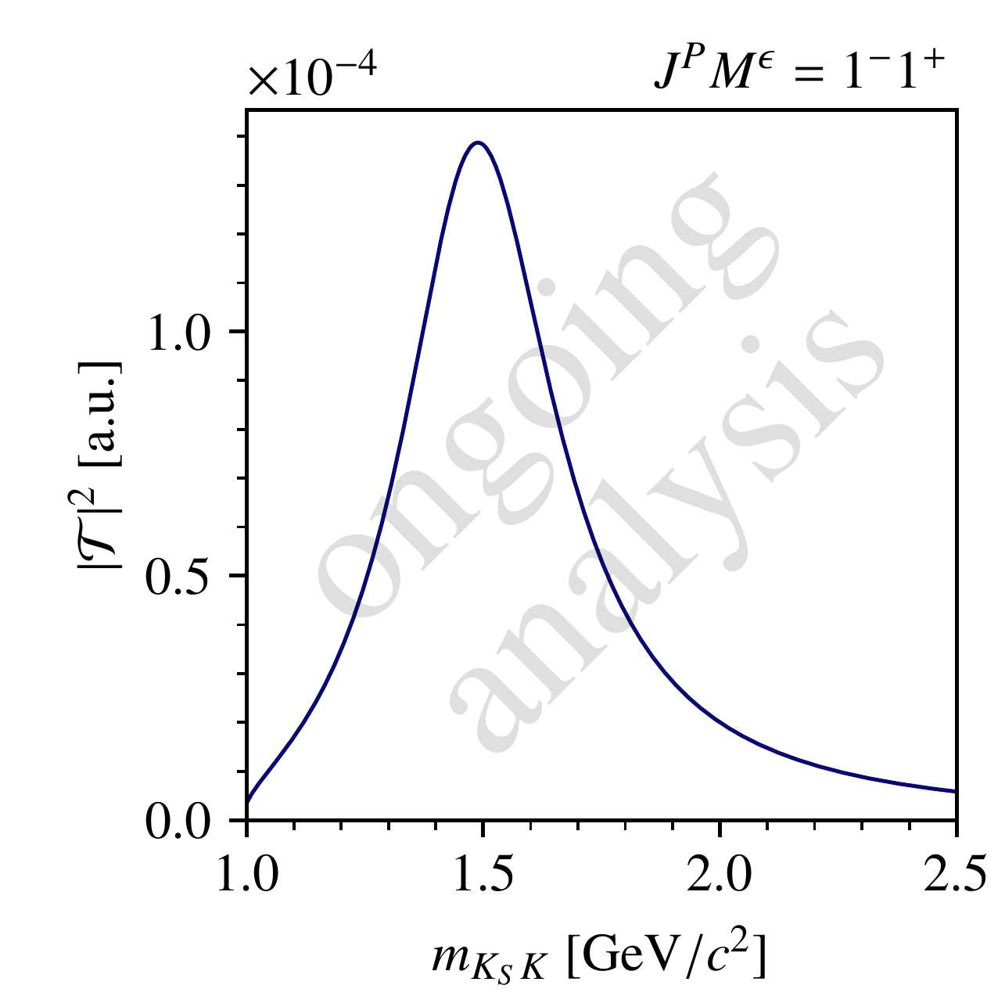
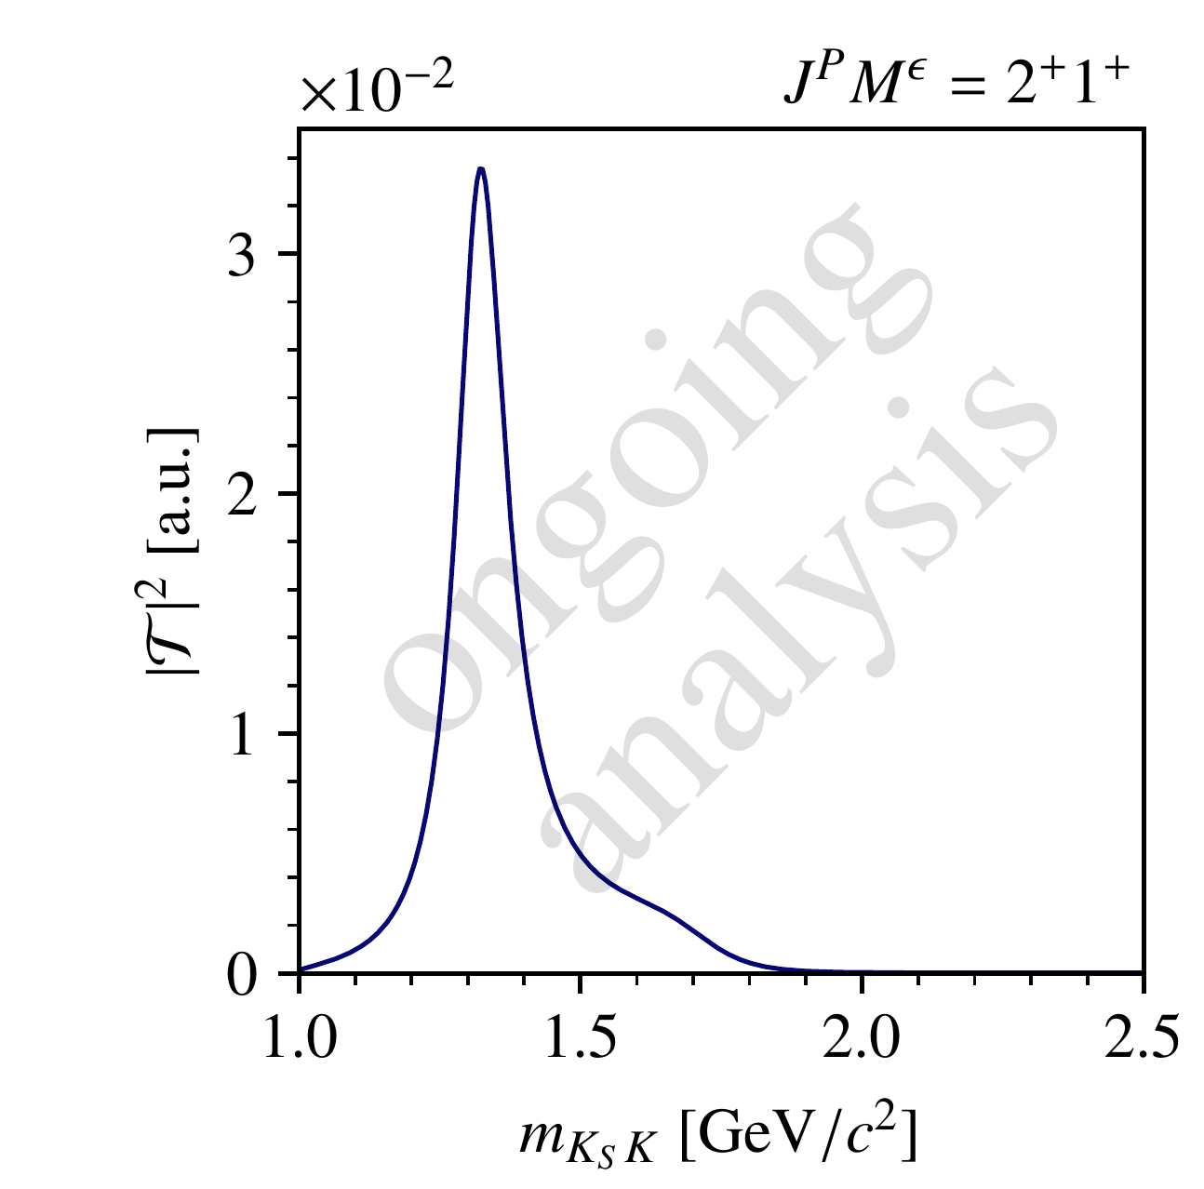
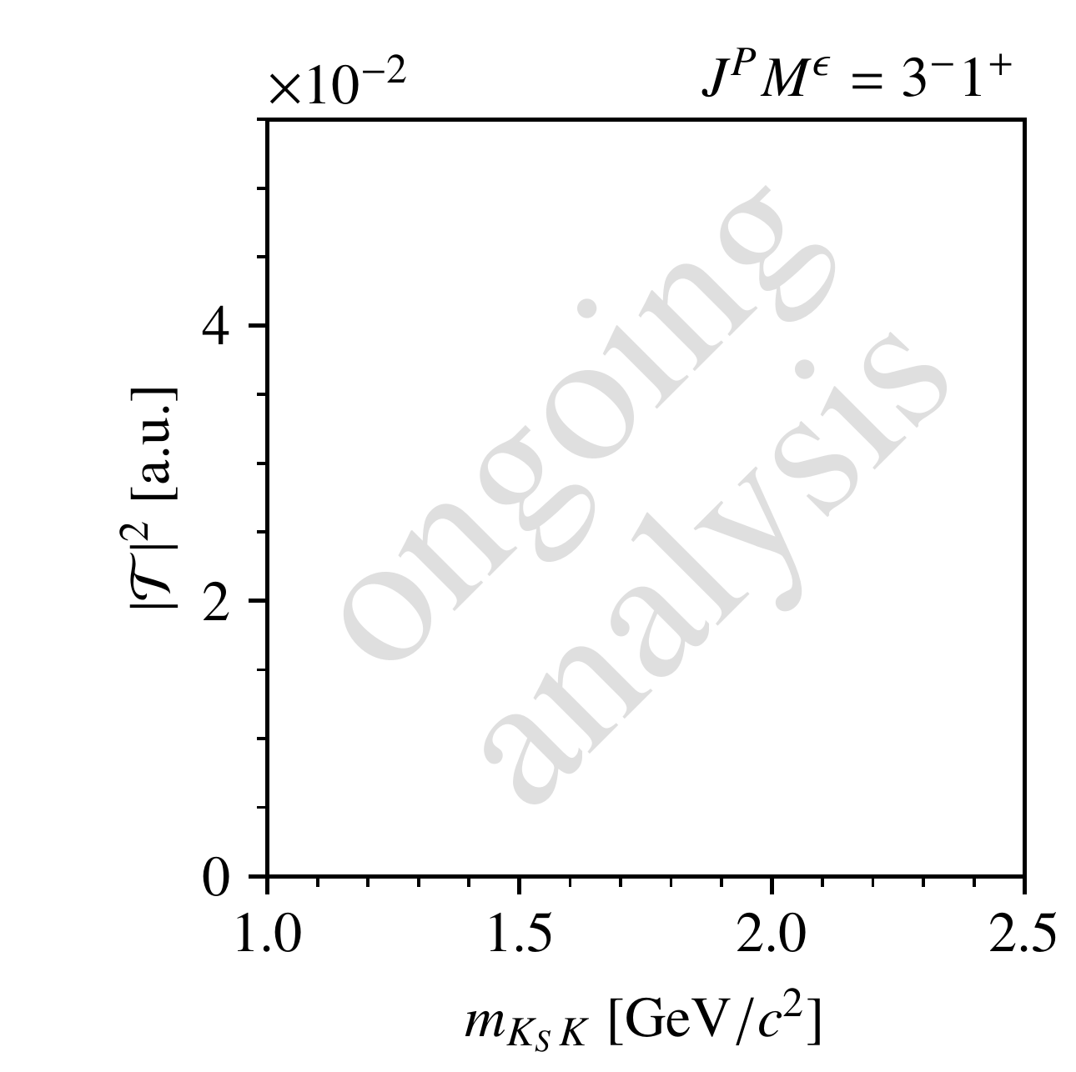
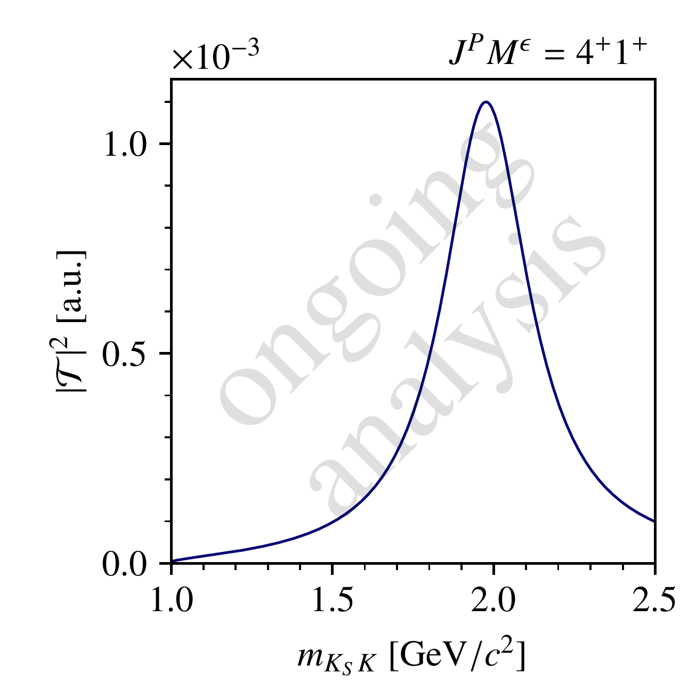
Study of the Ambiguities
Continuous amplitude model
Create an amplitude model for four partial waves
Sample points in $m_{KK}$ and calculate ambiguous solutions
How do the ambiguous solutions look like (continuity, signals, …)?

Slide 18
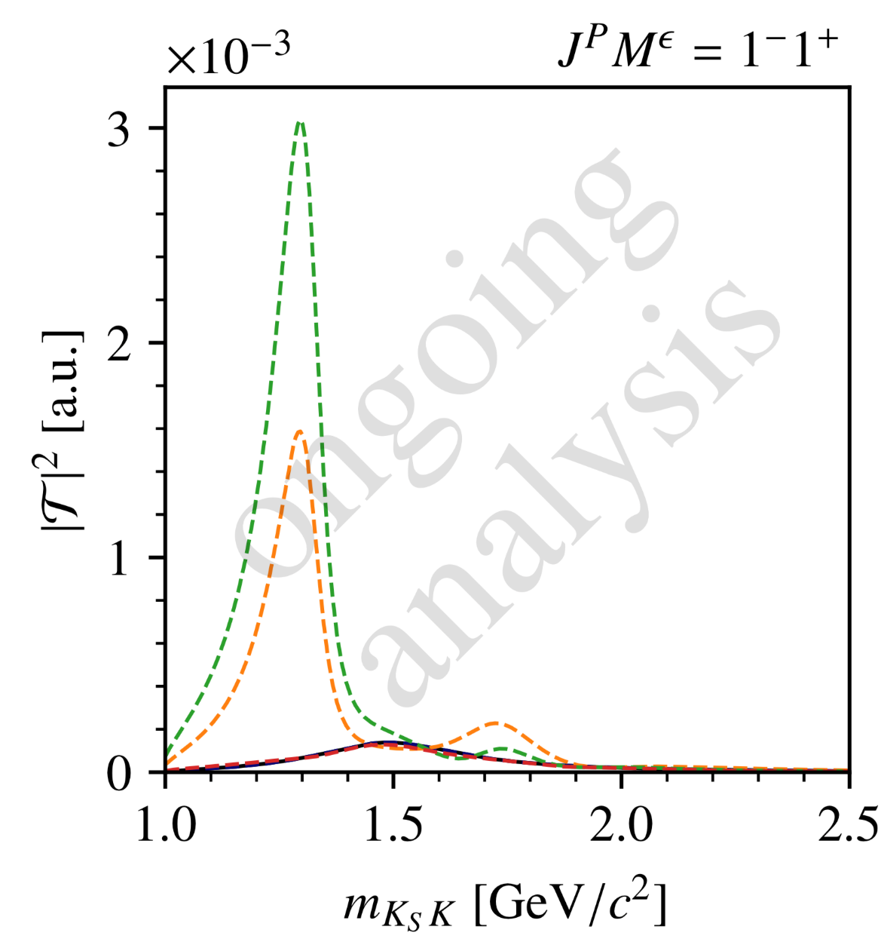
Continuous Amplitude Model
Continuous amplitude model
How do the ambiguous solutions look like?
Create an amplitude model for four partial waves
Sample points in $m_{KK}$ and calculate ambiguous solutions
Ambiguous intensities are also continuous
Not all solutions are different from each other!
Highest-spin ($4^{++}$) intensity is invariant!
$$N_{a}=3$$
sol. 1
sol. 2
sol. 3
model

Slide 19
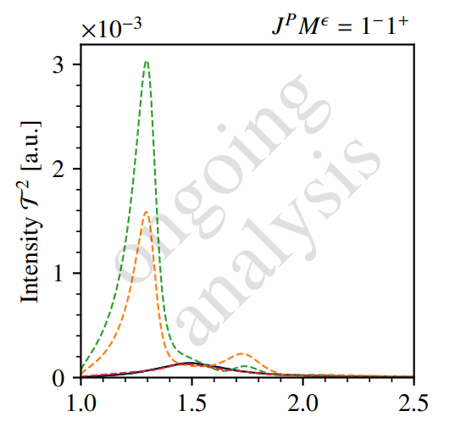
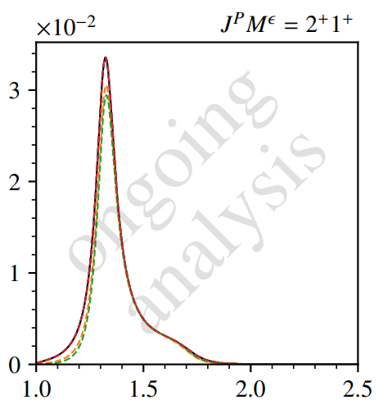
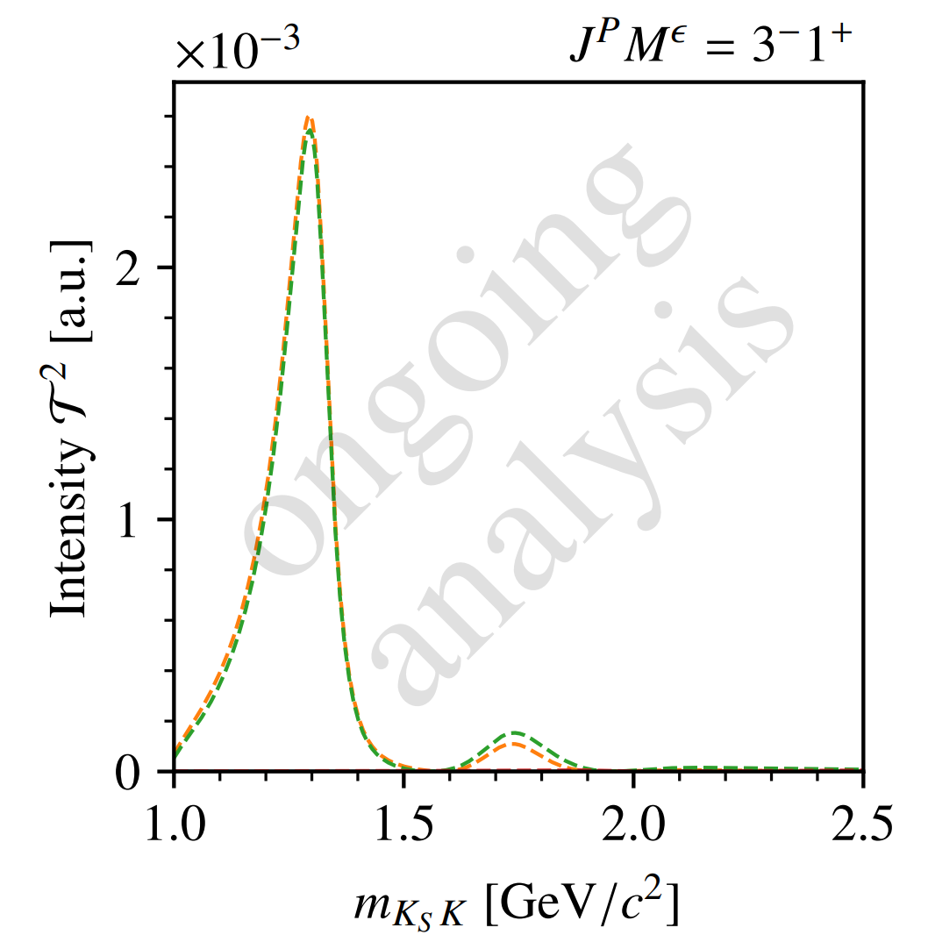
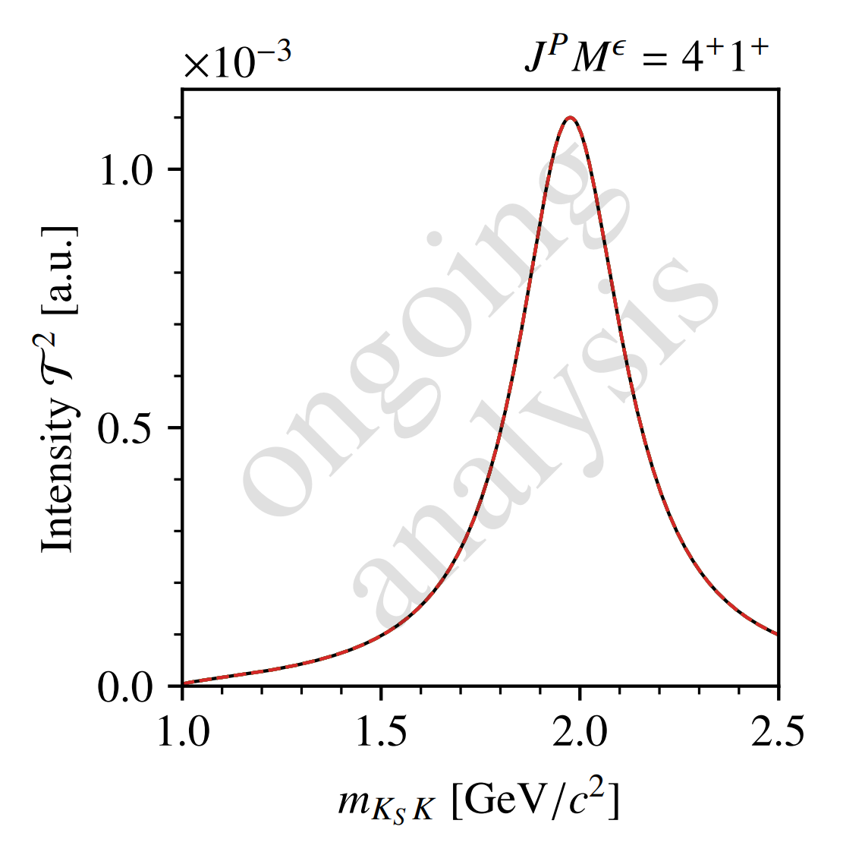
Continuous Amplitude Model
Continuous amplitude model
How do the ambiguous solutions look like?
Create an amplitude model for four partial waves
Sample points in $m_{KK}$ and calculate ambiguous solutions
Ambiguous intensities are also continuous
Not all solutions are different from each other!
Highest-spin ($4^{++}$) intensity is invariant!
sol. 1
sol. 2
sol. 3
model
$$N_{a}=3$$

Slide 20
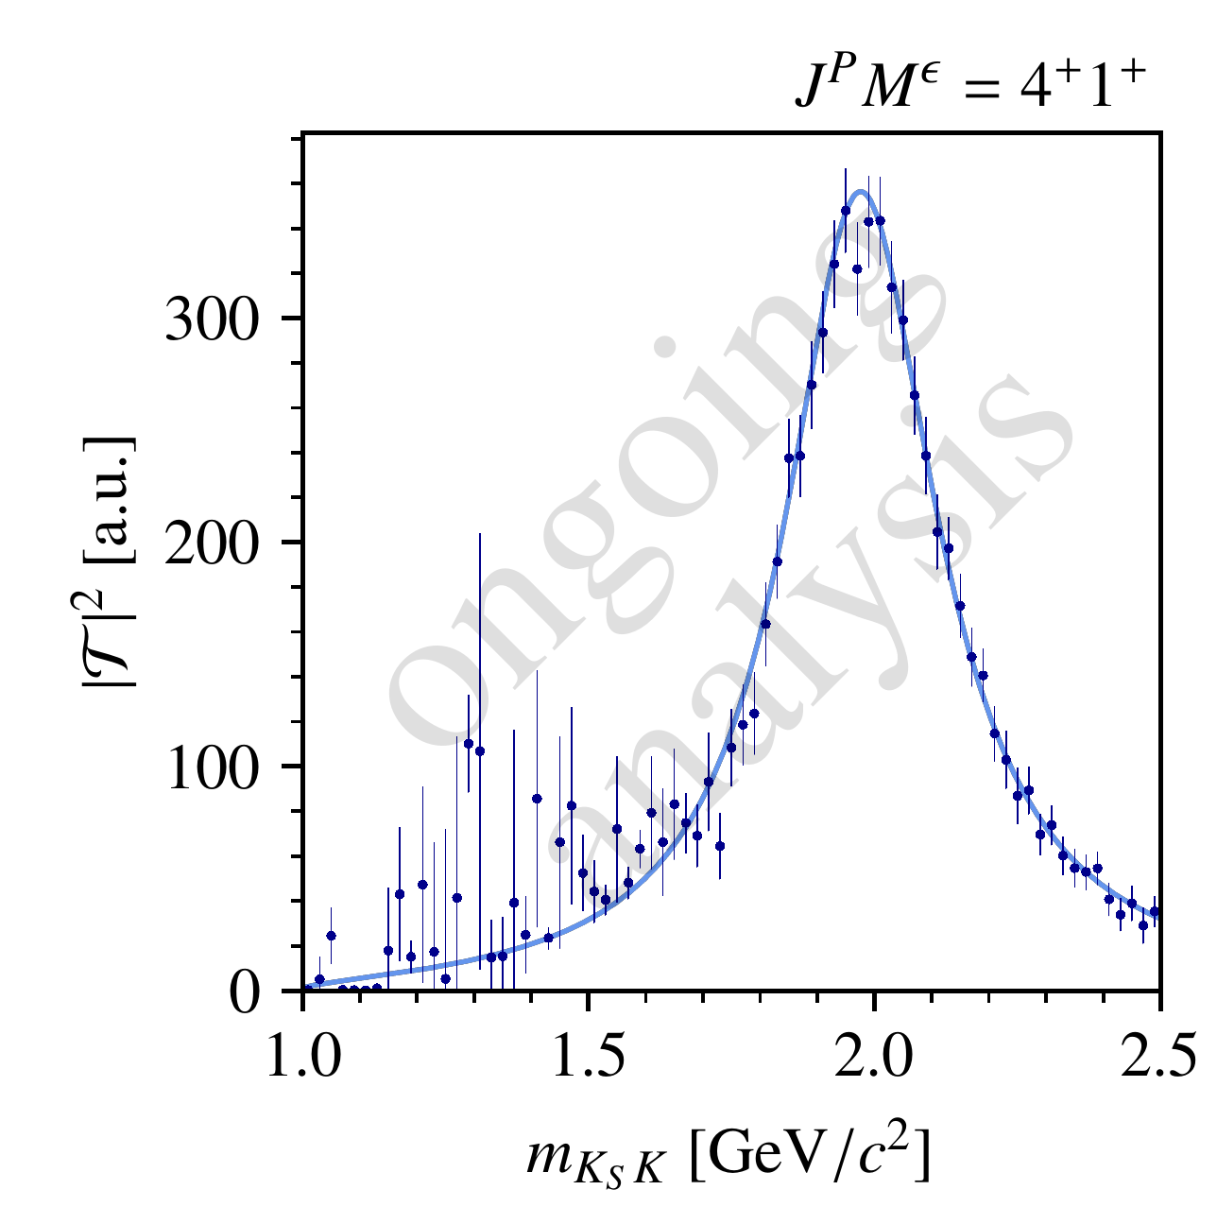
Partial-Wave Decomposition Fits on Pseudodata
Finite pseudo-data
reality: finite data and amplitudes unknown
generate pseudo-data according to model
perform a partial-wave decomposition fit
$→$ 3000 attempts with random start values
$4^{++}$ intensity is still invariant!
Overall, amplitude values found by the fit follow the calculated distributions
Not all solutions are found in each $m_{X}$ bin
$→$ PWD fit distorts the intensity distribution!

Slide 21
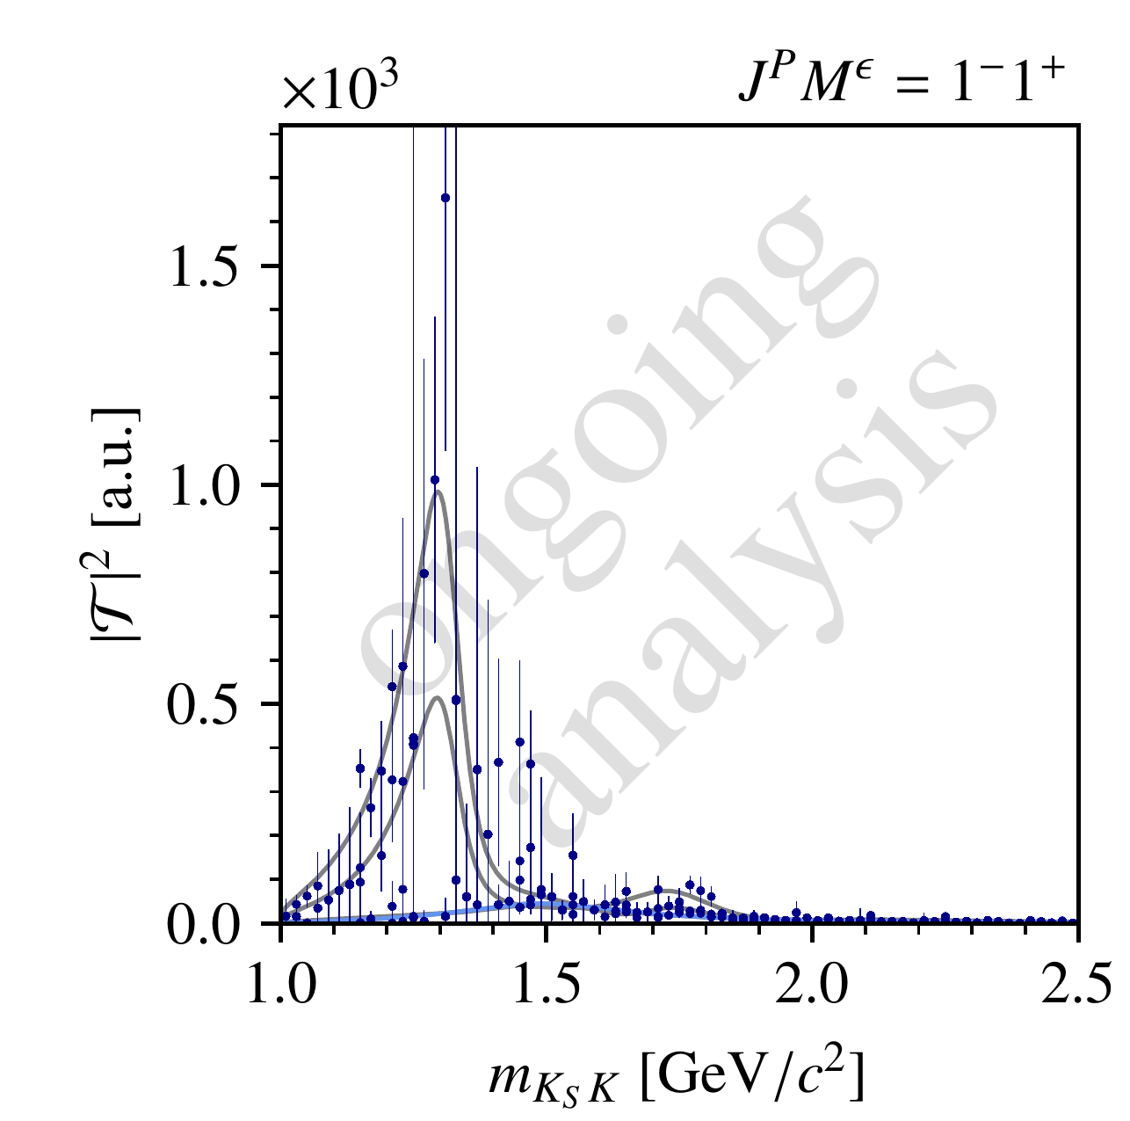
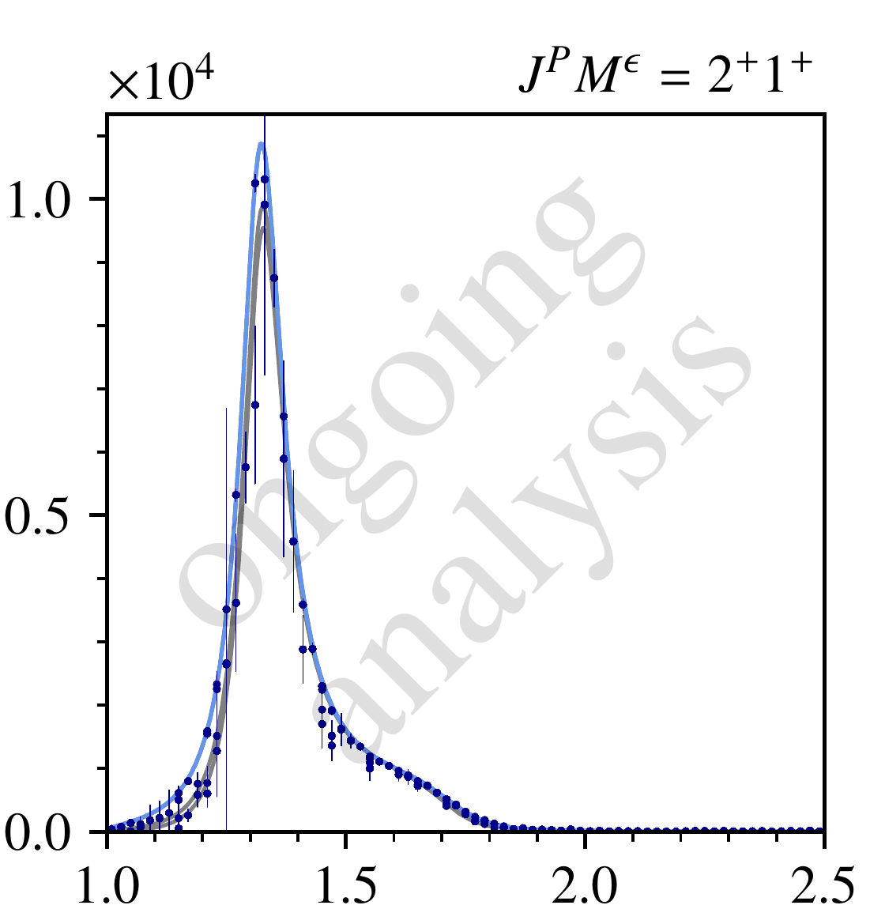
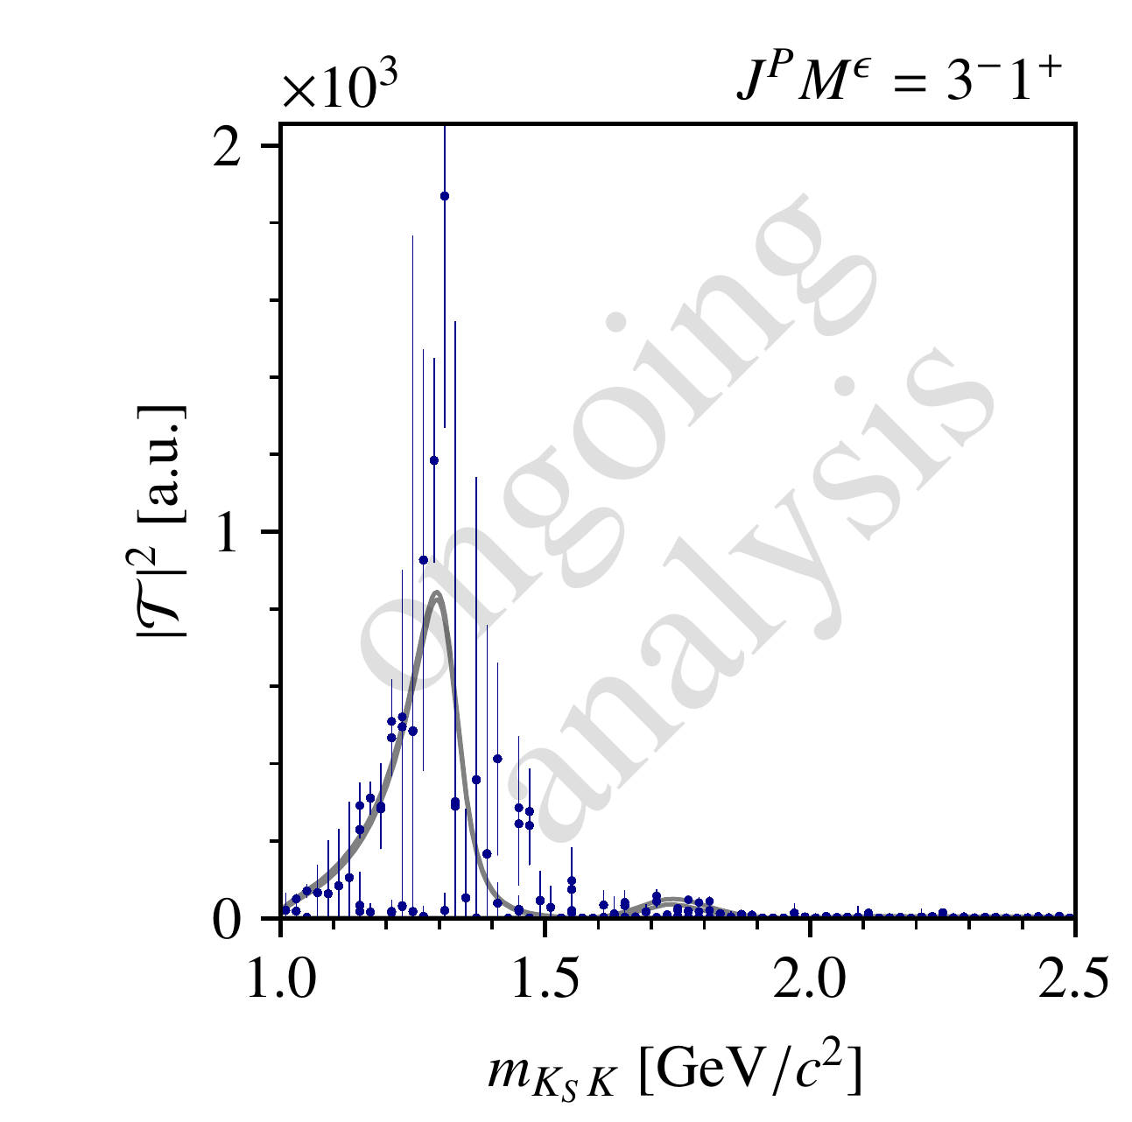
Partial-Wave Decomposition Fits on Pseudodata
Finite pseudo-data
reality: finite data and amplitudes unknown
generate pseudo-data according to model
perform a partial-wave decomposition fit
$→$ 3000 attempts with random start values
$4^{++}$ intensity is still invariant!
Overall, amplitude values found by the fit follow the calculated distributions
Not all solutions are found in each $m_{KK}$ bin
$→$ PWD fit distorts the intensity distribution!

Slide 22
Partial-Wave Decomposition Fits on Pseudodata
Finite pseudo-data
reality: finite data and amplitudes unknown
generate pseudo-data according to model
perform a partial-wave decomposition fit
$→$ 3000 attempts with random start values
$4^{++}$ intensity is still invariant!
Overall, amplitude values found by the fit follow the calculated distributions
Not all solutions are found in each $m_{KK}$ bin
$→$ PWD fit distorts the intensity distribution!

Slide 23
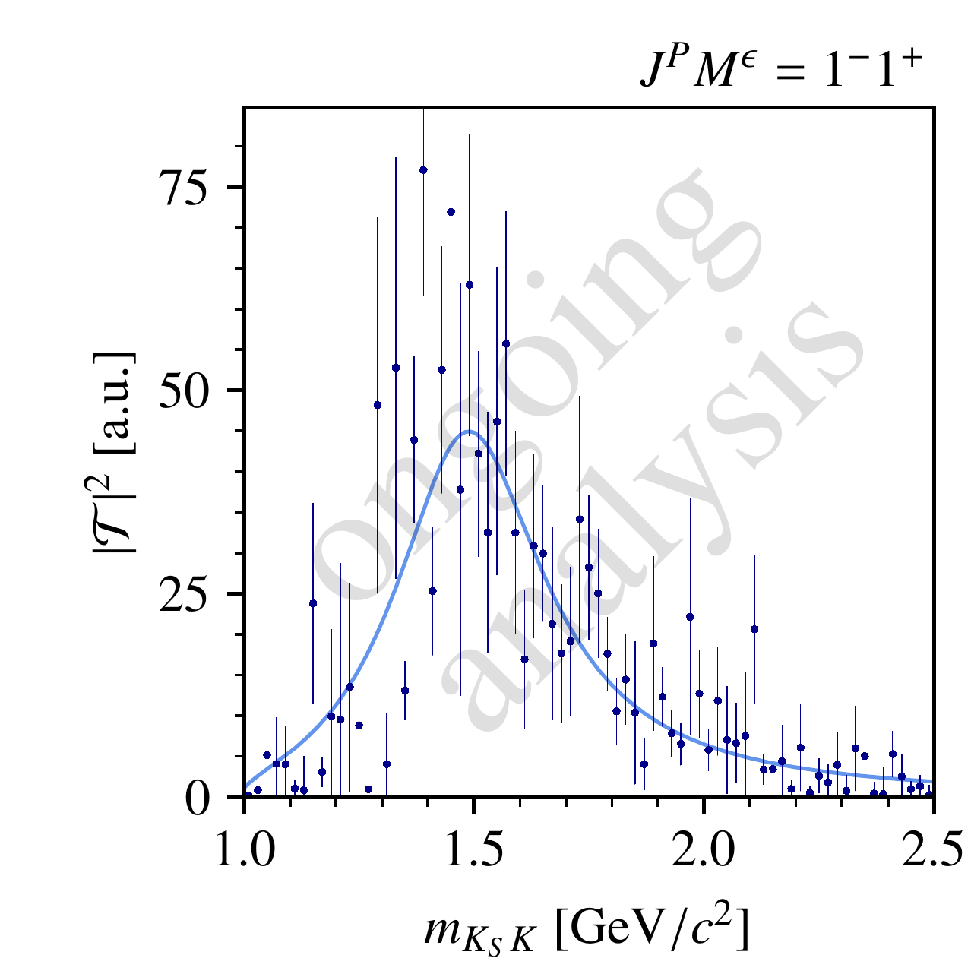
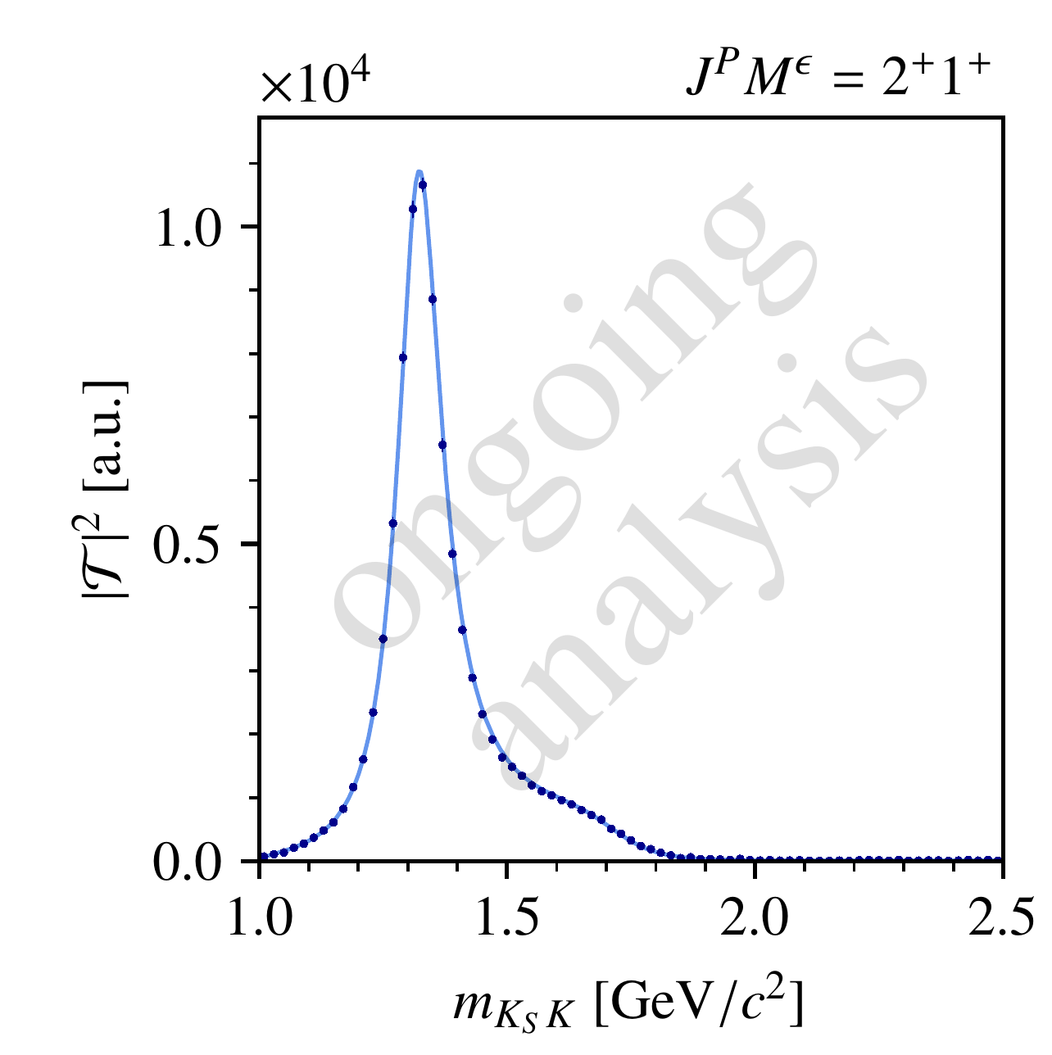
Reducing the Ambiguities
Intensity of highest-spin wave is unaffected by ambiguities
Remove one wave with $J<J_{max} →$ resolves ambiguities
At COMPASS: odd-spin waves strongly suppressed!
$→$ assume no ambiguities in the decomposition!
Except: Two solutions in the phases of the partial waves
$$I\left(θ,φ\right)={\left|\sum_{J}{T_{J} Y_{J}^{1}(θ,φ)}\right|}^{2}=\left|\sum_{J}{T_{J}^{∗} Y_{J}^{1}(θ,φ)}\right|$$

Slide 24
Partial-Wave Analysis of the $K_{S}^{0}K^{−}$ Final State at COMPASS: Physics Results
$$J^{PC}$$ | $$M^{ε}$$ | Resonances
$$2^{++}$$ | $$1^{+}$$ | $a_{2}$-like
 | $$2^{+}$$
$$4^{++}$$ | $$1^{+}$$ | $a_{4}$-like
$$6^{++}$$ | $$1^{+}$$ | $a_{6}$-like
$$(1^{−−}$$ | $$1^{+}$$ | $ρ$-like)
$→$ later
Previous study by . E. Cleland et al. “Resonance Production in the Reaction π±p →K0K±p at 30 GeV/c and 50 GeV/c”. In: Nucl. Phys. B 208 (1982)

Slide 25
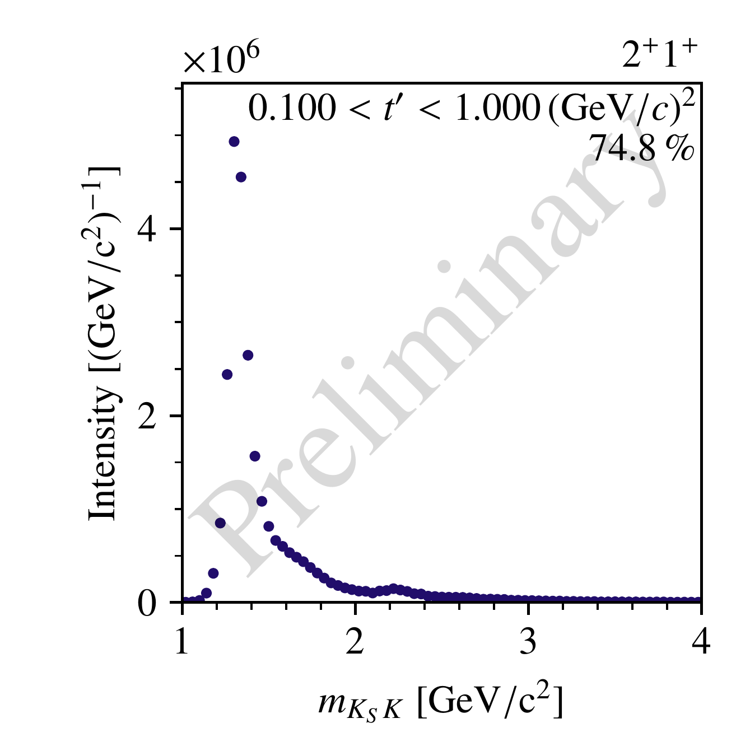
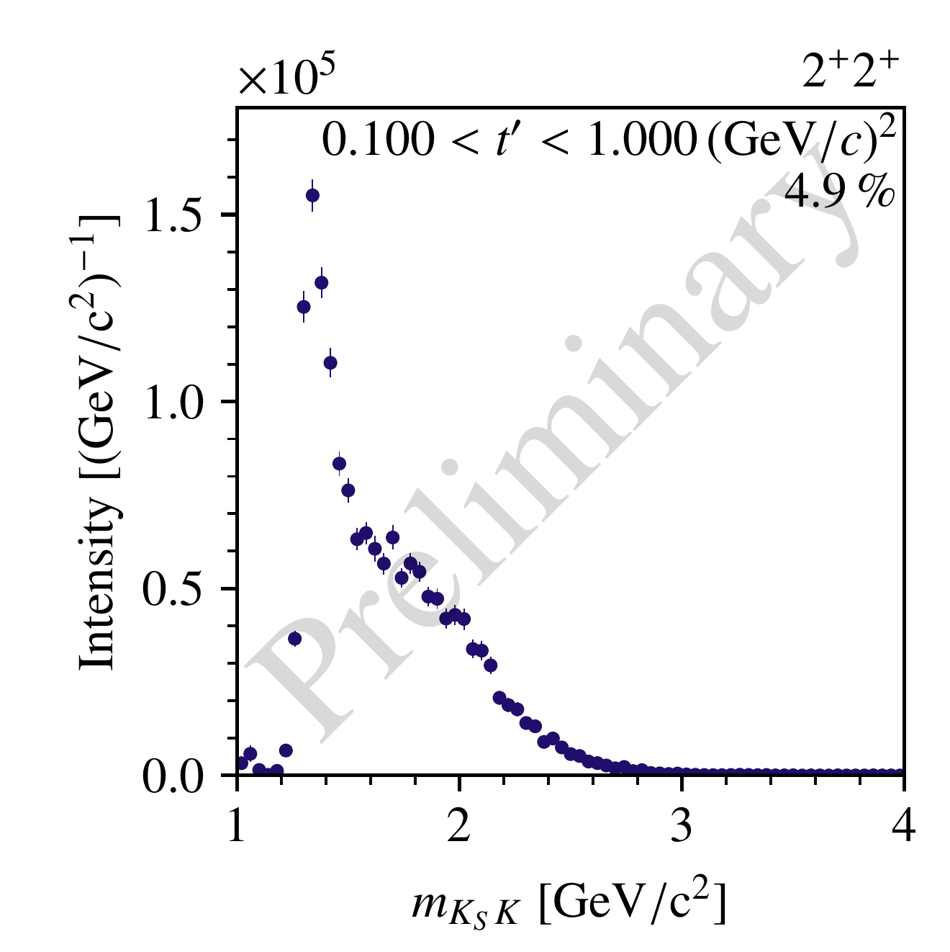
Results: Intensities and Phases
$$a_{2}\left(1320\right)$$
$$m_{PDG}=1.32 GeV$$
$$Γ_{PDG}=0.10 GeV$$
$$a_{2}\left(1320\right)$$
$$a_{2}\left(1320\right)$$
$$a_{2}\left(1700\right)$$
$$m_{PDG}=1.71 GeV$$
$$Γ_{PDG}= 0.38 GeV$$
$$a_{2}\left(1700\right)$$
$$a_{2}\left(????\right)$$
$$a_{2}\left(1700\right)$$
$$a_{2}\left(????\right)$$
$$a_{2}\left(????\right)$$

Slide 26
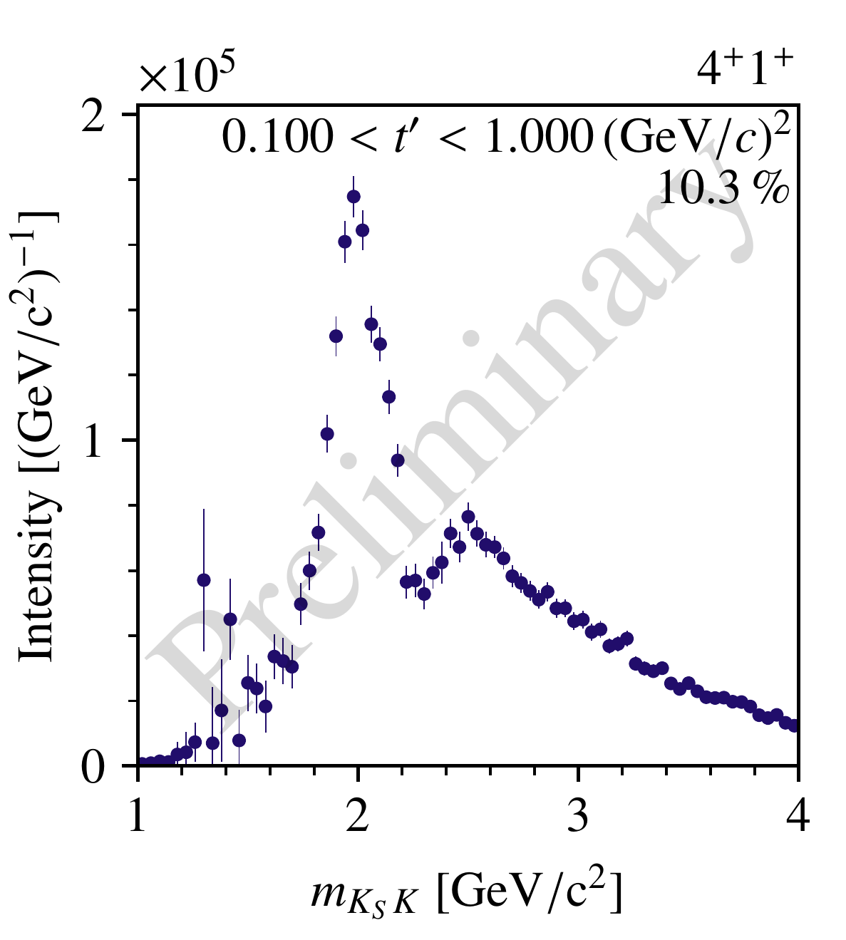
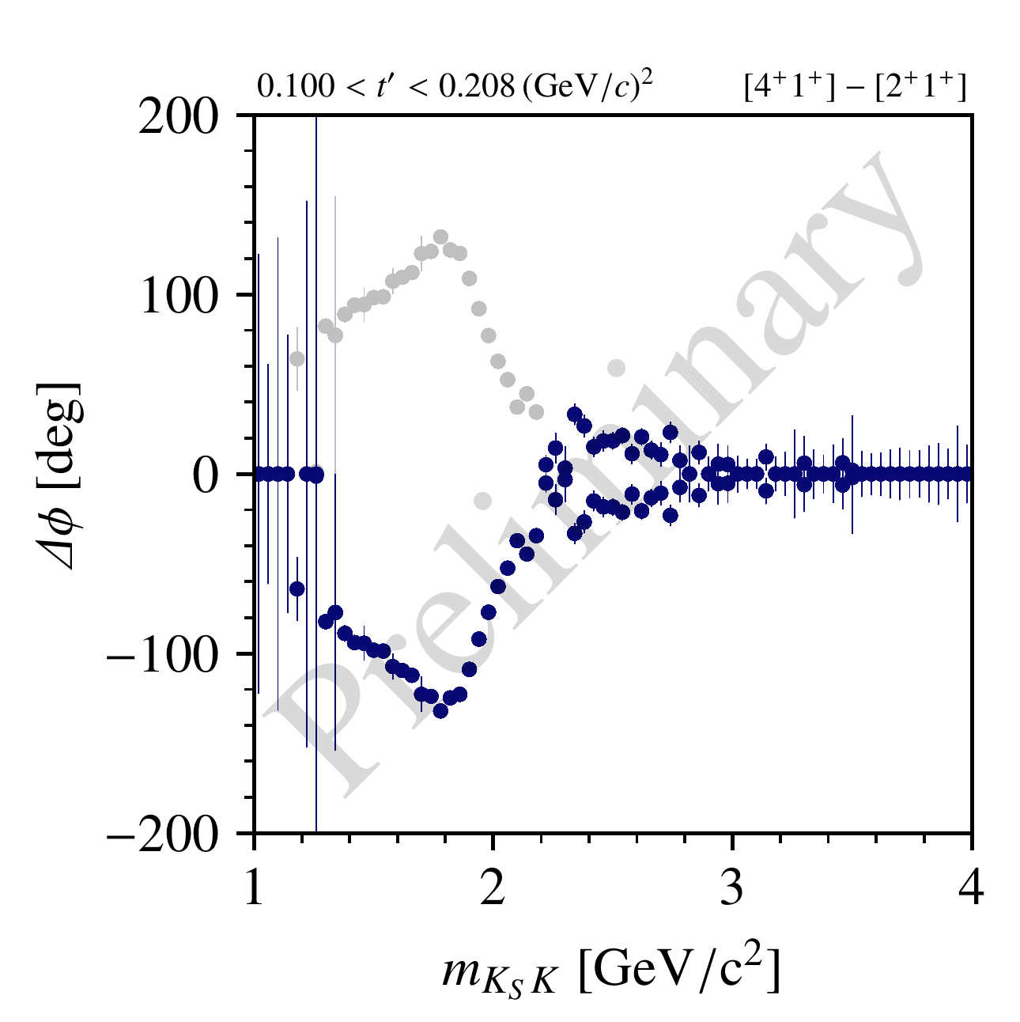
Results: Intensities and Phases
$$a_{4}\left(1970\right)$$
$$m_{PDG}=1.97 GeV$$
$$Γ_{PDG} =0.32 GeV$$
$$a_{4}\left(1970\right)$$
$$a_{4}\left(????\right)$$
$$a_{4}\left(????\right)$$

Slide 27
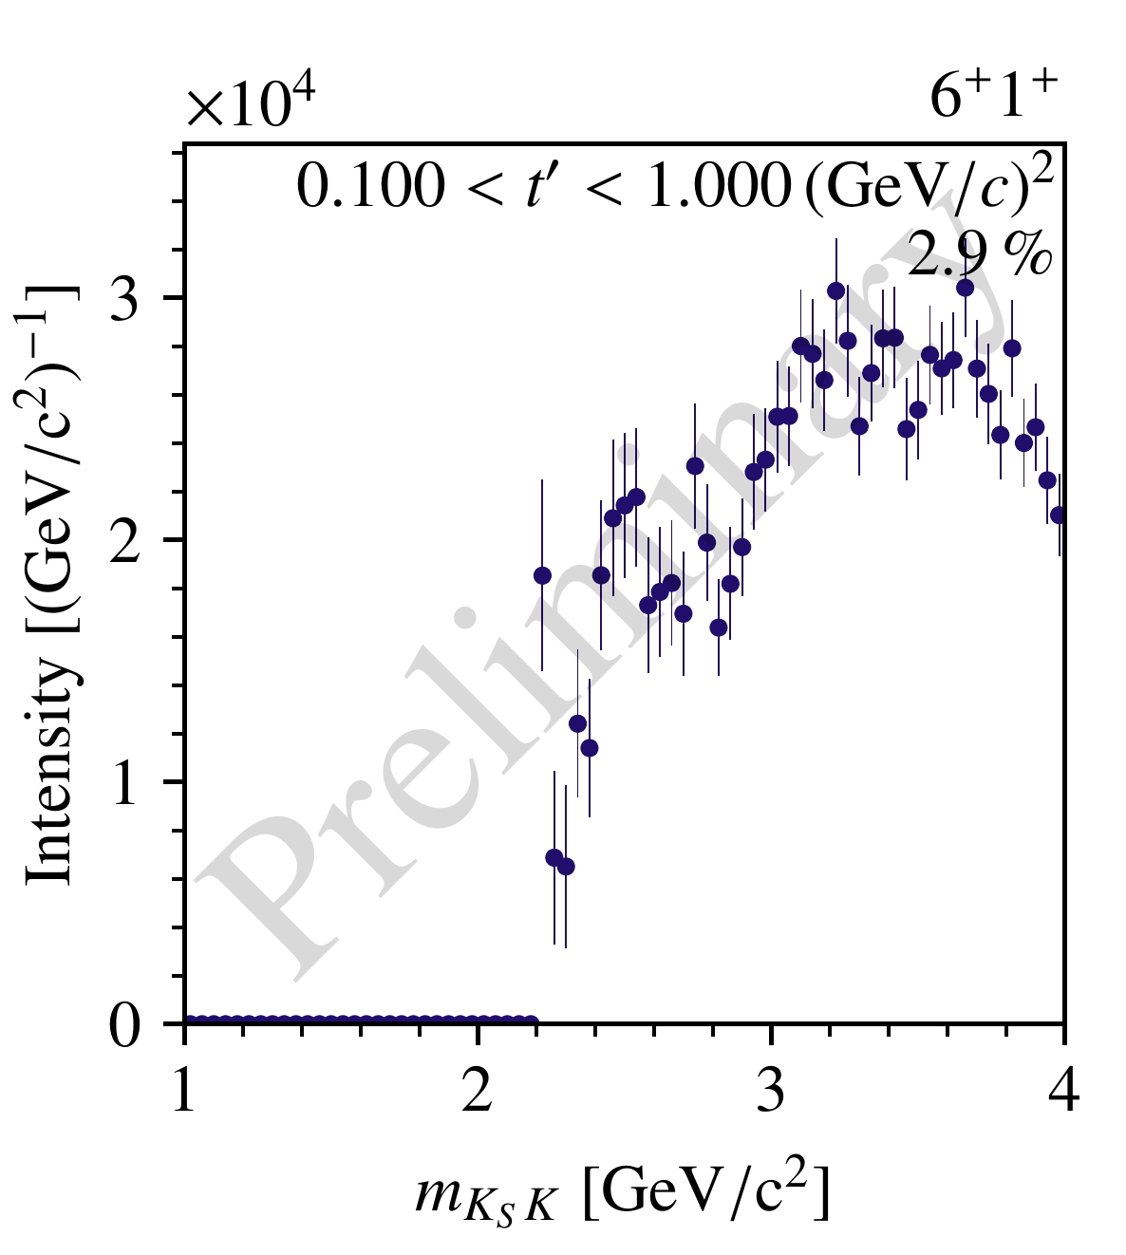
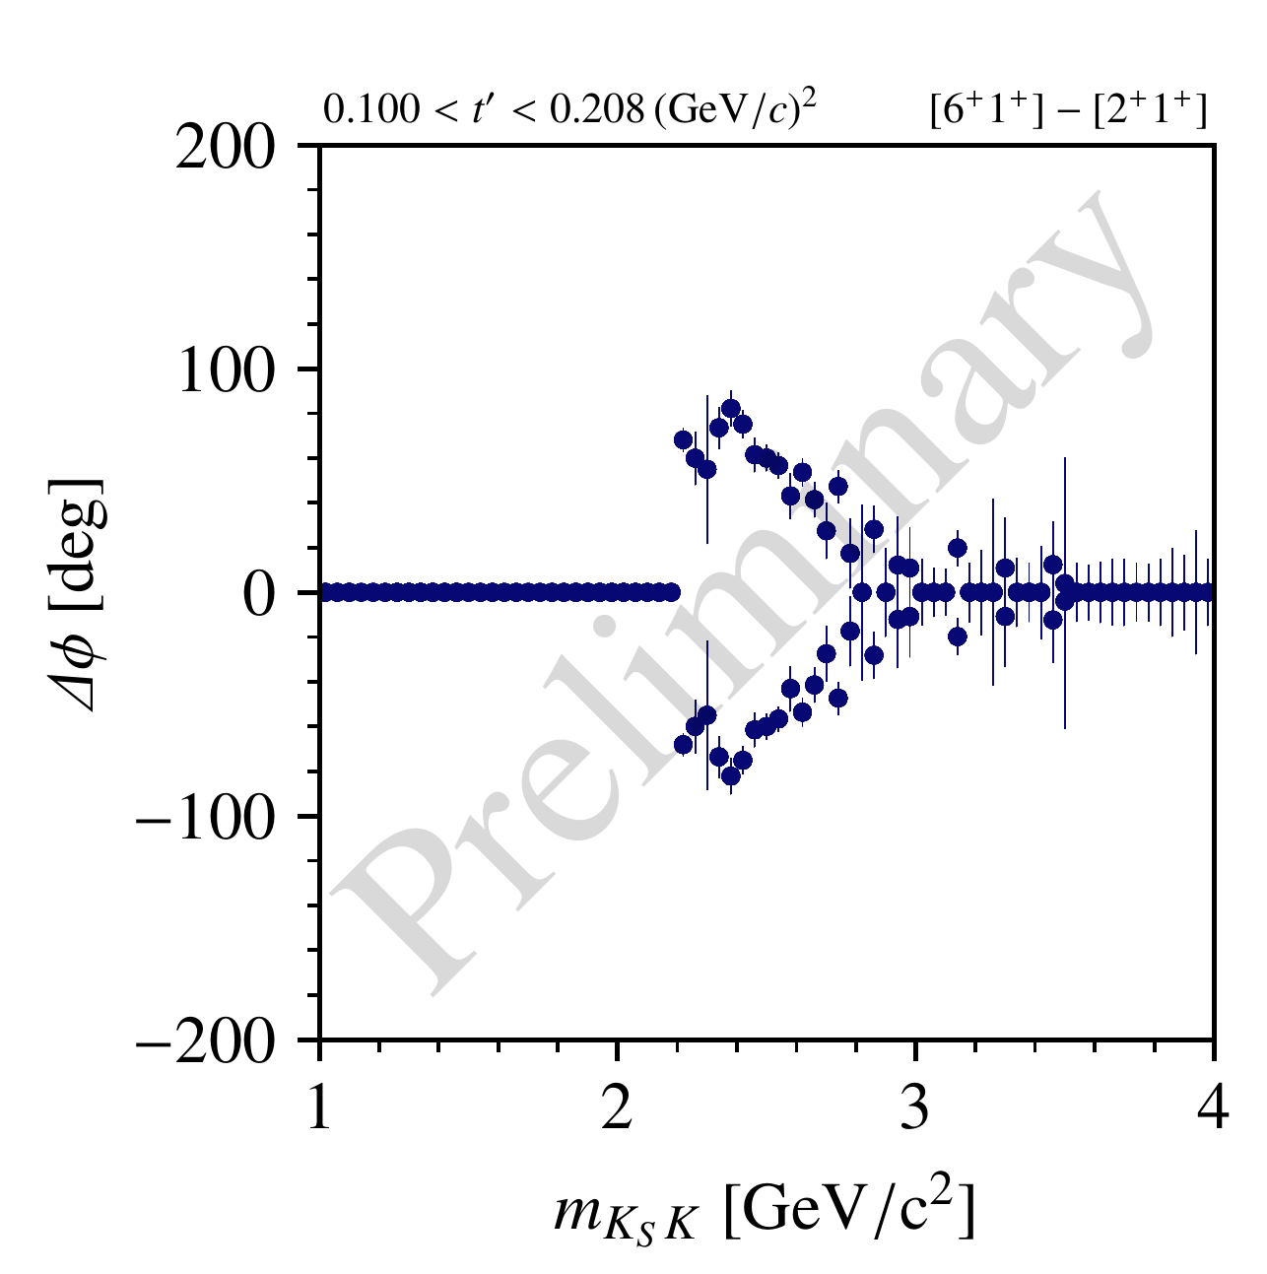
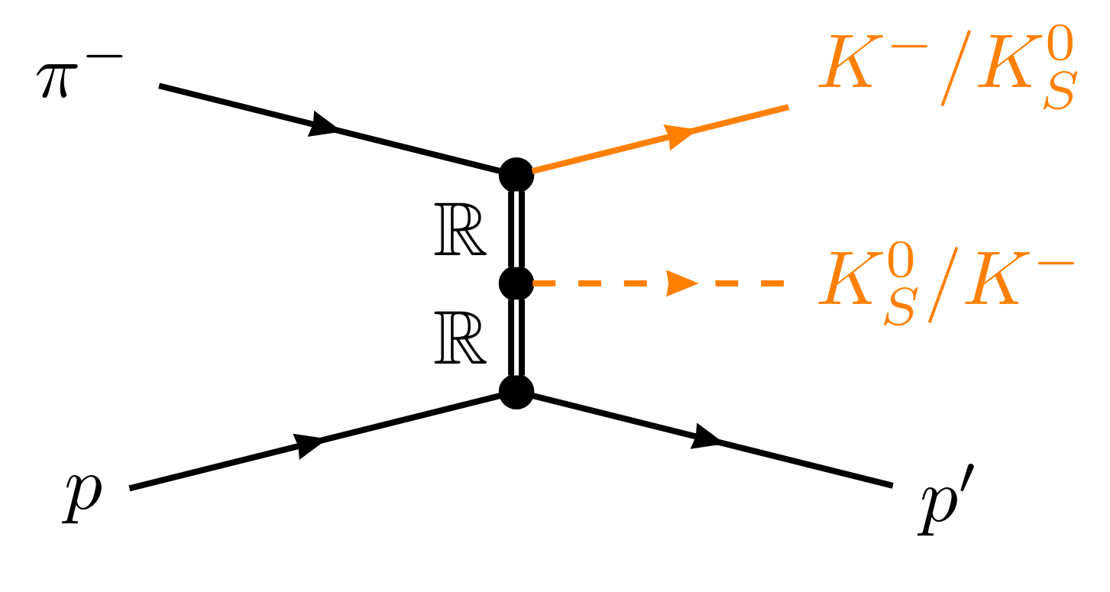
Results: Intensities and Phases
$$a_{6}\left(????\right)$$
$$a_{6}\left(????\right)$$

Slide 28
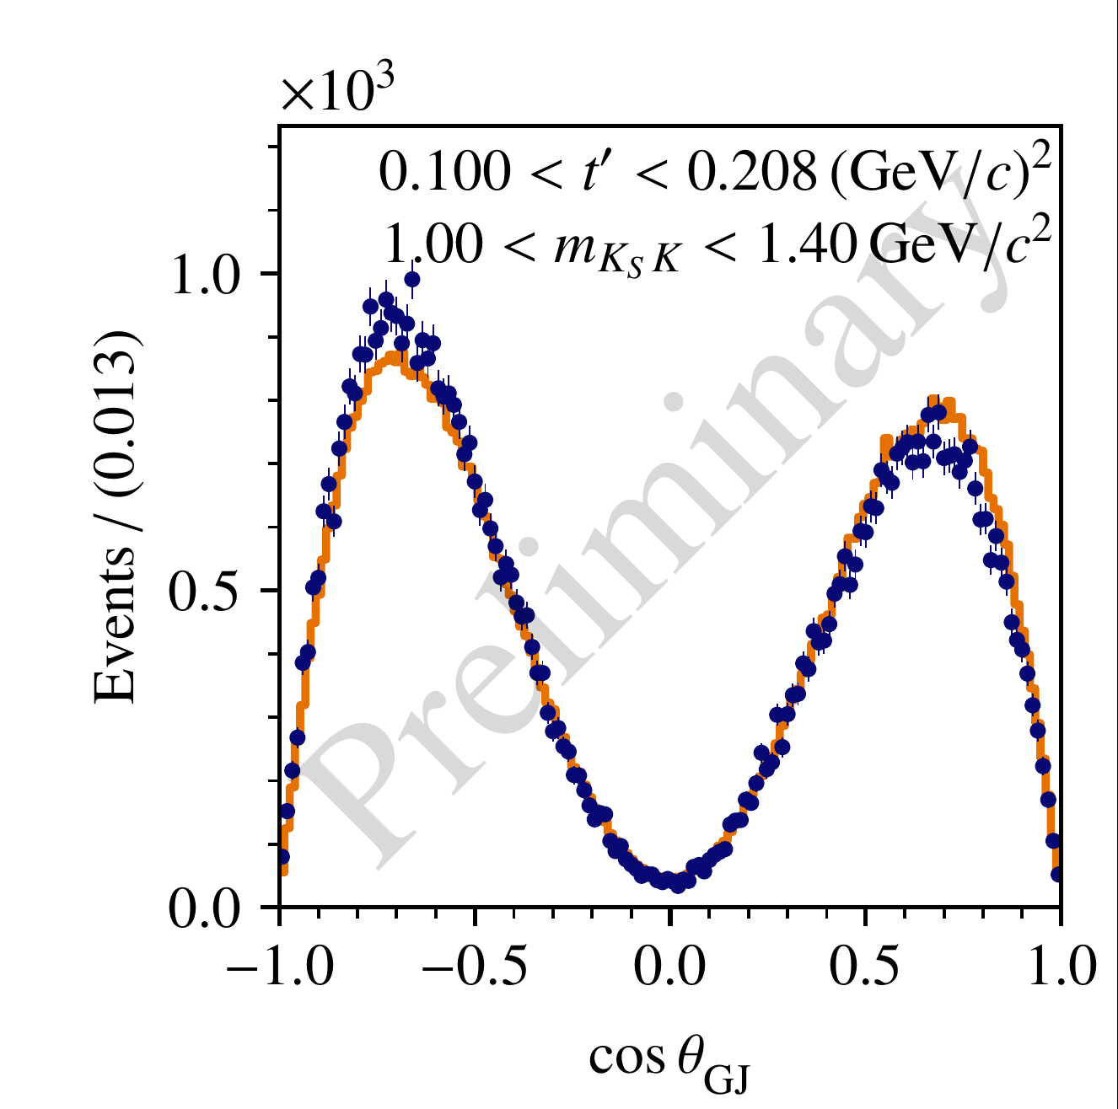
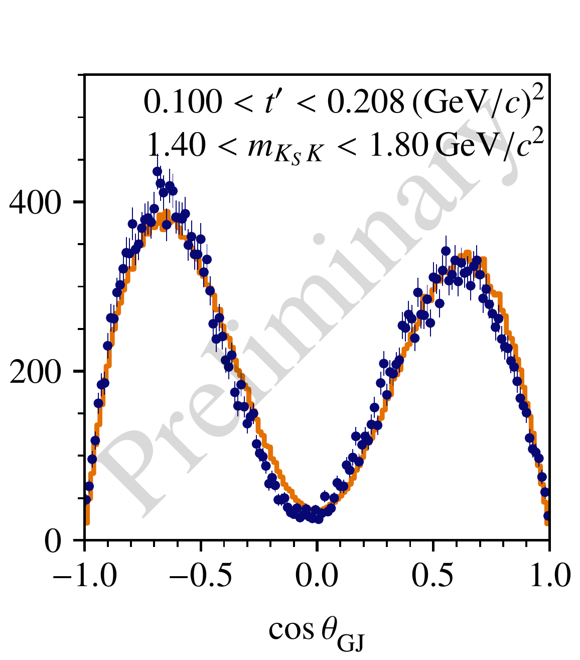
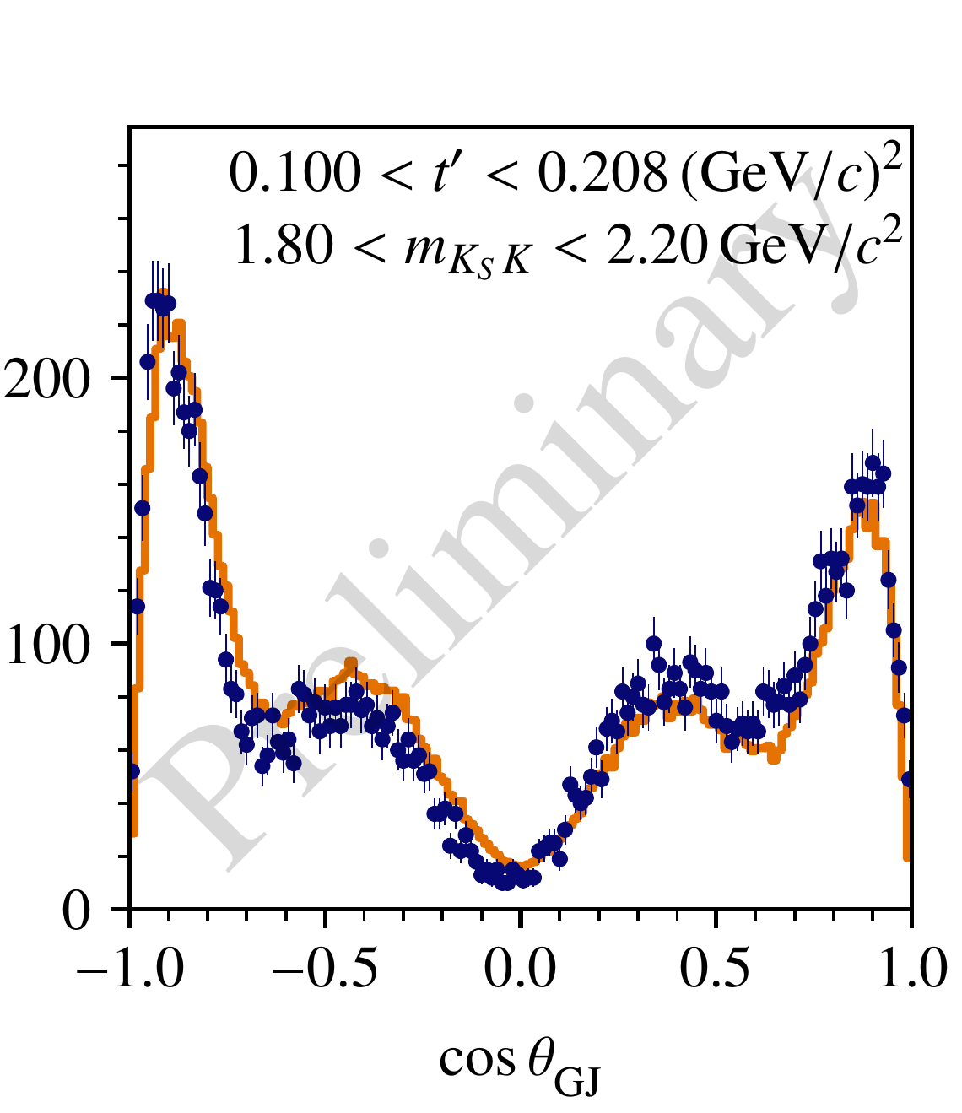
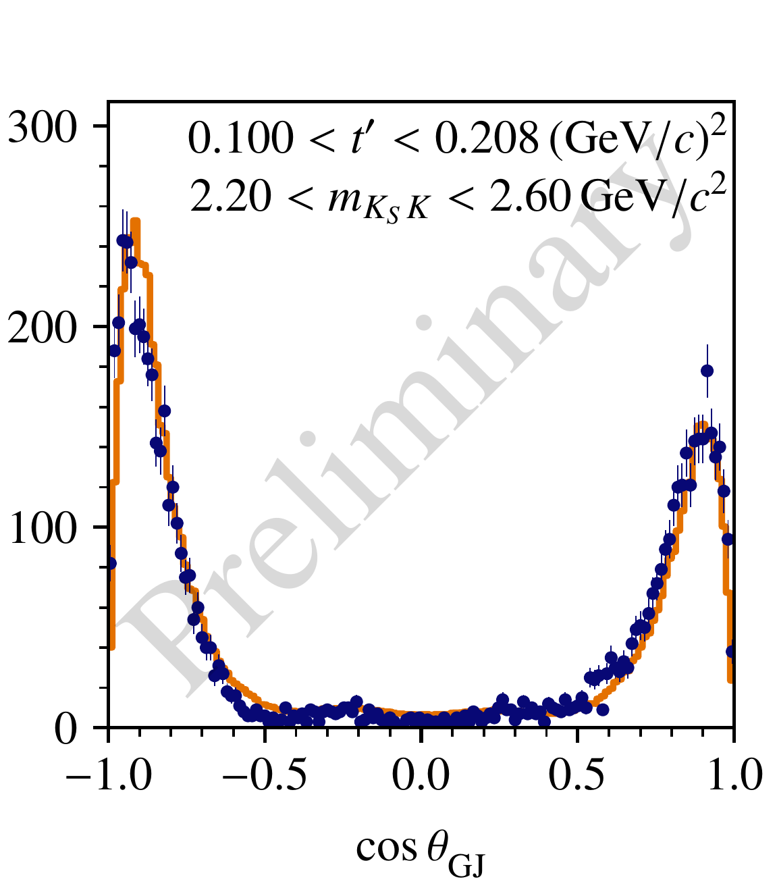
Agreement Between Model and Data
data
model
Angular distributions as predicted by the PWA model after the fit vs real data
Good agreement, but data exhibits larger asymmetry than predicted in the model

Slide 29
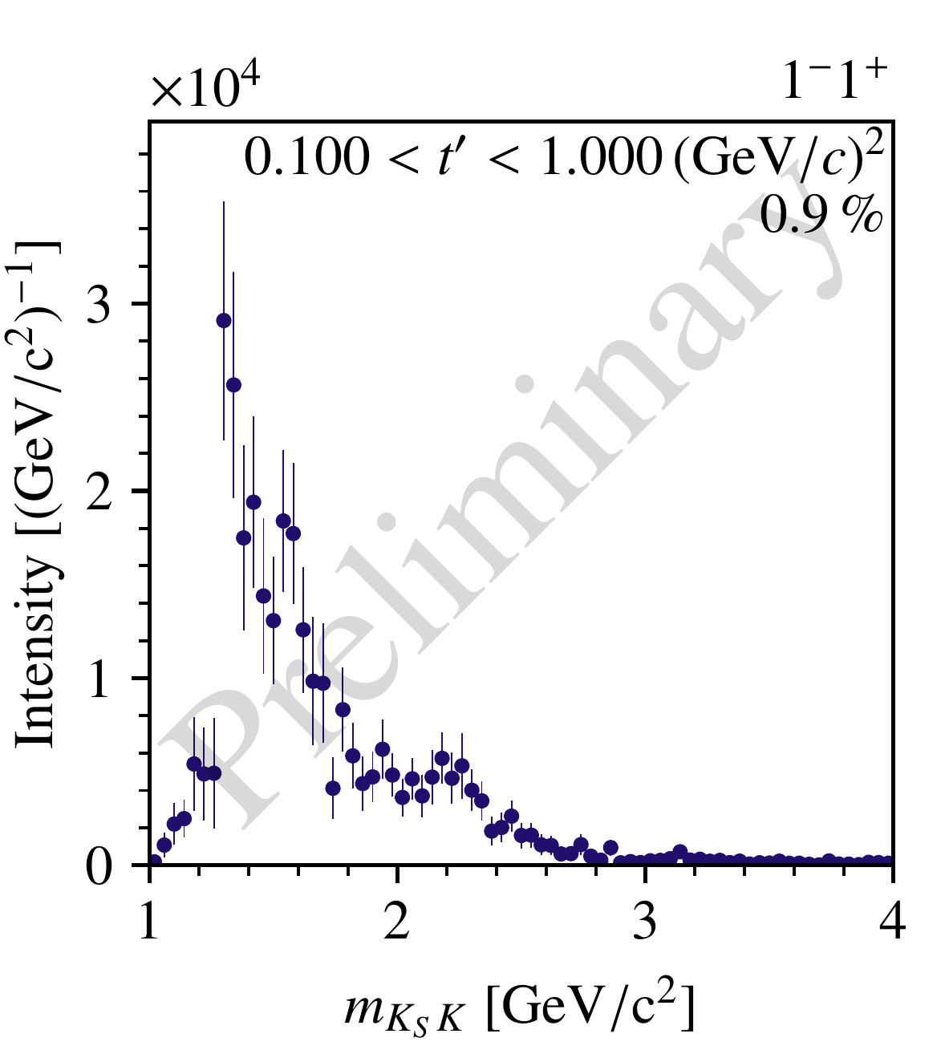
Adding an Odd-Spin Wave
How can we introduce asymmetry in the model?
Effects of the detector acceptance
Introduce partial wave(s) with odd spin $J$
Cannot be produced via Pomeron exchange!
(but e.g. by $ω$ exchange)
$I^{G}J^{PC}=1^{+}1^{−−}$
$$ρ\left(1450\right)$$
$m=1.47 GeV$
$Γ =0.40 GeV$
$$ρ\left(1700\right)$$
$m=1.73 GeV$
$Γ =0.25 GeV$

Slide 30
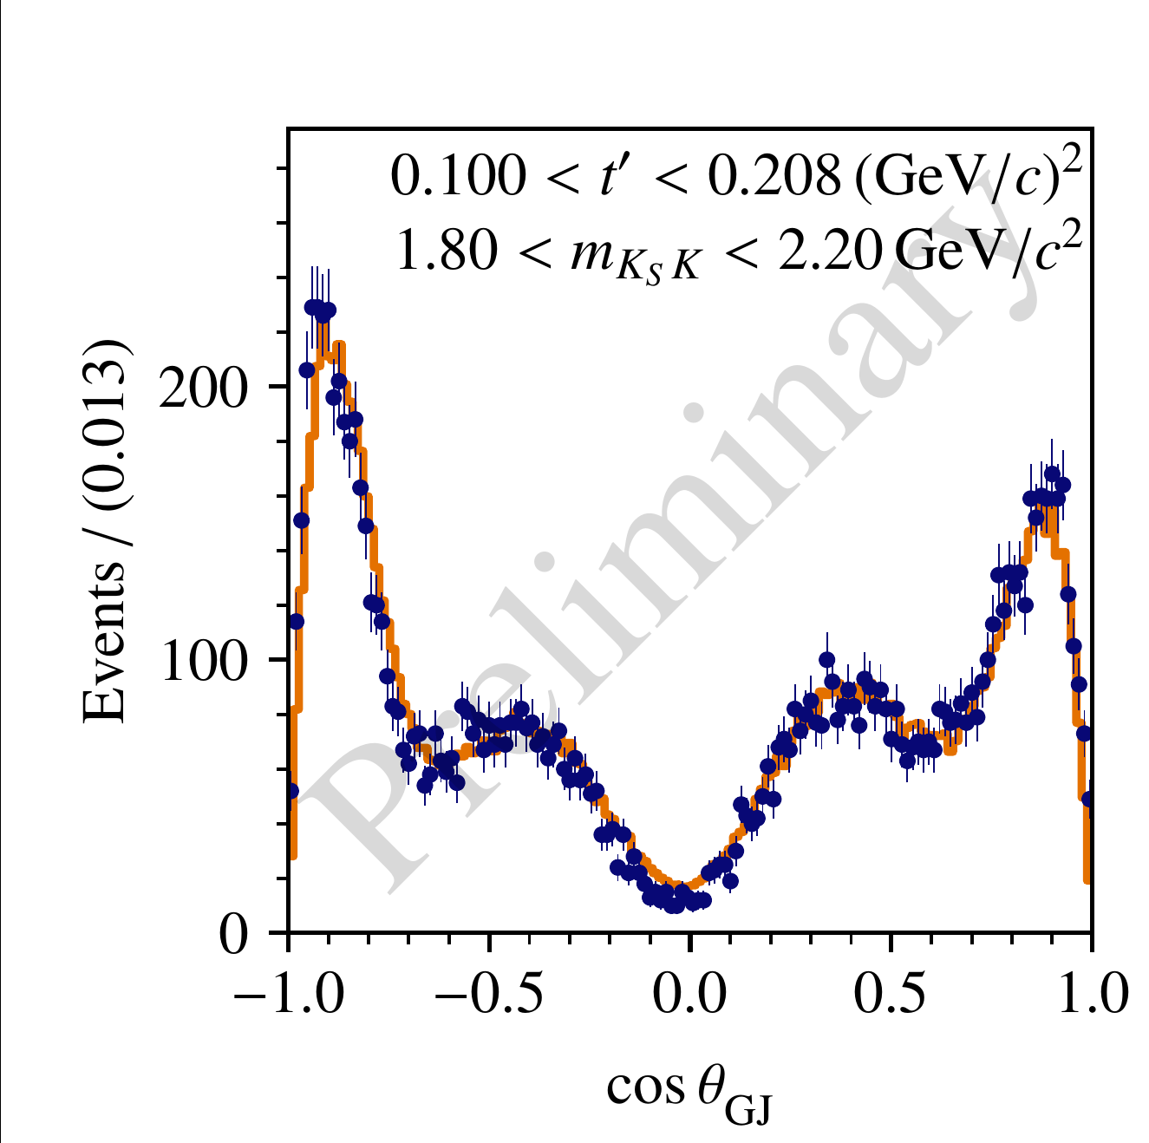
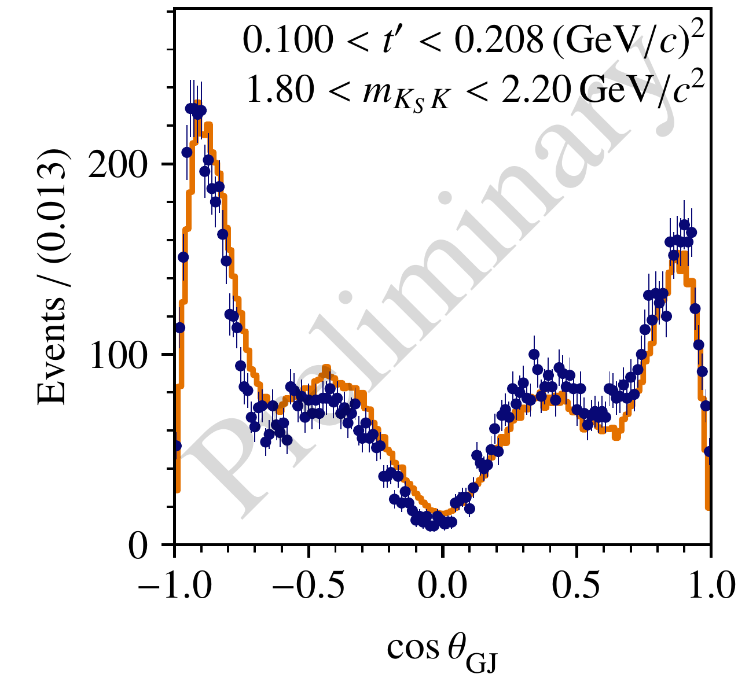
Agreement Between Model and Data II
Without $1^{−}$ wave
With $1^{−}$ wave
Interference of $J=1$ and even $J$ could explain the forward/backward asymmetry

Slide 31
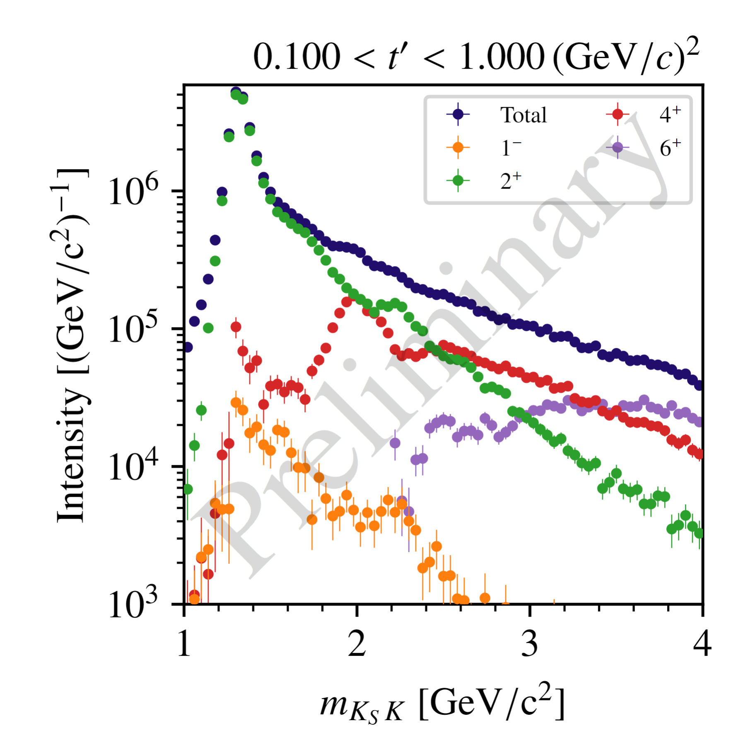
Conclusion and Outlook
Resonances appearing in the final state:
$J^{PC}=2^{++},4^{++},…→ a_{J}$ states (Pomeron exchange)
other exchanges may yield $J^{PC}=1^{−−},3^{−−},…$
Performed the partial-wave decomposition:
Clear signals of $a_{2}\left(1320\right)$ and $a_{4}\left(1970\right)$
Possible higher-lying $a_{2}$, $a_{4}^{′}$ and $a_{6}$
Indications of small intensity in $1^{−−}$ partial wave
Next step: Resonance-model fit
Extract resonance parameters by modelling $m_{KK}, t′$ dependences
Thank you for your attention!

Slide 33
BACKUP

Slide 34
Quantum Numbers of the $K_{S}^{0}K^{−}$ Final State
Quantum numbers of a $K_{S}^{0}K^{−}$ system
Quantum numbers of the produced $X^{−}$:
$→$ odd spins $J$ are suppressed!
$$J=L$$
$$I=1$$
$$G={\left(−1\right)}^{L+1}$$
all given by $L$!
$$P={\left(−1\right)}^{L}$$
$$C={G\left(−1\right)}^{I}={\left(−1\right)}^{L}$$
Reflectivity ($ε=±1$) basis:
eigenvalue of $\hat{ε}=\hat{P}R_{⊥}(π)$
$I^{G}=1^{−}$ for Pomeron ($I^{G}=0^{+}$ ) exchange
at high $\sqrt{s}$,
$$ε≈η$$
$η$: naturality of the exchange particle
$→ε=+1$ for Pomeron exchange
$$I^{G}J^{PC}=1^{+}1^{−−}, 1^{−}2^{++}, 1^{+}3^{−−},1^{−}4^{++},…$$
S. U. Chung, doi.org/10.1103/PhysRevD.11.633
S. U. Chung, C- and G-parity: A New Definition and Applications. https://suchung.web.cern.ch/Cparity7b.pdf

Slide 35
Ambiguities in Incoherent Sectors
$$I\left(m_{X},t^{′};θ,φ\right)={\left|\sum_{JM}{T_{JM}^{+}\left(m_{X},t^{′}\right) ψ_{JM}^{+}(θ,φ)}\right|}^{2}+{\left|\sum_{JM}{T_{JM}^{−}\left(m_{X},t^{′}\right) ψ_{JM}^{−}(θ,φ)}\right|}^{2}$$
$$ε=±1:$$
$$a_{0}^{−}=\sum_{J=0}^{J_{max}^{−}}{T_{J0}^{−} Y_{J}^{0}(θ,0)}$$
$$a_{1}^{+}=\sum_{J=1}^{J_{max}^{+}}{T_{J1}^{+} Y_{J}^{1}(θ,0)}$$
$$ε=−1, M=0$$
$$ε=+1, M=1$$
$$a_{1}^{−}=\sum_{J=1}^{J_{max}^{−}}{T_{J1}^{−} Y_{J}^{1}(θ,0)}$$
$$ε=−1, M=1$$
Define $a_{s}^{−}=a_{0}^{−}+a_{1}^{−}$, then same procedure as for only positive-reflectivity sector
New amplitudes for $ε=+1$: ${\left|a_{1}^{+}\right|}^{2}={\left|a_{1}^{−}\right|}^{2}−const.$ $→$ positivity requirement!

Slide 36
Study of the Ambiguities
How do the ambiguous solutions look like (continuity, signals, …)?
What are the effects of the partial-wave decomposition fit on finite data on the ambiguities?
Continuous intensity model
create an amplitude model for selected partial waves
calculate exact ambiguities
Finite pseudo-data
generate pseudo-data according to model
perform partial-wave decomposition

Slide 37
Continuous Amplitude Model
$$J^{PC}$$ | Resonances
$$1^{−−}$$ | $$ρ(1450)$$
$$2^{++}$$ | $$a_{2}\left(1320\right),a_{2}^{′}(1700)$$
$$3^{−−}$$ | $$None$$
$$4^{++}$$ | $$a_{4}\left(1970\right)$$
Continuous intensity model
create an amplitude model for four selected partial waves
In $1.0<m_{X}<2.5 GeV/c^{2}$
$m_{X}$-dependence by Breit-Wigner amplitudes (PDG parameters)

Slide 38
Continuous Amplitude Model
Continuous intensity model
Sample points in $m_{X}$ and calculate ambiguous solutions
Ambiguous intensities are also continuous
Not all solutions are different from each other!
Highest-spin ($4^{++}$) intensity is invariant!
sol. 1
sol. 2
sol. 3
model
$$N_{a}=3$$

Slide 39
Partial-Wave Decomposition Fits on Pseudodata
Finite pseudo-data
$4^{++}$ intensity is still invariant!
Overall, amplitude values found by the fit follow the calculated distributions
Not all solutions are found in each $m_{X}$ bin
$→$ PWD fit distorts the intensity distribution!

Slide 40
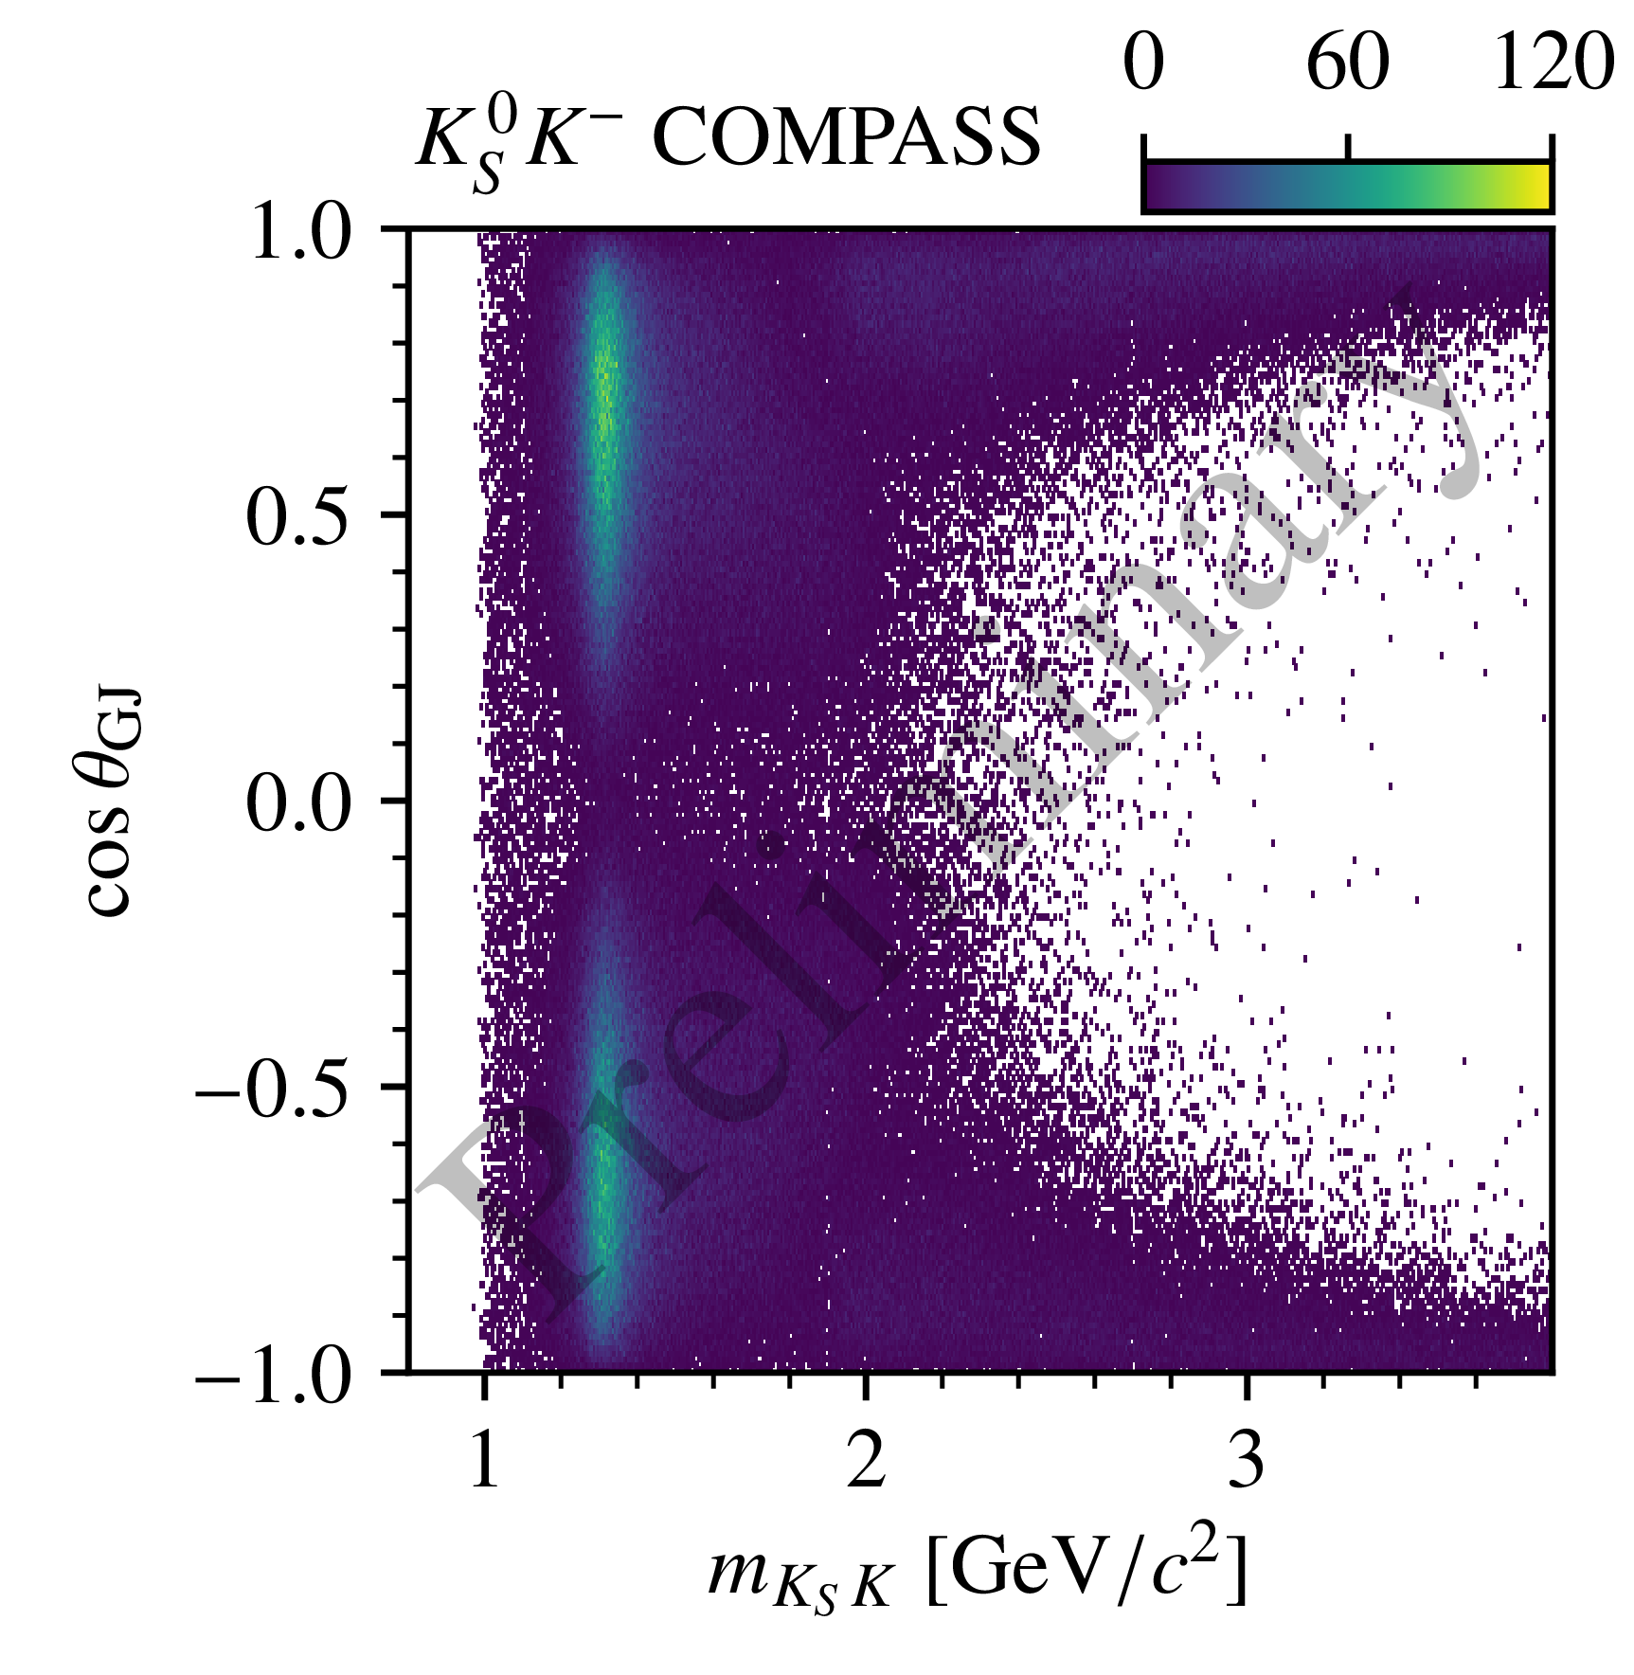

Slide 41
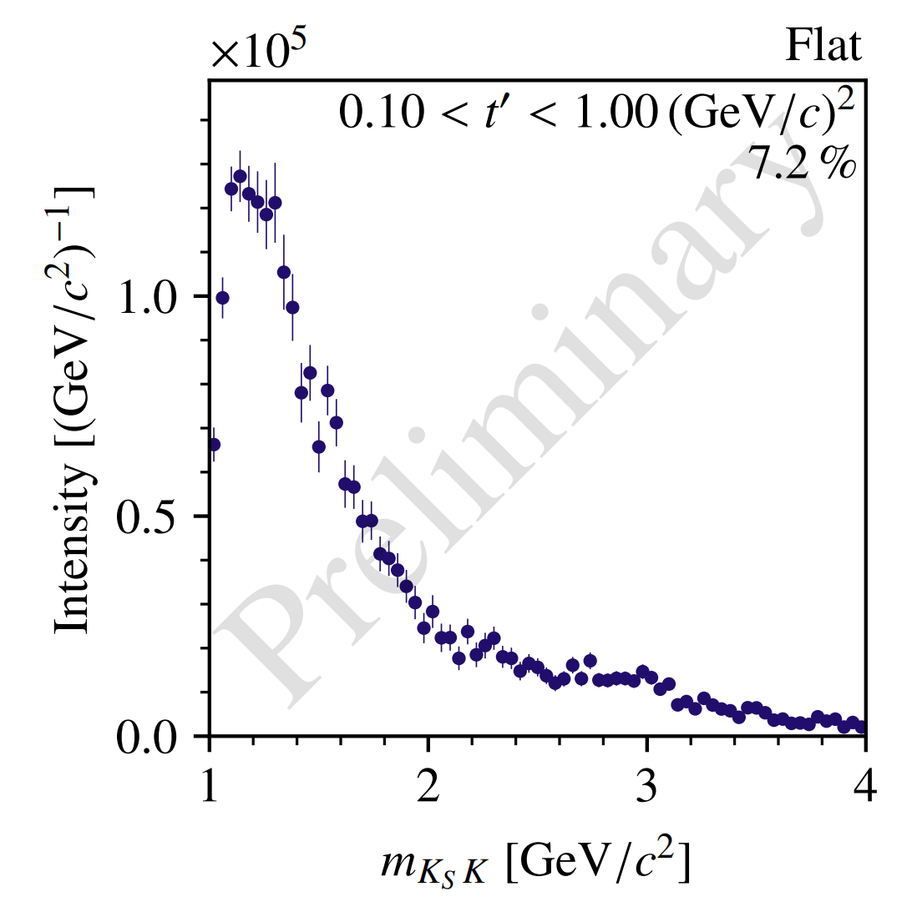
Results: Flat-Wave Intensity

Slide 42
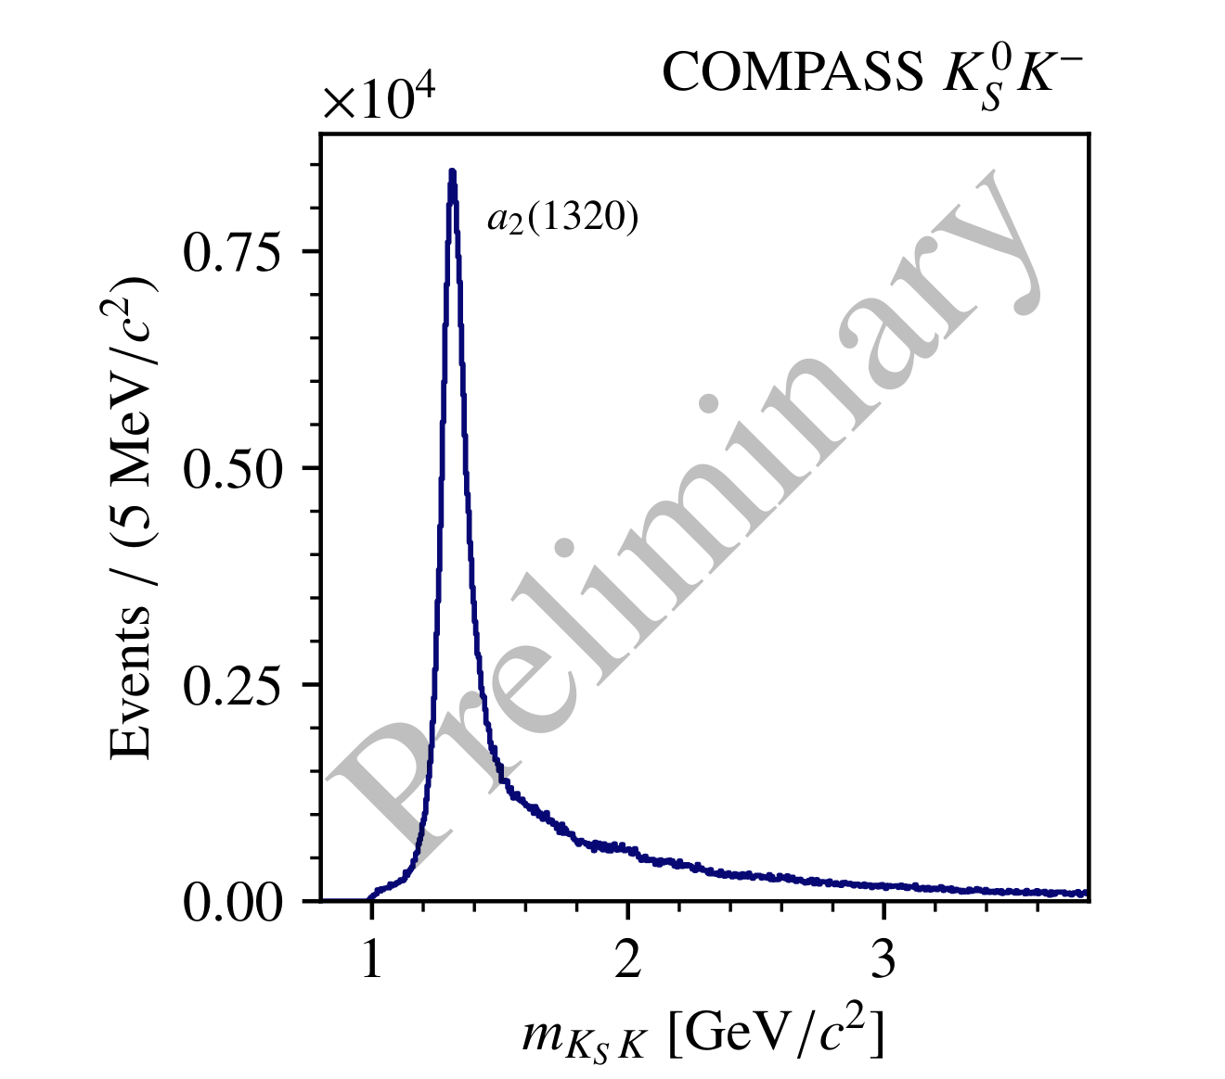
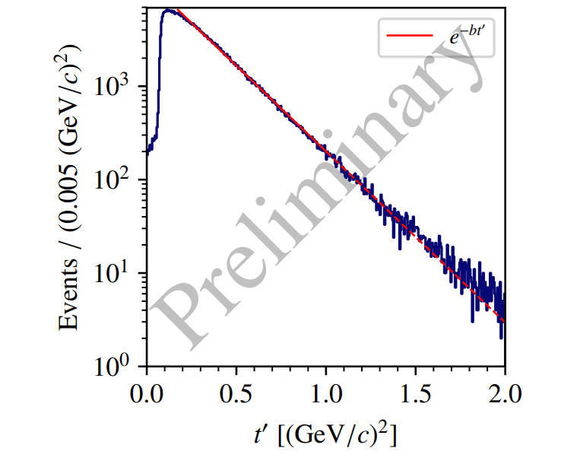
Kinematic Binning
Analyzed invariant mass range:
divided into 75 bins of $40 MeV/c^{2}$width
Analyzed $t’$ range
divided into four bins:
$$1.0<m_{K_{s}K}<4.0 GeV/c^{2}$$
$$0.1<t^{′}<1.0 {GeV}^{2}/c^{2}$$

Slide 43
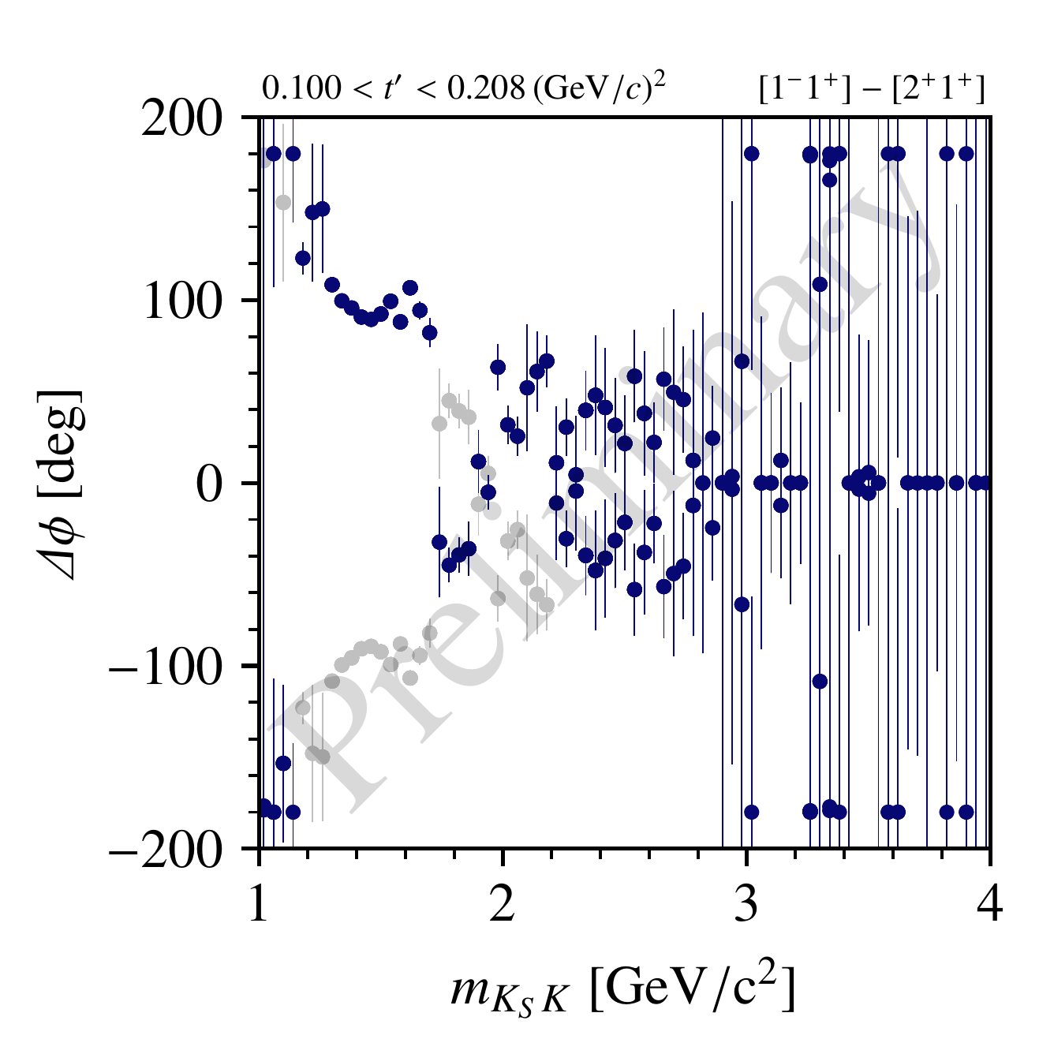
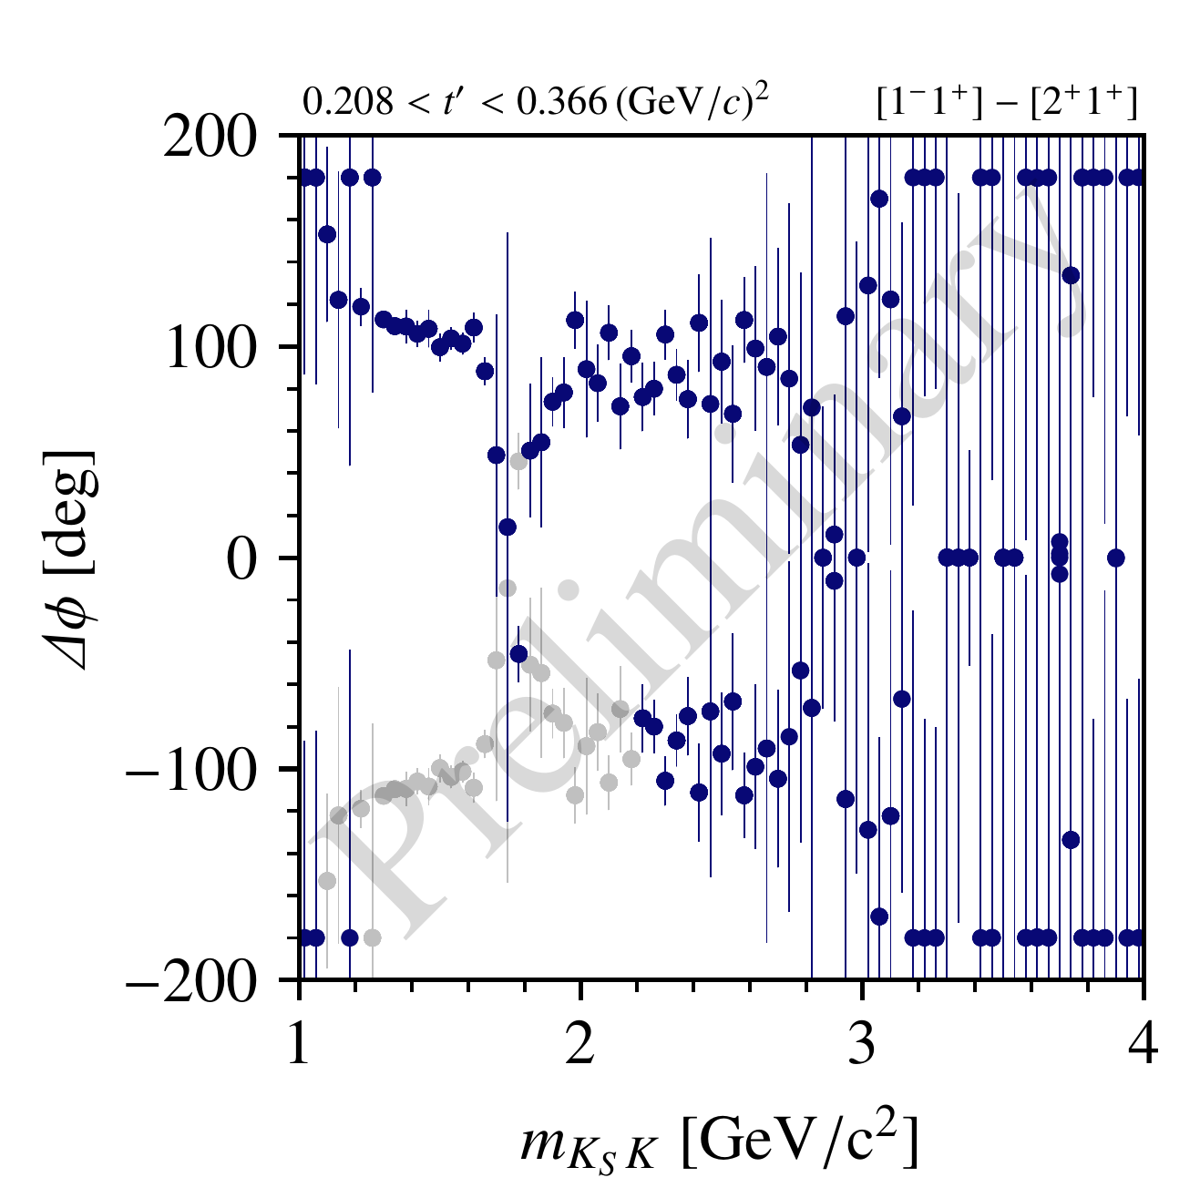
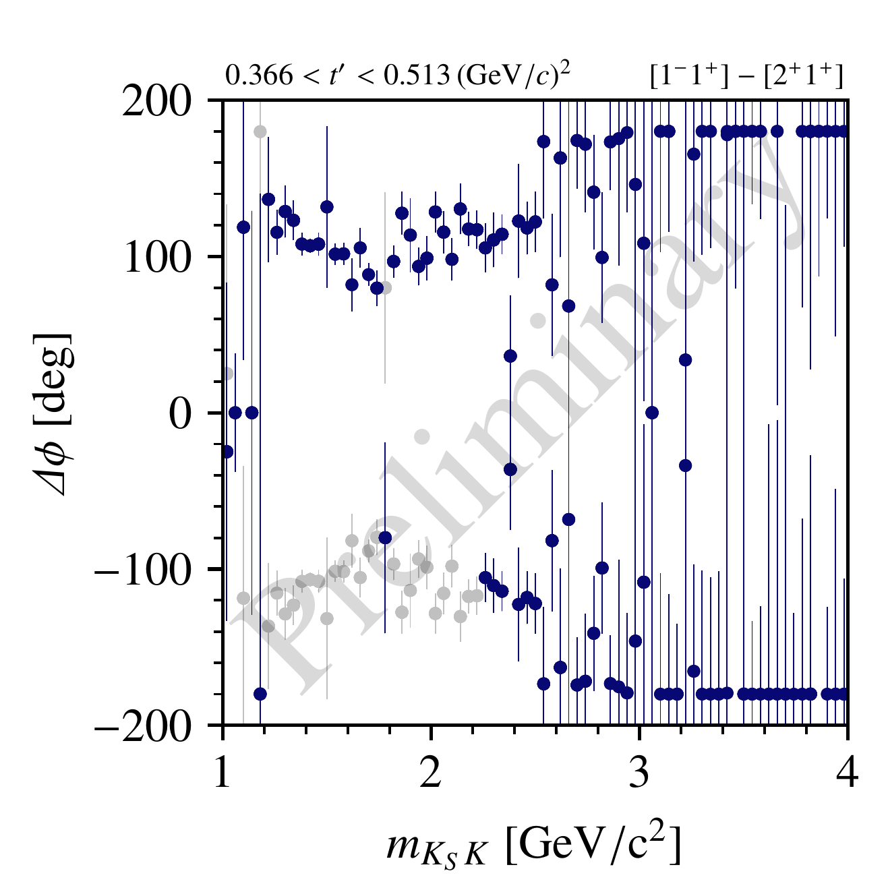
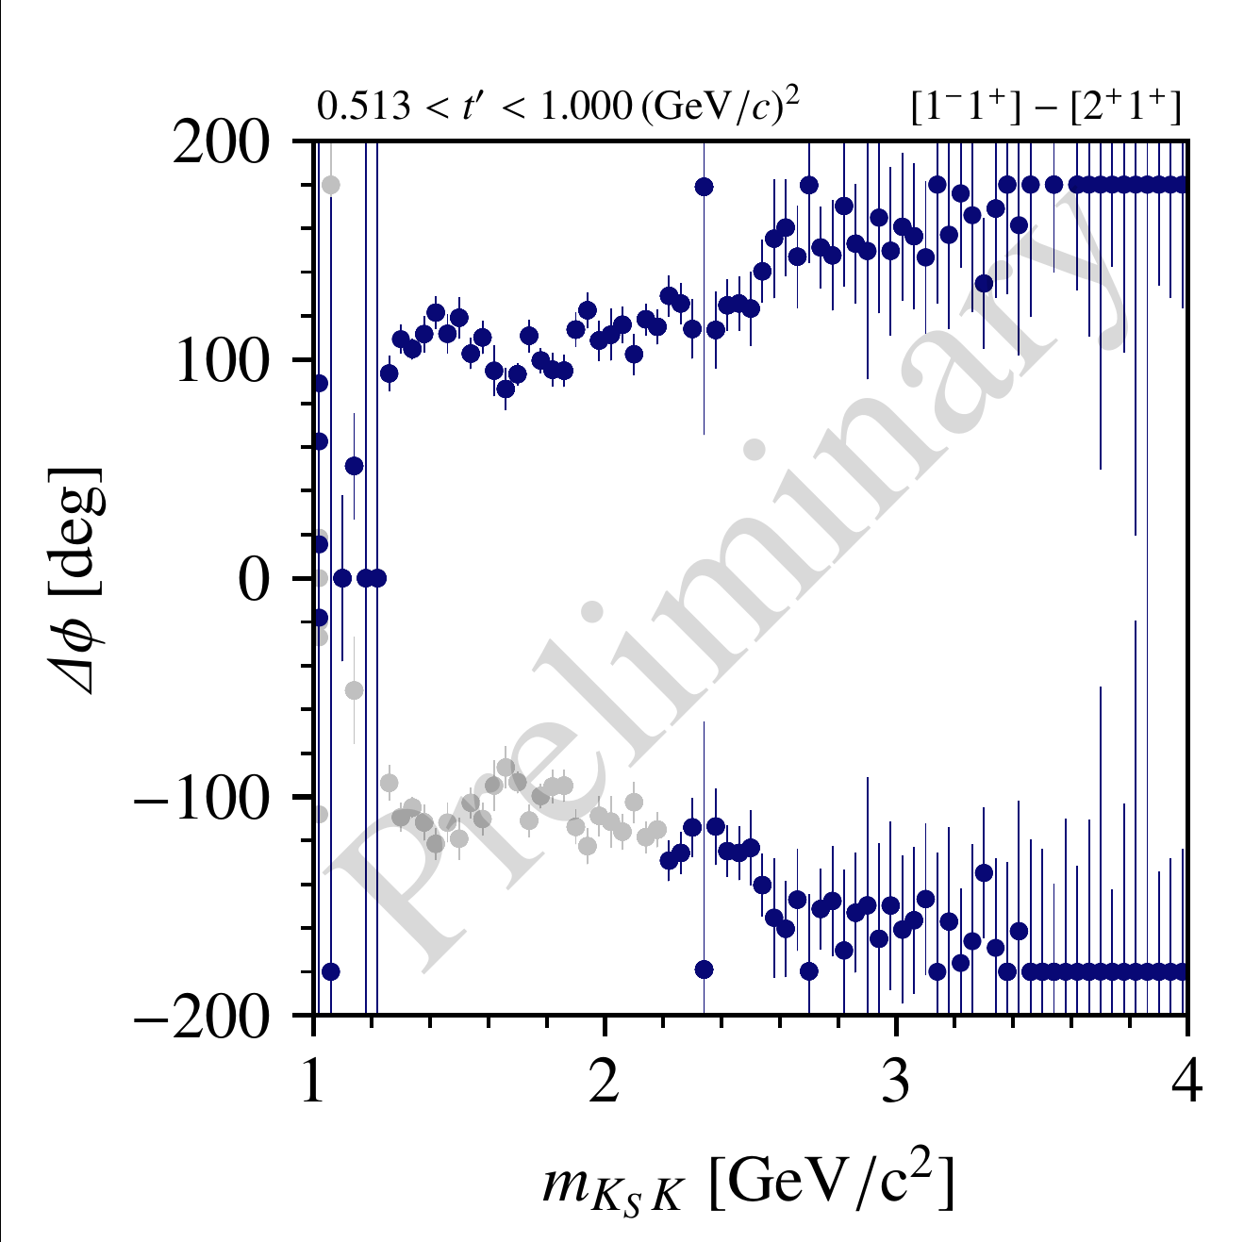
$J^{PC}=1^{−−}$ Partial Wave

Slide 44
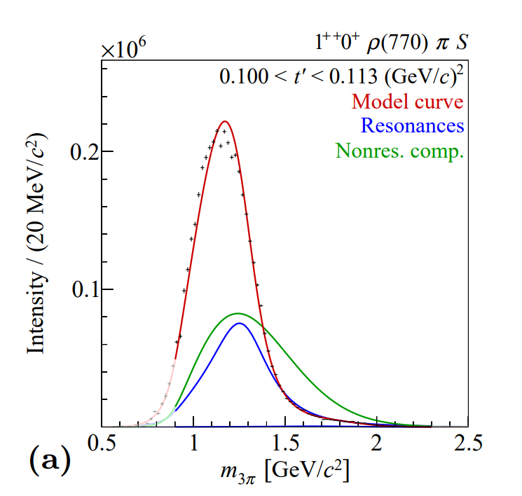
Resonance-Model Fit
Second step: extract resonance parameters
Build model for mass dep. of partial-wave amplitudes:
resonant (e.g. Breit-Wigner distribution)
+ non-resonant background components
$χ^{2}$ fit to output of partial-wave decomposition
$→$ get masses and widths of parameterized resonances
COMPASS PRD 98 (2018) 092003

Slide 45
