Slide 1
Energy Dependence of Dispersive Effects in Unpolarized Inclusive Elastic Electron/Positron-Nucleus Scattering
Spokespeople: John Arrington, DH, Pablo Giuliani and Paul Gueye (contact person)

Slide 2
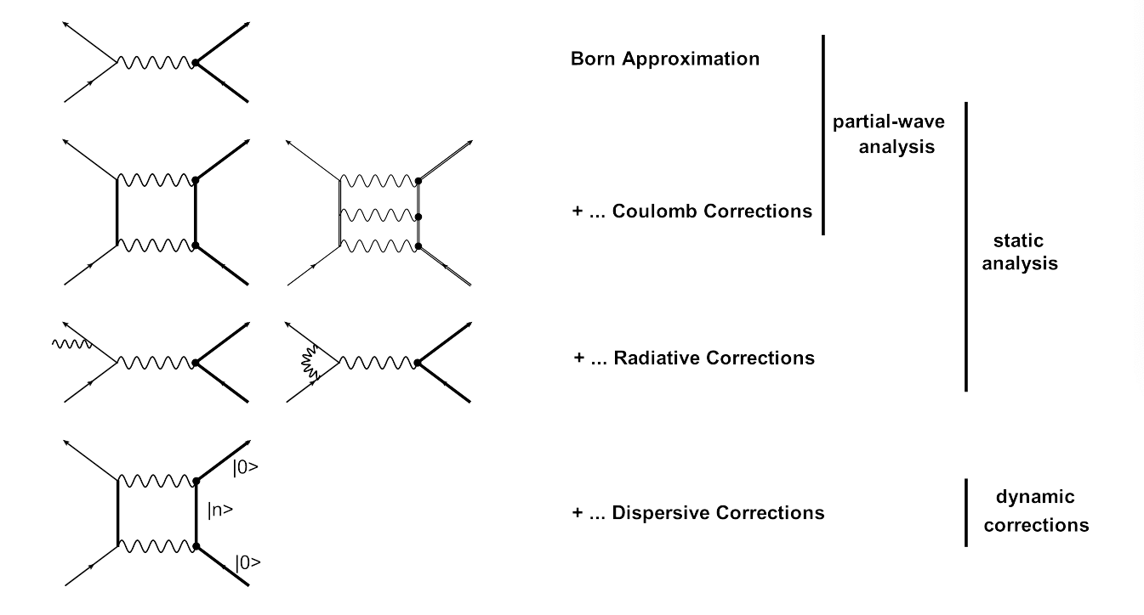
Elastic Scattering Feynman Diagrams

Slide 3
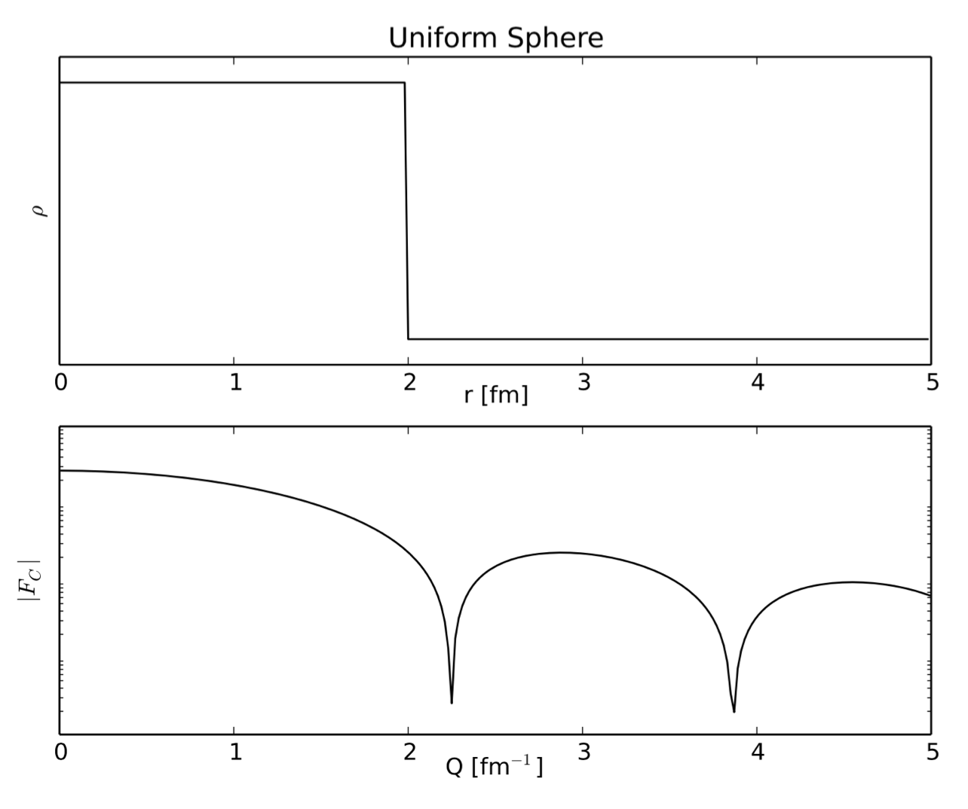
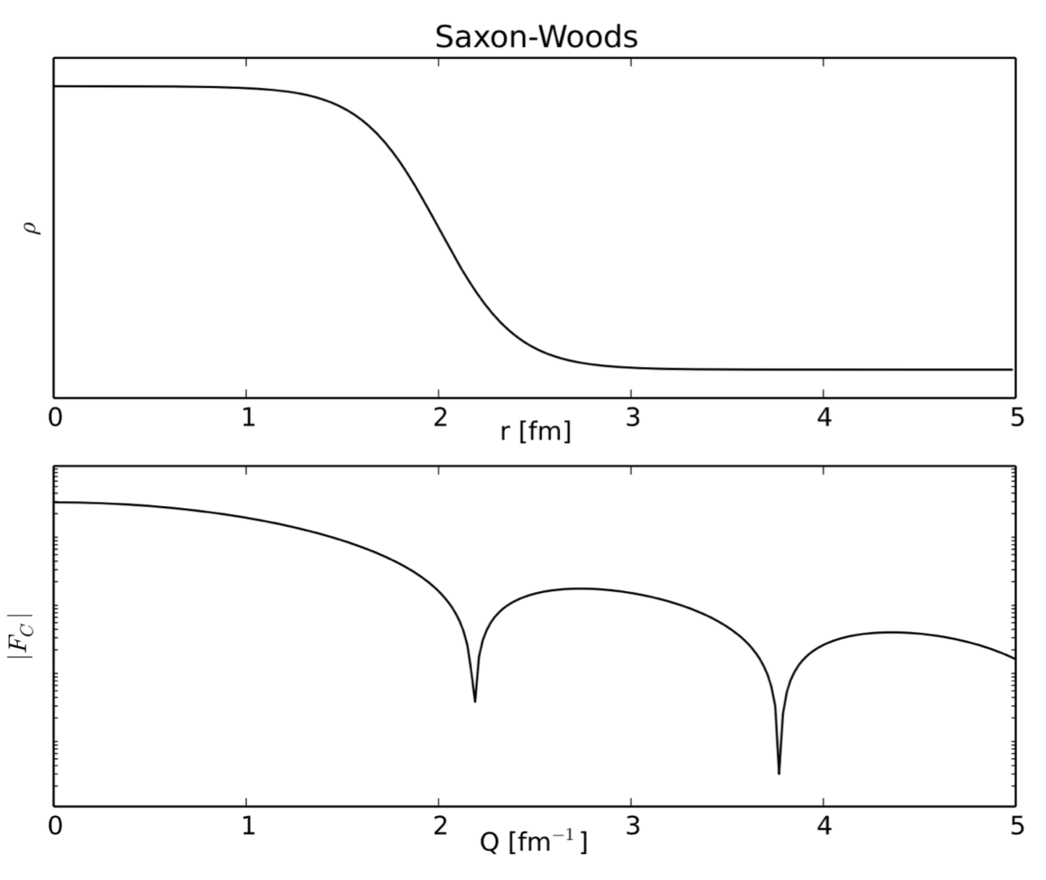
Electron Scattering Charge Radii from Nuclei
Fourier Transformation of Ideal Charge Distributions.
Example Plots Made By R. Evan McClellan (Jefferson Lab Postdoc)
e.g. for Carbon: Stanford high Q² data from I. Sick and J.S. McCarthy, Nucl. Phys. A150 (1970) 631.
National Bureau of Standards low Q² data from L. Cardman et. al., Phys. Lett. B91 (1980) 203.
3

Slide 4
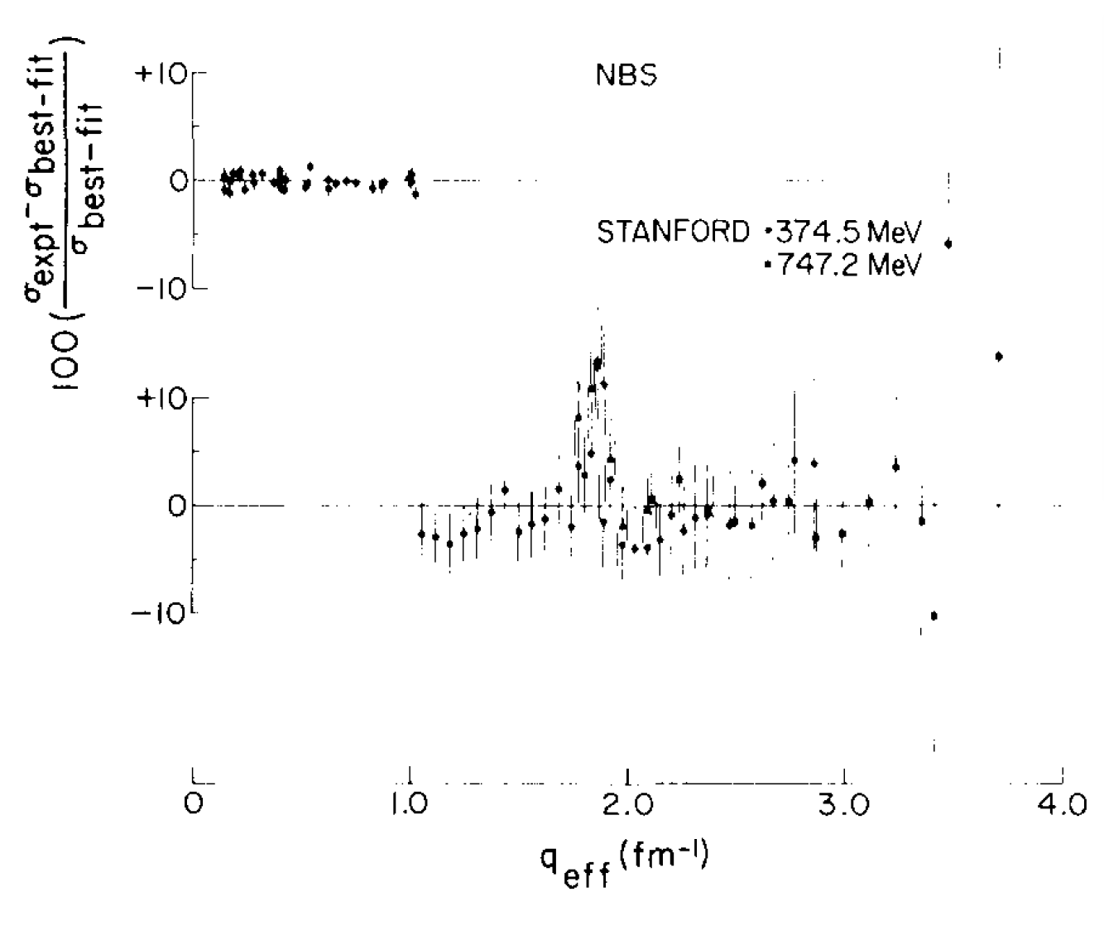
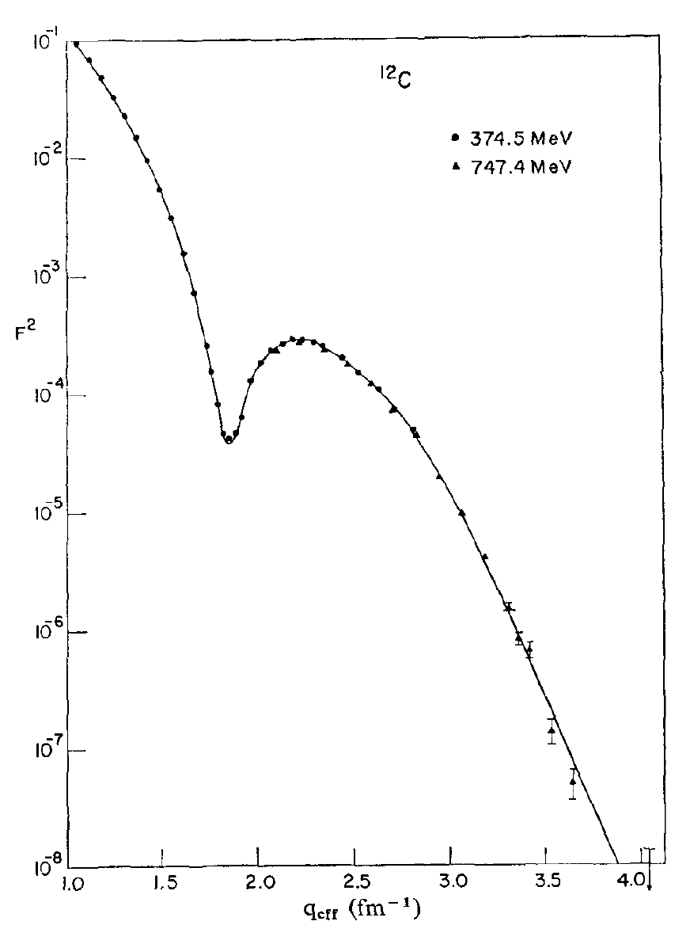
Determining the Charge Radius of Carbon
Stanford high Q² data from I. Sick and J.S. McCarthy, Nucl. Phys. A150 (1970) 631.
National Bureau of Standards (NBS) low Q² data from L. Cardman et. al., Phys. Lett. B91 (1980) 203.
4
See the L. Cardman’s paper for details of the carbon radius ( 2.46 fm ) analysis.

Slide 5
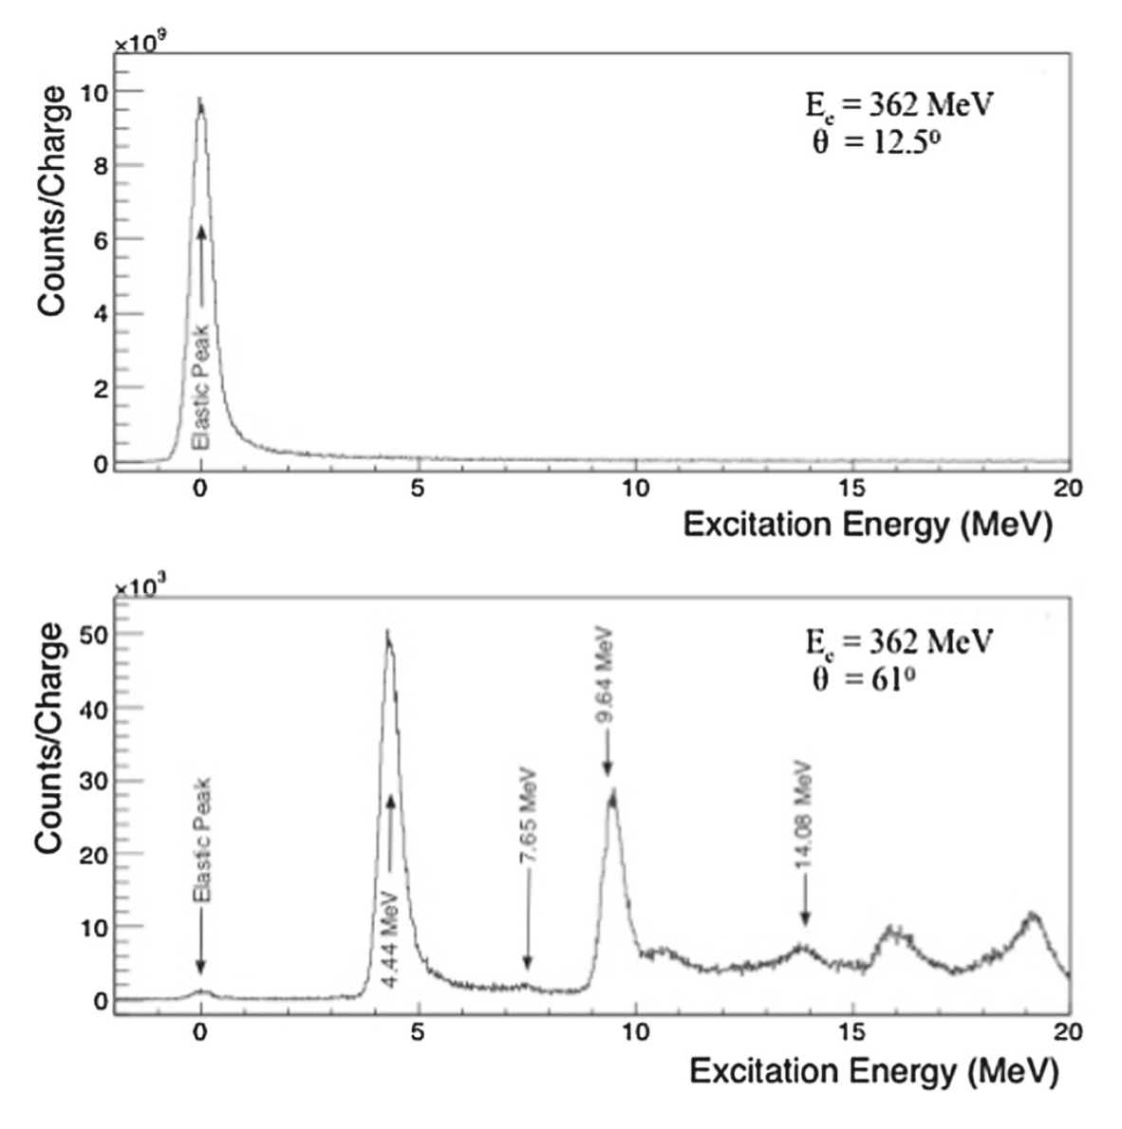
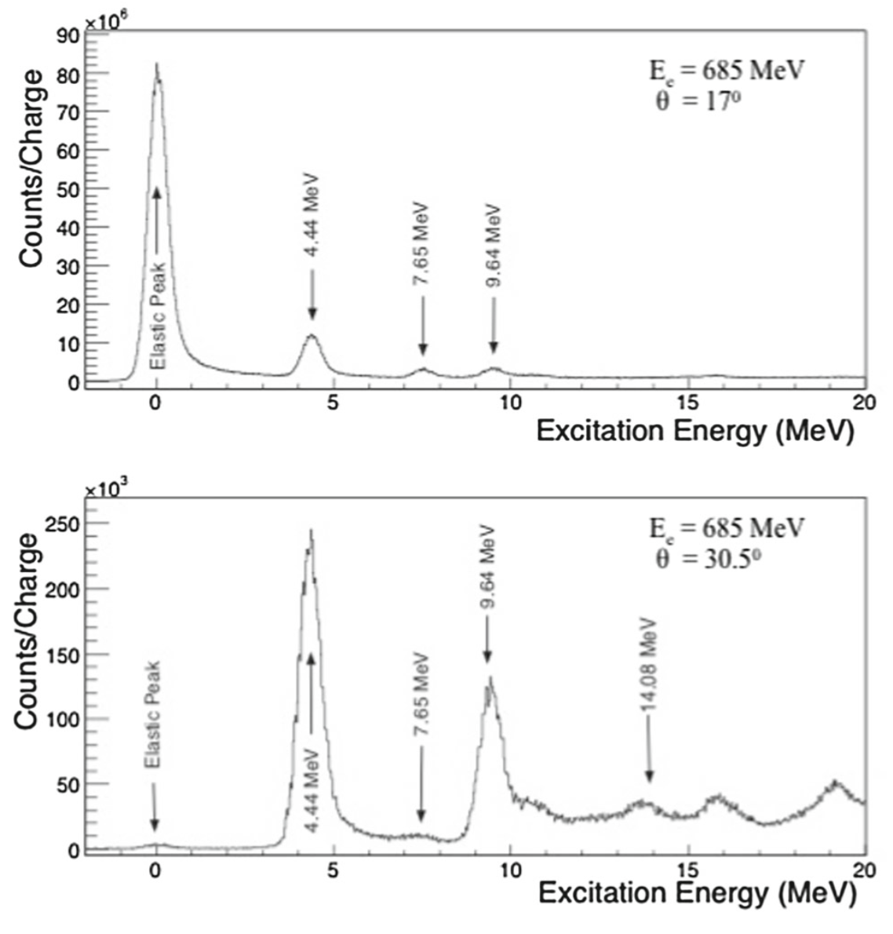
¹²C(e,e’) Data from Hall A LEDEX Experiment

Slide 6
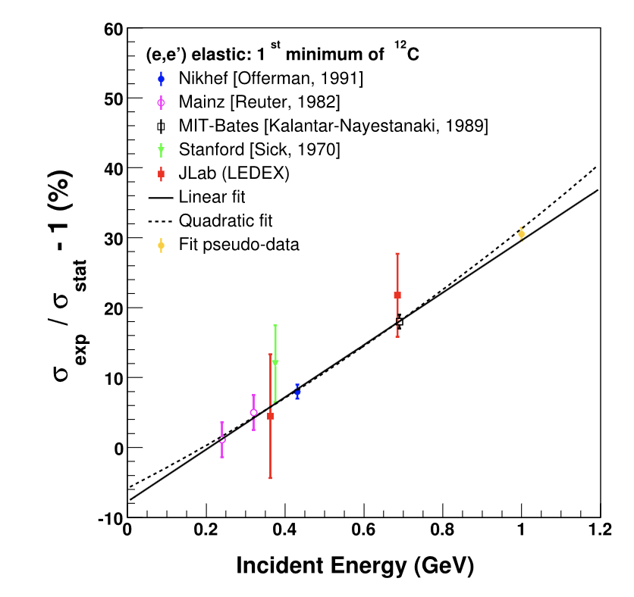
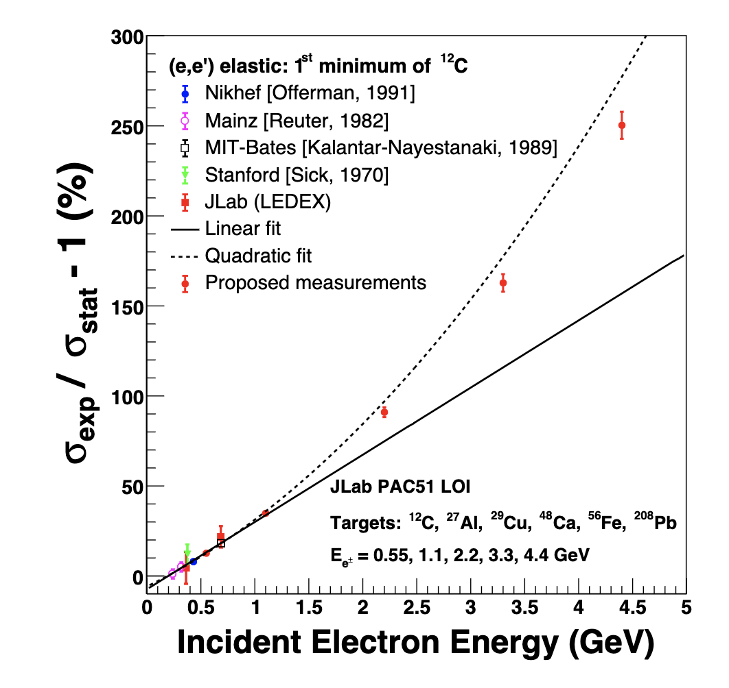
Current World Data
https://doi.org/10.1140/epja/s10050-020-00135-7
Proposed Points in LOI to JLab PAC51

Slide 7
LOTS TO DO!
Need to work out the details of the medium and heavy nuclei (²⁷Al, ²⁹Cu, ⁴⁸Ca, ⁵⁶Fe, ²⁰⁸Pb) to the same level as 12C is done.
Need to do full simulations of HMS/SHMS vs. an HRS.
Likely will need to be done in Hall C but this is an experiment that would benefit from more dispersion (looking into a different HMS/SHMS tune trading acceptance for dispersion would be fun).
Also need to fully work out the details the benefits of positrons and electrons.
Finally, there likely will be opportunities to run low energy (~100 MeV) in the LERF/Positron Source which should be investigated.
Opportunities for a young person(s) to take a leadership role.

