Slide 1








Discussion Session
Exploring Excited Nucleons
E45
PHY-2012826
PHY-2310034
Philip Cole Lamar University
June 20, 2024

Slide 2
The Panel
Izabela Ciepal – Institute of Nuclear Physics PAS, Kraków (Timelike Regime) [HADES]
Phil Cole – Lamar University, Chair of Session [JLab + E45 + BGOOD]
Ralf Gothe – University of South Carolina (electroproduction of baryon resonances) [JLab]
Shinhyung Kim – Kyungpook National University (πN -> ππN) [J-PARC-E45]
Yannick Wunderlich – University of Bonn (Amplitude Analysis)
There will be a short presentation on the exploring the production of N*s
with pion and electron beams, followed by a panel discussion and open forum.

Slide 3
Why this Session (see Abstract)
The focus of the session will be on the spectrum and structure of nucleon resonances (N*), as revealed through N* electro-excitation amplitudes. Such fundamental information on the mechanisms of strong-coupling QCD is crucial to validating any proposed solution to the theory and explaining the emergence of mass.
Precise data from both electron and pion beams are necessary for developing robust approaches for amplitude analyses, capable of delivering sound results for N* quantum numbers and excitation amplitudes over a broad range of q² to be interpreted starting from the QCD Lagrangian.
Our “workshop” will foster the synergies necessary to move this effort forward in a timely way.

Slide 4
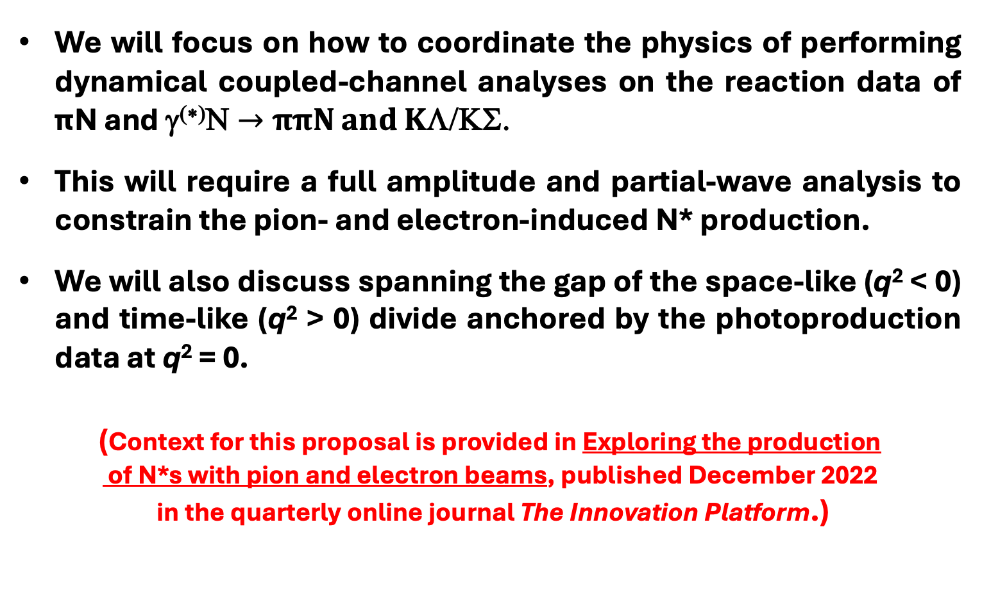
Why this Session (see Abstract)
We will focus on how to coordinate the physics of performing dynamical coupled-channel analyses on the reaction data of πN and γ^{(∗)}Ν $→$ ππN and KΛ/ΚΣ.
This will require a full amplitude and partial-wave analysis to constrain the pion- and electron-induced N* production.
We will also discuss spanning the gap of the space-like (q² < 0) and time-like (q² > 0) divide anchored by the photoproduction data at q² = 0.
(Context for this proposal is provided in Exploring the production
of N*s with pion and electron beams, published December 2022
in the quarterly online journal The Innovation Platform.)

Slide 5
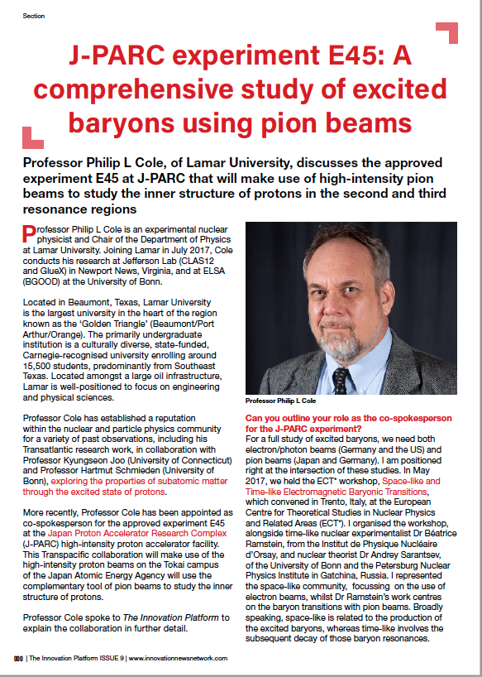
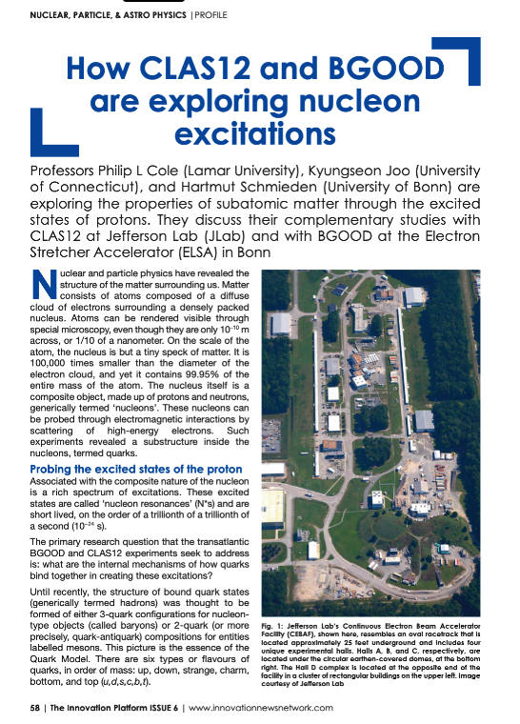
Getting the word out for why N*s to Policy Makers
The purpose of the articles was guided by the statement below:
The publication will be distributed digitally to over 200 000 people to include policy makers in nuclear physics in Europe, the US, Canada, Asia and the rest of the world. This will include local authorities, regional governments, government agencies, ministries and research councils as well as the scientific community, industry and academic institutions. It is also distributed to EU institutions like European Parliament, European Commission and the European Research Council and international agencies.
We seek to get the word out on the timeliness and importance of N* research.

Slide 6
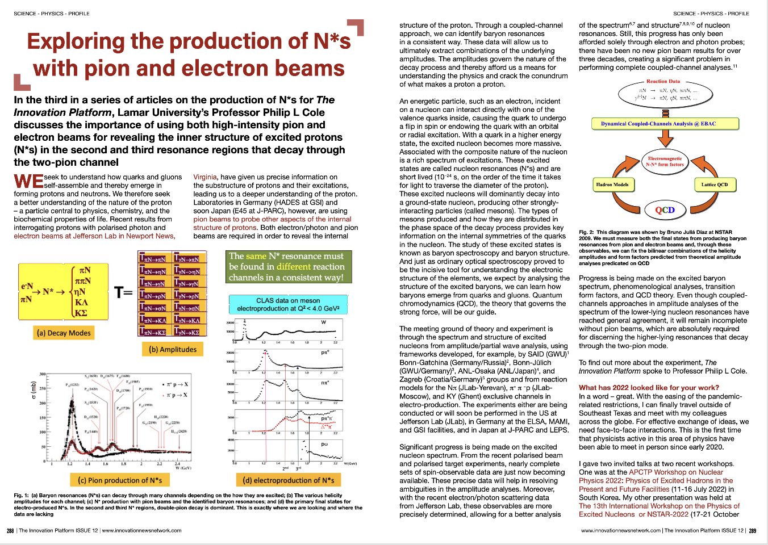
Exploring the production of N*s with pion and electron beams
This article stresses the need for Coupled–Channel Analysis
Issue 12 (December 2022) pages 288 to 292

Slide 7
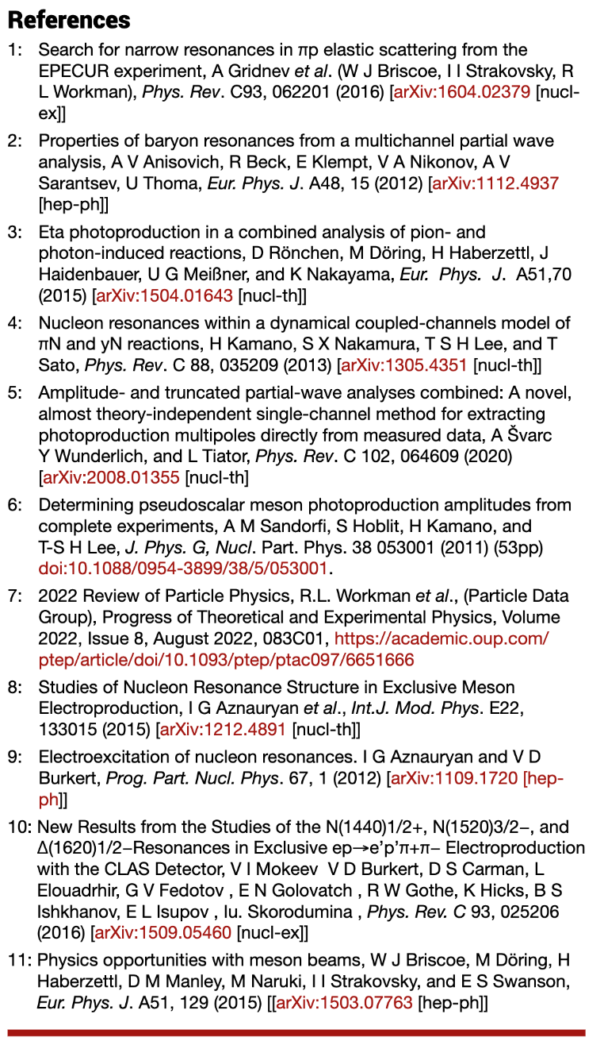
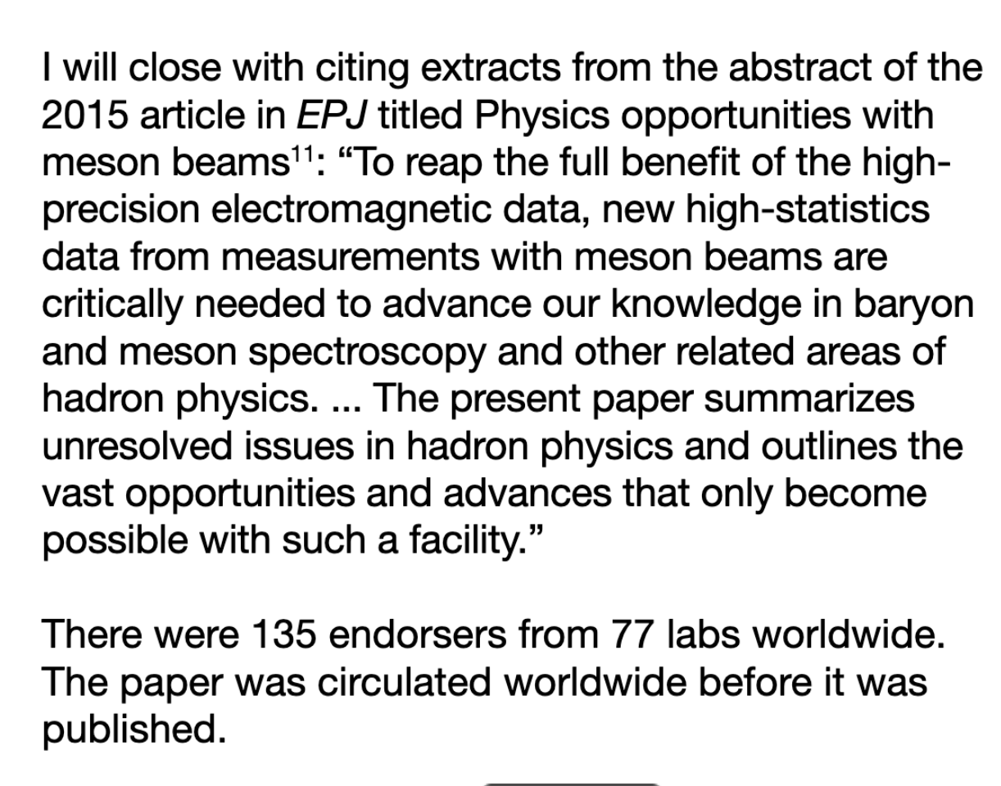
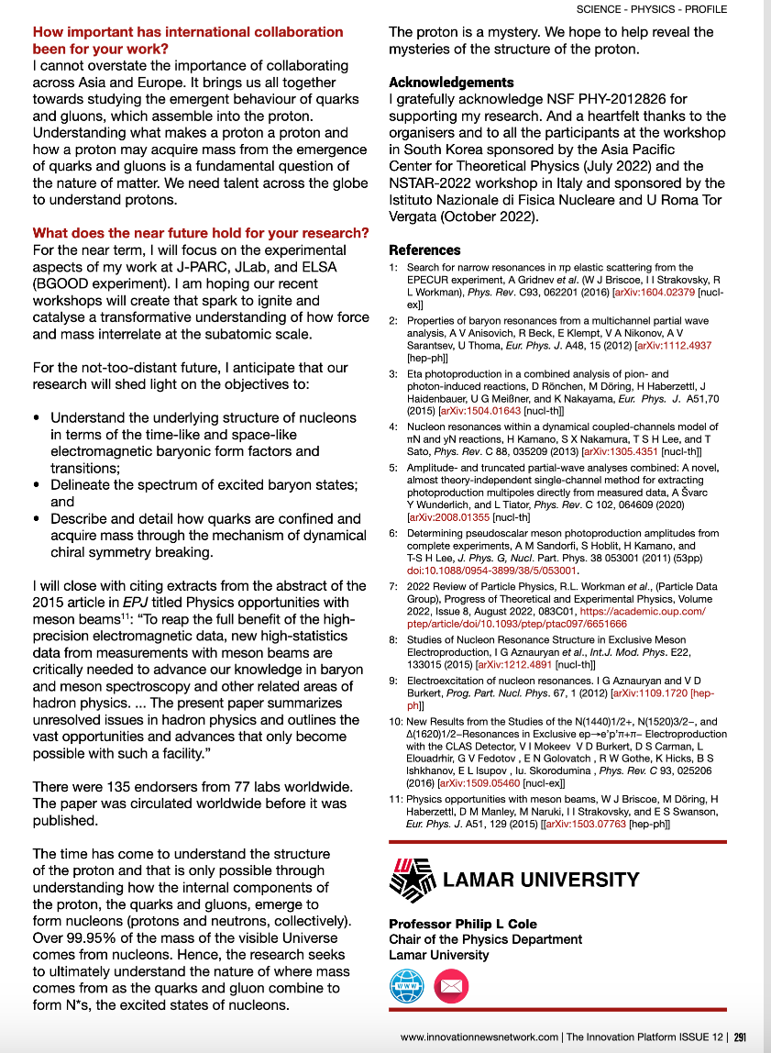
Exploring the production of N*s with pion and electron beams
This article stresses the need for Coupled–Channel Analysis
Issue 12 (December 2022) pages 288 to 292

Slide 8
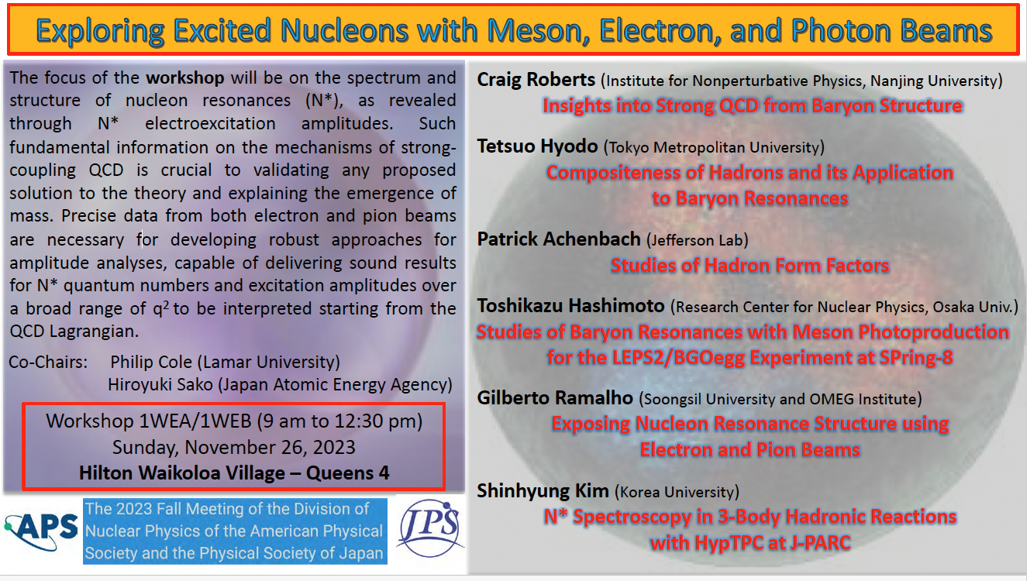
Over 40 people attended on a Sunday morning for our workshop in Hawaii (first day and the sun was shining and the water was nice)

Slide 9
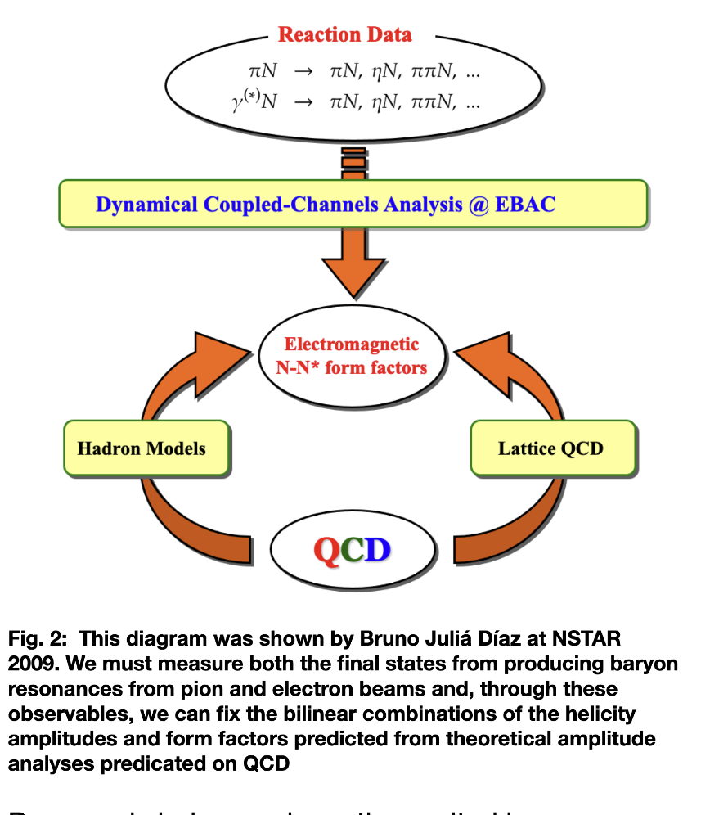
Pion and electron beams are crucial for
Coupled-Channels Analysis
This was presented at
NSTAR-2009
Bruno Julia Diaz
Beijing, PRC

Slide 10
Establishing N* parameters within a global coupled channel analyses of the data of experiments with electromagnetic &hadronic probes
πN
ππN
→ N* → ηN
KΛ KΣ
Accounting for the FSI within coupled channel approaches is vital to gain insight into the N* spectrum/structure in a way consistent with the restrictions imposed by a general unitarity condition.
e⁻N
πN
T
πΝ→πΝ
T
ηΝ→πΝ
T
γΝ→πΝ
T
ρΝ→πΝ
T
σΝ→πΝ
T
ΚΛ→πΝ
T
ΚΣ→πΝ
T
πΝ→ηΝ
T
ηΝ→ηΝ
T
γΝ−>ηΝ
T
ρΝ→ηΝ
T
σΝ→ηΝ
T
ΚΛ→ηΝ
T
ΚΣ→ηΝ
T
πΝ→γΝ
T
ηΝ→γΝ
T
γΝ→γΝ
T
ρΝ→γΝ
T
σΝ→γΝ
T
ΚΛ→γΝ
T
ΚΣ−>γΝ
T=
T
πΝ→ρΝ
T
ηΝ→ρΝ
T
γΝ→ρΝ
T
ρΝ→ρΝ
T
σΝ→ρΝ
T
ΚΛ→ρΝ
T
ΚΣ→ρΝ
T
πΝ→σΝ
T
ηΝ→σΝ
T
γΝ→σΝ
T
ρΝ→σΝ
T
σΝ→σΝ
T
ΚΛ→σΝ
T
ΚΣ→σΝ
T
πΝ→ΚΛ
T
ηΝ→ΚΛ
T
γΝ→ΚΛ
T
ρΝ→ΚΛ
T
σΝ→ΚΛ
T
ΚΛ→ΚΛ
T
ΚΣ→ΚΛ
T
πΝ→ΚΣ
T
ηΝ→ΚΣ
T
γΝ→ΚΣ
T
ρΝ→ΚΣ
T
σΝ→ΚΣ
T
ΚΛ→ΚΣ
T
ΚΣ→ΚΣ

Slide 11
A Campaign – across continents and NP subfields
Meeting Ground between
Theory and Experiment
From our PIRE proposal of 2016 –
continuation of the 2009 US/PRC one

Slide 12
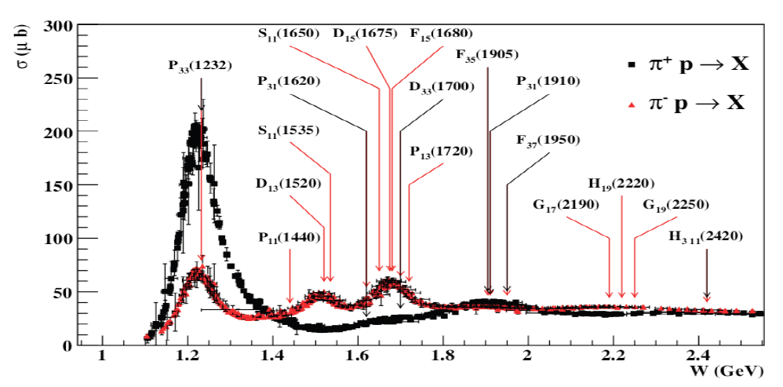
Baryon resonances (N*s and Δ*s)
σ (mb)
N*s are broadly overlapping
Notes:
Delta++/Delta0 cross section ratio is 3. Mention CR-coefs + Qual Prob.

Slide 13
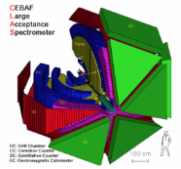
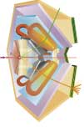
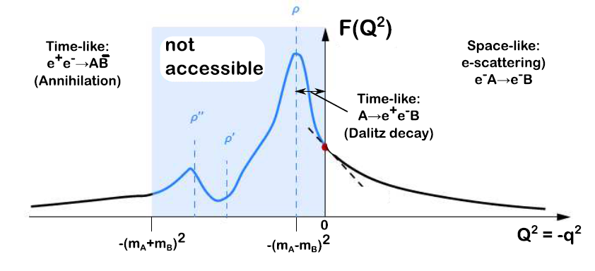
Electromagnetic baryonic transitions in time-like and space-like regions: towards a global picture?
Time-Like electromagnetic form factors
Space-Like electromagnetic form factors
preliminary studies with HADES/GSI
Precise data from JLab/CLAS up to -q²=4 GeV²
F(q²)
n
Inverse pion electroproduction
e⁺
q² <0 fixed
π ⁻
R
γ*
p
γ*
R
e⁻
p
e⁻⁻
e⁻
F(q²)
π⁻
q² =(M _{ee} )²> 0
variable
p
e⁻⁻
Béatrice Ramstein ECT* 2017
Theoretical tools: Dispersion Relations, Dyson-Schwinger, Vector Dominance, Constituent Quarks ?

Slide 14
E45 expected data summary
E45(proposal)
π- beam
π+ beam
HADES
only π⁻ beam
√s~1.5 GeV run done
Plan for √s~1.7 GeV
No continuous energy scan
√s(GeV) | p(GeV/c) | N(π+π-n) (/spill) | N(π0π-p) (/spill) | Hours(π-) | N(π+π+n) (/spill) | N(π0π+p) (/spill) | Hours(π+)
2.15 | 1.98 | 655.1 | 380.4 | 4.4 | 1162.2 | 281.5 | 5.9
2.13 | 1.92 | 655.1 | 380.4 | 4.4 | 1162.2 | 281.5 | 5.9
2.10 | 1.87 | 655.1 | 380.4 | 4.4 | 1162.2 | 281.5 | 5.9
2.08 | 1.81 | 655.1 | 380.4 | 4.4 | 929.8 | 281.5 | 5.9
2.05 | 1.75 | 655.1 | 380.4 | 4.4 | 929.8 | 281.5 | 5.9
2.03 | 1.70 | 655.1 | 380.4 | 4.4 | 929.8 | 281.5 | 5.9
2.00 | 1.65 | 655.1 | 380.4 | 4.4 | 929.8 | 281.5 | 5.9
1.97 | 1.58 | 655.1 | 380.4 | 4.4 | 929.8 | 281.5 | 5.9
1.94 | 1.52 | 655.1 | 380.4 | 4.4 | 929.8 | 281.5 | 5.9
1.91 | 1.46 | 655.9 | 409.1 | 4.1 | 925.5 | 267.1 | 6.2
1.87 | 1.38 | 654.2 | 383.7 | 4.3 | 961.9 | 240.1 | 6.9
1.83 | 1.30 | 608.6 | 358.4 | 4.7 | 901.9 | 183.4 | 9.1
1.79 | 1.22 | 609.4 | 380.4 | 4.4 | 806.4 | 125.1 | 13.3
1.76 | 1.15 | 679.6 | 443.8 | 3.8 | 696.5 | 125.9 | 13.2
1.73 | 1.10 | 770.9 | 497.9 | 3.3 | 704.9 | 110.7 | 15.1
1.70 | 1.05 | 858.8 | 521.5 | 3.2 | 753.1 | 131.0 | 12.7
1.68 | 1.02 | 902.7 | 530.8 | 3.1 | 800.4 | 151.3 | 11.0
1.66 | 0.98 | 917.9 | 513.1 | 3.2 | 825.0 | 155.5 | 10.7
1.64 | 0.94 | 885.0 | 567.2 | 2.9 | 829.2 | 149.6 | 11.1
1.62 | 0.91 | 787.8 | 448.0 | 3.7 | 807.2 | 149.6 | 11.1
1.60 | 0.87 | 690.6 | 412.5 | 4.0 | 724.4 | 127.6 | 13.1
1.57 | 0.81 | 584.9 | 394.7 | 4.2 | 584.9 | 394.7 | 4.2
1.54 | 0.77 | 540.1 | 407.4 | 4.1 | 383.7 | 60.9 | 27.4
1.52 | 0.74 | 515.6 | 408.3 | 4.1 | 280.6 | 47.3 | 0.0
Total(h) |  |  |  | 96.7 |  |  | 218.6
Total(d) |  |  |  | 4.027851 |  |  | 9.1
HADES
Proposed
HADES
Completed

Slide 15
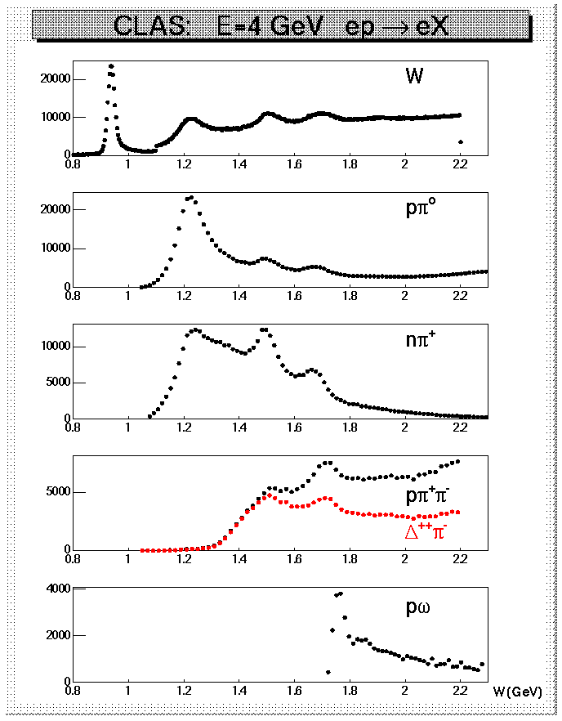
Why Nπ/Nππ electroproduction channels are important
CLAS data on meson electroproduction at Q² < 4.0 GeV²
  Nπ/Nππ channels are the two major contributors in N* excitation region;
  these two channels combined are sensitive to almost all excited proton states;
  they are strongly coupled by πN→ππN final state interaction;
  may substantially affect exclusive channels having smaller cross sections, such as ηp, KΛ, and KΣ.
Therefore, knowledge on Νπ/Νππ electroproduction and πΝ → ππΝ mechanisms are key for the entire
N* Program (Spectrum and Structure)

Slide 16
Roper Resonance in 2002 and 2023
V. D. Burkert, Baryons 2016
V.D. Burkert, eprint::2212.08980 [hep-ph],
D.S. Carman, R.W. Gothe, V.I. Mokeev, and C.D. Roberts, Particles 6, 416 (2023)

Slide 17

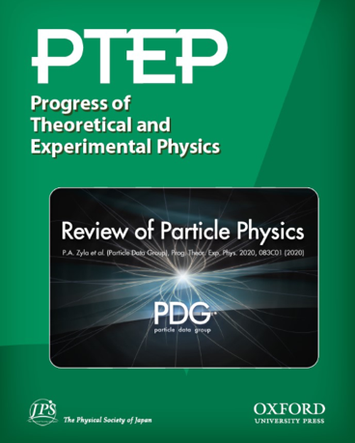
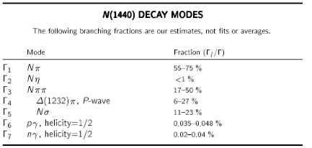
Decay Modes

Slide 18

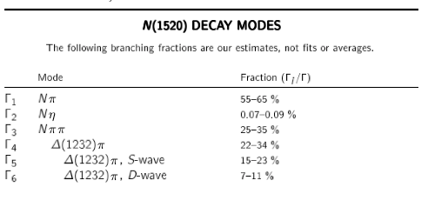
Decay Modes

Slide 19
E45 data and the PWA EBAC Model
We are developing this!
Experimental data
or model data
Model inputs
Resonances
(m_{i}, g_{i}, λ_{i})
Xsection or PWA Fit code
to extract resonance parameters
Total and differential
Xsections
Fit
Compare
PWA (T)
Total and Differential Xsections
Resonances
(m_{i}, g_{i}, λ_{i})
πN or ππN event generator
GEANT4
Compare
Analyzer
Reconstructed πN or ππN tracks
Total and differential Xsections
(slide provided by Hiroyuki Sako)

Slide 20
Wherefore & Whither EBAC?
We need theoretical HELP to resuscitate and resurrect
This is not a job for Experimentalists
We need Theoretical Guidance
Who will pick up the mantle for Coupled Channel Analysis?
Who can lead the way in Reaction Modelling?
Who is available in Asia/North America/Europe?
Employing pion and electron beams for insight into the
spectrum/structure of N*s
through their two-pion decays

Slide 21
Some Questions to Ponder
How to compare Helicity Amplitudes between SL and TL?
What are the relevant d.o.f. as a function of q² for the SL and TL regimes?
Amplitude Analysis
Coupled Channel Approach
WHITE PAPER for joining forces?

Slide 22
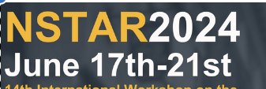
Baryon spectrum through meson photoproduction
Baryon resonances in experiments with hadron beams and in the e⁺e⁻ collisions
Baryon resonances in ion collisions and their role in cosmology
Baryon structure through meson electroproduction, transition form factors, and time-like form factors
Amplitude analyses and baryon parameter extraction
Effective field theory, Phenomenological models, and Functional methods
Baryon spectrum and structure from first principles of QCD
Exotic Hadrons
Advances in modeling of baryon spectrum & structure
Facilities and future projects

Slide 23
PWA for E45 (Today)
Strategy proposed by T.-S. Harry-Lee
[ See: ]
T.-S. Harry Lee – December 8, 2022
Approximate PWA to average intermediate resonance momentum k to reduce variable (k, W) → (W)
  π(k₀)N(-k₀)→Δ(k)π(-k) →π (k₁)N(k₂)π(-k)
  (J: total angular momentum, LπN, LπΔ: spin-angular momenta)
  Validity confirmed with ANL-Osaka model
Parameterize averaged ANL-Osaka PWA with polynomials as a function of W
(slides provided by Hiroyuki Sako)

Slide 24
PWA for E45 (cont.)
Fit E45 differential cross sections with the averaged parameterized PWA, using the initial parameters from ANL-Osaka PWA
  Development of a code to calculate differential cross sections from PWA was started in Kyungson Joo’s group
Use separable model based on CMB approach to fit E45 averaged PWA and extract new PWA and resonance poles
  Development of separable model in JAEA and KNU started. So far only a simple isobar model with 2-body reaction (pN→pN or pΔ)
Use a sophisticated coupled-channel model to fit to the E45 data to obtain the resonance information
  Only theorists can do this, and we need your support!

Slide 25
Strategy for PWA code development proposed by T.S. Harry-Lee
Study validity of averaged PWA with comparison of cross sections of ANL-Osaka model
  →Already confirmed by T. S. Harry-Lee
(1) Parameterize the averaged PWA of ANL-Osaka with the polynomials as functions of W
(2) Calculate the differential cross sections from the averaged PWA
→Being developed by Kyungseon Joo’s group but only 2-body reactions so far)
(3) Fit the differential cross sections of E45 with the initial parameters of (14) and obtain new averaged PWA
Go over if time
(slides provided by Hiroyuki Sako)

Slide 26
Procedures of PWA code development (Cont.)
Develop CMB model which is on-shell approximation and separable model (each pole can be resolved) of ANL-Osaka model to repeat Procedure 2. Then extract resonance poles from CMB model.
  We started this development with an isobar model.
Extract resonance poles from ANL-Osaka with the fit results of 2. (only by ANL-Osaka experts). Solving Coupled-Channel equations required.
Go over if time
(slides provided by Hiroyuki Sako)

Slide 27
Averaged partial wave amplitudes
Approximation to reduce the number of kinematic variables for 3-body reactions
Consider reaction
π(k₀)N(-k₀)→Δ(k)π(-k) →π (k₁)N(k₂)π(-k)
  k₀ : Initial π momentum
  k : Intermediate Δ momentum
  k₁ k₂ : π and N momenta decayed from Δ
  k = k₁ + k₂
Go over if time
(slides provided by Hiroyuki Sako)

Slide 28
Cross sections
Total cross section
J: Total angular momentum
LπΔ: angular momentum of πΔ
LπN: angular momentum of πN
Partial wave cross section of (J, LπΔ , LπN ) with the Partial Wave Amplitude T
M: invariant mass of final πN
W: invariant mass of initial πN
(3)
Go over if time
(slides provided by Hiroyuki Sako)

Slide 29
(4)
(5)
Go over if time
(slides provided by Hiroyuki Sako)

Slide 30
Averaged PWA
(10)
Averaged over intermediate Δ momentum k
(8)
(9)
Go over if time
(slides provided by Hiroyuki Sako)

Slide 31
PWA code Status
Goal: Develop an analysis code to fit to measured cross sections and extract resonance information in πN→ππN reactions
First step: Fit to πN→MB 2-body reactions with a simple isobar model
The code was created in C++ and ROOT by Shinhyung Kim based on T.S.H. Lee’s Fortran code.
1 resonance (Δ) and 1 channel (πN): done by Shinhyung
2 resonances and 1 channel (πN): done
2 resonances and 2 channels (πN and πΔ):done
M resonances and N channels→ Implemented (2/12)
with C++ complex matrix library Eigen
to be checked with M≧3, N≧3
Next step
Optimization of fitting algorithms
Fit is very difficult with even for 2 resonances and 1 channel
Implement Generator for GEANT4
  2-body decays
  3-body decays
Go over if time
(slides provided by Hiroyuki Sako)

Slide 32
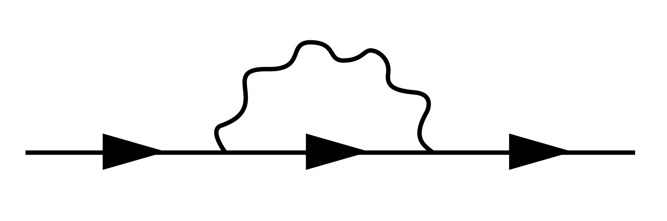
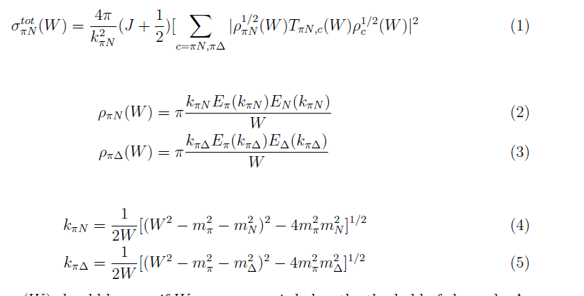
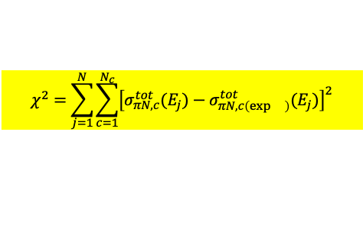
1 resonance + 1 channel
2 resonances + 1 channel
continuum
resonance
(17)
α,β : channels, i, j:resonance
g
g
g
π
NxN matrix
Σ=
Δ
Δ
Self energy
Self-energy
g
Ν
g
(18)
g
g
(19)
Fit with total cross section
$$χ^{2}=\sum_{j=1}^{N}{\sum_{c=1}^{N_{c}}{{\left[σ_{πN,c}^{tot}(E_{j})−σ_{πN,c\left(\exp{}\right)}^{tot}(E_{j})\right]}^{2}}}$$
(20)
Go over if time
(slides provided by Hiroyuki Sako)

Slide 33
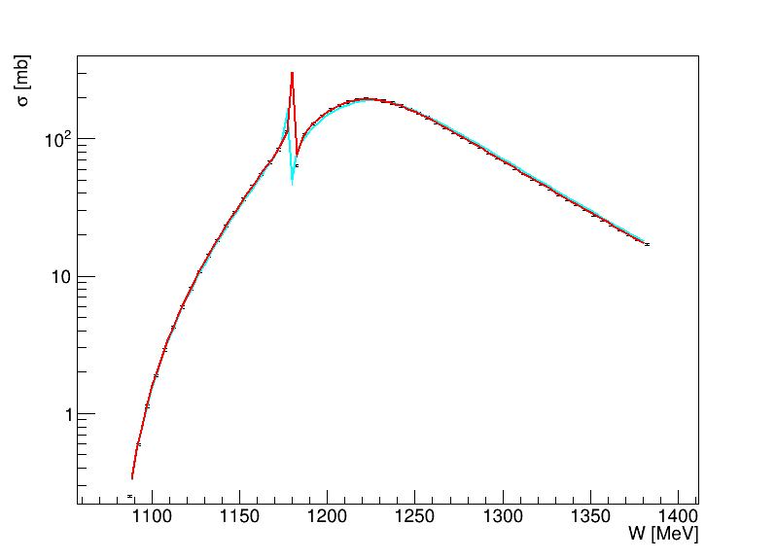
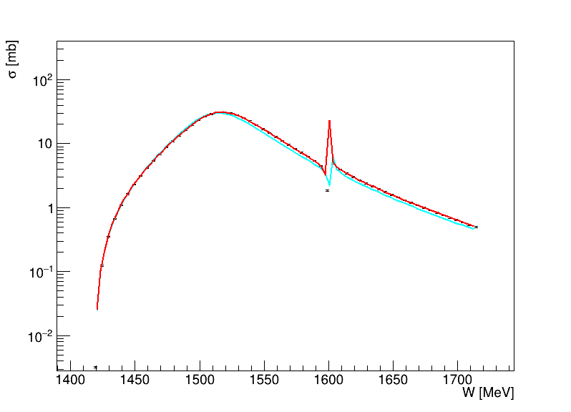
Fit result example (2 channels, w/ 2 hypothetical resonances)
πN→πN
πN→πΔ
Fit
Fit
Initial parameters
Points: cross section data
Initial parameters
Resonance 1
Resonance 2
Resonance 1
Resonance 2
Go over if time
(slides provided by Hiroyuki Sako)

Slide 34
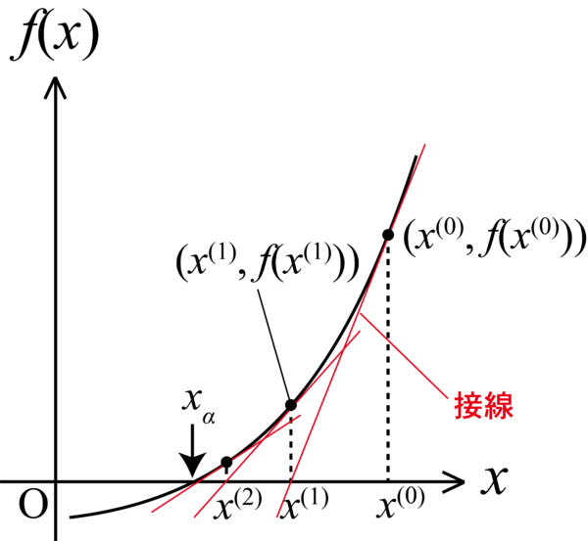
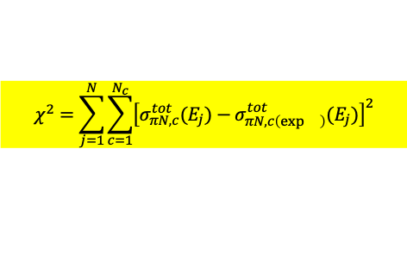
Development of Newton-Raphson method
$$χ^{2}=\sum_{j=1}^{N}{\sum_{c=1}^{N_{c}}{{\left[σ_{πN,c}^{tot}(E_{j})−σ_{πN,c\left(\exp{}\right)}^{tot}(E_{j})\right]}^{2}}}$$
Usually χ² (1-dimension) is minimized in many algorithms. χ² of the total cross section residuals of all data points
Simplex, gradient descent, … (implemented in Minuit library)
Instead of using χ², use residual vector of data-model at each data point!
S_{i}=f(x₁,x₂,…x_{n}, E_{i})-y(E_{i}): x₁,…x_{n}, model parameters, E_{i}: energy of i-th data point
  f: modeled cross section, y : measured cross section data
  χ² = ΣS_{i}² (i=1,…n, data points)
Require S=0, instead of minimizing χ²
And solve it with Newton-Raphson method (iterative)
x_{n+1} = x_{n} – (∂S(x_{n})/∂x)⁻¹S(x_{n})
∂S(x_{n})/∂x: Jacobian: J_{ij}= ∂S_{j}/∂x_{i}
Nonlinear equation is approximated to a linear solver problem!
Newton-Raphson method is very fast if the initial parameters are close to the true values.
Test with 2 resonances and 1 channel
χ² minimization (Minuit): 340 iterations
Newton-Raphson: 20 iterations
But, Newton-Raphson method can converge only if the initial parameters are close enough to the true values.
Tangent
line
Go over if time
(slides provided by Hiroyuki Sako)

Slide 35


