Slide 1
Motivation for Hadron Beams
Michael Doering
Department of Energy,
DOE DE-AC05-06OR23177
& DE-SC0016582
HPC support by JSC grant jikp07
National Science Foundation
Grant No. PHY 2012289

Slide 2
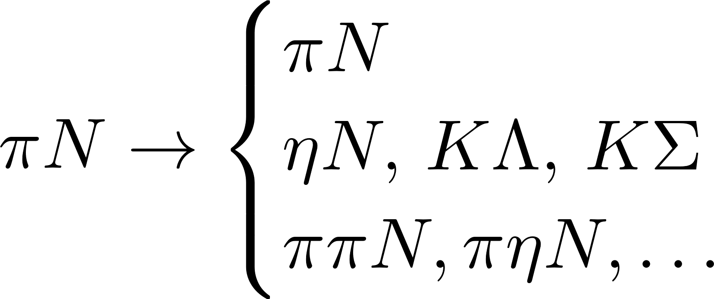
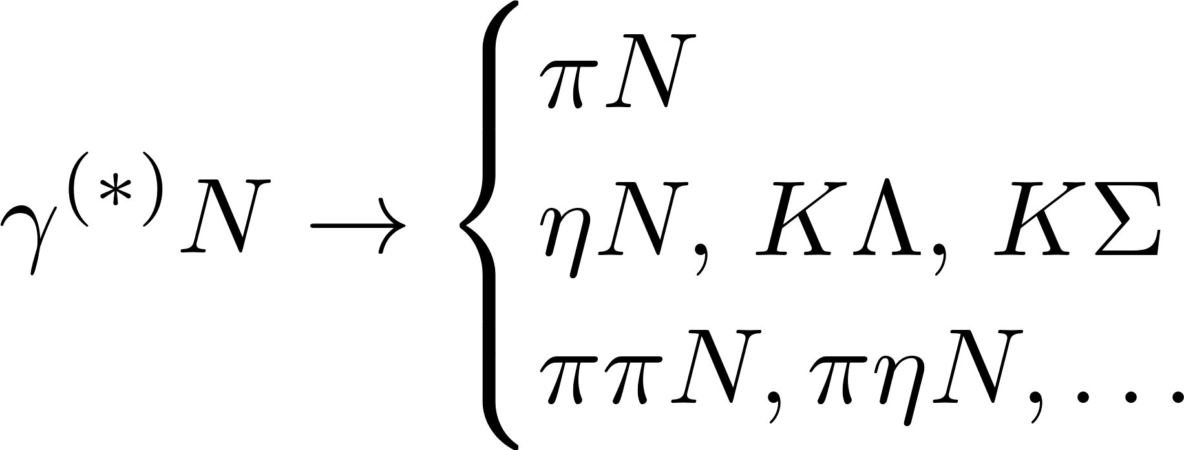
The role of meson beams in baryon spectroscopy
(Non-strange, light baryon sector)
Pion-induced reactions
Two complex amplitudes (g,h)
Photon-induced reactions
Final-state interaction as sub-process
Four (photo) or six (electro) complex amplitudes (CGNL, ...)
Data!
Photon-induced reactions have more d.o.f. and their analysis depends on meson-induced reaction data (except complete experiment).

Slide 3
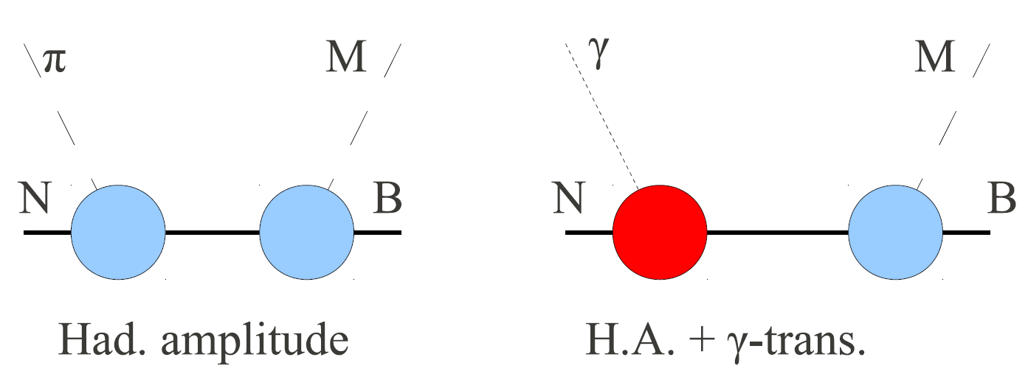
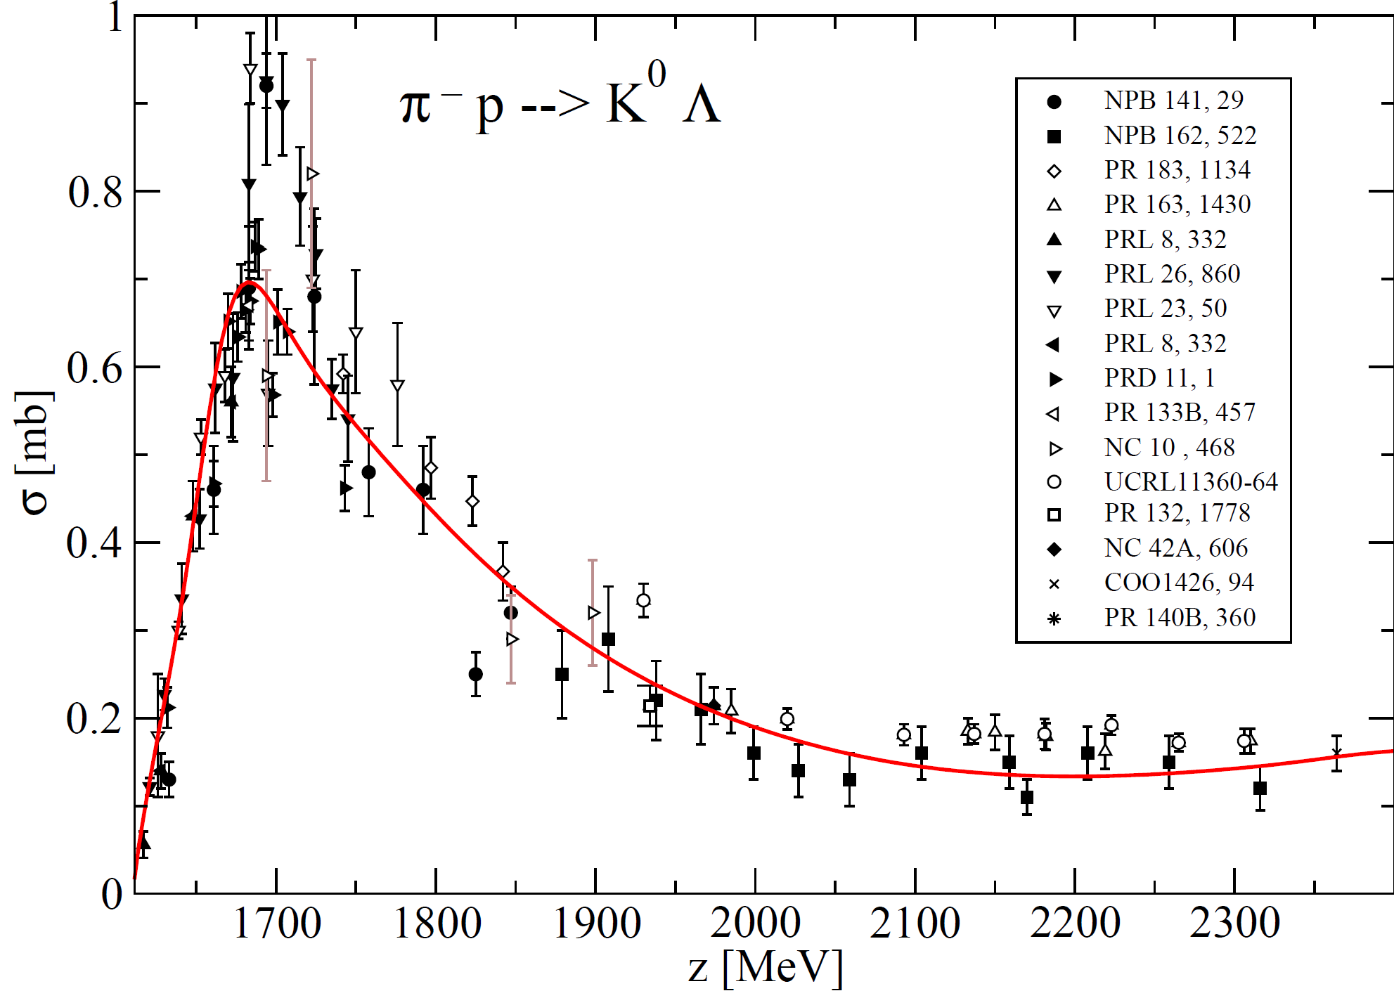
Data
Inconsistencies

Slide 4
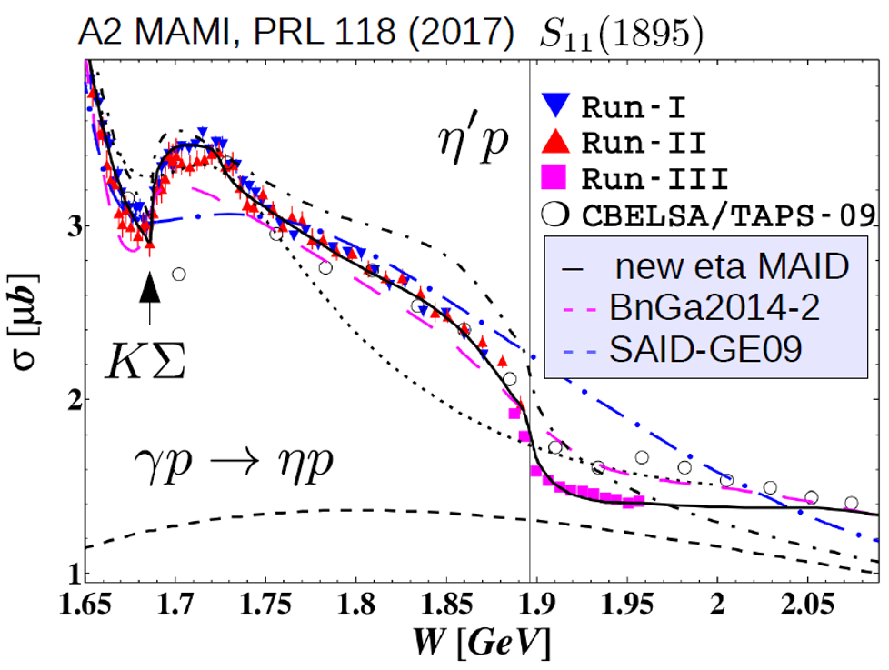
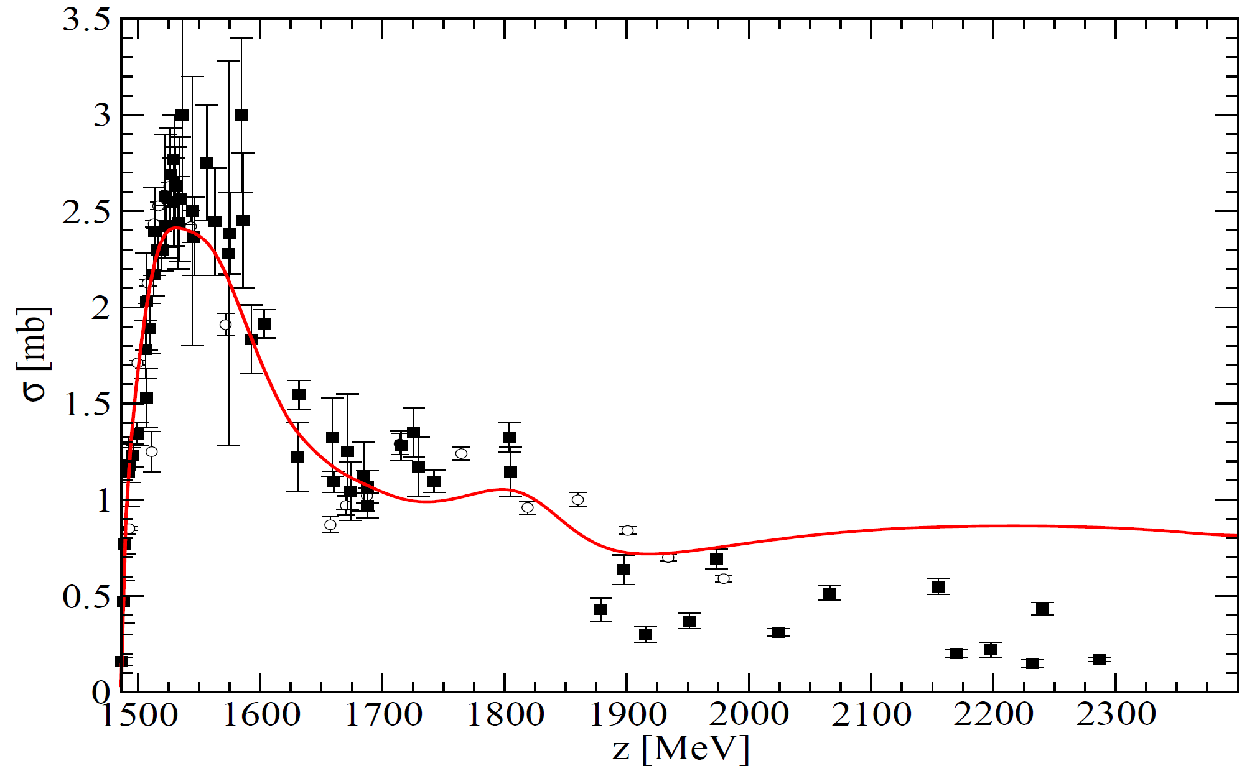
Data: η production
Large consistent data sets
Many different polarization data
Inconsistencies
No polarization data

Slide 5
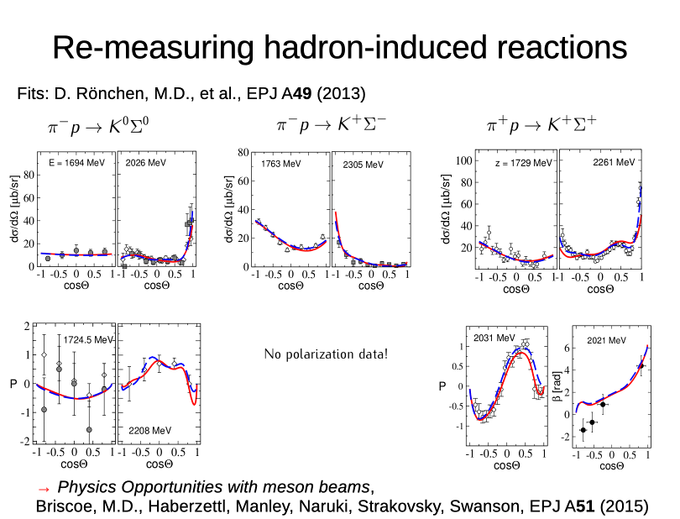

Slide 6
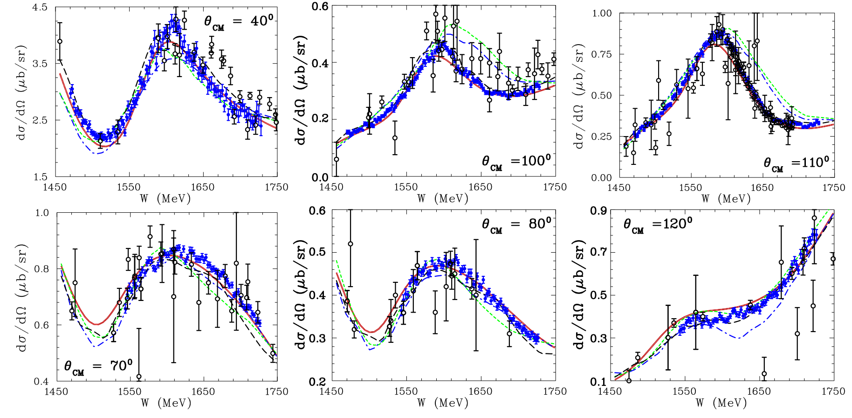
Example of recent improvements
Goal: Reduction of systematic uncertainties/ large body of consistent data
EPECUR experiment [Alekseev 2015] (blue) compared to previous measurements (black)

Slide 7
K-Long
KLF Wiki page: [https://wiki.jlab.org/klproject/index.php/Main_Page]
Overview of current experimental status: [Sean Dobbs 2022]
This talk is not about experimental status of approved KL experiment but provides some physics motivation for it.
See Wiki page for talks on experimental status.
Whitepaper [2020] ; secondary meson beam whitepaper [Briscoe 2015]
Extensive theoretical support:

Slide 8
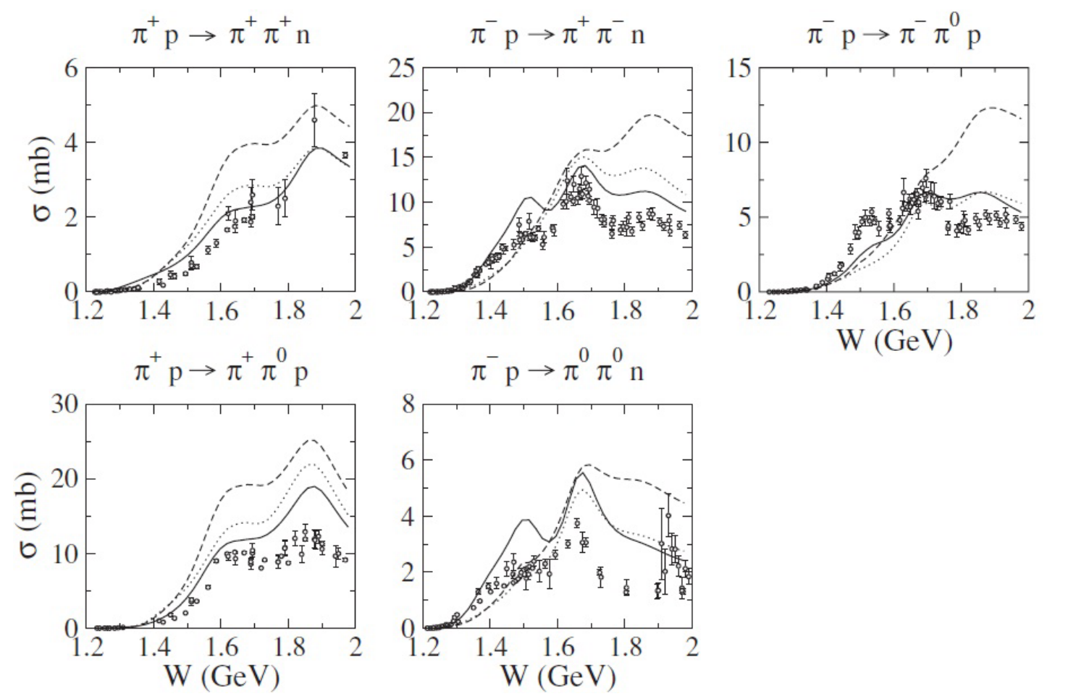
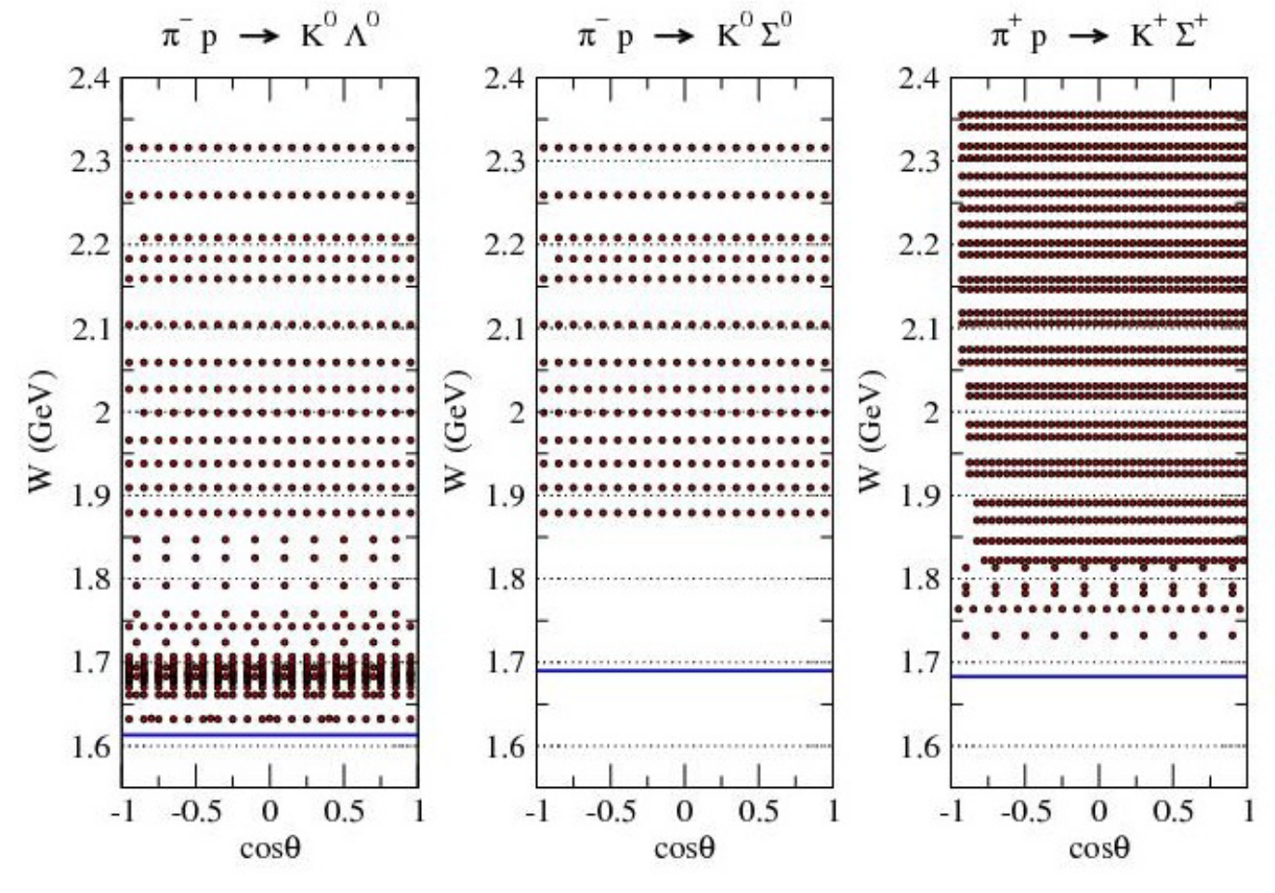
J-Parc experiments with pion beams
[Ohnishi et al., PPNP 2019]
J-Parc E19, [Naruki/E19 experiment, 2016]
Very valuable input
for all PWA efforts
in light baryon
spectroscopy
J-Parc E45 [Proposal 2012]
Calculation:
[EBAC 2008]

