Slide 2
What was EARLY?
The E.A.R.L.Y Workshop (NSTAR2024) is two-and-a-half days dedicated to early-career researchers in preparation for the 14th edition of the NSTAR conference. This hands-on and friendly workshop will bring professionals from academia and industry who will share their knowledge, experience and tips to get ahead of any career opportunities. Get your researcher starter pack by learning how to give fantastic talks, secure funding, tune your CV and launch your career!

Slide 3
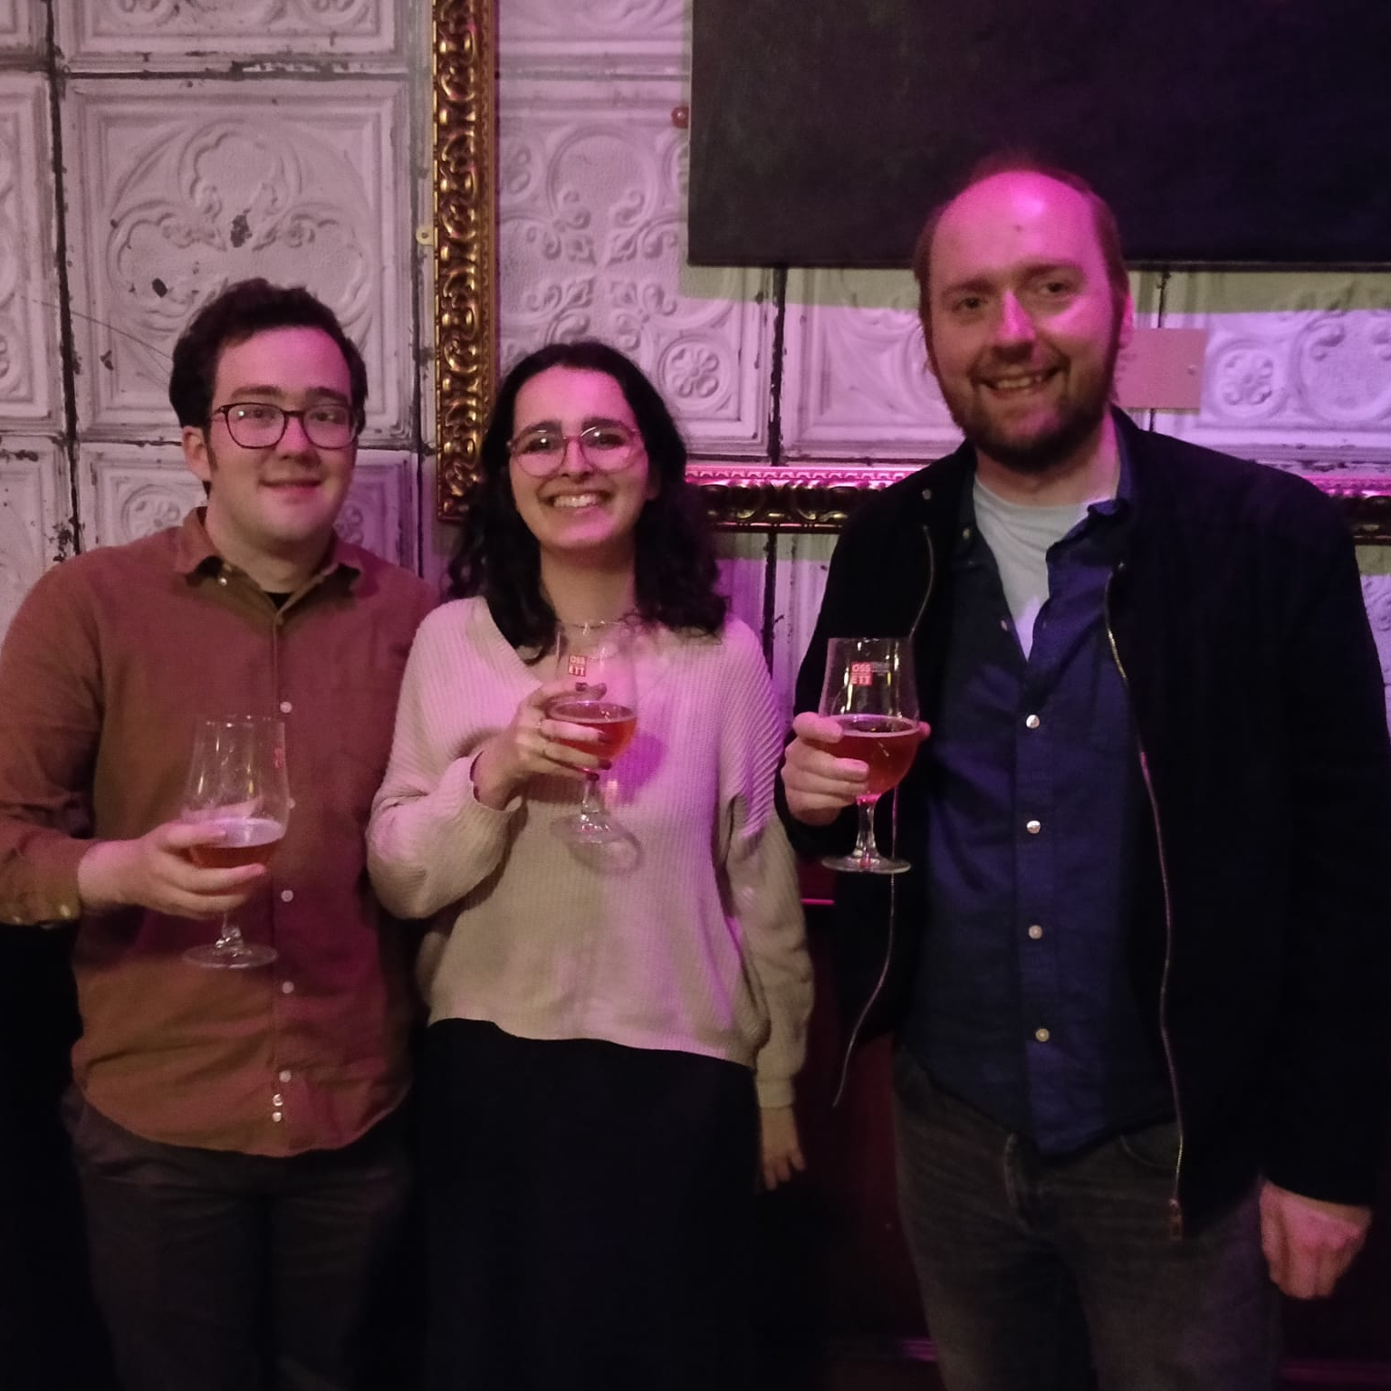
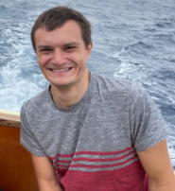
Organising Committee Members
Pierre Chatagnon – Jefferson Lab
Stuart Fegan – University of York
Ryan Ferguson – University of Glasgow
Noémie Pilleux – IJCLab Paris Saclay University
With help and guidance from Nick Zachariou – University of York

Slide 4
List of panels
CV Tune-up
How to give a good talk
Life as a post doc
Industry opportunities
Proposals and fellowships
Academia and funding

Slide 5
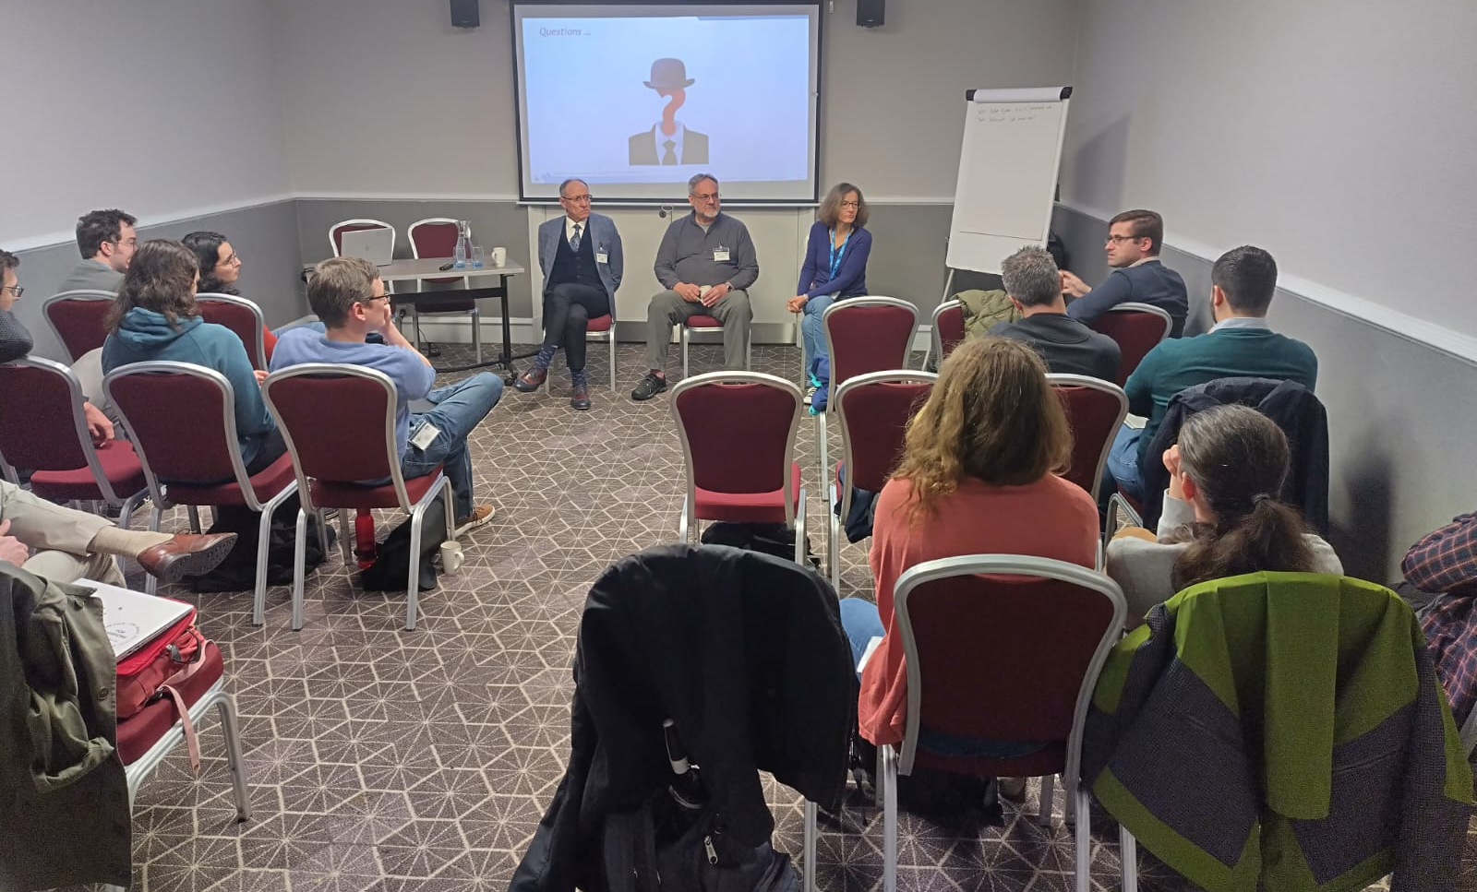
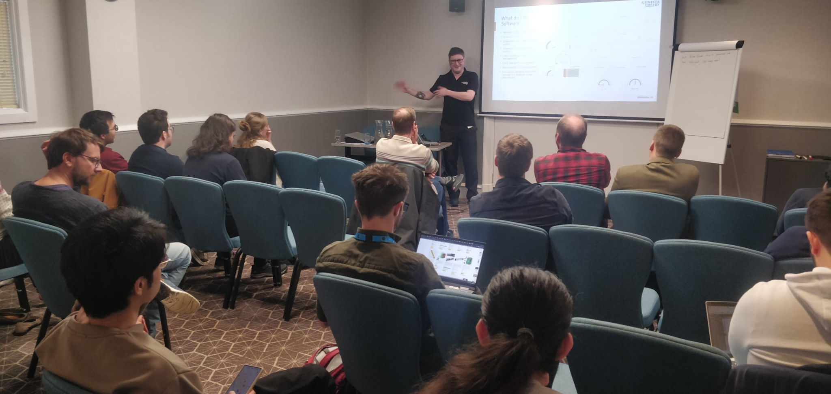
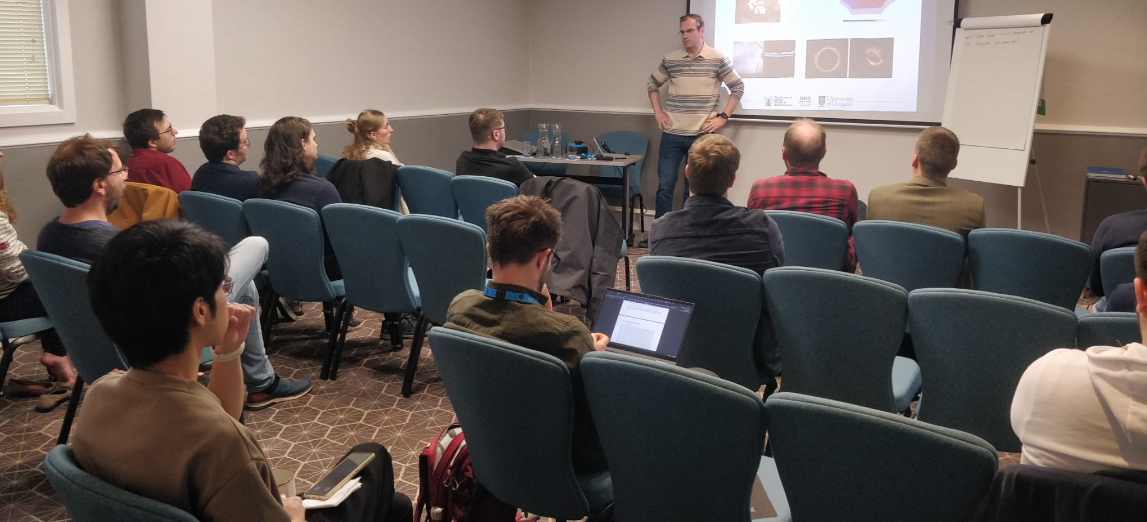
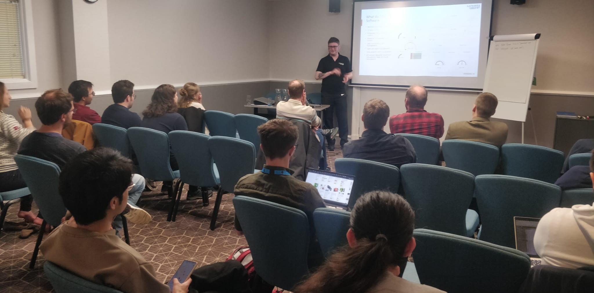

Slide 6
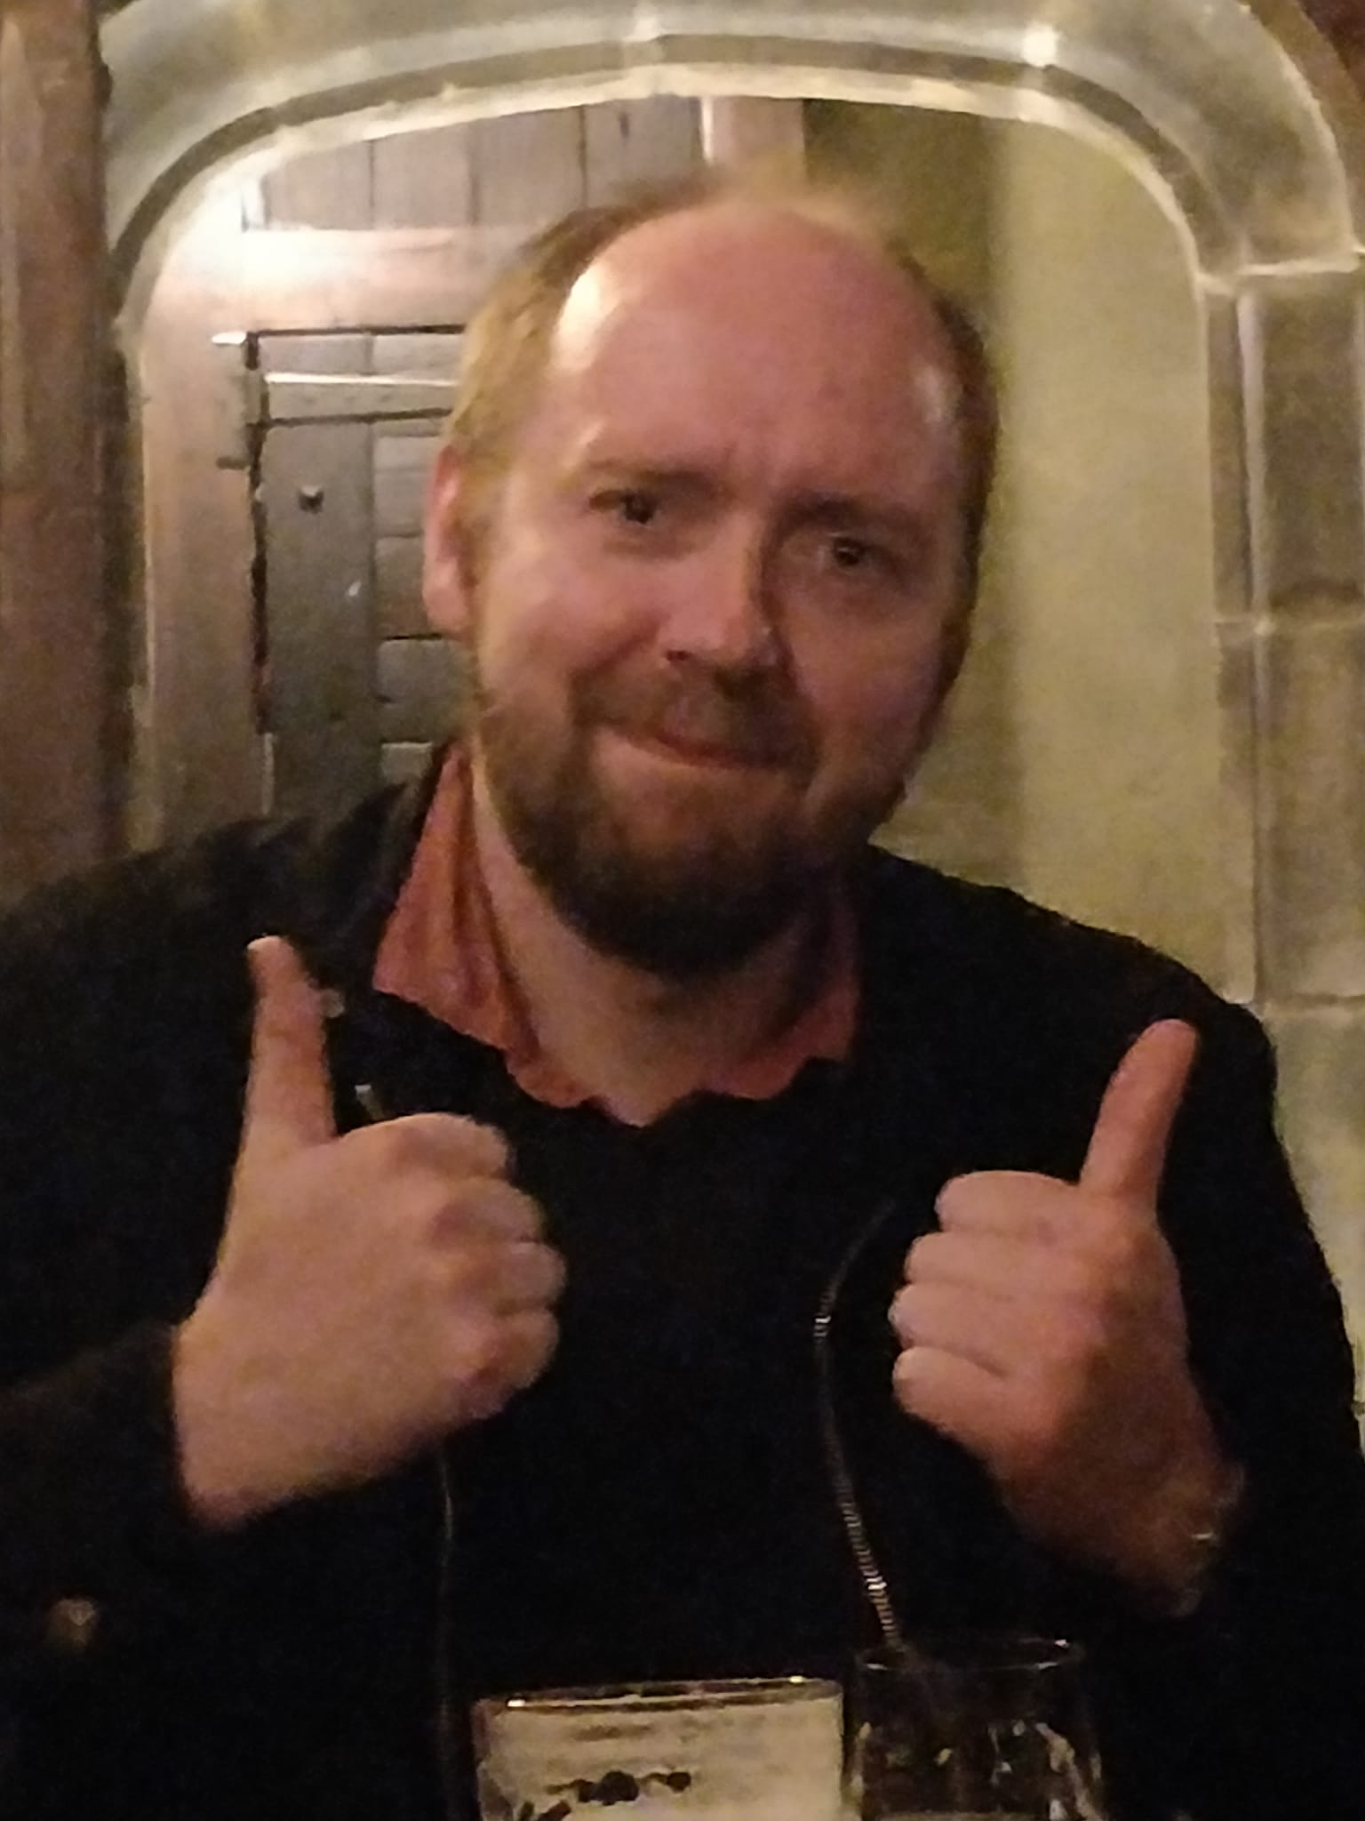
Feedback
Overall satisfaction was 88% from speakers and delegates.
“You should have a good supervisor that introduces you to the people.”
“The event helped me to decide between finding a post-doc or leaving academia.”
“I loved what I learned through the experience.”
“I thought the idea of flash talks for a non-physics audience was very interesting. I think it should be coupled in future iterations with more discussion of outreach.”

Slide 7
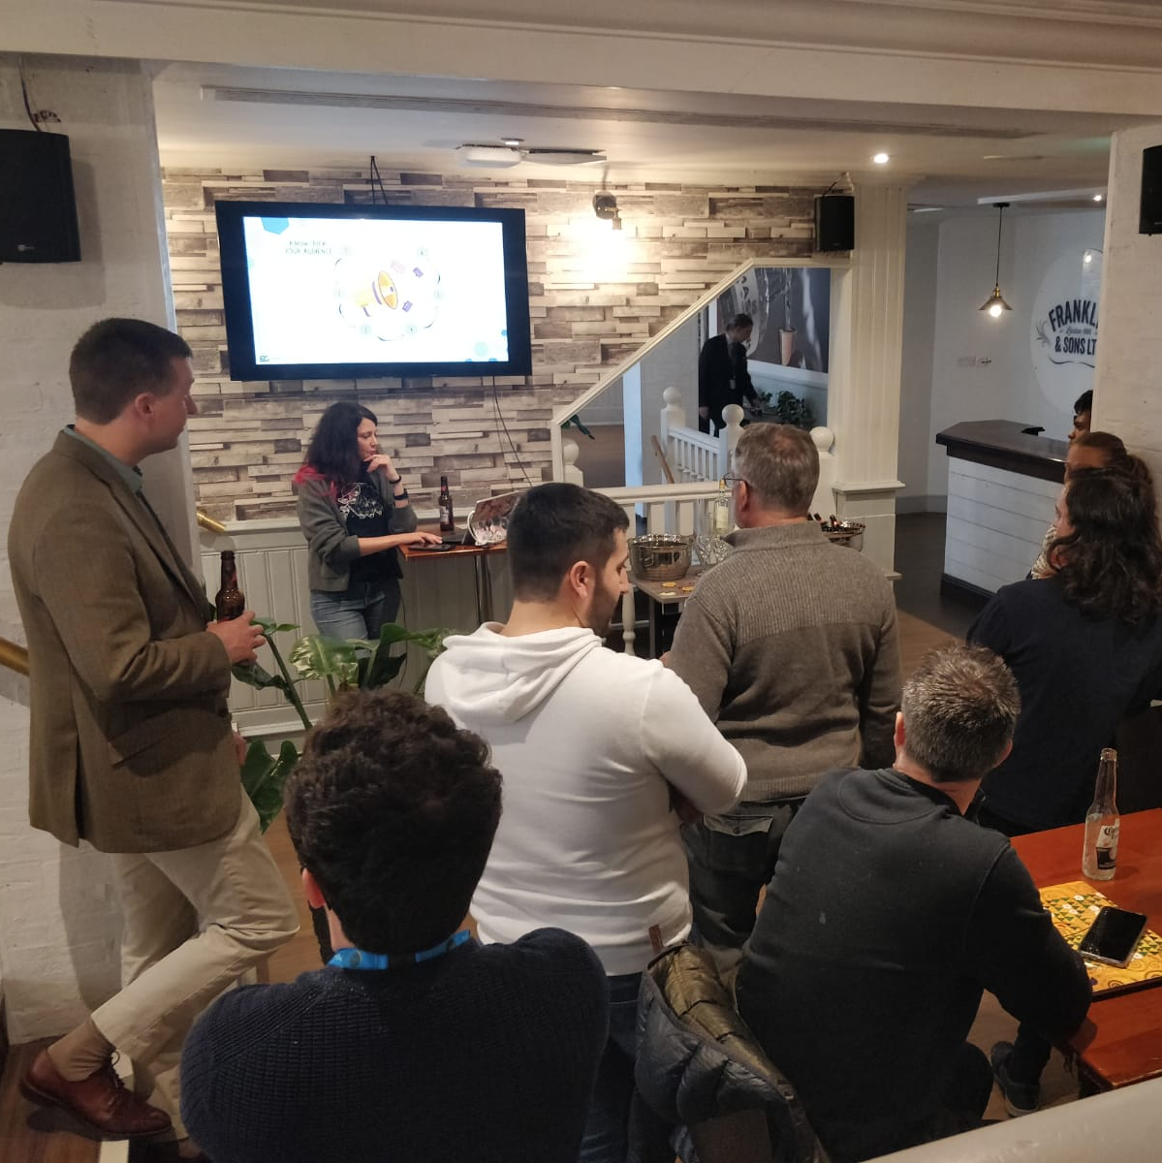
Pint of Science
An outreach program in more than 400 cities across 25 countries.
Designed to teach the public about concepts across science in an informal setting.

Slide 8
Flash Talks
Following the Pint of Science and how to give a good talk sessions, delegates were invited to give a 5-minute flash talk to explain their research to an audience with a non-science background.

Slide 9
Thanks for Listening

