Slide 1
Hadron Spectroscopy at the frontier of theory and experiment
Alessandro Pilloni
NSTAR 2024, June 19th, 2024

Slide 2
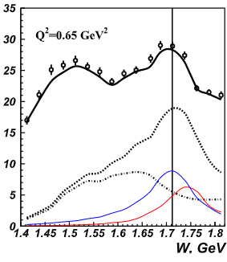
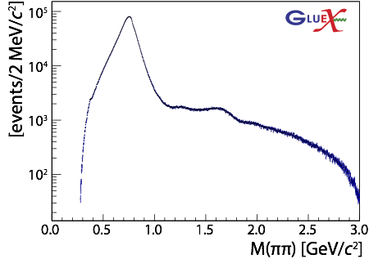
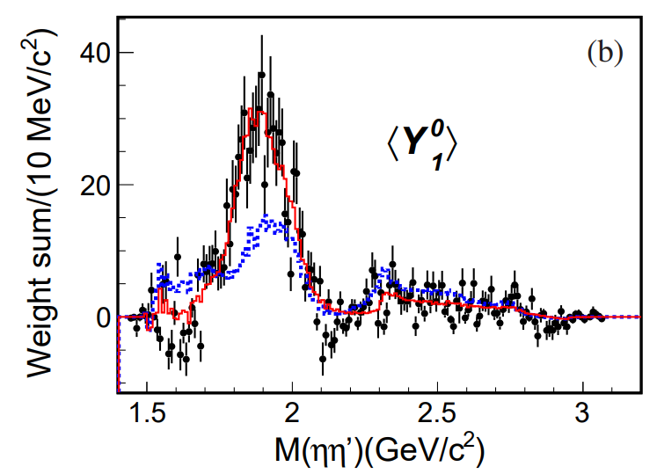
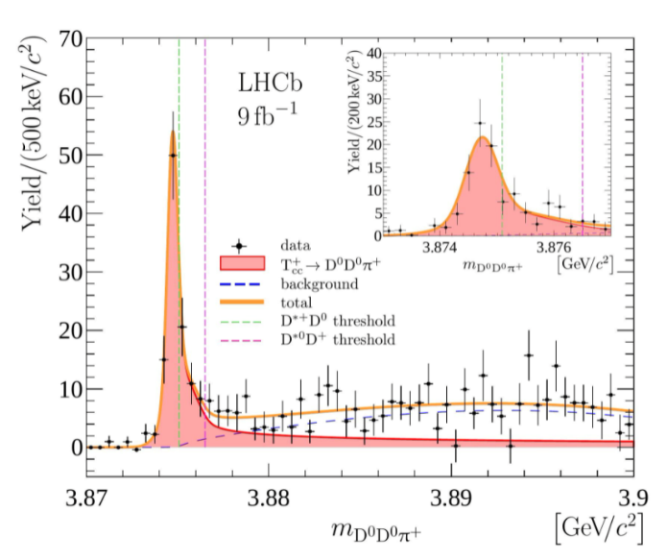
The richness of hadron spectrum
The structures populating hadron reactions are extremely rich
Ultimate goal is to understand them in term of QCD degrees of freedom
To do so, the spectrum of resonances must be correctly reconstructed
A. Pilloni – Hadron Spectroscopy at the frontier of theory and experiment
Notes:
2 slides su Zc, a Bes e a Belle
2 slide su tetraquark model: dall’hamiltoniana di Jaffe al calcolo delle masse
1 slide su molecular models, dove sono i carichi? (non in Tornqvist, si in Hanhart, vedere Braaten, citare Nefediev)
2 slides su decay channels, dove si dovrebbe vedere, e a seconda del modello, vedere qualche plot
1 slide su Y(4260), tetraquark? C’è lo strano (si vede la f0)
1 slide su Zc a cleo (anche il neutro)

Slide 3
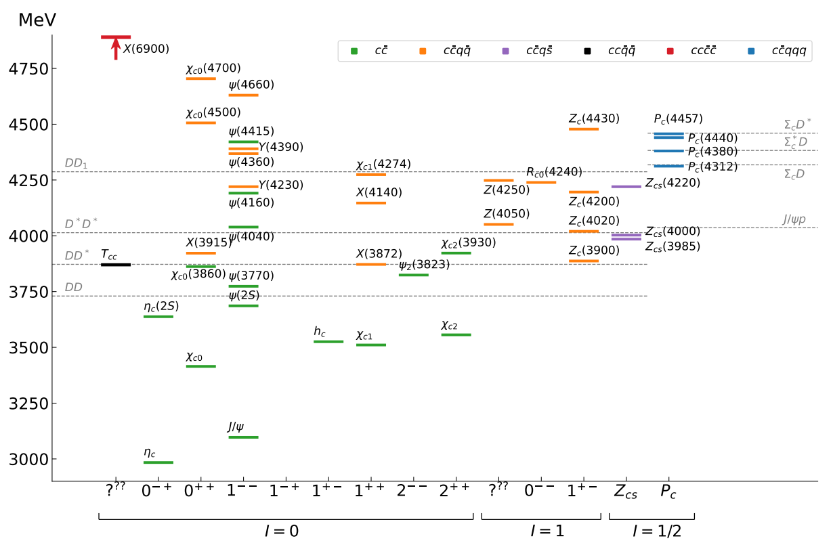
Exotics
The quark model is still the simplest tool to organize the spectrum
JPAC, PPNP 127 (2022), 103981
«Exotic hadrons» are Beyond the Standard (quark) Model
Organizing them teaches us some more about quark-gluon interactions
A. Pilloni – Hadron Spectroscopy at the frontier of theory and experiment
Notes:
2 slides su Zc, a Bes e a Belle
2 slide su tetraquark model: dall’hamiltoniana di Jaffe al calcolo delle masse
1 slide su molecular models, dove sono i carichi? (non in Tornqvist, si in Hanhart, vedere Braaten, citare Nefediev)
2 slides su decay channels, dove si dovrebbe vedere, e a seconda del modello, vedere qualche plot
1 slide su Y(4260), tetraquark? C’è lo strano (si vede la f0)
1 slide su Zc a cleo (anche il neutro)

Slide 4
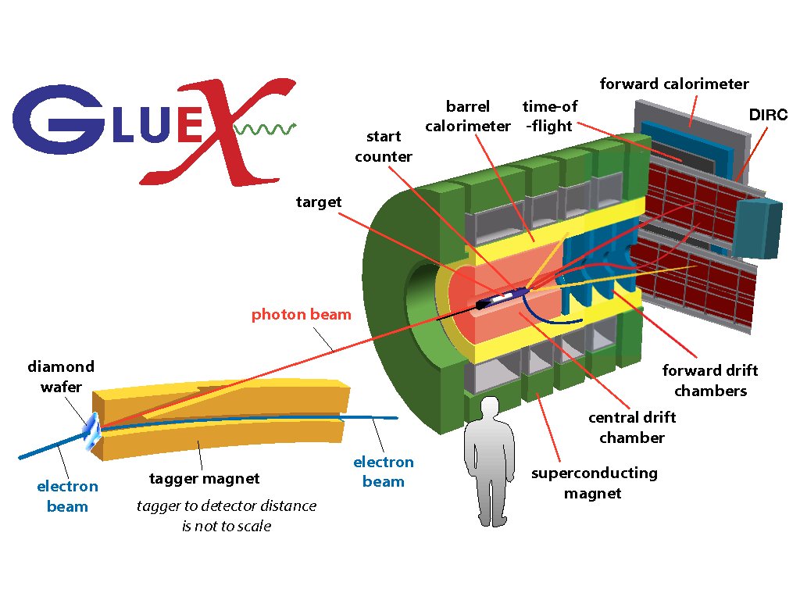
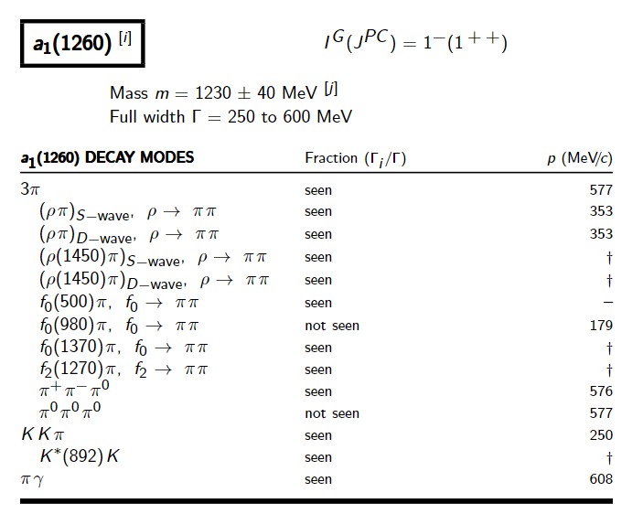
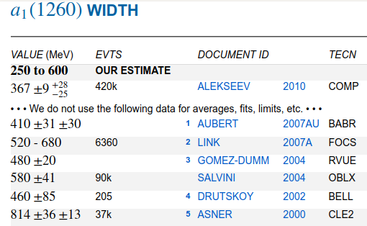
How theorists think of experiments
All the information about hadrons is collected by the Particle Data Group
$$G$$
Changing beam and target, you can change the font
P
D
What theorists see…
What experimentalists present…
A. Pilloni – Hadron Spectroscopy at the frontier of theory and experiment

Slide 5
Potential problems
We can’t afford being misguided by simplistic resonance extraction! (life is already hard enough without red herrings)
Amplitude analysis requires collaboration of theorists and experimentalists
However, we don’t have a universal recipe to do things right
We have to proceed:
Case-by-case
Keep in mind the limitations of each approach
Overstudy (the more approaches the better)
No overstatement (do-no-harm)
A. Pilloni – Hadron Spectroscopy at the frontier of theory and experiment

Slide 6
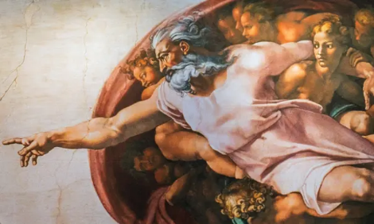
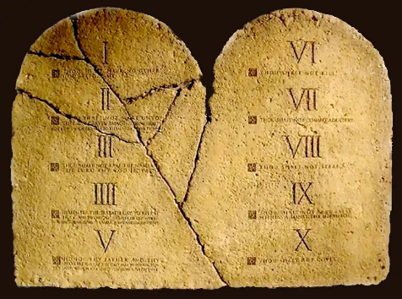
Top-down approach
You are given a model/theory
$$f(s)$$
You calculate the amplitude
You compare with data. Or you don’t.
Predictive power ✓
Physical interpretation ✓ (within the model! ✗) Biased by the input ✗
A. Pilloni – Hadron Spectroscopy at the frontier of theory and experiment

Slide 7
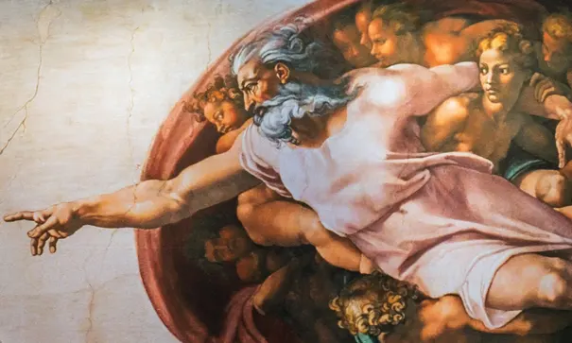
Options on the market
Quark-level calculations:
Quark models, DSE, pNRQCD, Hybrids, ...
Spectrum generally calculated as bound states of some potential
Decay rates as «overlap integrals» between two static configurations
Comprehensive picture ✓ Little scattering dynamics ✗
Hadron level calculations:
Microscopic models inspired to EFT + Unitarization
Compact states vs. molecules, triangles...
States as poles of scattering amplitudes
Couplings as residues at the poles
Scattering dynamics ✓ More case-by-case ✓✗
A. Pilloni – Hadron Spectroscopy at the frontier of theory and experiment

Slide 8
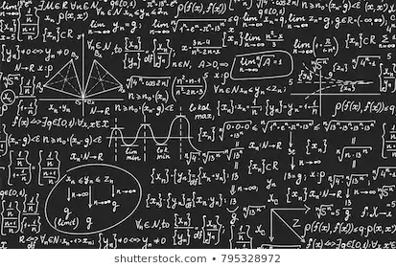
Bottom-up approach
Less predictive power ✗
Some physical interpretation ✗ Minimally biased ✓
You extract physics
You choose a set of generic amplitudes
You start with data
A. Pilloni – Hadron Spectroscopy at the frontier of theory and experiment

Slide 9
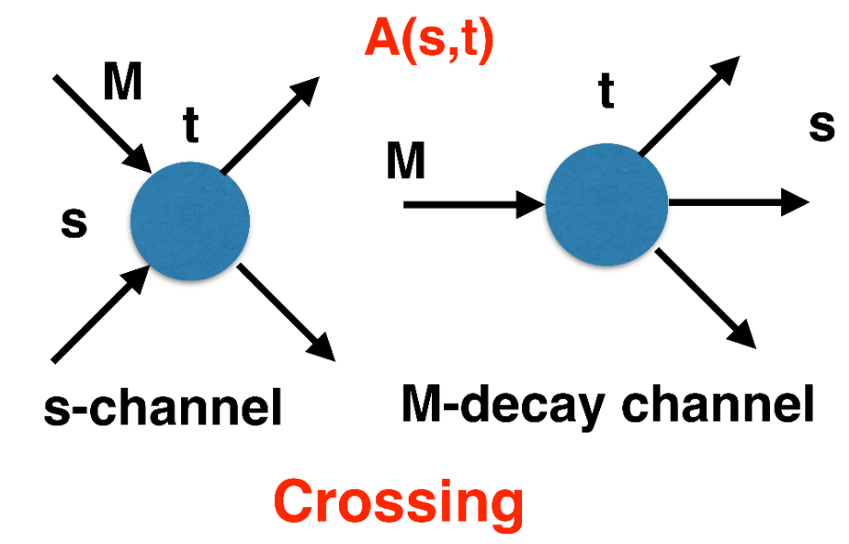
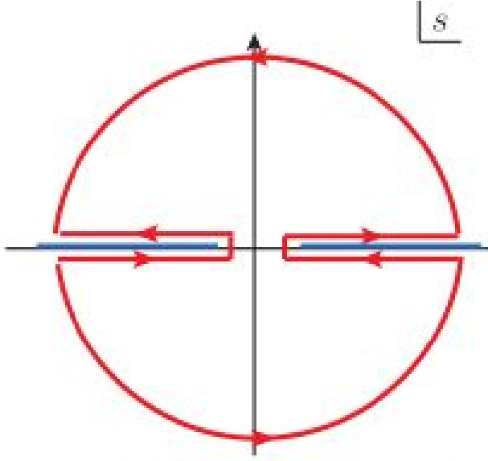
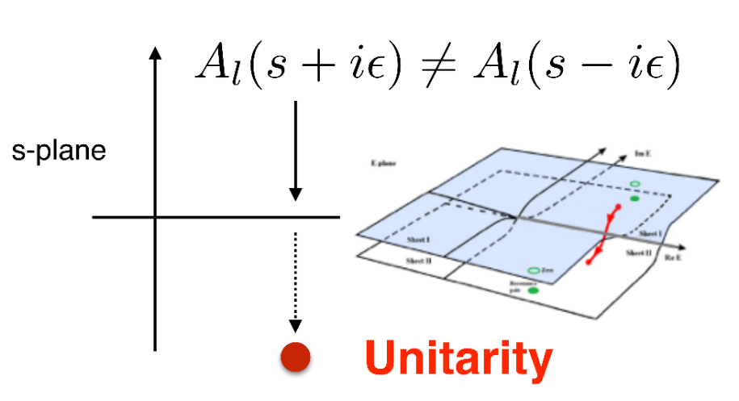
$S$-Matrix principles
$$t_{l}\left(s\right)=\lim_{ε→0}t_{l}(s+iε)⁡$$
Analyticity
$$\text{Im} t_{l}=ρ_{l}{\left|t_{l}\right|}^{2} ⁡$$
These are constraints the amplitudes have to satisfy, but do not fix the dynamics
They can be imposed with an increasing amount of rigor, to extract robust physics information
The «background» phenomena can be effectively parameterized in a controlled way
+ Lorentz, discrete & global symmetries
A. Pilloni – Hadron Spectroscopy at the frontier of theory and experiment
Notes:
Controlla la parte su Regge

Slide 10
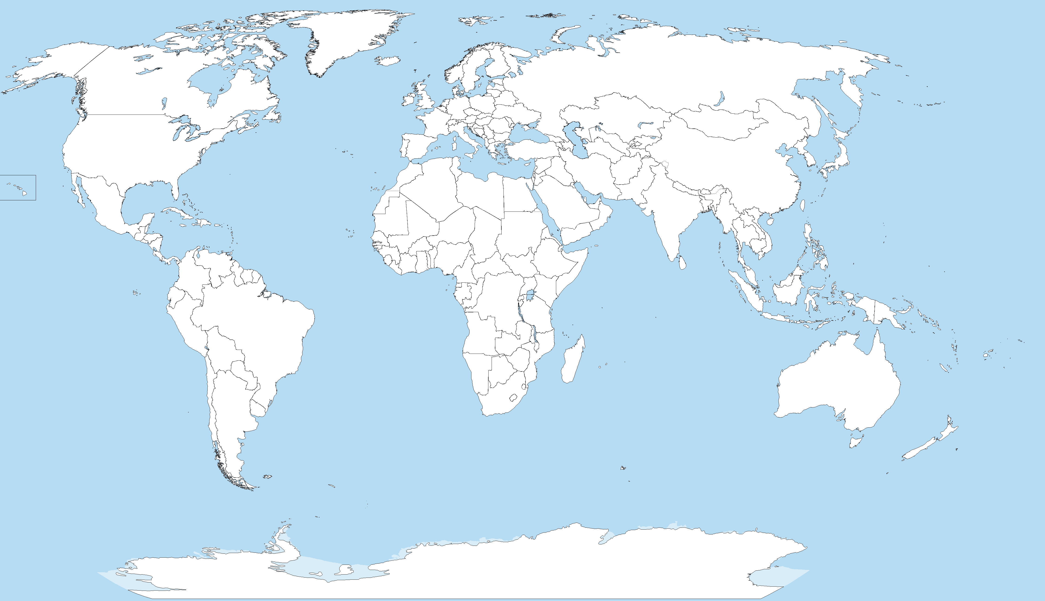
Joint Physics Analysis Center
Funded in 2013 as theory support originally for JLab exps, but grew up much larger
Creates bridges between theorists and experimentalists
40+ researchers affiliated during a decade
Running
Planned
A. Pilloni – Hadron Spectroscopy at the frontier of theory and experiment
Notes:
Controlla la parte su Regge

Slide 11
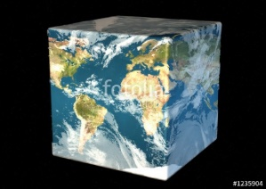
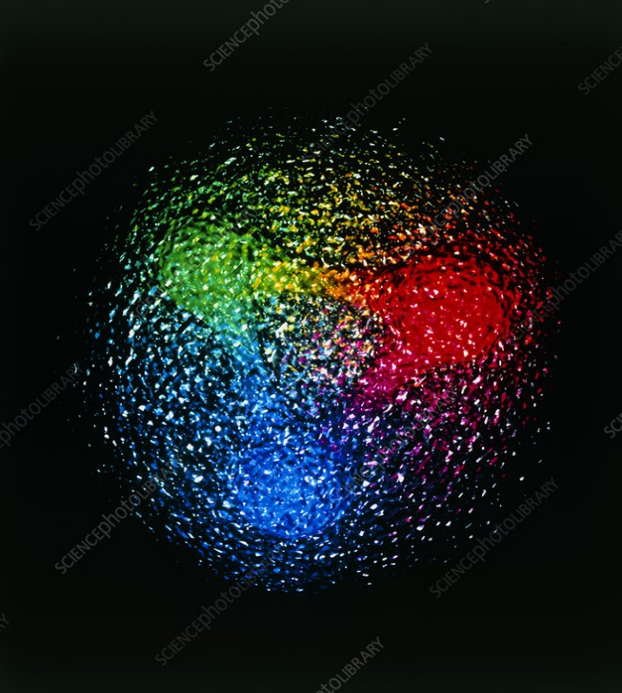
Exo(tic) Had(ron) TC
Funded in 2023 by DoE as a Topical Collaboration in Nuclear Physics
Hybrids from Scattering
Form factors
Lattice QCD
Aims at exploring all aspects of exotics (= hybrids at GlueX)
V. Mathieu, Plenary Mon 11.30am
C. Fischer, Parallel A Tue 2.25pm
G. Eichmann, Parallel A Thu 2.25pm
Quark level calculations
Lessons from EFTs
QCD
Studying details of production mechanisms of exotics at GlueX
Finite energy sum rules
Amplitude Analysis
Phenomenology
A. Pilloni – Hadron Spectroscopy at the frontier of theory and experiment
Notes:
Controlla la parte su Regge

Slide 12
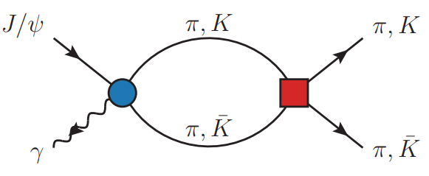
Amplitudes for $J/ψ→γ PP$
Rodas et al., EPJC 82, 1, 80
We build the partial wave amplitudes according to the $N/D$ method
$$n(s)$$
$$a\left(s\right)=\frac{n\left(s\right)}{D\left(s\right)}$$
$$D(s)$$
The $n\left(s\right)$ → background physics, process-dependent, smooth
The $D(s)$ contains all the Final State Interactions constrained by unitarity → universal
A. Pilloni – Hadron Spectroscopy at the frontier of theory and experiment
Notes:
Controlla la parte su Regge

Slide 13
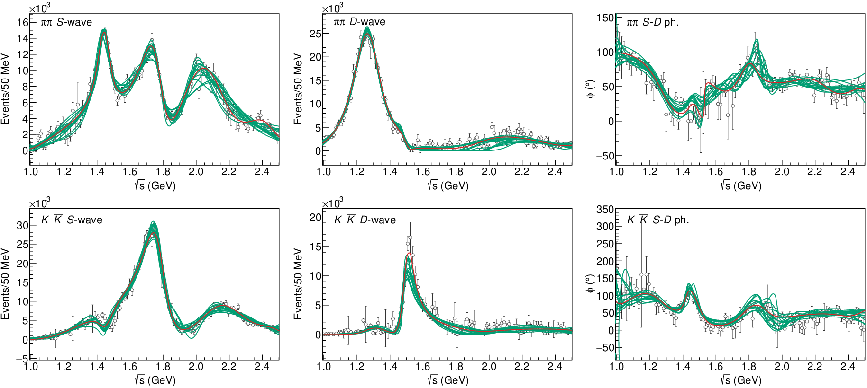
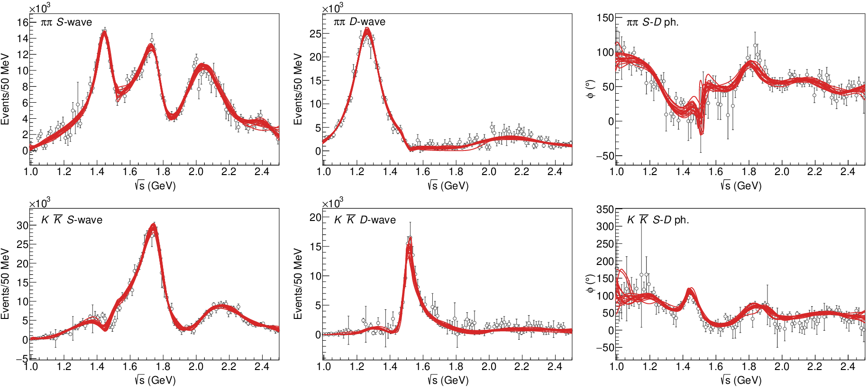
$J/ψ→γ π^{0}π^{0} and→γ K_{S}^{0}K_{S}^{0}$
The fit is decent, but it’s struggling in getting the $f_{2}′$ right Being quasi-elastic, it’s too constrained
Fit quality and local description improve when a third $ρρ$ channel is added
( data)
A. Pilloni – Hadron Spectroscopy at the frontier of theory and experiment

Slide 14
Pole extraction
For data-driven pole extractions, see also D. Binosi, A. Pilloni, R.-A. Tripolt PLB 839, 137809
A. Pilloni – Hadron Spectroscopy at the frontier of theory and experiment

Slide 15
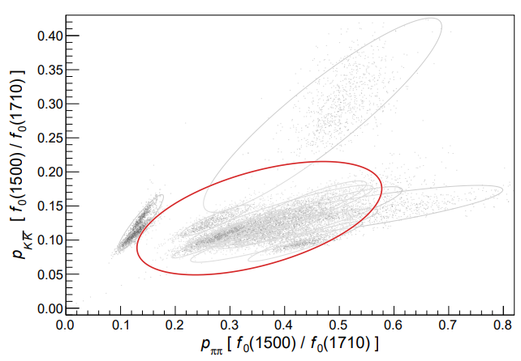
Looking at the residues
Despite the large systematics, the $f_{0}\left(1710\right)$ couples to kaons more than the $f_{0}\left(1500\right)$
Also, the $f_{0}\left(1710\right)$ couples to the initial gluon-rich state more than the $f_{0}\left(1500\right)$
Both these fact suggest a sizeable glueball component for the $f_{0}\left(1710\right)$
Caveats:
some of the relevant channels are neglected, hopefully ratios not affected
Left-hand cuts of scattering processes contribute to scattering. Poorly known and neglected here.
A. Pilloni – Hadron Spectroscopy at the frontier of theory and experiment

Slide 16
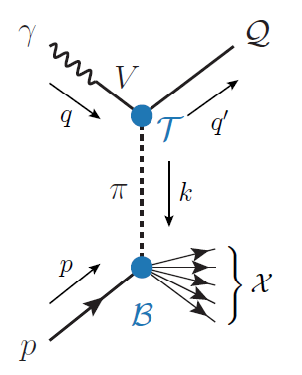
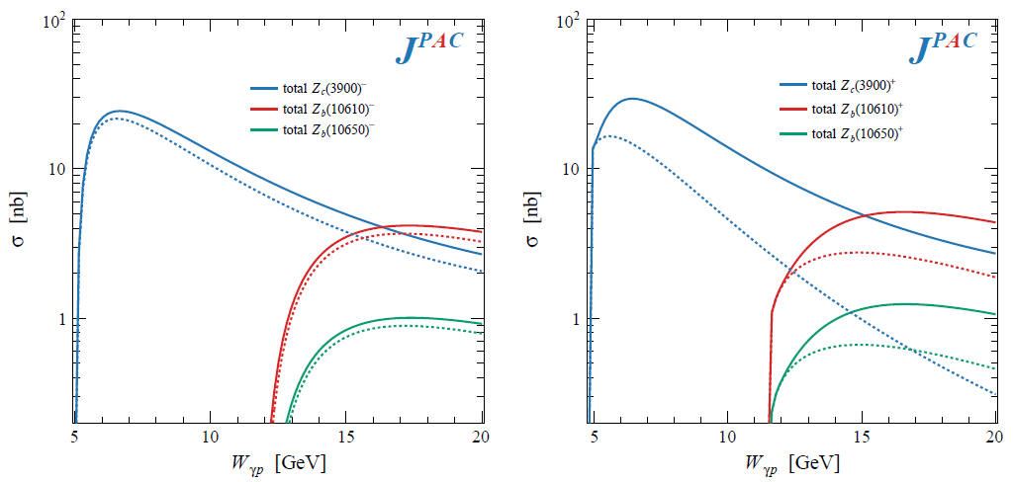
XYZ photoproduction
VMD-based predictions for reactions of interest at EIC and JLab22
J. Stevens Parallel C Wed 2.25pm, P. Rossi Plenary Tue 11.30am
Exclusive reactions: Albaladejo et al., PRD 102, 114010
Inclusive reactions with pion exchange: Winney et al., PRD 109, 094009
Inclusive reactions with pion exchange: Winney et al., arXiv:2404.05326
Code available on https://github.com/JointPhysicsAnalysisCenter/jpacPhoto
$$Z_{c}^{−}Δ^{++}$$
$$Z_{c}^{+}n$$
A. Pilloni – Hadron Spectroscopy at the frontier of theory and experiment

Slide 17
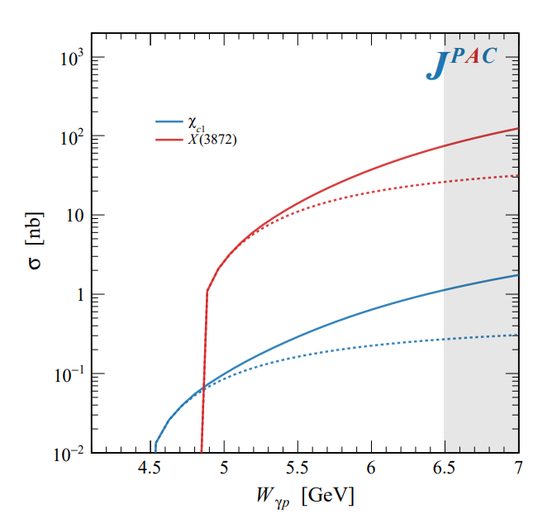
Semi-inclusive photoproduction
Semi-inclusive cross sections are typically larger
For small $t$ and large $x$, one can assume the process to be dominated by pion/vector exchange
The bottom vertex depends on the (known) total pion-nucleon cross section, or encoded in the PDFs at large $x$
$$π, ρ, ω$$
A. Pilloni – Hadron Spectroscopy at the frontier of theory and experiment

Slide 18
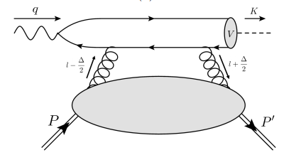
$J/ψ$ photoproduction at threshold
The common lore is that the study of vector quarkonium photoproduction at threshold is directly related to nucleon matrix elements
GPD
Assumptions:
Factorization proof for timelike DVCS can be extended at threshold as the heavy quark mass plays the role of a hard scale
The top vertex contains the trivial $γ$-$ψ$ coupling ${\left|ψ\left(0\right)\right|}^{2}$
The exchange of anything but gluons is (OZI-, mass-) suppressed
The exchange is dynamically dominated by gluons carrying $J=2$
Then one extracts matrix element of the energy momentum tensor $\left\langle p′ | T_{μν}(0) | p\right\rangle$
A. Pilloni – Hadron Spectroscopy at the frontier of theory and experiment

Slide 19
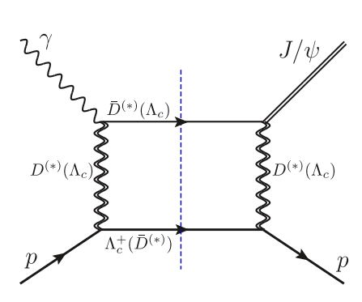
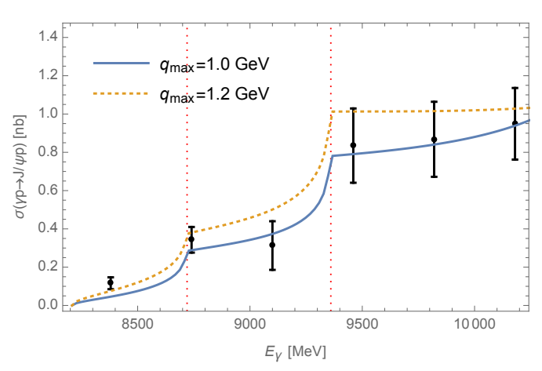
Role of open charm
Du et al. Eur.Phys.J.C 80, 11, 1053
The role of intermediate open charm thresholds has been pointed out,
Maybe «all that glitters is not glue» ….
Calculation based on EFT and known couplings, S-wave saturates the cross section
A. Pilloni – Hadron Spectroscopy at the frontier of theory and experiment
Notes:
2 slides su Zc, a Bes e a Belle
2 slide su tetraquark model: dall’hamiltoniana di Jaffe al calcolo delle masse
1 slide su molecular models, dove sono i carichi? (non in Tornqvist, si in Hanhart, vedere Braaten, citare Nefediev)
2 slides su decay channels, dove si dovrebbe vedere, e a seconda del modello, vedere qualche plot
1 slide su Y(4260), tetraquark? C’è lo strano (si vede la f0)
1 slide su Zc a cleo (anche il neutro)

Slide 20
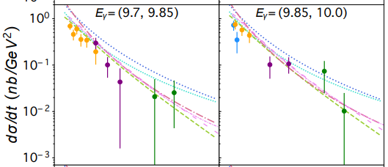
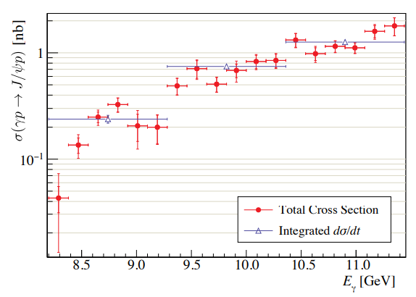
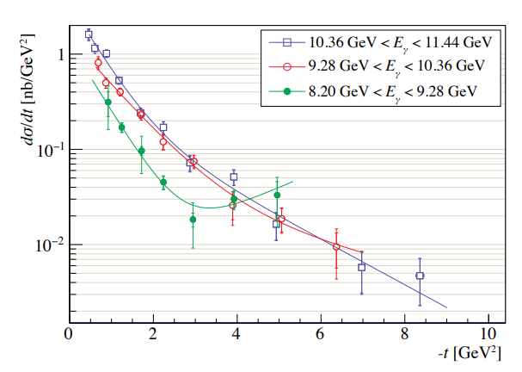
$J/ψ$ photoproduction at threshold
Nature 615, 813
Cusp at the $Λ_{c}\overline{D^{∗}}$ treshold
PRC108, 025201
A. Pilloni – Hadron Spectroscopy at the frontier of theory and experiment

Slide 21
Unitary reanalysis
Winney et al. PRD 108, 054018
Differential and total cross sections are fitted with a unitary model
In lack of polarization observables and SDME, only orbital angular momentum is considered (spinless approx.)
Truncated sum of PWs, $ℓ≤3$
The dominant S-wave can include coupled channels, for higher waves cusps are suppressed and there is no point
A. Pilloni – Hadron Spectroscopy at the frontier of theory and experiment

Slide 22
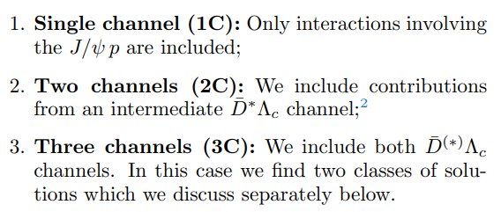
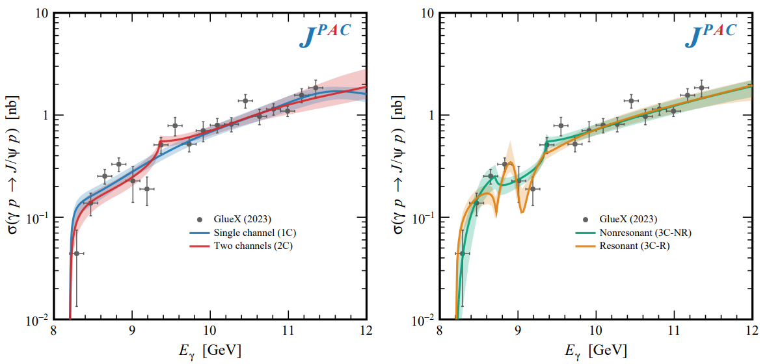
Total cross section
A. Pilloni – Hadron Spectroscopy at the frontier of theory and experiment

Slide 23
Contribution of open charm
Naively Wilk’s theorem says the single channel is unfavored at $3.7σ$
(no look elsewhere etc.),
indication but not the end of the story
Contribution of open charm $>25\%$ at 90% CL
A. Pilloni – Hadron Spectroscopy at the frontier of theory and experiment

Slide 24
Vector Meson Dominance
Since unitary model parametrize separately the production and scattering amplitude, one can compare with the predictions of VMD
$$γ$$
$$ψ$$
$$ψ$$
$$ψ$$
$$F\left(s,t\right)=$$
$=g_{γψ}×$
But $G\left(s_{\text{th}}\right)=0$
$$p$$
$$p$$
$$p$$
$$p$$
The value of the scattering amplitude at threshold is called scattering length
According to VMD, a small photoproduction cross sections implies a small scattering length O(1am)
With the unitary model, the value of the amplitude at threshold is an unrelated parameter, the scattering length enters with the energy dependence
A. Pilloni – Hadron Spectroscopy at the frontier of theory and experiment

Slide 25
Vector Meson Dominance
VMD badly excluded, except for the poorly constrained 3C-R model
Scattering lengths generally of O(1fm), but smaller ones are not excluded
Crucial to constrain better these fits by measuring open charm final states
A. Pilloni – Hadron Spectroscopy at the frontier of theory and experiment

Slide 26
Conclusions
Bottom-up approaches are important!
They allow us to get the most out of high statistics data!
JPAC and ExoHad will continue providing tools and results to understand the exciting spectrum of QCD
Thank you!
A. Pilloni – Hadron Spectroscopy at the frontier of theory and experiment
Notes:
2 slides su Zc, a Bes e a Belle
2 slide su tetraquark model: dall’hamiltoniana di Jaffe al calcolo delle masse
1 slide su molecular models, dove sono i carichi? (non in Tornqvist, si in Hanhart, vedere Braaten, citare Nefediev)
2 slides su decay channels, dove si dovrebbe vedere, e a seconda del modello, vedere qualche plot
1 slide su Y(4260), tetraquark? C’è lo strano (si vede la f0)
1 slide su Zc a cleo (anche il neutro)

Slide 27
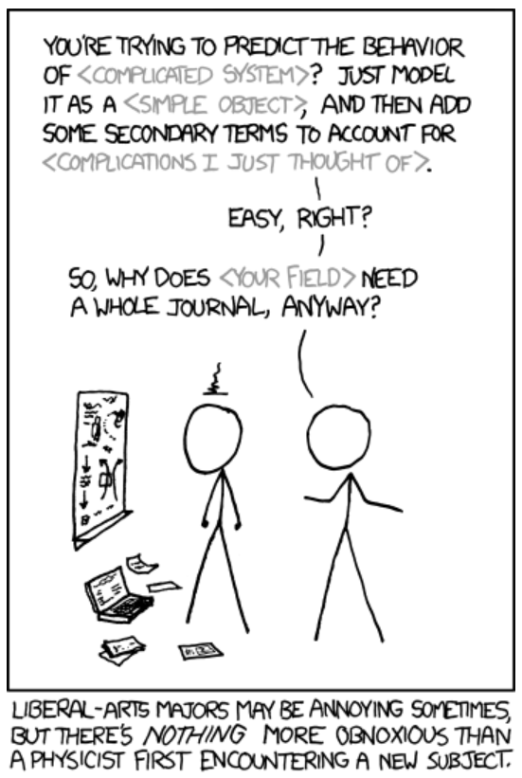
Real(istic) conversations between theorists and experimentalists
T: How could you not find the XXX quantum numbers?
E: Well, you know, 5D fit, O(100) parameters, local minima, systematics…
T: You are not that good, are you?
T: You shouldn’t use Breit Wigners!
E: Gimme some better
T: I have an analytic unitary parametrization, but it works in a given mass window and only knows about energy dependence, you can’t add background terms to it…
E: Breit Wigners.
T: Stop using complex couplings!
E: HAHAHAHHAHAHAHAHAHHHAHAHAHA
A. Pilloni – Hadron Spectroscopy at the frontier of theory and experiment
Notes:
2 slides su Zc, a Bes e a Belle
2 slide su tetraquark model: dall’hamiltoniana di Jaffe al calcolo delle masse
1 slide su molecular models, dove sono i carichi? (non in Tornqvist, si in Hanhart, vedere Braaten, citare Nefediev)
2 slides su decay channels, dove si dovrebbe vedere, e a seconda del modello, vedere qualche plot
1 slide su Y(4260), tetraquark? C’è lo strano (si vede la f0)
1 slide su Zc a cleo (anche il neutro)

Slide 28
Backup

Slide 29
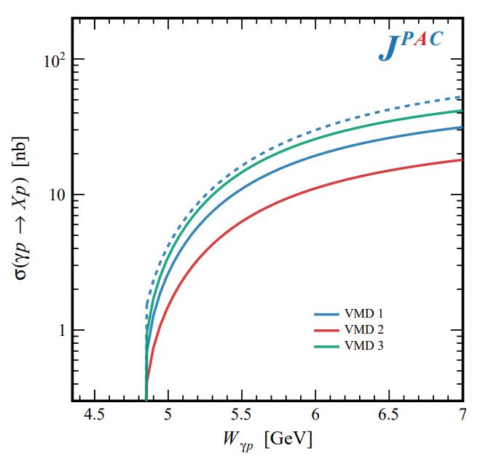
In defense of VMD
The weak point of the whole approach is the use of VMD While in the light sector it works reasonably, for heavy states is not justified
The X(3872) observed in purely hadronic and photonic modes gives us unique clue to efficacy of VMD
Belle extracted the coupling $X\left(3872\right)→γγ^{∗}$, that can be compared with the VMD predictions from $X\left(3872\right)→J/ψ ρ,ω$
Other estimate lead to differences of a factor $∼3$
A. Pilloni – Hadron Spectroscopy at the frontier of theory and experiment

Slide 30
New pentaquarks discovered
The lowest $P_{c}(4312)$ appears as an isolated peak at the $Σ_{c}^{+}{\overline{D}}^{0}$ threshold
A detailed study of the lineshape provides insight on its nature
Bottom-up: DON’T YOU DARE describing everything!!! Focus on the peak region
A. Pilloni – Hadron Spectroscopy at the frontier of theory and experiment
Notes:
Controlla la parte su Regge

Slide 31
Minimal(istic) model for $P_{c}(4312)$
Fernandez-Ramirez et al. (JPAC), PRL 123, 092001
Effective range expansion We can set $c_{ii}=0$ to reduce to the scattering length approximation
Points to a virtual state
$$c_{ii}=0$$
Finite $c_{ii}$
A. Pilloni – Hadron Spectroscopy at the frontier of theory and experiment
Notes:
2 slides su Zc, a Bes e a Belle
2 slide su tetraquark model: dall’hamiltoniana di Jaffe al calcolo delle masse
1 slide su molecular models, dove sono i carichi? (non in Tornqvist, si in Hanhart, vedere Braaten, citare Nefediev)
2 slides su decay channels, dove si dovrebbe vedere, e a seconda del modello, vedere qualche plot
1 slide su Y(4260), tetraquark? C’è lo strano (si vede la f0)
1 slide su Zc a cleo (anche il neutro)

Slide 32
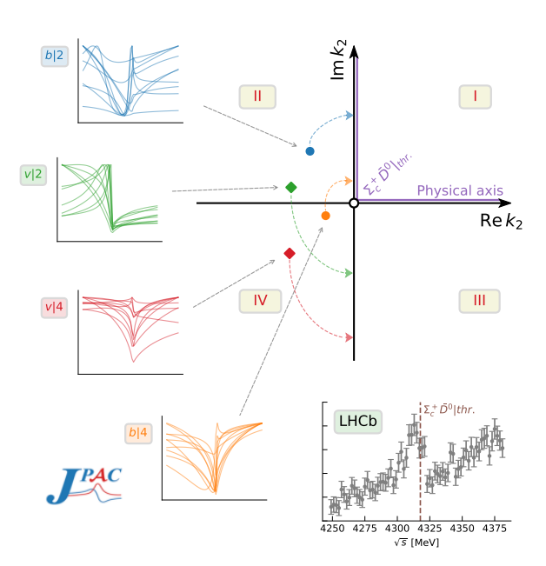
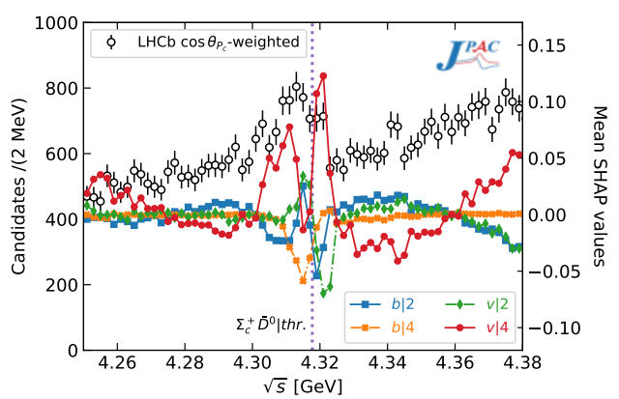
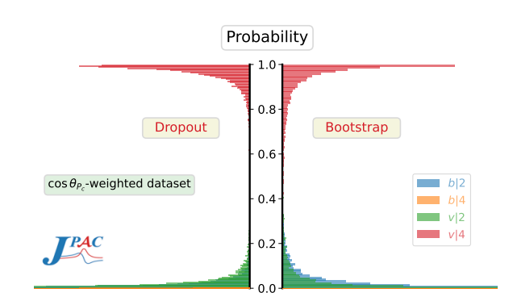
Minimal(istic) model with ANN
Ng, et al. (JPAC), PRD 105, L091501
Same conclusion reached if the analysis is performed with a Deep Neural Network
The peak region has the largest impact for the decision
Highest probability for a virtual state in the IV sheet
A. Pilloni – Hadron Spectroscopy at the frontier of theory and experiment
Notes:
2 slides su Zc, a Bes e a Belle
2 slide su tetraquark model: dall’hamiltoniana di Jaffe al calcolo delle masse
1 slide su molecular models, dove sono i carichi? (non in Tornqvist, si in Hanhart, vedere Braaten, citare Nefediev)
2 slides su decay channels, dove si dovrebbe vedere, e a seconda del modello, vedere qualche plot
1 slide su Y(4260), tetraquark? C’è lo strano (si vede la f0)
1 slide su Zc a cleo (anche il neutro)

Slide 33
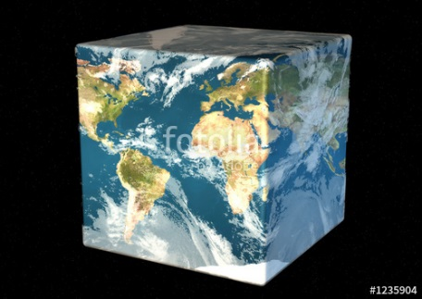
Hadron Spectroscopy
Hybrids
Tetraquark
Meson
Baryon
Glueball
$$π$$
$$π$$
$$J/ψ$$
$$π$$
Hadroquarkonium
Molecule
Experiment
Data
Amplitude analysis
QCD
Lattice QCD
Interpretations on the spectrum leads to understanding fundamental laws of nature

Slide 34
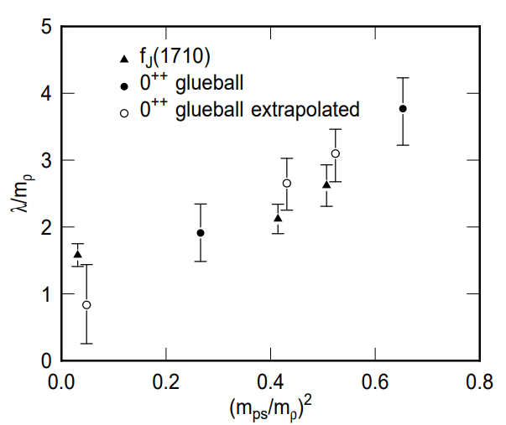
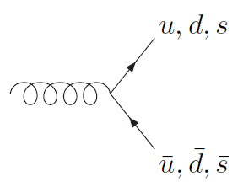
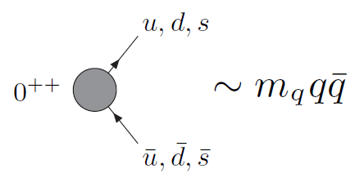
How to identify a glueball
You don’t. Since it mixes with light isoscalars, there is no model-independent way of saying which state is (mostly) the glueball. Only suggestions:
There is one too many wrt QM. Indeed, $f_{0}\left(1370\right),f_{0}\left(1500\right),$ $f_{0}\left(1710\right)$
A glueball couples to photons only throughout mixing, so radiative widths should be small
Their production is enhanced in gluon-rich processes, as $J/ψ$ radiative decays
It couples equally to mesons of all flavors (?)
$$c$$
However, an argument based on chiral symmetry claims the coupling proportional to quark mass
$$J/ψ$$
$$\overline{c}$$
G
A. Pilloni – Hadron Spectroscopy at the frontier of theory and experiment

Slide 35
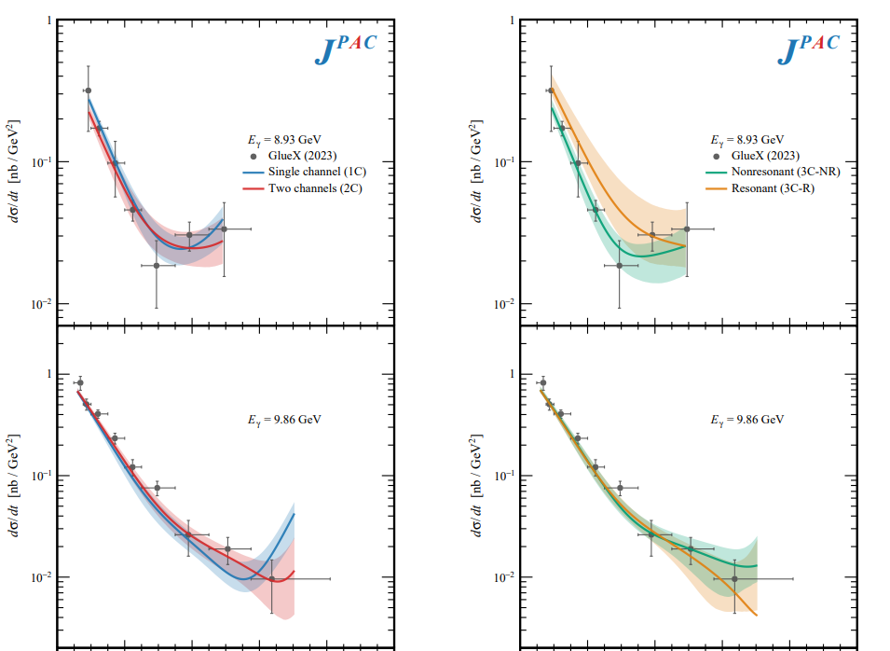
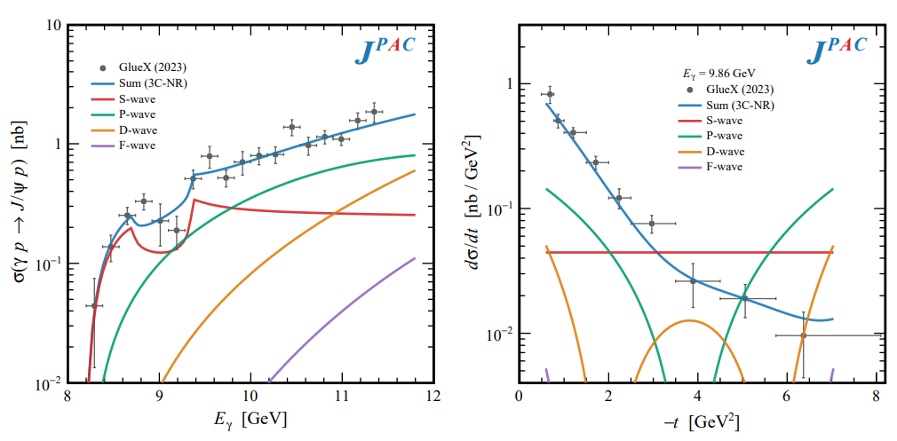
Differential cross section
This is realized with the interference of various waves, - constructive in the forward direction - distructive in the backward direction because of the Legendre polynomials
Good hierarchy between waves
A. Pilloni – Hadron Spectroscopy at the frontier of theory and experiment

Slide 36
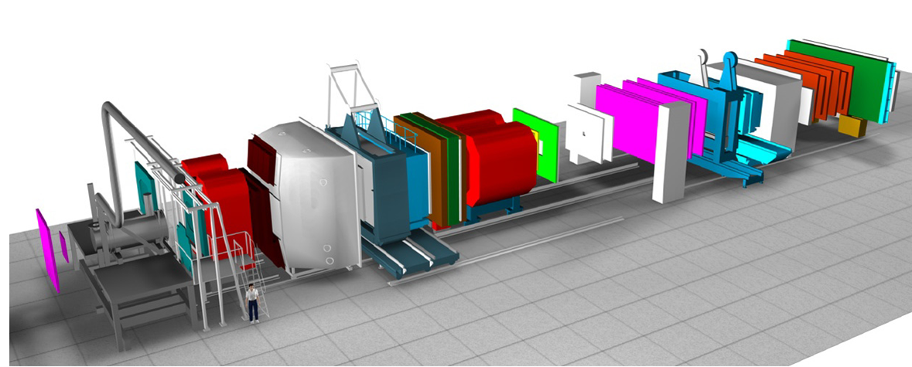
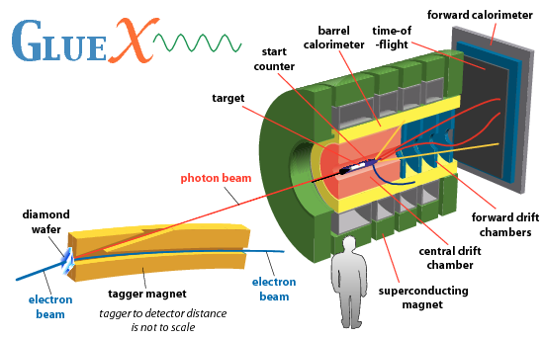
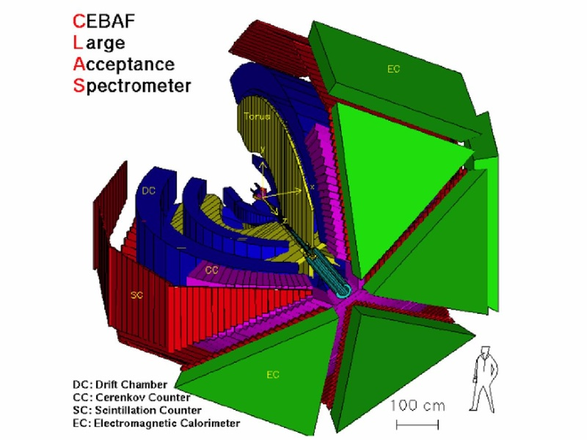
Spectroscopy from peripheral production
Need to establish Regge factorization
Single Regge pole dominate
A. Pilloni – Hadron Spectroscopy at the frontier of theory and experiment
Notes:
2 slides su Zc, a Bes e a Belle
2 slide su tetraquark model: dall’hamiltoniana di Jaffe al calcolo delle masse
1 slide su molecular models, dove sono i carichi? (non in Tornqvist, si in Hanhart, vedere Braaten, citare Nefediev)
2 slides su decay channels, dove si dovrebbe vedere, e a seconda del modello, vedere qualche plot
1 slide su Y(4260), tetraquark? C’è lo strano (si vede la f0)
1 slide su Zc a cleo (anche il neutro)

Slide 37
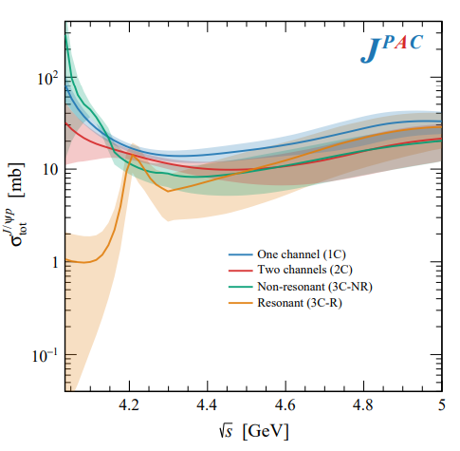
Total cross section
With optical theorem one gets the total cross section $J/ψ p→\text{X}$.
This has been estimated from the A-dependence of nuclear targets, $4\text{mb}$ at $\sqrt{s}=6.2 \text{GeV}$. VMD estimates provide values at least 1order of magnitude smaller
A. Pilloni – Hadron Spectroscopy at the frontier of theory and experiment

Slide 38
Options on the market
Quark-level calculations:
Quark models, pNRQCD, Hybrids, ...
Spectrum generally calculated as bound states of some potential
Decay rates as «overlap integrals» between two static configurations
Comprehensive picture ✓ Little scattering dynamics ✗
Hadron level calculations:
Microscopic models inspired to EFT + Unitarization
Compact states vs. molecules, triangles...
States as poles of scattering amplitudes
Couplings as residues at the poles
Scattering dynamics ✓ More case-by-case ✓✗
A. Pilloni – Hadron Spectroscopy at the frontier of theory and experiment

Slide 39
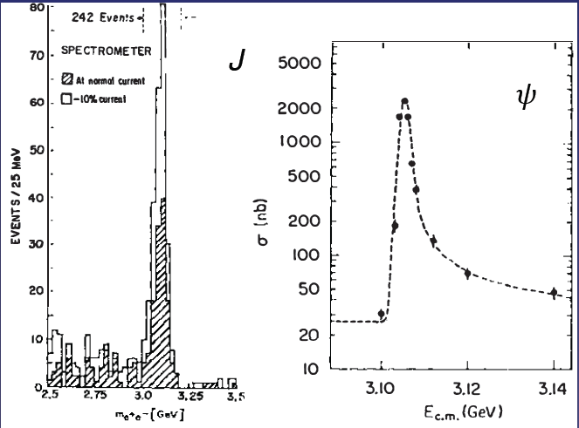
Quarkonium orthodoxy
$$Q$$
$$\overline{Q}$$
Potential models
(meaningful when $M_{Q}→∞$)
$$V\left(r\right)=−\frac{C_{F}α_{s}}{r}+σr$$
(Cornell potential)
$$α_{s}\left(M_{Q}\right)∼0.3$$
(perturbative regime)
OZI-rule, QCD multipole
Solve NR Schrödinger eq. → spectrum
Effective theories
(HQET, NRQCD, pNRQCD...)
Heavy quark spin flip suppressed by quark mass, approximate heavy quark spin symmetry (HQSS)
Integrate out heavy DOF
↓
(spectrum), decay & production rates
A. Pilloni – Hadron Spectroscopy at the frontier of theory and experiment
Notes:
2 slides su Zc, a Bes e a Belle
2 slide su tetraquark model: dall’hamiltoniana di Jaffe al calcolo delle masse
1 slide su molecular models, dove sono i carichi? (non in Tornqvist, si in Hanhart, vedere Braaten, citare Nefediev)
2 slides su decay channels, dove si dovrebbe vedere, e a seconda del modello, vedere qualche plot
1 slide su Y(4260), tetraquark? C’è lo strano (si vede la f0)
1 slide su Zc a cleo (anche il neutro)

Slide 40
Exotic landscape in $c\overline{c}$
Esposito, AP, Polosa, Phys.Rept. 668
JPAC, PPNP
A host of unexpected resonances have appeared
decaying mostly into charmonium + light Hardly reconciled with usual $q\overline{q}$ pheno
A. Pilloni – Hadron Spectroscopy at the frontier of theory and experiment
Notes:
2 slides su Zc, a Bes e a Belle
2 slide su tetraquark model: dall’hamiltoniana di Jaffe al calcolo delle masse
1 slide su molecular models, dove sono i carichi? (non in Tornqvist, si in Hanhart, vedere Braaten, citare Nefediev)
2 slides su decay channels, dove si dovrebbe vedere, e a seconda del modello, vedere qualche plot
1 slide su Y(4260), tetraquark? C’è lo strano (si vede la f0)
1 slide su Zc a cleo (anche il neutro)

Slide 41
Exotic landscape
Broad mesons seen in $b$ decay:
$X(4140)$, $Z(4430)$, $Z_{cs}(4000)$...
Narrow structures seen in $b$ decay:
$X\left(3872\right), P_{c}$, $(P_{cs})$
Scarce consistency between various production mechanisms
Narrow structures seen in $e^{+}e^{−}$:
$X(3872)$, $Y(4260)$, $Z_{c,b}^{(′)}$
A. Pilloni – Hadron Spectroscopy at the frontier of theory and experiment

Slide 42
Why photoproduction?
It’s new: no XYZ state has been uncontroversially seen so far
Rescattering mechanisms that could mimic resonances in multibody decays can be controlled better (one can change the energy beam but not the $B$ mass…)
The framework is (relatively) clean from a theory point of view
Radiative decays offer another way of discerning the nature of the states
A. Pilloni – Hadron Spectroscopy at the frontier of theory and experiment

Slide 43
Exclusive (quasi-real) photoproduction
XYZ have so far not been seen in photoproduction: independent confirmation
Not affected by 3-body dynamics: determination of resonant nature
Experiments with high luminosity in the appropriate energy range are promising
We study near-threshold (LE) and high energies (HE)
Couplings extracted from data as much as possible, not relying on the nature of XYZ
M. Albaladejo et al. [JPAC], PRD
$$<λ_{𝒬}λ_{N}^{′}|T|λ_{γ}λ_{N}>=\underset{V,ℰ}{∑}\frac{ef_{V}}{m_{V}}𝒯_{λ_{V}=λ_{γ},λ_{𝒬}}^{α_{1}⋯α_{j}}𝒫_{α_{1}⋯α_{j};β_{1}⋯β_{j}}ℬ_{λ_{N}λ_{N}^{′}}^{β_{1}⋯β_{j}}$$
VMD is used to couple the incoming photon to a vector quarkonium V
….we’ll come back to that!
A. Pilloni – Hadron Spectroscopy at the frontier of theory and experiment

Slide 44
Exclusive (quasi-real) photoproduction
XYZ have so far not been seen in photoproduction: independent confirmation
Not affected by 3-body dynamics: determination of resonant nature
Experiments with high luminosity in the appropriate energy range are promising
We study near-threshold (LE) and high energies (HE)
Couplings extracted from data as much as possible, not relying on the nature of XYZ
M. Albaladejo et al. [JPAC], PRD
$$<λ_{𝒬}λ_{N}^{′}|T|λ_{γ}λ_{N}>=\underset{V,ℰ}{∑}\frac{ef_{V}}{m_{V}}𝒯_{λ_{V}=λ_{γ},λ_{𝒬}}^{α_{1}⋯α_{j}}𝒫_{α_{1}⋯α_{j};β_{1}⋯β_{j}}ℬ_{λ_{N}λ_{N}^{′}}^{β_{1}⋯β_{j}}$$
Top vertex from measured $𝒬→Vℰ$ decay width
A. Pilloni – Hadron Spectroscopy at the frontier of theory and experiment

Slide 45
Exclusive (quasi-real) photoproduction
XYZ have so far not been seen in photoproduction: independent confirmation
Not affected by 3-body dynamics: determination of resonant nature
Experiments with high luminosity in the appropriate energy range are promising
We study near-threshold (LE) and high energies (HE)
Couplings extracted from data as much as possible, not relying on the nature of XYZ
M. Albaladejo et al. [JPAC], PRD
$$<λ_{𝒬}λ_{N}^{′}|T|λ_{γ}λ_{N}>=\underset{V,ℰ}{∑}\frac{ef_{V}}{m_{V}}𝒯_{λ_{V}=λ_{γ},λ_{𝒬}}^{α_{1}⋯α_{j}}𝒫_{α_{1}⋯α_{j};β_{1}⋯β_{j}}ℬ_{λ_{N}λ_{N}^{′}}^{β_{1}⋯β_{j}}$$
Bottom vertex from standard photoproduction pheno, exponential form factors to further suppress large t
A. Pilloni – Hadron Spectroscopy at the frontier of theory and experiment

Slide 46
Threshold vs. high energy
Fixed-spin exchanges expected to hold in the low energy region
$t$ channel grows as $s j$, exceeding unitarity bound, Regge physics kicks in: Reggeized tower of particles with arbitrary spin at HE
$$s^{j}⟶s^{α_{0}+α^{′}t }$$
Holds at low energy, fixed spin
Holds at high energy, resummation of leading $s$ power
If $ε≠$IP, $α_{0}<1$, $dσ/dt$ decreases with energy
Exchange of heavy particles further suppressed
A. Pilloni – Hadron Spectroscopy at the frontier of theory and experiment

Slide 47
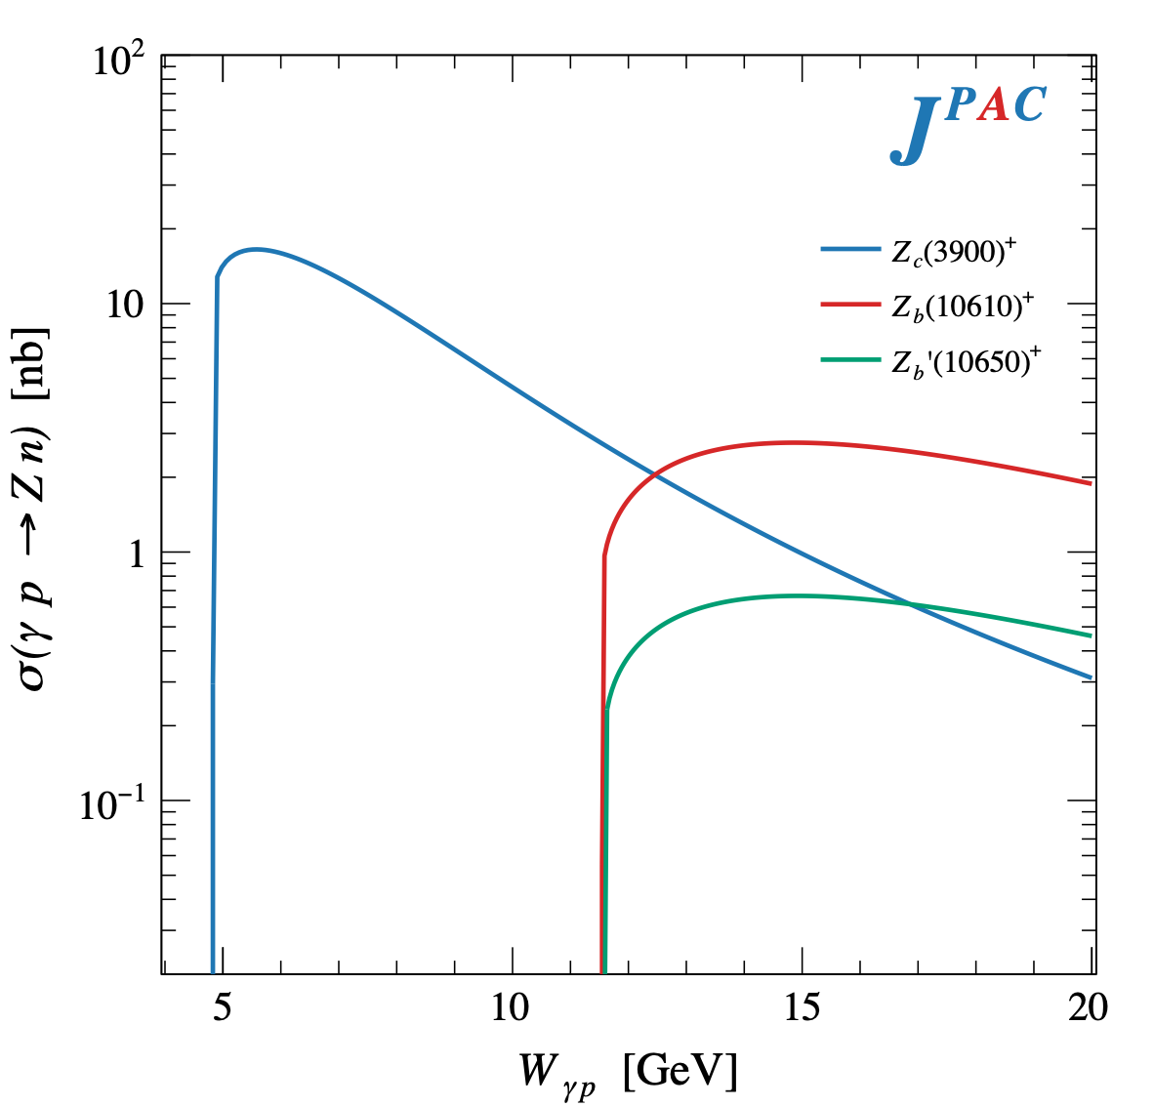
$Z$ photoproduction
The $Zs$ are charged charmoniumlike $1^{+−}$ states close to open flavor thresholds
Focus on $Z_{c}{\left(3900\right)}^{+}→J/ψ π^{+}$, $Z_{b}{\left(10610\right)}^{+},Z_{b}^{′}{\left(10650\right)}^{+}→Υ(nS) π^{+}$
The pion is exchanged in the $t$-channel
A. Pilloni – Hadron Spectroscopy at the frontier of theory and experiment

Slide 48
$X$ photoproduction
Focus on the famous $1^{++} X\left(3872\right)→J/ψ ρ,ω$
𝛚 and 𝛒 exchanges give main contributions:
Large theory uncertainty in the intermediate region
A. Pilloni – Hadron Spectroscopy at the frontier of theory and experiment

Slide 49
Semi-inclusive photoproduction
Semi-inclusive cross sections are typically larger
For small $t$ and large $x$, one can assume the process to be dominated by pion exchange
The bottom vertex depends on the (known) pion-proton total cross section
The pion is exchanged in the $t$-channel
Model benchmarked on $b_{1}$ production
Model underestimates lower bins, conservative estimates
The model is expected to hold in the highest bin
A. Pilloni – Hadron Spectroscopy at the frontier of theory and experiment

Slide 50
Semi-inclusive photoproduction
For the $Z_{c}^{+}$, the inclusive cross section is sizably larger than the exclusive process
$$Z_{c}^{−}Δ^{++}$$
$$Z_{c}^{+}n$$
A. Pilloni – Hadron Spectroscopy at the frontier of theory and experiment

Slide 51
Semi-inclusive photoproduction
At higher energies the triple Regge regime is reached, cross sections saturate
A. Pilloni – Hadron Spectroscopy at the frontier of theory and experiment

Slide 52
Hybrid hunting
Constituent gluon (quasiparticle excitation), $J^{PC}=1^{+−}$, mass $∼1.0\text{−}1.5 \text{GeV}$
Look for a $π_{1}$ state with $J^{PC}=1^{−+}$
decaying into $\left\{\begin{matrix}η π \text{and} η^{′}π \\ ρ π→3π \\ b_{1}π→5π\end{matrix}\right.$
$$\overline{r}$$
$$\overline{g}$$
$$r$$
$$g$$
A. Pilloni – Hadron Spectroscopy at the frontier of theory and experiment
Notes:
2 slides su Zc, a Bes e a Belle
2 slide su tetraquark model: dall’hamiltoniana di Jaffe al calcolo delle masse
1 slide su molecular models, dove sono i carichi? (non in Tornqvist, si in Hanhart, vedere Braaten, citare Nefediev)
2 slides su decay channels, dove si dovrebbe vedere, e a seconda del modello, vedere qualche plot
1 slide su Y(4260), tetraquark? C’è lo strano (si vede la f0)
1 slide su Zc a cleo (anche il neutro)

Slide 53
Amplitudes for $η^{(′)}π$
We build the partial wave amplitudes according to the $N/D$ method
Jackura, Mikhasenko, AP et al. (JPAC & COMPASS), PLB
Rodas, AP et al. PRL
$$a\left(s\right)=\frac{n\left(s\right)}{D\left(s\right)}$$
$$D(s)$$
The $D(s)$ contains all the Final State Interactions constrained by unitarity → universal
A. Pilloni – Hadron Spectroscopy at the frontier of theory and experiment
Notes:
Controlla la parte su Regge

Slide 54
Amplitudes for $η^{(′)}π$
We build the partial wave amplitudes according to the $N/D$ method
Jackura, Mikhasenko, AP et al. (JPAC & COMPASS), PLB
Rodas, AP et al. PRL
$$a\left(s\right)=\frac{n\left(s\right)}{D\left(s\right)}$$
$$D(s)$$
$$n(s)$$
The $n\left(s\right)$ → background physics, process-dependent, smooth
A. Pilloni – Hadron Spectroscopy at the frontier of theory and experiment
Notes:
Controlla la parte su Regge

Slide 55
Fit to $η^{(′)}π$
( data)
$$π_{1}\left(1400\right)?$$
$$a_{2}\left(1320\right)$$
$$a_{2}^{′}\left(1700\right)$$
$$π_{1}\left(1600\right)?$$
$$a_{2}\left(1320\right)$$
$$a_{2}^{′}\left(1700\right)$$
$$J^{PC}=1^{−+}$$
$$J^{PC}=2^{++}$$
A. Pilloni – Hadron Spectroscopy at the frontier of theory and experiment
Notes:
Controlla la parte su Regge

Slide 56
Pole hunting
( data)
$$π_{1}$$
$$π_{1}$$
A. Pilloni – Hadron Spectroscopy at the frontier of theory and experiment
Notes:
Controlla la parte su Regge

Slide 57
Final results
Agreement with Lattice is restored
That’s the most rigorous extraction of an exotic meson available so far!
A. Pilloni – Hadron Spectroscopy at the frontier of theory and experiment
Notes:
Controlla la parte su Regge

Slide 58
Primakoff X photoproduction
Using measurement of $Γ(X→γγ^{∗})$ from Belle, one can get predictions for Primakoff
Makes use of ion targets, enhancement of cross sections as $Z^{2}$
A. Pilloni – Hadron Spectroscopy at the frontier of theory and experiment

Slide 59
$Y$ (vector) photoproduction
Diffractive production, dominated by Pomeron (2-gluon) exchange
Existing data allow to put a 95% upper limit on the ratio of $ψ′/Y(4260)$ yields
Assuming previous formula, one gets: $Γ_{ee}^{Y}=930 eV$
(cfr. hep-ex/0603024, 2002.05641)
$BR\left(Y→J/ψππ\right)=0.96\%$
$R_{Y}=0.84$
$$R_{Y}=\frac{ef_{ψ}}{m_{ψ}}\sqrt{\frac{g^{2}(Y→ψππ)}{g^{2}(ψ→γgg)}\frac{g^{2}(ψ^{′}→ψgg)}{g^{2}(ψ^{′}→ψππ)}}$$
A. Pilloni – Hadron Spectroscopy at the frontier of theory and experiment

Slide 60
$Y$ (vector) photoproduction
Focus on the $1^{−−} Y\left(4260\right)→J/ψ π^{+}π^{−}$, check with $ψ′→J/ψ π^{+}π^{−}$
Diffractive production, dominated by Pomeron (2-gluon) exchange
Good candidates for EIC: diffractive production increases with energy!
We have $γψ$-pomeron coupling from our analyses 1606.08912, 1907.09393
How to rescale from $J/ψ$ to $ψ′$ ?
$$R_{ψ^{′}}=\sqrt{\frac{g^{2}(ψ^{′}→γgg)}{g^{2}(ψ→γgg)}}∼0.55$$
$$g^{2}(ψ→γgg)=\frac{6m_{ψ}ℬ(ψ→γgg)Γ_{ψ}}{PS(ψ→γgg)}$$
A. Pilloni – Hadron Spectroscopy at the frontier of theory and experiment

Slide 61
$Y$ (vector) photoproduction
Focus on the $1^{−−} Y\left(4260\right)→J/ψ π^{+}π^{−}$, check with $ψ′→J/ψ π^{+}π^{−}$
Diffractive production, dominated by Pomeron (2-gluon) exchange
Good candidates for EIC: diffractive production increases with energy!
We have $γψ$-pomeron coupling from our analyses 1606.08912, 1907.09393
How to rescale from $J/ψ$ to $Y(4260)$ ?
We assume VMD and $g^{2}\left(Y→ψππ\right)=g^{2}\left(Y→ψgg\right)×g^{2}(gg→ππ)$ (Novikov & Shifman)
$$R_{Y}=\frac{ef_{ψ}}{m_{ψ}}\sqrt{\frac{g^{2}(Y→ψππ)}{g^{2}(ψ→γgg)}\frac{g^{2}(ψ^{′}→ψgg)}{g^{2}(ψ^{′}→ψππ)}}$$
Caveat : $BR(Y→ψππ)$ only known times the leptonic width $Γ_{ee}^{Y}$
A. Pilloni – Hadron Spectroscopy at the frontier of theory and experiment

Slide 62
$Y$ (vector) photoproduction
Data from H1 hep-ex/971112
Existing data allow to put a 95% upper limit on the ratio of $ψ′/Y(4260)$ yields
Assuming previous formula, one gets: $Γ_{ee}^{Y}=930 eV$
(cfr. hep-ex/0603024, 2002.05641)
$BR\left(Y→J/ψππ\right)=0.96\%$
$R_{Y}=0.84$
A. Pilloni – Hadron Spectroscopy at the frontier of theory and experiment

Slide 63
Minimal(istic) model for $P_{c}(4312)$
( data)
Fernandez-Ramirez, AP et al. (JPAC), PRL 123, 092001
Effective range expansion We can set $c_{ii}=0$ to reduce to the scattering length approximation
$$c_{ii}=0$$
Finite $c_{ii}$
A. Pilloni – Hadron Spectroscopy at the frontier of theory and experiment
Notes:
2 slides su Zc, a Bes e a Belle
2 slide su tetraquark model: dall’hamiltoniana di Jaffe al calcolo delle masse
1 slide su molecular models, dove sono i carichi? (non in Tornqvist, si in Hanhart, vedere Braaten, citare Nefediev)
2 slides su decay channels, dove si dovrebbe vedere, e a seconda del modello, vedere qualche plot
1 slide su Y(4260), tetraquark? C’è lo strano (si vede la f0)
1 slide su Zc a cleo (anche il neutro)

Slide 64
Minimal(istic) model for $P_{c}(4312)$
Effective range expansion We can set $c_{ii}=0$ to reduce to the scattering length approximation
$$c_{ii}=0$$
Finite $c_{ii}$
A. Pilloni – Hadron Spectroscopy at the frontier of theory and experiment
Notes:
2 slides su Zc, a Bes e a Belle
2 slide su tetraquark model: dall’hamiltoniana di Jaffe al calcolo delle masse
1 slide su molecular models, dove sono i carichi? (non in Tornqvist, si in Hanhart, vedere Braaten, citare Nefediev)
2 slides su decay channels, dove si dovrebbe vedere, e a seconda del modello, vedere qualche plot
1 slide su Y(4260), tetraquark? C’è lo strano (si vede la f0)
1 slide su Zc a cleo (anche il neutro)

Slide 65
Minimal(istic) model for $P_{c}(4312)$
Effective range expansion We can set $c_{ii}=0$ to reduce to the scattering length approximation
Points to a virtual state
Doesn’t point to a resonance
$$c_{ii}=0$$
Finite $c_{ii}$
A. Pilloni – Hadron Spectroscopy at the frontier of theory and experiment
Notes:
2 slides su Zc, a Bes e a Belle
2 slide su tetraquark model: dall’hamiltoniana di Jaffe al calcolo delle masse
1 slide su molecular models, dove sono i carichi? (non in Tornqvist, si in Hanhart, vedere Braaten, citare Nefediev)
2 slides su decay channels, dove si dovrebbe vedere, e a seconda del modello, vedere qualche plot
1 slide su Y(4260), tetraquark? C’è lo strano (si vede la f0)
1 slide su Zc a cleo (anche il neutro)

Slide 66
Glueballs
The clearest sign of confinement in pure Yang-Mills The worst state to search in real life
Morningstar and Peardon PRD60, 034509
Gregory et al. JHEP1210, 170
A. Pilloni – Hadron Spectroscopy at the frontier of theory and experiment

Slide 67
$J/ψ→γ π^{0}π^{0} and→γ K_{S}^{0}K_{S}^{0}$
We consider the $S$ and $D$ wave by BESIII to use the information about their relative phase.
The D-wave is populated by two almost elastic resonances: the $f_{2}(1270)$ and $f_{2}′(1525)$
$f_{2}(1270)$
$f_{2}′(1525)$
A. Pilloni – Amplitude analysis of $J/ψ→γ π^{0}π^{0}$

