Slide 1



Design and qualification of a distributed readout system for multidetector arrays
Yuri Venturini (y.venturini@caen.it)
Notes:
Good Afternoon everybody, let me thank first of all the organizers of this Summer School for inviting CAEN to present in this industrial session and also thank you to all of you attending. My name is Yuri Venturini and I am an application scientisti in CAEN. CAEN is an Italian electronics provider for the Particle and Nuclear Physics community, in particualr we supply solutions for the power and readout of many detectors used in Physics Research. Today we will focus on the electronics for Neutron Detection and as Paul remarked just at the beginnin of the previous lecture, I would like to give you a perspective on how we see, as a commercialy company, the needs of neutron facilities users and how we try to develop electronics that is always at the forefront of the scientists’ needs in this field of application.

Slide 2
Overview
New challenges of NP / HEP experiments
Building a standard for the electronics:
      64 ch SiPM frontend
      64/128 ch. TDC
      64 ch frontend for low gain detectors (SDD, GEMs, PIN diodes , …)
Qualification in calorimetry, muon tomography and gamma imaging
TDC unit with high-timing resolution, walk correction and amplitude reconstruction

Slide 3
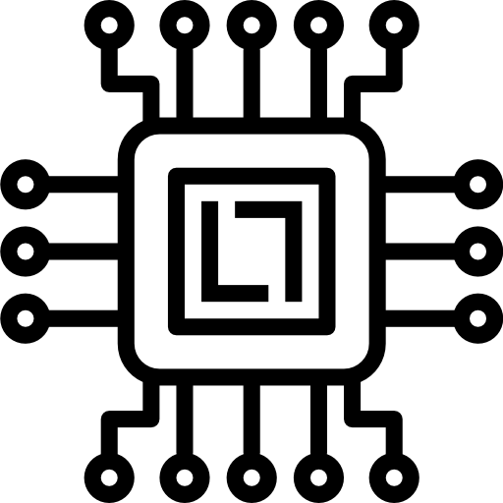



Challenges of new experiments
Miniaturization
Dense and compact solutions based on ASICs
Big data
Online processing and event building
Readout speed
→ 1 GB/s target
High channel count
Easy-scalability

Slide 4






Building a standard
ASICs for the readout of multi-detector systems in NP and HEP applications widely available from research groups and spin-off companies
The surrounding electronics and the relevant software must be redesigned and adapted for the specific application
Design of versatile modules facilitating the integration of ASICs, ensuring their adaptability across diverse applications through comprehensive hardware and software provision.
Design of Readout Electronics and Power Supply
COTS ASICs

Slide 5
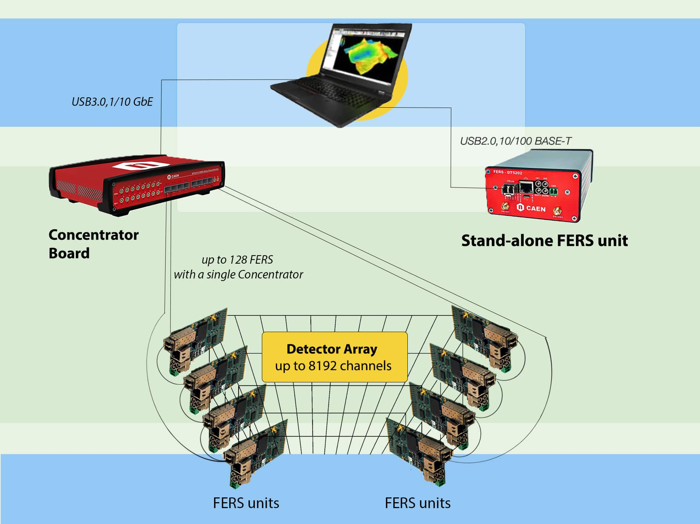
FERS-5200
Slow control
Statistics and Spectra
Jobs and Runs
Data saving
Janus software
Modular and Distributed readout of large arrays of detectors
Compact FERS units based on ASICs → front-end + digital
Concentrator Board to manage multiple FERS units
TDlink: 3.125 Gb/s Optical link providing Readout, Slow Control, Synchronization → Easy-scalability
Janus software to control the whole system and make standard DAQ
Notes:
Ok, I have concluded this first slot focused on the CAEN Digitizers, here we switch to another hardware, but still keeping in mind the motivations that I highlighted at the beginning of the talk, that is how to bring flexibility into the hardware when coming to readout protocol , synchronization and interface with external hardware or software.
With respect to the Digitizers, here we present a complete different approach based on ASICs and not on flash ADCs. We developed a platform called FERS-5200 that is a modular readout system for large arrays of detector. It is based on compact front-end cards, hosting the front-end ASIC, A/D conversion and readout interfaces. These compact cards can be spread on a large surface or a large volume, that is on the detector of the experiment, can be connected near to the detector and then, they can be all readout at once through a Concentrator board, that is far away from the detector. The front-end cards and the Concentrator communicate each other using optical fibers, so that up to 16 FERS units can be daisy-chained and readout by a single optical link of the Concetrator. The concentrator has 8 optical links, meanining that it is possible to scale the system to several thousands of channels. The readout protocol going over fiber is a proprietary protocol, called TDLink, that serves as readout and synchronization of the FERS units at once. We will focus on this protocol in the following slide. The concentrator board, in addition, has an embedded ARM, that allows to run middleware onboard for event building, data reduction, etcetera ….
You can see that this platform is very versatile, as you can connect a single fers unit directly to a PC, for example to evaluate its performance in the R&D phase, and then you can expand the system by adding as many FERS units as you need to read out your detector, while the Concentrator board automatically manages readout and synchronization, far away from the detector.

Slide 6
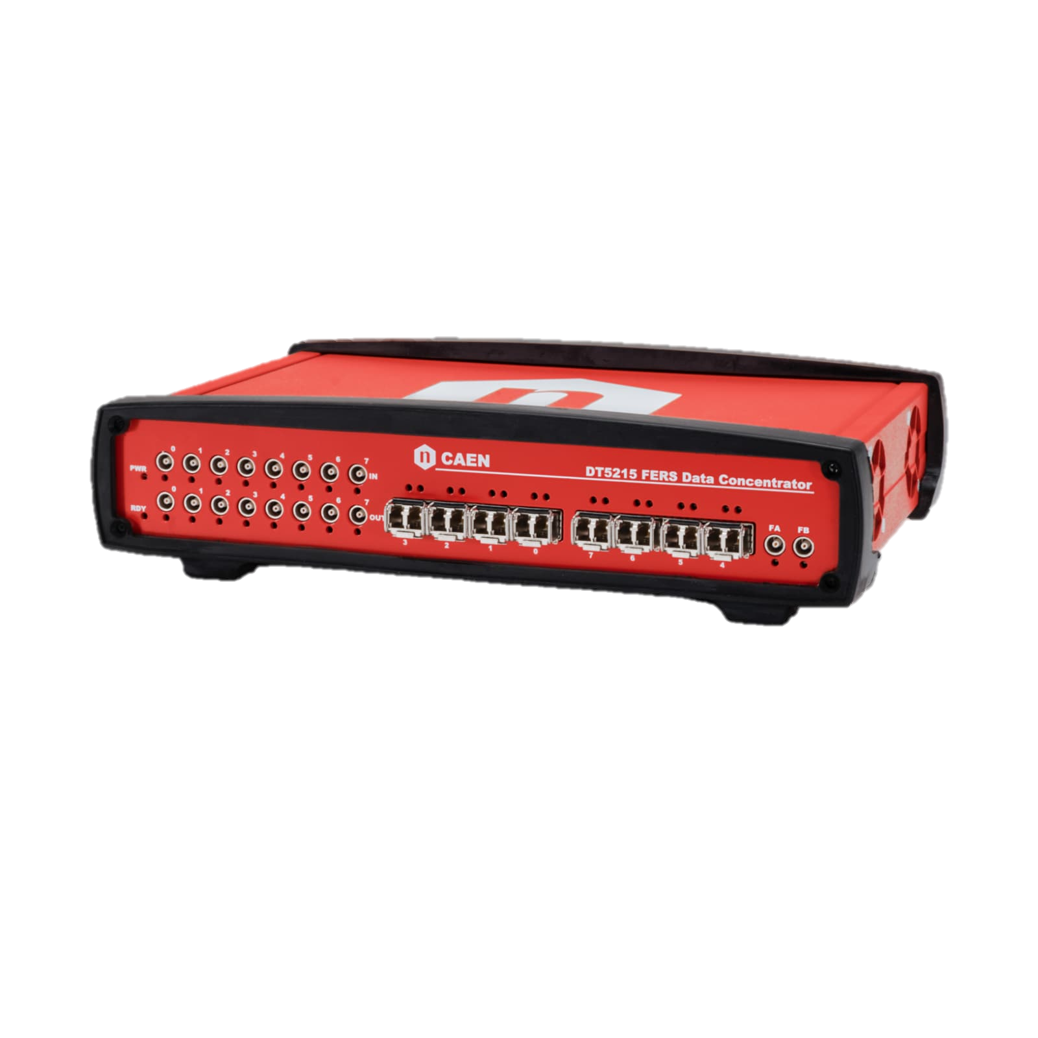
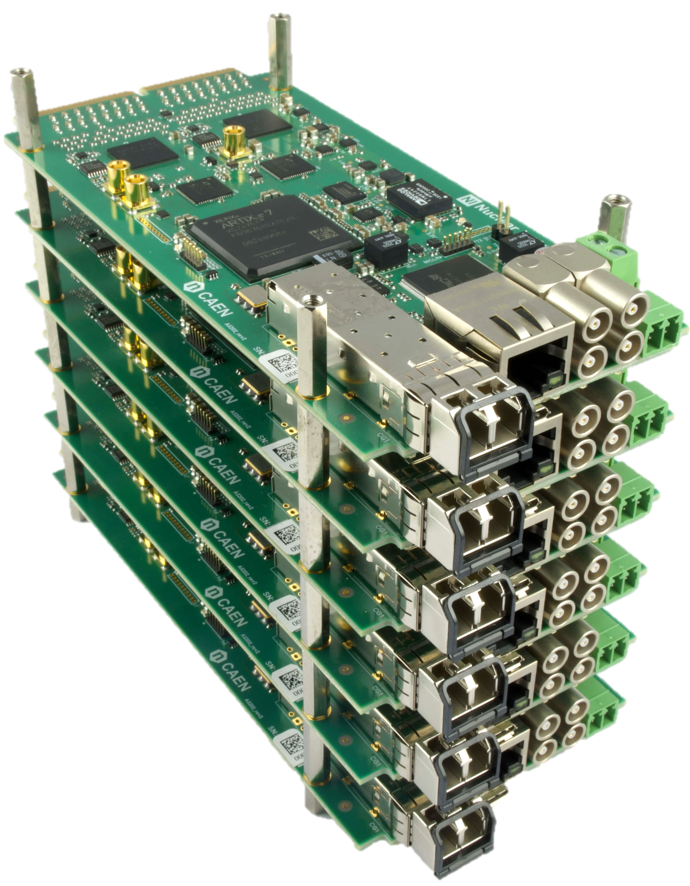
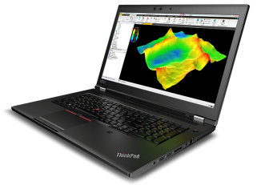
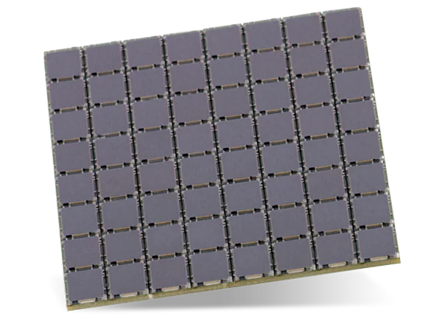
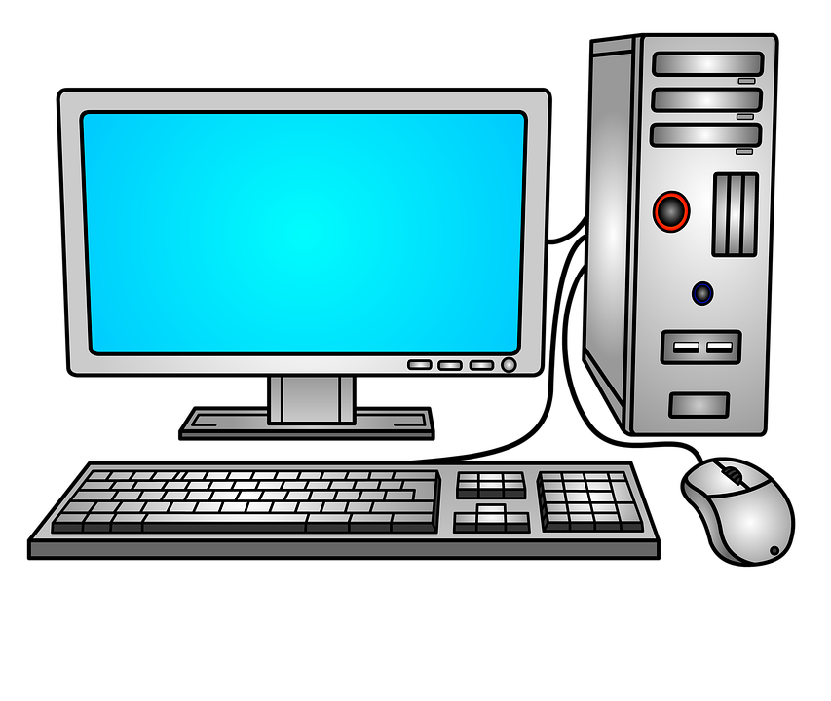

FERS-5200: block diagram
Direct Connect: easy but slow (~2 MB/s)
up to 128 FE cards
ETH 10/100T
USB 2.0
DETECTOR SPECIFIC
COMMON INFRASTRUCTURE
ASIC:
PREAMP
SHAPER
DISCRIM
ADC
ACQ
LOGIC
READOUT
INTERF
TRIGGERS
MEM
Concentrator
DT5215
1 GbE
TDC
TDlink
10 GbE
USB 3.0
CONFIG
SYNC
HV BIAS
Global Time
A520x
TDlink: Multi-board Readout + Sync + Config
Up to 300 MB/s

Slide 7
A5202: 64 channel SiPM readout
Notes:
This is the scheme of the A5202 with CITIROC: …………

Slide 8

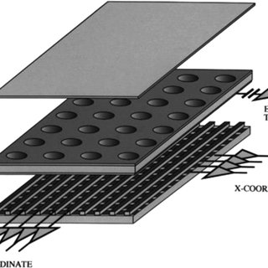


FERS Roadmap
GEMs, Si strip
and other low gain detectors
3 ps TDC
Weeroc Radioroc +
CERN picoTDC
Weeroc Citiroc
What’s next?
A5202
A5204
pin-to-pin compatible Weeroc chips
(e.g. MA-PMT…)
Switched Capacitor Arrays for high speed Waveform Digitizers (Nalu)
and others…
A5203
A5205
CERN picoTDC
Weeroc Psiroc +
CERN picoTDC
SiPM
SiPM

Slide 9


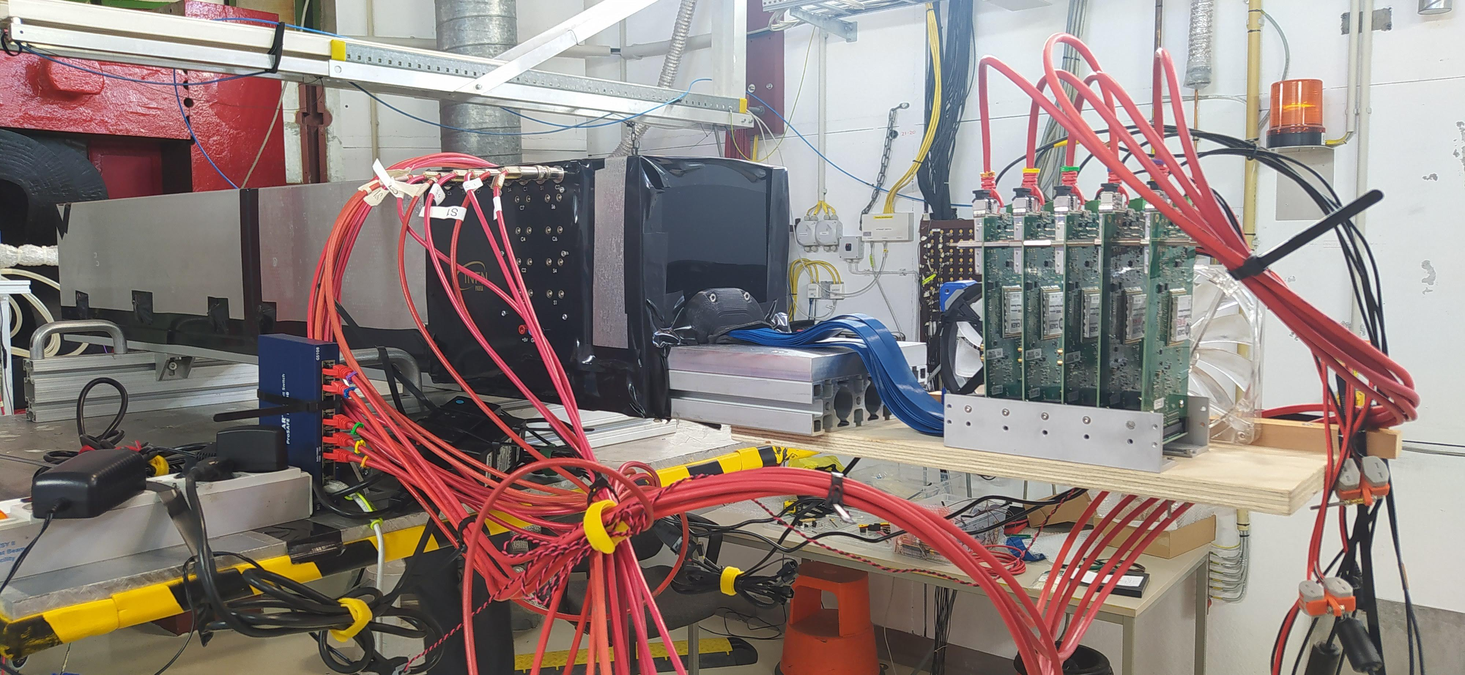
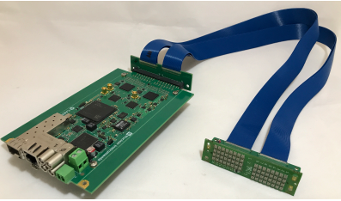
IDEA – dual-readout calorimeter
Dual readout highly granular calorimeter based on SiPM
Successful qualification of a module on beam with EM shower containment @Desy (June 2021) and @CERN (August 2021)
Plans to scale-up the system to handle more SiPMs for hadronic containment
320 SiPM = 5 A5202s
No Concentrator
Sync via LEMO cable
Custom SiPM holder with remotization cable
Courtesy of R. Santoro

Slide 10
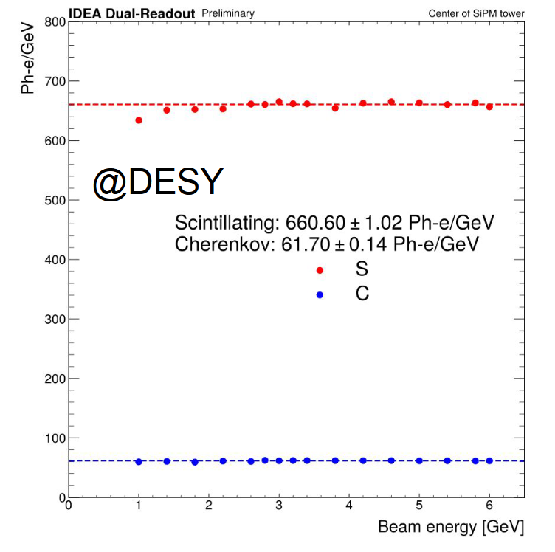
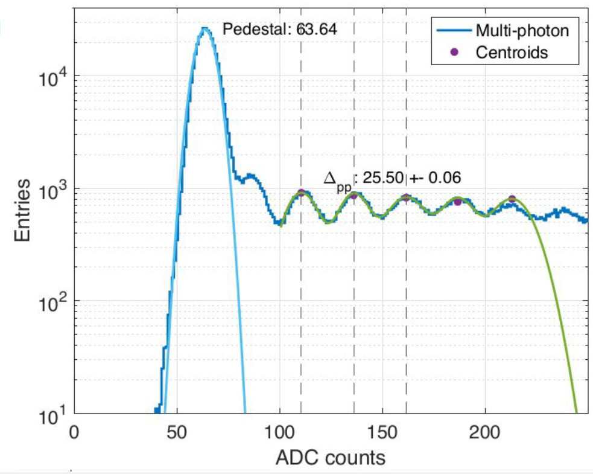
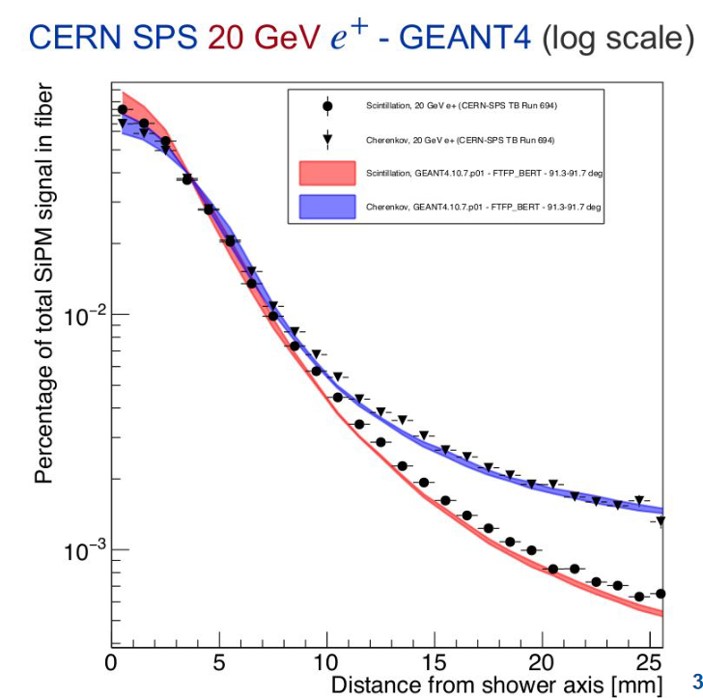
IDEA – dual-readout calorimeter
SiPM calibration in Ph-e
Calorimeter linearity
EM shower reconstruction
Each bar coupled to Hamamatsu 1.3x1.3 mm² SiPM.
https://doi.org/10.1016/j.nima.2022.167964
Notes:
Just to show some results they obtained, there were able to use the A5202 for SiPM calibration and calorimeter linearity measurements. And as you can see in these two plots, they achieved excellent results in the measurements of EM shower cointainment.

Slide 11

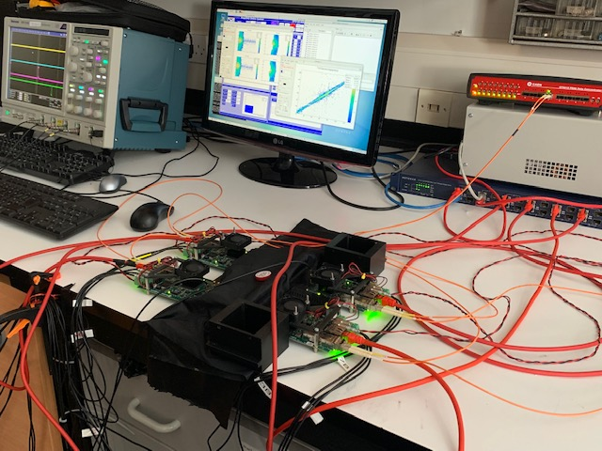
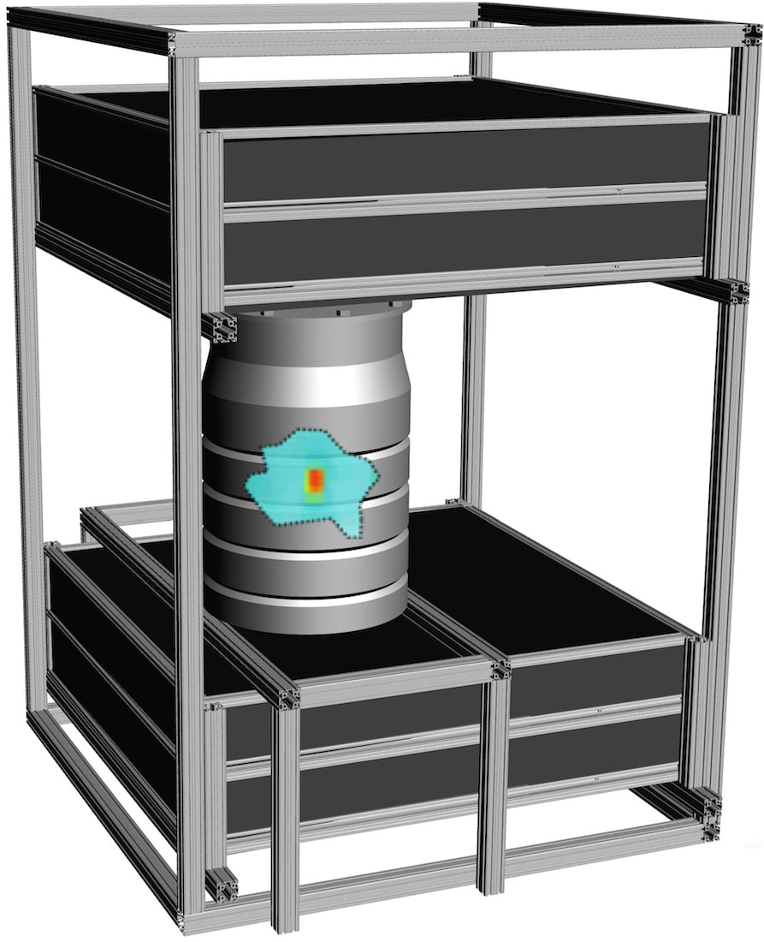
Muon tomography - nuclear waste
Muon tomography scanner, suitable for nuclear waste characterization, by Lynkeos Technology (Scotland)
First design with MA-PMTs successfully deployed at Sellafield site (UK)
Upgrading to SiPMs detectors in 2022 – readout electronics based on FERS A5202 (CITIROC)
1024 fibers + SiPMs
16 A5202s + 1 DT5215
~ 1m x 1m active area
  First-of-a-kind muography for nuclear waste characterization
  D. Mahon et al.
  Philos. Trans. R. Soc. A, 377 (2018), p. 0048, 10.1098/rsta.2018.0048

Slide 12

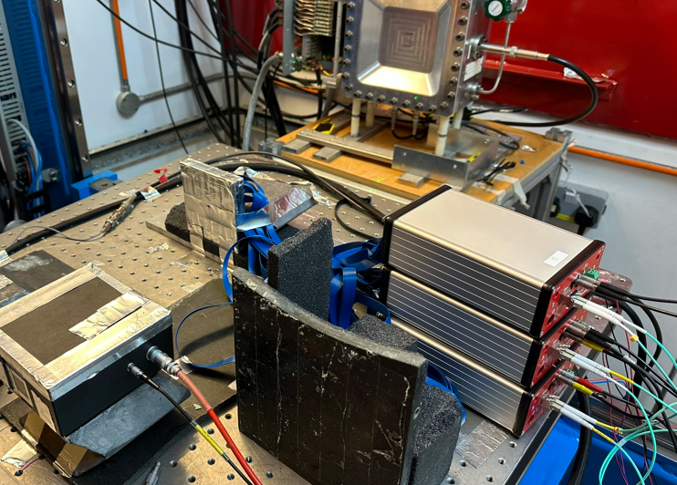
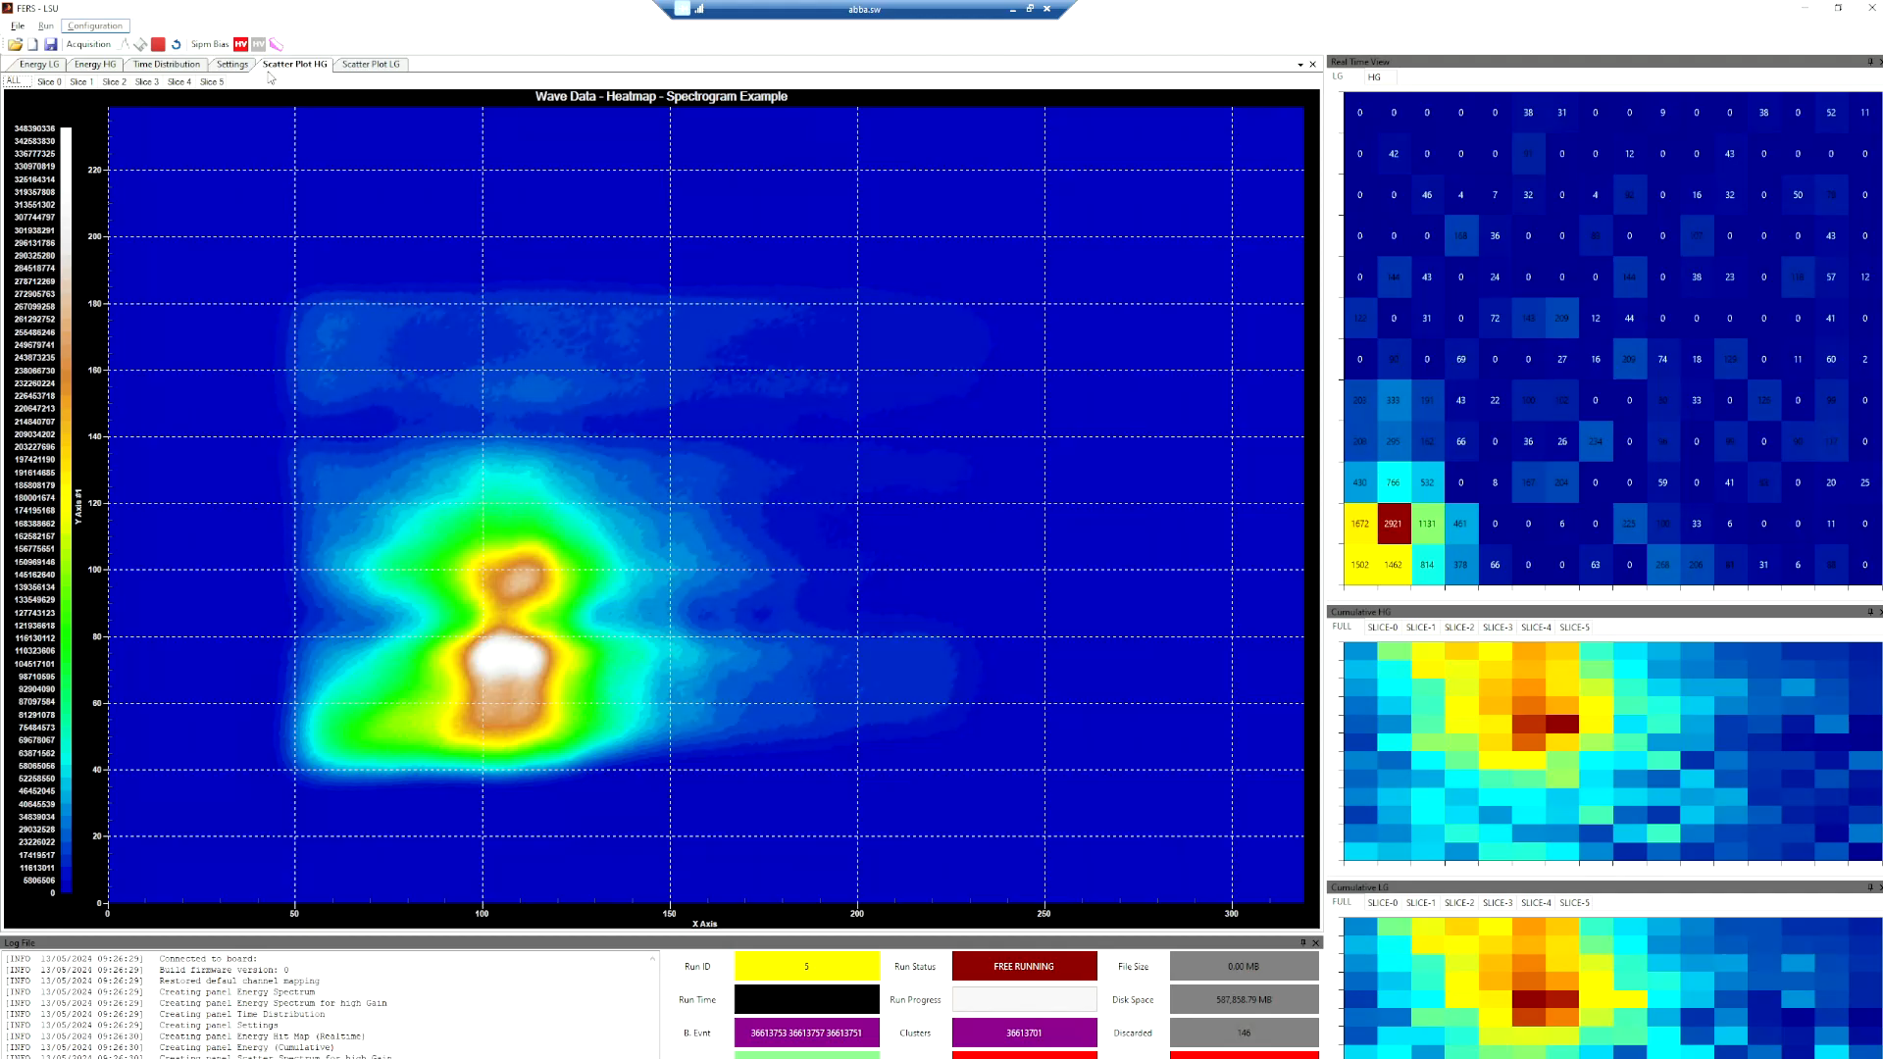
Neutron anger camera
Based on GS20 scintillators
6x6 mm SiPMs, 16x12 array (192 channels)
3 DT5202 + 1 DT5215 Concentrator
Center of Mass
SiPM Heat Map
Majority trigger
Gamma discrimination based on Energy Cut
< 1 mm spatial resolution

Slide 13
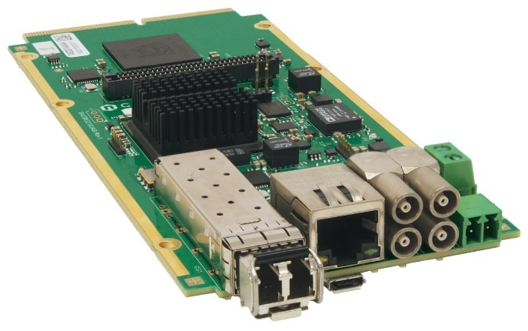
A5203: 64 channel 3 ps TDC
64-channels TDC unit for extremely high-resolution applications housing CERN picoTDC ASIC
Timing resolution LSB = 3.125 ps, RMS typ. 7 ps
LVDS-compliant input → possible coupling with external discriminator output or custom front-end
Acquisition of rising/falling edge timestamps → ToA and ToT
Notes:
This is the scheme of the A5202 with CITIROC: …………

Slide 14
ToT used for PHA and CFD
picoTDC: high timing resolution (~ 5 ps), high channel density, almost no dead time
But…
  need separate ADC readout chain to acquire energy information (PHA)
  picoTDC has no Front-End: need external fast discriminator (e.g. CAEN A5256)
picoTDC provides both Time of Arrival (ToA) and Time over Threshold (ToT) in one word
ToT can be used to reconstruct pulse amplitude
ToT – PHA curve is not linear => need calibration (pulse shape dependent)
ToT can be used to correct for time walk => no need of Constant Fraction Discriminator in hardware
Ongoing feasibility study of the ToT technique for the readout of 5000 PMTs in SAND (DUNE)

Slide 15
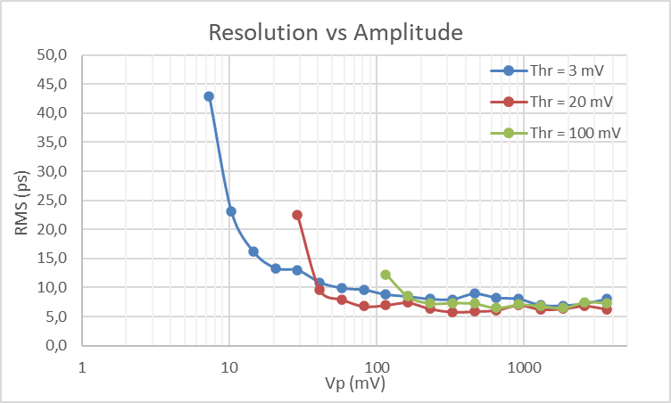
Walk degrades resolution
Start: 500 mV, 50 ns width, 0.8 ns rise
Stop: variable amplitude, 1.5 ns width, 0.8 ns rise
Notes:
The walk is the variation of the time measurement (from start to stop) as a function of the amplitude. This variation can reach several hundred of ps or even a few ns for slow signals. The time resolution obtained from pulses of variable amplitude is totally dominated by the effect due to the walk. It is therefore essential to correct the measurements for the walk to have a good resolution. The walk correction is often achieved by means of the Constant Fraction Discriminators (CFD), but this technique is rather complicated and difficult to tune.

Slide 16
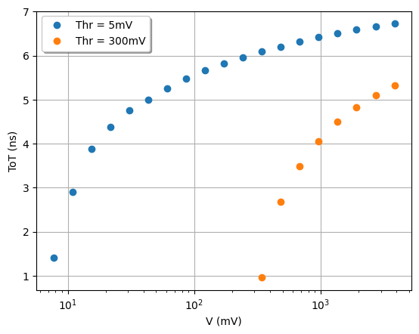
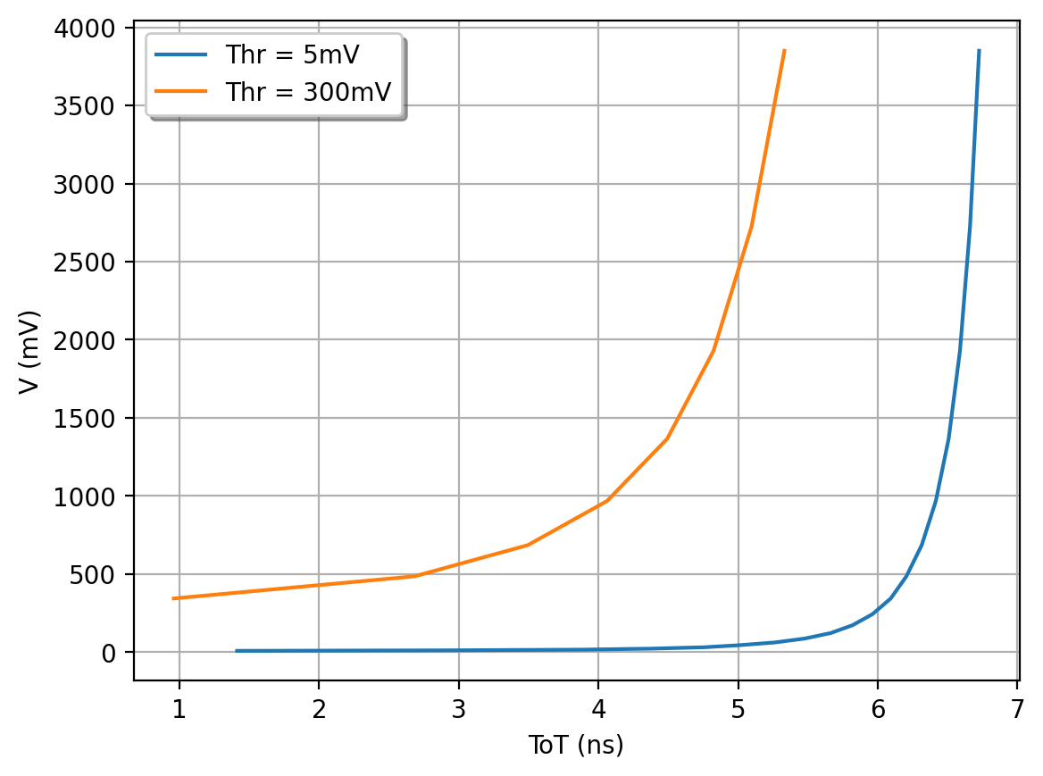
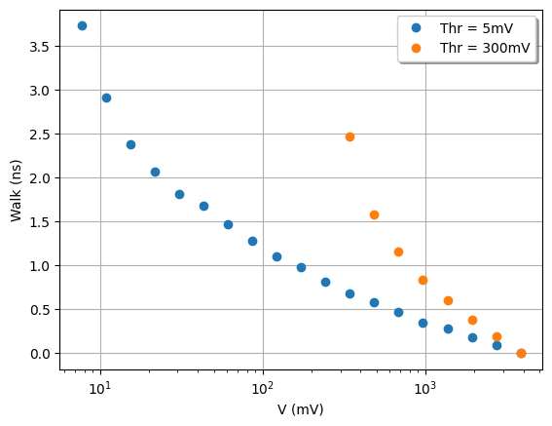
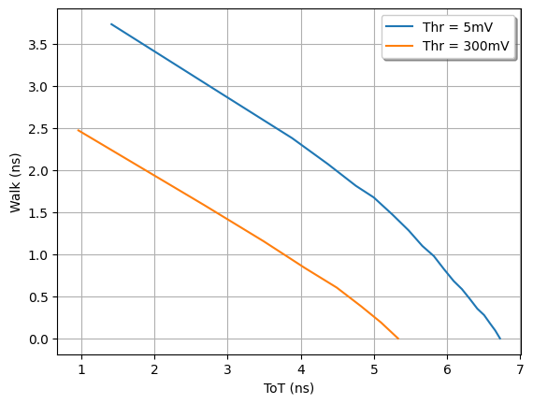
ToT calibration curves (double threshold)
Amp-ToT
ToT-Amp
Curve Fit
Amp-Walk
ToT-Walk
Notes:
ToT → Amplitude → Walk estimate
The Walk-vs-ToT curve can be fitted with a polynomial and used to apply the walk correction in the deltaT measurement.

Slide 17
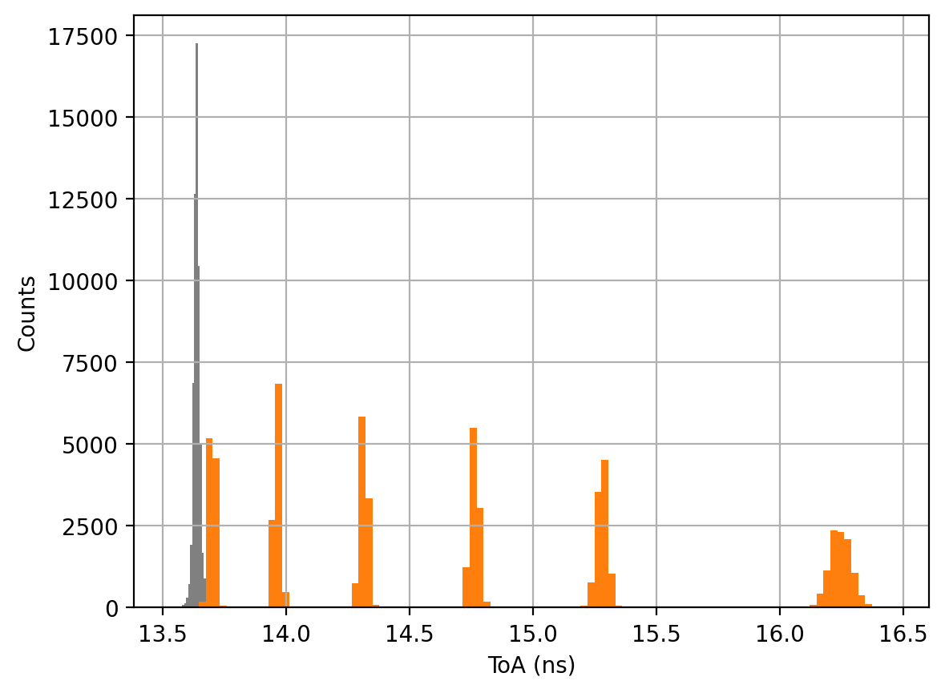
Walk Correction
Acquired pulses at 6 different amplitudes over a 50 dB dynamic range
The walk causes ~3 ns spread on ΔT:
6 separate peaks appear on the histogram. Timing resolution totally destroyed!
ΔT corrected by ToT using a 5th order polynomial fit of the ToT-Walk points taken at threshold = 5 mV
Corrected ΔT histogram presents one single peak:
18 ps RMS over 50 dB dynamic range
Walk Corrected Peak: σ=18 ps
3850 mV
1217 mV
385 mV
122 mV
38 mV
12 mV
ΔT (ns)

Slide 18
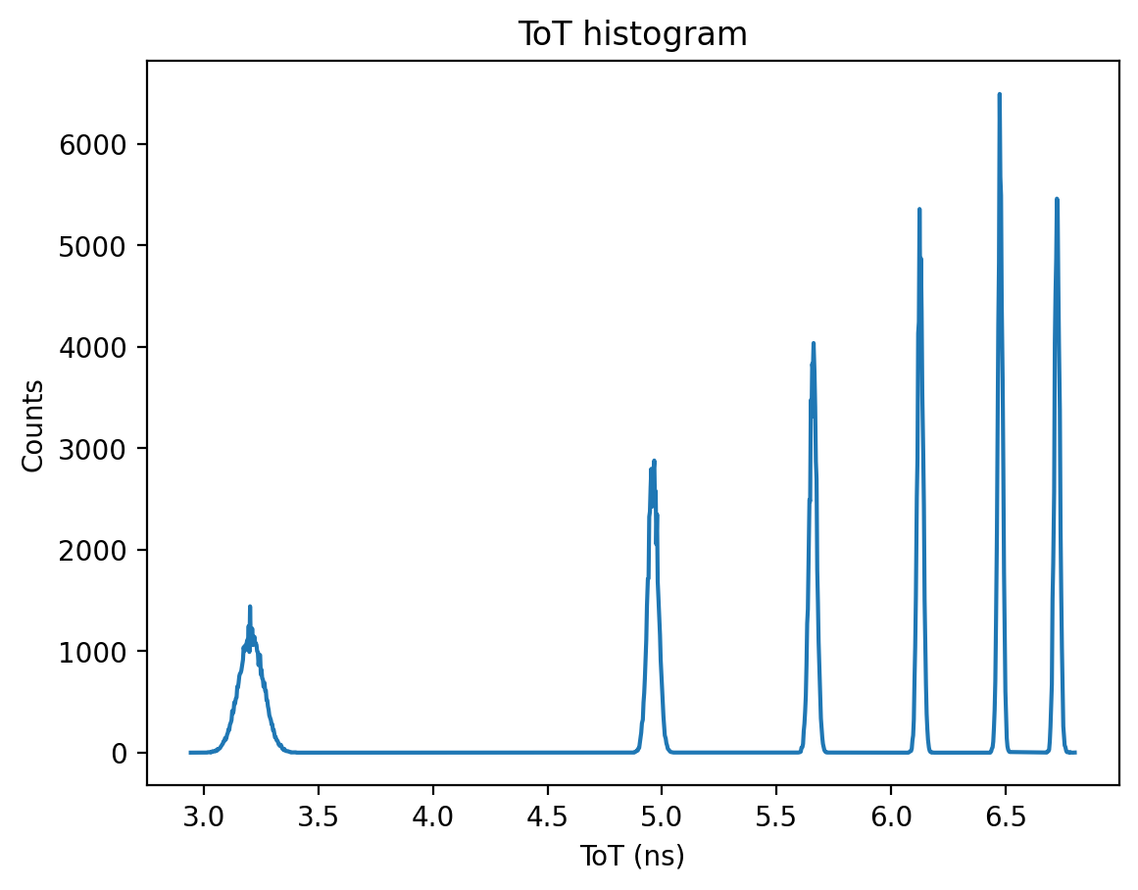
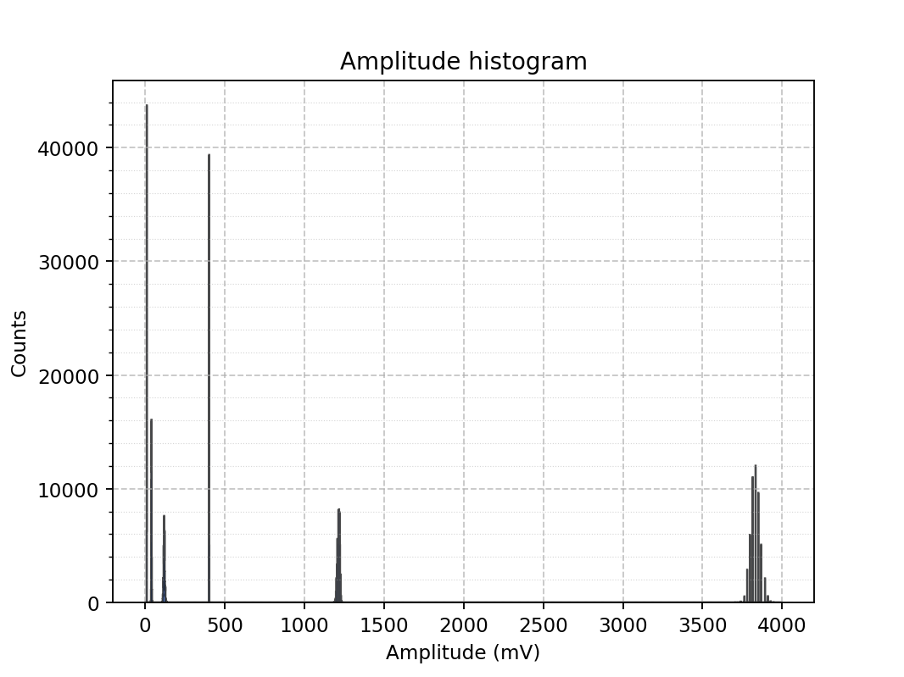
Amplitude Reconstruction
1217
Thr = 5 mV
385
3850
12 mV
122
385 mV
Ampl | Centroid | Sigma | Rel Res % | INL %FSR
12.2 | 11.3 | 0.1 | 1.1 | -0.16
38.0 | 41.1 | 1.3 | 3.1 | -0.05
121.8 | 120.9 | 4.0 | 3.3 | -0.14
385.0 | 403.0 | 0.4 | 0.1 | +0.39
1217.5 | 1215.4 | 7.6 | 0.6 | +0.00
3850.0 | 3831.0 | 29.4 | 0.8 | -0.03
38
12
ToT-Amp
Vin > 300 -> use High Thr curve (orange)
Vin < 300 -> use Low Thr curve (blue)
38 mV
3850 mV
122 mV
1217 mV

Slide 19

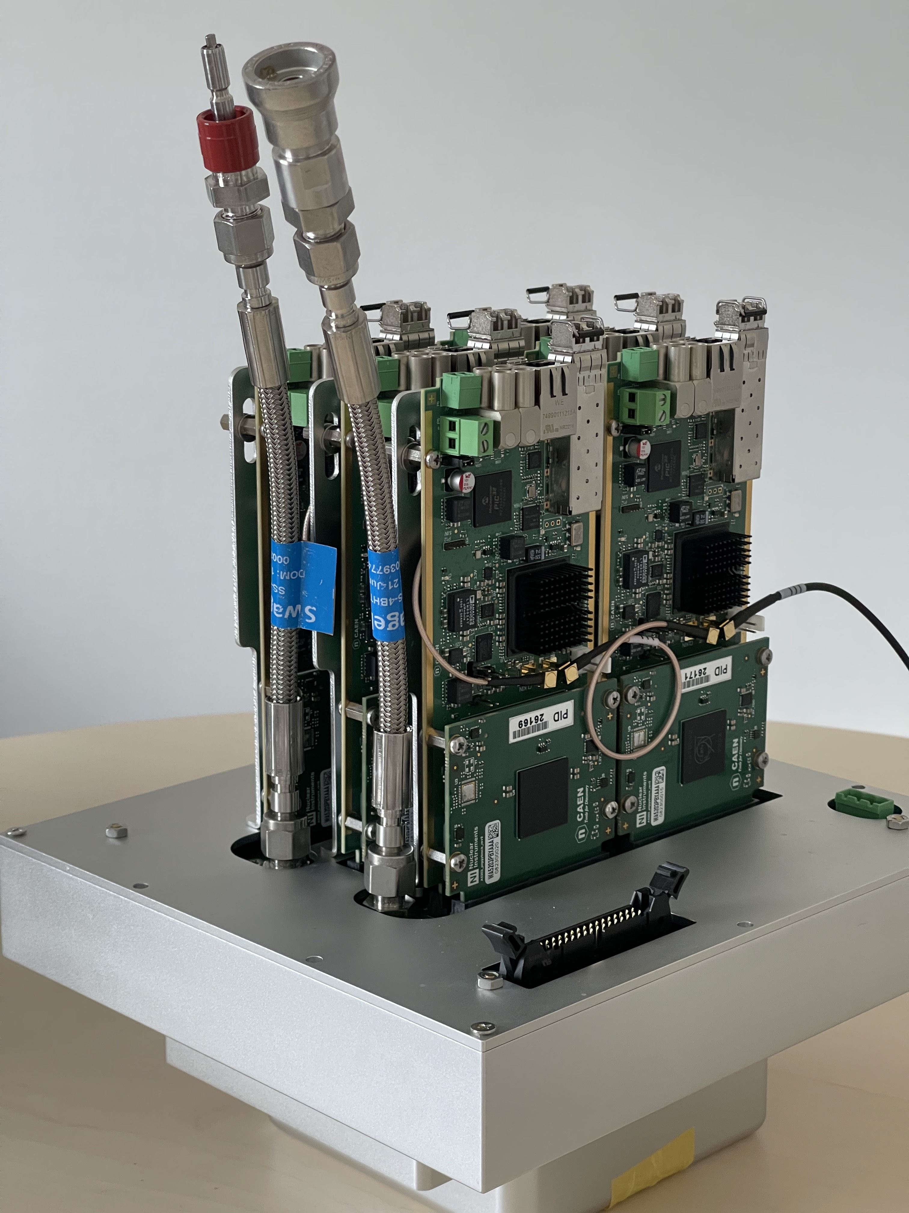
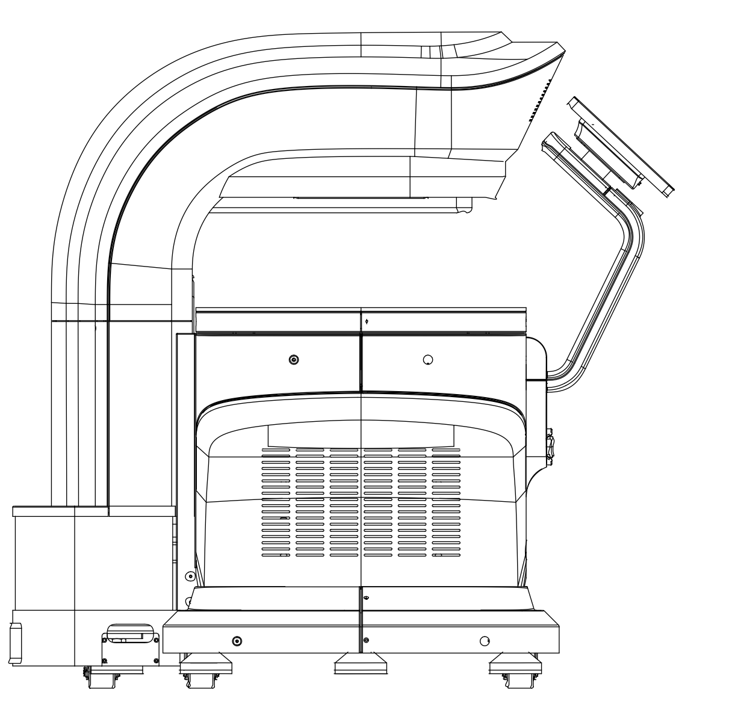
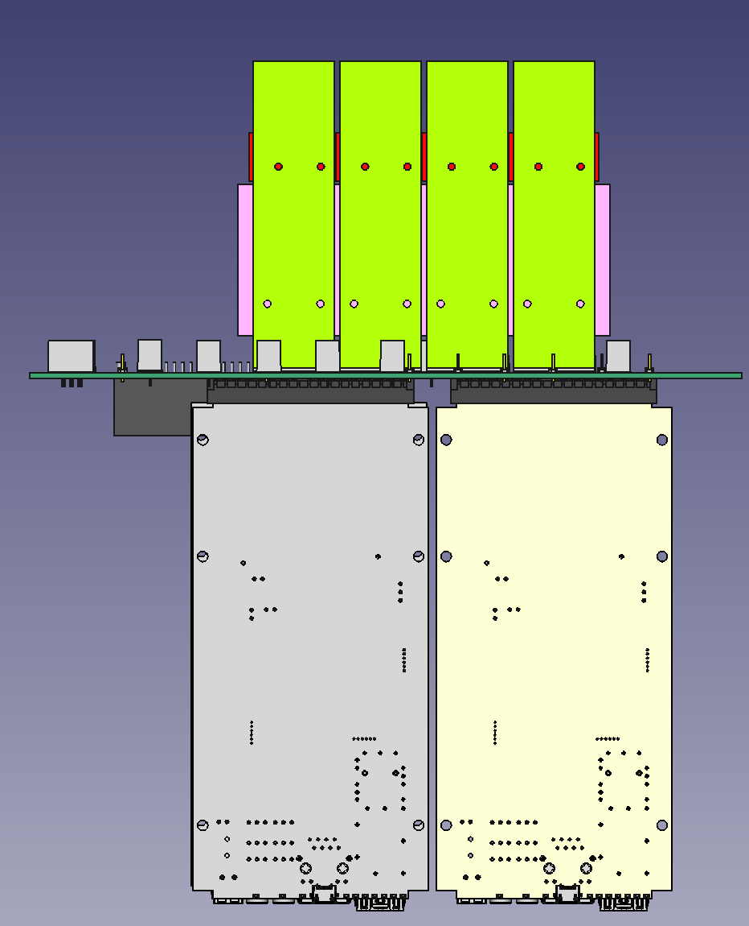
picoTech ProVision PET scanner
2x768 SiPM channels
2x6 A5203Bs (128 ch. TDC)
1 DT5215 Concentrator
Precise timing and ToT measurement
High throughput – almost zero deadtime
ToT cut for Dark Count and noise suppression
Courtesy of C. Williams

Slide 20
Conclusion
FERS is modular, easy-scalable and flexible
FERS allows for a quick and easy integration of ASICs developed for nuclear physics applications
Two models already available and deployed to site:
  A5202 for SiPM readout, mainly used in scintillating fibers readout
  A5203 ultra high resolution TDC, mainly used for PET systems
The ToT can be successfully used for pulse amplitude reconstruction and time walk correction (no CFD required)
Many applications in HEP/NP, Muon Tomography and Medical Imaging are using FERS modules for the detector readout
New models being designed…

Slide 21

Thank you for your attention
Visit us at our booth for a live demo of the FERS reading a SiPM matrix

Slide 22
Backup slides

Slide 23
Technical Specifications A5202 & A5204
A5202/A5204 (NEW): 64 channel SiPM Readout based on Citiroc/Radioroc+picoTDC
  Analog inputs (charge, not voltage)
  All-in-one readout: Preamp + Shaper + Discr + ADC + TDC + HV Bias (20-80 V)
  Dynamic Range: 1 to 2500 p.e.
  Single photon detection (threshold at 1/3 p.e.)
  Timing resolution = 55 ps FWHM (A5204 only)
  Acquisition Modes
    Counting (20 Mcps and more)
    Spectroscopy (PHA) => Common Trigger => Max Trg rate = 100 KHz
    Timing (ToA + ToT) => Individual Self Trigger => Max Hit rate = 1 Mcps/ch (depending on Model)
    Mixed (PHA + ToA)
Notes:
In particular, the A5202 and A5204 units are 64 channels boards used for SiPM readout ...

Slide 24
Technical Specifications A5203 & A5205
A5203: 64/128 channel picoTDC
  Digital inputs: LVDS (1.2 V max common mode, 1.45 V max voltage )
  LSB = 3.125 ps, dynamic range = 56 bit (extended by FPGA)
  Acquisition modes: Common Start, Common Stop, Trigger Matching, Streaming
  ΔT Resolution ^{(*)} :
    Same board: typ 5 ps RMS
    Board to board (with clock cables): ~8 ps RMS
    Board to board (without clock cables): ~20 ps RMS
A5205: 64 channel SSD, GEM, PIN diode readout based on Psiroc + picoTDC
  Pos/Neg inputs. Dynamic range up to 5 pC with PHA, 100 pC with ToT
  Programmable gain: 125 mV/pC up to 4 V/pC. Min trigger threshold = 0.5 fC
  Linearized ToT
COMING SOON
Reproduction, transfer, distribution of part or all of the contents in this document in any form without prior written permission of CAEN S.p.A. is prohibited.
Notes:
SSD = Silicon Strip Detectors, GEM = Gas Electron Multiplier

Slide 25
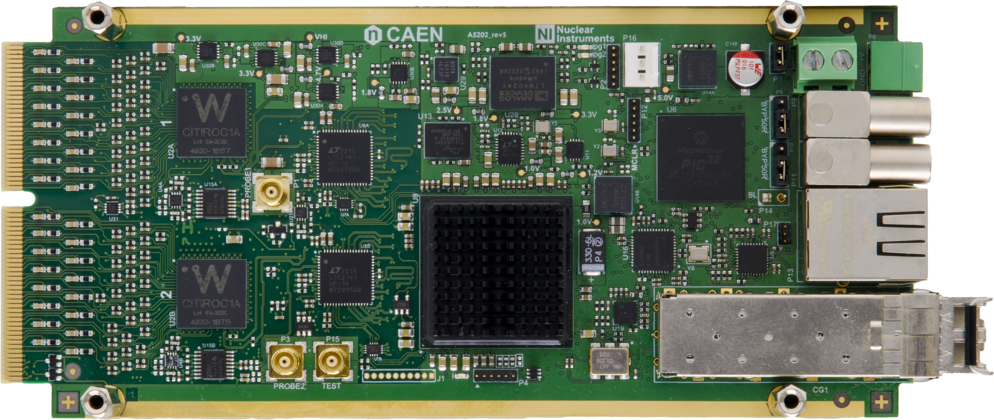
FERS A5202: 64 channel SiPM Readout
HV Bias (on the bottom)
uC
+12V DC-IN
2 In + 2 Out
Detector
inputs
Eth/USB
TDlink:
Data+Sync
FE-ASIC
ADC
FPGA
DETECTOR SPECIFIC FRONT-END
COMMON INFRASTRUCTURE

Slide 26
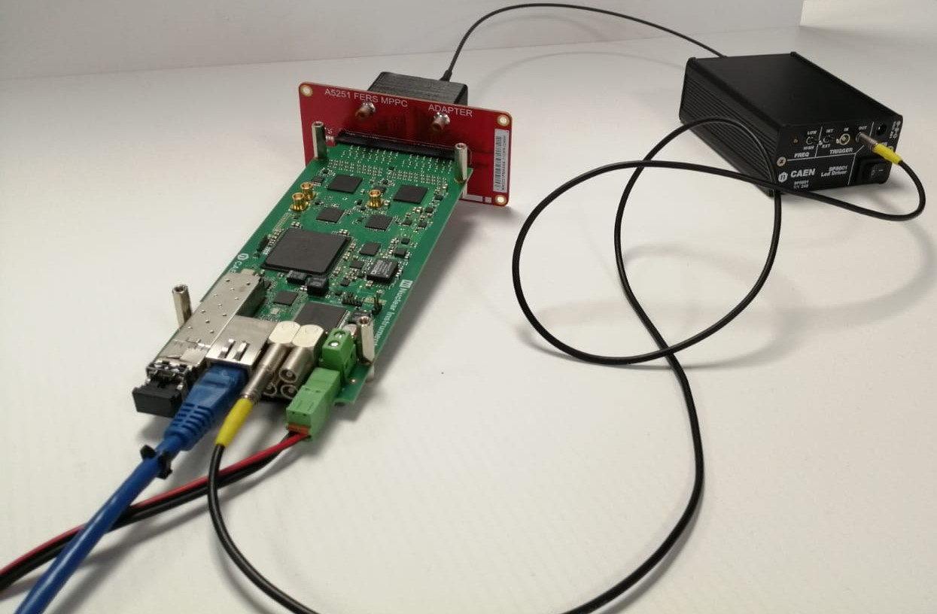
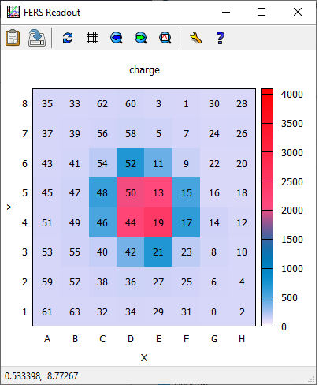
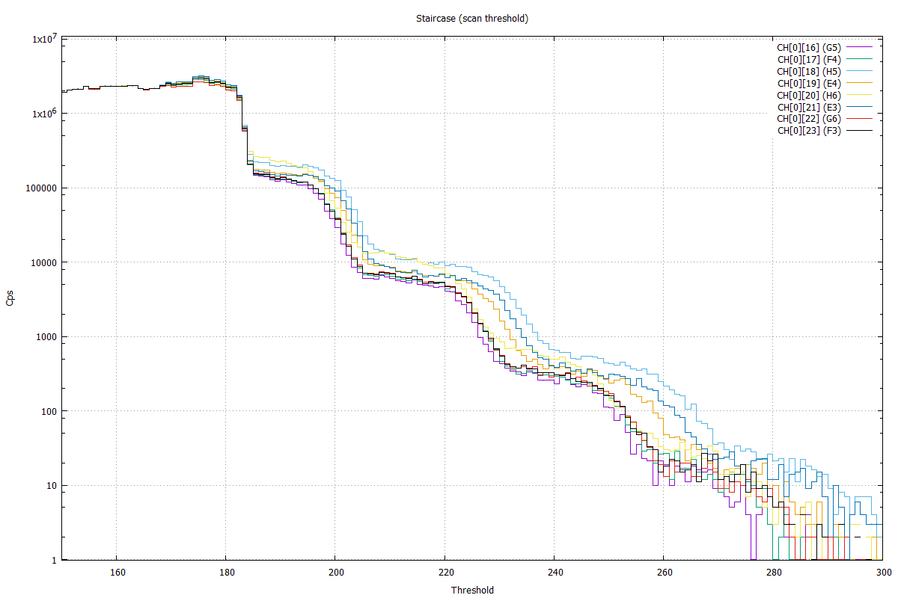
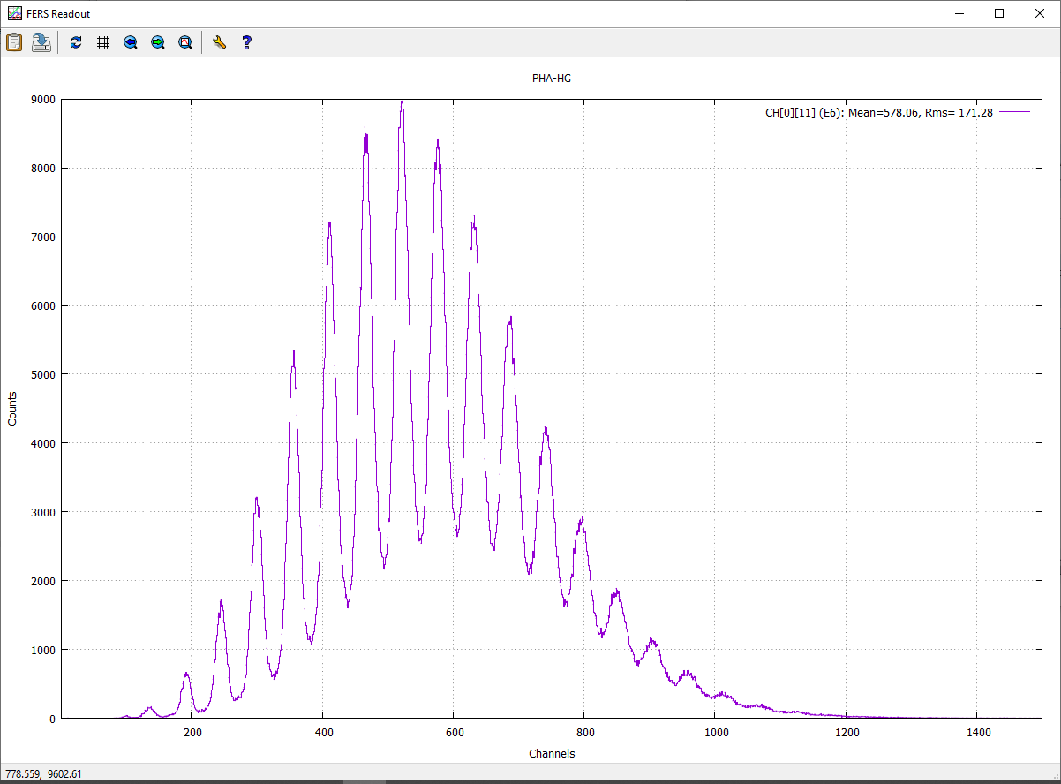
Qualification of A5202
One A5202 board
SiPM Matrix Hamamatsu S13361-3050AE-08
CAEN SP5601 LED Driver
Imaging
Staircase
SiPM spectrum with photopeaks
Notes:
Let’s see now some results. Here we see some typical qualification plots of SiPMs, made with a 64-ch Hamamatu matrix read and biased by the A5202 . It is possible to see that the electronics is able to resolve single p.e. peaks, both in the spectrum and in the staircase and it is good for imaging too.

Slide 27
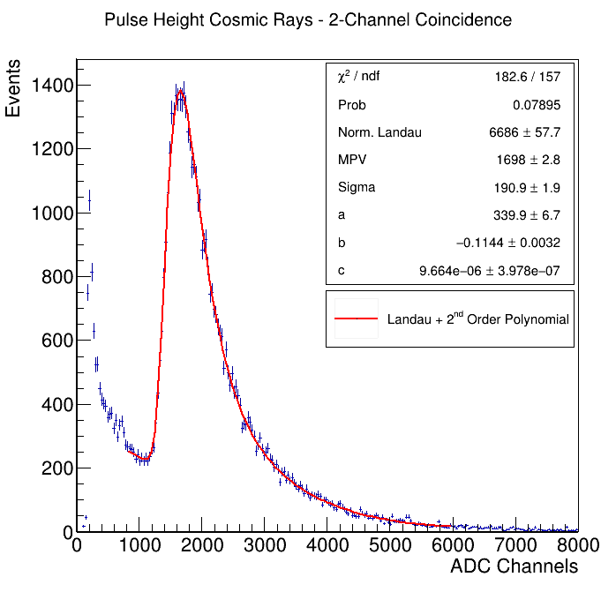
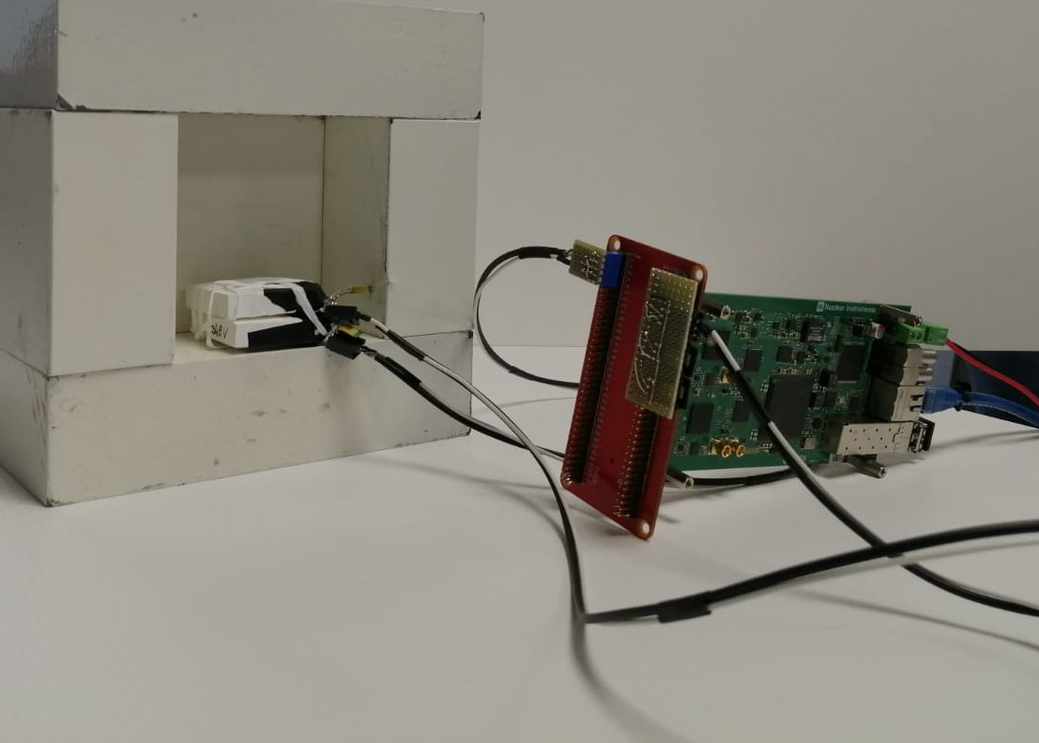
Measurement of Cosmic Ray Energy Loss
Preliminary measurements with one A5202 board. Setup:
Two 4.8 cm x 4.8 cm x 1 cm plastic scintillators, each one coupled to a Hamamatsu S13360-6050CS SiPM
Two channel coincidence (implemented at firmware level) used as trigger for PHA acquisition
Landau from relativistic muons loss of energy clearly visible
Notes:
Another test we made was the measurements of cosmiic ray energy using two plastic scintillators coupled to SiPMs and acquired by the A5202 in coincidence. As you can see in the plot, we were able to measure the Landau distribution of relativistic muons loss of energy.

Slide 28
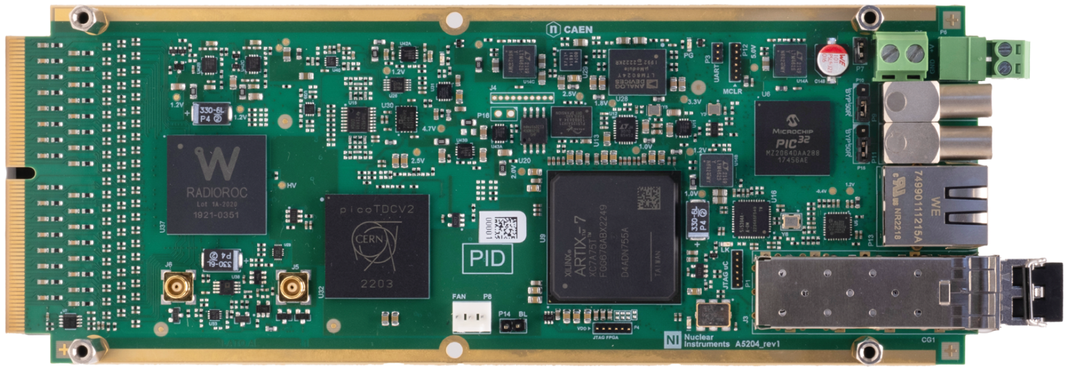
FERS A5204: 64 channel SiPM Readout
HV Bias (on the bottom)
uC
+12V
2 In + 2 Out
Eth/USB
TDlink:
Data+Sync
Radioroc
picoTDC
FPGA

Slide 29
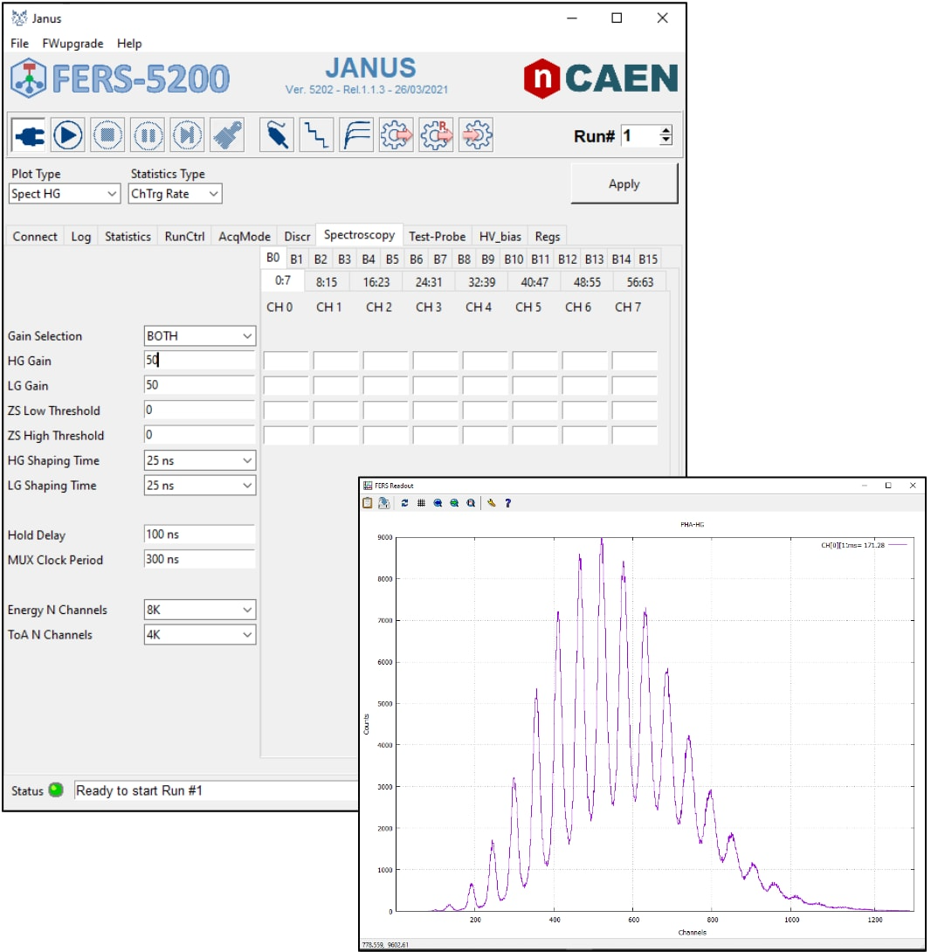
Janus Software
Open source software for multi-board configuration
and data readout
Python GUI and C/C++ readout program
SDK for user customization (libs + demo)
Multi parametric Jobs and Runs with time or counts preset
Output files: lists in .bin or .csv format, spectra, raw data
Off-line runs for Post-processing and Event Building
Live plots (with gnuplot) and statistics monitor
Up to 300 MB/s data throughput (with DT5215 Concentrator via USB 3.0 or 10G Eth)

Slide 30
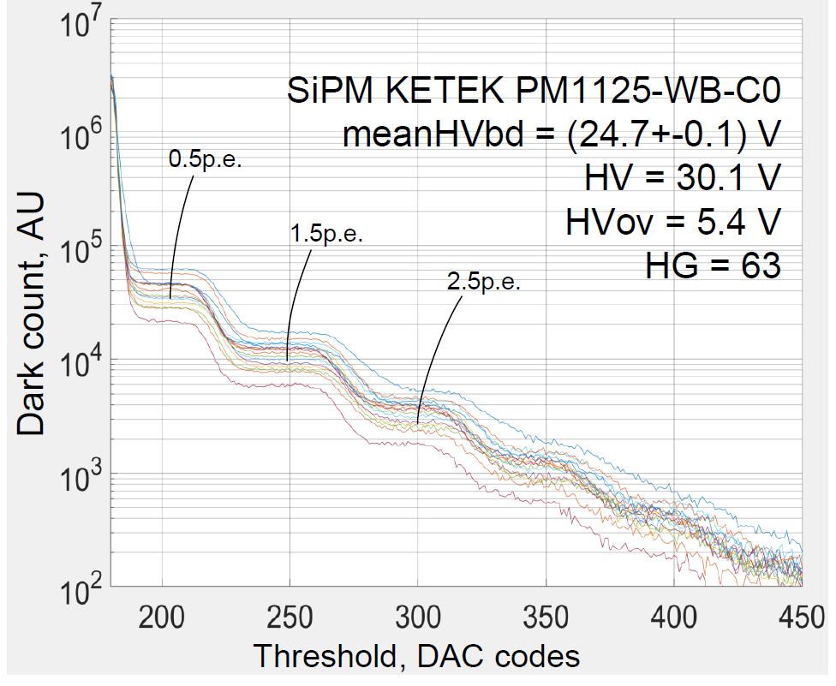
ORIGIN project
Biomedical application: real-time, in-vivo dosimeter imaging for oncological brachytherapy treatment
Standalone desktop version DT5202 used to readout 16/32 PMMA fibers with scintillators in their tip
CAEN DT5202 demonstrated to have a good imaging resolution and uniformity among channels
Close staircases, clearly-resoluted p.e. and negligible noise
See NSS-MIC 2021 poster “Qualification of a Silicon Photomultiplier scalable readout system” (#912)
Notes:
Still the same research group is using the FERS in a complete different field, that is real-time, in-vivo dosimeter imaging for oncological brachytherapy treatment. Here they exploited the standalone version of the unit, the DT5202, that is this box here. And they were able to readout PMMA fibers with SiPMs in their tips. The readout system demonstrated to be able to resolve single p.e. as it si possible to see in these staircases and they saw a good uniformity among channels. If you would like to have more details about this and the previous application, you can have a look at the conference poster …blablabla

Slide 31

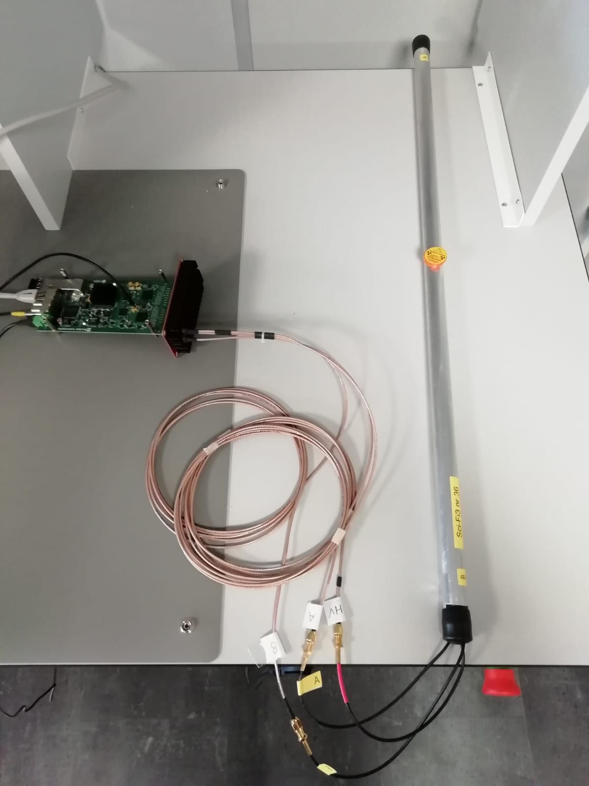
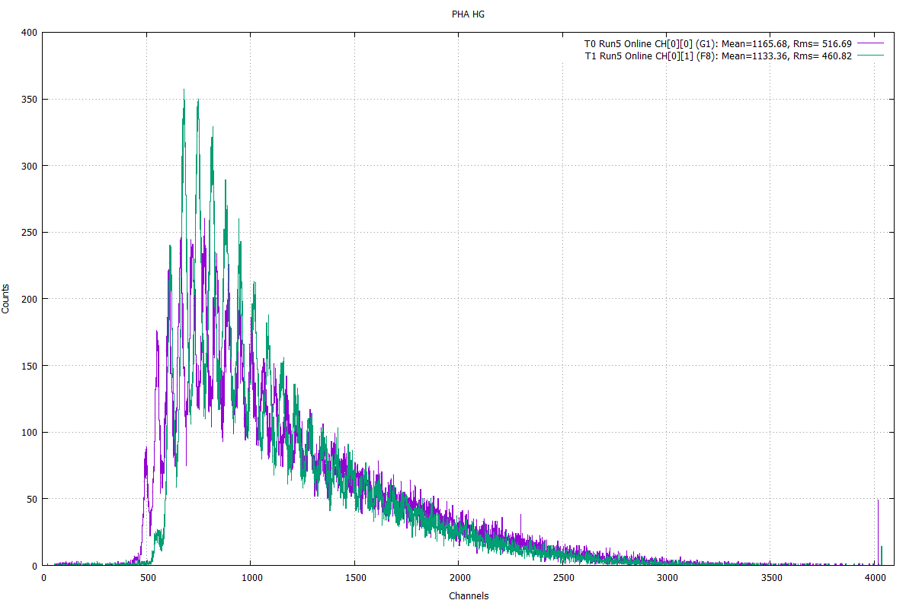
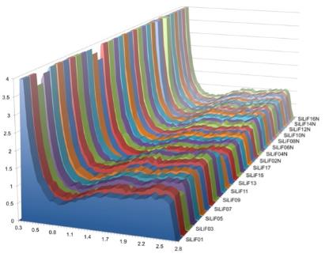
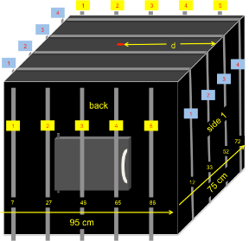
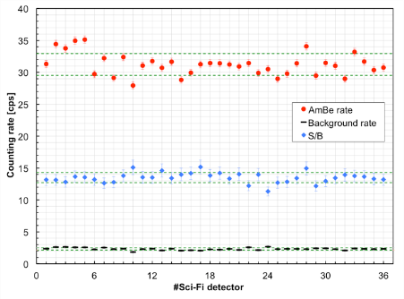
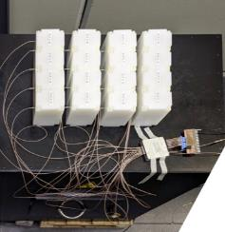
FERS in D&D operations
https://www.micado-project.eu/
SiPM A
Detection system for gammas and neutrons, based on SciFi & SiLiF detectors
SiPM-coupled SciFiGamma bar using A5253 adapter
Coincidence trigger
Na22
Each bar coupled to Hamamatsu 1.3x1.3 mm² SiPM.
SiPM B
Notes:
And we already succesfully tested the board for the readout of the bar you see in the picture, also thanks to our set of adapters and cables. The plot shows simply the energy spectrum acquired in coincidence at the two ends of the bar when a Na22 source is placed in the middle.

Slide 32

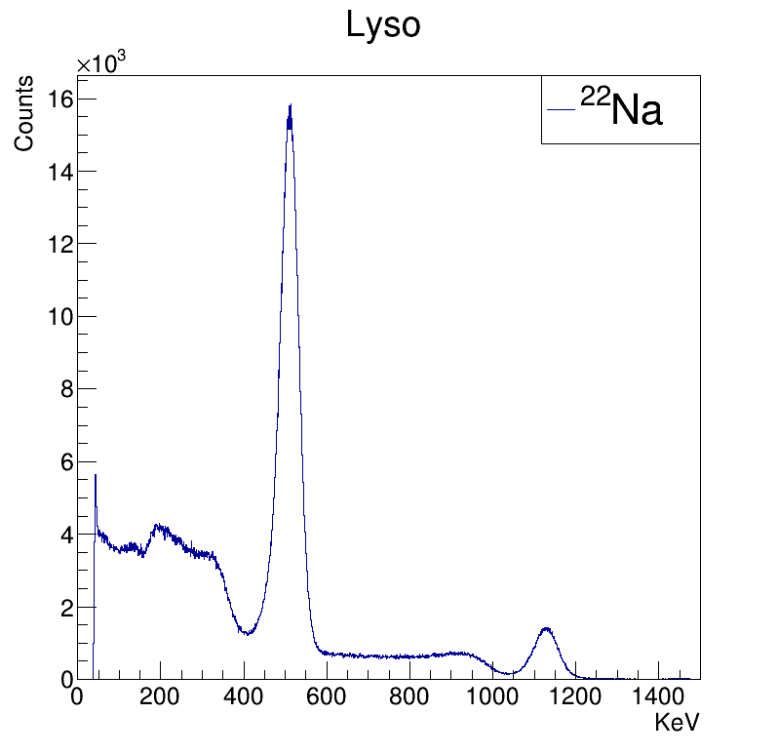
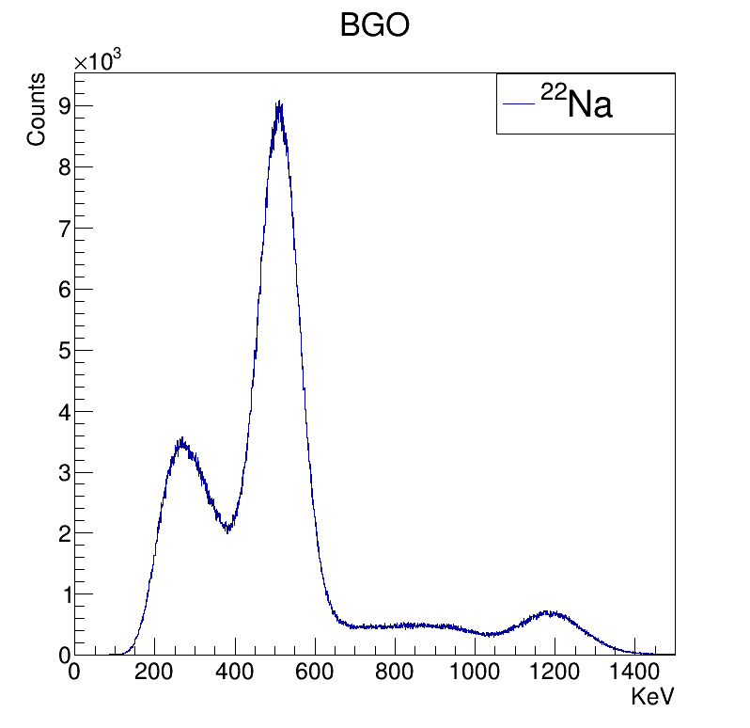
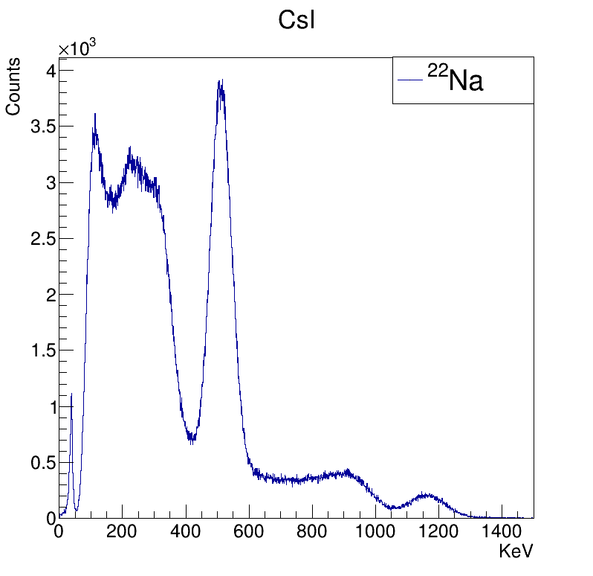
Gamma spectroscopy
Amplitude Measurements with SiPM and ASIC (Citiroc 1A) Front-End Electronics
M.Perri et al.
Nuclear Inst. and Methods in Physics Research, A
https://ieeexplore.ieee.org/document/10092191

Slide 33


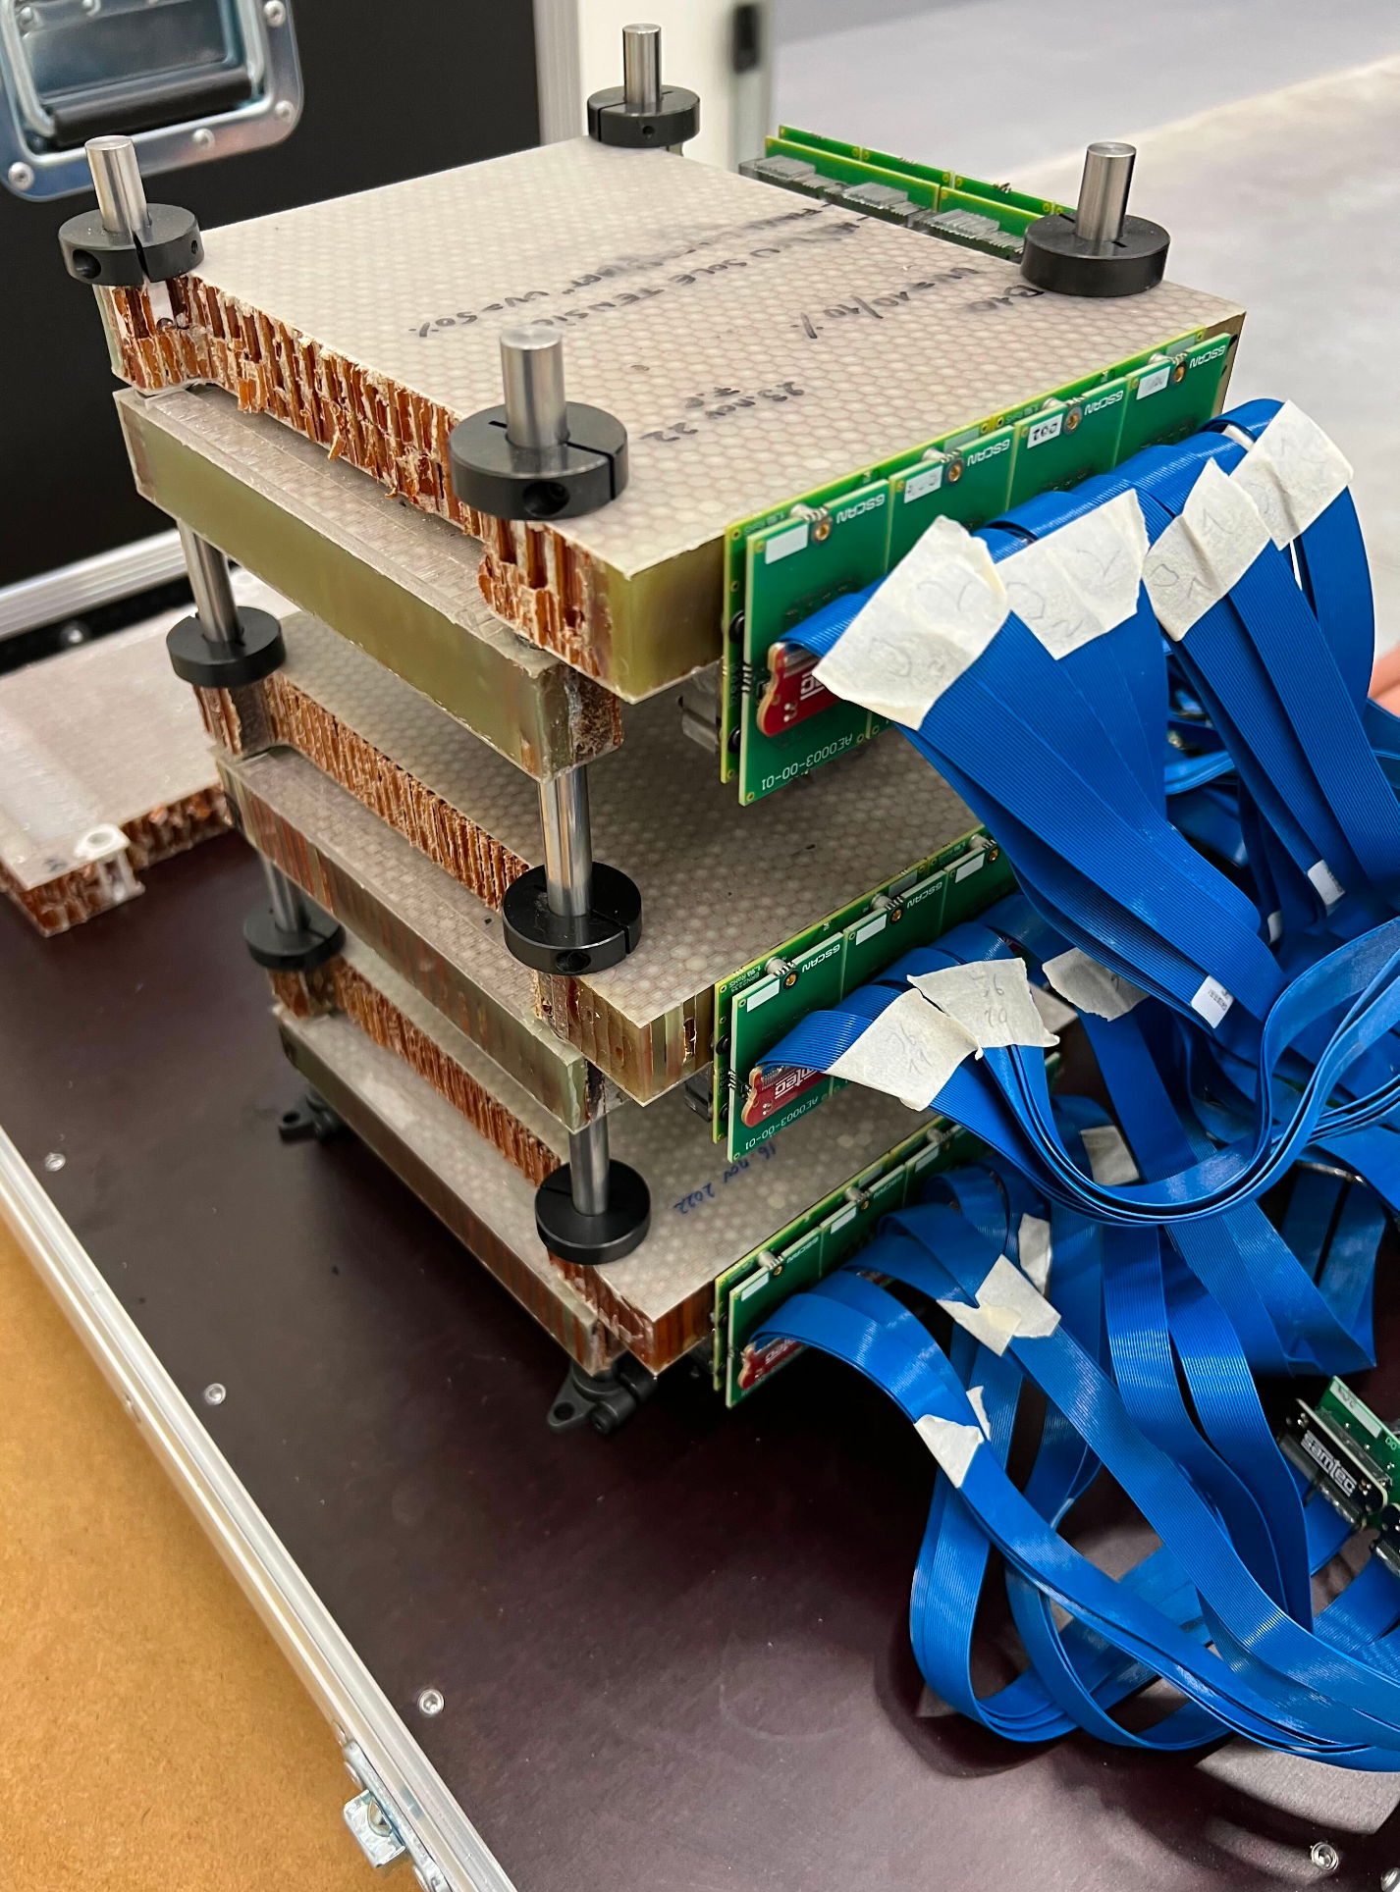
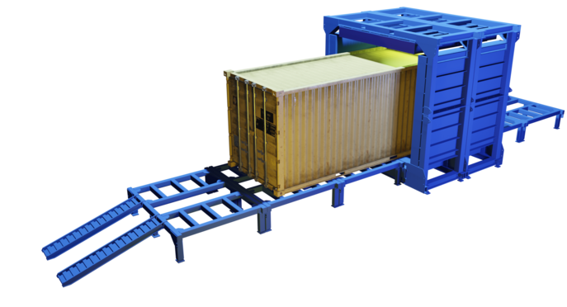

Silent Border
Funded by the European Union
Cosmic Ray Tomograph for identification of hazardous and illegal goods hidden in Trucks and Sea Containers
221.184 Fibers + SiPMs
1 mux = 64 SiPMs = 4 FERS channels (X+, X-, Y+, Y-)
216 A5202 FERS units
3 DT5215 (Data Concentrator)
Mux Constellation
Y+
Y-
X-
X+

Slide 34


Muon tomography - geophysics
Imaging sensor for mining, Oil&Gas
Two A5202 reading SiPM in the buried sensor
One DT5215 with 300 m optical fiber on the ground surface
Installed in Atacama Desert
Each bar coupled to Hamamatsu 1.3x1.3 mm² SiPM.
https://muonvision.com/technology-how-does-muon-vision-work/

Slide 35



Neutron anger camera (cont.)
GS20 THICKNESS = 1mm
101 mm
DT5202 (64 ch)
AL-ANODIZED
GS 20 SCINTILLATOR
GLASS
76 mm
DT5215

Slide 36

picoTech ProVision PET scanner (cont.)
Pico2023: 8 channel differential amplifier-discriminator with amplitude encoded into pulse width

Slide 37
FERS-5200: generic block diagram
Direct Connect: easy but slow (~2 MB/s)
up to 128 FE cards
ETH 10/100T
USB 2.0
DETECTOR SPECIFIC
COMMON INFRASTRUCTURE
ASIC:
PREAMP
SHAPER
DISCRIM
ADC
ACQ
LOGIC
READOUT
INTERF
TRIGGERS
MEM
Concentrator
DT5215
1 GbE
TDC
TDlink
10 GbE
USB 3.0
CONFIG
SYNC
HV BIAS
External Sync
(GPS, ExtClk, etc)
A5204
TDlink: Multi-board Readout + Sync + Config
Up to 300 MB/s

Slide 38
A5204: block diagram

Slide 39








Input Adapters and Front-End
A5253
A5250
A5256
A5255
Back Panel
A5251
A5254
Front Panel
A5260: Remotization cable

Slide 40
Technical Specifications
A5202/A5204: 64 channel SiPM Readout based on Citiroc/Radioroc+picoTDC
  All-in-one readout: Preamp + Shaper + Discr + ADC + TDC + HV Bias (20-80 V)
  Dynamic Range: 1 to 2500 p.e.
  Single photon detection (threshold at 1/3 p.e.)
  Timing resolution = 55 ps FWHM (A5203 only)
  Acquisition Modes
    Counting (20 Mcps and more)
    Spectroscopy (PHA) => Common Trigger => Max Trg rate = 100 KHz
    Timing (ToA + ToT) => Individual Self Trigger => Max Hit rate = 1 Mcps/ch (depending on Model)
    Mixed (PHA + ToA)

Slide 41
Technical Specifications (cont.)
A5203: 64/128 channel picoTDC
  LSB = 3.125 ps, dynamic range = 56 bit (extended by FPGA)
  Acquisition modes: Common Start, Common Stop, Trigger Matching, Streaming
  ΔT Resolution ^{(*)} :
    Same board: typ 5 ps RMS
    Board to board (with clock cables): ~8 ps RMS
    Board to board (without clock cables): ~20 ps RMS
A5205: 64 channel SSD, GEM, PIN diode readout based on Psiroc + picoTDC
  Pos/Neg inputs. Dynamic range up to 5 pC with PHA, 100 pC with ToT
  Programmable gain: 125 mV/pC up to 4 V/pC. Min trigger threshold = 0,5 fC
  Linearized ToT
(*) Tested with A5256. Pulse: 0.5 Vpp, 0.8 ns rise time

