Slide 1
Beam-Recoil polarisation observables: challenging PWA
Mikhail Bashkanov

Slide 2
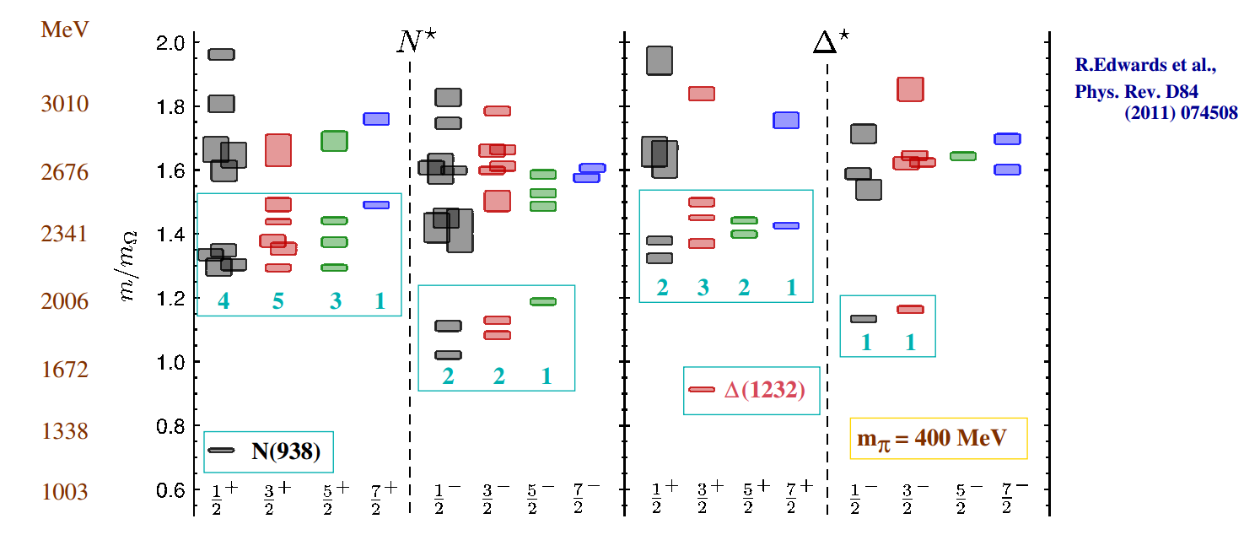
Lattice QCD

Slide 3
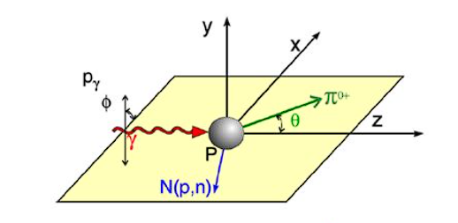
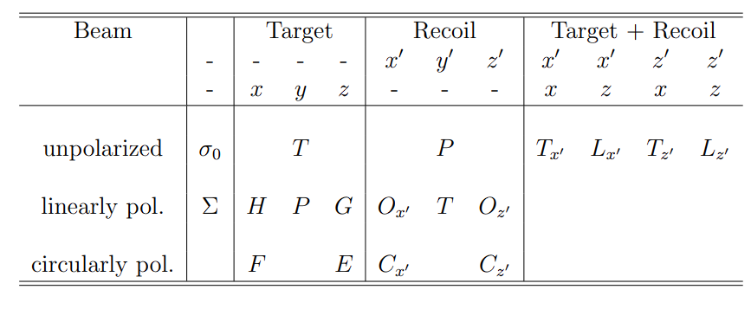

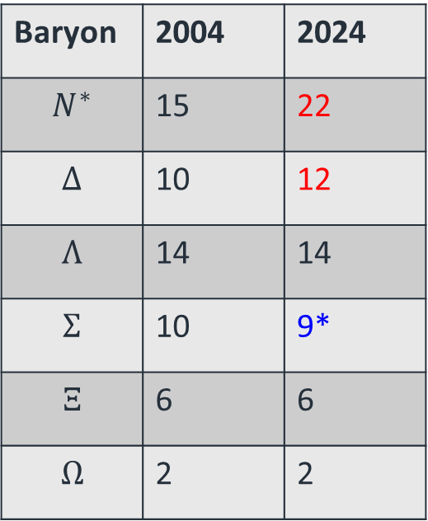
Baryon spectroscopy
Number of 3- and 4-star Resonances
Baryon | 2004 | 2024
$$N^{∗}$$ | 15 | 22
$$Δ$$ | 10 | 12
$$Λ$$ | 14 | 14
$$Σ$$ | 10 | 9*
$$Ξ$$ | 6 | 6
$$Ω$$ | 2 | 2
*$Σ\left(2250\right)$ was downgraded
MAMI, ELSA, JLAB
3

Slide 4

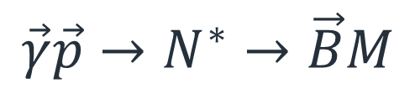
The full experiment
$$\vec{γ}\vec{p}→N^{∗}→\vec{B}M$$
4

Slide 5
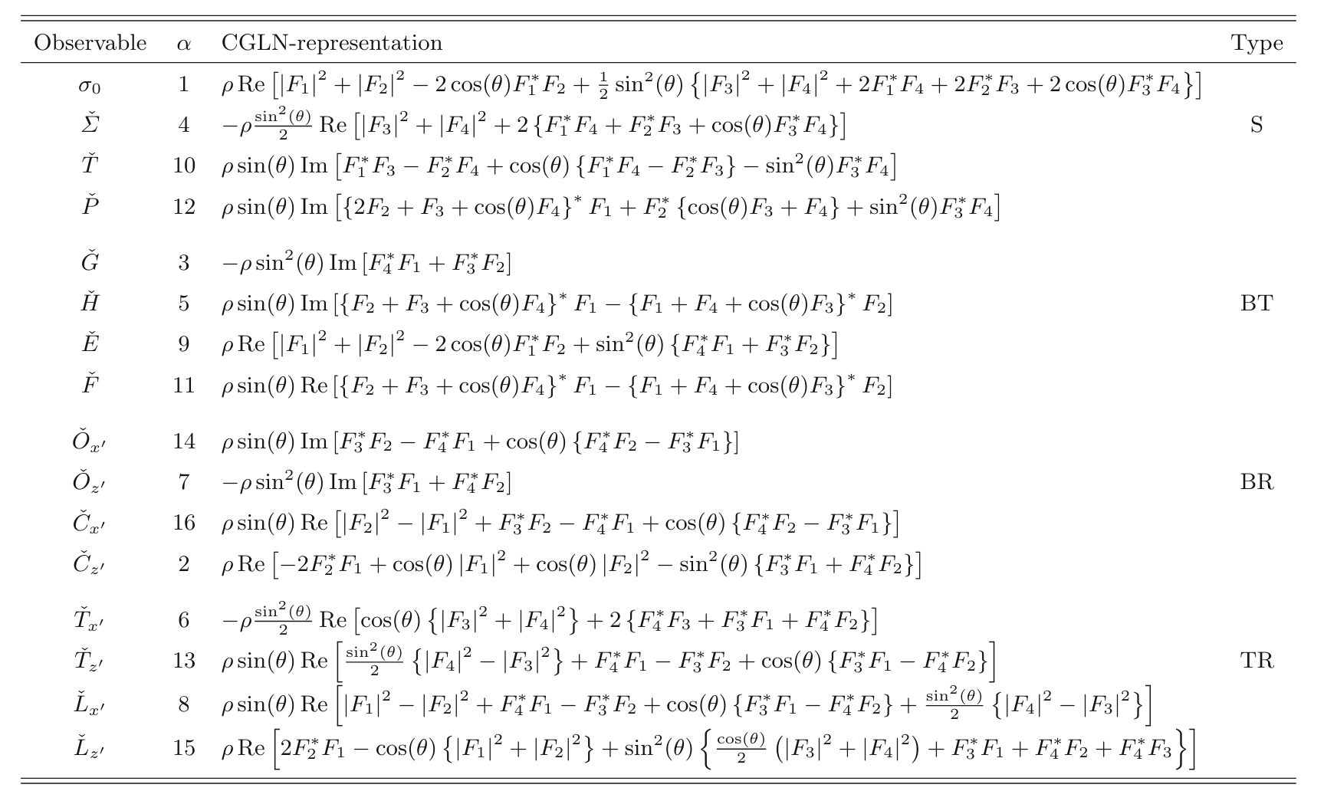
Pion photoproduction
4 complex amplitudes -> 8 observables to define everything
May be even less (Y. Wunderlich, F. Afzal, A. Thiel, R. Beck, Eur. Phys. J. A 53, 5, 86, 2017)
5

Slide 6
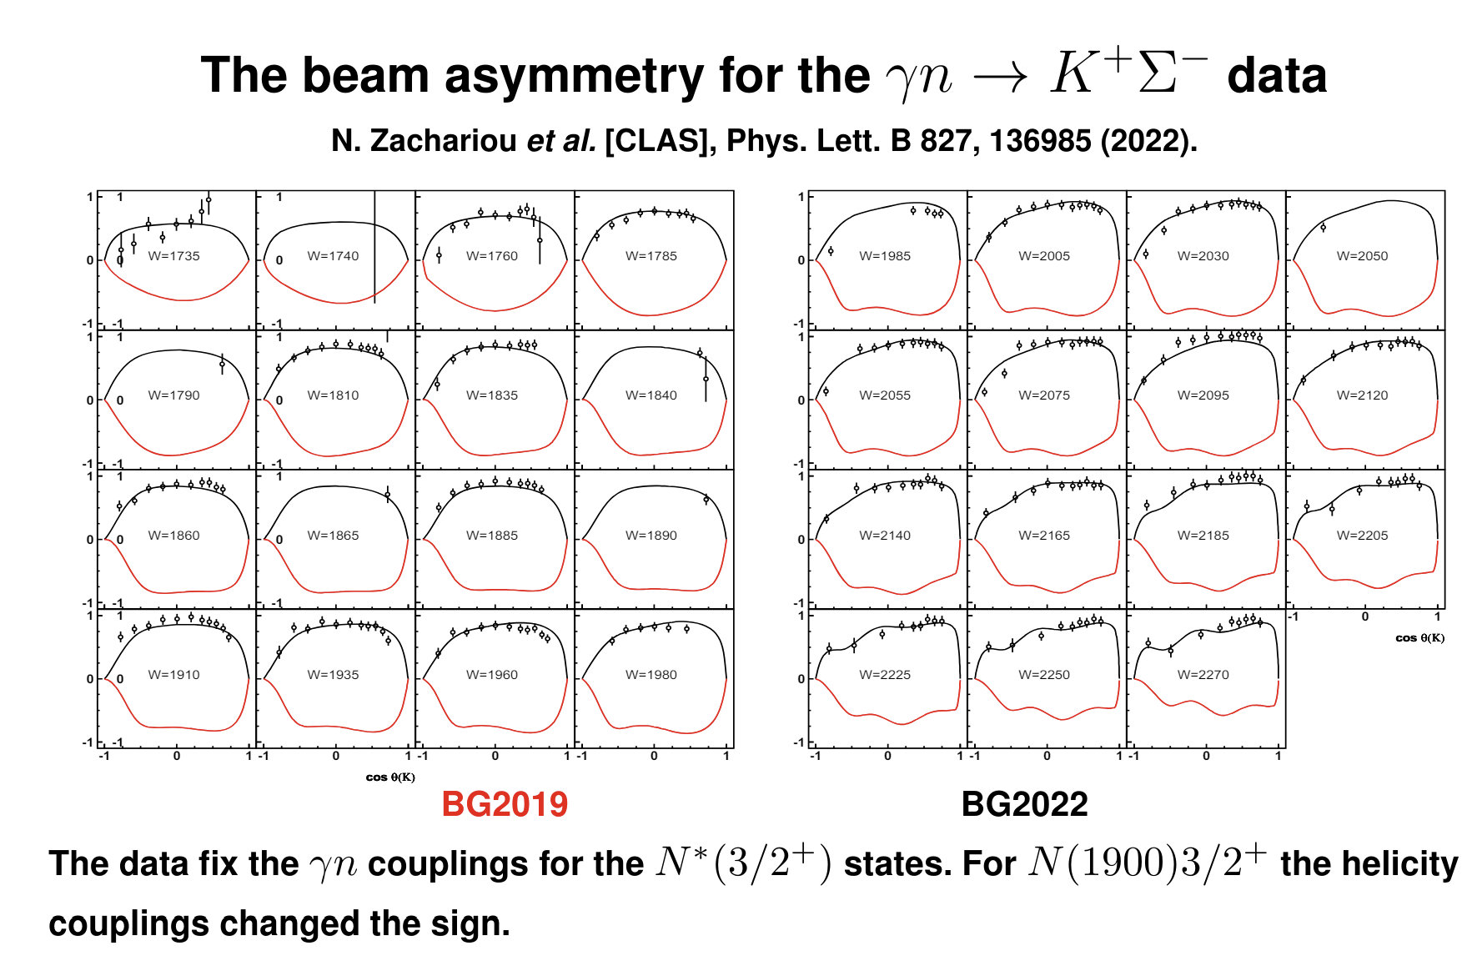
New observables
From A. Sarantsev, Nstar 2022
6

Slide 7
The full experiment
$$\vec{γ}\vec{p}→N^{∗}→\vec{B}M$$
7

Slide 8



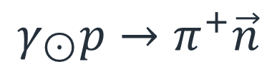


Cx observable
Analysing power
Polarisation
$$γ_{\begin{aligned}⊙ \\ \end{aligned}}p→π^{+}\vec{n}$$
$$γ$$
$$π^{+}$$
$$n$$
$$Θ,φ,E$$
p
Target
$$Θ^{′},φ′$$
Polarimeter
8

Slide 9
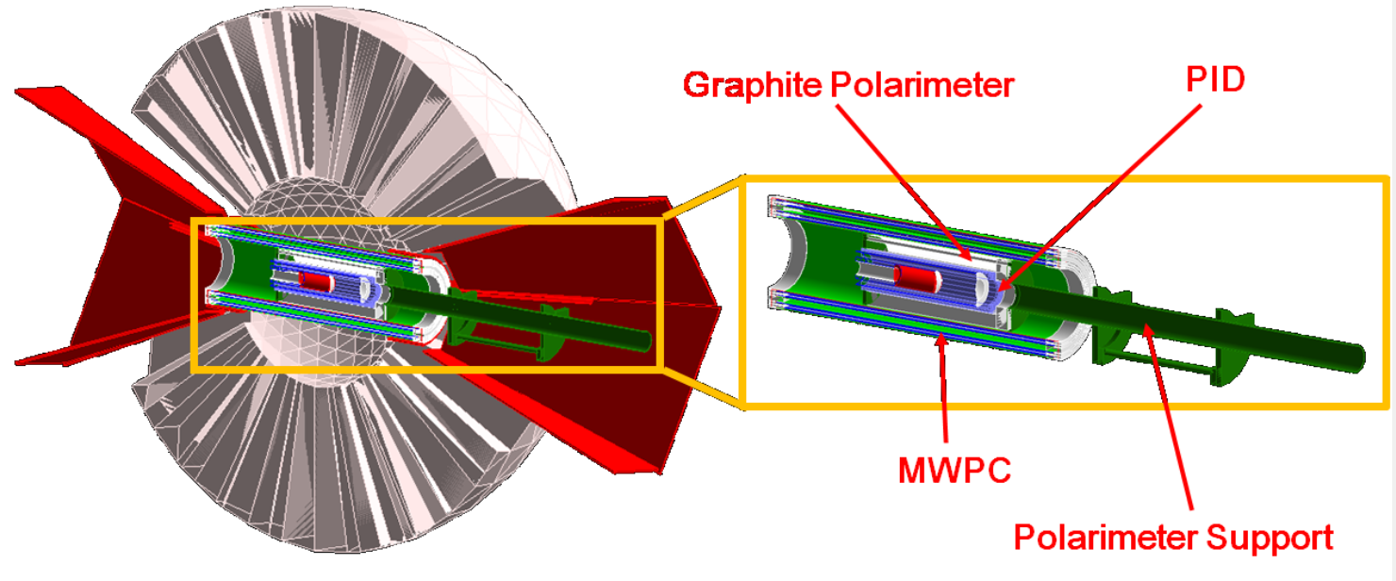
Setup
9

Slide 10
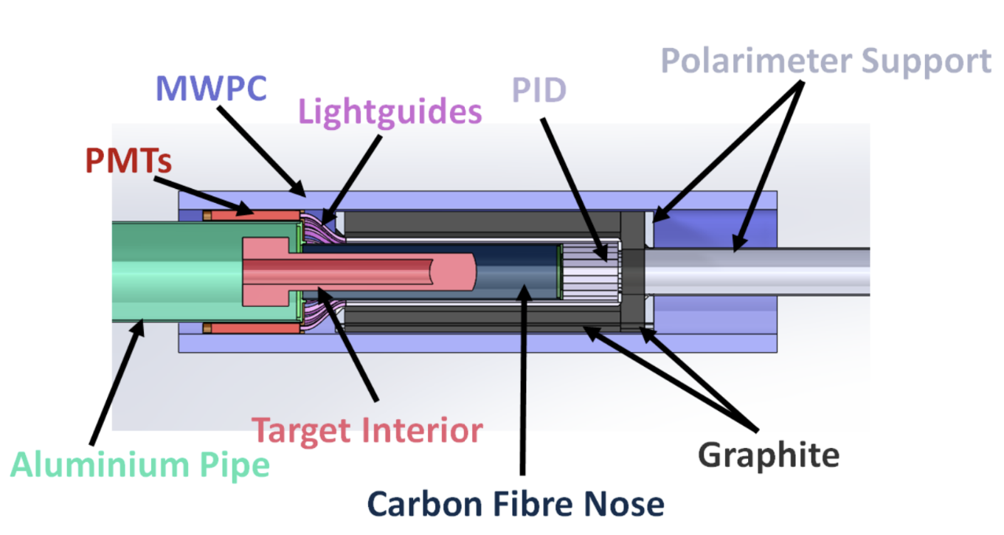
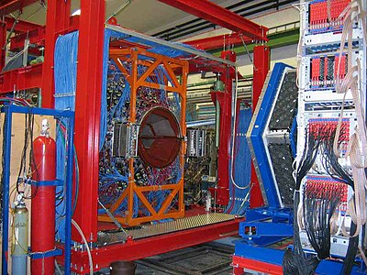
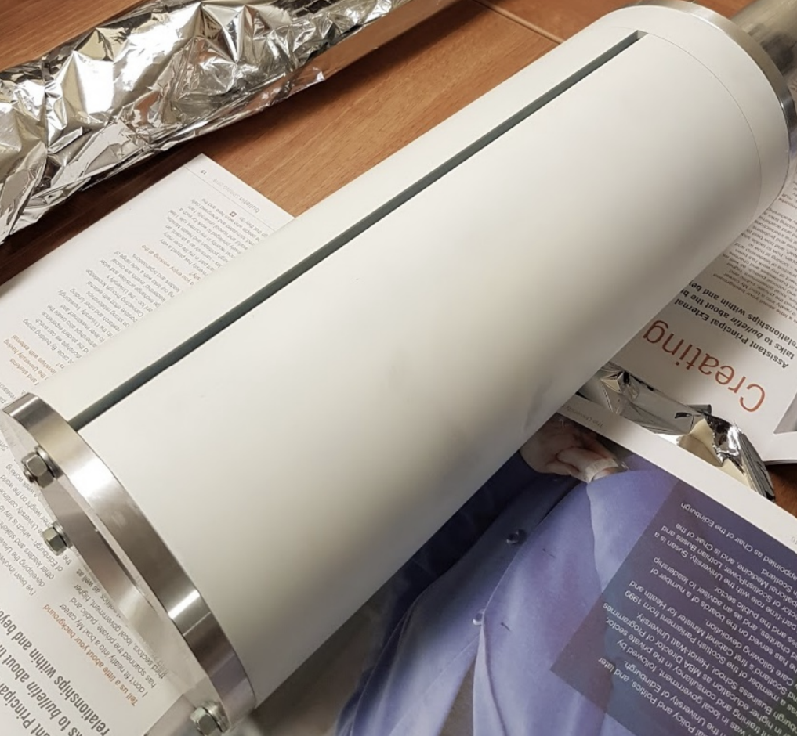
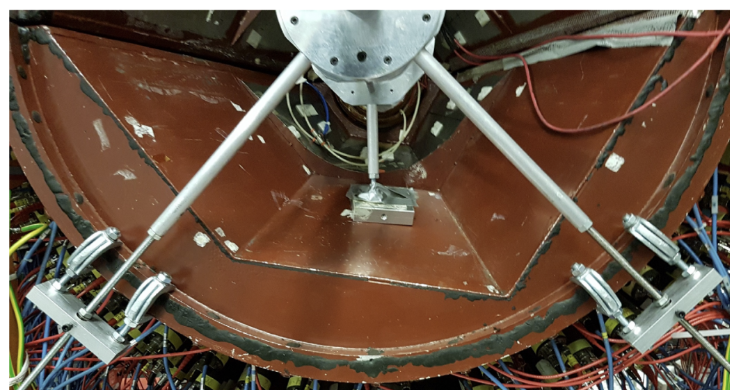
Setup
10

Slide 11
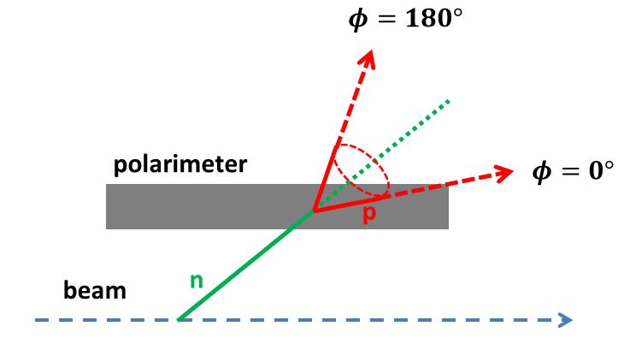
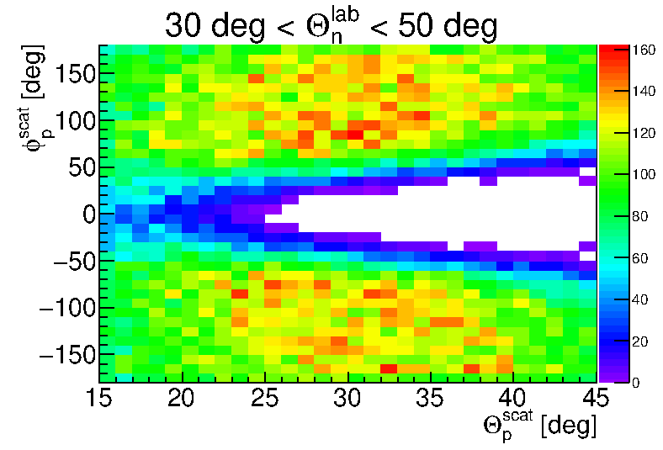
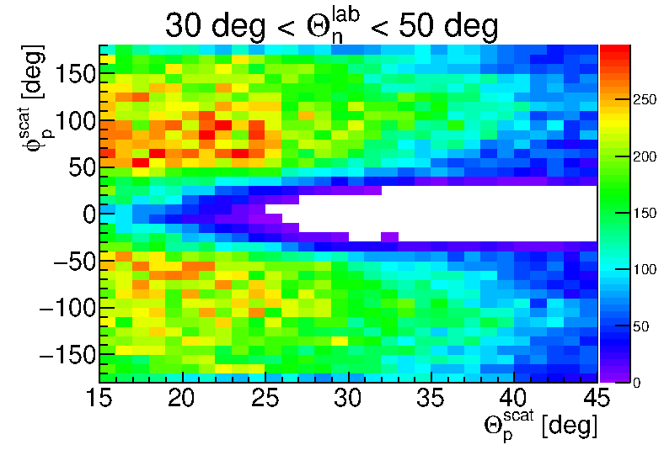


Geometrical Acceptance
$$Θ_{}^{n}−Θ_{scatt}^{p}>27°$$
MC
Data
11

Slide 12
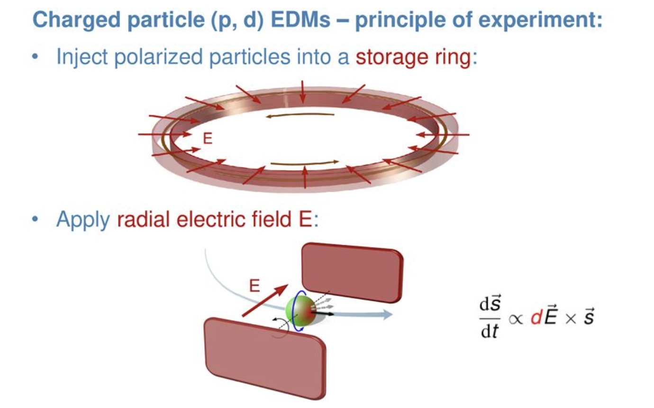
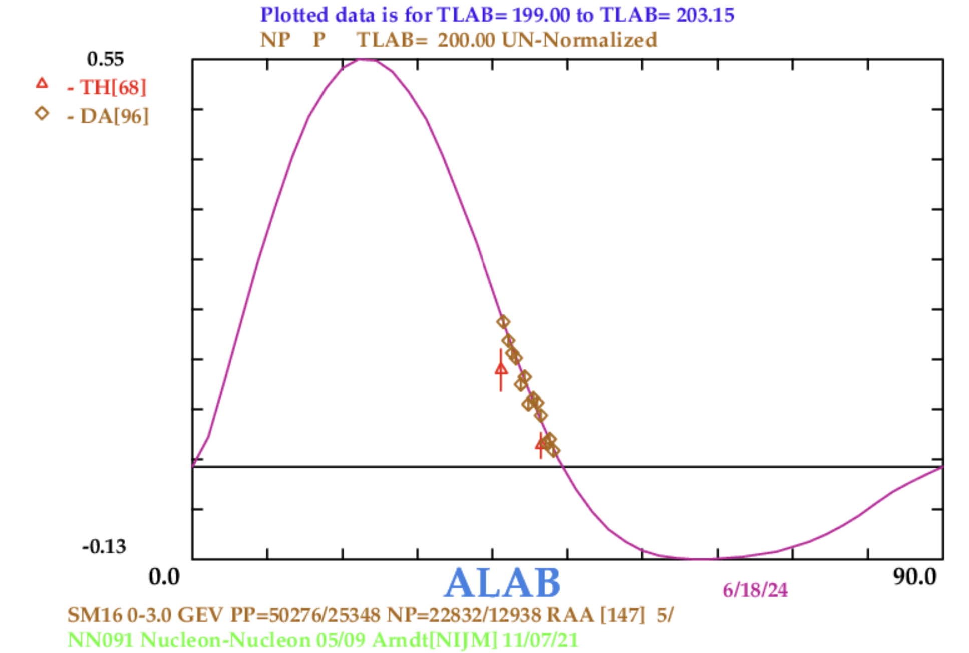
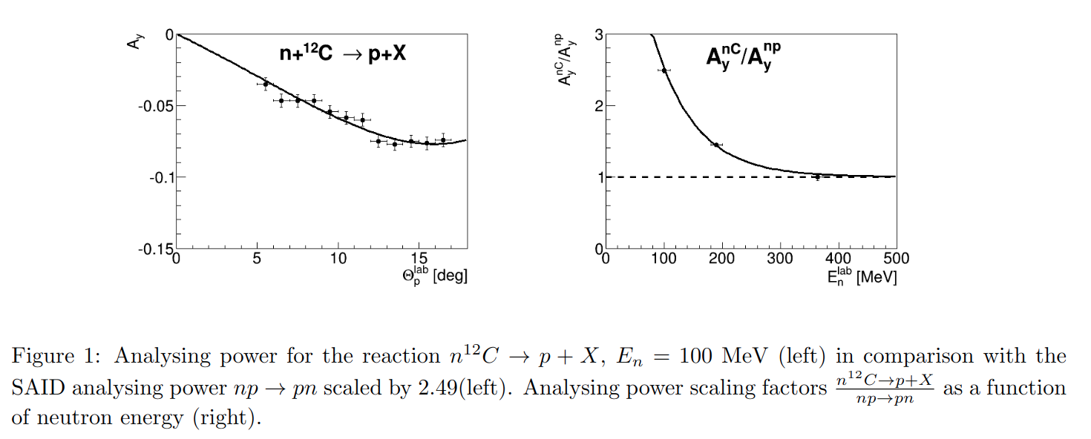
Analysing power
SAID database: np->pn Ay
12

Slide 13
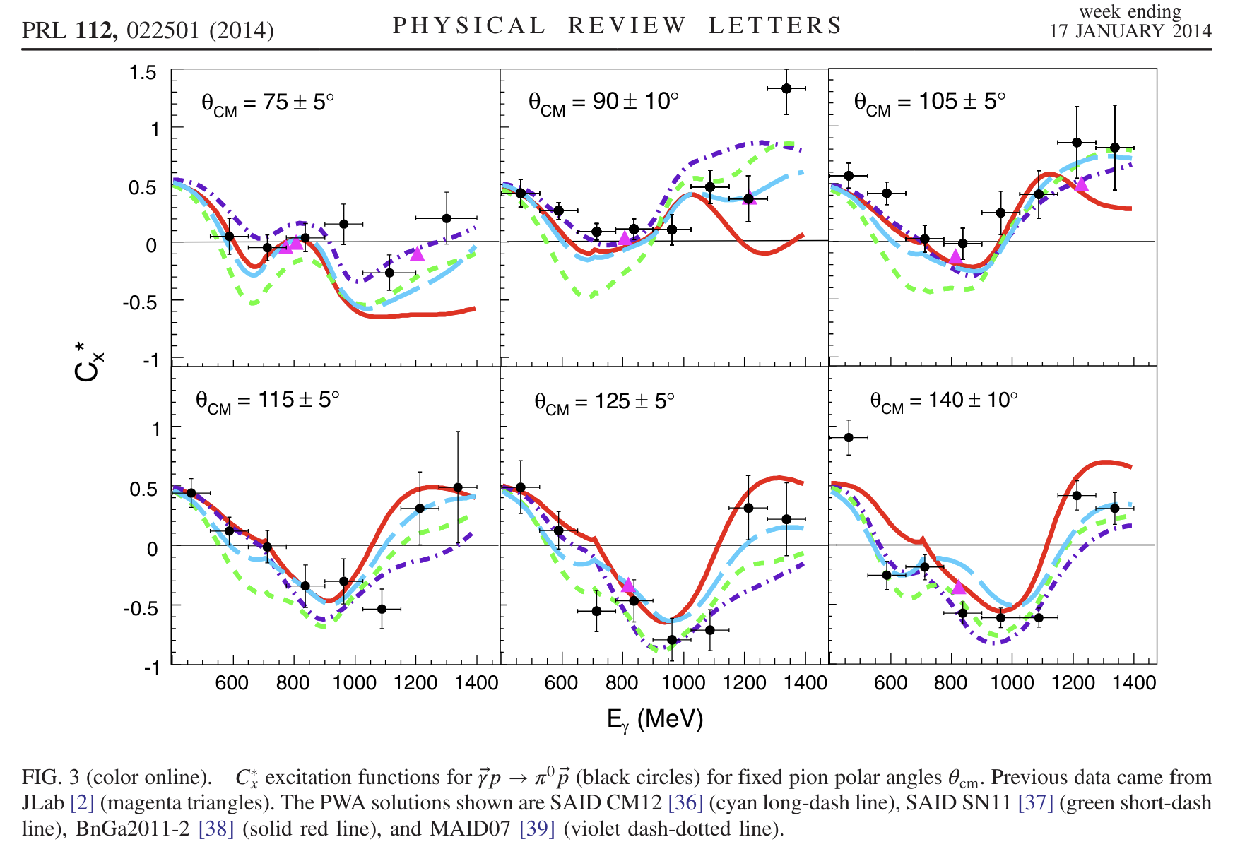
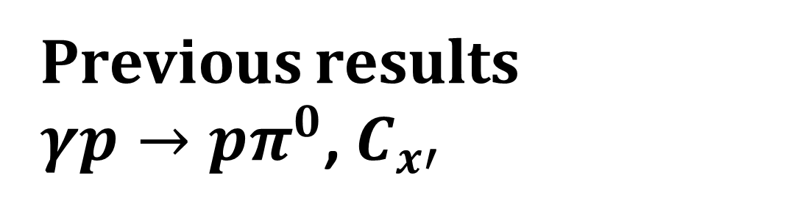
Previous results
$γp→pπ^{0}$, $C_{x′}$
13

Slide 14
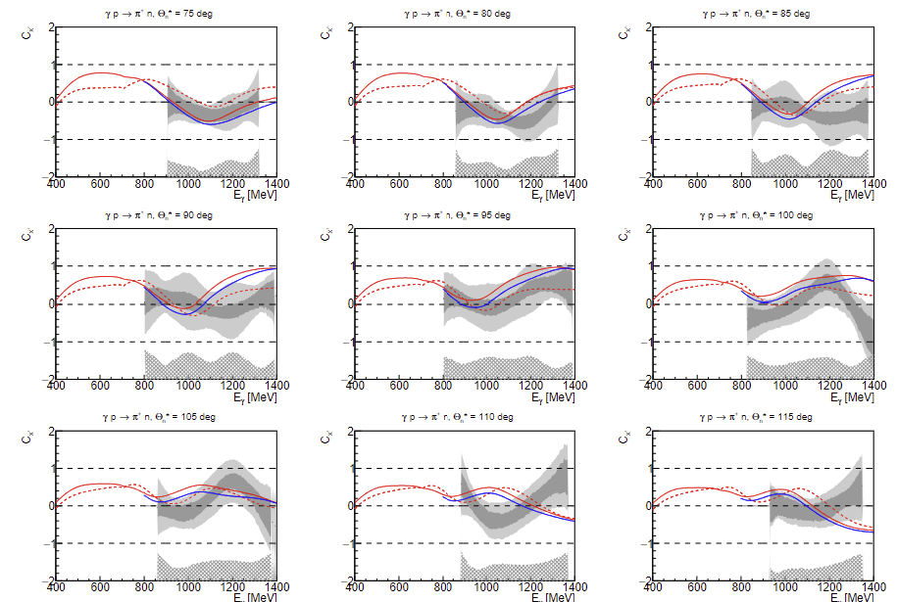
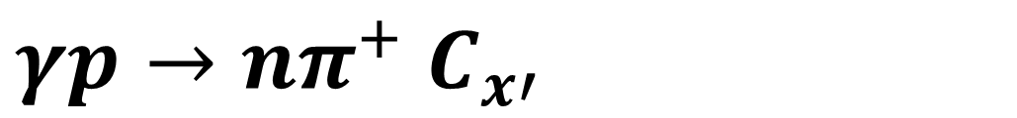
$γp→nπ^{+}$ $C_{x′}$
M. Bashkanov et. al, Phys. Let. B 847 (2023) 138283
SAID22, SAID23, BnGa
14

Slide 15
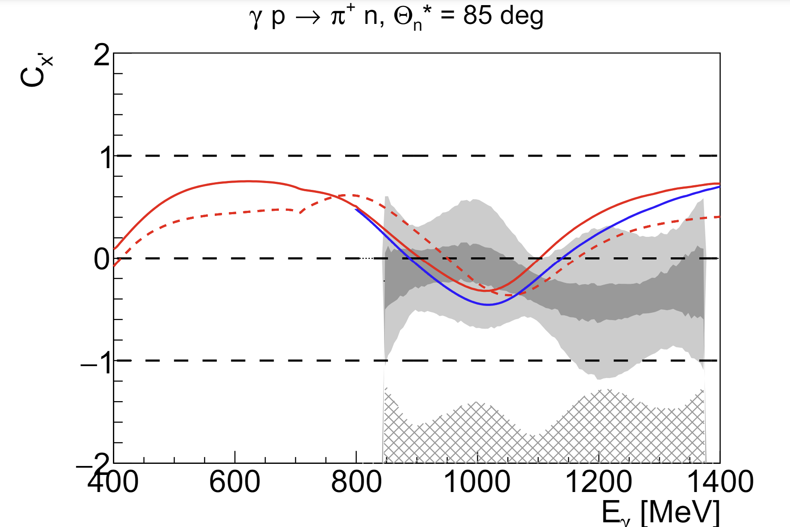
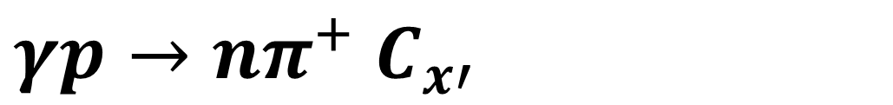
$γp→nπ^{+}$ $C_{x′}$
M. Bashkanov et. al, Phys. Let. B 847 (2023) 138283
SAID22, SAID23, BnGa
15

Slide 16
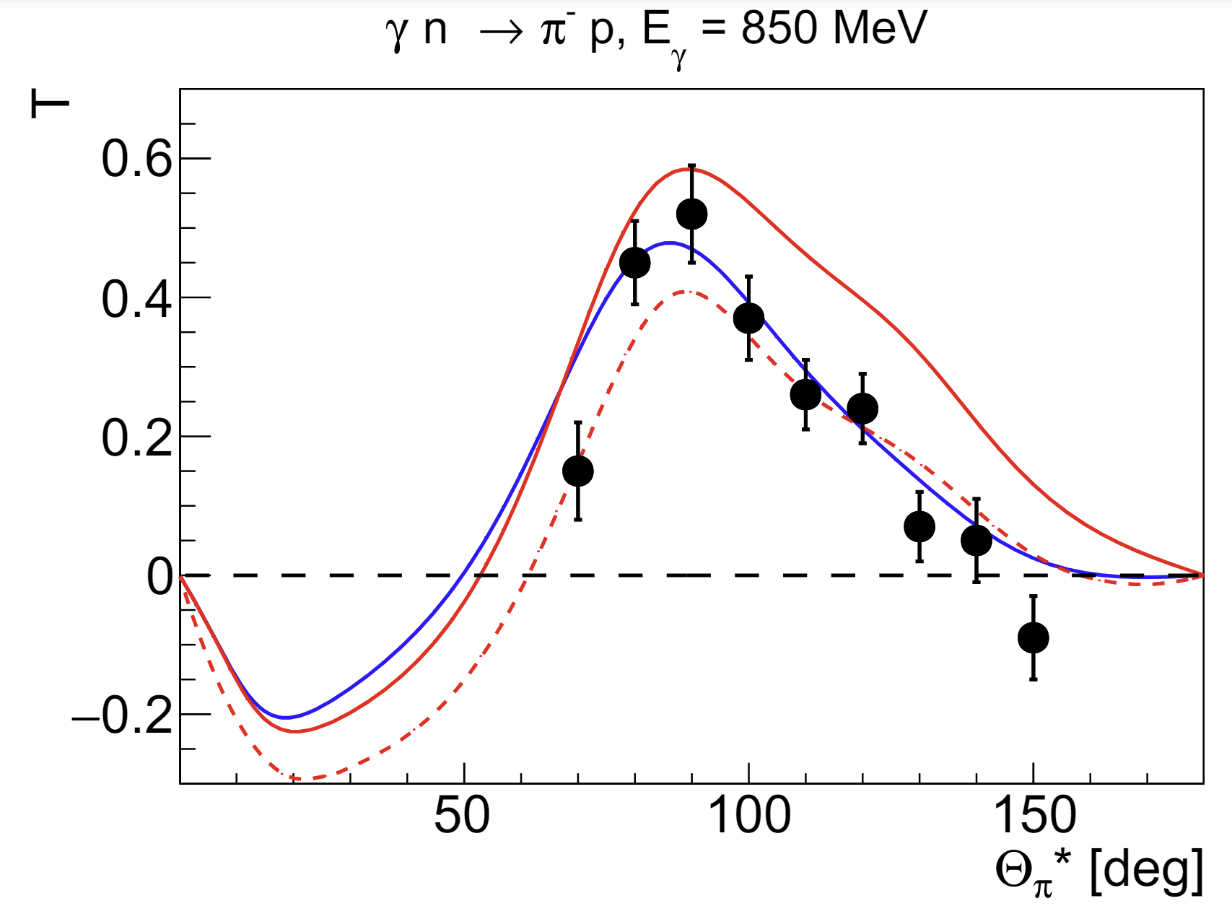
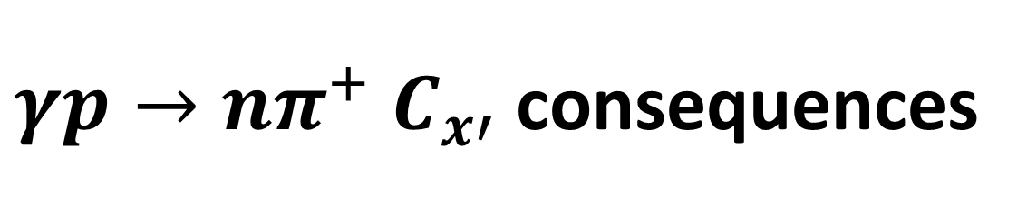
$γp→nπ^{+}$ $C_{x′}$ consequences
SAID22, SAID23, BnGa
16

Slide 17
Conclusion
Double-polarisation measurements is a powerful tool
  Systematics
  Baryon spectroscopy
  Need other measurements besides Beam-Target
17

Slide 18
Thank you
ΔΩ

