Slide 1

N* Physics with CLAS12 at Jefferson Lab
Patrick Achenbach (Jefferson Lab)
On behalf of
The CLAS Collaboration
June 2o24

Slide 2
CLAS12 N* Physics at NSTAR2024
Complementing the talks of
Ralf Gothe: Probing Bound Three-Quark Excitations
from Low to High Photon Virtualities
Dan Carman: Strangeness Production at JLAB
Victor Mokeev: N* Structure and the Emergence of Hadron Mass
Stefan Diehl: Exploring resonance structure with transition GPDs
Kyungseon Joo: Inclusive Electron Scattering Off the Proton in the
Resonance Region with CLAS12 at Jefferson Lab
Asli G. Acar: Elucidating Strangeness with CLAS12
Patrizia Rossi: Future Plans at JLab
others …
There is room for some history and general overview in my talk

Slide 3
The Bigger Picture
People have always been fascinated by what is hidden from their view
and by what might be found inside objects

Slide 4
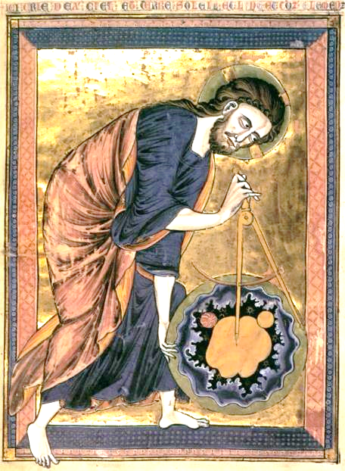
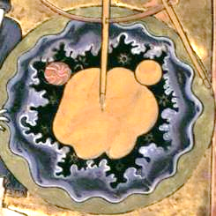
A Long-Standing Human Tradition in Deciphering Nature
A medieval European vision of
studying the Universe
by an unknown painter ca. 1250
Properties of hadrons:
Shape and symmetries
Size and scale
Sub-structures
Structure variations
with distance
Hadrons make up the visible Universe
mass emerged
confinement
Properties of N*s and other hadrons closely connected to the structure and evolution of the Universe
[F. Gross et al, Eur. Phys. J. C 83,1125 (2023)]

Slide 5
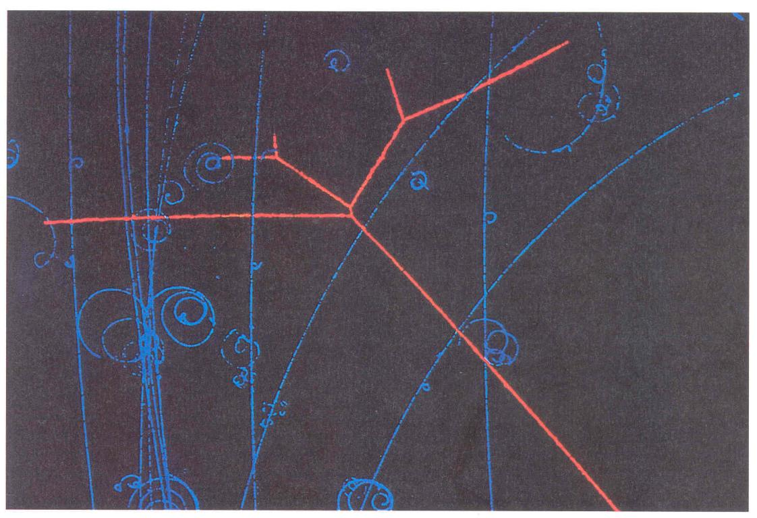
The Proton as a Hard Sphere Scattering Center
[Lawrence Berkeley Laboratory]
Proton as an invisible scattering center
Billiard balls are hard spheres of equal masses colliding with each other
One important principle of pool: when one ball strikes another without spin, the two balls will always separate at 90°
This principle is a direct result of energy and momentum conservation
Spherical objects have smallest surface-to-volume ratio of any three-dimensional form: minimal potential energy for a free system
Many freely formed objects in nature have a spherical shape, for example planets, stars, bubbles, and water drops
p
In a bubble chamber, proton scattering on hydrogen resembles “billiards kinematics”: no inelasticity, no N*s

Slide 6
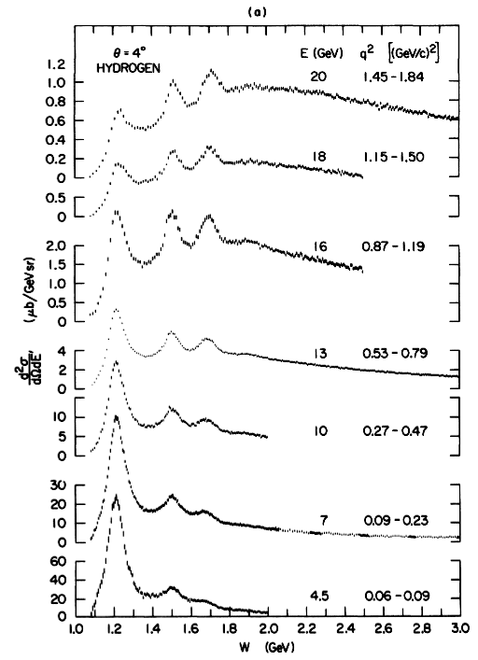
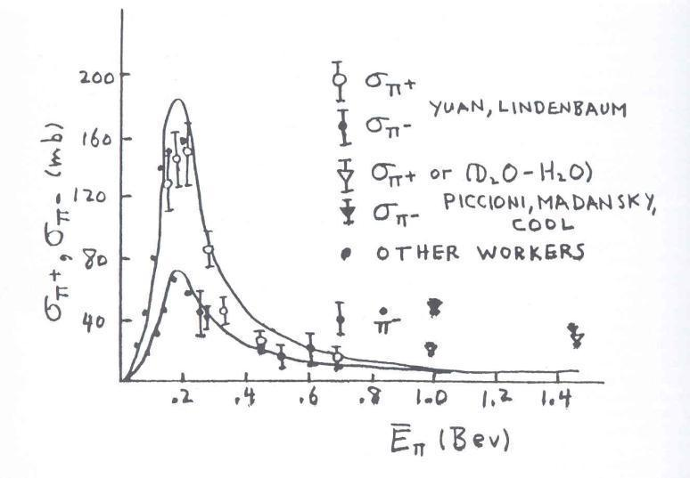
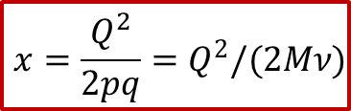
Excitation of Proton Resonances
[Stein et al., Phys. Rev. D 12 (1975)]
[Yuan, Rochester Conference (1954)]
Virtuality of photon:
Charged pion beams revealed a clear
proton resonance as early as 1954
(and established charge independence)
Electron scattering on protons revealed
several resonance regions in the 1970s
Inelasticity of process:
$$x={\frac{Q^{2}}{2pq}=Q}^{2}/(2Mν)$$
Mass of excited proton:

Slide 7
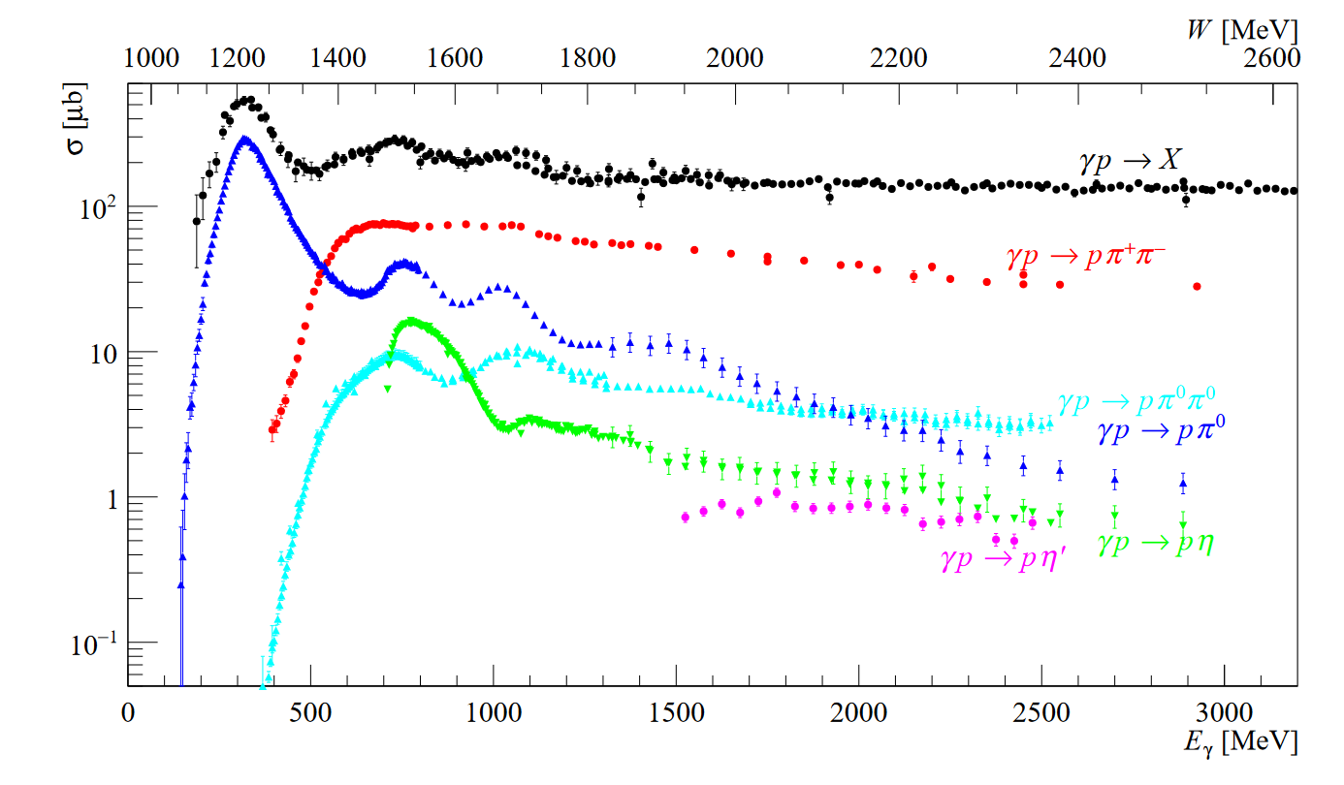
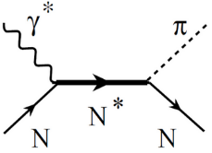
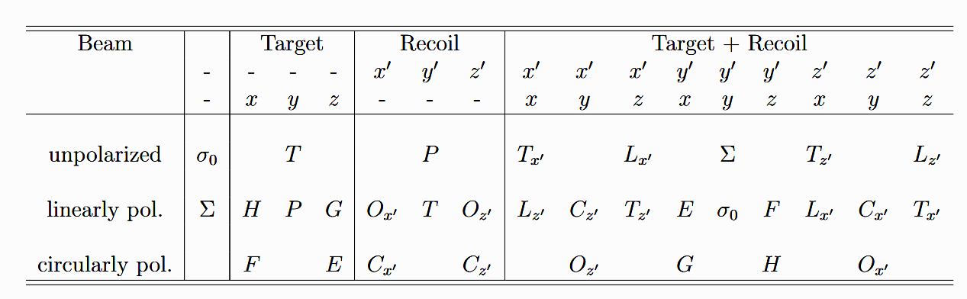
The Virtue of Electro- (and Photo-) Excitations
Clean process with electromagnetic vertex well known from QED
Study of many relevant observables:
– Excitation spectrum / quantum numbers
– Selective and exclusive reactions
Single-pion production
as an example:
  – Q² evolutions in electroproduction
– Polarization observables:
[A. Thiel, F. Afzal, Y. Wunderlich,
Prog. Part. Nucl. Phys. 125, 103949 (2022)]
Light baryon spectroscopy by meson-production reactions at electron accelerators

Slide 8

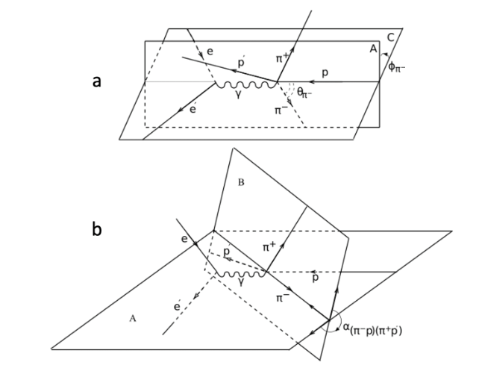
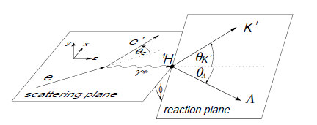

Separation of Cross Sections Into Structure Functions
Five-fold differential cross section separates in virtual photon flux and virtual photoproduction
Single-kaon production:
Double-pion production:
Degree-of-polarization of photon:
Helicity of incoming electron: h
[E. Amaldi, S. Fubini, and G. Furlan, Pion-Electroproduction (1979)]
[A. Donnachie & G. Shaw, Electromagnetic Interactions of Hadrons (1978)]

Slide 9
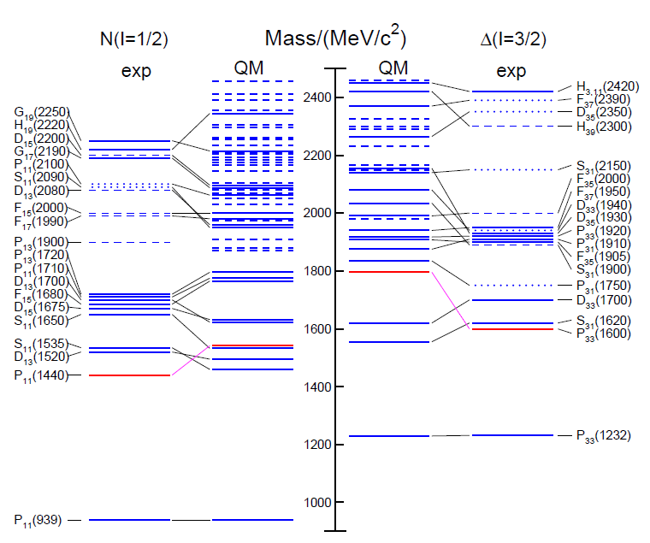
N* Spectrum in Experiments vs. Quark Models
State | 2010 | 2020 | πN | KΛ | KΣ | γN
N(1710)1/2⁺ | *** | **** | **** | ** | * | ****
N(1875)3/2⁻ |  | *** | ** | * | * | **
N(1880)1/2⁺ |  | *** | * | ** | ** | **
N(1895)1/2⁻ |  | **** | * | ** | ** | ****
N(1900)3/2⁺ | ** | **** | ** | ** | ** | ****
N(2000)5/2⁺ | * | ** | * |  |  | **
N(2060)5/2⁻ |  | *** | ** | * | * | ***
N(2100)1/2⁺ | * | *** | *** | * |  | **
N(2120)3/2⁻ |  | *** | ** | ** | * | ***
Δ(1600)3/2⁺ | *** | **** | *** |  |  | ****
Δ(1900)1/2⁻ | ** | *** | *** |  | ** | ***
Δ(2200)7/2⁻ | * | *** | ** |  | ** | ***
Some problems are evident:
– Ordering and clustering of states
– Missing resonances
– Incomplete/uncertain data (*/**)
L_{2I 2J} (mass)
L = angular momentum state
I = isospin of resonance
J = total spin of resonance
N/Δ(mass)J^{P}
[PDG Review Part. Phys. (2022)]
The nucleon’s excitation spectrum reflects its complexity where our knowledge is incomplete

Slide 10
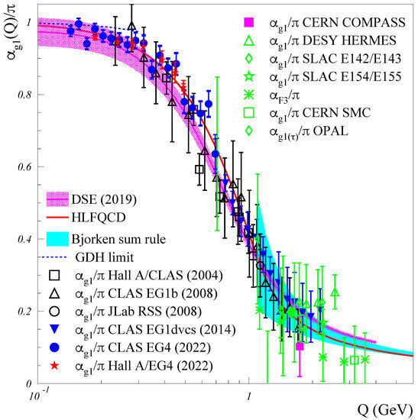
Non-Perturbative QCD Phenomena
For 𝑄 ≪ 1 GeV, 𝛼_{s}(𝑄) ≳ 1, which is one of the crucial pieces leading to quark confinement
Calculation of non-perturbative QCD phenomena can be performed numerically in Lattice QCD
Continuum QCD methods such as Dyson-Schwinger and Bethe-Salpeter equations (DSE/BSE) do not require a discretization of spacetime
Data show that the QCD effective charge α_{g1}(Q) becomes Q-independent at very low Q
Data compare well with two recent predictions based on DSE and on the AdS/CFT duality
α_{g1}(Q) approaches QCD running coupling α_{s}(Q) and characterizes magnitude of the strong interaction
[A. Deur et al., "Experimental Determination of the QCD Effective Charge α_{g1}(Q)", Particles 5, 171 (2022)]
Experimental access to QCD observables through spin structure of neutron and proton

Slide 11
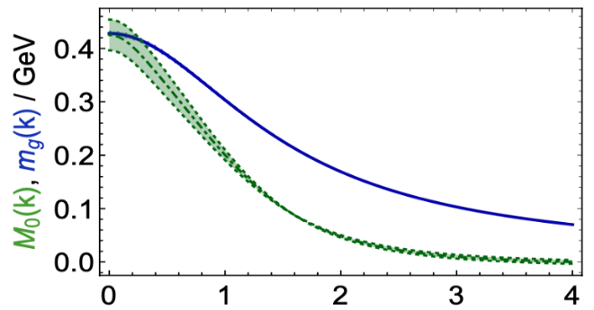


QCD Dynamics with Dressed Quarks
Concepts within Continuum Schwinger Method:
Dressed quark mass depends on its momentum
Emergence of hadron mass (EHM) from QCD
Consistency on momentum evolution of dressed quark mass function to validate of insight into EHM
Confinement & constituent quark mass
M=M(p)
m₀=m_{HM}
dressing kernel
dressed quark
bare quark
Dressed
gluons
Dressed
quarks
Bare Higgs mass
Momentum (k), GeV
[M. Ding, C.D. Roberts, S.M. Schmidt, Emergence of Hadron Mass and Structure, Particles 6, 57 (2023)]
Hadron masses are an emergent feature of QCD

Slide 12
Program of N* Physics at Electron Accelerators
Study of exclusive reaction channels over a broad kinematic range: πN, ωN, φN, ƞN, ƞ’N, ππN, KY, K*Y, KY*
Common efforts at Jefferson Lab, ELSA, MAMI, and others:
- Separation of resonant and non-resonant contributions
Extraction of electrocouplings from zero to high Q²:
- Quark mass momentum dependence shapes N* states and Q² evolution of electrocouplings
Many facets of non-perturbative strong interaction are reflected in N* states and emergence from QCD
Goal must be to explore the spectrum and structure of N* states and their connection to QCD dynamics

Slide 13
CLAS12 for Jefferson Lab Experimental Hall B
Good physics needs good tools

Slide 14
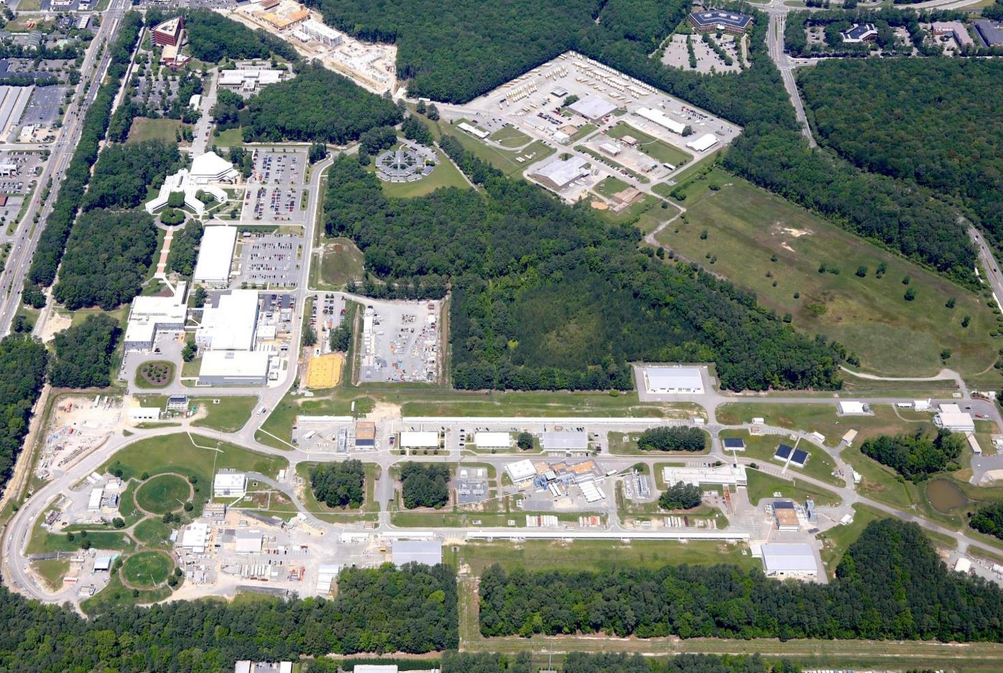
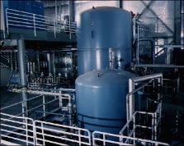
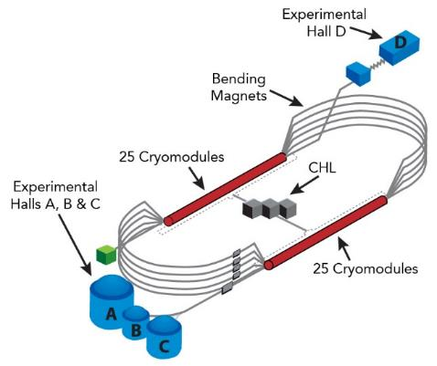
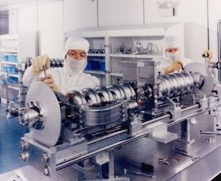
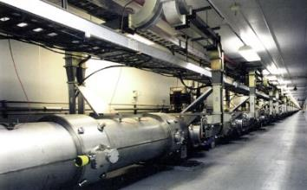
Jefferson Lab Operating the 12-GeV CEBAF
Cryogenic refrigeration plant
CEBAF at 12-GeV schematics
Superconducting niobium radiofrequency cavities
Linearly pol. photon beam
D
A
Cryomodules in the accelerator tunnel
B
3 electron beams, cw, E_{max}= 10.6 GeV, P ~ 90%
C
Recirculation arcs

Slide 15
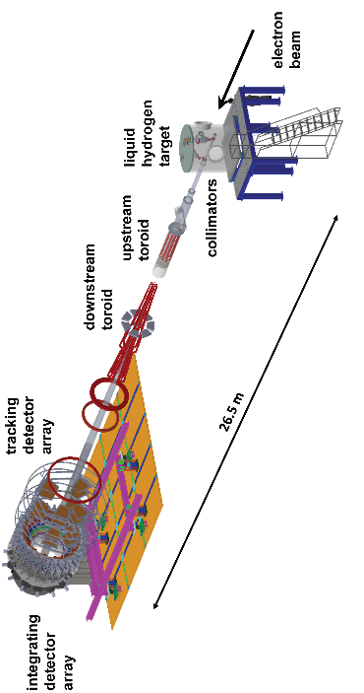
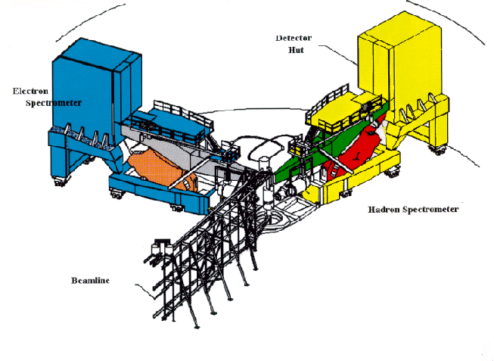
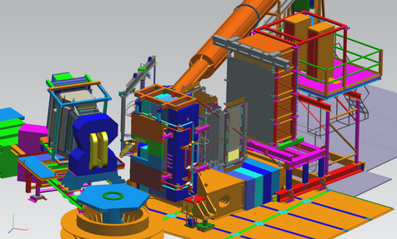
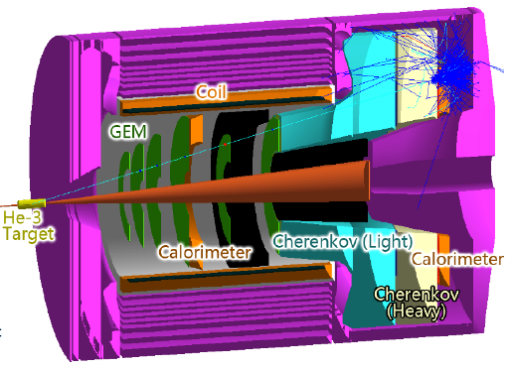
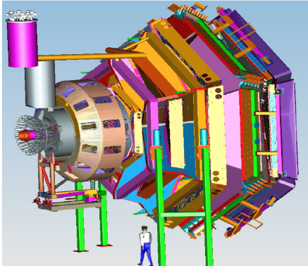
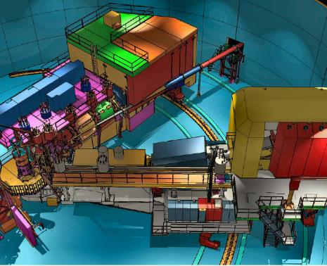
Spectrometers and Instruments in Halls A, B, and C
L+R HRS
Hall A
BigBite & SBS
Hall A
MOLLER
To come in Hall A
SOLID
Proposed in Hall A
CLAS12
Hall B
HMS & SHMS
Hall C
NPS
Hall C

Slide 16
Design Model of The CLAS12 Spectrometer
Beam
85% longitudinally pol. electrons
Max. luminosity: 10³⁵ s⁻¹cm⁻²
Energies: up to ~ 10.6 GeV
Torus & Forward Detector
Targets (org. by Run Groups)
Proton (RG-A/K)
Deuteron (RG-B)
Nuclei (RG-M/D/E)
Long. pol. NH₃/ND₃ (RG-C)
Solenoid & Central Detector
Magnetic Field
beam
[V.D. Burkert et al., Nucl. Inst. and Meth. A 959, 163419 (2020)]
Ideal instrument to study exclusive meson electroproduction
in the nucleon resonance region
Notes:
- Review the design of the CLAS12 spectrometer its components and its properties.

Slide 17
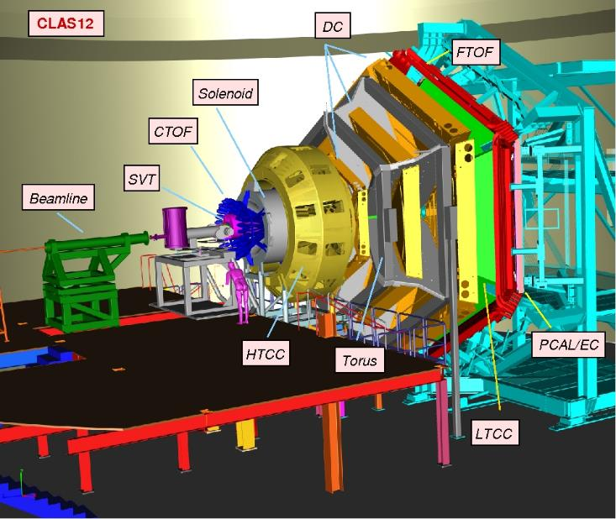
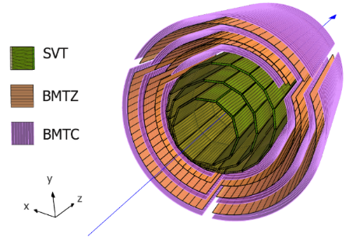
Subsystems of the CLAS12 Spectrometer
C
E
N
T
R
A
L
Beamline
Target
Central Vertex Tracker
Central Time of Flight
Central Neutron Det.
Back-Angle Neutron Det.
High Threshold Cherenkov
Forward Tagger
Drift Chambers
Low Threshold Cherenkov
Ring Imaging Cherenkov
Forward Time of Flight
EM Calorimeter
F
O
R
W
A
R
D
Notes:
- Highlight photograph of CLAS12.

Slide 18
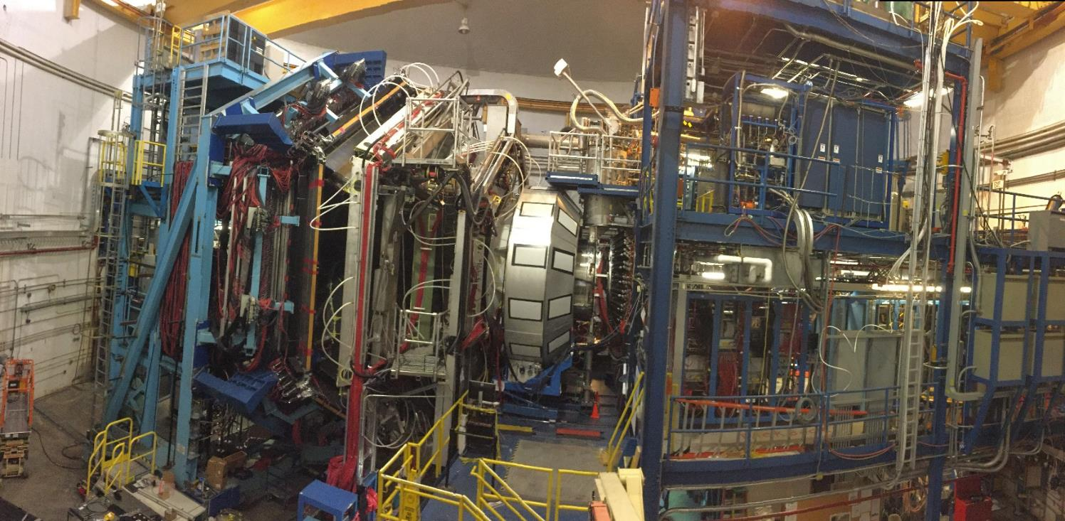
Side View Photograph of CLAS12 Spectrometer
1m
Electron beam
Central
Detector
Forward
Detector

Slide 19
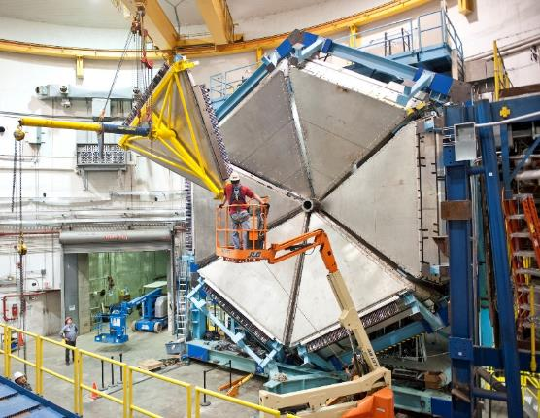
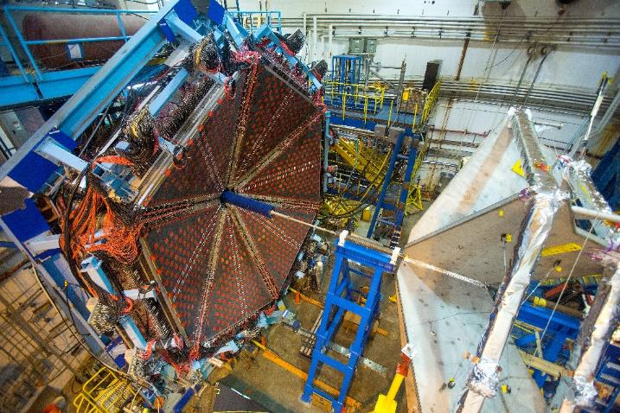
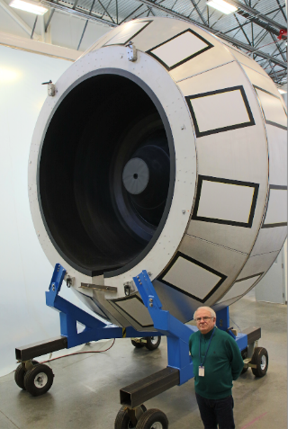
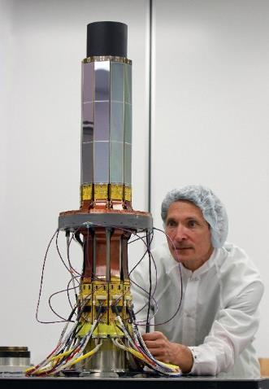
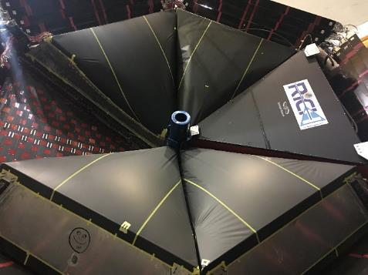
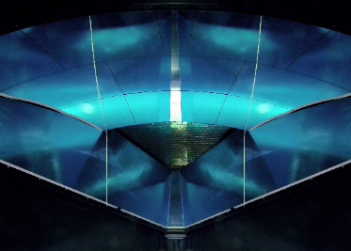
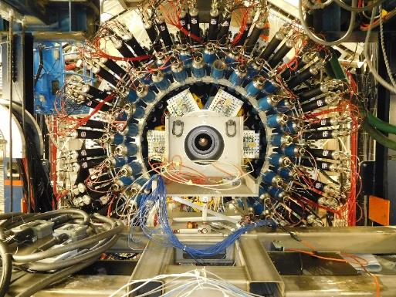
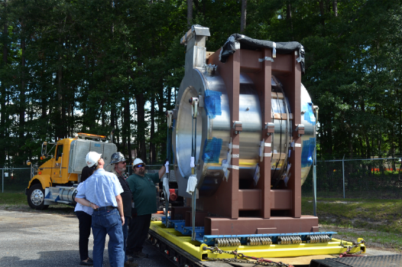
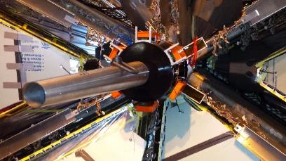
CLAS12 Subsystems During Installation

Slide 20
CLAS & CLAS12 Nucleon Resonance Studies
Not all bumps are resonances, not every resonance generates a bump in all observables

Slide 21
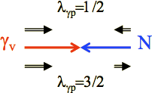
Overview of Extractions of Electrocouplings
Reaction Channel | N*, Δ* States | Q² ranges of γ_{v}pN* Electrocouplings (GeV²)
π⁰p, π⁺n | Δ(1232)3/2⁺ N(1440)1/2⁺, N(1520)3/2⁻, N(1535)1/2⁻ | 0.16 – 6.0 0.30 – 4.16
π⁺n | N(1675)5/2, N(1680)5/2⁺, N(1710)1/2⁺ | 1.6 – 4.5
ƞp | N(1535)1/2⁻ | 0.2 – 2.9
π⁺π⁻p | N(1440)1/2⁺, N(1520)3/2⁻ Δ(1620)1/2⁻, N(1650)1/2⁻, N(1680)5/2⁺, Δ(1700)3/2⁻, N(1720)3/2⁺, N’(1720)3/2⁺ | 0.25 – 1.5 0.5 – 1.5
Analysis codes employed for extractions:
Unitary Isobar Model (UIM)
Fixed-t dispersion relations (DR)
Data-driven reaction model for π⁺π⁻N (JM09, JM16, JM19) [I.G. Aznauryan et al., Int. J. Mod. Phys. E 22, 1330015 (2013)]
[V. Mokeev, Few-Body Syst. 57, 909 (2016)]
[V. Mokeev and D. Carman, Few-Body Syst. 63, 59 (2022)]
Helicity amplitudes:
e’
}
A_{1/2} , A_{3/2} : transverse
S_{1/2}: longitudinal
γ_{v}
M
for πN and ƞN
e
N*,△*
Q²
N
B

Slide 22
Amplitude Extraction using Breit-Wigner Parametrization
Cross sections of resonance r of mass M_{r} and width Γ_{tot}(M_{r}) = Γ_{r} and spin J_{r}:
with following kinematic definitions:
Electromagnetic decay widths at the resonance point W = M_{r} given by:

Slide 23
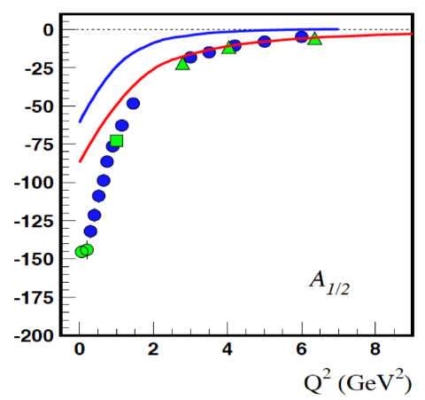
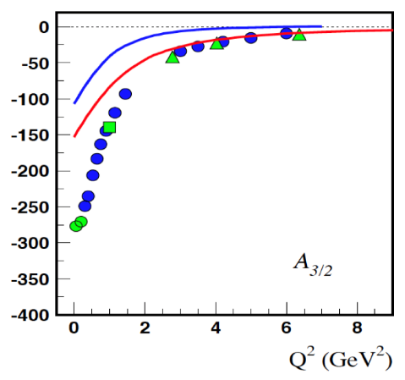
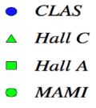
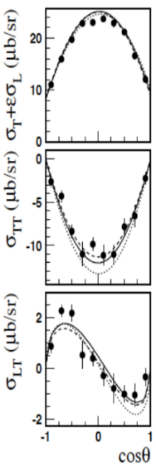
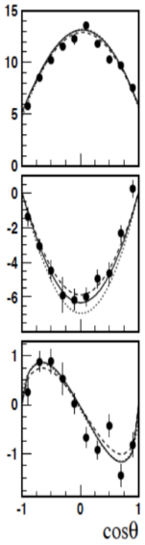
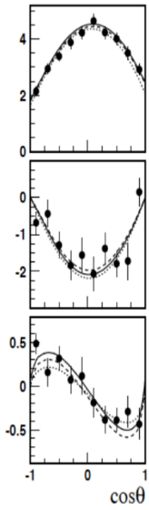
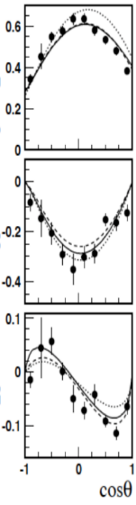
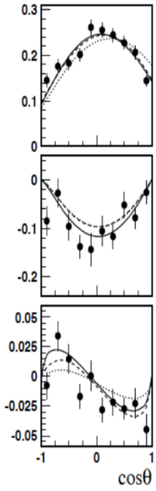
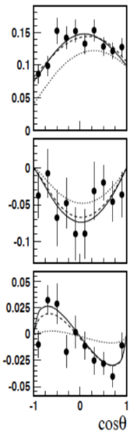
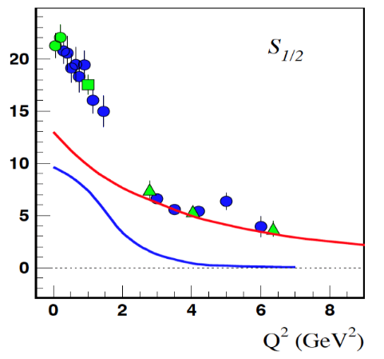
CLAS N* Electrocouplings – First Resonance Region
γ*p → π⁰p
W = 1.232 GeV
Q² = 0.4 GeV² 0.75 1.45 3.0 4.2 5.0
A_{1/2}*1000 (GeV^{-1/2})
A_{3/2}*1000 (GeV^{-1/2})
Δ(1232)3/2⁺
QCD calculations compatible with data where meson cloud does not contaminate evolution Q² ≤ 2 GeV²
LC RQM
MB (inferred)
S_{1/2}*1000 (GeV^{-1/2})
Good agreement between UIM and DR approaches
[I.G. Aznauryan et al., Phys. Rev. C 80, 055203 (2009)]

Slide 24
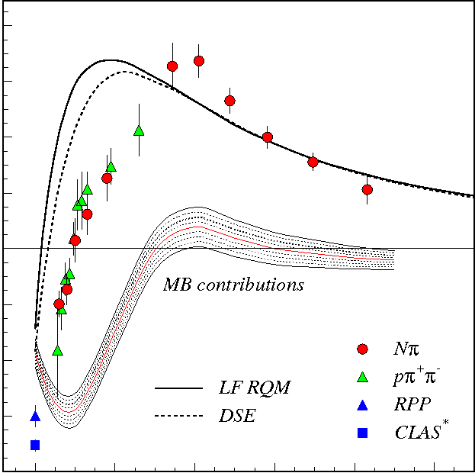
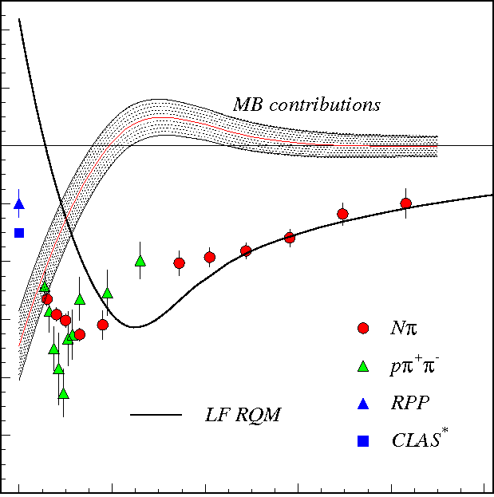
CLAS N* Electrocouplings – Second Resonance Region
80
60
40
20
0
-20
-40
-60
-80
N(1440)1/2⁺
γ*p → pπ
γ*p → pππ
40
20
0
-20
-40
-60
-80
-100
-120
N(1520)3/2⁻
A_{1/2}*1000 (GeV^{-1/2})
A_{1/2}*1000 (GeV^{-1/2})
0 1 2 3 4 5
0 1 2 3 4 5
Q² (GeV²)
[V.D. Burkert, Few-Body Syst. 57, 873 (2016)]
Q² (GeV²)
Electrocouplings reveal different interplay between meson-baryon cloud and quark core
  Good agreement of the extracted N* electrocouplings from Nπ and Nππ:
  - Compelling evidence for reliability of results
  - Different channels have very different mechanisms for non-resonant background
Need for data on the electrocouplings over broad range of Q²

Slide 25



CLAS N* Electrocouplings – Third Resonance Region
γ*p → pππ
Most high-lying N* states decay mainly to Nππ with much smaller strength to Nπ
Δ(1620)1/2⁻
Δ(1700)3/2⁻
N(1720)3/2⁺
1.46-1.56 GeV
1.56-1.66 GeV
1.61-1.71 GeV
1.61-1.71 GeV
1.66-1.76 GeV
1.71-1.81 GeV
1.61-1.71 GeV
1.66-1.76 GeV
1.71-1.81 GeV
S_{1/2}*1000 (GeV^{-1/2})
A_{1/2}*1000 (GeV^{-1/2})
A_{3/2}*1000 (GeV^{-1/2})
[Mokeev, Aznauryan, IJMPC 26, 1460080 (2014); Mokeev et al., PRC 93, 025206 (2016); Carman, Joo, Mokeev, FBS 61, 29 (2020)]
Nππ channel gave first electrocoupling results on higher-lying states up to 1.8 GeV

Slide 26


Description of pπ⁺π⁻ Data by a Reaction Model
5-fold differential cross section $\frac{d^{5}σ}{d^{5}τ}$ , where the denominator consists of differentials for the five variables that define the final state kinematics
JLab-Moscow Reaction Model (JM)
Full
Resonances
Background
[V.I. Mokeev et al., Phys. Rev. C 86, 035203 (2012)]
Model provides reasonable description of data for extraction of resonance electrocouplings

Slide 27

Nucleon Resonance Electroexcitation Amplitudes
[D.S. Carman, R.W. Gothe, V.I. Mokeev, and C.D. Roberts, Particles 6, 416 (2023)]
G_{M}*
N→Δ(1232)3/2⁺ magnetic FF
N(1440)1/2⁺
0
-5
-10
-15
-20
-25
Δ(1600)3/2⁺
A_{1/2}*1000 (GeV^{-1/2})
A_{1/2}*1000 (GeV^{-1/2})
Substantial contributions from meson-baryon cloud
Continuum Schwinger Method (CSM) Theory
2 2.5 3 3.5 4 4.5
Q² (GeV²)
Q² (GeV²)
Q² (GeV²)
Satisfactory description for ∆(1232)3/2⁺, N(1440)1/2⁺, ∆(1600)3/2⁺
Continuum QCD predictions:
[Y. Lu et al., Phys. Rev. D 100, 034001 (2019)]
Important evidence for the different internal structures of nucleon resonances
Insight into strong interaction dynamics underlying Emergence of Hadron Mass
Data compared to Continuum Schwinger Method with momentum-dependent quark masses

Slide 28
Strangeness and Multi-Strangeness Production
Stranger in a Strange Land

Slide 29





Electroproduction of the Very Strangest Baryons
Study of S = −2 and −3 baryons
with the CLAS12 detector
S = −1
Ω baryon is unique but simple I = 0 system of 3 strange quarks: place to study internal structure of baryons
Little known of excited Ω and Ξ baryons
- Only 2 Ω and 6 Ξ states well-established
- Even fewer spin-parity assignments
- SU(3) flavor multiplets are incomplete
Old way of spectroscopy
S = −2 and −3

Slide 30


Strategies to Access Multi-Strange Baryons
Production processes:
$ep→\text{e}\text{’}\text{K}\text{+}\text{K}\text{+} {\text{Ξ}}^{−(∗)}$
$ep→$ e’K⁺K⁺K⁰ Ω$−$
Decay processes:
Ω$−→$(Ʌ→pπ−)K⁻$, \text{Ξ}0$π−
$\text{Ξ}∗→\text{Ξ}\text{π}$
$\text{Ξ}→\text{(Ʌ}\text{→}\text{p}\text{π}\text{−}\text{)}\text{π}$
Multiparticle charged final states:
- High efficiency
- Good kaon PID
Cross sections small, background high:
Displaced vertices
[V. Ziegler, in progress]

Slide 31



Identification of Weak Decays
ed → e’K+(Ʌ→pπ−)n
Dependence on vertex displacement
long. vertex displ.
Study of dependence on momentum transfer Q²
ed → e’K+(Ʌ→pπ−)n
ed → e’K+(Ʌ→pπ−)n
PRELIMINARY
PRELIMINARY
PRELIMINARY
PRELIMINARY
ep → e’K+(Ʌ→pπ−)
PRELIMINARY
PRELIMINARY
PRELIMINARY
trans. vertex displ.
PRELIMINARY
1.5 < Q² < 2.5
2.5 < Q ² < 3.5
Invariant mass
[V. Ziegler, in progress]

Slide 32
Resonance Structure from Deep Processes

Slide 33




First Access to Transition GPDs in π⁻Δ⁺⁺ Electroproduction
Transition GPDs as a generalization of GPDs to N → Δ processes
Exploratory measurement of 3D structure of resonances
ep → e’ p π ⁻(π ⁺)
[S. Diehl et al. (CLAS Collab.), Phys. Rev. Lett. 131, 021901 (2023)]

Slide 34






N* Structure in Three Dimensions
[R, Hofstadter et. al., Phys. Rev. 91, 422 (1953)]
[R, Hofstadter, Rev. Mod. Phys. 28, 214 (1956)]
[R. Feynman, Phys. Rev. Lett. 23, 1415 (1969)]

Slide 35
In Conclusion

Slide 36





What is Missing to Complete the Picture?
Study of low-Q² region
Study of very high-Q² region
Study of hadronic couplings
RG-A data 10.6 GeV
N(1440)1/2⁺
A. Accardi et al., e-print:2306.09360 [nucl-ex]

Slide 37
Concluding Remarks on the CLAS N* Program
Study of N* states is one of the key foundations of the CLAS physics program
CLAS has provided a huge amount of data up to Q² ~ 5 GeV²
Electrocouplings of most N* states < 1.8 GeV have been extracted for the first time
CLAS12 will extend these studies to 0.05 < Q² < 12 GeV² and W < 2.4 GeV
Exclusive electroproduction of Nπ, Nƞ, Nππ, KY reactions from
unpolarized proton target with longitudinally polarized electron beam
Data will provide access to higher-lying N* states
Goal is the understanding of active degrees of freedom
that account for N* structure vs. distance scale
Probed N* structure is very complex and relates to fundamental QCD phenomena

Slide 38







Where Do We Stand in Deciphering Nature?
Hot QCD, ~ some μs old Universe, …
Simplification
Time/Energy
One-photon approximation, effective models, …
Complexity
Emergence of mass, gluon & quark dressing, running couplings, …
N* physics is sufficiently complex to reveal hidden phenomena, but not so complex that fundamental theories are bound to fail
[F. Gross et al, Eur. Phys. J. C 83,1125 (2023)]

Slide 39
END

