Slide 1
Experimental program for Super Tau-Charm Facility
Xiaorong Zhou
(On behalf of STCF working group)
University of Science and Technology of China
NSTAR2024
17/6/2024-21/6/2024, York

Slide 2
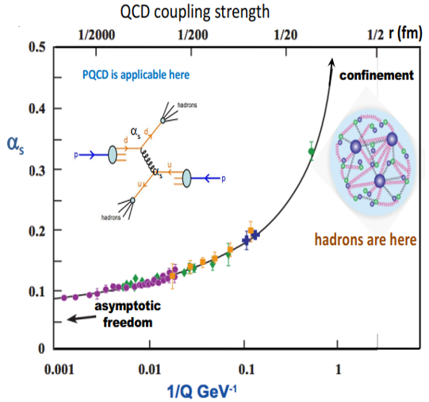
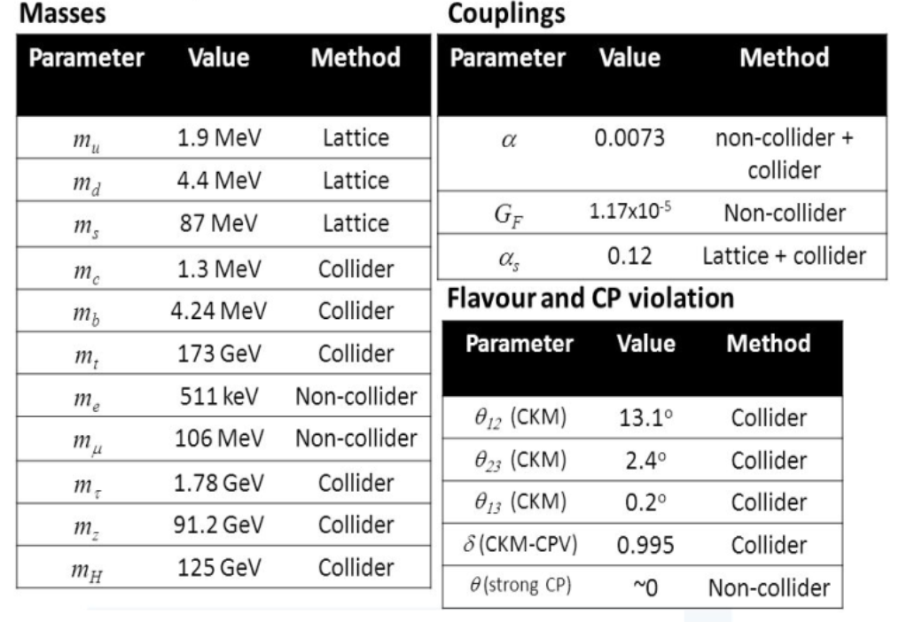
Challenges of the SM model
The SM of particle physics is a well-tested theoretical framework
However, the SM has a number of unresolved questions that require further investigations:
Confinement: formation of colorless bound states —— “hadrons”
Matter-antimatter asymmetry of the Universe; dark matter, numbers of flavors, etc.

Slide 3
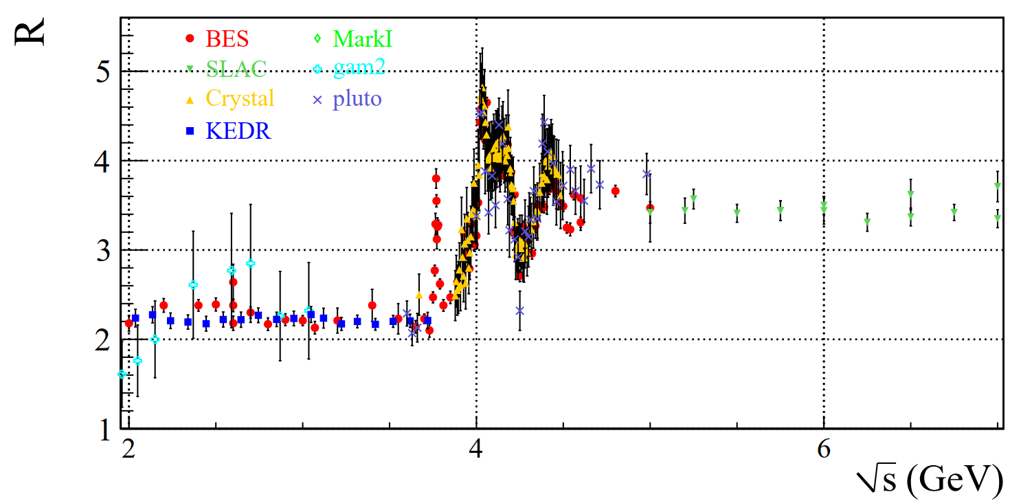

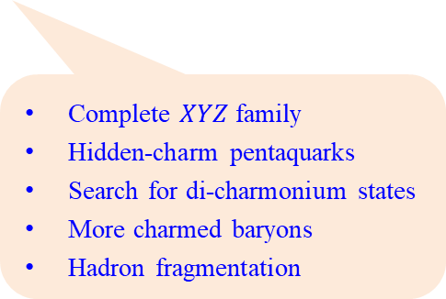
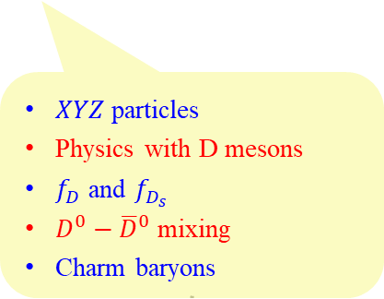
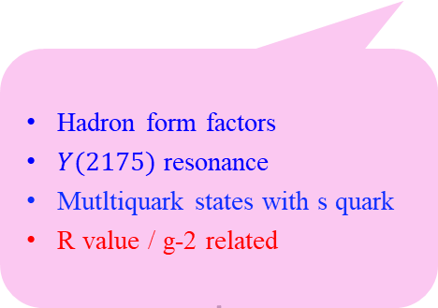
Rich Physics in the Tau-Charm Energy Region
The tau-charm energy region covers a unique transition region between perturbative and non-perturbative QCD, with unique and rich physics programs
Opportunities in 5~7 GeV
Hadron form factors
$Y(2175)$ resonance
Mutltiquark states with s quark
R value / g-2 related
Light hadron spectroscopy
Gluonic and exotic states
Processes of LFV and CPV
Rare and forbidden decays
Physics with τ lepton
$XYZ$particles
Physics with D mesons
$f_{D}$ and $f_{D_{s}}$
$D^{0}−{\overline{D}}^{0}$ mixing
Charm baryons
Complete $XYZ$ family
Hidden-charm pentaquarks
Search for di-charmonium states
More charmed baryons
Hadron fragmentation
Notes:
STCF covers unique transition region between perturbative and non-perturbative QCD
with extremely high statistics data for precision measurements to find answers to these key science questions
Transition region between perturbative and non-perturbative energy region
Rich resonances, large production cross section of charmonium, threshold production of hadron and tau pair
Huge exotic hadrons, gluonic, multi-quark and hybrid states
STCF is expected to have higher detection efficiency and low bkg. for productions at threshold
STCF has excellent resolution, kinematic constraining
with extremely high statistics data for precision measurements to find answers to these key science questions.

Slide 4
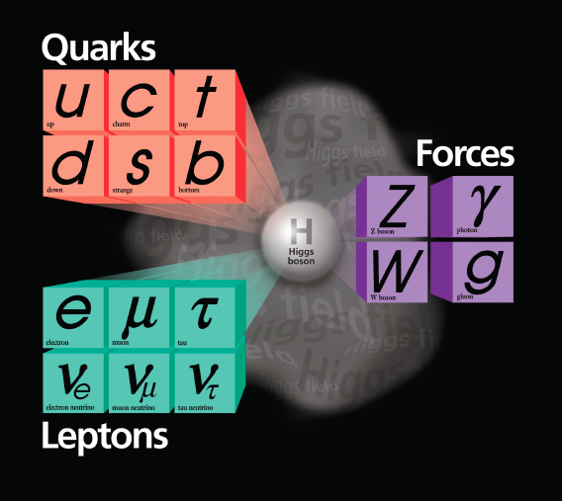
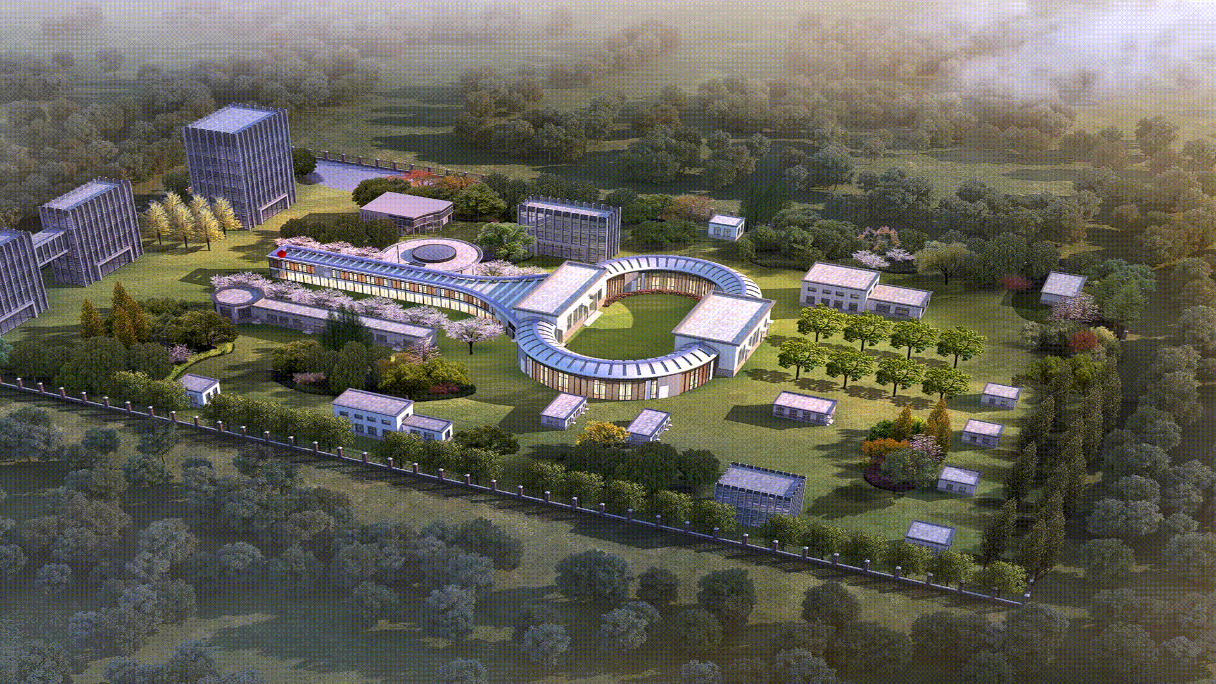
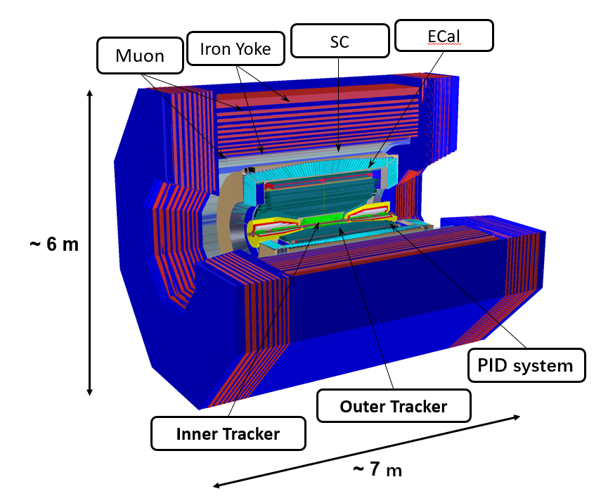

The Super Tau Charm Facility
LINAC: 400m
Collider ring: 800m
Energy range E_{cm} = 2-7 GeV
Peak luminosity >0.5$×$10³⁵ cm⁻²s⁻¹ at 4 GeV
Potential to increase luminosity & realize beam polarization
Total cost: 4.5B RMB
1 ab⁻¹ data expected per year
STCF with energy range 2-7 GeV, is expected to have higher detection efficiency and lower bkg. for productions at threshold
Important area for the study of QCD, exotic hadrons, flavor, and search for new physics
Notes:
A leading international Lab for over 30 years

Slide 5
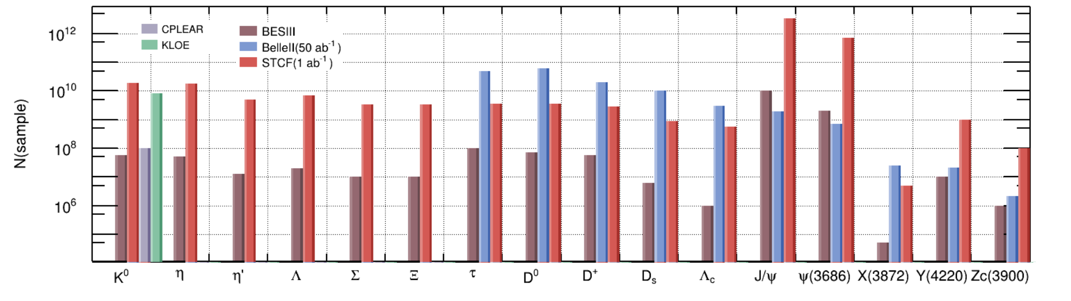
A Super Particle Factory
Rich resonances, large production cross-sections of charmonium, threshold production of hadron and tau pairs
Huge numbers of exotic hadrons, including multi-quarks & states with gluonic excitations
One year
Exotic hadrons
Light hadrons
Tau lepton
Hadrons with charm quarks

Slide 6
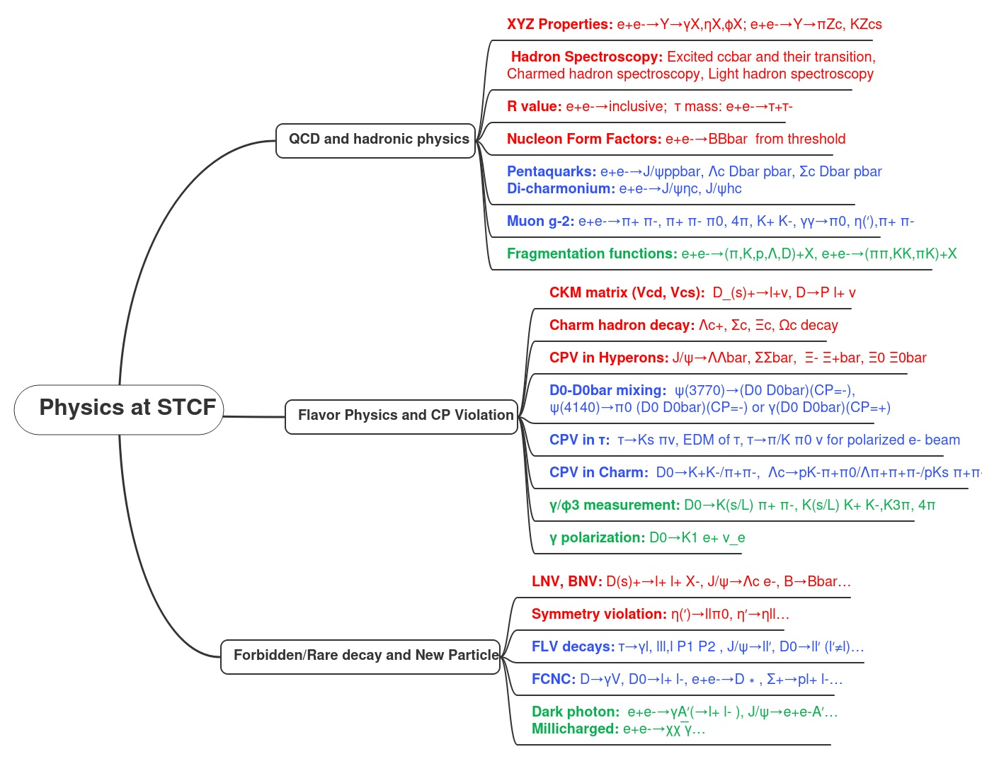

Physics Program at STCF
M. Achasov, et al., STCF conceptual design report (Volume 1): Physics & detector, Front. Phys. 19(1), 14701 (2024)
Leading role
In Competition with Belle II/LHCb
Synergy with BelleII/LHCb/Eic/EicC

Slide 7
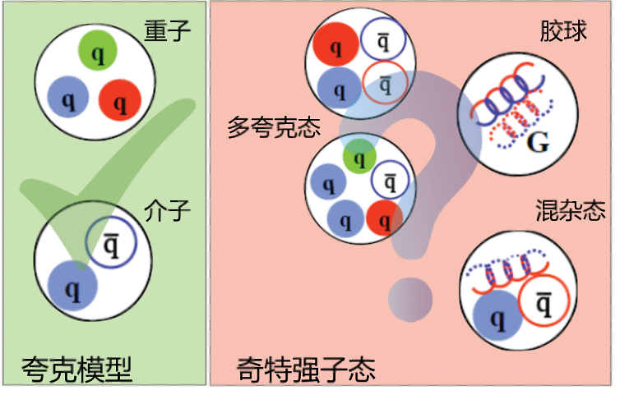
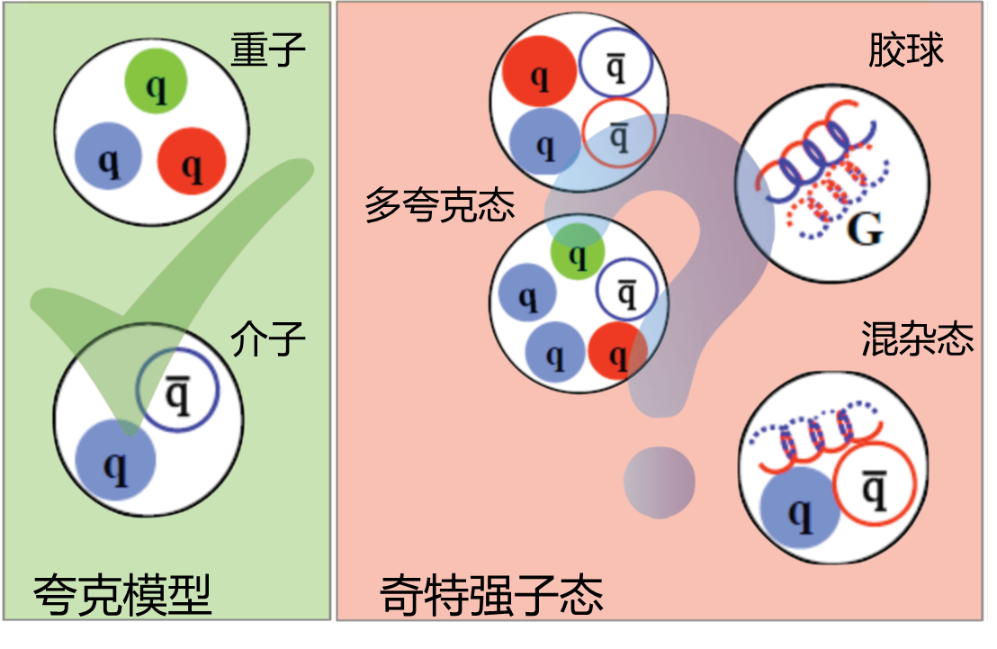

Key Question: Inner structure of hadrons
QCD Couplint $α_{s}$
Exotic hadrons
Hadron structure/spectroscopy is a crucial way to explore the QCD theory and confinement

Slide 8
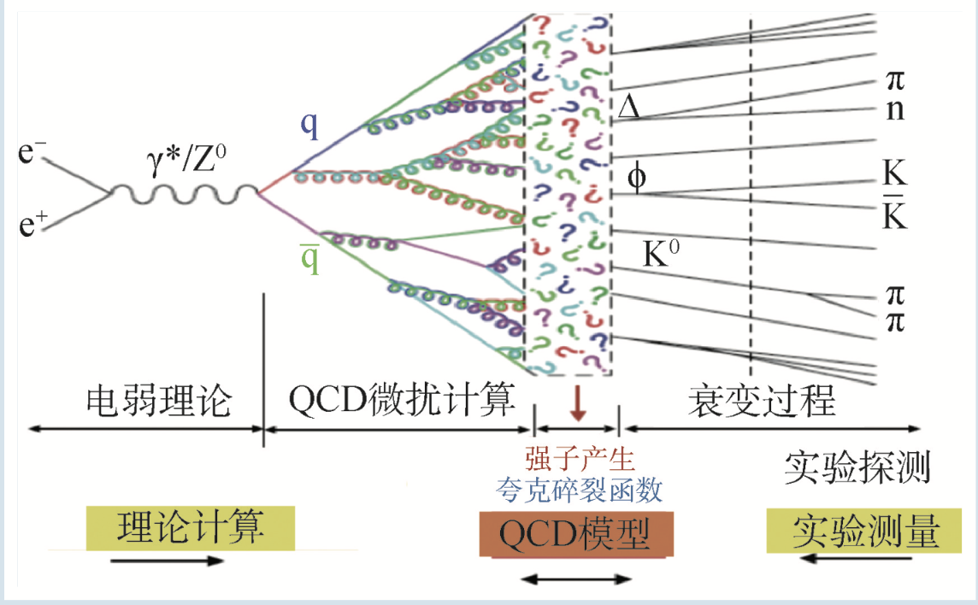
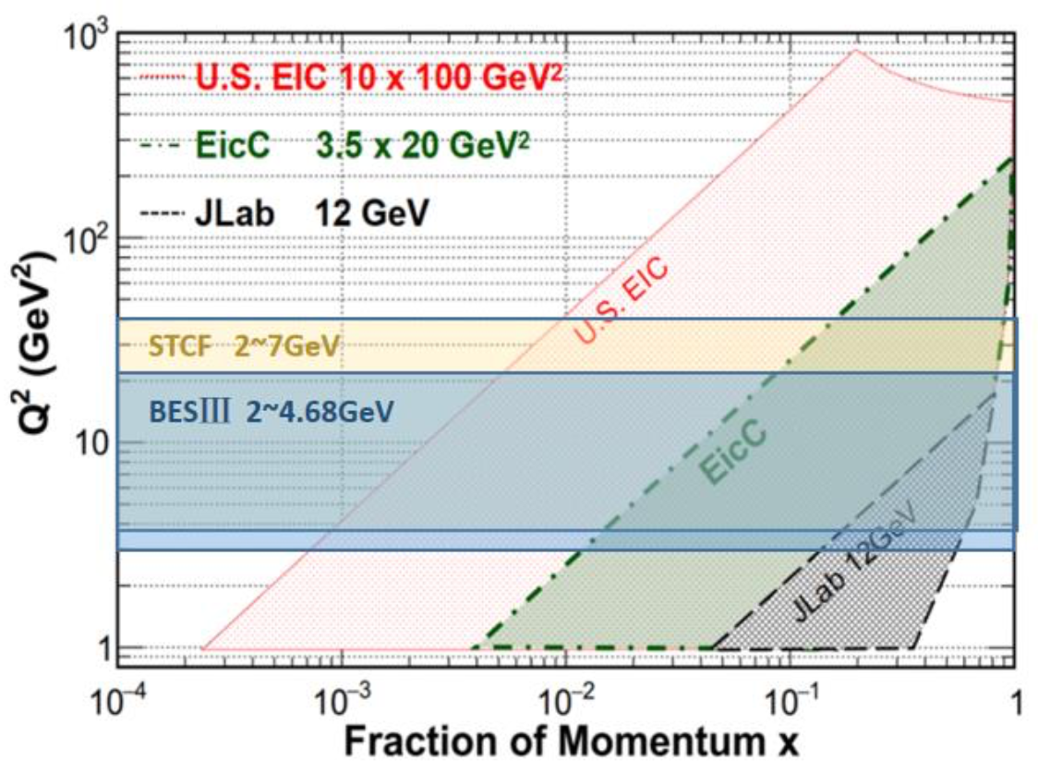
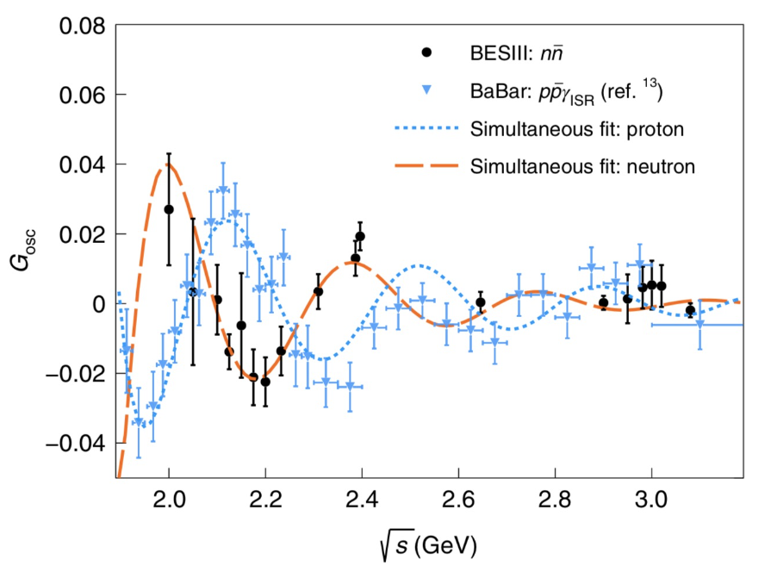
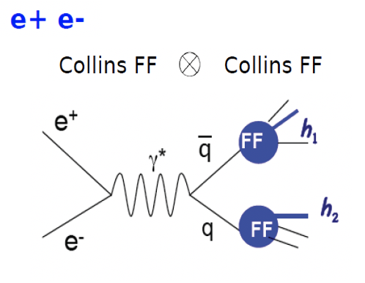
QCD and hadron structure
Remaining big challenge in SM：non-perturbative effect in QCD theory
The largest uncertainty is from the low-energy non-perturbative energy region
STCF fine (ISR) scan from 0.6−7 GeV to study production of hadrons inclusively and exclusively
EicC
STCF
BESIII discovers oscillation of neutron form factor
Hadron form factor and fragmentation function:
complementary measurements between deep inelastic experiments and STCF in similar Q² region

Slide 9
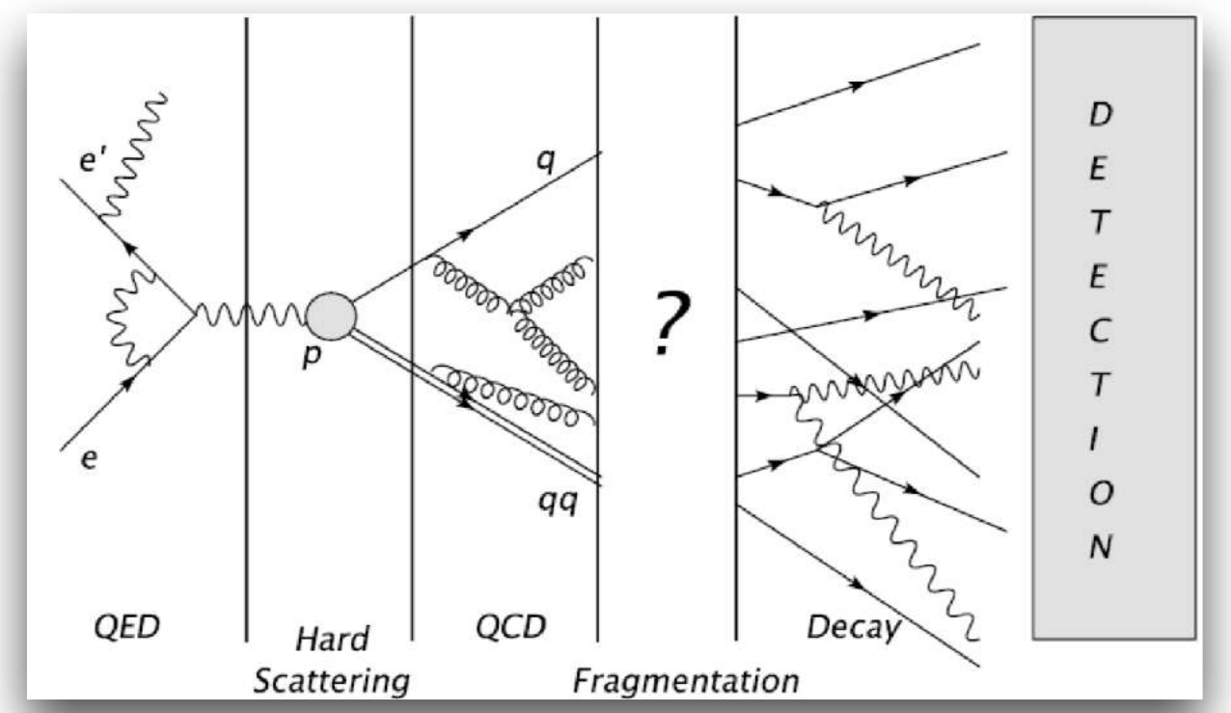
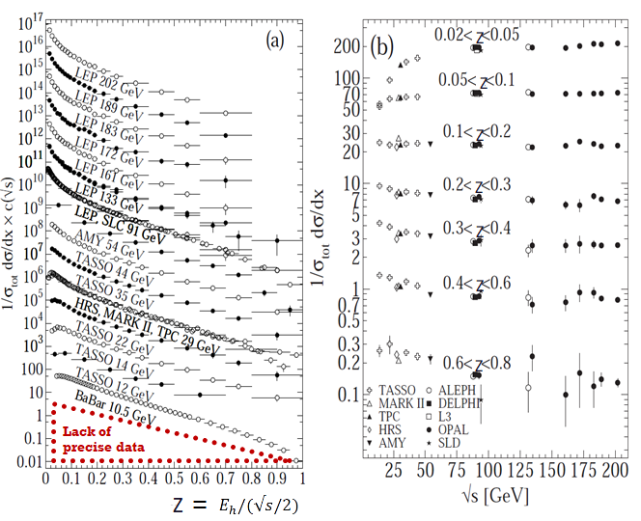
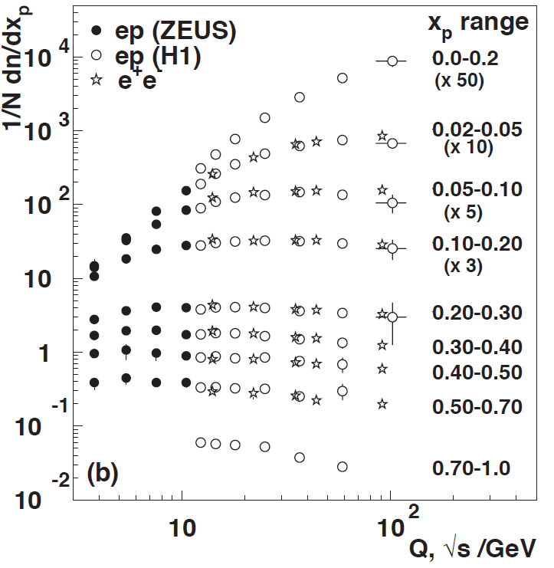
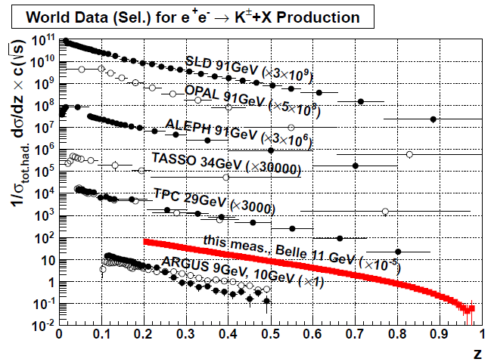
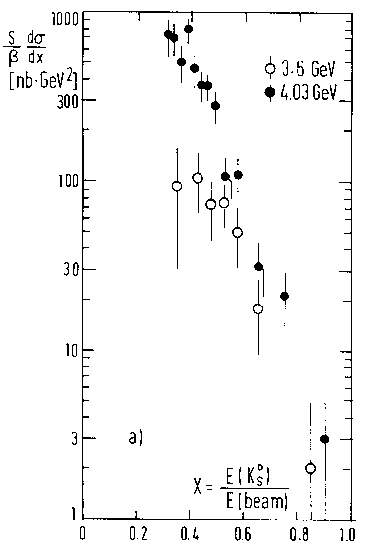
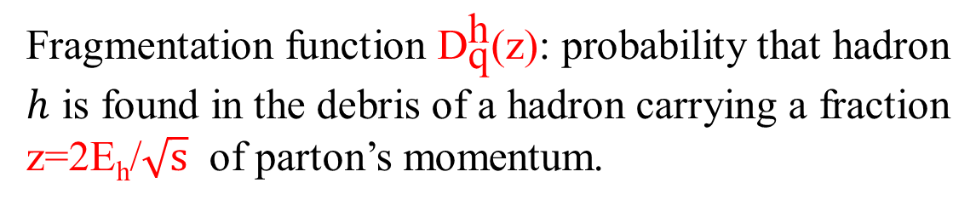
Fragmentation functions
Fragmentation function ${\text{D}}_{\text{q}}^{\text{h}}\text{(}\text{z}\text{)}$: probability that hadron $h$ is found in the debris of a hadron carrying a fraction z=2E_{h}/$\sqrt{s}$ of parton’s momentum.
World data: Pion
World data: Kaon
z
PLUTO
Precise e⁺e⁻data
needed

Slide 10
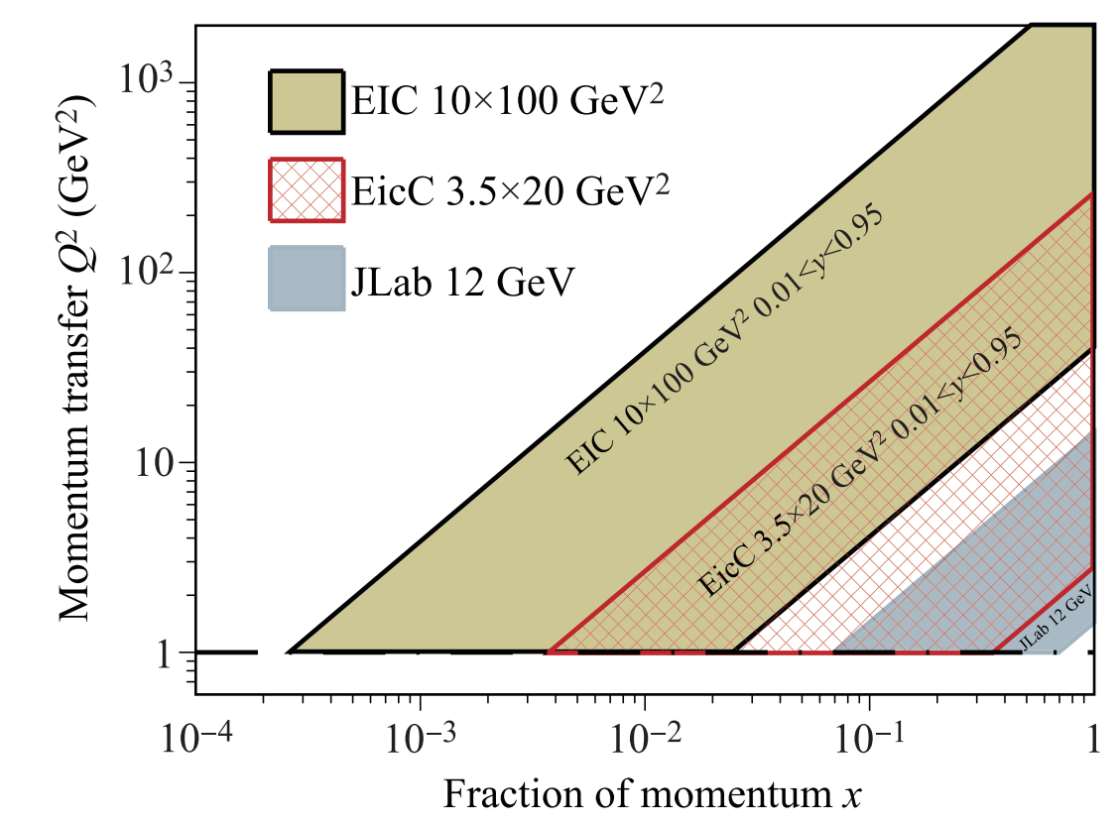
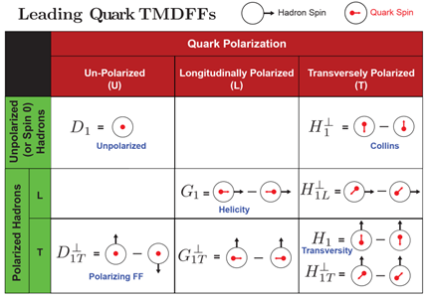
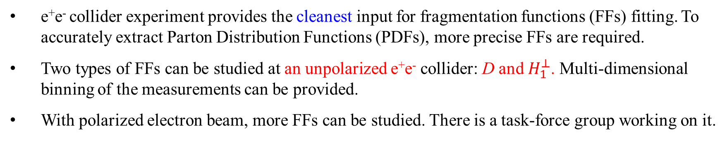
Fragmentation functions at STCF
e⁺e⁻ collider experiment provides the cleanest input for fragmentation functions (FFs) fitting. To accurately extract Parton Distribution Functions (PDFs), more precise FFs are required.
Two types of FFs can be studied at an unpolarized e⁺e⁻ collider: D and $H_{1}^{⊥}$. Multi-dimensional binning of the measurements can be provided.
With polarized electron beam, more FFs can be studied. There is a task-force group working on it.
Notes:
With the choice of angular modulation, it allows us to separate the TMD factorization.
Here is an example from SIDIS: the transverse single-spin asymmetry receive contribution from various sources, including sivers effect, Collins effect and pretzelosity distributon. Where D is the normal unpolarized FF.
The prediction power of TMD factorization leads one to expect that the TMDs will be process-independent.
However, there are different in various measurements, such Sivers function measured in SIDIS and in Drell-Yan process differ by a singn.
The simple and generalized universality should preserve the predictive power of TMD factorization approach.
The spin-average quark distributions are symmetric in the transverse plane. However, if the nucleon is transversely polarized, the quark distribution shows an azimuthal asymmetry. The TMD quark silvers quantify these asymmetries.
The slives effect describes how hadron spin influence the parton transverse motion inside a transversely polarized hadron
Collins: fragmentation of transversely polarized quarks probed in transverse momentum distributions.
The Collins effect described how the parton transverse spin affects its hadronization.
问题：这一页，BESIII目前做的是f1 and h1？ Collins effect/ Collins function
The knowledge of FFs is not only an important ingredient in our understanding of non-perturbative QCD dynamics, but also an essential tool in the description of a number of processes used to examine the internal structure of nucleons.
The momentum-transfer Q for the existing SIDIS data from fixed-target experiments like the ones at JLAB, COMPASS and HERMES covers the range from 1 to 10 , where only sparse SIA data exist. Moreover, the proposed EIC and EICC will provide very high precision structure function measurements which, in order to determine precise parton distribution function for various quark flavors, would put unprecedented requirements on the precision of FFs for the Q value down to 1 GeV and almost complete z coverage from 0 to 1. Therefore, comprehensive investigations on the single inclusive anni hilation with identified pion and kaon final states, espe cially in the region not well covered by previous data, will provide valuable input for the nucleon structure study.

Slide 11
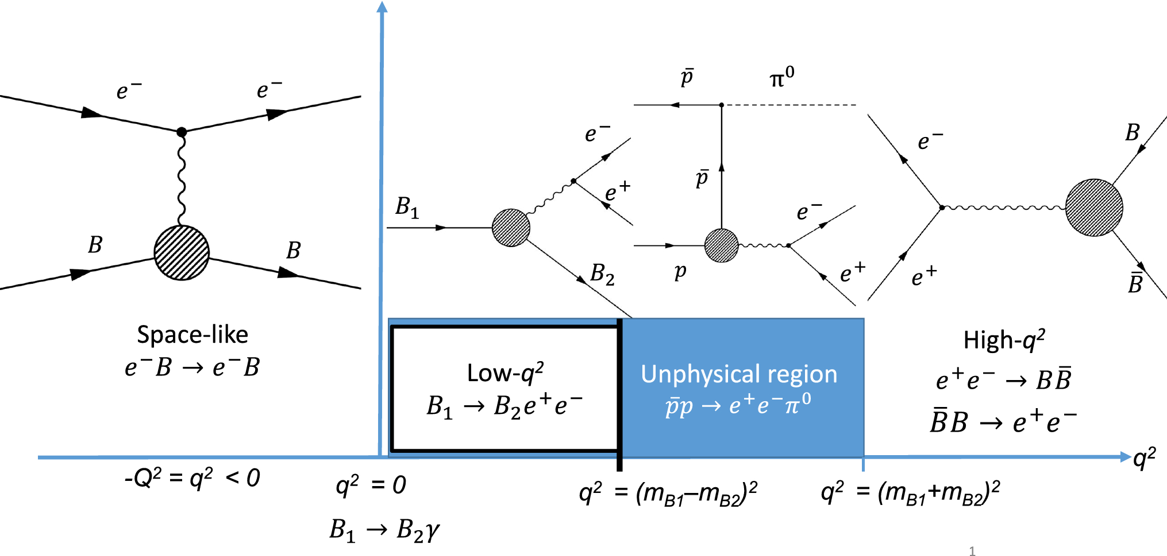
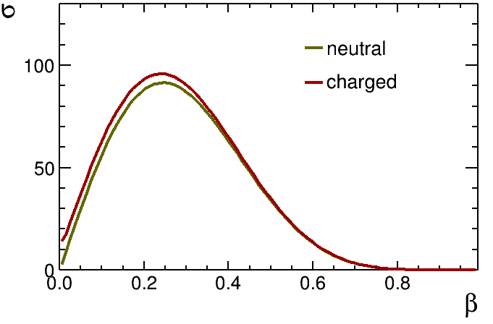
Electromagnetic form factors (EMFFs)
Electromagnetic Form Factors are fundamental properties of the nucleon
  Connected to charge, current distribution
  Crucial testing ground for models of the nucleon internal structure
pQCD predicts continuous transition at high q², with the scaling behavior: $F_{1}∝q^{−4}, F_{2}∝q^{−6}$
pQCD predicts continuous transition at high q², with the scaling behavior: 𝑭_𝟏∝𝒒^(−𝟒), 𝑭_𝟐∝𝒒^(−𝟔)
Modified scaling expression in nonperturbative region: $\frac{q^{2}F_{2}}{F_{1}}∝ln(\frac{q^{2}}{Λ^{2}})$, with $Λ≈0.3$ GeV
Modified scaling expression in nonperturbative region: (𝒒^𝟐 𝑭_𝟐)/𝑭_𝟏 ∝𝐥𝐧(𝒒^𝟐/𝜦^𝟐 ), with Λ≈0.3 GeV
VMD model described the effect of meson cloud $\left|G_{eff}\right|=\frac{𝓐}{\left(1+\frac{q^{2}}{m_{a}^{2}}\right)[1−q^{2}/q_{0}^{2}]^{2}}$
VMD model described the effect of meson cloud |𝑮_𝐞𝐟𝐟 |=𝓐/((𝟏+𝒒^𝟐/(𝒎_𝒂^𝟐 ))[𝟏−𝒒^𝟐/𝒒_𝟎^𝟐 ]^𝟐 )
Various theoretical models describe TLFF in non-perturbative region: ChEFT, VMD, relativistic CQM, parton model, pQCD etc.
Dispersion theoretical analysis, provide a coherent framework for the joint interpretation of SL and TL EMFFs over the entire physical range of q².

Slide 12
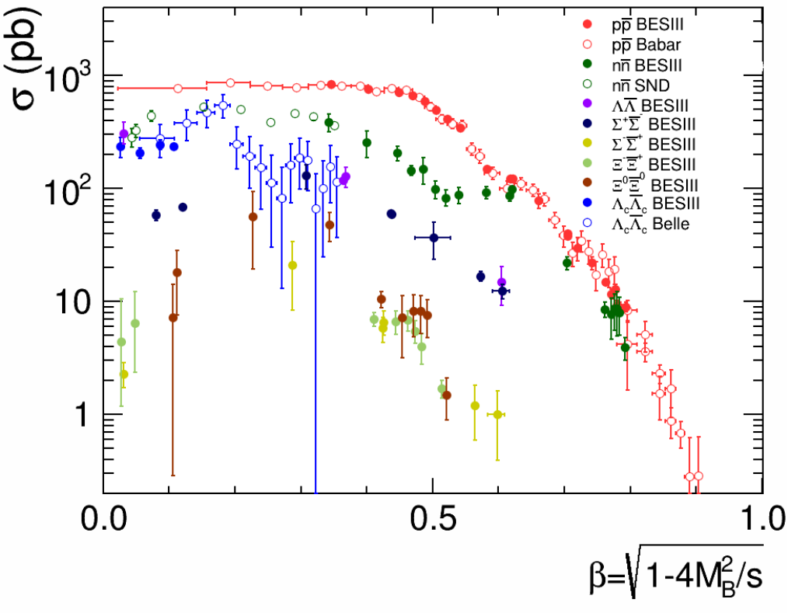
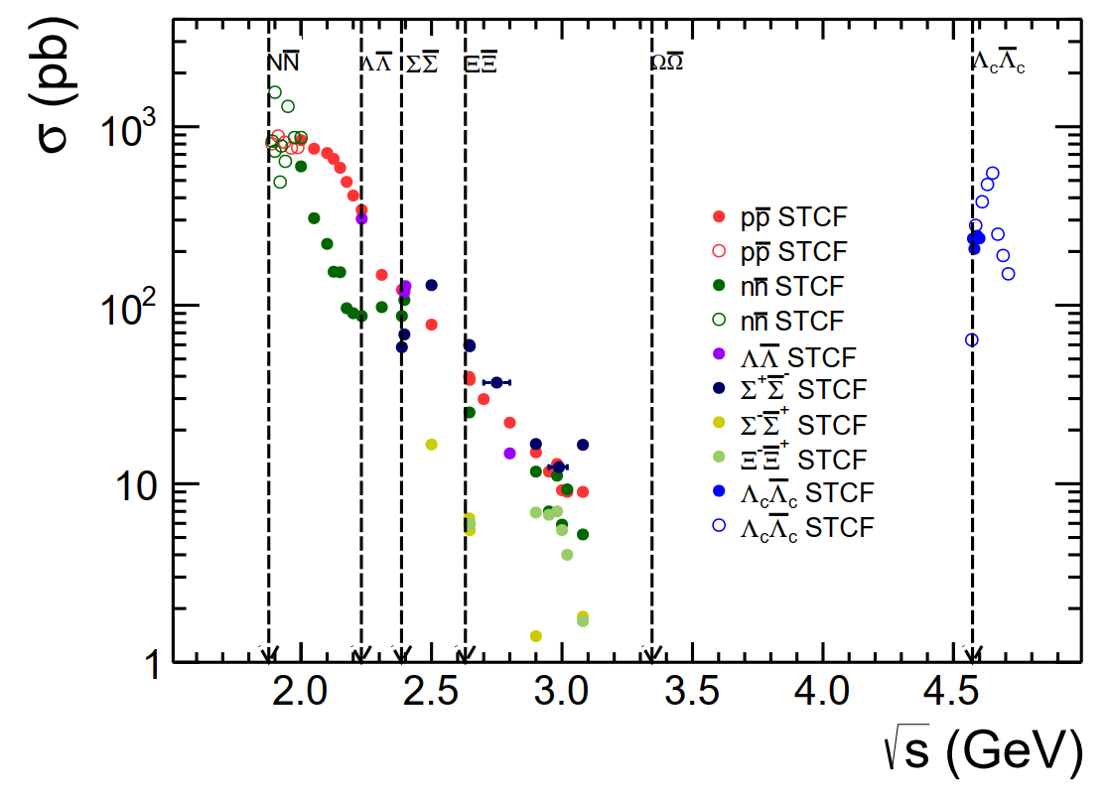
Prospect of TL-EMFF at STCF
Remaining questions of TL-EMFFs:
  Step-like behavior of production cross section, indication of near-threshold singularity.
  Damped oscillation distribution after subtracting modified dipole in effective FF.
  Damped oscillation distribution of |G_{E}/G_{M}| ratio.
  Evolution of the phase between G_{E} and G_{M}.
  The asymptotic behavior of TL-EMFFs
Current status
Prospect at STCF
Natl.Sci.Rev. 8 (2021) 11, nwab187

Slide 13
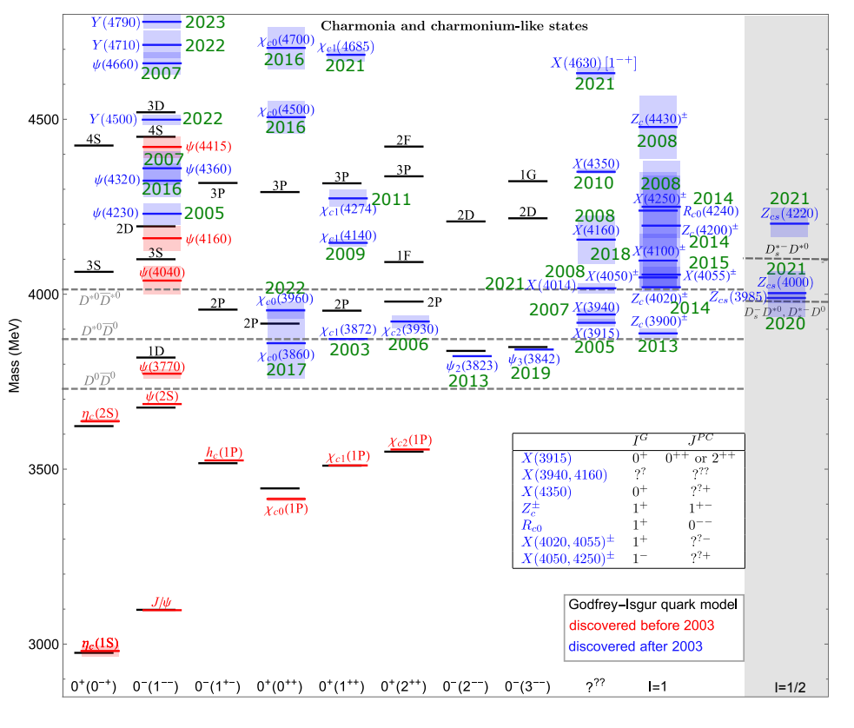
Charmonium (like) States
The overpopulated charmonium spectrum is a unique territory to study exotic hadrons
Existing XYZ puzzles:
Masses away from quark model predictions, e.g. X(3872), Y(4230) and Y(4260)
Many seen in final states of charmonium, instead of open-cham channels (Not all)
Charged structures like Z_{c(s)} must contain at least four quarks. Their connections to Y and X are of interest
An overall classification is still lacking

Slide 14
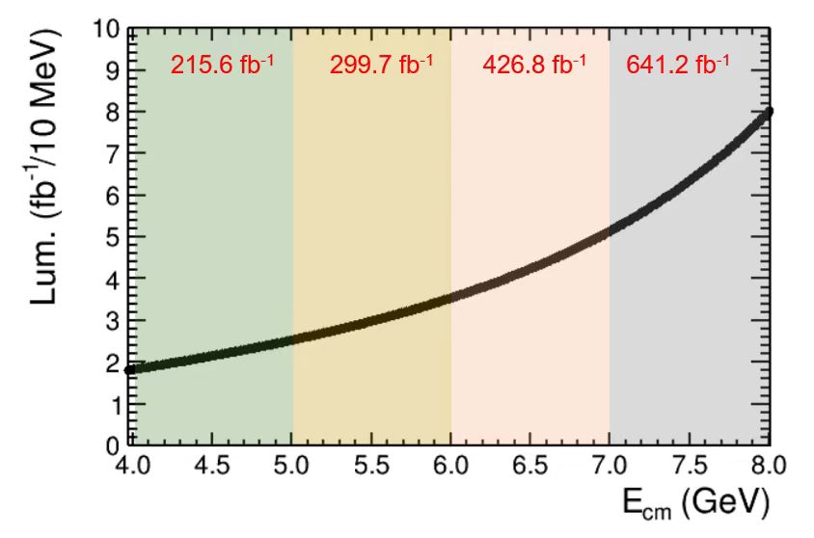
Charmonium(like) States at STCF
STCF provides unique fine scan of the exotic hadron states
1 ab⁻¹/year luminosity at STCF can produce: 1B Y(4230), 100M Z_{c}(3900) and 5M X(3872)
More opportunities at STCF:
Energy dependent structures of Z_{c(s)}
Structures in more channels, with larger production rates above 5 GeV
Charged hadron final states of the whole energy range
Hybrid candidates
Missing charmonium states and their transitions
@ 4.26 GeV for π⁺π⁻J/ψ
ε_{BESIII} = 46%, ε_{Belle} = 10%
ISR-return luminosity from Belle II (50 ab⁻¹)
Notes:
Search for spin multiplet partner of Z_{c(s)} states. The connection between Y(4230), X(3872) and Z_{c}(3900) can be understood clearly

Slide 15
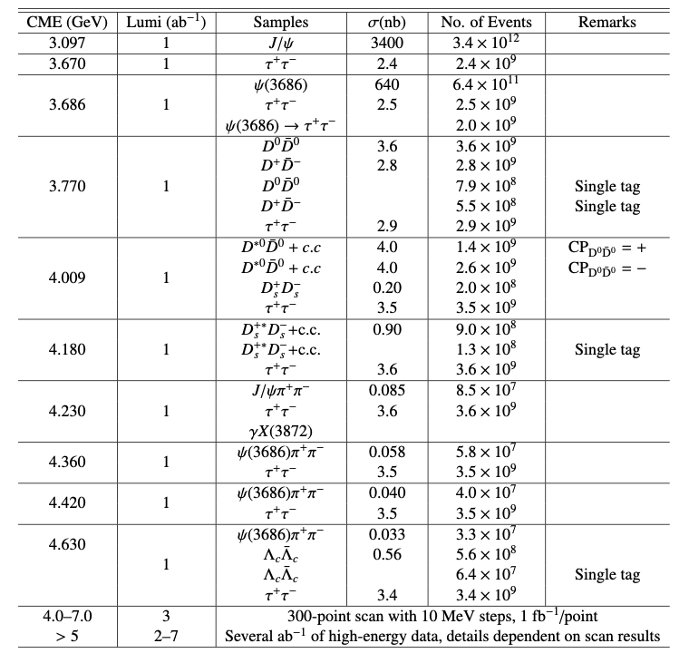
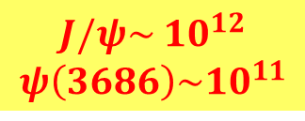
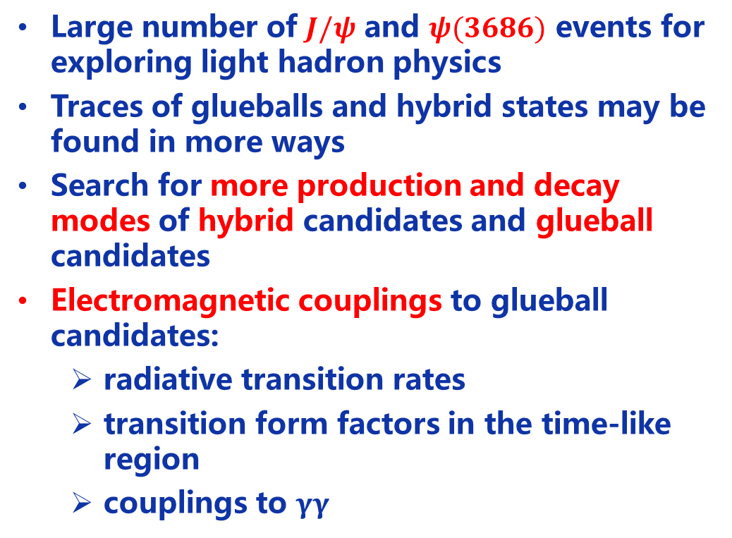
Light Hadron Opportunity at STCF
High Statistical Data : 1 ab⁻¹/year
Large number of $J/ψ$ and $ψ(3686)$ events for exploring light hadron physics
Traces of glueballs and hybrid states may be found in more ways
Search for more production and decay modes of hybrid candidates and glueball candidates
Electromagnetic couplings to glueball candidates:
  radiative transition rates
  transition form factors in the time-like region
  couplings to $γγ$
$$J/ψ\sim 10^{12}$$
$$ψ\left(3686\right)\sim 10^{11}$$

Slide 16
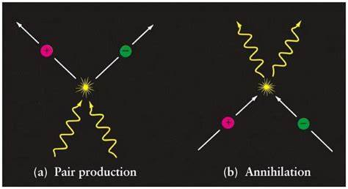
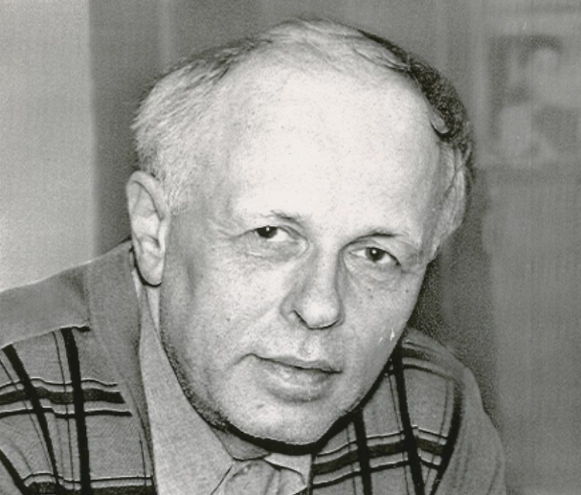
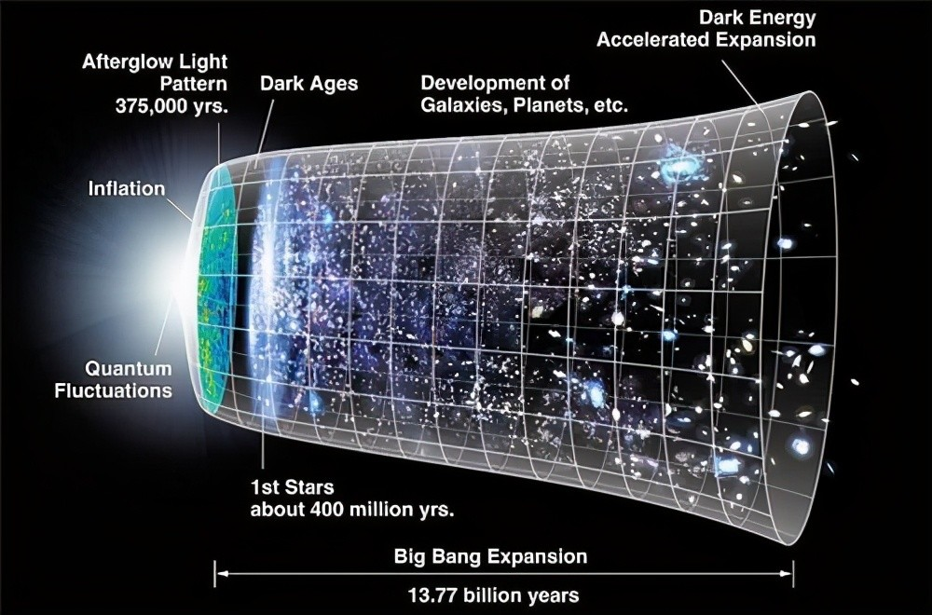
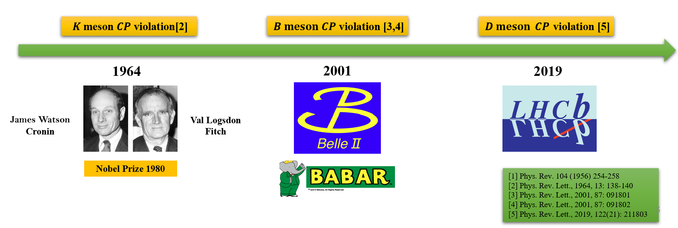
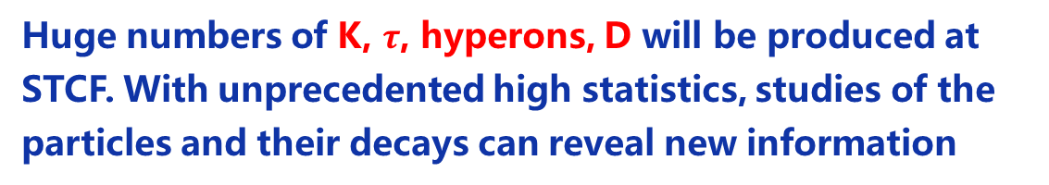
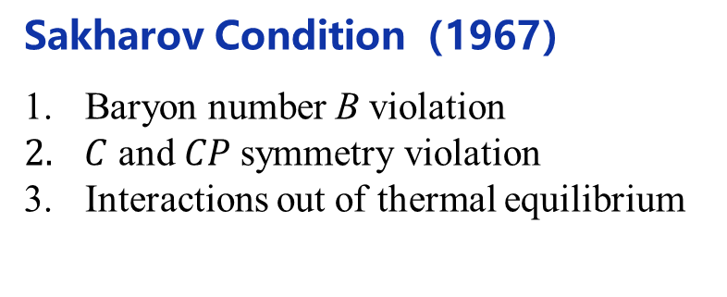
Key Question: matter-antimatter asymmetry
The very fact that we exist in a matter-dominated universe.
Sakharov Condition（1967）
Baryon number B violation
$C$ and $CP$symmetry violation
Interactions out of thermal equilibrium
Andrei Sakharov
（1921-1989）
Huge numbers of K, $τ$, hyperons, D will be produced at STCF. With unprecedented high statistics, studies of the particles and their decays can reveal new information

Slide 17
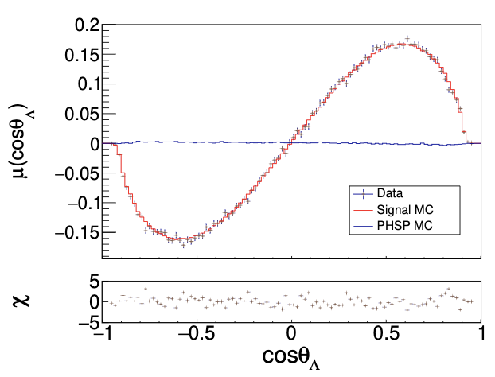
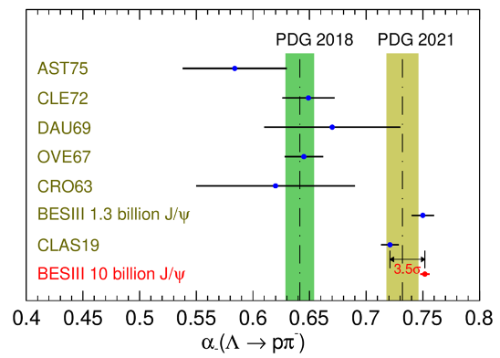
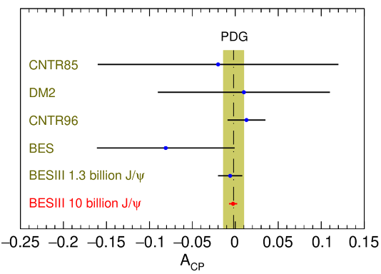
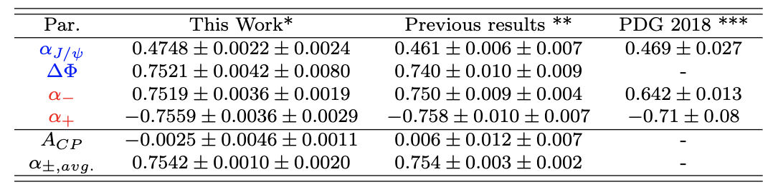



Polarization of $Λ$ Hyperons and CP Test
Updated results based on 10B $J/ψ$ events: ~0.42M signals
Decay asymmetries with best precisions ever
CP test ${ A}_{CP}=\frac{α_{−}+α_{+}}{α_{−}−α_{+}}$
PRL 129, 131801 (2022)
~7σ upward shift from all previous measurements
0.5% level sensitivity for CPV test
SM prediction:10⁻⁴~10⁻⁵

Slide 18
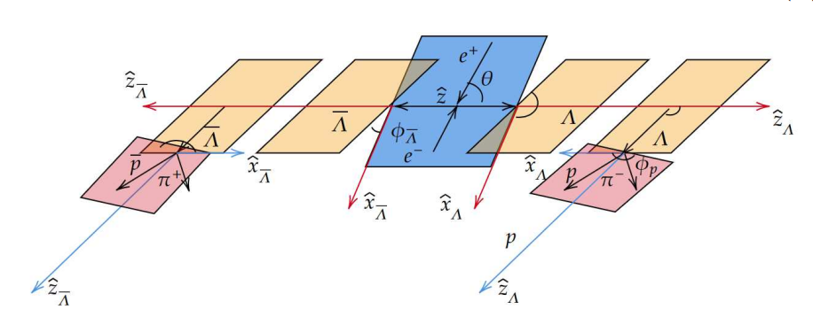

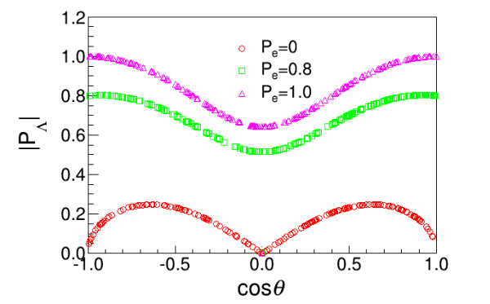
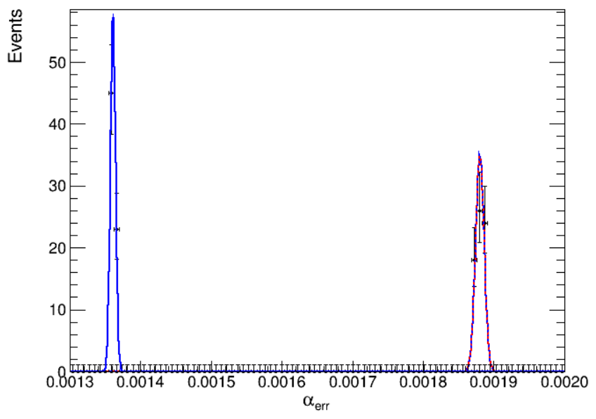
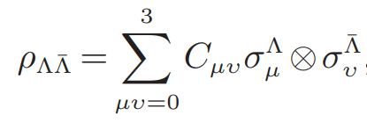









CP Test in 𝜦 Decay with Polarized Electron Beam
$P_{e}$=80%
$P_{e}$=0
Large statistics and electron polarization will improve the sensitivity of CPV significantly
The sensitivity of CPV follows :
$$\underset{⇒}{1×{10}^{9} Λ\overline{Λ}, \left\langle P_{B}^{2}\right\rangle =0.1}σ_{A_{CP}}\sim 1.4×{10}^{−4}$$
$$\underset{⇒}{1×{10}^{9} Λ\overline{Λ}, \left\langle P_{B}^{2}\right\rangle =0.8}σ_{A_{CP}}\sim 0.5×{10}^{−5}$$

Slide 19




Searching for Hyperon EDM
Detailed dynamics in 𝐽/𝜓 decay to hyperon pair have been studied:
$μ:$ magnetic dipole moment
$d:$ electric dipole moment
$$𝒜=ε_{μ}\left(λ\right)\overline{u}\left(λ_{1}\right)\left(F_{V}γ^{μ}+\frac{i}{2M_{Λ}}σ^{μν}q_{ν}H_{σ}+γ^{μ}γ^{5}F_{A}+σ^{μν}γ^{5}q_{ν}H_{T}\right)ν(λ_{2})$$
Systematic measurement of the EDMs of the hyperon family!
Non-zero EDM will violate $P$ and $T$ symmetry: $T$ violation $↔CP$ violation, if CPT holds.
X.G.He, J.P. Ma, Phys.Lett.B 839(2023)137834

Slide 20

Sensitivity of Precision Measurements
★ muon g-2 anomaly
The precision frontier for testing of SM parameters
Uncertainties from reducible (selection-based), and irreducible sources (theoretical input, instrument effect)

Slide 21

Sensitivity of Rare or Forbidden Decays
Sensitivity of various rare/forbidden decays measurements at STCF are compared with various BSM models
The excellent precision at STCF can be used to distinguish between various BSM models

Slide 22

Challenges of STCF Accelerator
Goal: ultra-high luminosity in tau charm energy region (2-7 GeV), high-quality beam, stable operation
Characteristics: extremely small bunch size, high current intensity, strong nonlinearity and collective effect
Preliminary machine parameters
Parameters | Units | STCF (April. 2024)
Optimal beam energy, E | GeV | 2
Circumference, C | m | 848.4
Crossing angle, 2q | mrad | 60
Horizontal emittance, ex | nm | 6.919
Coupling, k |  | 0.50%
Vertical emittance, ey | pm | 34.595
Ver. beta function at IP, 𝜷y | mm | 0.6
Ver. beam size at IP, sy | mm | 0.144
Beam current, I | A | 2
Single-bunch charge | nC | 8.04
SR power per beam, PSR | MW | 0.572
Bunch length, sz | mm | 8.43
Ver. beam-beam parameter, ξy |  | 0.094
Luminosity, L | 10³⁵ cm⁻² s⁻¹ | 1.19

Slide 23






STCF Accelerator R&D
Positron Source Design
MDI Design
Bunch-by-Bunch 3D position measurement
Photocathode RF gun
Low level RF system

Slide 24






STCF detector
ITK
<0.25%X0 / layer
σ_{xy}< 100 $μ$m
MDC
σ_{xy}< 130 $μ$m
σp/p ~ 0.5% @ 1 GeV
dE/dx~6%
PID
π/K (and K/p) 3-4σ separation up to 2GeV/c
EMC
E range: 0.025-3.5 GeV
σ_{E} @ 1 GeV: 2 .5% in barrel, 4% at endcaps
Pos. Res. : ~ 4 mm
Requirement:
High detection efficiency and good resolution
Superior PID ability
Tolerance to high rate/background environment
MUD
0.4 - 1.8 GeV
π suppression >30

Slide 25








STCF Detector Conceptual Design
Electromagnetic Calorimeter
pCsI +APD
Muon Detector
Resistive Plate Chamber+ Plastic scintillator
Particle Identification System
Barrel：RICH-like
Endcap：DIRC-like
Inner tracker
𝛍RWELL Detector
CMOS MAPS
Central Tracker
Low material-budget Main Drift Chamber
25

Slide 26

STCF Detector R&D — Detector Prototypes

Slide 27


Offline Software
Offline Software System of Super Tau-Charm Facility (OSCAR)
  External Interface+ Framework +Offline
SNiPER framework provides common functionalities for whole data processing
Offline including Generator, Simulation, Calibration, Reconstruction and Analysis
OSCAR
Applications
Generator
Reconstruction
Simulation
Analysis
Core Software
SNiPER
EDM
IO
Service
User Interface
External Libraries and Tools
DD4hep
Geant4
PODIO
ROOT
Python
cmake
W.H. Huang et al 2023 JINST 18 P03004
Full simulation under OSCAR is undergoing: $e^{+}e^{−}→π^{+}π^{−}J/ψ$, $Λ\overline{Λ}$, $ππ/Kπ/KK+X$, $D^{0}{\overline{D}}^{0}$…

Slide 28

Site of STCF : Hefei
Funded R&D: 0.4 Billion CNY funded by the Anhui government
Construction budget: 4.5 Billion CNY

Slide 29
Tentative Project Schedule for STCF
 | 2018 | 2019 | 2020 | 2021 | 2022 | 2023 | 2024 | 2025 | 2026 | 2027 | 2028 | 2029 | 2030 | 2031 | 2032-2047
CDR
Key Technology R&D & TDR
Construction
Operation |  |  |  |  |  |  |  |  |  |  |  |  |  |  | 15 years

Slide 30
Summary
STCF covers a unique transition region between perturbative and non-perturbative QCD, providing precision measurements aimed at answering key questions in QCD and search for new physics BSM
STCF will utilized and challenge key technologies accelerator, particle detection and data processing, computing and networking
Anhui province and USTC have committed support, aiming for applying construction approval during the 15th five-year plan (2026-2030)
International collaboration is crucial, with ongoing efforts to expand collaborations both domestically and internationally

Slide 31

FTCF2024-Guangzhou
The 6th International Workshop on Future Tau-Charm Facilities (FTCF2024-Guangzhou) will be hosted by Sun Yat-sen University (SYSU) in Guangzhou, China, Nov. 17-21, 2024.
https://indico.pnp.ustc.edu.cn/event/1948/

Slide 32
Thanks for your listening!

