Slide 1
Grant no. 12135007
Craig Roberts … http://inp.nju.edu.cn/
Strong QCD from Studies of $N^{∗}$ Structure
Notes:
25+5

Slide 2
Basic Questions in Nature …

Slide 3
Basic Questions in Nature … that physics might answer in the foreseeable future
What is the origin of the nuclear-physics mass scale
$m_{p}=$ proton mass
that characterises all visible matter?
Whatever it is, why is the pion seemingly oblivious?
How is this phenomenon expressed in measurable quantities?
The expressions are bound to be system dependent

Slide 4
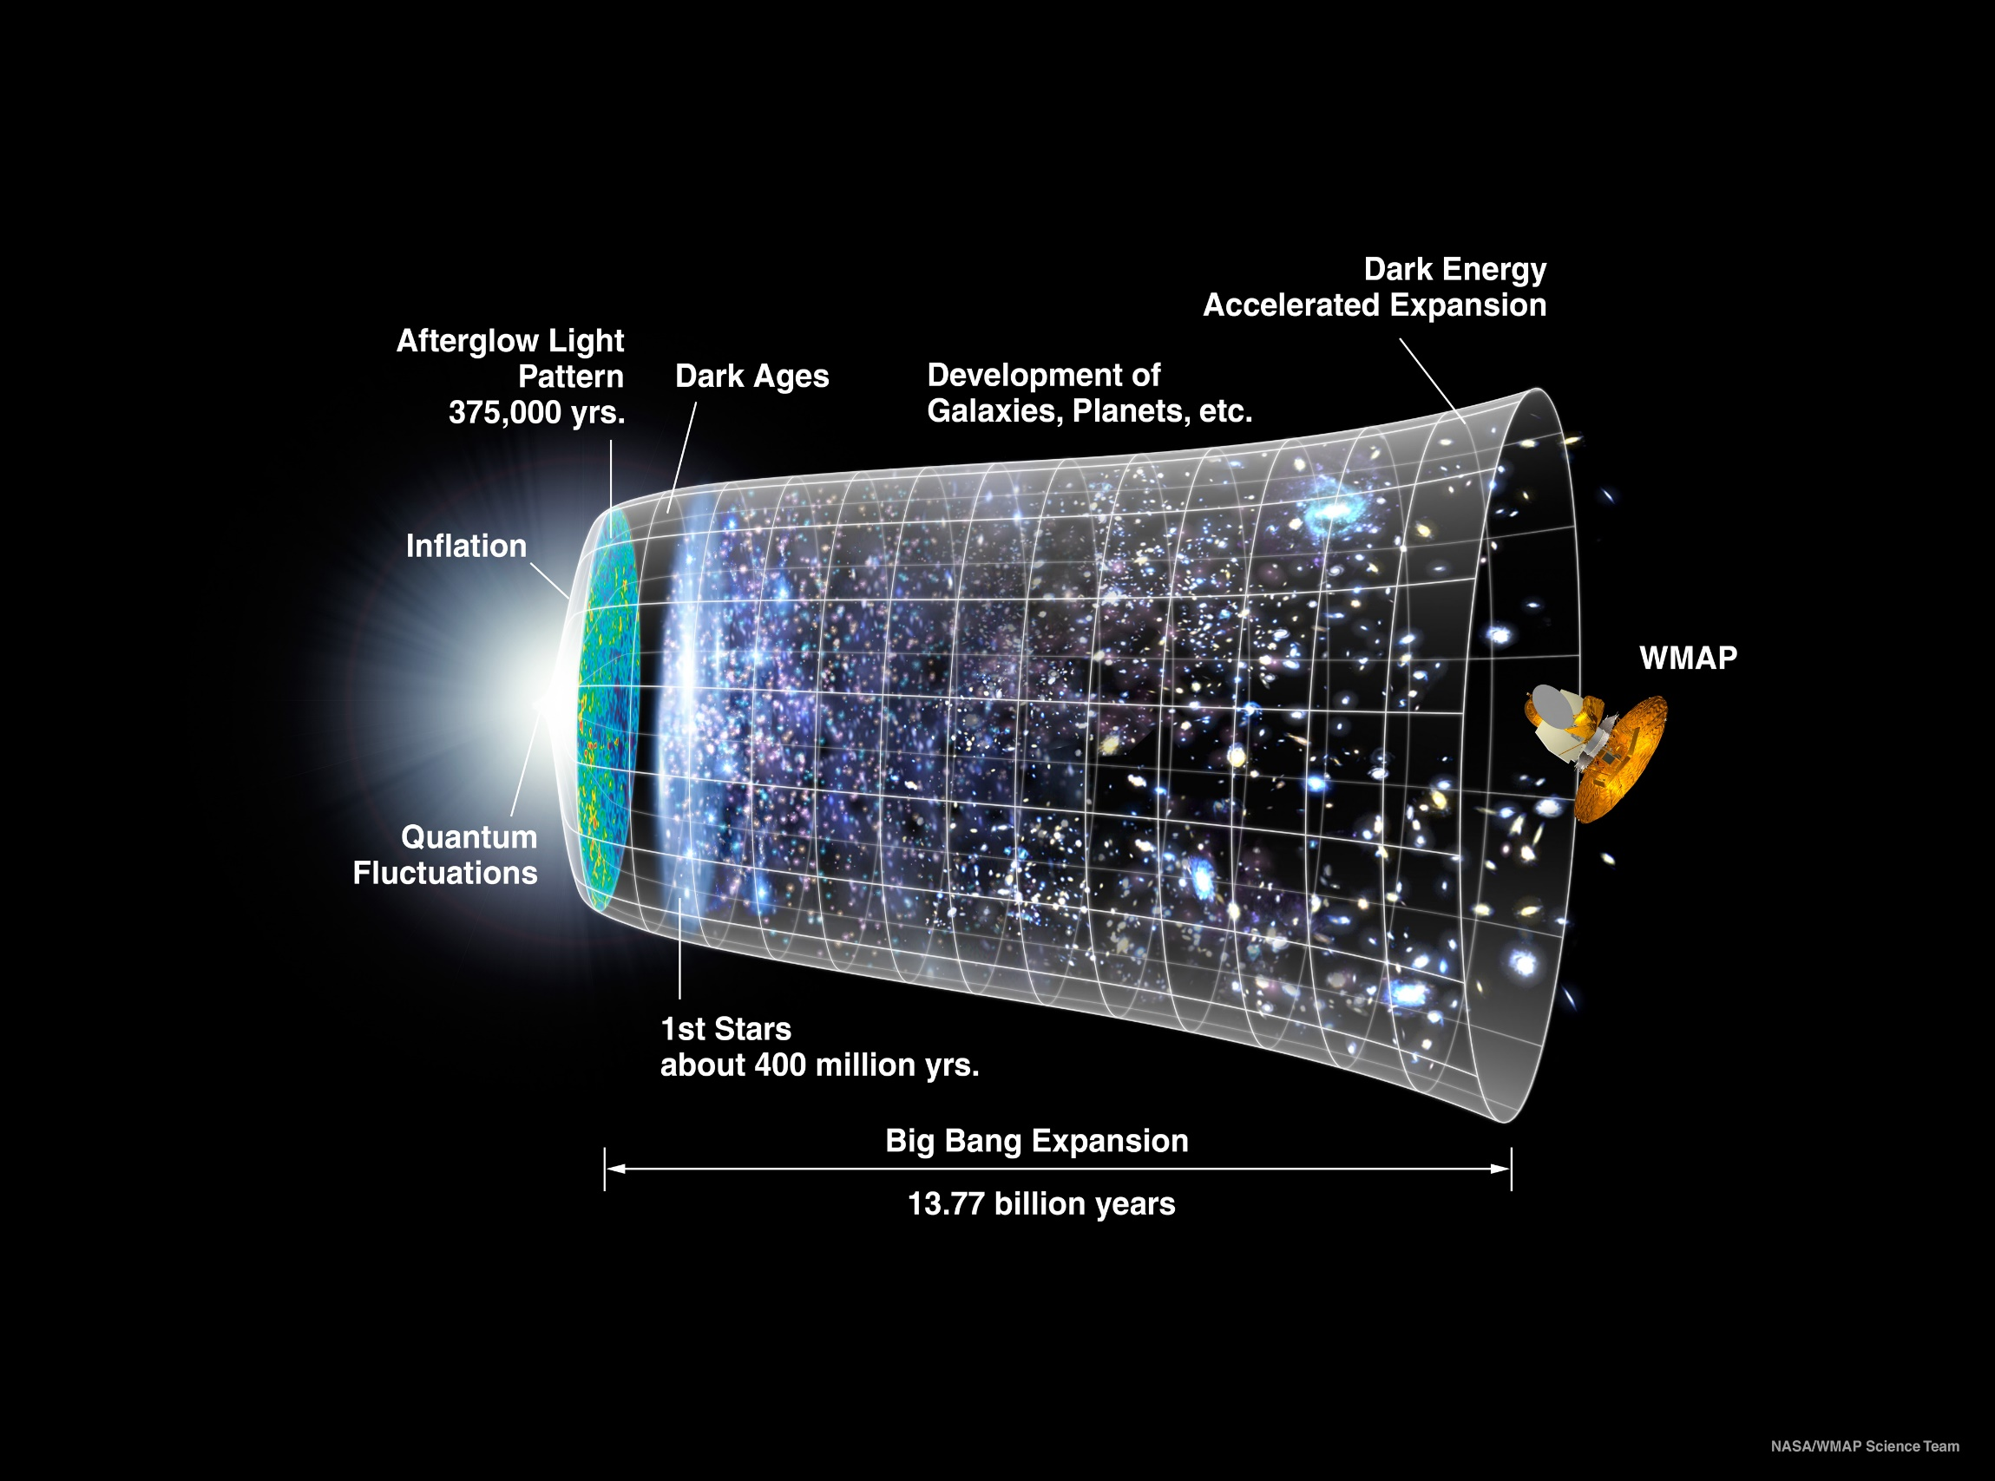
Our Universe
Mass emerged 0.000001 seconds after the Big Bang
Its appearance was crucial to the formation of the Universe as we know it

Slide 5
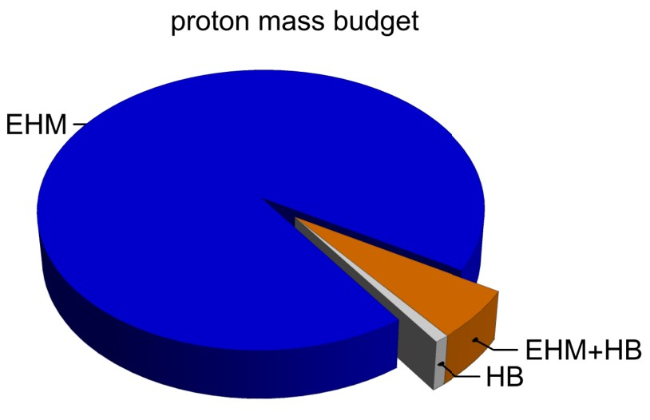
Emergence of Hadron Mass
Standard Model of Particle Physics has one obvious mass-generating mechanism
= Higgs Boson … impacts are critical to evolution of Universe as we know it
However, Higgs boson alone is responsible for just ∼ 1% of the visible mass in the Universe
Proton mass budget … only 9 MeV/939 MeV is directly from Higgs
Decomposition is
gauge invariant
Poincaré invariant
scale invariant
Evidently, Nature has another very effective mechanism for producing mass:
Emergent Hadron Mass (EHM)
Alone, it produces 94% of the proton’s mass
Remaining 5% is generated by constructive interference between EHM and Higgs-boson
What is the origin of EHM?

Slide 6
Quantum Chromodynamics
$$L= \frac{1}{4}G_{μν}^{a}\left(x\right)G_{μν}^{a}\left(x\right)+\overline{ψ}\left[γ⋅∂_{x}+m+ig \frac{λ^{a}}{2}γ⋅A^{a}\left(x\right)\right]ψ\left(x\right)$$
$$G_{μν}^{a}\left(x\right)=∂_{μ}A_{ν}^{a}(x)−∂_{ν}A_{μ}^{a}(x)−f^{abc}A_{μ}^{b}{(x)A}_{ν}^{c}(x)$$
One-line Lagrangian – expressed in terms of gluon and quark partons
Which are NOT the degrees-of-freedom measured in detectors
Questions
What are the (asymptotic) detectable degrees-of-freedom?
How are they built from the Lagrangian degrees-of-freedom?
Is QCD really the theory of strong interactions?
Is QCD really a theory … or just another EFT?
$⇒$ Implications far beyond Standard Model

Slide 7
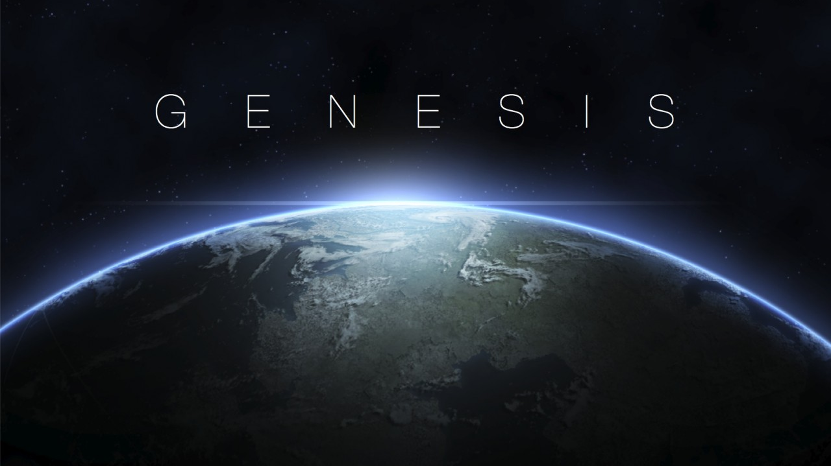

Slide 8
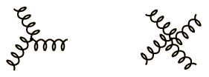
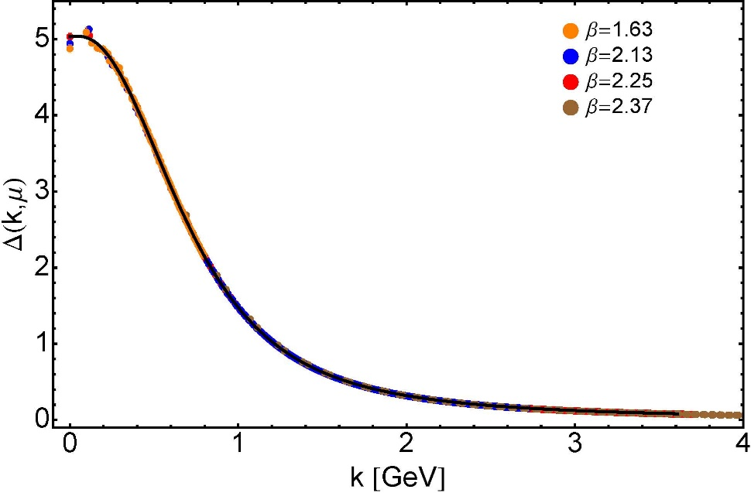
Modern Understanding Grew Slowly from Ancient Origins
More than 40 years ago
Dynamical mass generation in continuum quantum chromodynamics,
J.M. Cornwall, Phys. Rev. D 26 (1981) 1453 … $>1100$ citations
Owing to strong self-interactions, gluon partons $⇒$ gluon quasiparticles,
described by a mass function that is large at infrared momenta
3-gluon vertex
4-gluon vertex
$$\frac{1}{m_{g}^{2}}$$
Truly mass from nothing
An interacting theory, written in terms of massless gluon fields, produces dressed gluon fields that are characterised by a mass function that is large at infrared momenta
Gluon propagator … continuum and lattice QCD agree
QCD fact
Continuum theory and lattice simulations agree
Empirical verification?

Slide 9
Modern Understanding Grew Slowly from Ancient Origins
D. Binosi, Emergent Hadron Mass in Strong Dynamics, Few Body Syst. 63 (2022) 42.
M. N. Ferreira, J. Papavassiliou, Gauge Sector Dynamics in QCD, Particles 6 (1) (2023) 312–363.
EHM means
Gluons are massive – Schwinger Mechanism
More than 40 years ago
Dynamical mass generation in continuum quantum chromodynamics,
J.M. Cornwall, Phys. Rev. D 26 (1981) 1453 … $∼1050$ citations
Owing to strong self-interactions, gluon partons $⇒$ gluon quasiparticles,
described by a mass function that is large at infrared momenta
3-gluon vertex
4-gluon vertex
$$\frac{1}{m_{g}^{2}}$$
Truly mass from nothing
An interacting theory, written in terms of massless gluon fields, produces dressed gluon fields that are characterised by a mass function that is large at infrared momenta
Gluon propagator … continuum and lattice QCD agree
QCD fact
Continuum theory and lattice simulations agree
Empirical verification?

Slide 10
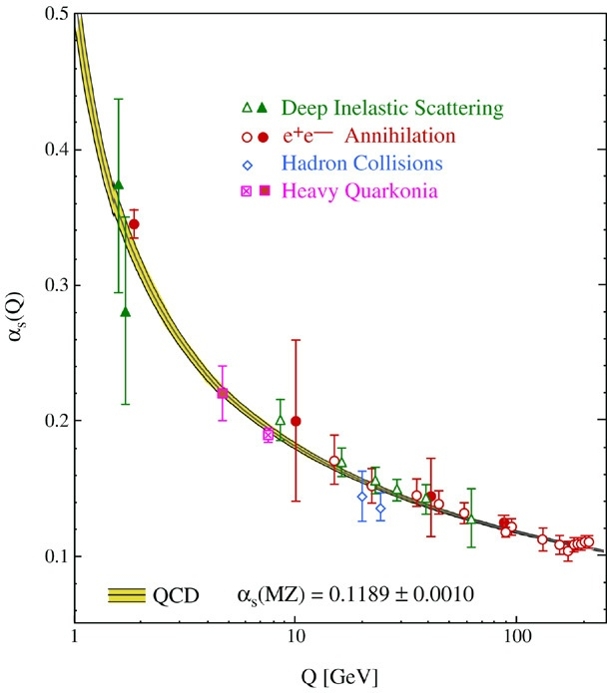
QCD’s Running Coupling
This is where we live
Asymptotic Freedom
Interaction becomes weaker
as energy grows
(as charges get closer together)
⇐
What’s happening
out here?!

Slide 11
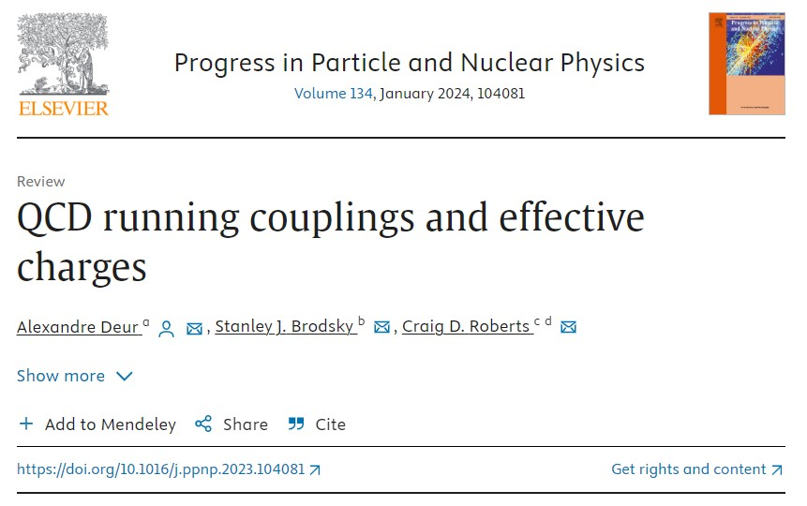
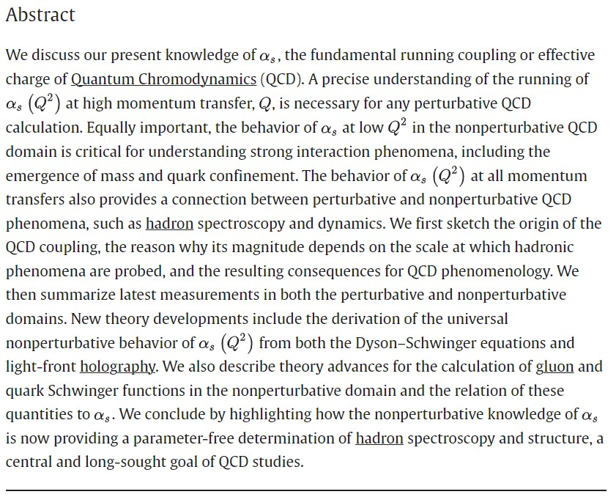

Slide 12
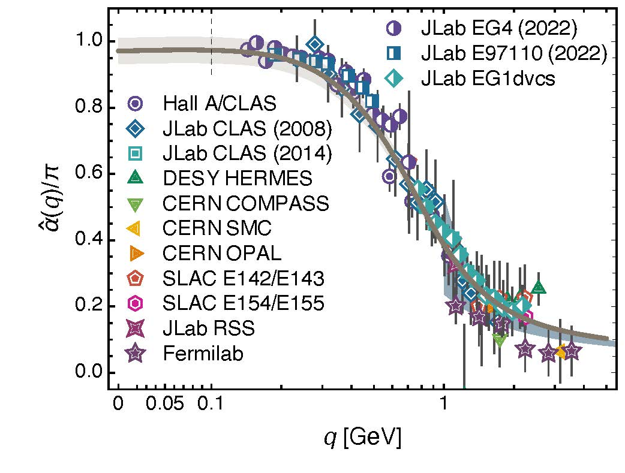
Process independent effective charge = running coupling
W orkshop on Dyson-Schwinger Equations in Modern Mathematics
and Physics (DSEMP2014) Trento, Italy, September 22-26, 2014
Effective charge from lattice QCD, Zhu-Fang Cui, Jin-Li Zhang et al.,
NJU-INP 014/19, arXiv:1912.08232 [hep-ph], Chin. Phys. C 44 (2020) 083102/1-10
$2492$ total downloads
Modern theory enables unique QCD analogue of
“Gell-Mann – Low”
running charge to be
rigorously defined and calculated
Analysis of QCD’s gauge sector
yields a parameter-free prediction
N.B. Qualitative change in α̂_{PI}(k) at k ≈ ½ m_{p}
No Landau Pole
“Infrared Slavery” picture – linear potential – is not viable explanation of real-world confinement
Below $k∼{{\hat{m}}_{0}}_{ },$interactions become scale independent, just as they were in the Lagrangian; so, QCD becomes practically conformal again
Process independent strong running coupling
Daniele Binosi et al., arXiv:1612.04835 [nucl-th], Phys. Rev. D 96 (2017) 054026/1-7
Experimental determination of the QCD effective charge α_{g1}(Q).
A. Deur; V. Burkert; J.-P. Chen; W. Korsch, Particles 5 (2022) 171
QCD Running Couplings and Effective Charges, Alexandre Deur, Stanley J. Brodsky and Craig Roberts, e-Print: 2303.00723 [hep-ph], Prog. Part. Nucl. Phys. 134 (2024) 104081

Slide 13
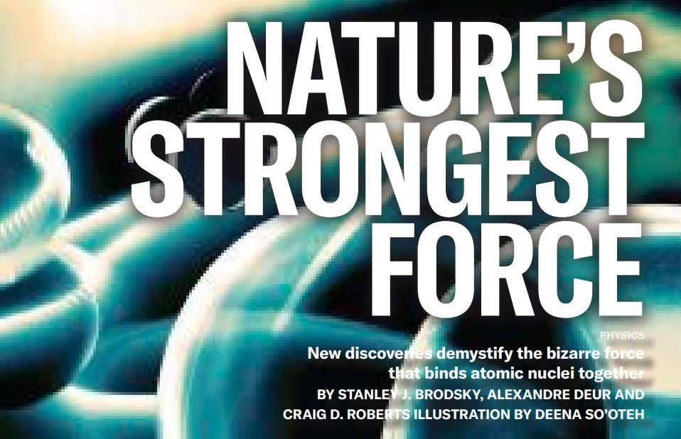
Process independent effective charge = running coupling
W orkshop on Dyson-Schwinger Equations in Modern Mathematics
and Physics (DSEMP2014) Trento, Italy, September 22-26, 2014
Effective charge from lattice QCD, Zhu-Fang Cui, Jin-Li Zhang et al.,
NJU-INP 014/19, arXiv:1912.08232 [hep-ph], Chin. Phys. C 44 (2020) 083102/1-10
$2467$ total downloads
Modern theory enables unique QCD analogue of
“Gell-Mann – Low”
running charge to be
rigorously defined and calculated
Analysis of QCD’s gauge sector
yields a parameter-free prediction
N.B. Qualitative change in α̂_{PI}(k) at k ≈ ½ m_{p}
No Landau Pole
“Infrared Slavery” picture – linear potential – is not viable explanation of real-world confinement
Below $k∼{{\hat{m}}_{0}}_{ },$interactions become scale independent, just as they were in the Lagrangian; so, QCD becomes practically conformal again
May 2024
Process independent strong running coupling
Daniele Binosi et al., arXiv:1612.04835 [nucl-th], Phys. Rev. D 96 (2017) 054026/1-7
Experimental determination of the QCD effective charge α_{g1}(Q).
A. Deur; V. Burkert; J.-P. Chen; W. Korsch, Particles 5 (2022) 171
QCD Running Couplings and Effective Charges, Alexandre Deur, Stanley J. Brodsky and Craig Roberts, e-Print: 2303.00723 [hep-ph], Prog. Part. Nucl. Phys. 134 (2024) 104081

Slide 14
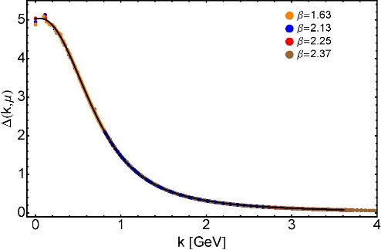
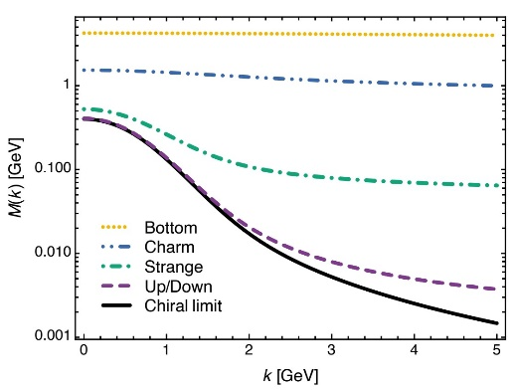
EHM Basics
Absent Higgs boson couplings, QCD Lagrangian is scale invariant
Yet …
Massless gluons become massive
A momentum-dependent charge is produced
Massless quarks become massive
EHM is expressed in
EVERY strong interaction observable
Challenge to Theory =
Elucidate all observable consequences of these phenomena
and highlight the paths to measuring them
Challenge to Experiment =
Test the theory predictions so that
the boundaries of the Standard Model can finally be drawn
Three pillars of EHM
$3×M\left(0\right)$ sets the scale of the proton mass.
Meson-loops provide $20$% quantum corrections

Slide 15
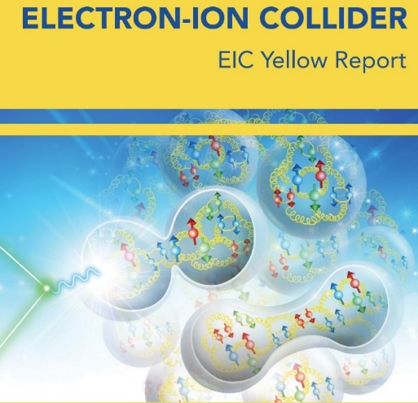
Charting EHM using High Intensity, High Luminosity Facilities

Slide 16
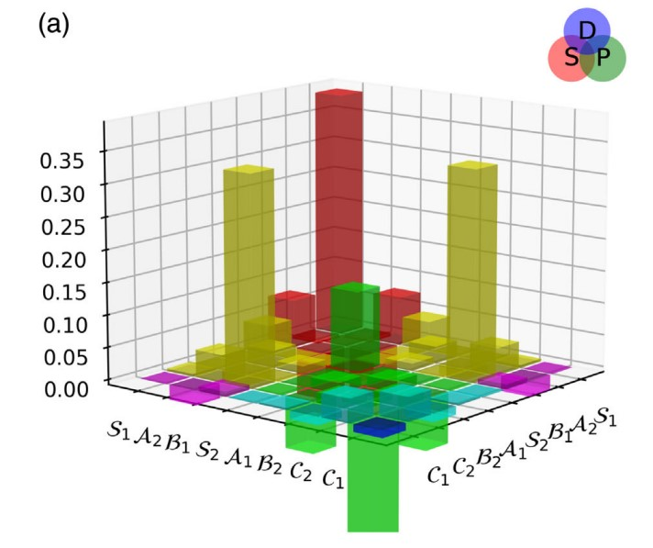
Nucleon & Its Resonances

Slide 17
Charting EHM
Proton was discovered 100 years ago … It is stable; hence, an ideal target in experiments
But just as studying the hydrogen atom ground state didn’t give us QED,
focusing on the ground state of only one form of hadron matter will not solve QCD
New era is dawning … high energy + high luminosity
$⇒$ Science can move beyond the focus on the proton
Precision studies of the structure of
Nature’s most fundamental Nambu-Goldstone bosons ($π$ & K) will become possible
Baryon excited states
Baryons are the most fundamental three-body systems in Nature
If we don’t understand how QCD, a Poincaré-invariant quantum field theory, builds each of the baryons in the complete spectrum, then we don't understand Nature.
EHM is not immutable
its manifestations are manifold
experience $⇒$ each hadron reveals different facets
One piece does not complete a puzzle
AMBER @ CERN
EIC
EicC & SCT & CEPC
JLab12 & JLab20+

Slide 18
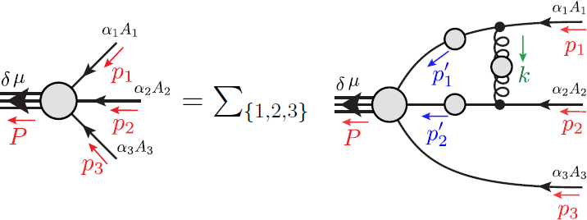
Faddeev Equation for Baryons
Nucleon mass from a covariant three-quark Faddeev equation
G. Eichmann et al., Phys. Rev. Lett. 104 (2010) 201601
Nucleon charge and magnetisation distributions: flavour separation and zeroes,
Zhao-Qian Yao et al., e-Print: 2403.08088 [hep-ph]

Slide 19
Electromagnetic Current
Nucleon mass from a covariant three-quark Faddeev equation
G. Eichmann et al., Phys. Rev. Lett. 104 (2010) 201601
Nucleon charge and magnetisation distributions: flavour separation and zeroes,
Zhao-Qian Yao et al., e-Print: 2403.08088 [hep-ph]

Slide 20
Nucleon charge and magnetisation distributions: zeroes and flavour separation
Parameter-free unification of pion, kaon, nucleon electromagnetic form factors
Gap equation + Bethe-Salpeter Equation + 3-body Faddeev Equation
Proton electric form factor possesses a zero:
$$Q^{2}={8.86}_{−0.86}^{+1.93} GeV^{2}$$
Neutron electric form factor is positive definite
$⇒G_{E}^{n}\left(Q^{2}\right)>G_{E}^{p}\left(Q^{2}\right)$ on $Q^{2}≥4.7 GeV^{2}$
On this domain, electric form factor of charge-neutral neutron is larger than that of charge-one proton
Verification is within JLab reach
Prediction underestimates
$G_{E}^{n}\left(Q^{2}\right)$ by 20%
Nucleon charge and magnetisation distributions: flavour separation and zeroes,
Zhao-Qian Yao et al., e-Print: 2403.08088 [hep-ph]

Slide 21
Structure of Baryons
Poincaré covariant Faddeev equation sums all possible exchanges and interactions that can take place between three dressed-quarks
Evidently, direct solution of Faddeev equation using rainbow-ladder truncation is now possible … remains a challenging numerical problem

Slide 22
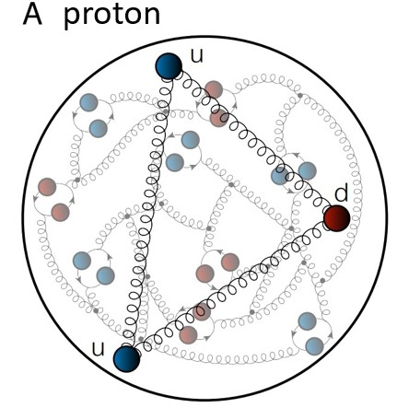
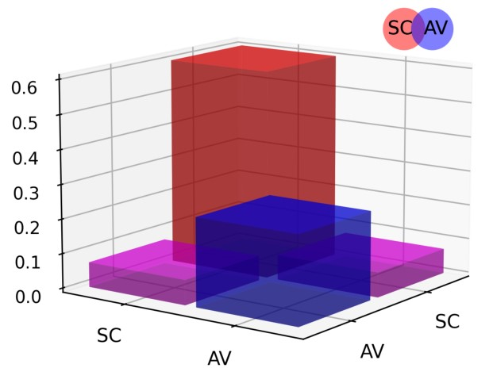
Structure of Baryons
Solution delivers
Poincaré-covariant
proton wave function
Poincaré covariant Faddeev equation sums all possible exchanges and interactions that can take place between three dressed-quarks
Evidently, direct solution of Faddeev equation using rainbow-ladder truncation is now possible … remains a challenging numerical problem
For many applications, diquark approximation to quark + quark scattering kernel is used
Prediction: owing to EHM phenomena, strong diquark correlations exist within baryons
proton and neutron … both scalar and axial-vector diquarks are present
CSM prediction = presence of axialvector (AV) diquark correlation in the proton
AV Responsible for $≈40\%$ of proton charge

Slide 23
Structure of Baryons
Solution delivers
Poincaré-covariant
proton wave function
Poincaré covariant Faddeev equation sums all possible exchanges and interactions that can take place between three dressed-quarks
Direct solution of Faddeev equation using rainbow-ladder truncation is now possible, but numerical challenges remain
For many applications, diquark approximation to quark+quark scattering kernel is used
Prediction: owing to EHM:
proton wave function is not just S-wave, but contains strong P-wave contributions
baryon wave functions
necessarily contain
orbital angular momentum
CSM prediction = canonical normalization dominated by $S⊗S$, but receives large $S⊗P$ and $P⊗P$
contributions
Non-$S⊗S$make-up 6$0\%$ of proton charge

Slide 24
Diquarks - Facts
Theory predicts experimental observables that would constitute unambiguous measurable signals for the presence of diquark correlations.
Some connect with spectroscopy of exotics
tetraquarks and pentaquarks
Numerous observables connected with structure of conventional hadrons, e.g.
existence of zeros in d-quark contribution to proton Dirac and Pauli form factors
$Q^{2}$-dependence of nucleon-to-resonance transition form factors
$x$-dependence of proton structure functions
deep inelastic scattering on nuclear targets (nDIS) … proton production described by direct knockout of diquarks, which subsequently form into new protons

Slide 26
Baryon Structure
Poincaré covariance $⇒$ irrespective of quark model assignments $n^{2s+1}ℓ_{J}$,
every hadron contains orbital angular momentum, e.g.,
$π$ contains two S-wave components and two P-wave components
Few systems are simply radial excitations of another
No separation of $J$ into $L+S$ is Poincaré invariant
Consequently, e.g., negative parity states are not simply orbital angular momentum excitations of positive parity ground states
In quantum field theory, there is no direct connection between parity and orbital angular momentum
Parity is a Poincaré invariant quantum number
$L$ is not Poincaré invariant = value depends on the observer’s frame of reference
QCD structure of hadrons – mesons and baryons – is far richer than can be produced by quark models, relativized or not
Baryons are the most fundamental three-body systems in Nature
If we don’t understand how QCD, a Poincaré-invariant quantum field theory, builds each of the baryons in the complete spectrum, then we don't understand Nature.

Slide 27
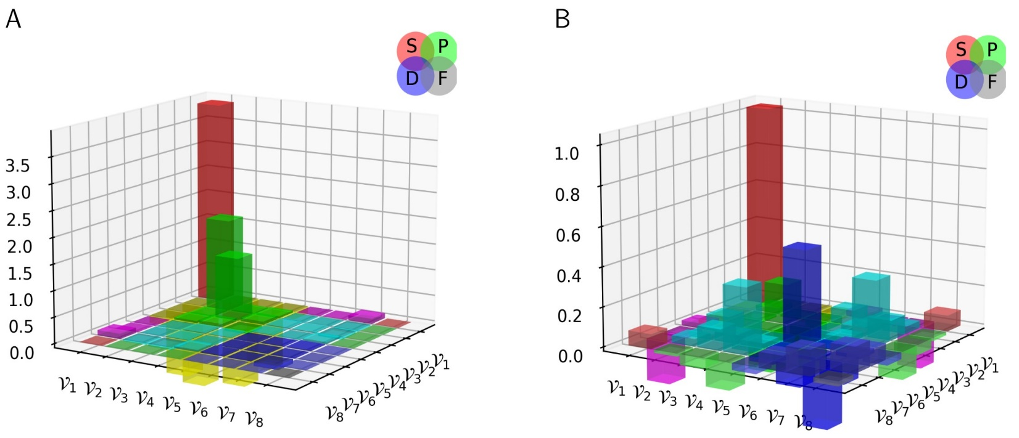
Composition of low-lying J=${\frac{3}{2}}^{±}$ $Δ$-baryons
Poincaré-covariant quark+diquark Faddeev equation
$⇒$ insights into the structure of four lightest $\left(I,J^{P}\right)=(\frac{3}{2},{\frac{3}{2}}^{±})$ baryon multiplets.
Prediction: Whilst these systems can contain isovector-axialvector $\left({1,1}^{+}\right)$ and isovector-vector $({1,1}^{−})$ diquarks, one may neglect the latter and still arrive at a reliable description.
$(\frac{3}{2},{\frac{3}{2}}^{+}$) are the simpler systems & features bear some resemblance
to quark model pictures
Most prominent rest-frame orbital angular momentum component is $S$-wave
$Δ\left(1600\right){\frac{3}{2}}^{+}$may fairly be viewed as radial excitation of $Δ\left(1232\right){\frac{3}{2}}^{+}$
$Δ\left(1600\right){\frac{3}{2}}^{+}$mainly $S$-wave, but significant $D$-wave.
$Δ\left(1232\right){\frac{3}{2}}^{+}$mainly $S$-wave.
Rest-frame angular momentum decompositions

Slide 28
Composition of low-lying J=${\frac{3}{2}}^{±}$ $Δ$-baryons
Poincaré-covariant quark+diquark Faddeev equation
$⇒$ insights into the structure of four lightest $\left(I,J^{P}\right)=(\frac{3}{2},{\frac{3}{2}}^{±})$ baryon multiplets.
Prediction: Whilst these systems can contain isovector-axialvector $\left({1,1}^{+}\right)$ and isovector-vector $({1,1}^{−})$ diquarks, one may neglect the latter and still arrive at a reliable description.
Large momentum transfer resonance electroexcitation experiments can test these predictions; so, will shed light on the nature of emergent hadron mass.
$(\frac{3}{2},{\frac{3}{2}}^{+}$) are the simpler systems & features bear some resemblance
to quark model pictures
Most prominent rest-frame orbital angular momentum component is $S$-wave
$Δ\left(1600\right){\frac{3}{2}}^{+}$may fairly be viewed as radial excitation of $Δ\left(1232\right){\frac{3}{2}}^{+}$
$Δ\left(1600\right){\frac{3}{2}}^{+}$mainly $S$-wave, but significant $D$-wave.
$Δ\left(1232\right){\frac{3}{2}}^{+}$mainly $S$-wave.
Rest-frame angular momentum decompositions

Slide 29
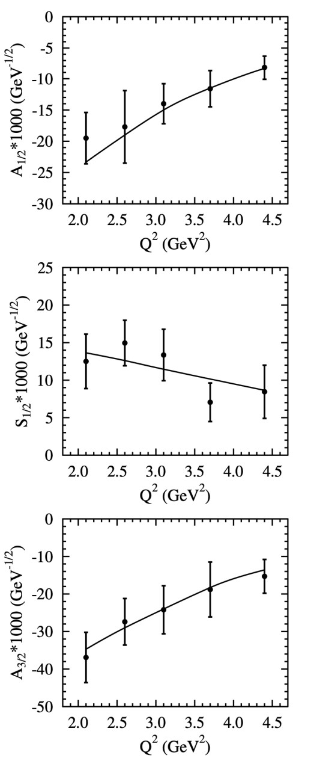
Composition of low-lying J=${\frac{3}{2}}^{±}$ $Δ$-baryons
Poincaré-covariant quark+diquark Faddeev equation
$⇒$ insights into the structure of four lightest $\left(I,J^{P}\right)=(\frac{3}{2},{\frac{3}{2}}^{±})$ baryon multiplets.
Prediction: Whilst these systems can contain isovector-axialvector $\left({1,1}^{+}\right)$ and isovector-vector $({1,1}^{−})$ diquarks, one may neglect the latter and still arrive at a reliable description.
Example … recent progress
V. I. Mokeev et al., Phys. Rev. C 108 (2023) 2, 025204 New analyses of CLAS $ep→e^{′}π^{+}π^{−}p^{′}$ cross sections
Comparison with CSM predictions made 4 years before: Ya Lu et al. Phys. Rev. D 100 (2019) 034001/1-13
Remarkable agreement, suggesting confirmation of CSM predictions for structure of baryon wave functions
CSM
$(\frac{3}{2},{\frac{3}{2}}^{+}$) are the simpler systems & features bear some resemblance
to quark model pictures
Most prominent rest-frame orbital angular momentum component is $S$-wave
$Δ\left(1600\right){\frac{3}{2}}^{+}$may fairly be viewed as radial excitation of $Δ\left(1232\right){\frac{3}{2}}^{+}$
$Δ\left(1600\right){\frac{3}{2}}^{+}$mainly $S$-wave, but significant $D$-wave.
$Δ\left(1232\right){\frac{3}{2}}^{+}$mainly $S$-wave.
CSM
CSM
Rest-frame angular momentum decompositions

Slide 30
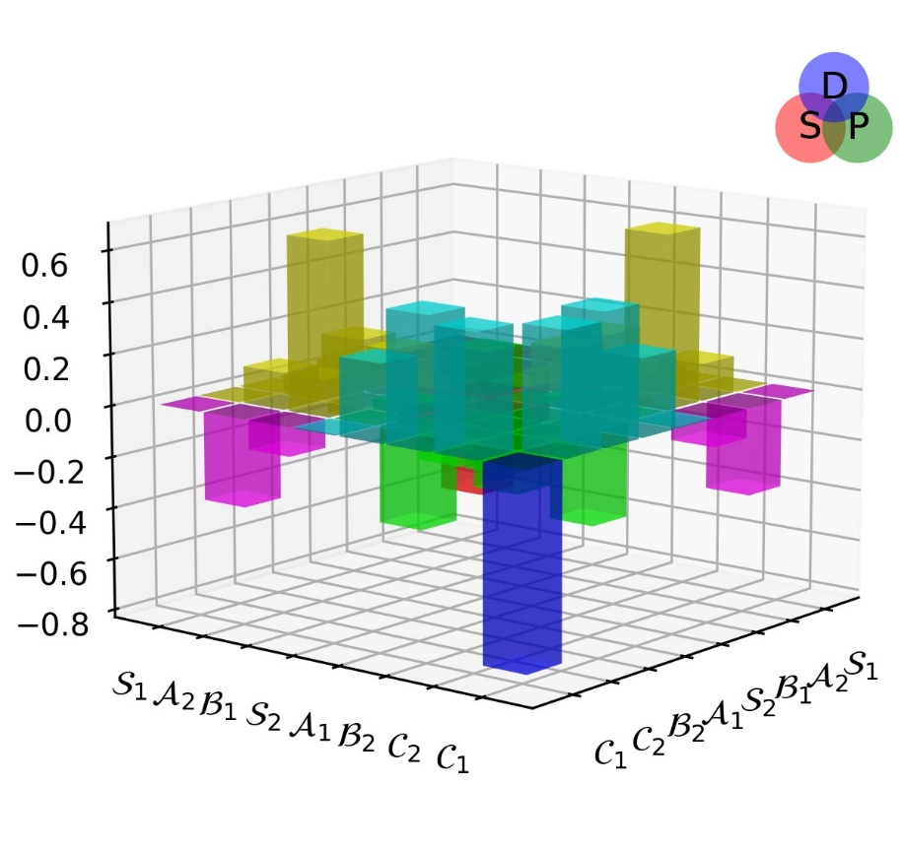
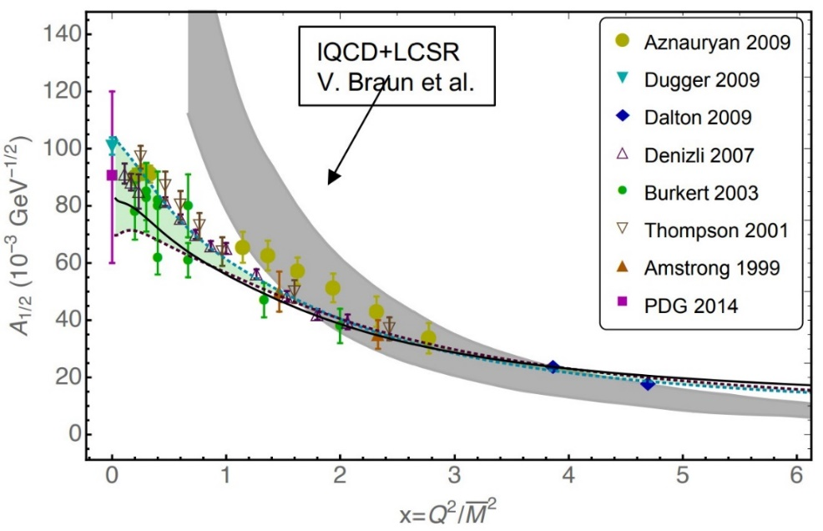
Numerous other resonances
Roper resonance: Toward a solution to the fifty year puzzle,
Volker D. Burkert and Craig D. Roberts,
arXiv:1710.02549 [nucl-ex], Rev. Mod. Phys. 91 (2019) 011003/1-18
CSM quark+diquark predictions exist
for $γ^{∗}p→Δ(1232)$ & $γ^{∗}p→N(1400)$
Good agreement with data on quark core domain, which varies from system to system
$N(1535)$
CSM quark+diquark wave function available
Rest frame: complex angular momentum structure
strong P-wave & strong S$⊗$P, P $⊗$D, S $⊗$D interference
$γ^{∗}p→N\left(1535\right)$
Contact interaction studies exist – qualitatively sound picture
Preliminary CSM quark+diquark results available
promising $⇔$ confirmation of complicated wave function
Dynamical diquarks in the γ*p → N(1535)1/2− transition,
Khépani Raya et al., NJU-INP 046/21, arXiv:2108.02306 [hep-ph],
Eur. Phys. J. A 57 (2021) 266/1-16

Slide 31
Parity Doubling
QCD = quantum field theory & in QFT parity partners have a strict definition
Baryons
Suppose $ψ^{P}$ satisfies a given bound-state equation
then parity partner of that state is the $γ_{5}ψ^{P}$solution of the same equation
No parallel in quark model because $P=$ Poincaré-invariant state label, whereas $L$ is not
Solve Faddeev equation for baryons and their parity partners,
one finds the following QFT identifications:
Wave functions of these QCD parity partners are very different
Differences driven by DCSB = corollary of EHM
When comparisons are made between states that are properly called parity partners,
then always a large mass splitting
partner $(γ_{5})$ | N(1535)${\frac{1}{2}}^{−}$ | N(1650) ${\frac{1}{2}}^{−}$ | $$Δ(1700){\frac{3}{2}}^{−}$$ | $$Δ\left(1940\right){\frac{3}{2}}^{−}$$ | N(1720) ${\frac{3}{2}}^{+}$ | N(1900)${\frac{3}{2}}^{+}$
ground | N(940) ${\frac{1}{2}}^{+}$ | N(1440) ${\frac{1}{2}}^{+}$ | $Δ\left(1232\right){\frac{3}{2}}^{+}$ | $$Δ\left(1600\right){\frac{3}{2}}^{+}$$ | N(1520)${\frac{3}{2}}^{−}$ | N(1700)${\frac{3}{2}}^{−}$
Splitting/GeV | 0.57 | 0.29 | 0.46 | 0.44 | 0.17 | 0.22

Slide 32
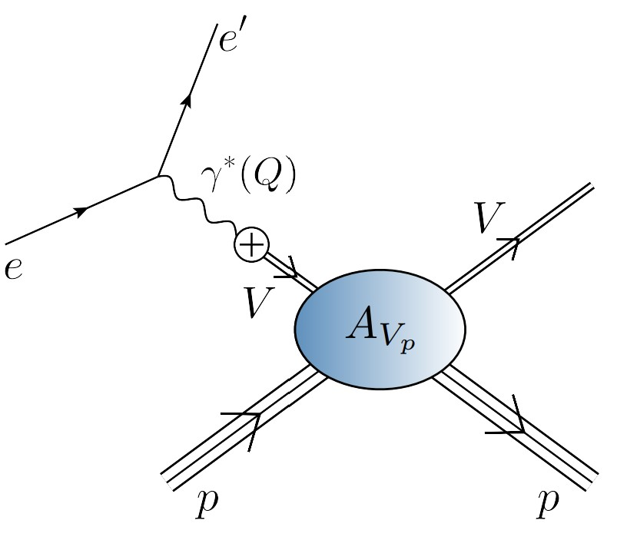
Photoproduction of heavy vector mesons

Slide 33
EHM Measurements How does the mass of the nucleon arise?
Once considered viable …
Electromagnetic process ($V=J/ψ, Υ$) … $e+p→e^{′}+V+p$
to access purely hadronic process … $V+p→V+p$
But …
Deciphering the mechanism of near-threshold J/ψ photoproduction, M.-L. Du, V. Baru, F.-K. Guo et al., Eur. Phys. J. C 80, 1053 (2020)
Vector-meson production and vector meson dominance, Yin-Zhen Xu, Si-Yang Chen, Zhao-Qian Yao et al., Eur. Phys. J. C 81 (2021) 895/1-11
Near threshold heavy quarkonium photoproduction at large momentum transfer, P. Sun, X.-B. Tong, F. Yuan, Phys. Rev. D 105 (2022) 5, 054032
There is no objective, model-independent means by which to connect $e+p→e^{′}+V+p$ with $V+p→V+p$
Hence, vector meson photoproduction
does not provide a path to the QCD trace anomaly
(or anything else)

Slide 34
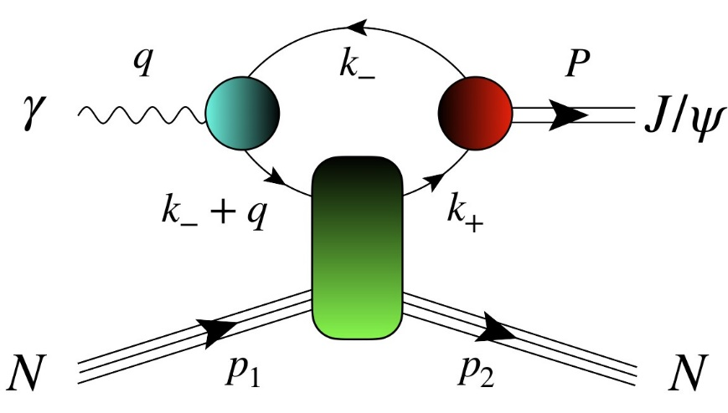
$J/ψ$ photoproduction: from threshold to very high energies
J/ψ photoproduction: threshold to very high energy, Lin Tang (唐淋) et al., NJU-INP 089/24, e-Print: 2405.17675 [hep-ph]
If GPD scheme valid at all, then only very near threshold.
All $W$ unification impossible
Some modern proposals for reaction model:
GPD treatment – gain access to in-proton gluon gravitational form factors
Coupled channels treatment – $P+ J/ψ p rescattering$
S. Sakinah, T. S. H. Lee, H.-M. Choi, Dynamical Model of J/Ψ photoproduction on the nucleon – arXiv:2403.01958 [nucl-th]
Suggestion = Final state interactions dominate cross-section near-threshold, so obscuring any connection with in-proton gluon distributions and/or gluon gravitational form factors.
$γ+p→c+\overline{c}+P+p→J/ψ+p$
Lin Tang (唐淋) et al. NJU-INP 089/24
Exposes $c+\overline{c}$ content of the dressed photon
Couples the intermediate $c+\overline{c}$system to
proton’s valence quarks via Pomeron exchange

Slide 35
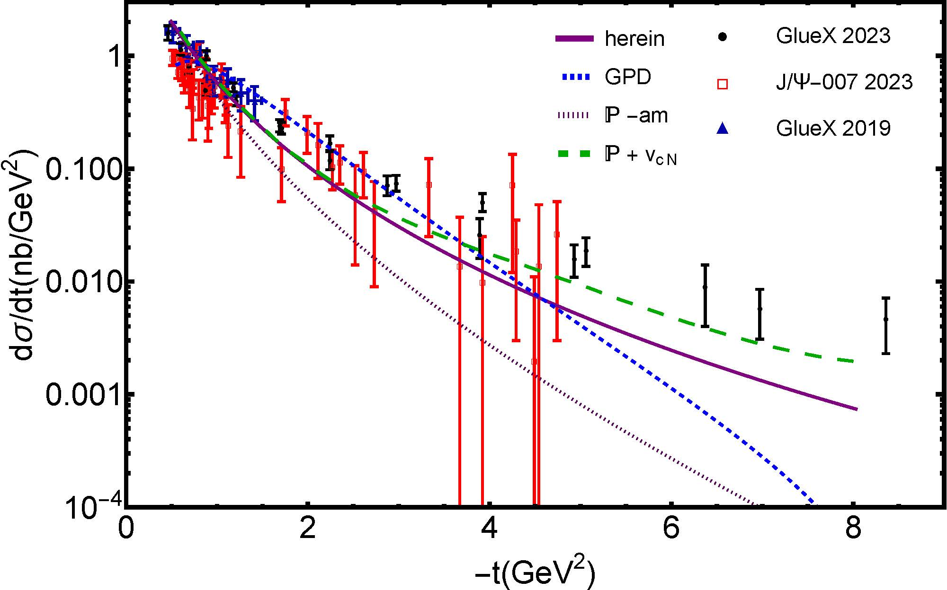
$J/ψ$ photoproduction: threshold differential cross-section
GPD model (dotted blue)
overfitting issue
concave differential cross-section with max. at low $\left|t\right|$
trying to reconcile GlueX and $J/ψ$-007 data (some tension)
all other reaction models produce convex $\frac{dσ}{dt}$
$P+J/ψp$ rescattering
dashed green – $χ_{dof}^{2}=8$
$P+quark loop$
solid purple – $χ_{dof}^{2}=7$

Slide 36
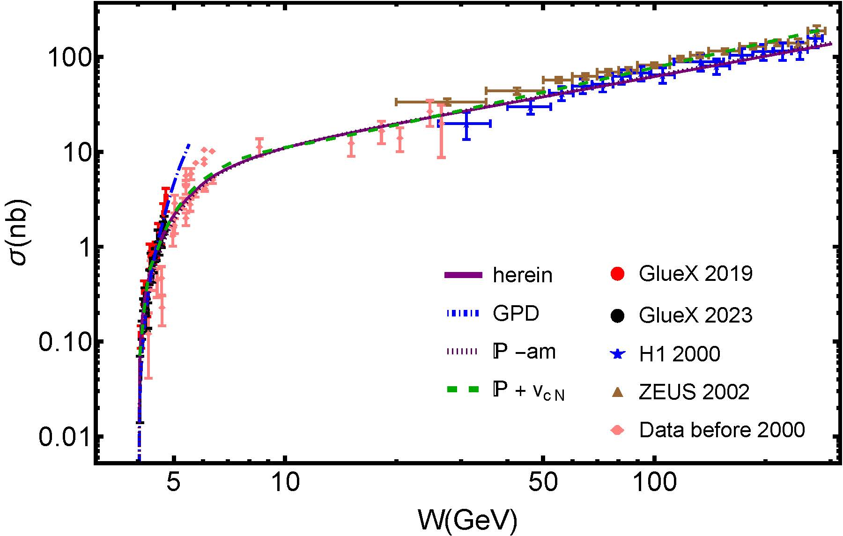
$J/ψ$ photoproduction: total cross-section, threshold to high-$W$
Reported ZEUS uncertainty in W is large, but uncertainty in $σ$ is small
Distorts $χ^{2}$
GPD model (dotted blue)
Inapplicable on $W>5$ GeV
$χ_{dof}^{2}$ undefined
$P+J/ψp$ rescattering
dashed green
ZEUS+H1 $χ_{dof}^{2}=2.1$
H1 $χ_{dof}^{2}=1.6$
$P+quark loop$
solid purple
ZEUS +H1 $χ_{dof}^{2}=3.5$
H1 $χ_{dof}^{2}=1.0$

Slide 37
$J/ψ$ photoproduction: from threshold to very high energies
Two reaction models provide viable unification
differential and total cross-section data
GPD model does NOT
Premature to connect γ + p → J/ψ + p photoproduction data with anything derived from/connected with GPDs
Theory predicts that proton mass radius < proton charge radius – see Empirical Determination of the Pion Mass Distribution, Y-Z. Xu (徐胤禛) et al., NJU-INP 070/23, e-Print: 2302.07361 [hep-ph], Chin. Phys. Lett. Express 40 (2023) 041201/1-7.
Best description of data is provided by CSM reaction model
$(W,t)$ dependence of quark loop is important to differential cross-section near threshold
Photoproduction probes quark structure of $γ→J/ψ$ not glue in proton

Slide 38
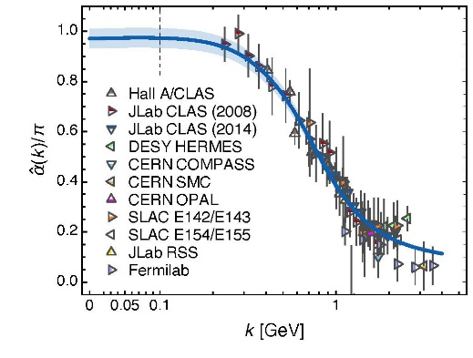
Synergy of Experiment, Phenomenology, Theory
Gather all pieces of the puzzle … Reveal the source of Nature’s basic mass-scale
Drawing detailed map of the proton is important because proton is Nature’s only absolutely stable bound state.
However, while QCD is the proton, the proton is not QCD
Strong interaction theory is maturing
Expanding array of parameter-free predictions for the proton – yes
And all the other hadrons whose properties express the full meaning of QCD
Structure of Nature’s most fundamental Nambu-Goldstone bosons
Structure of baryons, e.g., $Q^{2}$-dependence of nucleon resonance transition form factors
Spectrum is insufficient – many models give same spectrum, but transition form factors discriminate between pictures.
Understanding how QCD’s simplicity explains the emergence of hadron mass and structure requires investment in facilities that can deliver precision data on much more than one of Nature’s hadrons.
AMBER@CERN, EIC, EicC, STCF, CEPC, JLab22, LHeC could …
Deliver precise structure data on a wide range of hadrons with distinctly different quantum numbers
Thereby move Science into a new realm of understanding.

Slide 39
Emergent Hadron Mass
Grant no. 12135007
QCD is unique amongst known fundamental theories of natural phenomena
The degrees-of-freedom used to express the scale-free Lagrangian are not directly observable
Massless gauge bosons become massive, with no “human” interference
Gluon mass ensures a stable, infrared completion of the theory through the appearance of a running coupling that saturates at infrared momenta, being everywhere finite
Massless fermions become massive, producing
Massive baryons and simultaneously Massless mesons
These emergent features of QCD are expressed in every strong interaction observable
They can also be revealed via
EHM interference with Nature’s other known source of mass = Higgs
We are capable of building facilities that can validate these concepts, proving QCD to be
the 1st well-defined four-dimensional quantum field theory ever contemplated
This may open doors that lead far beyond the Standard Model

Slide 40
$${\text{L}}_{Nature}= ?$$
There are theories of many things,
But is there a theory of everything?
Thankyou

Slide 42
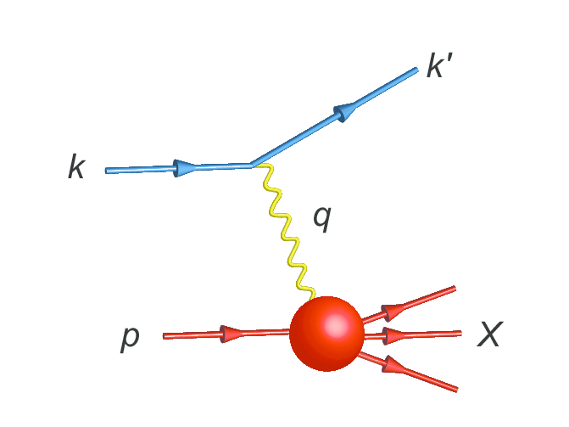
Parton Distribution Functions

Slide 43
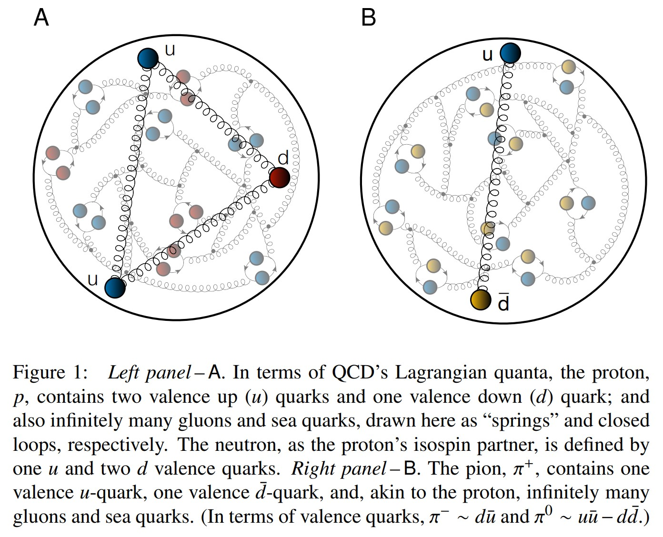
Proton and pion distribution functions in counterpoint
massive
almost massless
Today, despite enormous expense of time and effort, much must still be learnt before proton and pion structure may be considered understood in terms of DFs
Most simply, what are the differences, if any, between the distributions of partons within the proton and the pion?
The question of similarity/difference between proton and pion DFs has particular resonance today as science seeks to explain EHM
How are obvious macroscopic differences between protons and pions expressed in the structural features of these two bound-states?
proton
pion

Slide 44
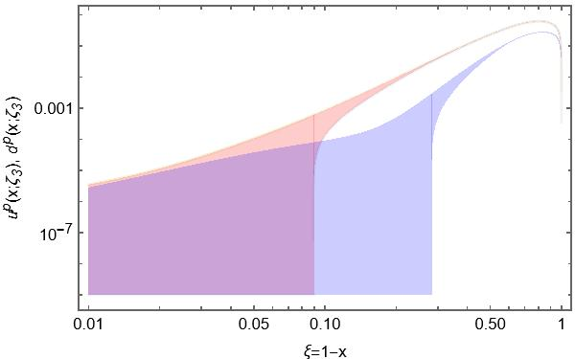
Phenomenology – global fits – of proton valence quark DFs
Example: NNPDF4.0 inferences of proton valence quark DFs
$d(x)$ is unknown on $x>0.7$
Can be negative on this domain
$u(x)$ is unknown on $x>0.9$
Can be negative on this domain
QCD makes firm predictions on valence-quark domain
They are overlooked in agnostic fitting procedures
To claim understanding of QCD, reliable path from data to theory DF predictions must be found
Far valence domain

Slide 45
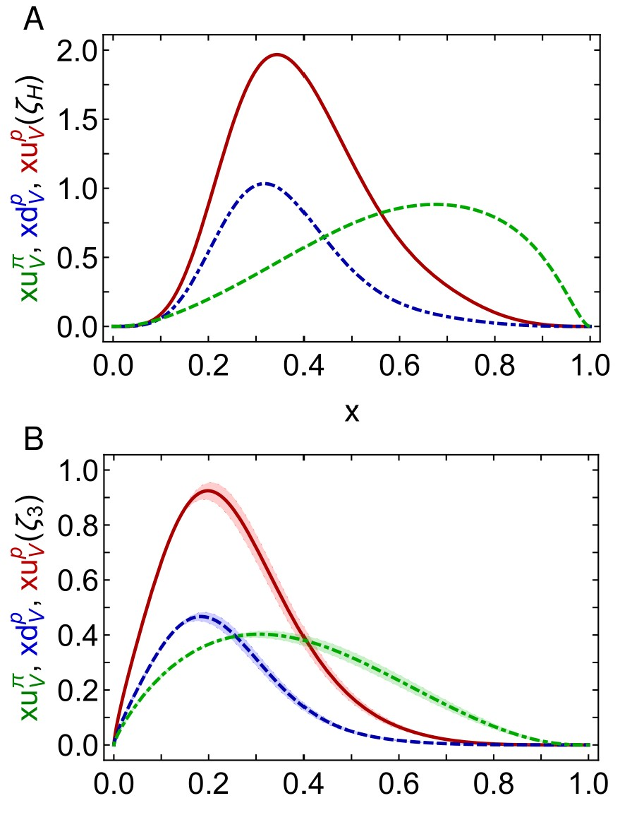
Proton and pion distribution functions in counterpoint
Proton and pion distribution functions in counterpoint, Ya Lu (陆亚) et al.,
NJU-INP 056/22, e-Print: 2203.00753 [hep-ph], Phys. Lett. B 830 (2022) 137130
Pion distribution functions from low-order Mellin moments, Ya Lu et al., e-Print: 2311.01613 [hep-ph], Phys. Lett. B 850 (2024) 138534/1-6
Symmetry-preserving analyses using CSMs deliver hadron scale DFs that agree with QCD constraints
Valence-quark degrees-of-freedom carry all hadron’s momentum at $ζ_{H}$:
Diquark correlations in proton, induced by EHM
${⇒u}_{V}(x)≠2d_{V}\left(x\right)$
Proton and pion valence-quark DFs have markedly different behaviour – $u^{π}(x;ζ_{H})$ is Nature’s most dilated DF
“Obvious” because ${\left(1−x\right)}^{2}$ vs. ${\left(1−x\right)}^{3}$ behaviour & preservation of this unit difference under evolution
Also “hidden” = strong EHM-induced broadening
Dilation and endpoint power-law behaviour are consistent with analyses of modern lQCD results
dilation
u in proton
d in proton
u in pion
dilation

Slide 46
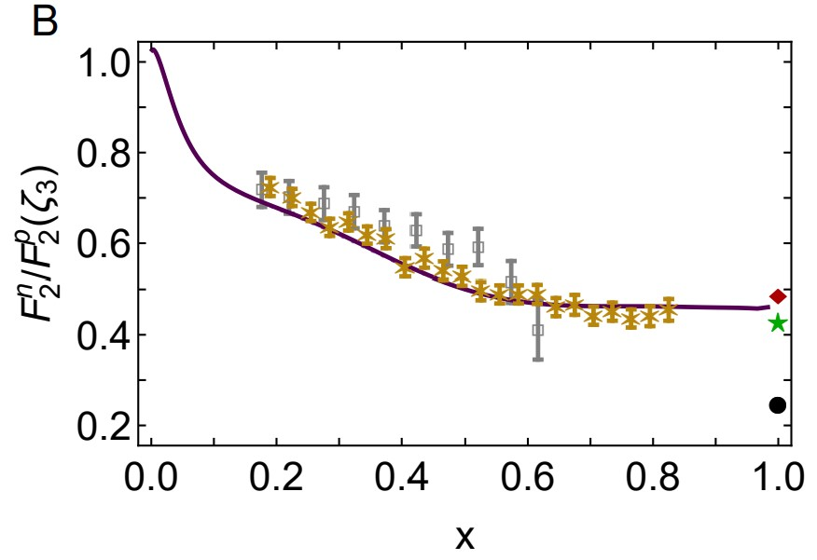
Neutron/Proton structure function ratio
CSM prediction = presence of axial-vector diquark correlation in the proton
Responsible for $≈40\%$ of proton charge
Ratio $1^{+}/0^{+}$ diquarks in proton wave function
is measure of EHM
Structure function ratio is clear window onto $d_{V}(x)/u_{V}(x)$
$U\left(x;ζ\right)=u\left(x;ζ\right)+\overline{u}\left(x;ζ\right)$, $D\left(x;ζ\right)=d\left(x;ζ\right)+\overline{d}\left(x;ζ\right)$
$Σ\left(x;ζ\right)=s\left(x;ζ\right)+\overline{s}\left(x;ζ\right)$+ $c\left(x;ζ\right)+\overline{c}\left(x;ζ\right)$
Comparison with MARATHON data
[D. Abrams, et al., Measurement of Nucleon $F_{2}^{n}/F_{2}^{p}$Structure Function Ratio by the Jefferson Lab MARATHON Tritium/Helium-3 Deep Inelastic Scattering Experiment – arXiv:2104.05850 [hep-ex], Phys. Rev. Lett. (2022) in press]
Agreement with modern data on entire x-domain – parameter-free prediction
Sea quark dominance on x<0.2
Valence quark dominance on x>0.2
🎆 Valence quark ratio in the proton, Zhu-Fang Cui, (崔著钫), Fei Gao (高飞), Daniele Binosi, Lei Chang (常雷), Craig D. Roberts and Sebastian M. Schmidt, NJU-INP 049/21, e-print: 2108.11493 [hep-ph], Chin. Phys. Lett. Express 39 (04) (2022) 041401/1-5: Express Letter
Probability that scalar diquark only models of nucleon might be consistent with available data is 1/141,000

