Slide 1
Gaussian Process
Machine Learning for Observable Interpolation and Data Analysis
Ryan Ferguson
r.ferguson.3@research.gla.ac.uk

Slide 2
Contents
Why are we doing this?
Assumptions
How do we know it works?
What does real data look like?
What are the next steps?

Slide 3
Why are we doing this?

Slide 4
Why?
Information from hardon data is limited by incomplete and potentially inconsistent datasets.
Hadronic data often is for different observables and comes from different experiments.
Often these datasets can be sparsely populated in kinematic regions of interest.
This fit can prove difficult to accurately constrain when using different observables measured at different kinematic variables.
Ideally, a process which can reliably provide a value and associated uncertainty at any given kinematic variable should be used. This can be achieved using machine learning.
Notes:
Incomplete, inaccurate datasets
Sparsely populated in kinematic regions of interest and extracting useful information challenging.

Slide 5
What can machine learning do?
A Gaussian Process (GP) can be used to predict the mean and standard deviation of other, unknown, datapoints.
This can be used to build a more consistent, accurate and complete dataset.
Datasets from different experiments of the same variable can be compared and checked using some statistical measures.
The GP could provide significantly improved datasets which theorists can use to test models and check for significant areas of divergence between the GP fit and theoretical models.
Notes:
Check other datasets.
Improve datasets to help theorists, check for areas of divergence.

Slide 6
How does it work?

Slide 7
Assumptions
The Gaussian Process only requires 3 assumptions to operate:
Some kernel function can be used to measure the covariance between known datapoints.
This same kernel function can predict the covariance of other, unknown datapoints.
The style of posterior distribution is known (e.g., smoothness, continuity, periodicity, monotonically increasing, etc.).
A full mathematical description is included in the back-up slides.
From this, the GP can provide a mean and uncertainty for these other, unknown discrete datapoints.

Slide 8
How do we know it works?

Slide 9
Pseudodata
We can test the GP using some suitable pseudodata. Thus, define a 2D surface of the form, modelled on polarisation observables:
$$y_{func}=f\left(E_{γ},\cos{θ}\right)=\sum_{l=0}^{n}{c_{l}∗g_{l}\left(E_{γ}\right)∗P_{l}(\cos{θ}) }$$
With
$c_{l} ε \left[−1,1\right]$ is some weight
$g_{l}\left(E_{γ}\right)\text{∼}𝒩\left(μ_{l},{σ^{2}}_{l}\right)$
$P_{l}(\cos{θ})$ is an ordinary Legendre polynomial
In our case n=3 so we have 12 parameters.
Note also that $\left|y_{func}\right|≤1$.

Slide 10
Radial Basis Function Kernel
Various kernels can be used depending on the desired output, e.g. smoothness, periodicity, etc. Here the simplest kernel, the radial basis function (RBF), is tested:
$$κ\left(\underline{a},\underline{b}\right)=exp⁡\left[\sum_{i=0}^{p−1}{\frac{−{d(a_{i},b_{i})}^{2}}{2{l_{i}}^{2}}}\right]$$
Where:
$\underline{a},\underline{b}$ are some vectors of length p (e.g. have p parameters)
$d(∙,∙)$ is the Euclidean distance.
$\underline{l}$ is a hyperparameter called the length scale. For this kernel, it is a measure of how smooth the function is.

Slide 11
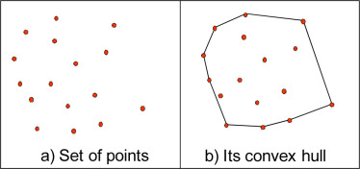
Convex Hull
It was found in testing that the GP performs well at interpolating but not at extrapolating.
As such a set of discrete points of the convex hull¹ of the known datapoints is the space that the GP gives a prediction for (with resolution in each dimension chosen by the user).
Notes:
A convex hull is the minimal convex polygon that encloses all points in the set of known points.

Slide 12
3 Tests
We can perform 3 tests on the pseudodata output to check the GP is performing as intended:
Unbiased Pulls
Number of points in different confidence intervals
Unbiased Pull of Fitted coefficients

Slide 13
Unbiased Pull
Calculate pull: $pull=\frac{y_{func}−y_{fit}}{e_{fit}}$
For each surface, check the pull distribution mean and variance, which should be 0 and 1, respectively.
Check the pull distribution of the GP fit at the same energies and angles as the “known” datapoints.
Calculate the mean and variance of both pull distributions for every generating surface.

Slide 14
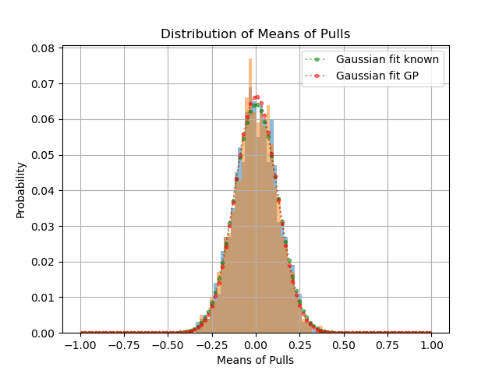
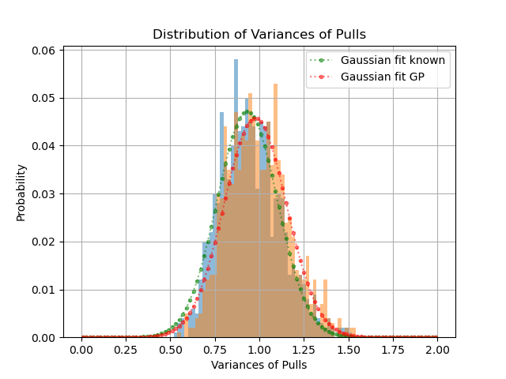
Unbiased Pull
Centred at 0
Centred at 1

Slide 15
Points within confidence intervals
Calculate pull: $pull=\frac{y_{func}−y_{fit}}{e_{fit}}$
$\left|pull\right|≤1⟹y_{func} ϵ \left[y_{fit}−e_{fit} , y_{fit}+e_{fit}\right]$, i.e., the predicted point is within its uncertainty of the actual point.
From this the total percentage of points within different confidence intervals can be calculated by scaling $e_{fit}$as required and repeat.

Slide 16
Points within confidence intervals
Confidence interval | Expected percentage of points within confidence interval (%) | Mean percentage of points within confidence interval (%)
0.67σ | 50 | 84.5
1σ | 68.3 | 94.6
1.96σ | 95 | 99.7

Slide 17
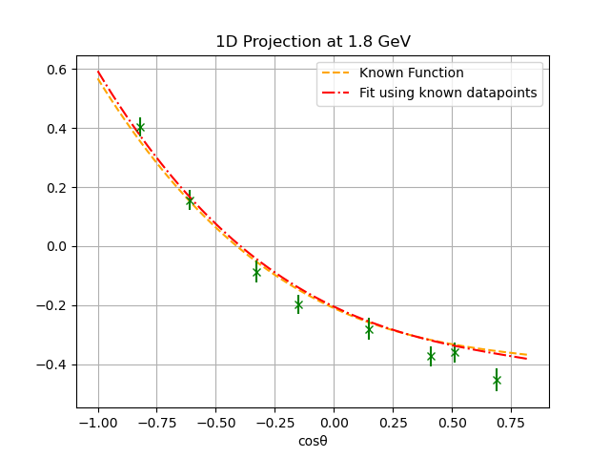
Fitting Parameters
The functional form of the 2D surface can be fitted to some datapoints, using a least squares method, shown below:
Notes:
As stated previously, most of the information of hadron resonances is obtained from the fitting the theoretical functional form to data. As such is important to check that fits to GP data are appropriate.

Slide 18
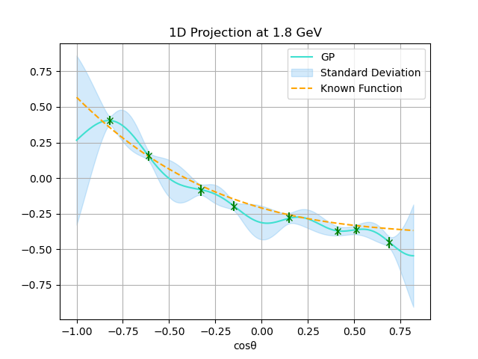
Fitting Parameters
A Gaussian Process fit is then performed on the same datapoints:

Slide 19
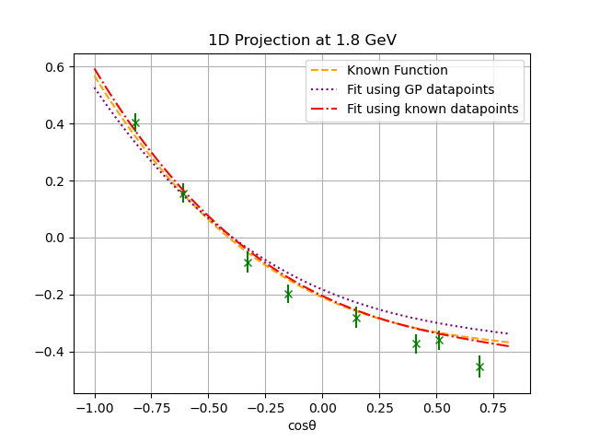
Fitting Parameters
The GP datapoints are used to fit the functional form of the 2D surface:

Slide 20
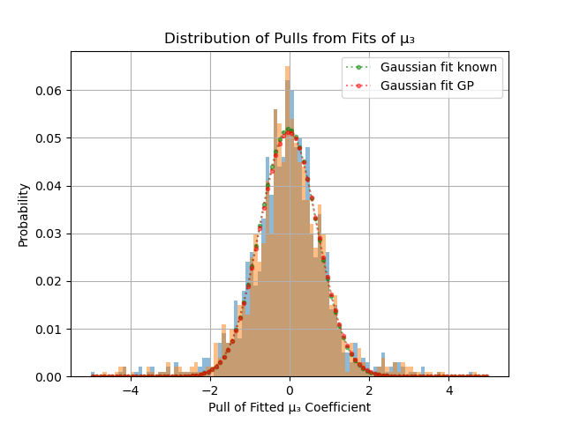
Fitting Parameters
This can be further verified by finding the pull distribution of each of the surface coefficients which should be Gaussians centred at 0 with width 1. An example of one coefficient, $μ_{3}$, is shown below:

Slide 21
What does real data look like?

Slide 22
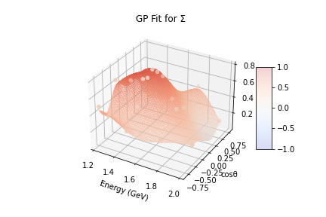
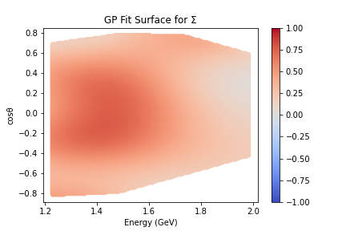
Data from CLAS
The GP has been used on data recently submitted for publication by the CLAS collaboration at Jefferson Lab, specifically 5 polarisation observables (Σ, P, T, O_{x} and O_{z}) of the K⁰Σ⁺ reaction.² Example plots for Σ:

Slide 23
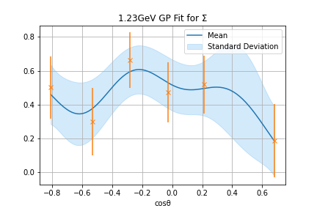
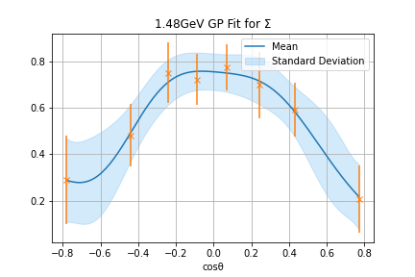
GP 1D Projections for Σ

Slide 24
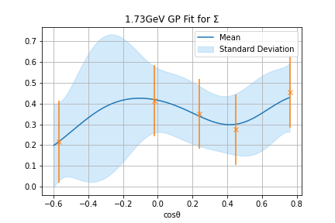
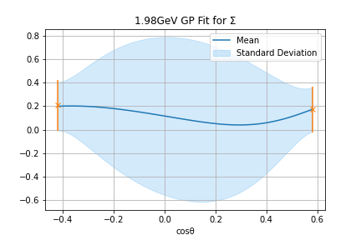
GP 1D Projections for Σ

Slide 25
What are the next steps?

Slide 26
Comparing Datasets
Additional work is also ongoing to develop a methodology to check the consistency between different datasets of the same variable.
This will enable theorists to use an expanded datasets to test theories, build more rigorous models, etc.

Slide 27
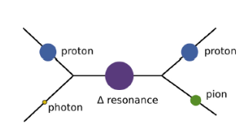
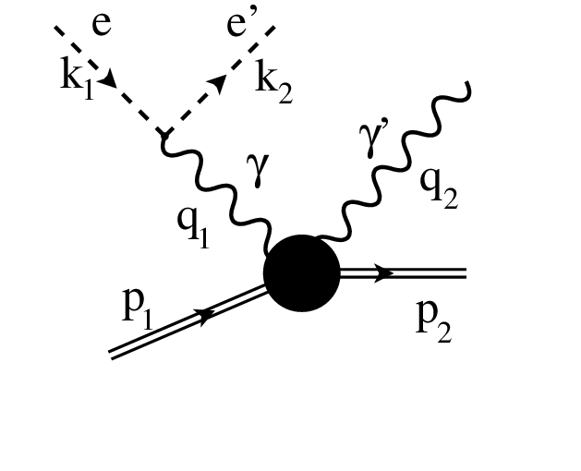
Expanding to Higher Dimensions
Testing is underway to expand the GP to higher dimensions, ensuring it still passes the 3 tests shown here.
Current testing is in 5 dimensions, based on data of Deeply Virtual Compton Scattering (DVCS) of the pion, but other physics quantities are planned.
Photomeson Production in 2D.³
DVCS in 5D.⁴

Slide 28
Conclusion
A Gaussian Process is an extremely useful machine learning tool to expand existing, limited datasets, requiring only 3 simple assumptions to operate.
The GP has been demonstrated to work on pseudodata modelled on 2D polarisation observables.
Work is ongoing to expand to other physics quantities and to higher dimensions (particularly DVCS of pions in 5D) and to develop a metric for testing if 2 datasets are consistent with one another.

Slide 29
Thanks for listening

Slide 30
References
R. Laurini, Geographic Knowledge Infrastructure, 2017, www.sciencedirect.com/topics/earth-and-planetary-sciences/convex-hull [accessed May 28th 2024]
L. Clark et al, Photoproduction of the Σ+ hyperon using linearly polarized photons with CLAS, 2024, https://arxiv.org/abs/2404.19404 [accessed May 30th 2024]
F. Rieger, HIGH ENERGY ASTROPHYSICS - Lecture 9, 2024, www.mpi-hd.mpg.de/personalhomes/frieger/HEA9.pdf [accessed May 30th 2024]
R. Fiore et al, Kinematically complete analysis of the CLAS data on the proton structure Function F2 in a Regge-Dual model, 2006, https://www.researchgate.net/publication/46776238_Kinematically_complete_analysis_of_the_CLAS_data_on_the_proton_structure_Function_F2_in_a_Regge-Dual_model?_tp=eyJjb250ZXh0Ijp7ImZpcnN0UGFnZSI6Il9kaXJlY3QiLCJwYWdlIjoiX2RpcmVjdCJ9fQ [accessed May 30th 2024]
M. Krasser, Gaussian processes. 2018. URL: krasserm.github.io/2018/03/19/gaussian-processes/ [accessed May 26th 2024]

Slide 31
Back-up Slides

Slide 32
Mathematical Process I
Assume that we have n known datapoints of the form $\left({\vec{x}}_{i},y_{i}\right)$ with known errors $e_{i}$. Here ${\vec{x}}_{i}$ is a vector of length p (whose parameters could include energy, scattering angle, or some other kinematic variable) used to define the expression form $\vec{y}=f\left(X\right)$ where $\vec{y}$ is a column vector of length n made up of the scalers $y_{i}$ and $X$ is a n x p matrix whose rows are the collection of ${\vec{x}}_{i}$.
Assume that $\vec{y}$ is drawn from a Multivariate Gaussian of the form $p\left(\vec{y} | X\right)∼𝒩\left(\vec{0},K\right)$, where $K=κ(X,X)+ {\vec{e}}^{2}I_{n}$ is the n x n covariance matrix and κ is some kernel function that is used to measure the covariance. Here $K_{ab}=κ\left({\vec{x}}_{a},{\vec{x}}_{b} \right)+δ_{ab}{e_{a}}^{2},$ where ${\vec{x}}_{a},{\vec{x}}_{b}$ are rows of the matrix $X$.

Slide 33
Mathematical Process II
Assume that there are m known datapoints of the form outlined previously, with known ${\vec{x_{∗}}}_{i}$with unknown scalars ${y_{∗}}_{i}$, e which are correlated to the n known datapoints.
Note that for $∀i=1,...n, ∃ j$ such that ${\vec{x}}_{i}={\vec{x_{∗}}}_{j}$.
An m x p matrix $X_{∗}$ can then be generated whose rows are the vectors $\vec{x_{∗}}$.
As $\vec{y_{∗}}$ (a column vector of length m) is correlated to $\vec{y}$, they are drawn from the same multivariate Gaussian:
$$\left[\begin{matrix}\vec{y} \\ \vec{y_{∗}}\end{matrix}\right]∼𝒩\left(\underline{0}, \left[\begin{matrix}K & K_{∗} \\ {K_{∗}}^{T} & K_{∗∗}\end{matrix}\right]\right)$$
where $K_{∗}=κ\left(X,X_{∗}\right)$, $K_{∗∗}=κ\left(X_{∗},X_{∗}\right)$.

Slide 34
Mathematical Process III
By using the conditional of a multivariate Gaussian, a prediction for $\vec{y_{∗}}$ can be obtained:
$p\left(\vec{y_{∗}} | X_{∗},X,\vec{y} \right)∼N\left(\vec{μ_{∗}},Σ_{∗}\right)$ where
$\vec{μ_{∗}}={K_{∗}}^{T}K^{−1}\vec{y}$
$Σ_{∗}=K_{∗∗}−{K_{∗}}^{T}K^{−1}K_{∗}$
Thus, the GP now has a prediction for the mean and covariance matrix, and thus the standard deviation, of $\vec{y_{∗}}$. ⁵

Slide 35
Generating Pseudodata I
A generated asymmetry datapoint is based on the effective number of counts measured. This can be expressed as
$$A=\frac{N_{+}−N_{−}}{N_{+}+N_{−}}$$
where $N_{+},N_{−}$ are used to describe the 2 different states which are used to estimate the effective count. These take into account beam polarisation, recoils, target dilution and other such factors. These random variables are generated from “true” values:
$$N\sim \text{Pois}\left(n_{±}\right)$$
where $n_{±}=\frac{1}{2}n_{e}\left[1±f\left(w,\cos{θ}\right)\right]$. Here $n_{e}$ is defined as the effective number of events and is in the range [200,1000] which is estimated based on real data.

Slide 36
Generating Pseudodata II
By using standard propagation of errors, the error on A is given by:
$$δA=\frac{2}{{\left(N_{+}+N_{−}\right)}^{2}}\sqrt{N_{+}N_{−}\left(N_{+}+N_{−}\right)}$$

Slide 37
Length Scale Calculation - Energy
The mean distance between adjacent measured energy levels. This is mathematically expressed as (assuming n measured energy levels):
$$L_{E_{γ}}=\frac{1}{n−1}\sum_{j=1}^{n−1}{\left[e_{j−1}−e_{j}\right]}$$

Slide 38
Length Scale Calculation - Angle
For each measured energy level calculate the mean distance between adjacent measured, degenerate datapoints. Take the resulting mean of these values. This is expressed mathematically as (where $m_{j}$ is the number of datapoints measured at the j-th energy level):
$$L_{\cos{θ}}=\frac{1}{n}\sum_{j=1}^{n}{\left(\frac{1}{m_{j}−1}\sum_{i=1}^{m_{j}−1}{\left[a_{j,i+1}−a_{j,i}\right]}\right)}$$

Slide 39
Resolution Choice
Any “reasonable” choice of resolution for a given dimension is acceptable. Specifically, assume that $D$ is the set of all measured points in a given dimension and $R$ is the resolution of this dimension, then mathematically:
$$∀d_{1},d_{2}∈D,∃ z∈ℤ s.t.$$
$$d_{1}−d_{2}=zR$$
Or equivalently:
$$∀d∈D,∃ z∈ℤ s.t.$$
$$\min\left(D\right)−d=zR$$

Slide 40
Coefficient | Mean of pull distribution from known datapoints fit | Variance of pull distribution from known datapoints fit | Mean of pull distribution from GP datapoints fit | Variance of pull distribution from GP datapoints fit
$$c_{0}$$ | 0.04 | 0.91 | 0.06 | 0.92
$$μ_{0}$$ | -0.04 | 0.82 | -0.05 | 0.84
$${σ_{0}}^{2}$$ | 0.0 | 0.77 | -0.01 | 0.79
$$c_{1}$$ | 0.04 | 0.89 | 0.04 | 0.91
$$μ_{1}$$ | -0.03 | 0.74 | -0.02 | 0.73
$${σ_{1}}^{2}$$ | -0.1 | 0.77 | -0.09 | 0.78
$$c_{2}$$ | -0.06 | 1.01 | -0.06 | 1.05
$$μ_{2}$$ | -0.05 | 0.73 | -0.05 | 0.75
$${σ_{2}}^{2}$$ | -0.17 | 0.82 | -0.17 | 0.83
$$c_{3}$$ | -0.06 | 0.95 | -0.07 | 0.96
$$μ_{3}$$ | -0.02 | 0.73 | -0.04 | 0.74
$${σ_{3}}^{2}$$ | -0.07 | 0.73 | -0.07 | 0.76

