Slide 1


Delta resonance mass distribution in A-A collisions
Szymon Harabasz (TU Darmstadt) for the HADES collaboration and:
Wojciech Florkowski (Jagiellonian University in Krakow)
Radoslaw Ryblewski (Polish Academy of Sciences)
NSTAR2024, York
Delta resonance mass distribution in AA collisions

Slide 2

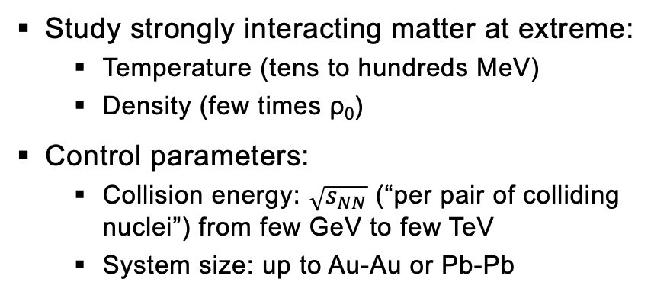

Relativistic Heavy-Ion Collisions 101
time $∼{10}^{−23}$ s
„First chance“ „Pre-equillibrium“ Fireball Freeze-out Late stage
Very different a.f.o. $\sqrt{s_{NN}}$
Picture credits: Galatyuk, Seck
Study strongly interacting matter at extreme:
  Temperature (tens to hundreds MeV)
  Density (few times ρ₀)
Control parameters:
  Collision energy: $\sqrt{s_{NN}}$ (“per pair of colliding nuclei”) from few GeV to few TeV
  System size: up to Au-Au or Pb-Pb
Main goals
Transport coefficients of strongly interacting matter
Equation of State of QCD
Restoration of spontaneously broken symmetries
Deconfinement
Search for 1st order phase transition and critical points

Slide 3
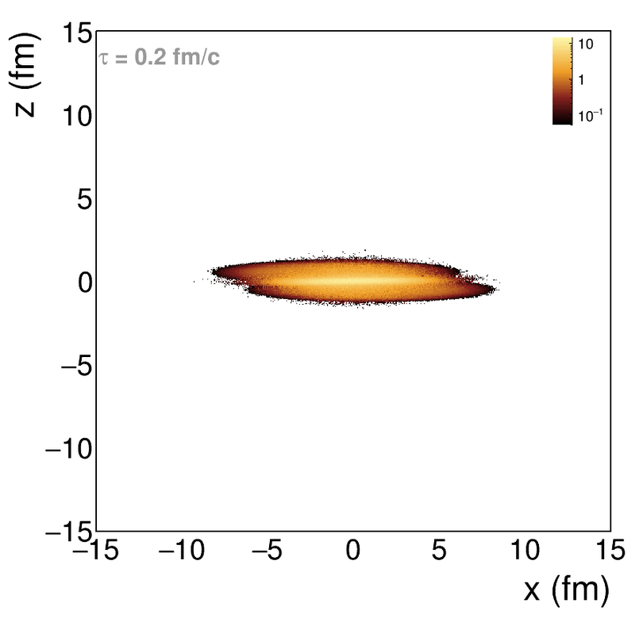
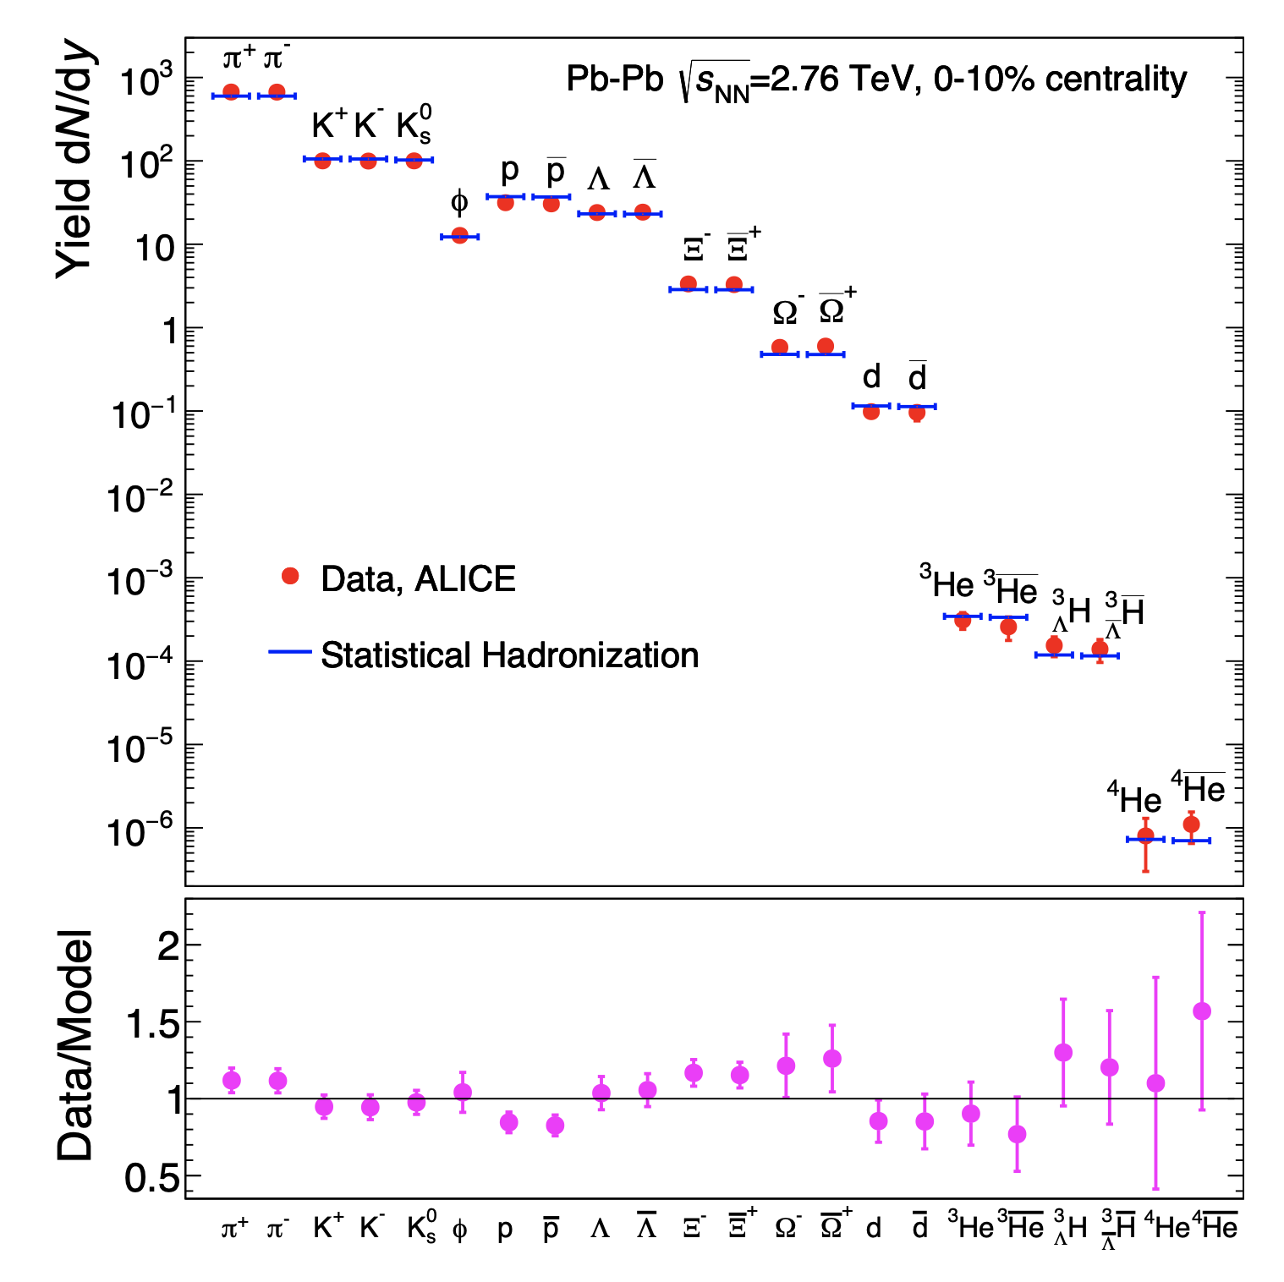
High Energy edge
A. Andronic et al., Nature 561 (2018) 7723, 321-330
Colliding nuclei are highly Lorentz-contracted and transparent to each other
We detect mostly newly produced particles (E=mc²)
Mass hierarchy:
  Mesons more abundant
  They dominate the properties of the matter
Statistical Hadronization:
  Model of an ideal gas of hadrons and resonances
  Particle yields calculated from grand canonical partition function
  Fit to the data gives thermodynamic parameters (temperature, chemical potential(s))

Slide 4
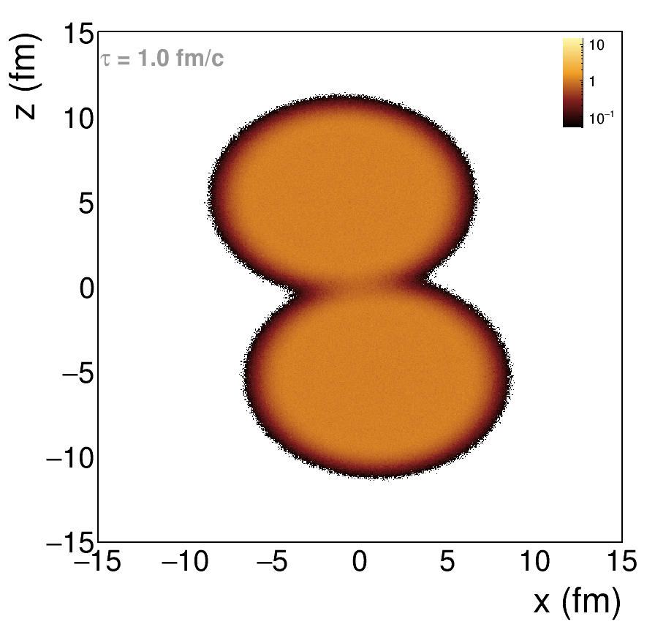
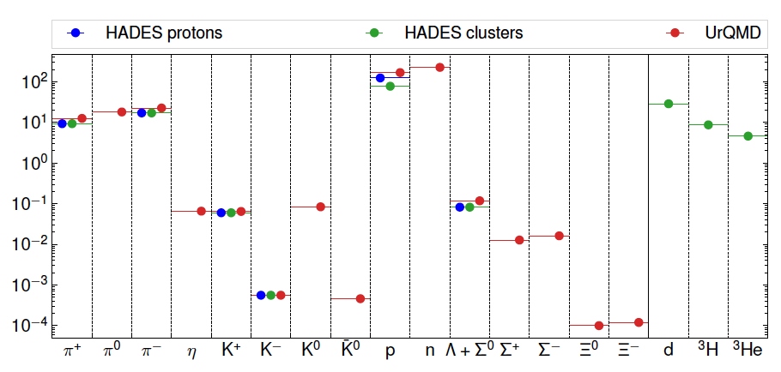

LOW Energy edge
A. Motornenko et al., PLB 822 (2021) 136703
Au-Au $\sqrt{s_{NN}}$=2.42 GeV, 0-10% centrality
Not so strong Lorentz contraction but low transparency
We detect mostly nucleons:
  Incoming nuclei
  Decays of baryonic resonances
  Baryon-dominated matter

Slide 5
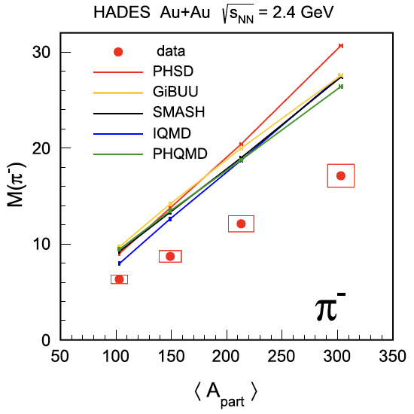
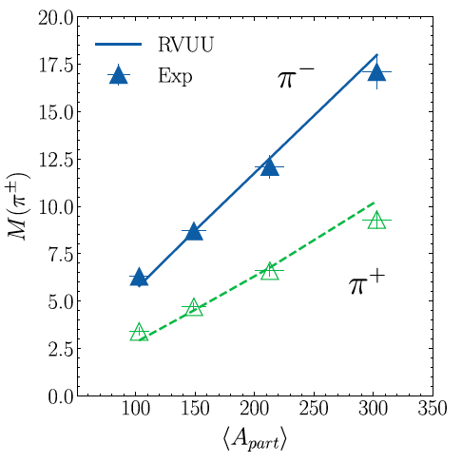
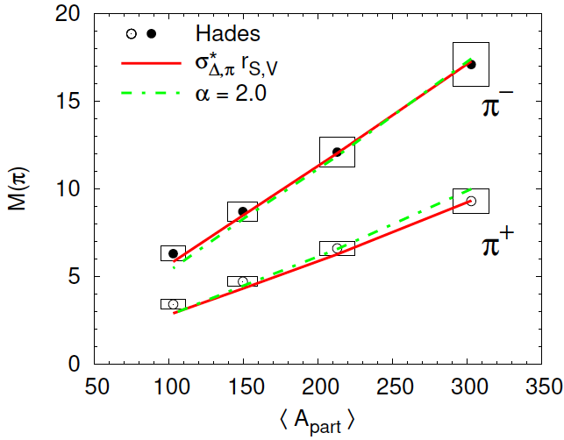
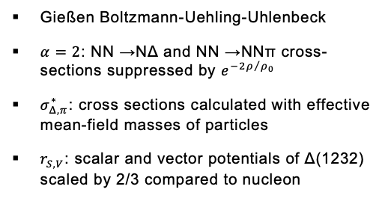
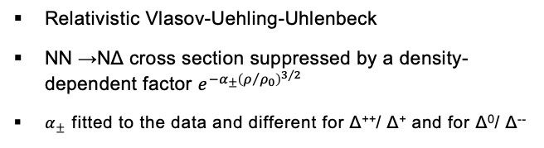
Pion production mystery
HADES, EPJA 56 (2020) 259
K. Godbey et al., PLB 829 (2022) 137134
C. Kummer et al., PRC 109 5, 054901
Relativistic Vlasov-Uehling-Uhlenbeck
NN →NΔ cross section suppressed by a density-dependent factor $e^{−α_{±}{\left(ρ/{ρ_{0}}\right)}^{3/2}}$
$α_{±}$ fitted to the data and different for Δ⁺⁺/ Δ⁺ and for Δ⁰/ Δ⁻⁻
Gießen Boltzmann-Uehling-Uhlenbeck
$α=2$: NN →NΔ and NN →NNπ cross-sections suppressed by $e^{−2ρ/{ρ_{0}}}$
$σ_{Δ,π}^{∗}$: cross sections calculated with effective mean-field masses of particles
$r_{S,V}$: scalar and vector potentials of Δ(1232) scaled by 2/3 compared to nucleon
Simular situation for π⁺
Common kinetic transport models fail to reproduce pion yields measured by HADES

Slide 6
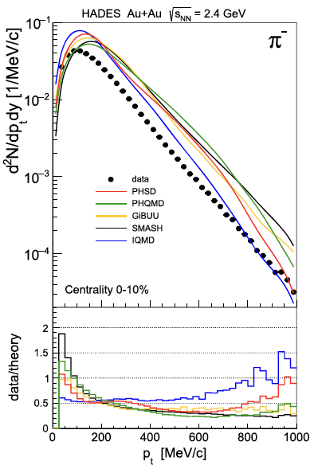
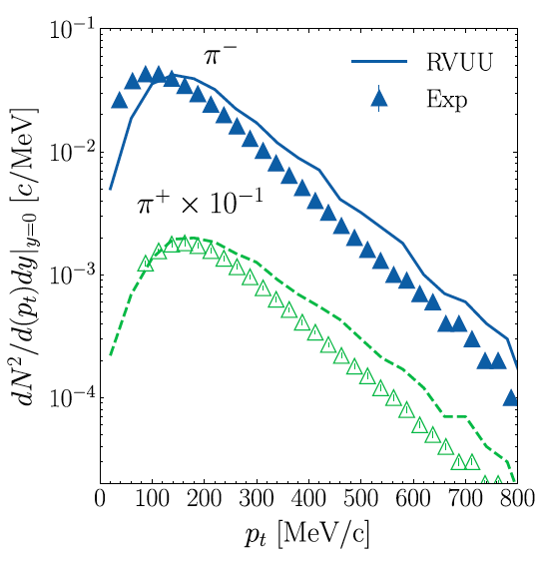
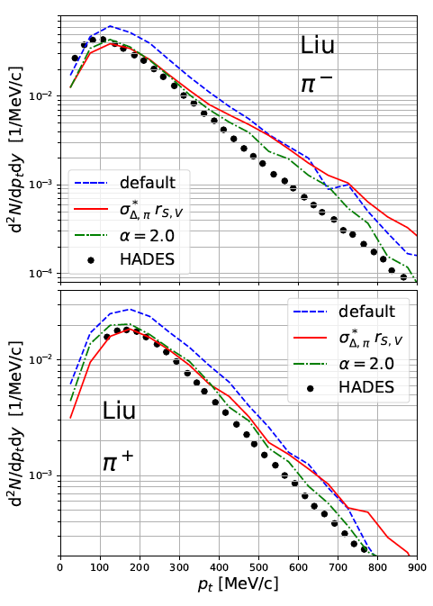
We Are On A GOOD Way…
HADES, EPJA 56 (2020) 259
K. Godbey et al., PLB 829 (2022) 137134
C. Kummer et al., PRC 109 5, 054901
Proper treatment of Δ in medium is crucial for describing hadron spectra but current approaches are still too schematic

Slide 7
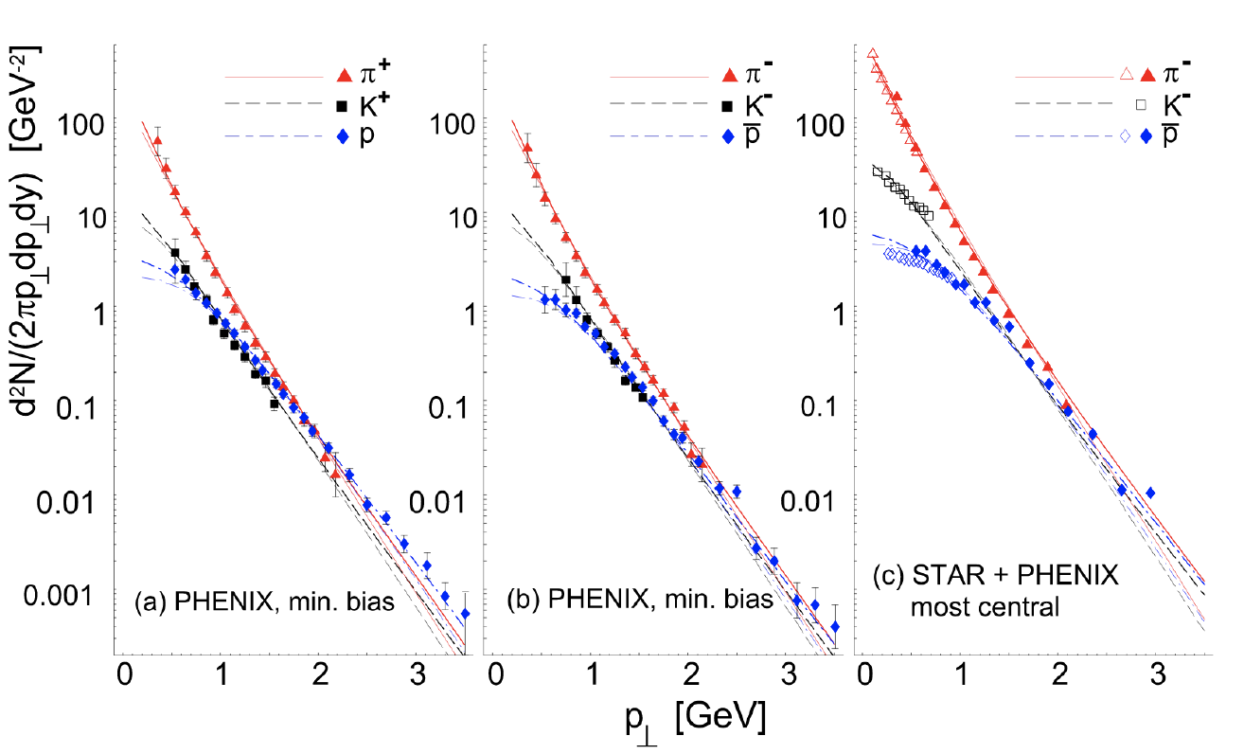
Single freeze-out scenario at RHIC energies
W. Broniowski and W. Florkowski, PRL 87 (2001) 272302
Chemical (= particle abundances fixed) and kinetic
(= particle momenta fixed) freeze-outs coincide
Hadron yields are given by the integrals of hadron spectra
Feed-down from resonance decays included
Implemented in the event generator Therminator 2
Successful at RHIC, does it work at SIS18 energies?
7

Slide 8
Thermal Event Generator
(Therminator 2)
M. Chojnacki et al., Comput. Phys. Comm. 103 (2012) 746-773
SH, W. Florkowski, T. Galatyuk et al., PRC 102 (2020) 5, 054903
SH, W. Florkowski, T. Galatyuk et al., PRC 107 (2023) 3, 034917
Ingredients of the method:
Fix parameters with particle multiplicity ratios:
  Six equations for six parameters:
protons (incl. those bound in light nuclei): 124.1
π⁺: 9.3
π⁻: 17.1
K⁺: 0.0598
K⁻: 0.00056
Λ: 0.0822
HADES data:
M. Szala, Proc. of SQM 2019
EPJA 56 (2020) 10, 259
PLB 778 (2018) 403-407
PLB 793 (2019) 457-463
T μ_{B} μ_{I3} μ_{S} γ_{S} R
H in Hubble-like expansion v = tanh(Hr)
δ - eccentricity parameter for the spheroid
in the momentum space
m_{t} spectra of p and π in five rapidity bins
Femtoscopic radii
ε - eccentricity parameter for the spheroid
in the position space
8

Slide 9
Proton spectra
HADES data:
M. Szala, Springer Proc.Phys. 250 (2020) 297-301
EPJA 56 (2020) 10, 259
PLB 778 (2018) 403-407
PLB 793 (2019) 457-463
SH et al., PRC 102 (2020) 5, 054903, PRC 107 (2023) 3, 034917
Parameter | Case A p_{z}-prolate | Case B p_{z}-prolate | Case A spherical
T (MeV) | 49.6 | 70.3 | 49.6
R (fm) | 15.7 | 6.06 | 15.7
μ_{B} (MeV) | 776 | 876 | 776
H (GeV) | 0.01 | 0.0225 | 0.008
δ | 0.2 | 0.4 | 0
A and B are just two degenerate minima of χ²
The prolate fireball (in momentum space) is more realistic than the spherical one.
Case A
p_{z}-prolate
Case B
p_{z}-prolate
Case A
Spherical
9

Slide 10
Pion spectra
HADES data:
M. Szala, Springer Proc.Phys. 250 (2020) 297-301
EPJA 56 (2020) 10, 259
PLB 778 (2018) 403-407
PLB 793 (2019) 457-463
SH et al., PRC 102 (2020) 5, 054903, PRC 107 (2023) 3, 034917
Case A
p_{z}-prolate
Case B
p_{z}-prolate
Case A
Spherical
Case A
p_{z}-prolate
Case B
p_{z}-prolate
Case A
Spherical
Reasonable description of protons and pions with common thermal parameters (including fireball prolateness)
10

Slide 11
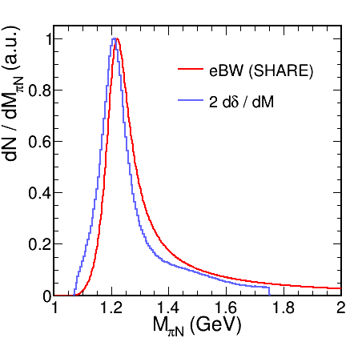
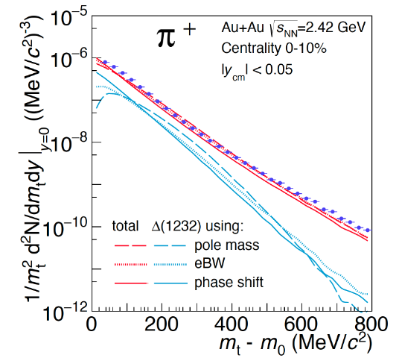

Resonance treatment
R. Dashen, S. K. Ma and H. J. Bernstein, Phys. Rev. 187 (1969) 345 (1969)
R.Venugopalan, and M. Prakash, NPA 546 (1992) 718
W. Weinhold, and B. Friman, PLB 433 (1998) 236
Pok Man Lo, EPJC 77 (2017) no.8, 533
πN phase shift in the P₃₃ channel
Spectral function: $B_{l}\left(M\right)=2\frac{d}{dM}δ_{l}$
Sensitivity of hadron spectra
Pok Man Lo et al., PRC 96, 015207
GW WI08: R.L. Workman et al. PRC 86, 035202
11

Slide 12
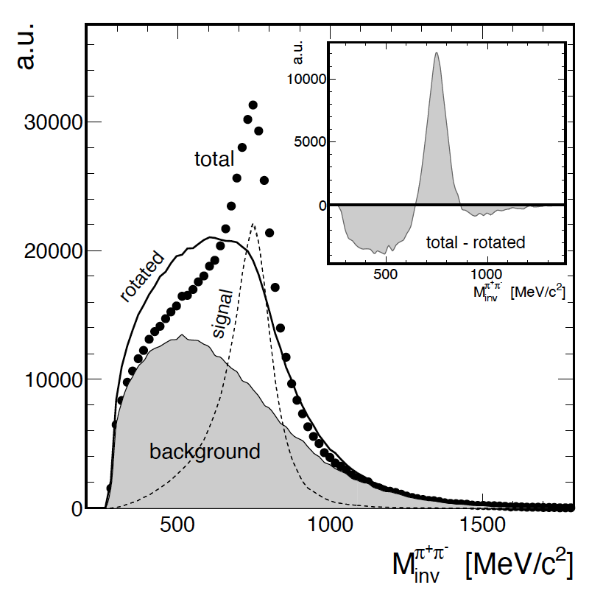
Extracting BROAD Signals From Very HIGH Backgrounds
G. Kornakov, T. Galatyuk., EPJA 55 (2019) 11, 204
U - some particle decorrelating operation
  Event mixing
  Position swapping
  Momentum rotation
It is non-linear
Total yield = signal + combinatorial background
T = S + B
Inset: T – U(T)
Peak contains only signal, even if underestimated
  First approximation S⁰ = max[T – U(T), 0]
Next steps: S^{k+1} = max{T – [U(T)– U(S^{k})], 0}
(The negative part is always ignored)
Convergence when S^{k+1} = S^{k}
12

Slide 13
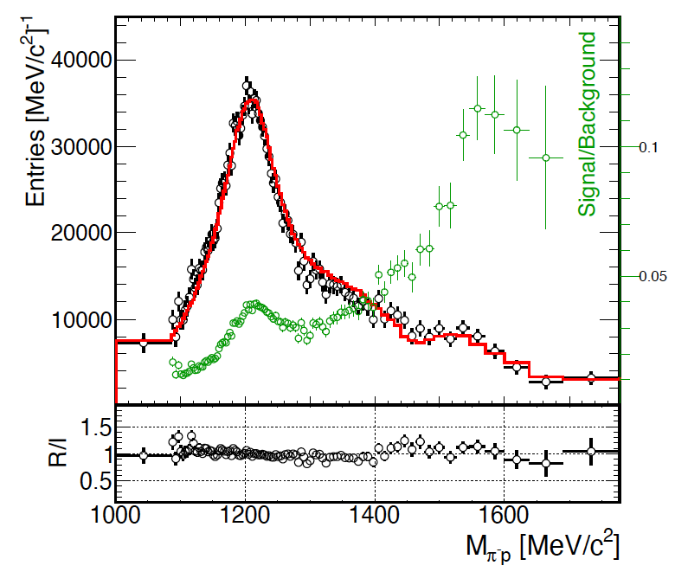
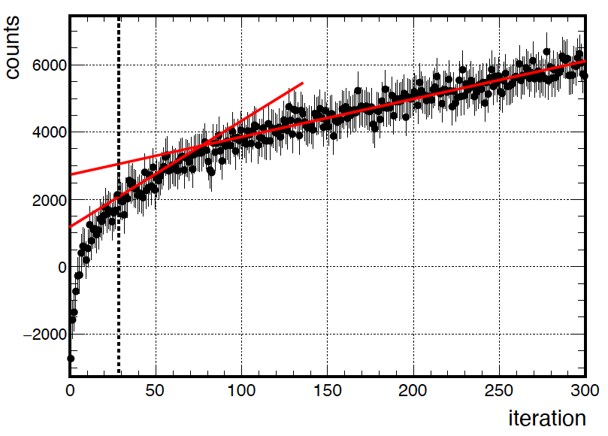
TESTING with Monte Carlo
SIMULATION
G. Kornakov, T. Galatyuk., EPJA 55 (2019) 11, 204
Final comparison
  Points: reconstructed signal
  Line: original signal
Background not shown, but note the S/B ratio
Thermal source of protons (~80%), pions (~10%), most abundant Deltas and N*s (~10%)
We keep increasing signal in max{…} due to fluctuations
  Real convergence impossible
  But the growth rate changes trend
13

Slide 14
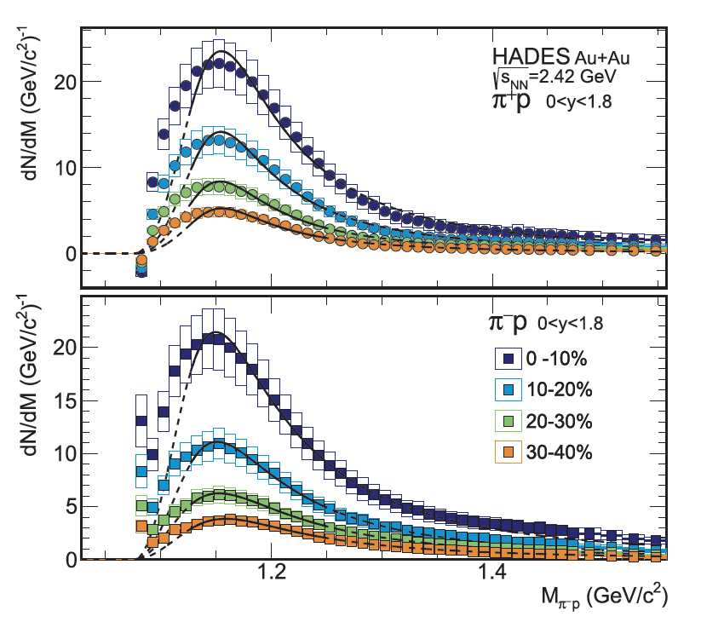
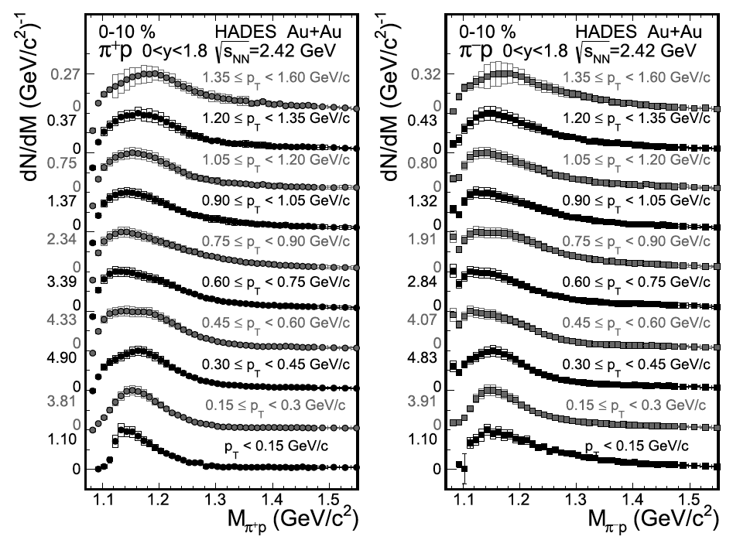
Extracting signal in Experimental Data
HADES, PLB 819 (2021) 136421
Unprecedented statistical and systematic precision, allowing for multi-differential analysis
14

Slide 15
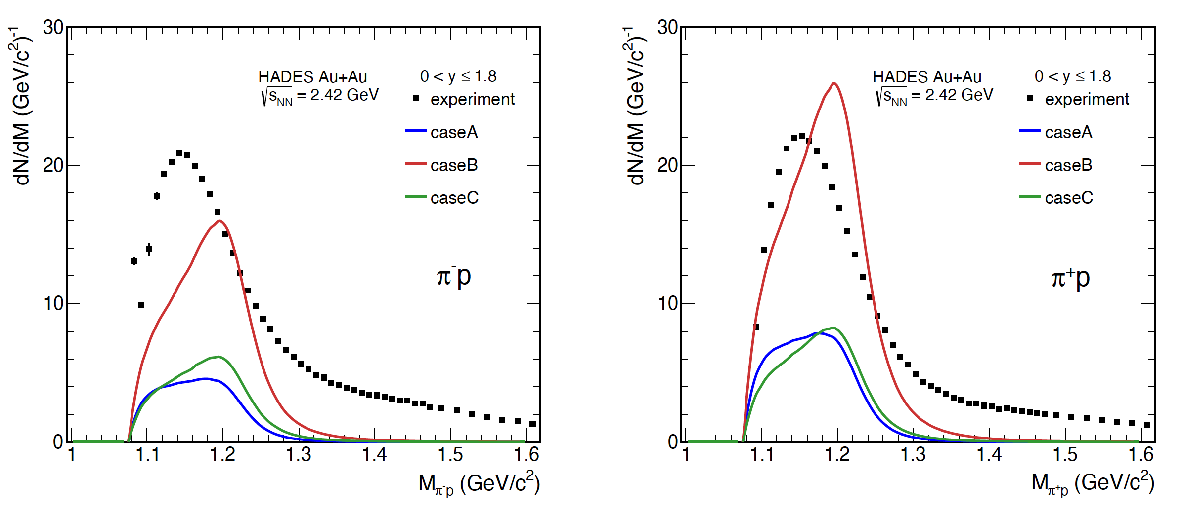
Comparison to thermal model
M. Kurach, Master’s thesis, Warsaw University of Technology (in preparation)
Interplay of freeze-out parameters:
  caseA: low T, low μ_{B}, large volume (clusters produced by coalescence, first minimum)
  caseB: high T, high μ_{B}, small volume (clusters produced by coalescence, other minimum)
  caseC: medium T, low μ_{B}, medium volume (clusters produced thermally, unique, but bad, minimum)
Phase shift corresponds to vacuum spectral function
Particle production at the freeze-out only
15

Slide 16
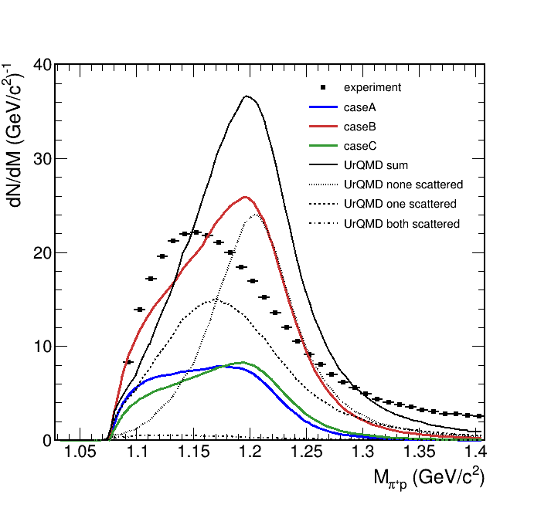
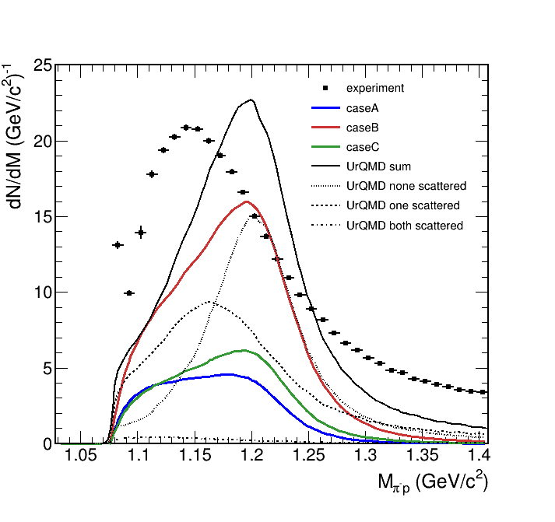
Adding Kinetic transport model
HADES data: PLB 819 (2021) 136421
Thermal model: M. Kurach, Master’s thesis, Warsaw University of Technology (in preparation)
UrQMD: T. Reichert et al., J. Phys G 46 (2019) 105107
Calculation with public UrQMD version 3.4
If one of the daughter particles rescatters, the shape starts to resemble experimental data
  Dashed line
  Effect still too weak
  In most cases, none of the daughters rescatter
Shape without scattering similar to the thermal model
  Enhancement of thermal model at low mass
  Role of the thermal factor?
  Non-resonant part of the phase shift?
In-medium effects are too small in the transport model.
16

Slide 17
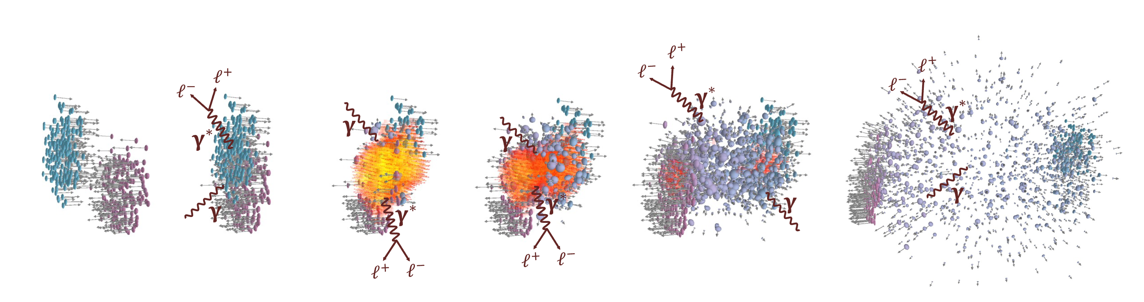
Electromagnetic probes
Photons (virtual and real):
Do not undergo strong interaction
Probe all the stages of heavy-ion collisions

Slide 18
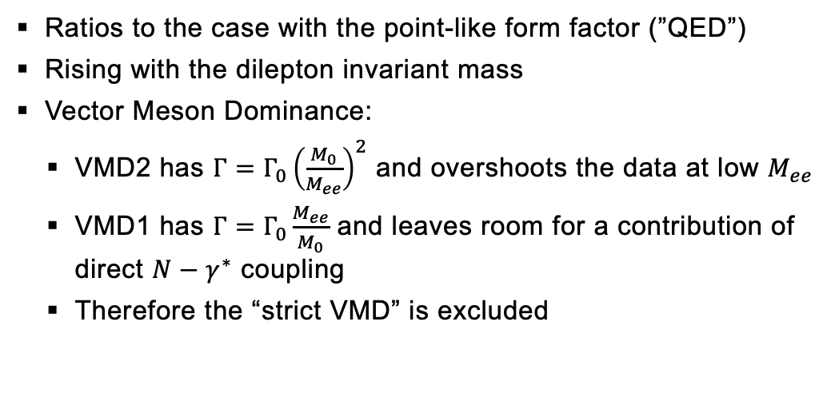
Baryons as extended objects
Exclusive analysis of π⁻p → n e⁺e⁻ at $\sqrt{s}$ = 1.49 GeV
Ratios to the case with the point-like form factor (”QED”)
Rising with the dilepton invariant mass
Vector Meson Dominance:
  VMD2 has $Γ=Γ_{0}{\left(\frac{M_{0}}{M_{ee}}\right)}^{2}$ and overshoots the data at low $M_{ee}$
  VMD1 has $Γ=Γ_{0}\frac{M_{ee}}{M_{0}}$ and leaves room for a contribution of direct $N−γ^{∗}$ coupling
  Therefore the “strict VMD” is excluded
Data: arXiv:2205.15914 [nucl-ex]
Zétényi: PRC 104, 015201 (2021)
Ramalho: PRD 95, 014003 (2017), PRD 101, 114008 (2020)
18

Slide 19




Thermal Dileptons From Baryon-Rich Matter
HADES, Nature Phys. 15 (2019) 1040
Thermal dilepton production rates
L. D. McLerran, T. Toimela, PRD 31 545 (1985)
Properly described by in-medium spectral function from many-body calculation
Rapp and Wambach, Adv. Nucl. Phys 25 (2000) 1
  Successful at all collision energies
  At low ones: local thermal equilibrium – coarse graining Galatyuk et al., EPJA, 52 5 131 (2016)
Crucial role of coupling to baryonic resonances
Thermal factor
(“Planck-like” radiation)
$$\frac{dN_{ll}}{d^{4}qd^{4}x}=−\frac{α_{em}^{2}}{π^{3}}\frac{L\left(M^{2}\right)}{M^{2}}f^{B}\left(q_{0},T\right)ImΠ_{em}(M,q,T,μ_{B})$$
In-medium ρ spectral function
$$R=Δ, N\left(1520\right), a_{1}, …$$
$$ρ$$
>
>
$$h=N, π, K, …$$

Slide 20
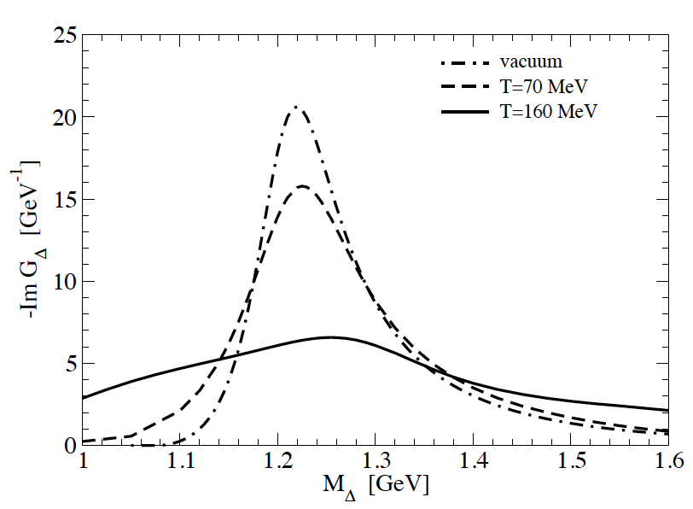
Summary AND OUTLOOK
Heavy-ion collisions study QCD matter at extreme temperatures and densities
At relatively low energy, the system is dominated by baryons
Baryonic resonances and their interactions play an important role in the dynamics
  Their understanding is essential even for most common observables
HADES experiment offers a rich data set of pion-proton resonances reconstructed in Au-Au collisions
Current models are not sufficient to explain the data
One should use in-medium spectral function of Δ?
H. van Hees and R. Rapp, PLB 606 (2005) 59-66

Slide 21
Thank you for youR attention

