Slide 1
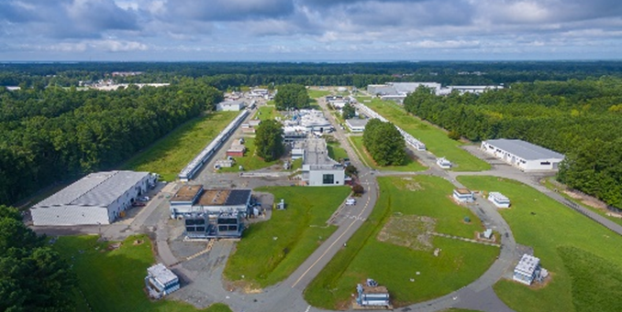
PAC51 Charge
Cynthia Keppel
PAC51
July 24, 2023

Slide 2
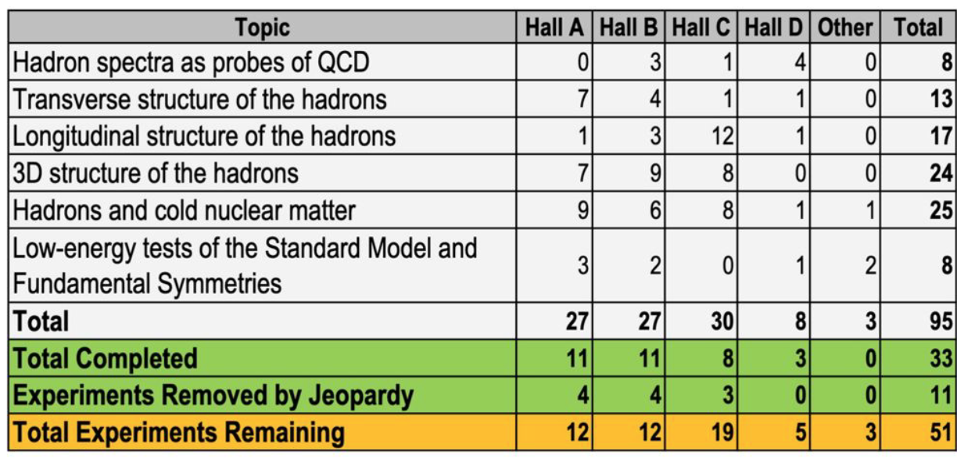
12 GeV Approved Experiments (status Feb 15, 2023)

Slide 3
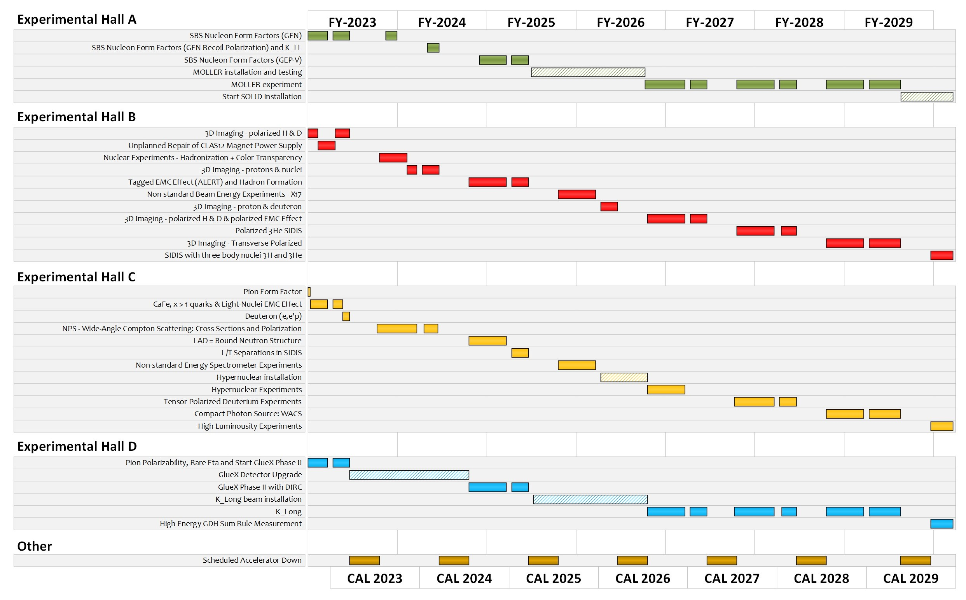
Extended Experimental Schedule – has assumptions!
SoLID installation
could start ~mid-FY29
86% complete in
FY29 without SoLID, 70% complete with
SoLID (assuming optimal running operation)
…not including new proposals
May move into upgrade era
3

Slide 4
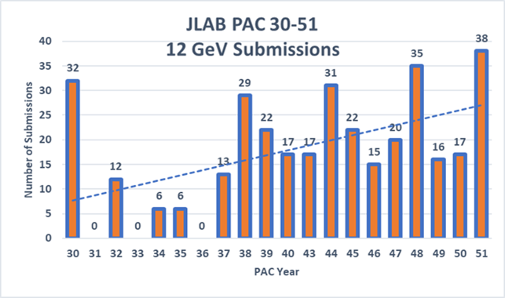
Exciting times!
Record number of PAC submissions
Positrons, user increase, new questions to unravel
PAC 51

Slide 5
Policy on letters of intent
Letters of Intent will be given the same “rights” to their scientific ideas as are currently afforded to deferred experiments, i.e.:
LOI has established a claim to a physics measurement that lasts for the next two successive PAC meetings.

Slide 6
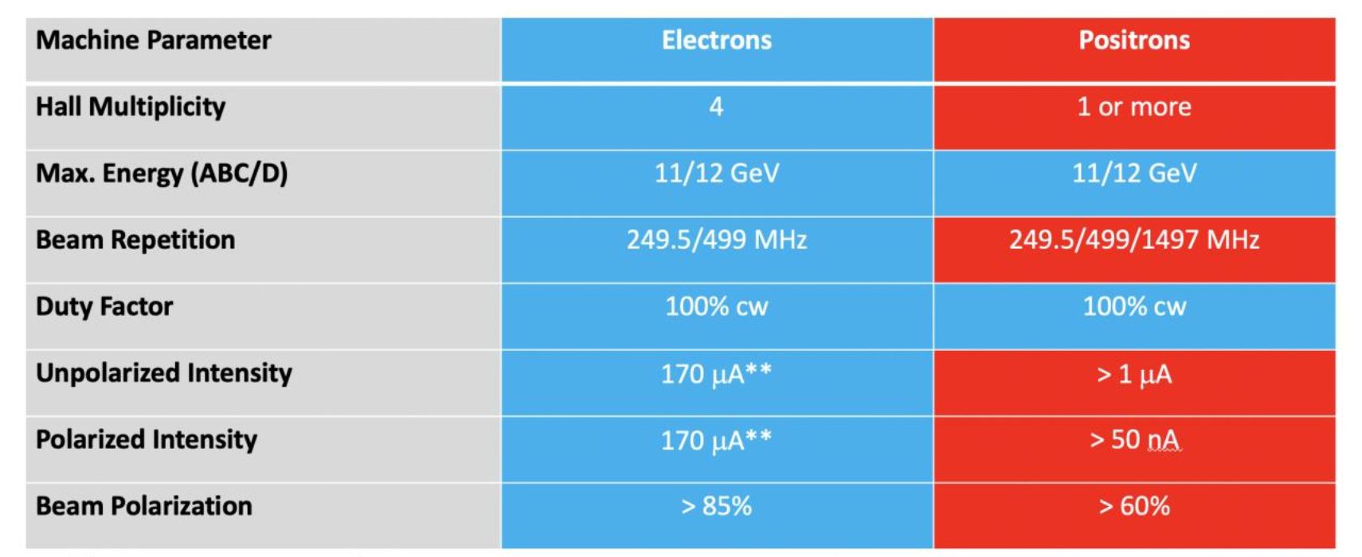
POSITRONS (Patrizia to discuss upgrade.)
May 4, 2023 memo to PAC
Please note any requests outside of the above parameters.

Slide 7
PAC51
Charge:
Review new proposals, previously conditionally approved proposals, jeopardy proposals, and letters of intent for experiments that will utilize the 12 GeV upgrade of CEBAF and provide advice on their scientific merit, technical feasibility and resource requirements.
Identify proposals with high-quality physics that, represent high quality physics within the range of scientific importance represented by the previously approved 12 GeV proposals and recommend for approval.
Also provide a recommendation on scientific rating and beam time allocation for jeopardy proposals (if revision is sought) and those newly recommended for approval.
Identify other proposals with physics that have the potential for falling into this category pending clarification of scientific and/or technical issues and recommend for conditional approval. Provide comments on technical and scientific issues that should be addressed by the proponents prior to review at a future PAC.

Slide 8
Conditional Approval
Two types:
C1 – Approval (with grade) pending technical review,
no need to return to PAC
C2 – Approval pending further review by
future PAC

Slide 9
Jeopardy
Policy
Finalized after discussion with UGBOD in September 2016
Rationale
Use normal yearly PAC for ~4 years to address all presently approved proposals that have not been scheduled. Estimate ~5-10 proposals per meeting
Started in 2019, hoping to reach steady state in 2024 - proposals that have been approved for 4 years or more but are not scheduled will be considered in Jeopardy.
- on track

Slide 10
Jeopardy issues
Is there any new information that would affect the scientific importance or impact of the Experiment since it was originally proposed?
2) If the Experiment has already received a portion of its allocated beam time and/or is on the presently published accelerator schedule, the spokespersons should provide an analysis of the existing data set, the projected result for any additional time on the published schedule, and the projected result for the complete data set including all remaining unscheduled time. The goal is to show the physics impact of the respective data sets.
3) What is the status of the collaboration in terms of institutes, committed staff, and prospective students?
4) Should the remaining beam time allocation and experiment grade be reconsidered?

Slide 11
Proposals with Parallel Running
Parallel running procedure (in equal time)
Intent is to encourage new proposals of “run groups”
– Only Summary needed for additions to existing run group
- These run in parallel with previously approved or conditionally approved proposals, so they are considered already approved (or conditional) and are presented by collaborations or Hall Lead
– The PAC will provide a written comment for each of these in the report.

Slide 12
Policy on Equipment Availability
Categories for resource availability:
– Stage I: resources need to be identified/obtained
– Stage II: resources are essentially available
This will be considered a Laboratory issue
(not for PAC).

Slide 13
PAC Report
Draft report text must be complete before closeout on Friday. We will review all the draft text Friday afternoon before the closeout.
Pamela Cole will assemble the draft text into a report for a final round of edits by email during 2 weeks following the PAC meeting.

Slide 14
Role of User Chair on PAC
Monitor communications between PAC and spokespersons – identify issues.
Monitor PAC meeting proceedings for conflicts of interest.
Monitor PAC meeting proceedings to identify issues of fairness and ethical behavior.
Participate in all scientific discussions to provide additional expertise (except where there is a conflict of interest)

Slide 15
Communication with PAC
Communication with PAC members should be limited to:
Submission of proposal before the deadline
Presentation/discussion at PAC meeting, must be in-person (not remote connection)
Responses from spokespersons and/or contact person to inquiries from PAC for further information or clarification
Note: TAC and Theory reports are not public documents – please do not distribute beyond your collaboration.

Slide 16
Thank you!
We’re new, bear with us!
Questions?
Please discuss any suggestions informally with Doug and I. We will also meet with Markus after meeting.

