Slide 1
Accelerator Status & Experiment Schedule
Douglas Higinbotham
Physics Division

Slide 2
CEBAF Improvement Plan Is Proceeding
Last run period, we pushed the CEBAF accelerator to 1047 MeV/linac
  A good energy for delivering high polarization to Halls A, B and C
  This equates to 10.5 GeV for A, B, C and 11.6 GeV for Hall D
We ran at that energy the entire 32 weeks of physics beam!
  Down side was limited beam current and high trip rates
During this SAD (scheduling accelerator down) we have added a C100 to the north linac and replaced one in the south linac.
  We are planning to continue with the 1047 MeV/linac with what should be more stable beam.
  We have had a series of safety pauses which have caused a short term delay, but hopefully will mean smoother & safer long term running.
Looking ahead the goal is to get CEBAF well into the operational energy range needed for the MOLLER experiment (10.6 to 11 GeV for Hall A)

Slide 3
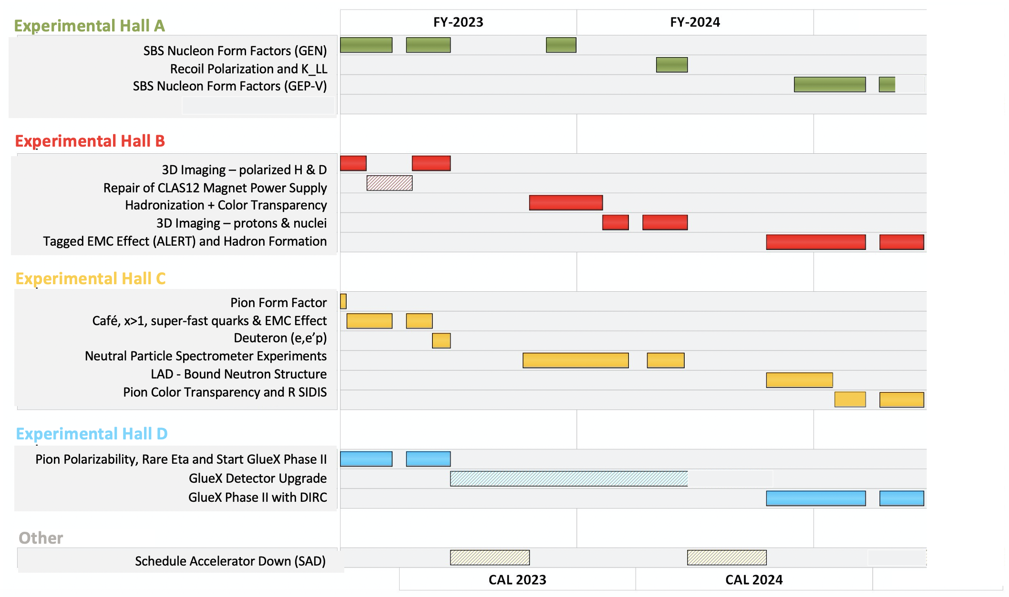

Slide 4
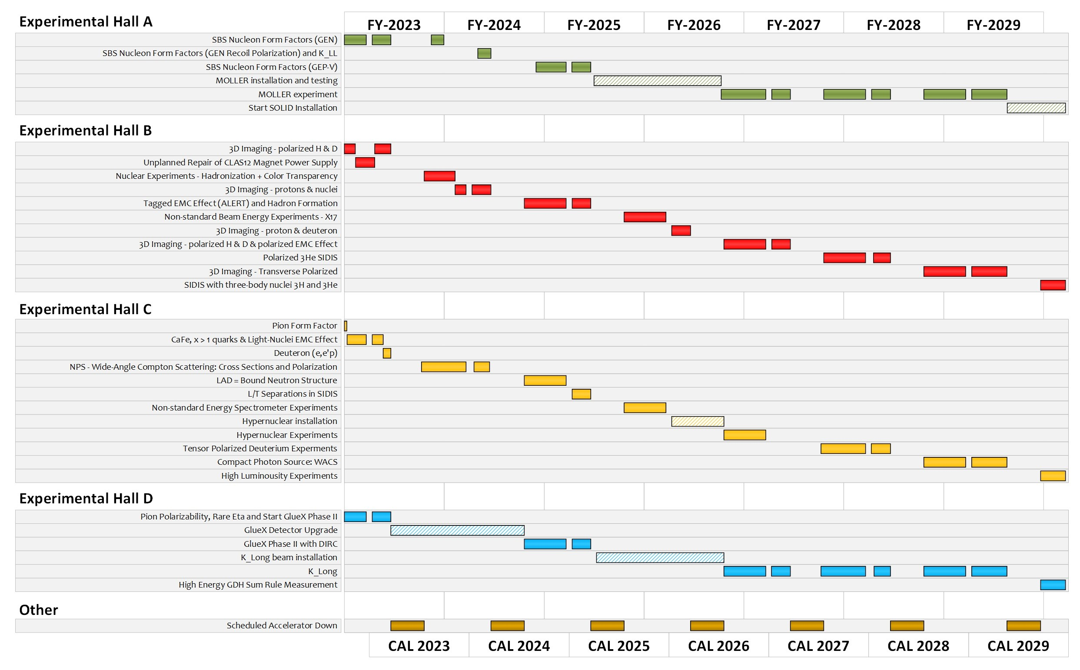
Extended Experimental Schedule
205 completed experiments to-date (28 full; 28 partial in 12 GeV era)
51 experiments remaining
~7 years at ~30 weeks/year
…not including SoLID
…not including new proposals

Slide 5
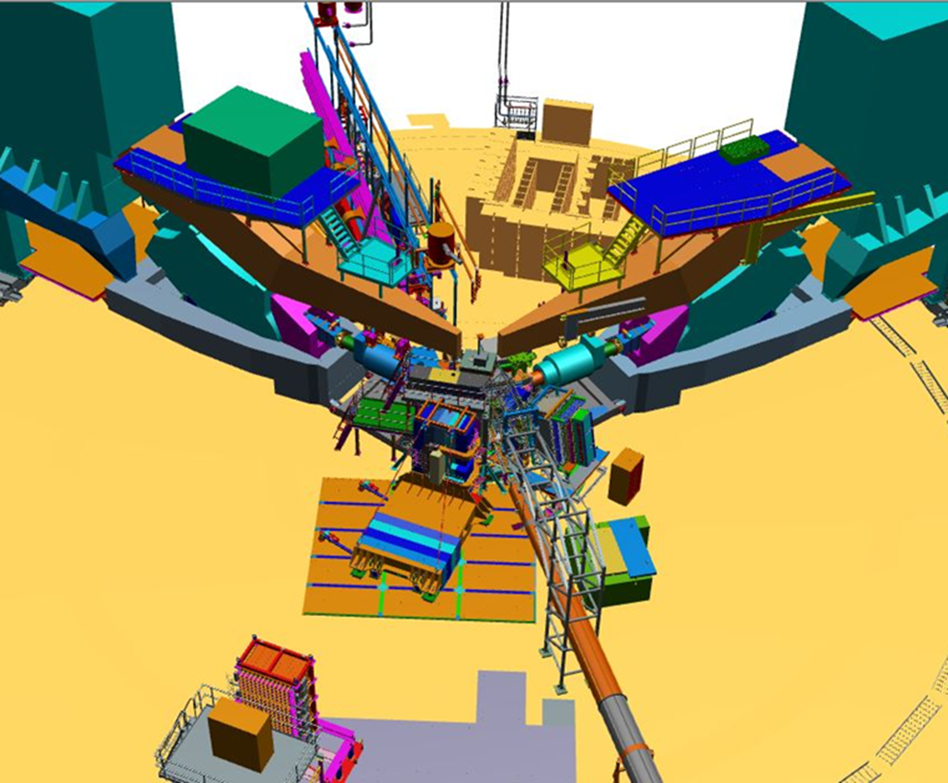
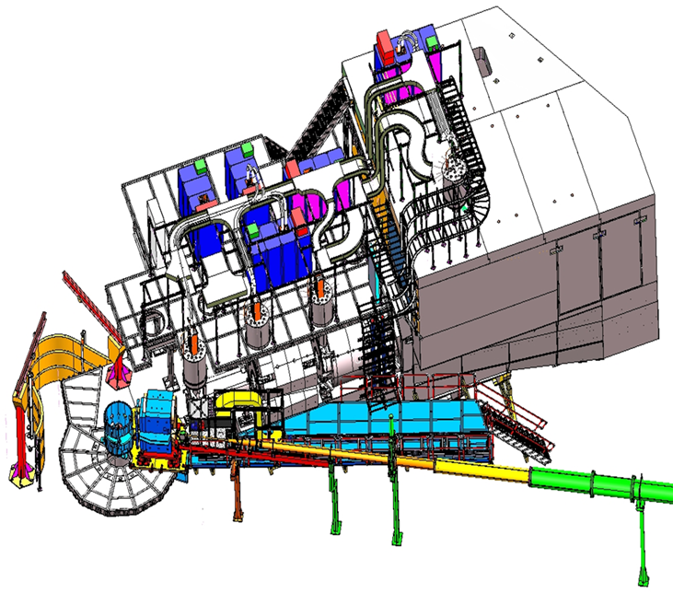
Hall A/C Status
Hall A:
Neutron G_{E}/G_{M} by Beam-target Asymmetry
Hall C:
Neutral Particle Spectrometer
Mark Jones, Hall A/C Group Leader, PAC meeting , July 2023
Bob Michaels, Hall A/C Deputy Group Leader

Slide 6
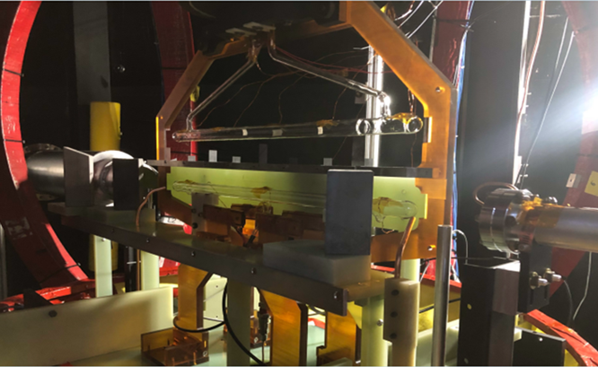
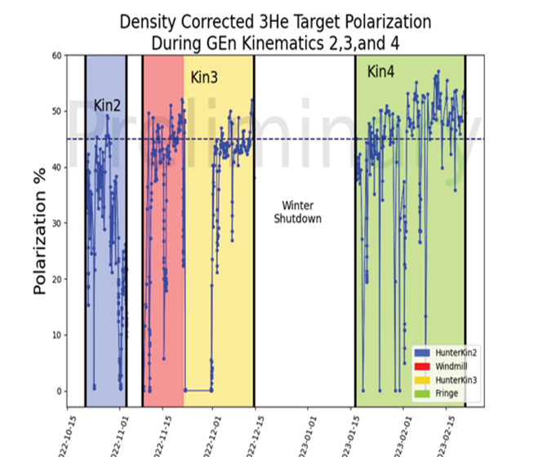
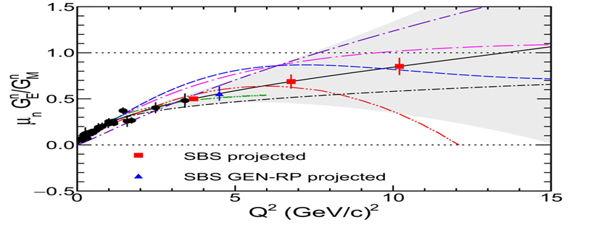
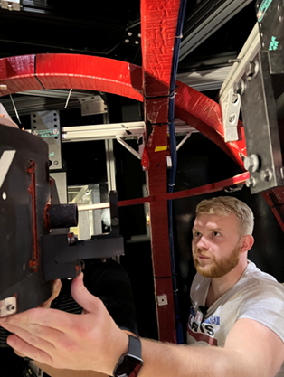
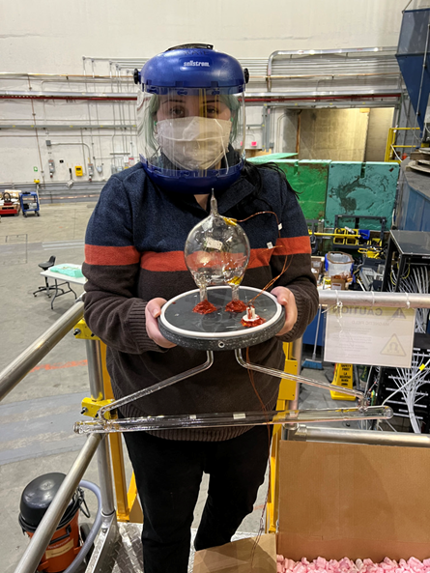
Hall A: Past Year’s Experiments (July 2022- March 2023)
Neutron G_{E}/G_{M} by Beam-target Asymmetry on polarized 3He
Started in Oct 2022
  Completed Q²= 2.9 and 6.6 GeV²
  Q² = 9.9 GeV² is partially done.
  Complete final 6 weeks running from Sept 2023-Nov 2023
Polarized 3He target
  First time running with 60cm long 3He cell
  50-55% polarization in beam!
Red points projected errors
45%

Slide 7
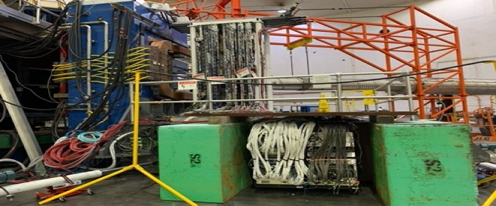
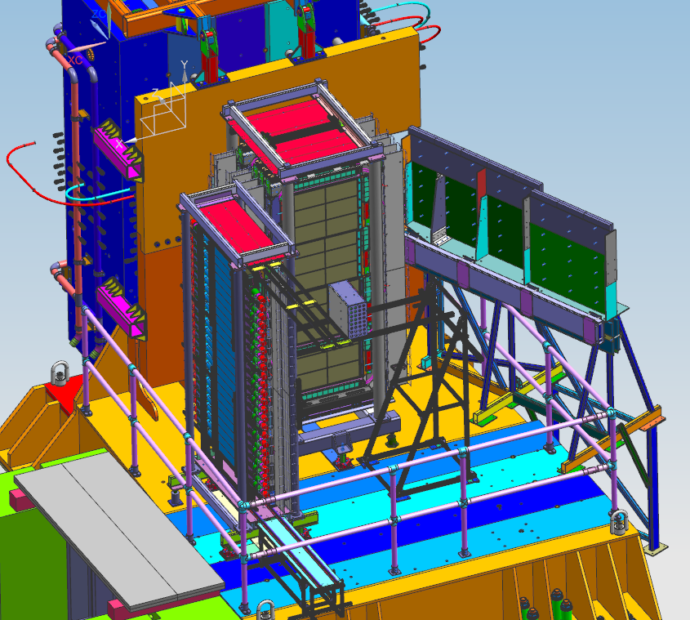
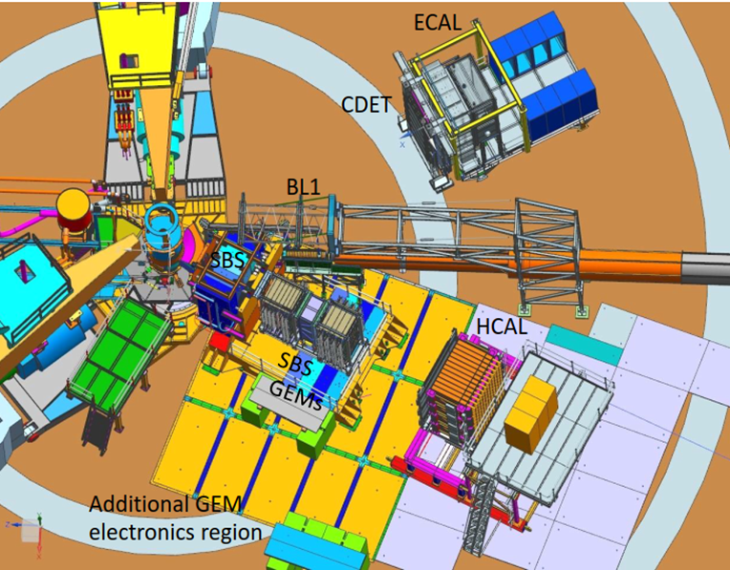
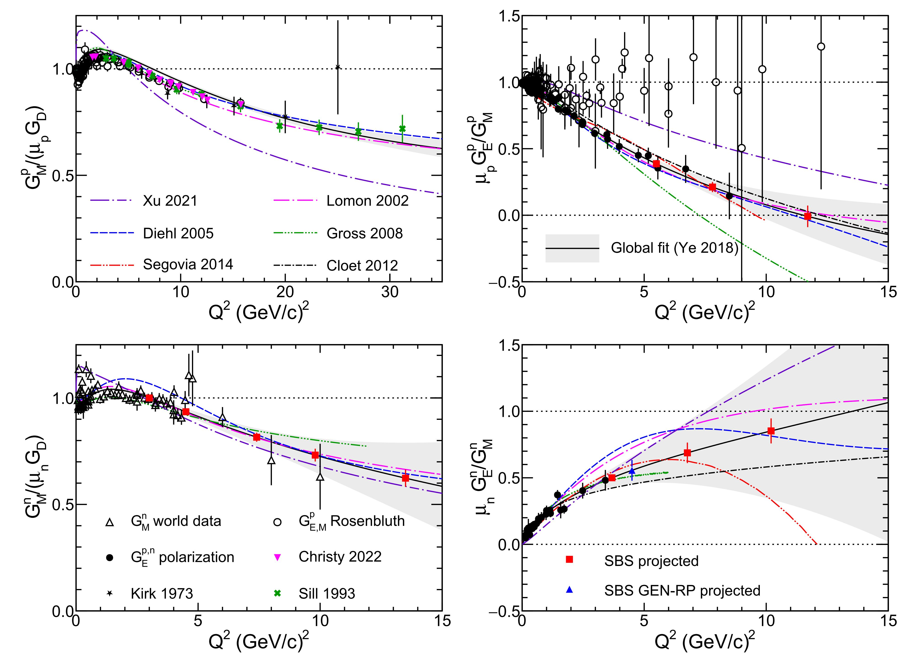
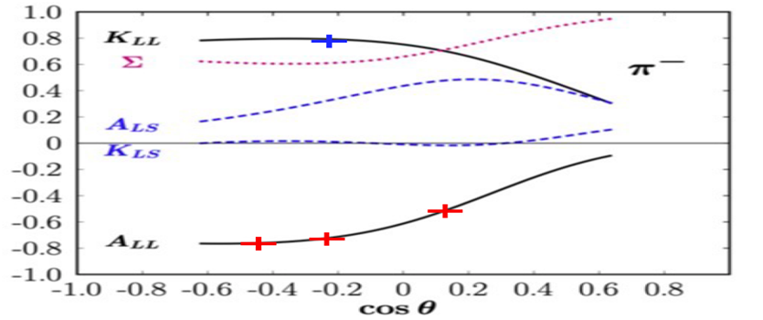
Hall A : Plan for coming years (Jan 2024 – July 2025)
Neutron G_{E}/G_{M} by recoil polarization
Proton G_{E}/G_{M} by recoil polarization
Switch from 3He to LH2/LD2
Plan to start in Spring 2024, Q² = 4.5
ECAL platform is in Hall A and plan to start stacking in August.
After Neutron Recoil Polarization is completed
  Need about 6 months for installation
Experiment will run in late 2024 to spring 2025.
Red points projected errors
Test of SBS GEMs during
3He GEn.
Polarimeter layout
Pion photo-production on neutron
Short experiments
Beam-target asymmetry, A_{LL}
Recoil polarization, K_{LL}

Slide 8
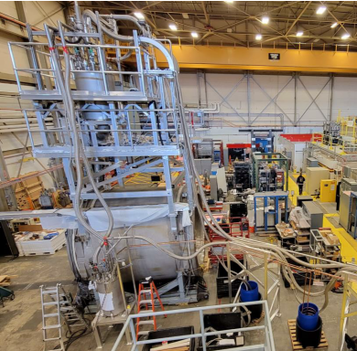
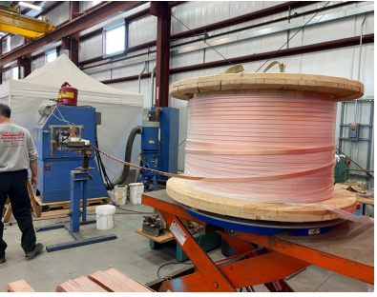
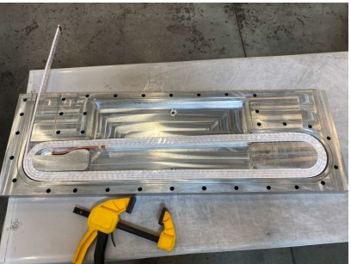
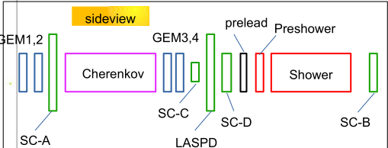
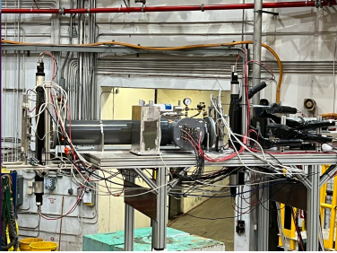
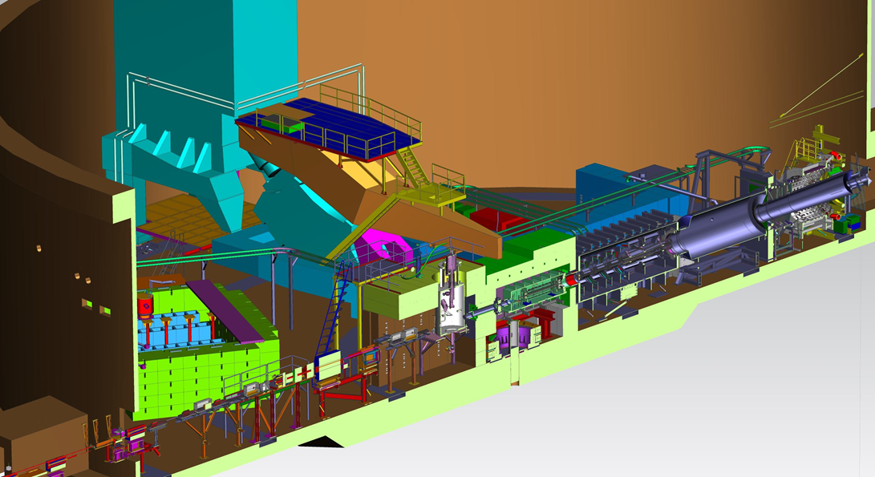
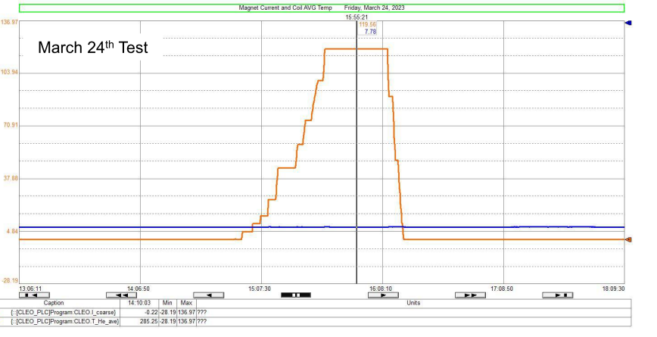
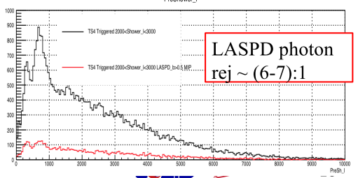
Hall A : Plans beyond July 2025
MOLLER
SoLID
Inflation Reduction Act provided full funding.
In Jan 2023, passed CD-3A review and spending CD-3A funds.
CD2 /CD3 review in October 2023.
Aggressive installation schedule of 18 months after GEp run ends
3 years of running. Starting in Fall 2026
Reuben Fair is new PM, Klaus Dehmelt is new DPM (Sept 1).
CLEO magnet cold test at 120A completed.
High rate test of SoLID detector. Set at 8⁰ and 17⁰ in Hall C.
SoLID mentioned in Recommendation 1 in the Hot/Cold QCD and the recommendations of FSNN LRP town meetings
Magnet test
High rate test
Coil production underway
Ramp to 120A
Coil temps constant

Slide 9
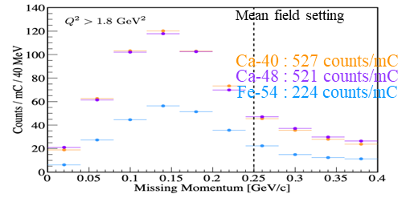
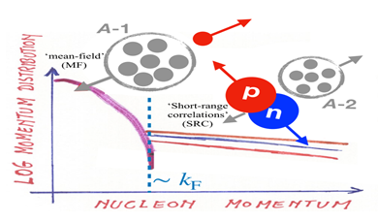
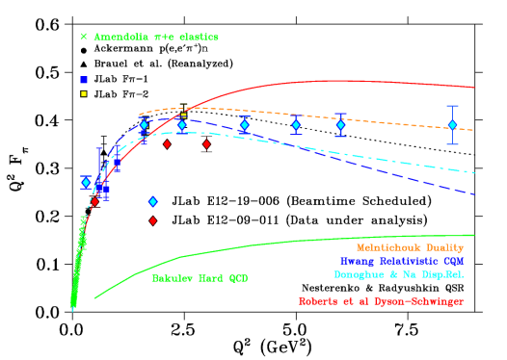
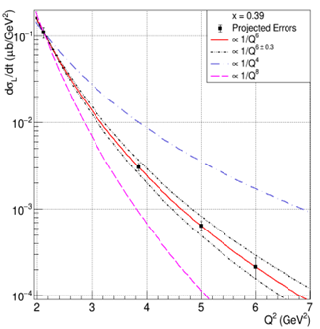
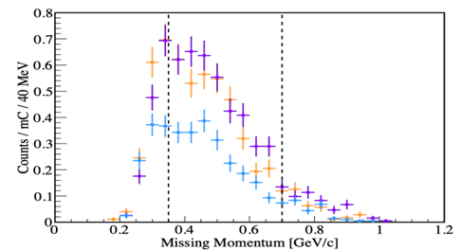
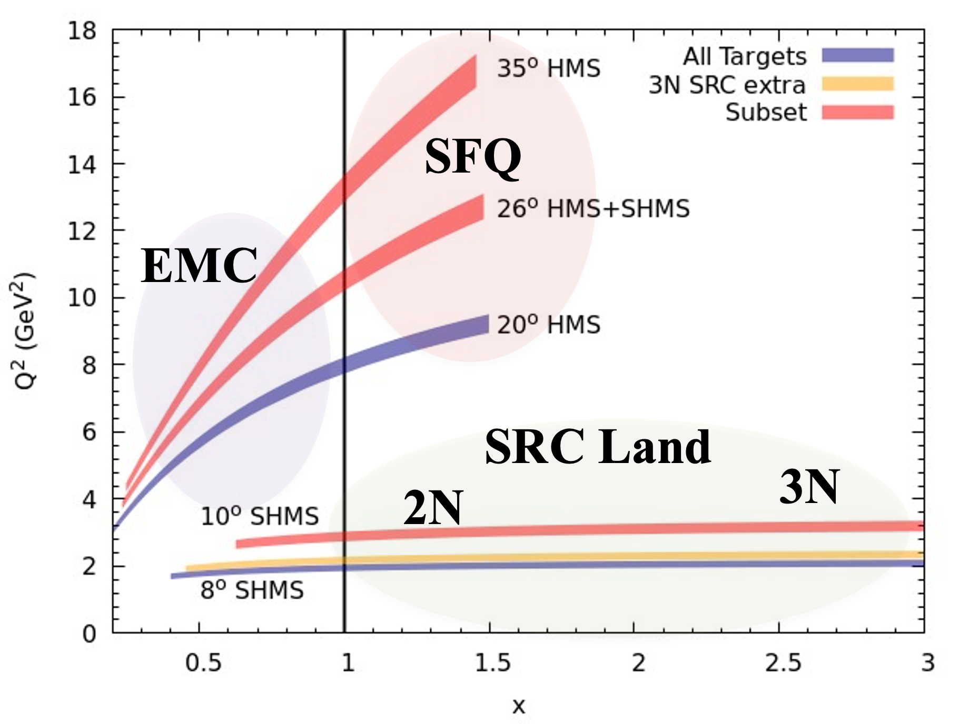
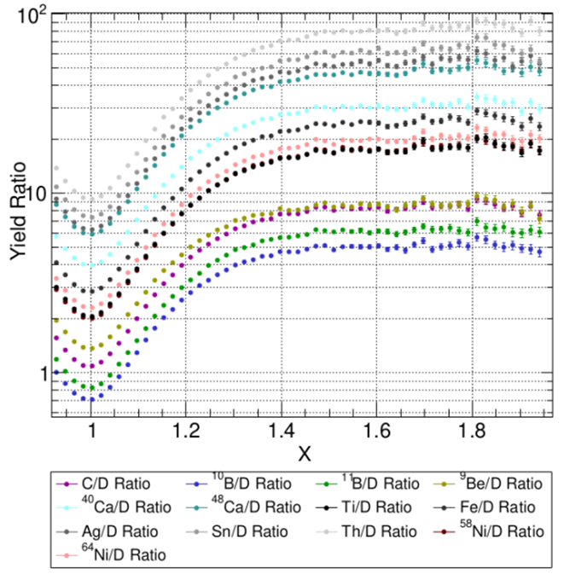
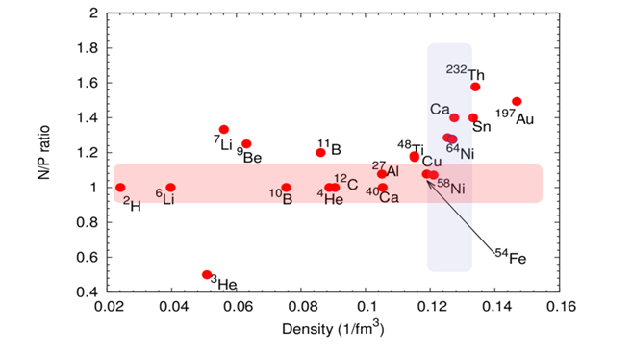
Hall C: Past Year’s Running (July 2022-March 2023)
E12-19-006 : Ran from June to mid Sept to complete high ε points to match low ε points taken the previous run cycle.
E12-17-005 : Ran at the end of Sept 2022 for two weeks
Pion form factor to Q² = 8.5
Proposed error bars
Test of factorization by measuring Q² dependence of σ_{L}
Compare 40Ca, 48Ca, 54Fe
Mean-field setting
SRC setting
E12-10-008 Study EMC effect over range of nuclei
  6Li and 7Li added to light nuclei already measured
  Flavor dependence with 40Ca and 48Ca
E12-06-105 Inclusive Scattering from Nuclei at x > 1
  Precision measurement of 2N SRC
      A-dependence in light nuclei
      Variation with neutron excess
      Connect EMC effect and SRC
  First observations of 3N SRC
  Nuclear PDFs at x > 1 and look for superfast quarks
E12-10-003 Deuteron Electro-Disintegration at Very High Missing Momentum
Preliminary online results
By Casey Morean

Slide 10
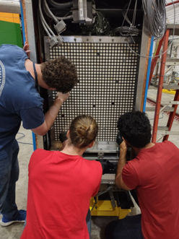
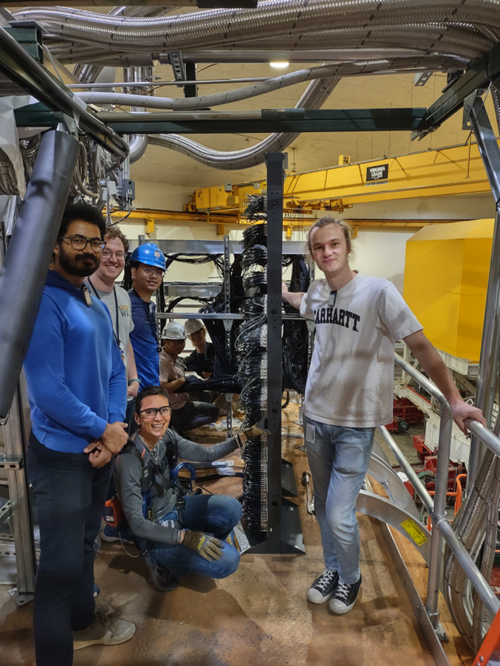
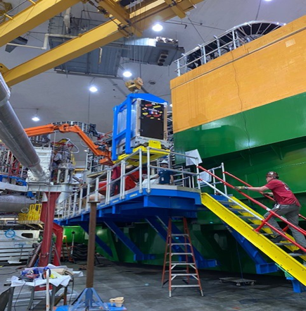
Hall C : Plan for next year ( July 2023- July 2024)
      Neutral Particle Spectrometer
      Sweeping Magnet with calorimeter.
        Magnet and power supply have been tested.
      NPS attached to SHMS carriage to allow easy angle change.
        The calorimeter is on rails, cabled and taking cosmics.
      1080 Lead-Tungstate blocks in calorimeter to detect γ and π⁰
Two experiments using the NPS
E12-13-010 is two concurrent experiments
  Exclusive Deeply Virtual Compton on proton
        SIDIS (e,e’,π⁰) cross section.
          Map the transverse momentum dependence.
      E12-22-006
        Exclusive Deeply Virtual Compton on deuteron
        Subtract the proton data from deuteron data to get neutron.
      Proposal PR12-23-014 would be a new run group that measures R=σ_{L}/σ_{T} in SIDIS (e,e’,π⁰) cross section.
Students putting fiducial marks on Calo
Cabling crew with Simona Malace who has led the installation of NPS Calo
NPS Calo craned onto the NPS platform

Slide 11
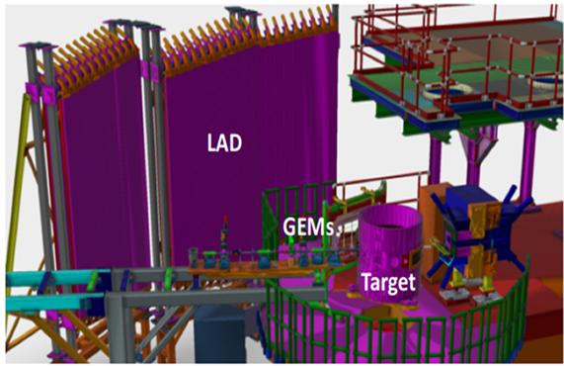
Hall C: Plans beyond July 2024
Experiments to run in Fall 2024- Spring 2025
Standard SHMS/HMS
  E12-06-104 R=σ_{L}/σ_{T} in SIDIS on 1H and 2H
  E12-06-107 Complete CT experiment
  E12-11-107 Spectator tagged DIS d(e,e’p_{s})
  Install Large Angle Detector
  HMS/SHMS detect electron
Fall 2025 and beyond
Depends on PAC recommendations
Starting in Fall 2025
    Standard SHMS/HMS experiments.
    Experiments with non-standard beam energies
    New proposals
Running during MOLLER and after:
  During MOLLER, limits on total target power and beam current in the two halls
      Hypernuclear experiments in 2026
      Polarized deuteron experiments
      WACS and other experiments using the NPS
      Experiments using the Compact Photon Source
          Capital project is ongoing
      SBS/BB experiments that did not run in Hall A
      Exciting new letters of intent
Future plans will incorporate needs of the other halls and target group resources.

Slide 12

Hall B Status Report
Status of Hall B Group
Status of CLAS12 Detector and Experimental Hall
Status of Run Groups, Data Processing & Analyses
Status of Experiment Schedule
With Backup Slides for more Details
Patrick Achenbach
July 2o23

Slide 13
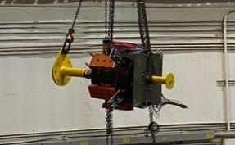
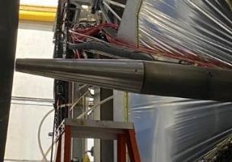
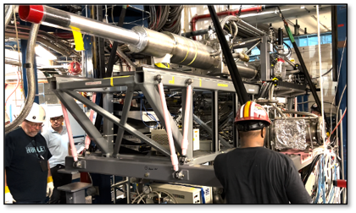
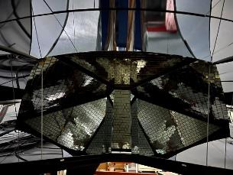
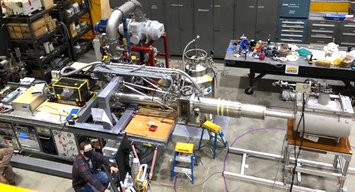
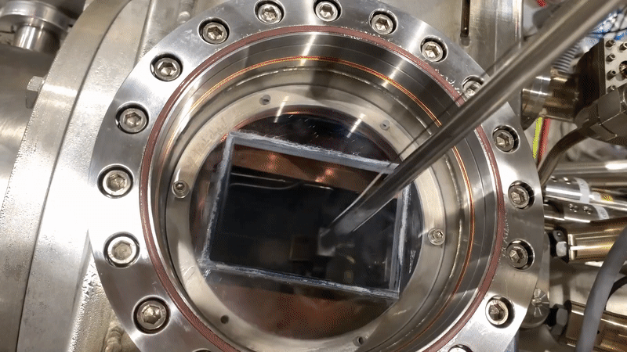
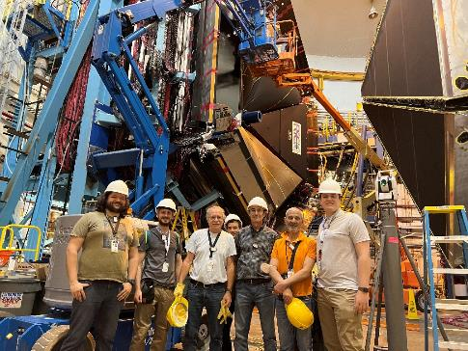
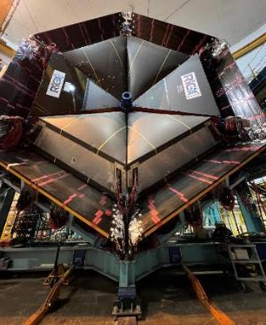
Hall B Experimental Setup 2022–23
Longitudinally polarized cryo-target inside solenoid
Multiple configurations: NH₃, ND₃, C, CH₂, CD₂, …
Forward Tagger
Replaced with …
… Møller shield
Additional 2nd sector RICH
coverage with 50,048 channels
Thermoluminescence of target material
Installation in Hall B, June 2022
Testing in Target Lab, March 2022
Rapid exchange of target samples
Proton
Deuteron
< ~ 80% H polarization
< ~ 45% D polarization
DNP by 140 GHz µwaves
1 K with ℓHe refrigerator

Slide 14
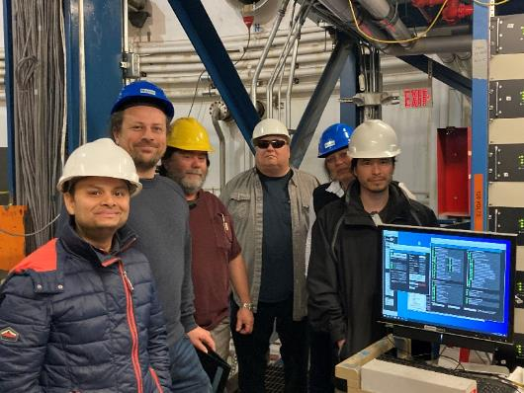
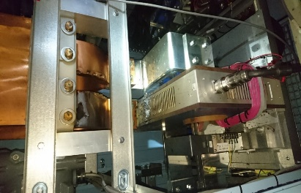
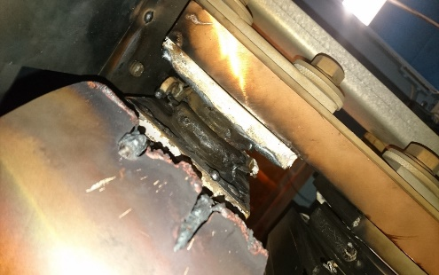
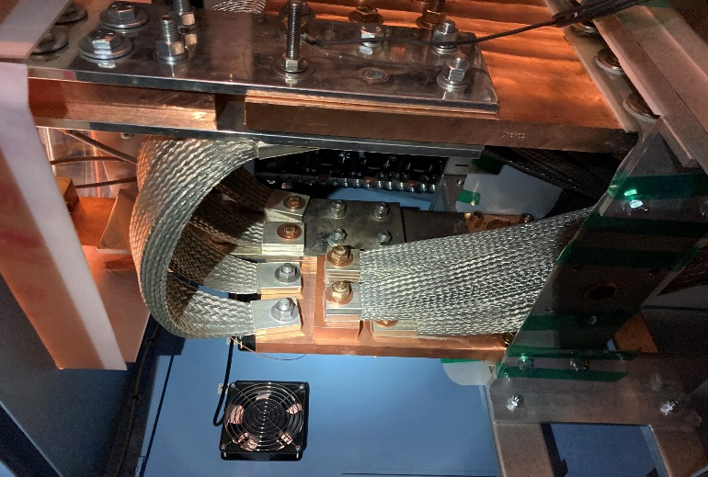
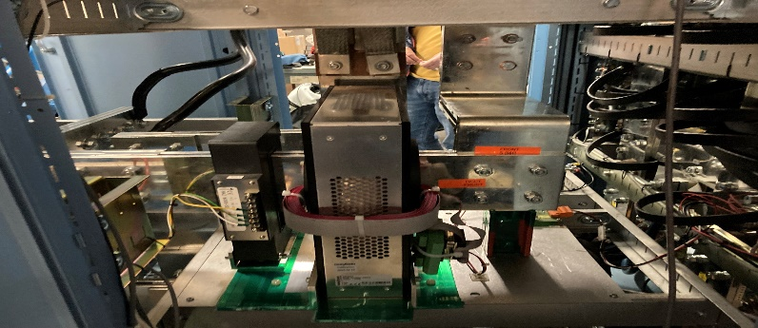
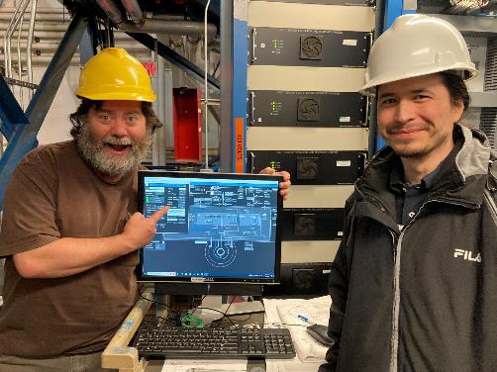
Solenoid Power Supply Failure in Fall 2022
Polarity reversal at I > 1 kA sparked, melted copper links and contacts on 11 Nov 22
Team from Danfysik, DC Power, Hall B, DSG
Hall B was down for 80 days from Nov 22 to Feb 23 →
Scheduled run for RG-C (240 cal. days) could not get completed
Repair completed 30 Jan 23

Slide 15
Unpolarized Cryo-Target for Runs Starting 2023
New Modular Design
Conventional 1 K refrigerator
Compatibility with existing cells and RG-D/E foil targets
Solid targets cooling decoupled from cryo-target and cooled by heat shield
Nesting conical mount of condenser to He coolant evaporator: Target cell easily removable

Slide 16
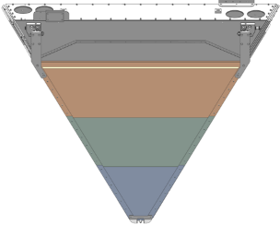
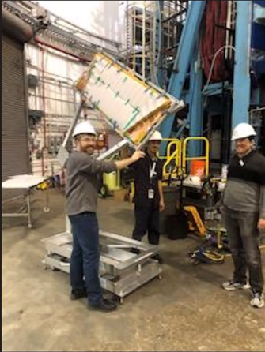



μRWELL Development for Luminosity Upgrade
µRWELL module
μRWELL with capacitive sharing readout will provide 2D points in front of DC
for luminosity upgrade to $L={2×10}^{35}{cm}^{−2}\sec^{−1}$
Simulation studies with background merging and μRWELL + DC + AI result in improved inefficiency of better than 0.1 % per nA, better than upgrade design goal
Inconclusive beam-tests of a large-area µRWELL during the last days of RG-C run
Largest-ever prototype now at CERN for repairs
CLAS12 readiness for higher luminosities is key for future success

Slide 17


Data Processing Status
With use of latest software including improvements in tracking and reconstruction:
RG-A: Spr19 pass-2 cooking completed (23 June – 13 July)
RG-B: Spr19 pass-2 cooking completed (26 May – 27 June)
RG-M: pass-1 (with pass-2 software) cooking in progress (at 85% since 27 June)
RG-K pass-2 cooking will come next
RG-A F18 pass-2 cooking following
Machine Learning Implementations
Track identification in Drift Chambers
Drift Chamber Data De-Noising
RICH Particle Identification
Up to ~35% gain in physics
Moving to higher Luminosities

Slide 18














Hall B High-Impact Publications 2022–23
> 10 CLAS papers published
1 HPS paper published
Several other papers published
A few recent research highlights …

Slide 19




First Displaced Vertex Analysis in Heavy Photon Search
Including both, bump hunt and displaced vertex search
Results from 2.3 GeV 2016 engineering run
Excludes A’ production over mass range 40 – 180 MeV down to ϵ² = 10⁻⁵
[P. H. Adrian et al. (HPS Collab.), Phys. Rev. D 108, 012015, 21 July 2023]

Slide 20




Hard Exclusive π⁻Δ⁺⁺ Electro-Production off Protons
Transition GPDs
Generalizing GPDs to N → Δ processes
Exploratory measurement
No other world data
Access to transversity transition GPDs: 3D structure on resonances
Access to d-quark content of the nucleon
ep → e’ p π ⁻(π ⁺)
Figures in arxiv:2303.11762
[S. Diehl et al. (CLAS Collab.), Phys. Rev. Lett. 131, 021901,11 July 2023]

Slide 21




DVCS Beam-Spin Asymmetries
DVCS
Addressing Compton Form Factors, constraints on GPDs, and mechanical properties of the proton such as pressure and force distributions
1600 new BSA data points
25% of total beam time for CLAS12 DVCS experiment on unpolarized proton
First measurement of the DVCS beam-spin asymmetry using CLAS12
Extending Q² and Bjorken-x phase space
$$ep→e^{′}p^{′}γ$$
[G. Christiaens et al. (CLAS Collab.), Phys. Rev. Lett. 130, 211902, 25 May 2023]

Slide 22



First Determination of Distribution of Forces in the Proton
Distribution of forces as function of distance from proton center
Graviton coupling to the proton
Deeply Virtual Compton Scattering (DVCS)
Normal forces Tangential forces
[V. D. Burkert et al., submitted to Rev. Mod. Phys. (2023)]

Slide 23
Updated Tentative Run Group Scheduling
Disentangling Color Transparency Effects and Hadronization in the Nuclear Medium
RG-D: Sep to Nov 2023, ~30 PAC days to complete
RG-K: Nov to Dec 2023, and Jan to Mar 2024
to reach ~50% PAC days
RG-E: Mar to May 2024, to reach ~ 50% PAC days
2024 SAD for installation of ALERT
RG-L: Sep to Dec 2024, ~55 PAC days to complete
Spring 2025 to be discussed
2025 SAD for setup/target change
Remaining PAC days for run groups
RG-A: >70 PAC days
RG-B: +/- 40 PAC days
RG-C: +/- 25 PAC days
RG-E: 30 PAC days
RG-M: 10 PAC days
Not scheduled
Non-CLAS12 expts: PRad-II, π⁰TFF, X17
CLAS12 expts: Polarized He-3, H-3 and He-3, transverse polarized H/D, long. polarized LiH/LiD
Data-taking 2023: Experiments with CLAS12 probing incoherent ρ meson electroproduction off nuclei
Data-taking 2024: Study of quark propagation and hadron formation in the nuclear medium

Slide 24
Final Remarks
First polarized target experiment with CLAS12 was successfully performed in Run Group C
Run Group D to start in September with a completely refurbished unpolarized cryo-target
Pass-2 cooking started with AI-assisted software upgrades and is progressing well
CLAS and HPS published several papers in high-impact journals
Four Hall B proposals to PAC51:
Two proposals for CLAS12 setup:
RG-K addítion and RG-L extension
One proposal for PRad setup:
Deuteron radius and form factor
Two proposals for CLAS12+ setup:
2γ-exchange and pDVCS
One proposal for PRad+ setup:
Dark photon search

Slide 25


Slide 26


Slide 27


Slide 28


Slide 29


Slide 30


Slide 31


Slide 32


Slide 33


Slide 34


Slide 35


Slide 36


Slide 37
JLab Positrons & 22 GeV
Patrizia Rossi
PAC51
Jefferson Lab, July 24-28, 2023

Slide 38







Science at the Luminosity Frontier: JLab Upgrade Development
Topical issue on An Experimental Program with Positron Beams at Jefferson Lab
Eur. Phys. J. A 58 (2022) 3, 45
Strong Interaction Physics at the Luminosity Frontier with 22 GeV Electrons
2306.09360 [nucl-ex] 435+ authors
JLab PWG = ~250 Physicists
J-Future - Messina (Italy) 28–30 Mar 2022
International Workshop on Physics with Positrons at Jefferson Lab, JPos09, March 2009
International Workshop on Physics with Positrons at Jefferson Lab, JPos17, September 2017
XVIIIth International Conference on Positron Annihilation, Orlando (USA), August 2018
Positron Working Group Workshop –UVA (USA), Mar 2023
High Energy workshop series 2022 - Jefferson Lab, June - August 2022
Hadron Physics Opportunities with JLab Energy Upgrade – Pohang (S. Korea), July 2022
Opportunity with JLab Energy and Luminosity Upgrade- ECT* Trento (Italy), September 2022
Science at the Luminosity Frontier: JLab at 22 GeV – Jefferson Lab, January 2023
Positron Working Group Workshop –
UVA Maarrch 2023
Science at the Luminosity Frontier: JLab at 22 GeV – JLab January2023
Broad community interest in this science

Slide 39



What a Positron Beam will bring?
Positron beams, both polarized and unpolarized, open the door to understanding a range of physics that can’t be accessed with electrons alone
E.M. processes (BCA)
  Two-photon exchange
  DVCS
Annihilation processes
  Light dark matter searches
Charged-current processes
  Inverse beta-decay
  Strangeness with charm-tagging
  Charged lepton flavor violation
  Axial Form Factor
Two-photon exchange
A challenge to calculate
Leading contribution has opposite effect for $e^{+}$
Measurements of $σ_{e^{+}}/σ_{e^{−}}$ isolate TPE
Accessible with JLab 12 GeV
6 Proposals and 5 LOI submitted to this PAC
39
39

Slide 40
What a 22 GeV Upgrade will bring?
-
A NEW territory to explore ➜ cross the critical threshold into the region where cc states can be produced in large quantities, and with additional light quark degrees of freedom.
A BETTER (and needed) insight into our current program ➜ enhancement of the phase space
A BRIDGE between JLab @ 12 GeV and EIC ➜ test and validation of our theory from lower to higher energy and with high precision
The physics program will:
Leverage on the uniqueness of CEBAF HIGH LUMINOSITY
Utilize largely existing or already-planned Hall equipment
Take advantage of recent novel advances in accelerator technology
40
40

Slide 41






Photoproduction of Hadrons with Charm Quarks
  Potentially decisive information about the nature of some 5-quark and XYZ candidates
Intense linearly pol. photon beam
Many “XYZ” states observed in B decays, e⁺e- but scarce consistency between various production mech.→ internal structure not understood yet
$$γp→Jψπ^{+}n$$
Full CLAS12 signal MC simulation with EXISTING detector → capabilities of the existing detectors to measure these reactions
Never directly produced using γ/lepton beam → possibility to study the reaction mechanism without re-scattering effects
CW e- : E_{max}, =12 GeV, Pol.~ 90%
Near-threshold J/ ψ photoproduction: a unique method to probe the proton’s gluonic structure
  gluon GPD
  mass radius of the proton
  anomalous contr. to p mass
IF
Thresholds crossed and t range opens up at higher energy

Slide 42







Nucleon 3D Structure
SIDIS - TMD
Exclusive Process
Q² evolution studies possible
Enanchement of P_{T} range
GPDs
One of the most stringent tests of factorization : x-section Q² dependence
σ_{L} scales to LO as Q⁻⁶
σ_{T} expectation as Q⁻⁸
As Q² becomes large: σ_{L} >> σ_{T}
Complementarity with EIC
ALL SF measurement possible
JLAB12
X=0.3
JLAB22
JLAB22
Pion FF
F_{LL}
F_{LU}
σL/σ_{T} separation only possible at Jlab
EIC 5x41
EIC 18x275
42

Slide 43








…and More
D(t) term and the determination of the pressure distribution inside the proton
insight into hadron mass generation & the emergence of the N* structure through the Q² evolution of the γ_{v}pN* electrocouplings (CSM approach)
Access the anti-shadowing region (small effect!) (x~0.1-0.3) at moderate Q² using multiples exp. techniques
π⁰ Primakoff production off an electron target
Reach to the nuclear forces dominated by nuclear repulsion
Small!
JLAB22
43

Slide 44




Feasible, Cost effective, Innovative Path from e⁺ to 22 GeV
Capitalize on recent science insights and US-led accelerator science and technology innovations to develop a staged program at the luminosity frontier
Remove the highest recirculation pass (Arc 9 and A) and replace them with two FFA arcs including TOF chicane
New 650 MeV injector
NO new SRF (1.1 GeV per linac)
Recirculate 4.5+6times to get to 22 GeV
CW e- : E_{max}, =12 GeV GeV, Pol.~ 90%
Positrons (e+) in the LERF with transport to CEBAF
R&D developments on-going supported by Laboratory Directed (LDRD )funds
A prototype magnet built and evaluated for mechanical integrity
44

Slide 45

Summary
Understanding the different facets of the dynamics of non-pQCD that manifest in hadron/nuclei structures is a complex problem which requires multiple observables using different approaches and measurements
    Positron beams, both polarized and unpolarized, are essential tools for a precise understanding of the electromagnetic structure of the nucleon and nuclei, in both the elastic and the deep-inelastic regimes (form factors, PDFs, GPDs,…), but also for search for physics beyond the standard model.
    With CEBAF at higher energy: a) some important thresholds will be crossed providing new territories to explore, b) a better insight into our current program will be possible, and c) a bridge between JLab @ 12 GeV and EIC will be established. This will be critical to elucidate the properties of QCD in the valence regime.
A rich scientific program to leverage existing infrastructure and the uniqueness of CEBAF HIGH LUMINOSITY is being developed and it has been presented at the Long Range Plan of NP
45

