Slide 1
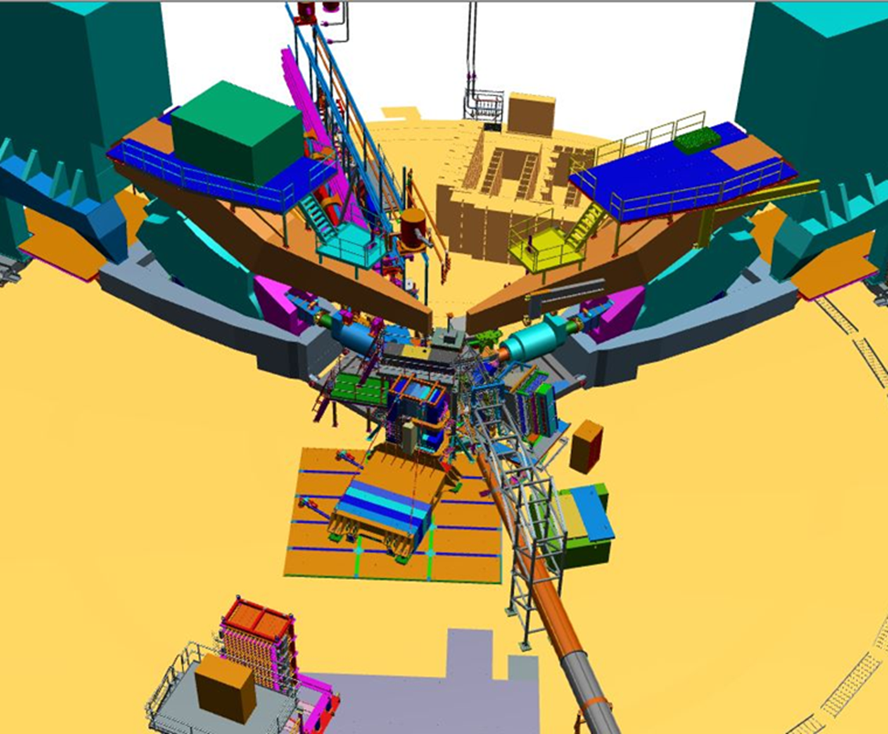
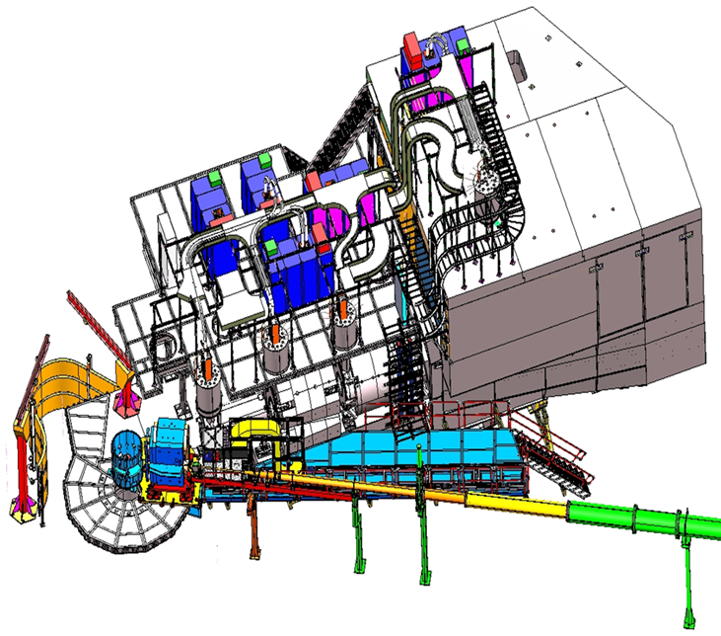
Hall A/C Status
Hall A:
Neutron G_{E}/G_{M} by Beam-target Asymmetry
Hall C:
Neutral Particle Spectrometer
Mark Jones, Hall A/C Group Leader, PAC meeting , July 2023
Bob Michaels, Hall A/C Deputy Group Leader

Slide 2
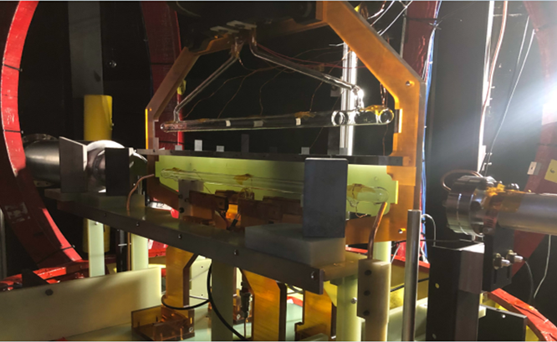
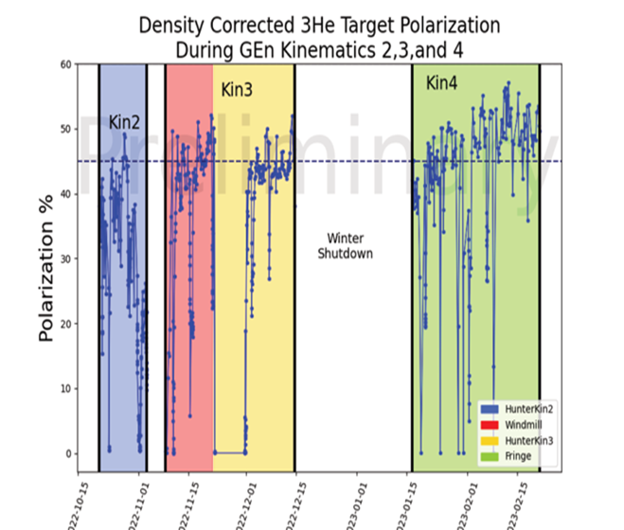
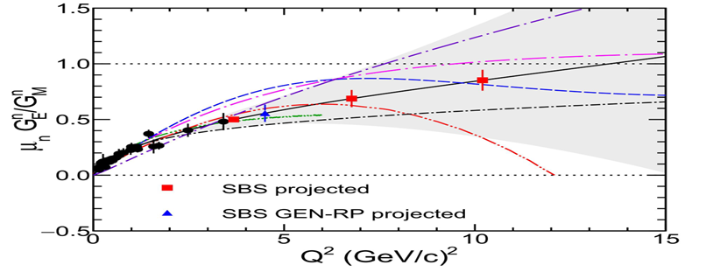
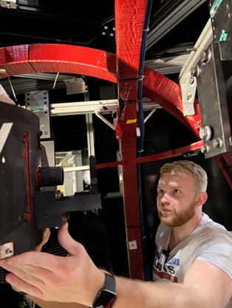
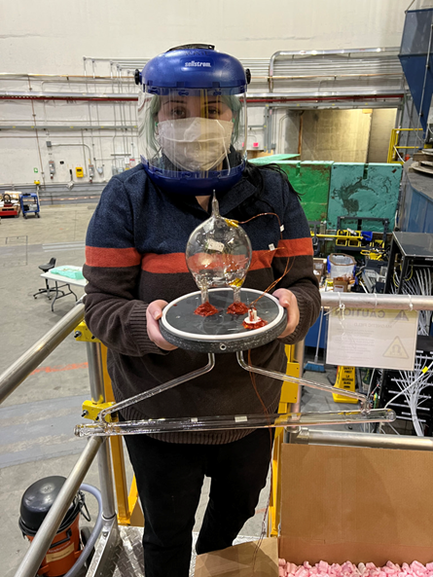
Hall A: Past Year’s Experiments (July 2022- March 2023)
Neutron G_{E}/G_{M} by Beam-target Asymmetry on polarized 3He
Started in Oct 2022
Completed Q²= 2.9 and 6.6 GeV²
Q² = 9.9 GeV² is partially done.
Complete final 6 weeks running from Sept 2023-Nov 2023
Polarized 3He target
First time running with 60cm long 3He cell
50-55% polarization in beam!
Red points projected errors
45%

Slide 3
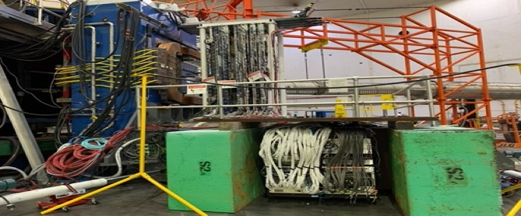
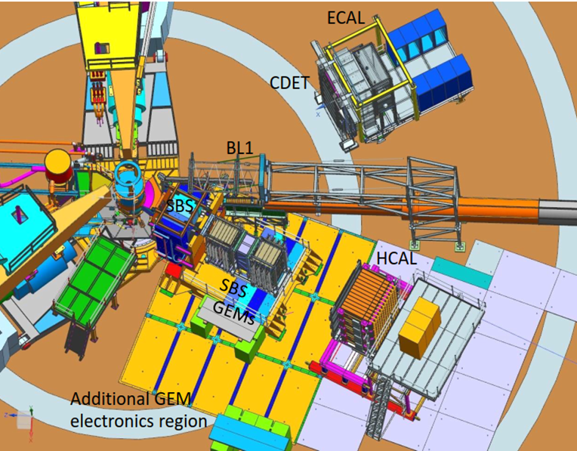
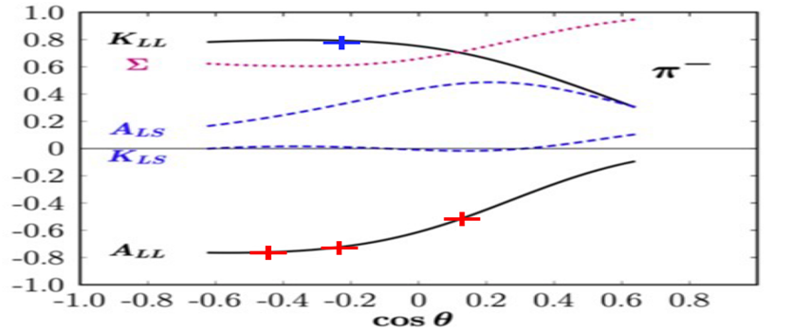
Hall A : Plan for coming years (Jan 2024 – July 2025)
Neutron G_{E}/G_{M} by recoil polarization
Proton G_{E}/G_{M} by recoil polarization
Switch from 3He to LH2/LD2
Plan to start in Spring 2024, Q² = 4.5
ECAL platform is in Hall A and plan to start stacking in August.
After Neutron Recoil Polarization is completed
Need about 6 months for installation
Experiment will run in late 2024 to spring 2025.
Red points projected errors
Test of SBS GEMs during
3He GEn.
Polarimeter layout
Pion photo-production on neutron
Short experiments
Beam-target asymmetry, A_{LL}
Recoil polarization, K_{LL}

Slide 4
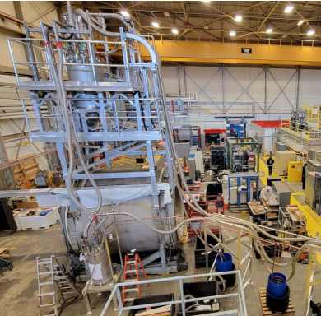
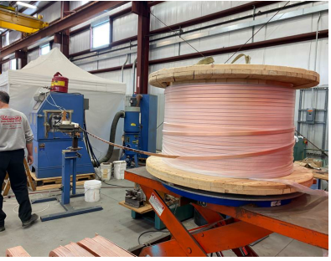
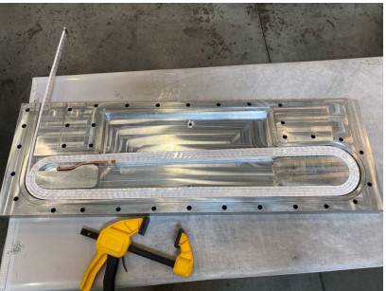
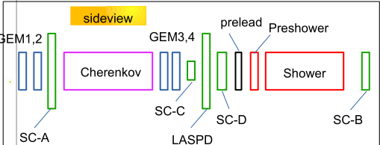
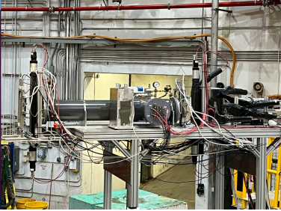
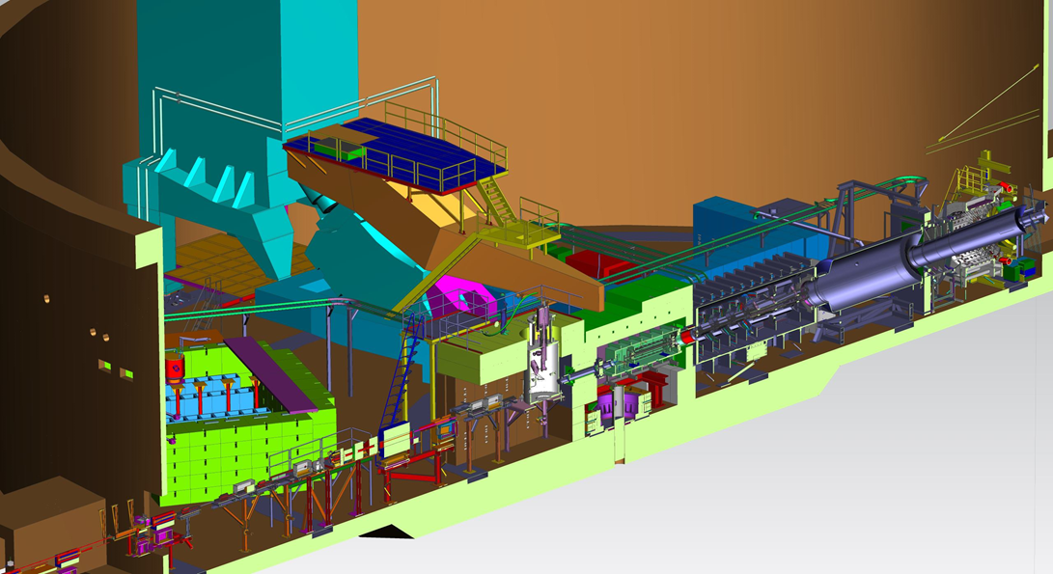
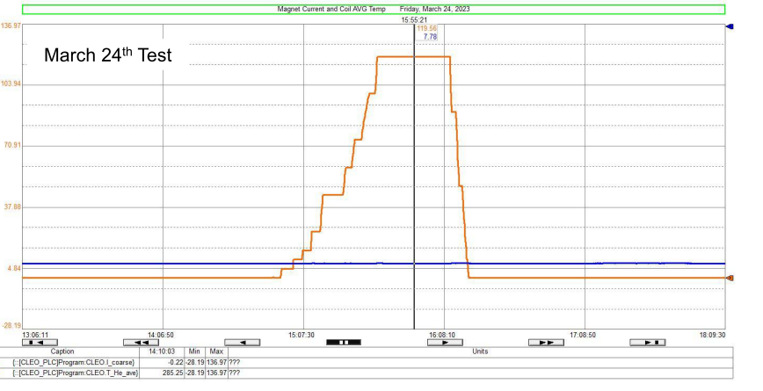
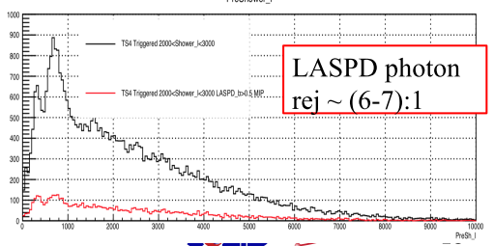
Hall A : Plans beyond July 2025
MOLLER
SoLID
Inflation Reduction Act provided full funding.
In Jan 2023, passed CD-3A review and spending CD-3A funds.
CD2 /CD3 review in October 2023.
Aggressive installation schedule of 18 months after GEp run ends
3 years of running. Starting in Fall 2026
Reuben Fair is new PM, Klaus Dehmelt is new DPM (Sept 1).
CLEO magnet cold test at 120A completed.
High rate test of SoLID detector. Set at 8⁰ and 17⁰ in Hall C.
SoLID mentioned in Recommendation 1 in the Hot/Cold QCD and the recommendations of FSNN LRP town meetings
Magnet test
High rate test
Coil production underway
Ramp to 120A
Coil temps constant

Slide 5
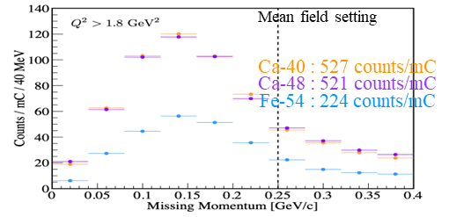
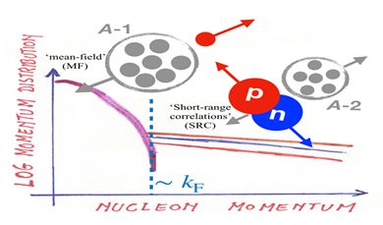
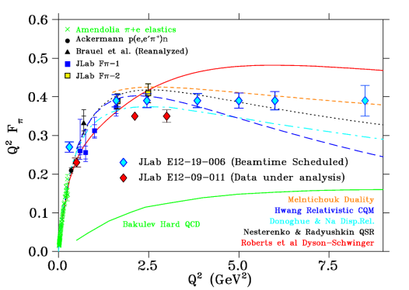
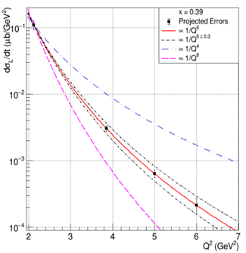
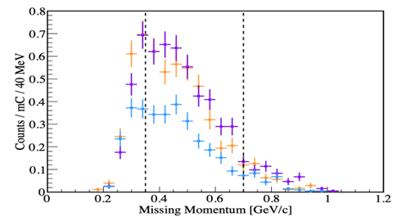
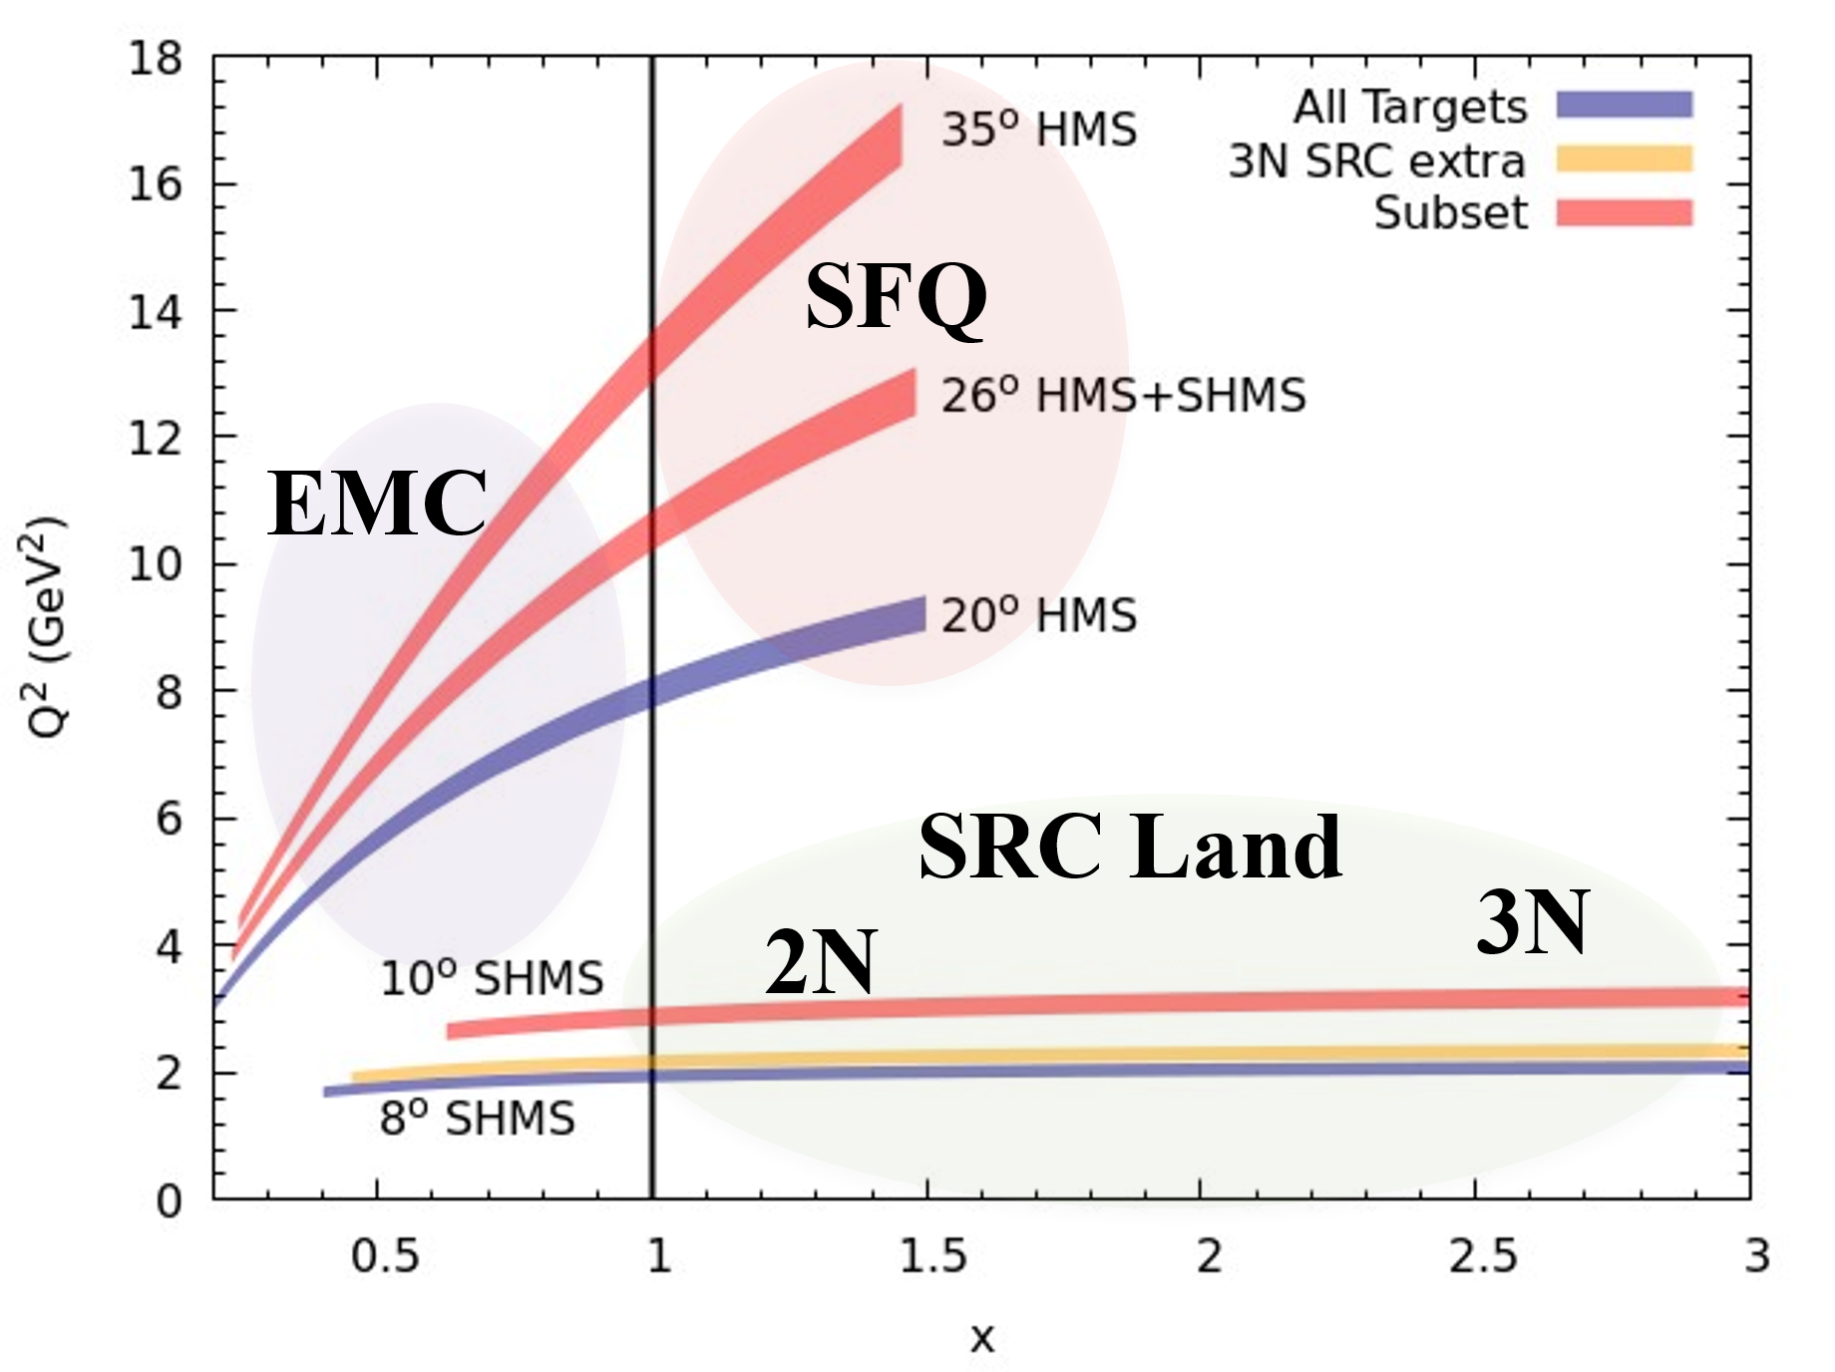
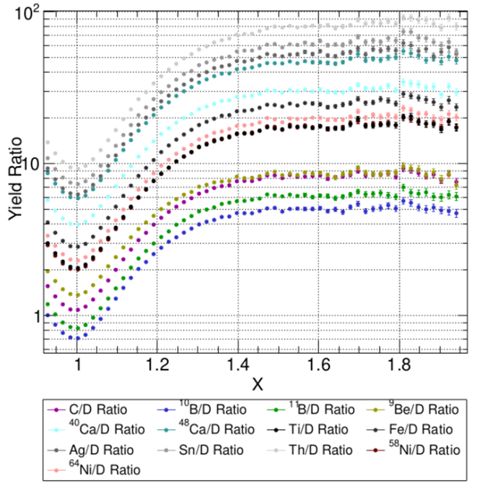
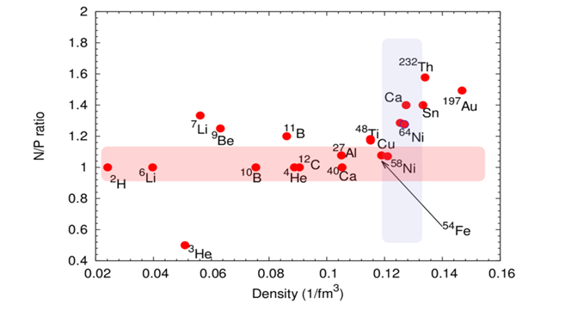
Hall C: Past Year’s Running (July 2022-March 2023)
E12-19-006 : Ran from June to mid Sept to complete high ε points to match low ε points taken the previous run cycle.
E12-17-005 : Ran at the end of Sept 2022 for two weeks
Pion form factor to Q² = 8.5
Proposed error bars
Test of factorization by measuring Q² dependence of σ_{L}
Compare 40Ca, 48Ca, 54Fe
Mean-field setting
SRC setting
E12-10-008 Study EMC effect over range of nuclei
6Li and 7Li added to light nuclei already measured
Flavor dependence with 40Ca and 48Ca
E12-06-105 Inclusive Scattering from Nuclei at x > 1
Precision measurement of 2N SRC
A-dependence in light nuclei
Variation with neutron excess
Connect EMC effect and SRC
First observations of 3N SRC
Nuclear PDFs at x > 1 and look for superfast quarks
E12-10-003 Deuteron Electro-Disintegration at Very High Missing Momentum
Preliminary online results
By Casey Morean

Slide 6
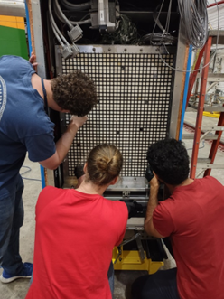
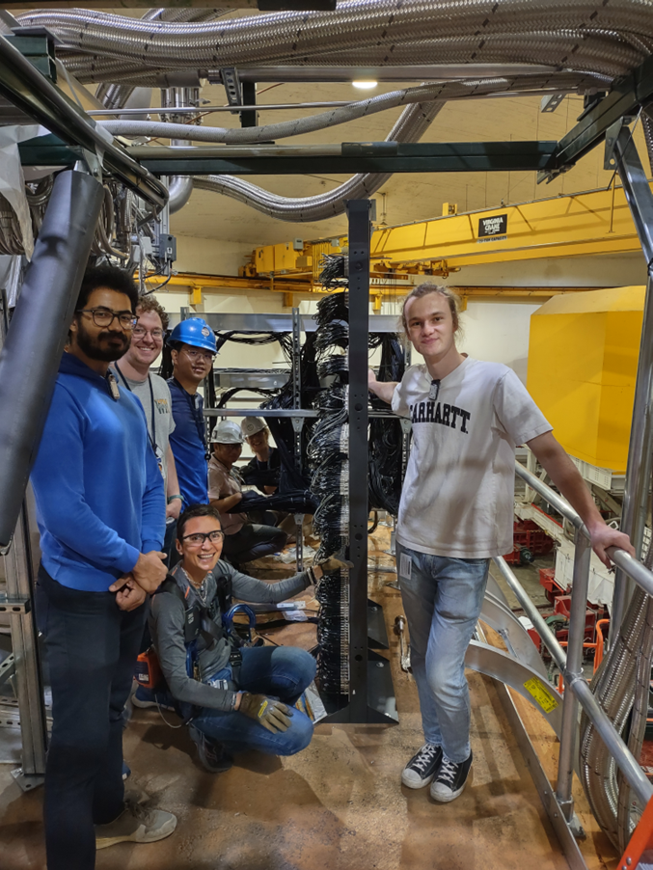
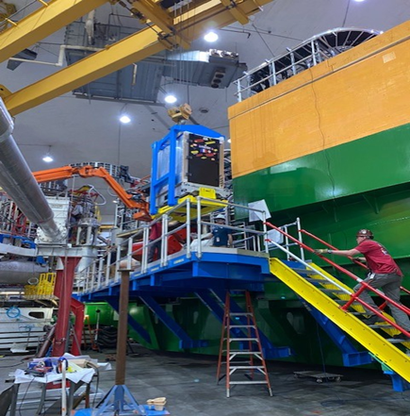
Hall C : Plan for next year ( July 2023- July 2024)
Neutral Particle Spectrometer
Sweeping Magnet with calorimeter.
Magnet and power supply have been tested.
NPS attached to SHMS carriage to allow easy angle change.
The calorimeter is on rails, cabled and taking cosmics.
1080 Lead-Tungstate blocks in calorimeter to detect γ and π⁰
Two experiments using the NPS
E12-13-010 is two concurrent experiments
Exclusive Deeply Virtual Compton on proton
SIDIS (e,e’,π⁰) cross section.
Map the transverse momentum dependence.
E12-22-006
Exclusive Deeply Virtual Compton on deuteron
Subtract the proton data from deuteron data to get neutron.
Proposal PR12-23-014 would be a new run group that measures R=σ_{L}/σ_{T} in SIDIS (e,e’,π⁰) cross section.
Students putting fiducial marks on Calo
Cabling crew with Simona Malace who has led the installation of NPS Calo
NPS Calo craned onto the NPS platform

Slide 7
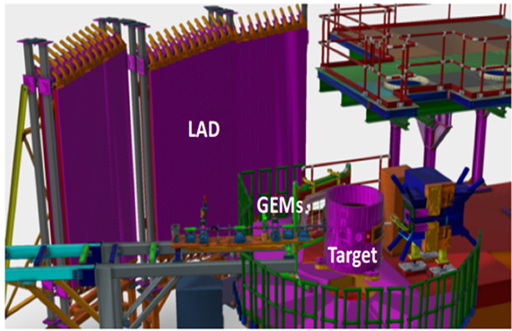
Hall C: Plans beyond July 2024
Experiments to run in Fall 2024- Spring 2025
Standard SHMS/HMS
E12-06-104 R=σ_{L}/σ_{T} in SIDIS on 1H and 2H
E12-06-107 Complete CT experiment
E12-11-107 Spectator tagged DIS d(e,e’p_{s})
Install Large Angle Detector
HMS/SHMS detect electron
Fall 2025 and beyond
Depends on PAC recommendations
Starting in Fall 2025
Standard SHMS/HMS experiments.
Experiments with non-standard beam energies
New proposals
Running during MOLLER and after:
During MOLLER, limits on total target power and beam current in the two halls
Hypernuclear experiments in 2026
Polarized deuteron experiments
WACS and other experiments using the NPS
Experiments using the Compact Photon Source
Capital project is ongoing
SBS/BB experiments that did not run in Hall A
Exciting new letters of intent
Future plans will incorporate needs of the other halls and target group resources.

