Slide 1
Accelerator Status & Experiment Schedule
Douglas Higinbotham
Physics Division

Slide 2
CEBAF Improvement Plan Is Proceeding
Last run period, we pushed the CEBAF accelerator to 1047 MeV/linac
A good energy for delivering high polarization to Halls A, B and C
This equates to 10.5 GeV for A, B, C and 11.6 GeV for Hall D
And we ran at that energy the entire 32 weeks of physics beam!
Down side was limited beam current and high trip rates
During this SAD (scheduling accelerator down) we have added a C100 to the north linac and replaced one in the south linac.
We are planning to cont. with the 1047 MeV/linac with what should be more stable beam.
We have had a series of safety pauses which have caused a short term delay, but hopefully will mean smoother & safer long term running.
Looking ahead the goal is to get CEBAF well into the operational energy range needed for the MOLLER experiment (10.6 to 11 GeV for Hall A)

Slide 3
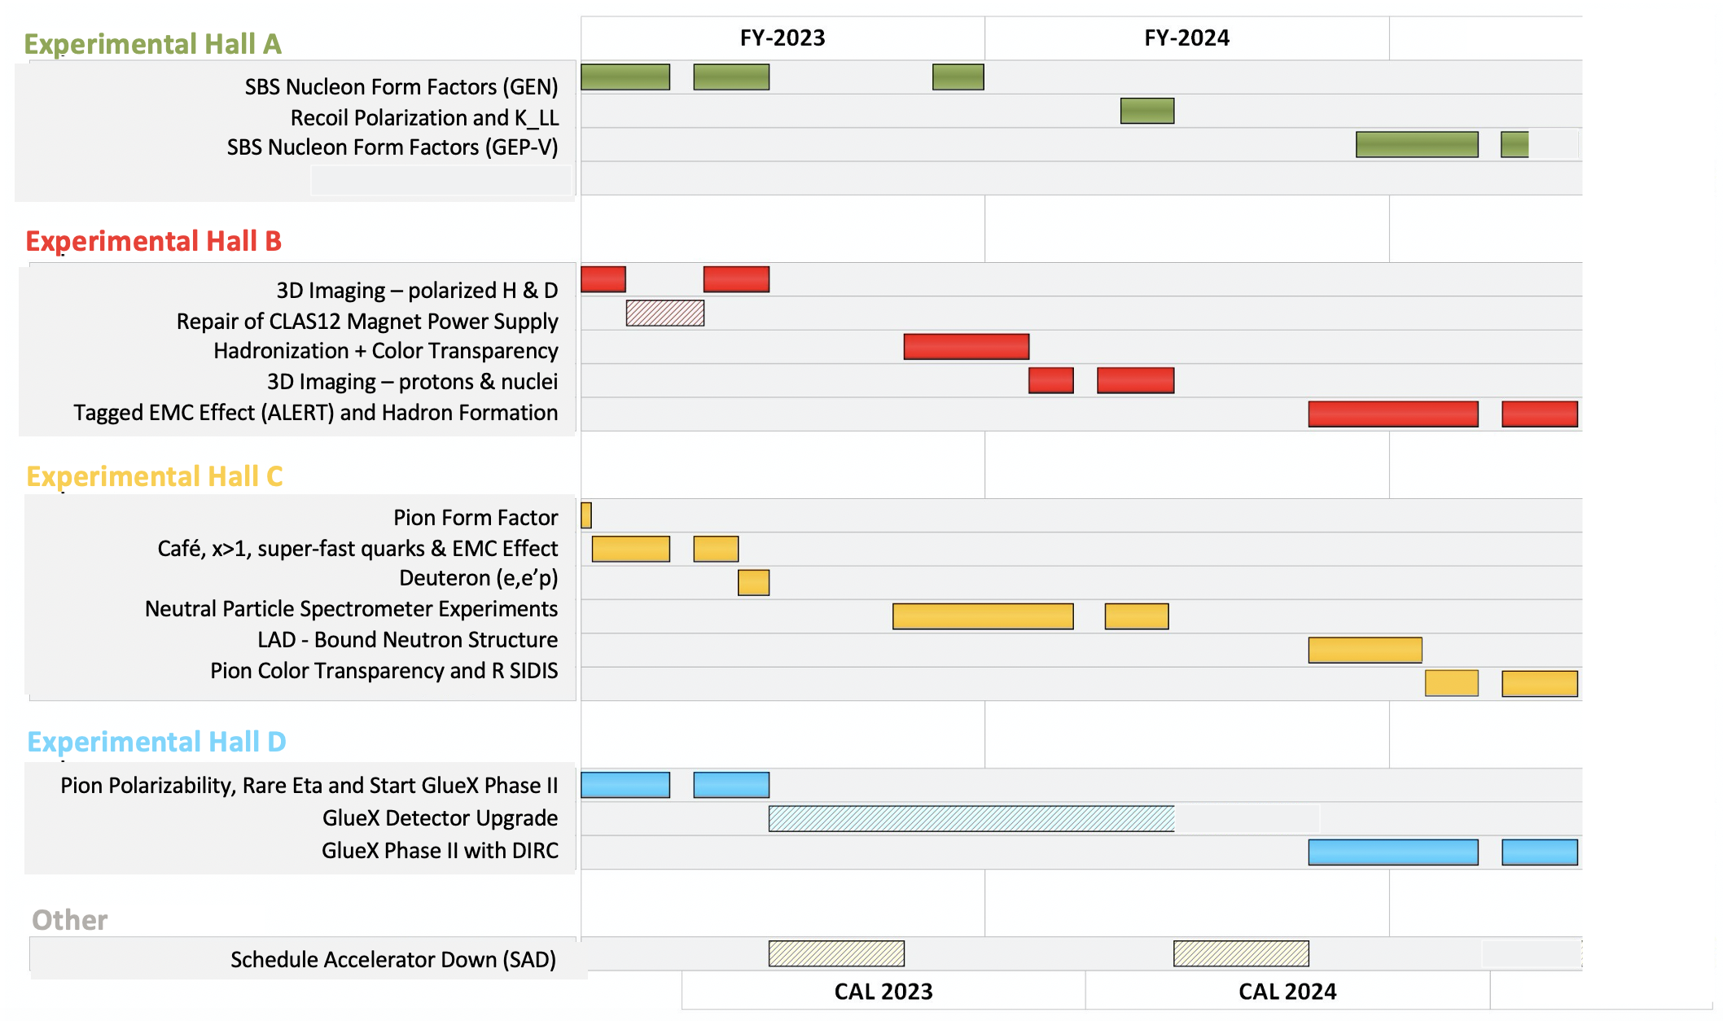

Slide 4
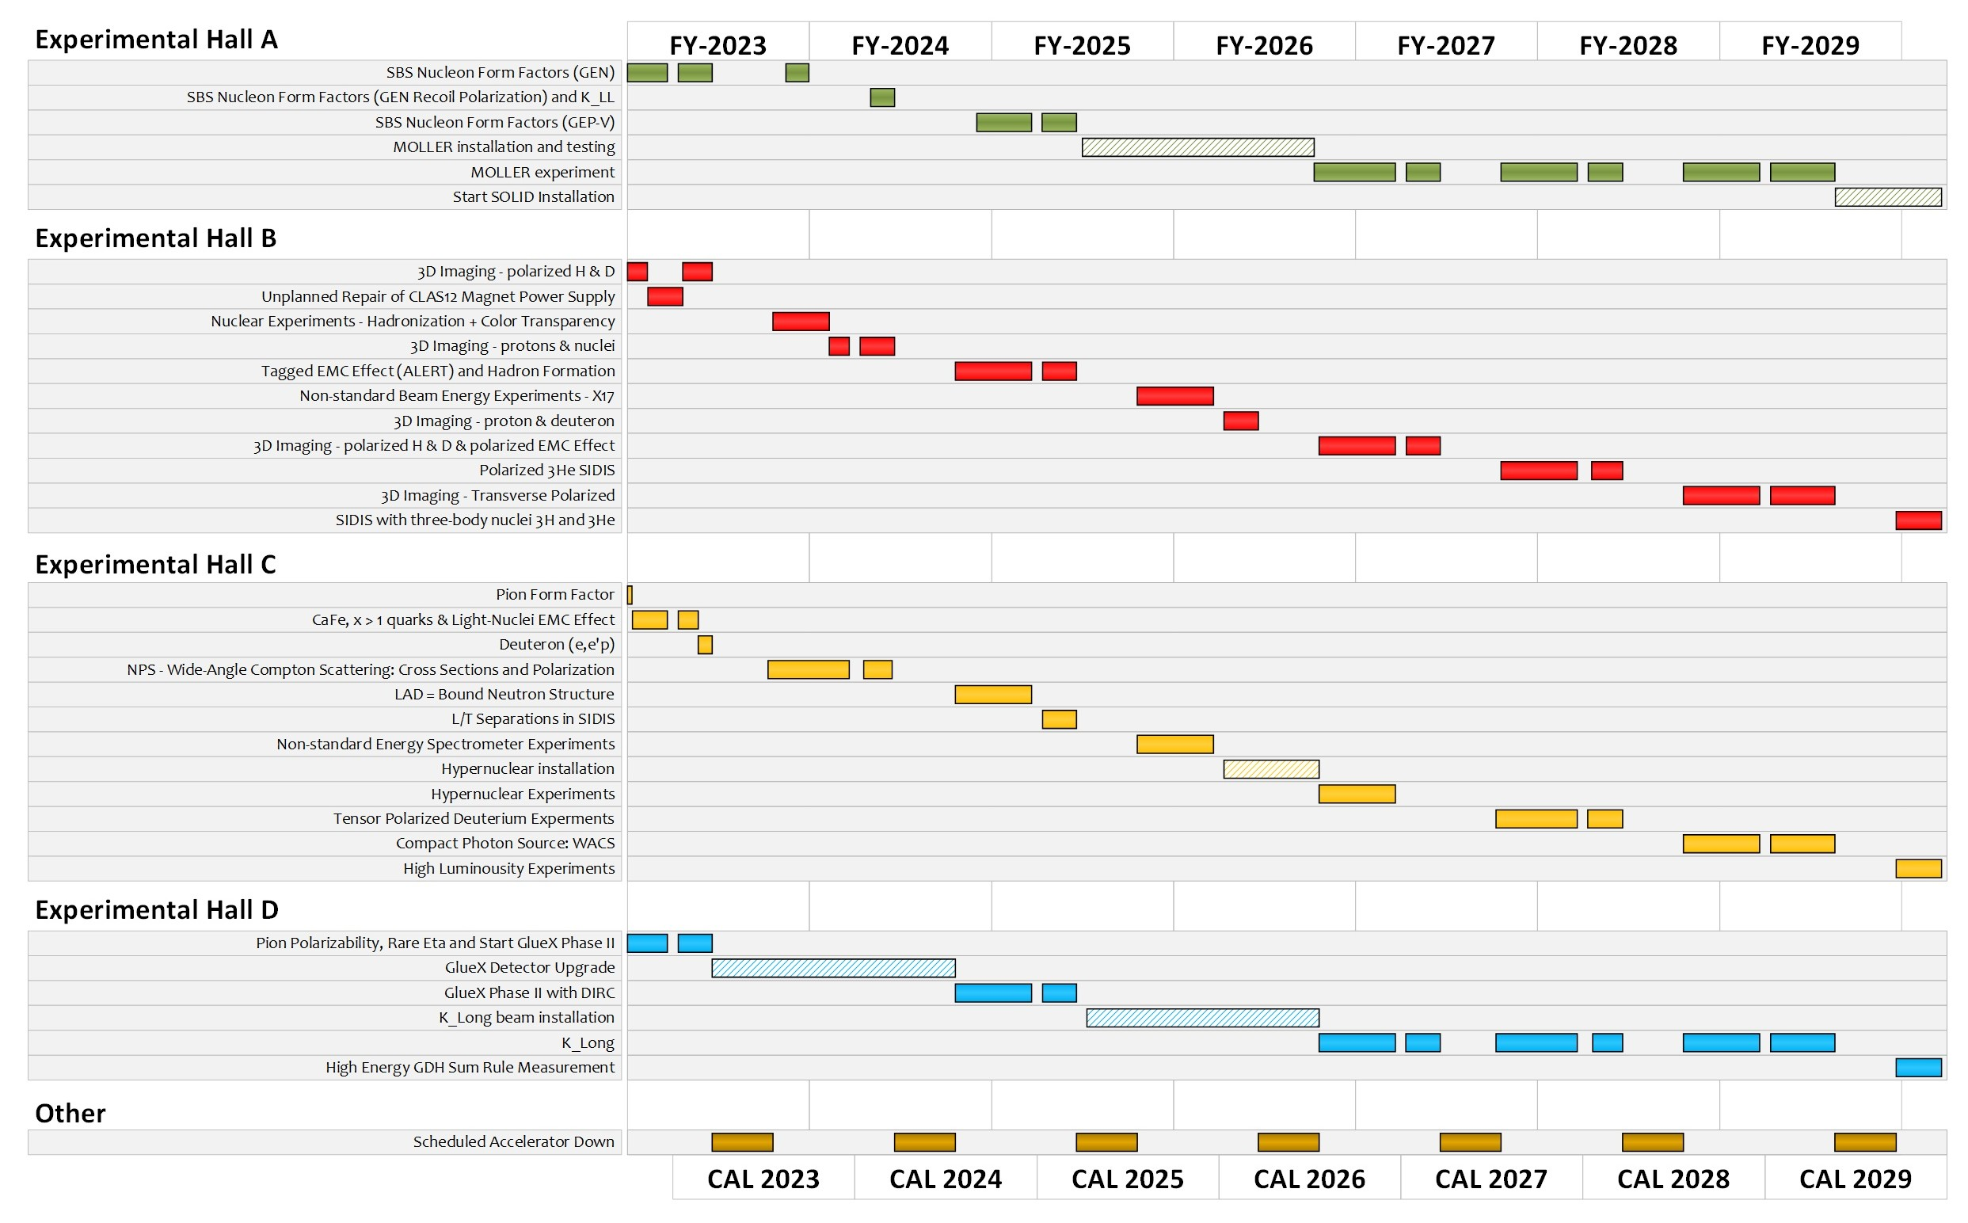
Extended Experimental Schedule
205 completed experiments to-date (28 full; 28 partial in 12 GeV era)
51 experiments remaining
~7 years at ~30 weeks/year
…not including SoLID
…not including new proposals

