Slide 1
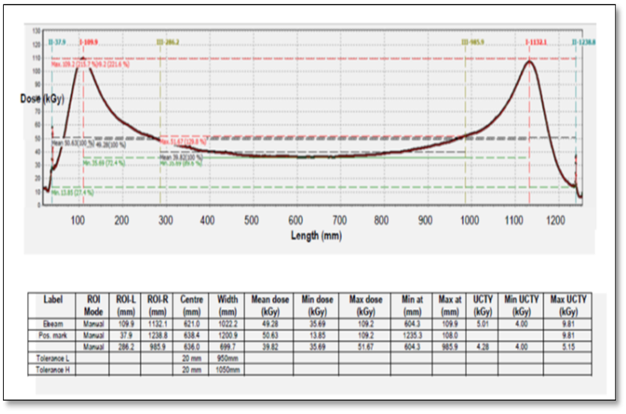
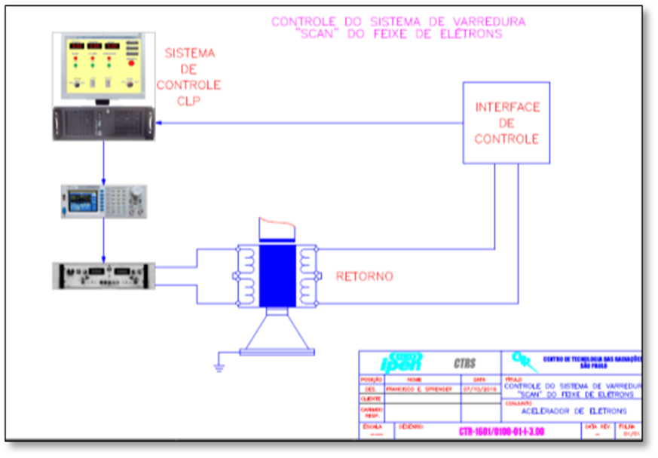
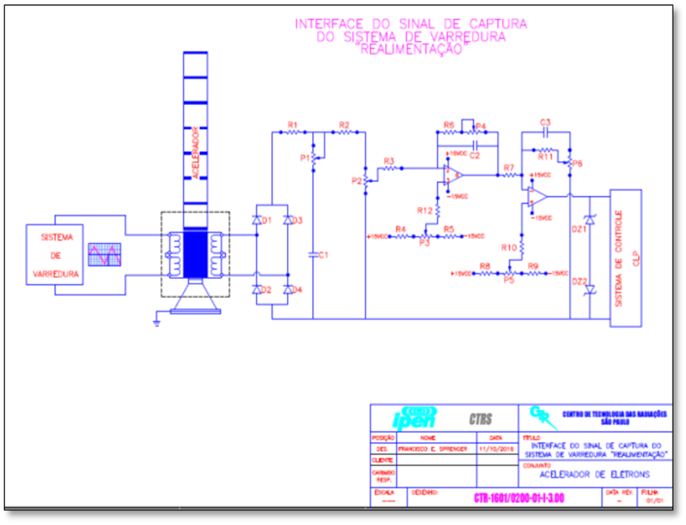
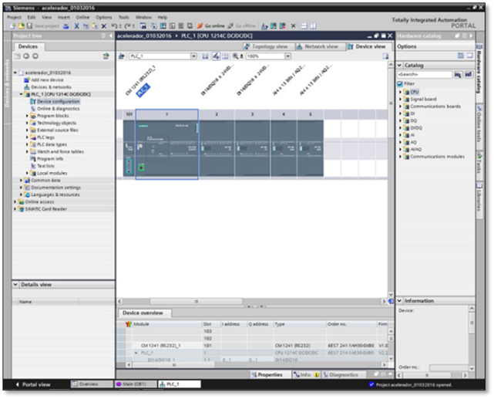
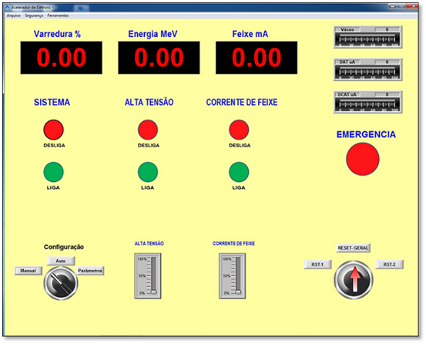
DYNAMITRON® DC 1500/25/4 TYPE ELECTRON BEAM ACCELERATOR SCAN SYSTEM UPDATE
Samir L. Somessari Heitor G. Duarte, Elizabeth SR Somessari,
Institute of Energy and Nuclear Research – IPEN-CNEN ( Brazilian Nuclear Energy Commission ) - Av.Prof. Lineu Prestes, 2242 – São Paulo – SP – Brazil
Abstract
The proposed theme of this research focuses on studying, developing and nationalizing an automated system scanning the Dynamtron ® DC1500/25/4 electron beam accelerator with energy of 1.5 MeV , beam current of 25 mA and beam scanning of 60 to 120 cm , with a total power of 150 kW, installed at Ipen-CNEN /SP in 1978 and since then used in radiosterilization, disinfestation , treatment of industrial and domestic effluents, modification and cross-linking of polymeric materials, curing of composite materials among other applications . The scanning system of the electron beam accelerator aims to control the length of the electron beam from 60 to 120 cm with a thickness of 25.4 mm, in which the magnet and electronic coils are controlled for scanning control. This entire system is in the original configuration of the accelerator manufacturer, RDI Radiation Dynamics, Inc , installed at IPEN in 1978, however, since 1987, it no longer provides spare parts for this type of accelerator. Next, a new control system was developed, where the scanning system with control signal is composed of a Siemens S7-1200 programmable logic controller , an arbitrary function generator and other components. This updated system allowed greater agility in routine operations, continuing the work using this electron accelerator, which serves research improvements in different areas such as human tissues, precious stones, new composites and polymers, food and medical products and health, in addition to demands services for external companies
Results
Data:
The operation of the scanning system is directly linked to the accelerator energy. To obtain dose certification, it was necessary to carry out an accelerator dosimetry and test the reliability of the developed system, using energy data in MeV, relating the supply currents as per Table 1, for software development and also dosimetry, as shown in Figure 7 (beam curve).
CONCLUSIONS
Industrial automation played an essential role in the development of the automated operational control process of the Dynamitron® Industrial Electron Accelerator (scan system), model DC1500/25/4, in order to increase its productivity and flexibility, with high quality and reliability, reducing costs and avoiding human errors, with the implementation of Good Manufacturing Practices (GMP) in the material irradiation process, at IPEN-CNEN/SP.
The automated system developed in this work to control the scan system featured cutting-edge technology, using the programmable logic controller (PLC), which integrated comfort and practicality for operators during operation, who can manage the process through a microcomputer (notebook), with the help of a supervisory system. Thus, with the high-definition graphical interface, the system provides objective information during operation.
References
International Atomic Energy Agency; International Irradiation Association. Industrial Electron Beam Processing, IAEA, IIA (2010).
Calvo, W.A.P.; Duarte, C.L.; Machado, L.D.B.; Manzoli, J.E.; Geraldo, A.B.C.; Ko-dama, Y.; Silva, L.G.A.; Pino, E.S.; Poli, D.C.R.; Tobias, C.C.B.; Mathor, M.B.; Somessari, S.L.; Omi, N.M.; Somessari, E.S.R.; Silveira, C.G.; Rela, P.R.. Needs and Emerging Opportunities of Electron Beam Accelerators on Radiation Processing Technology for Industrial and Environmental Applications in South America. Inter-national Topical Meeting on Nuclear Research Applications and Utilization of Accel-erators, IAEA, Vienna, 4-8 May 2009.
Cleland, M.R.; Galloway, R.A.. Electron Beam Crosslinking of Wire and Cable In-sulation. Technical Information Series TIS 01812. IBA Industrial, Inc., Edgewood, New York, USA.
Cleland, M.R.. Industrial Applications of Electron Accelerators. IBA Industrial, Inc., Edgewood, New York, USA.
IBA Industrial, Inc.. PLC Dynamitron Training Manual for Electron Accelerator (2012).
Somessari S.L teses: Desenvolvimento de Sistema automatizado para controle opera-cional do acelerador industrial de eletrons Cockroft –Walton – USP ~São Paulo 2019
A new beam scanning control system (Figures 01 and 02) was developed, computerized and automated with greater efficiency, which is already operational, due to breakdowns and malfunctions of the manufacturer's original scanning system. There is a lack of original replacement parts and components, in addition to the manufacturer not providing operating details. The new control proposed in this project is operational and interconnected to the machine's original control system. When starting up with other systems proposed and presented in this work, the sweep control developed will be interconnected.
Figure 1- Electron beam scan
control diagram
Figure 2– Diagram of the scan system feedback process.
Automation systems are used with Siemens PLC model S7-1200 and computerized graphical operating interface systems (Indusoft supervisory system), shown in Figures 3, and 4 . These systems fully meet the needs of this development. The operating logic of the electronic, mechanical, pneumatic devices and other peripherals developed will be tested individually and, after integration between them, simulation and operation will be carried out in the system.
Figure 3 – TIA Siemens software for
programming in the PLC
Figure 5 – Accelerator HMI control
and monitoring screen

