Slide 1
W. Edwards Deming and the Cost of Nuclear Energy
Muons, Inc.
www.muonsinc.com
An Accelerator-driven Green Power Plant - OR
Rol Johnson, Mary Anne Cummings, J. D. Lobo, Milorad Popovic, Tom Roberts, Muons, Inc. Batavia, IL 60510
“Improve Constantly and Forever” using Accelerator-Driven Molten Salt Subcritical Small Modular Reactors with Radiotoxic Volatile Gas Removal to Ease Regulatory Burdens

Slide 2
W. Edwards Deming – Fascinating Fellow
Wikipedia Article on Deming is excellent!
1900- Born in Iowa
1922-1947 several degrees, engineering, mathematics, physics, statistics - many jobs
1925- e.g. Yale - Ph.D. dissertation is on the packing of nucleons in the helium atom: "A Possible Explanation of the Packing Effect of Helium.“
1947 goes to Japan to help census, meets people, gives lectures over 10 years
1951 Deming Prize established. Toyota, Sony, etc. pay attention. Also S. Korea
1950-1980 Japan eats lunch of US Automakers. Rise of Japan as an industrial and economic powerhouse after WWII due to Deming’s transformative theories and teachings.
1980- Ford Co. asks Deming to consult
1980-1990 Ford becomes larger than other US Car Cos.
1992-3 Deming Institute founded, he passes

Slide 3
Deming’s Differences-Examples
Standard Company Deming Company * Quality is expensive * Quality leads to lower costs * Defects are caused by workers * Most defects caused by the system * Buy at lowest cost * Use vendors committed to quality * Fear and reward to motivate * Fear leads to disaster * Play one supplier off against another* Work with suppliers

Slide 4
Demings Differences-Examples
What are the basic principles of Deming?
Create a constant purpose toward improvement.
Plan for quality in the long term.
Resist reacting with short-term solutions.
Don't just do the same things better
find better things to do.
Predict and prepare for future challenges, and
always have the goal of getting better.

Slide 5
Demings 14 key principles for management to follow to improve the effectiveness of a business or organization
1. Create constancy of purpose toward improvement of product and service,
with the aim to become competitive and to stay in business, and to provide jobs.
2. Adopt the new philosophy. We are in a new economic age. Western management must awaken to the challenge, must learn their responsibilities, and take on leadership for change.
3. Cease dependence on inspection to achieve quality. Eliminate the need for inspection on a mass basis by building quality into the product in the first place.
4. End the practice of awarding business on the basis of price tag. Instead, minimize total cost. Move toward a single supplier for any one item, on a long-term relationship of loyalty and trust.
5. Improve constantly and forever the system of production and service, to improve quality and productivity, and thus constantly decrease costs.
6-14 seen after last slides

Slide 6
NRC Approach Does NOT Allow Key Principle #5
Decades required to certify a reactor design and materials.
Regulatory process time consuming and expensive (~$1B for Nuscale).
Design is cast in concrete after License is issued
No Significant Changes for the following 6-8 decades.
Muons, Inc. New Concept
Superconducting Linac Driven Subcritical Molten Salt Fueled SMR with continuous Removal of Volatile Radiotoxic Isotopes
Allows principle # 5 -Improve constantly and forever - because
Low Risk of Criticality or Radioactive Release Accidents

Slide 7
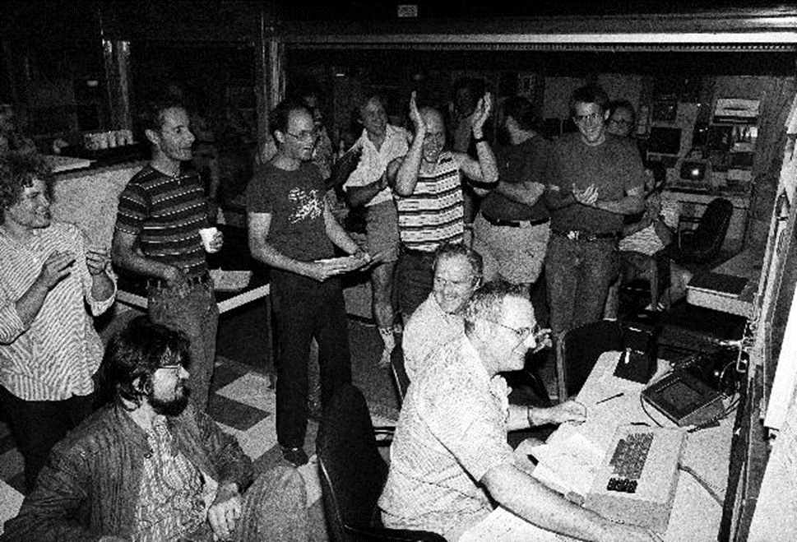
Principle #5 Unleashes Human Creativity to do Extraordinary Things!
Muons, Inc. has over 21 years of R&D experience developing particle accelerators and related technology, having been awarded and delivered over 34M USD in private and government contracts in partnership with 11 National Labs and 9 Universities. Founded by scientists from National Labs.

Slide 8
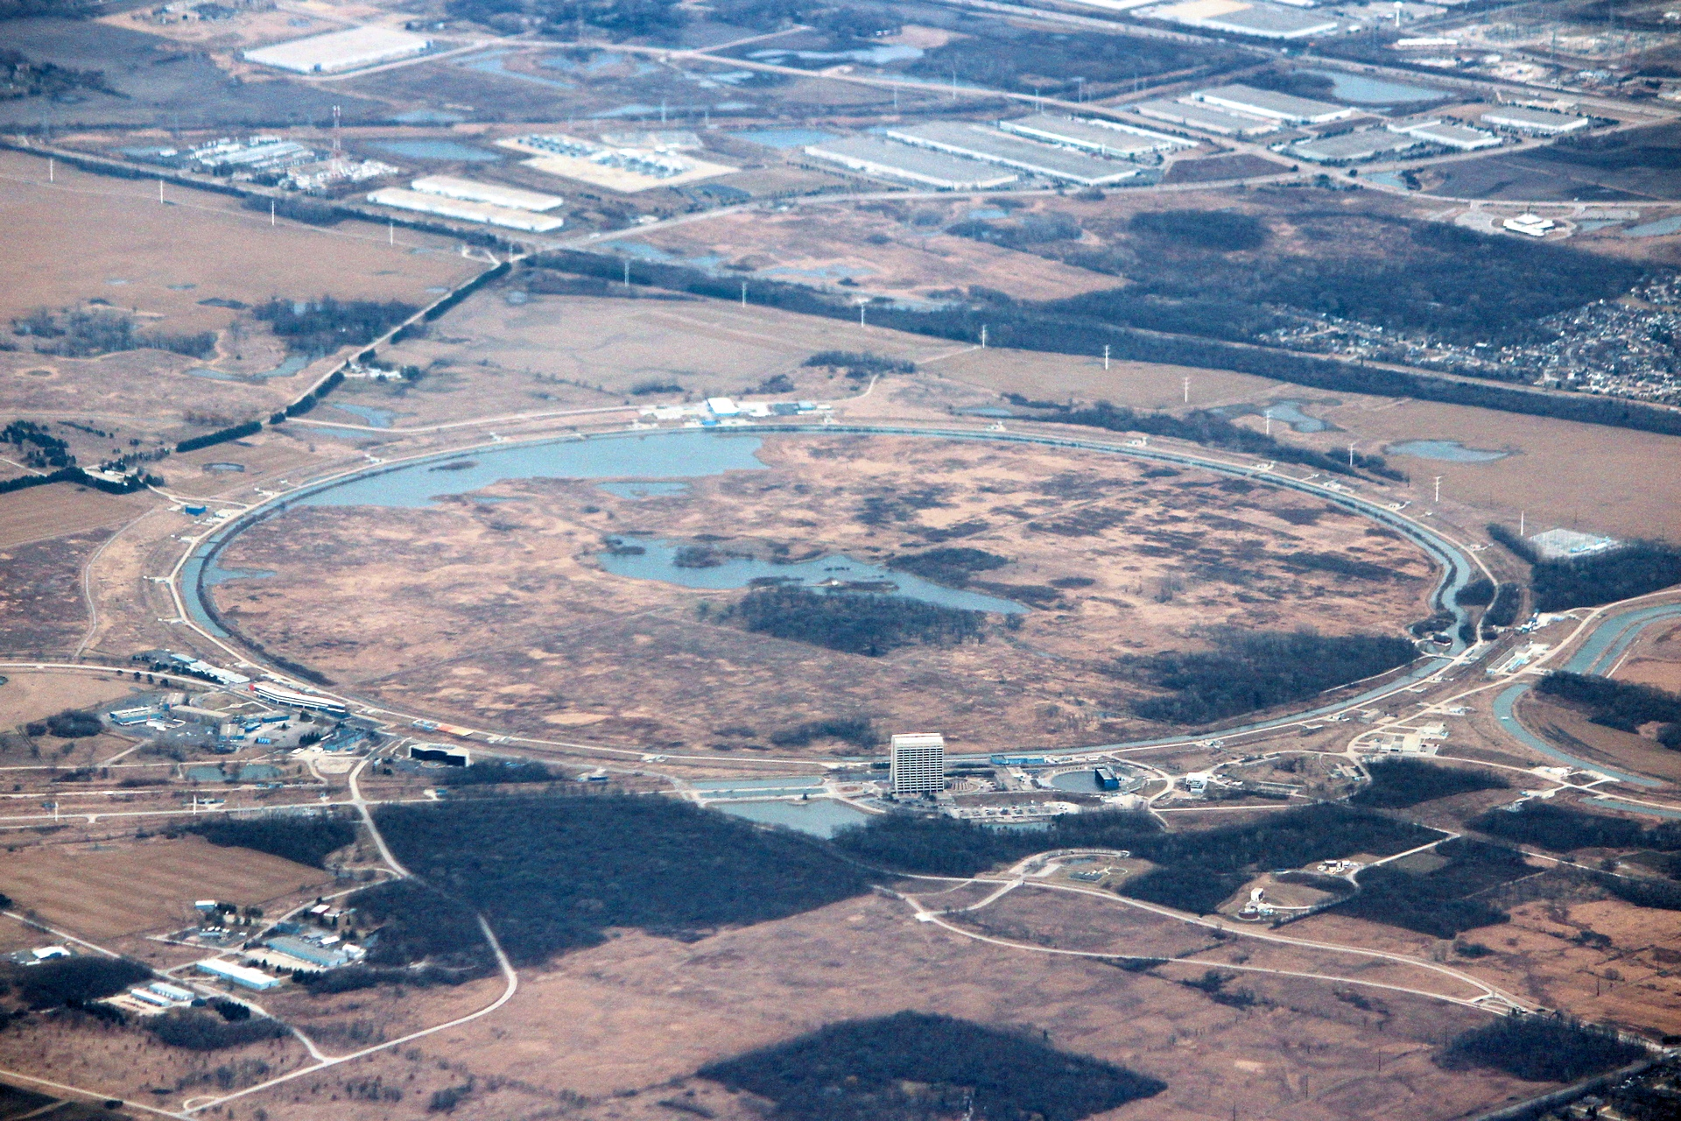
Notes:
In 1982 I worked at CERN to learn how to make intense beams of antiprotons from the inventor of the essential techniques, Simon van der Meer (Nobel Prize in 1984 with Carlo Rubia). In 1984 I returned to Fermilab to lead the team designing the antiproton accumulator and then the Tevatron proton–antiproton collider, which uses a 1 km radius ring of 880 dipole electromagnets (the superconducting wire developed was an enabling technology for MRI machines). The Tevatron collider was a powerful microscope, able to turn energy into matter (E=mc²) to observe the most elusive things in the universe. The power is expressed in Luminosity, L. We needed L=1 or more to be sure of funding. (For the scientific inclined, the unit is L=1 x 10^30 /cm²-s ) We experimented extensively with designs and parameters we conceived to make the simulations for the design reach L=1, even selecting the most optimistic interpretations of component performance. We eventually succeeded to simulate that we could get close enough to L=1, and we were allowed to build the Tevatron collider and its detectors.

Slide 9
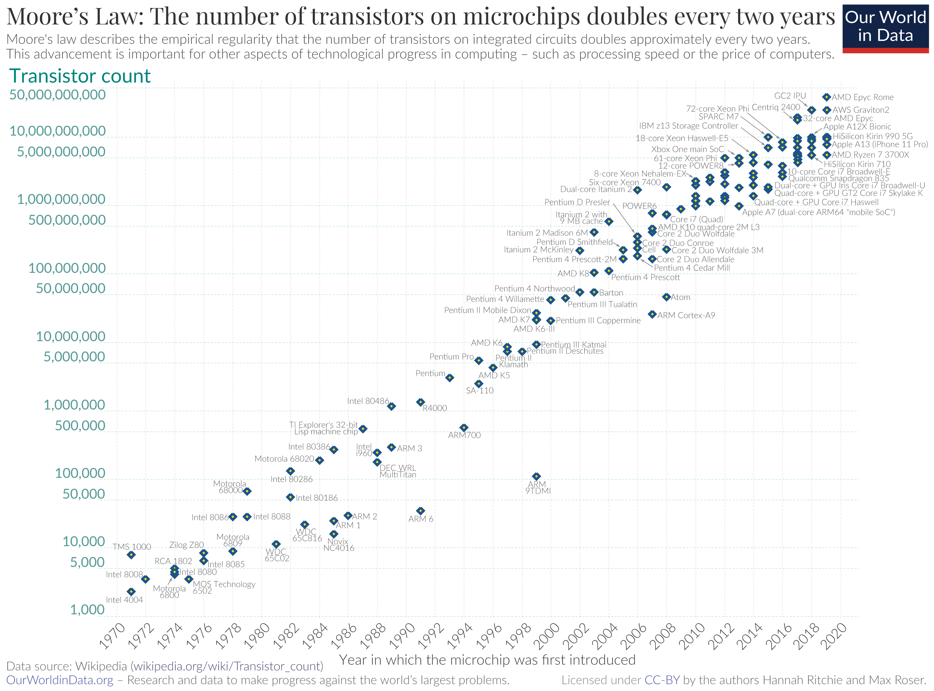
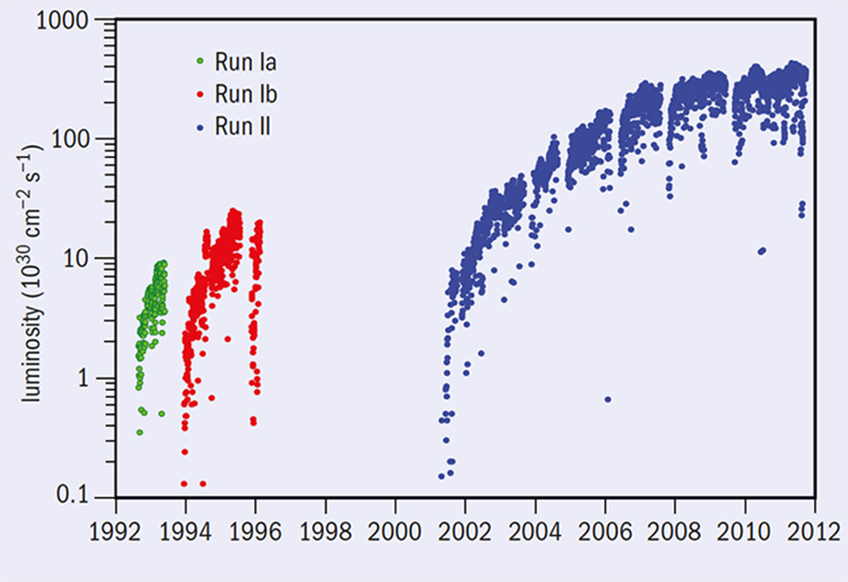
TEVATRON performance over 20 years, showing 350 times (35,000%) improvement in Luminosity
Moore’s Law now approaching 60 years of human ingenuity
The results were amazing, but in successful companies, such stories are normal for those that can follow Deming’s principle to “Improve Constantly and Forever…”
EarthX 2023 - Rol Johnson

Slide 10
Nuclear Improvements Frozen by Regulations
The Nuclear Energy Industry is hobbled by Regulatory Demands to prevent:
Criticality Accidents (like Chernobyl)
Accidental Release of Radioactive Isotopes (like Chernobyl, 3-Mile Island, Fukushima)
These challenges can be overcome with an ACCELEATOR-DRIVEN SUBCRITICAL DESIGN and MOLTEN SALT FUEL with continuous removal of volatile radioactive isotopes.
CFR10: a nuclear reactor is defined as "any apparatus or device in which a nuclear chain reaction can be sustained and controlled in a self-supporting or neutron multiplying medium, and which is designed or used to produce heat, power, or any other form of radiation."
CFR10 Part 50, Appendix A: nuclear power plants must limit the release of radioactive materials into the environment following an accident. The limit for the release of iodine-131 is 5 curies per day. The limit for the release of cesium-137 is 15 curies per day.

Slide 11
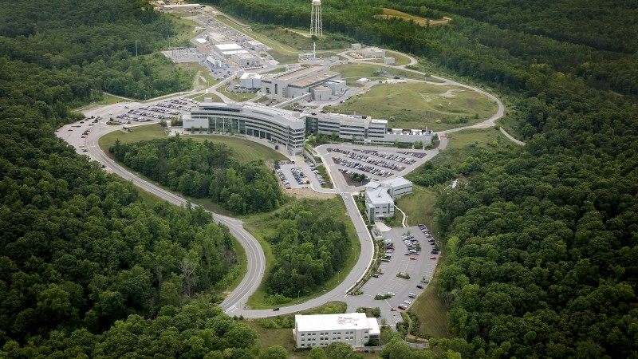
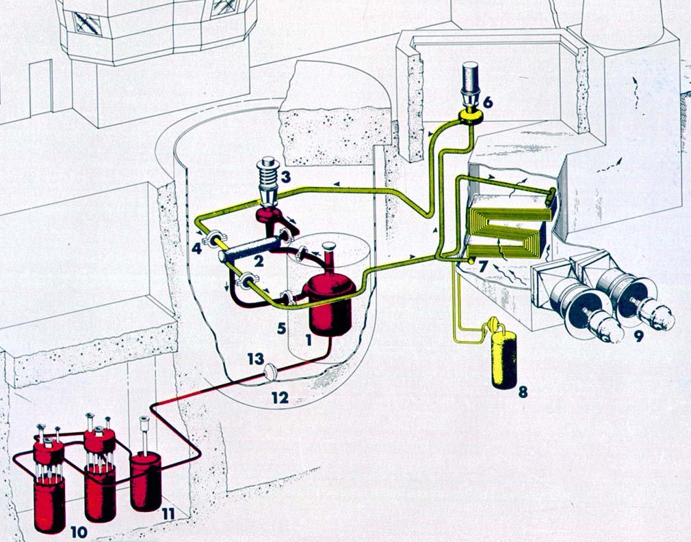
Overcoming challenges using proven US National Lab Innovations
Our Solution to overcoming the two constraints come from one new and one old development at Oak Ridge National Laboratory. The Superconducting Linac of the Spallation Neutron Source (SNS) which has the power to drive multiple subcritical Small Modular Reactors (operated from 2010 to now)
ORNL SNS (2010-…) ORNL MSRE (1965-1970) Diagram
The Molten Salt Reactor Experiment (MSRE) (operated from 1965 to 1970) which demonstrated how we can continuously remove volatile fission products from an operating reactor.

Slide 12
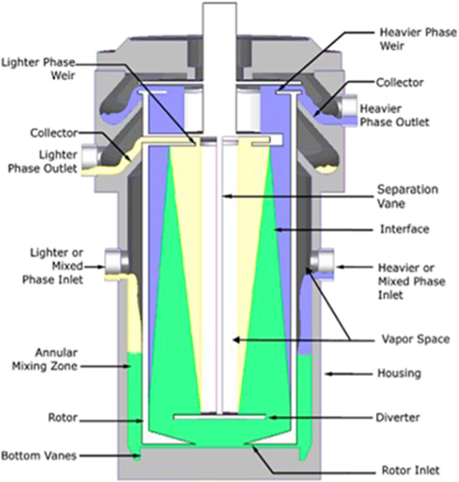
Improvement for Removing Neutron Poisons / PUREX inspired

Slide 13
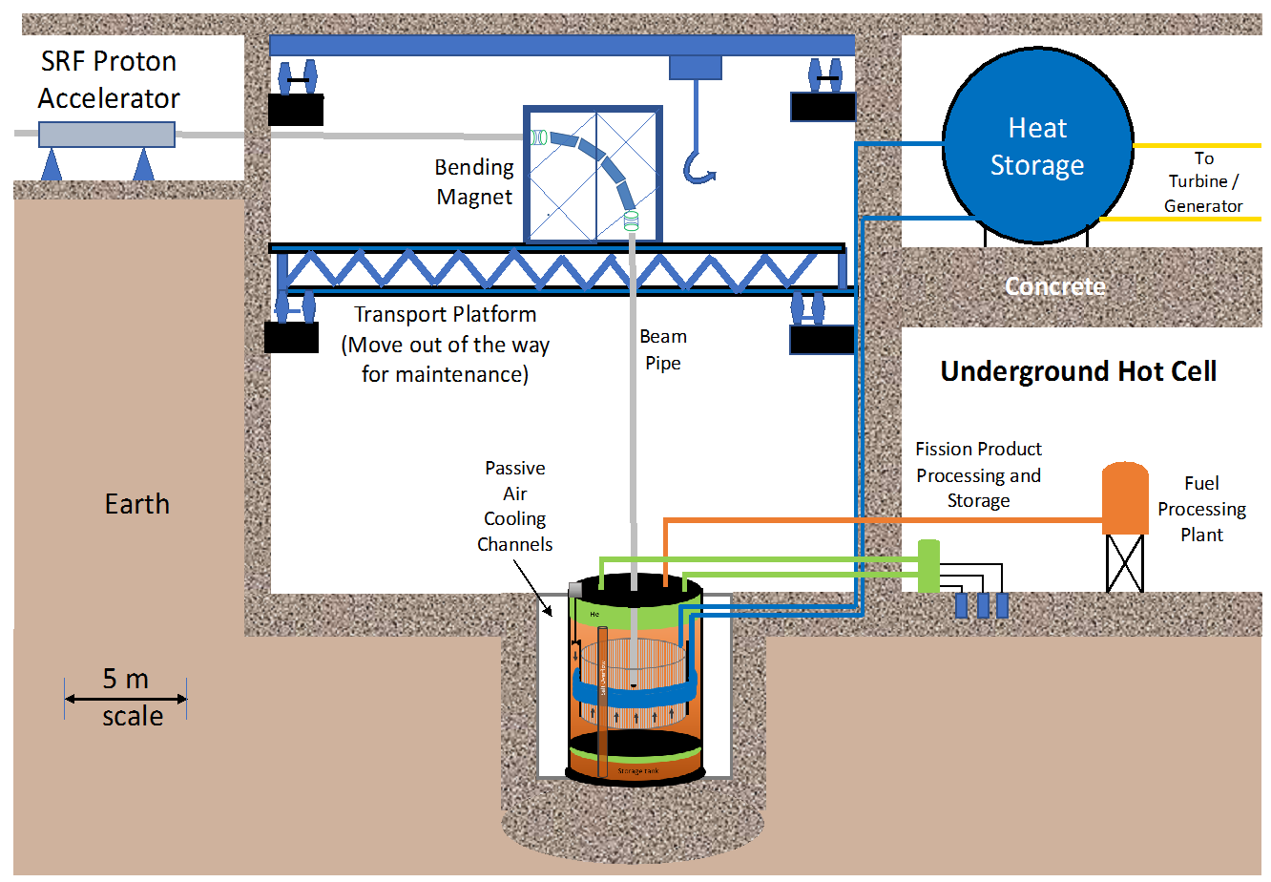
Underground Build:
MS fuel prep
FP Removal
FP Storage
MS Heat Storage
Decay Heat
Downtimes
SRF Linac
Mu*STAR SMR
Mu*STAR MS SMR
Subcritical
Based on MSRE
Internal Spallation Target
Built in Factories

Slide 14
<- This GAIN Voucher Grant showed that conversion (not reprocessing) can close the fuel cycle
Can we get a grant to show that effective removal of FP and volatile radioisotopes from a MSR sidestream is possible while leaving actinides in the fuel?
Collaborators:
Jinsuo Zhang (VT)
Bruce McNamara (PNNL)
ORNL Reactor People (large MS effort underway)

Slide 15
SUMMARY - Mu*STAR Nuclear Power Plants Clean Nuclear Energy - Converting UNF to Energy
Flexible Regulatory Approach Possible -> Improve Continuously and Forever
Subcritical - No Criticality Accidents
Accidental Radioactive Releases Mitigated by Online Fission Product Removal
Uranium and Plutonium consumed in reactor –> Cleaner Final Waste Disposal
Decouples nuclear energy from nuclear weapons
No Uranium enrichment
No reprocessing facility with plutonium stream
Reduced weapons proliferation risks –> bomb materials consumed in reactor
Inexpensive Nuclear Energy -> High burnup of Used Nuclear Fuel (UNF)
Online neutron poison removal improves efficiency
Consumes waste from other reactors – UNF becomes a valuable commodity
Extraordinary Energy Independence/Security for US and other nuclear countries
Mu*STAR NPPs at >65 US vetted locations with UNF can provide energy for centuries

Slide 16
Thanks! Any Questions or Comments?
Muons, Inc.
www.muonsinc.com

Slide 17
Demings 14 key principles for management to follow to improve the effectiveness of a business or organization
6. Institute training on the job.
7. Institute leadership. The aim of supervision should be to help people and machines and gadgets to do a better job. Supervision of management is in need of overhaul, as well as supervision of production workers.
8. Drive out fear, so that everyone may work effectively for the company.
9. Break down barriers between departments. People in research, design, sales, and production must work as a team, to foresee problems of production and in use that may be encountered with the product or service.
10. Eliminate slogans, exhortations, and targets for the work force asking for zero defects and new levels of productivity. Such exhortations only create adversarial relationships, as the bulk of the causes of low quality and low productivity belong to the system and thus lie beyond the power of the work force.

Slide 18
Demings 14 key principles for management to follow to improve the effectiveness of a business or organization
11a. Eliminate work standards (quotas) on the factory floor. Substitute leadership.
11b. Eliminate management by objective.
Eliminate management by numbers, numerical goals. Substitute leadership.
12a. Remove barriers that rob the hourly worker of his right to pride of workmanship.
The responsibility of supervisors must be changed from sheer numbers to quality.
12b. Remove barriers that rob people in management and in engineering of their right to pride of workmanship. This means, inter alia, abolishment of the annual or merit rating and of management by objective.
13. Institute a vigorous program of education and self-improvement.
14. Put everybody in the company to work to accomplish the transformation.
The transformation is everybody's job.

Slide 19
Demings Seven Deadly Diseases of Management – the most serious barriers that management faces
1. Lack of constancy of purpose to plan product and service
that will have a market and keep the company in business and provide jobs.
2. Emphasis on short-term profits: short-term thinking
(just the opposite from constancy of purpose to stay in business),
fed by fear of unfriendly takeover, and by push from bankers and owners for dividends.
3. Evaluation of performance, merit rating, or annual review.
4. Mobility of management; job hopping.
5. Management by use only of visible figures,
with little or no consideration of figures that are unknown or unknowable.
6. Excessive medical costs. - cost of medical care for their employees was amongst their largest overall expenses, not to mention the cost of medical care embedded in the purchase price of what they purchased from their suppliers.
7. Excessive costs of liability, swelled by lawyers that work on contingency fees.

Slide 22
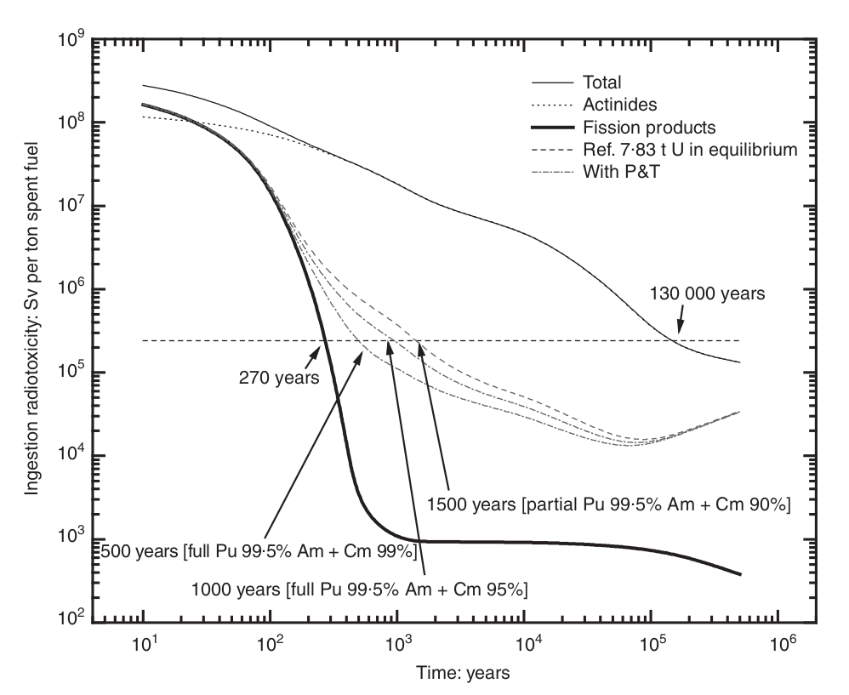

Slide 23
