Slide 1
Industrial Application of Accelerators
Demands of Accelerator Performance to Support Industrial X-Ray Imaging
Stephen Halliwell – VJ Group

Slide 2
Industrial X-Ray Imaging Evolution Timeline
1895: Wilhelm Conrad Röntgen discovered Bremsstrahlung Radiation
1896: Fluoroscope invented
Next 20 years: Development of high-vacuum x-ray tubes few hundreds kV
1928: Linear Accelerator development begins
Early 1930’s: American Society of Mechanical Engineers (ASME) approved X-ray techniques for pressure vessel weld inspection
1930’s: Development of Image Intensifier – Analog imaging
Early 1970s: Computed Tomography developed/demonstrated – Godfrey Hounsfield
1970’s: Digital Detector Line Array – Digital line-scan imaging
1990’s: Amorphous Silicon Panel – Digital Area array

Slide 3

“Fast Forward” to Today’s X-Ray Inspection Challenges
Aerospace and Additive Manufacturing
Safety critical parts, high value, very complex volumetric geometries
Increasing use of high density “exotic” materials in complex structures made possible by additive manufacturing techniques require high-energy x-ray to fully penetrate the object
High Performance, High-Energy CT
Enhanced Accelerator Performance Needed

Slide 4
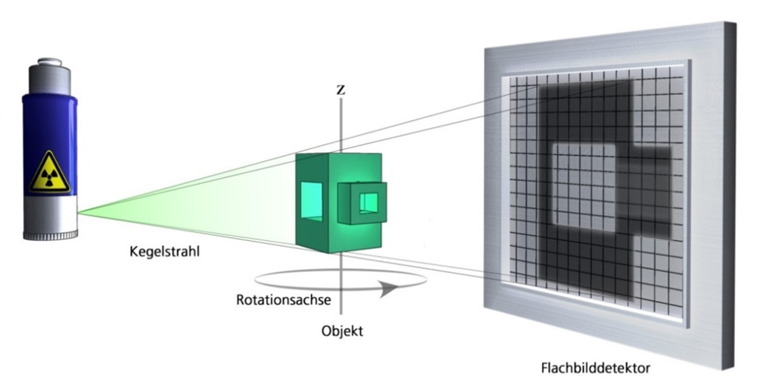
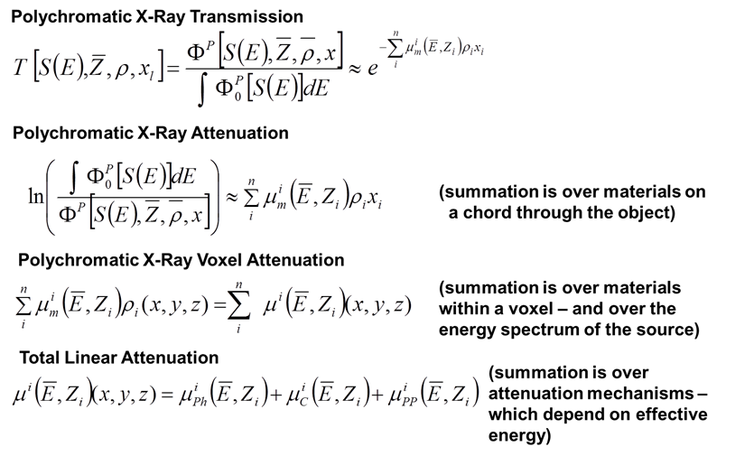
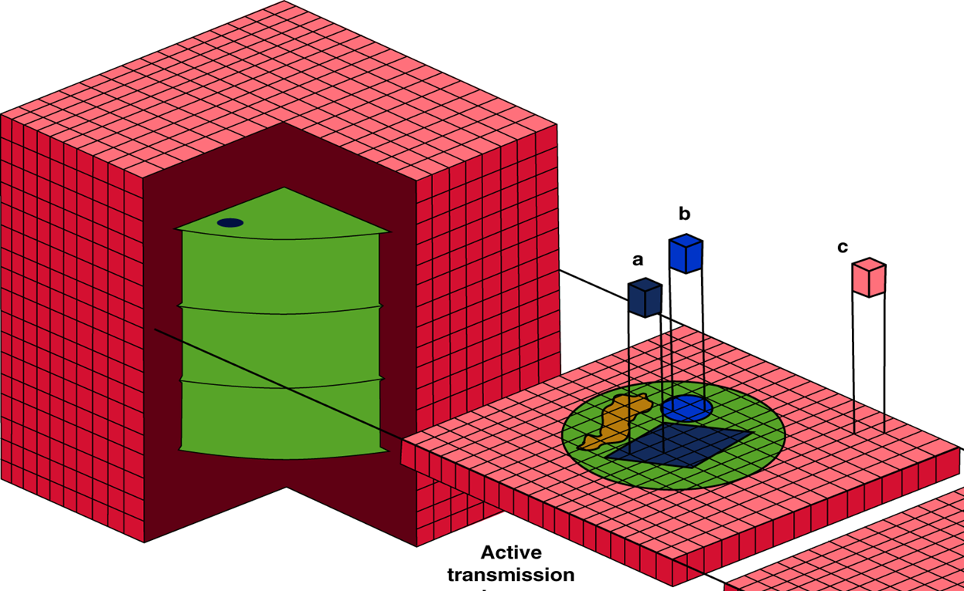
Computed Tomography (CT) - Most Demanding Requirements
High Resolution required
High Energy for full penetration of object required to avoid artifacts due to lack of data
High Fidelity CT requires 2,000 to 4,000 image projections = long scan times up to several hours

Slide 5
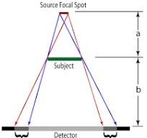
High Spatial Resolution is Required
X-Ray Imagers/Detectors – Large area 17”x17” with pixels typically ~150µm, but 100µm available
Standard Linear Accelerators have target/focal spot size ~2mm, some ~1mm
Projected Image has penumbra aka geometric unsharpness
Smaller the Target – Less the geometric unsharpness
Subject to Detector distance (b) determined by size of part
Source to Subject distance (a) determined by size of vault and power of source
Sweet spot is where geometric unsharpness and pixel size are about the same
Smaller the target/focal spot, higher the spatial resolution – 0.5mm or smaller desired
Ug = f.b/a

Slide 6
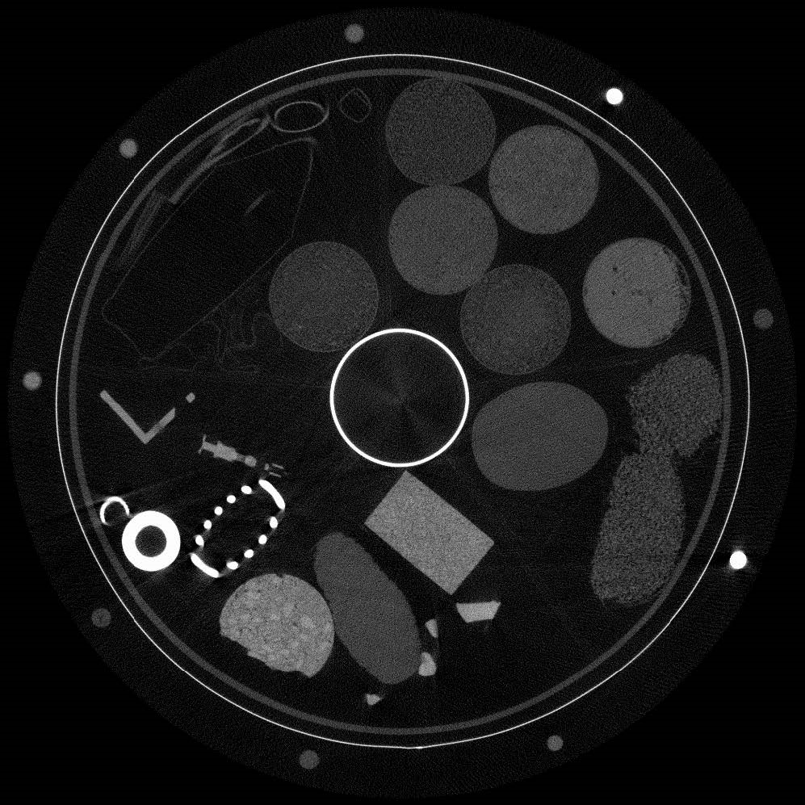
Why is High Energy Needed
Failure to fully penetrate the longest chords of a part being inspected results in artifacts, known as “Beam-Hardening” artifacts.
X-ray Energies of Several MeV is Required for Many Aerospace Parts
Cross-Sectional Slice with Beam Cross-Sectional Slice with
Hardening Artifacts Good Penetration

Slide 7
Lengthy Run Times Essential to Achieve High Fidelity CT
High Fidelity CT images require many image projections at small angles of rotation
Signal to noise is enhanced by averaging of many images at each angle of rotation
Diagram Illustrates Effect of Number of Scan Angles on Image Fidelity
Requirement for linear Accelerators Capable of Meeting Other Imaging Requirements and to Run for Days when required

Slide 8
Summary of X-Ray Imaging Demands of Accelerators
Industrial X-Ray Imaging Requires:
Smaller Targets/Focal Spots than currently available
But
Smaller Target must still run at High Energy and High Power
      And
Must run continuously for several hours and often for over a day or more for large object scanning
      And
With High Reliability and Availability

Slide 9
Thank You
Questions?

