Slide 1
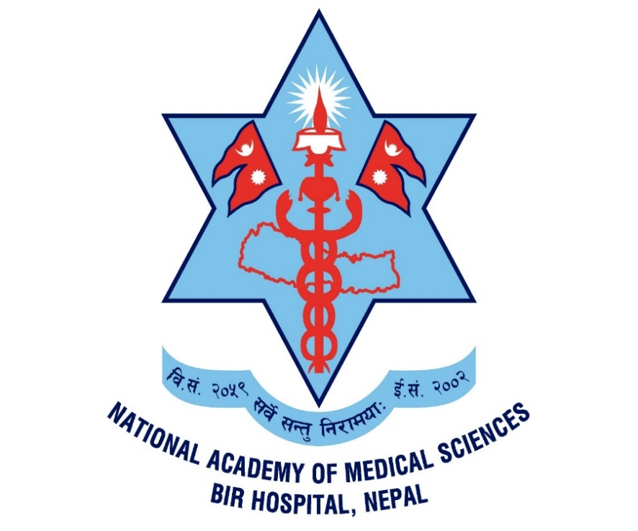
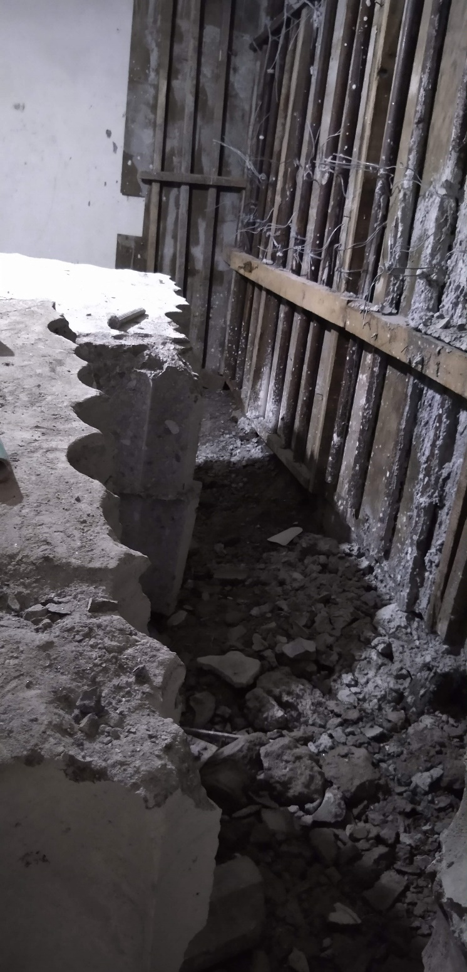
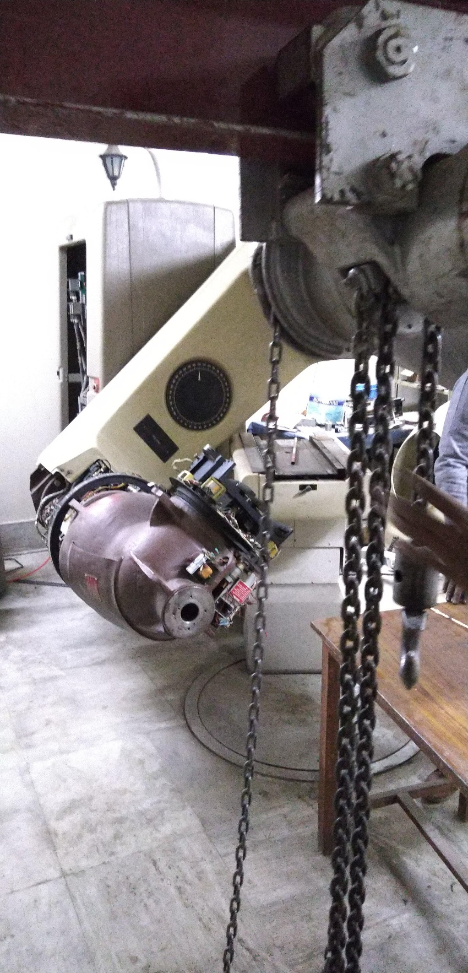
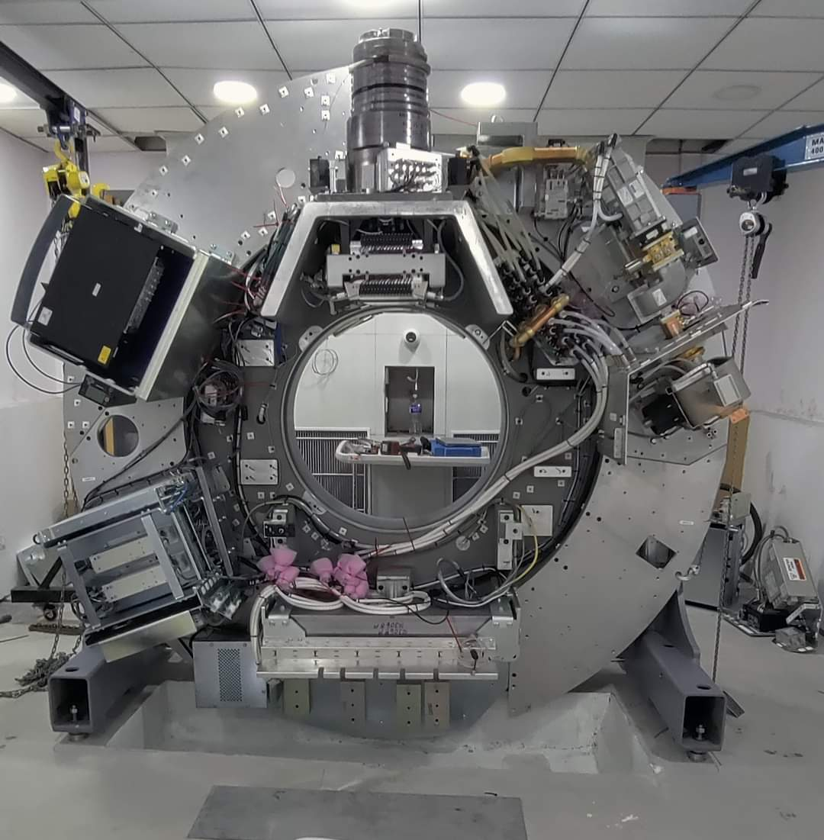
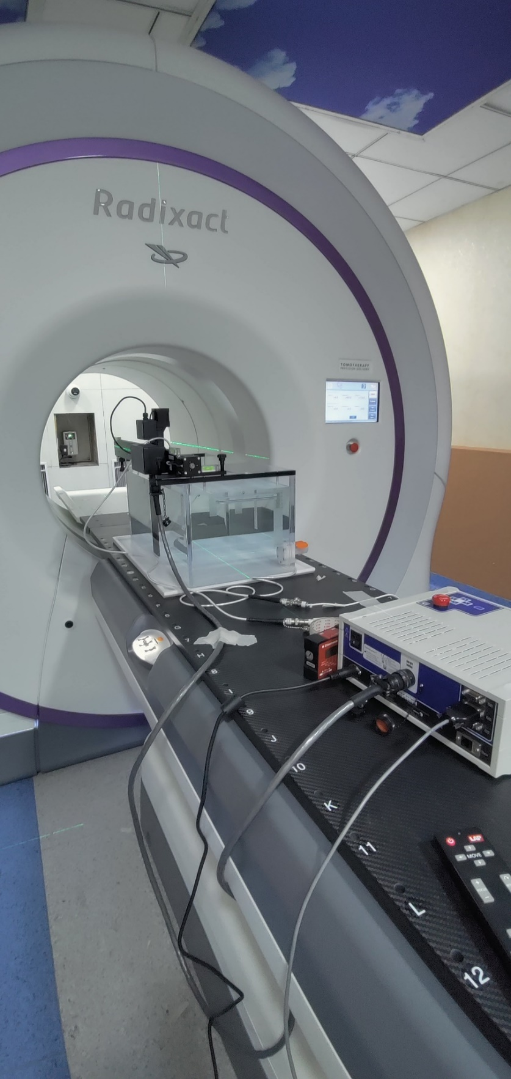
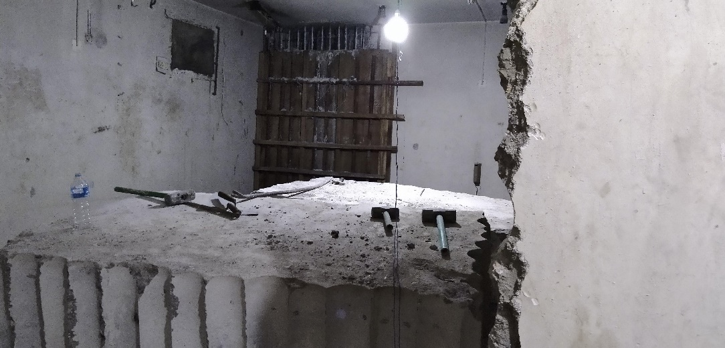
Challenges and Considerations in Transitioning from Cobalt-60 to Linear Accelerators for Radiotherapy in LMICs Healthcare Settings: A Case Study of Nepal
Kanchan P. Adhikari
National Academy of Medical Sciences, Bir Hospital, Kathmandu, Nepal
Abstract
Challenges
Lesson Learned
1. Infrastructure Challenges:
One of the primary hurdles in adopting linacs in LMICs countries is the lack of infrastructure. In Nepal, where the healthcare infrastructure is still evolving, there is a discernible need for substantial investments in facility upgrades. Initiatives to build and retrofit radiation therapy centers must be undertaken with careful planning and consideration of available resources. The retrofitting of the cobalt-60 bunker to accommodate the new 6 MV linac is imperative, necessitating additional shielding due to the existing cobalt-60 bunker. Similarly, a stable and high-voltage power supply was a requisite during this process.
2. Competent and Skilled Human resources:
Transitioning to new technology necessitates a skilled workforce capable of operating and maintaining highly sophisticated equipment. In Nepal, where specialized academic and training programs for medical physicists and radiation therapists is limited.
3. Regulatory Compliance:
The Radioactive Substances (Utilization and Regulation) Act of 2020 mandates the establishment of an independent regulatory authority, a requirement that Nepal has yet to fulfill with a competent and independent body.
4. Financial Implications:
The financial burden associated with the acquisition and maintenance of linear accelerators can pose significant challenges. The initial investment in procuring the equipment, combined with ongoing expenses for maintenance, training, and infrastructure development, can strain the limited budgets of underdeveloped healthcare systems. To address these financial challenges, innovative financing models and international collaborations, including partnerships with organizations like the International Atomic Energy Agency (IAEA), become essential..
Retrofitting the Cobalt-60 bunker for the 6 MV linac requires additional shielding and a stable power supply.
Collaboration with international institutions and online training can address the need for skilled human resources.
Quality assurance programs, equipment audits, and continuous education ensure patient safety during the transition.
Establishing an independent regulatory authority aligns with international standards.
Partnerships with organizations like the IAEA and US DOE ORS offer expertise and resources.
Decommissioning Co-60 involves complex paperwork and logistical challenges; cost-effective solutions supported by international collaborations can mitigate financial burdens.
Vigilant monitoring and strategic approaches are crucial for adapting to unforeseen circumstances during the implementation of advanced technologies.
For decades, Cobalt-60 machines have been the workhorses of radiotherapy in low- and middle-income countries (LMICs) like Nepal. Their affordability, relative ease of use, and lower maintenance needs made them the go-to technology for providing essential cancer treatment. In recent years, the field of medical physics has witnessed significant advancements in radiation therapy technology, with linear accelerator emerging as a preferred choice for delivering precise and targeted radiation doses. However, the transition from traditional cobalt-60 machines to linacs poses unique challenges, especially in underdeveloped healthcare settings like Nepal.
Conclusions/Discussion
Introduction
Transitioning from Cobalt-60 to linac in LMICs presents significant challenges but also unprecedented opportunities for enhancing cancer care. Addressing these challenges strategically enables LMICs to leverage the clinical advantages of linacs, improving radiotherapy services for millions of patients. Decisions to transition should be tailored to each healthcare setting's unique needs and resources, emphasizing a case-by-case approach. Vigilant monitoring, anticipating challenges, and adopting adaptable strategies are crucial for success. Sustainable financing models are essential for long-term operation and maintenance, recognizing the need for resilience in implementing advanced medical technologies. Nepal's efforts in addressing infrastructure, finances, workforce training, regulations, and community engagement can lead to successful integration of modern radiation therapy. International collaborations and knowledge-sharing initiatives are vital for ensuring equitable access to advanced cancer treatment in the region.
The transition from Co-60 to Linacs in LMICs is undeniably a formidable challenge, but also signifies an unparalleled opportunity to enhance cancer care. To address these challenges through a strategic and multidimensional approach empowers LMICs to overcome hurdles and capitalize on the clinical advantages of linac, ultimately delivering improved radiotherapy services. Nepal, by addressing infrastructure limitations, financial constraints, workforce training, regulatory compliance, & community engagement, can pave the way for a successful integration of modern radiation therapy technology. International collaborations, knowledge-sharing initiatives, and a steadfast commitment to improving healthcare infrastructure will play pivotal roles in ensuring equitable access to advanced cancer treatment in the region.
Acknowledgement:
I am very thankful to all the concerned staffs at NAMS, Bir Hospital & concerned ministries and international partners.
For Further Questions:
Dr. Kanchan P Adhikari, Associate Professor Medical Physics
National Academy of Medical Sciences, Bir Hospital, Kathamandu, NEPAL
kanchanadhikari@gmail.com / X- @K_Adhikari
Figure 1: Co-60 Bunker fortification for Lilacs and Decommission & Disposal of Co-60
Figure 2: Newly installed Radixact

