Slide 1
Isotope Harvesting at the Facility for Rare Isotope Beams
Greg Severin
AccelApp24

Slide 2
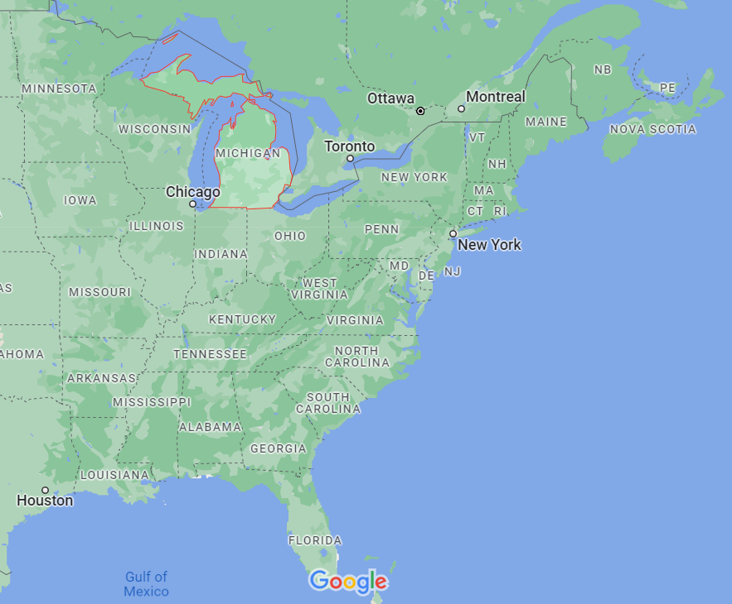

FRIB is a Nuclear Physics Laboratory at Michigan State University

Slide 3
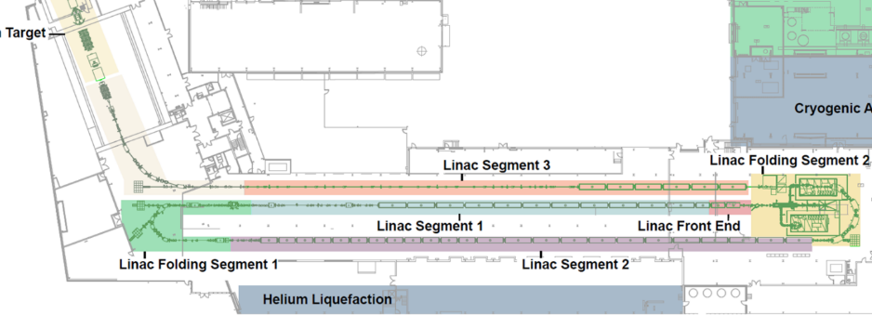
The Heart of FRIB is a Linear Heavy Ion Accelerator
For example:
⁴⁸Ca²⁰⁺ is accelerated to > 200 MeV/nucleon, 1-50 μA (up to 400kW)
The beam hits a thin target and creates fragmentation-product radionuclides inflight
The fragmentation products are steered to experimental stations downstream
Notes:
Updated w/ new version 3/3/2021 -- KZK
Updated to new version TG used in Tali deck 8/18/2020 – AZ
No updates 7/7/17 – CB
No changes 1/24/18 – CB

Slide 4
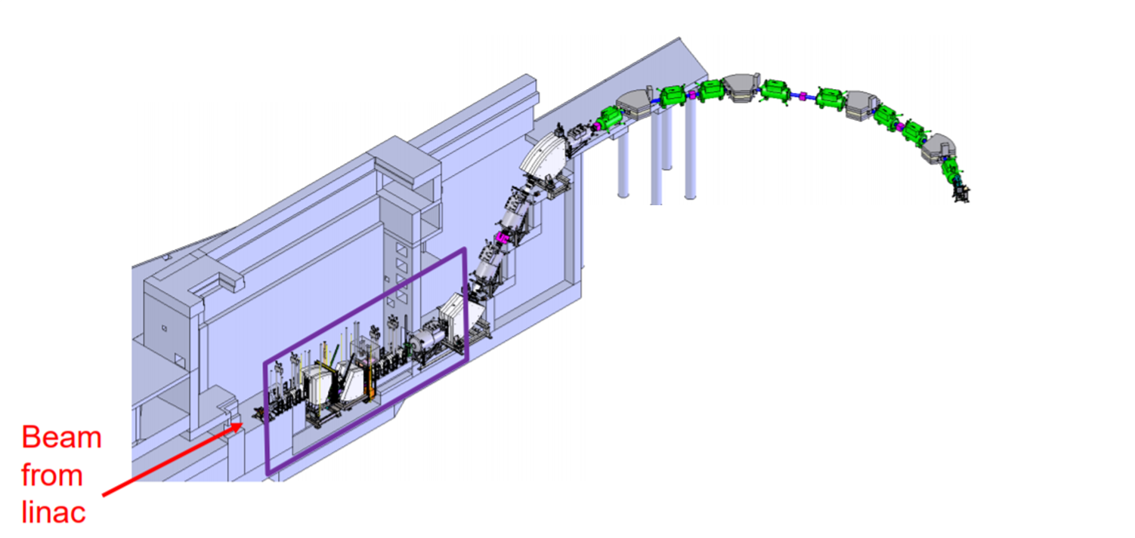
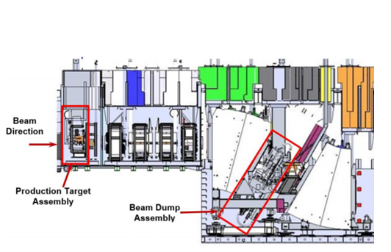
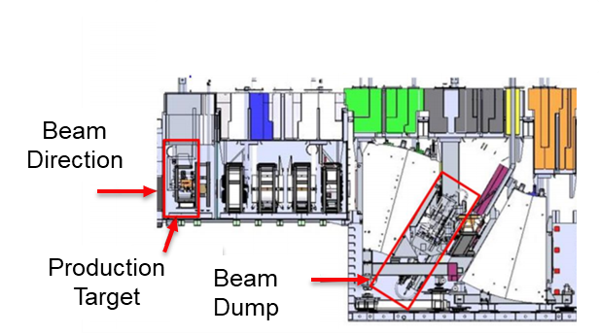
90% of the FRIB Beam is Dumped
Beam Direction
Production Target
Beam Dump
90% of Beam is dumped
Figure adapted from Dali Georgobiani, FRIB Radiation Studies, HPT Workshop, June 2018

Slide 5
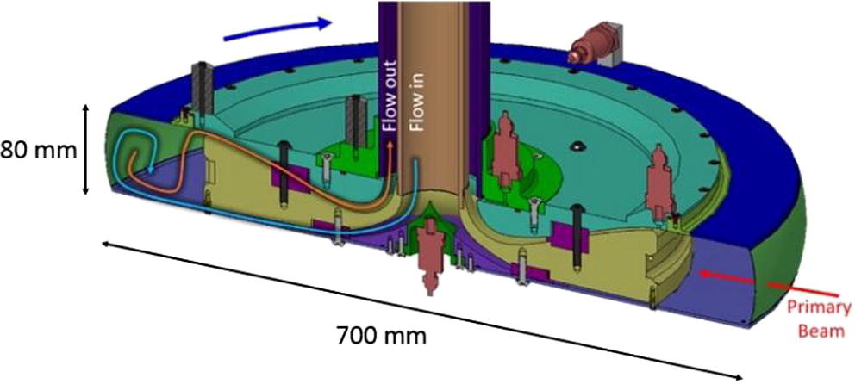
The FRIB water-filled beam dump
Primary Beam
For example ⁴⁸Ca²⁰⁺ @400kW (2x10¹⁴ pps)

Slide 6
Rare Isotope Production at NSCL/FRIB and Isotope Harvesting
Beam Dump
unused primary beam
secondary beam
Primary Beam

Slide 7
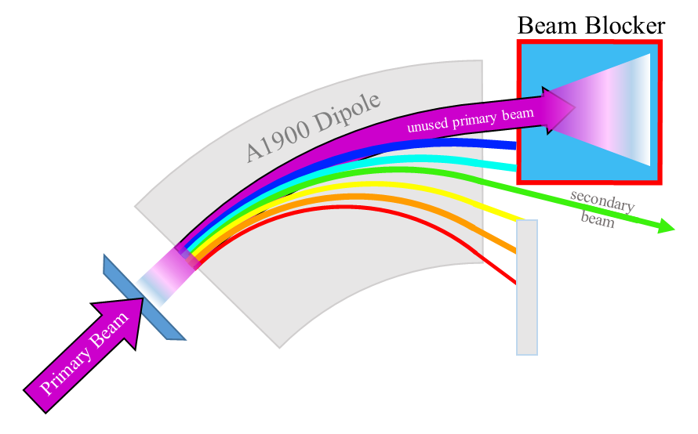
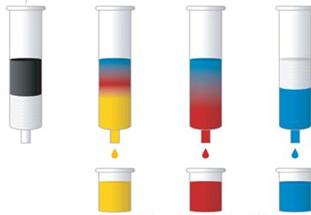
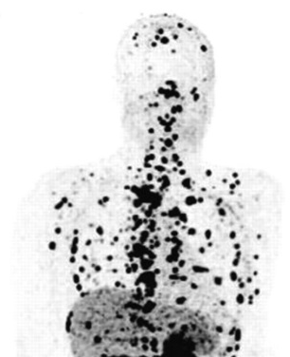
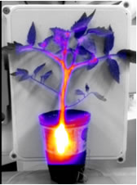
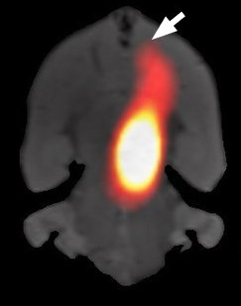
“Harvesting”
Harvesting

Slide 8
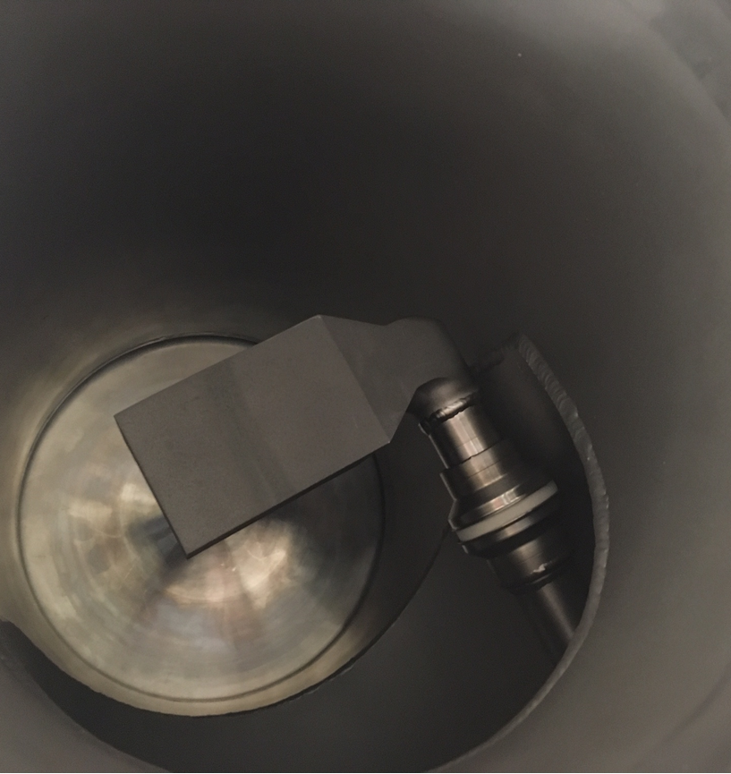
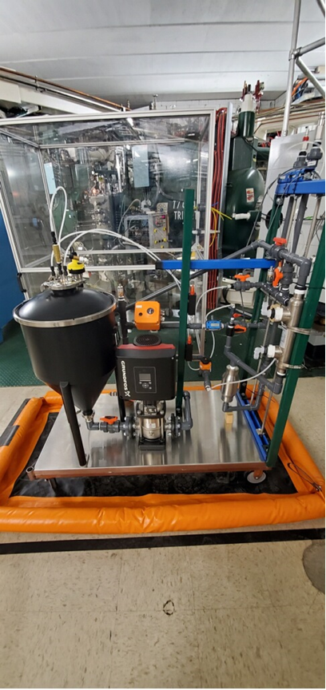
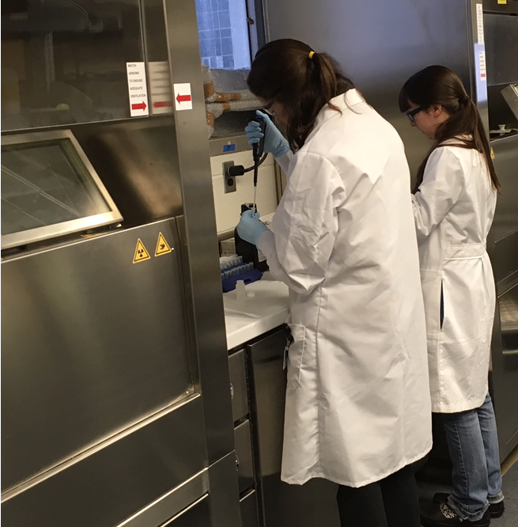
The Harvesting Process was Tested at “NSCL” (FRIB’s Predecessor)
Objective: Collect by-product radionuclides for use in off-line experiments.
Benefits: NSCL/FRIB produce a vast number of useful radionuclides. Harvesting will expand the user base and provide otherwise difficult-to-obtain radionuclides.
Heavy-ion beam reacts in beam dump
Cooling water
Return carries reaction products
Reaction products removed for chemical processing offsite

Slide 9
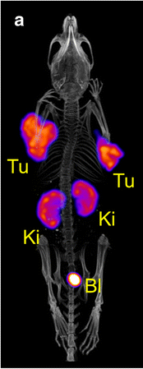
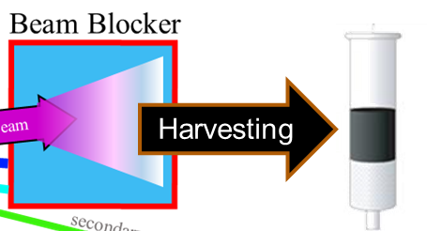
⁴⁷Sc can be Produced by Isotope Harvesting
Primary Beam: ⁴⁸Ca 4x10¹¹ /sec
→ ⁴⁷Ca 1x10¹⁰ /sec
  (2% conversion!)
we want ⁴⁷Ca as a generator for ⁴⁷Sc (to destroy tumors)
element | mass | Activity (mCi)
K | 43 | 8.820
Ca | 47 | 8.433
K | 42 | 5.645
Na | 24 | 1.794
Sc | 47 | 1.393
Be | 7 | 1.287
P | 32 | 1.139
Sc | 48 | 0.928
P | 33 | 0.629
Sc | 44 | 0.600
Sc | 44m | 0.566
Mg | 28 | 0.481
Ca | 45 | 0.157
Sc | 46 | 0.061
Si | 31 | 0.017
Sc | 43 | 0.012
S | 38 | 0.009
Na | 22 | 0.006
Ni | 57 | 0.004
V | 48 | 0.003
Cr | 51 | 0.002
Mn | 52 | 0.002
Collect for 1 day,
Decay for 1 day
⁴⁷Sc DOTANOC SPECT

Slide 10

Calcium-48 + Water Makes a Mess
Paige Abel
Nuclide | Percent Conversion | Projected Activity at NSCL (GBq)
 |  | After 5-day Irradiation | After 24-hour cool down
Na-24 | 0.084(2) | 0.378(7) | 0.125(2)
Mg-27 | 0.0311(8) | 0.140(3) | -
Mg-28 | 0.0187(7) | 0.082(3) | 0.037(1)
S-38 | 0.0129(8) | 0.058(3) | 1.7(1)E-4
Cl-34m | 0.00039(5) | 0.0177(6) | -
Cl-38 | 0.116(5) | 0.58(4) | -
Cl-39 | 0.066(2) | 0.297(9) | -
K-42 | 0.343(7) | 1.54(3) | 0.402(8)
K-43 | 0.422(3) | 1.85(1) | 0.878(6)
K-44 | 0.26(4) | 1.2(2) | -
K-45 | 0.16(1) | 0.74(5) | -
Ca-47 | 1.69(2) | 4.05(4) | 3.48(3)
Sc-44m | 0.482(8) | 0.164(2) | 0.124(2)
Sc-46 | 0.52(1) | 0.095(2) | 0.094(2)
Sc-47 | 0.41(2) | 3.2(3) | 3.5(4)
Sc-48 | 0.220(2) | 0.841(9) | 0.580(6)

Slide 11
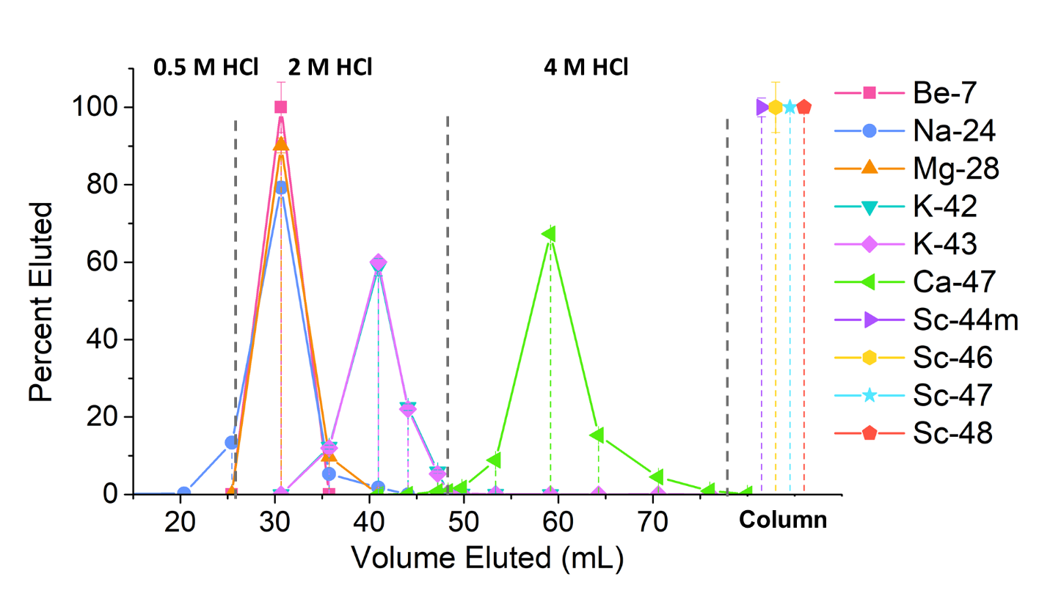
Calcium-48 Beam – Separation of ⁴⁷Ca on AGMP-50

Slide 12
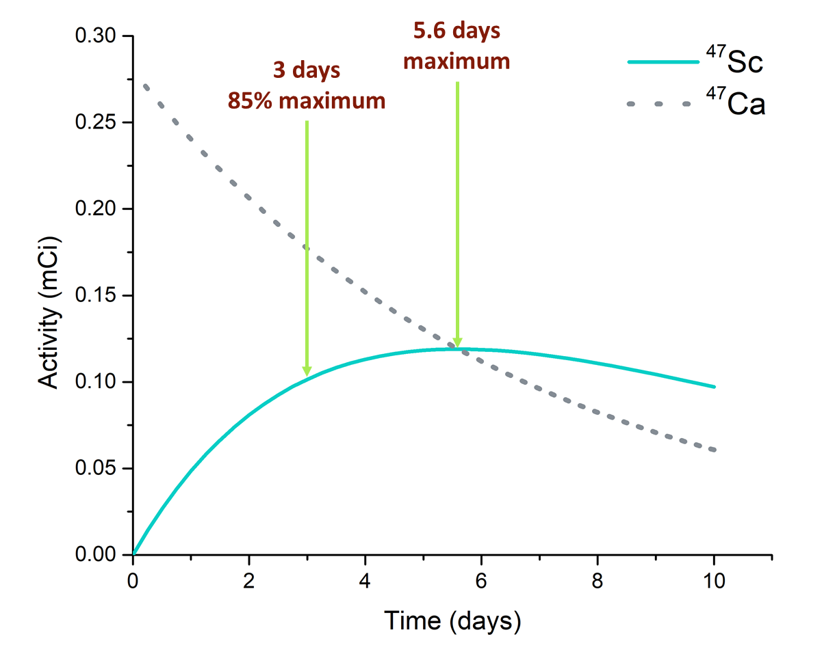
⁴⁷Ca Decays to Produce Clean ⁴⁷Sc

Slide 13
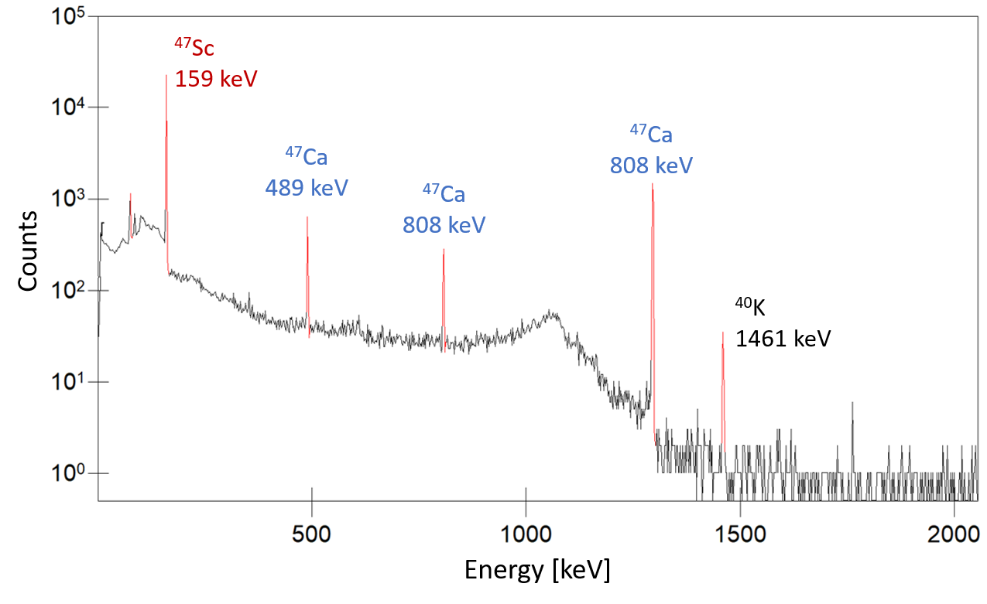
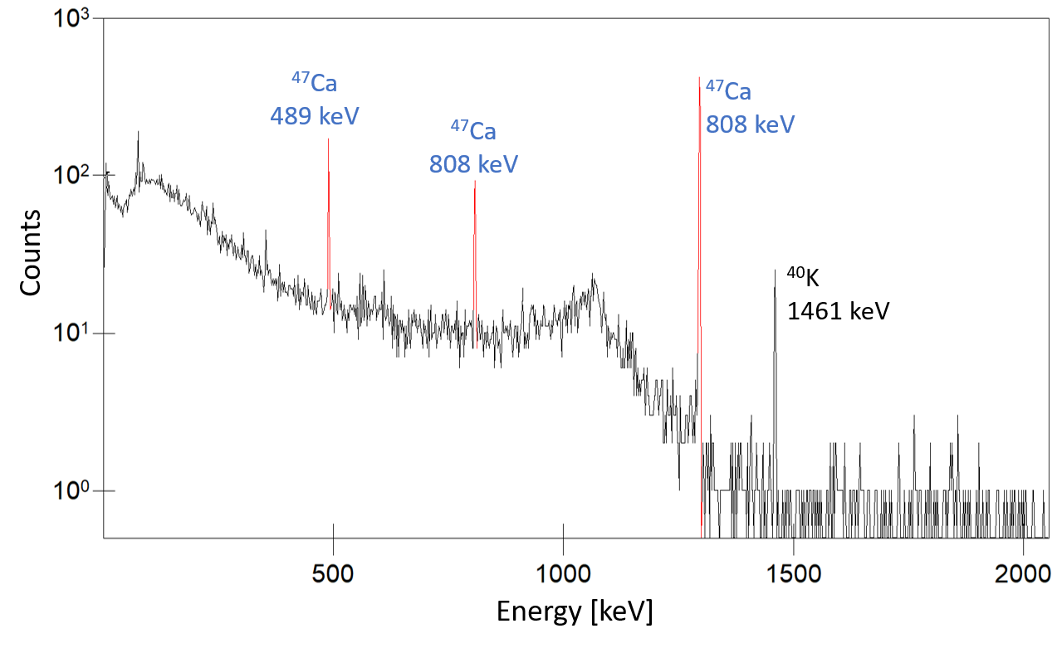
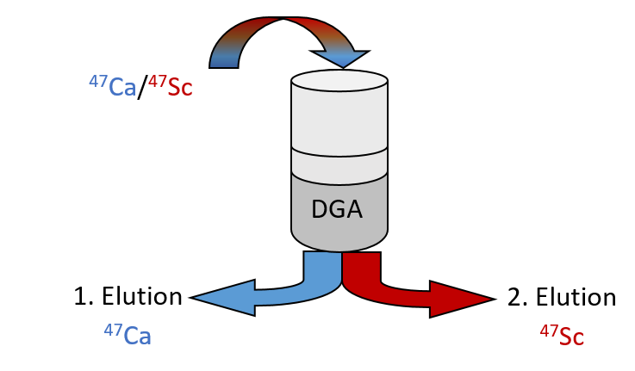
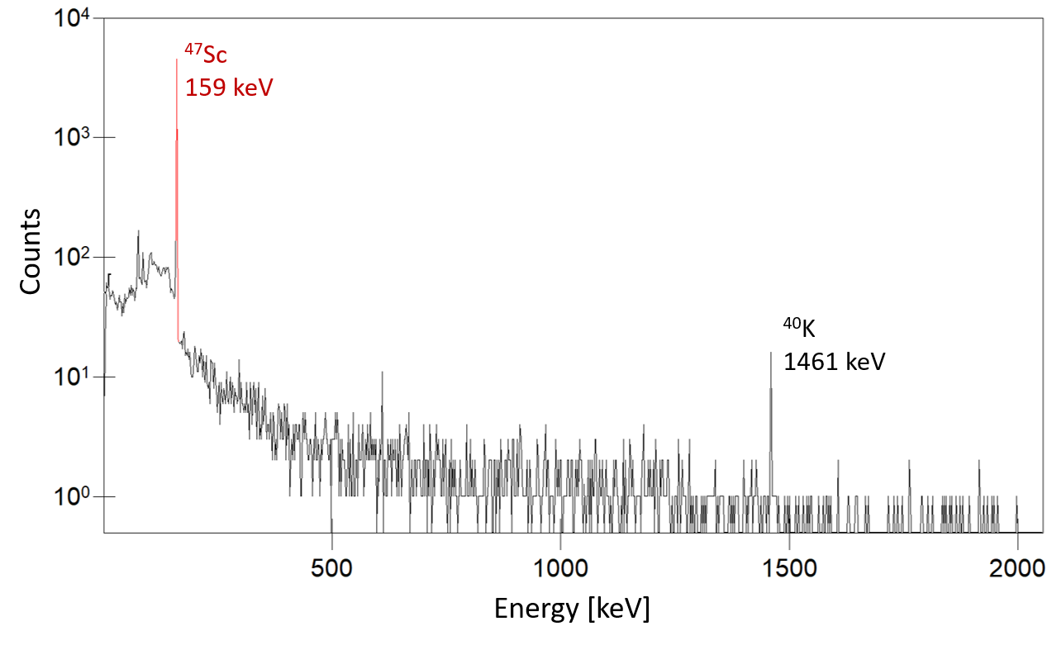
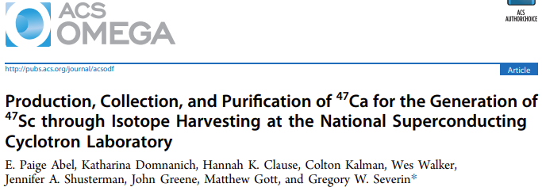
⁴⁷Ca/⁴⁷Sc on column
⁴⁷Ca-fraction
Pure ⁴⁷Sc-eluate

Slide 14
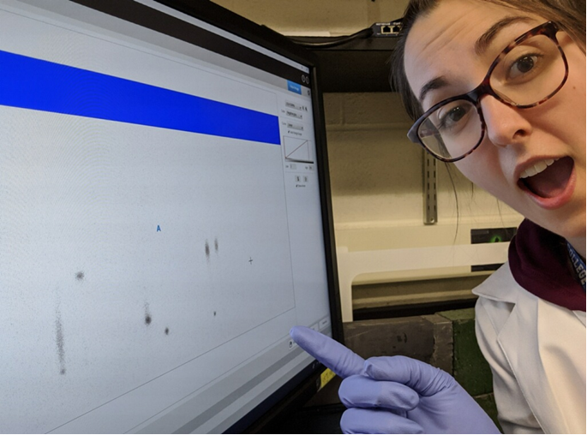

Harvested 47Sc is Used for Radiolabeling
⁴⁷Sc-DTPA-TOC

Slide 15
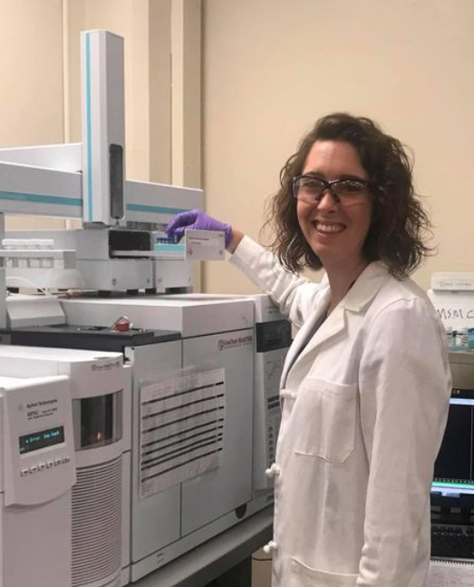
Krypton-78 Beam Creates New By-Products
 | t1/2 |  | uCi measured | uCi 1:1 | #per 78Kr
76Kr | 14.8 | h | 1.02E+02 | 5.83E+04 | 1.75E-03
76Br | 16.2 | h | 9.60E+01 | 5.40E+04 | 1.78E-03
77Br | 57.036 | h | 4.40E+01 | 1.68E+04 | 2.62E-03
73Se | 7.15 | h | 1.20E+02 | 1.05E+05 | 1.15E-03
66Ga | 9.304 | h | 5.12E+01 | 8.57E+04 | 5.97E-04
72As | 26 | h | 2.19E+01 | 3.53E+04 | 6.19E-04
69Ge | 39.05 | h | 1.59E+01 | 2.41E+04 | 6.59E-04
71As | 65.3 | h | 1.31E+01 | 1.47E+04 | 8.92E-04
75Br | 1.611 | h | 4.73E+02 | 2.33E+05 | 2.03E-03
77Kr | 74.4 | m | 1.08E+03 | 2.50E+05 | 4.32E-03
79 Kr | 35 | h | 1.50E+01 |  | 3.34E-04
7Be | 53.22 | d | 5.81E+00 | 7.77E+02 | 7.48E-03
67Ga | 3.2617 | d | 6.09E+00 | 1.24E+04 | 4.93E-04
24Na | 14.997 | h | 7.14E+00 | 5.77E+04 | 1.24E-04
61Co | 1.649 | h | 1.62E+02 | 2.32E+05 | 7.01E-04
62Zn | 9.186 | h | 7.61E+00 | 8.66E+04 | 8.78E-05
72Se | 8.4 | d | 2.62E+00 | 4.87E+03 | 5.38E-04
52Mn | 5.591 | d | 2.14E+00 | 7.28E+03 | 2.94E-04
61Cu | 3.339 | h | 1.77E+01 | 1.72E+05 | 1.03E-04
81Rb | 4.572 | h | 1.01E+01 | 1.43E+05 | 7.09E-05
83Sr | 32.41 | h | 2.03E+00 | 2.88E+04 | 7.06E-05
56Mn | 2.5789 | h | 8.64E+00 | 1.94E+05 | 4.45E-05
80Sr | 106.3 | m | 6.33E+00 | 2.26E+05 | 2.80E-05
47Sc | 3.3492 | d | 5.00E-02 | 1.20E+04 | 4.17E-06
70As | 52.6 | m | 1.83E+01 | 2.69E+05 | 6.82E-05
74mBr | 46 | m | 3.45E+01 | 2.76E+05 | 1.25E-04
63Zn | 38.47 | m | 2.19E+01 | 2.84E+05 | 7.71E-05
74Br | 25.4 | m | 3.49E+01 | 2.97E+05 | 1.18E-04
Hannah Clause

Slide 16
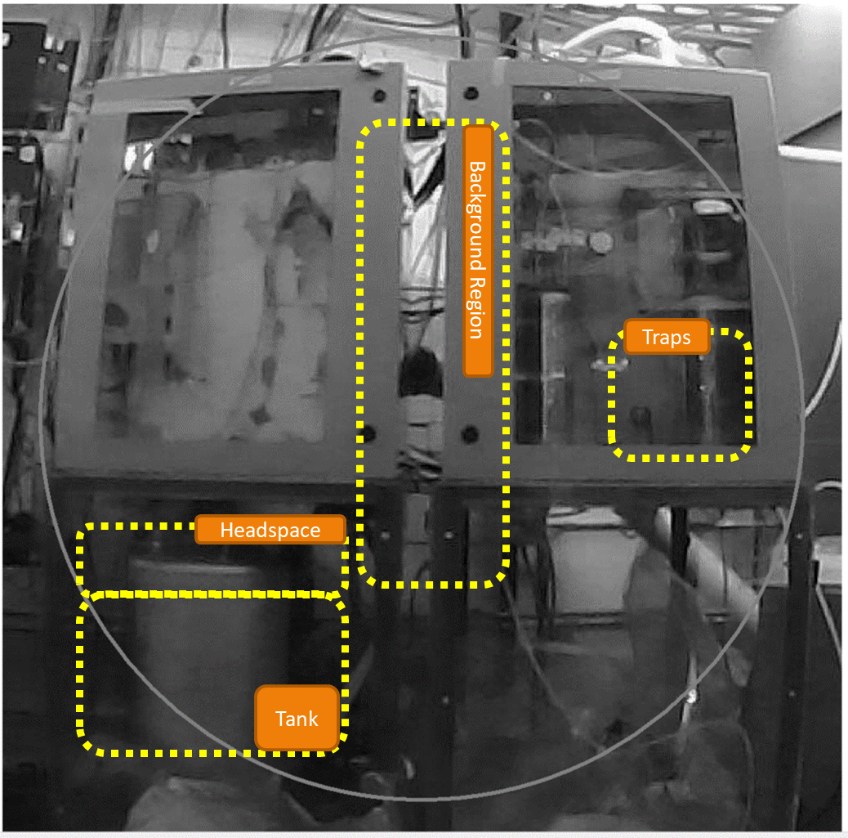
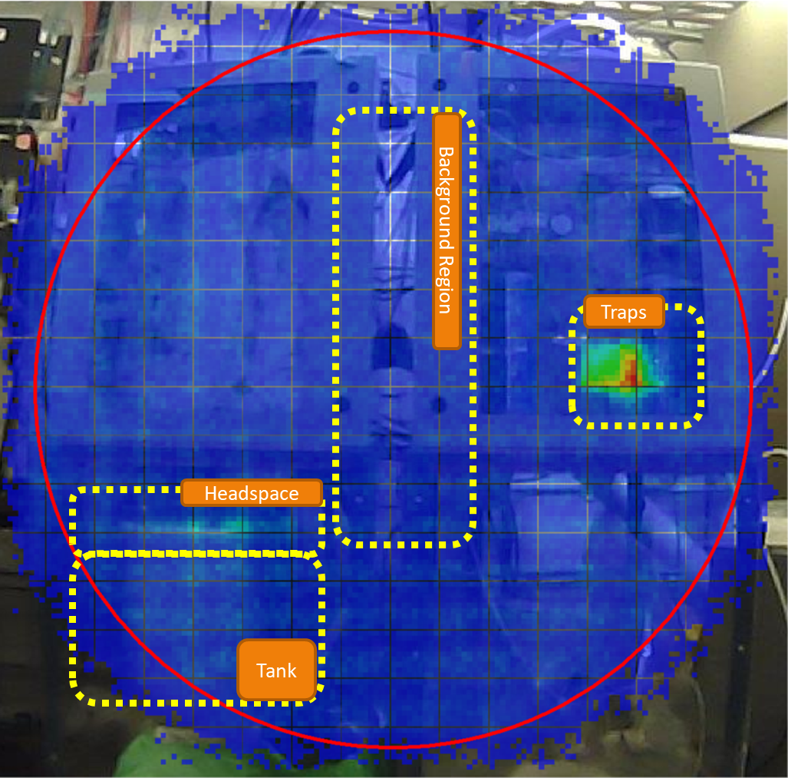
It is Possible to Harvest From the Gas Phase
HPGe pinhole radiograph showing the accumulation of ⁷⁷Kr in harvesting traps
Dr. Hannah Clause (Now Faculty at LSSU)

Slide 17
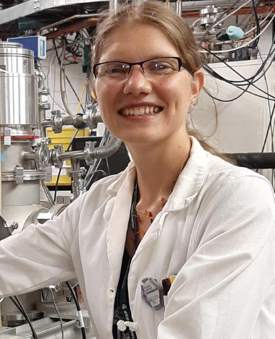
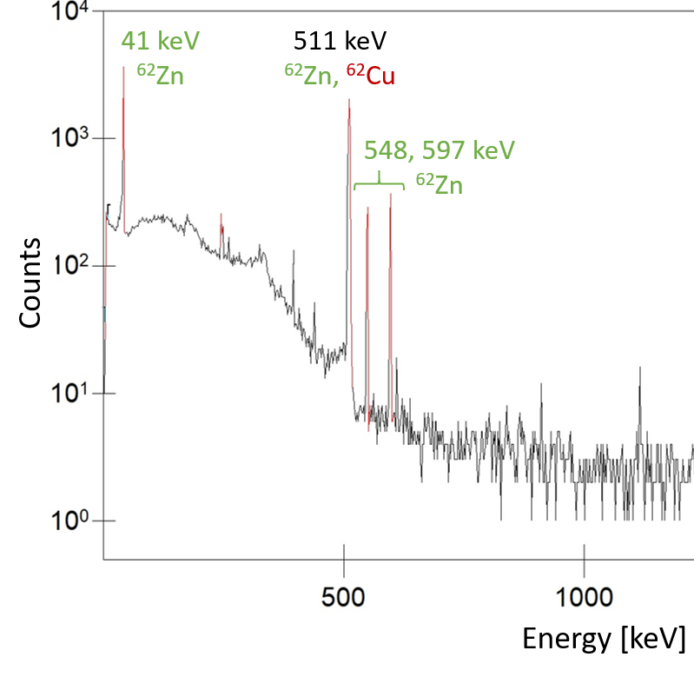
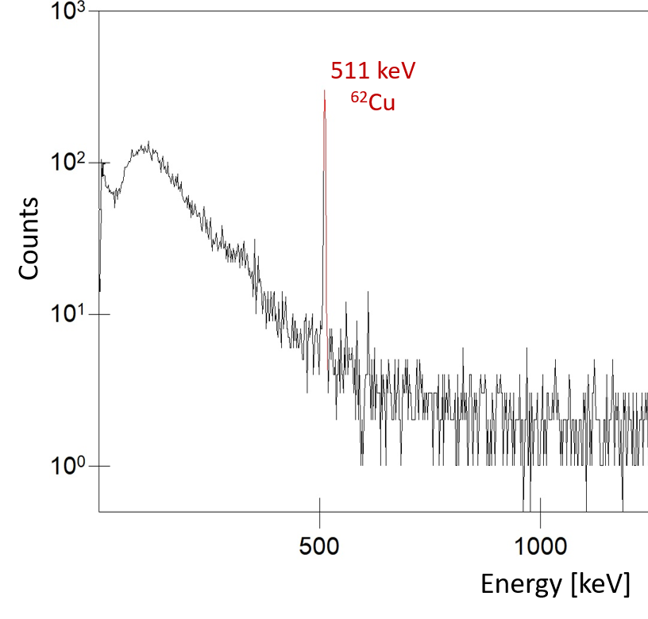
It is Possible Simultaneously Harvest Many Products
Pure ⁶²Zn/⁶²Cu was obtained at the same time as pure ⁷⁶Kr/⁷⁶Br (HPGe spectra)
⁶²Zn generates ⁶²Cu
Dr. Katharina Domnanich
⁷⁶Kr generates ⁷⁶Br
Dr. Hannah Clause

Slide 18
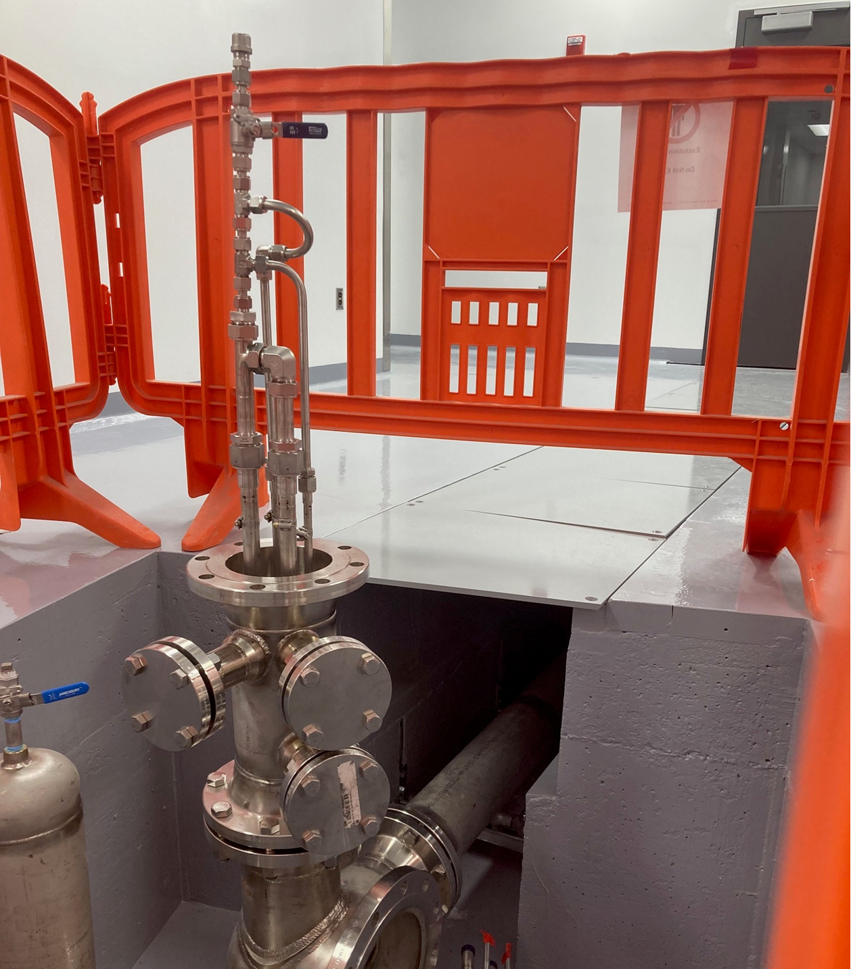
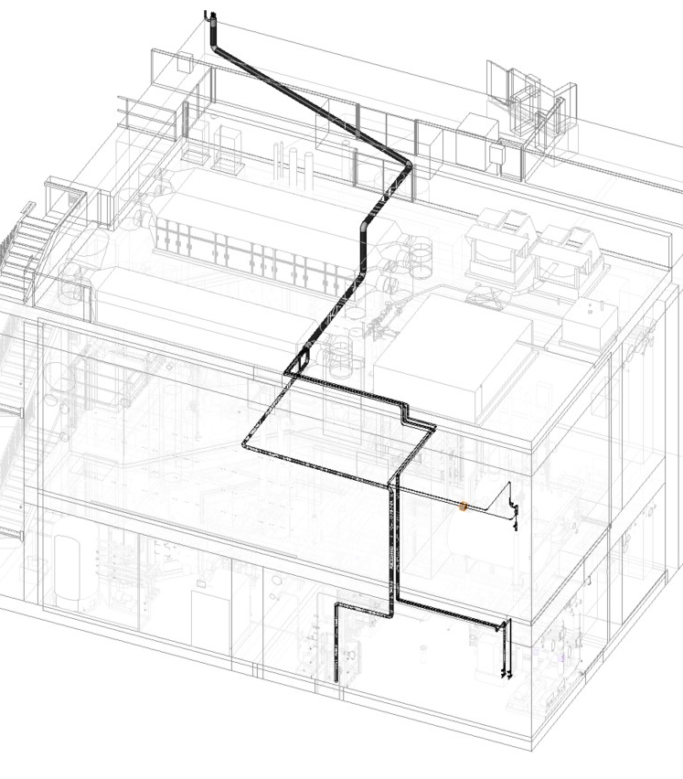
Piping for Accessing Radioisotopes is Installed

Slide 19
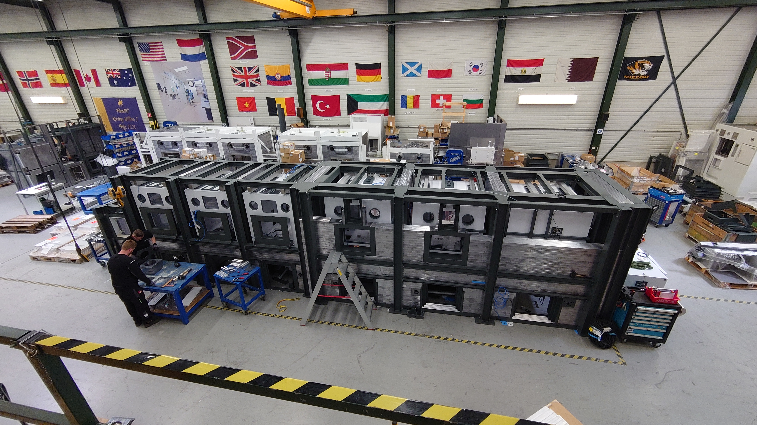
Hot Cell Construction in Netherlands[1]

Slide 20
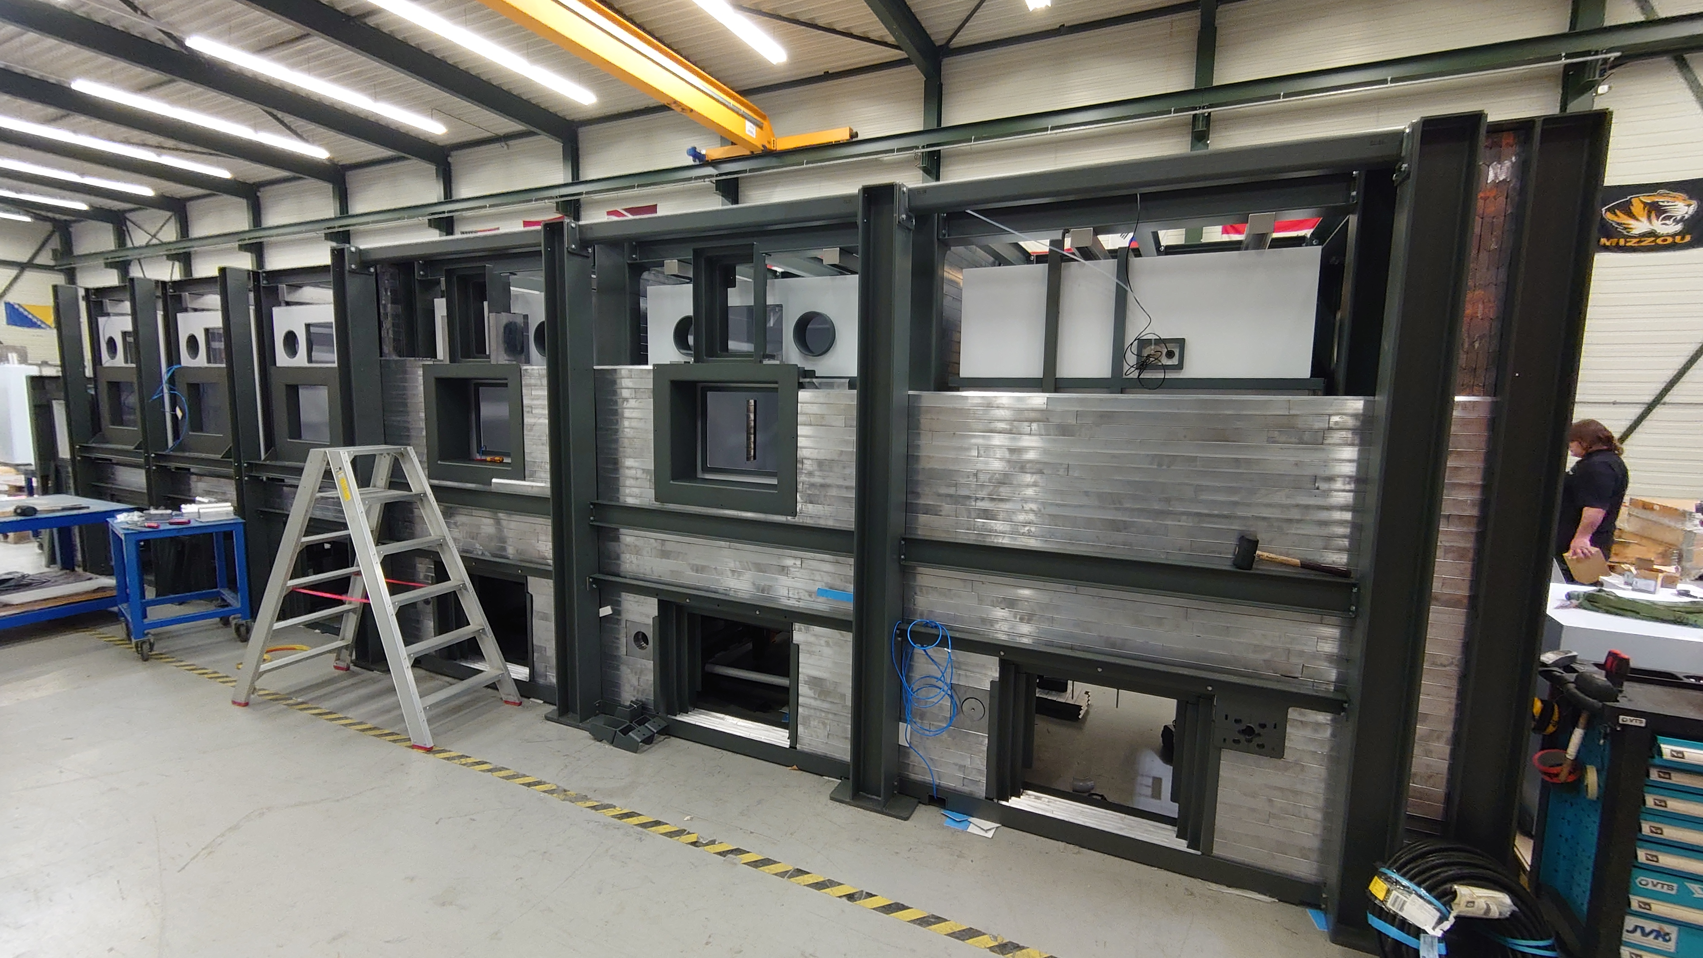
Hot Cell Construction in Netherlands[2]

Slide 21
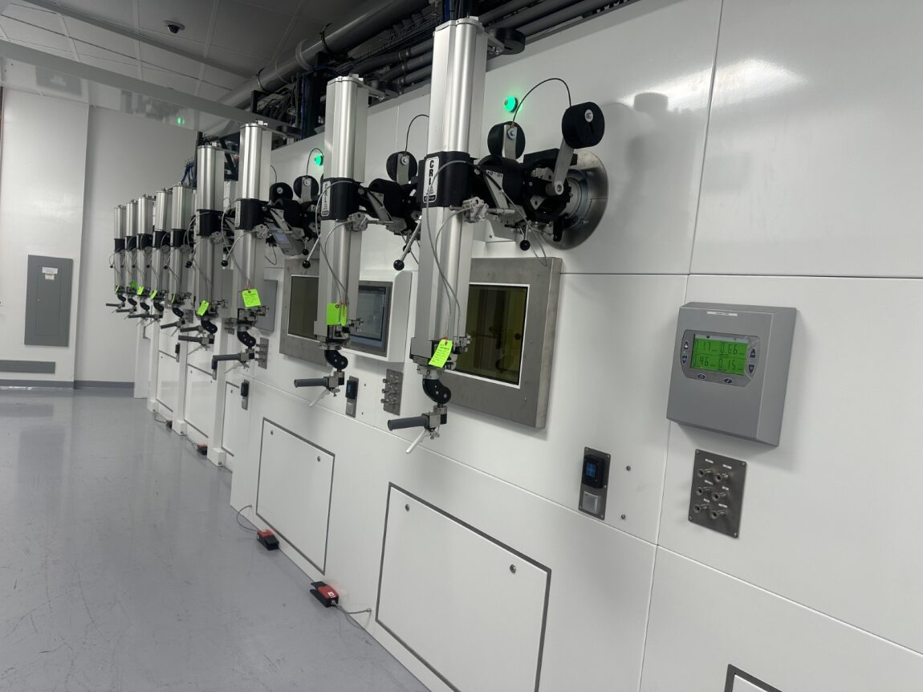
Hot Cells Installed at MSU [1]

Slide 22
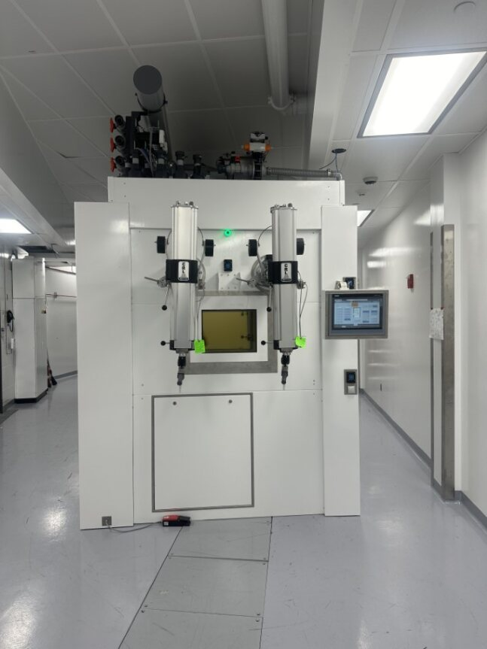
Hot Cells Installed at MSU [2]

Slide 23
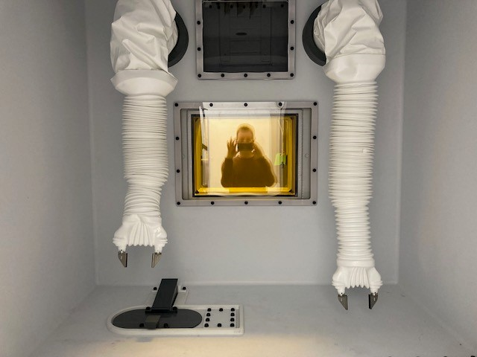
Hot Cells Installed at MSU [3]

Slide 24
Schedule
Hot cell Site Acceptance Test TODAY!
Final connection to FRIB beam dump loop Summer 24
Aiming for first test batches late CY24
  Likely ⁴⁷Ca/⁴⁷Sc will be our first product

Slide 25
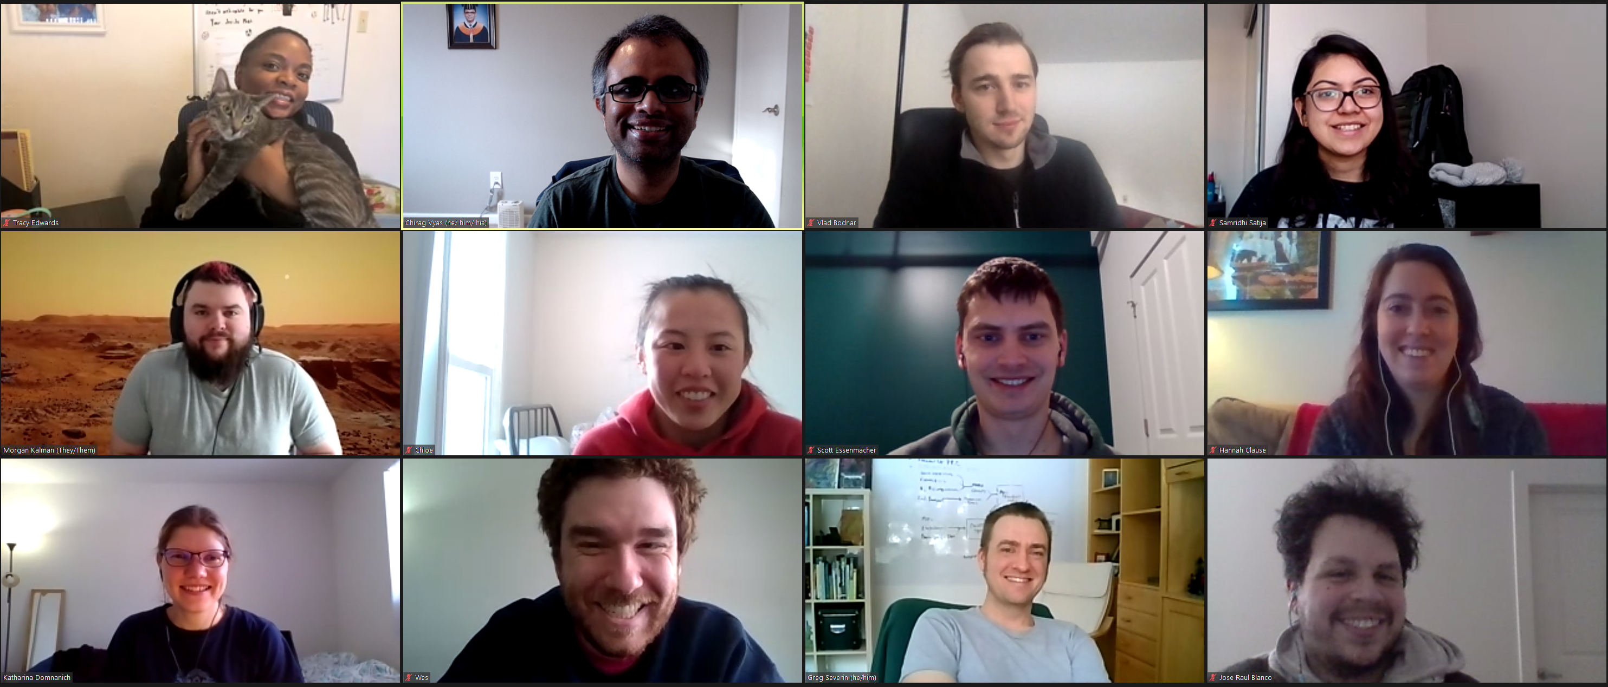


Acknowledgements
Tracy
Chirag
Vlad
Samridhi
Morgan
Scott
Chloe
Hannah
Kathi
Jose
Wes
Greg

