Slide 1
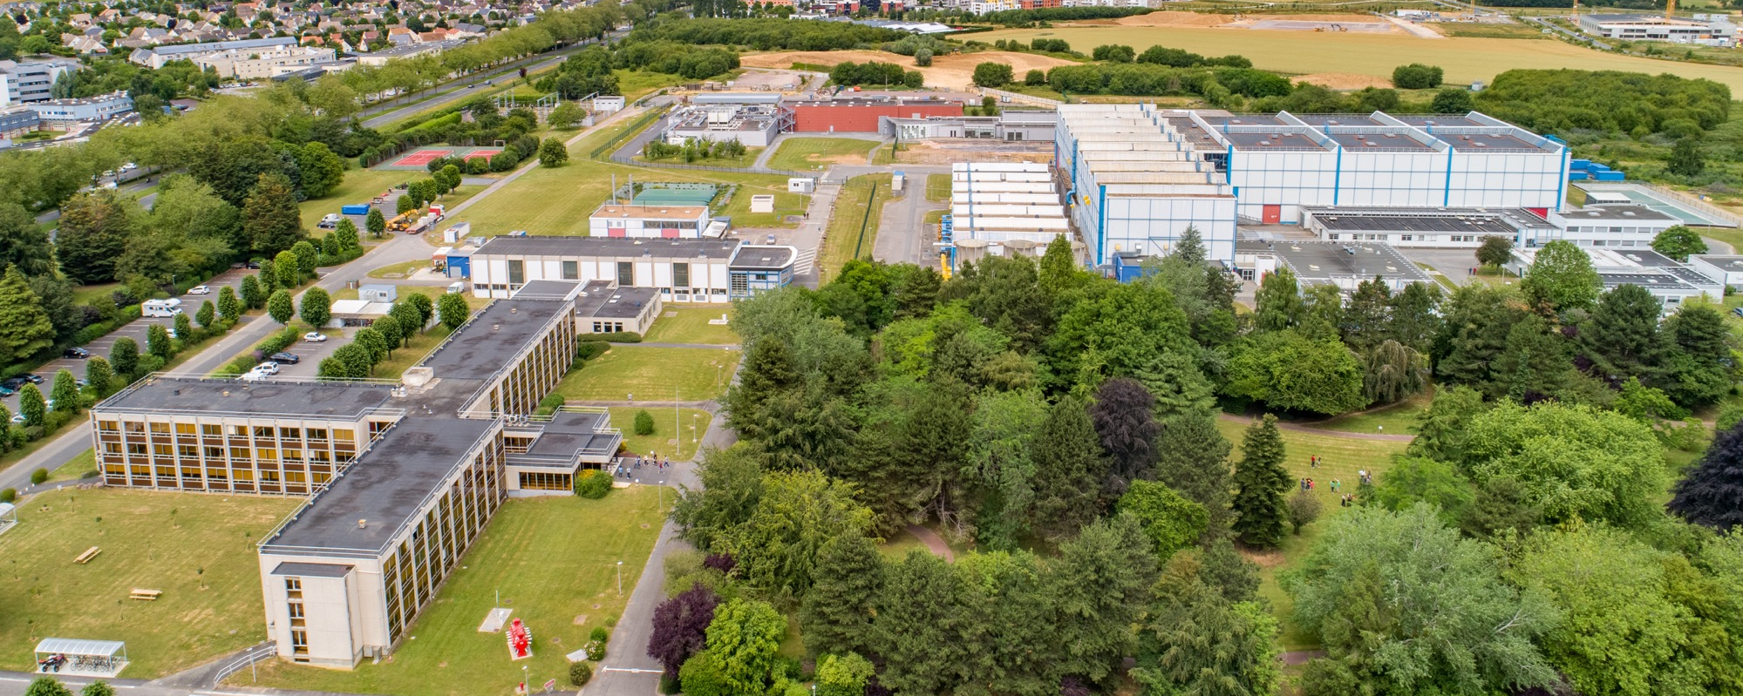


Applications of GANIL Research Activities and Techniques
Fanny Farget,
Patricia Roussel-Chomaz, Eloïse Dessay, Gilles De France, Anne-Marie Frelin,
Diego Ramos, Antoine Lemasson, Xavier Ledoux, Diane Doré
François Chevalier, Clara Grygiel, Stéphane Guillous, Isabelle Monnet, Yvette Ngono

Slide 2
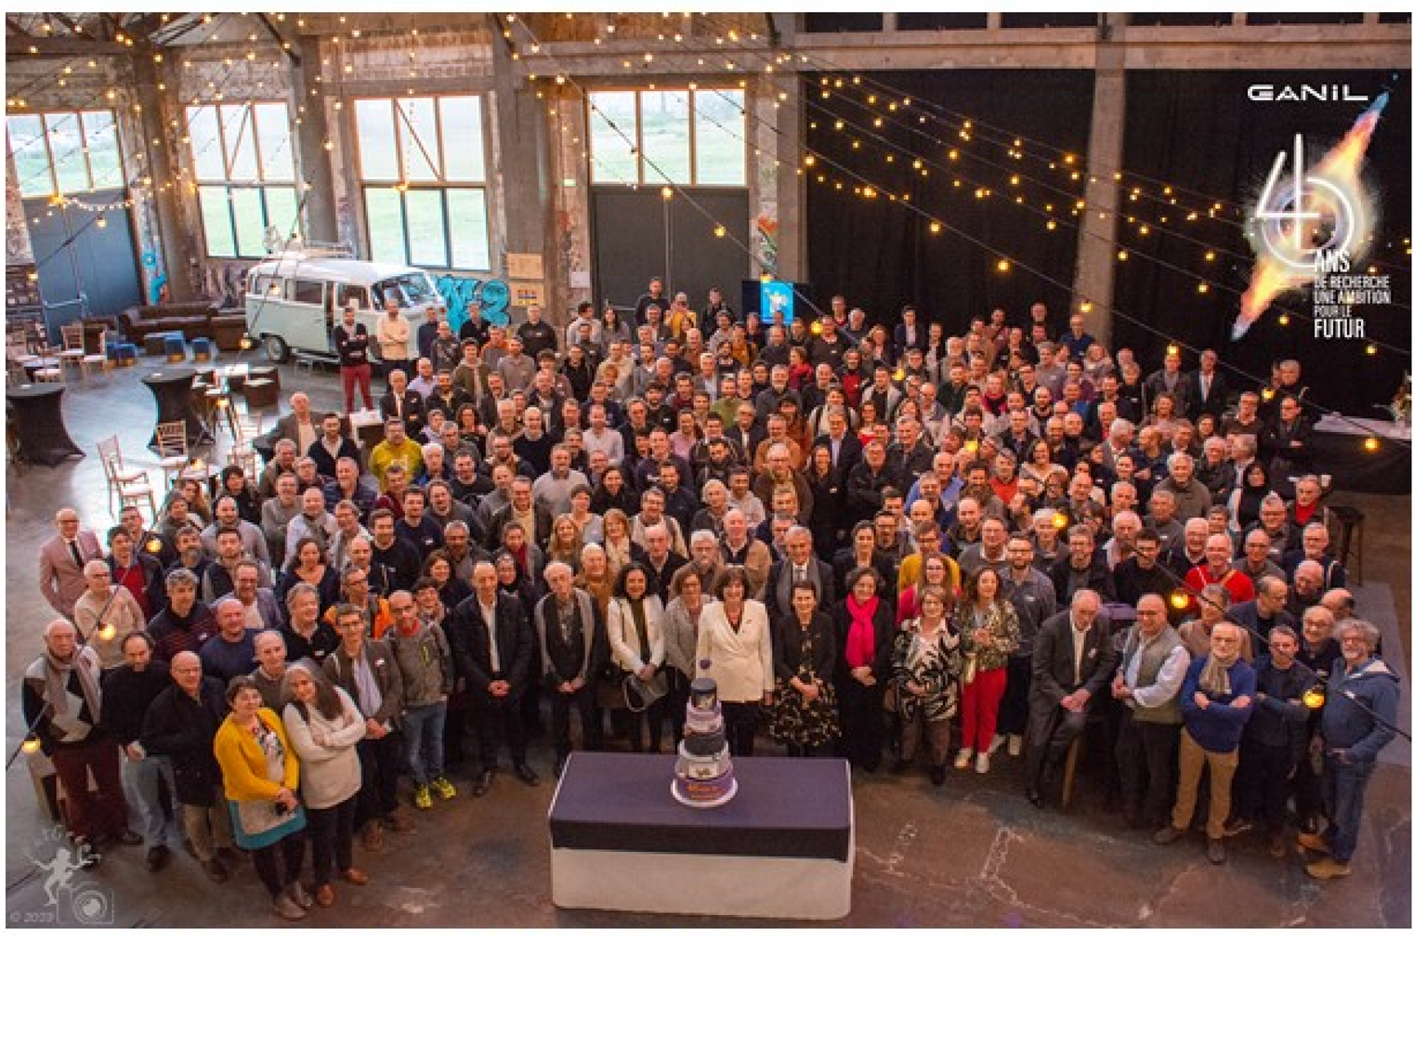
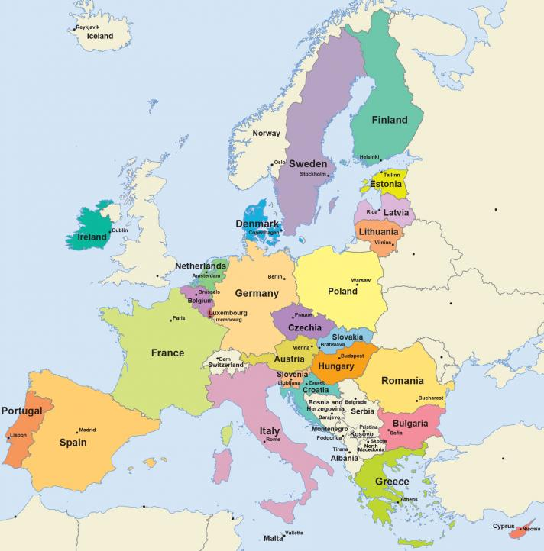
40th anniversary of first GANIL experiment
1983-2023

Slide 3
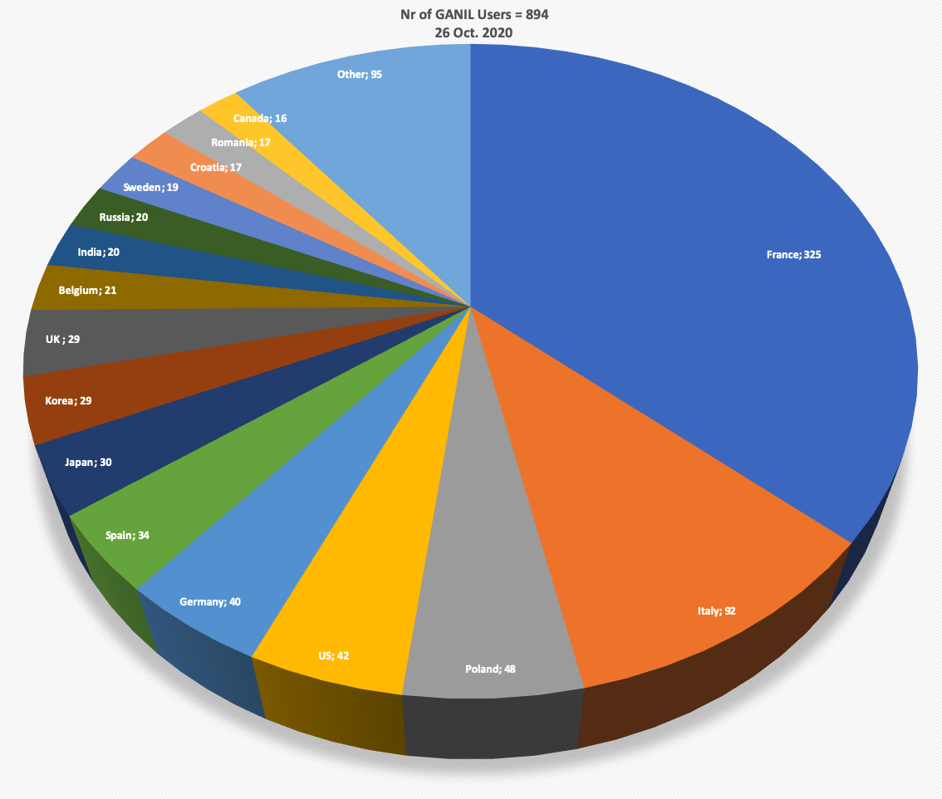
Some numbers
230 permanent staff members from CNRS and CEA :
engineers, technicians and 28 researchers
70 temporary staff (20 PhD, 11 postdocs)
CIMAP : (CIRIL Platform)
24 permanent staff + 15 PhD + 8 postdocs
An international scientific community of ≈ 1000 members
More than 85 PhD based on GANIL experiments and R&D
France
Italie
Pologne
USA
Allemagne
Espagne
Japon
Corée
Royaume Uni
Belgique
Inde
Russie
Suède
Roumanie
Canada

Slide 4
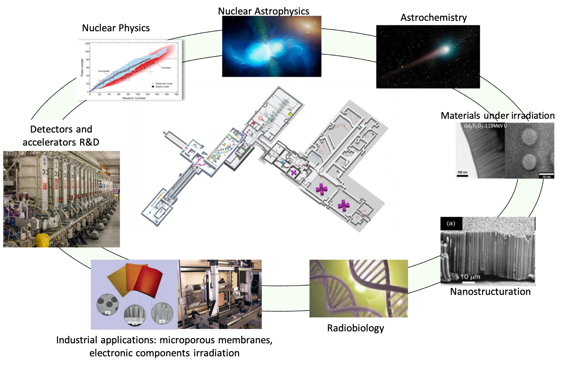
GANIL : a multi-disciplinary facility

Slide 5
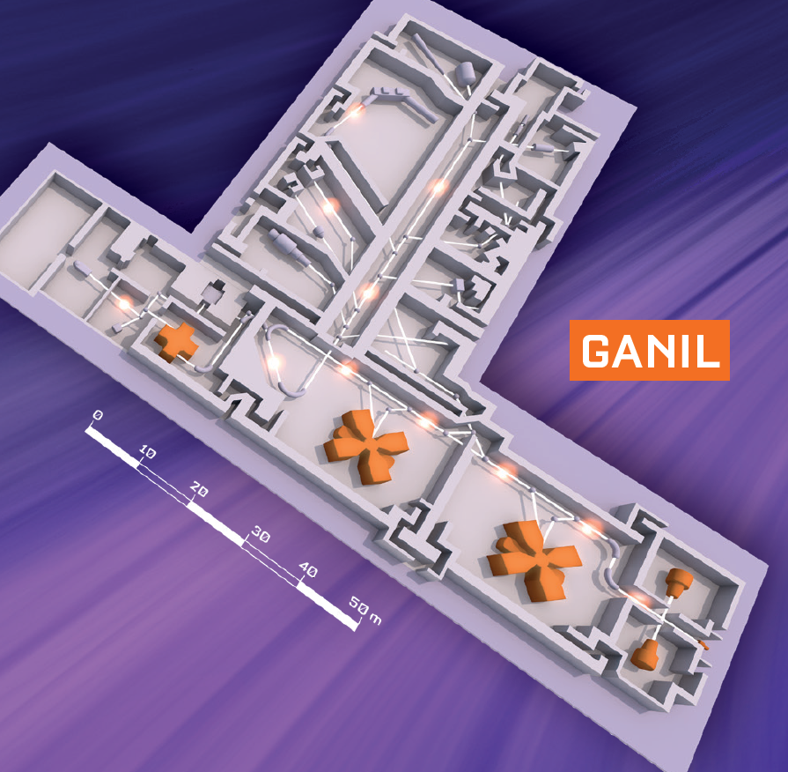
GANIL : a multi-user facility with parallel beams
12C to 238U
5 A.MeV to 95 A.MeV
1983
Notes:
ARIBE : avantage = ions plus légers 15 qkeV

Slide 6
GANIL : a multi-user facility with parallel beams
12C to 238U
5 A.MeV to 95 A.MeV
1989
1983
Notes:
ARIBE : avantage = ions plus légers 15 qkeV

Slide 7
GANIL : a multi-user facility with parallel beams
Fragmentation
ISOL exotic beams
2001
SPIRAL1
12C to 238U
1 A.MeV to 95 A.MeV
1983
Notes:
ARIBE : avantage = ions plus légers 15 qkeV

Slide 8
GANIL : a multi-user facility with parallel beams
12C to 238U
5 A.MeV to 95 A.MeV
1983
IRRSUD
2004
12C to 238U
1 A.MeV
Notes:
ARIBE : avantage = ions plus légers 15 qkeV

Slide 9
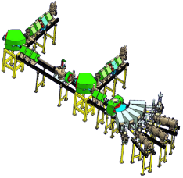
GANIL : a multi-user facility with parallel beams
12C to 238U
5 A.MeV to 95 A.MeV
1983
IRRSUD
X
ARIBE, 2005
2004
12C to 238U
1 A.MeV
Lighter ions
25 qAkeV
Notes:
ARIBE : avantage = ions plus légers 15 qkeV

Slide 10
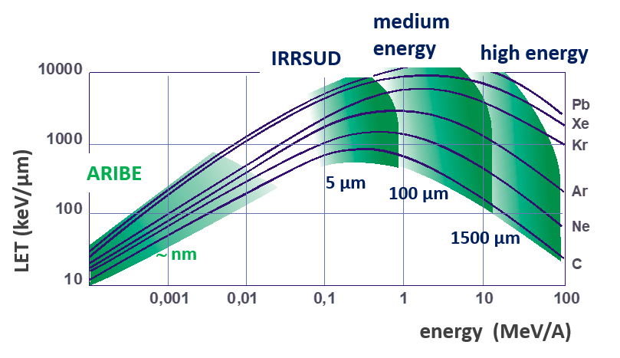
GANIL : a multi-user facility with parallel beams
12C to 238U
5 A.MeV to 95 A.MeV
1983
A broad range of ion species and energies
IRRSUD
X
ARIBE, 2005
2004
12C to 238U
1 A.MeV
Lighter ions
25 qAkeV
Notes:
ARIBE : avantage = ions plus légers 15 qkeV

Slide 11
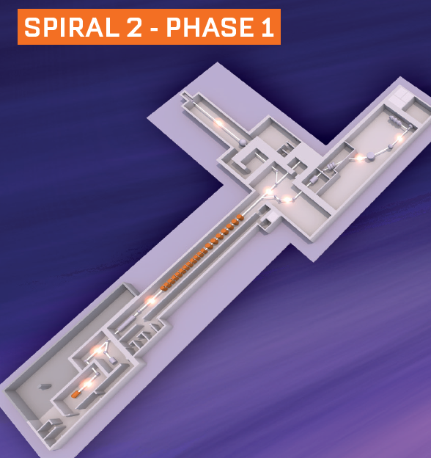
GANIL : a multi-user facility with parallel beams
2019
X
Notes:
ARIBE : avantage = ions plus légers 15 qkeV

Slide 12
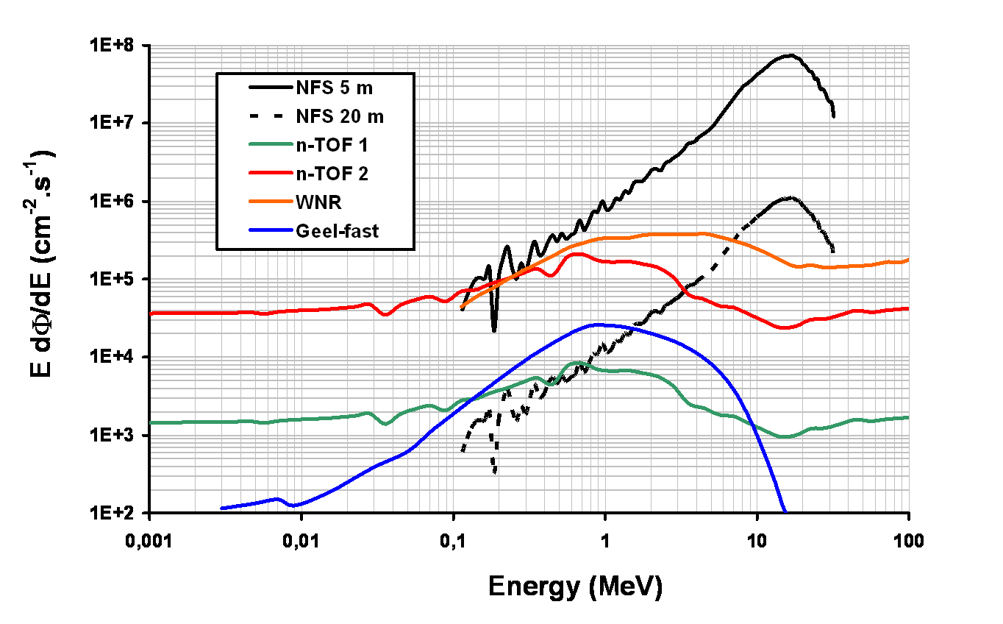
GANIL : a multi-user facility with parallel beams
2021
NFS
2019
X
Notes:
ARIBE : avantage = ions plus légers 15 qkeV

Slide 13
GANIL : a multi-user facility with parallel beams
S³
2025
X
Notes:
ARIBE : avantage = ions plus légers 15 qkeV

Slide 14
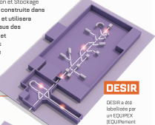
GANIL : a multi-user facility with parallel beams
2027
SPIRAL1
S³
2025
X
Notes:
ARIBE : avantage = ions plus légers 15 qkeV

Slide 15
Applications @ GANIL
Spatial application
Radioisotopes
Nuclear data
Nuclear data
Spatial application
Radiobiology, hadrontherapy, dosimetry
Material Science, Nanostructuration
X
ASTROCHEMISTRY Material Science, Nanostructuration
ASTROCHEMISTRY
Material Science, Nanostructuration

Slide 16
Applications @ GANIL
Radioisotopes
Radiobiology, hadrontherapy, dosimetry

Slide 17
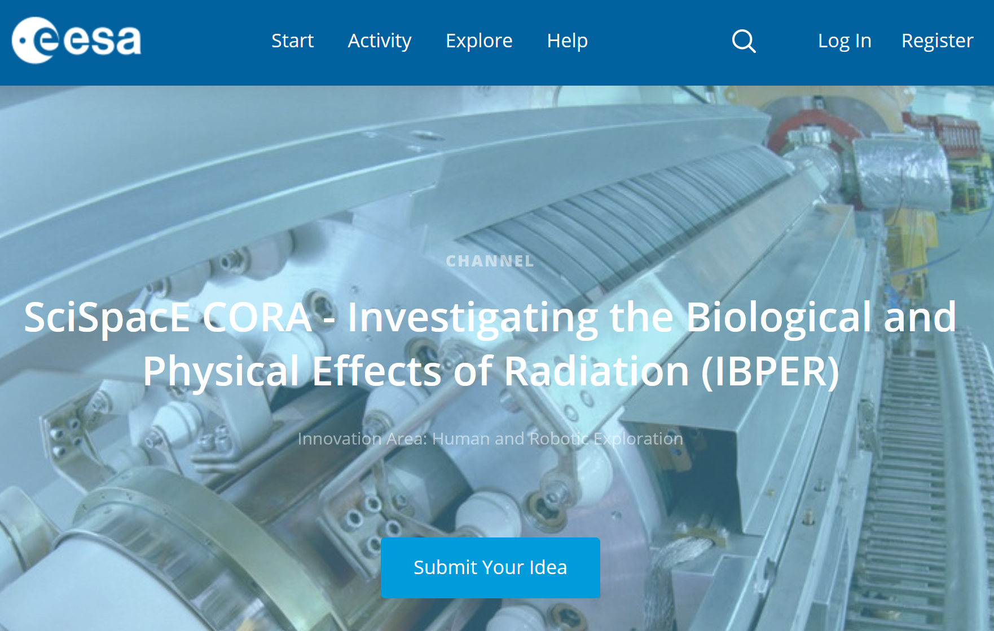
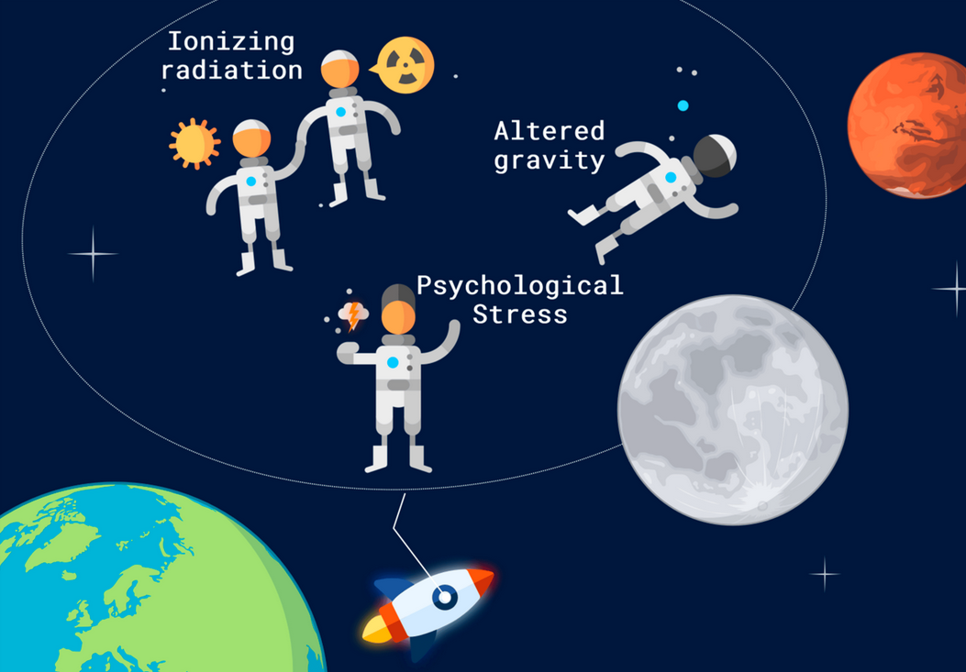
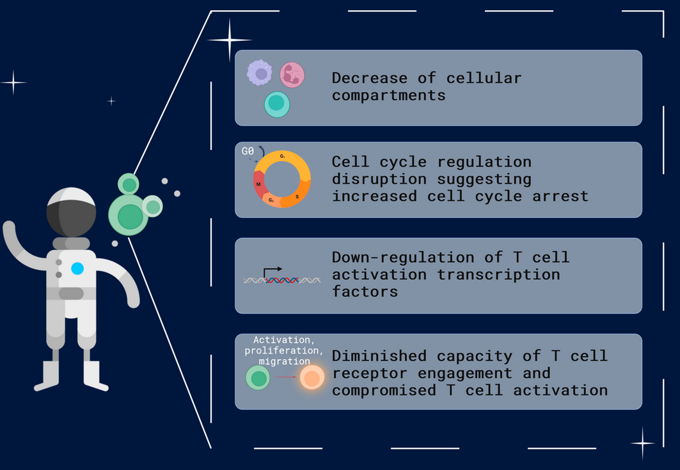
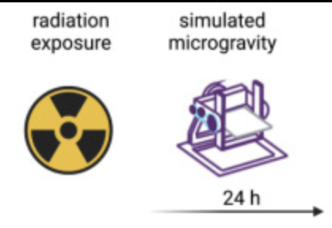


Investigation of biological and physical effects of radiation
Example of project done on the iRiA platform:
The immune system in Space
T-cell dysfunction mechanisms
Decreasing of immunity
Miranda et al. Int. J. Mol. Sci. 2023, 24(23), 16943
Plateforme
labellisée 2023

Slide 18
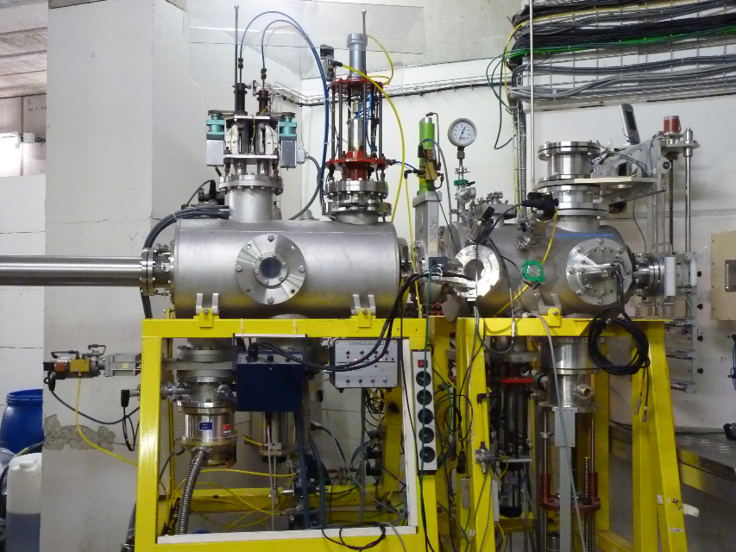
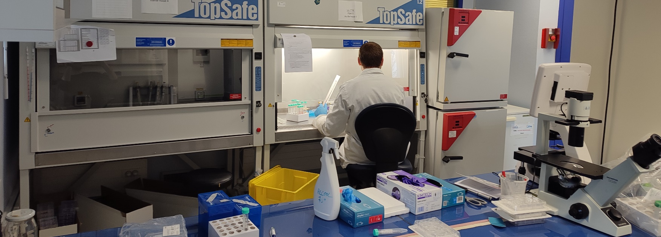
Study of advanced irradiation modalities for cancer treatment
High LET carbon ions 12C 95 A.MeV. 25 UT/year
Fundamental research on radio-resistance
(hypoxia, cancer stem cells)
Radio-sensitization with nanomaterials
Improve biological effect of particles with DNA repair inhibitors
Reduce side effects on healthy tissues with high dose rate (FLASH)
Develop original in vitro models (organoids)
Plateforme
labellisée 2023

Slide 19

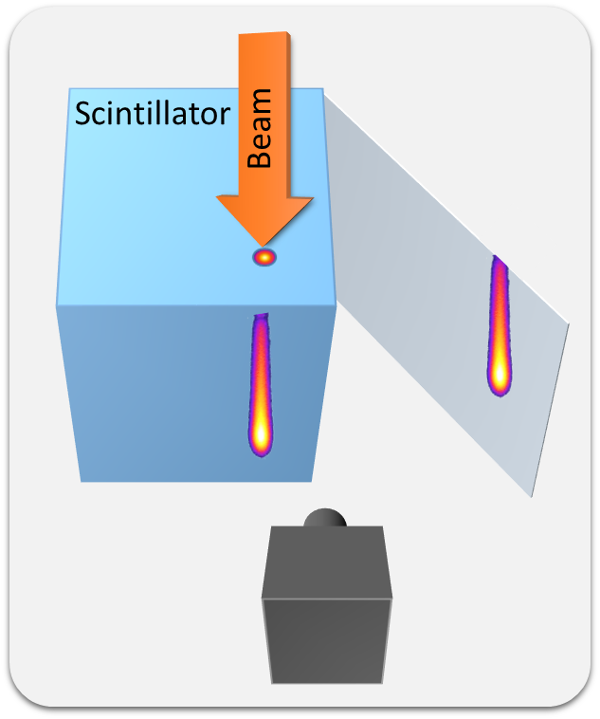
Hadrontherapy : development of a proton therapy dosimeter
High spatial resolution of the beam monitoring for small-size tumors
Recording of each particle
10 × 10 × 10 cm³ BC412 plastic scintillator
Ultra fast camera: up to 5200 fps @ 1200 × 800 px
Synchronized to the “bursts delivery” (delivered at 1 kHz)
  ← logical signal provided by the Proteus®ONE
Notes:
What is the resolution ?

Slide 20
Hadrontherapy : development of a proton therapy dosimeter
Control of Pencil beam characteristics
3D dosimetry in progress (G. Daviau PhD thesis)
10 × 10 × 10 cm³ BC412 plastic scintillator
Ultra fast camera: up to 5200 fps @ 1200 × 800 px
Synchronized to the “bursts delivery” (delivered at 1 kHz)
  ← logical signal provided by the Proteus®ONE

Slide 21
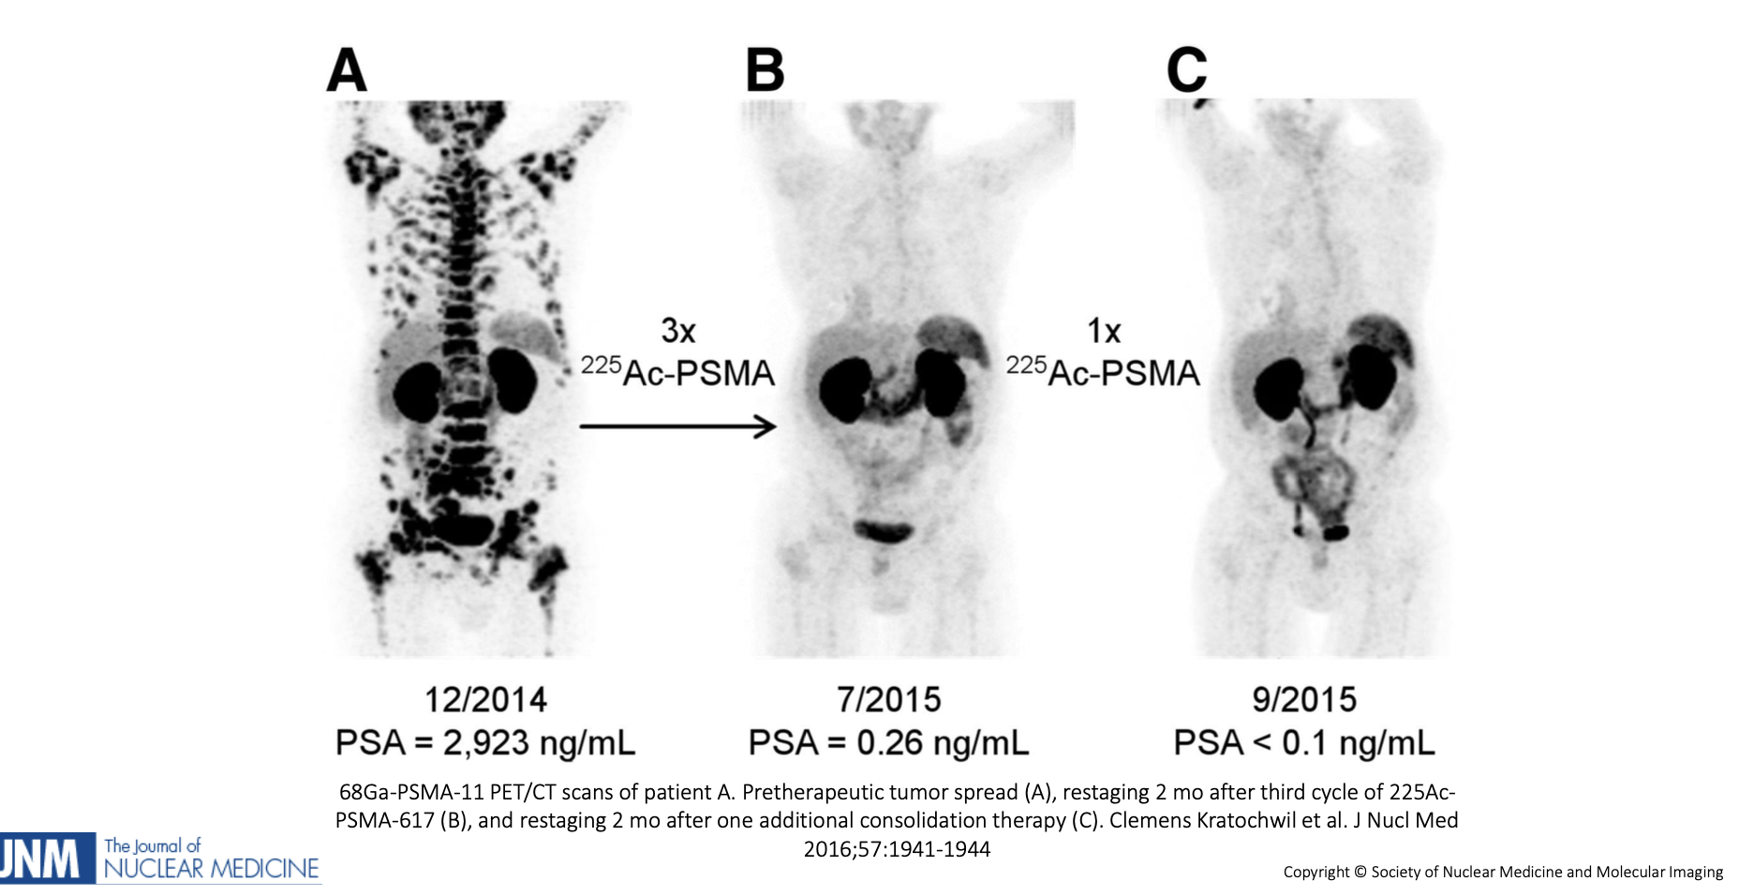
Production of innovative radio-isotopes for targeted alpha-therapy
Radio-isotope carried to cancer sites by appropriate vectors
circulating or distributed tumors
High-let of alpha particles with range comparable with cancer cell is a precise knife
Dedicated project on 211 At :
Advantages of ²¹¹At :
May be used as theranostic
Only one alpha decay

Slide 22
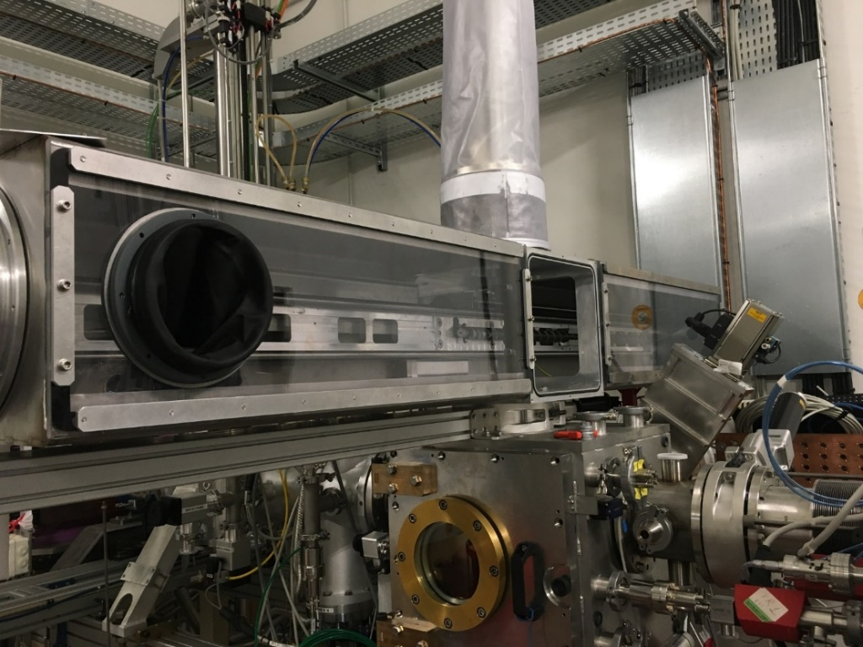

Production of innovative radio-isotopes for targeted alpha-therapy
Tests in NFS converter room
Production of At in NFS converter room with He beam and rotating thin solid cooled Bi targets
  Hardware, soft, beam synchro, vacuum, handling,…
  Contamination, production yield,…
  Activity, shipment to ARRONAX,…
  New beam time request for 2024
  Proof of principle can be achieved in GANIL, but real production needs
  the construction of a dedicated room

Slide 23
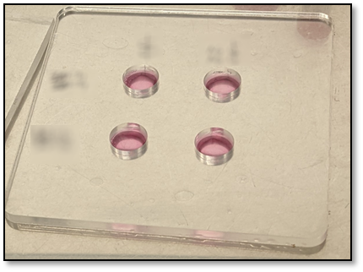
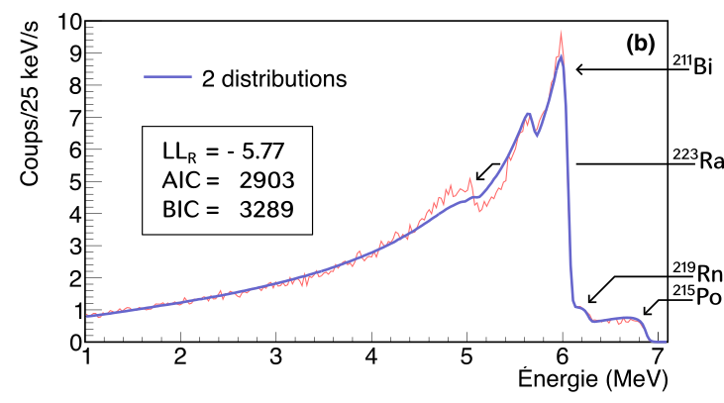
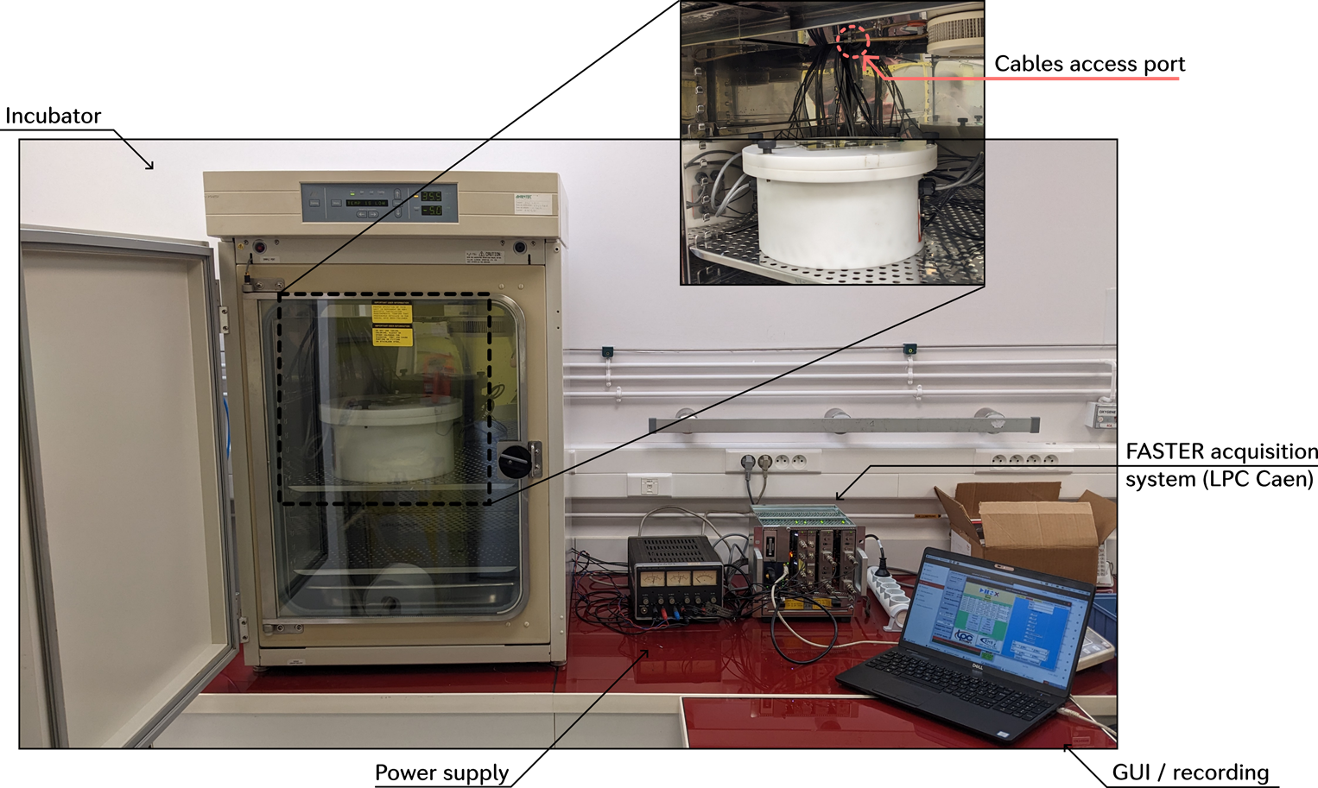
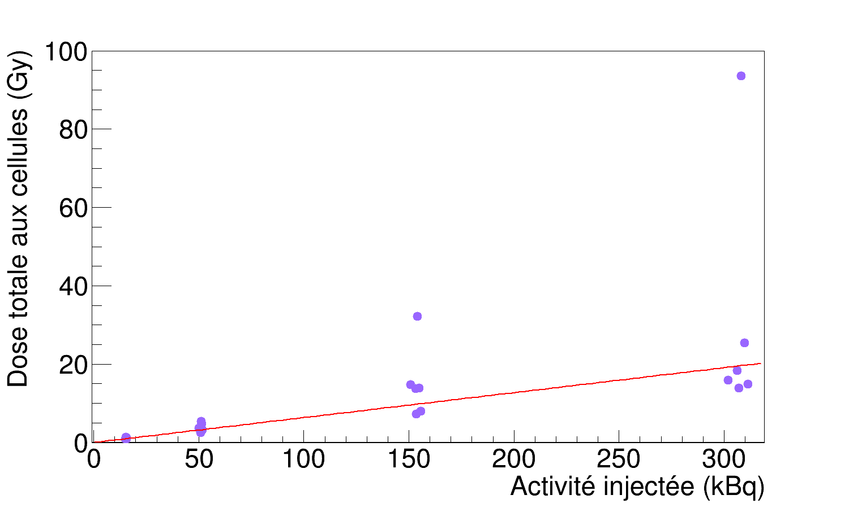
Alphatherapy : Development of new dosimeter for in-vitro experiments
Biological efficiency is studied as a function of the activity in the solution
solution
A. Doudard PhD thesis
15 kBq
50 kBq
CELLS
Detection
150 kBq
300 kBq
Ajustement linéaire :
Dose = (6,367 ± 0,009) 10⁻² × Activité
R² = 0,57
New experimental setup
Dose computation from energy spectroscopy

Slide 24
Applications @ GANIL
Nuclear data
Nuclear data

Slide 25
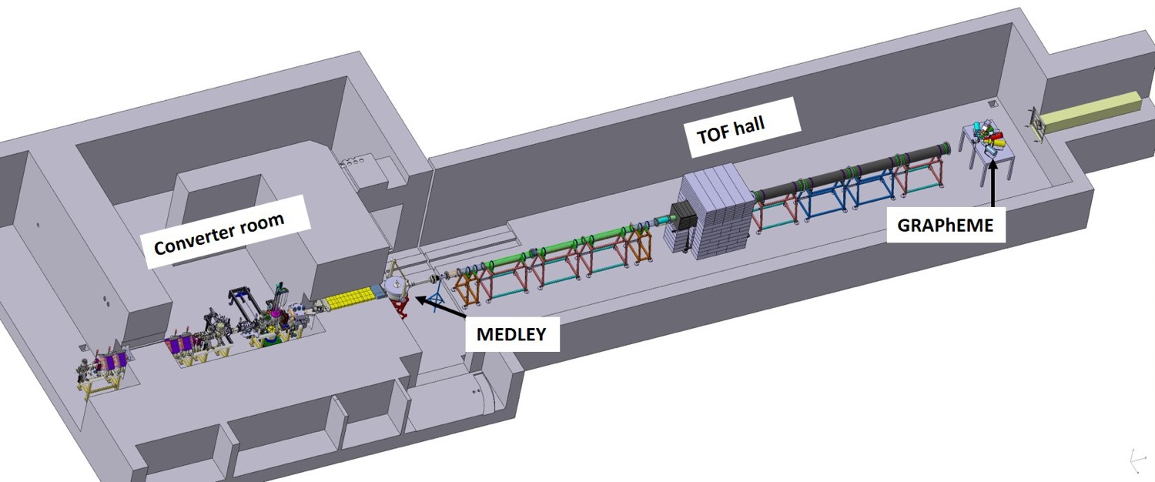
Neutrons For Science NFS
Collimateur
● Nuclear reactions induced by neutrons and ions
● Irradiation stations (n, p, d)
LINAC
beam
Main topics
Basic science
Astrophysics
New generation nuclear power plants
Fusion technologies
Radioisotopes for medical applications
radiobiology
Instrumentation development
Spatial application
High neutron flux and good complementarity with other facilities

Slide 26
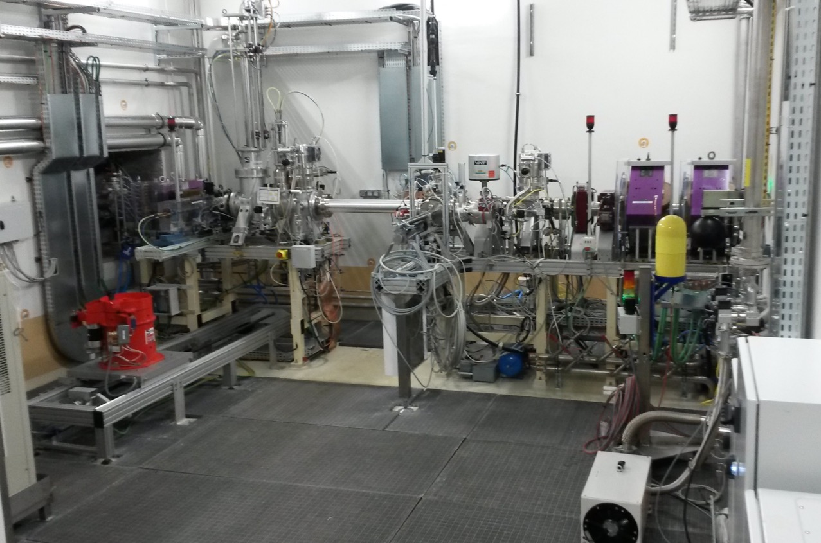
NFS Converter room and Collimator
Carbon
converter
Pneumatic transfer system
Li converter
Irradiation station

Slide 27
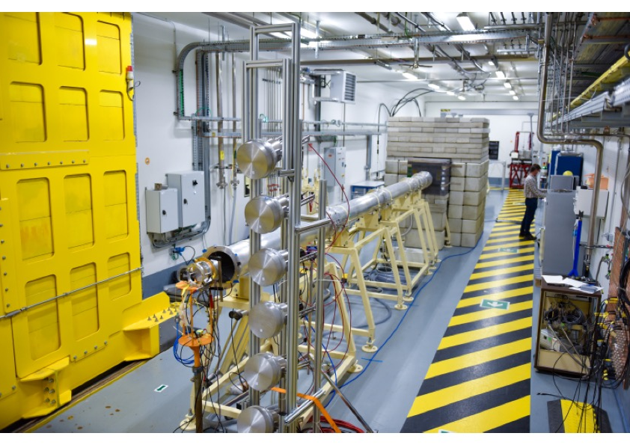
NFS Time-of-Flight hall

Slide 28
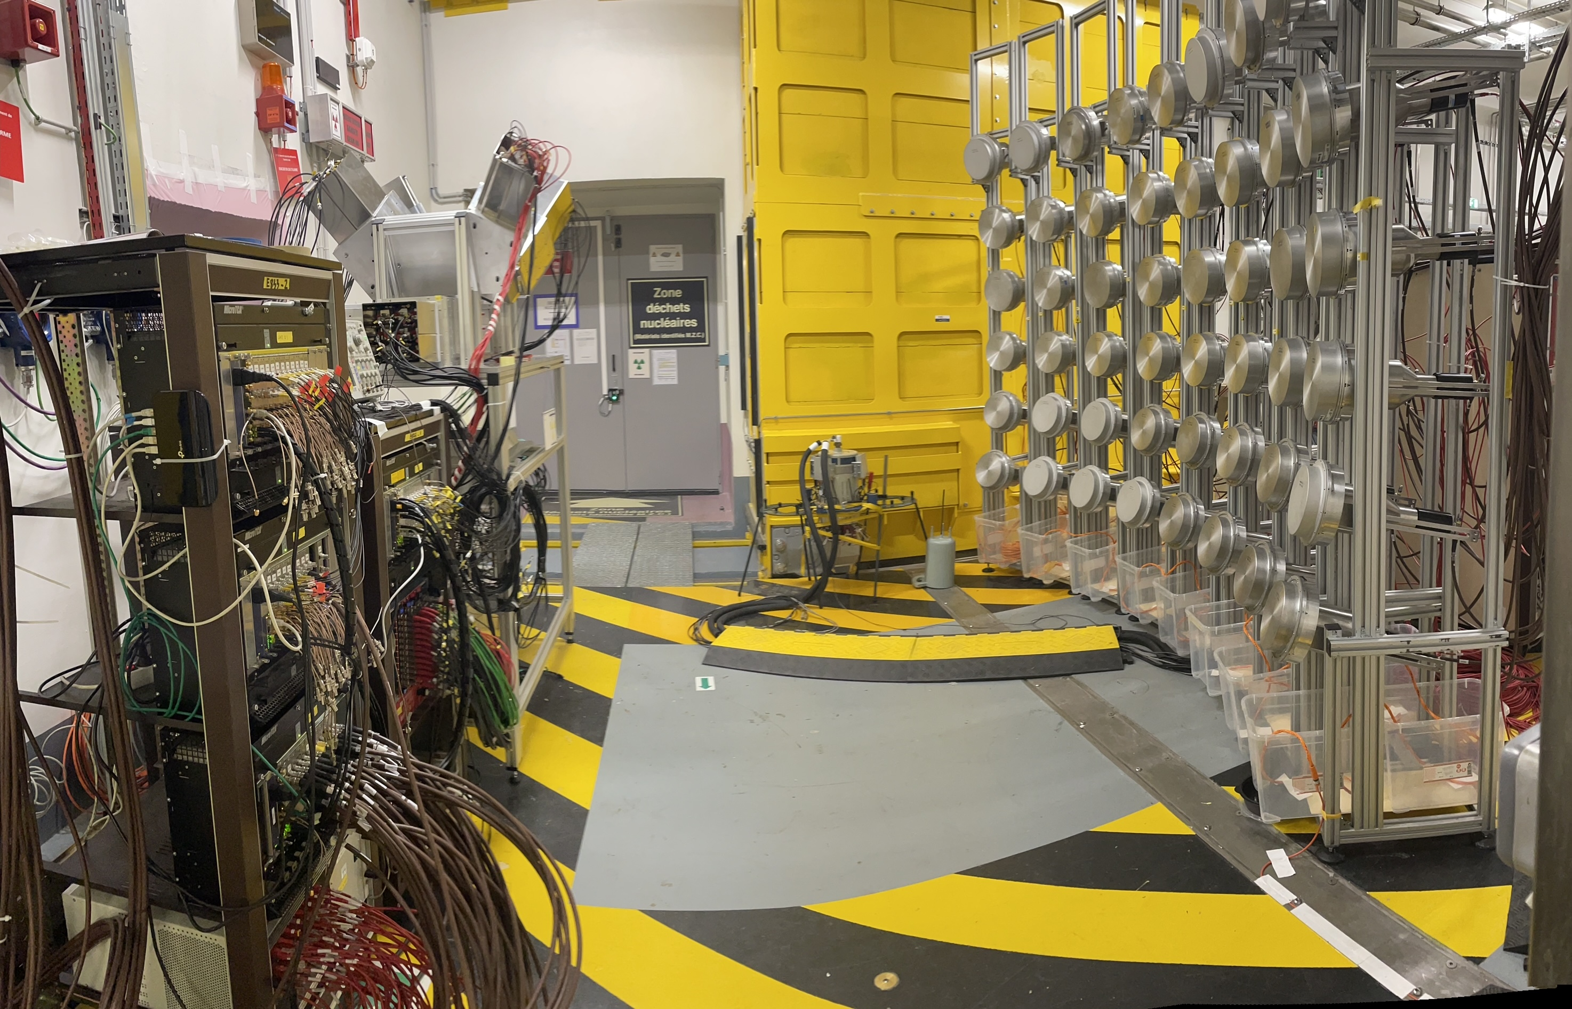
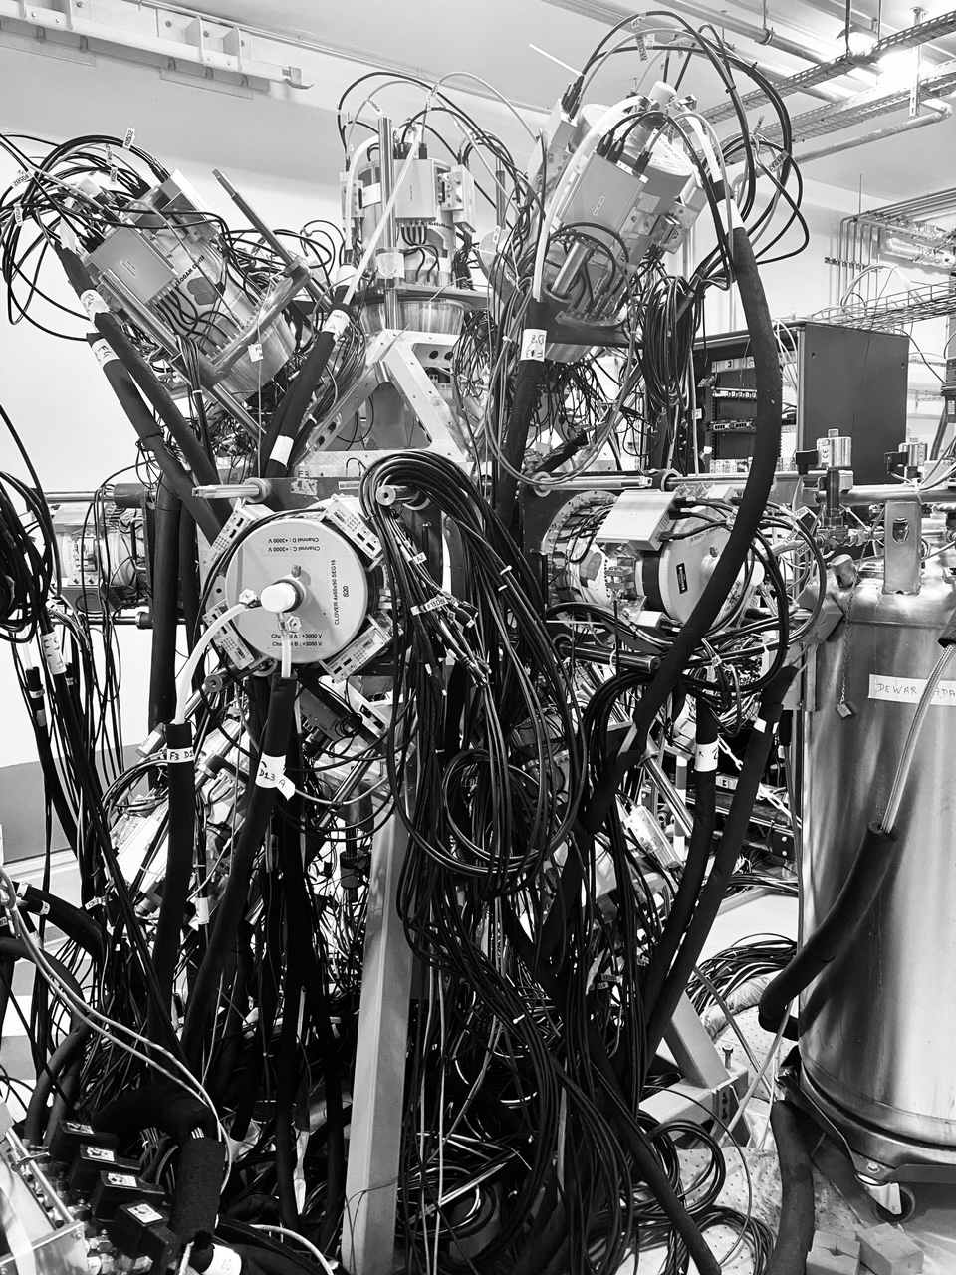
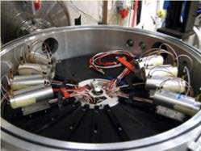
NFS Experiments
Pygmy dipole resonance in ¹⁴⁰Ce using the (n,n’γ) reaction,
Marine Vandebrouck et al
LIONS: Light ions production studies with MEDLEY at the NFS facility, Diego Tarrio et al
GARIC: Gas pRoduction in Chromium, Iron by neutrons, Diego Tarrio et al
(n,xn γ) reaction cross section measurements for nuclear energy, M. Kerveno
Shedding new light
on the structure of
⁵⁶Ni using (n,3n)
reaction at NFS,
E. Clement et al
MEDLEY
²³⁵U fisFALSTAFF at NFS, D. Doré et al.
sion fragment study with

Slide 29
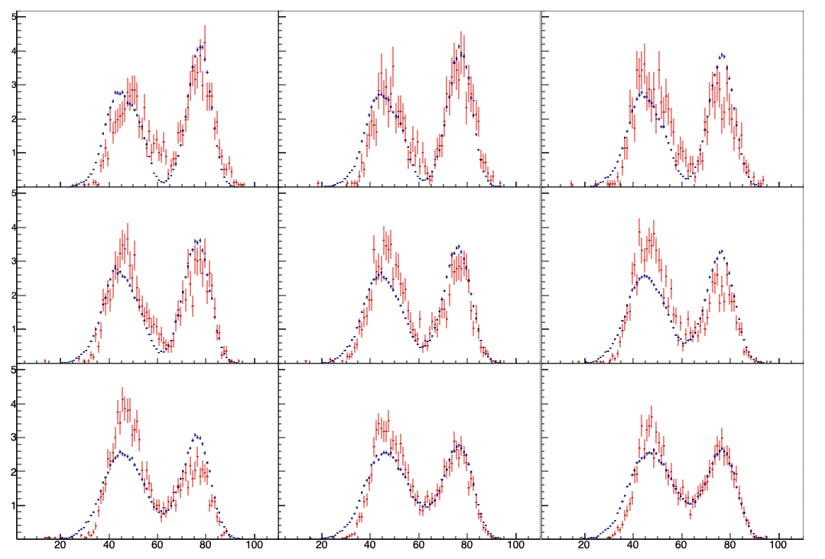
Evolution of 235U fission-fragment distribution with neutron energy
En = 2 MeV
En = 4 MeV
En = 6 MeV
Yield (a.u.)
En = 8 MeV
En = 10 MeV
En = 12 MeV
En = 14 MeV
En = 16 MeV
En = 18 MeV
Energy (MeV)
Characterization of actinide fission fragments in the fast neutron domain
Notes:
Spectra normalized to integral En bin width : 1 MeV

Slide 30
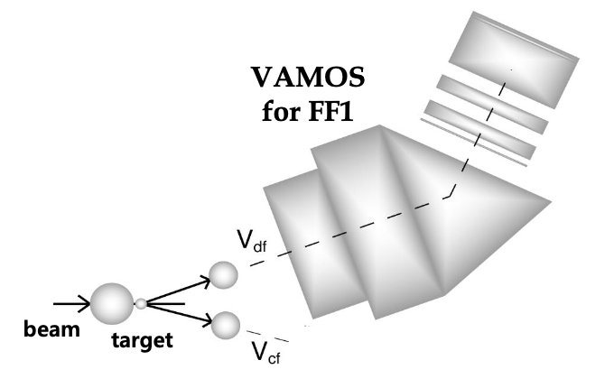
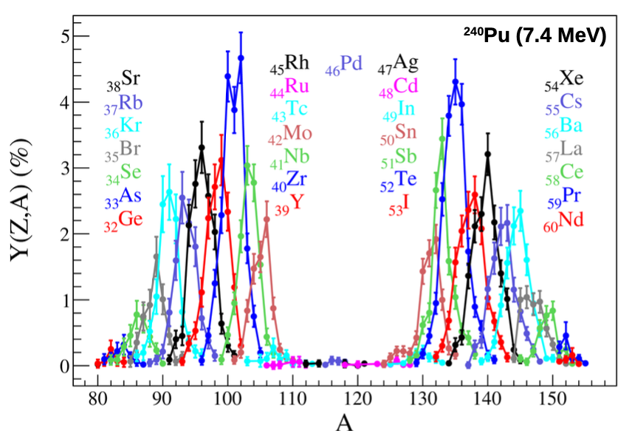
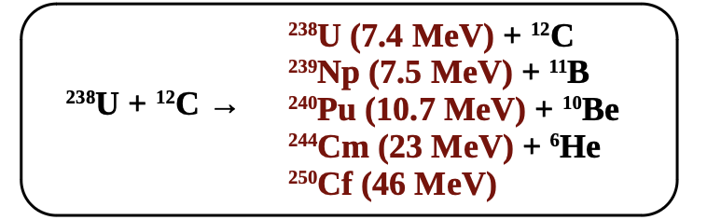
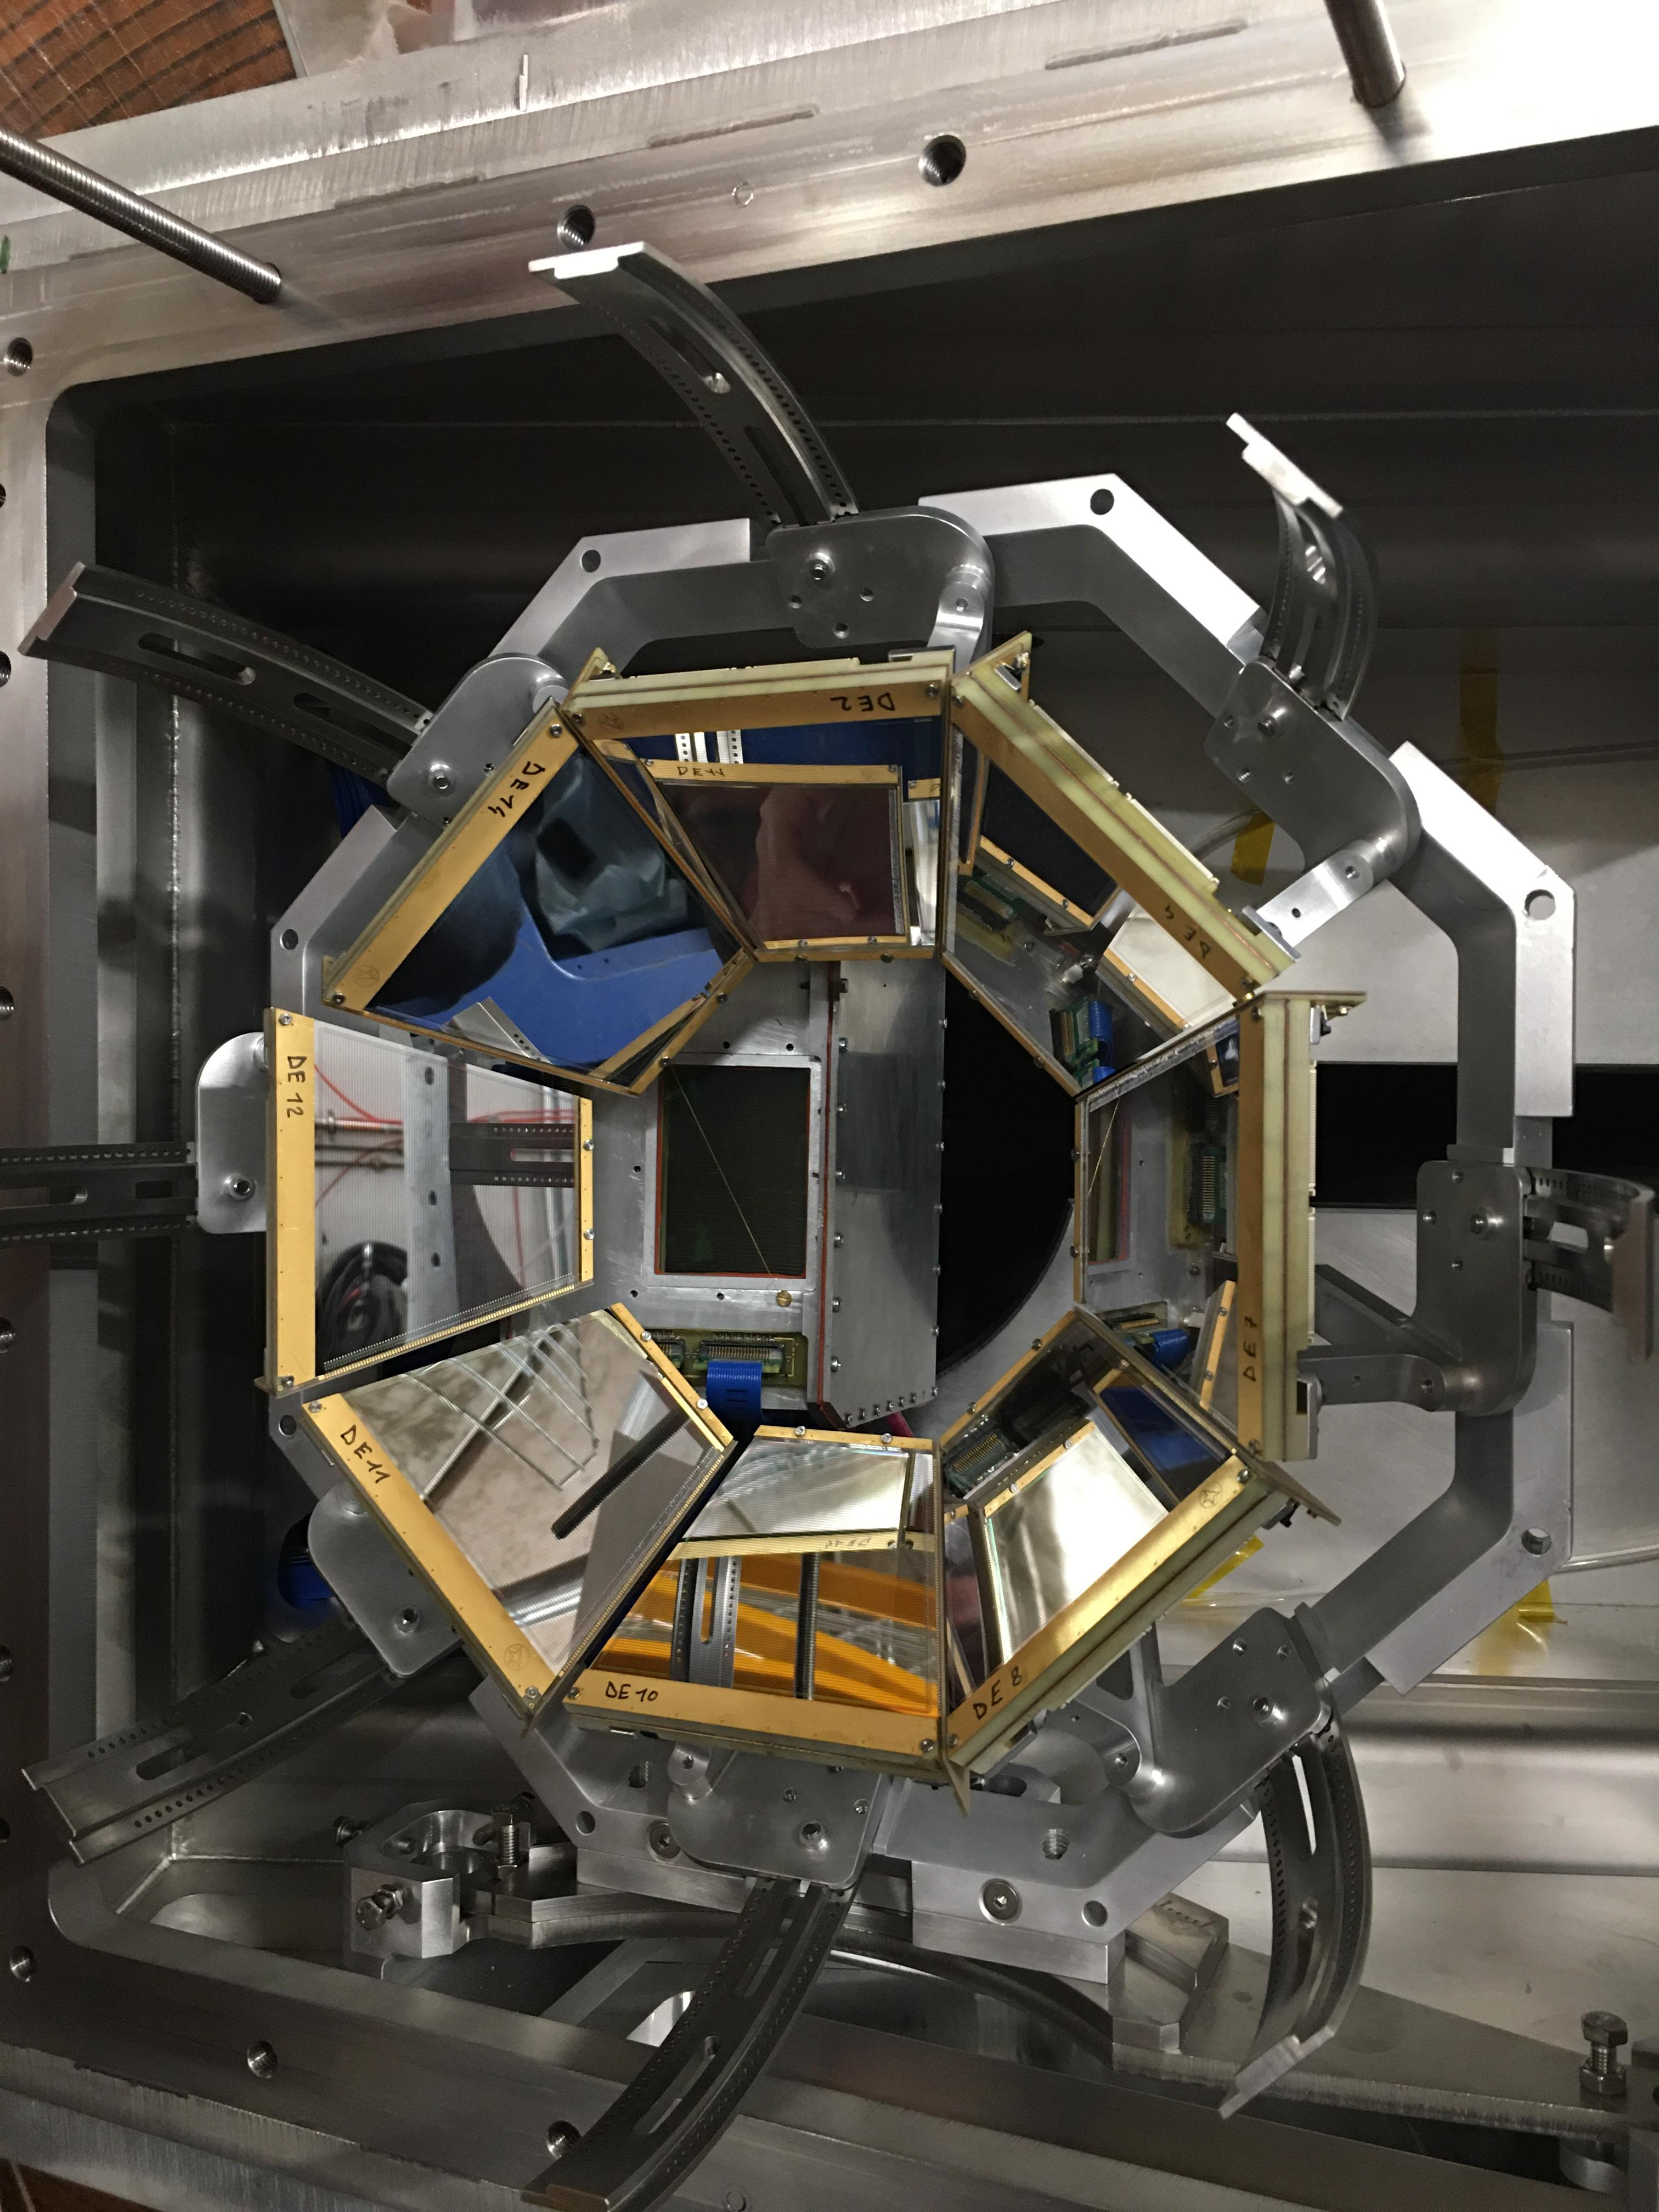
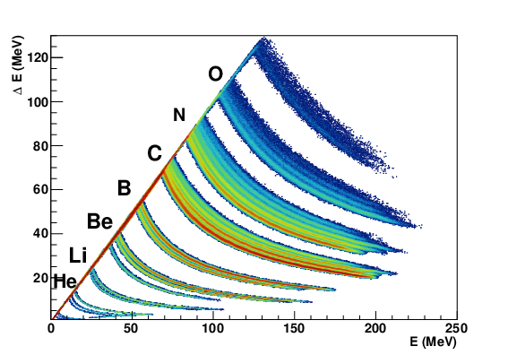
Isotopic fission-fragment distribution using inverse kinematics
Precious data for improvement of codes and
Nuclear data evaluation
New Th beam for other fissioning systems

Slide 31
Applications @ GANIL
Spatial application
Spatial application
X

Slide 32
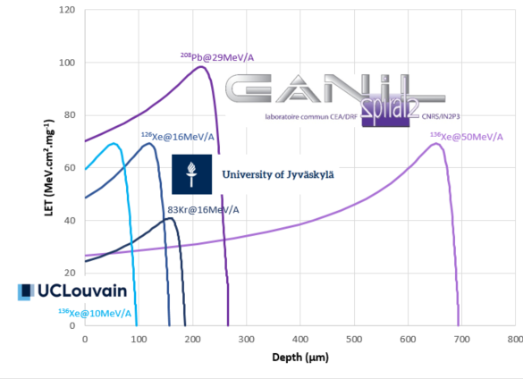
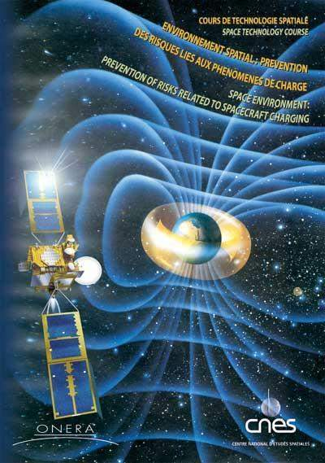
Spatial Applications @ GANIL Accelerators : SAGA
Project under discussion with CNES aiming at increasing the beam time for industrial users at GANIL.
Strong increase of beam time request for tests of electronic components for spatial industry since 2022. Only 1/3 of the requests could be accepted in 2023, even with an increase of 2 of the dedicated beam time

Slide 33
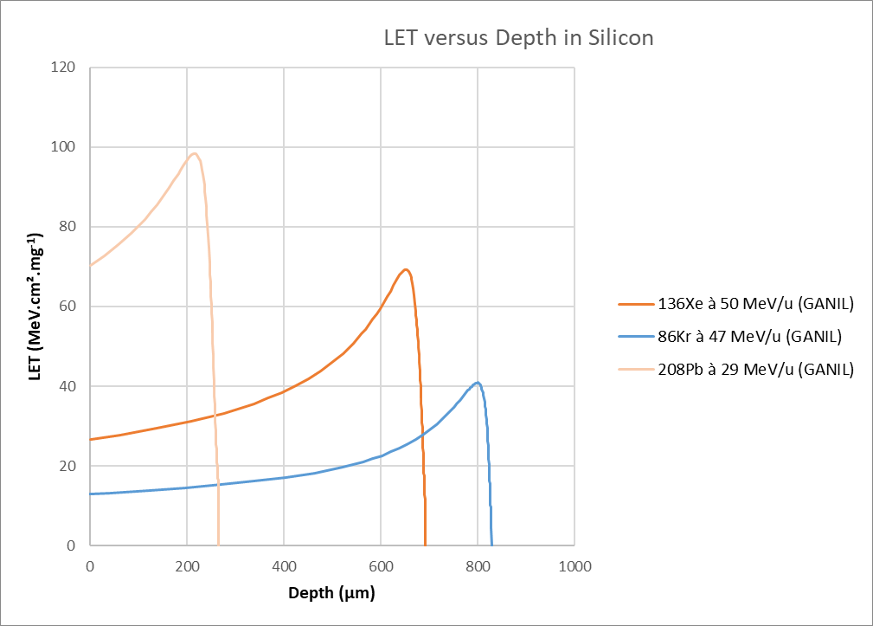
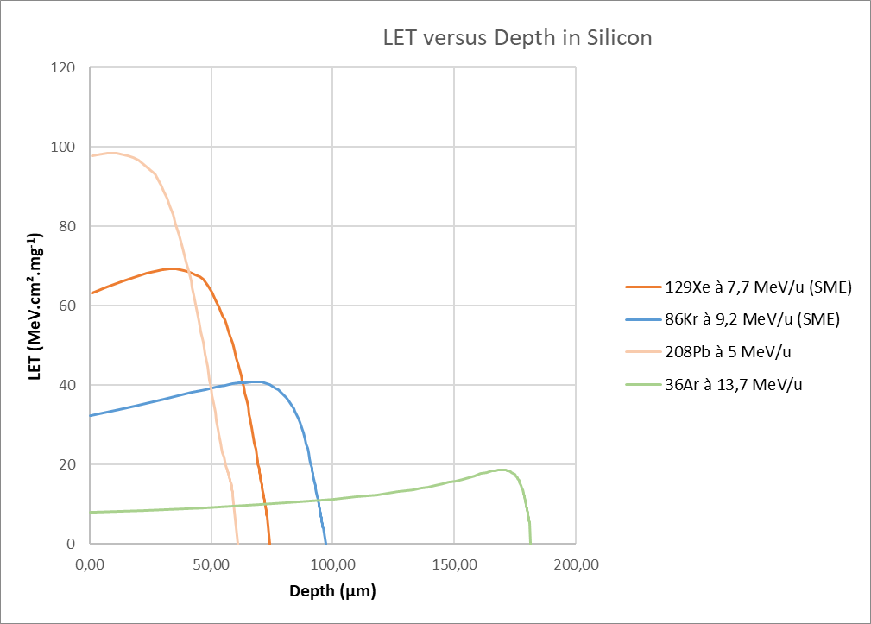
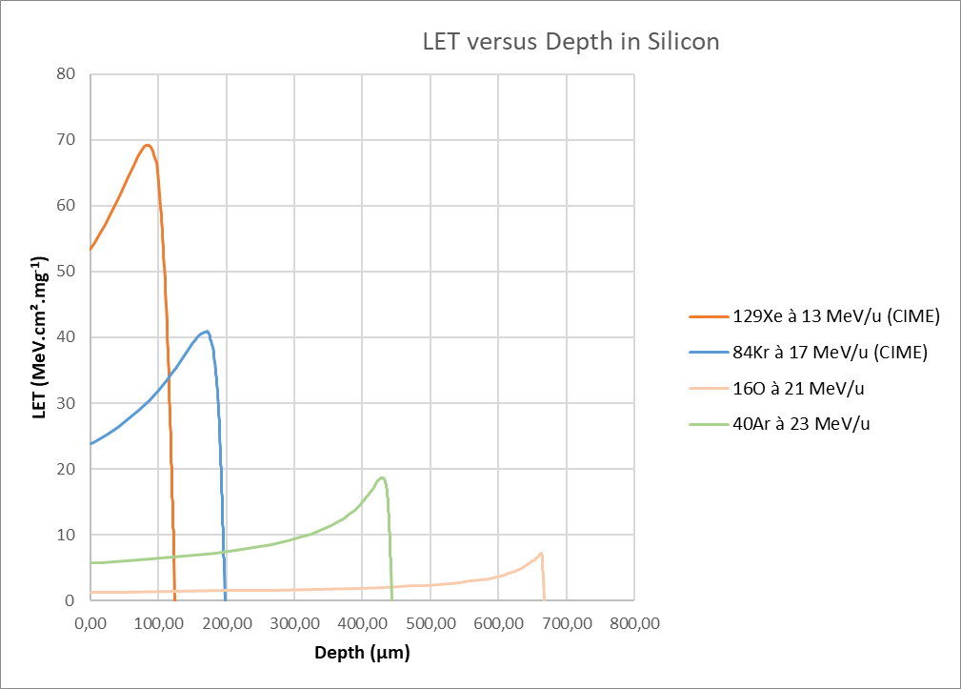
Perspective for industrial irradiations
G41-HE
G32-HE
D1-ME -> irradiation in vaccuum
G41-HE
-> irradiation in air
+ G32-HE
D1-ME
CIME 0°
CIME 0° -> irradiation in air

Slide 34
Deployment of irradiation for spatial applications
+
G41
UT simultaneous SP2/GANIL
2025
↑ G41+ Simultaneous SP2/GANIL
+
D1-ME
2026-2027
+
CIME 0°
↑ G41
UT GANIL
2024
2028
+
G32
2023

Slide 35

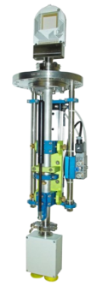





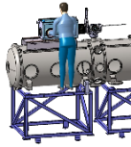
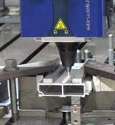
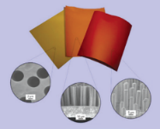


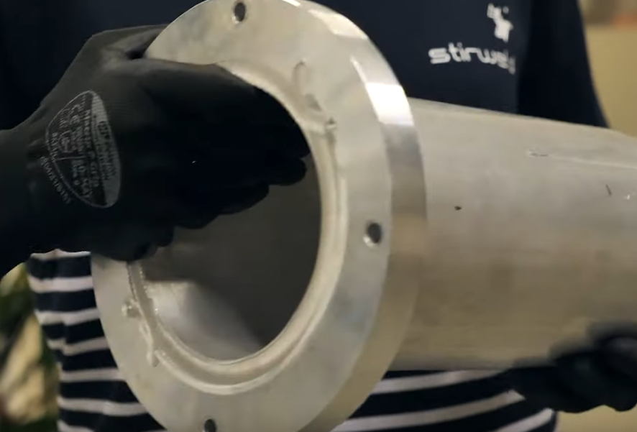
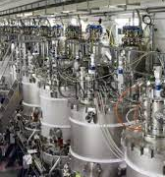




Links with industries
Prestations
Irradiation
components
electronics
Space
Know-how:
Ion beam profile
detectors
Collaboration
R&D
Soudure FSW
appliquée vide aux
technologies du vide
et des accélérateurs
Design and production
of an innovative glove box
for research needs
Improving preventive
maintenance of LINAC
by integrating
AI in the management
cryogenics valves
Irradiation
Membrane
microporous
Patent :
Manufacture of
vacuum tube
all-aluminium
Equipements for
research use
Technology
transfers

Slide 36
Applications @ GANIL
Material Science, Nanostructuration
X
ASTROCHEMISTRY Material Science, Nanostructuration
ASTROCHEMISTRY
Material Science, Nanostructuration

Slide 37

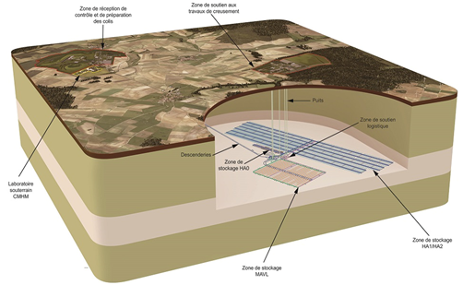


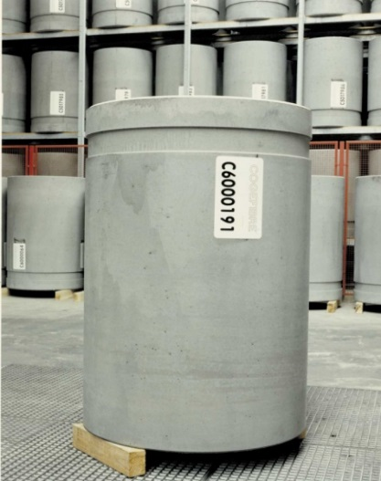

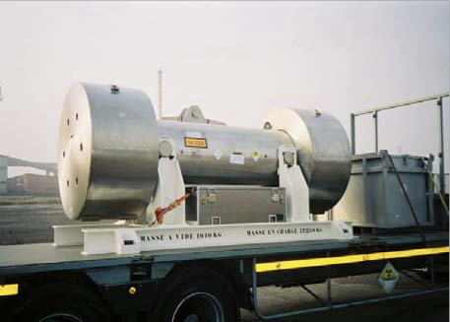


Materials under irradiation
Polymers :
Joints, vinyls, tapes, gloves, …
2 types of defaults :
Radiolysis gas
Creation of macromelcules
Nuclear waste : Impact of alpha radioactivity
  Gaz emission : safety issue
  Creation of water-soluble molecules : migration of radionucleides
Storage - Exploitation
Gas emission
  RT Dose ++
Transportation
Gas mission
Heat 150°C Doses +
Slong-term storage
Gas emission 
Leaching
Mobility of radionucleides

Slide 38

Simulation of alpha radioactivity
Two analysis procedures
MS on line ligne + FTIR in-situ
  SME
Spectroscopy ex-situ
  IRRABAT
Equivalent energy deposition

Slide 39





Material science
Understand the origin of electronic defaults
New materials for electronics and also battery, C02 captation
Defect engineering
Nanostructuration :
Amorphous phase may
Have beneficial properties
New membranes with selective effects using
Grazing irradiation
Graphene sper-conductor or oxydation insulator

Slide 40



PELIICAEN apparatus @GANIL
From surface nano manufacturing to localized analyses using singly and multiply charged focused ion beams (down to 100 nm)
  Some materials of interest:
  Complex oxides (Multiferroics, 2D electron gases, rare earth nickelates…)
  2D Materials (Graphene, MoS₂, WS₂,hBN…)
  Quantum Dots (Au, InGaAs, ZnO, CdSe,…)
  Rare earth in « Laser » Materials (Er, Yb in YSO et CaWO₄…)
  Impurities and defects control in matrices: Si, SiC, Diamond…
stephane.guillous@ganil.fr
Fields of Application:
Materials for Quantum technologies
  Quantum computing
  Communication/information security (cryptography)
  Information storage
  Sensors/ Instrumentation
  Micro electronics of the future (spintronics, quantronics)
Materials for Energy
  CO2 captation
  Water to H2 conversion
  Photon emission
  Energy conversion (photovoltaic,…)
  Energy storage (specific surface,…)

Slide 41






ASTROCHEMISTRY
Icy mantles are formed from simple molecules (H₂O, CO, CO₂, NH₃, CH₄, etc)
Energetic processing by: photons (including UV and X-rays), electrons (high and low-energy), ions (cosmic rays, solar wind, magnetosphere)
Irradiation leads to: ice structural changes, desorption/sputtering, radiolysis (fragmentation) and formation of species.
Why heavy ions?
Abundances
Radiolysis
Sputtering
Scaling laws: S_{e}^{n} with n ≈ ½,1,³/₂,2

Slide 42





MIRRPLA: an unique worldwide multi-beam platform
Multiple-beam IRRadiation PLAtform to investigate the origin and evolution of organic matter of the Solar System
SIMULTANEOUS IRRADIATION : UV photons - Electrons - Ions
keV-GeV ions + 100eV-10keV e-, UV photons
Samples : 10-300K (ices/films)
Analysis : in-situ FTIR, QMS, CG-orbitrap
Others prospects: health (biomolecules and DNA fragments), environmental science (evolution under ionizing radiation of air pollutants like PAHs, soot particles), material science (developa new generation of polymer materials, radiation effects on materials used in spacecraft)
Notes:
Start in march 2023
Development in D2, orbitrap arrive au printemps 2024
Ouverture mirrplat to users: 2026
Others prospects: health (unique opportunity to investigate fundamental processes at molecular level by mixed irradiation of biomolecules and DNA fragments (cancer therapy + exposure of living beings in space mission)
Environmental science : evolution under ionizing radiation of air pollutants like PAHs, soot particles
Material science : to develop, characterize and optimize design a new generation of polymer materials, radiation effects on materials used in spacecraft

Slide 43
Conclusion
GANIL : Accelerator Laboratory with basic science missions
Broad range of ions and experimental set-ups with versatile applications rose throughout the years
Unique detection and analysis set-ups
From radiobiology, radio-isotopes production for nuclear medicine to New materials for radioactive waste containments, new materials for electronics, quantum technologies, or Nuclear data…
Many fields of science with direct societal applications are going on in GANIL

