Slide 1
High-Fidelity Neutronics Simulation Aided Target Study for the SNS Proton Power Upgrade Project
Wei Lu, Franz X. Gallmeier & Kevin C. Johns
Oak Ridge National Laboratory, Oak Ridge, TN 37831
2024 International Topical Meeting on Nuclear Applications of Accelerators (AccApp'24), Norefolk, VA
Mar. 20, 2024

Slide 2
Outline
Proton Power Upgrade (PPU) project
High-fidelity modeling method at SNS FTS
PPU target design
Energy deposition analysis on the PPU target
Target shape impacts on the moderator performance
Optimization of target length
Summary

Slide 3
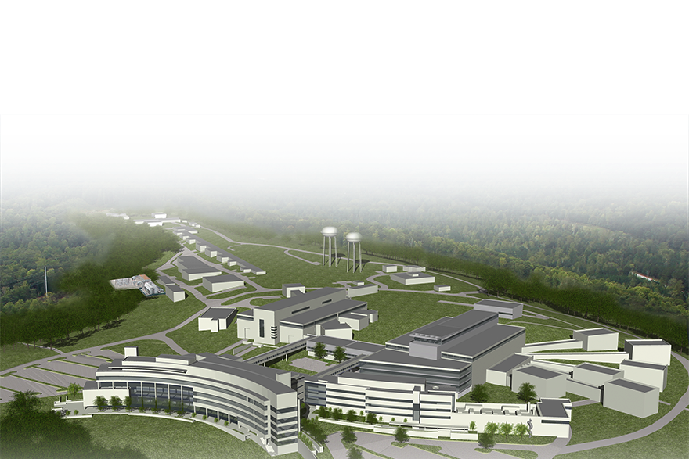
Proton Power Upgrade (PPU) project at SNS
Increase the proton beam energy from 1.0 GeV to 1.3 GeV
Increase the power delivered to FTS to 2.0 MW
Serves as a platform for STS, in which the accelerator power capacity is further improved to 2.8 MW
Cost of PPU is estimated at ~ $216 M
PPU completion is imminent in June 2024
PPU has an expected facility lifetime of 40 yrs, extending SNS FTS lifetime by 20 yrs
SNS FTS will operate at 1.7 MW in June and ramp to 2.0 MW in 2026

Slide 4
High-fidelity Modeling Method at SNS
Conventional modeling uses code provided surface/body definitions to manually construct geometry model
  Time consuming and limited to simple geometries
  Not keeping up with engineering design demands
High-fidelity modeling
  Converts a CAD model automatically into an input file for the Monte Carlo simulation: SuperMC & MCAD
    Geometry is again limited by the MC codes, specially not able to deal with spline surfaces
  Converts a CAD model into an unstructured mesh in MCNP6.1 after
    enables hybrid with conventional models and direct use of meshes for engineering analysis
    extensively used by our STS colleagues
  Directly run a CAD model in a Monte Carlo simulation: DAGMC
    Versatile in handling geometry
    Computation speed is ~2-3 slower

Slide 5
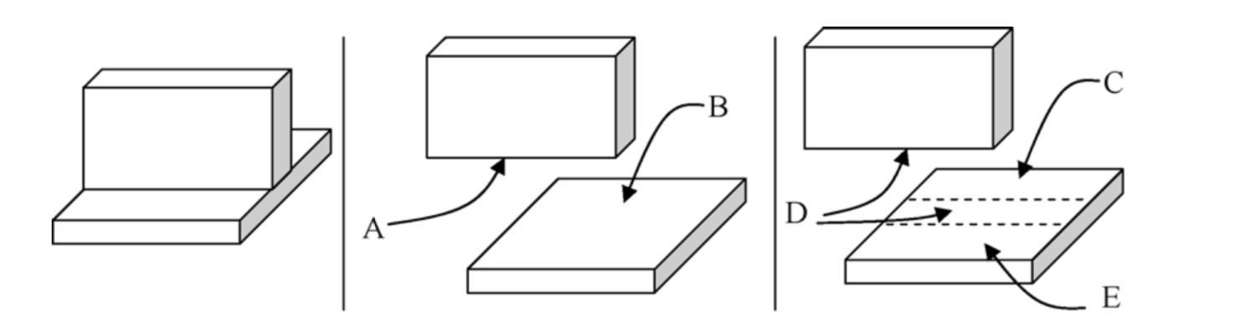
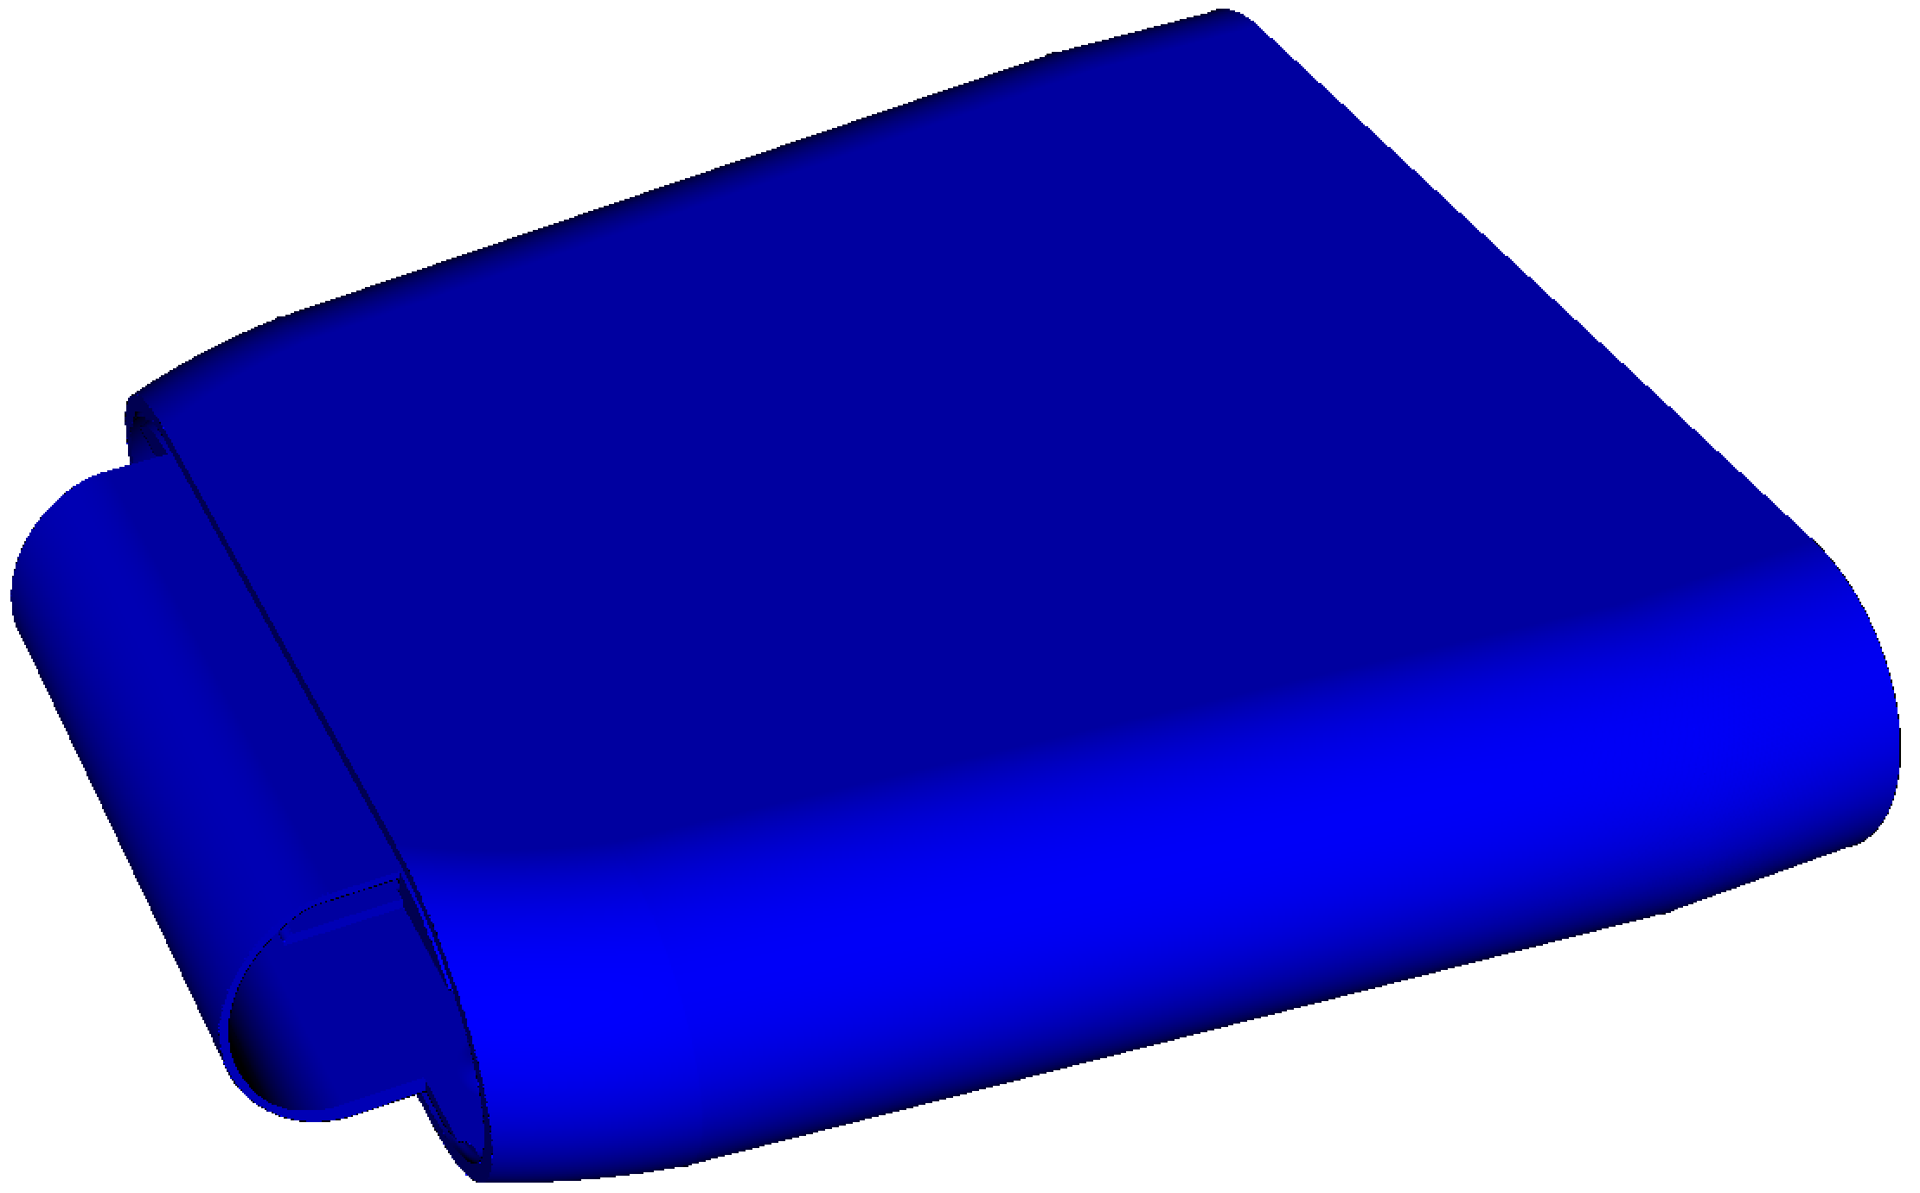
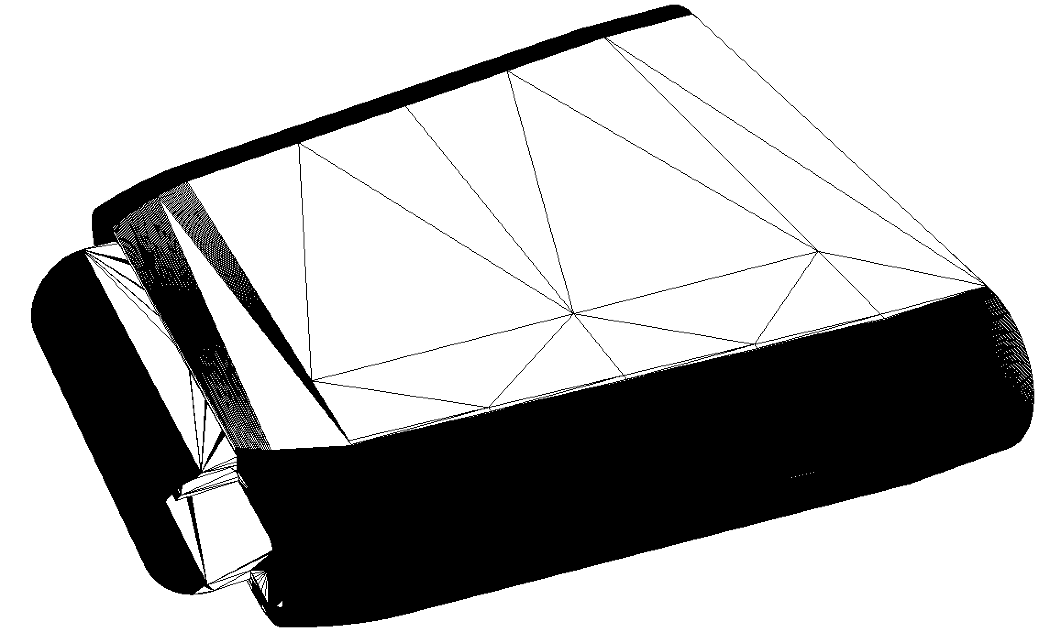
DAGMC (Direct Accelerated Geometry Monte Carlo)
Developed by Prof. P. Wilson’s team, Univ. of Wisconsin-Madison http://svalinn.github.io/DAGMC/index.html
Supports MCNP6 (sponsored by SNS), FLUKA, & OpenMC
Demonstration implementation for Shift, Tripoli & GEANT4
Acceleration techniques
  Imprint/merge
  Surface faceting
  Oriented bounding box & bounding box tree
It relies on Cubit/Trellis for the model processing
* P.P.H. Wilson et al. / Fusion Engineering and Design 85 (2010) 1759–1765
faceting

Slide 6
High-fidelity Modeling Method at SNS
A native CAD model is usually not suited for DAGMC-MCNP6 run
  Loose definition of geometry in CAD vs. water-tight requirement in MC
    Gaps
    Overlaps
  Small details not necessarily needed
  Fluid space not defined
CAD model has to be fixed and checked before DAGMC-MCNP6 run
Flow-chart of CAD model preparation for a DAGMC-MCNP6 run

Slide 7
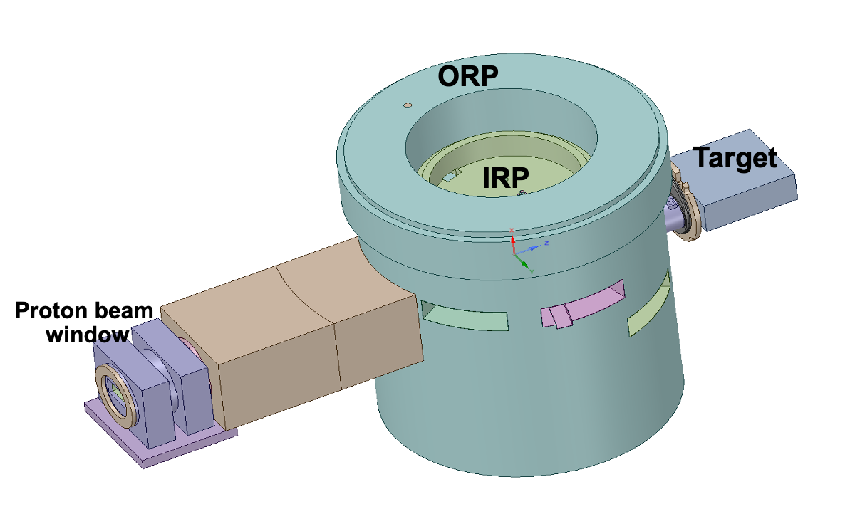
SNS FTS (First Target Station) as-built/as-designed in MCNP
IRP3: 3rd generation inner reflector plug
to be used after PPU
ORP: outer reflector plug

Slide 8
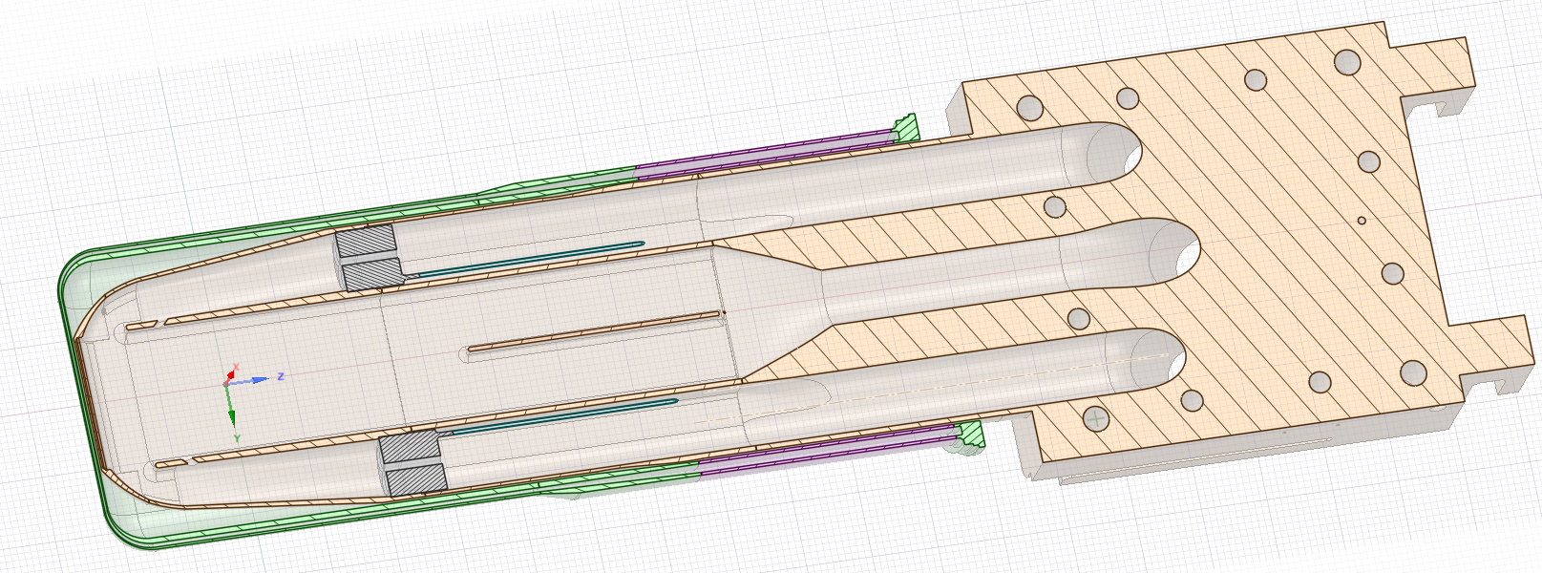
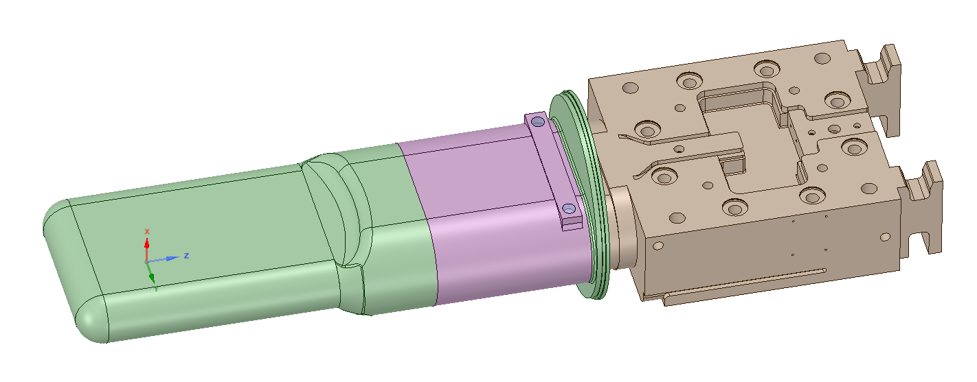
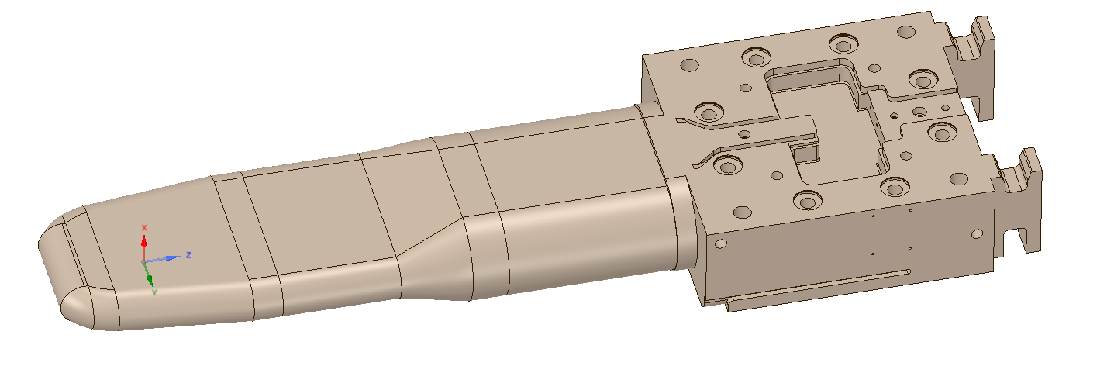
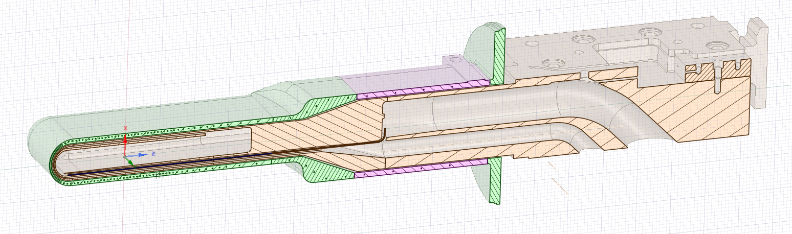
As-designed PPU Target
water-cooled shroud
water-cooled shroud
mercury target

Slide 9
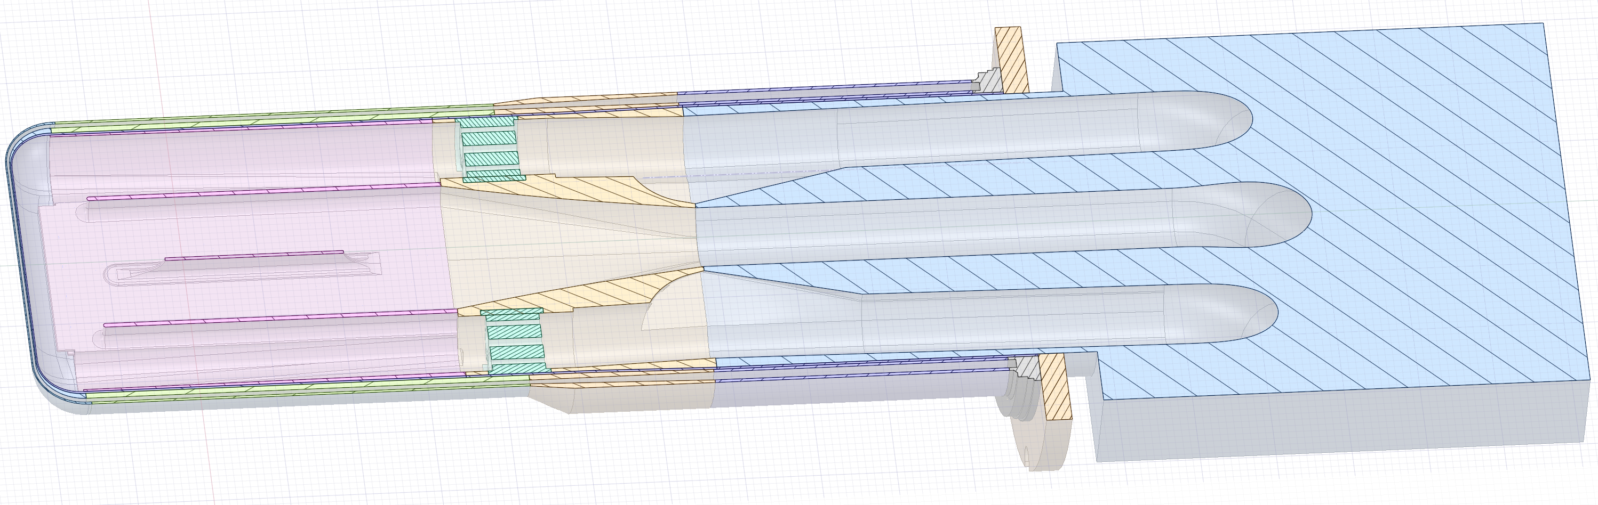
As-designed PPU Target
Current target
Major concern to mitigate cavitation damage
  tapered front
  bubbler location
Structure stability
  center baffle location
PPU target

Slide 10
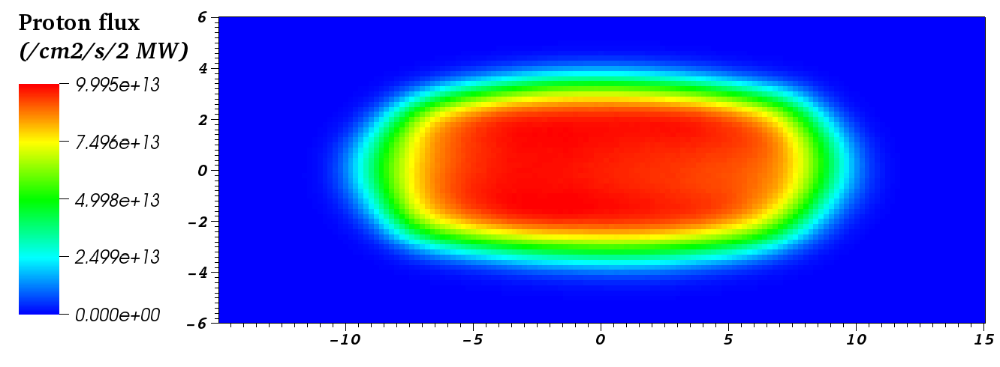
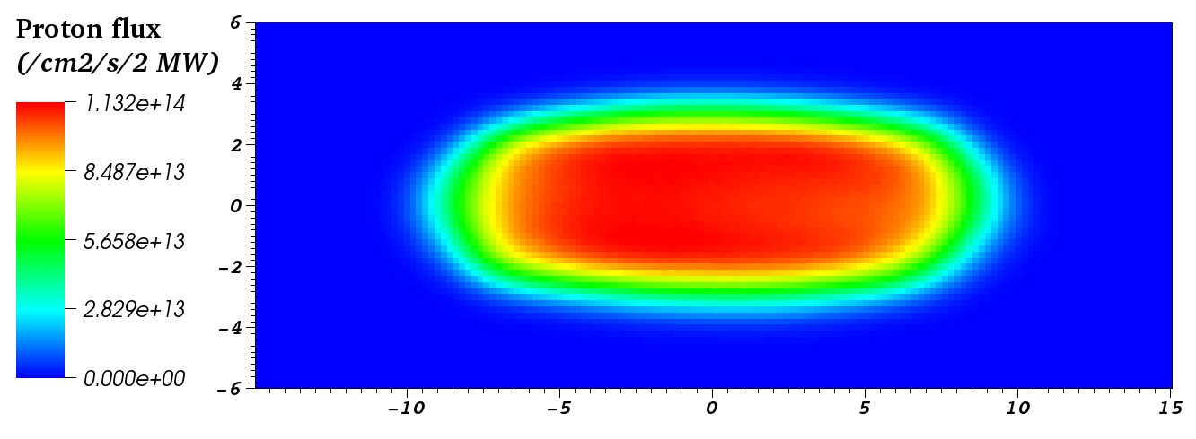
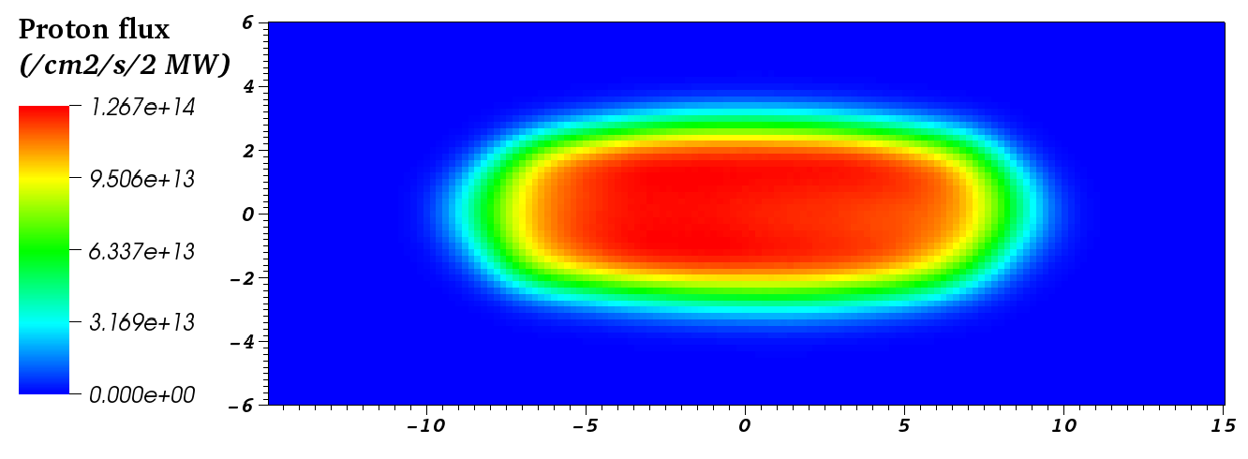
Energy Deposition at the PPU Target
Energy deposition study is the first step to start the iteration with CFD and structure analysis for the target design
A desirable incident proton beam profile from accelerator was generated, as well as two off-normal cases
Underfocused
PBW
Nominal
Incident proton beam profiles | Peak proton flux (p/cm²/s/2 MW)
 | PBW | Target
Nominal | 1.17E+14 | 1.13E+14
Overfocused | 1.29E+14 | 1.27E+14
Underfocused | 1.04E+14 | 1.00E+14
Target
Target
Overfocused

Slide 11
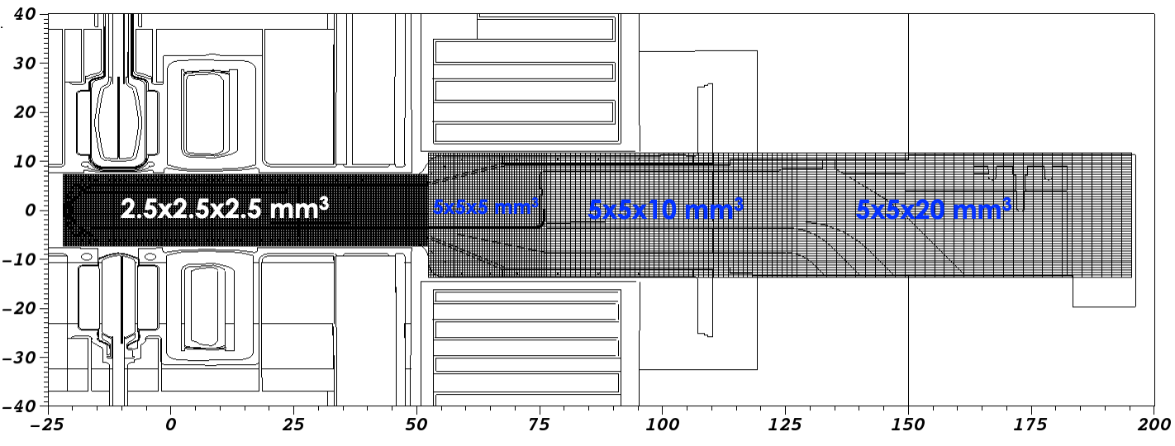
Energy Deposition at the PPU Target
Revised TMESH tally, which is capable to tally individual material within each element of the mesh

Slide 12
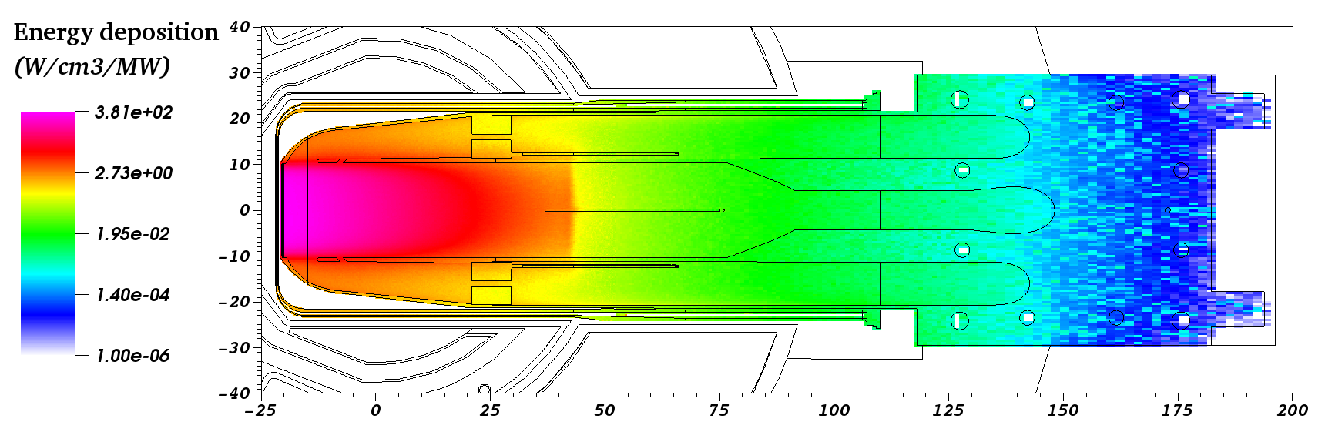
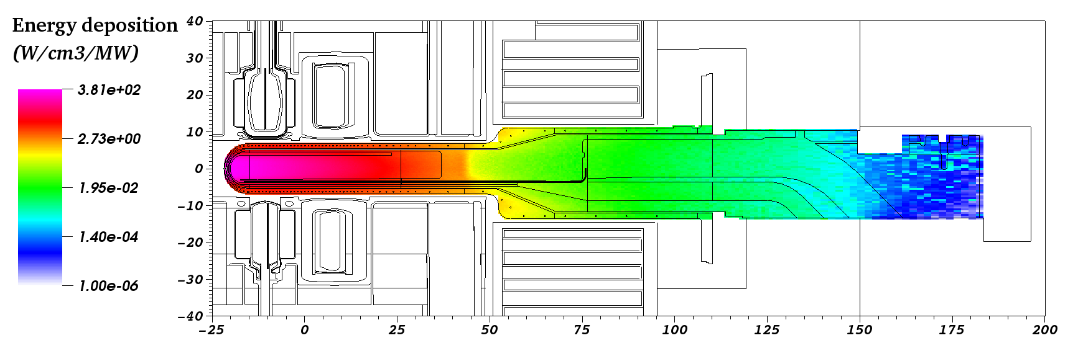
Energy deposition results - nominal

Slide 13
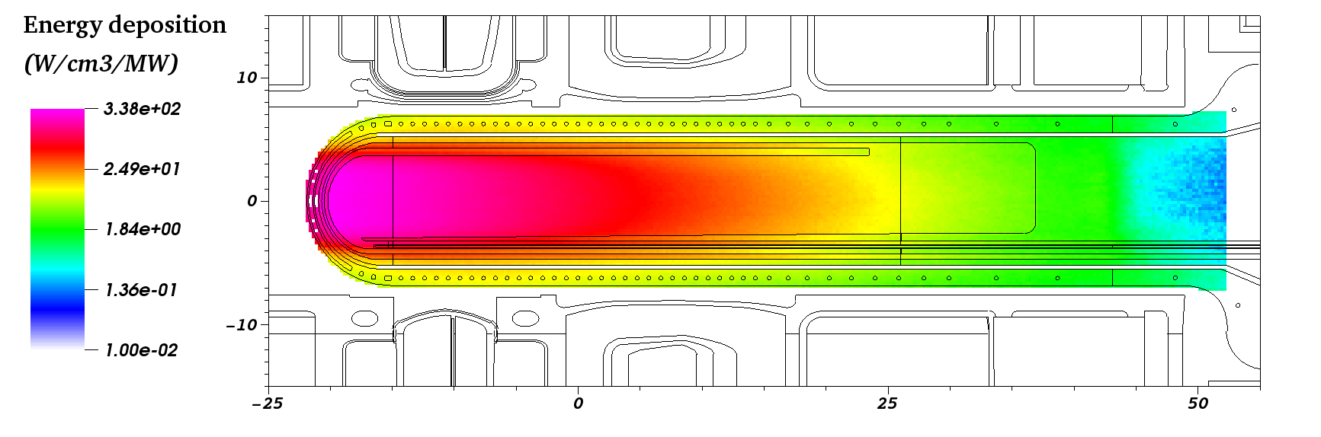
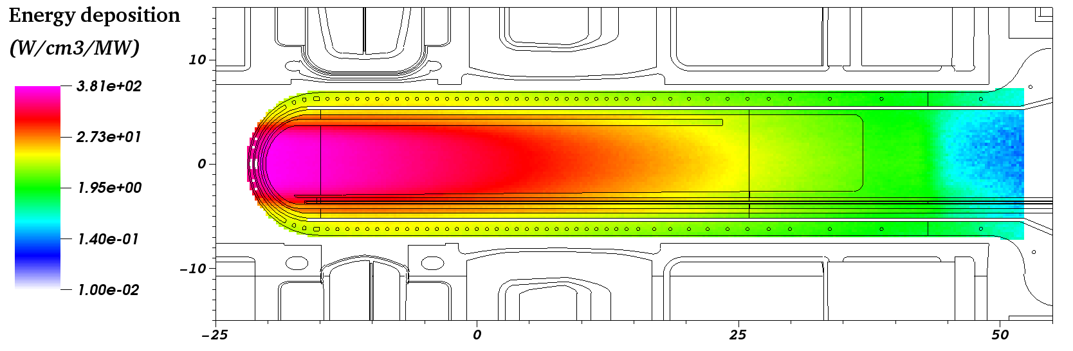
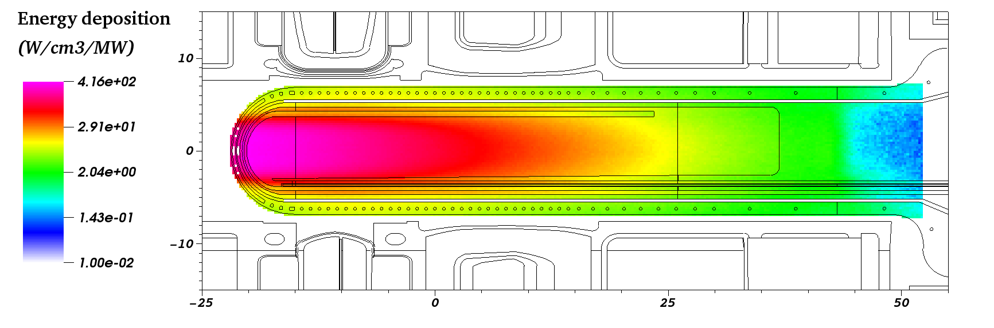
Energy deposition results
Underfocused
Nominal
Overfocused

Slide 14
Target Shape Impact on Moderator Performance
A preliminary design has a more slanted shape of the front target

Slide 15
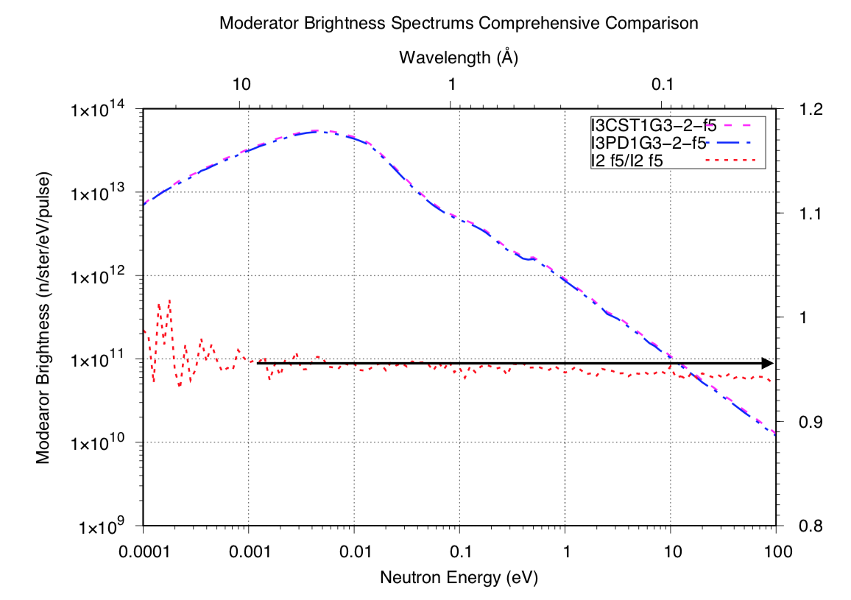
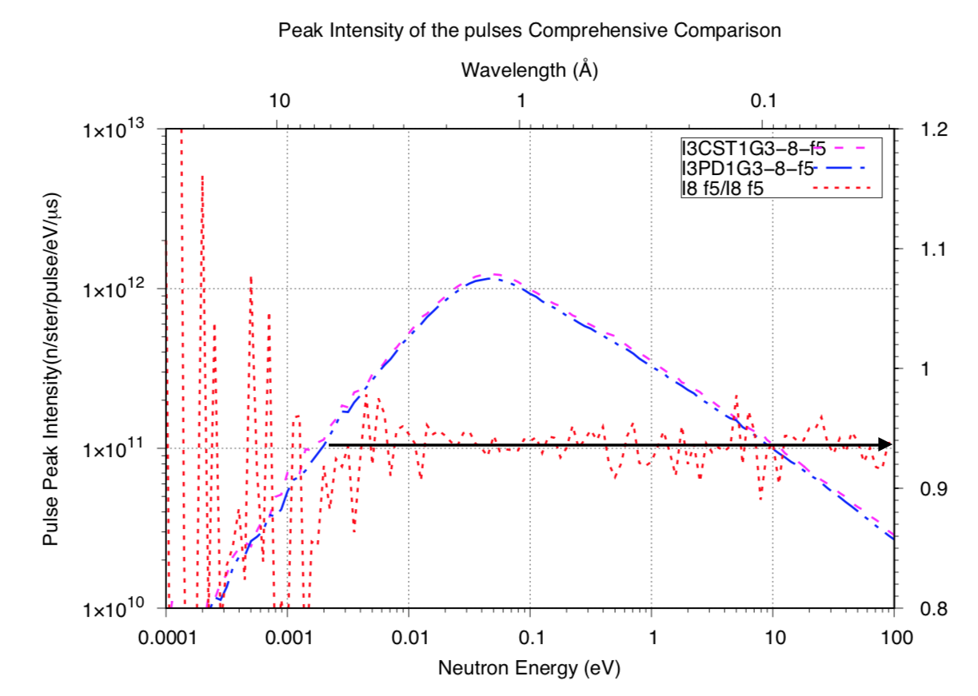
Target Shape Impact on Moderator Performance
Decoupled hydrogen moderator
Decoupled water moderator
Moderator performance for the preliminary PPU design

Slide 16
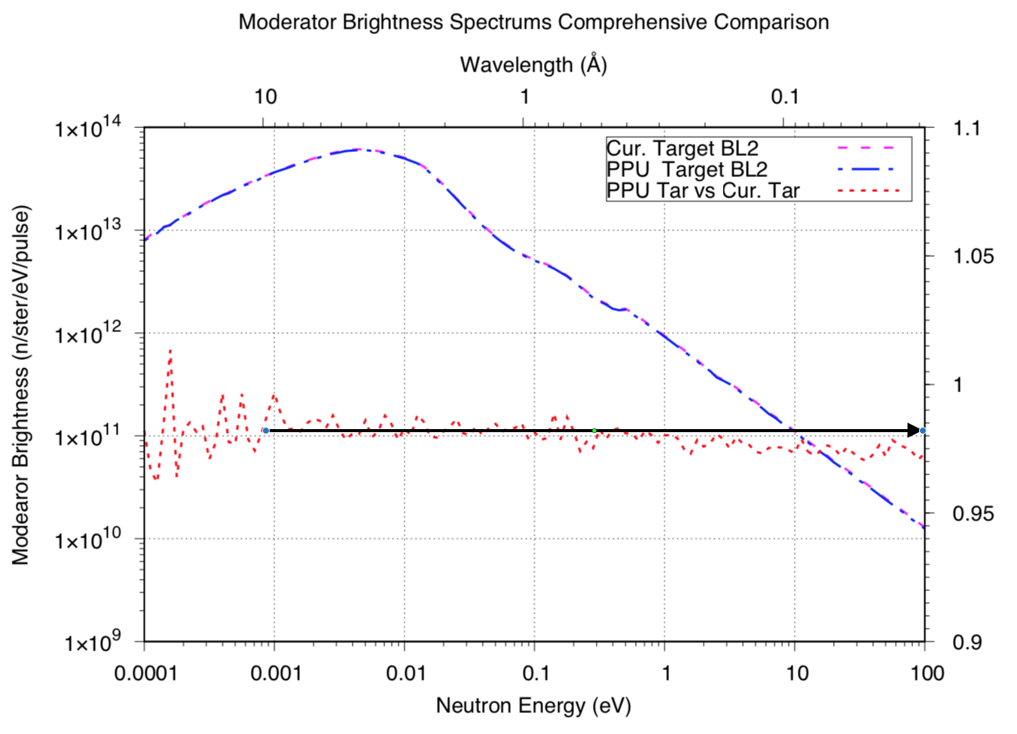
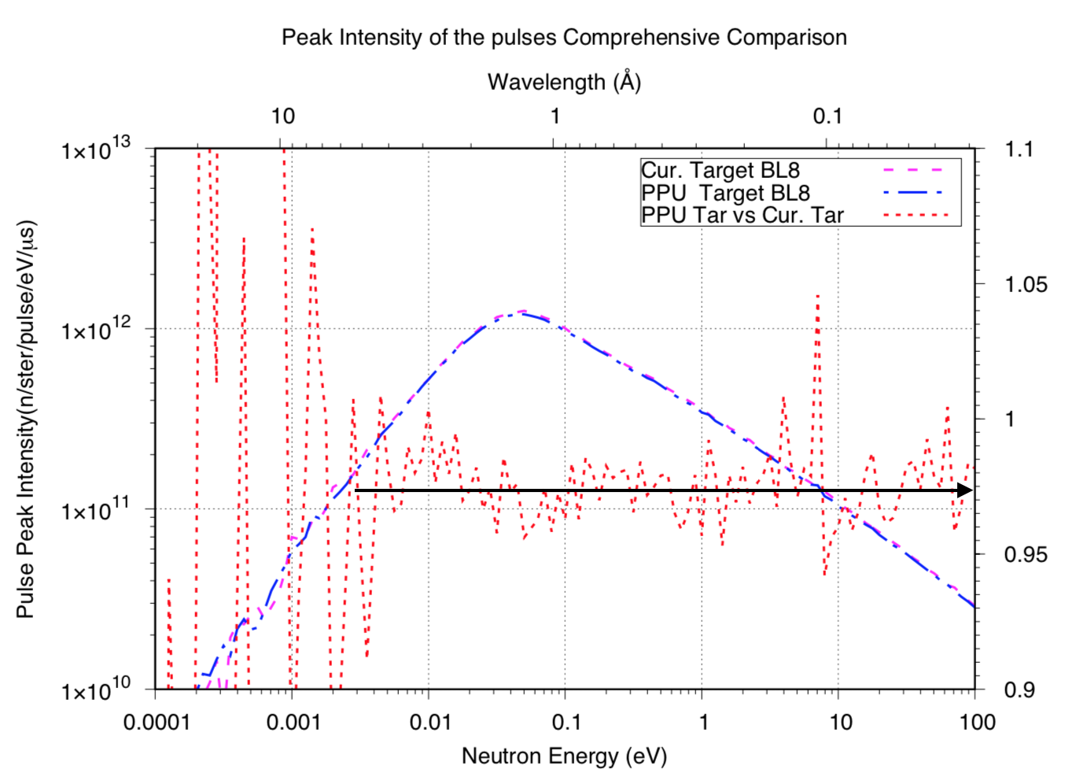
Target Shape Impact on Moderator Performance
Decoupled hydrogen moderator
Decoupled water moderator
Moderator performance for the final PPU design

Slide 17
Optimization of Target Length
The increase of proton beam energy from 1.0 GeV to 1.3 GeV shifts the peak neutron production zone slightly downstream
Raised the question of whether target position needs to be reoptimized
But such a shift is not supposed to be big, therefore, a step size of 5 mm change of target length was performed for the moderator performance impact

Slide 18
Target Length Impact on Moderator Performance
Upstream decoupled hydrogen moderator
Downstream coupled hydrogen moderator

Slide 19
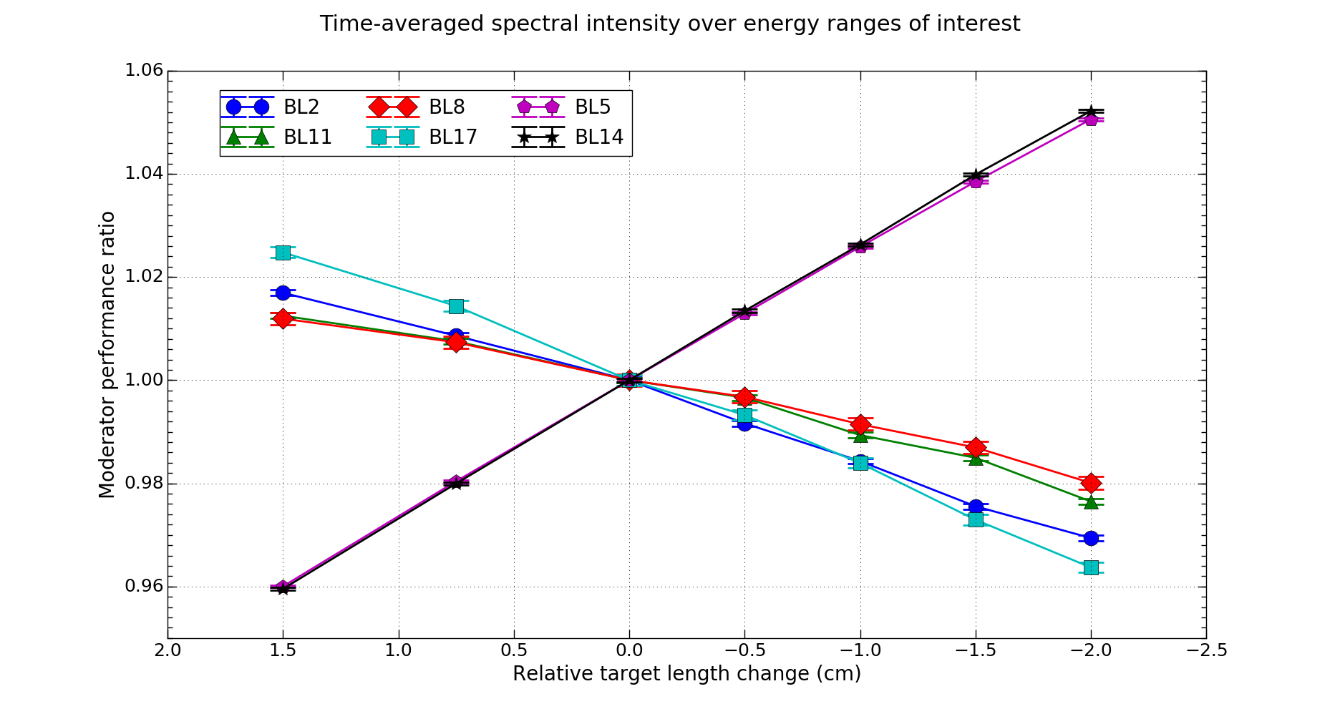
Target Length Impact on Moderator Performance
Moderator performance metrics
  1 meV < E < 100 meV for hydrogen moderators
  5 meV < E < 500 meV for the water moderator

Slide 20
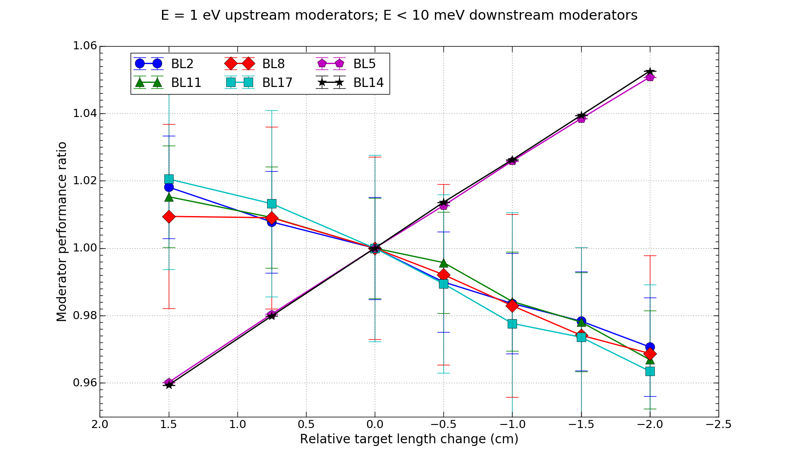
Target Length Impact on Moderator Performance
Moderator performance metrics
  1 eV for decoupled hydrogen and water moderators
  E < 10 meV for the coupled hydrogen moderator

Slide 21
Optimization of Target Length
Either metrics shows that
  for a 1.5 cm shortening of the target
    upstream moderators gain ~2% in neutron performance
    downstream moderators lose ~4% in neutron performance
  for a 2.0 cm extension of the target
    upstream moderators lose ~2.5% in neutron performance
    downstream moderators gain ~5% in neutron performance
  impacts on the downstream moderators are ~2 times larger than those on the upstream moderators
Upstream moderators host ~2 times more instruments
Target length unchanged due to no significant net gain in term of all instruments

Slide 22
Summary
SNS FTS is to enter new phase after the completion of PPU project
DAGMC was used as a high-fidelity modeling method at SNS FTS to perform neutronics studies for the PPU project
Such neutronics study efficiently assisted the design of the PPU
  energy deposition analysis helped target structure design
  moderator performance concern led to target shape redesign
  target length was kept the same after optimization

