Slide 1
Radiation Shielding Design Analysis for the Ring to Second Target Beam Transport at the Spallation Neutron Source Second Target Station
Wouter C. de Wet, PhD
dewetwc@ornl.gov
Accelerator Design and Technology
19 March 2024

Slide 2
Outline
Introduction to Second Target Station Project - RTST
Shielding Design Guidance
Radiation Transport Methodology
Analysis 1: Truck Access Tunnel & Labyrinth
Analysis 2: HVAC Ducts
Analysis 3: Soil Berm and Electrical Chases

Slide 3
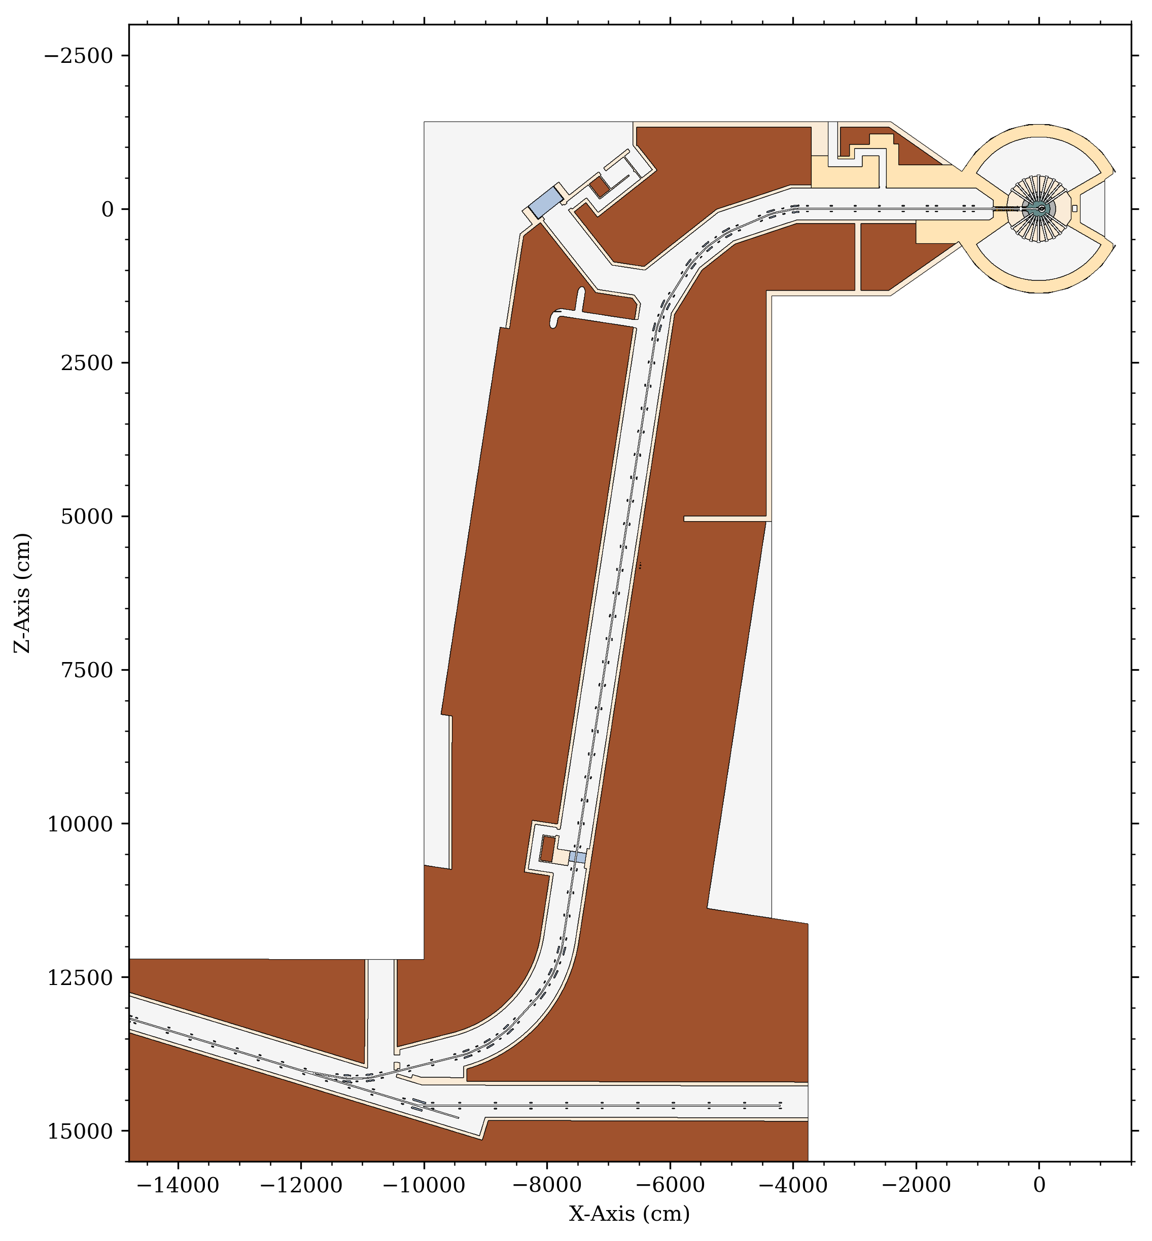
STS-RTST Overview
STS Accelerator Geometry
RTST Truck Access Tunnel & Labyrinth
Soil
Concrete (HD)
Concrete
Steel 1020
Air
RTST - Ring to Second Target Beam Transport
Beam Power is 700 kW (15 Hz)
Proton Energy is 1.3 GeV
Total Length is ~220 m
56 Quadrupole Magnets
15 Dipole Magnets
0.7 MW
STS Target Building
HVAC System
RTST Straightaway:
CSB Chases
Soil Berm Height
RTST
Accumulator Ring
PPU Stub
2.7 MW
RTBT Leg 2
RTBT Leg 1
2.0 MW
First Target Station

Slide 4
Shielding Design Guidance
Dose rates in generally occupied regions should be <0.25 mrem/hr during normal operations
Requirement begins 30 cm from shielding surface
Exceptions possible for regions in which continuous occupation not plausible

Slide 5
Radiation Transport Methodology
Transport Model
In this work, all reported results are obtained using the MCNP6.2 radiation transport code.
Source
In the case of “Monte Carlo” transport, increasing simulation run times reduces uncertainty in results.
Geometry (CSG, Uns. Mesh, etc.)
Radiation Transport Code (MCNP, PHITS, HZETRN, etc.)
Results
Time
Tallies (Flux, Dose, etc.)
Variance Reduction
Cleverly implemented variance reduction techniques can greatly reduce the amount of time required. In this work, a variety of techniques are implemented, including DXTRAN Spheres and Weight Windows generated using the ADVANTG code.

Slide 6
Transport Sources
Plan View: Proton Flux in RTST Tunnel
Linear beam losses along active transport lines
Assume 1 W/m of beam
1.3 GeV protons
Lost protons placed in beam tube walls
Backscatter from primary beam
700kW primary beam on tungsten target
1.3 GeV protons

Slide 7
Transport Tallies
MCNP6 TMESH
25 cm rectilinear mesh
3 Particle Species
Protons
Neutron
Photons
Quantities
Flux
Dose Rate
Exposure contributions calculated via whole-body external exposure effective dose rate flux-to-dose conversion factors.

Slide 8
Analysis 1
Truck Access Tunnel & Labyrinth

Slide 9
Truck Access Tunnel
STS Accelerator Geometry
Soil
Concrete (HD)
Concrete
Source: 1 W/m beam losses in RTBT, RTST, and 1 MW primary beam-on-target backscatter.
Region: RTST Truck Access Tunnel and Labyrinth.
Steel 1020
Air
Objective Determine if dose rates in occupied regions outside of Truck Access Tunnel and Labyrinth are <0.25 mrem/hr during normal operations.

Slide 10
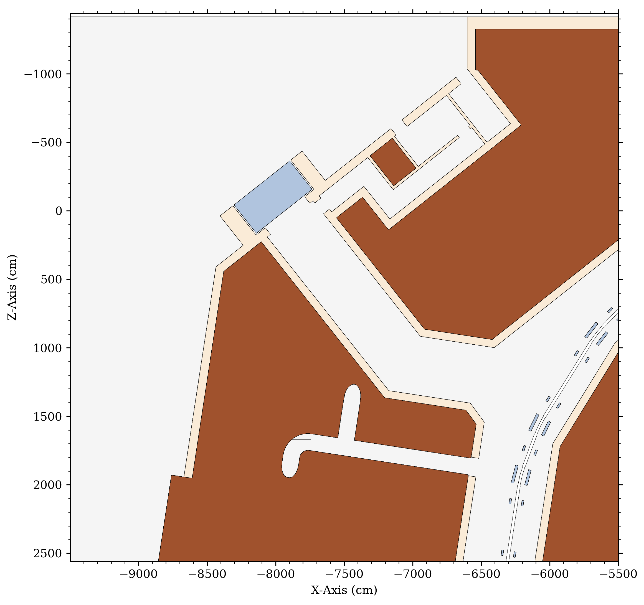
Truck Access Tunnel Continued
Material Specifications
Plan View 1: Truck Access Region Geometry
Soil, ρ_{bulk} = 1.931g/cm³, (21% H₂O content)
Concrete, ρ = 2.339 g/cm³
Steel, ρ = 7.039 g/cm³
Air, ρ = 0.0011988 g/cm³
Elevation View 1 Slice is perpendicular to the truck access tunnel centerline and parallel with the interior face of the stacked steel shielding.
Slice is intentionally placed in the gap between the exterior wall of the truck access tunnel and interior face of the stacked steel shielding mass.
Elevation View 2 Slice is directly along the truck access tunnel centerline.
Stacked Steel Shielding Blocks
Generally Accessible Room
Concrete Shielding
(labyrinth-side)
Generally Accessible Room
Labyrinth
Concrete Shielding
(CSB-side)
Elevation Views
Truck Access Tunnel
Elevation View 1 Slice
RTST
HVAC Ducts
Elevation View 2 Slice

Slide 11
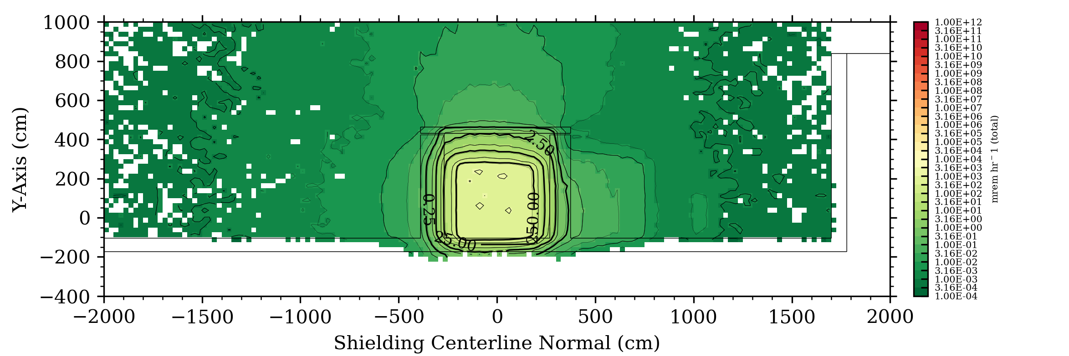
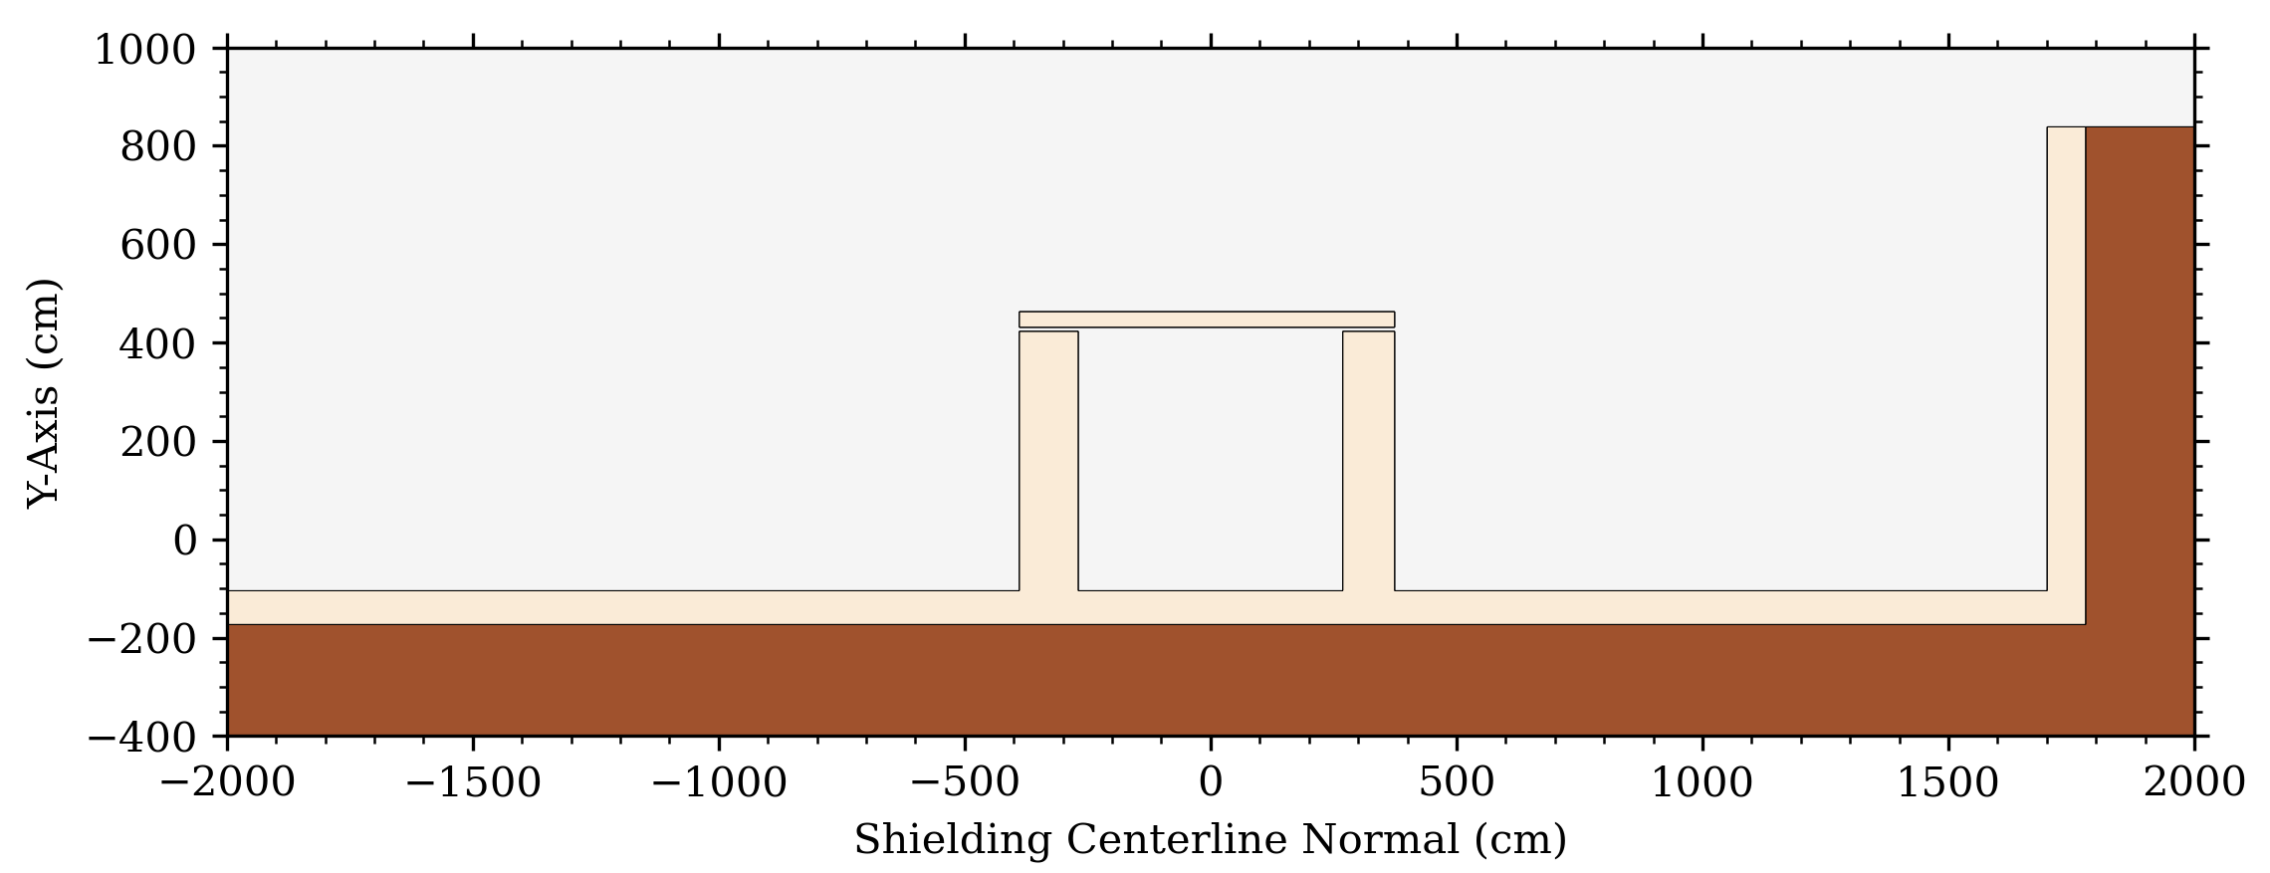
Elevation View 1, Concrete Shielding & Lintel
Elevation View 1: Total Dose Rate (1W/m Beam Losses & Target Backscatter)
Dimension(s)
a
528.3 cm
Height of concrete shielding from tunnel floor.
b
110.0 cm
Required width of concrete shielding (CSB-side).
c
538.32 cm
Interior spacing between concrete shield walls.
d
733.32 cm
Full width of concrete lintel (outer concrete extents).
e
85.0 cm
Required width of concrete shielding (labyrinth-side).
f
30.5 cm
Height of concrete lintel.
g
537.3 cm
Concrete lintel distance from tunnel floor.
Elevation View 1: Geometry
h
9.0 cm
Vertical gap between concrete lintel and walls.
Excess volume to be trimmed
h
Plan View
Notes
Concrete inner walls are equidistant from the steel shielding centerline. In other words, midpoint of c lies directly along the truck access tunnel centerline.
Gap h is not necessary. It may be filled by increasing a to match g. It may not be removed by decreasing g to match a.
d
f
(labyrinth-side)
(CSB-side)
(labyrinth side)
a
c
g
(CSB-side)
b
e
Soil
Concrete (HD)
Location of Elevation Slice
Concrete
Steel 1020
Air

Slide 12
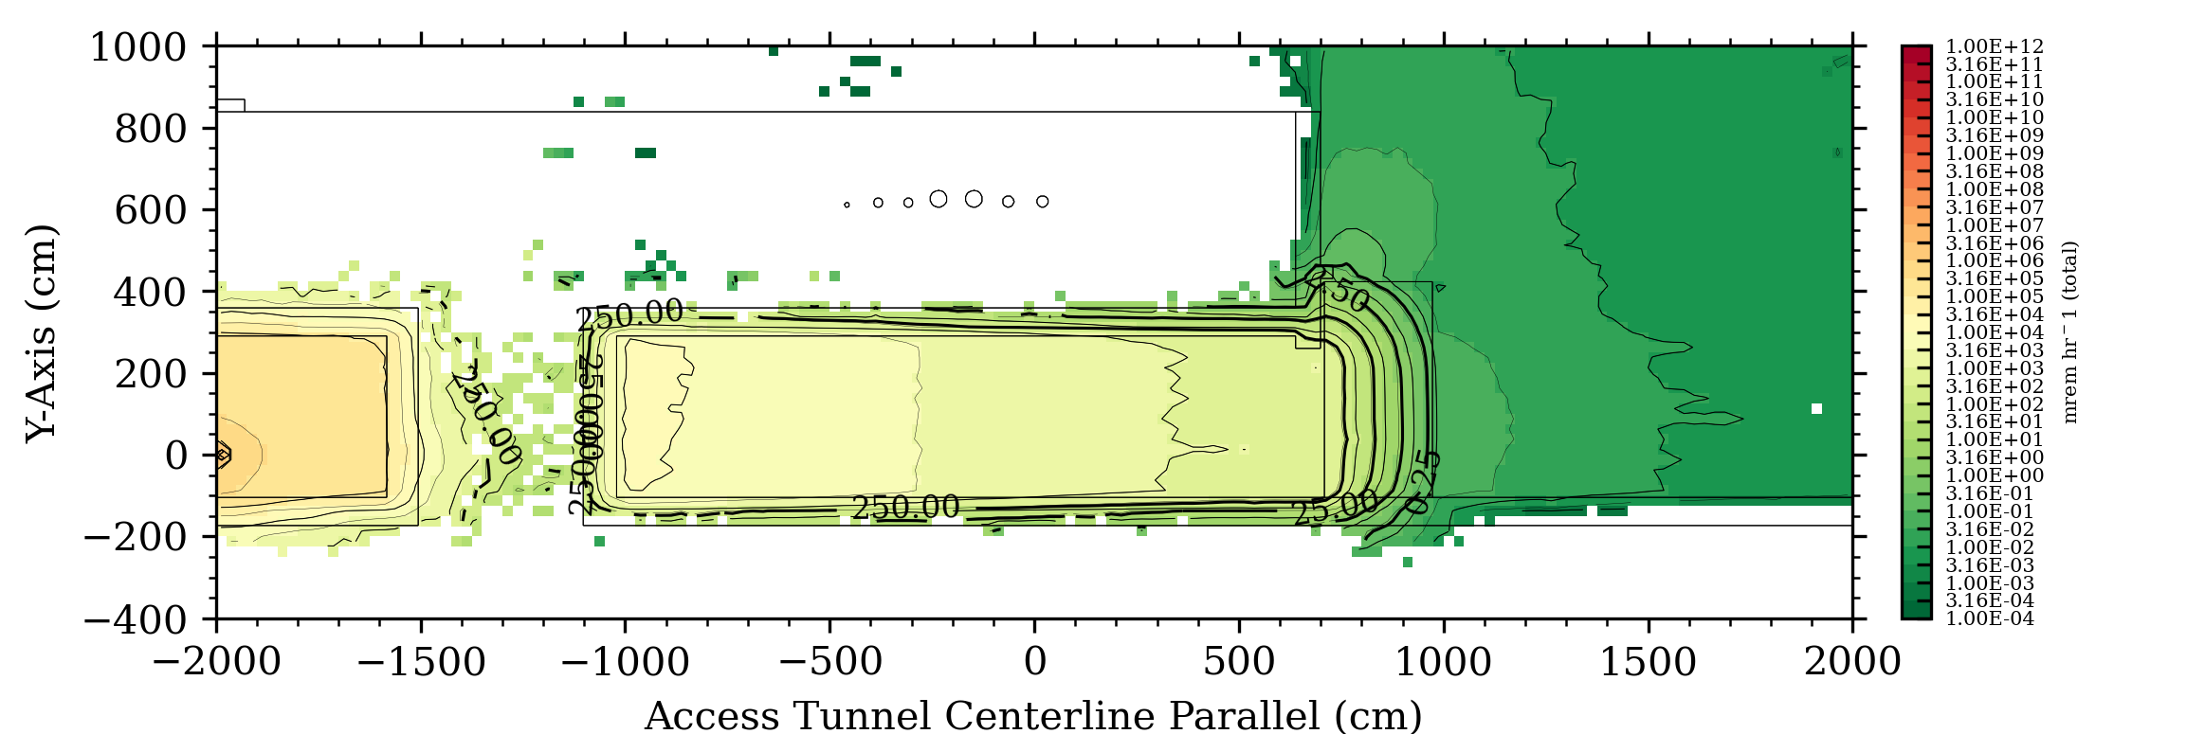
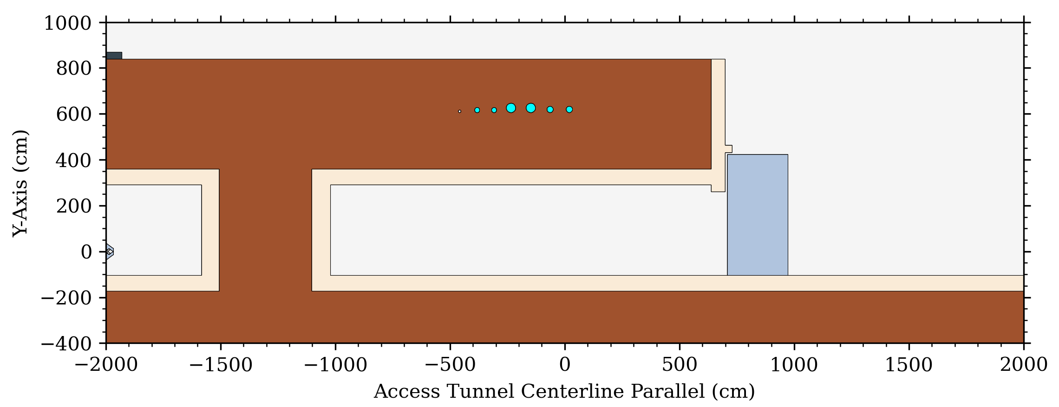
Elevation View 2, Steel Shielding Centerline & Lintel
Elevation View 2: Total Dose Rate (1W/m Beam Losses & Target Backscatter)
i
30.5 cm
Concrete lintel depth.
j
245.0 cm
Required depth of stacked steel shielding.
k
528.3 cm
Height of stacked steel shielding.
l
9.0 cm
Gap between truck access tunnel exterior wall and interior face of stacked steel shielding blocks.
m
9.0 cm
Gap between concrete lintel and stacked steel shielding.
Notes
Soil
There is no gap between the underside of the stacked steel shielding blocks and the tunnel floor/road elevation. Blocks will sit directly on the ground.
Dose rates streaming through HVAC ducts exceeding 0.25 mrem/hr on left side of plots are for the first design iteration and are no longer relevant.
Concrete (HD)
Concrete
Elevation View 2: Geometry
Steel 1020
Air
i
Plan View
m
(labyrinth-side)
k
l
j
(CSB-side)
Location of Elevation Slice

Slide 13
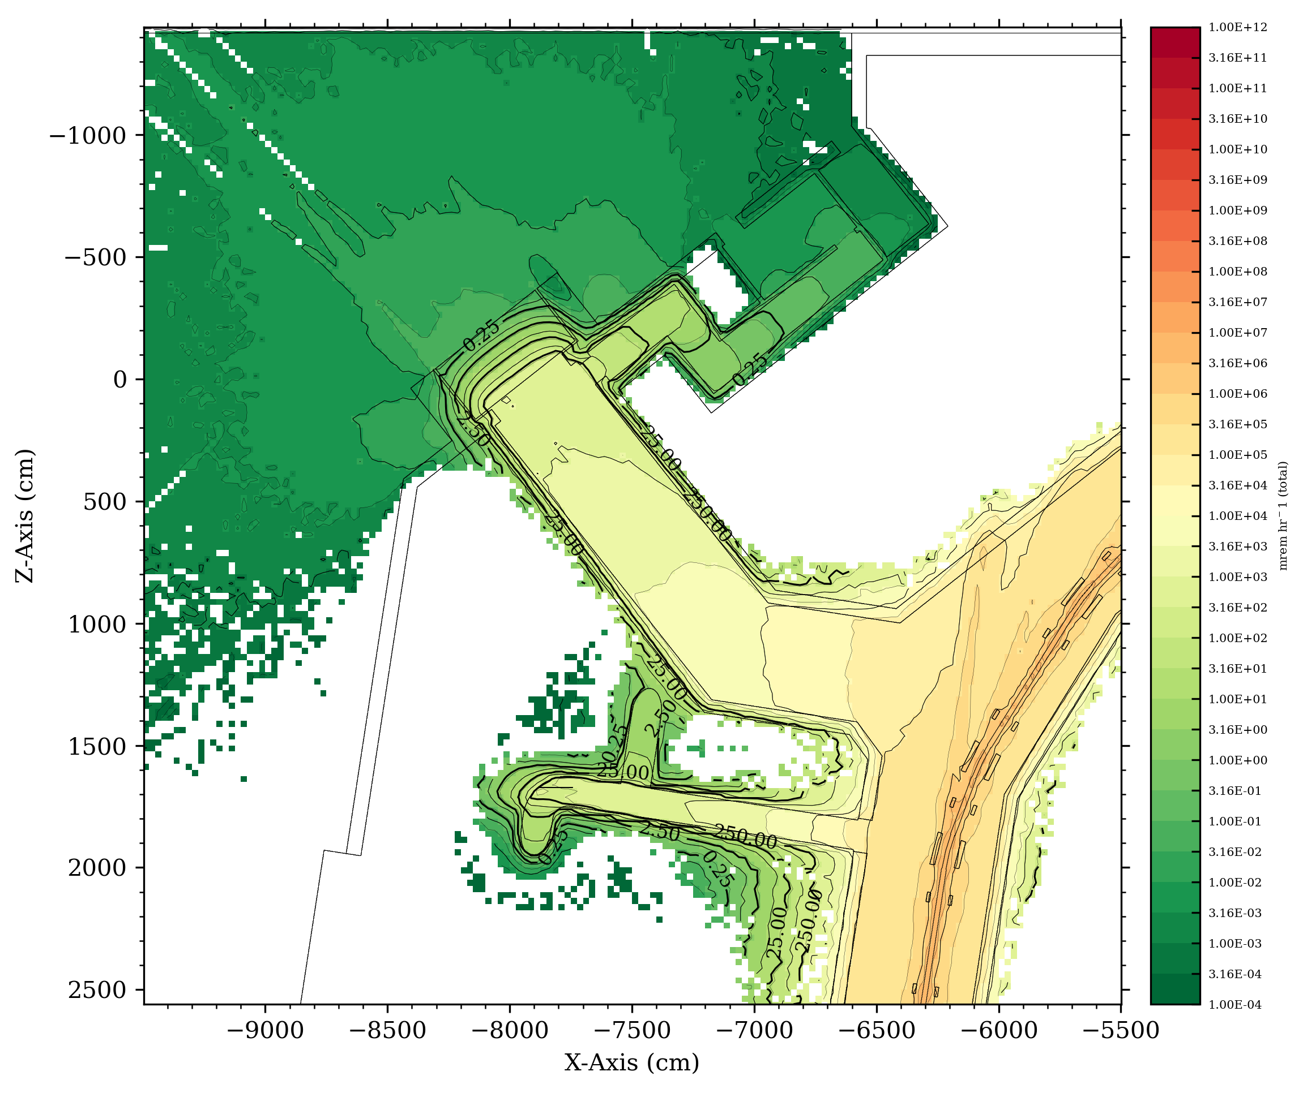
Plan View 1, Truck Access Shielding & Labyrinth
Plan View 1: Geometry
Plan View 1: Total Dose Rate (1W/m Beam Losses & Target Backscatter)
Soil
Concrete (HD)
Concrete
Steel 1020
Air

Slide 14
Plan View 1, Truck Access Shielding & Labyrinth
Plan View 1: Geometry
Plan View 1: Geometry
Dimension(s)
Excess volume to be trimmed
n
60.96 cm
Truck Access Tunnel outer concrete wall thickness.
Soil
o
528.3 cm
Width of stacked steel shielding blocks. Does not include the 5.0 cm gaps on either side between the interior faces of concrete shielding walls and steel mass.
Concrete (HD)
Concrete
Length of first hallway in Truck Access Tunnel labyrinth (width is 147.32 cm).
Steel 1020
2
s
p
452.12 cm
Air
q
x
1
t
z
q
20.32 cm
Truck Access Tunnel labyrinth concrete wall thickness surrounding inner soil shielding mass.
v
y
r
452.12 cm
Length of second hallway in Truck Access Tunnel labyrinth (width is 152.4 cm).
o
r
p
s
208.28 cm
Truck Access Tunnel labyrinth inner soil shielding mass thickness in the dimension perpendicular to the Truck Access Tunnel centerline.
w
t
279.4 cm
Truck Access Tunnel labyrinth inner soil shielding mass thickness in the dimension parallel to the Truck Access Tunnel centerline.
3
n
u
55.88 cm
Truck Access Tunnel concrete wall thickness.
u
v
152.4 cm
Width of third hallway in Truck Access Tunnel labyrinth.
w
55.88 cm
Truck Access Tunnel labyrinth concrete wall thickness.
x
20.32 cm
Truck Access Tunnel labyrinth interior concrete wall thickness.
y
883.92 cm
Length of third hallway in Truck Access Tunnel labyrinth.
z
55.88 cm
Truck Access Tunnel labyrinth concrete wall thickness.
1
5.0 cm
Gap between concrete shielding wall (CSB-side) and and stacked steel shielding mass.
2
5.0 cm
Gap between concrete shielding wall (labyrinth-side) and and stacked steel shielding mass.
3
9.0 cm
Gap between stacked steel shielding blocks and Truck Access Tunnel outer wall.

Slide 15
Analysis 2
HVAC Supply and Return Ducting

Slide 16
HVAC Supply and Return Ducting
STS Accelerator Geometry
Soil
Concrete (HD)
Concrete
Source: 1 W/m beam losses in RTBT, RTST, and 1 MW primary beam-on-target backscatter.
Region: HVAC ducts just upstream of the beam-right bend between CSB and RTST Truck Access Tunnel.
Steel 1020
Air
Objective Determine if dose rates in occupied regions on berm surface outside HVAC ducts are <0.25 mrem/hr during normal operations.

Slide 17
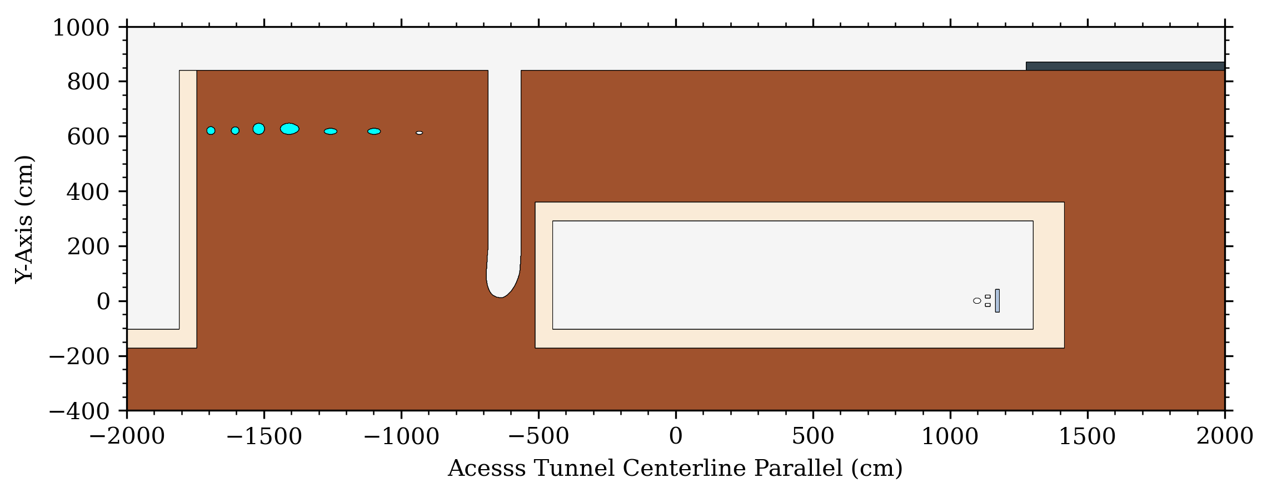
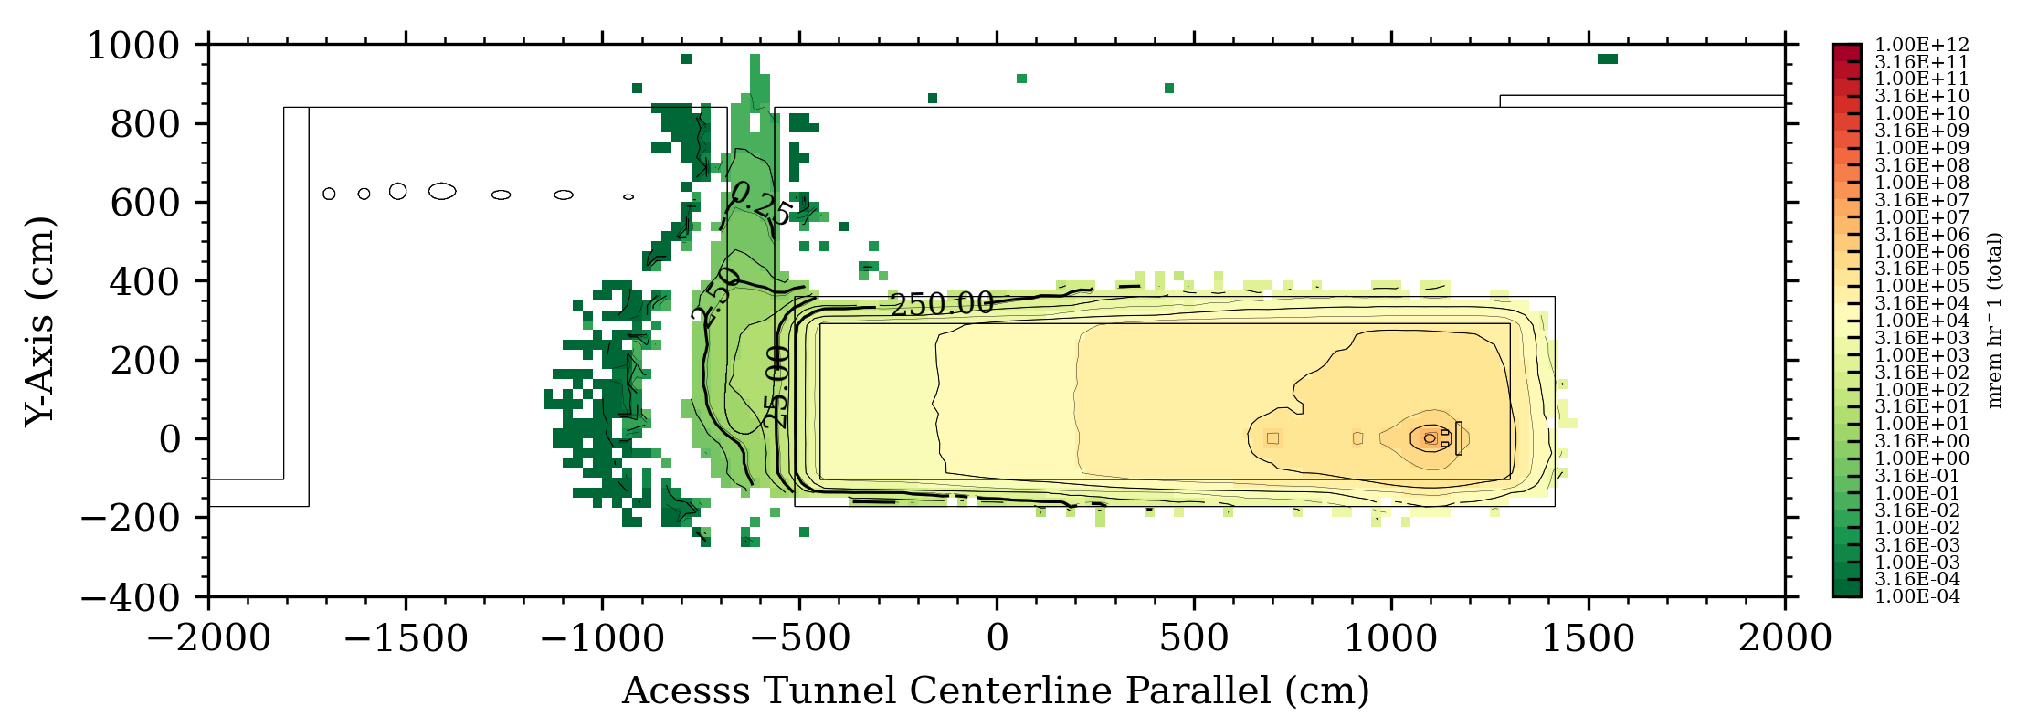
HVAC Supply and Return Ducting
STS Accelerator Geometry
Elevation Slice Geometry
Elevation Slice
Total Dose Rate, mrem/hr
Soil
Concrete (HD)
Concrete
Steel 1020
Air

Slide 18
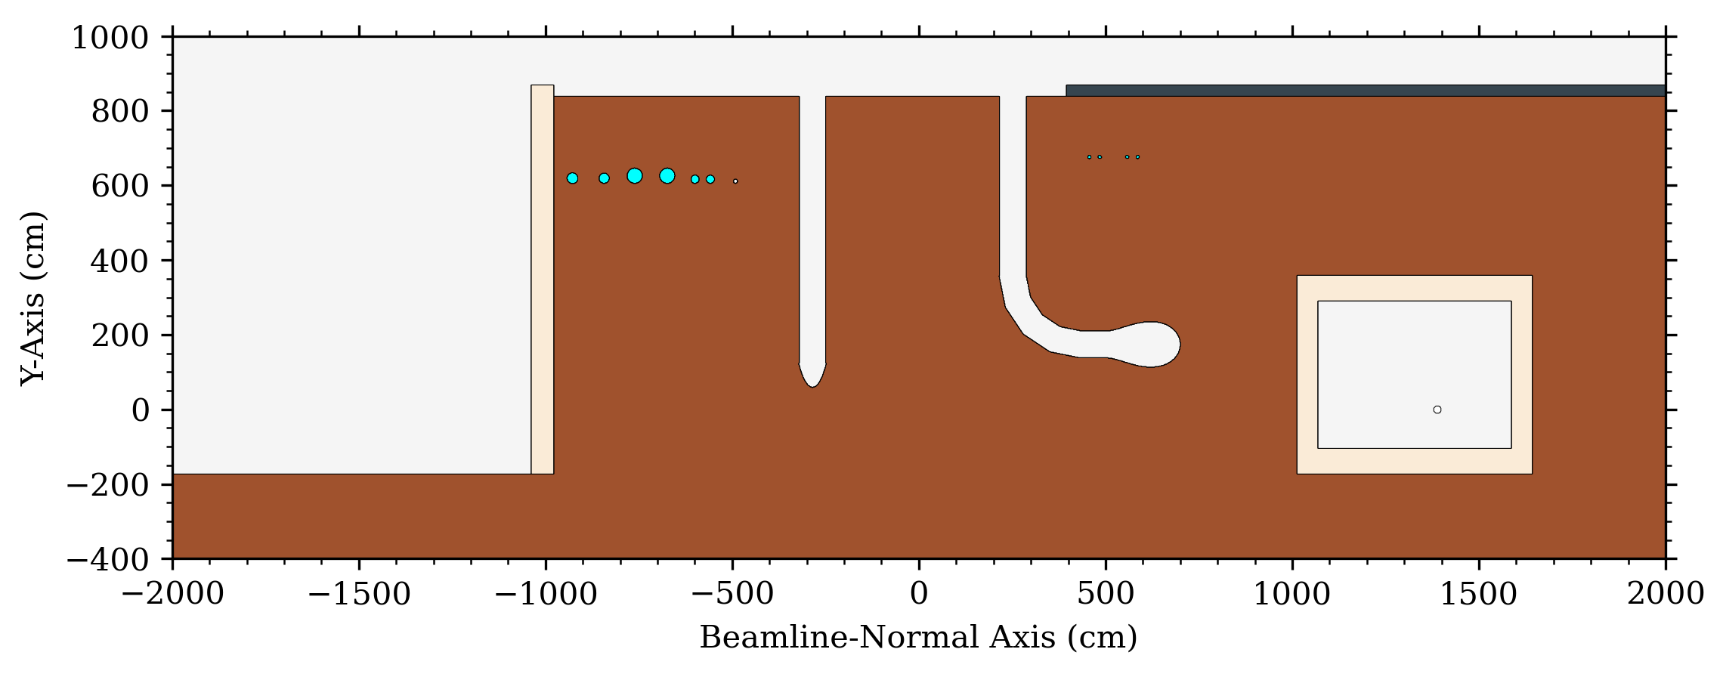
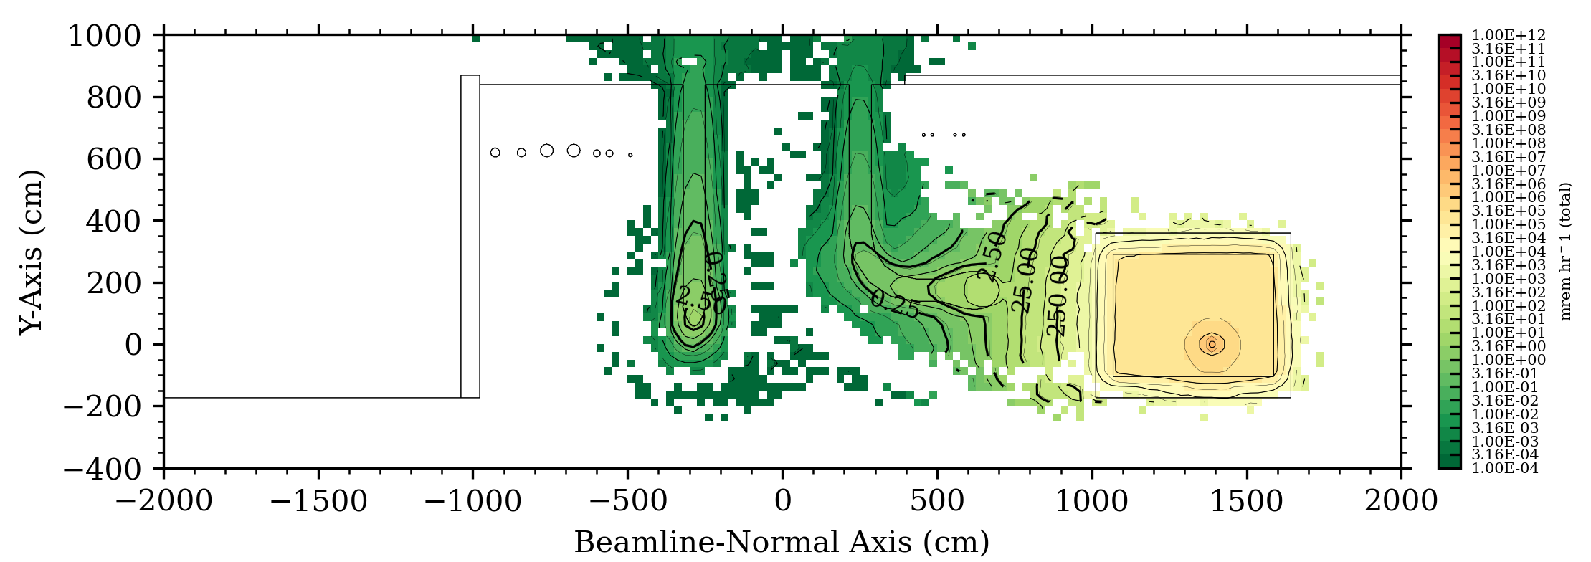
HVAC Supply and Return Ducting
STS Accelerator Geometry
Elevation Slice Geometry
Soil
Concrete (HD)
Concrete
Steel 1020
Air
Elevation Slice
Total Dose Rate, mrem/hr

Slide 19
Analysis 3
RTST-to-CSB Concrete Chases

Slide 20
RTST-to-CSB Concrete Chases
STS Accelerator Geometry
Soil
Concrete (HD)
Concrete
Source: 1 W/m beam losses in RTBT, RTST, and 1 MW primary beam-on-target backscatter.
Region: Concrete chases inside the soil berm above the RTST tunnel.
Berm thickness is ~530 cm.
Steel 1020
Air
Objective Determine if dose rates in occupied regions on berm surface and inside CSB due to streaming through concrete chases are <0.25 mrem/hr during normal operations.

Slide 21
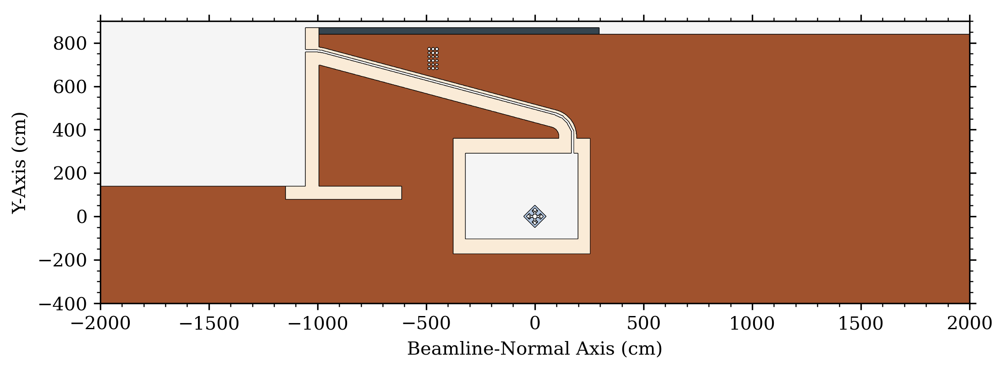
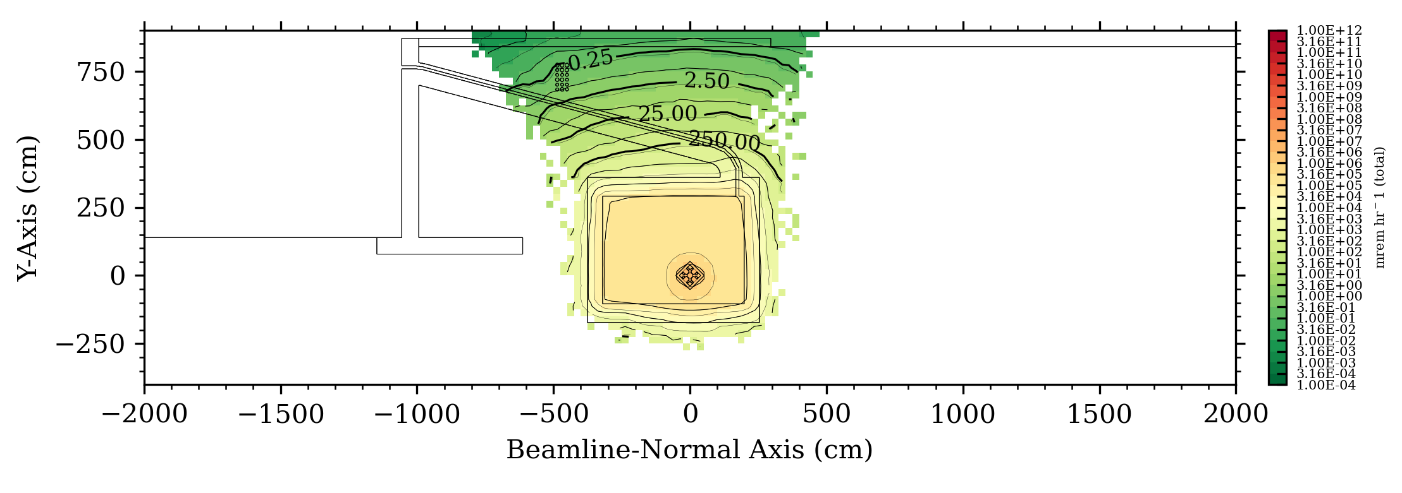
RTST-to-CSB Concrete Chases
STS Accelerator Geometry
Elevation Slice Geometry
Soil
Concrete (HD)
Concrete
Steel 1020
Air
Elevation Slice
Total Dose Rate, mrem/hr

Slide 22
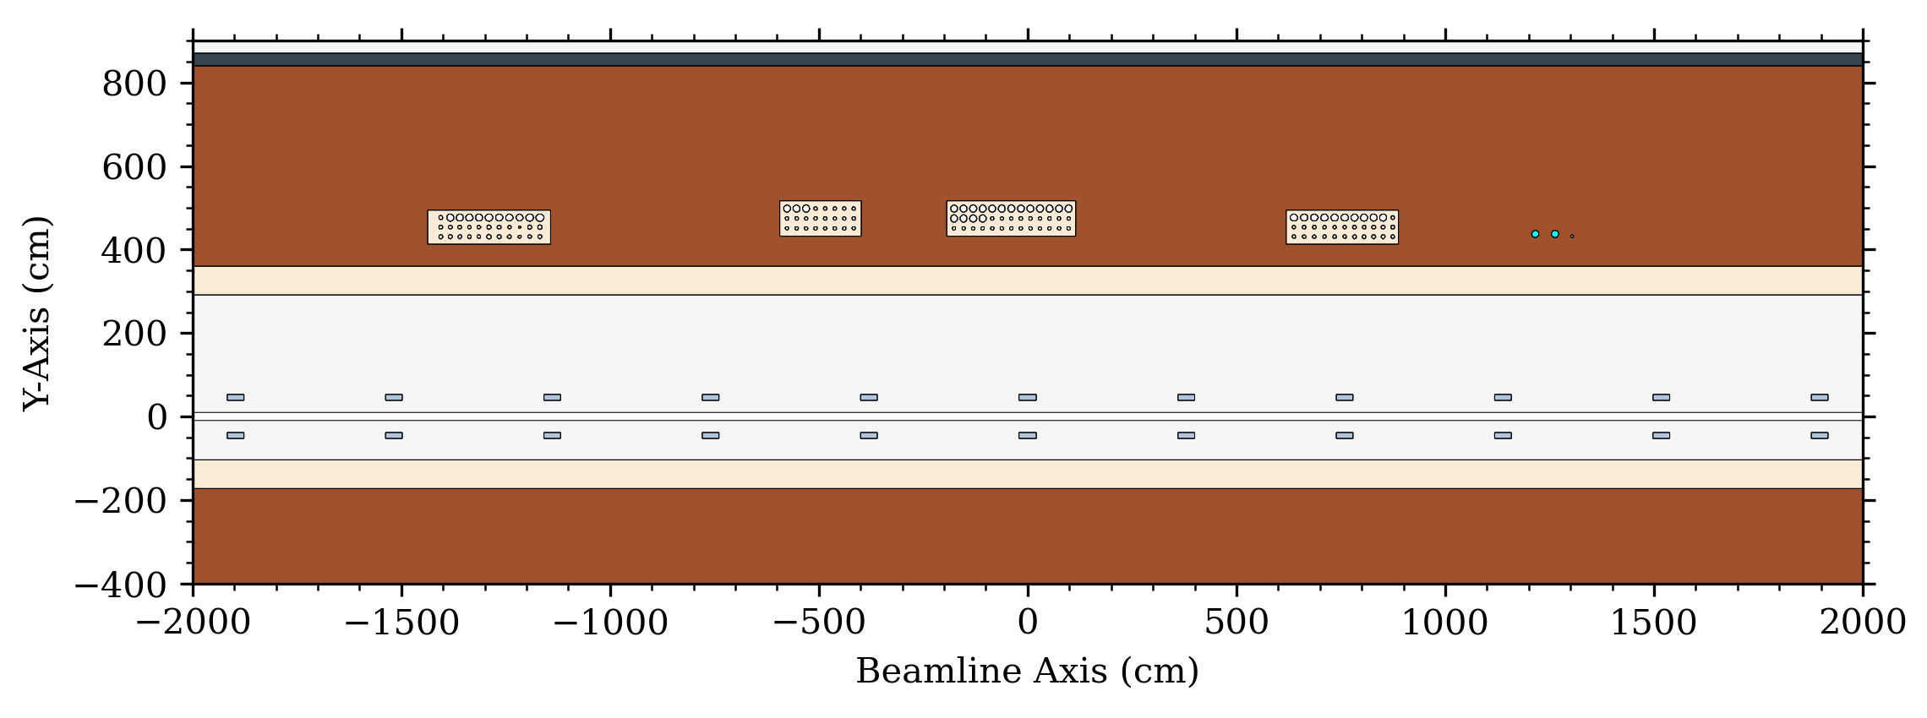
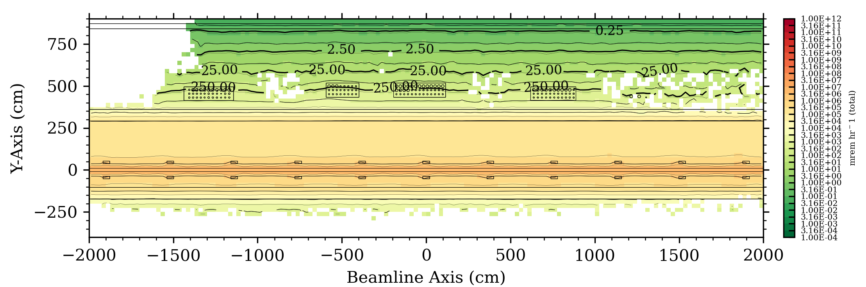
RTST-to-CSB Concrete Chases
STS Accelerator Geometry
Elevation Slice Geometry
Soil
Concrete (HD)
Concrete
Steel 1020
Air
Total Dose Rate, mrem/hr
Elevation Slice

Slide 23
Summary
Second Target Station RTST tunnel shielding design includes a multitude of smaller independent designs.
These major component designs are demonstrated to meet their intended shielding design requirements during continuous operation of the RTST beamline:
Truck Access Tunnel & Labyrinth
HVAC Ducts
Soil Berm and Electrical Chases

Slide 24
Questions?

Slide 25
Backup Slides

Slide 26
RTST Geometry

Slide 27
RTST Geometry (slightly closer)

