Slide 1
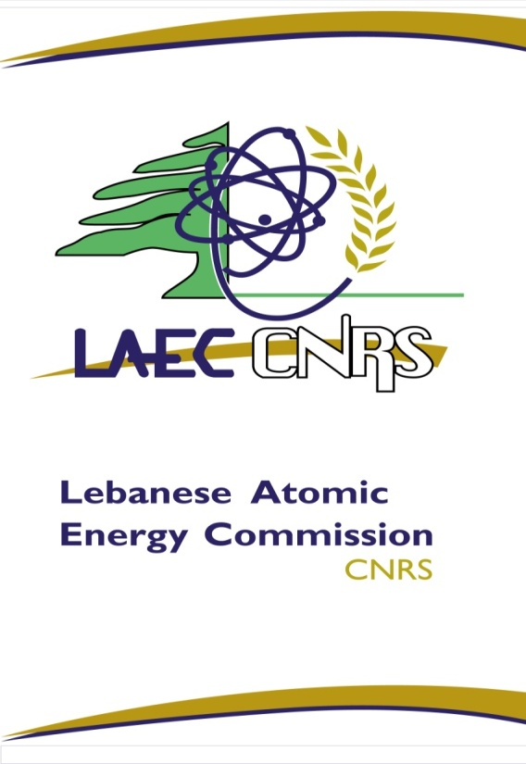

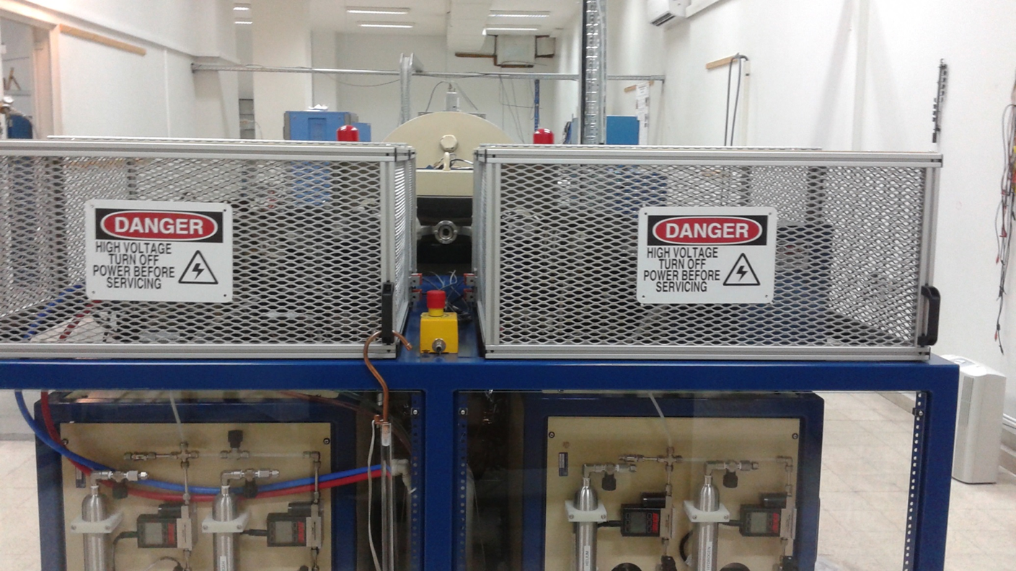
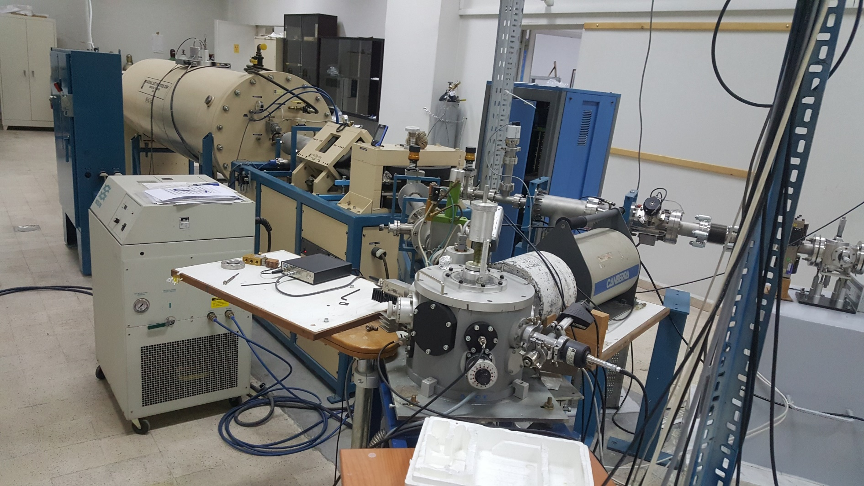
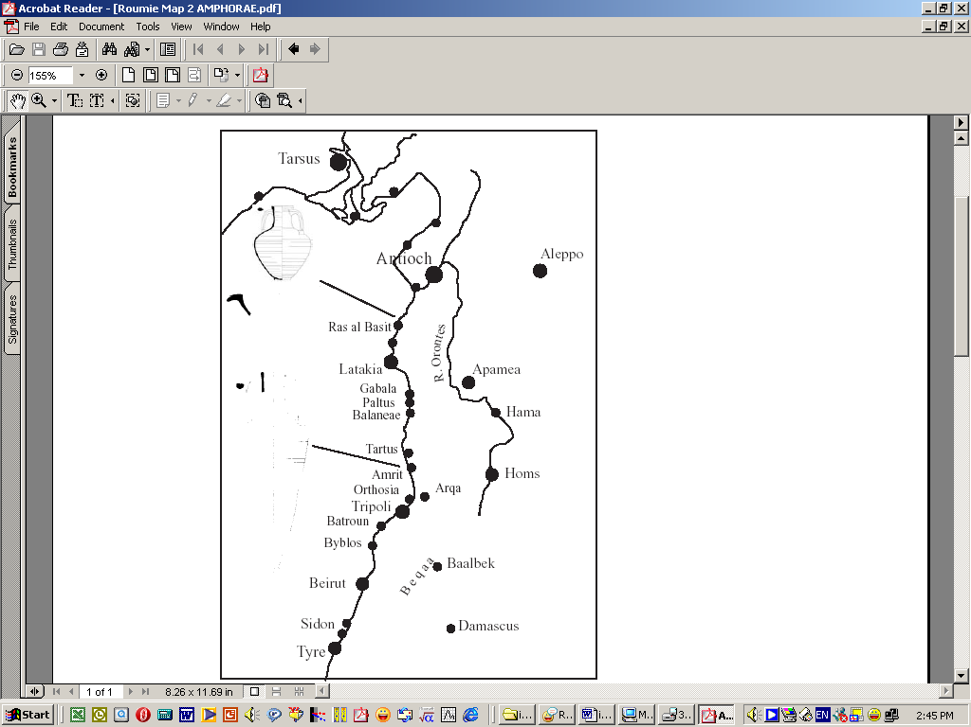
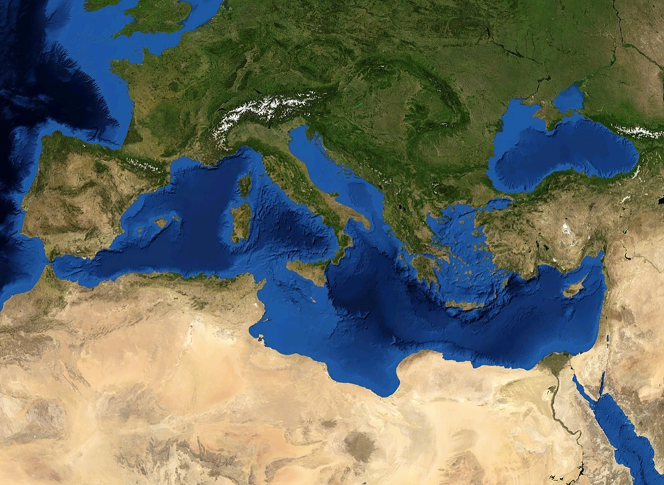
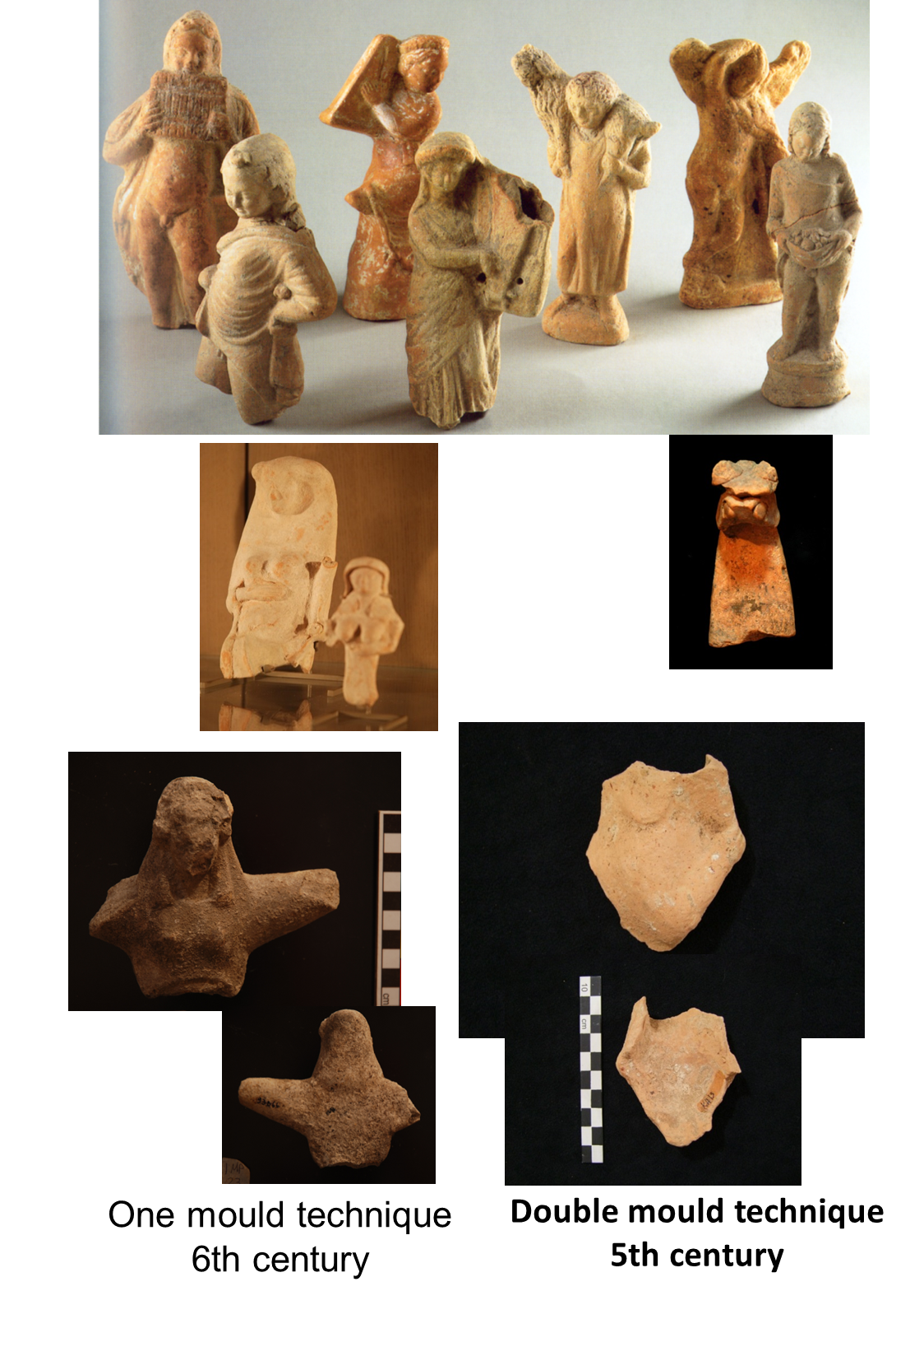
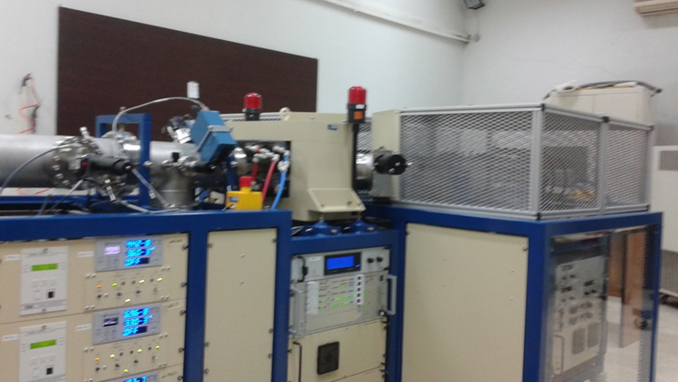
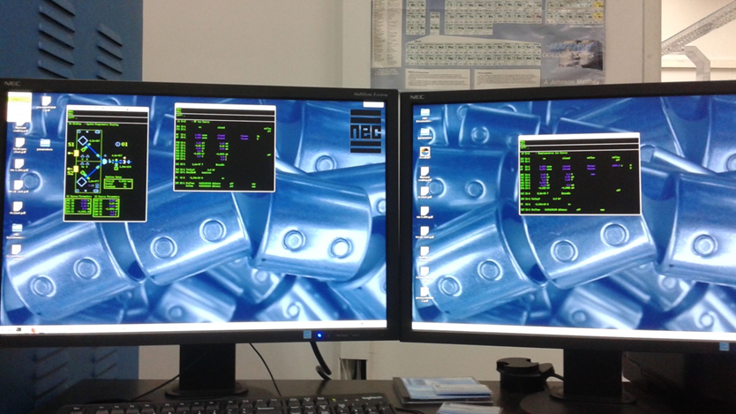
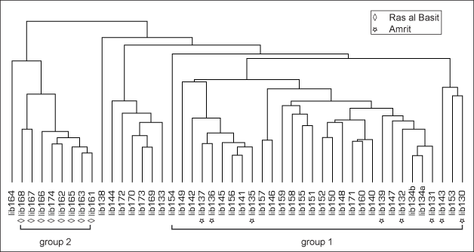
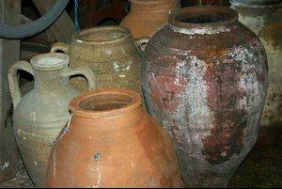
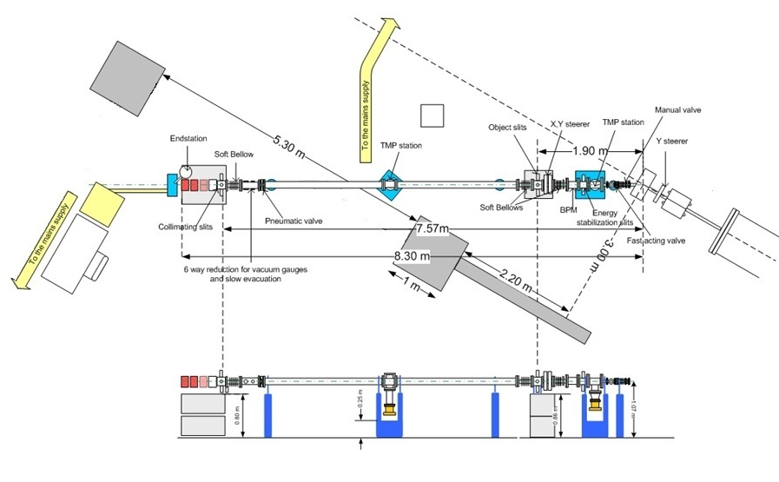
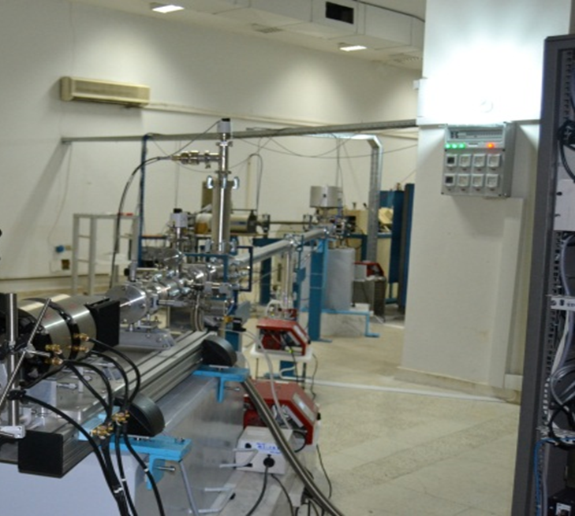
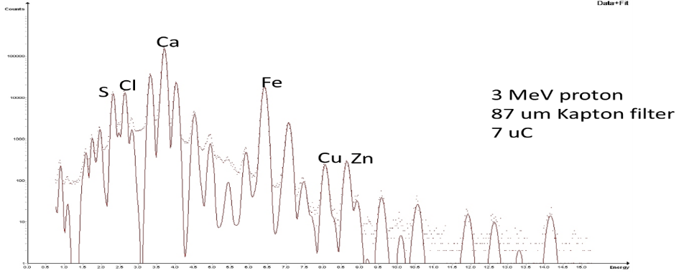


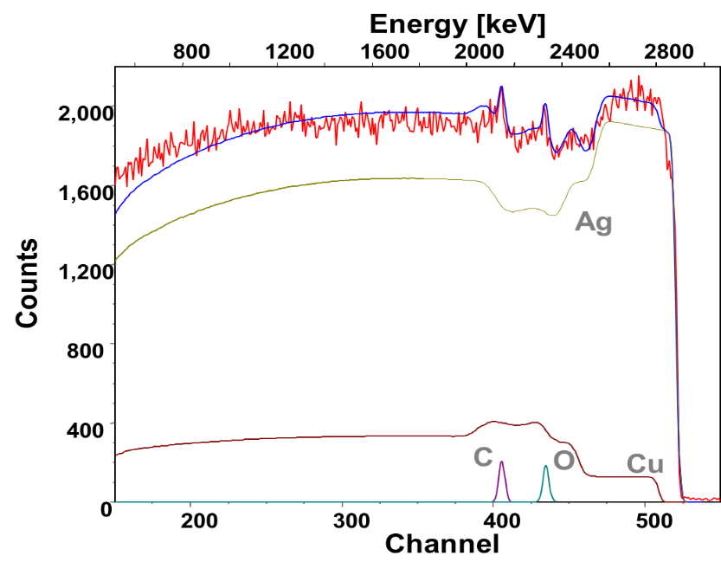
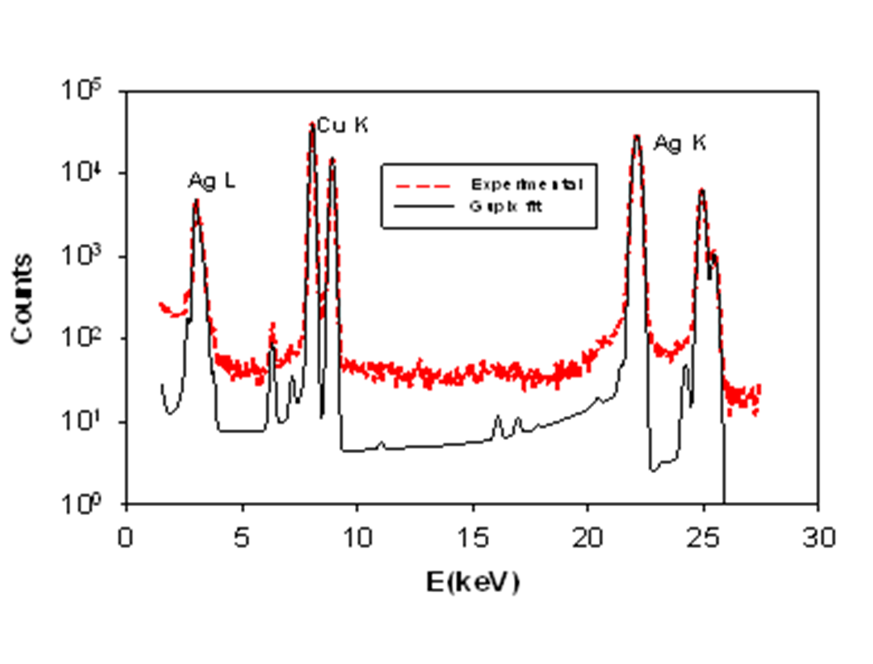
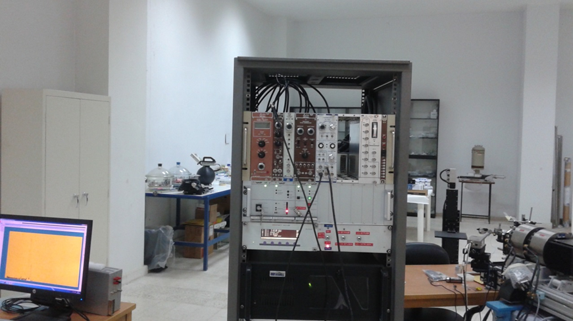
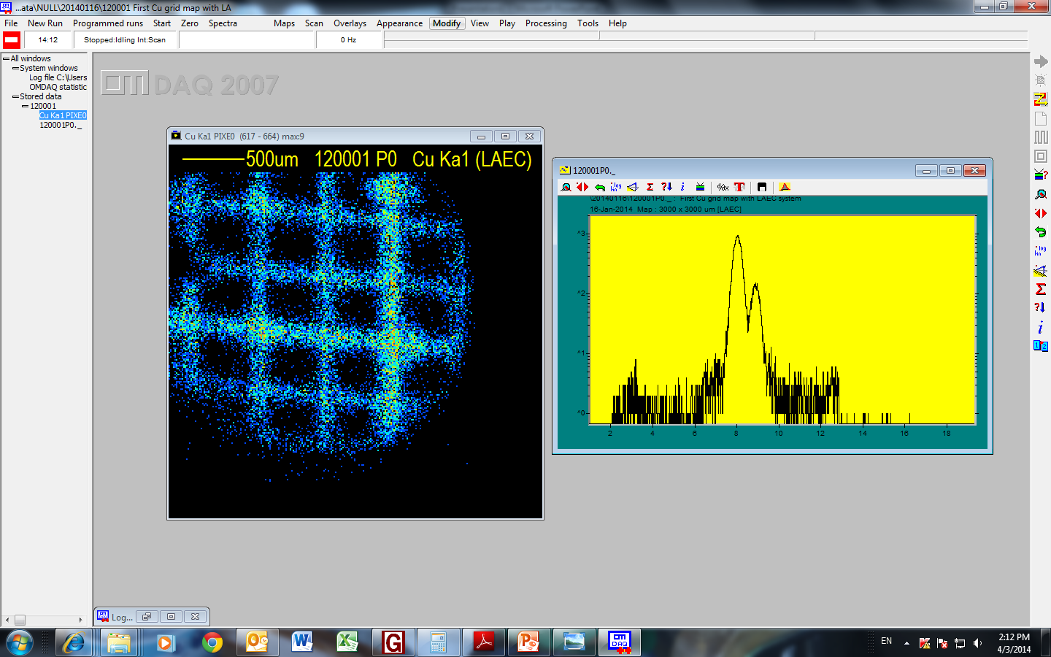
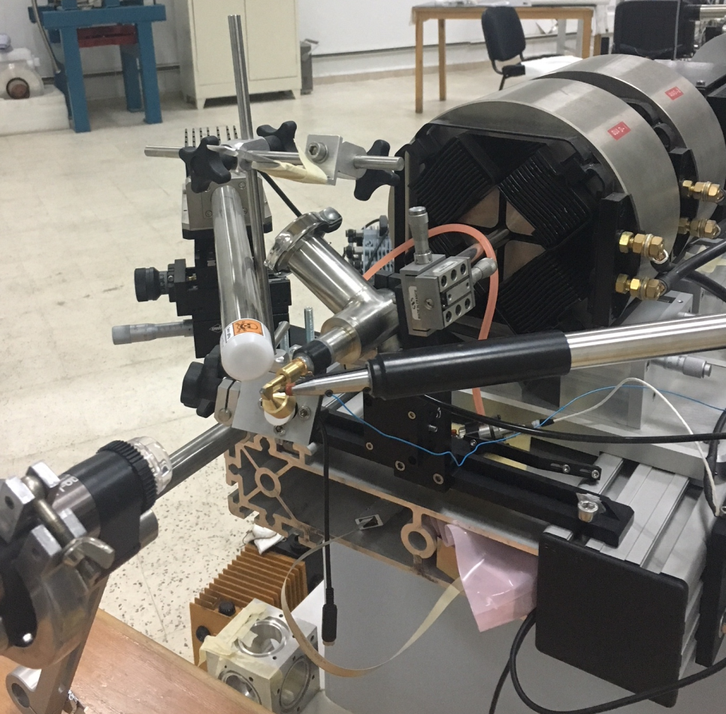
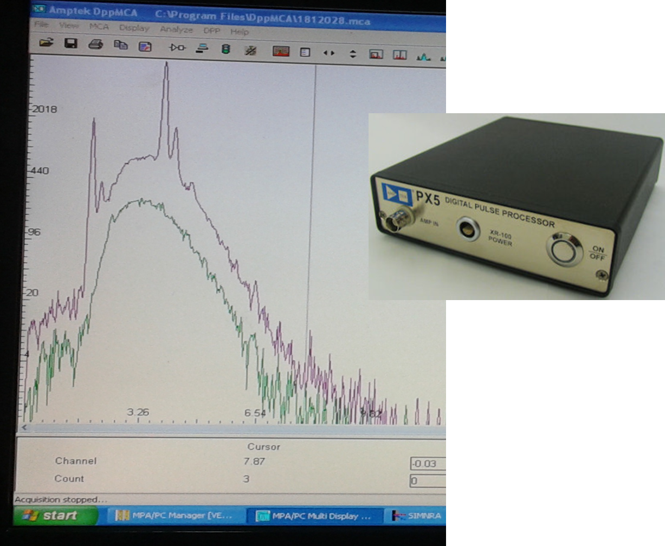
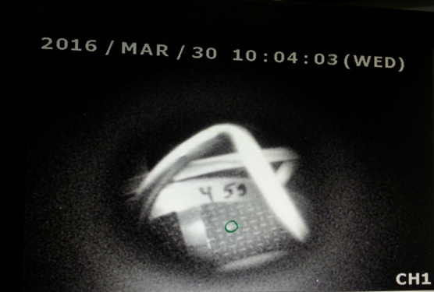
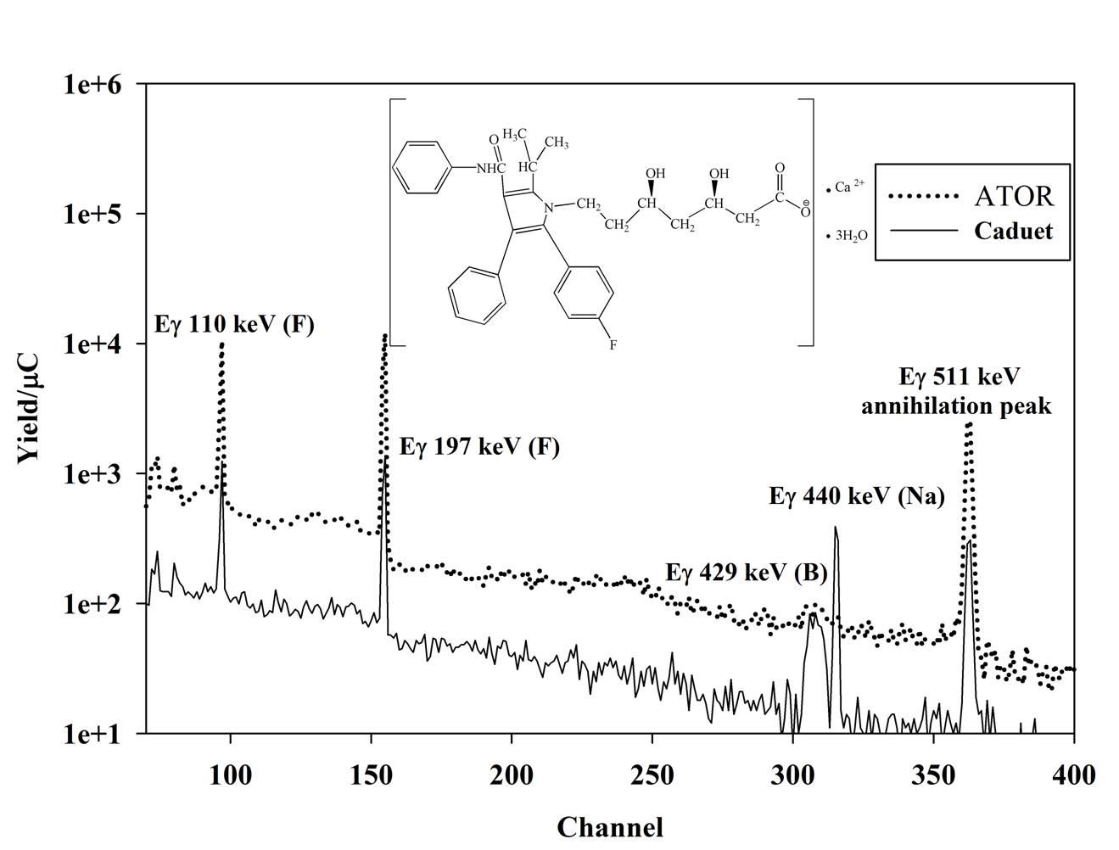

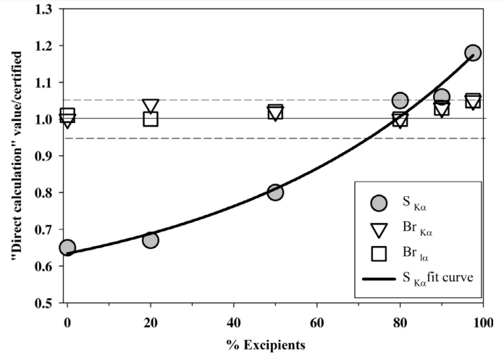
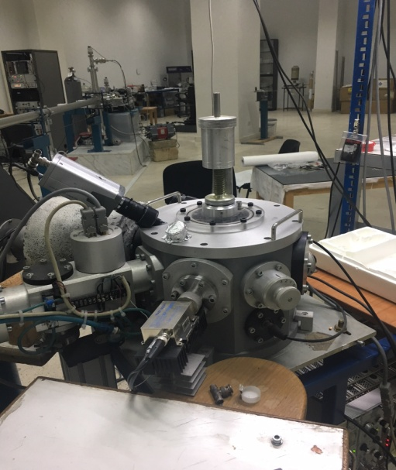
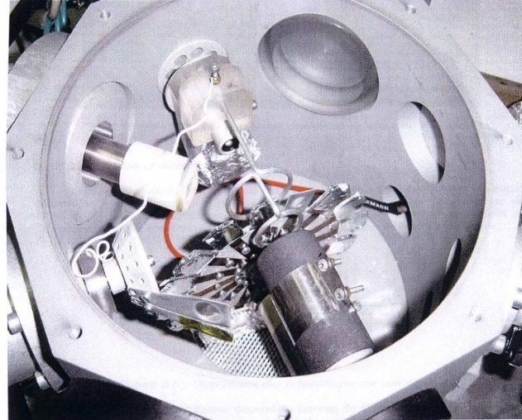
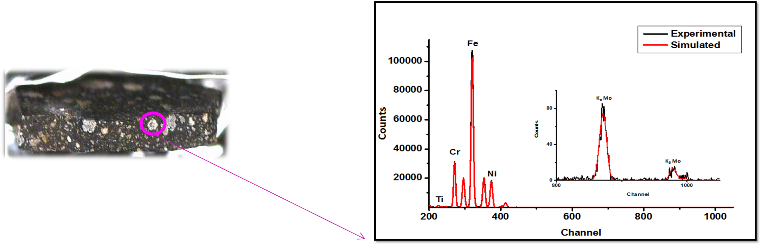
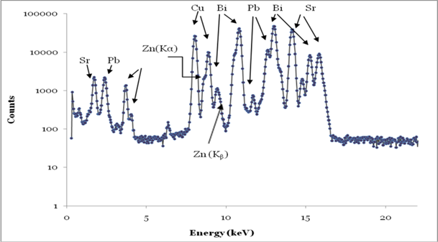
Upgrading and Development of the Lebanese Accelerator Setup for IBA Applications in Environment and Archaeology
Mohamad Roumie, Manale Noun, Ahmad Reslan, Bilal Nsouli
Accelerator Laboratory, Lebanese Atomic Energy Commission, CNRSL, Beirut, Lebanon
Abstract
5SDH Pelletron Tandem Accelerator of 1.7 MV
Case studies
A 5SDH Tandem Pelletron accelerator was commissioned at the Lebanese Atomic Energy Commission in 1999 to advance in the use of ion beam analysis techniques (IBA) among the local scientific community and facilitate collaborative projects with international partners. This work shows some performed IBA applications, including in cultural heritage, environment and materials science.
Provenance study and workshop fabric identification of excavated pottery and figurines using PIXE and statistical analysis
PHOINIKES
DUOPLASMATRON
ALPHATROSS
Classical sites of Levant
Classification and attribution of studied ceramics found in Beirut using PIXE technique and hierarchical cluster analysis
Experimental Setup and Techniques
Environment-Air quality: Investigation of atmospheric particulate matter PM₁₀ and PM_{2.5}
Introduction
The continuous upgrading of the accelerator concerns the use of SDD detectors, the installation of a new external microbeam line and recently the modification of the ion injector by adding a dual ion source, comprising a new alphatross radio frequency and a duoplasmatron. Thus, it will be shown the improvement in the performance and the new capabilities of the modified setup, also highlighting some significant case studies.
Authenticity determination of Ag-Cu Lebanese coins using combined PIXE and RBS techniques
Quality control of pharmaceutical drugs
In-air micro-beam + scanning possibility and imaging
Accelerator
Sources and beamlines
  Protons: 0.2- 3.4 MeV, 1-300 nA,
  Alpha-particles: 0.5-5.1 MeV, 1-100 nA
  SDDs, HPGe and PIPS detectors
  GUPIXwin, SIMNRA, MPAwin, DppMCA, OMDAQ
Paris Meteorite
*Dual Ion Sources:
- Alphatross Radio-Frequency for alpha (2.4 µA) and protons (4.2 µA).
- Duoplasmatron for protons (20 µA)
*Two Beam-lines:
- Conventional for Elemental Analysis under Vacuum.
- External Micro-beam for bulky, fragile and precious objects.
  Conventional vacuum chamber with mm beam spot
Improvement of superconducting properties
Simultaneous IBA Techniques for Materials Characterization
(Bi,Pb)2223 phase by adding ZnO nano particles
Proton Induced X-Ray Emission: Elemental composition of Na-Pb
References
*IBA for Materials Characterization
*Applications: Materials science, art and archeology, environment and Bio-Medicine
Proton Induced Gamma-Ray Emission: Elemental composition of B-Na
M. Roumie, B. Nsouli, K. Zahraman, A. Reslan, NIM B, 2004, 219-220, p.389-393
M. Roumie, S.Y, Waksman, B. Nsouli, P. Reynolds, S. Lemaitre, 2004, NIM B, 215, p.196-202
M. Roumie, N. Saliba, B. Nsouli, M. Younes, M. Noun, R. Massoud, 2011, NIM B, 269, P.3106-3110
B. Nsouli, K. Zahraman, A. Bejjani, S. Assi, F. El-Yazbi, M. Roumie2006, NIM B, 249, p.692-696
M. Roumie, B. Nsouli, G. Chalhoub, M. Hamdan,2010, NIM B, 268, p.1916-1919
M. Noun, M. Roumie, T. Calligaro, B. Nsouli, R. Brunetto, D. Baklouti, L. d’Hendecourt, S. Della-Negra, NIM B, 2013, 306, p.261-264
M. Roumie, W. Abdeen, R. Awad, M. Korek, I. Hassan, R. Mawassi, 2014, J. Low Temp Phys, 174, p.45-63
Elastic Backscattering Spectrometry: thickness and stoichiometry of thin layers, elemental depth profile

