Slide 1
U4 Driver for Timely Energy —IFE from Inertial Confinement Fusion
R.J. Burke and A.T. Burke
Nuclear Applications of Accelerators
Norfolk, Virginia
March 19, 2024
Notes:
Accelerator driver for IFE. Now is the time to unfreeze the heavy ion beam driver program. NIF is igniting pellets. The Cold War is over, but not the fight for love and glory. Fight for existence. Existence with dignity. A share of good living.

Slide 2
Introduction
Alex Burke

Slide 3
Heavy Ion Fusion
… since 1976.
Energy from inertial confinement fusion
driven by beams of high energy heavy ions
generated by systems of mainstream accelerator technology.
Notes:
Permission requested. Forgot to save my message, but only thing matters is if they get back to me.

Slide 4
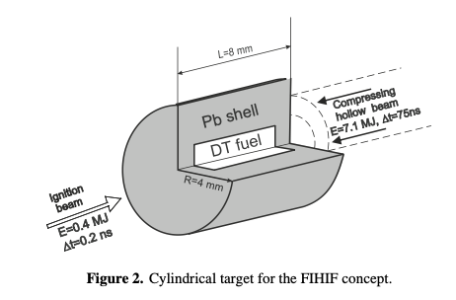
U4 BOE/pulse
Multi-isotope beams
both ends for prepulse, compression,and ignition
Basko et al. 2002
Compression
35-40 MJ
Ignition
> 1 PW
> 1 ns

Slide 5
U4 HIF IFE energy system
Big Energy for Big Needs

Slide 6
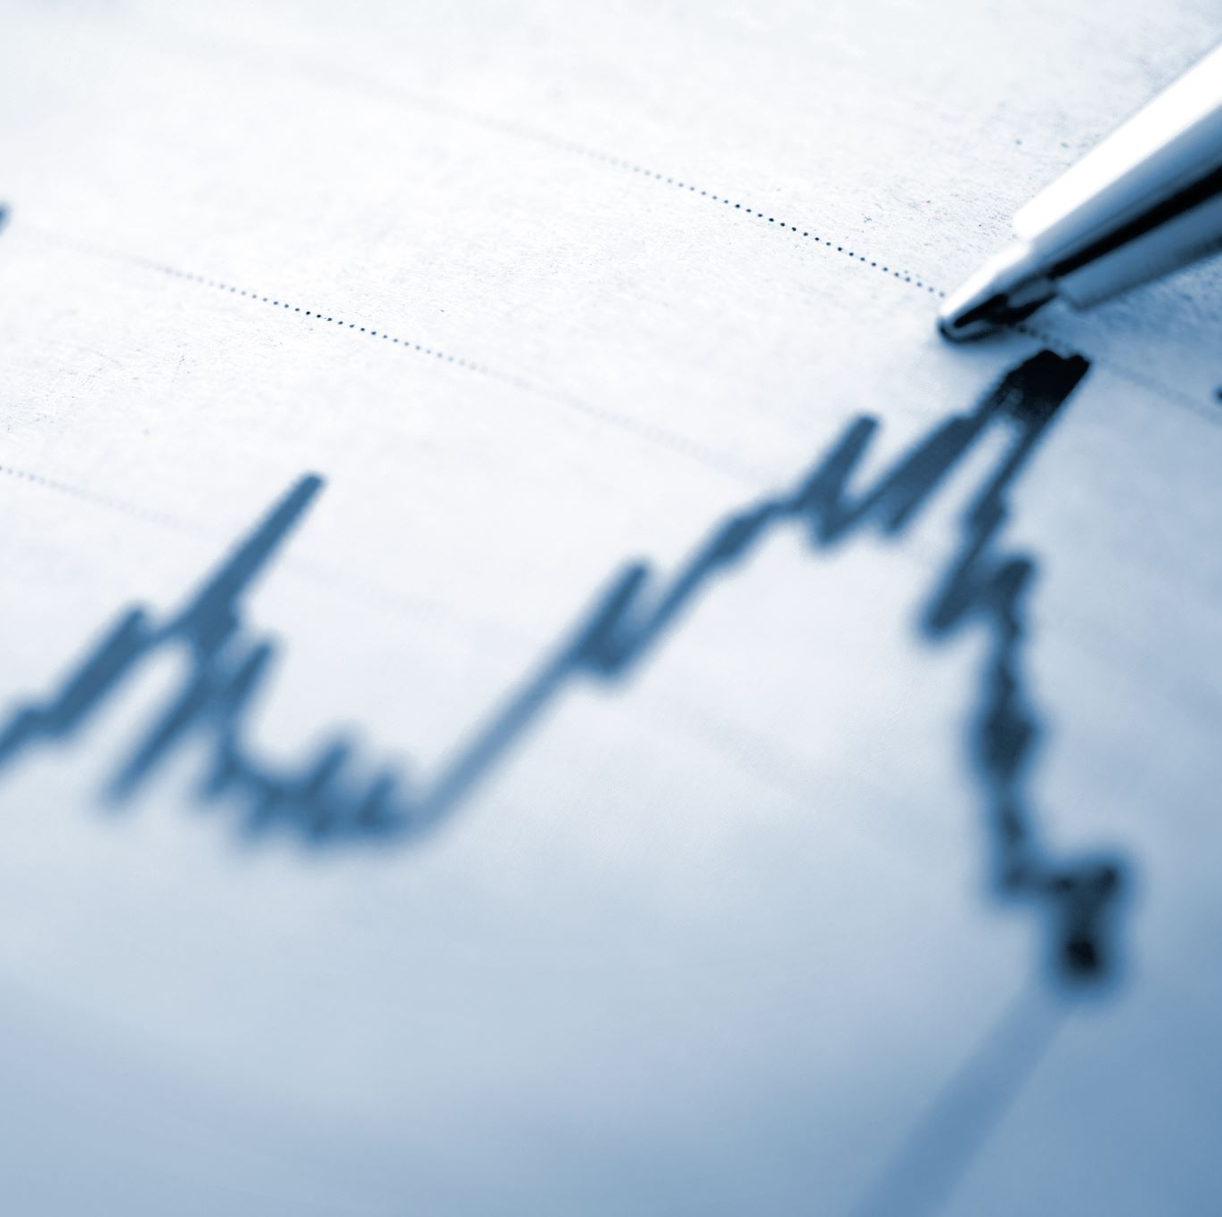
$50trillion, IEA est. 2014-2035
investment req’d
https://tenor.com<div class="tenor-gif-embed" data-postid="22282843" data-share-method="host" data-aspect-ratio="1" view/we-dont-have-a-lot-of-time-so-ill-cut-to-the-chase-eric-cartman-clyde-donovan-kenny-mccormick-south-park-gif-22282843">We Dont Have A Lot Of Time So Ill Cut To The Chase Eric Cartman GIF</a>from <a href="https://tenor.com/search/we+dont+have+a+lot+of+time+so+ill+cut+to+the+chase-gifs">We Dont Have A Lot Of Time So Ill Cut To The Chase GIFs</a></div> <script type="text/javascript" async src="https://tenor.com/embed.js"></script>/bDJOM.gifhttps://tenor.com/bDJOM.gif
Meet projected demand
Not all 10B people
Continues to be mostly fossils.
Clean air goals still not met.
Notes:
The investment needs in the world’s energy supply and distribution system grow as decades go by.

Slide 7
1978
Figure 1. The Department of Energy Policy for Fusion Energy recommended program

Slide 8
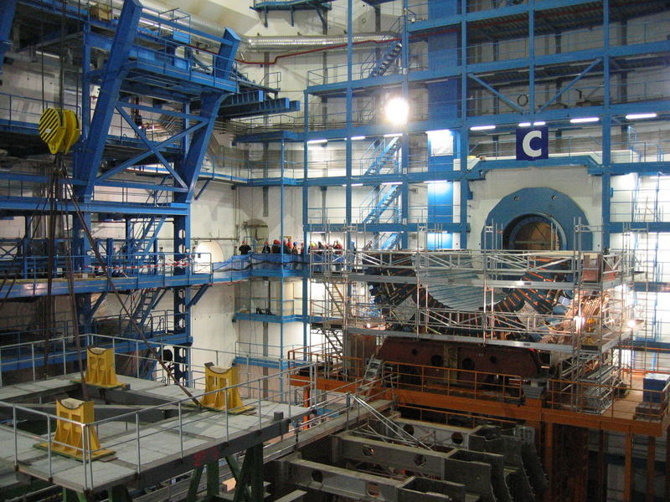
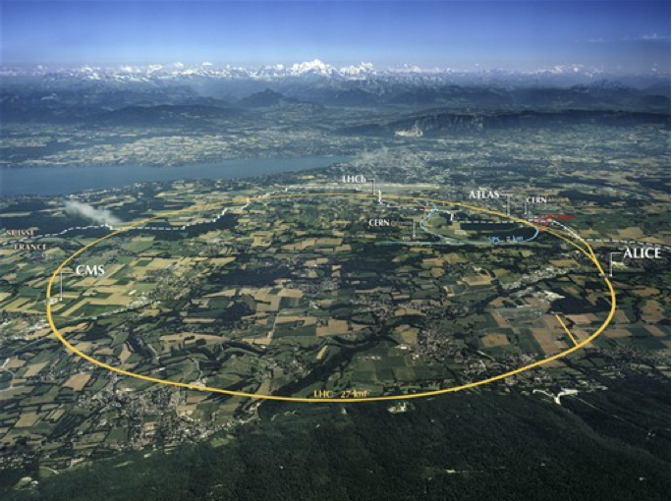
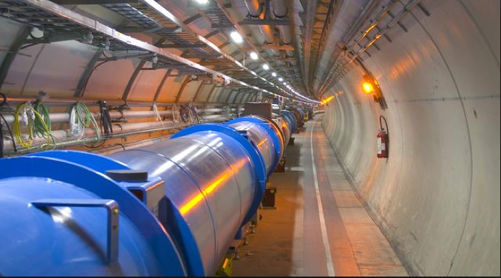
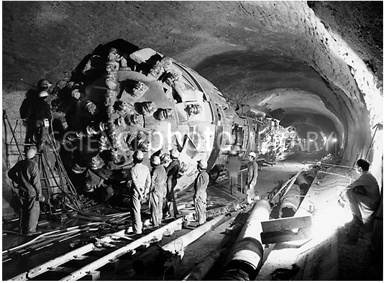
HIF technology.
Notes:
What’s not to love?

Slide 9
U4 Driver
Bob Burke

Slide 10
Fusion Energy System
DRIVER PELLET CHAMBER HX ELECTRICITY HYDROGEN
SYNTHETIC HYDRO-CARBONS & -NITROGENS WATER: DESAL, RECYCLE
Pellet. Driver. Chamber. Heat Transfer. Energy Conversion.
Regional Economic Engine. Clean Industry. Water Cycle.

Slide 11
Great Circle Route
Injected lithium
Common steel
Neutron protection
Economics
Supergiant oil field
Energy mix
Water 6000 Ac-ft/day
Multiple chambers
Economies of scale
High Yield
Slow pulse 1/sec
Efficient conversion
Safety/
Health/
Environment

Slide 12
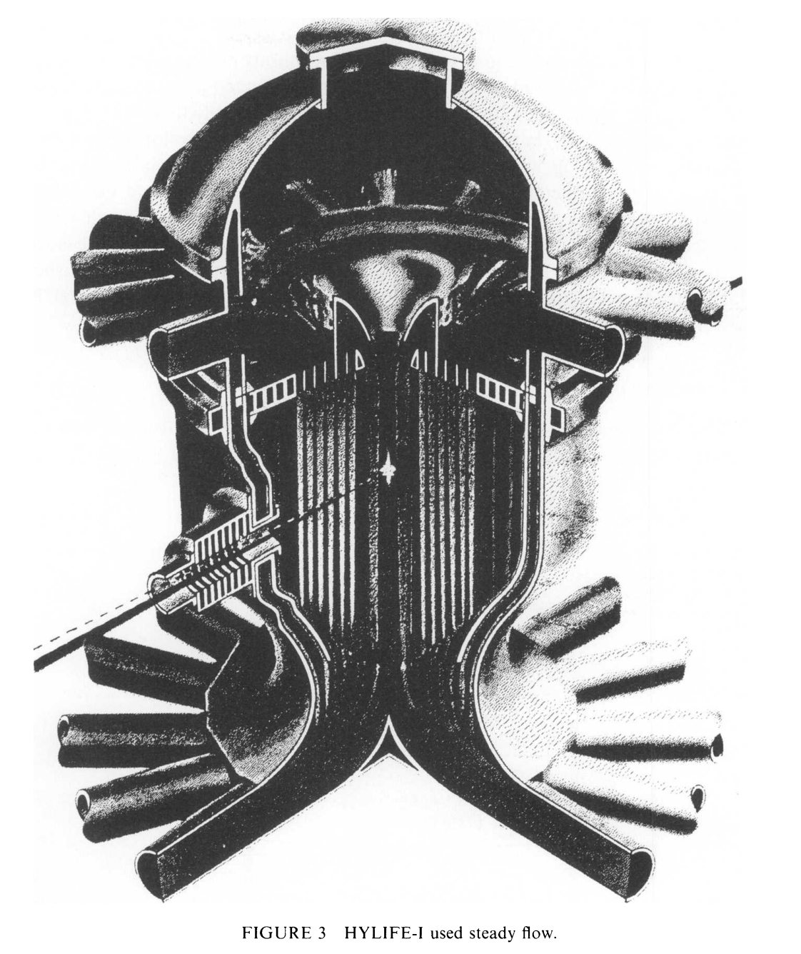
Neutron Protection: LLNL HYLIFE
High Yield pulses required
each pulse disrupts buffering geometry of a ton of lithium.
One pulse per second per chamber.
Laser or particle beams

Slide 13
Cylinder Fusion Pellet
Russia and German development
Fast ignition simulated 1984. Avrorin. Chelyabinsk.
Basko team. ITEP/Moscow. Meyer-ter-Vehn & assoc. Julich. Frascatti. Madrid.

Slide 14
Pellets for Proof of Principle or Power
Hohlraum target for weapons research demonstrate central compression physics of inertial fusion for energy.
HIF cylindrical pellet is industrial grade.

Slide 15
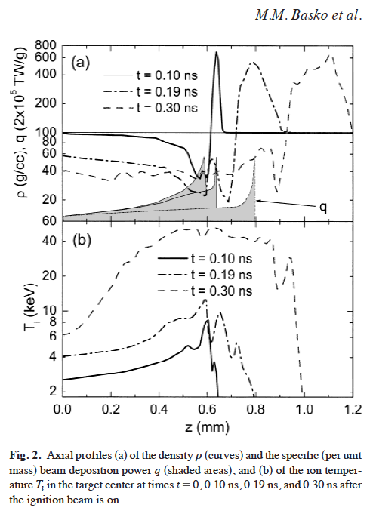
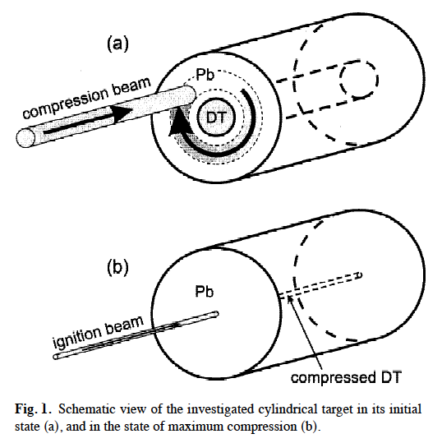
Basko team imploding cannon barrel - venerable hydro of A-bomb. Classical energy deposition. - not x-ray method of H-bomb and laser driven hohlraum.
Fusion Energy Gain
50-150x & up by U4
boot
foot
Laser and Particle Beams (2002), 20, 411–414.
Prospects of heavy ion fusion in cylindrical geometry
M.M. BASKO, M.D. CHURAZOV, and A.G. AKSENOV Institute for Theoretical and Experimental Physics, Moscow, Russian Federation

Slide 16
Fast Ignition whopper advantage
Ignite small mass of precompressed DT fuel before it flies apart.
Our case:
100 g/cc
50 µm radius
≥ 35 kJ
100 psec
LLNL

Slide 17
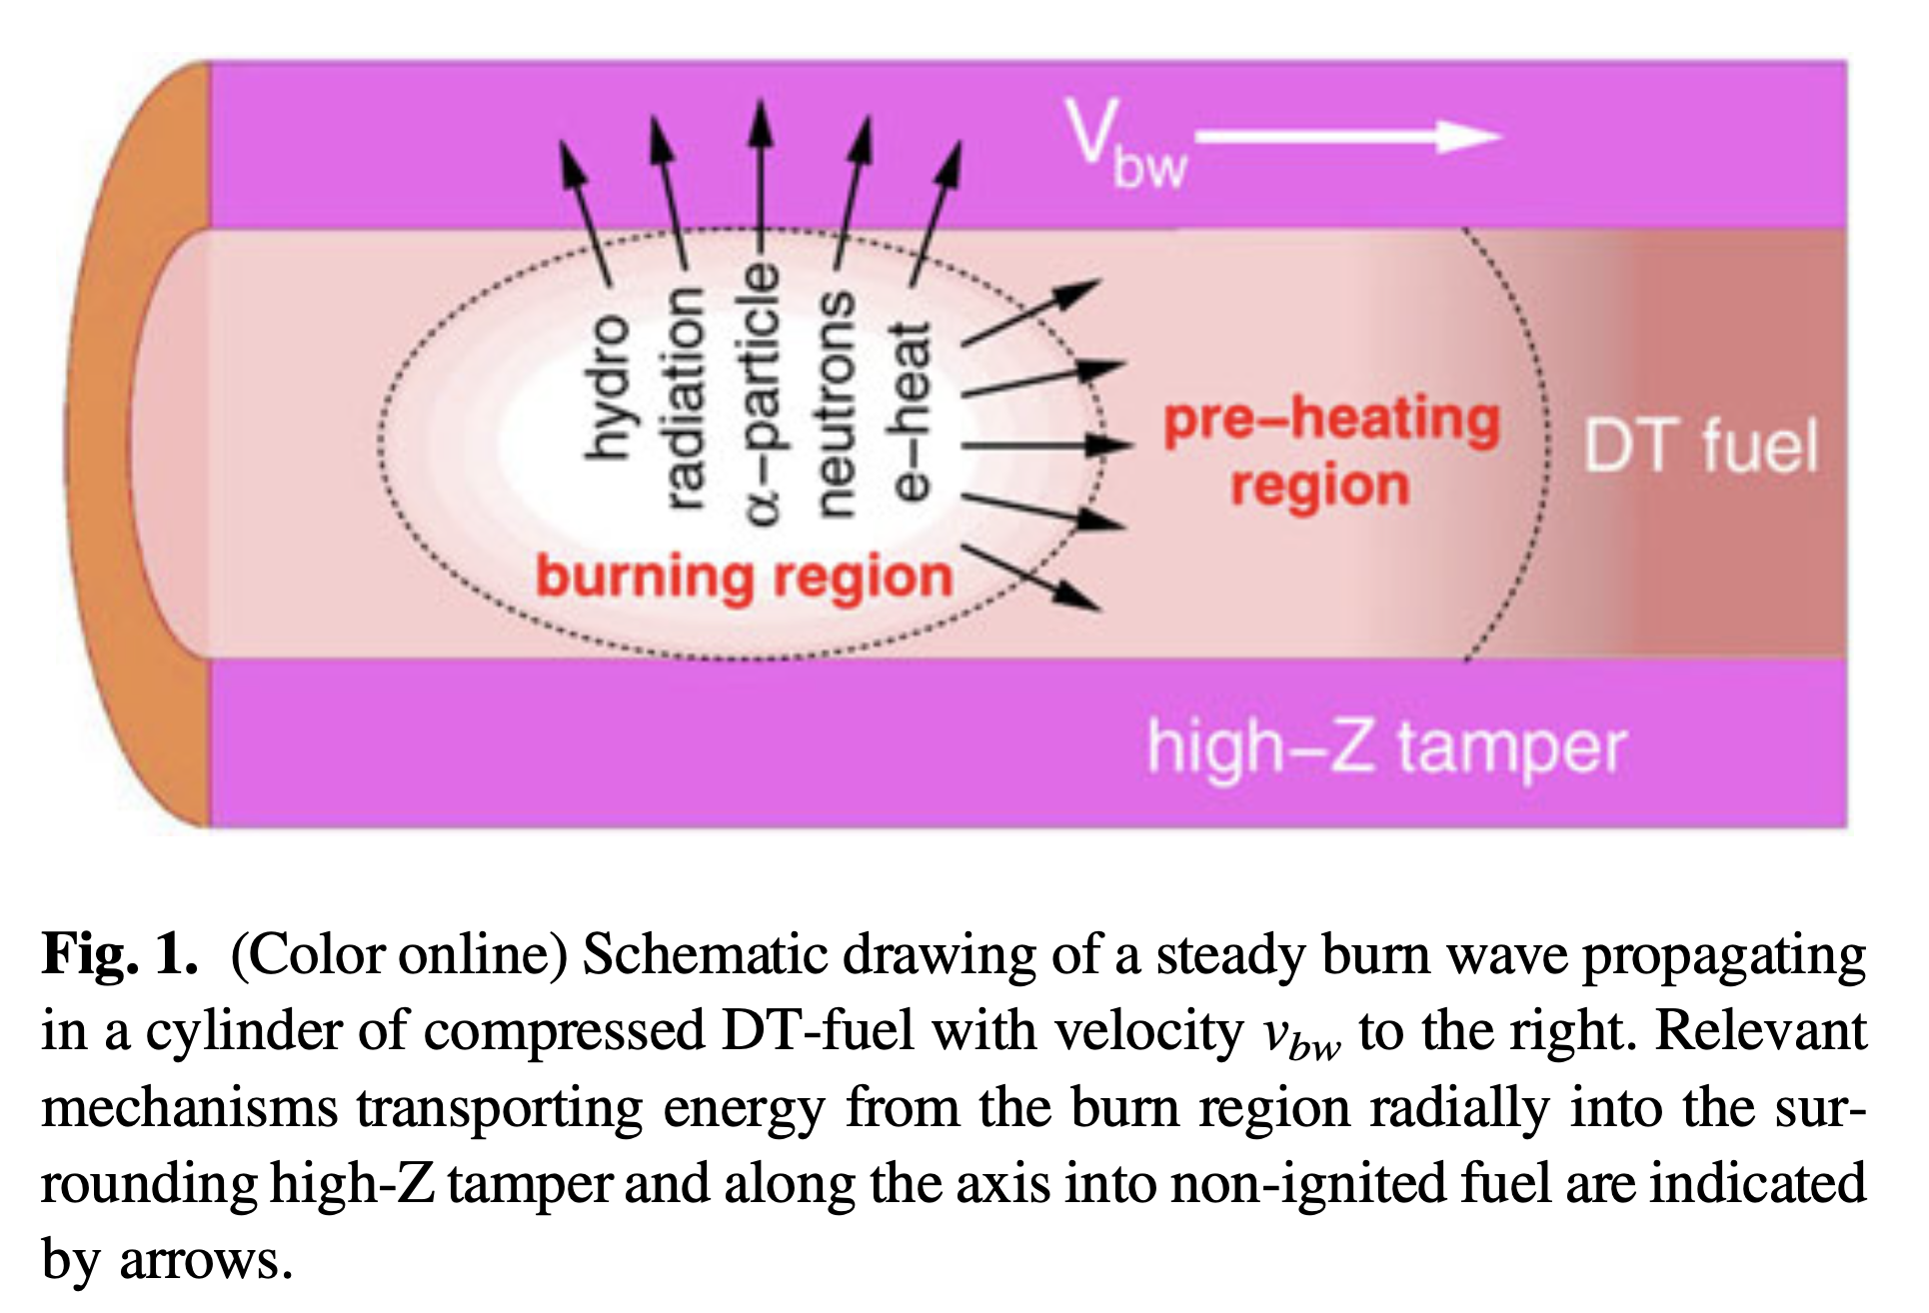
Basko burn propagation
Pusher layer lead compresses to 400 g/cc.
R. Ramis and J. Meyer-ter-Vehn 2014

Slide 18
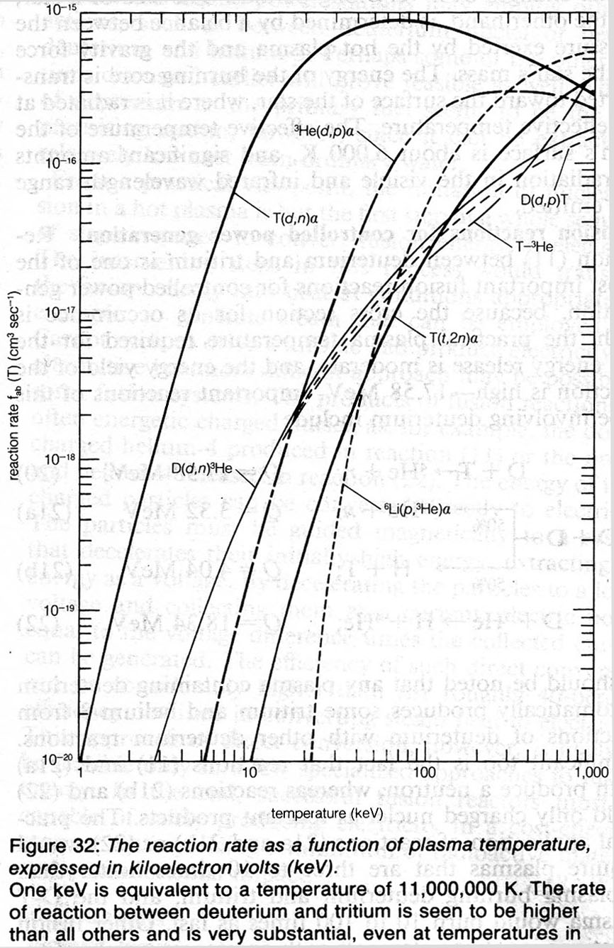
Basko burn propagation R. Ramis and J. Meyer-ter-Vehn 2014
90 keV
90 keV
5 keV

Slide 19
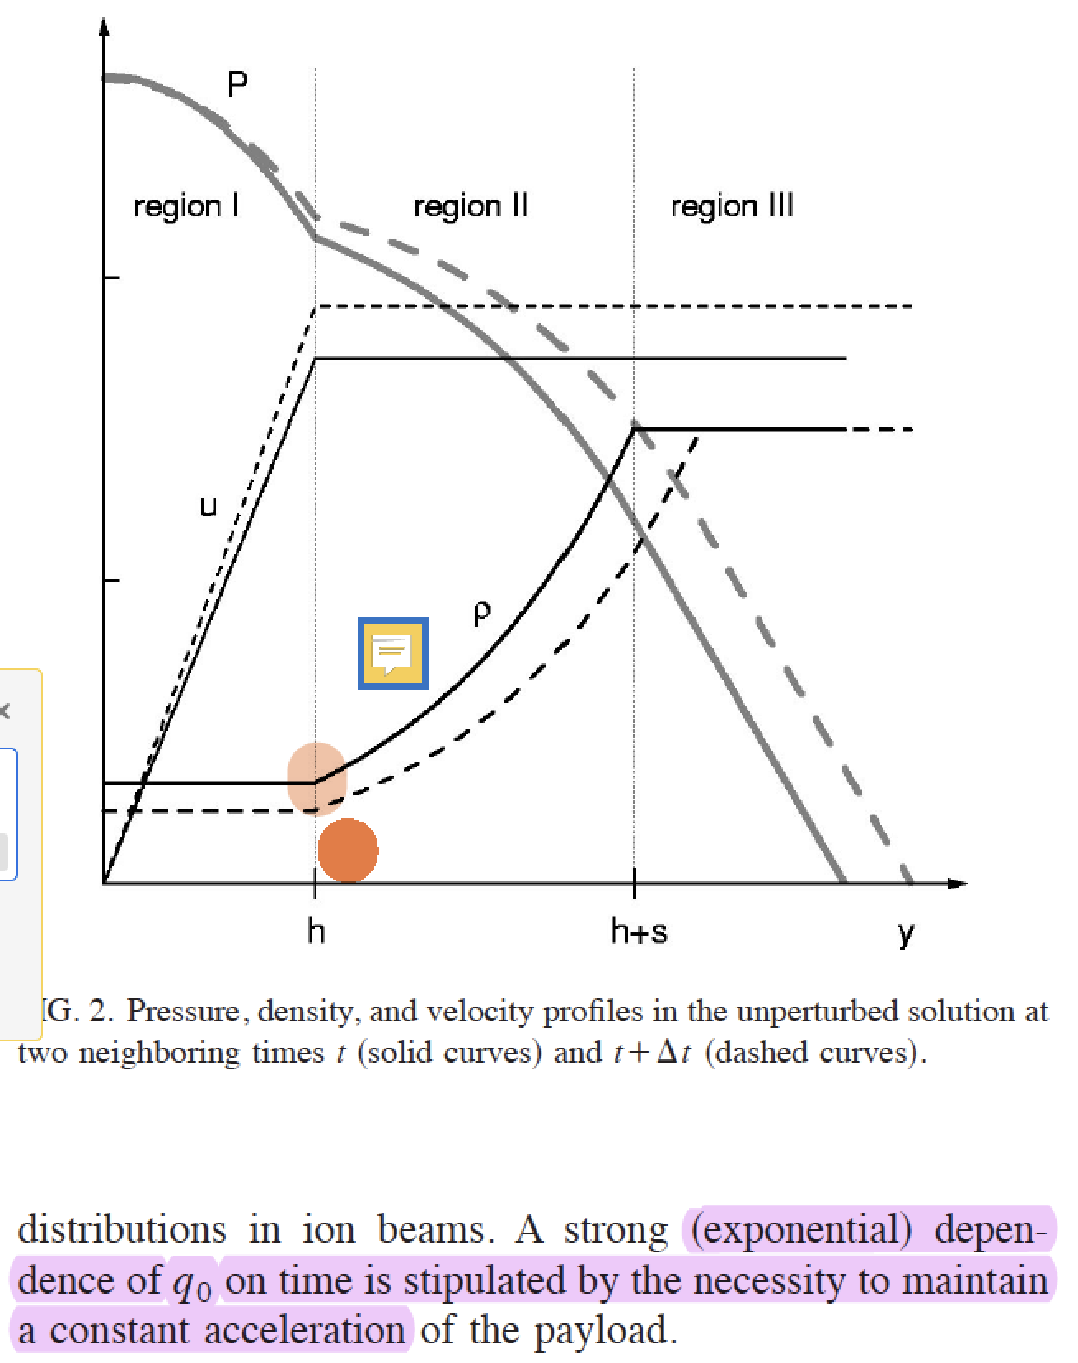
Raleigh-Taylor Stability
Absorber/Pusher density difference
Maintain constant acceleration.
PHYSICS OF PLASMAS VOLUME 9, NUMBER 4 APRIL 2002
Hydrodynamic instability of shells accelerated by direct ion beam heating
M. M. Basko^{a)} and J. A. Maruhn, T. Schlegel
Institut fu¨rTheoretische Physik, Universita¨t Frankfurt,
Frankfurt, Germany
TU Darmstadt, Institut fu¨r Kernphysik, Darmstadt, Germany

Slide 20
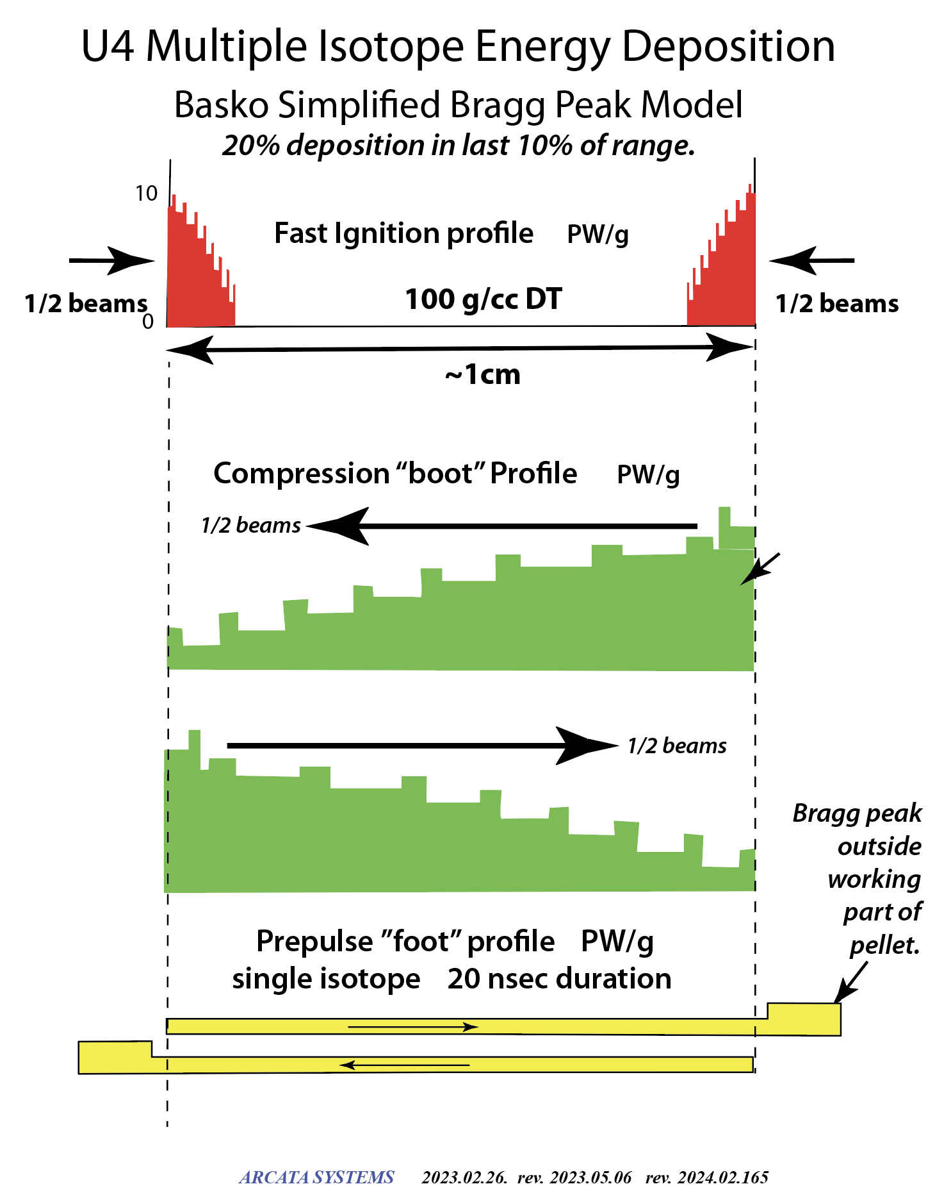
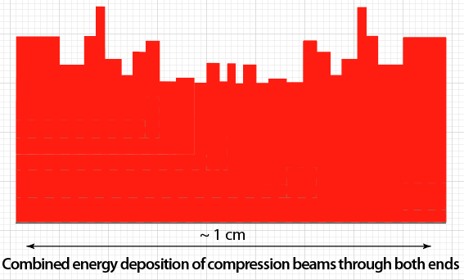
U4 Energy Deposition
PW/g
10 —
1 beam
1 beam

Slide 21
U4 pellet-driver differences from Basko
Equal compression and ignition requirements
Geometric similarity
No waste of beam energy for compression
40 MJ vs. 6 MJ (w/o waste) for compression—more fuel for economics
Beam whirl spirals to axis as wobbler fields decrease.
Intense heating of 400 g/cc lead on brink of fast ignition
Intense heating of 100 g/cc annulus next to axial fast ignition
Equal heating intensity for fast ignition—less deep in fuel.

Slide 22
Whirligig transition from compression to fast ignition
New U4 phenomena promise to enhance ignition

Slide 23
Configuring a heavy ion beam driver
Focus sub-mm main beam, 50 µm short pulse peak power
10s of GeV heavy ions, range up to 10 g/cm²
500 TW, 2 PW peak, 10s of MJ
100s of mA sources — 100s of kA at pellets
Time compression—multi-µsec source pulses, 100 ns profiled at fusion pellet
Multiple sources
Multiple beams
No funny stuff—innovative mainstream accelerator methods

Slide 24
U4 IFE system
Multiple isotope sources
and linac trees (not shown)
.

Slide 25
U4 single-pass operations
Multiple isotopes—Telescoping beams
SKSOZ sources—200 mA heavy ions
Individual linacs—essential to compaction
Mirror image (+) and (-) beams—charge balanced transport (CBN)
Duplex linacs and beamlines—packaging (+) and (-) beams
Toggle (+) & (-) bending magnet—back and forth to (±) CBN
Chirped Slug compression—Slug ~ macropulse
Wobbling per isotope—combined ±
Kvetch transform—isotopic slug trains multi-isotope slug trains (MISTs)
Equal time of flight Kvetch to Pellets
Single beam focused each side—Merge 8:1 in final leg CHASP
Super-peak finale—heat 400 g/cc pusher before 100 g/cc DT fast ignition

Slide 26
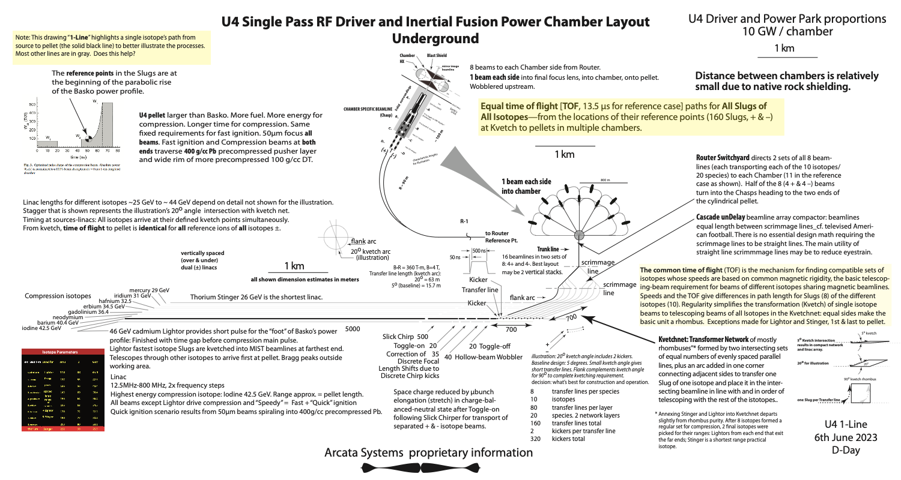
Visit our poster to discuss these details.

Slide 27
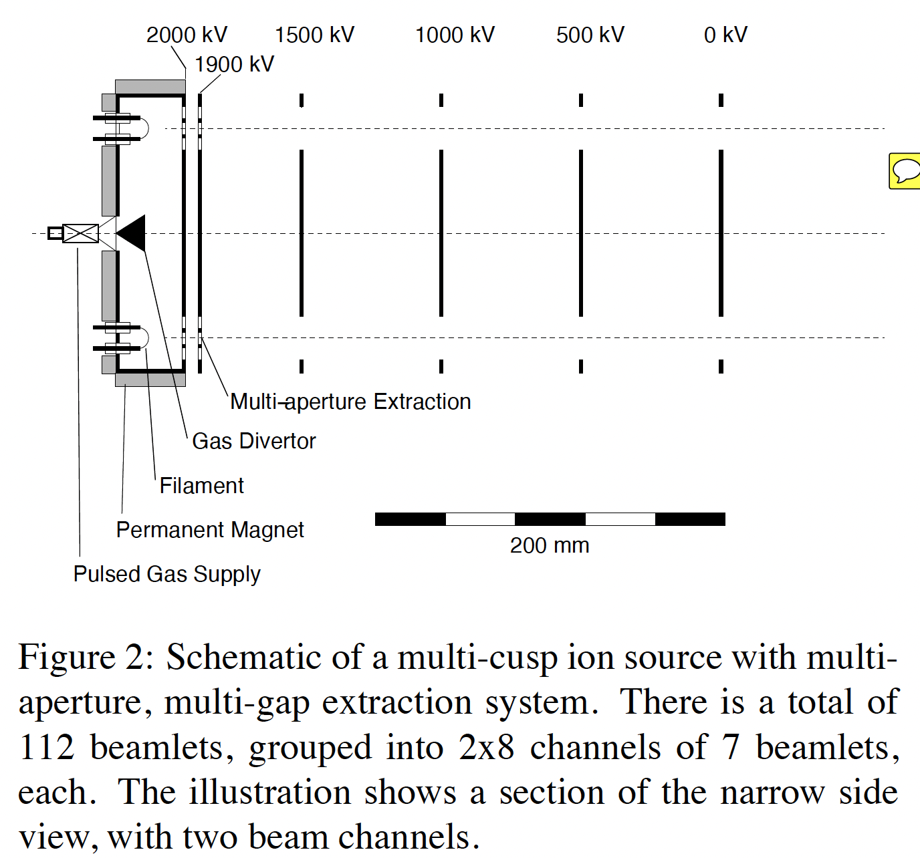
200 mA source
2005 HEDP driver
Staples
Keller
Sessler
Ostroumov
Chou

Slide 28
Slugs are glorified single-isotope macropulses
Individual µpulses stretch to ~ 2 nsec.
Fast ignition rises quickly, beam spiral final 100 µm to axis—but…
Continues for 2 nsec µpulse length.
Intense heating of annular rim of 100 g/cc DT preceded by heating 400 g/cc Pb pusher.

Slide 29
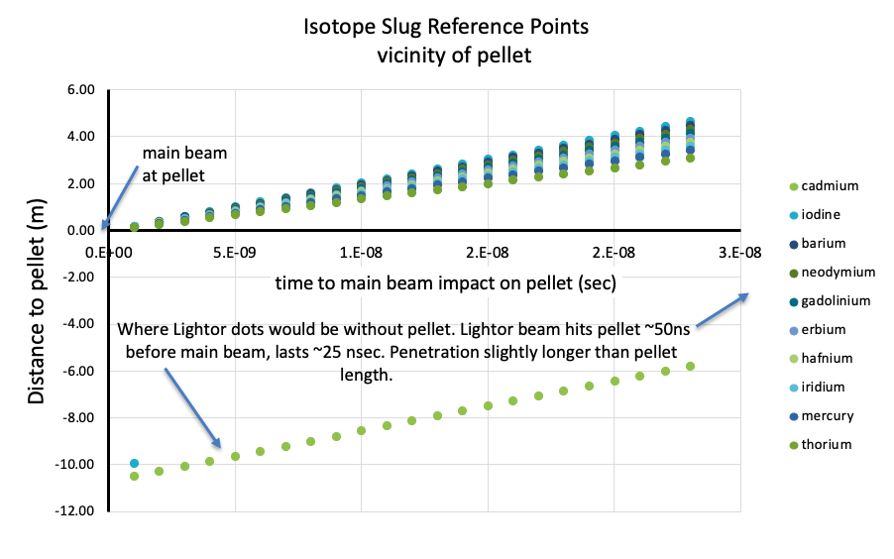
Telescoping Slugs —coordinated reference points
Isotopic Slug reference points
Snapshots from input to CHASP
Isotope Slug reference points
Snapshots near pellet.
Input to CHASP (≤ 200 m to pellet)
Near Pellet (≤ 5 m to pellet)

Slide 30
Kvetch Transform isotopes of different colors
Kvetchnet
linacs

Slide 31
Kvetch illustrated with 90º intersection

Slide 32
Packaging Kvetchnet and linac array in tunnels. 5 degree Kvetch intersection
80 m

Slide 33
Chirp & Slick contract Slugs
Input correction of focal length shifts here…
to prevent chromatic aberration here

Slide 34
Per-µbunch adjustment of transport matrix to compensate Chirp change of momentum.
400 µbunches per 500 nsec isotope Slug

Slide 35
Sweet 16
Holy Grail,
here we come!
A scrimmage line is where leading edges of Slug trains are simultaneous—to hit pellet together.
leave the
20 Slug trains
of single isotopes enter the Kvetchnet.

Slide 36
Koshkarev’s (+) and (-) charge balancing is reversible— toggle on/off.
B. U. Sharkov, Russian HIF Program, 2005

Slide 37
8:1 8 beamlines merge to 1 in CHASP

Slide 38
Large, clean power source
10 GJ per pulse
1 per second in each of ~10 fusion power chambers
100 GW fusion energy
T_{hot} ~1300º C — lithium condensation at heat exchangers
Energy conversion efficiency ≥ 65%

