Slide 1
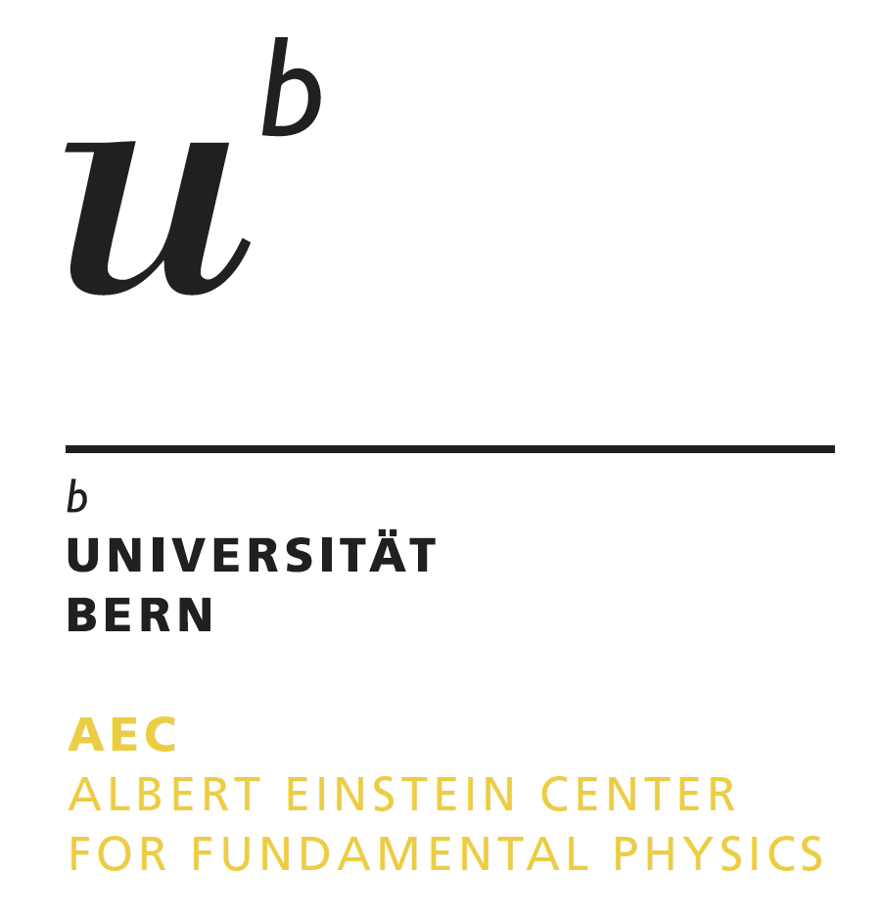
A compact medical cyclotron
for research into
medical and multi-disciplinary applications
Saverio Braccini
Albert Einstein Center for Fundamental Physics (AEC),
Laboratory of High Energy Physics (LHEP),
University of Bern, Switzerland

Slide 2
Outline
The Bern medical cyclotron laboratory
  GMP industrial production of radiopharmaceuticals and academic research under the same roof
Multi-disciplinary research based on tools and methods from high-energy physics
  Radioisotopes for theranostics in nuclear medicine
  Targets, beam monitoring detectors and irradiation systems
  Radiation hardness
  Proton induced neutron beams
  Cell irradiation in both conventional and FLASH regime

Slide 3
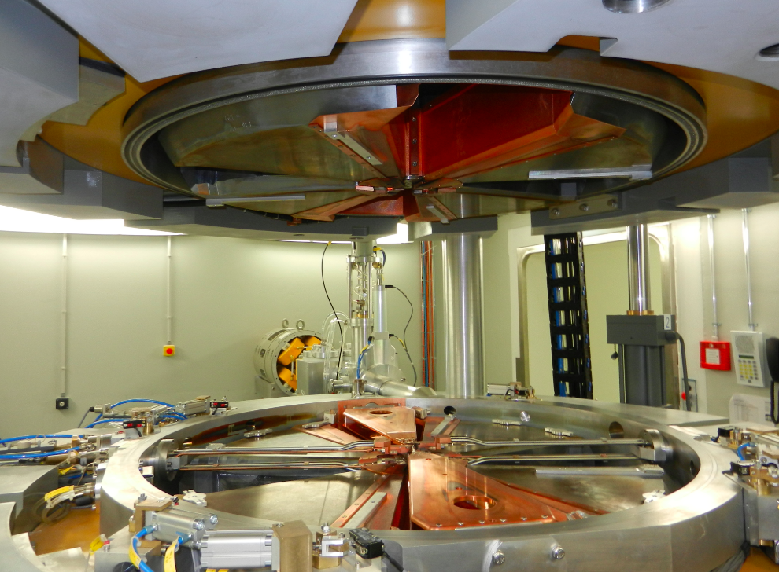
The cyclotron at the Bern University Hospital (Inselspital)
In operation since 2013

Slide 4
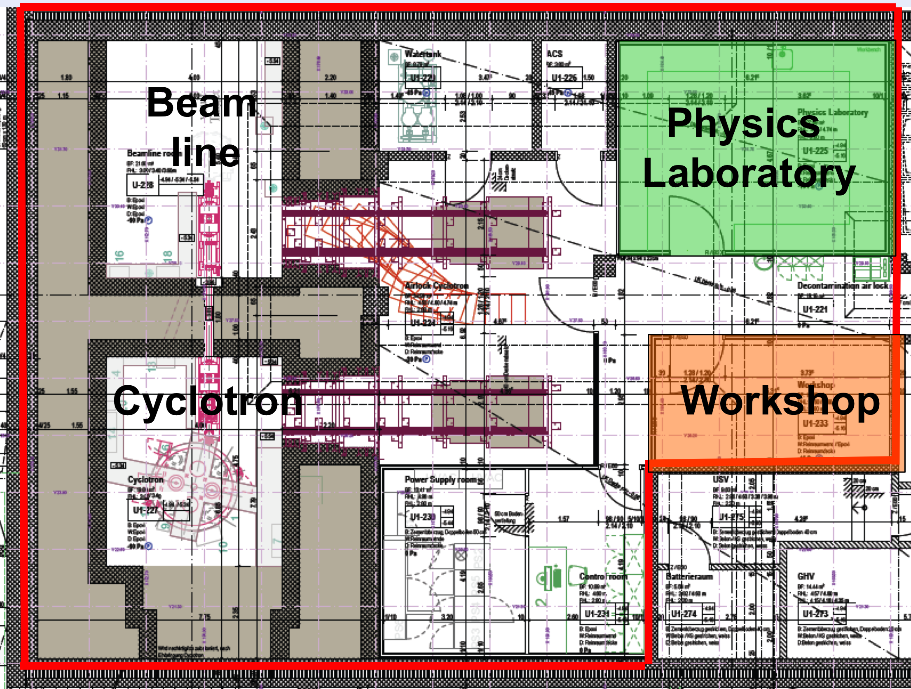
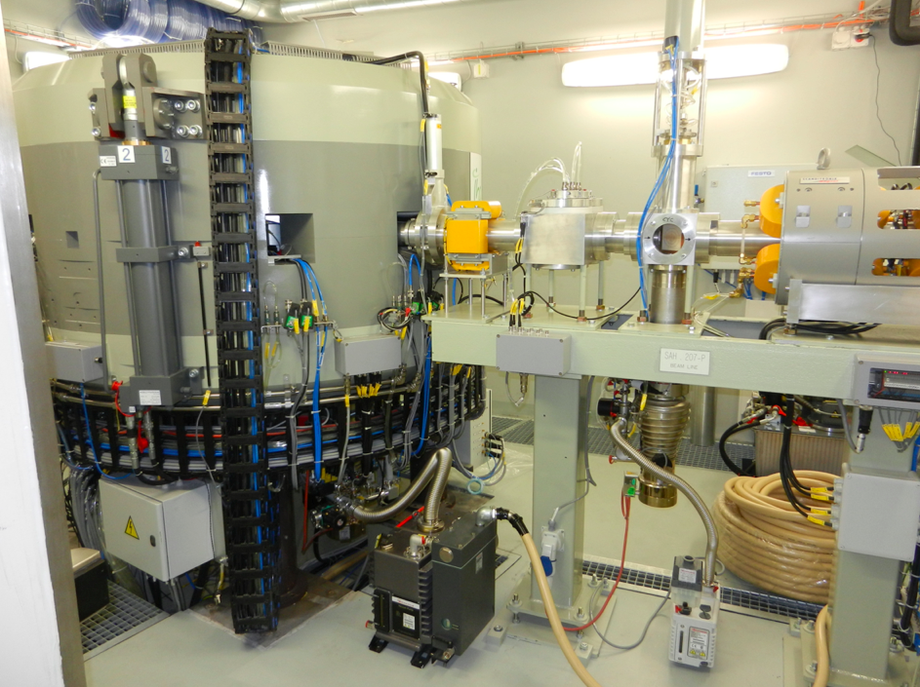
The Bern medical cyclotron and its research Beam Transport Line (BTL)
IBA 18 MeV high current cyclotron (up to 150 μA) – 2 H⁻ ion sources
2 ¹⁸F liquid targets: daily GMP industrial production (up to 1 TBq per run)
External Beam Transfer Line (BTL) in a separate bunker: research
Solid target Station (STS): research
Specific method to produce currents down to 1 pA

Slide 5


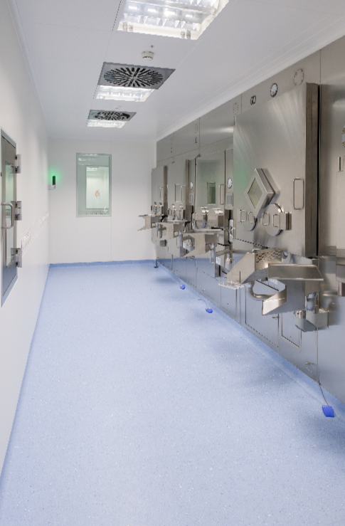
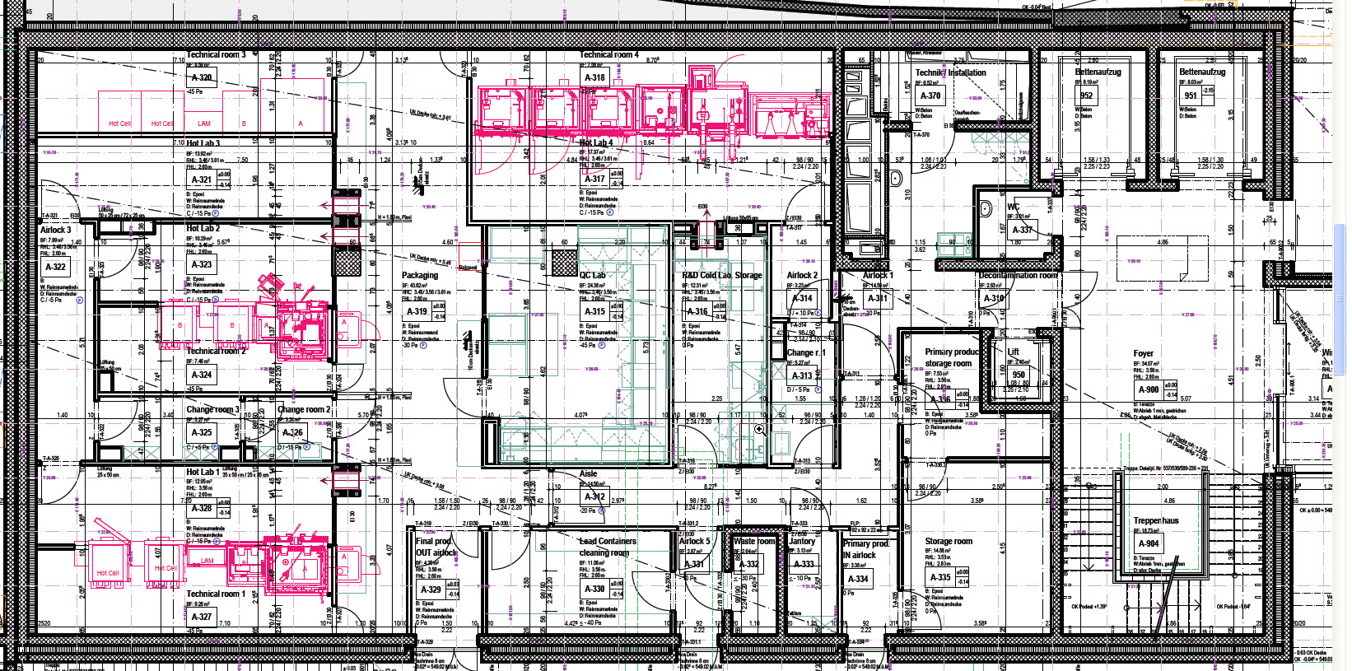
The hot labs
3 GMP production labs (SWAN Isotopen AG – ¹⁸F, ⁶⁸Ga, ¹⁷⁷Lu radiopharmaceuticals)
1 GMP clinical research lab (Nuclear Medicine, Inselspital)

Slide 6
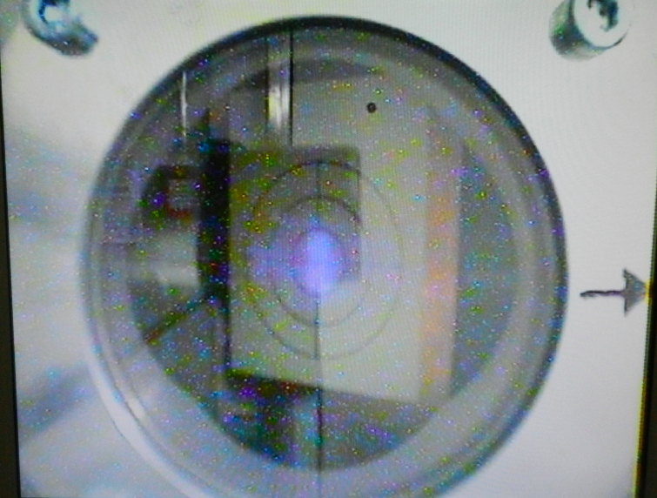
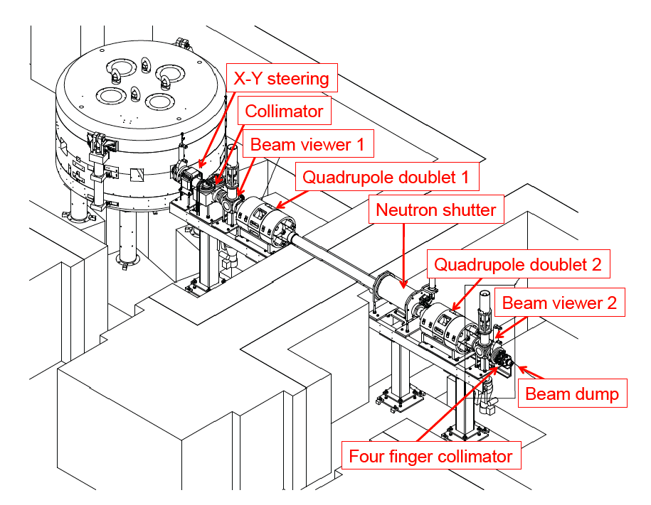
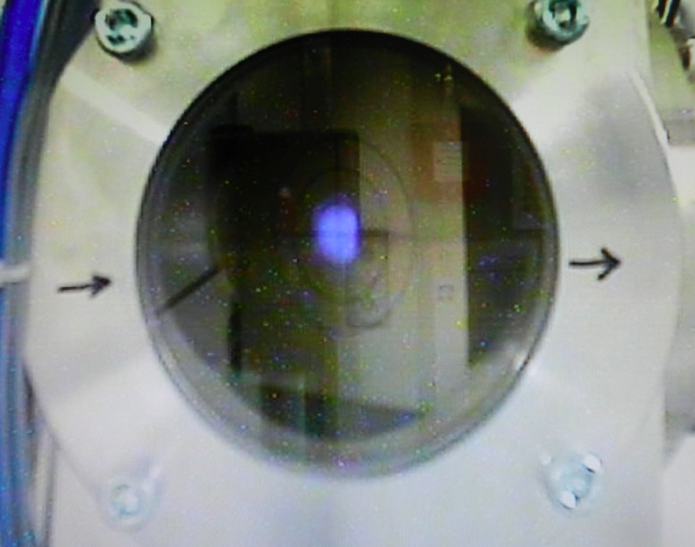
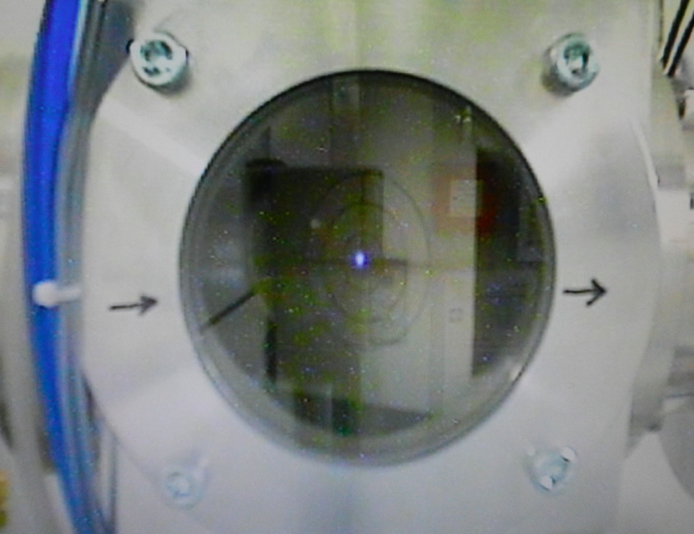
The BTL
Beam from cyclotron
Beam from BTL
S. Braccini, AIP Conf. Proc. vol. 1525, p. 144, 2013

Slide 7
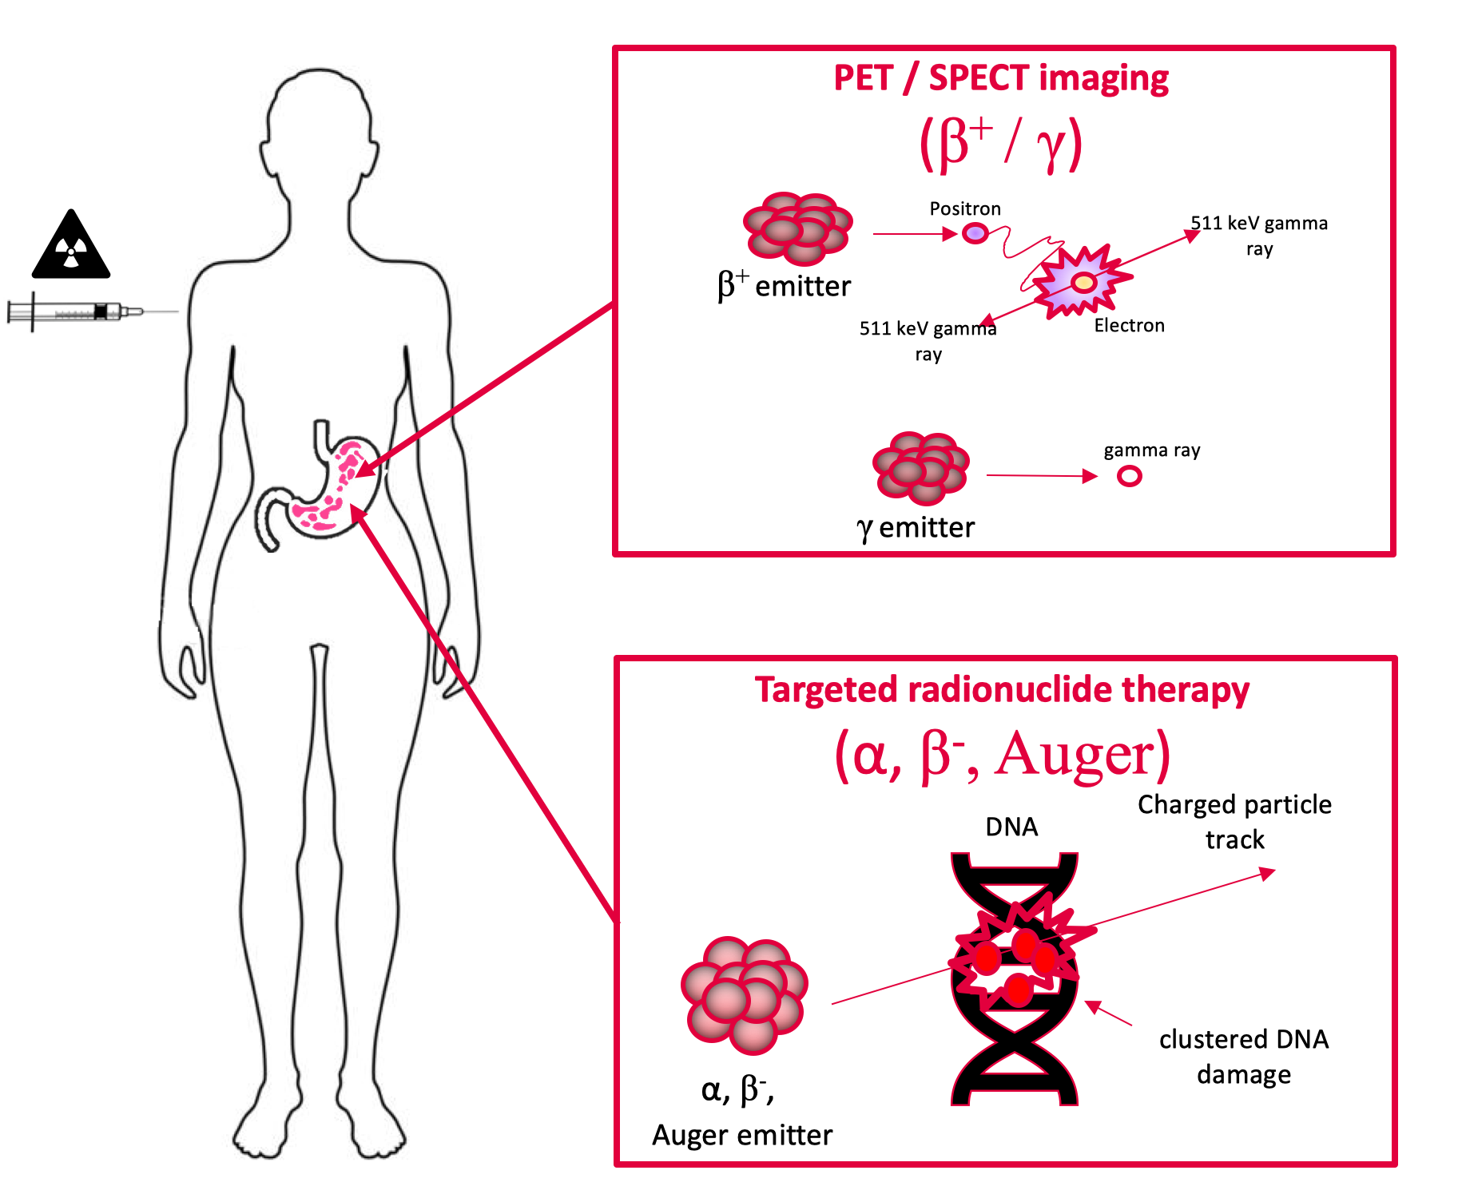
Theranostics in nuclear medicine
  Promising pairs:
    ⁶⁸Ga/¹⁷⁷Lu and ⁶⁸Ga/²²⁵Ac
    ⁴³Sc/⁴⁷Sc and ⁴⁴Sc/⁴⁷Sc
    ⁶¹Cu/⁶⁷Cu and ⁶⁴Cu/⁶⁷Cu
    ¹⁵⁵Tb/¹⁴⁹Tb and ¹⁵⁵Tb/¹⁶¹Tb
  Radiometals

Slide 8
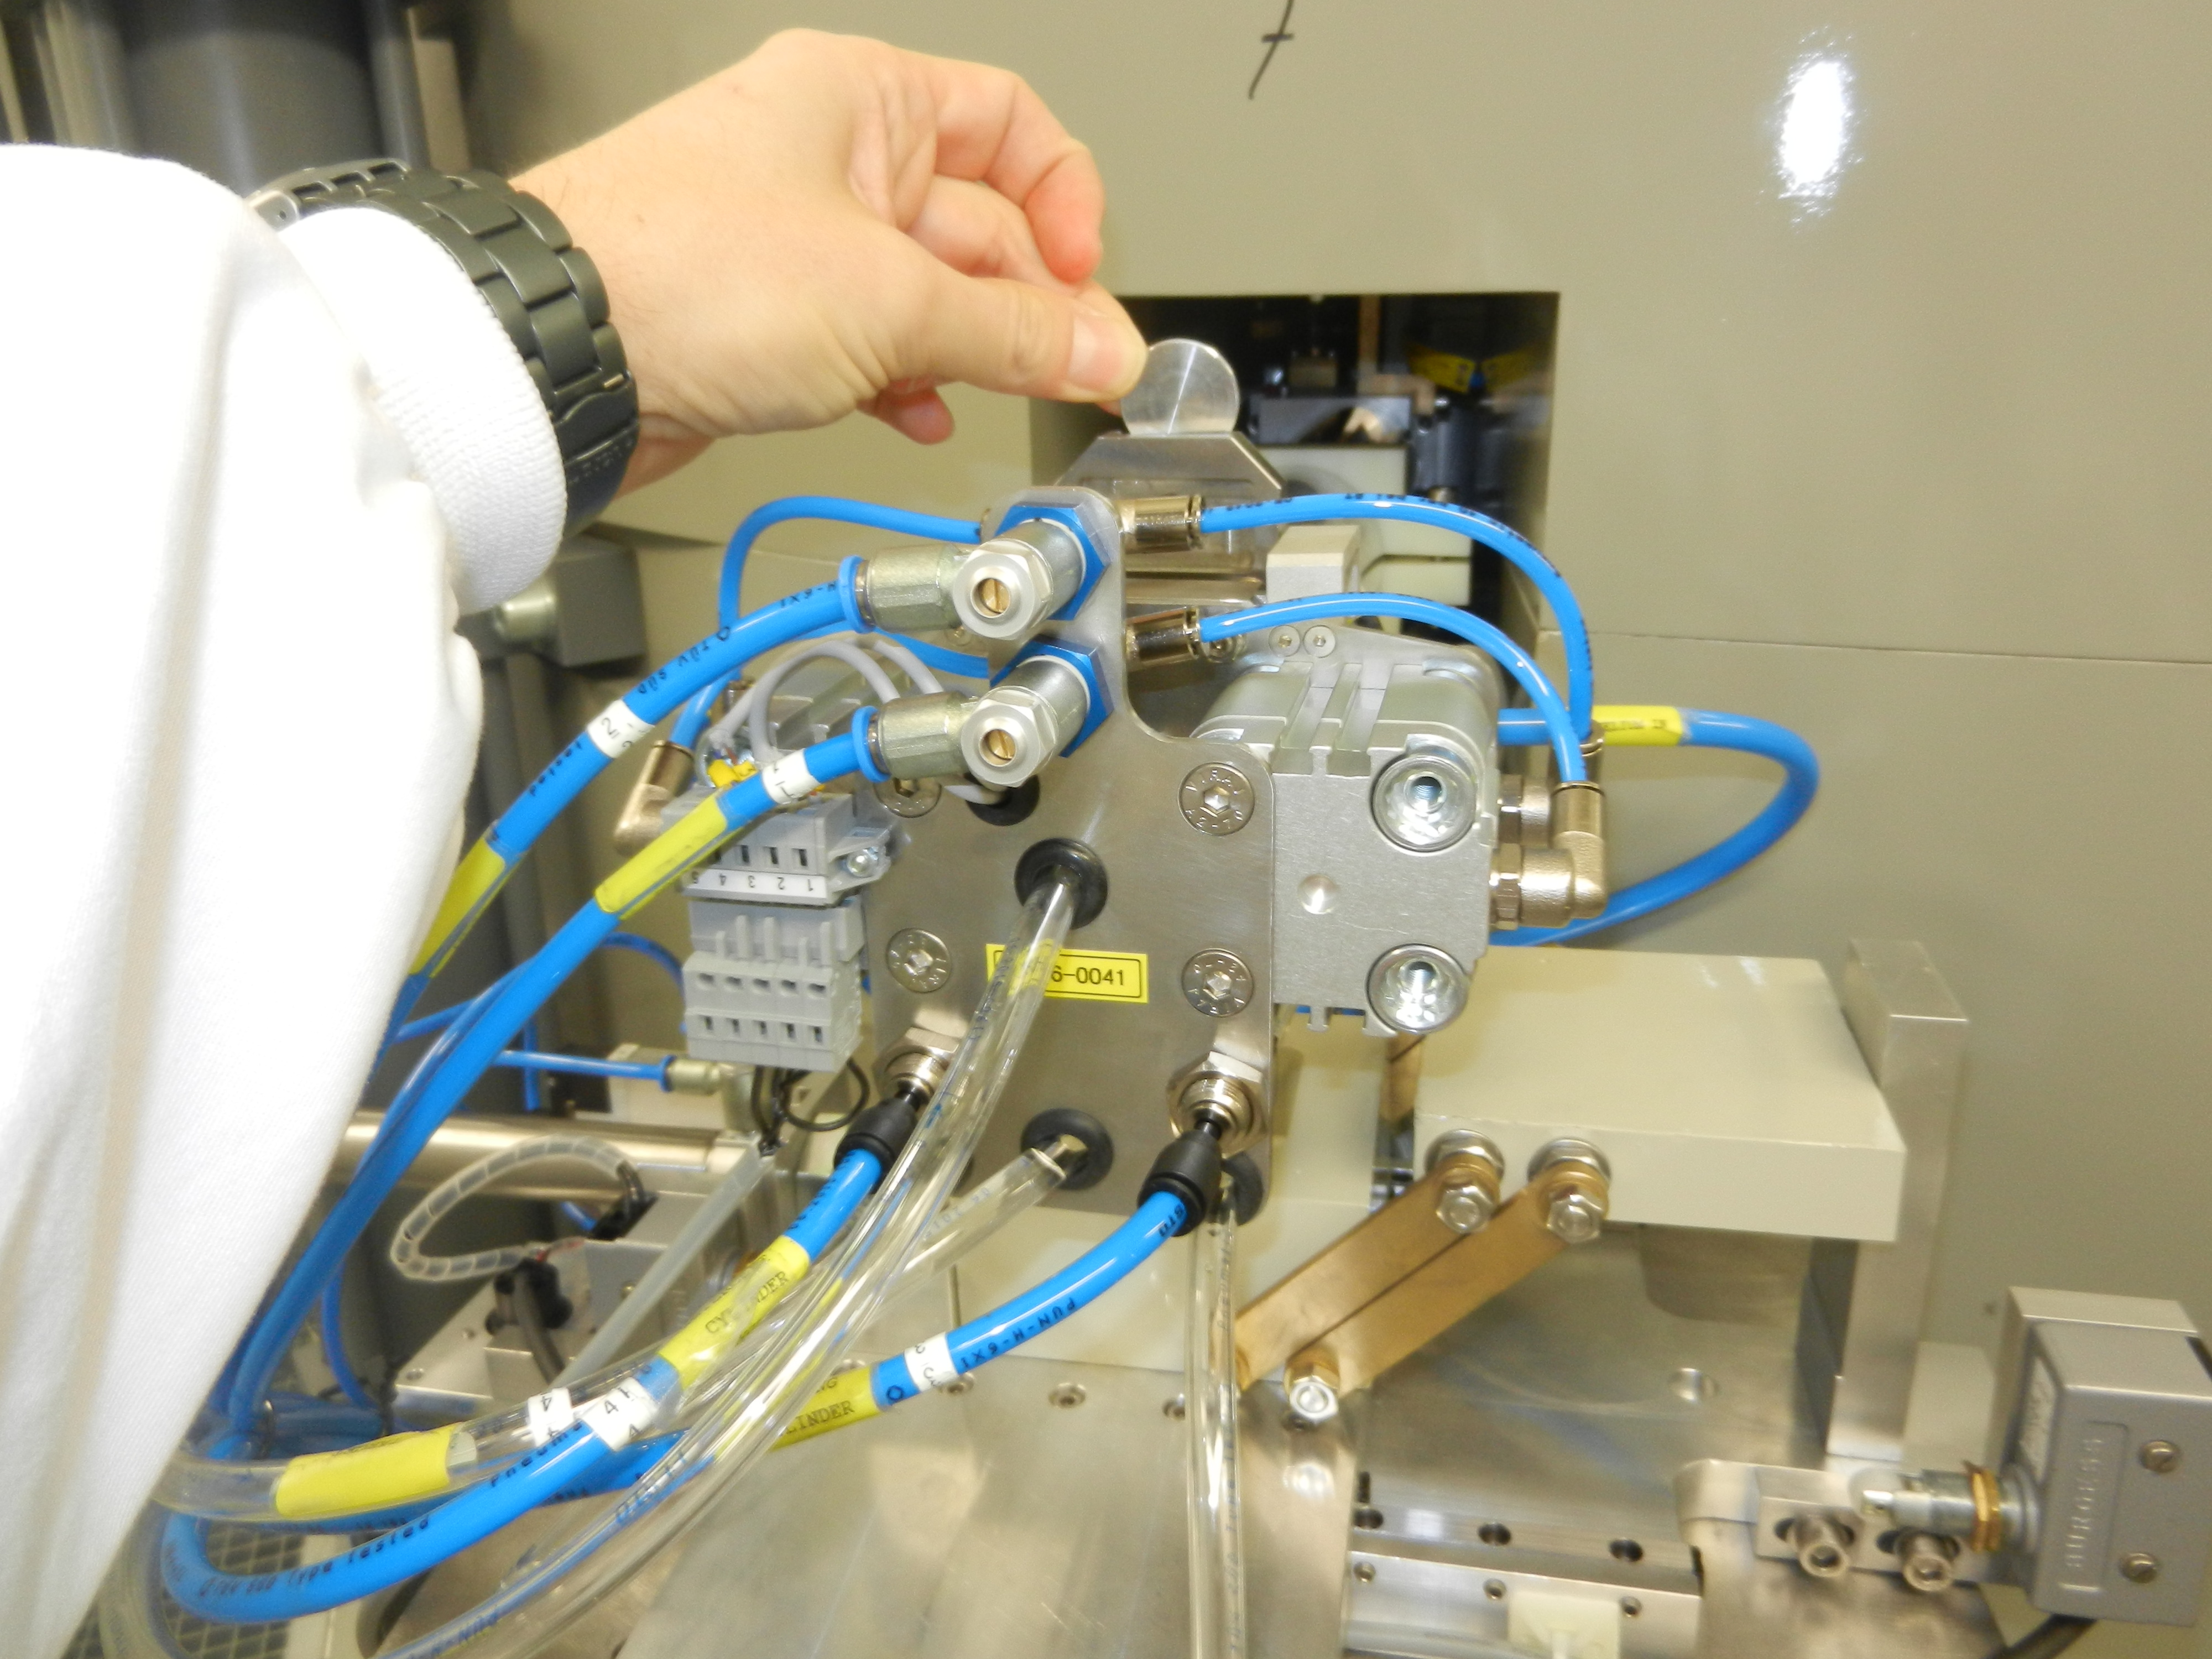
Our starting point: commercial solid target station
  IBA Nirta “COSTIS”
  Target:
    24 mm diameter 2 mm thick disk
    electro-plated materials
  Manual insertion and recovery of the disk
  Cooling: water in the back, helium in the front
Radiometals
Target material:
~10 mg
~ 5 mm diameter
Powder
Target: ?
Beam: ?
Radioprotection: ?

Slide 9
Our strategy
Accurate knowledge of the beam (position, shape, energy)
  Beam monitoring detectors
Novel targets + transfer systems
Nuclear data
  Production cross sections (also for impurities!)
Novel irradiation systems

Slide 10
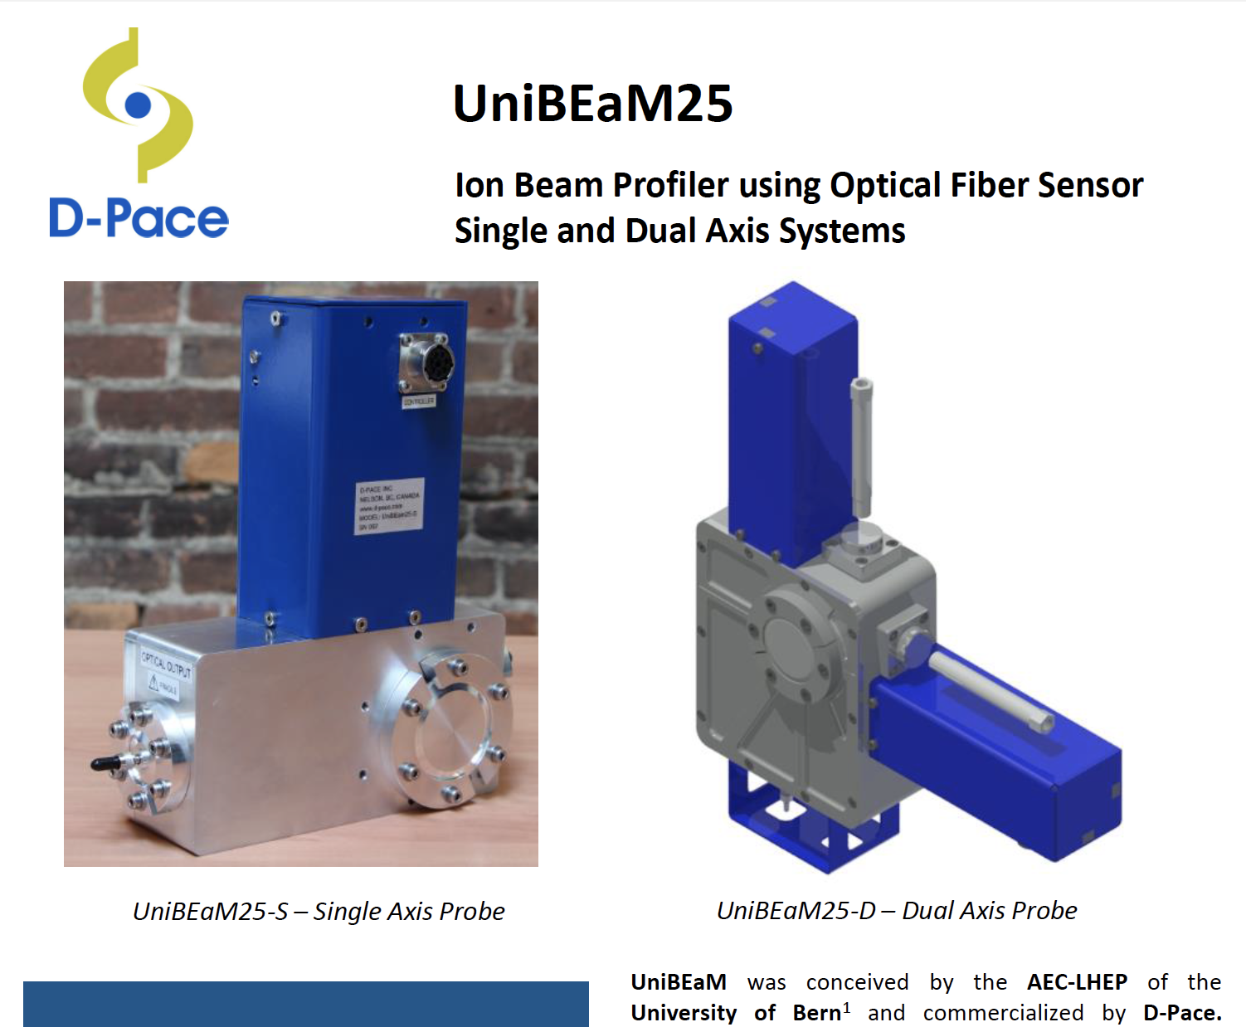
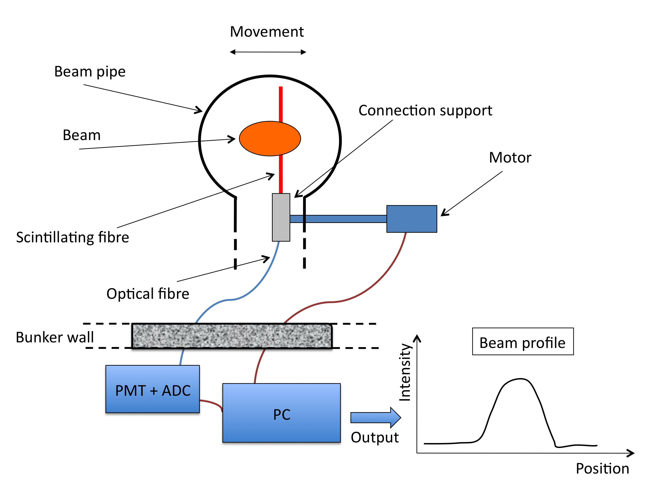
The UniBEaM detector
  2D beam profiler based on (doped) optical fibres passed through the beam
  On-line, minimal interference with the beam
  Developed by LHEP and commercialized by D-Pace (Canada)
M. Auger et al., J. Instrum. 2016, 11, P03027001
D. Potkins et al., Phys. Procedia 2017, 90, 215–222

Slide 11
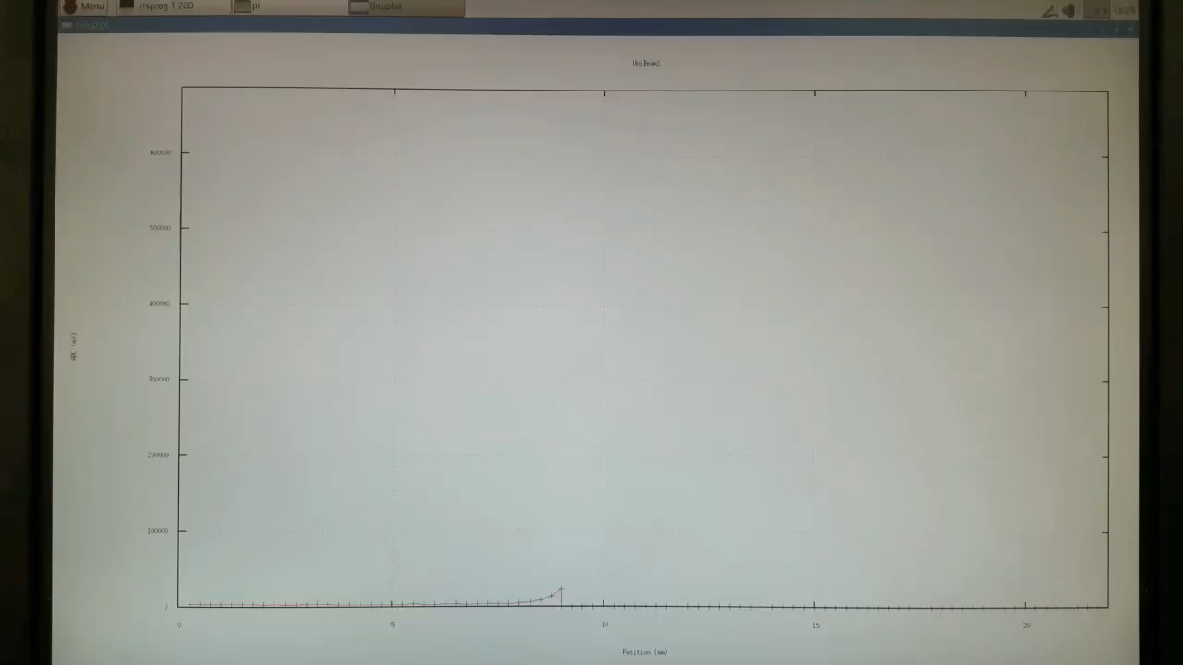
On-line monitoring with UniBEaM

Slide 12
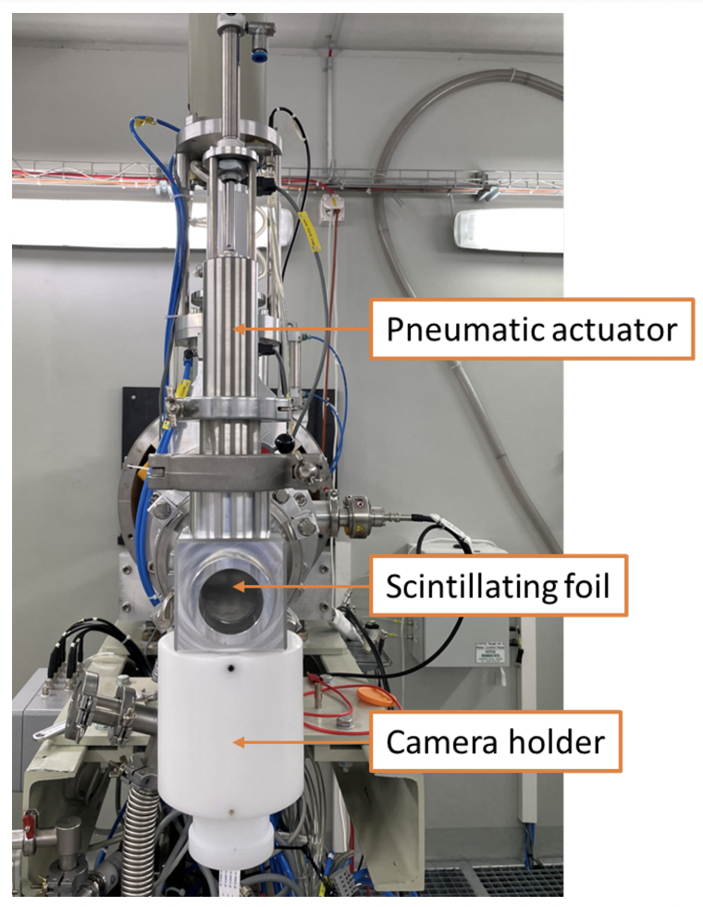
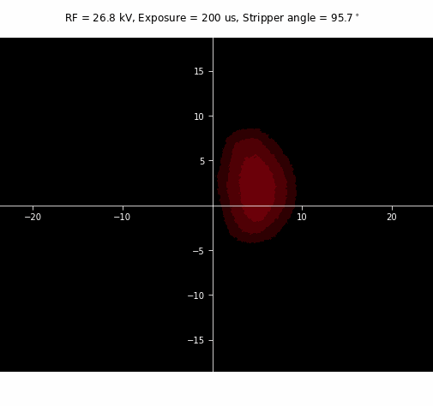
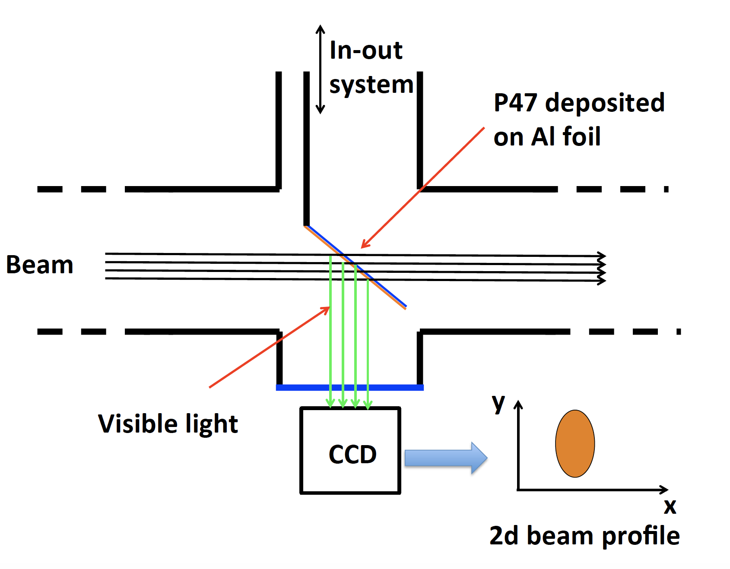
The Pi2 detecor
S. Braccini et al., Appl. Sci. 2023, 13, 3657

Slide 13
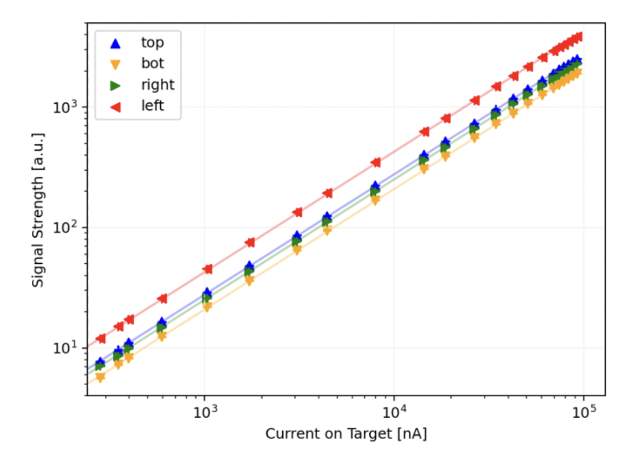
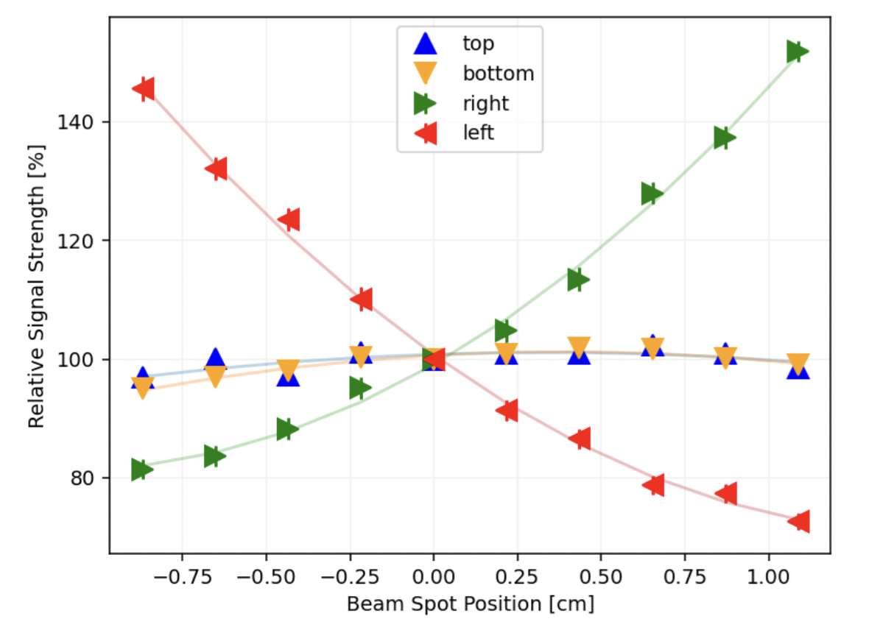
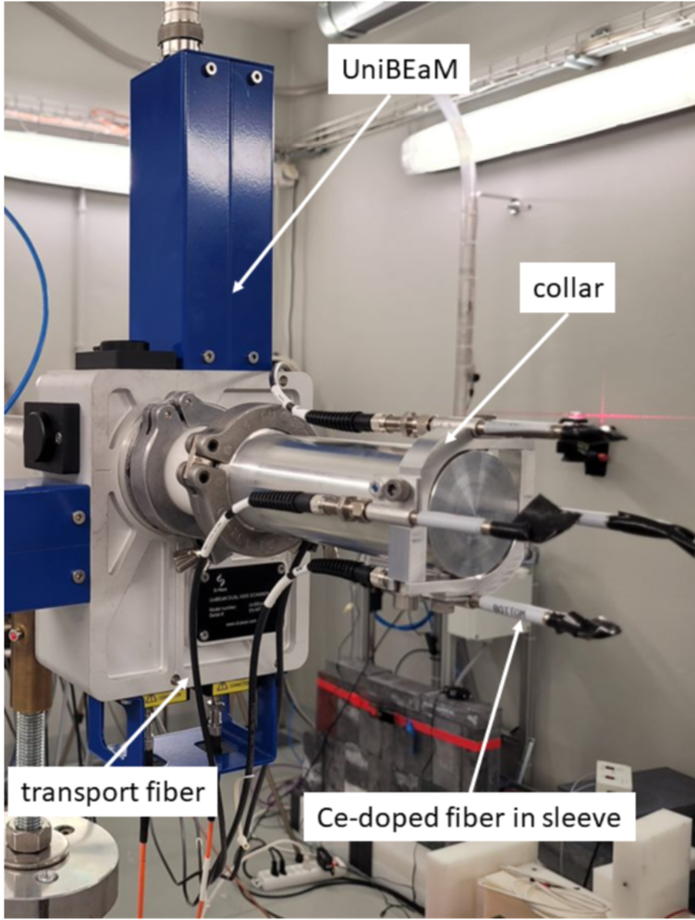
The Collar detector
Scintillating fibres located around the beam pipe in front of the target
In collaboration with TRIUMF and D-Pace
C. Hoehr et al., Proc. IPAC’23, Venice, Italy

Slide 14
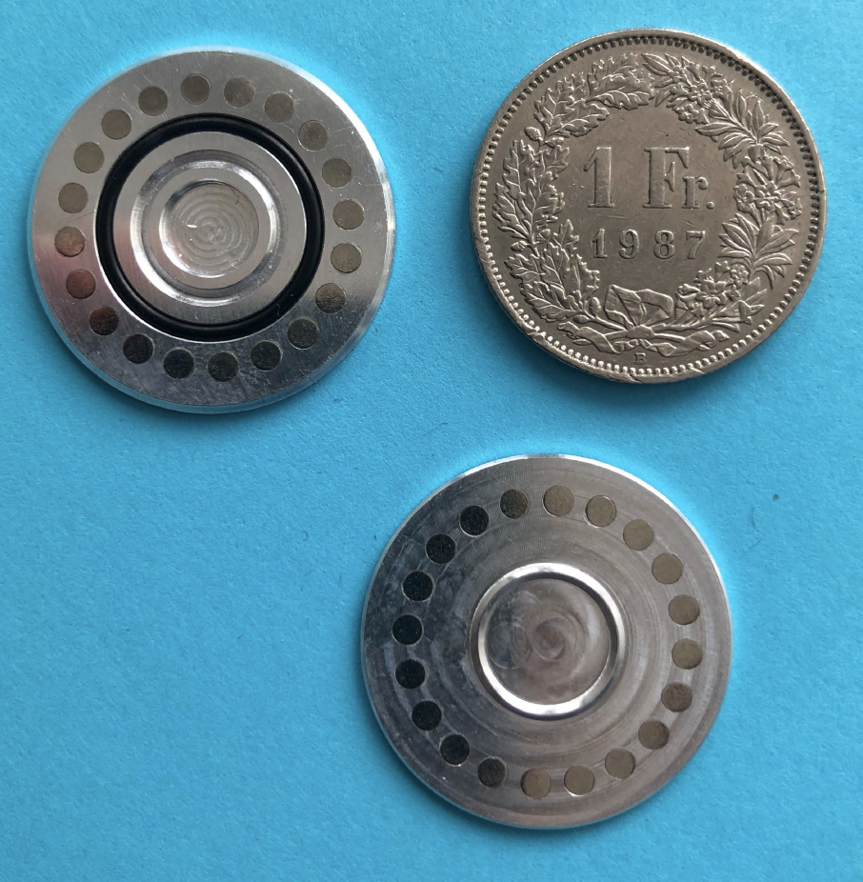
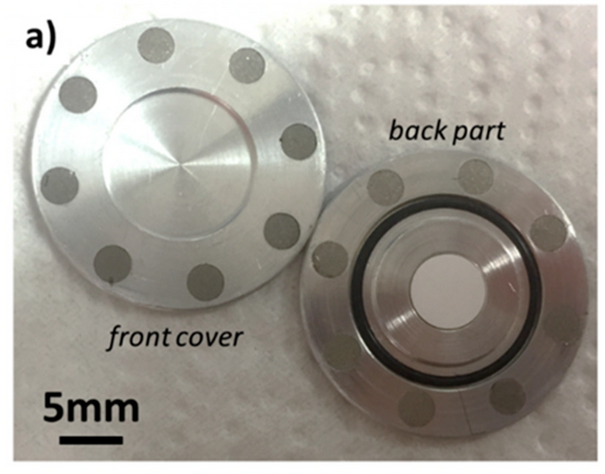
The target coin
Target material pellet
High-purity aluminum
Two halves kept together by permanent magnets
  SmCo, 350ºC Curie temperature
O-ring (viton) to avoid radioactive degassing
Variable thickness of the front (entry energy variation)

Slide 15
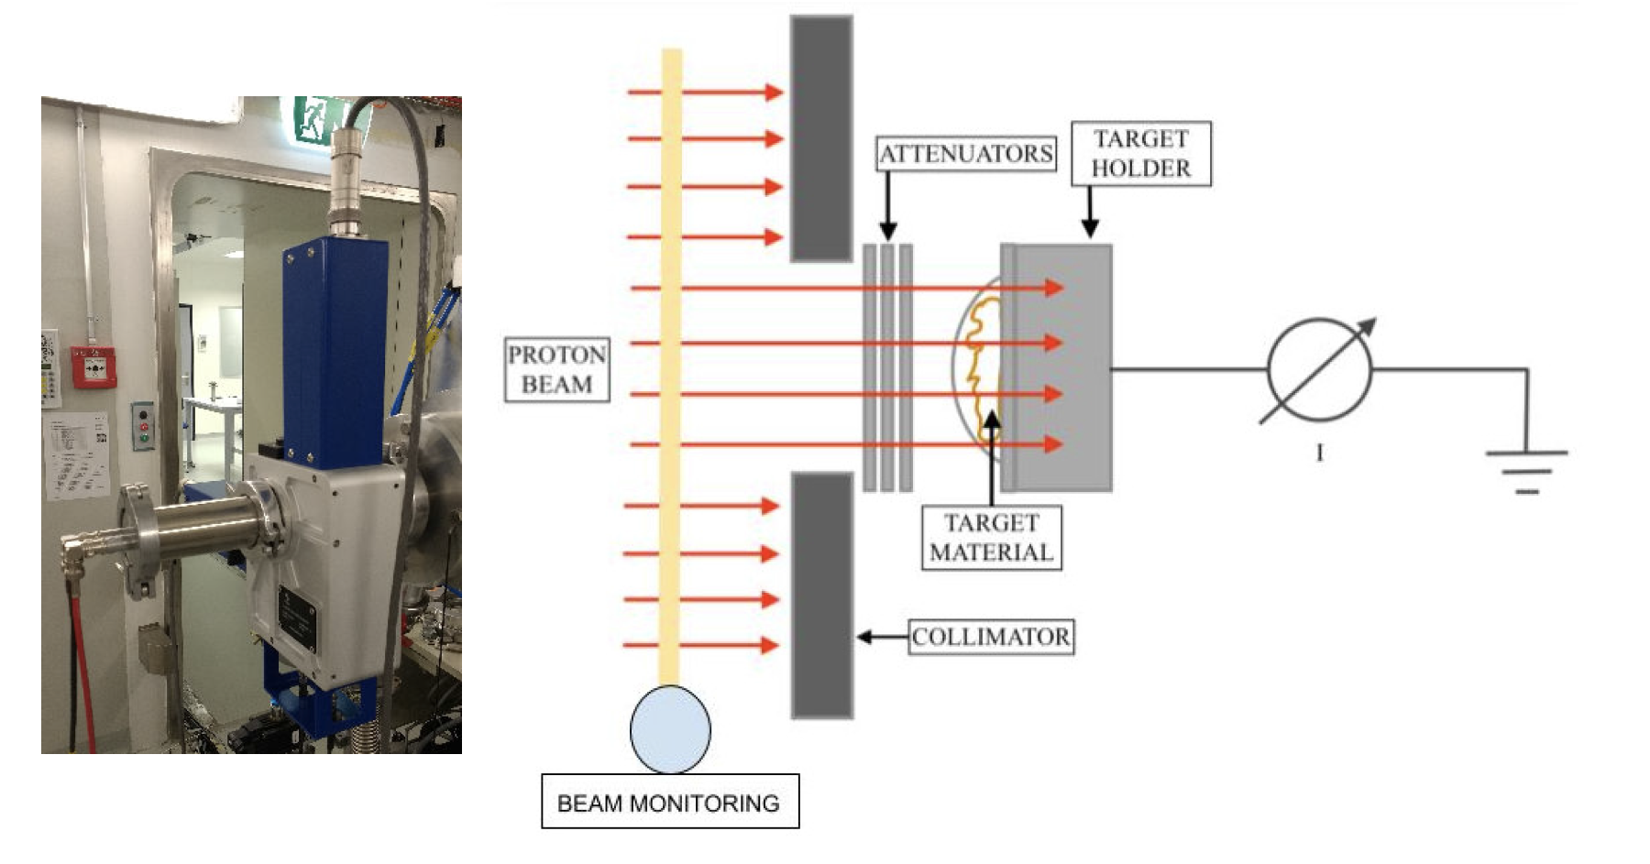
Cross section measurements with a novel method
T. Carzaniga et al., Appl. Radiat. Isot. 129 (2017) 96–102

Slide 16
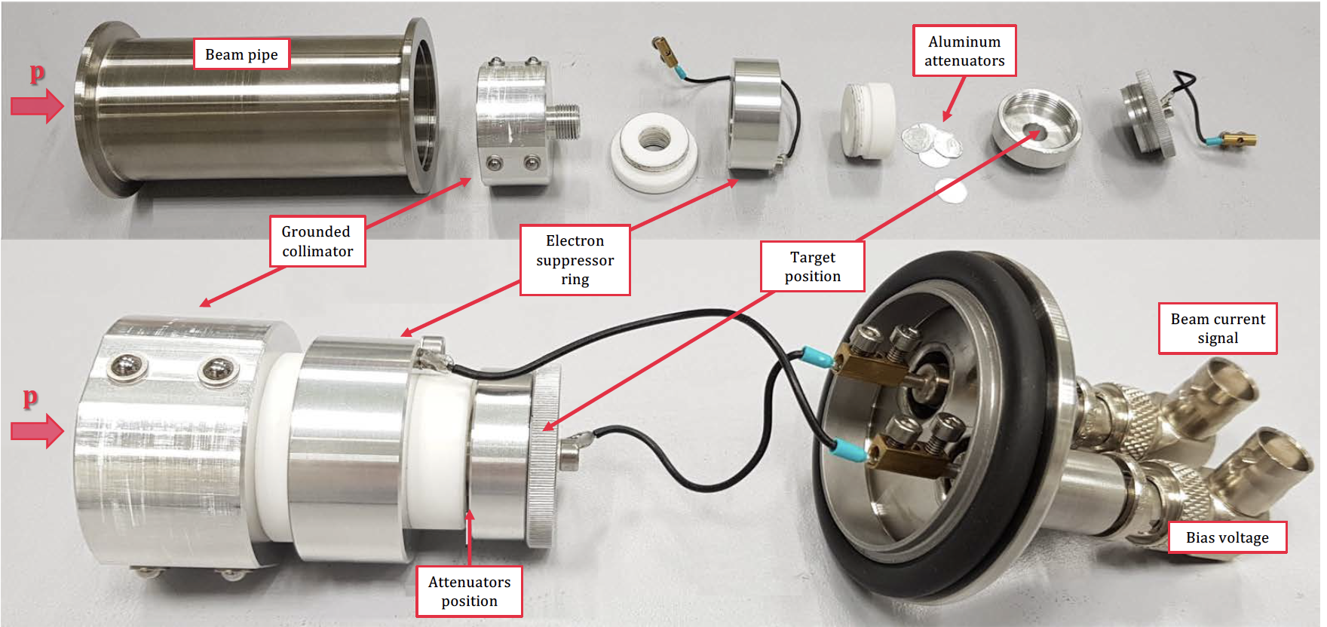
The target station for cross section measurements
Studied radionuclides of medical interest:
⁴³Sc, ⁴⁴Sc, ⁴⁷Sc, ⁴⁸V, ⁶¹Cu, ⁶⁴Cu, ⁶⁷Cu, ⁶⁶Ga, ⁶⁷Ga, ⁶⁸Ga,
¹⁵⁵Tb, ¹⁶⁵Er, ¹⁶⁵Tm, ¹⁶⁷Tm

Slide 17
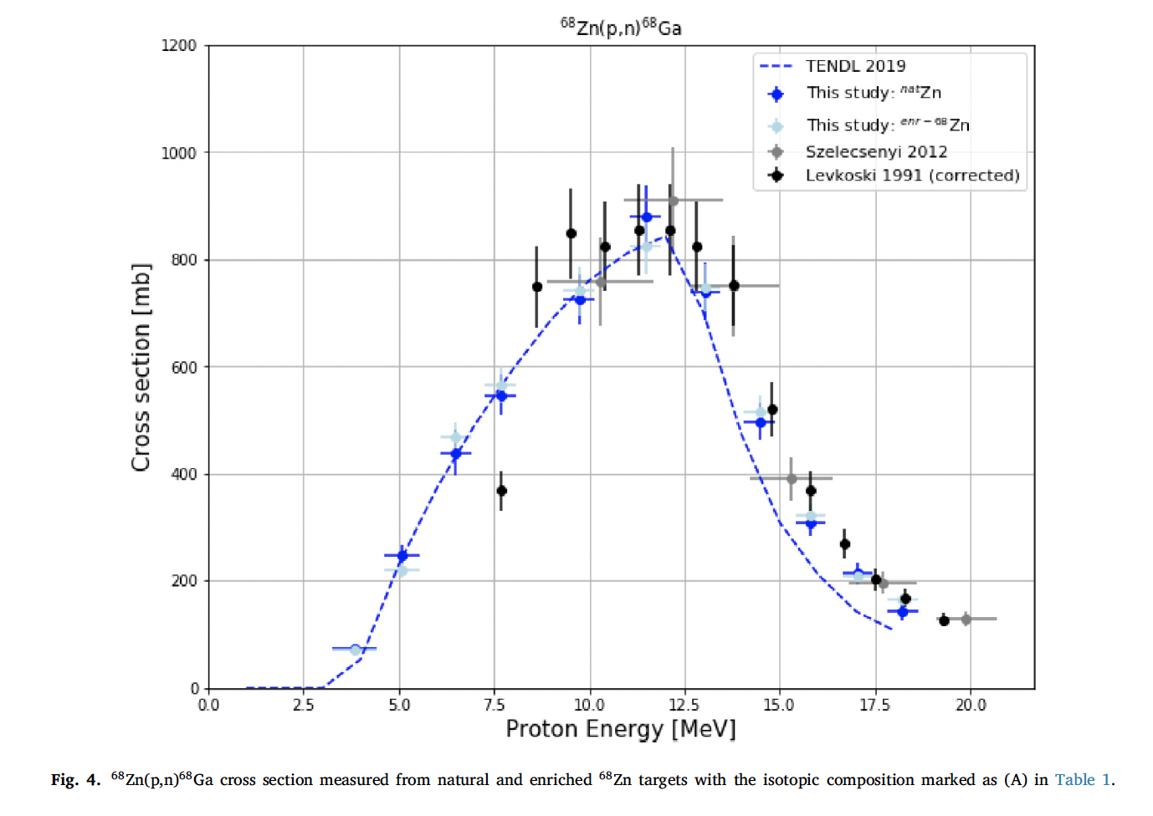
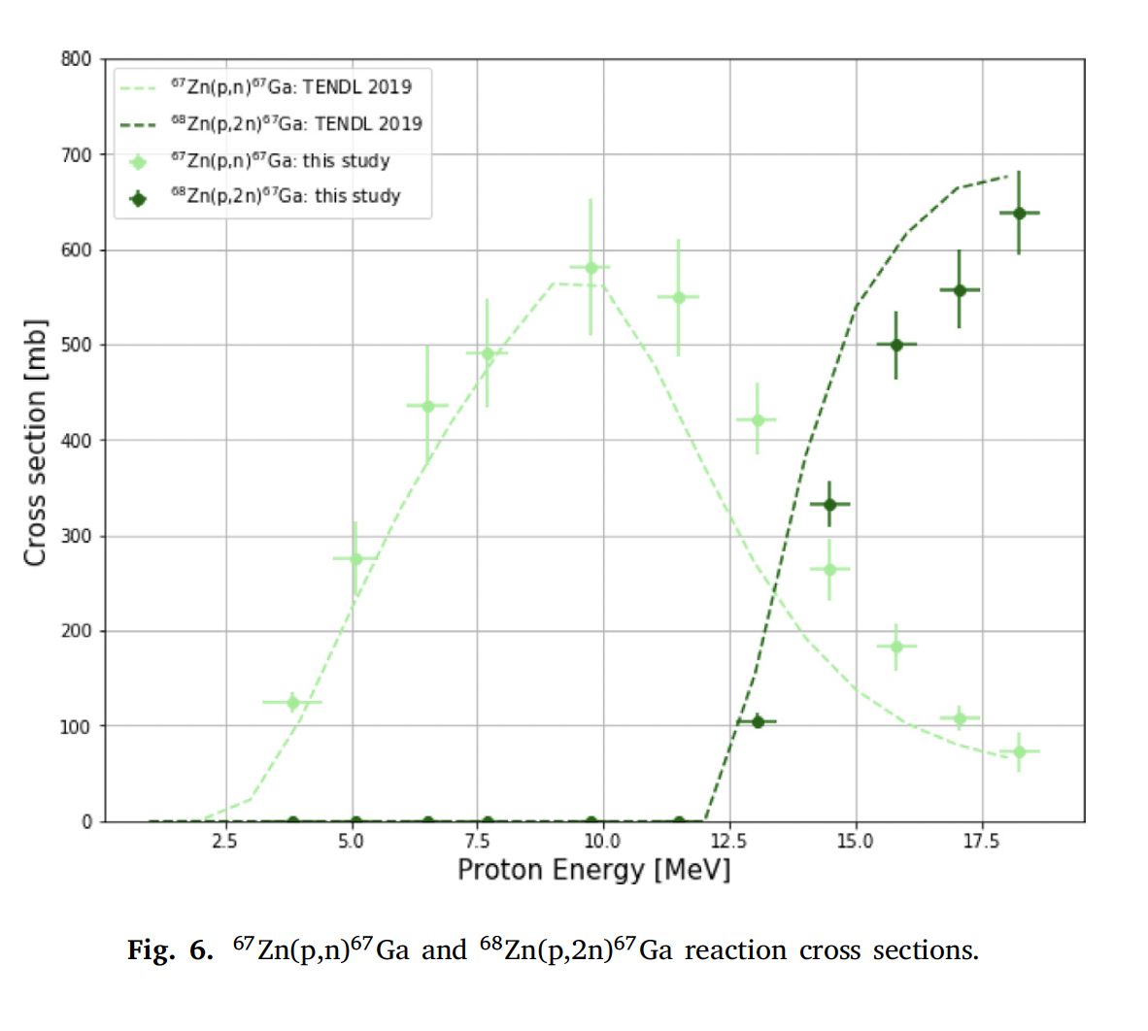
Cross sections and radio-nuclidic purity: the case of ⁶⁸Ga
Use of two different enriched materials: the (p,n) and (p,2n) ⁶⁷Ga nuclear reactions can be measured!
S. Braccini at al., Appl. Radiat. Isot., 186 (2022) 110252

Slide 18
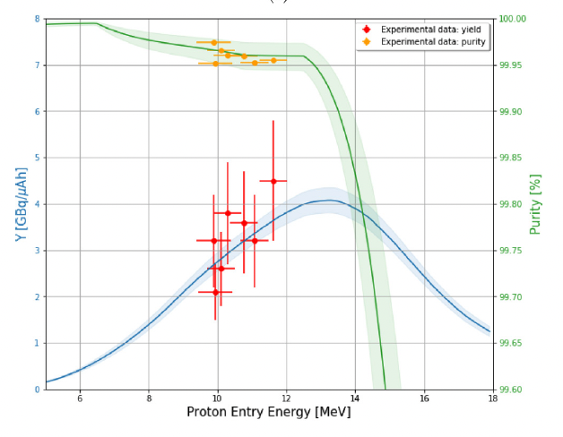
Yield, purity and production tests
⁶⁸Ga

Slide 19
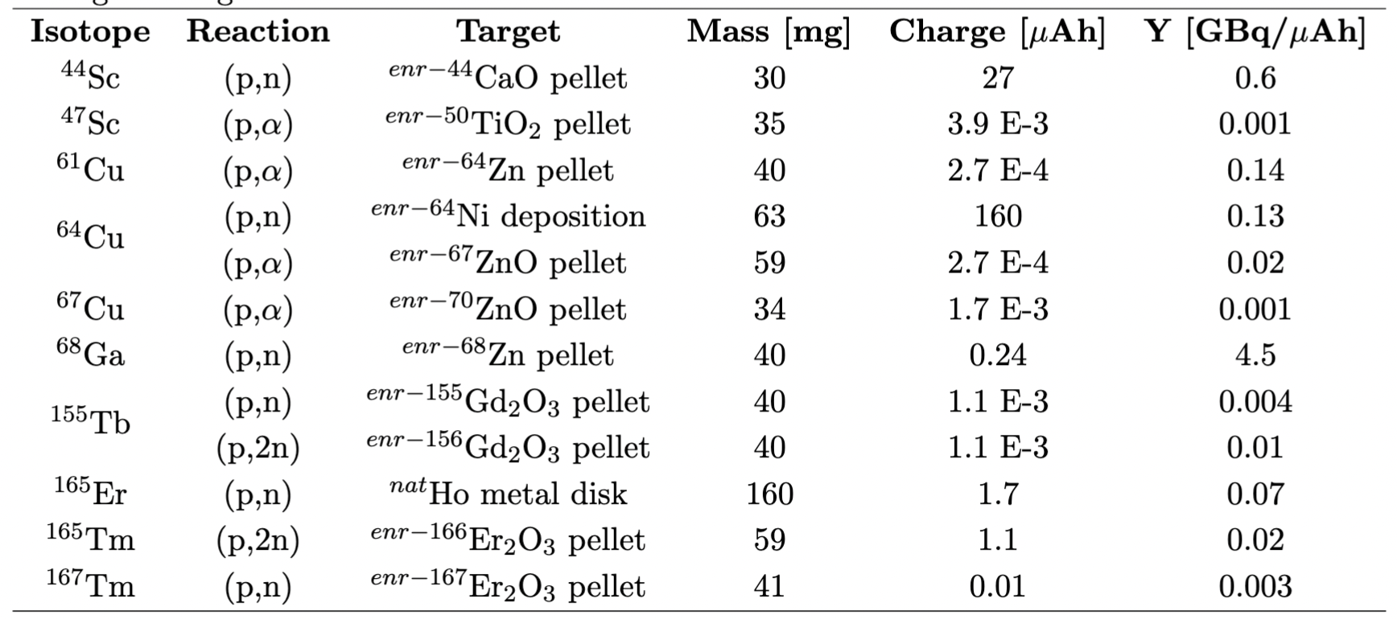
Some produced radioisotopes
G. Dellepiane et al, Appl Rad Isot 189 (2022): 110428 (scandium)
G. Dellepiane et al, Appl Rad Isot 191 (2023): 110518 (copper)
S. Braccini et al., Appl Rad Isot 186 (2022): 110252 (gallium)
G. Dellepiane et al, Appl Rad Isot 184 (2022): 110175 (terbium)
Contributions to fundamental physics:
High Efficiency Cyclotron Trap Assisted Positron Moderator, Instruments 2 (2018) 10.
High-resolution laser resonance ionization spectroscopy of ¹⁴³⁻¹⁴⁷Pm, Eur. Phys. J. A (2020) 56:69

Slide 20
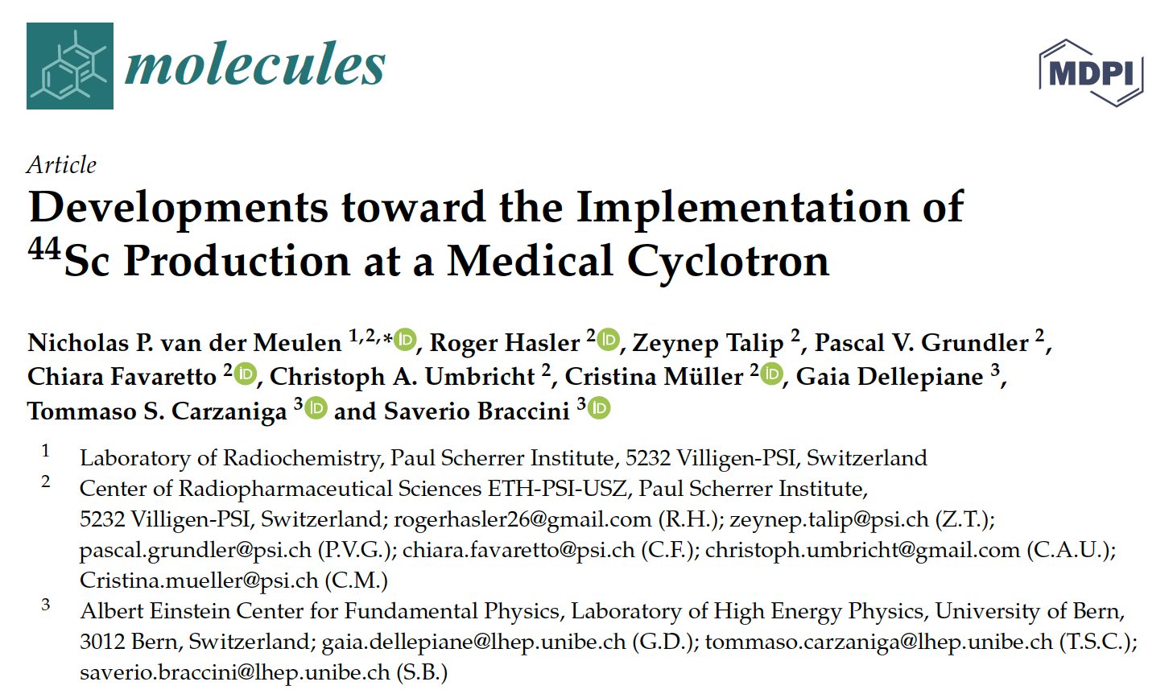
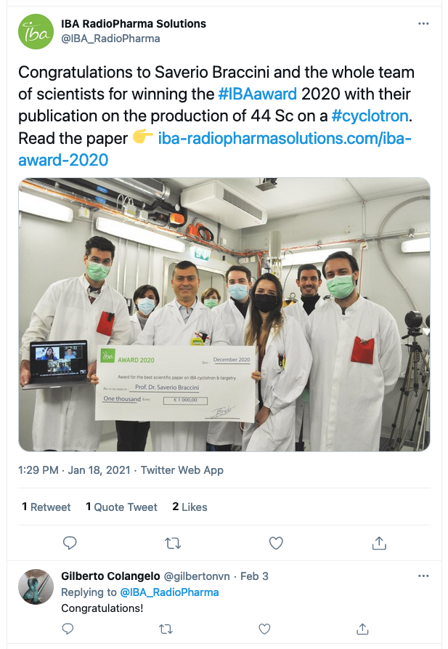
⁴⁴Sc is ready for clinical applications
15 GBq in 5 h irradiation!
In collaboration with PSI
IBA Award 2020

Slide 21
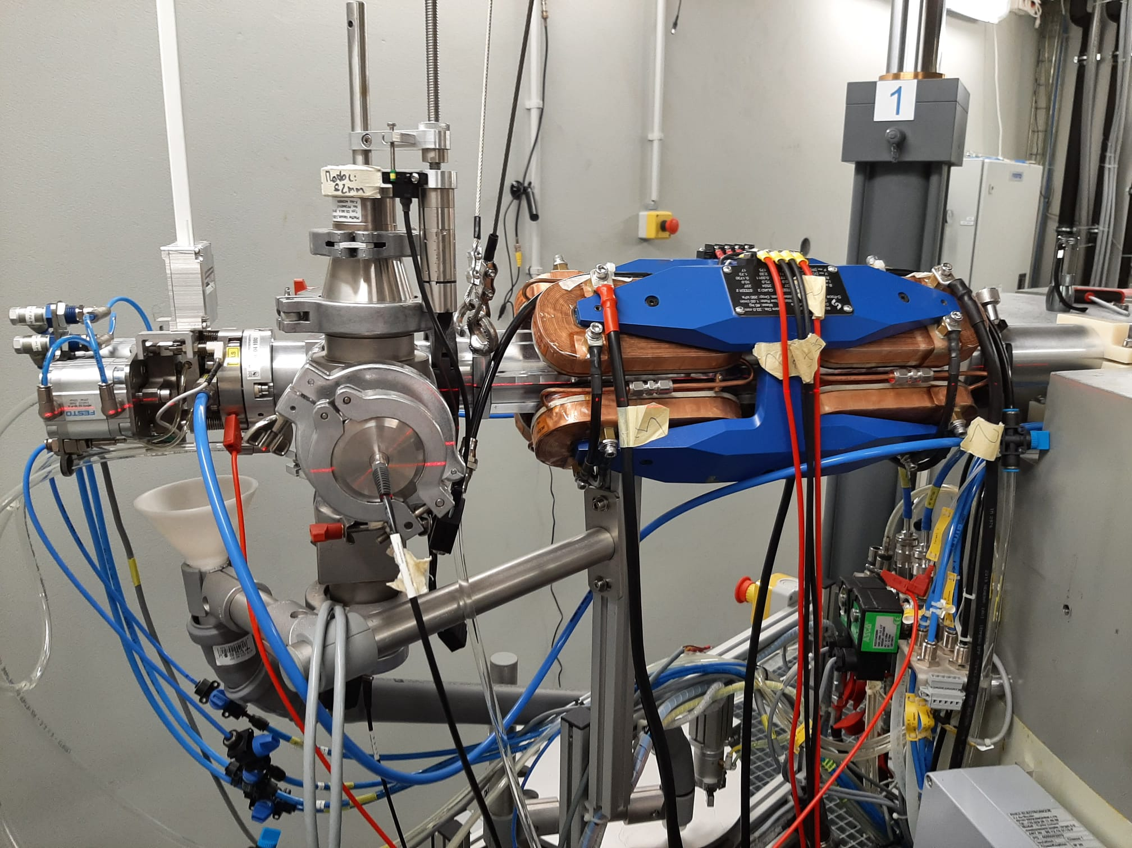
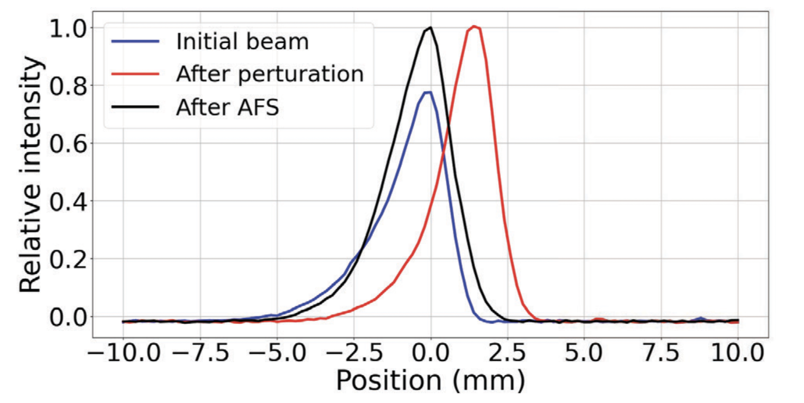
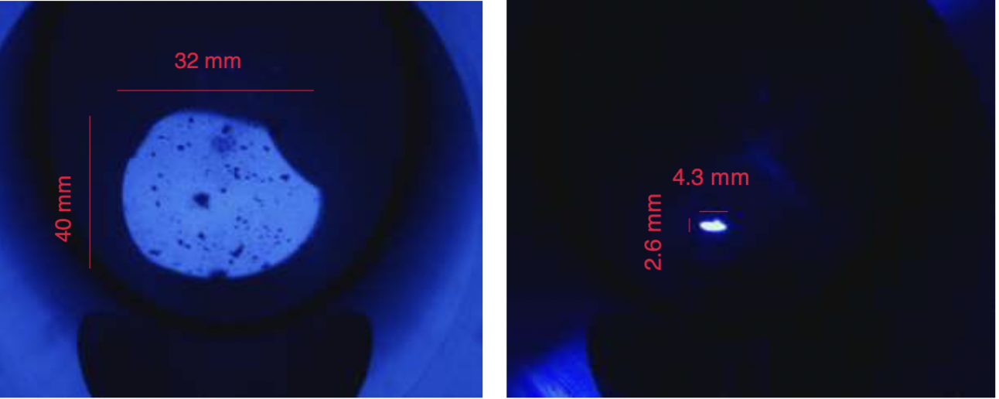
The Automatic Focusing System (AFS)
Control system
MiniBeamLine
2D Beam monitor
STS
STS
Feedback beam monitor
MBL Magnets
Beam line
Cyclotron
before
after
P. Haffner et al., Appl. Sci. 11.6 (2021): 2452

Slide 22
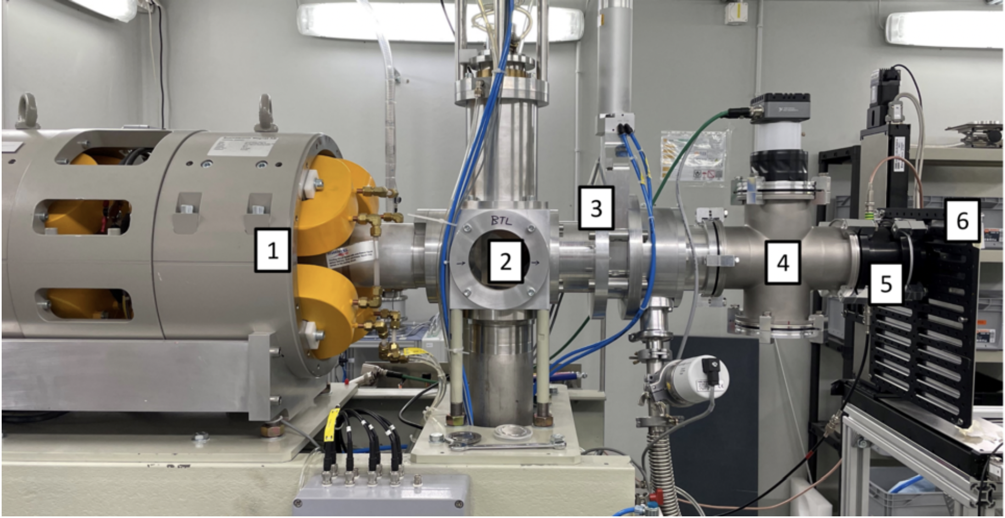
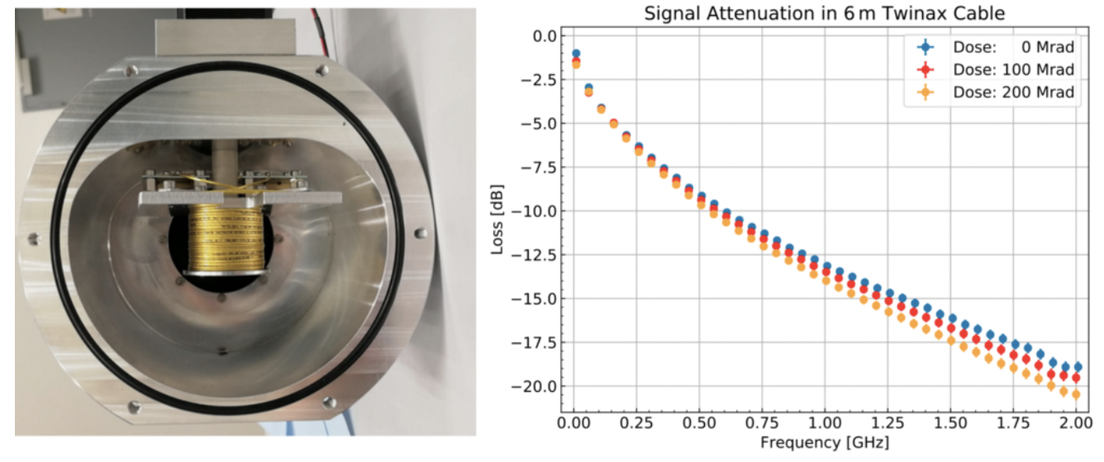
Radiation hardness studies
Applications in space (Juice mission), HEP (ATLAS at CERN), material science
Example: Twinax cable for ATLAS pixel detector
J. Anders at al., 2022 JINST 17 P04021

Slide 23
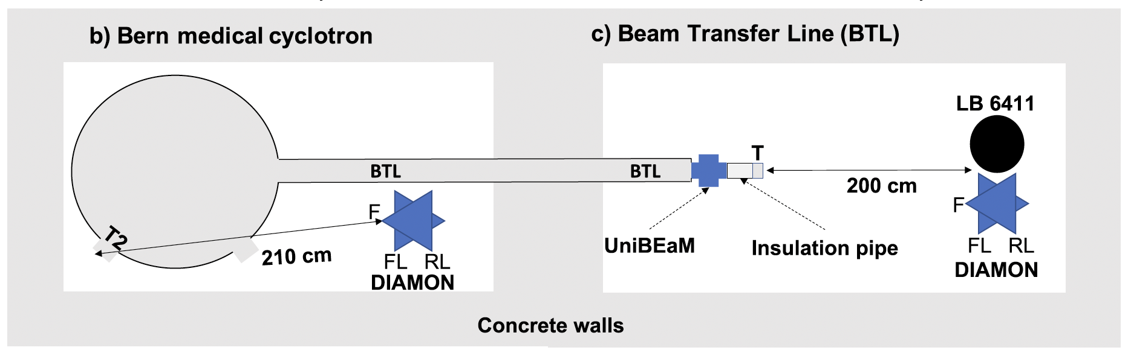
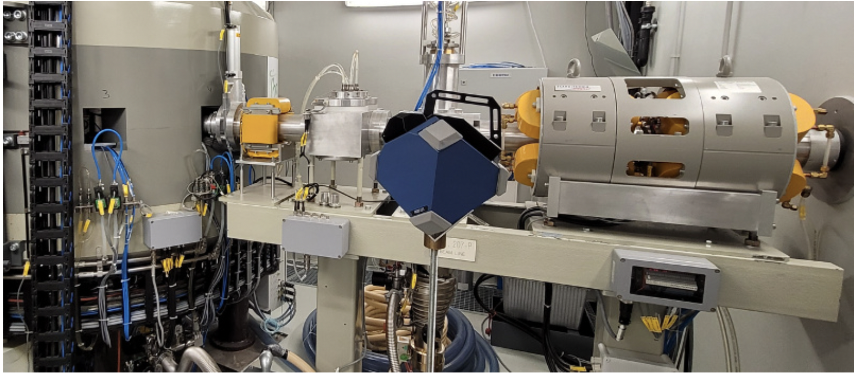
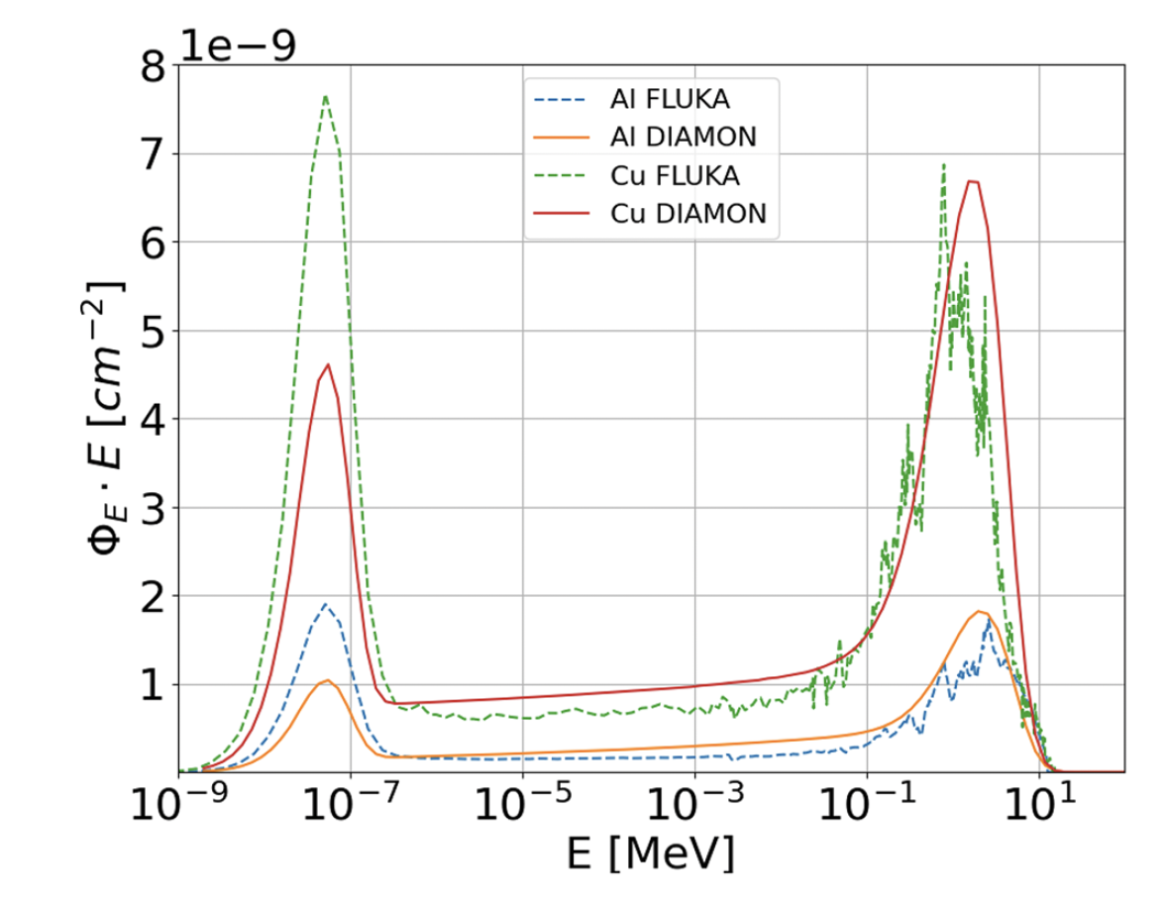


Proton induced neutron beams
Several materials for the target (Al, Cu, Li, ¹⁸O-water)
DIAMON neutron spectrometer
In collaborator with
S. Braccini et al., Sci Rep 12, 16886 (2022).

Slide 24
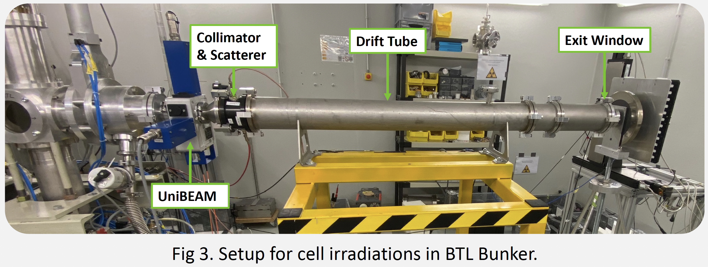
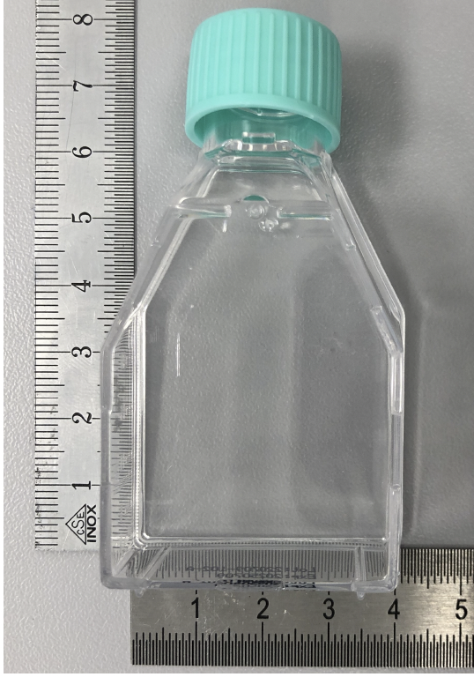
Cell irradiation
Protons vs photons
PRELIMINARY
Ionization
chamber
Cell survival of B16-F10
mouse melanoma
https://zenodo.org/records/10478639
The cells are plated on a flask
In collaboration with the
Institute of Anatomy of the Univesity of Bern

Slide 25
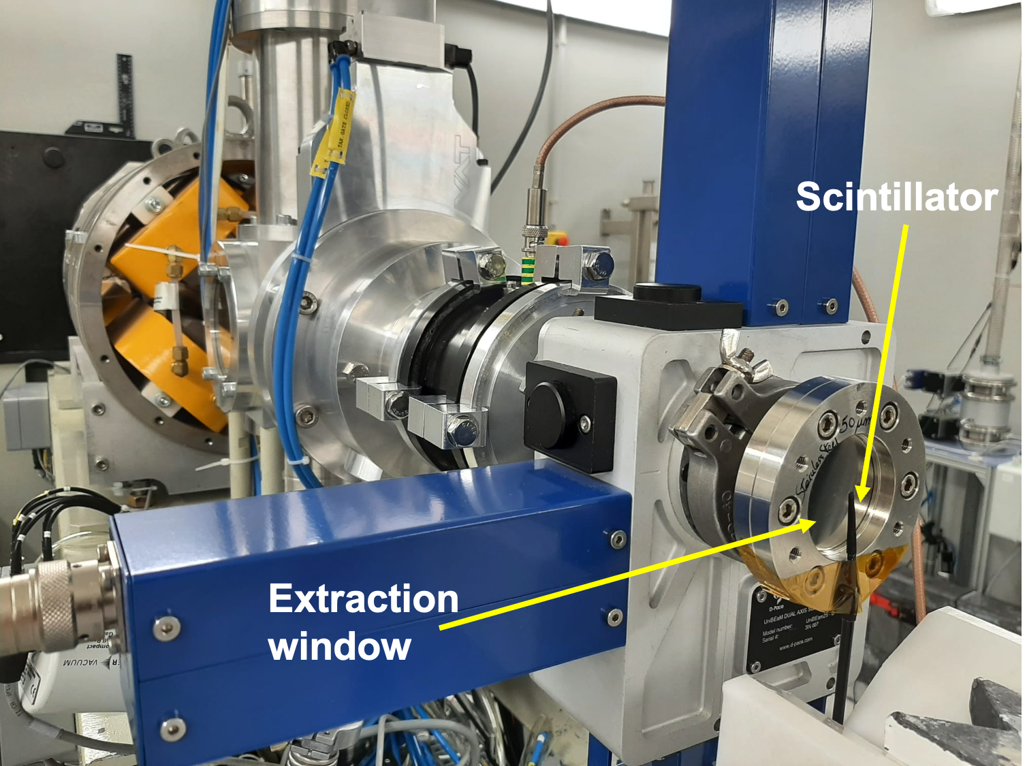
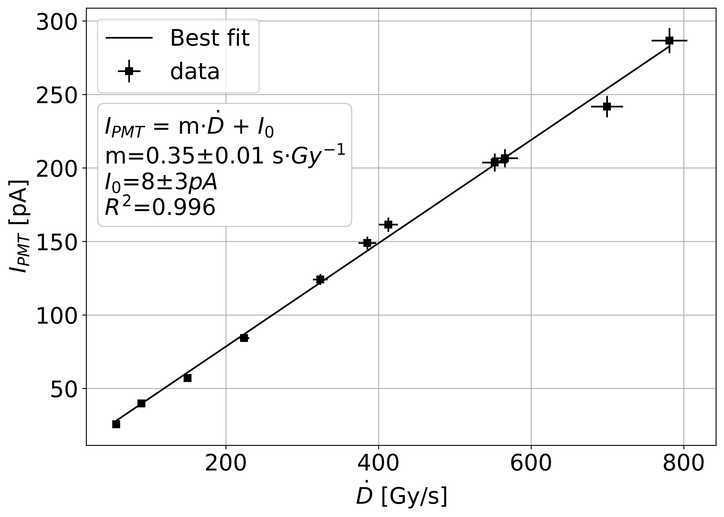
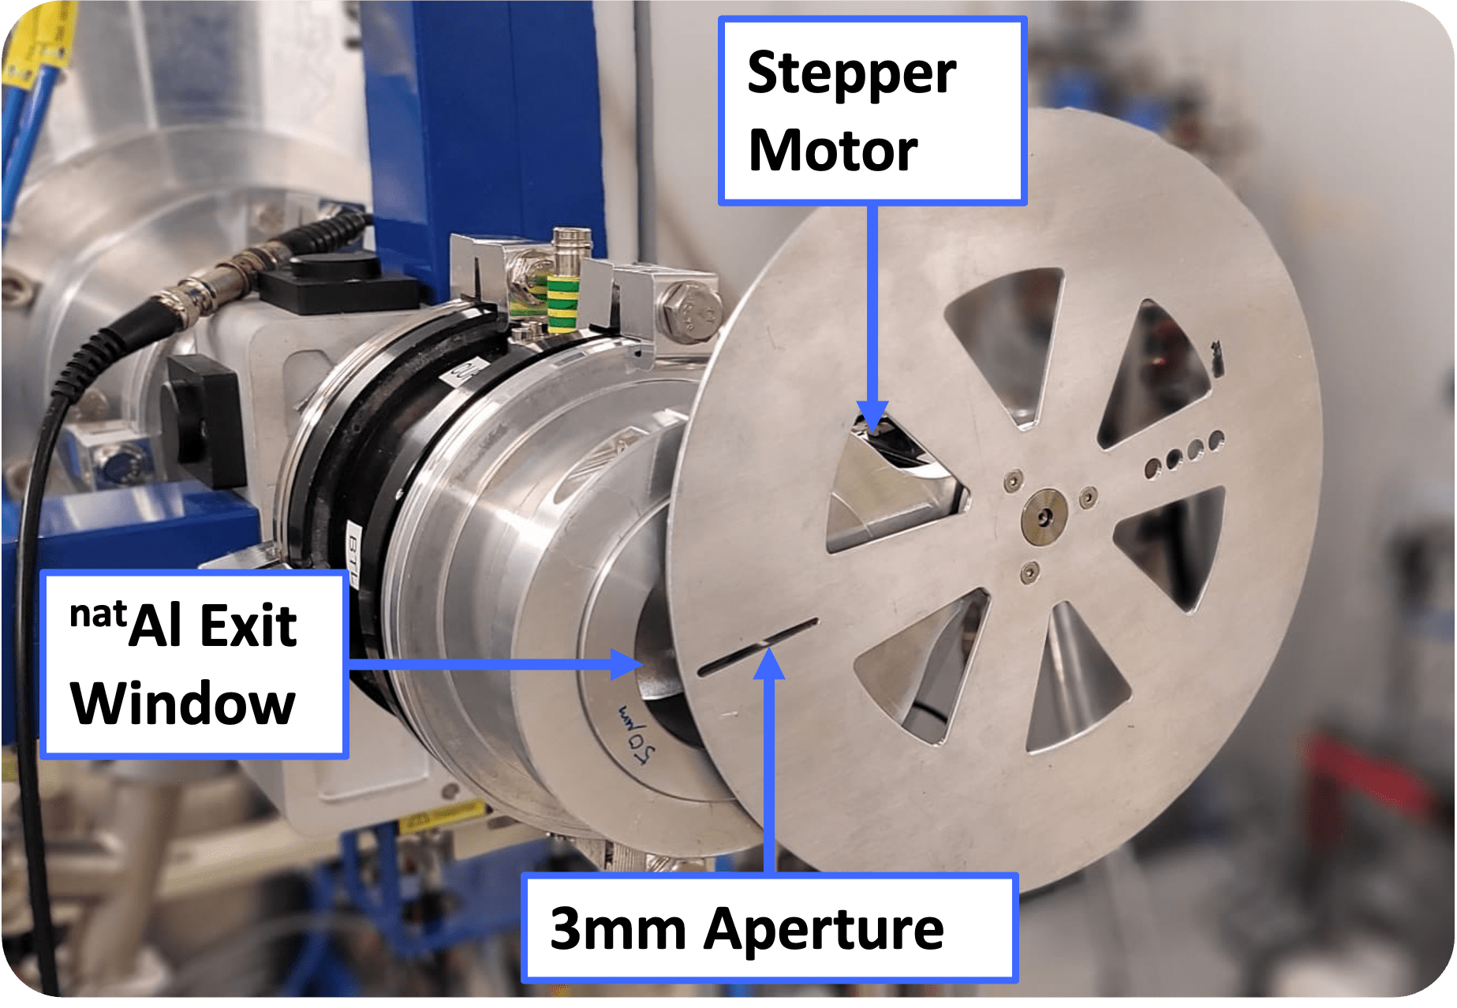
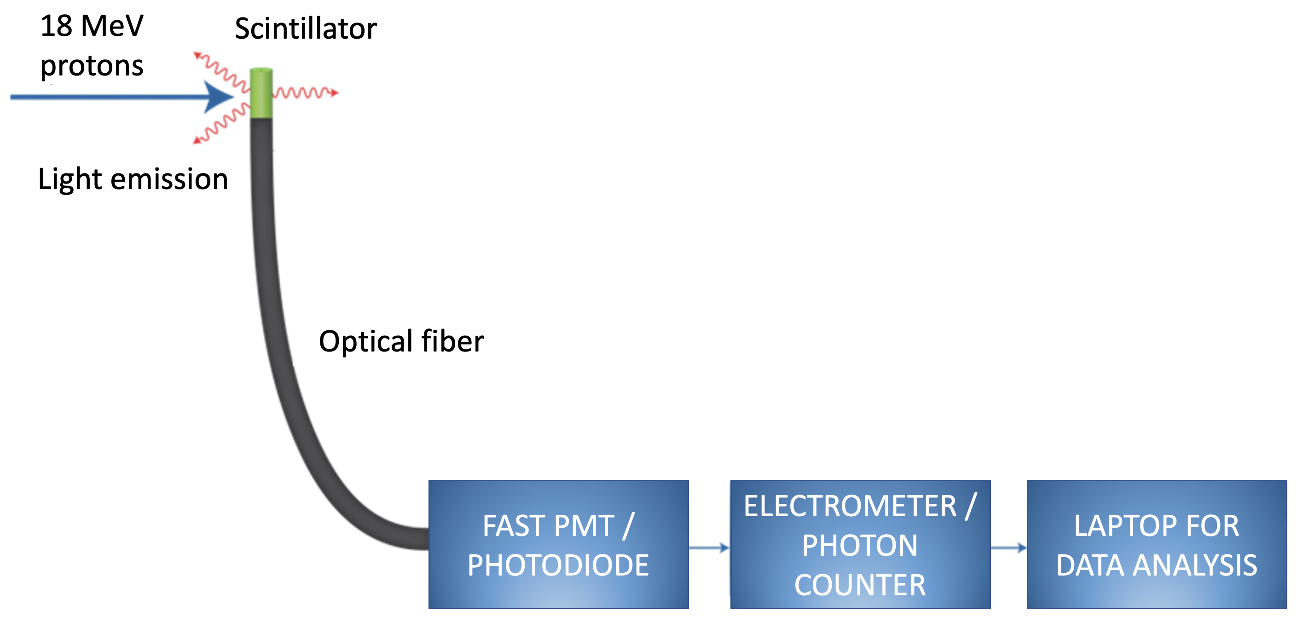
Exploring the FLASH regime
PRecision dOsimetry in
FLASH radiotherapy with Optical Fibers (PROOF)
High currents are an advantage!
P. Casolaro et al., 11th Int. Beam Instrum. Conf. (2022)

Slide 26
Conclusions and Outlook
Medical cyclotrons:
  Tools of choice for radioisotope production in a hospital-based environment
  Have a high scientific potential
  Excellent for the training of young scientists
  Production and research can run in parallel
Several multi-disciplinary research programs at the Bern medical cyclotron in the last 10 years
… we are open to collaborations!

Slide 27
Acknowledgements
Seniors and PostDocs: P. Scampoli, I. Mateu, L. Mercolli, P. Casolaro, L. Franconi, C. Belver Aguilar, E. Kasanda
PhD students: A. Gottstein, A. Oliveira, G. Dellepiane (2023), P. Häffner (2021), T. Carzaniga (2019), K. Nesteruk (2017)
Master and Bachelor Students (last 5 years):
  L. Eggimann, D. Wermelinger, T. Stammbach, M. V. Rossi (2024), R. Zehnder (2024), M. Schmid (2021), E. Zyaee (2021), N. Voeten (2022), D. Wüthrich (2019), J. Askew (2022), D. Wermelinger (2023), M. Wenger (2022), N. Kämpfer (2020), A. Gaschen (2023), N. Gaschen (2023), A. Andrey (2023), Andreas Gsponer (2019), Melina Lüthi (2019)
LHEP mechanics and electronics workshop; SWAN Team
https://www.lhep.unibe.ch/research/medical_applications/index_eng.html

