Slide 1
The IFMIF-DONES Accelerator: Target & Irradiation Challenges and Future Research Opportunities
Claudio Torregrosa-Martín
On behalf of the IFMIF-DONES Team

Slide 2
List of Authors
A. Ibarra, W. Królas, F. Arbeiter, S. Becerril, D. Bernardi, L. Buiglins, J. Castellanos, M. Cappelli, P. Cara, T. Dézsi, A. Diaz, M. García, J. Gutiérrez, D. Jimenez-Rey, M. Luque, J. Maestre, F. Martín-Fuertes, J.C. Marugán, C. de la Morena, G. Miccichè F. S. Nitti, C. Oliver, F. Ogando, I. Podadera, Y. Qiu, D. Regidor, D. Sánchez-Herranz, T. Tadić, M. Vázquez, U. Wiącek, M. Weber

Slide 3
OUTLINE
Introduction to the IFMIF-DONES Facility
The Irradiation Modules
Summary
The IFMIF-DONES Accelerator
The Lithium Target
Future Research Opportunities
1
2
3
4
5
6

Slide 4
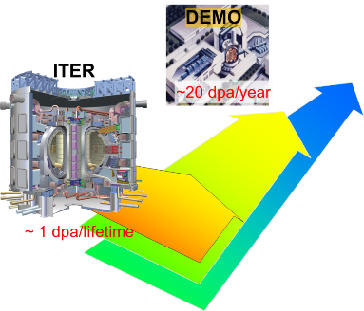
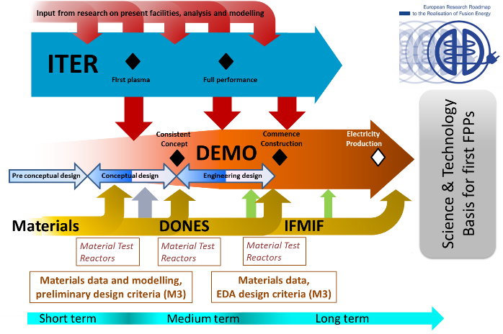
WHY IFMIF-DONES
One of the main differences between ITER and DEMO is the radiation dose: at DEMO more than one/two orders of magnitude higher
20-50 dpa/lifetime
1-3 dpa/lifetime

Slide 5
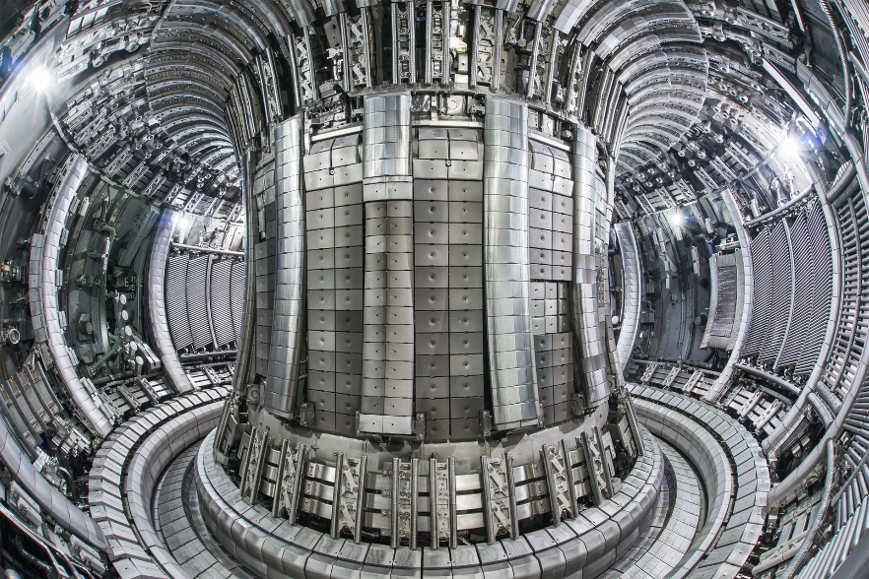
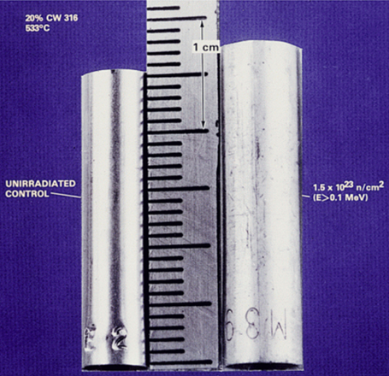
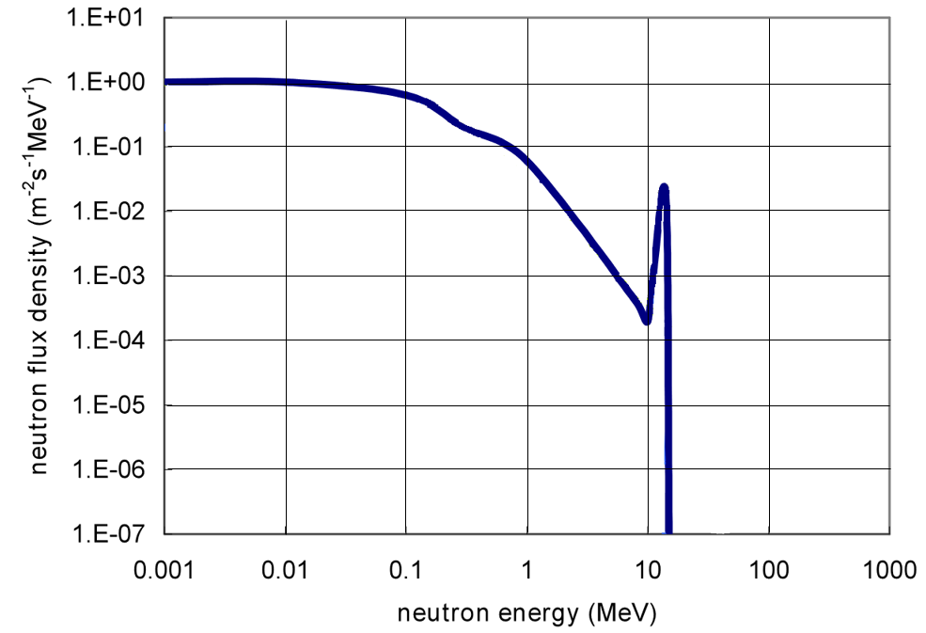
Radiation Damage to Fusion Materials
Radiation makes materials swell
It makes them brittle!
Normalized neutron energy spectrum DEMO first-wall
Radiation damage processes are very dependent on the neutron energy spectrum
Fusion neutrons spectrum differ significantly from the ones of Fission Reactors and Spallation Neutron Sources
A fusion-like neutron source is needed!

Slide 6
A fusion-like neutron source
We need to produce fusion-like neutrons with:
Intensity large enough for accelerated testing (as compared to DEMO)
Damage level above the expected operational lifetime
Irradiation volume large enough for the characterization of the macroscopic properties of the materials of interest required for the engineering design of DEMO (and the Power Plant)
The most feasible approach based on Li(d,xn) sources
Requirements based on EU DEMO needs
> 10 dpa(Fe)/fpy
The IFMIF project since 90´s
20 dpa(Fe) in 1.5 y
50 dpa(Fe) in 3.5 y
300 cm³
Broader Approach IFMIF/EVEDA since 2007 (LIPAc & IFMIF IIEDR)
The
IFMIF-DONES Project
EUROfusion WPENS since 2015

Slide 7
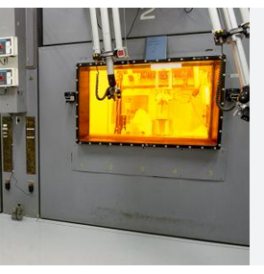
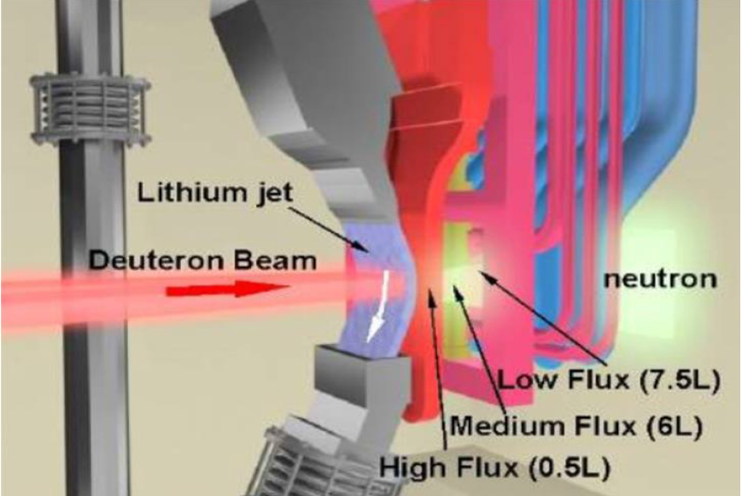
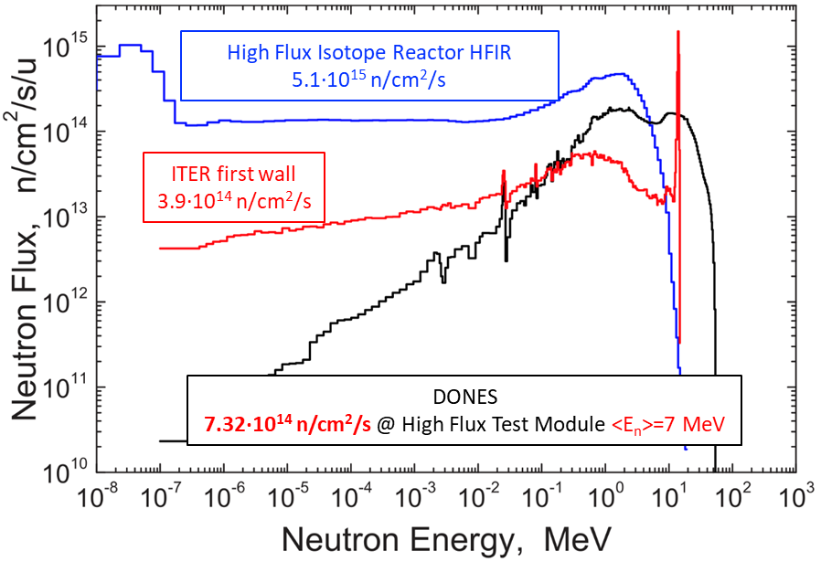
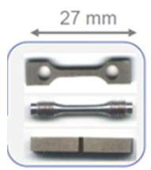
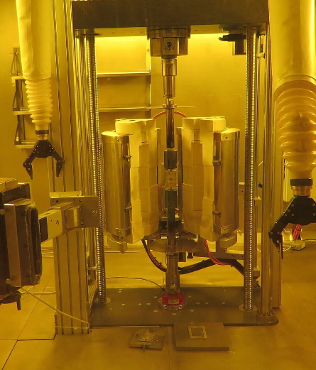
What is IFMIF-DONES?
IFMIF-DONES is an accelerator-based fusion-like neutron source to be used for the qualification of the materials for the DEMO Fusion Reactor
IFMIF-DONES is a combination of:
High Intensity Deuteron Accelerator
Liquid Lithium Loop Facility
Irradiation Modules to house material specimens in a controlled environment

Slide 8
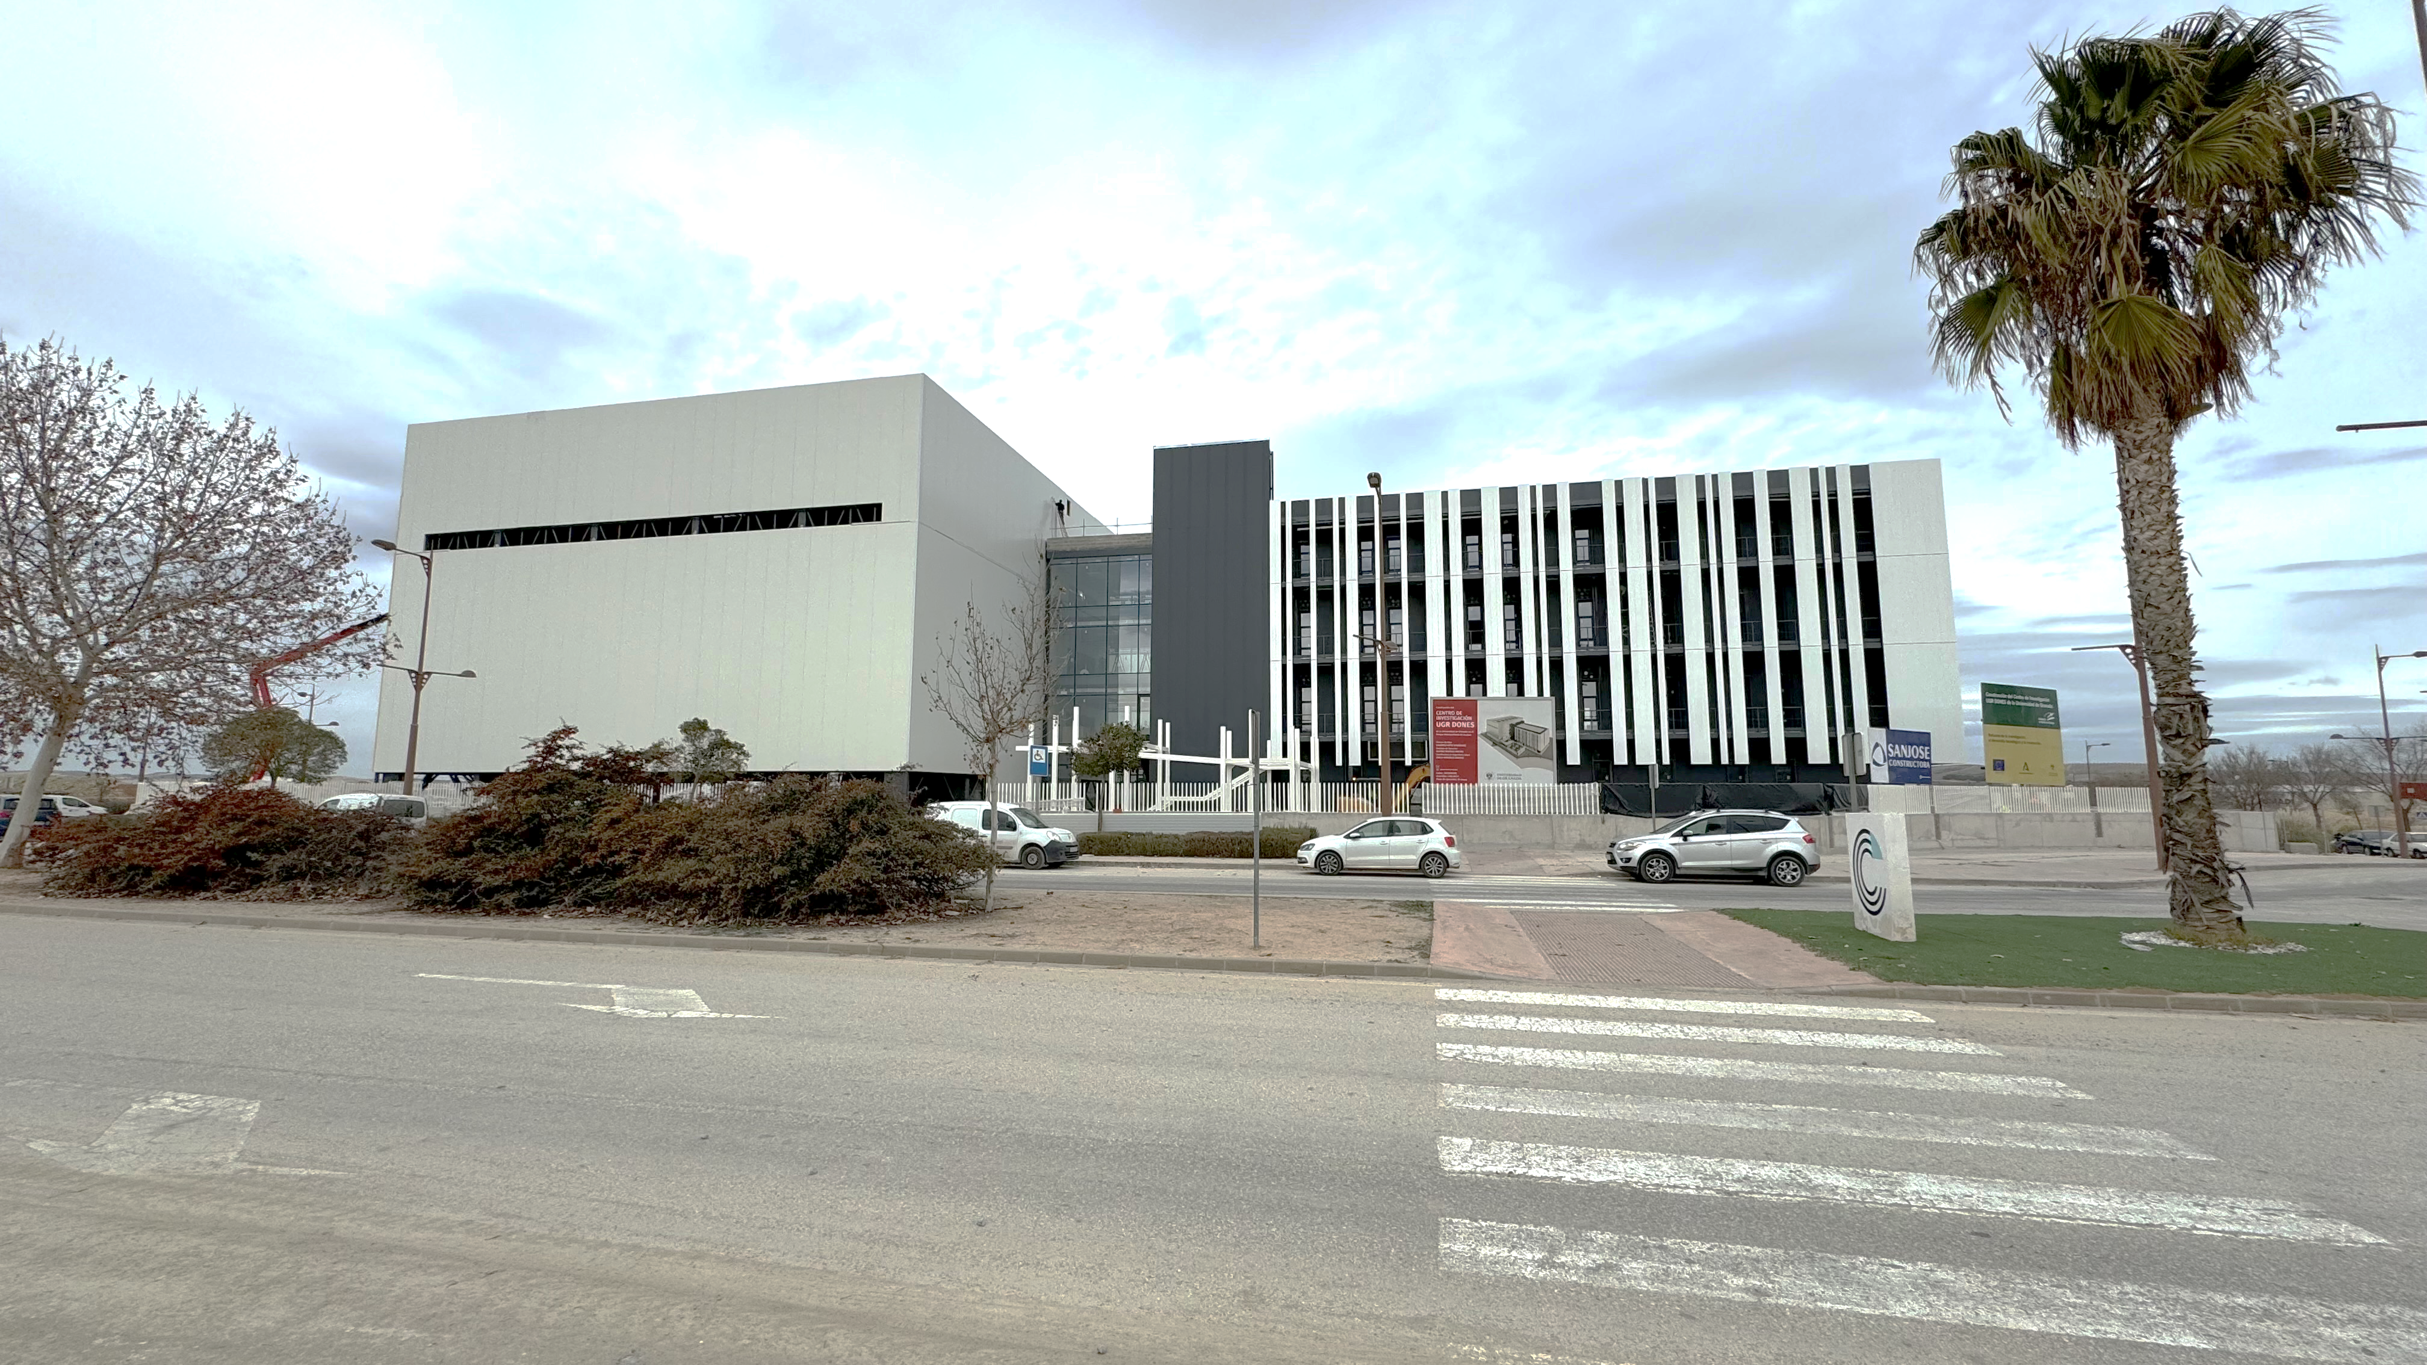
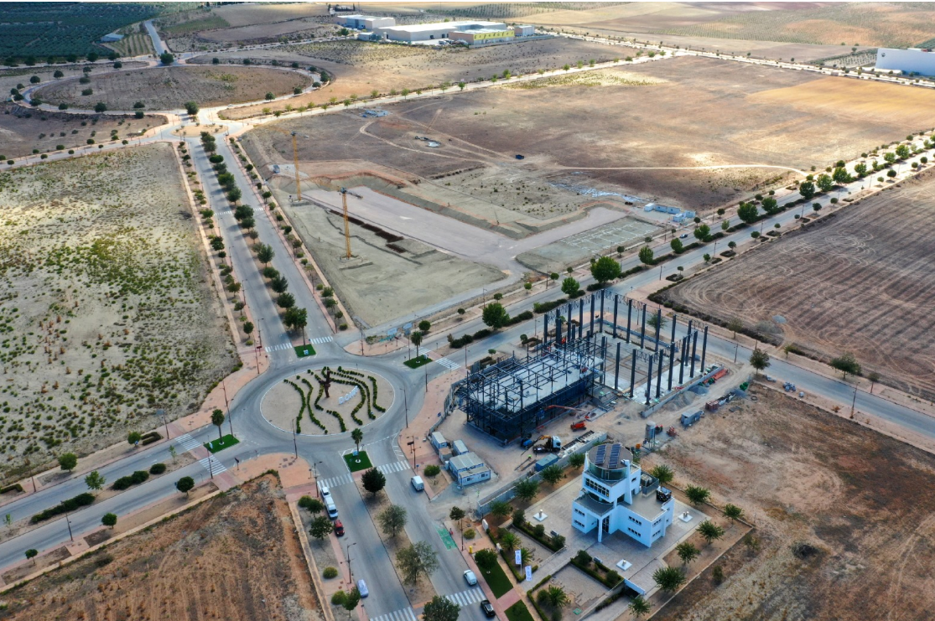
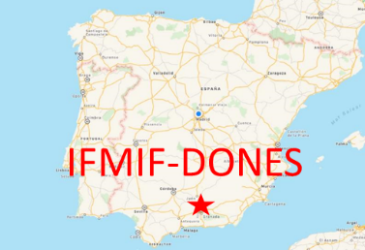
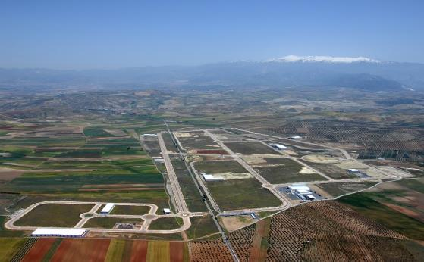
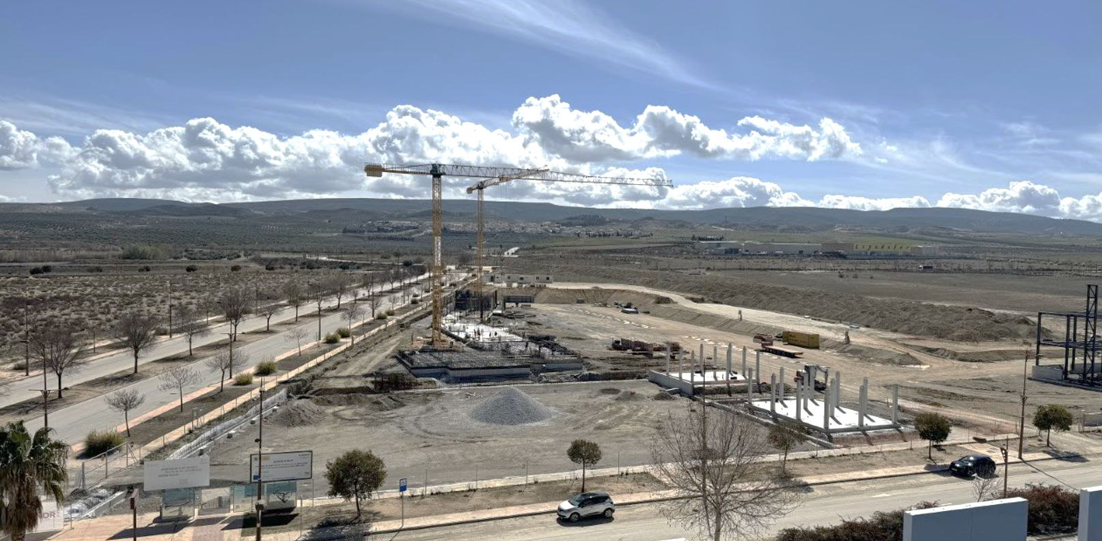
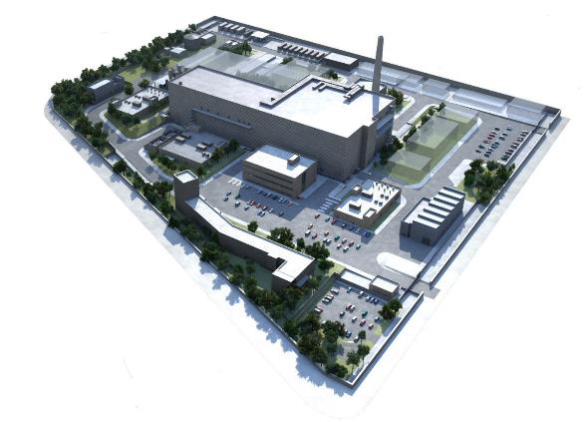
The IFMIF-DONES site in Granada, Spain
The site is located at Escúzar -18 km southwest from Granada city- Spain

Slide 9
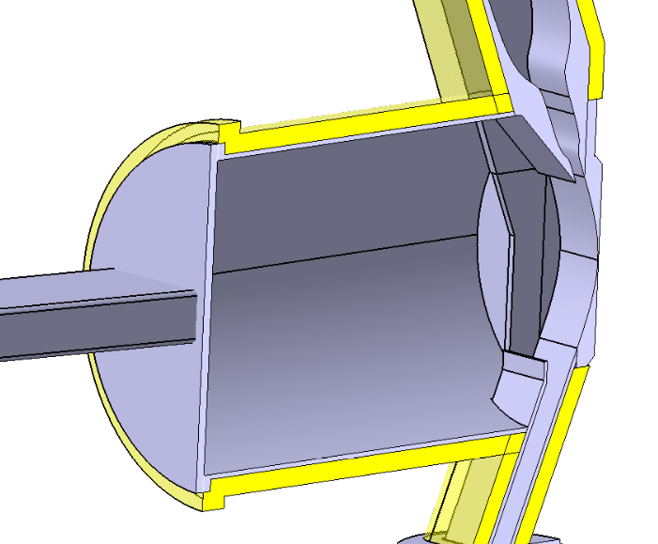
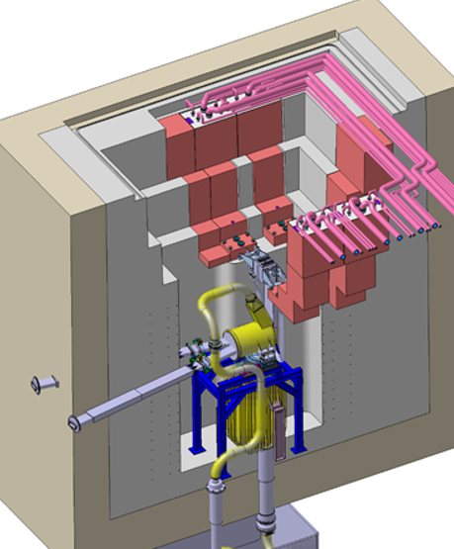
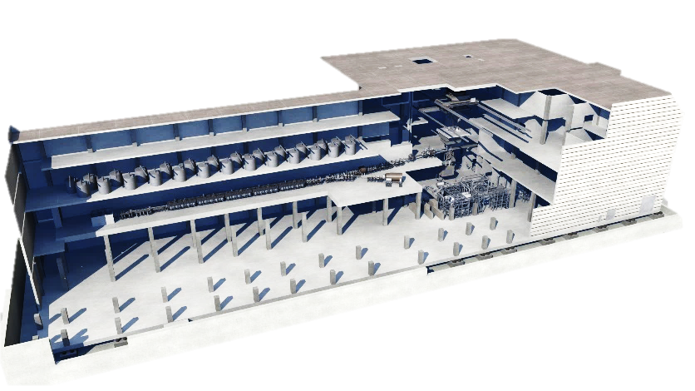
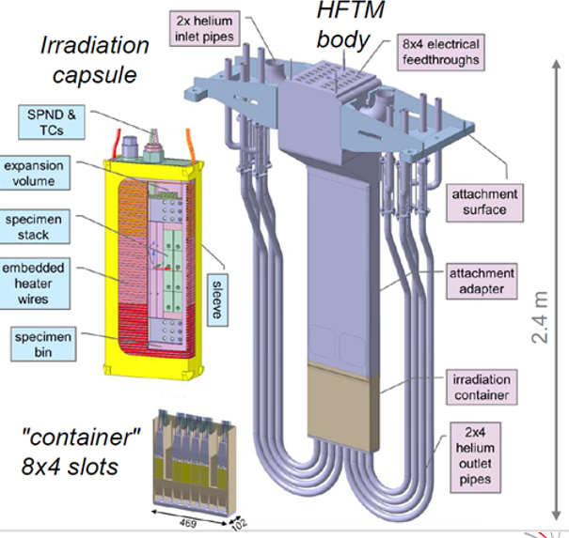
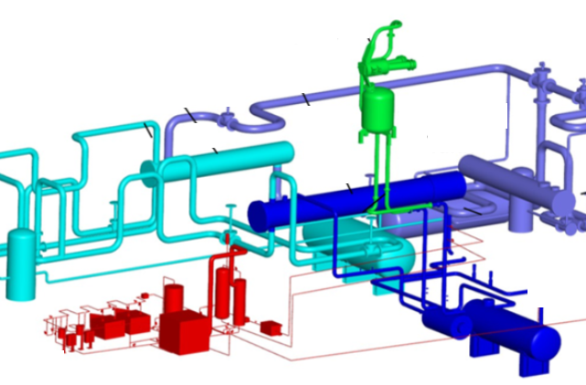
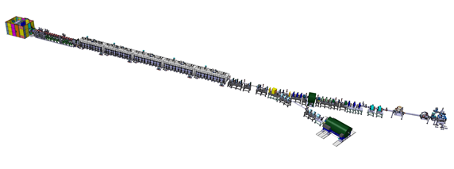
The Facility
Irradiation Facility delivering up to 10¹⁵ n/cm²/s (10¹⁷ n/s) with a broad peak at 14 MeV.
Operational at least 255 days/year (70% Operational Availability).
Li Target, Irradiation Modules and Test Cell
Deuteron Beam
Li Loop and Oil Cooling Loops
LINAC Accelerator of Deuterons
40 MeV
125 mA, CW
5 MW output power
100 l/s Li
Strict Li Purity Control
~100 m

Slide 10
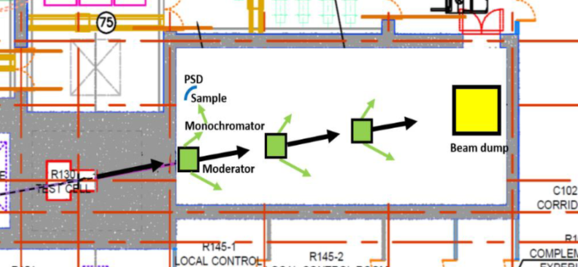
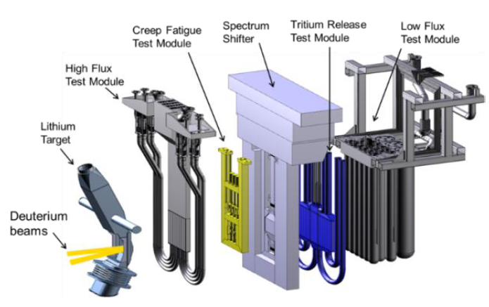
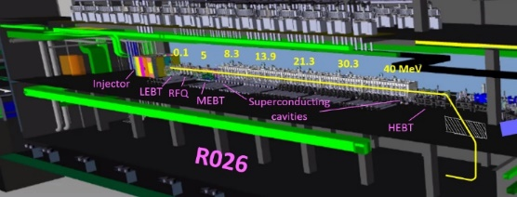
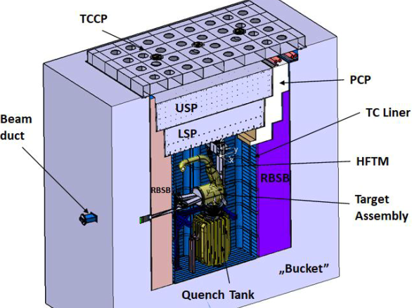
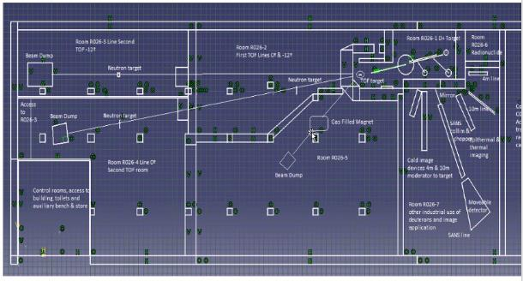
AREAS FOR NON-FUSION EXPERIMENTS
OTHER FUSION
TEST MODULES
R160: 300 m² Area
Same floor as the Test Cell
Profiting from a continuous neutron beam from the TC via a Neutron Beam Aperture/Collimator (Ø20-12 cm)
Estimated neutron flux at the duct exit:
2∙10¹⁰ n/cm²/s, 99.5% of fast neutrons, En > 100 keV
High flux Modules
Medium Flux Modules
Low Flux Modules
R160
R026: 2100 m² Area
Ground floor, below the Accelerator Vault
Profiting from Pulsed Deuterons beams via a beam extraction from the accelerator
Deuteron extraction at 40 MeV (0.1 % intensity)
Experiment using deuterons & pulsed neutrons (by neutron production with a Target)

Slide 11
OUTLINE
Introduction to the IFMIF-DONES Facility
The Irradiation Modules
Summary
The IFMIF-DONES Accelerator
The Lithium Target
Future Research Opportunities
1
2
3
4
5
6

Slide 12
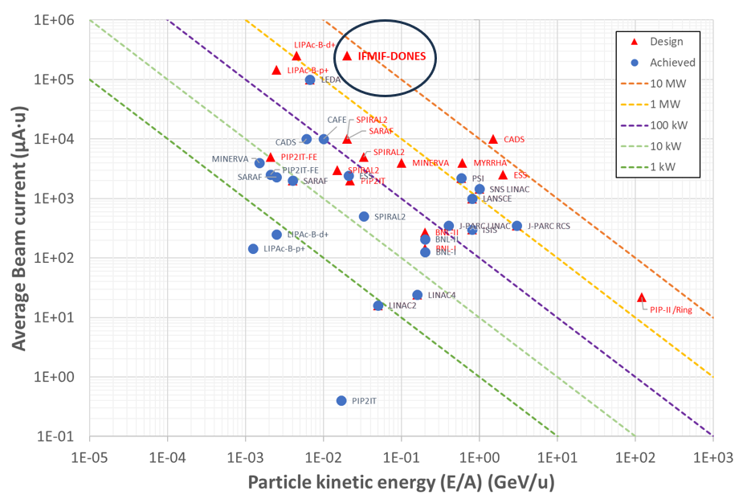
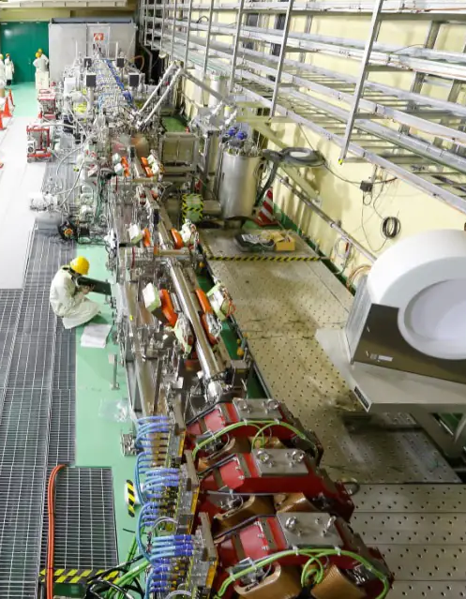
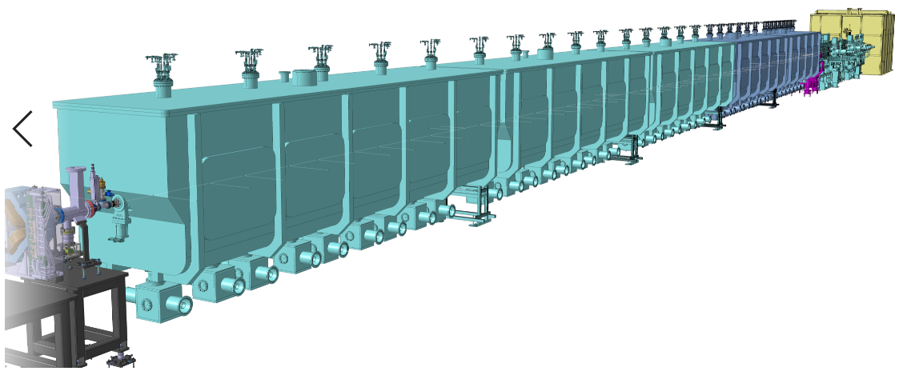
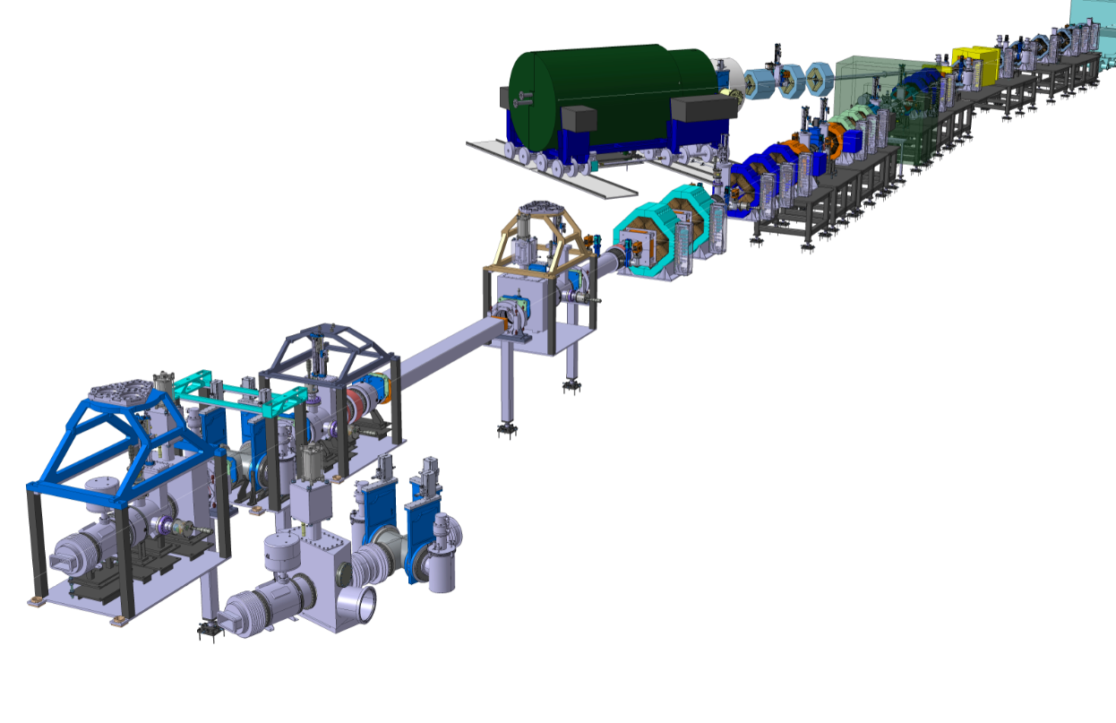
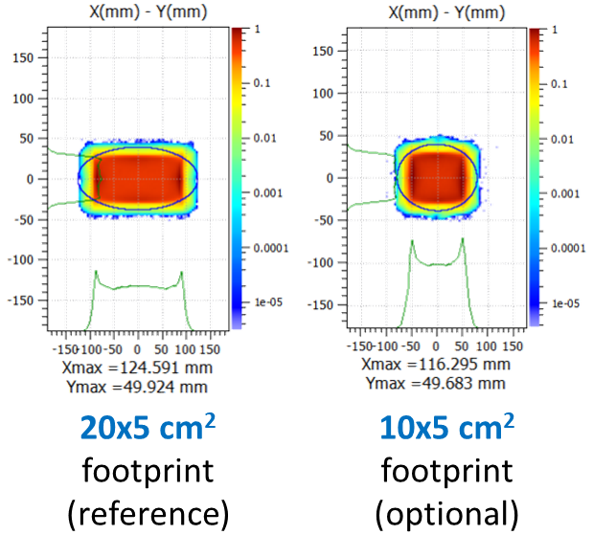
A 5 MW Power LINAC
D+ CW beam
125 mA / 40 MeV → 5 MW
Highest current LINAC
Top H+ and D+ Injector Performance needed
Longest RFQ
Windowless liquid Li target
87% availability
High residual doses in the area
Very challenging beam Diagnostics and Beam Loss Monitoring
MEBT
CM#4
CM#5
Injector
LIPAc Acceletaror (5 MeV) built in Rokkasho (Japan) as integrated Prototype of the:
Injector
LEBT
RFQ
Dump
1st Cryomodule
HEBT-S1
HEBT-BDTL
HPBD
RFQ
CM#1
CM#2
CM#3
HEBT-S2
Beam footprint at the Target
HEBT-S3
Main HEBT @ TIR
Towards the Target

Slide 13
OUTLINE
Introduction to the IFMIF-DONES Facility
The Irradiation Modules
Summary
The IFMIF-DONES Accelerator
The Lithium Target
Future Research Opportunities
1
2
3
4
5
6

Slide 14
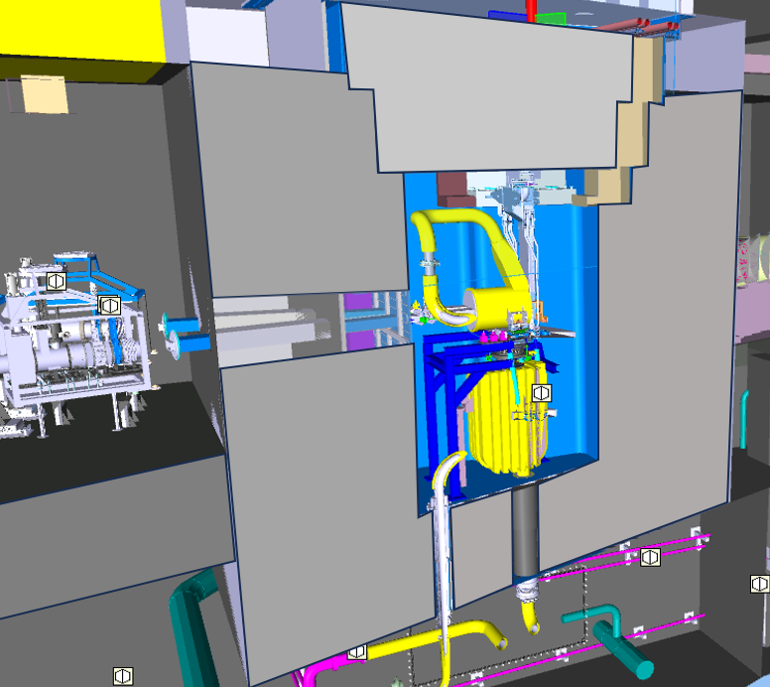
The Target/Test Cell Environment
Test Cell
Radiation in the exposed zone of Irradiation Modules:
10⁴ MGy/fpy
30 MGy/fpy (at the connectors bridge)
Target Interface Room
(TIR)
Secondary Line (diagnostics)
Irradiation Module
(HFTM/
STUMM)
Target Vacuum Chamber
Radiation in around the Target Vacuum Chamber:
100 MGy/fpy
Primary Line (beam line)
Inlet/Outlet Li Pipes
Radiation in the Target Interface Room (TIR):
1-2 MGy/fpy
~3 m
Concrete
Shielding
Li Loop Cell
(LLC)
Li Loop Cell
(LLC)

Slide 15
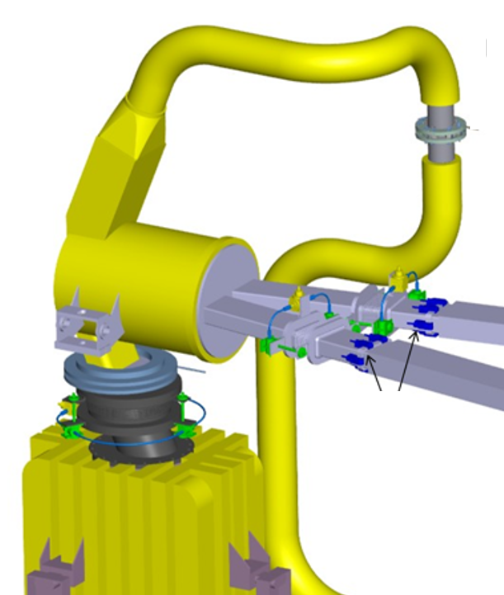
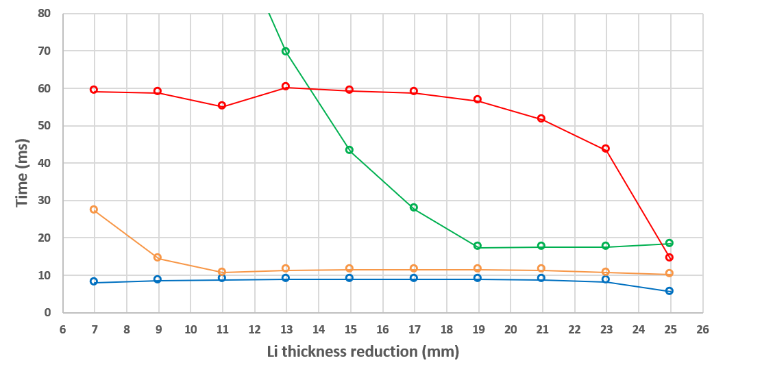
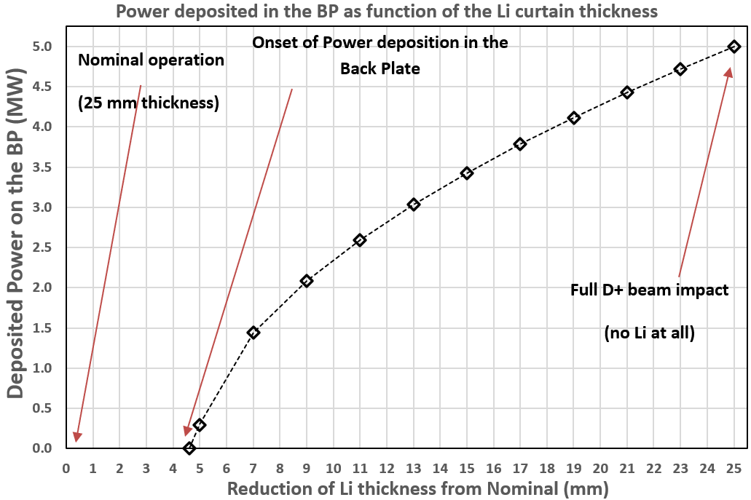
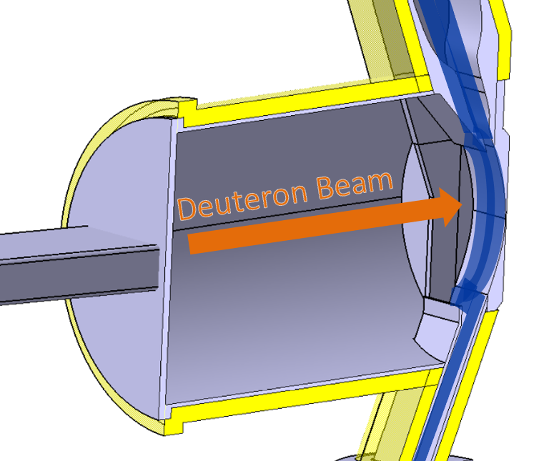
Liquid Lithium Target Challenges (1)
Liquid Li jet flowing at 15 m/s,
thickness = 25+/- 1 mm.
Jet stability & Target position is critical to avoid Back-Plate rupture.
Time for BP melting onset
Time for 25% BP material melting
E. Wakai et al., Nucl. Mater. Energy 9 (2016), 278-285
Time for 75% BP material melting
Time for BP vaporization onset
A Li thickness reduction
> 4/5 mm would lead to power deposition in the Back-Plate
Failure/melting could take place in less than 10 ms
Li Target: Jet flowing at 15 m/s, thickness = 25+/- 1 mm.
Jet stability & Target position is critical to avoid Back-Plate rupture.
Target Vacuum Chamber shall be within 10⁻⁴ -10⁻⁵ mbar.
Full Remote Handling replacement/maintenance.

Slide 16
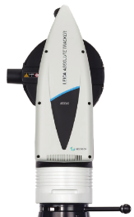
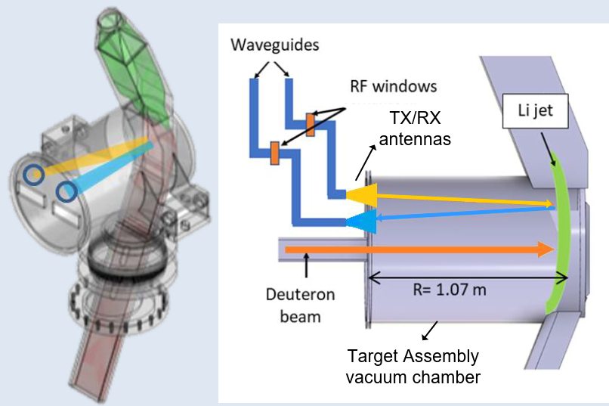
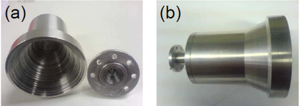
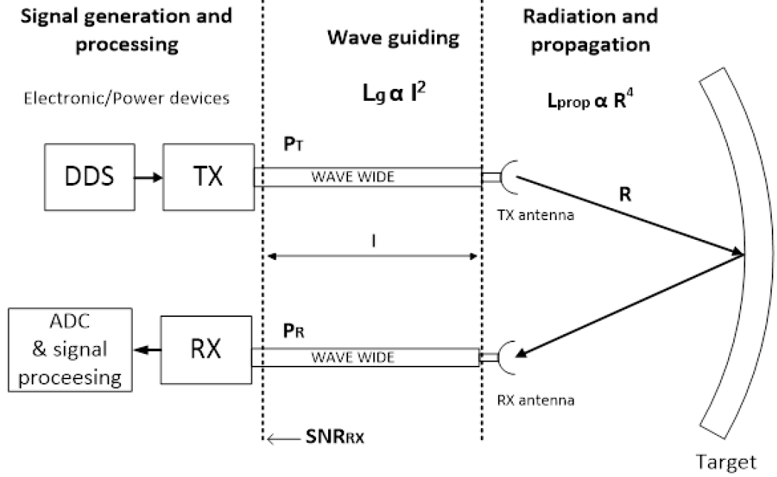
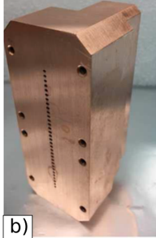
Technologies to monitor the Li Target thickness
Laser measurement: Amplitude-modulated Continuous-wave Light Detection and Ranging (AMCW LiDAR)
High-frequency modulation at 550 MHz
100 microns accuracy
Acquisition times within 1 ms per point and <100 ms per line.
Compatible with the 1-2 MGy/fpy in the TIR
Radiofrequency (mmWave radar techniques)
Linear Frequency Modulated Continuous Wave (LFM-CW) Radar

Slide 17
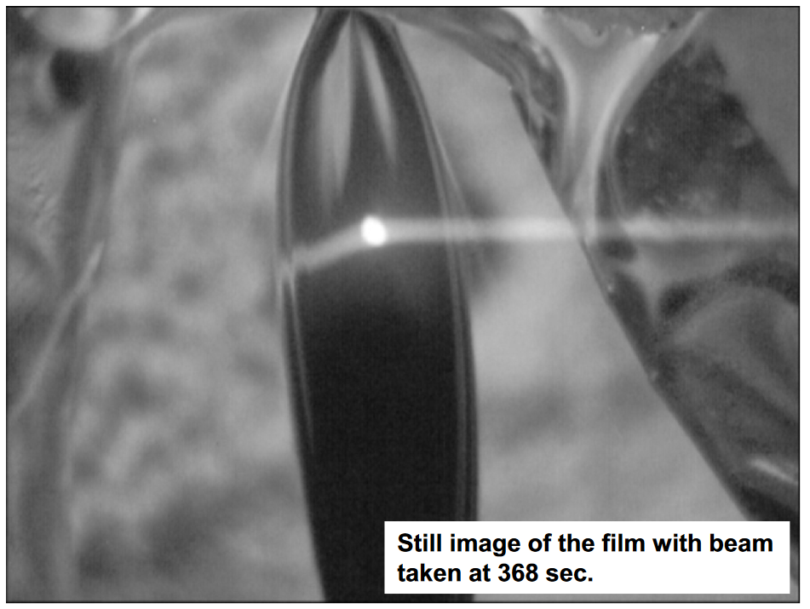
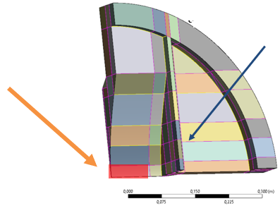
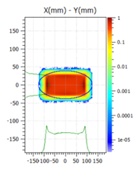
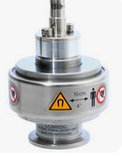
Liquid Lithium Target Challenges (2)
Beam-on-Target Position
Beam foot-print Area (20 x 5 cm)
(Up to 25 cm wide counting with the tales)
Only 5 mm margin in each side to avoid touching the wall
Camera pointing to the jet through an optical path from the TIR diagnostic port.
Recording interaction between the beam and the lithium surface (OTR) and residual gas fluoresce
Y. Momozaki et al. Journal of Radioanalytical and Nuclear Chemistry volume 305, pages 843–849 (2015)
Keeping vacuum in the Target chamber within 10⁻⁴ – 10⁻⁵ mbar
Avoid Li boiling !! (above vapor saturation pressure)
Managed by Ar injection system to achieve a differential vacuum pressure in the accelerator
Very high radiation (100 MGy/fpy) disables the installation of vacuum gauges in the TVC
Monitoring the vacuum pressure in the TVC

Slide 18
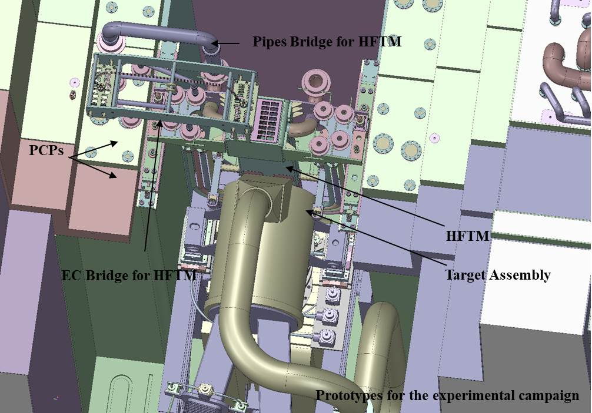
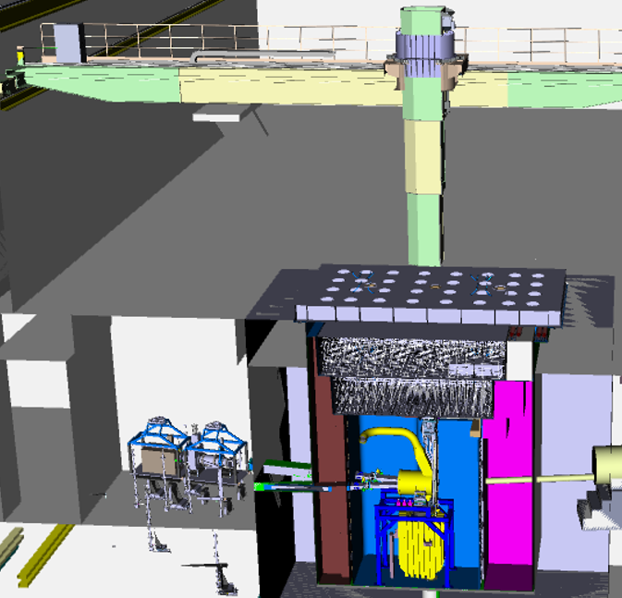
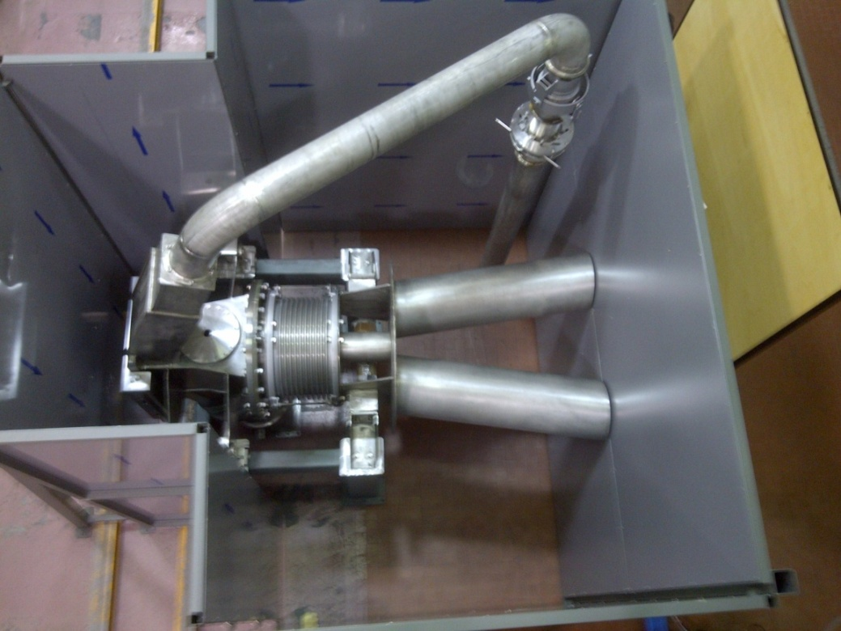
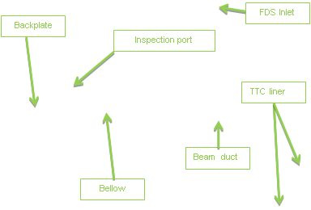
Liquid Lithium Target Challenges (3)
Yearly replacements of the Target is required
It must be fully done by remote tele-manipulators and cranes.
x2 large vacuum flange connections
Inlet/outlet Li pipes
Alignment of the assembly

Slide 19
The Liquid Lithium Loop and 2nd/3rd Oil Loops
100 l/s of Li at 300 °C.
EMP Pump, heaters, Heat-Exchangers and Dump tank.
Li Loop room in Inert atmosphere (Ar)
ELTL Lithium Loop Prototype in Oarai (Japan)
Liquid Li loop at 40 l/s
1:1 for Loop height and jet velocity (15 m/s)
Operating within 2010-2014
Fluid-Dynamic stability of the Li jet validated (1560 h)
Permanent Magnets Electro-Magnetic Pump
Impurity Control Loop
Extremely low impurities requires
Purification loops with “Traps” Cold Traps, Tritium/H traps, N Traps
E. Wakai et al., Nucl. Mater. Energy 9 (2016), 278-285

Slide 20
OUTLINE
Introduction to the IFMIF-DONES Facility
The Irradiation Modules
Summary
The IFMIF-DONES Accelerator
The Lithium Target
Future Research Opportunities
1
2
3
4
5
6

Slide 21
Challenges of the Irradiation Modules (1)
Characterizing the radiation field with high spatial and time resolution
5·10¹⁴/10¹⁵ n/cm²s
Up to 14 MeV (80% above 1 MeV). Fast neutrons dominating
Spatial resolution: 10 mm
Time resolution: 10 µs.
Maintain n-field calibration during 1 year
10⁴ MGy/fpy exposed zone, 30 MGy/fpy at connectors plate
Surface of 50x40 cm for integrating remote handling connectors for more than 330 different signals.
Very low current signals, long cables, EMC sensibility..
Online/Offline Radiation Diagnostics
SPNDs (Self-powered Neutron Detectors). (compatible with high temperatures)
µFission (U238/U235) & Ionization chambers
Activation foils
Pneumatic Rabbit transporting activation balls (for the STUMM)

Slide 22
Challenges of the Irradiation Modules (2)
Irradiation Capsules with miniaturized materials Specimens
Prototyping Activities of Irradiation Modules at KIT
32 irradiation capsules, 850 specimens can be irradiated to 12 – 25 dpa/fpy.
Irradiation temperatures shall be controlled within 250 – 550 ºC. -> Heaters and thermocouples for each capsule.
Filled by Liquid Na, homogeneous Temperature
Necessary to know the integral radiation to which the specimens have been exposed. (SPNDs and activation foils)

Slide 23
OUTLINE
Introduction to the IFMIF-DONES Facility
The Irradiation Modules
Summary
The IFMIF-DONES Accelerator
The Lithium Target
Future Research Opportunities
1
2
3
4
5
6

Slide 24
IFMIF-DONES Users Community!
A Users Community is being launched to enhance Experiment Proposals for both fusion and non-fusion applications in multidisciplinary fields
Each year, a “DONES Users Workshop“ is organized
1st IFMIF-DONES Users Workshop in 2022 -> Online
2nd IFMIF-DONES Users Workshop in 2023 -> Granada
3rd IFMIF-DONES Users Workshop in 2024 -> to take place in Zagreb, Croatia, 1st-2nd October 2024
More info in: https://ifmif-dones.es/dones-users-2/
Some examples of proposals/applications in the next slides

Slide 25
Additional Irradiation Modules in the Test Cell
1) Experiments Irradiating Material Specimens
Creep Fatigue Test Module (CFTM)
2) Experiments Irradiating Components
Activated Corrosion Product Test Module (ACPTM)
Irradiation of Instruments and Diagnostics
In-situ Ceramic Breeder Test Modules
3) Experiments on Tritium Breeders Materials
Ceramic breeders (Li4SiO4)
Liquid Metal breeders (like PbLi)
4) Radioisotopes Production

Slide 26
Complementary Experiments using neutrons in the R160
Continuous neutron beam 2∙10¹⁰ n/cm²/s, 99.5% of fast neutrons, En > 100 keV
R160
1) Experiments with samples exposed to neutrons:
Activation of small samples by neutrons
Characterization of materials by radiation analysis
Neutron imaging
Fast neutron irradiation of components, devices or bio-samples
2) Fundamental particle physics studies with cold and ultra-cold neutrons.
3) Neutron scattering experiments with moderated beams

Slide 27
Complementary Experiments using neutrons in the R026
Profiting from Pulsed Deuterons beams via a beam extraction from the accelerator at 40 MeV (0.1 % total intensity -> 0.125 mA)
Experiments using Pulsed Neutron Beams (nTOF):
(via deuteron/neutron converter)
Neutron Cross-section measurements
Gamma-spectroscopy of the nuclei produced in fast-neutron-induced fission reaction
Half-life measurements of long-lived isotopes
2) Experiments using Pulsed Deuterons Beams
Production of radionuclides with intense deuteron beams
Research on Deuteron-induced reactions

Slide 28
OUTLINE
Introduction to the IFMIF-DONES Facility
The Irradiation Modules
Summary
The IFMIF-DONES Accelerator
The Lithium Target
Future Research Opportunities
1
2
3
4
5
6

Slide 29
SUMMARY
IFMIF-DONES will be a 1st kind and 1st Class Accelerator Facility.
Its technological challenges are pushing the state-of-the-art in many aspects of accelerator, targets and instrumentation.
Extensive R&D programs and ambitious prototypes have been carried out and are ongoing to develop the technical solutions required (and many more will follow).
Aiming at reinforcing links and collaborations between Accelerators, Fusion and Fission Communities
Pursuing a wide range of Applications in an extensive variety of multidisciplinary nuclear fields, in addition to fusion.

Slide 30
Thanks very much!!
Questions?

