Slide 1
Status of the Second Target Station Project with Target Systems Highlight
Peter Rosenblad
with Michael Allitt, Gary Bloom, Leighton Coates, Steve Hartman, and Ken Herwig
ANS AccelApp ‘24 Conference, Norfolk, VA

Slide 2
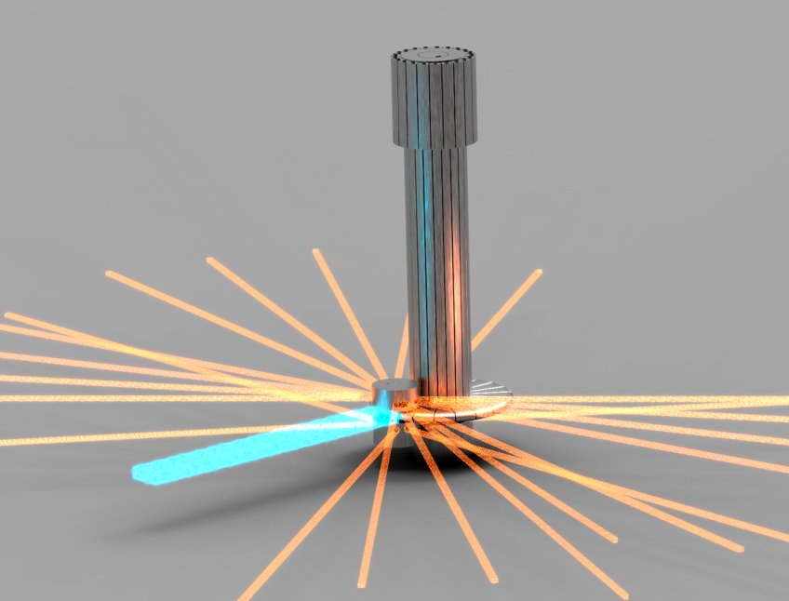
Topics
Neutrons at ORNL
SNS Overview and Upgrades
Second Target Station (STS) Project
STS Target Systems

Slide 3
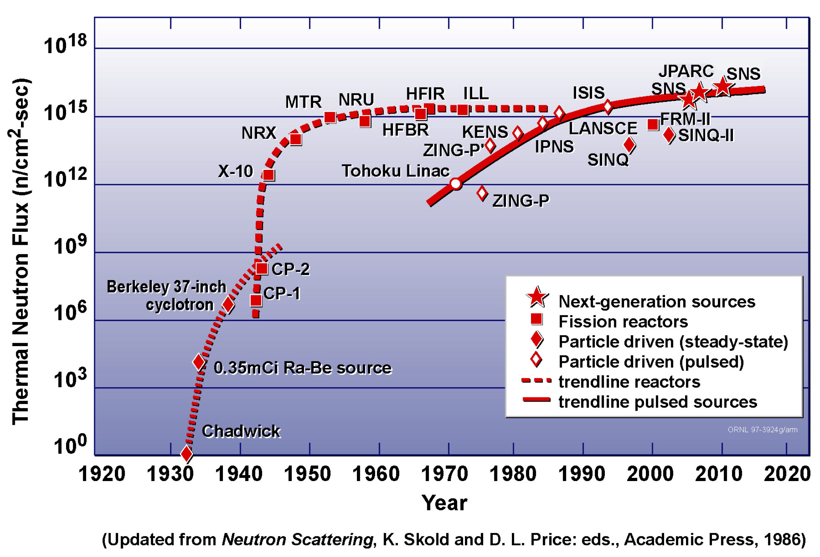
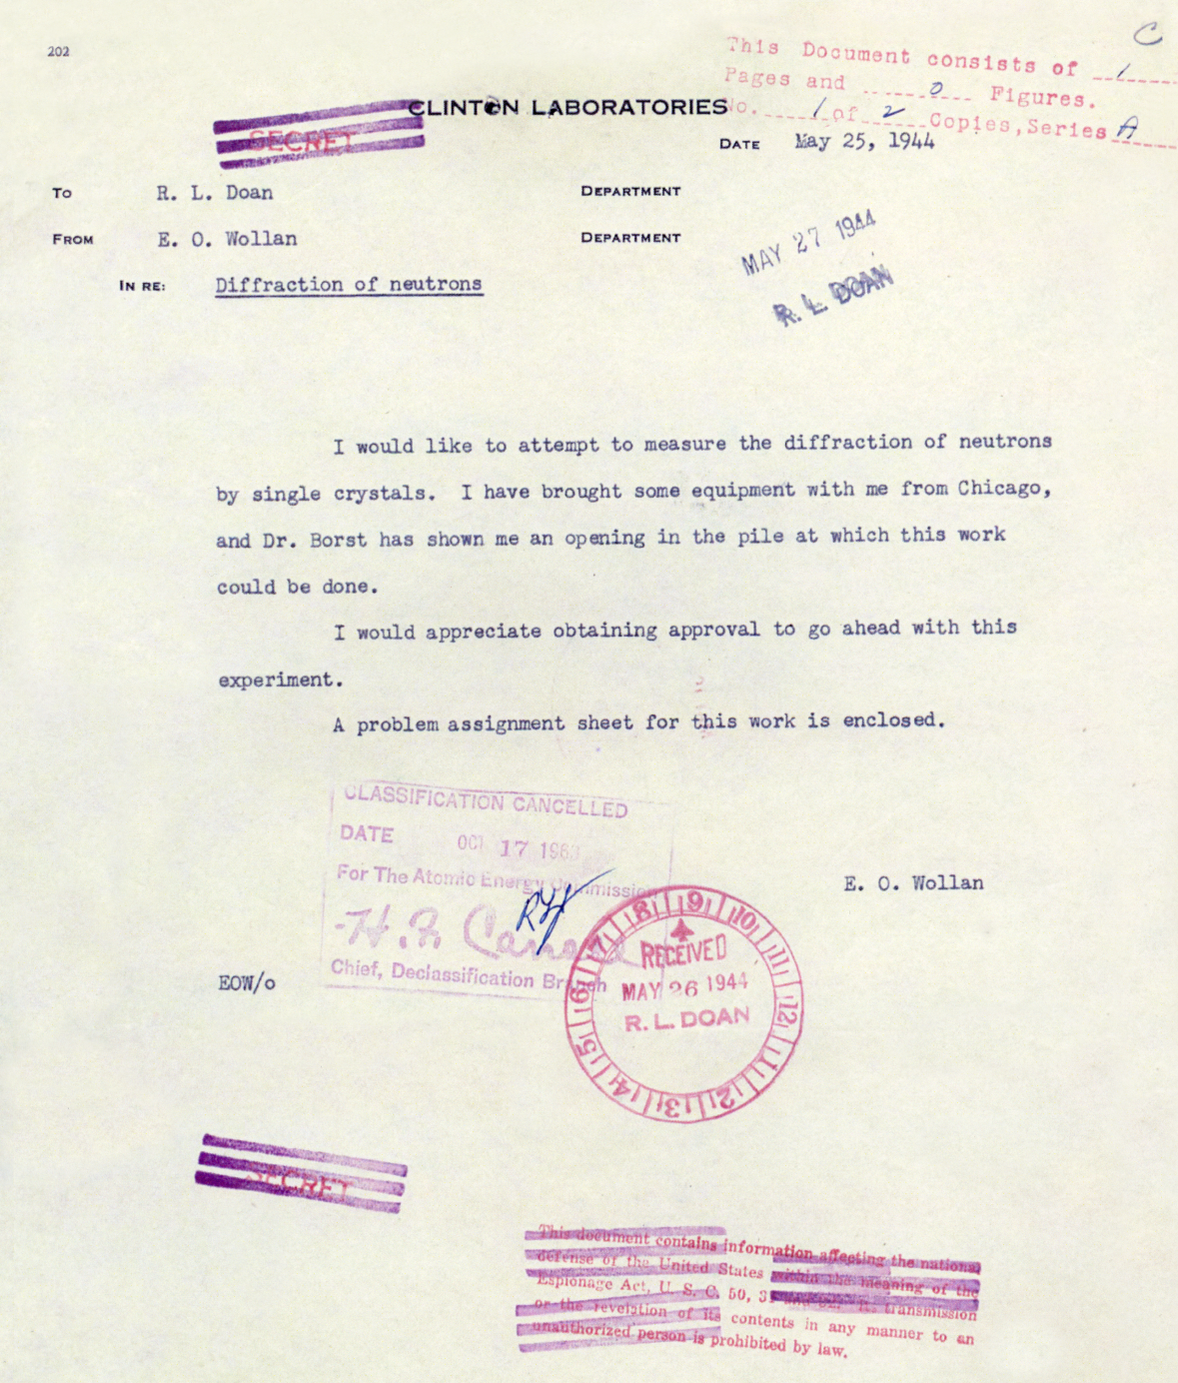
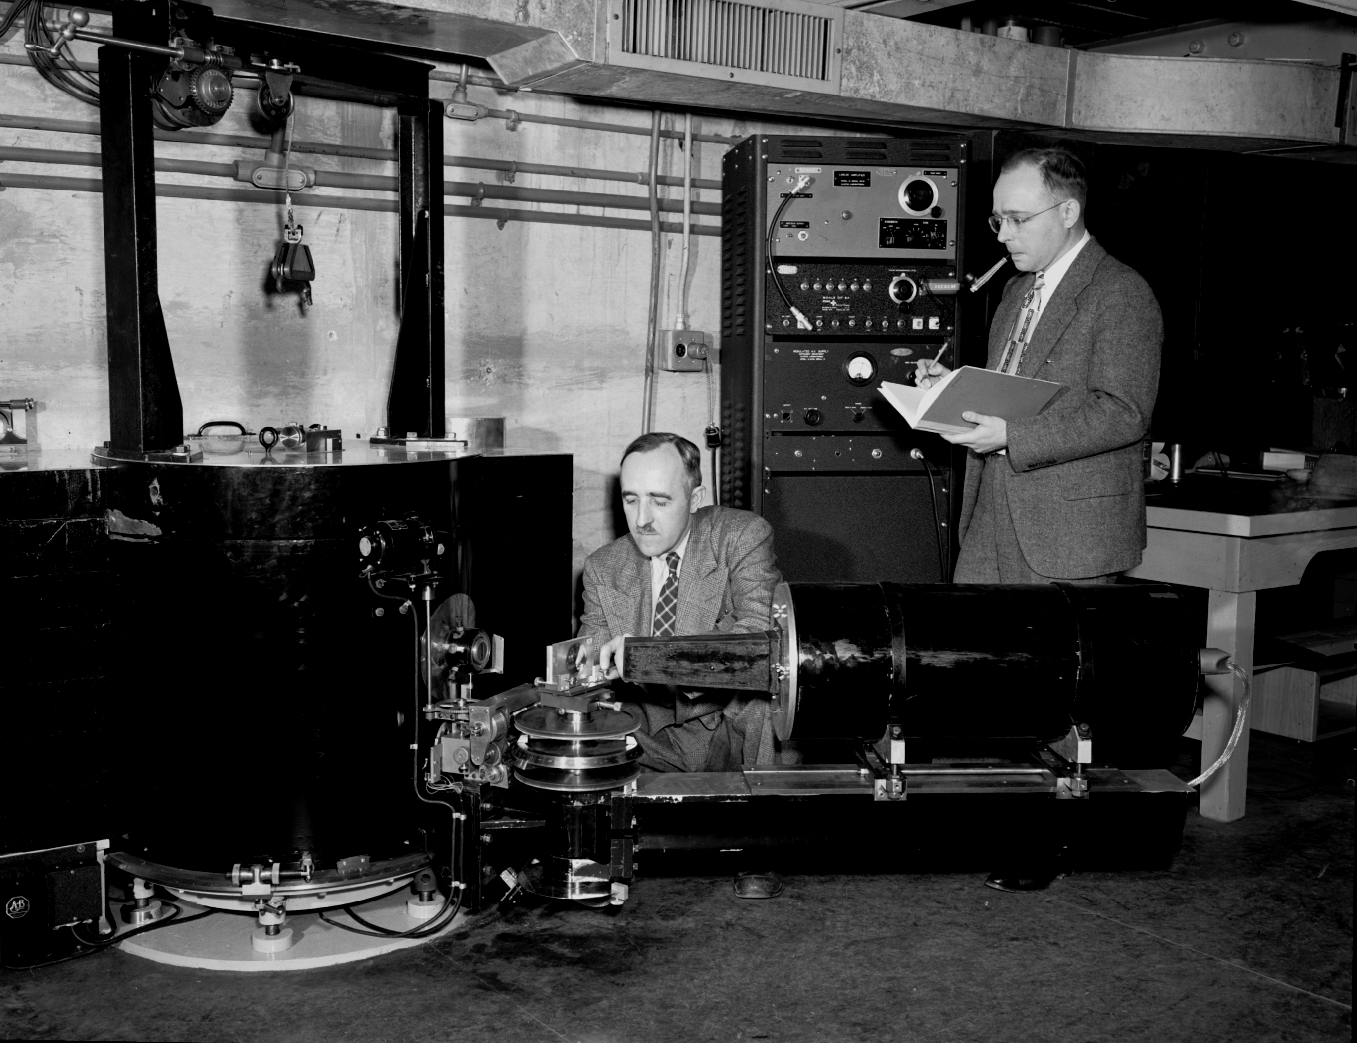
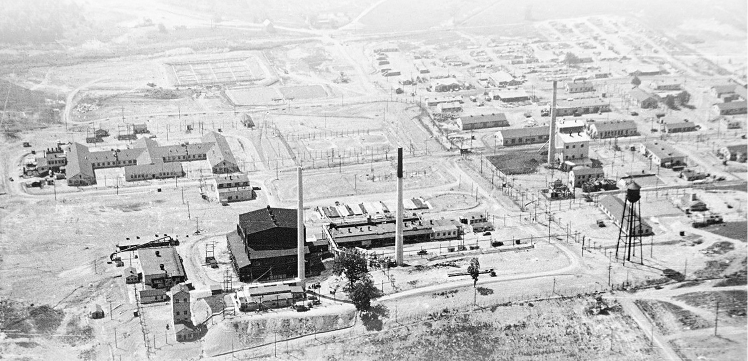
ORNL has an 80-year history of developing neutron sources and neutron sciences
Courtesy Erik Iverson
Ernie Wollan requested beam access at “the pile” in 1944, just after the reactor started operation
ORNL (Clinton Laboratories) in 1943
The Clinton X-10 Pile was the world’s first continuously operated nuclear reactor
1943
1994 Nobel Prize in Physics awarded to Shull and Brockhouse for development of neutron scattering
Wollan (seated) and Shull at 1950 diffractometer
Notes:
Source limiting technologies – removal of waste heat, target robustness

Slide 4
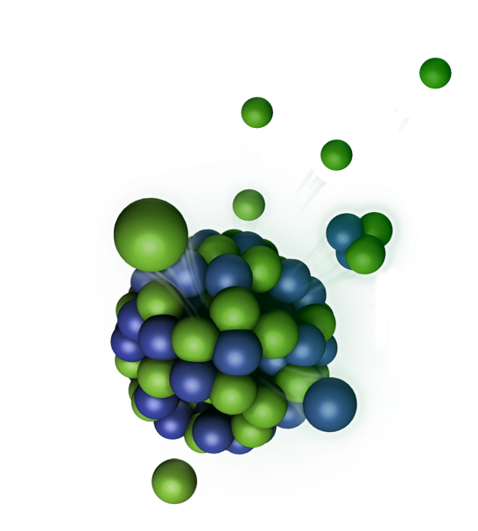
Today ORNL operates two of the brightest neutron sources
Spallation Neutron Source (SNS)
Highest peak neutron brightness
High Flux Isotope Reactor (HFIR)
Highest continuous neutron flux
2.5 n/fission
190 MeV/useful n
Continuous
Hg
26 n/proton (1 GeV)
25 MeV/useful n
Pulsed
33 instruments
600 publications/year
1200 experiments/year
1200 unique users/year

Slide 5
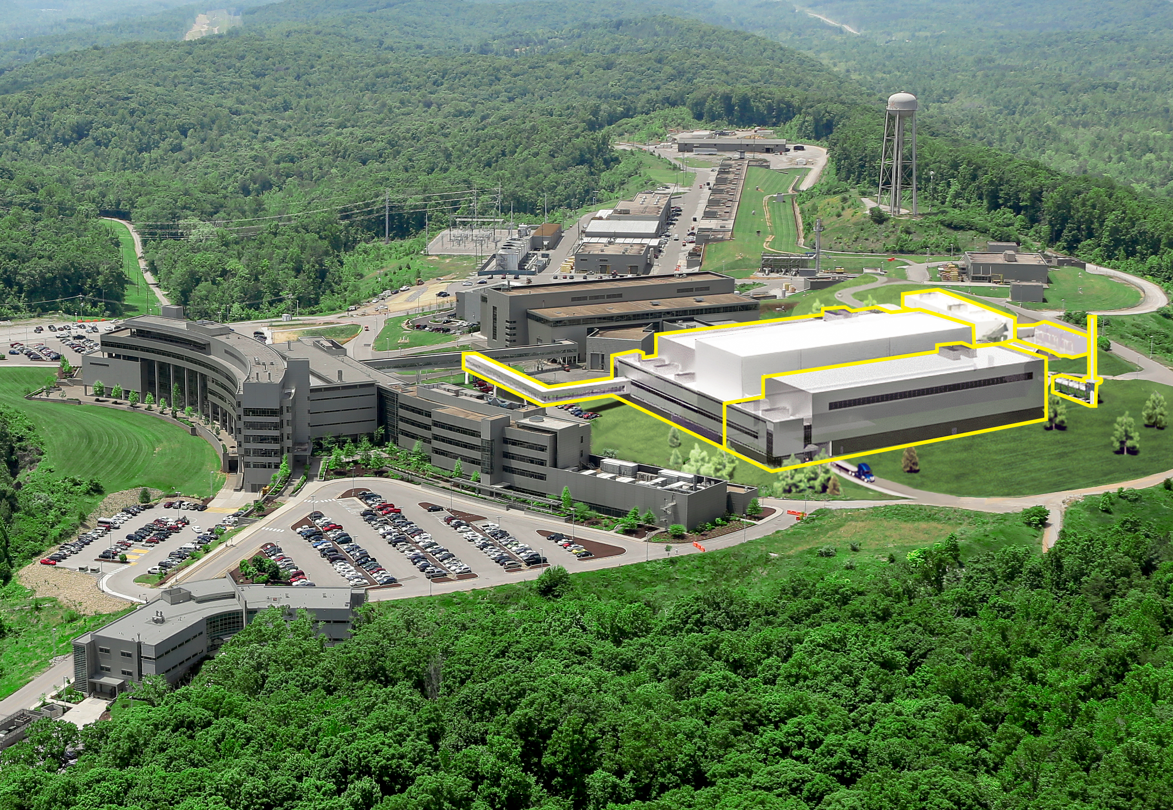
SNS upgrades will accelerate scientific progress and deliver wholly new capabilities
PPU project: Double the power of the existing accelerator structure
First Target Station (FTS) is optimized for thermal neutrons
Increases the brightness of beams of pulsed neutrons
Provides new science capabilities for atomic resolution and fast dynamics
Provides a platform for STS
STS project: Build the second target station with initial suite of beam lines
Optimized for cold neutrons
World-leading peak brightness
Provide new science capabilities for measurements across broader ranges of temporal and length scales, real-time, and smaller samples
STS instruments see 4x more and 100x faster than today’s similar instruments
Notes:
SNS was planned from its outset to be upgraded to operate at higher power and to share this power with a second target station.
The Proton Power Upgrade, or PPU, project, which is a totally separate project from STS, will double the power of the SNS accelerator.
PPU is well underway and they are already assembling cryomodules and building infrastructure
I should also mention that the First Target Station is optimized for thermal neutrons and with the PPU power increase it will be among the brightest sources of thermal neutrons in the world
The STS Project, which is outlined in yellow on this artists concept of the SNS site, is the subject of this review. STS will be optimized for cold neutrons, in-line with its Mission Need.
In fact, as I will show in a later slide, STS will achieve the highest brightness of cold neutrons in the world, which will provide scientists the capability to make measurements across a broader range of length and time scales and to examine smaller samples

Slide 6
STS will make optimal use of the PPU-upgraded SNS accelerator capability
1 out of 4 proton pulses
15 Hz
700 kW
Accumulator Ring
60 Hz accelerator
46.7 kJ/proton pulse
2.8 MW capable
Ion Source
Linac
Second Target Station (STS)
Short pulses at 15 Hz enables simultaneous measurement across broad wavelength range (Δλ =13.2 Å at 20 m from source)
Complementarity with FTS – uses all available accelerator capability provided by PPU
Flexibility will be provided to operate both FTS and STS at the same time or separately if either is shutdown
First Target Station (FTS)
3 out of 4 proton pulses
45 pulses/sec
2 MW
*animation courtesy of Matt Stone
Notes:
Both the first and second target station make use of the same accelerator infrastructure of the SNS. Negatively ionized hydrogen atoms are accelerated along the linear accelerator up to about 90% of the speed of light. The particles pass through a foil which strips them of their electrons, leaving just a positively charged proton. The protons are injected into a storage ring and further accelerated and bunched together into pulses. These pulses then are sent to the liquid mercury target of the first target station to produce neutrons. The second target station will use the same accelerator, but operate at a rate of 15 Hz. So one in four of the first target stations pulses will be sent to the second target station. To compensate for this loss of neutrons at the first target station, the linear accelerator is currently going through a power upgrade to operate at up to 2 MW peak power compared to the current 1.4 MW.
Both of these target stations can operate independently If the first target station is under a maintenance outage, the second target station can continue to operate.

Slide 7
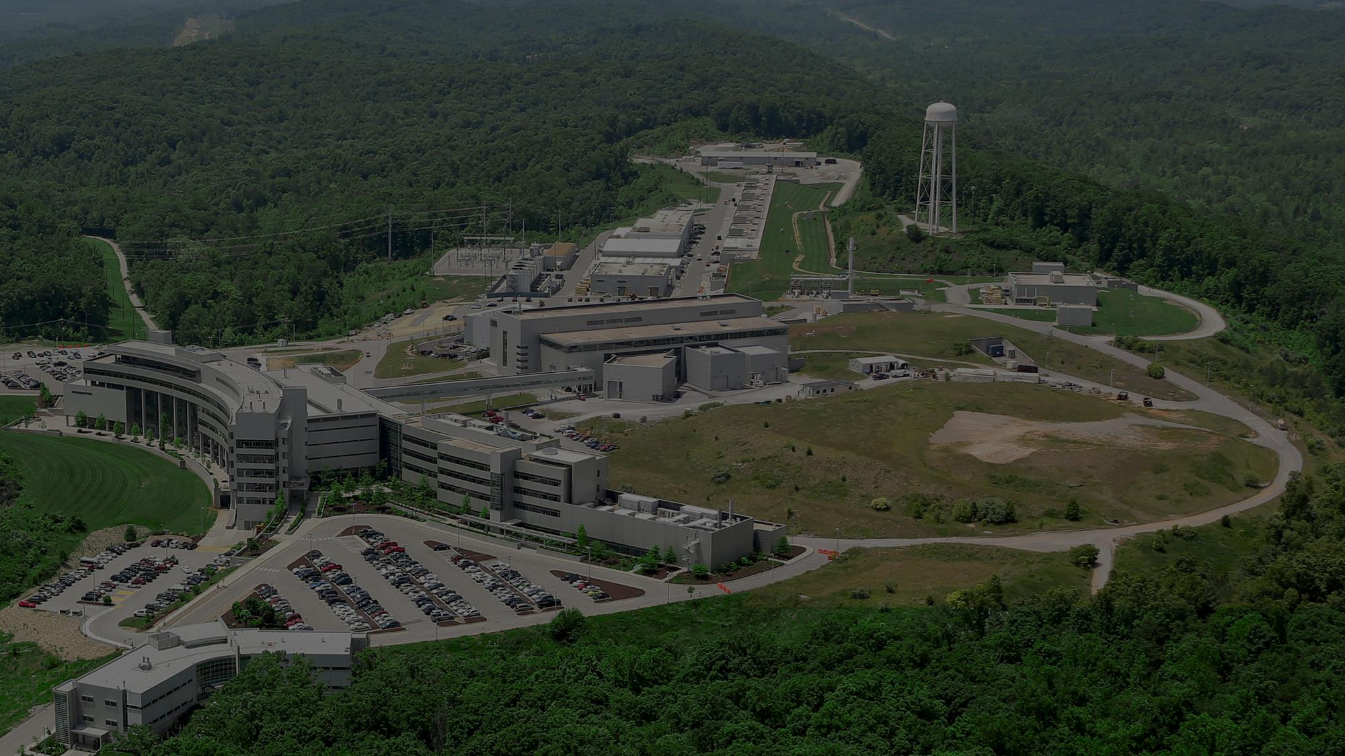

Slide 8
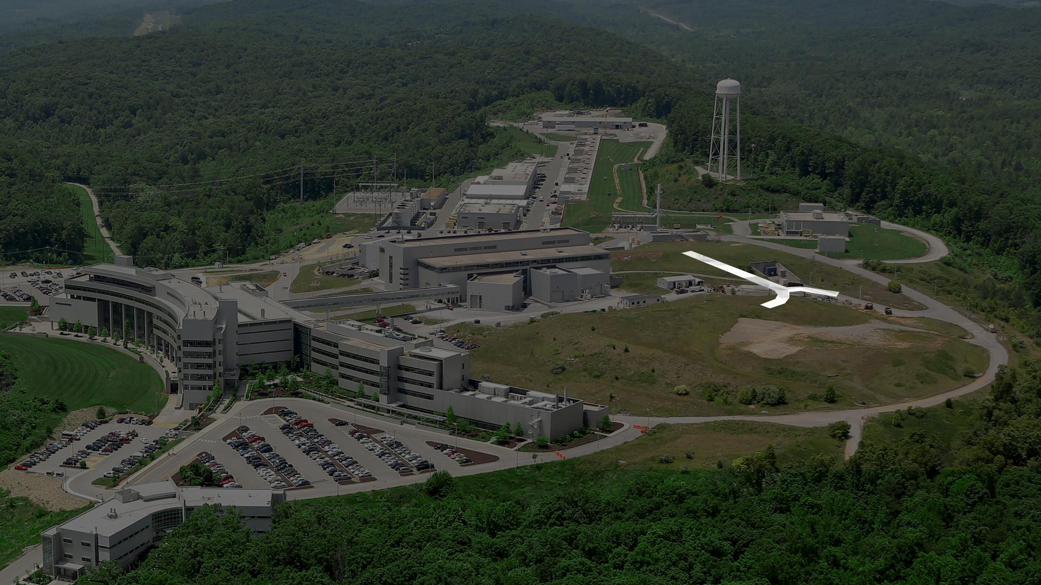

Slide 9
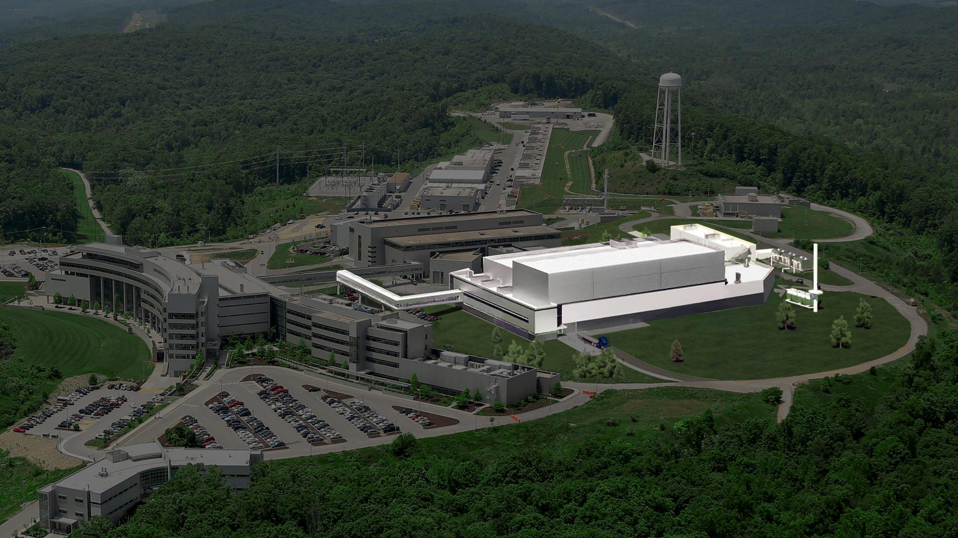

Slide 10
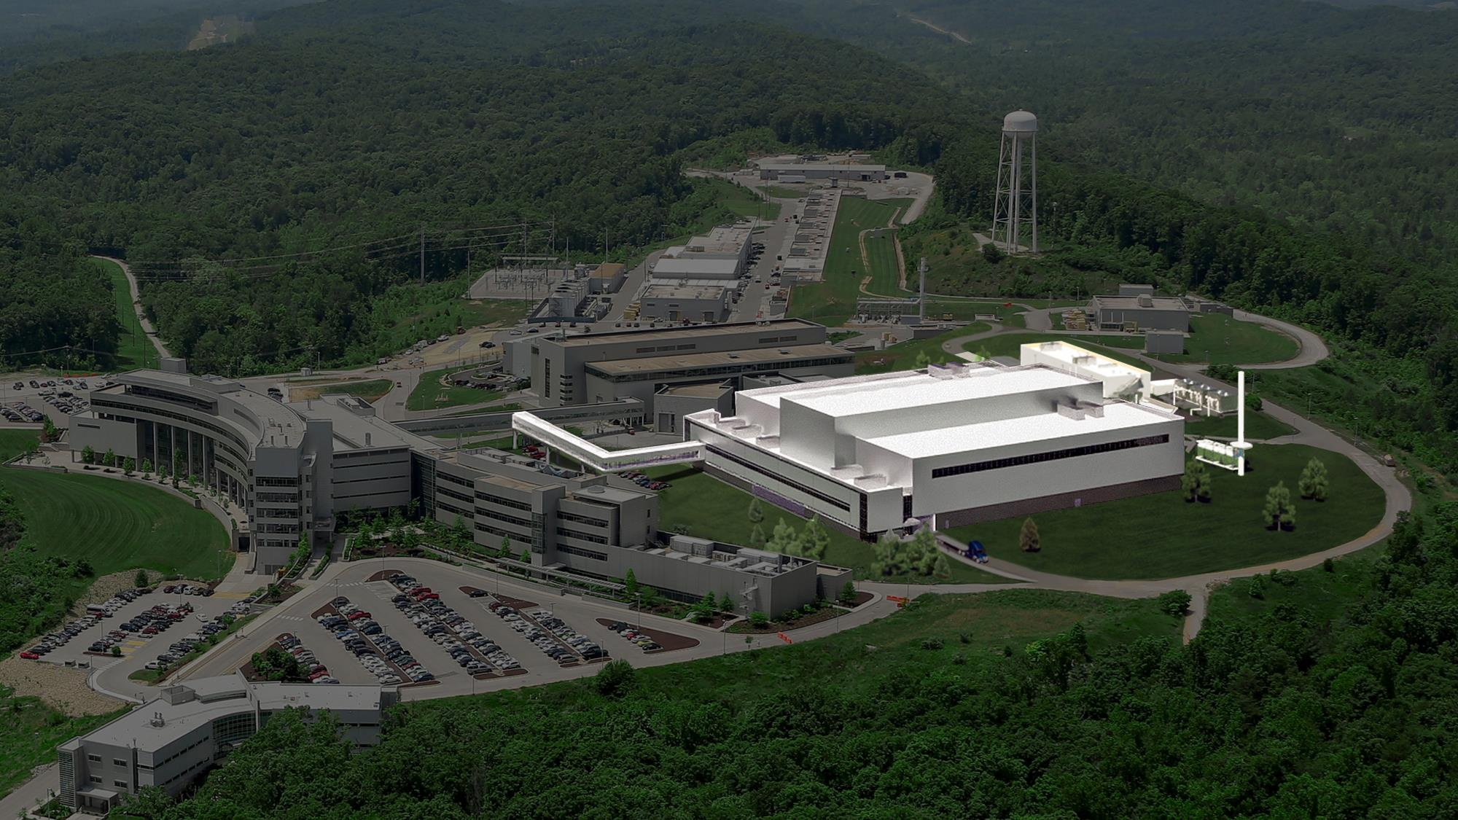

Slide 11
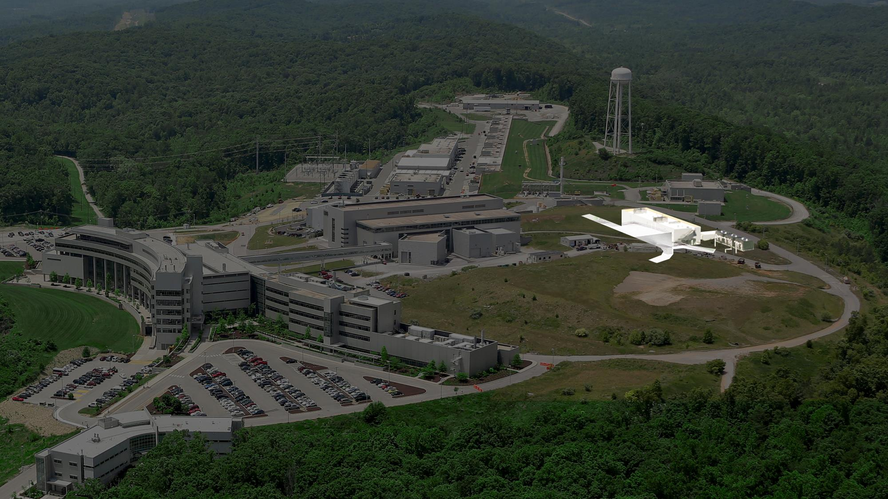
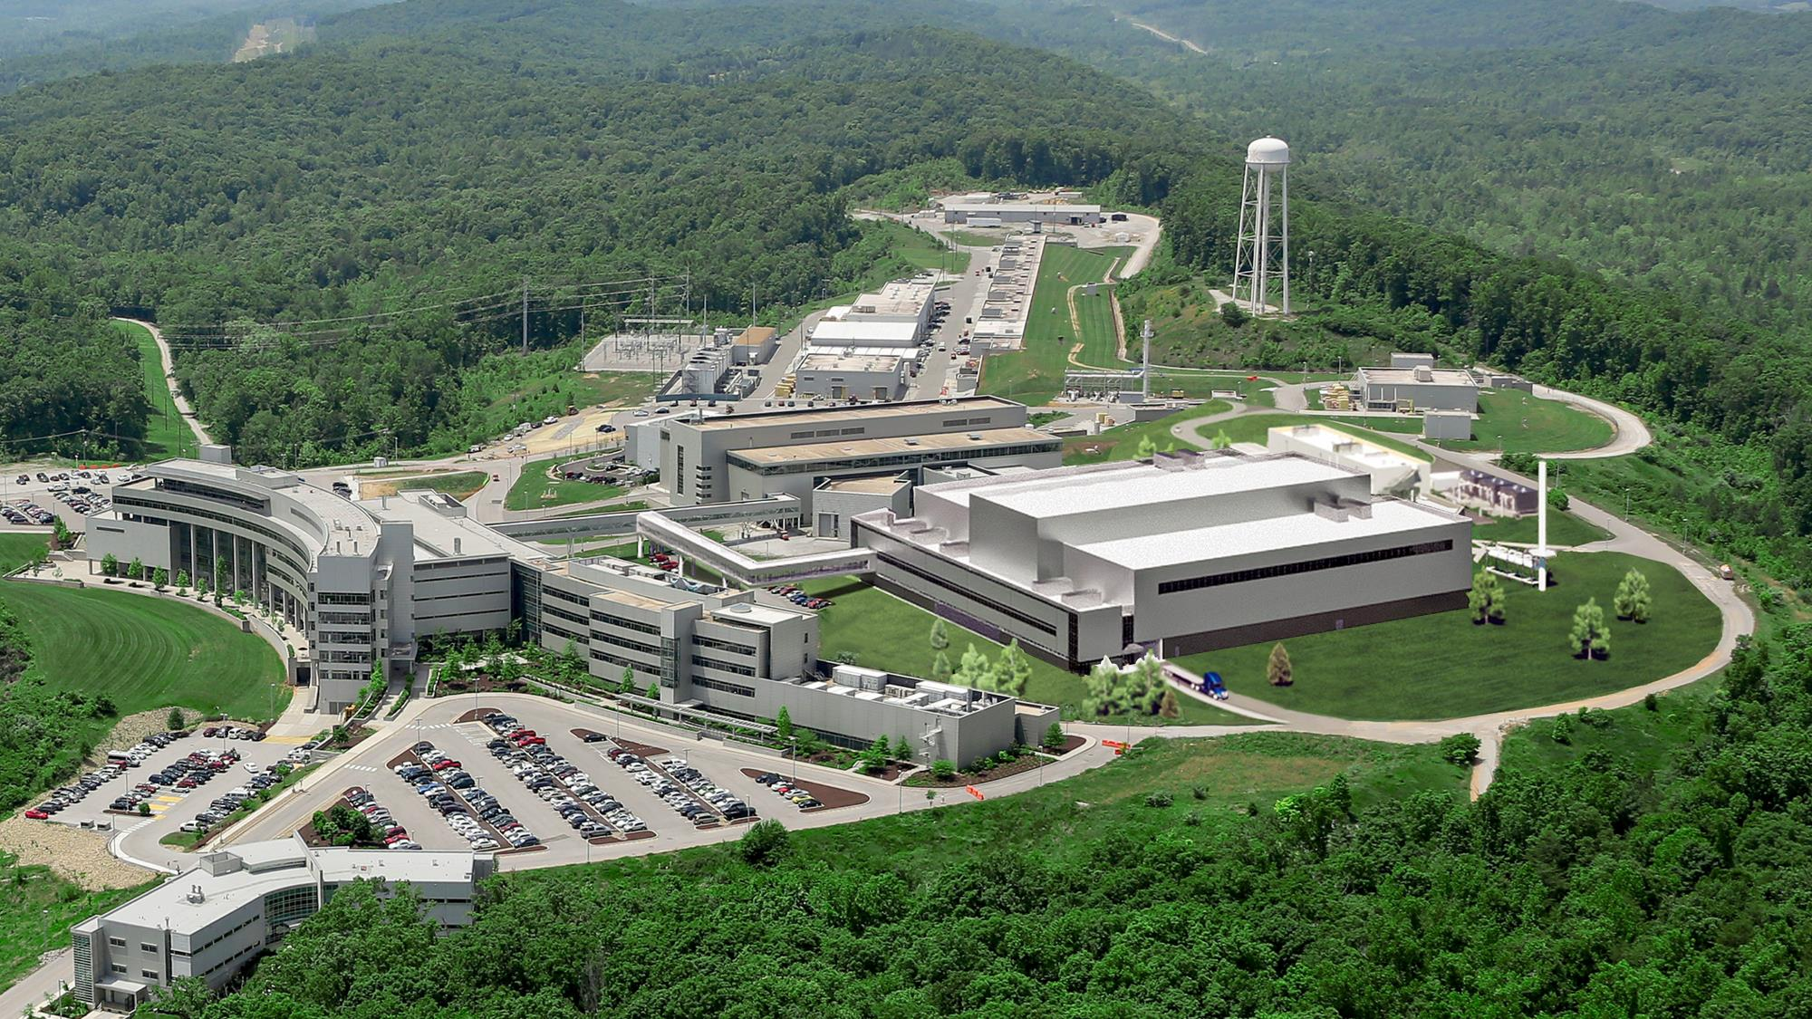

Slide 12
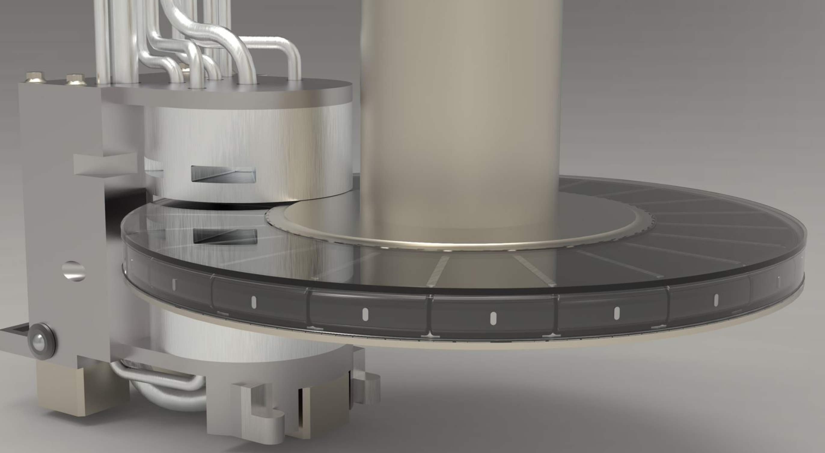
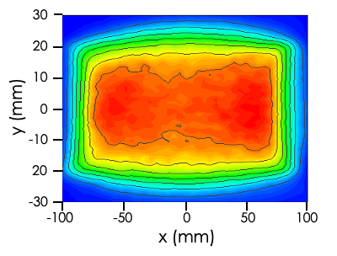
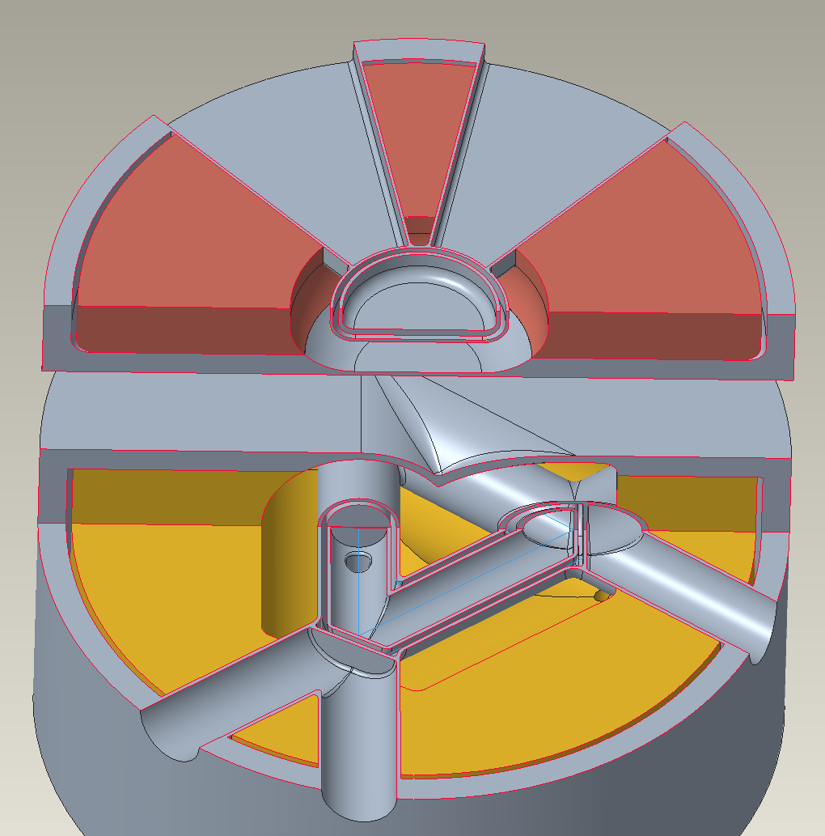
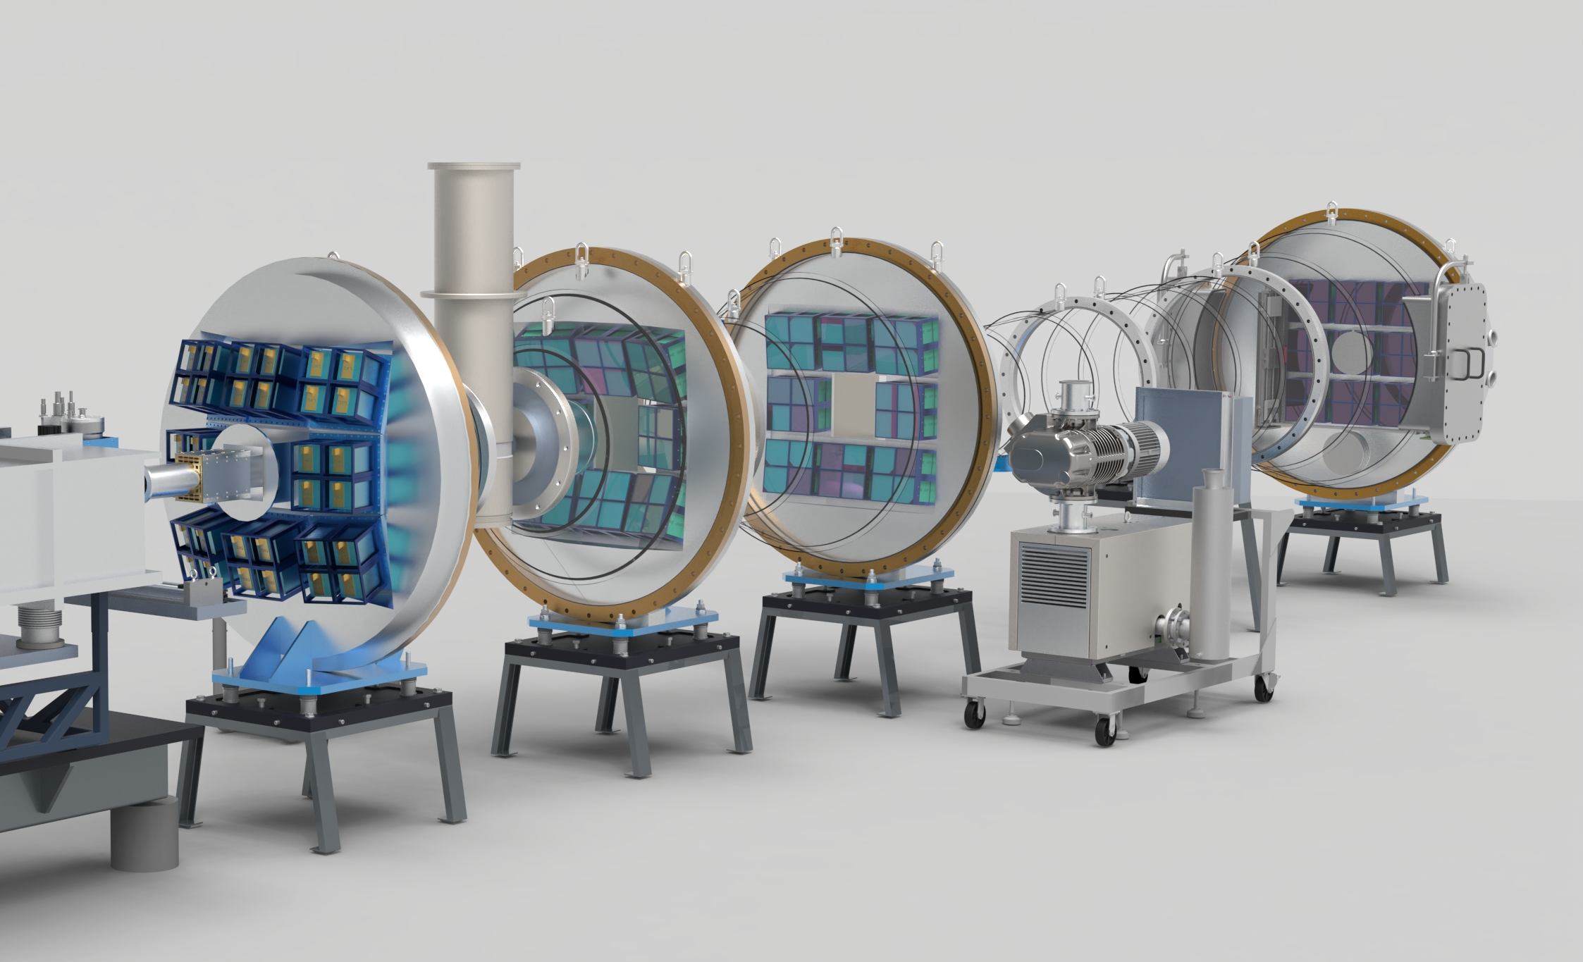
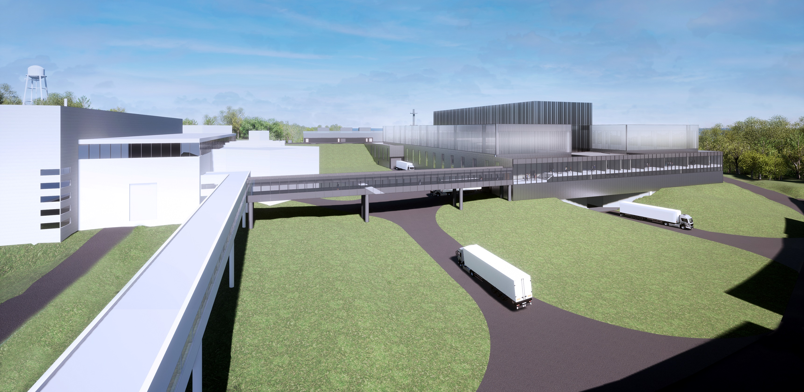
STS uniquely combines advanced technologies to deliver new science capabilities needed to understand more complex materials, processes, and devices
Start with the world’s most powerful hadron accelerator – the SNS
Use the accumulator ring to compress the proton pulse
Add optics & transport to produce uniform proton spot size on the target
Add rotating, segmented solid-tungsten target
PPU upgraded SNS
46.7 kJ/proton pulse
60 Hz, 2.8 MW capable
1 msec linac production compressed to < 1 μsec
Spreads heat load over larger volume with longer lifetime
STS proton area = 60 cm²
FTS proton area = 140 cm²
Add low dimensional moderators, tightly-coupled to neutron production zone
Add science-driven, optimized instrument designs
Next generation neutron facility with science capabilities needed for materials innovation: materials discovery & materials in-action.
8 initial STS instrument, latest technologies, integrated controls, scientific software, proposed by and selected with the user community
Two high-brightness, geometrically-optimized moderators (cylinder & tube)

Slide 13
World class performance for 8 initial instruments
λ = 5 Å
short-pulse
SNS-STS
ESS (5 MW)
J-PARC
SNS-FTS (2 MW)
ESS (2 MW)
SNS-FTS
ISIS TS2
CSNS
long-pulse
HFIR
ISIS TS1
LUJAN
FRM-II
ILL
NIST
SONATE (est.)
PSI
steady-state
ORPHEE
USA
Planned
Asia
Existing
ST01
EXPANSE
ST02
QIKR
ST03
CUPI2D
ST04
BWAVES
ST05
CHESS
ST06
Future
ST07
VERDI
ST08
PIONEER
ST09
CENTAUR
Europe

Slide 14
Major Projects Take Time
2024
2020, November – DOE approved the project’s CD-1 status
2017, April –Selection of major STS technical alternatives: 15 Hz pulse repetition rate, 700 kW proton beam power, short pulse options.
2016, January – Initiated STS conceptual design activities.
2010
2009 – DOE approved Critical Decision-0 (CD-0)
2019, October – Dedicated STS Project Office established.
2000
2013 – A DOE advisory committee noted STS is “absolutely central” to US leadership in science.
1996
1999 - Environmental Impact Statement for SNS included a Second Target Station (STS).
1996 – A DOE advisory committee recommended that SNS proceed and include additional target station capability.

Slide 15
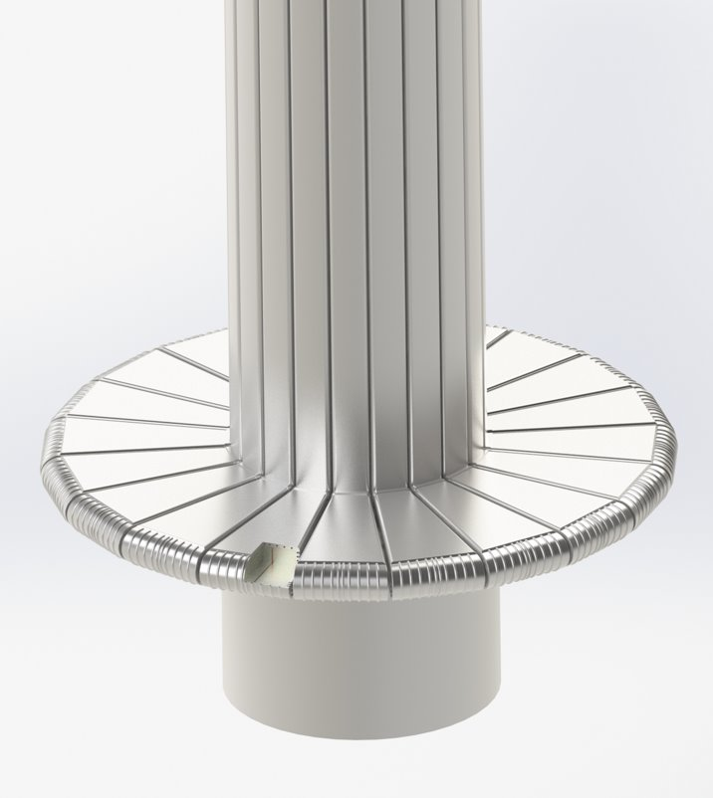
Significant progress has been made across the project over the past 4 years
Segment
Target Concept
Selected
New proton transport lattice
MRA/Inst. Sys. Interface Sheet issued
RTST & CSB design begins
Preliminary neutronic heating, structural & CFD analysis completed
TS/AS beam parameter IS Rev 2 issued
T & I bldg. design begins
2021 IPR
Preliminary Moderator Optimization Complete
Lasagna
Target Concept
Selected
PDR proton beam optics
Segmented Target
2021
2022
2023
8 STS Project Neutron Instruments selected
Site plan established
Two beam flavors workshop report issued
Requirements documents issued for all 8 instruments
Second critical device workshop for FTS target cart out of position
PDR Timing System, Run Permit System, & Linac LLRF controls
PDR for CHESS, PIONEER, & QIKR optics
Independent Control
700 kW proton beam power
Peak Brightness
≥ 8 neutron instruments
Technical review of initial designs for 4 instruments complete
ICDs & ICSs with AS & SNS issued
QIKR Instrument

Slide 16
Notional Execution Strategy
FY24
FY25
FY26
FY27
FY28
FY29
FY30
FY31
FY32
FY33
FY34
FY35
FY36
FY37
FY38
FY39
FY40
Subproject 1 – Conventional Facilities
CD-4
CD-3A
CD-2/3
Early Finish
Early Science
Subproject 2 – Accelerator, Target, 3 Instruments
CD-2
CD-3
Early Finish
CD-4
Subproject 3 – 5 remaining Instruments
All CD dates represent ESAAB Approval dates
CD-2
CD-3
Early Finish
CD-4

Slide 17
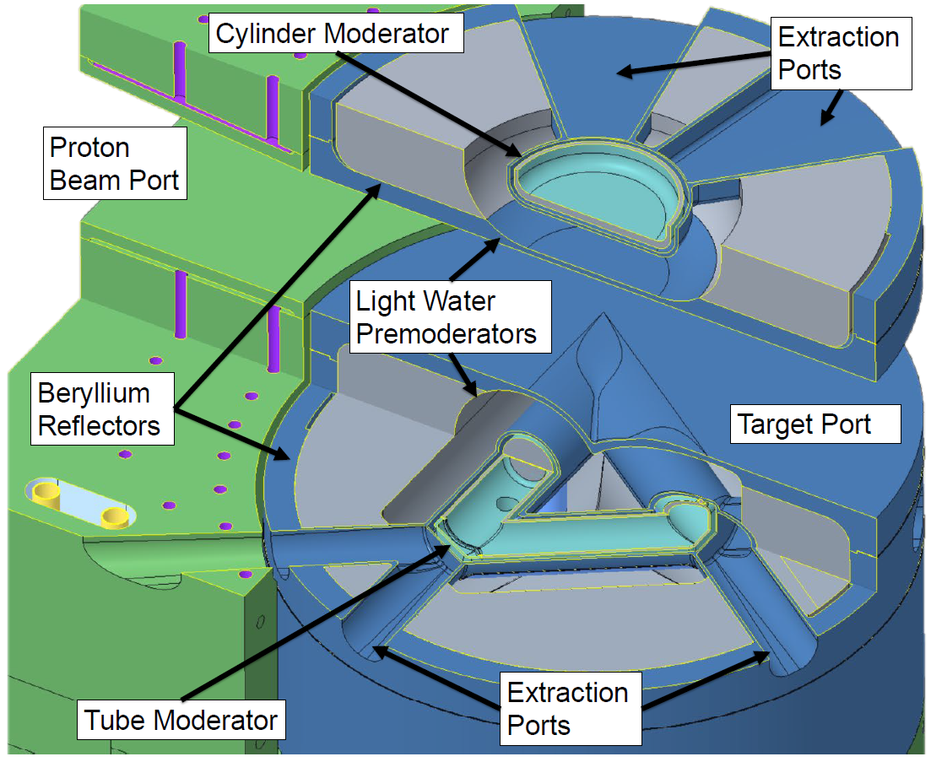
STS Target Systems key parameters / features
1.3 GeV, 700 kW, 15 Hz, 46.7 kJ/pulse
Rotating tungsten target 1.1 m diameter x 60 mm tall
Small (3 cm) 20 kelvin supercritical hydrogen moderators
Coupled and not poisoned
2 cm light water pre-moderator
Be reflector, no heavy water
Aluminum proton beam window
Core Vessel with flexibility for helium or rough vacuum operation
Vertical only maintenance

Slide 18
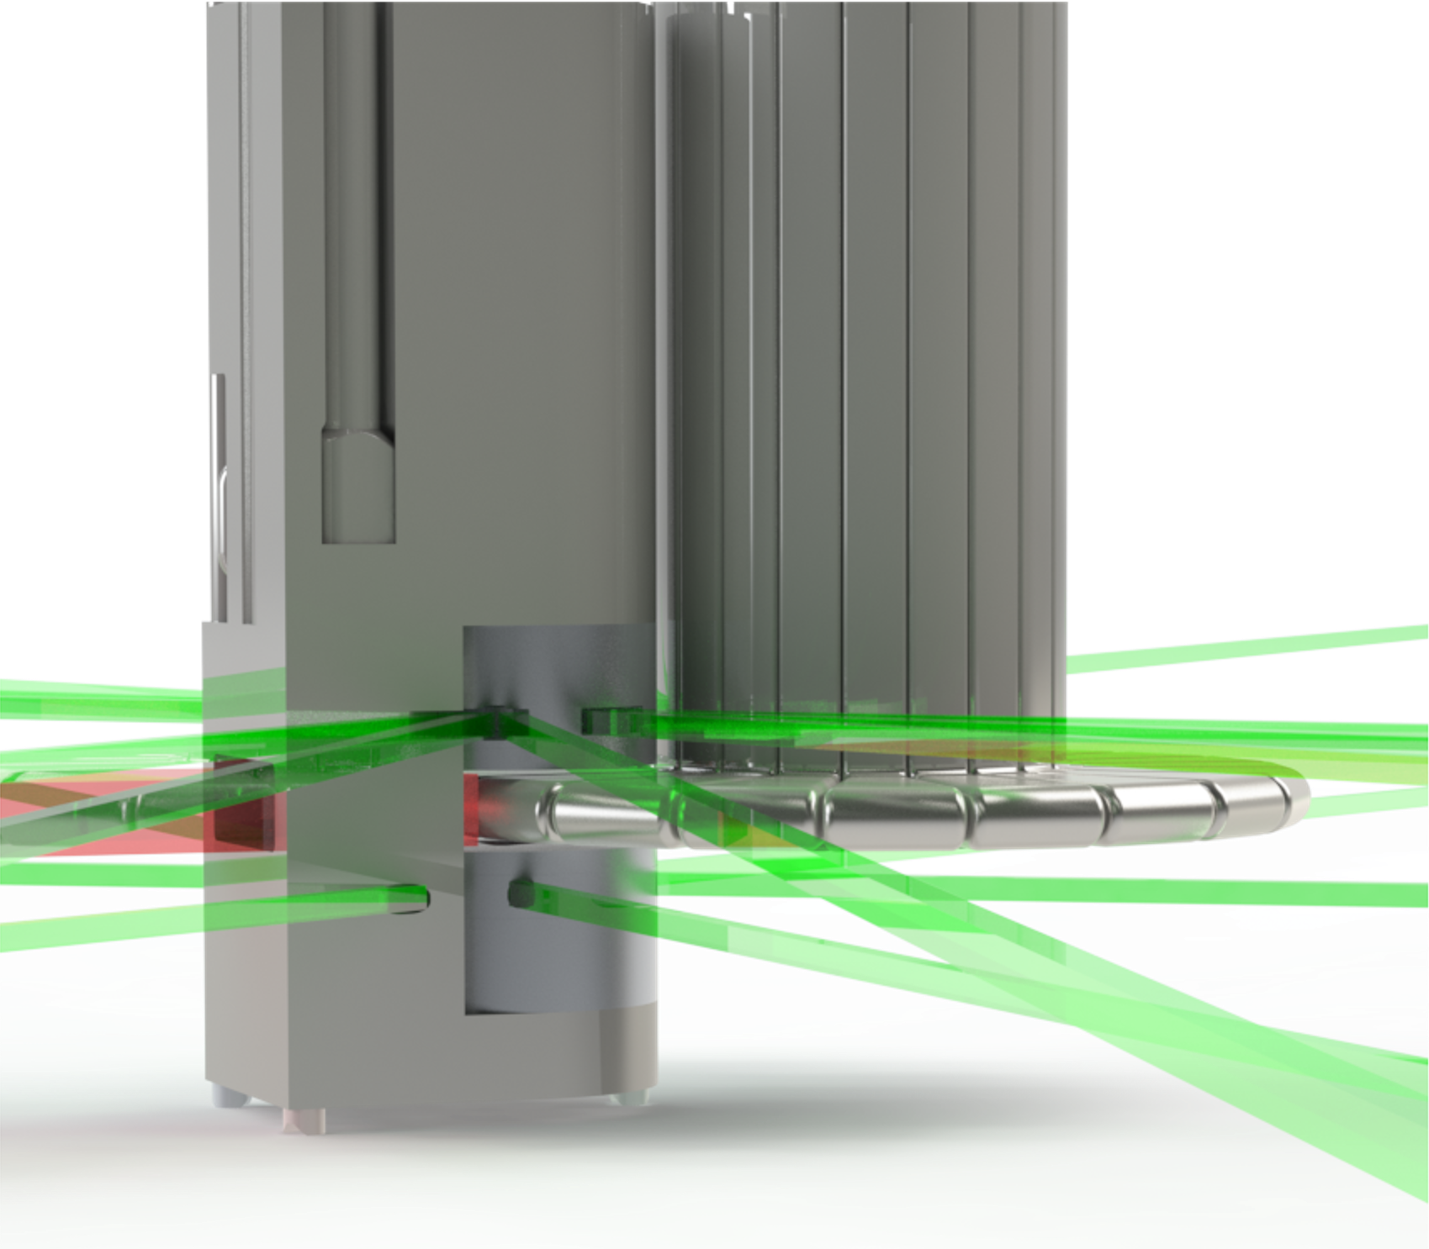
Target Systems challenge: to provide world’s brightest neutron source
Small beam footprint – started at 30 cm², grown to a range of 60 – 90 cm²
Time – pulses are less than 1 micro-second
Energy – each pulse = 2.5 times the energy of a .50 caliber round
Small moderators (3 cm) closely coupled
Alignment – laser, not flood light
Cost effectiveness
Reliability
Maintainability
Notes:
The hart of the STS is the rotating tungsten target, surrounded by the two moderators.
On the top we have cylindrical moderator.
On the bottom is the so-called “tube” moderator.
Both use para-hydrogen at 20 degrees Kelvin for the moderator material.
A catalytic converter is included in the hydrogen loop to control the ortho-para content. Para-hydrogen is surrounded by the water pre-moderator and the beryllium reflector. All vessels are made from aluminum. The gap between the moderators and the target will be ~ 10 mm.

Slide 19
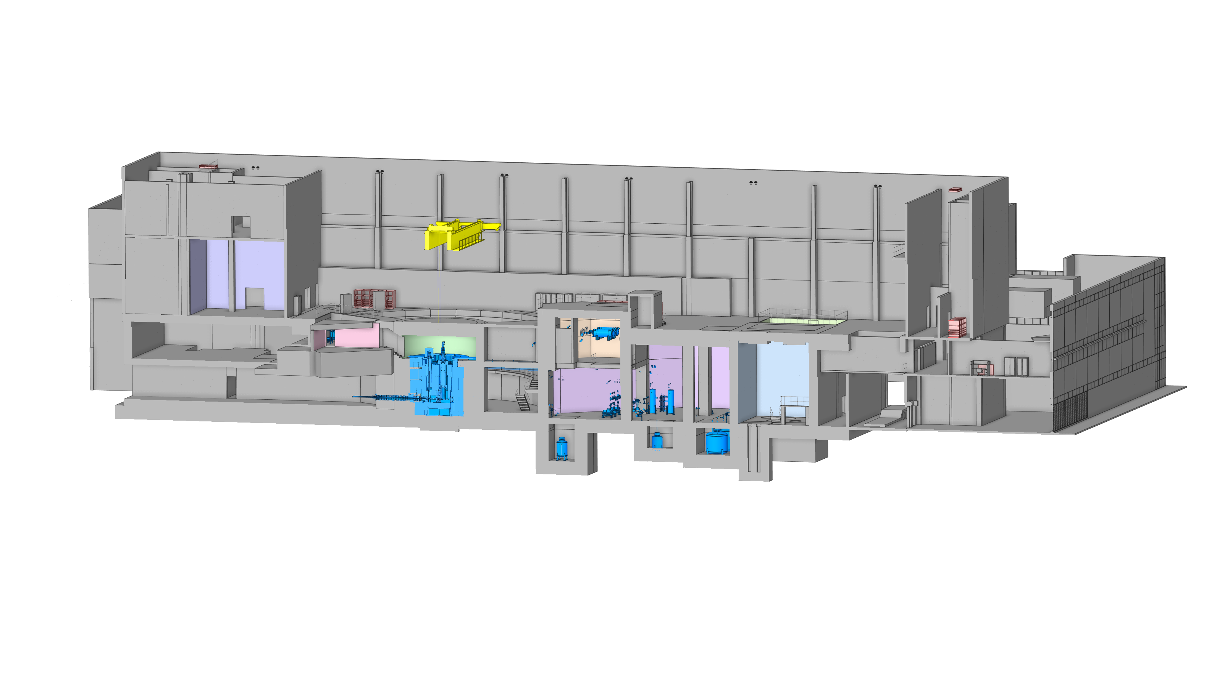
Target Systems in the Building
Cryogenic Moderator System rooms
Target drive room
Service cell
Mock-up test stand
Monolith
Gas liquid separator and delay tank cavity
Hot process vault

Slide 20
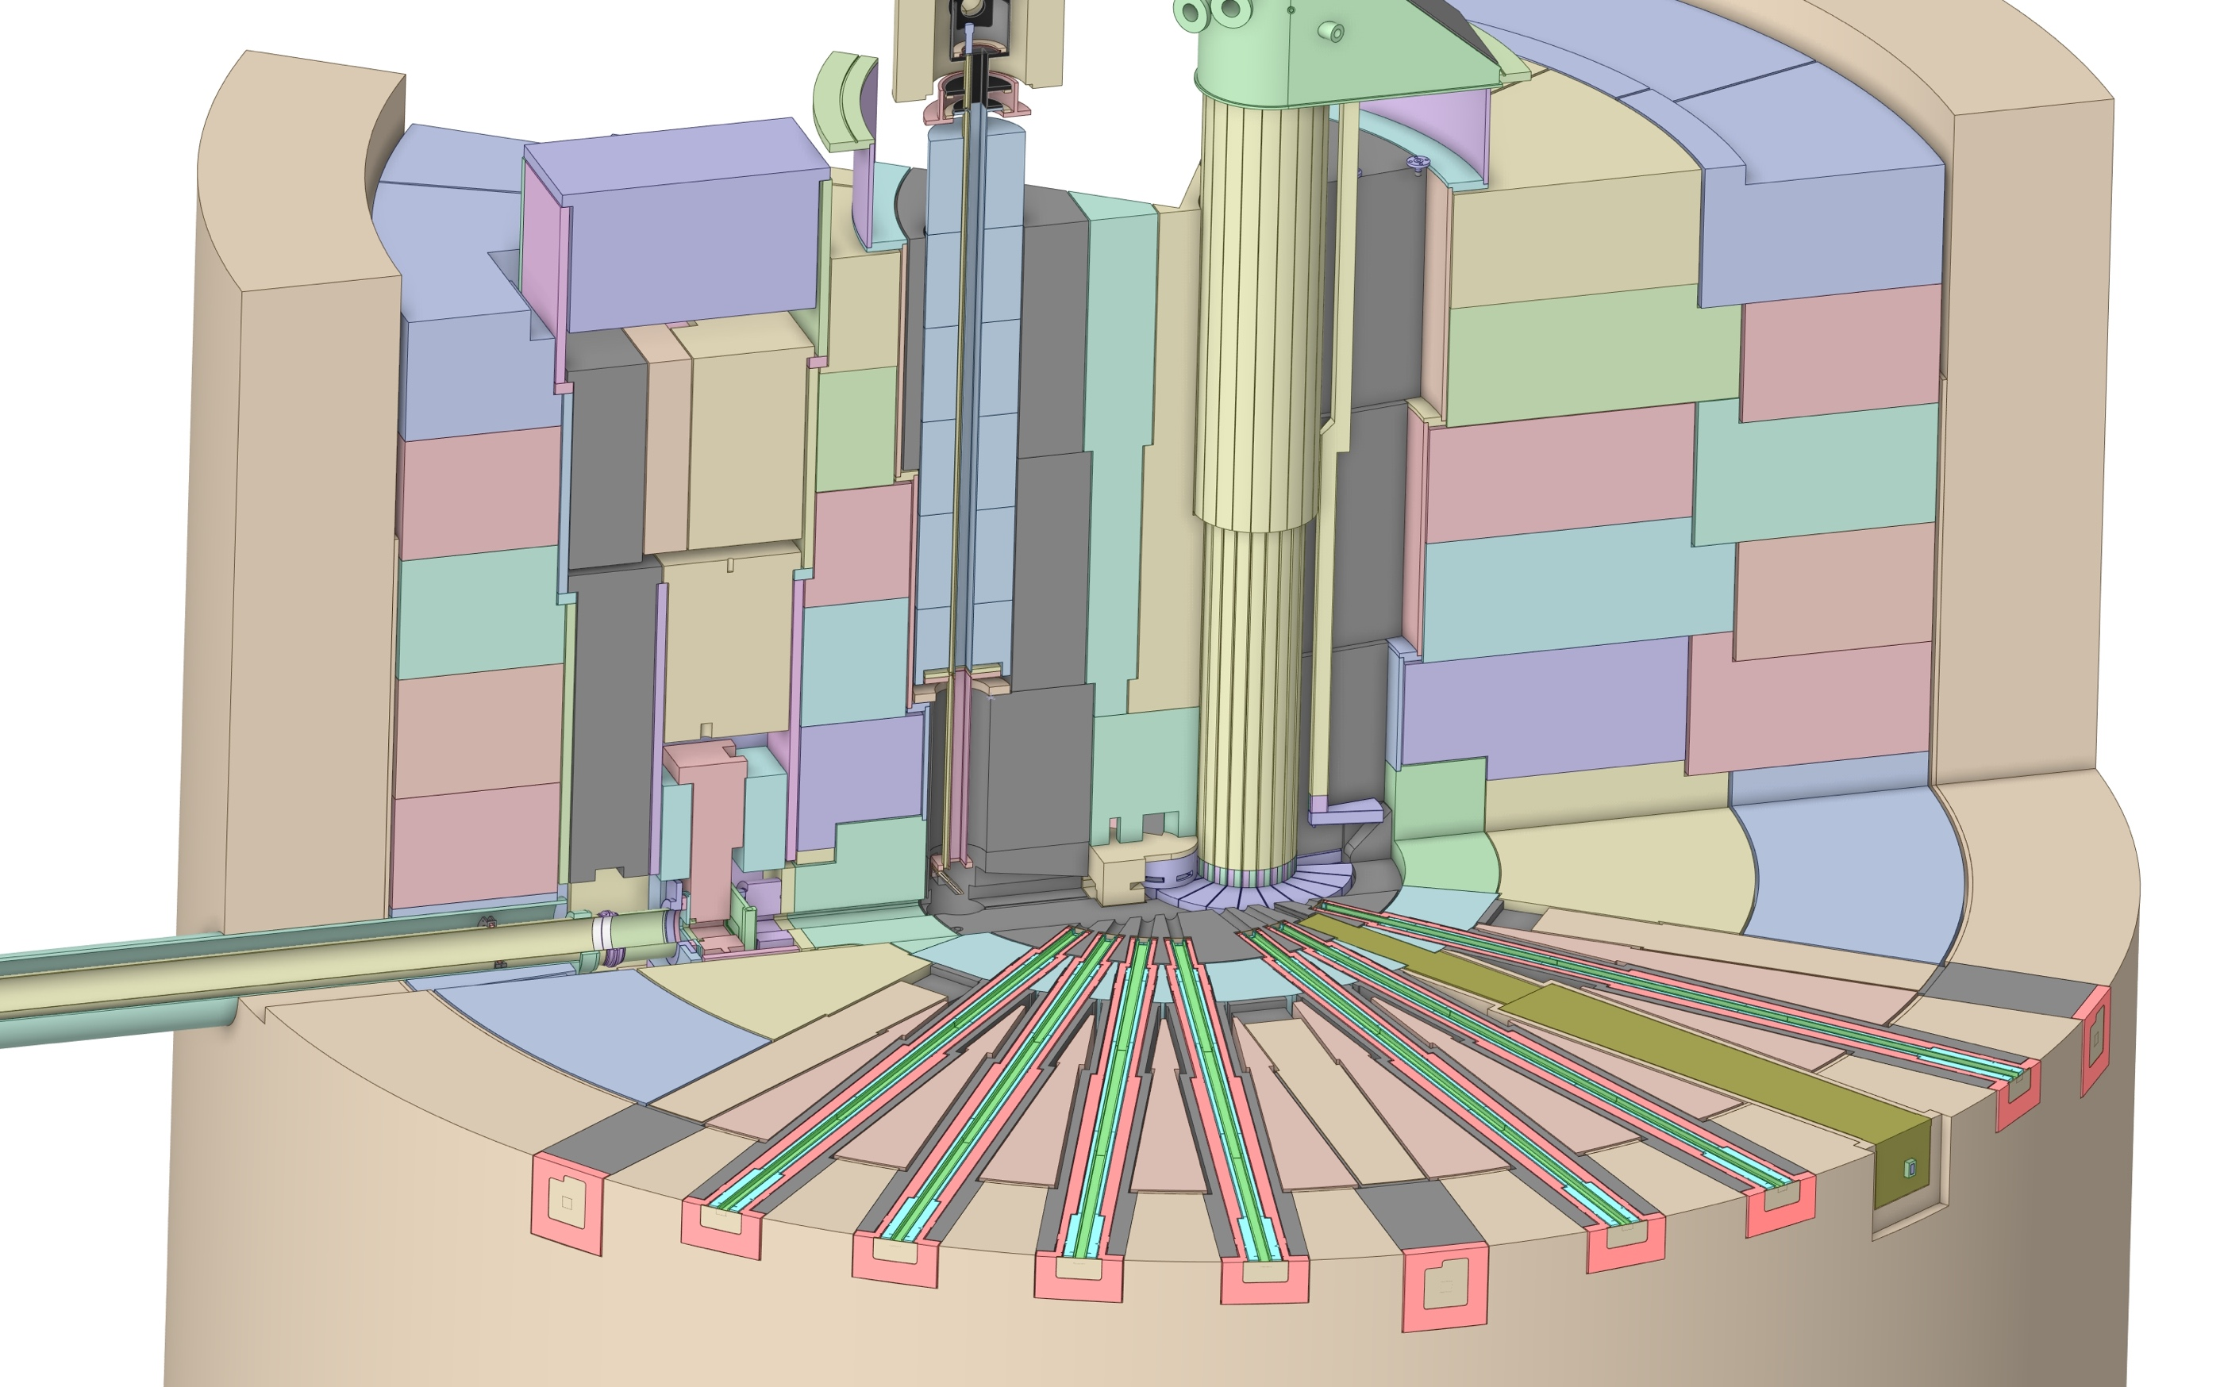
Monolith – “Core” of STS
Target Viewing Periscope
Core vessel shielding
Moderator Reflector Assembly
Core Vessel
Target assembly, drive, shaft segments
Proton beam window
Bulk steel shielding,
(Ø8.7 m)
Target disk (Ø1.2 m)
Nozzle Extension
Proton beam tube assembly
Instrument Optics Insert

Slide 21
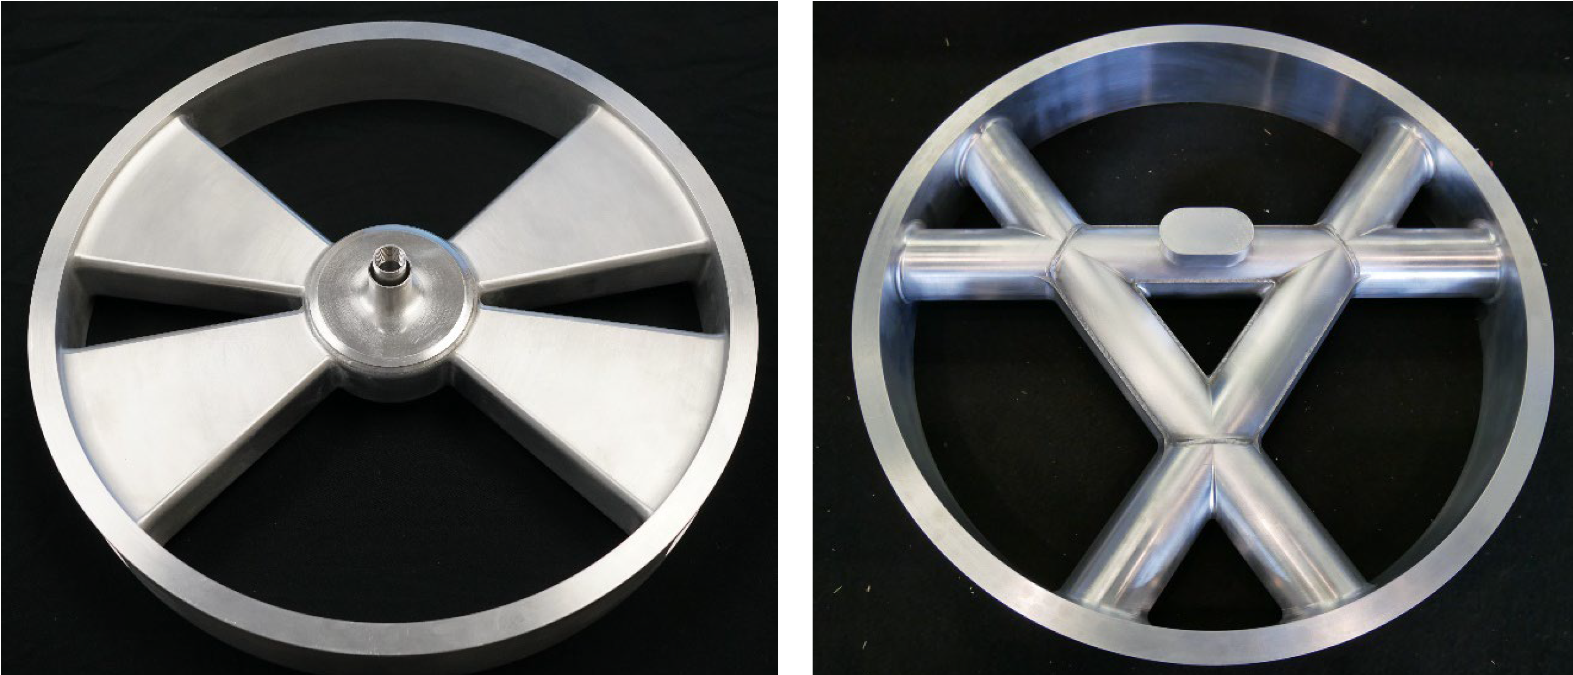
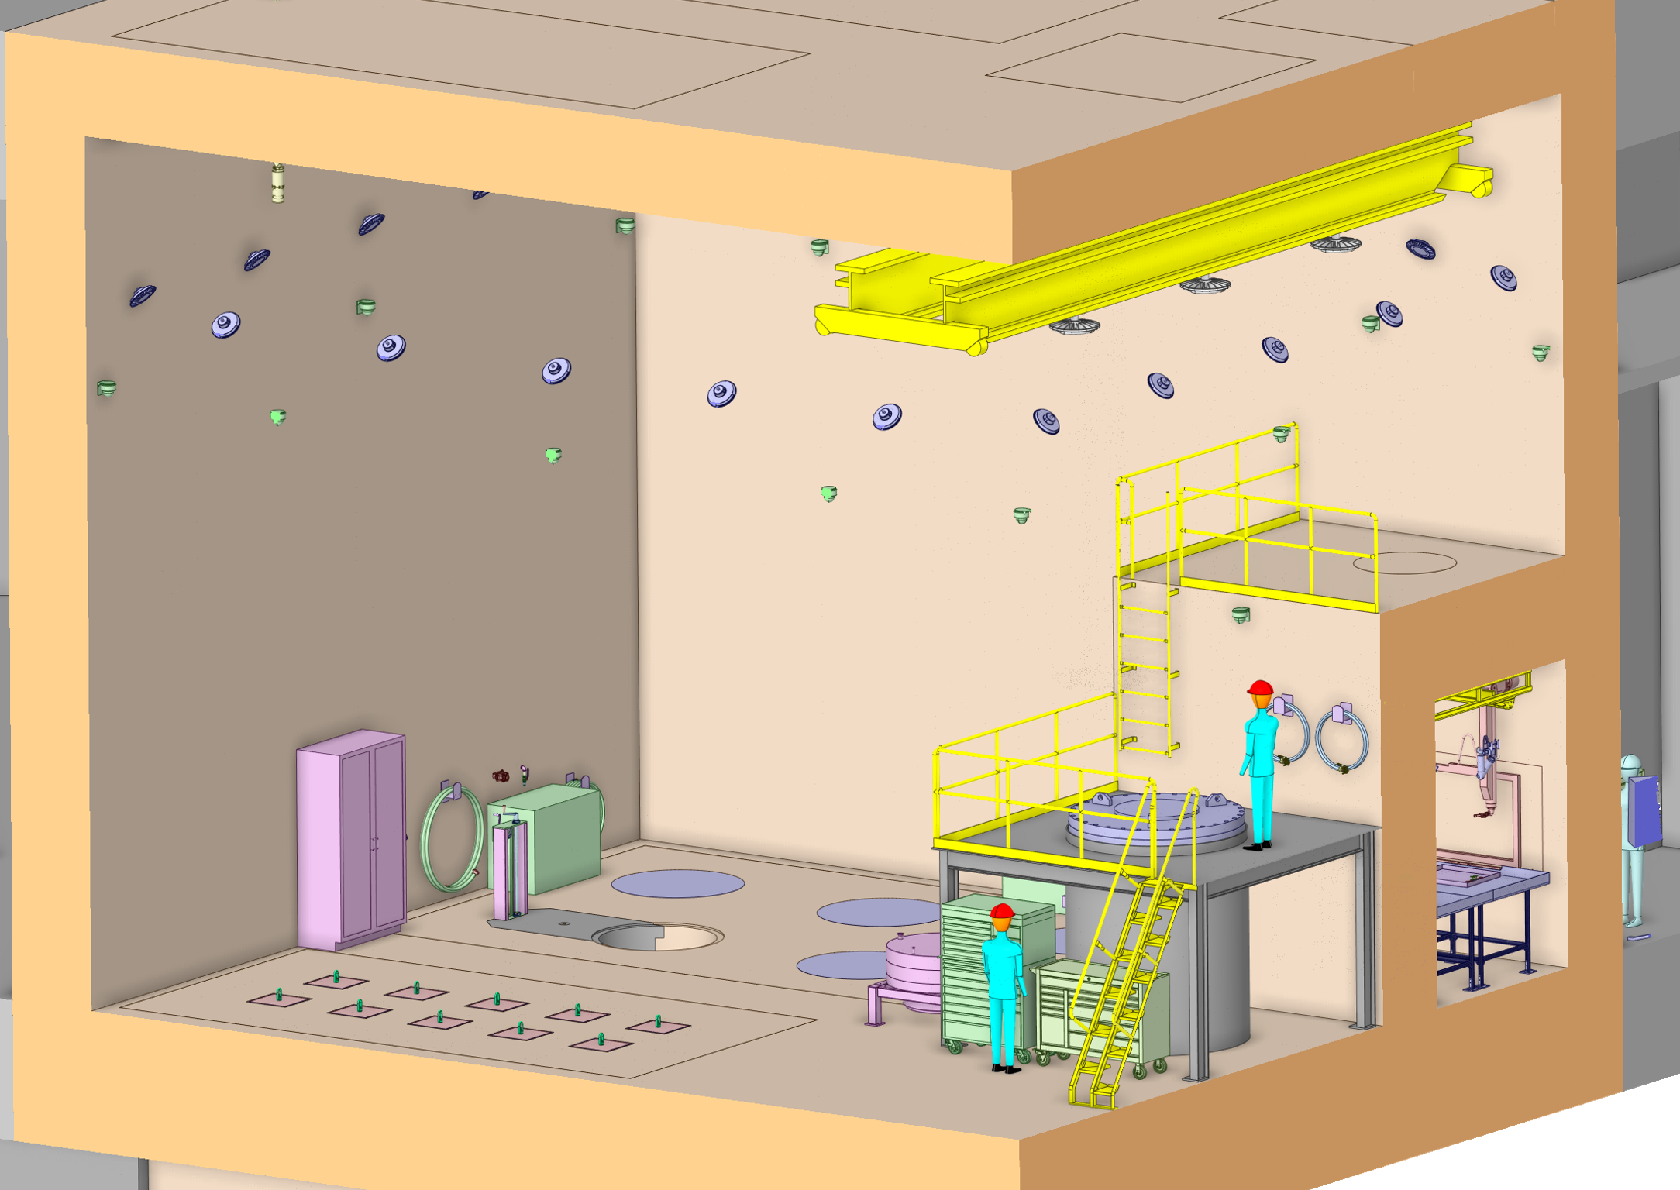
Key Target Systems decisions taken, and challenges overcome
Segmented Target – maintenance, availability, and flexibility
Target Block Design – eliminate water to tungsten or tantalum contact
Moderator configuration and manufacturability – See J. Janney Poster
Compact moderator alignment
Single hydrogen loop for both moderators – facility simplification and cost savings
Cost effective future PIE capability included
Target Viewing Periscope included
Core Vessel Nozzle Extension manufacturability
Simplified water cooling – one loop for target and one loop for all remaining components

Slide 22
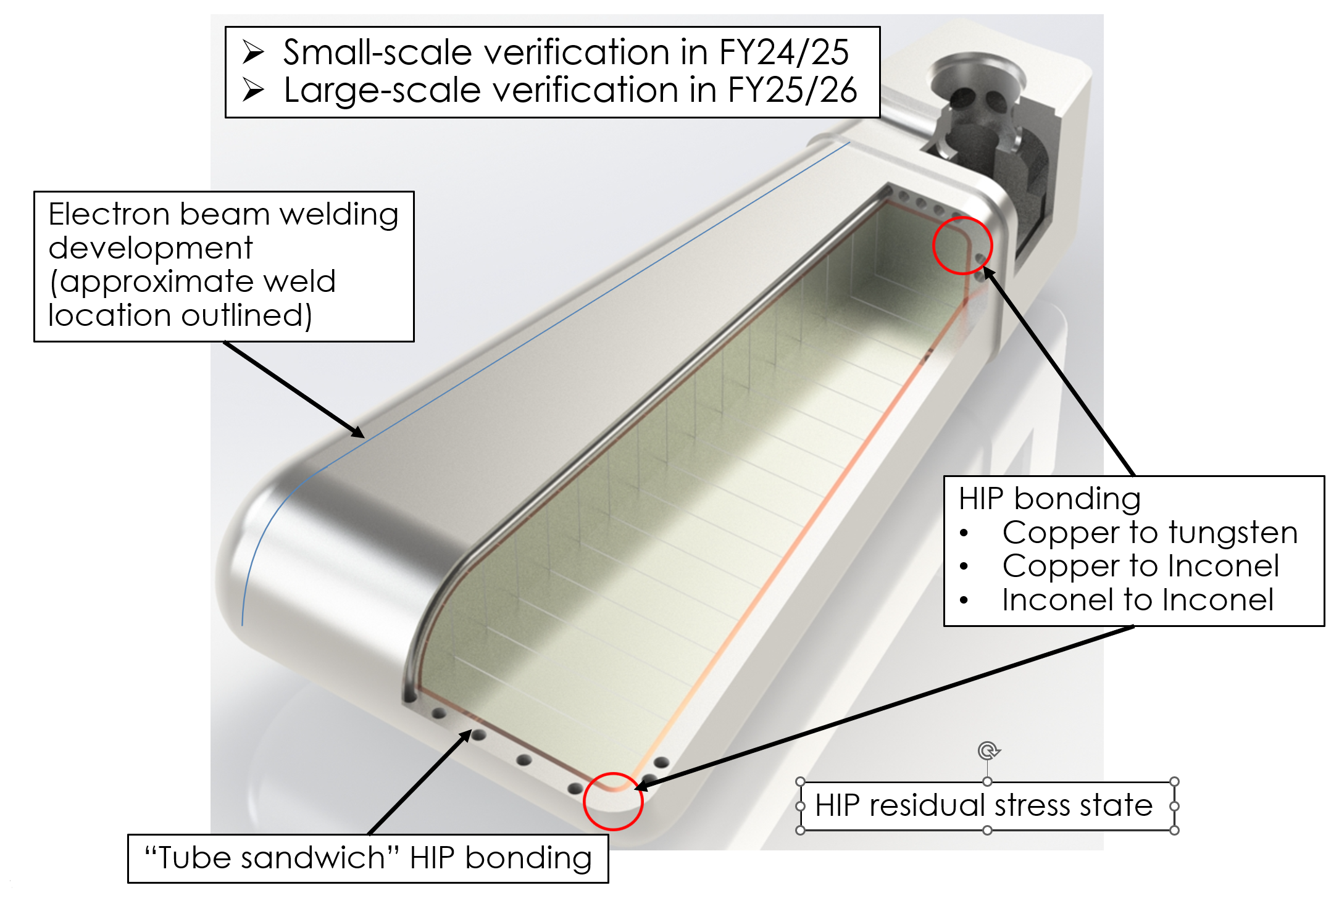
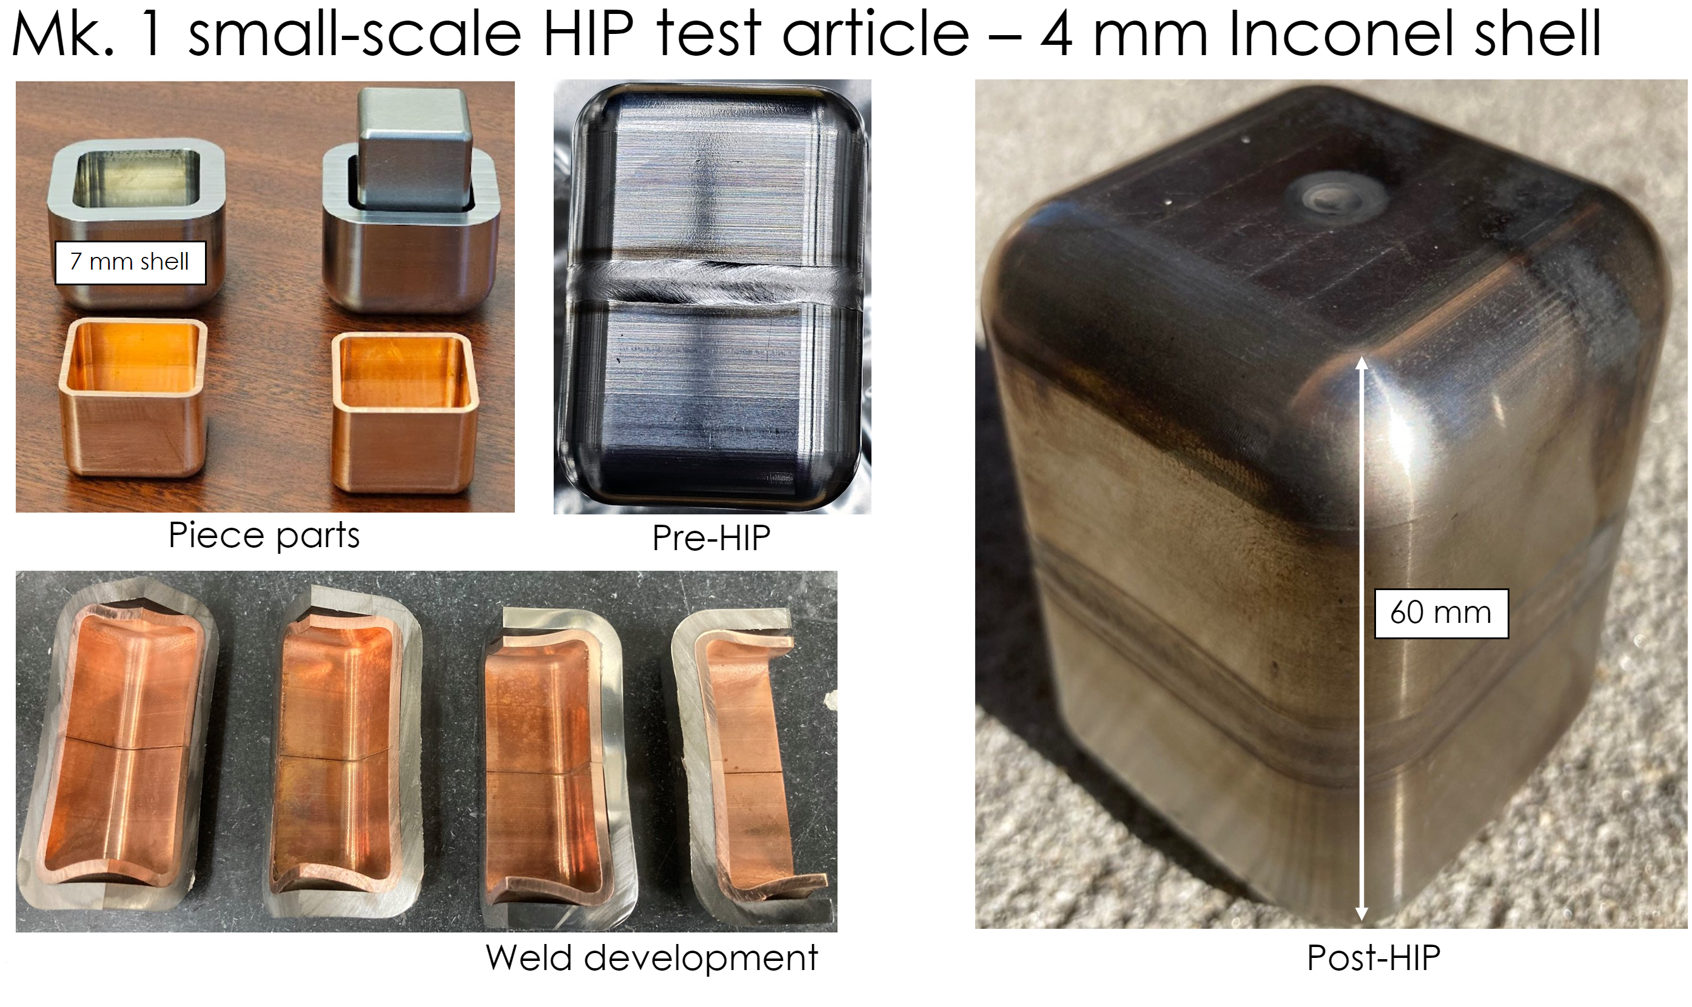
Remaining Target Systems key challenges
Target block manufacturability
Core Vessel Beltline manufacturability
Design coordination, particularly with conventional facilities and integrated controls
Execution!

Slide 23
Conclusion and Discussion!
ORNL and DOE Basic Energy Sciences seek to strengthen long term leadership is material science with neutrons
STS will provide world leading peak brightness by stealing 1 out of 4 pulses from the upgraded existing Spallation Neutron Source
To reach peak brightness, STS Target Systems employ a novel combination of designs and material systems, but design features are based on previously proven technologies

