Slide 1
High-Power Beam Intercepting Devices in Particle Accelerators
Antonio PERILLO MARCONE (SY-STI-TCD)
Contributions from M. Calviani, N. Solieri, F.-X. Nuiry, R. Franqueira-Xmenes
AccelApp’24 – 20/03/2024

Slide 2
Beam Intercepting Devices
Safety function
Beam stoppers
Beam cleaning & control
Collimators
Scrapers
Beam dumps
Strippers
Slits
Physics
Particle producing targets

Slide 3
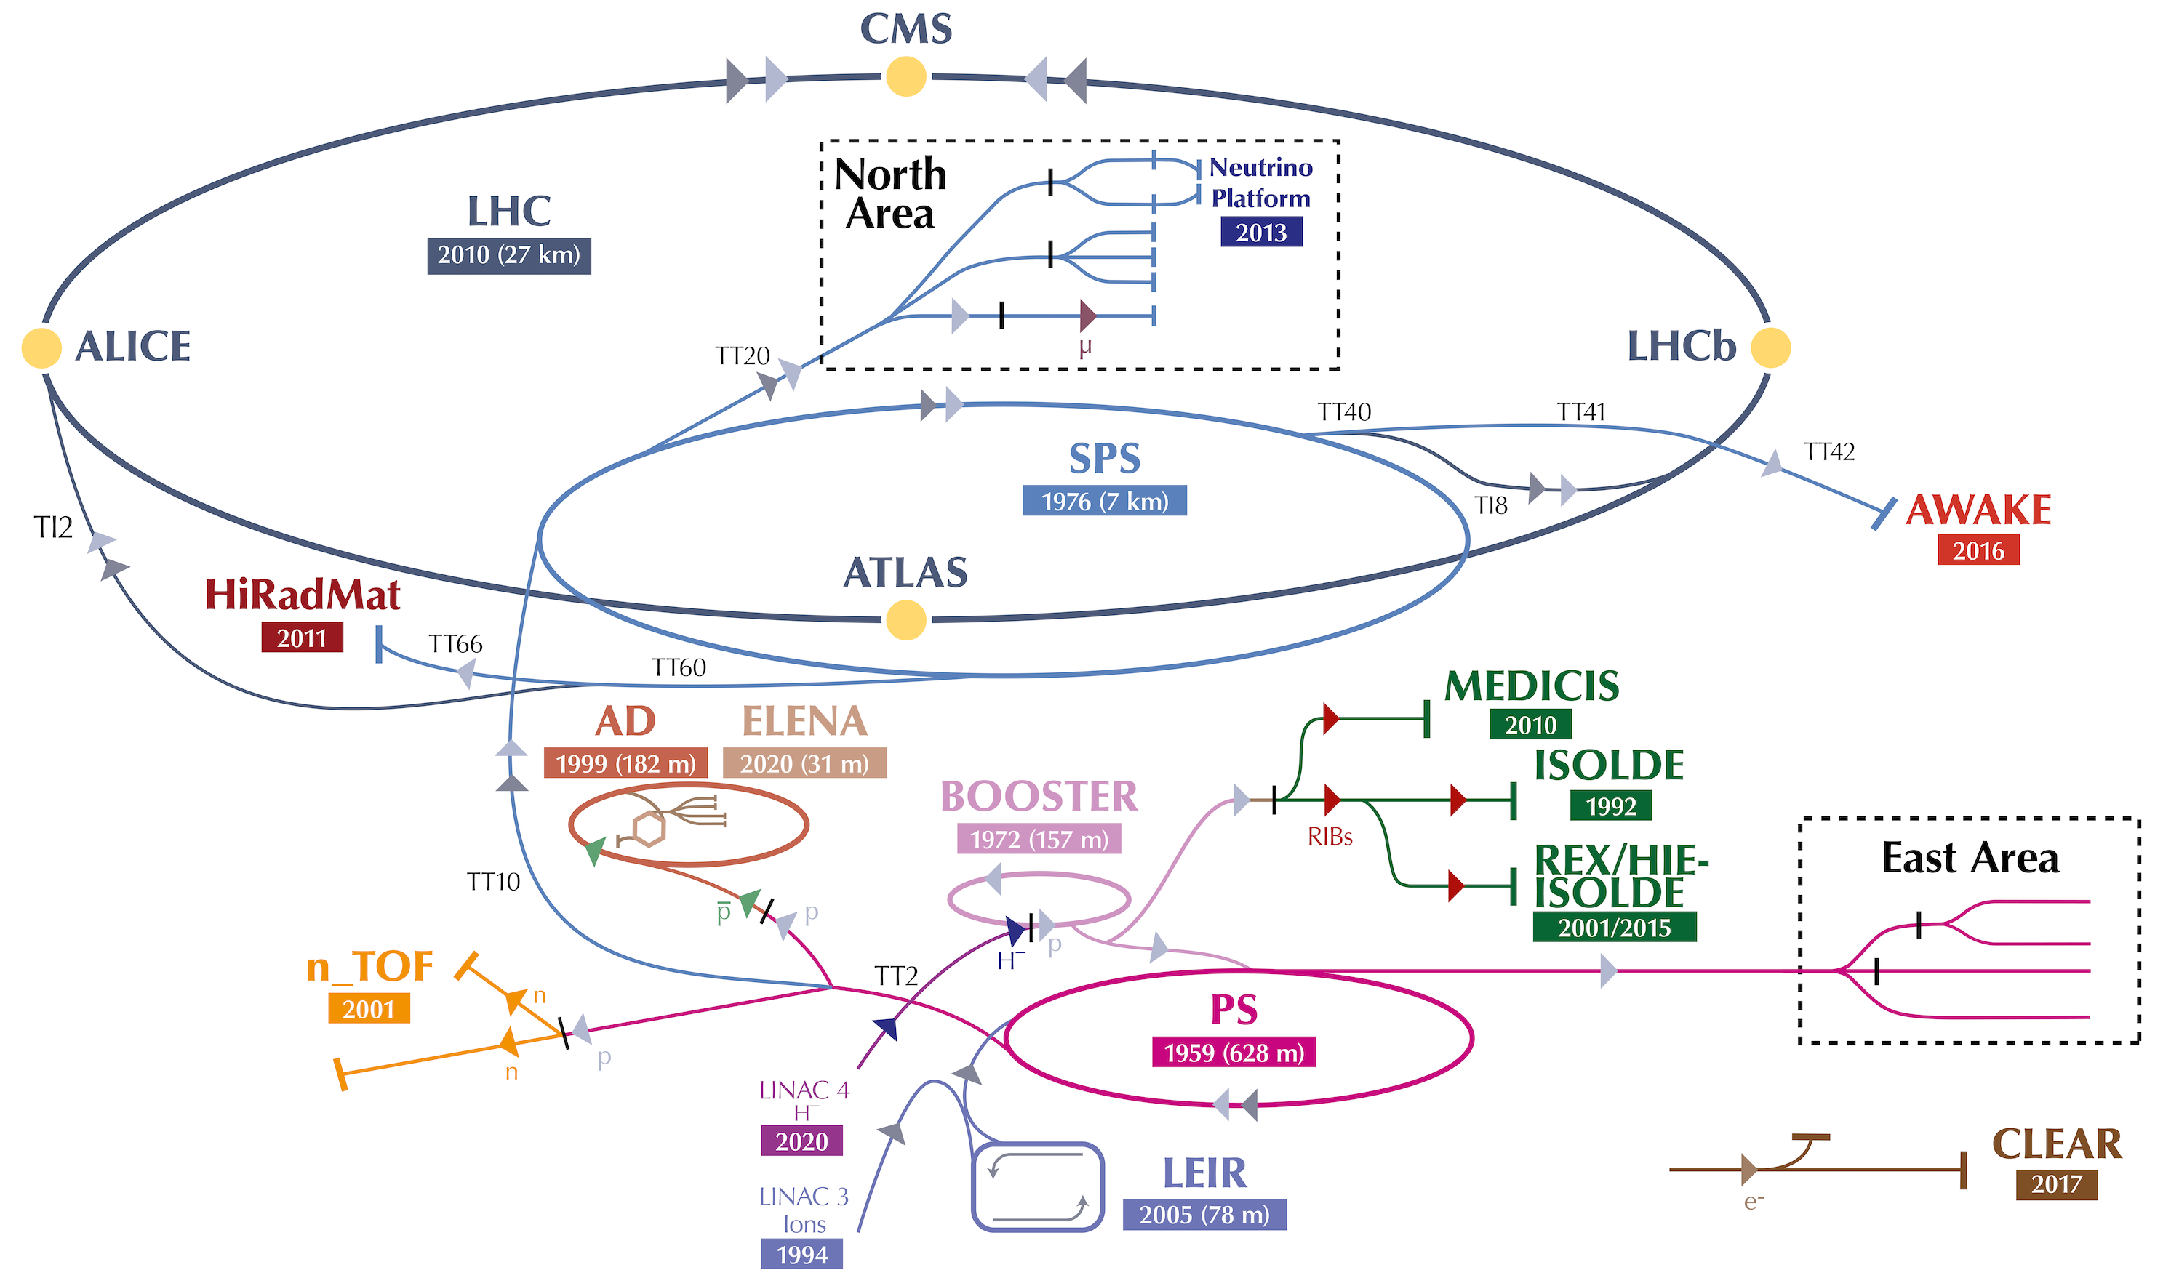
CERN Accelerator Complex – High-Power BIDs
LHC Collimators
BDF (future)
SPS Dump
PSB Dump
n_TOF Target

Slide 4
PS Booster Dump
Design parameters:
Max beam intensity: 1E14 ppp
Beam energy: 2 GeV
Pulse period: 1.2 s
Maximum average deposited power : 9.7 kW (50% of beam)
Operational requirements:
Max. dump rate: 10% operation, 50% commissioning
Lifetime: ~30years
No access to dump, i.e. zero maintenance design (apart from cooling)
Robust, reliable design
https://doi.org/10.1103/PhysRevAccelBeams.23.063001

Slide 5
PS Booster Dump

Slide 6
PS Booster Dump
Good contact between blocks
No contact between blocks
CuCr1Zr

Slide 7
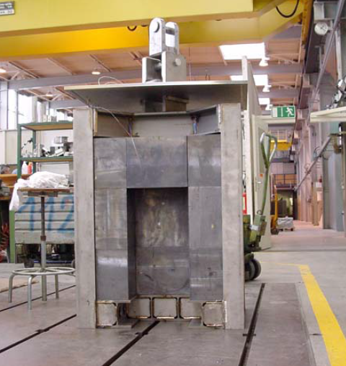
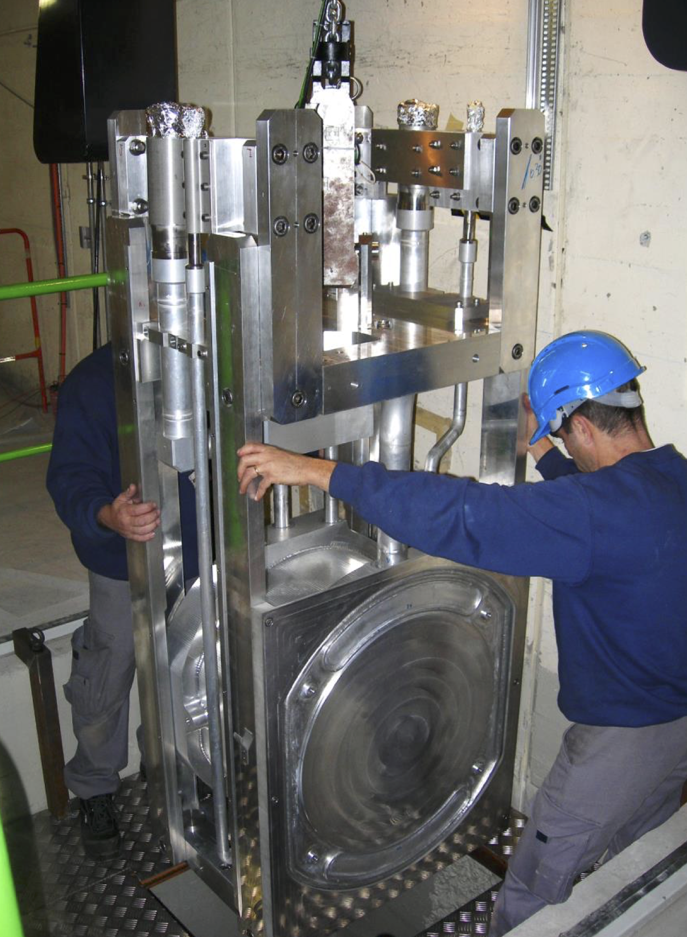
n_TOF Spallation Neutron Target
Thanks to M. Calviani
n_TOF is a white high-intensity spallation neutron source operating at CERN
Dedicated to measurement with unmatched S/N ratio for radioactive or low mass samples
Focus is high intensity per pulse, not average power (limited to around 6 kW)
Operated with 20 GeV/c proton beam, 8.5*10¹² ppp, 7 ns 1σ
Beam kinetic energy = 27 kJ , beam pulse = 7 ns → Instantaneous power = 3.8 TW
Target #1 (1999-2004)
Pure Pb used as target material
Target #2 (2008-2018)

Slide 8
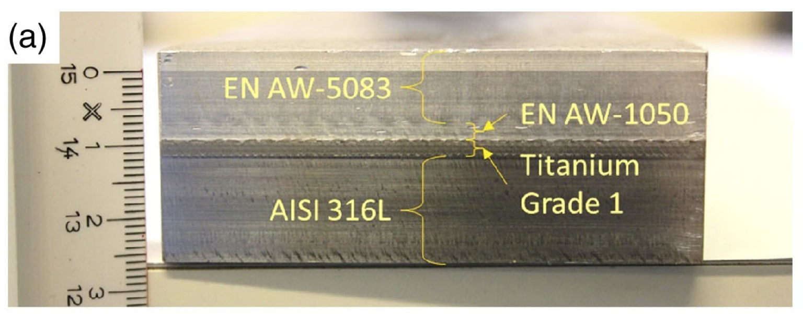
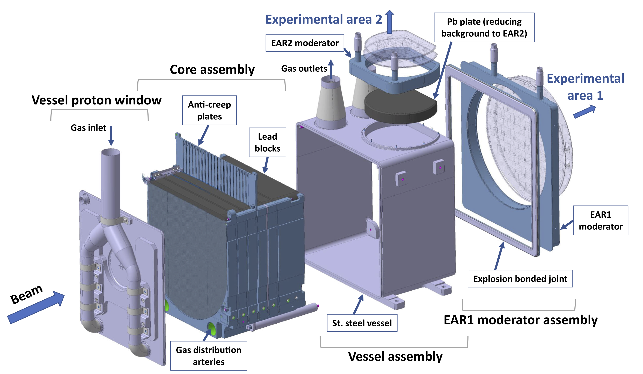
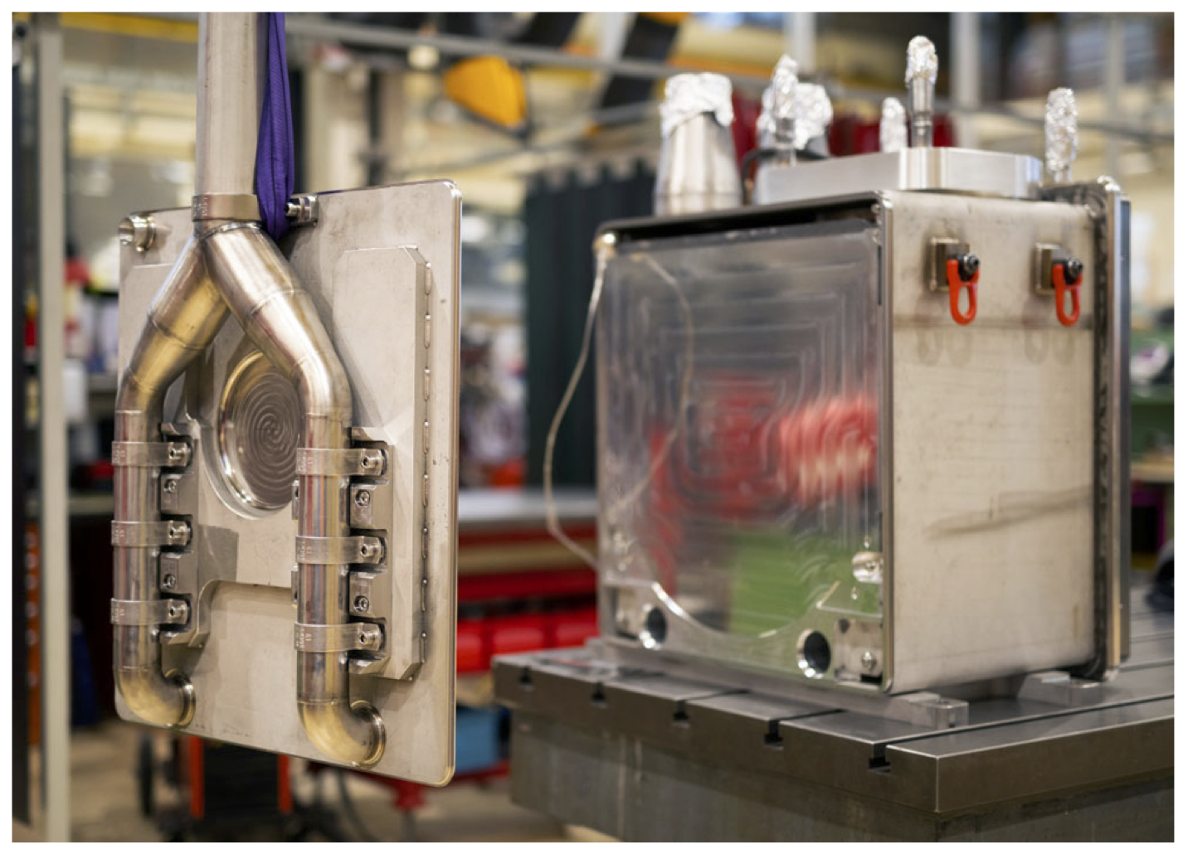
n_TOF Target (3rd generation)
Thanks to M. Calviani
3rd generation spallation target, pure Pb based, N₂-gas cooled, water moderated, operational since July 2021
Several innovations introduced, including bimetallic transitions & nitrogen gas cooling
Focus – reliability & physics performance
Phys. Rev. Accel. Beams 24, 093001 (2021)

Slide 9
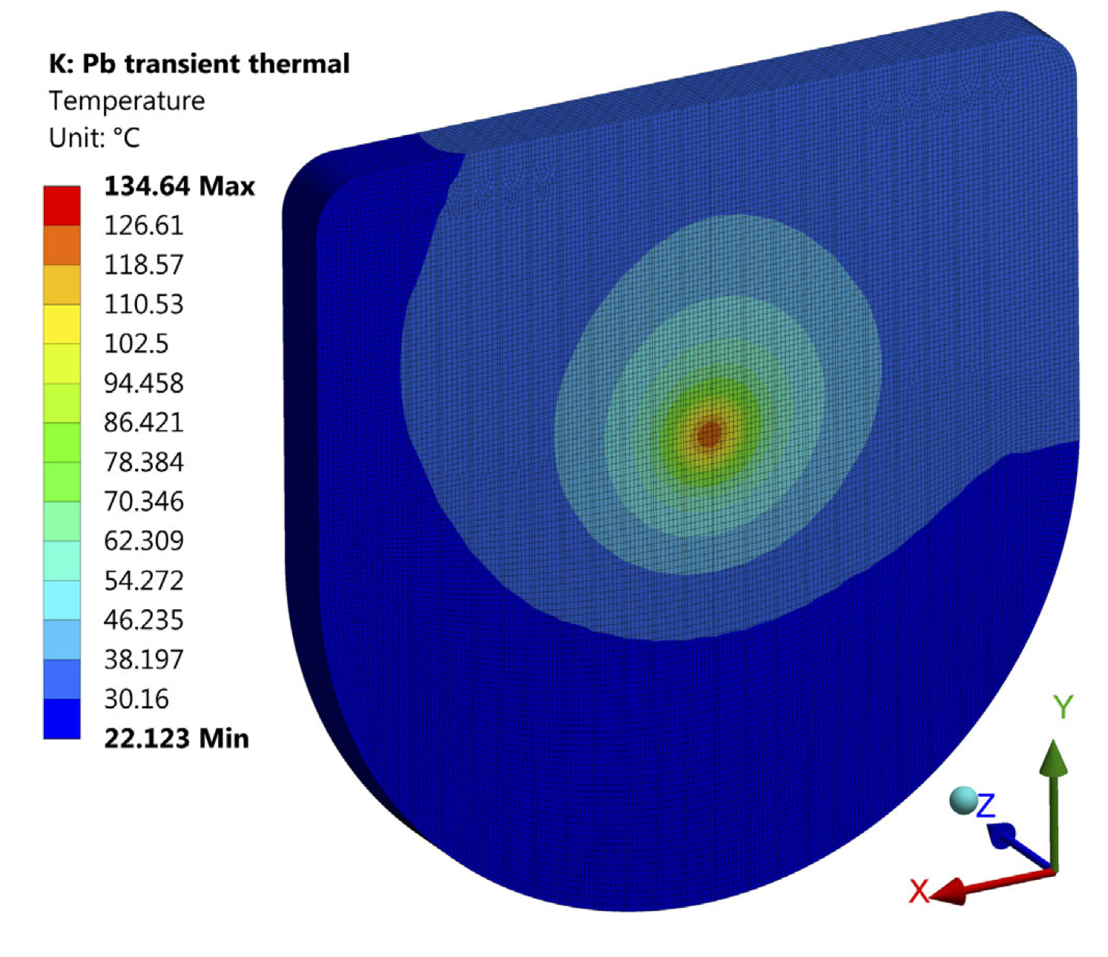
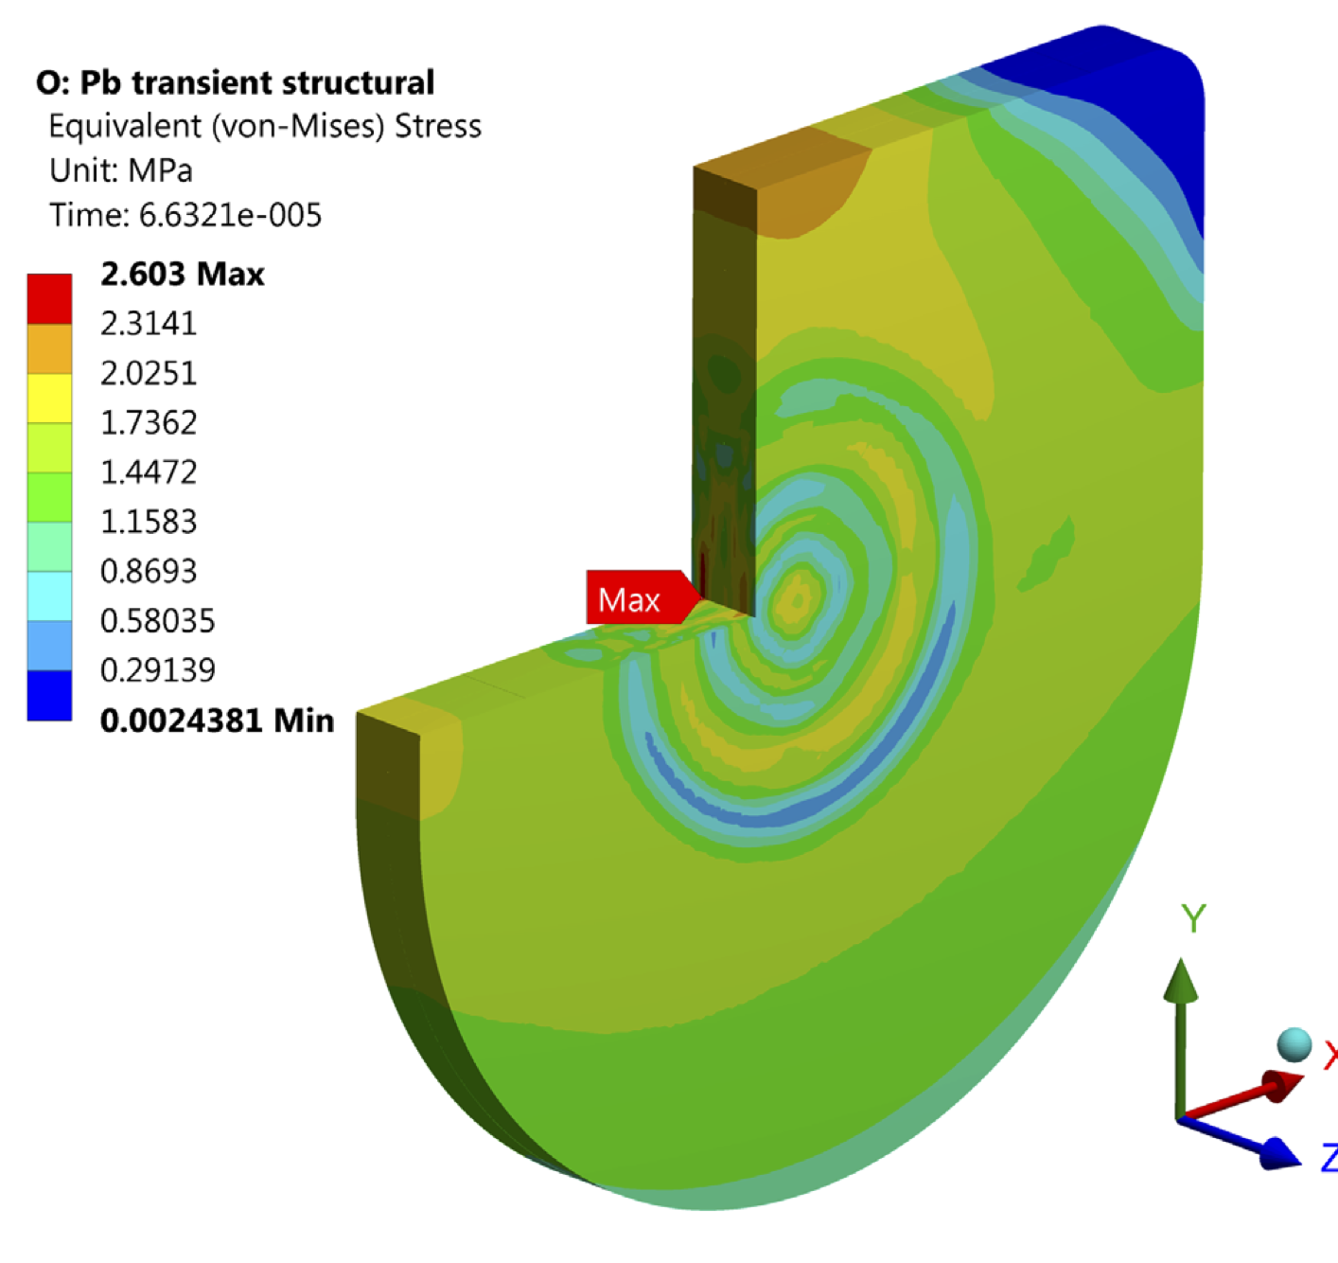
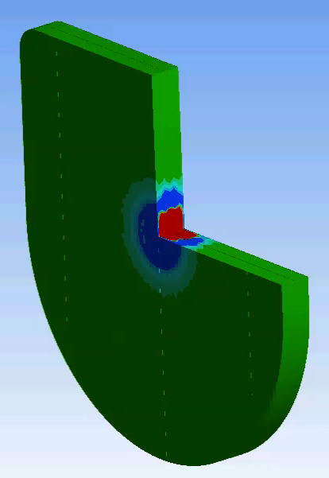
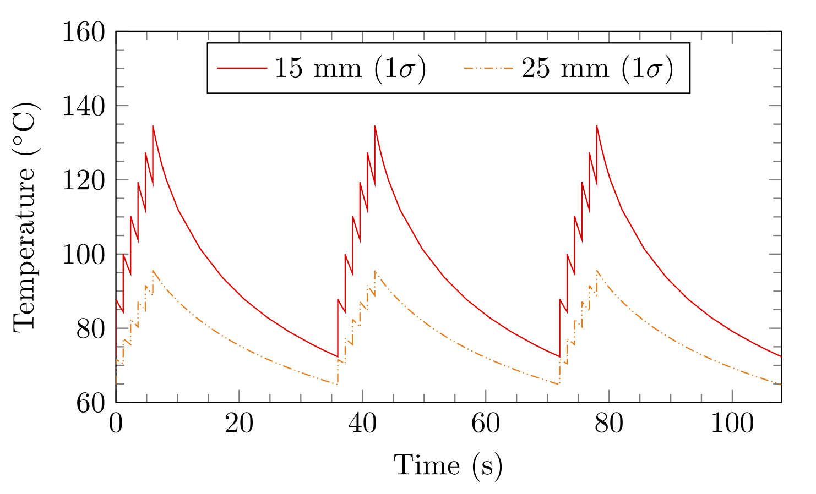
N_TOF Target challenges/limitations
Thanks to M. Calviani
Pb is a non-structural material, low melting point, very low yield stress
0.7 T_{m}
2.6 MPa vs. 1 MPa (plastic flow onset)

Slide 10
SPS Beam Dump (1/3)
Beam
14 – 450 GeV
up to 5.6 MJ/pulse
up to 260 kW

Slide 11
SPS Beam Dump (2/3)
Need to absorb up to 260 kW
Internal dump
  In UHV
  Close to the beam
  Tight geometrical tolerances
  Impedance considerations
Highly radioactive
Surrounded by massive shielding
No maintenance planned – must be reliable!
~520 t cast iron
90 t concrete
50 t marble

Slide 12
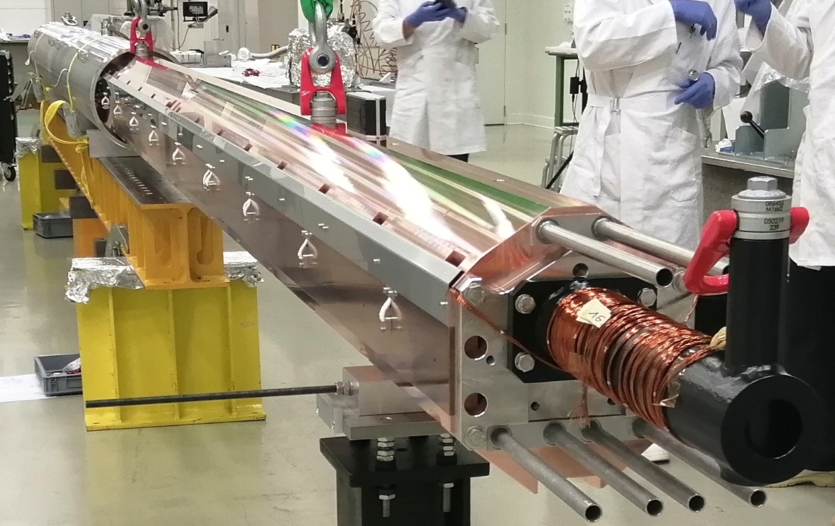
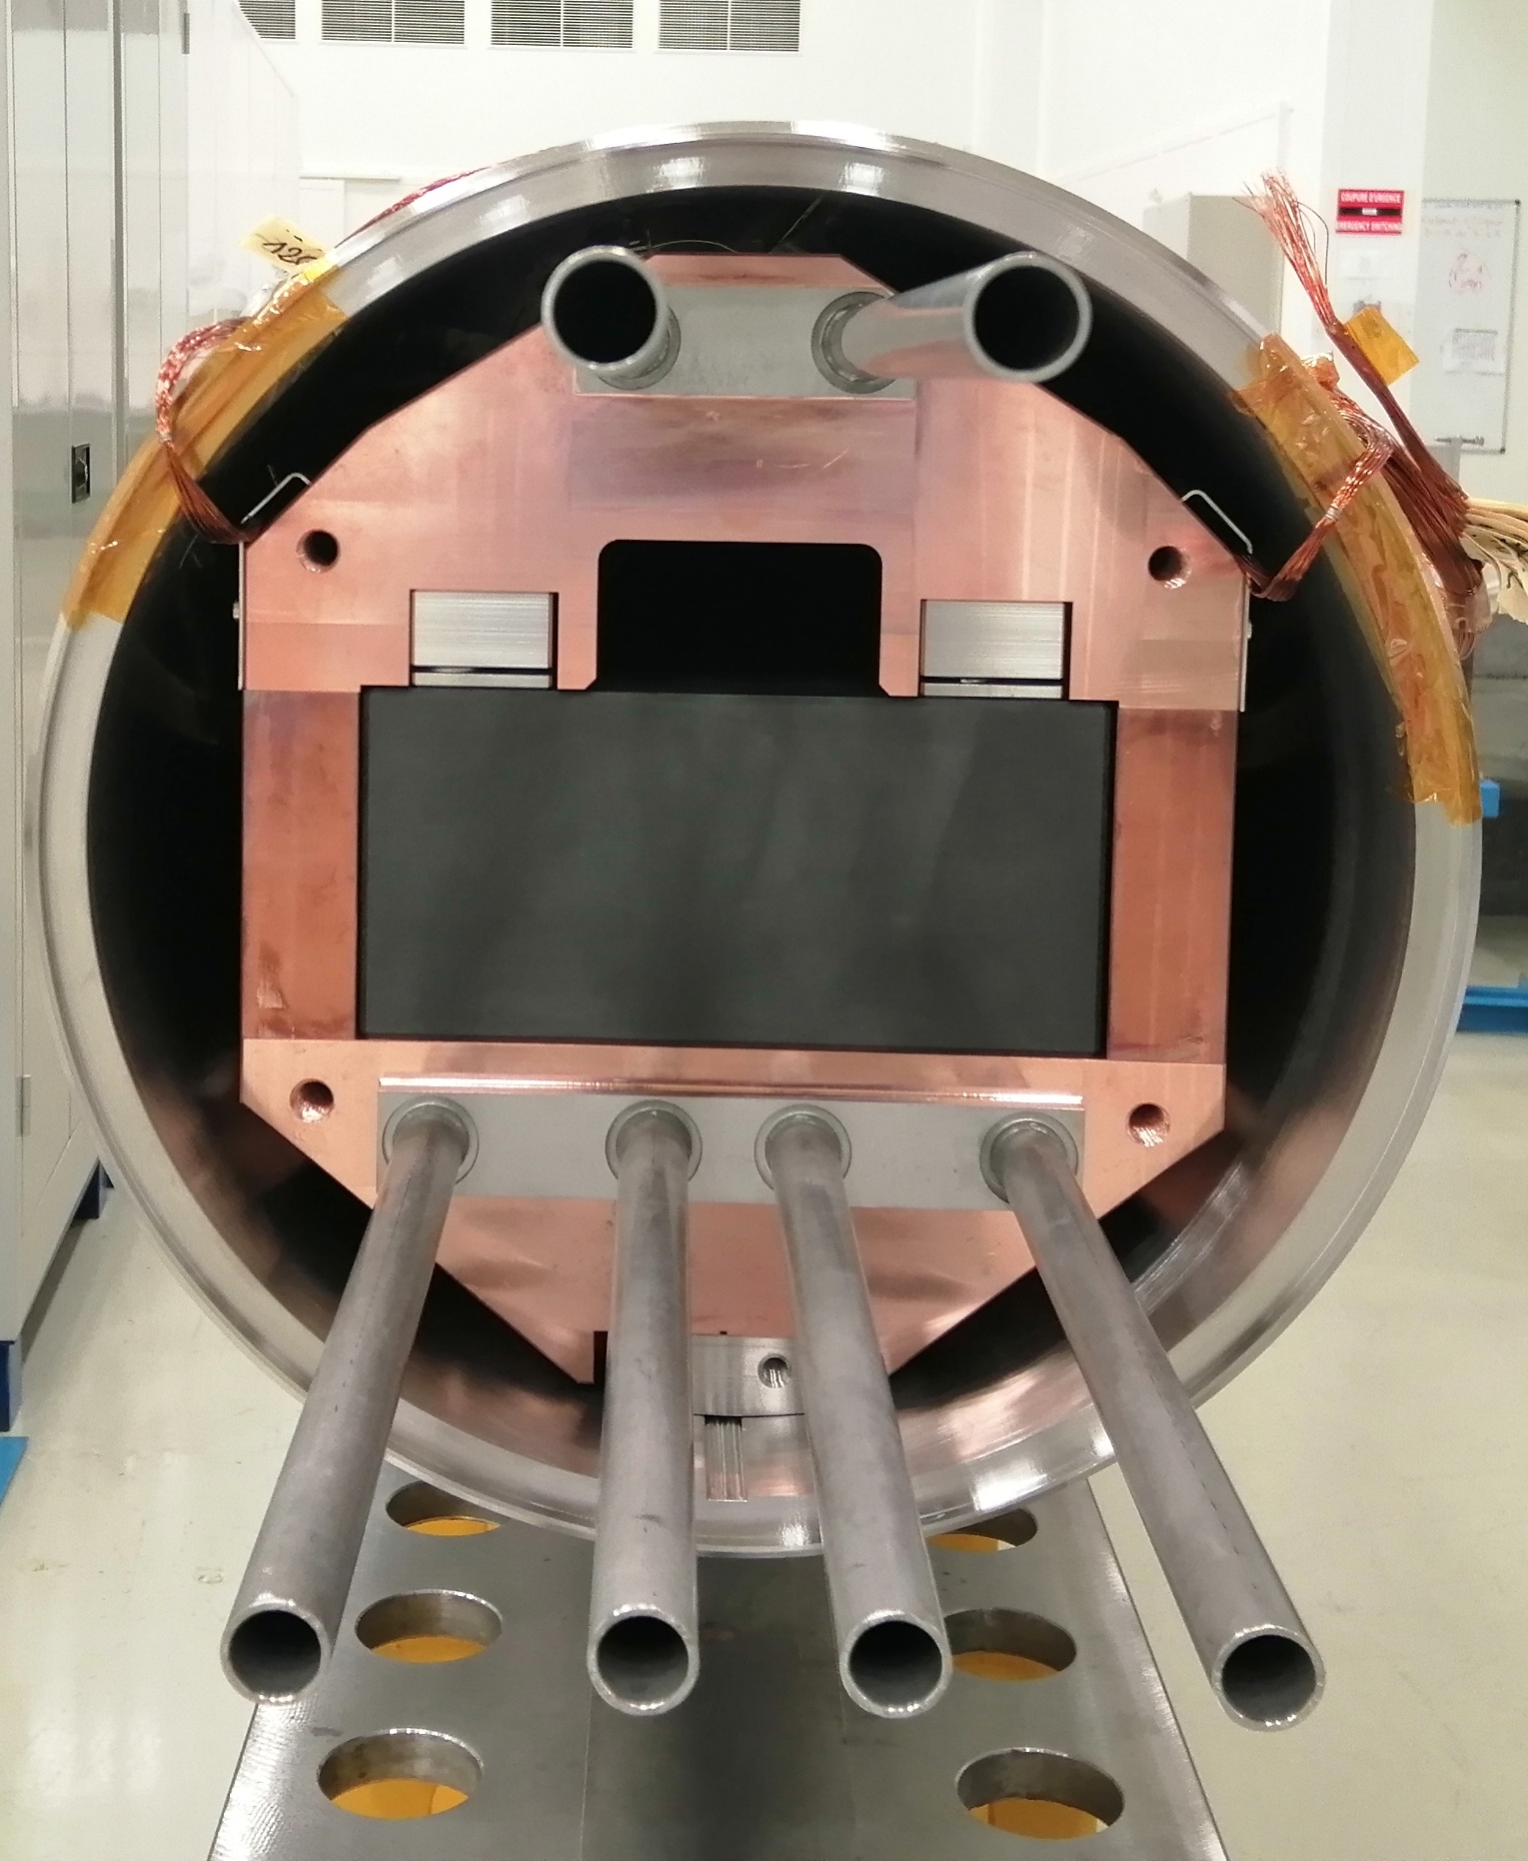
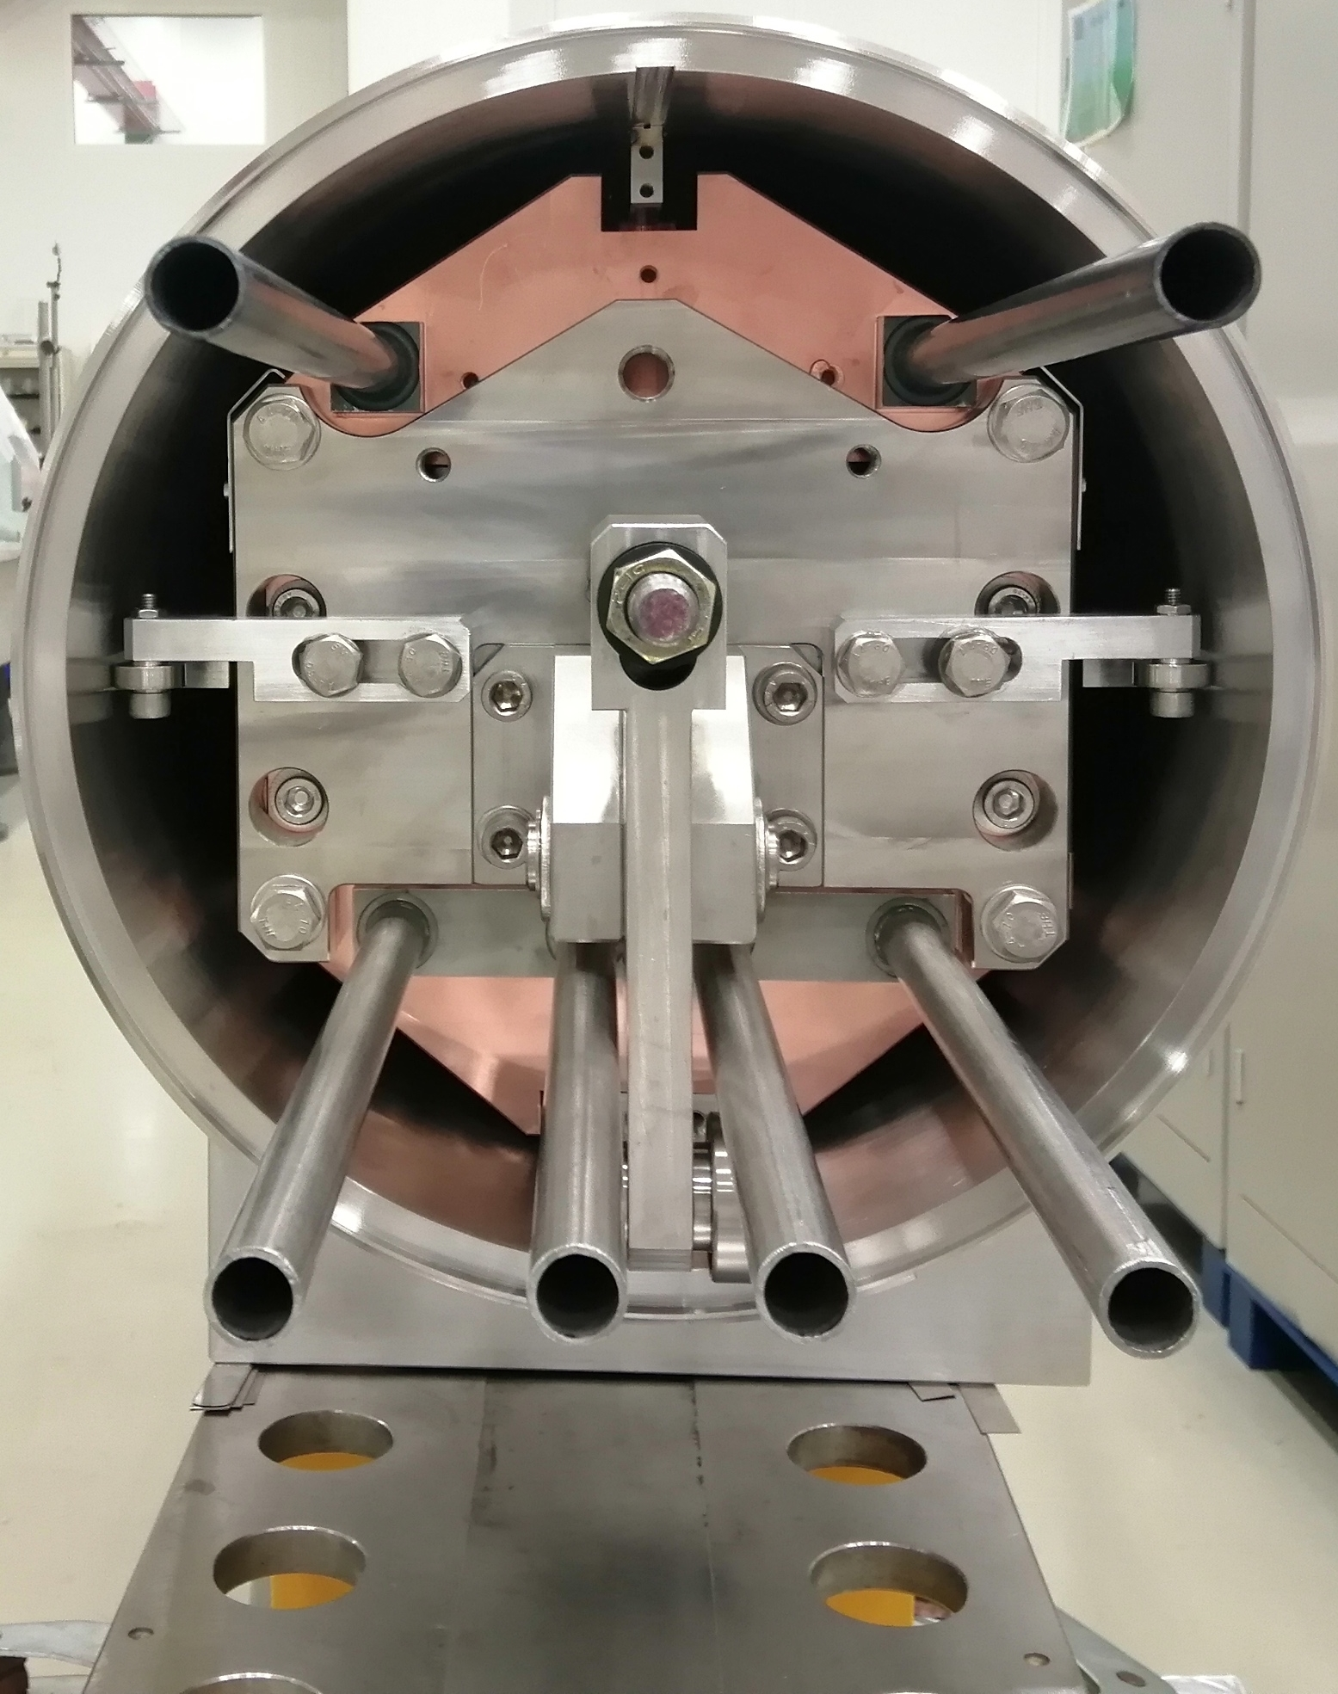
SPS Beam Dump (3/3)
core insertion into the vacuum chamber
Upstream
Downstream

Slide 13
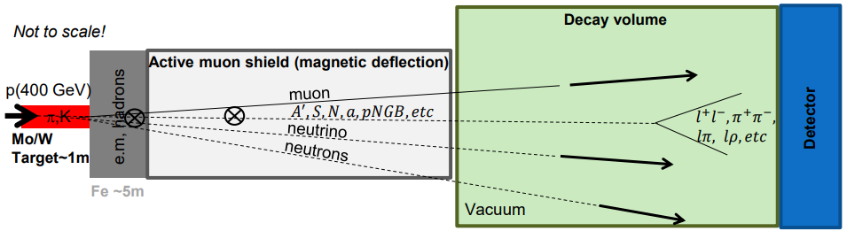
Beam Dump Facility (BDF)
BDF: General-purpose facility at CERN dedicated to beam dump and fixed target experiments. – Proposal → approved in March 2024 → operation start in 2030
To be initially exploited by the Search for Hidden Particles Experiment (SHiP).
Beam Dump Target → absorb and provoke hard interactions of the highest possible p+ per pulse to maximize production of charmed mesons and search for feebly interacting particles.
  Essentially acting as a n spallation target !
High energy → production of charmed and beauty mesons
High ppp & POT → overcome small prod cross-section of extra rare events of hidden particles
High ρ, Z & A → Maximize p+ interaction
Shortest λ → Force absorption of K & π to reduce muon & neutrino background
SPS Beam Dump Facility: Comprehensive Design Study, https://doi.org/10.23731/CYRM-2020-002
SHiP Experiment - Comprehensive Design Study report, https://cds.cern.ch/record/2704147
R. Jacobsson

Slide 14
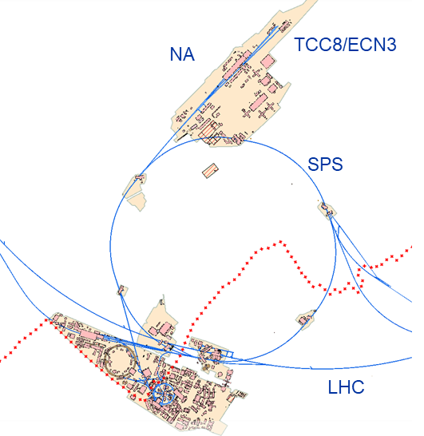
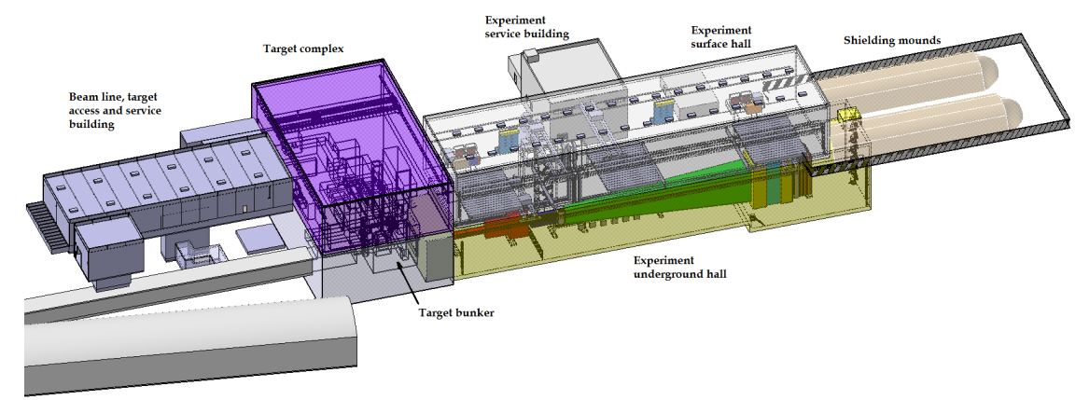
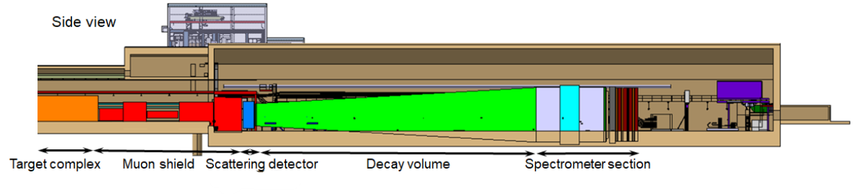
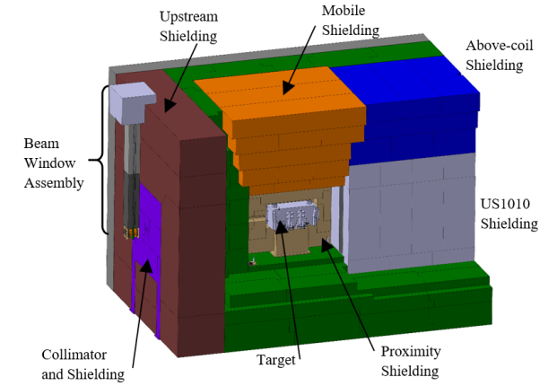
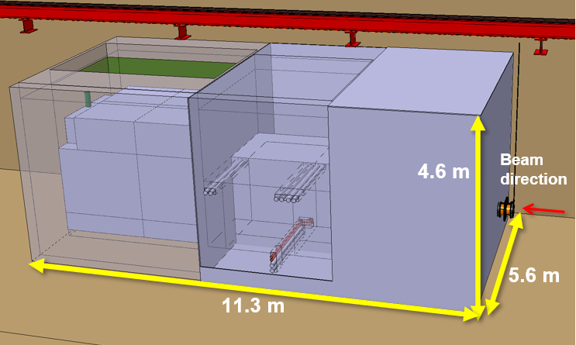
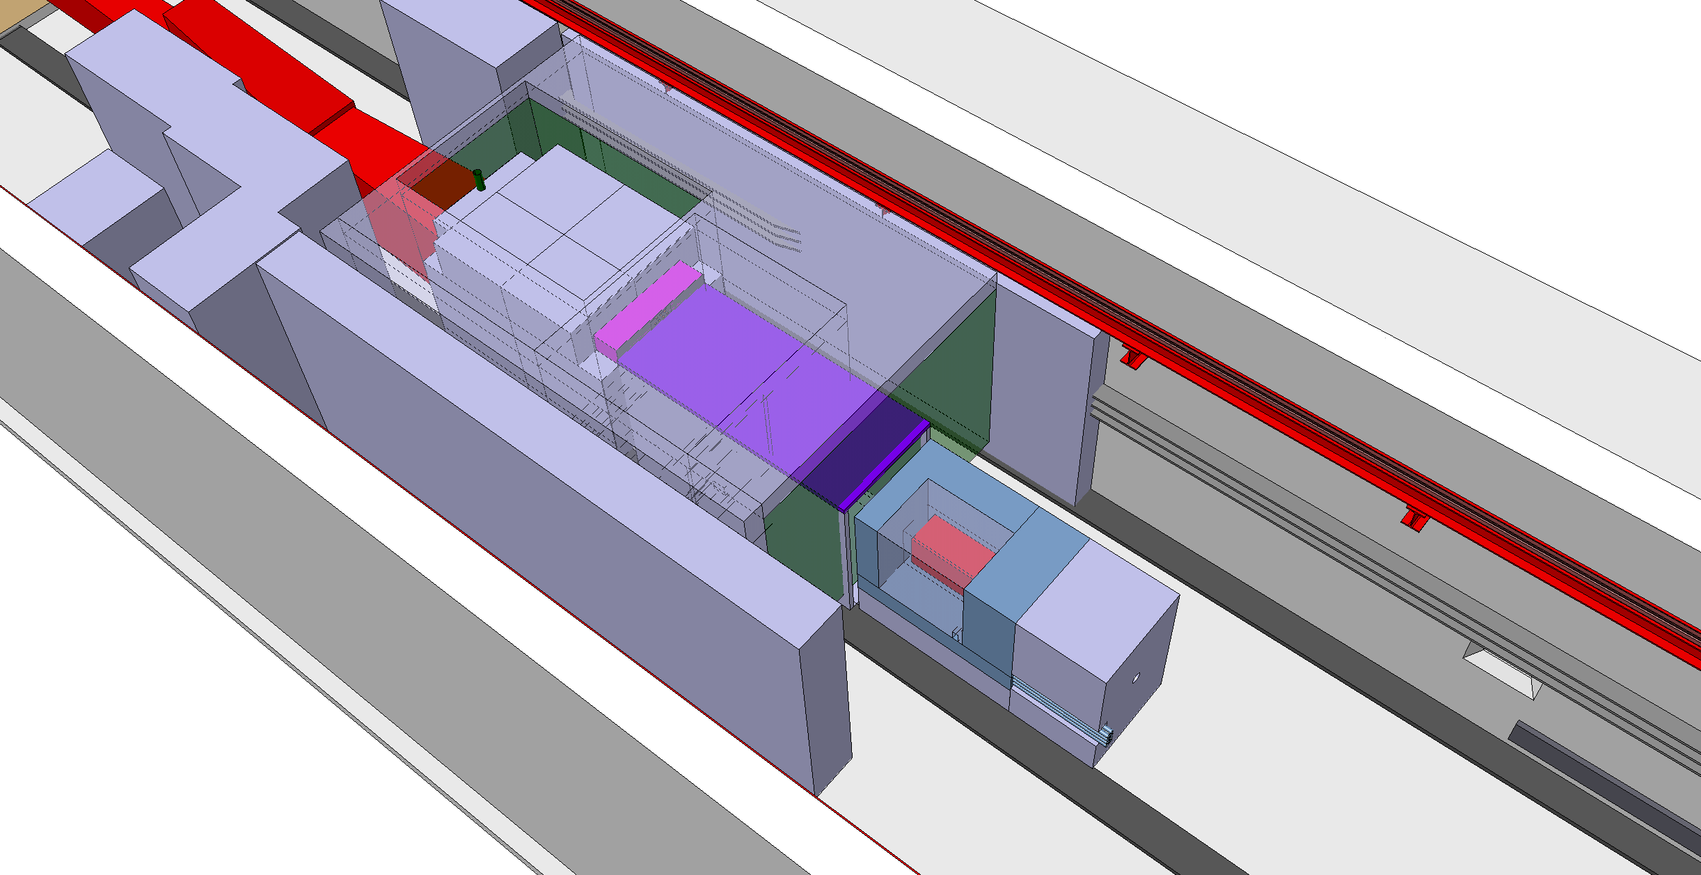
Beam Dump Facility (BDF)
Optimization of the Target station with respect to the CDR version
CDR Target complex
2022/23 ECN3 Target Complex
TCC8/ECN3 Concept of the Target Complex and Experimental Area
Concept of the Target Complex and Experimental Area
N2 Vessel with Target handling from the side
Vacuum vessel with longitudinal target handling with trolley
7.9 m
8.2 m
11.2 m
Target Bunker

Slide 15
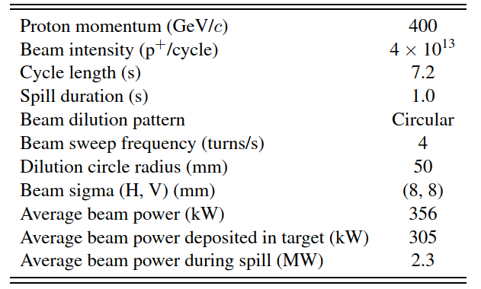
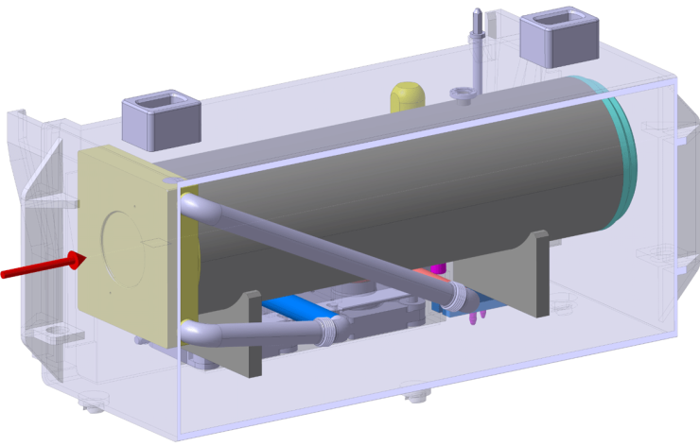
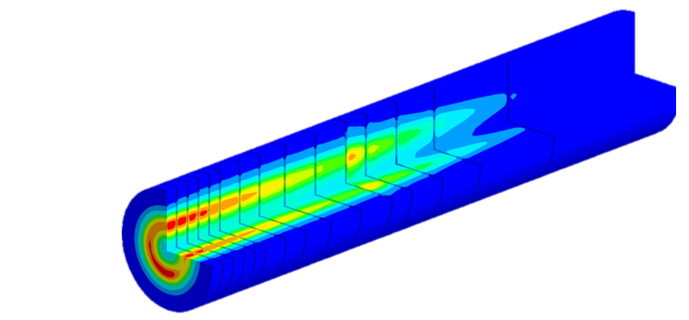
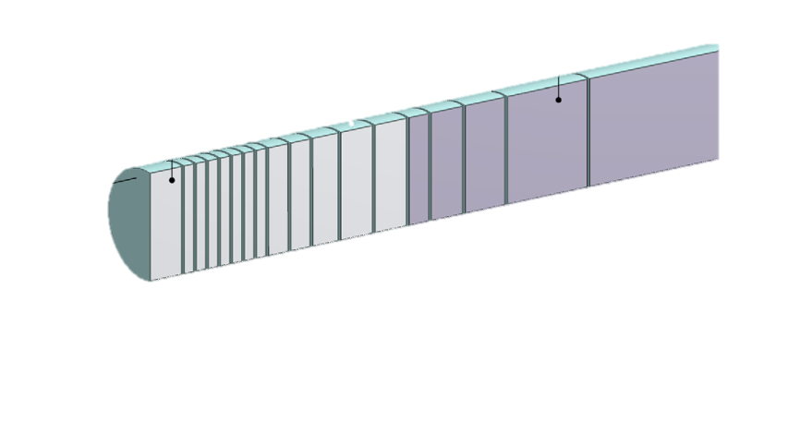
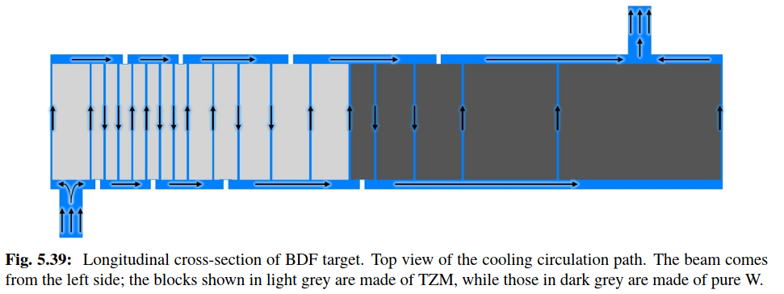
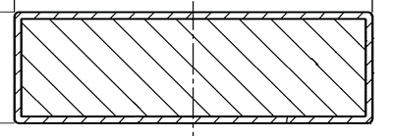
Beam Dump Facility (BDF)
Baseline beam parameters of the BDF Target operation. https://doi.org/10.23731/CYRM-2020-002
High thermal power (300 kW) → cooling needs
High POT → radiation damage
Slow extraction but high spill power density → Quasi-static thermal-induced stresses
TZM & W core Target as reasonable physics & engineering compromise. Ta2.5W HIPed cladding (Baseline design)
~ 4.0×10¹⁹ p⁺/y
⌀250 mm
25-350 mm
BDF Target water cooling layout (20bar, 5m/s)
13 x TZM blocks (580 mm)
5x W blocks (780 mm)
1.5 mm
https://doi.org/10.1103/PhysRevAccelBeams.22.113001
Ta2.5W cladding

Slide 16
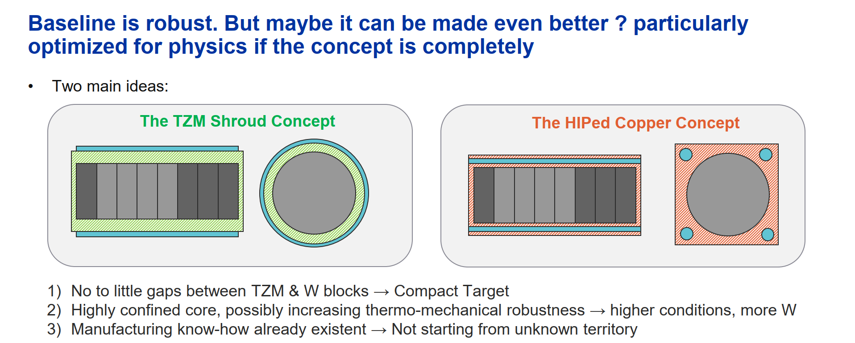
BDF – New ideas to be explored in 2024

Slide 17
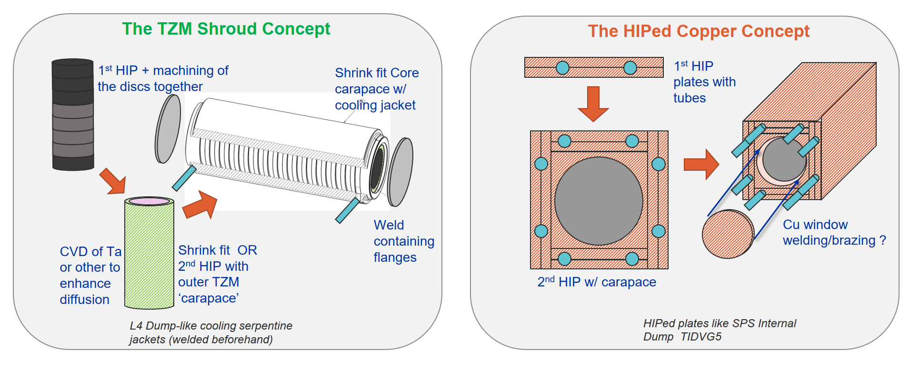
BDF – New ideas to be explored in 2024

Slide 18
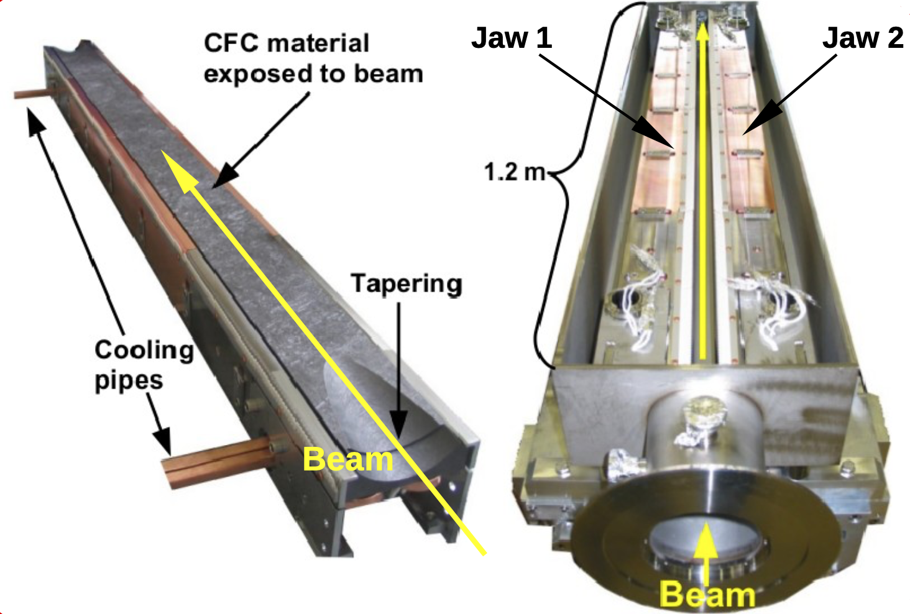
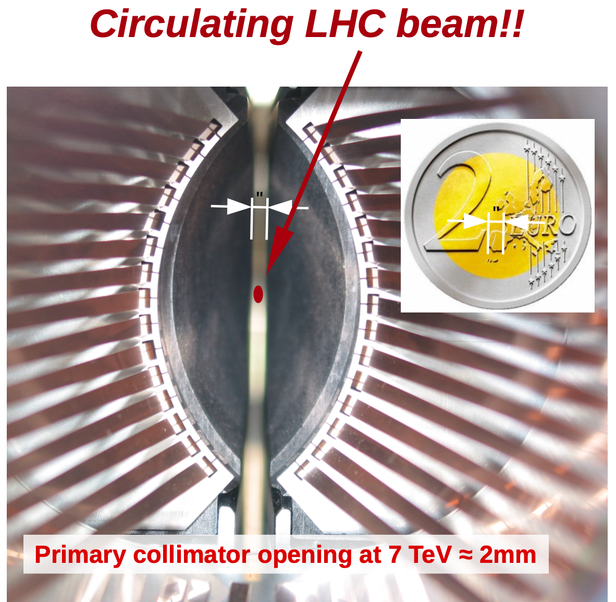
CERN – LHC Collimators
Functions of a collimation system
Quench mitigation for superconducting magnets (mW/cm³!)
Protection against long-term radiation damage to magnets (passive masks)
Concentration of losses/activation in controlled areas
Cleaning physics debris (for colliders)
Optimise background in the experiments
Beam tail/halo scraping, halo diagnostics
Thanks to M. Calviani, F-X. Nuiry and D. Baillard

Slide 19
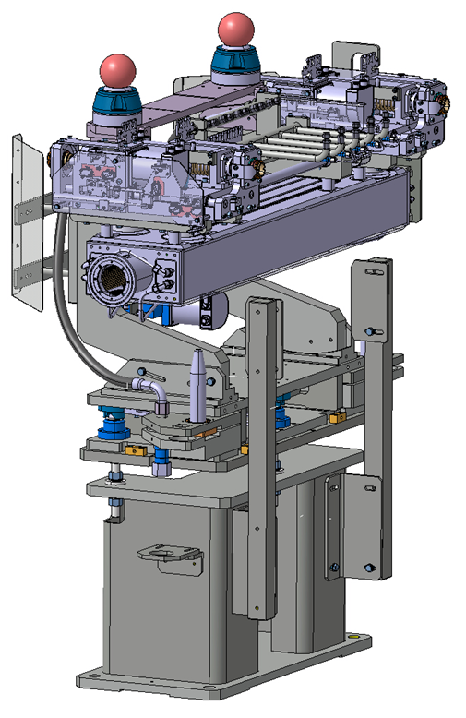
Thanks to M. Calviani, F-X. Nuiry and D. Baillard
Collimator jaws designed (and tested!) to cope with:
10 kW steady losses of 1 hour
Direct beam impact at injection and during asynchronous beam dumps at 7 TeV

Slide 20
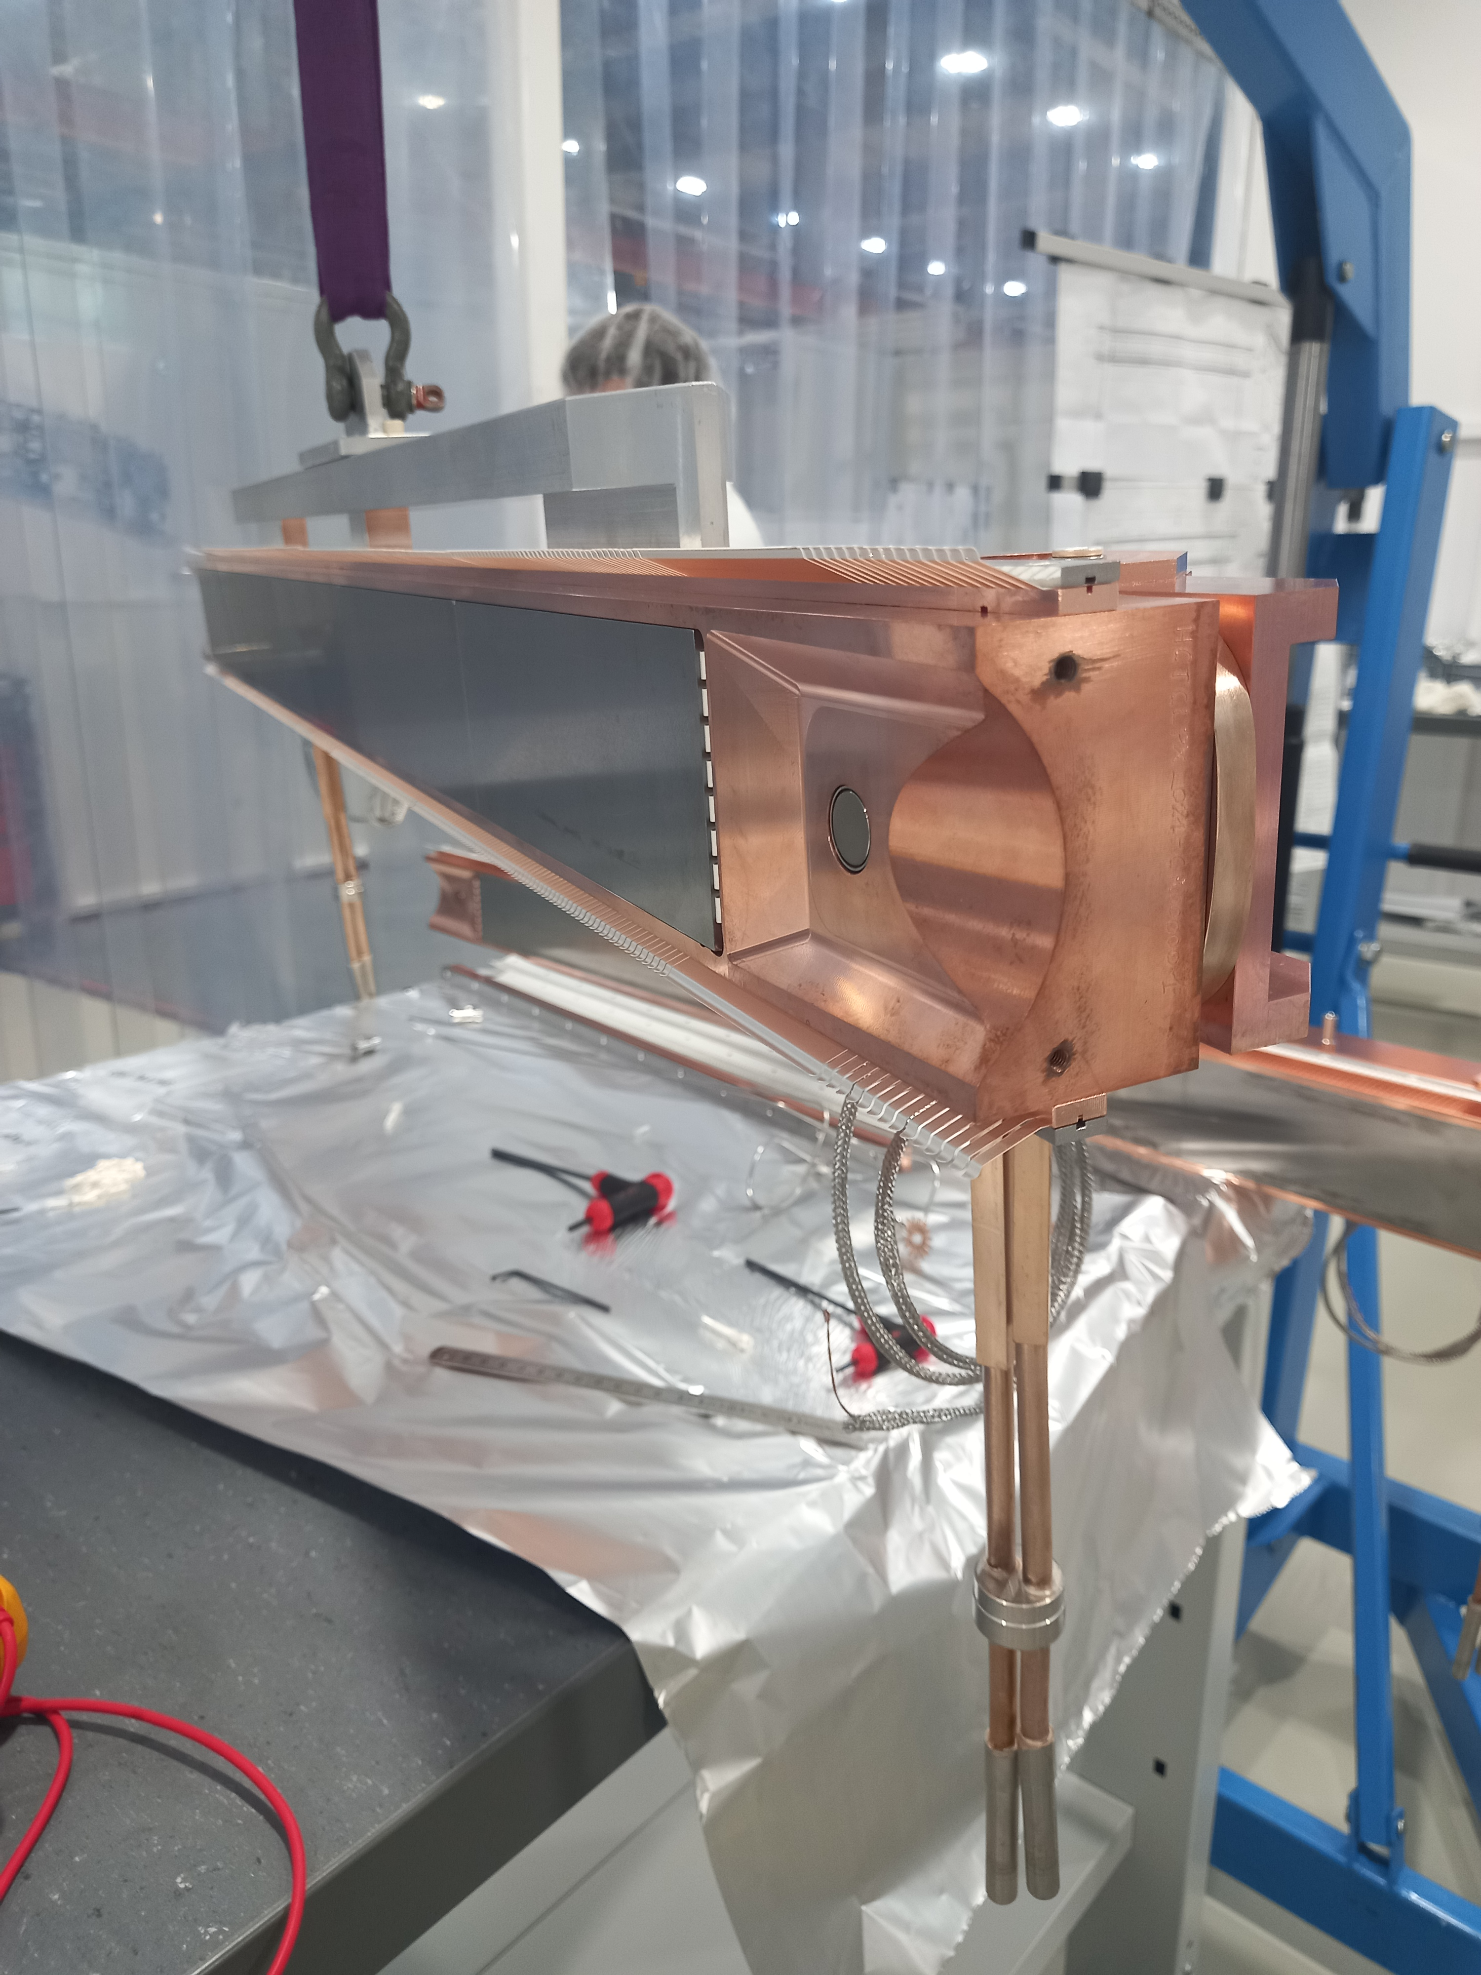
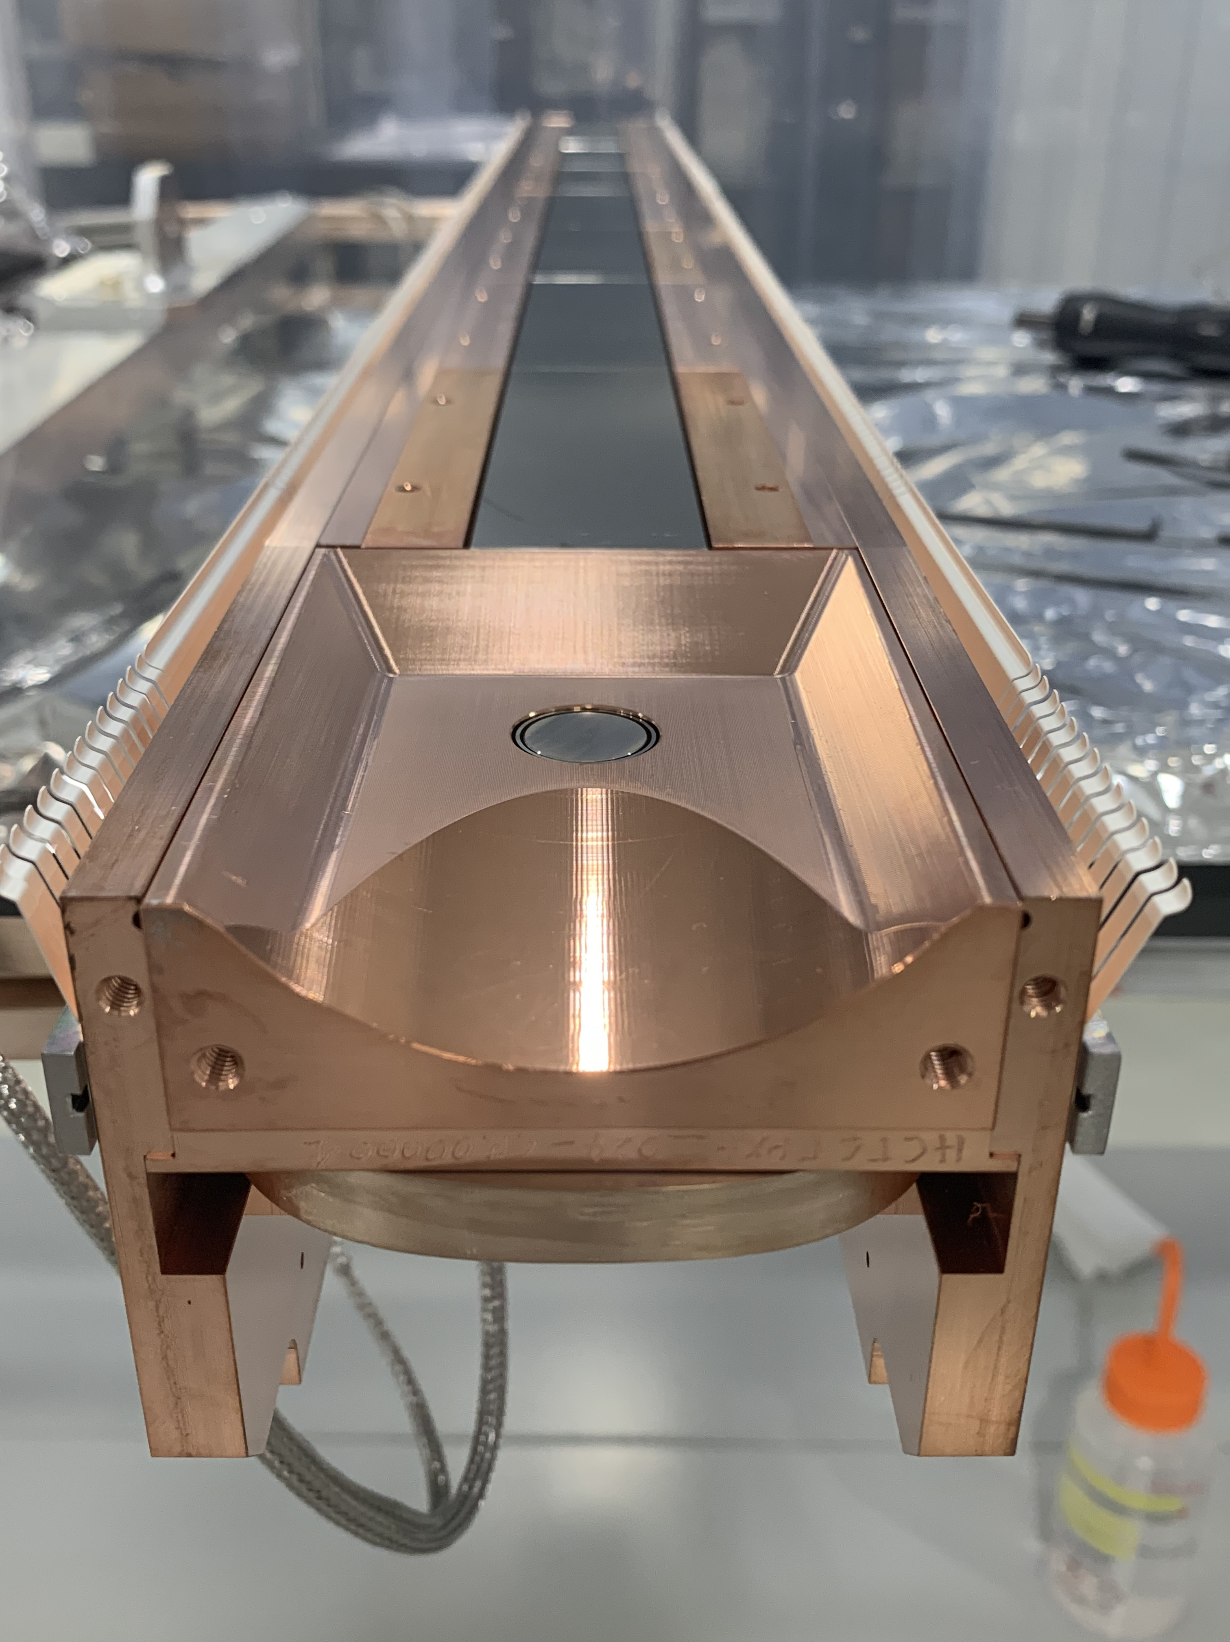
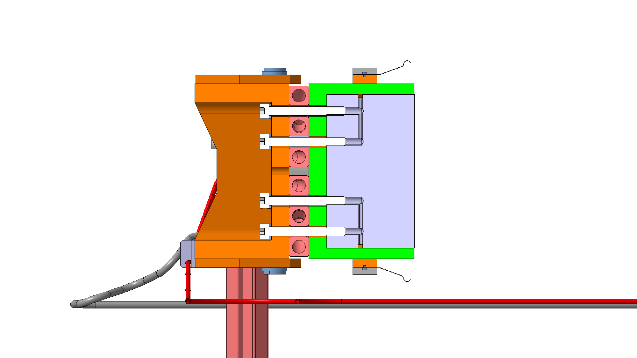
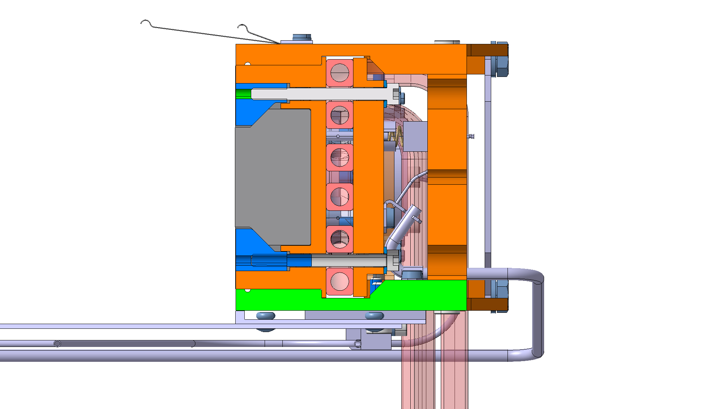
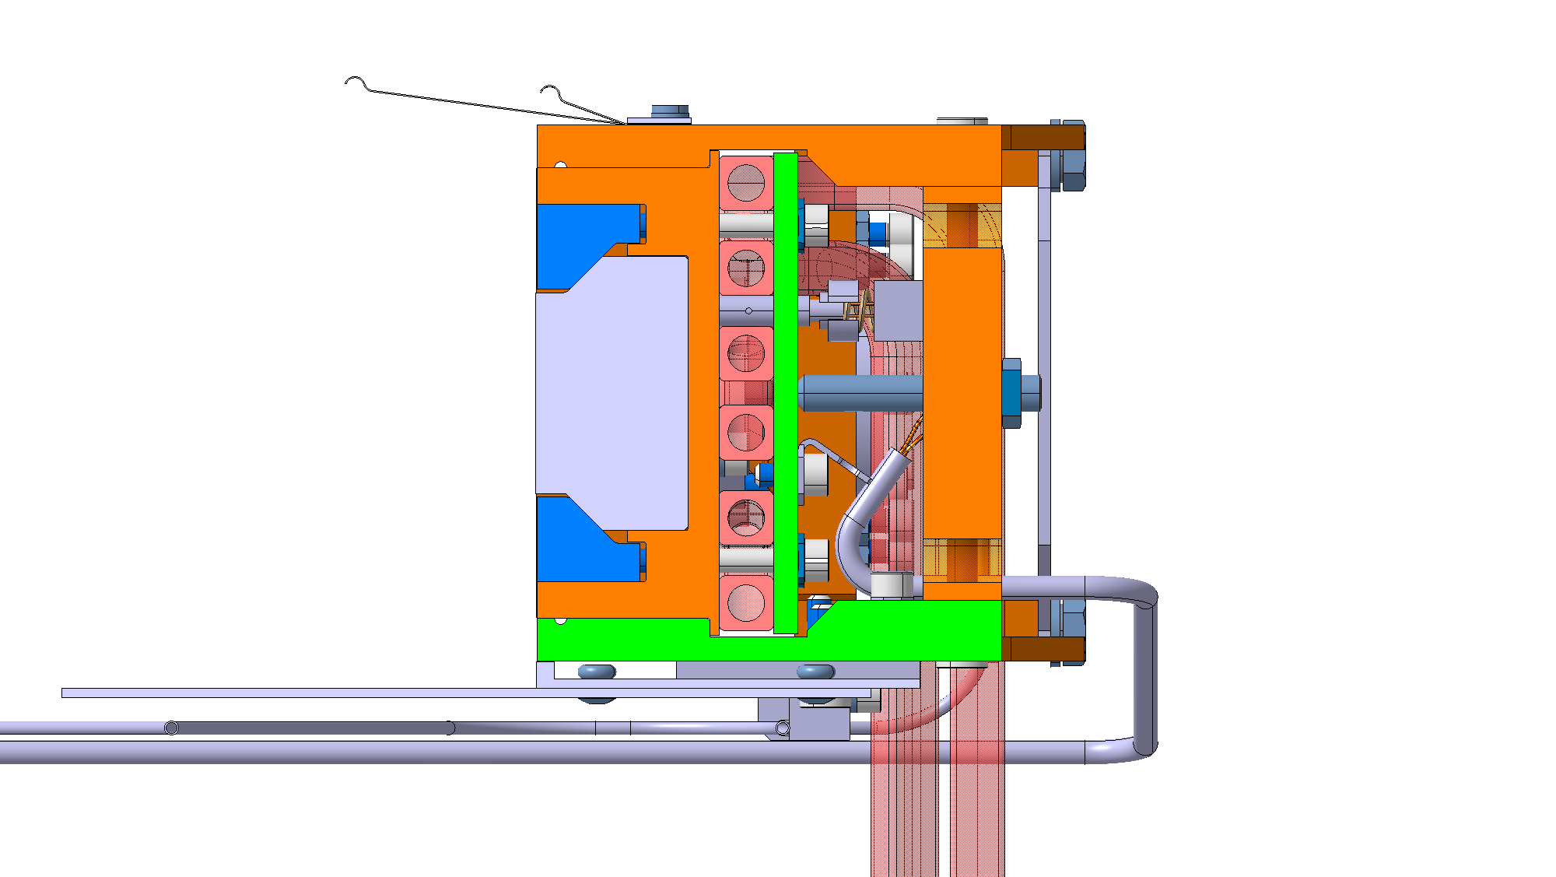
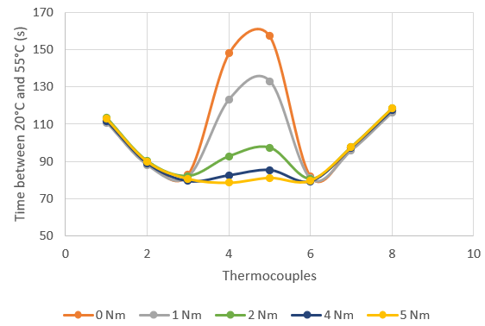
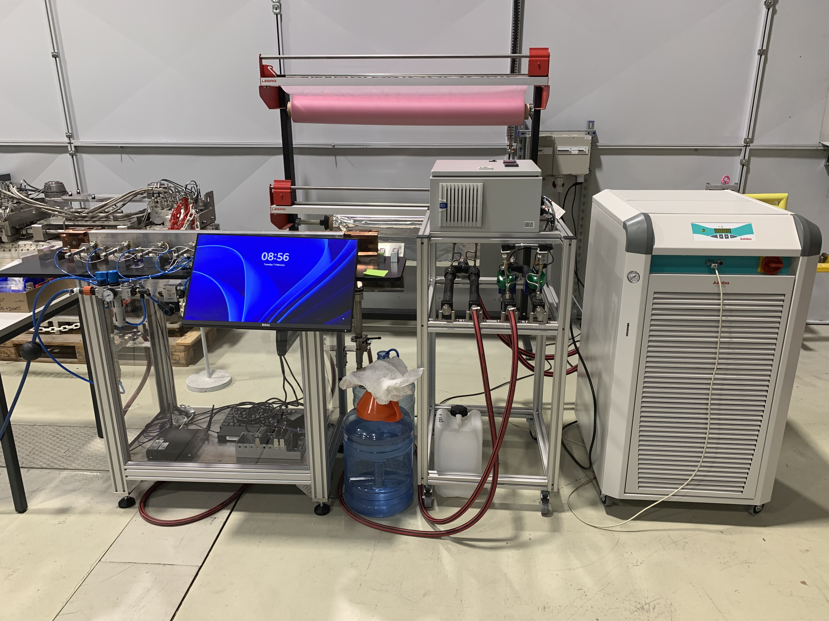
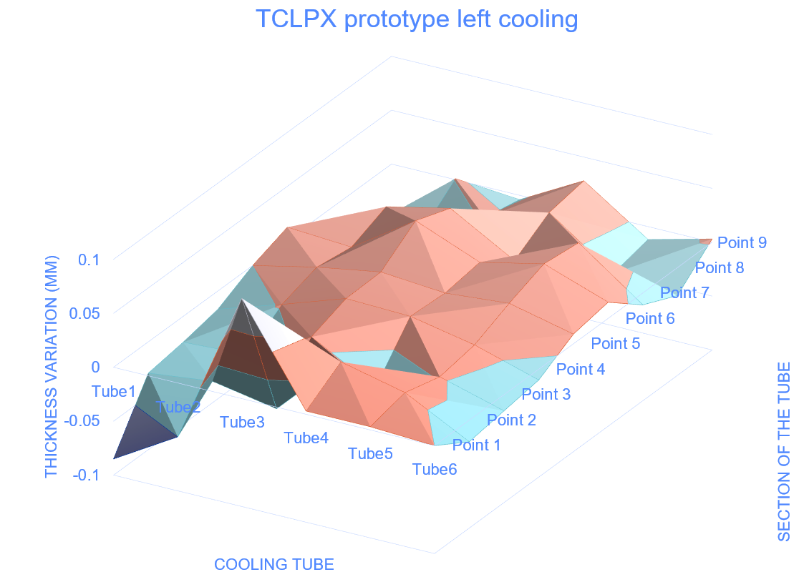
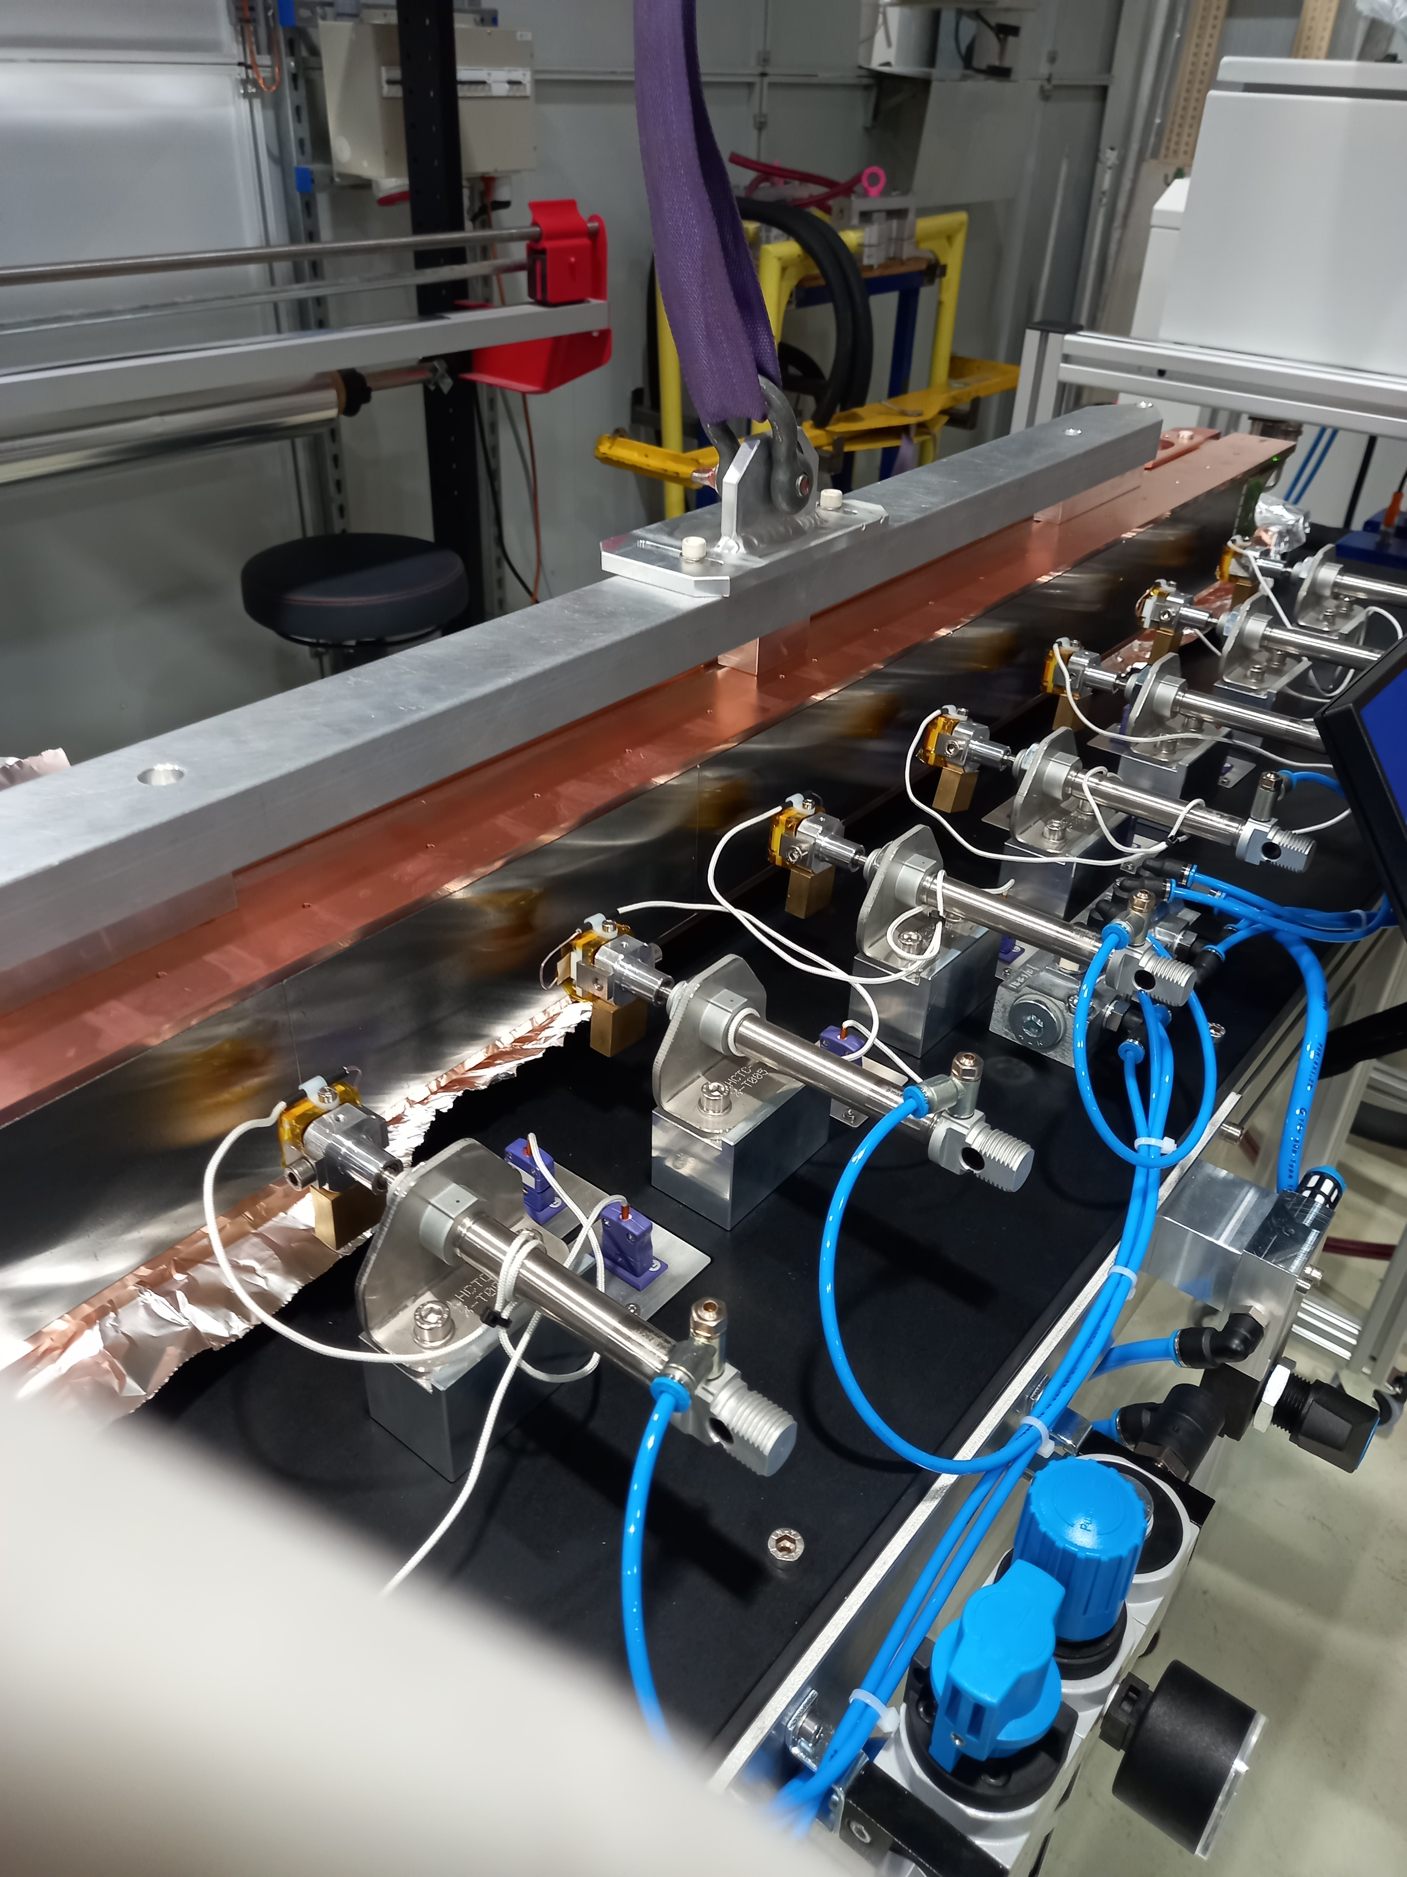
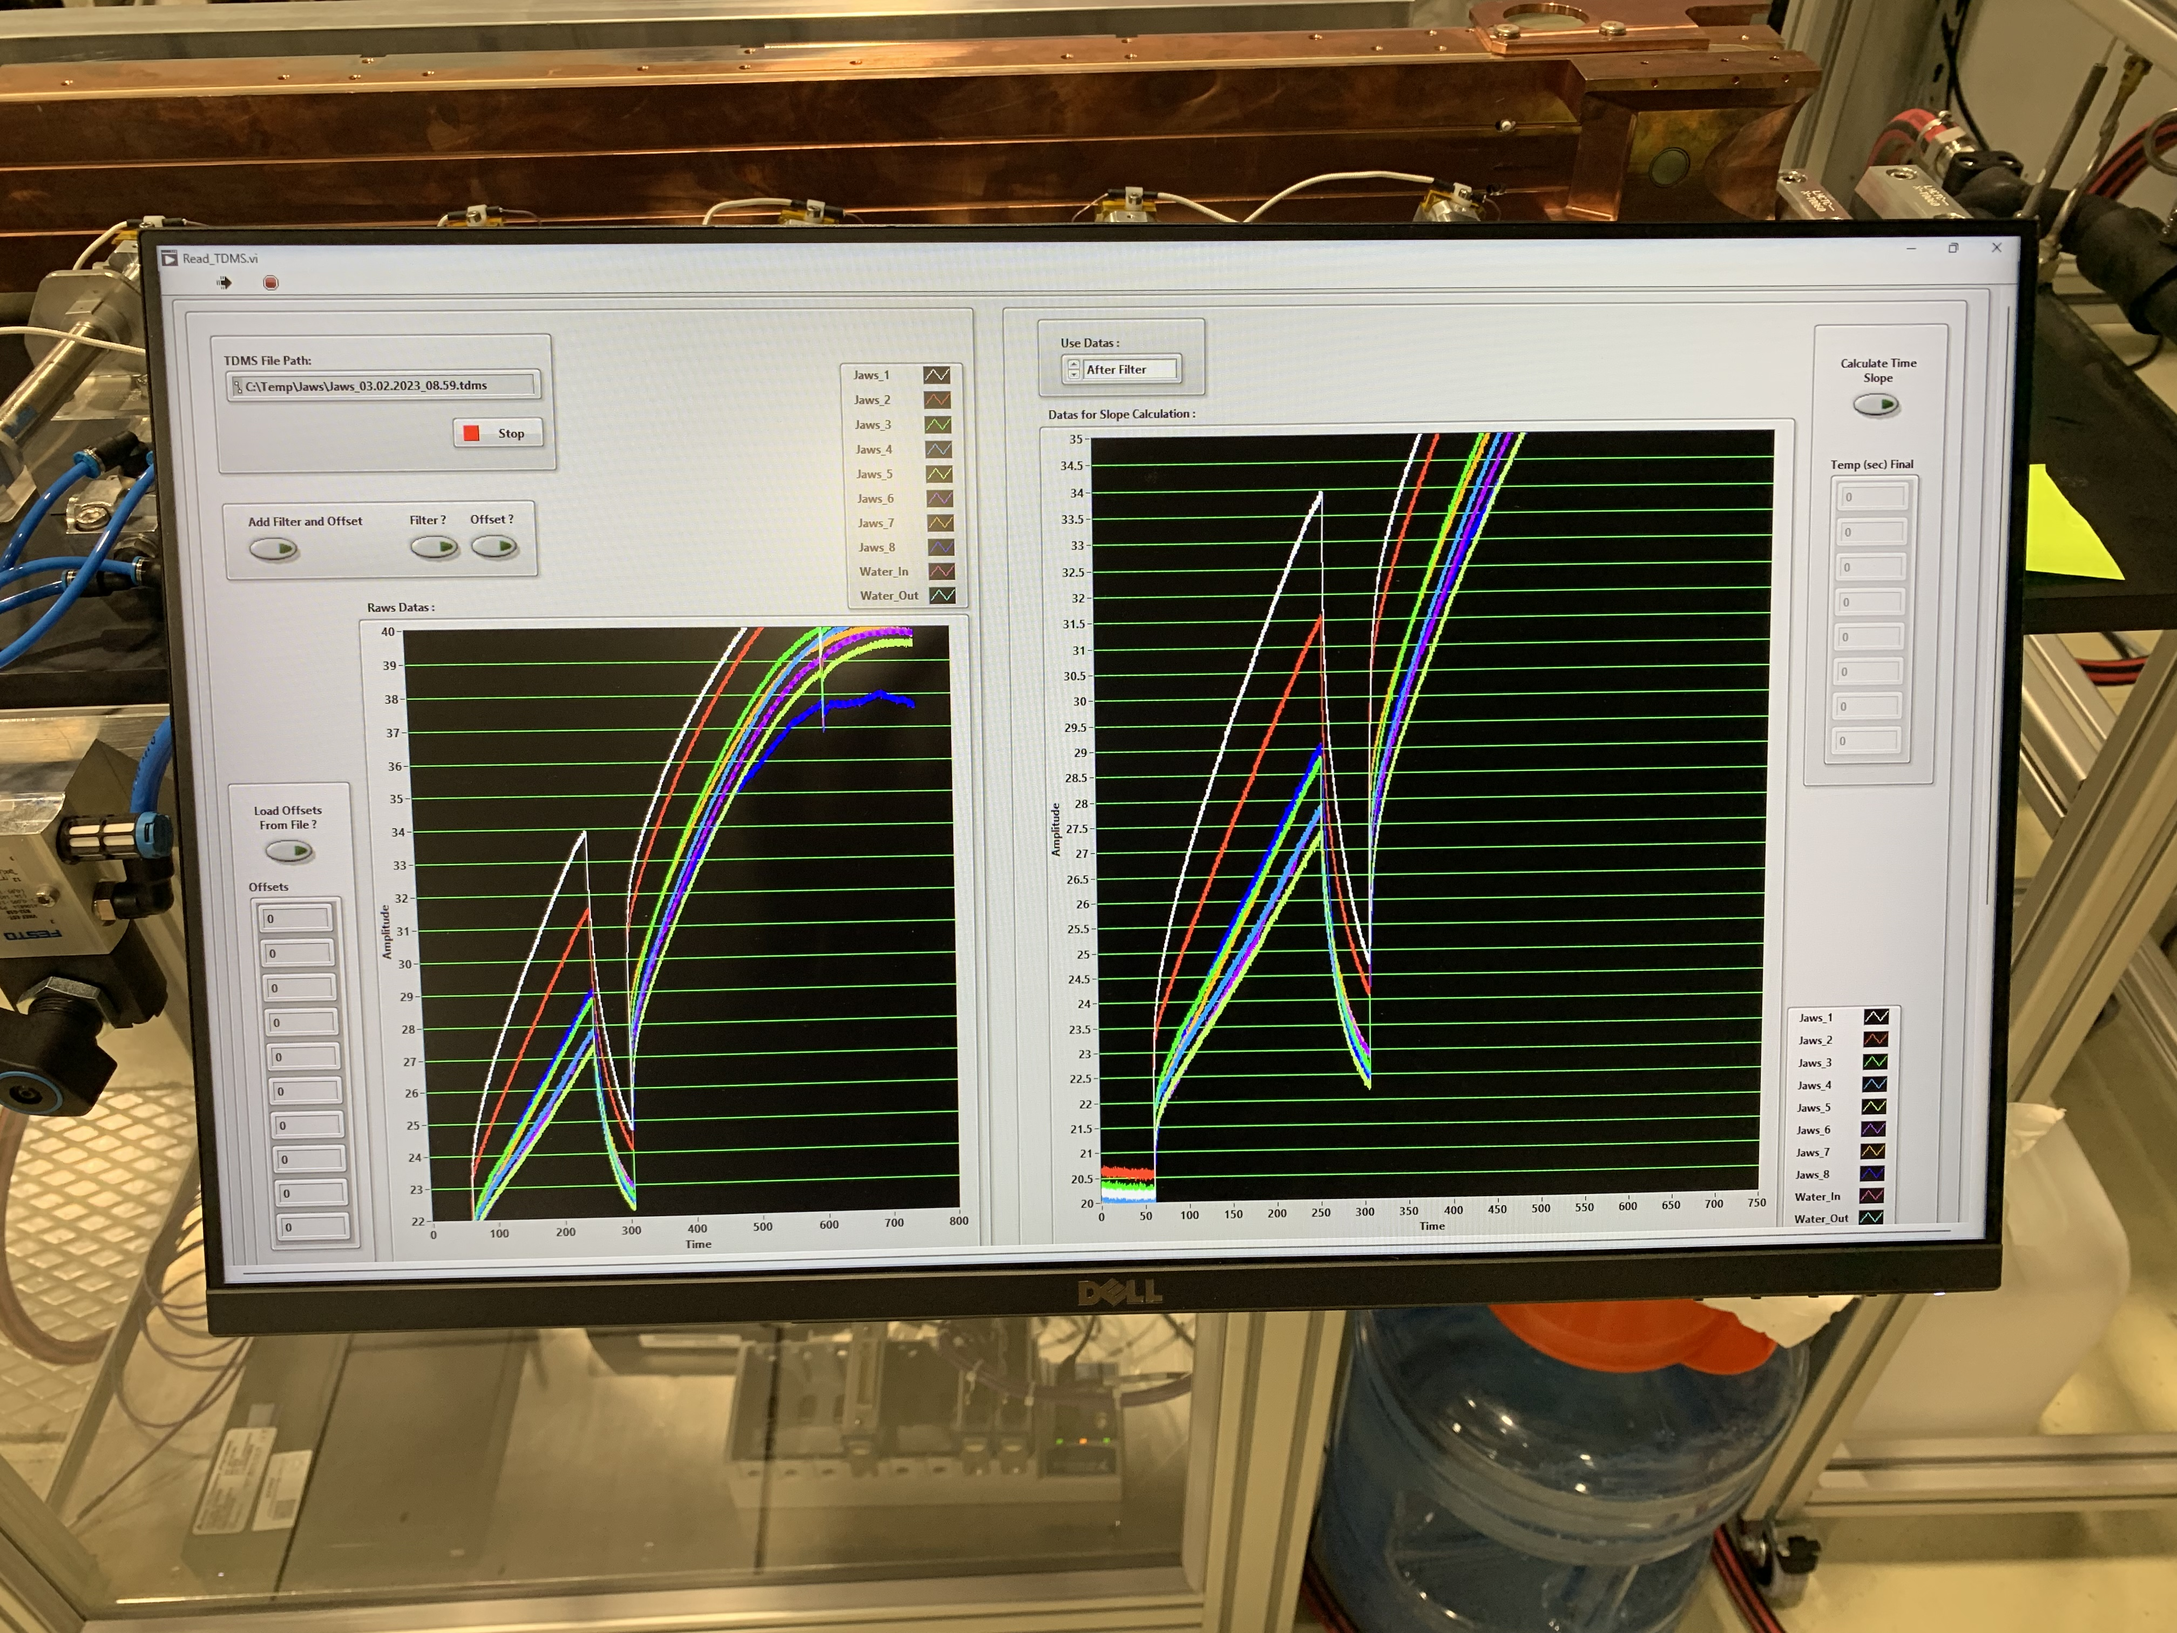
General challenges : Jaw performance
Thanks to M. Calviani, F-X. Nuiry and D. Baillard
Absorbing materials choice
  Find a materials meeting the operation requirements in term of thermal shock resistance
  High conductivity to limit impedance
  Machinability, reproducibility (reliability)
Flatness requirements (a few dozen µm)
  Hard to obtain because of segmented design accumulating tolerances defect
  Geometrical tolerances hard to obtain for certain materials (tungsten alloy)
  Long copper parts and cooling pipes highly flexible wrt required tolerances
Thermal contact conductance
  Good thermal contact conductance required between components. Difficult to quantify.
  Complex testbench to crosscheck simulation and experimental results.

Slide 21
Conclusions
Wide variety of challenges found in BIDs
Material specifications, characterisation, testing, simulations are critical
Instrumentation necessary to understand the behaviour of BIDs (but often a challenge itself)
Efficient cooling is vital for good performance of BIDs
Operation in UHV imposes strong constraints for robust designs
Impedance to be taken into account in some cases
Irradiation damage may be an issue
Manufacturing methods / reliability / fatigue need to be considered

