Slide 1
High power targetry for Accelerator-Driven Systems: challenges and perspectives
AccelApp‘24 Conference, Norfolk, VA
20 March 2024
Franco Di Ciocchis

Slide 2
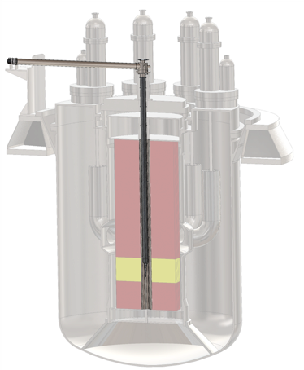
State-of-the-Art Targetry Design for ADS
Proton Beam Window Design and Challenges
Worldwide ADS projects
Research and Development Needs

Slide 3
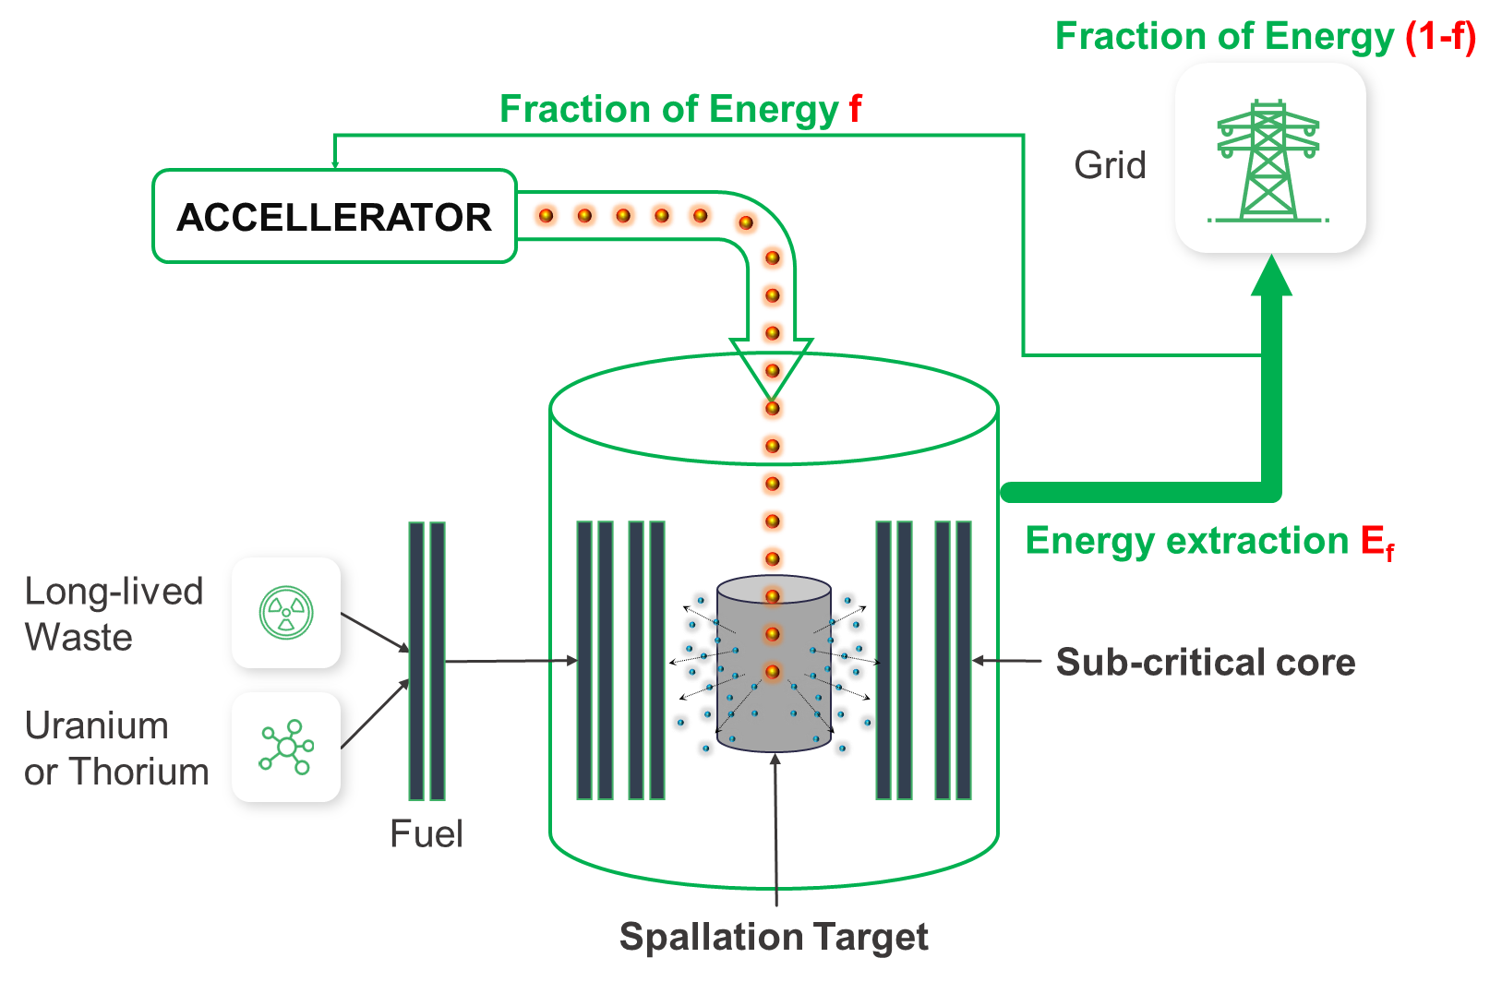
Accelerator-Driven-Subcritical-Reactor (ADSR)
AccelApp’24
  Technical challenges
  Highly reliable multi-MW CW beams
  Durable multi-MW spallation targets
An Accelerator-driven Green Power Plant by Rolland Johnson
https://indico.jlab.org/event/722/contributions/14171/

Slide 4
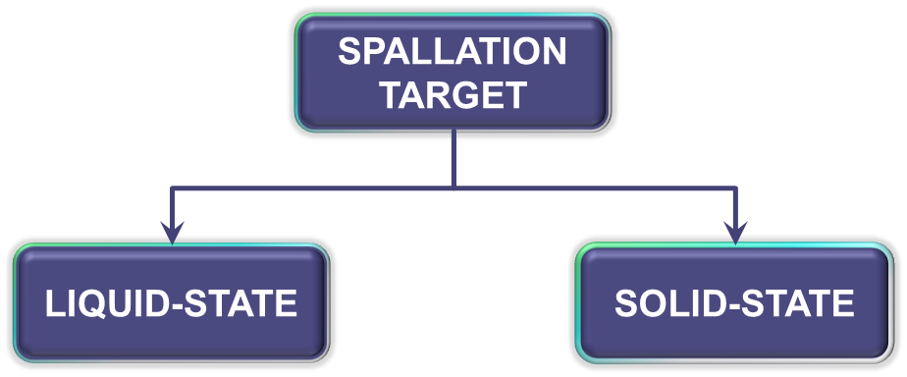
Targetry design for ADS
AccelApp’24
  Numerous interdependent requirements & constraints
  High-level requirements
  Neutron yield, in-core footprint, durability
  Solution-specific constraints
  Temperature range, coolant velocity limit…
  ADS introduces unique integration-related requirements
  Regulatory compliance is a critical constraint, dictating permissible actions and methodologies
  Broad classification
  Prevailing Consensus
Heavy-Liquid-Metal primary reference for Multi-MW spallation targets
Viable up to 1 MW from thermal management point of view

Slide 5
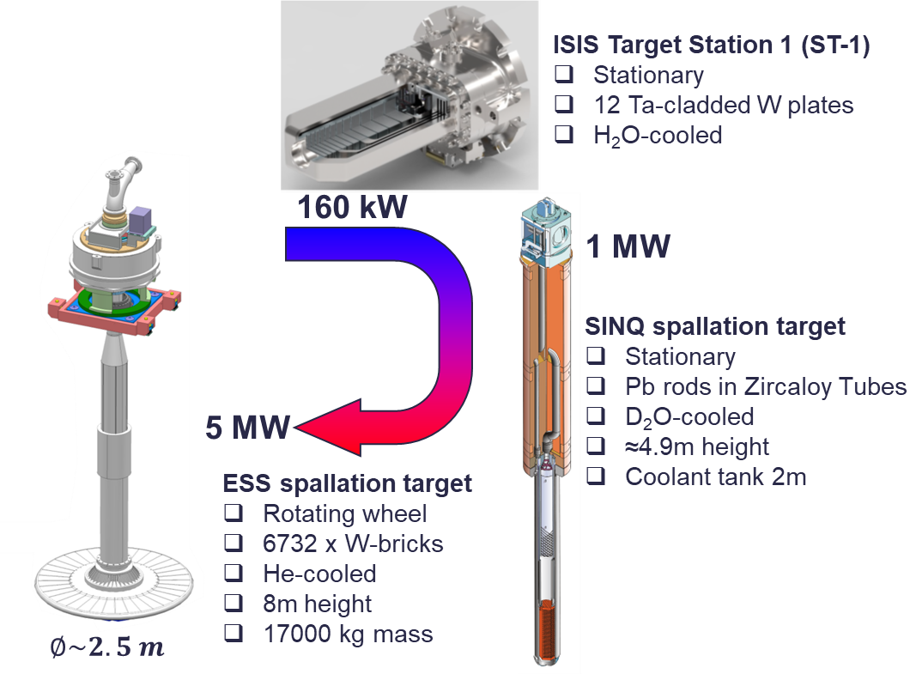
Solid-State Spallation Target
AccelApp’24
  High-Z materials (W, Pb, U…) to maximize neutron yield
  Spallation zone segmentation to distribute beam power
  Either gas (He, Ar, N₂) or liquid (H₂O, D₂O) as coolant
  Multiple proven solutions for kW-class
  ISIS TS-1, ISIS TS-2, LANSCE, CSNS…
Challenges for Multi-MW-class targets in ADS
  Heat removal is the primary challenge
  Large footprint
  Durability

Slide 6
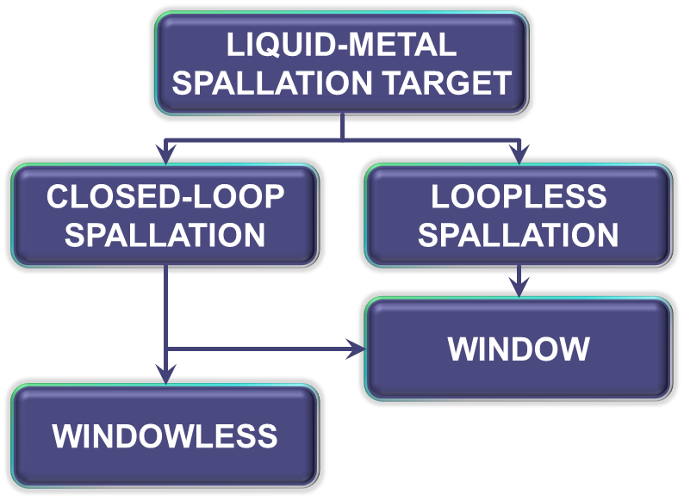
Heavy Liquid-Metal (HLM) Spallation Targets
AccelApp’24
Design solutions for ADS
Advantages
High heat removal capability (several hundreds of kW/L)
High neutron yield
Low neutron capture
Disadvantages
Corrosion, erosion and liquid-metal embrittlement (LME)
Confinement of volatile spallation products
Prior experience in MEGAPIE project
1MW-LBE target successfully operated for 4 months (2006)
Heavy-Liquid-Metal (HLM) is the primary reference for Multi-MW-class Targets in ADS

Slide 7
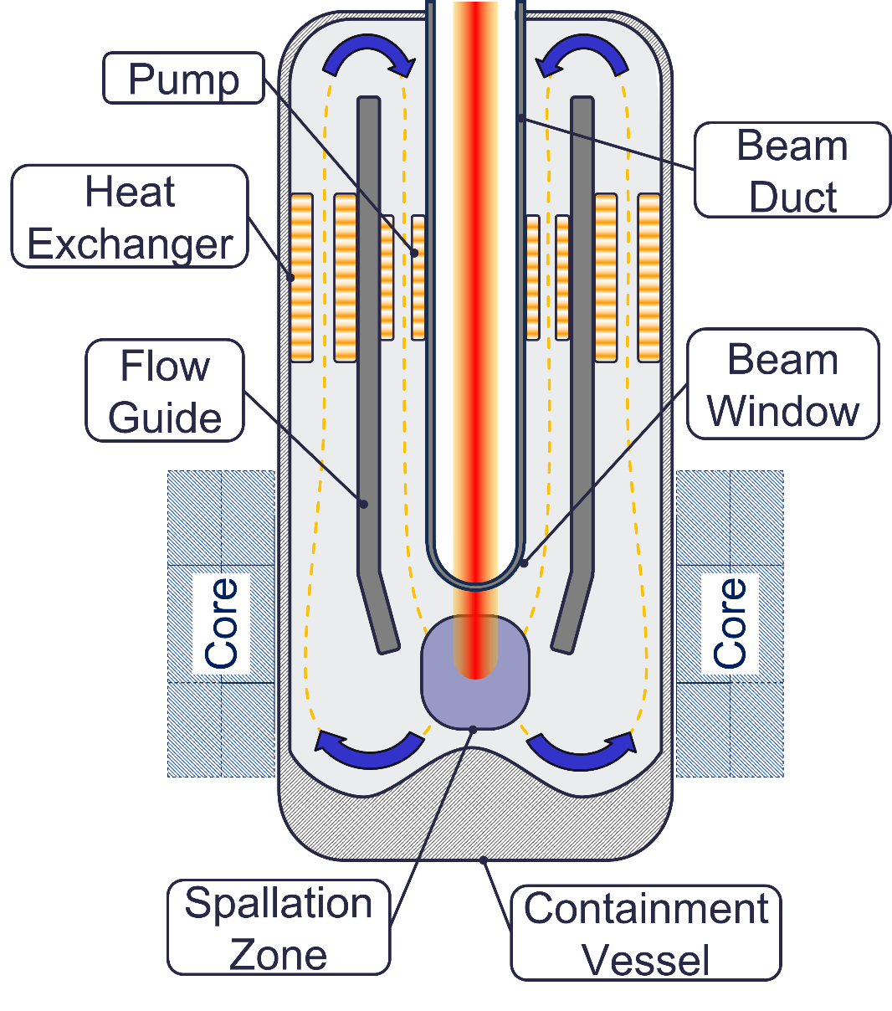
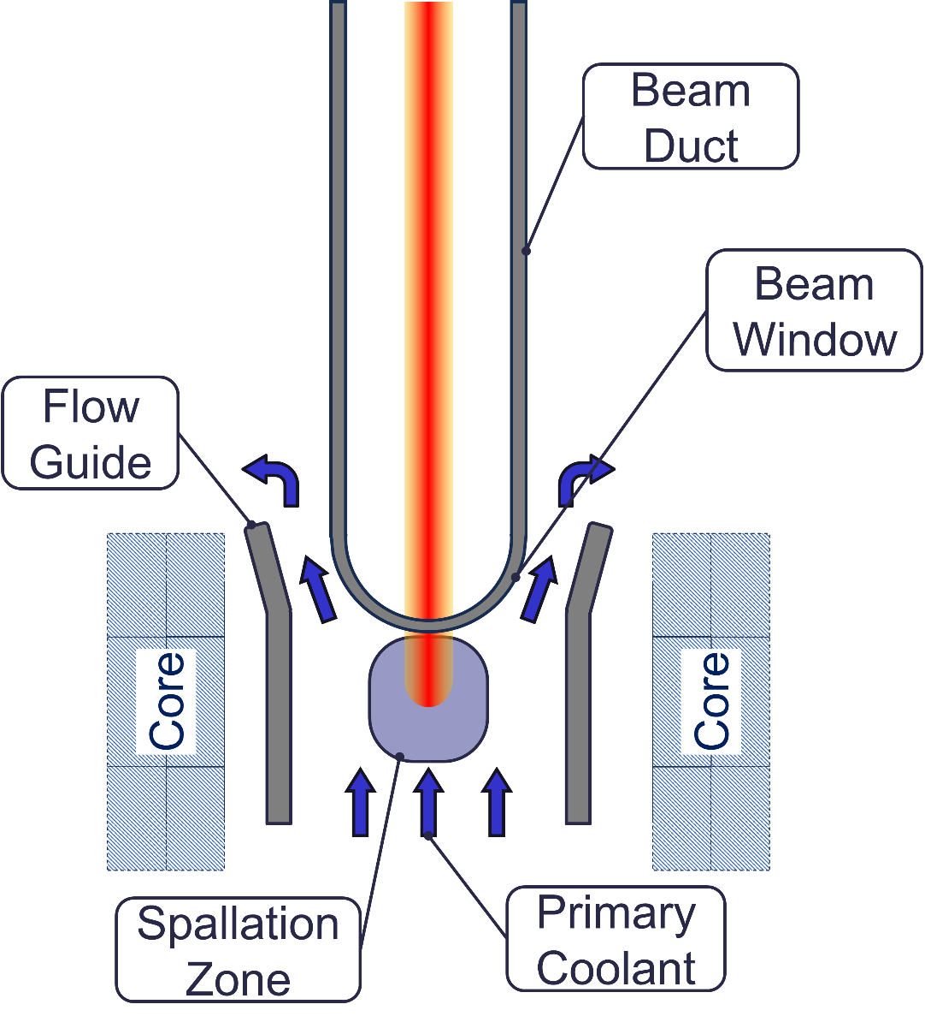
HLM Spallation Targets for ADS: Design Solutions
AccelApp’24
  Closed-loop spallation: target cooling circuit and spallation zone separated from the reactor
  Loopless spallation: reactor coolant directly serves as spallation medium
LOOPLESS SPALLATION
CLOSED-LOOP SPALLATION
Advantages
Minimized in-core footprint
Lower number of elements
Enhanced system coupling
Advantages
  Larger Operational Flexibility
  Easier replaceability
  Multiple-barrier concept
LIQUID SPALLATION TARGET
Disadvantages
Limited Operational Flexibility
  Primary coolant contamination
  Disadvantages
  Greater number of elements
  Larger in-core footprint

Slide 8
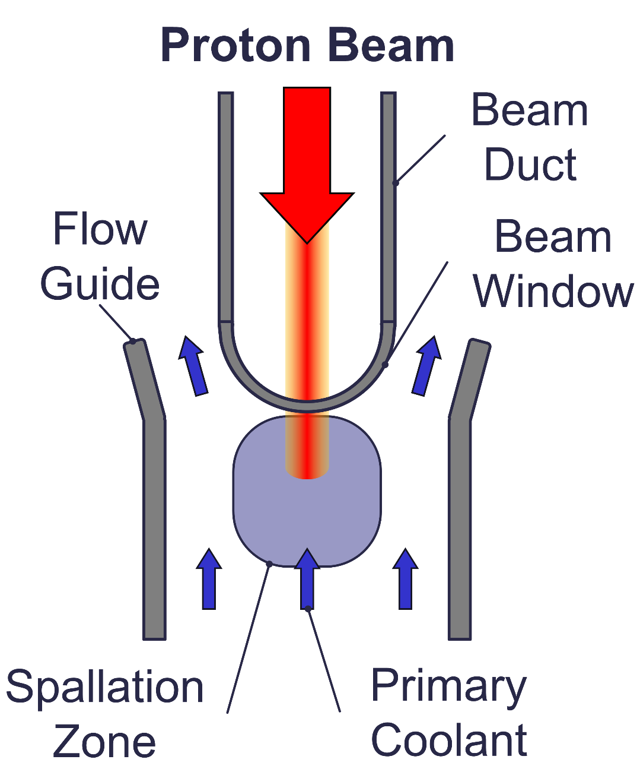
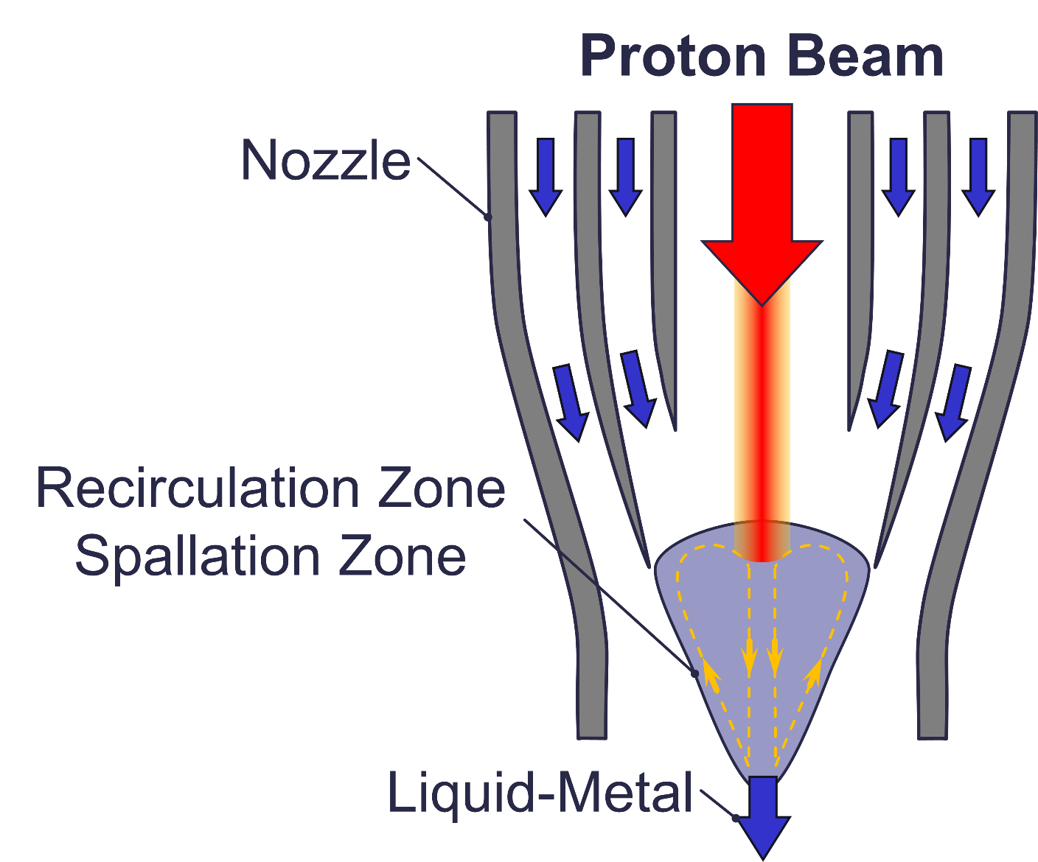
Closed-Loop spallation target: Design Configurations
AccelApp’24
  Window: beam hits first a metal interface separating beam vacuum from spallation zone
  Windowless: beam directly hits liquid metal without separation from vacuum and spallation zone
WINDOWLESS CONFIGURATION
WINDOW CONFIGURATION
Advantages
  High power densities
  Reduced risk of structural failures
Advantages
  Spallation products confinement
  Enhanced safety
Disadvantages
  Free-surface instability
  Potential violation of the defence-in-depth principle
Disadvantages
  Window heat removal
  Risk of structural failure

Slide 9
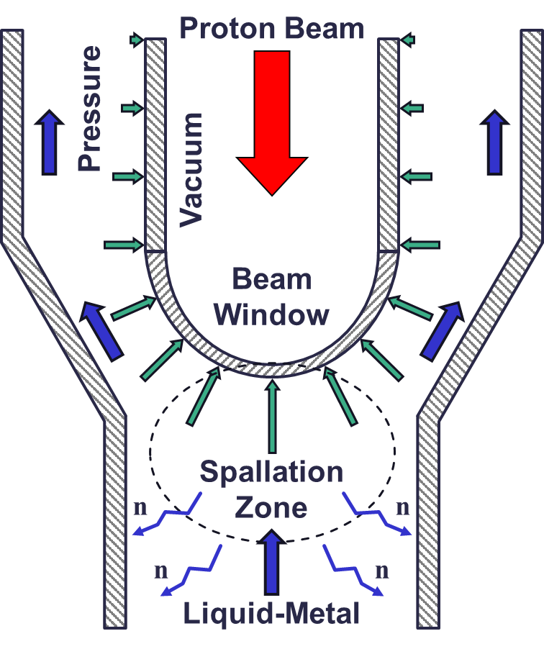
Beam Window (BW) in ADS applications
AccelApp’24
The Window is the configuration of reference for MW-class liquid-metal spallation target
High power densities in BW lattice (several MW/m³)
BW is subjected to severe conditions
  Aggressive liquid-metal coolant environment
  High operating temperature
  Static and cyclic thermal-mechanical stresses
  Irradiation-induced damage
  Durability is the main high-level requirements
The BW is undoubtedly the weakest element of the liquid-state spallation target!

Slide 10
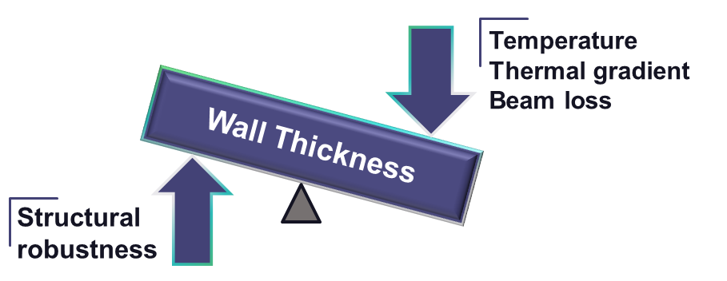
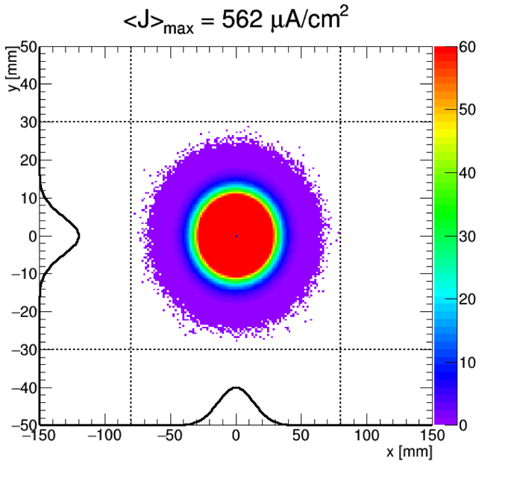
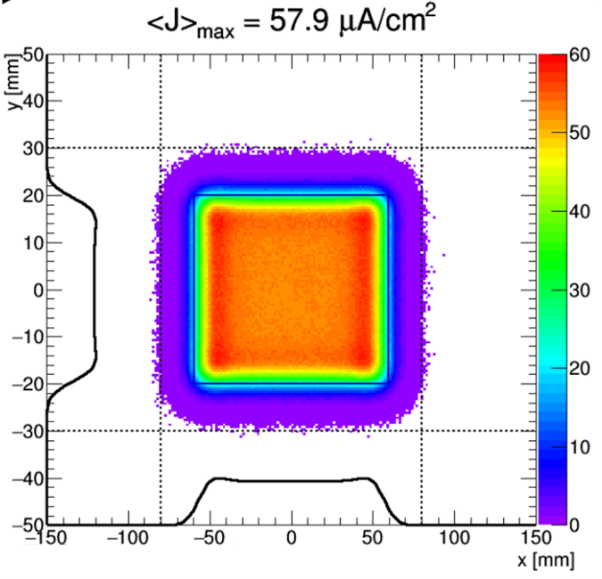


Beam Window Design
AccelApp’24
Geometry
Hemispherical-type geometry commonly adopted
Thickness determined through trade-off analysis
  Limit operating temperature/thermal gradient/beam losses
  Provide adequate structural stability
  Desing Optimization
  Multi-objective optimization by varying
    Shape & thickness
    Beam profile (gaussian, parabolic, sweeping/rastering)
$562 μA/{cm}^{2}$
$57.9 μA/{cm}^{2}$
Nominal (Gaussian)
Rastering
H. D. Thomsen et al., “The Beam Raster System of the European Spallation Source”
https://indico.cern.ch/event/509528/contributions/2270865/attachments/1330030/1998322/2016_09_01_Thomsen.pdf

Slide 11
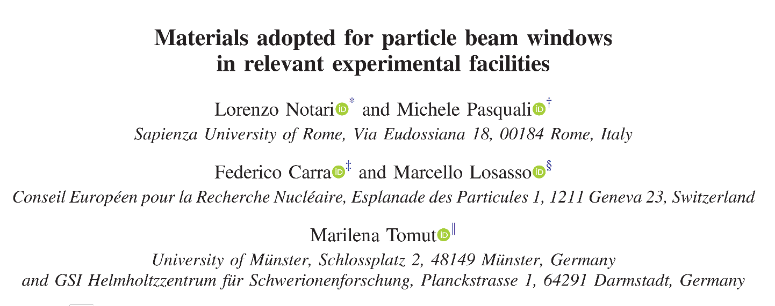

Beam Window Material
AccelApp’24
  Vast range of materials: Stainless Steel, Beryllium, Titanium, Aluminium…
  In ADS applications the candidate list is restricted
  Unknown susceptibility to liquid-metal environment
  Scarcity of data in irradiated conditions (especially at high DPA ranges)
  Not qualified in nuclear standards
T91 steel is the primary choice for LBE applications
  Already qualified in nuclear standards
  Extensively tested in LBE
  High-temperature strength
  But…
https://journals.aps.org/prab/pdf/10.1103/PhysRevAccelBeams.27.024801
SUB-CRITICAL REACTOR
Set of desirable properties
  Low atomic number
  High Thermal Conductivity
  Low Thermal Expansion Coefficient
  High melting temperature
  High-temperature strength
  Corrosion resistance
  Radiation tolerant
T91 is susceptible to liquid-metal embrittlement

Slide 12
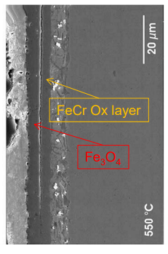
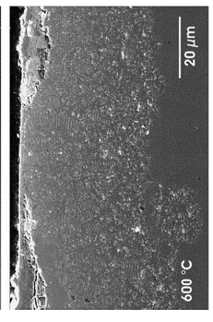
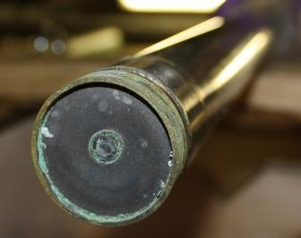
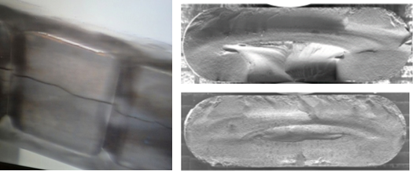
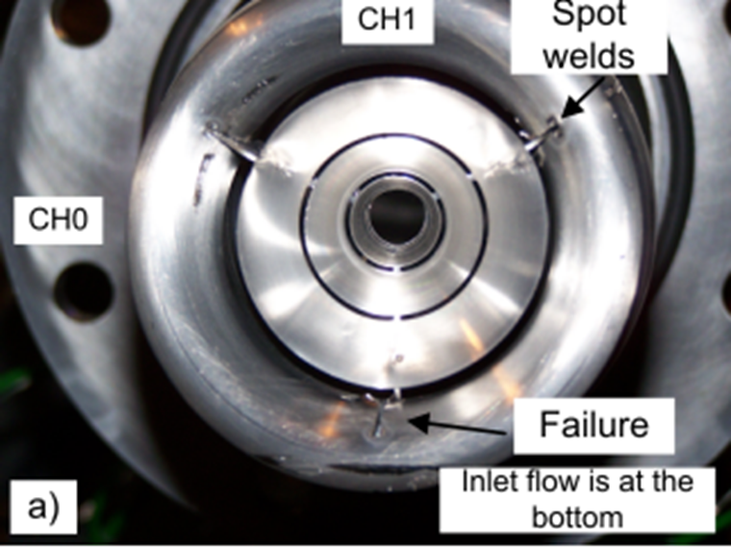
Beam Window Durability Challenges
AccelApp’24
Corrosion of 15-15 Ti in Pb
Liquid-metal damage
Corrosion/Erosion
Liquid-metal embrittlement (LME)
Cavitation-induced erosion damage
Radiation-induced damage
Embrittlement: loss of material ductility
Swelling: volume expansion
Irradiation Creep
Reduction of thermal conductivity
Gas production (mainly He and H)
Fatigue-induced Damage
Thermal fatigue
Mechanical fatigue (flow-induced vibration)
Courtesy of EU GEMMA Project
Be window embrittlement
MINOS NT-02 target failure due to swelling
Novel Materials R&D for Next-Generation Accelerator Target Facilities, K. Ammigan, HPTW2023
Flow-Induced Vibration Fatigue in METEX1 (Eurisol Project)

Slide 13
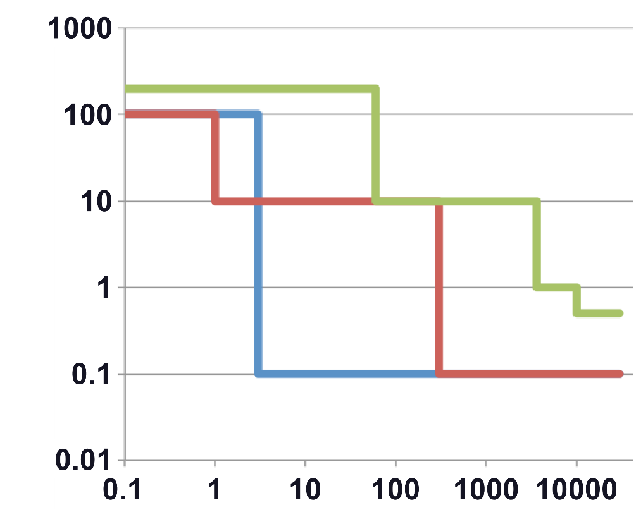
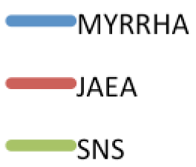
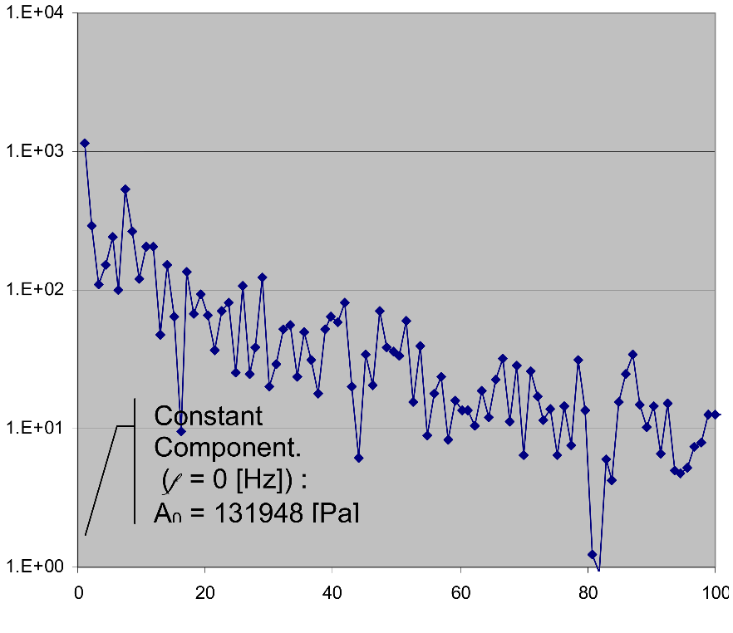
Beam Window: Fatigue induced damage
AccelApp’24
Beam Trip Frequencies for different ADS projects
D. Vandeplassche, et al, “Accelerator Driven Systems”, in IPAC2014, 20-25 May 2012
Thermal Fatigue
Caused by beam interruptions (beam trips)
  Reliability-oriented accelerator design is essential
Stress amplitude influenced by
  Beam trip duration
  PBW design (thickness/size) and its material (heat capacity)
Mechanical Fatigue
Arise from flow-induced vibrations
  LES model may help capturing flow instabilities
  Proper mechanical design can mitigate/alleviate this effect
Trips/day
Trip duration [s]
Point 42 – Discrete Fourier Transform
Amplitude [Pa]
Frequency [Hz]
METEX1 (MErcury Target EXperiment 1)

Slide 14
ADS projects in the world (not exhaustive)
AccelApp’24
 |  | ACCELERATOR |  |  |  | SUB-CRITICAL CORE
Project Name | Location | Type | Operation Mode | Energy [GeV] | Current [mA] | Primary Coolant | Power [MW_{th}] | Project scope | Status
CiADS | China | LINAC | CW/Pulse | 0.5 | 5 | Pb-Bi | 7.5 | ADS demo | Construction
MYRRHA | Belgium | LINAC | CW | 0.6 | 4 | Pb-Bi | 70 | ADS demo | Construction
TRANSMUTEX | Switzerland (Company) | Cyclotron | CW | 0.8 | 5 | Pb | 600 | Commercial | Design
JAEA-ADS | Japan | LINAC | CW | 1.5 | 20 | Pb-Bi | 800 | Waste Transmutation | Design

Slide 15
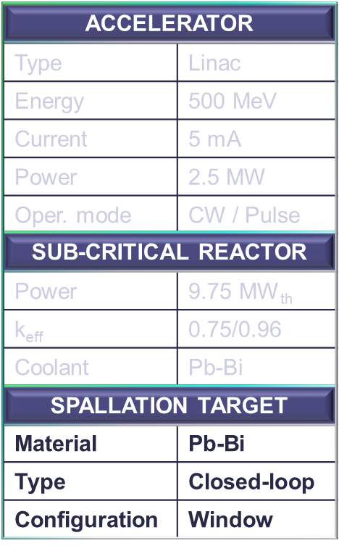

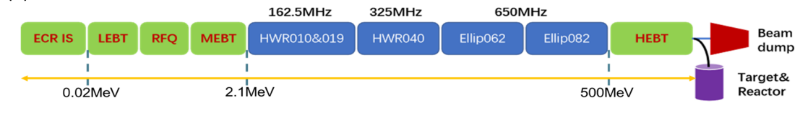
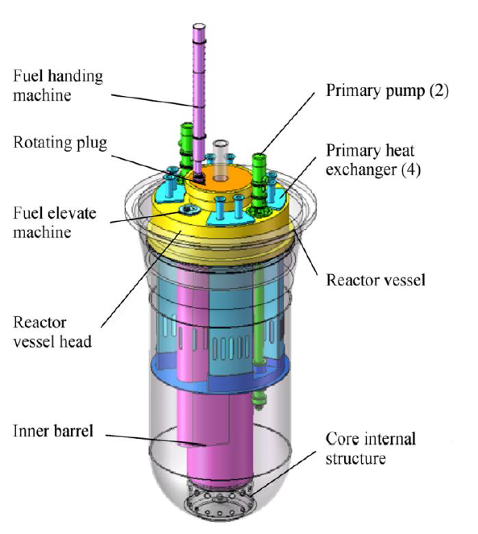
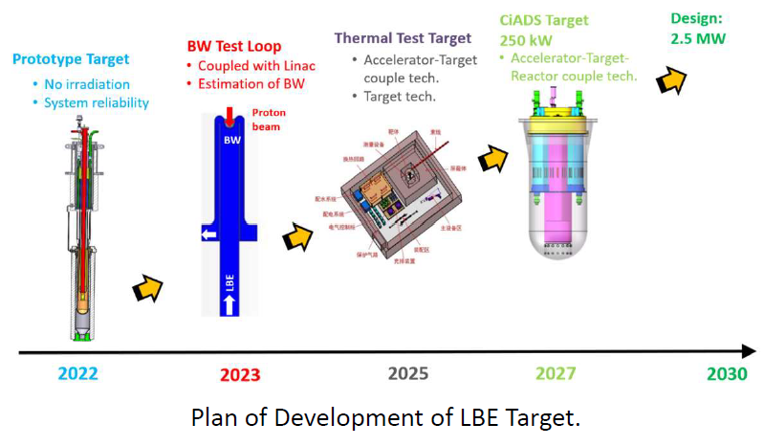
CiADS – ADS: General Overview
AccelApp’24
China initiative Accelerator Driven System (CiADS) will be located in Huizhou, China
CiADS Linac layout
CiADS Sub-Critical Reactor
RoadMap for LBE Target development

Slide 16
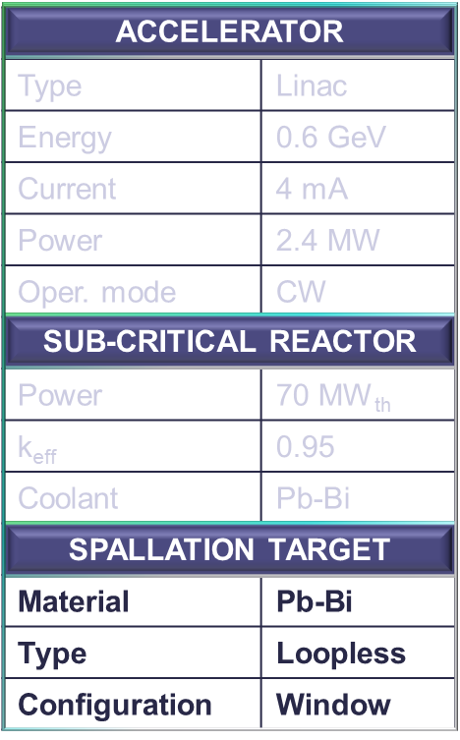

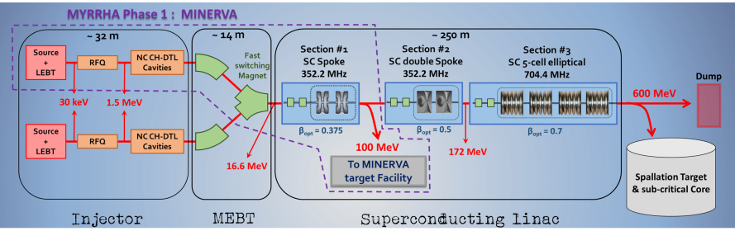
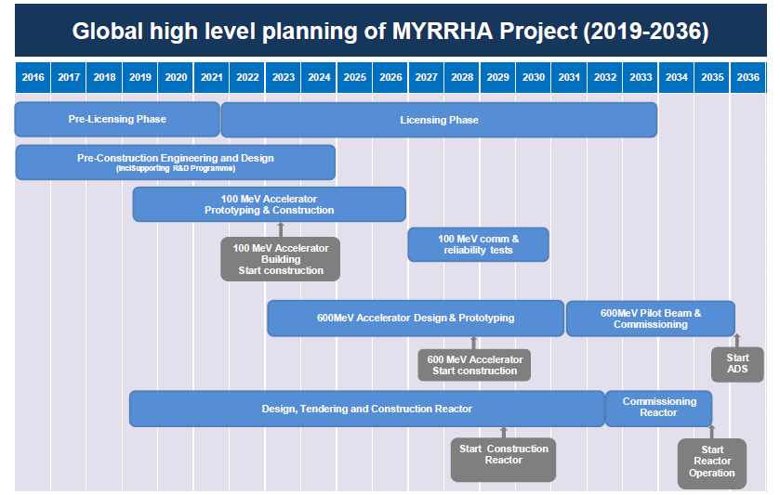
MYRRHA – ADS: General Overview
AccelApp’24
Multi-purpose hYbrid Research Reactor for High-tech Applications (MYRRHA) will be located in Mol, Belgium
MYRRHA and its driver accelerator by Adrian Fabich
https://indico.jlab.org/event/722/contributions/13945/
MYRRHA Linac layout
MYRRHA Sub-Critical Reactor
MYRRHA – Road Map

Slide 17
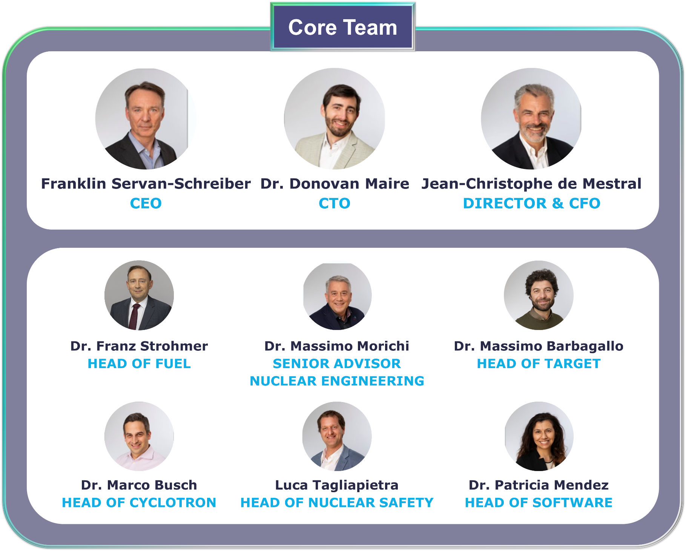

TRANSMUTEX SA
AccelApp’24
Transmutex is a Geneva-based company founded in 2019
Our goal is to deliver the first commercial ADS
Transmutex is backed by leading venture firms in U.S. & EU

Slide 18
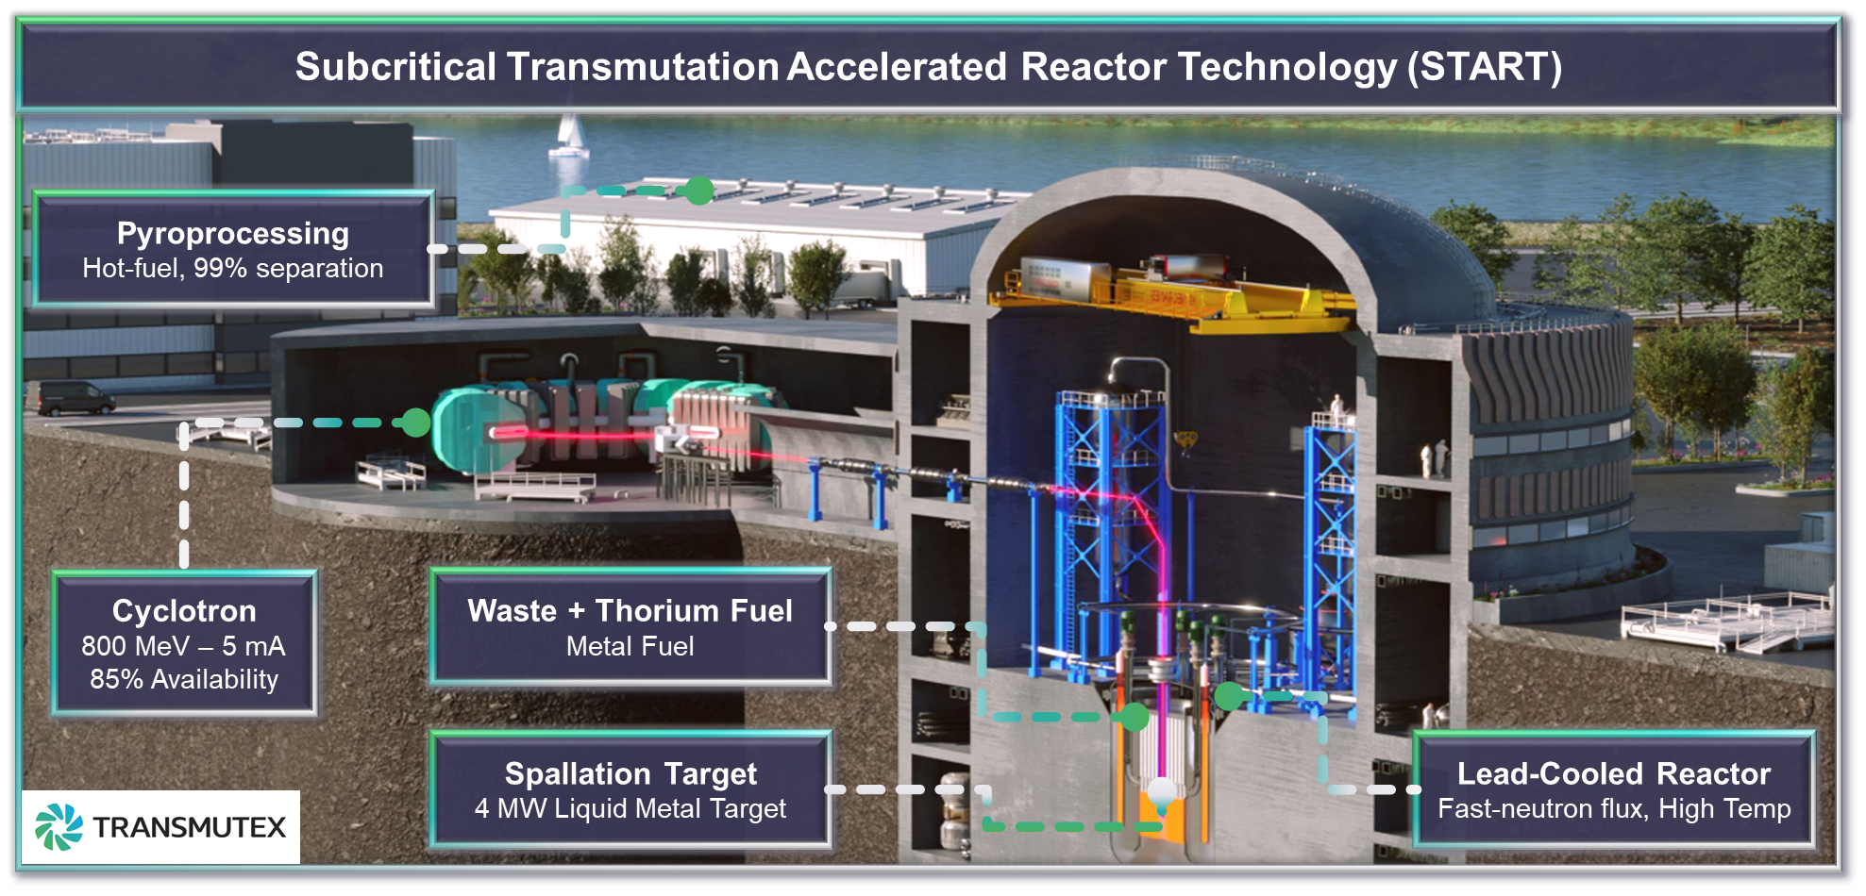

AccelApp’24

Slide 19

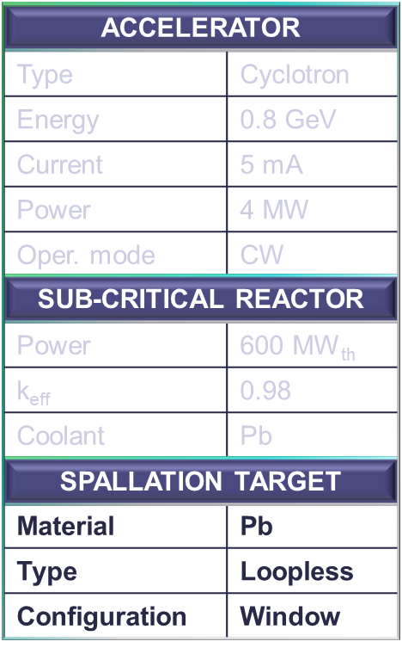
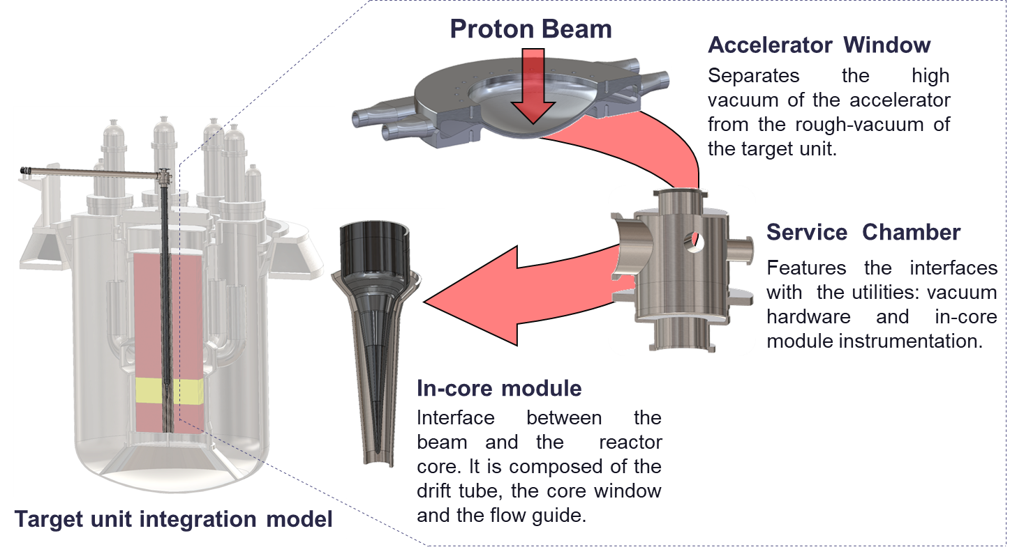
TRANSMUTEX SA: Target Design Overview
AccelApp’24

Slide 20
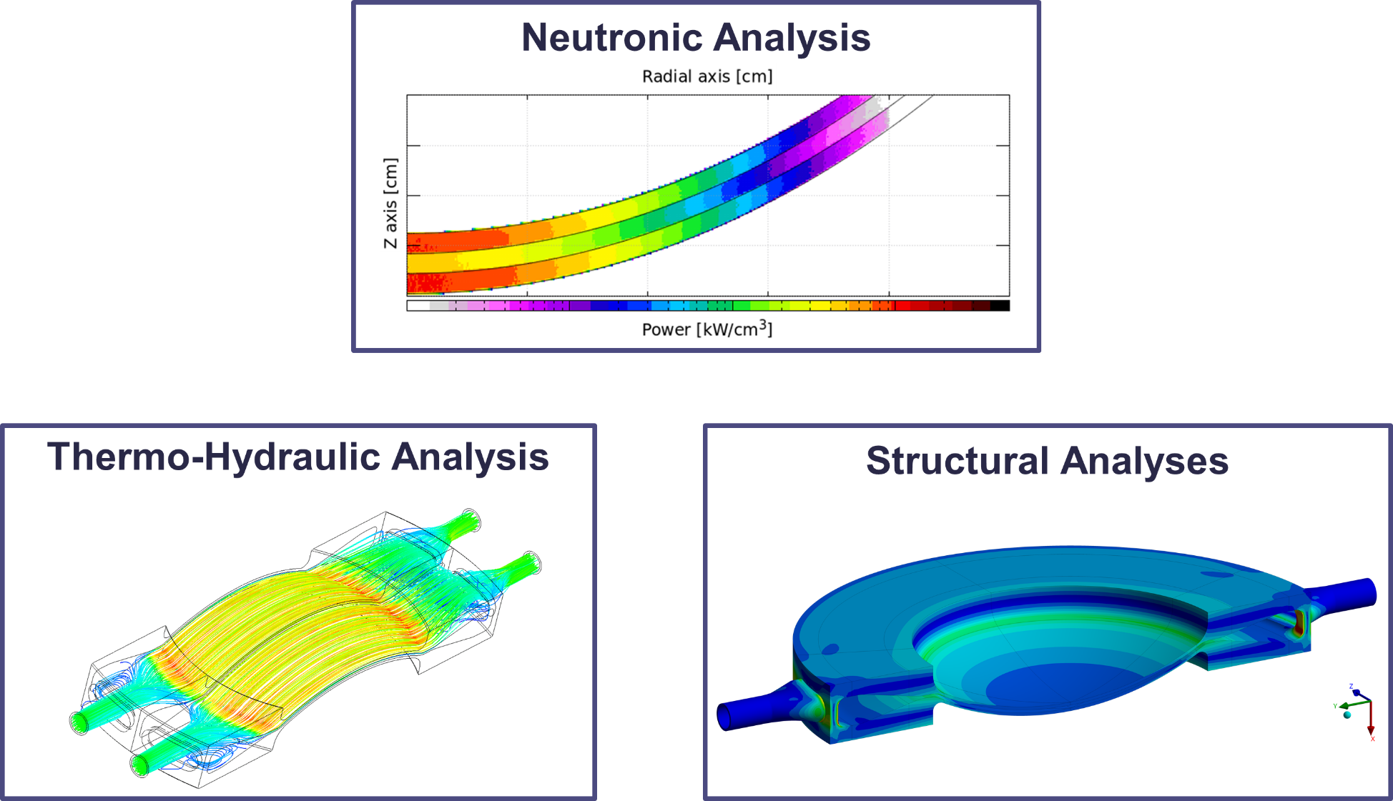
TRANSMUTEX SA: Target Design Status
AccelApp’24
Conceptual design is matured
Completed physics, thermal-hydraulic and thermal-mechanical studies
Developed system integration and reactor interfaces
We are now moving to the engineering phase
Planning of experiments to support the engineering design
    Material characterization in irradiated conditions
    Material testing in Pb environment
We welcome collaboration opportunities with stakeholders interested in our project

Slide 21
R&D Needs (among others)
AccelApp’24
High-power targetry development is strictly linked to material performances
Support development of novel structural materials (HEA, AFA steels, ODS…)
Identify and quantify material susceptibility in LM environment
Further develop screening methods
    Accelerated (ion-irradiation) and miniaturized tests (nano/micro testing)
Densify data at higher DPA levels (identify saturation points if any)
Support the establishment of licensing and regulatory compliance frameworks
Synergistic collaboration among relevant stakeholders is important to combine expertise and capabilities

Slide 22
Summary
AccelApp’24
ADS technology has the potential of reducing nuclear waste and safely produce green energy
Multi-Megawatt Proton Beams are essential for promoting ADS in energy production
Liquid-Metal Spallation Targets are the current baseline for most ADS projects
Accelerator reliability and material radiation tolerability are crucial for target lifetime
Synergistic scientific and international collaboration is crucial to combine expertise and capabilities

Slide 23


THANK FOR YOU ATTENTION
fdc@transmutex.com
Franco Di Ciocchis

Slide 25
References
AccelApp’24
B. Yee-Rendon, “OVERVIEW OF ADS PROJECTS IN THE WORLD”, on LIA 2020, 19-23 Oct. 2020.
https://accelconf.web.cern.ch/linac2022/papers/tu2aa01.pdf
K. Ammigan, Novel Materials R&D for Next-Generation Accelerator Target Facilities, HPTW2023
https://indico2.riken.jp/event/3102/contributions/21918/
D. Vandeplassche et al., “Accelerator Driven Systems”, in IPAC2014, 20-25 May 2012
https://accelconf.web.cern.ch/IPAC2012/papers/moyap01.pdf
H. D. Thomsen et al., “The Beam Raster System of the European Spallation Source”, 2016
https://indico.cern.ch/event/509528/contributions/2270865/attachments/1330030/1998322/2016_09_01_Thomsen.pdf
L. Notari et al., “Materials adopted for particle beam windows in relevant experimental facilities”,
https://journals.aps.org/prab/pdf/10.1103/PhysRevAccelBeams.27.024801
G.S. Bauer, “DEVELOPMENT OF HIGH POWER TARGETS”, EPAC 2004, Lucerne, Switzerland
https://accelconf.web.cern.ch/e04/papers/frxch01.pdf
T. Broome, “HIGH POWER TARGETS FOR SPALLATION SOURCES”, Rutherford Appleton Laboratory, Chilton, Didcot, Oxon., UK.
https://accelconf.web.cern.ch/e96/PAPERS/orals/tuy04a.pdf
W. Pan, “Overview of worldwide accelerator for ADS”, in IPAC2014, 15-20 June 2015
https://accelconf.web.cern.ch/IPAC2014/papers/frxcb01.pdf
K. Samec, “Final Report: the Multi-Megawatt Target Station”,2009
https://cds.cern.ch/record/1355048/files/document.pdf
S. Keijers et al., “Design of the MYRRHA Spallation Target Assembly”, 2015
https://inis.iaea.org/collection/NCLCollectionStore/_Public/47/093/47093756.pdf
Y. Kadi, “Application of Accelerator to Nuclear Energy”, on ASP16, 17th Aug. 2016
https://indico.cern.ch/event/528094/contributions/2212815/attachments/1323998/1986795/YKadi.ASP2016.pdf
D. Weiping et al., “Thermal-mechanical Analysis of Beam Window for ADS Granular Flow Target”, IMP & HIRFL Annual Report (2021)
https://english.imp.cas.cn/research/journals/report/2021nb/2021nbnb_nb_nb/202304/P020230424385351260733.pdf

Slide 26
References
AccelApp’24
Y. Weifeng et al., “Geometrical Design and Simulation Study of upward Spiral Flow Windowless Target”, IMP & HIRFL Annual Report 2019
https://english.imp.cas.cn/research/journals/report/2019/nt2019/202108/P020210823638839001241.pdf
J. Yang, “Status & challenges of HIAF and brief introduction of CiADS”, HB 2023
https://indico.cern.ch/event/1138716/contributions/5437849/attachments/2730098/4745815/MOA2I2_TALK.pdf
K. TSUJIMOTO, “Accelerator-Driven System (ADS) for MA Transmutation”, 2014
https://www.jaea.go.jp/english/news/symposium/RRW2014/shiryo/7-5.pdf
Y. Dai, “Final Report on MEGAPIE Target Irradiation and Post-Irradiation Examination”, 2015
https://www.osti.gov/servlets/purl/1188406
J. Yang, “Challenges & Status of HIAF project and brief introduction of CiADS project in China”, HB2023
https://indico.cern.ch/event/1138716/contributions/5437849/attachments/2730098/4745815/MOA2I2_TALK.pdf
F. Bouly et al, “SUPERCONDUCTING LINAC DESIGN UPGRADE IN VIEW OF THE 100 MeV MYRRHA PHASE I”, IPAC’19
https://accelconf.web.cern.ch/ipac2019/papers/mopts003.pdf
H. A. Abderrahim, “Realization of a new large research infrastructure in Belgium: MYRRHA contribution for closing the nuclear fuel cycle making nuclear energy sustainable”, 2020
(PDF) The MYRRHA ADS project in Belgium enters the Front End Engineering Phase (researchgate.net)
N. Tak et al., “CFD Analysis on HYPER Spallation Target under Beam Transients”, 2008

Slide 27
BACK UP SLIDES
AccelApp’24

Slide 28
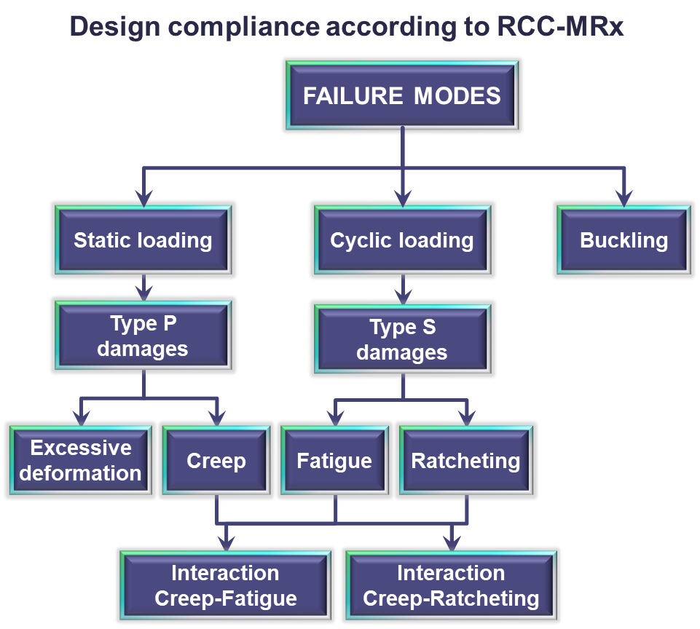
Beam Window (BW) Structural Assessment
AccelApp’24
  BW subjected to multiple loading conditions
  Thermal static and cyclic stresses (beam trips)
  Mechanical static stresses (pressure) and cyclic stresses (vibrations)
  Adherence to standards
  Structural integrity assurance for all scenarios and failure modes
  Material allowable, margin of safety
  Rules on how to conduct the structural assessment
  Unqualified materials or materials in diverse environments (liquid metals) may introduce unique failure modes

Slide 29
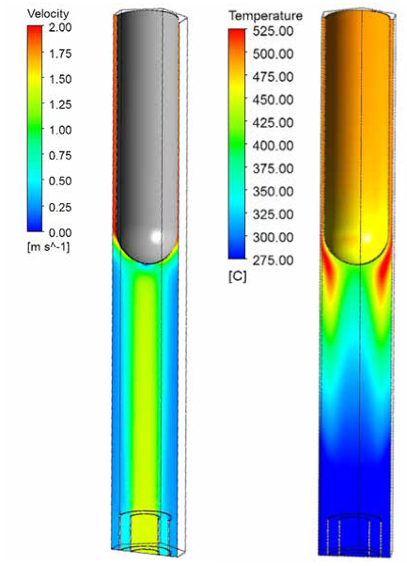
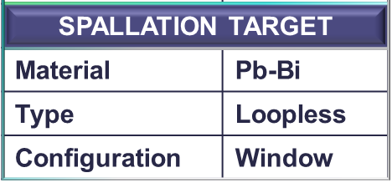
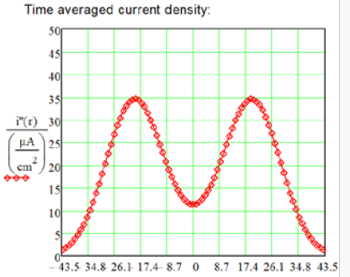
MYRRHA – ADS: Target Design Overview
AccelApp’24
Velocity and temperature distribution (beam current 3.5mA)
Beam profile
Gaussian σ = 9.5 mm
Sweeping radius: 21.5 mm
Beam window
Material: T91
Geometry: Hemispherical

Slide 30
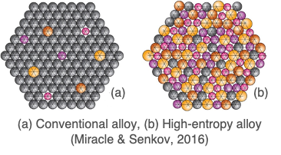
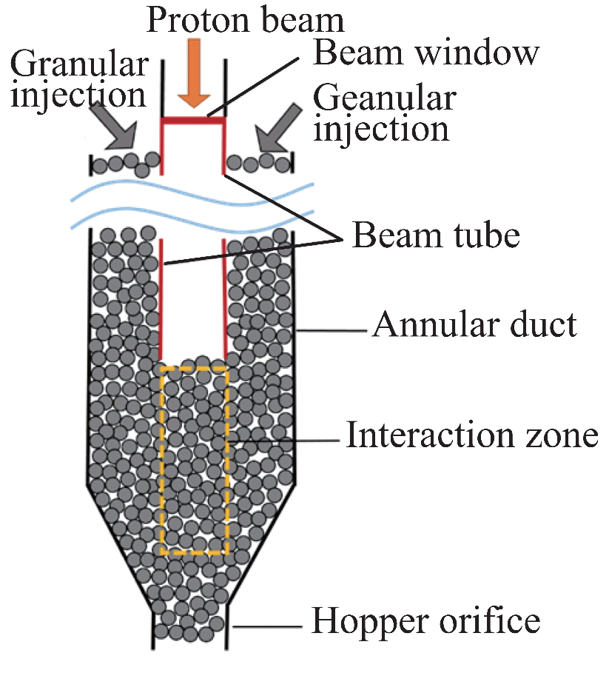
Perspectives: What’s on the horizon
AccelApp’24
Novel Material Class for BW
High-Entropy Alloys (HEAs)
High-temperature strength & High specific strength
Improved fatigue and fracture properties
Corrosion and oxidation resistance
Enhanced radiation tolerance
Novel spallation target concepts
Solid-state: gas-cooled granular flow target
Liquid-state: upward spiral flow target (liquid-metal)
Granular Flow
Institute of Modern Physics
Upward Spiral Flow Windowless Target
Institute of Modern Physics

