Slide 1

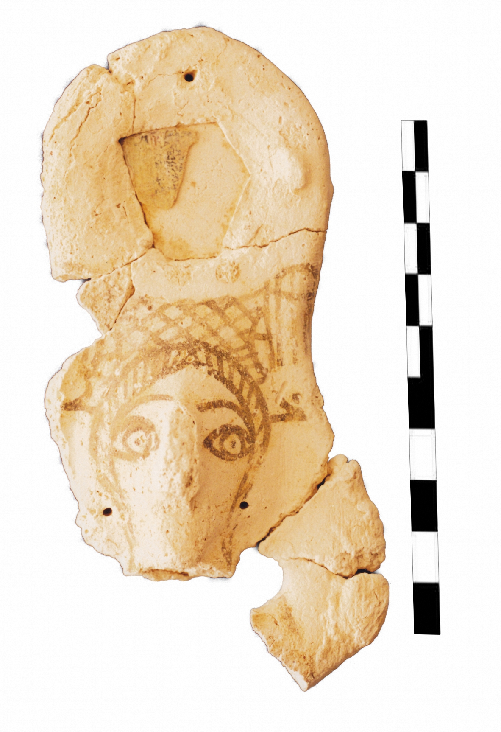
SYNCHROTRON-BASED X-RAY FLUORESCENCE
ANALYSIS OF BYZANTINE PLASTER FIGURINES
FROM JORDAN MUSEUM
Sahar al Khasawneh¹, Kafa Al-Khasawneh², Allayth Aldrabee⁴, Messaoud Harfouche⁵,
¹ Faculty of Archaeology, Yarmouk University, Irbid, Jordan
² Jordan Research and Training Reactor- Neutron Activation Analysis, Irbid, Jordan
³ Hamburg University
⁴ Jordan Atomic Energy Commission, Amman, Jordan
⁵ Synchrotron-Light for Experimental Science and Applications (SESAME), Jordan Atomic Energy Commission, Amman, Jordan
Notes:
Here, I will present an example of synchrotron beam analysis for archaeological artifacts.
I will show you the first analytical analysis was ever applied for plaster figurines artifacts excavated from Khirbet es-Samra, Jordan, using the Synchrotron-based X-ray fluorescence.

Slide 2
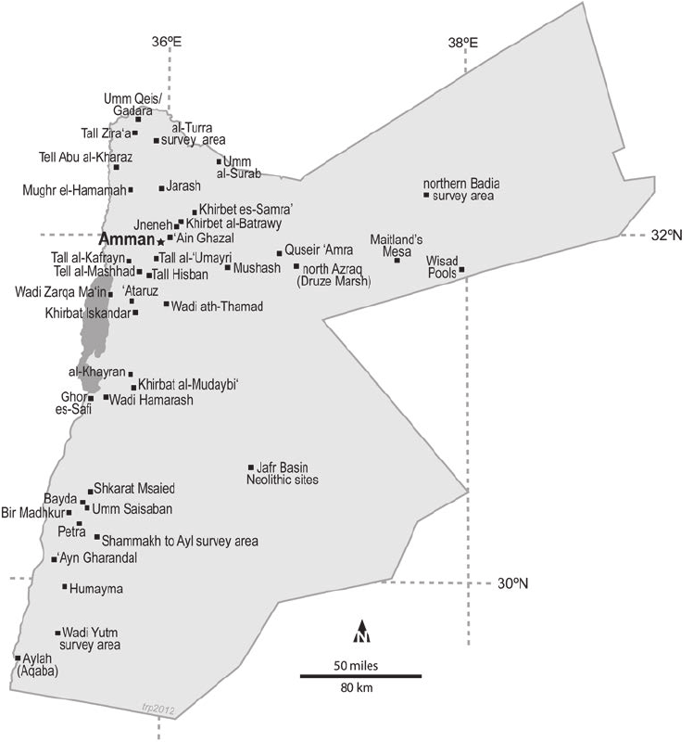
Khirbet es-Samrāʾ is a Roman-Byzantine archaeological site in north-eastern Jordan, about
50 km north-east of the capital, Amman
Jordan map (after Keller, 2012)

Slide 3
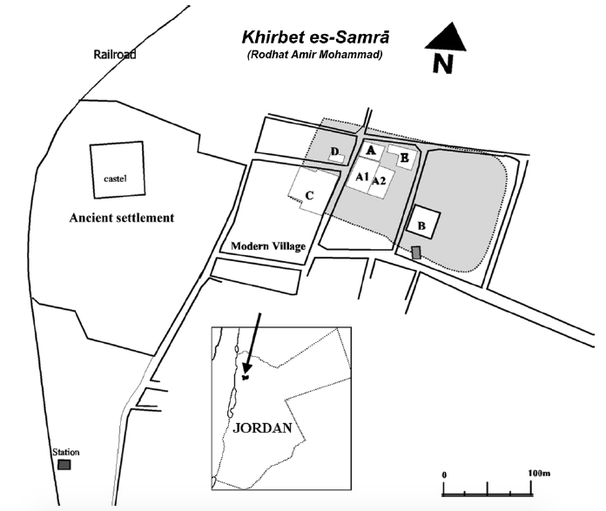
Khirbet es-Samrā site map showing the Byzantian ancient cemetery (after Nabulsi, 2019)
Jordan map (after Keller, 2012)

Slide 4
The plaster objects are most likely were produced in the 7th century AD

Slide 5
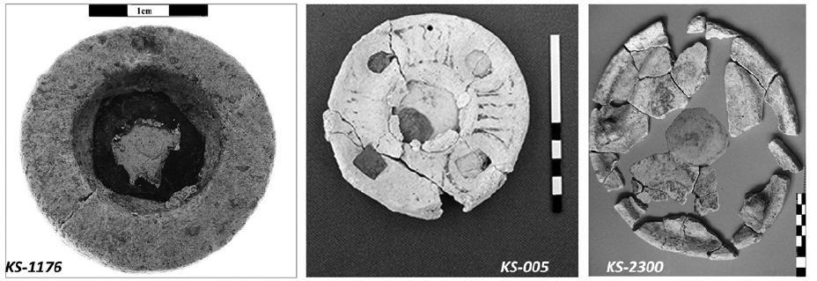
The majority of the geometric plaster objects are rounded disks (9-12cm diameter) with an inserted rounded mirror on one side that sometimes is surrounded by simple black painted lines

Slide 6
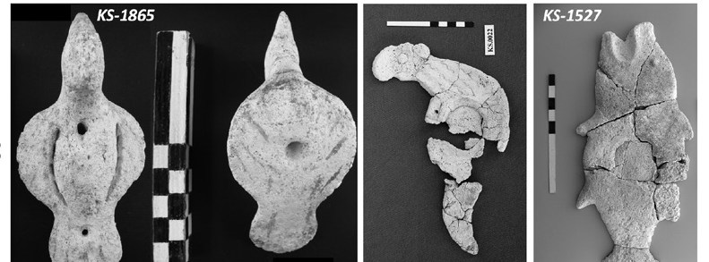
Animal figurines which were decorated with an inserted rounded or rectangular mirror.

Slide 7
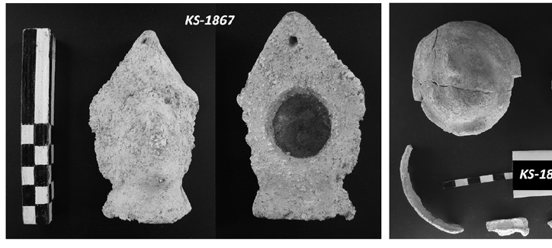
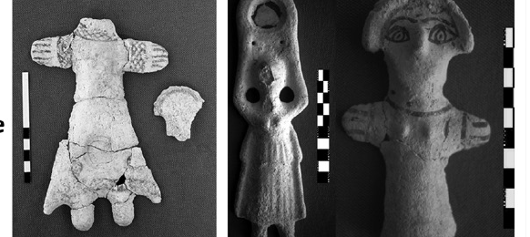
Human figurine type is that of a standing female (ca. 7-30cm height) with rudimentary arms stretched out or raised over the head, dressed in a long garment that is often decorated with a small mirror, and small protruding feet.

Slide 8
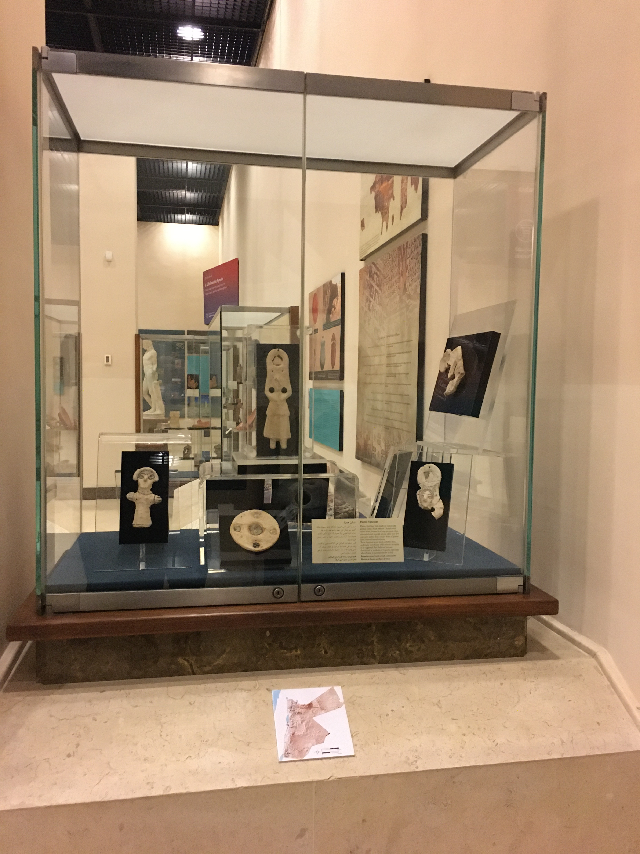
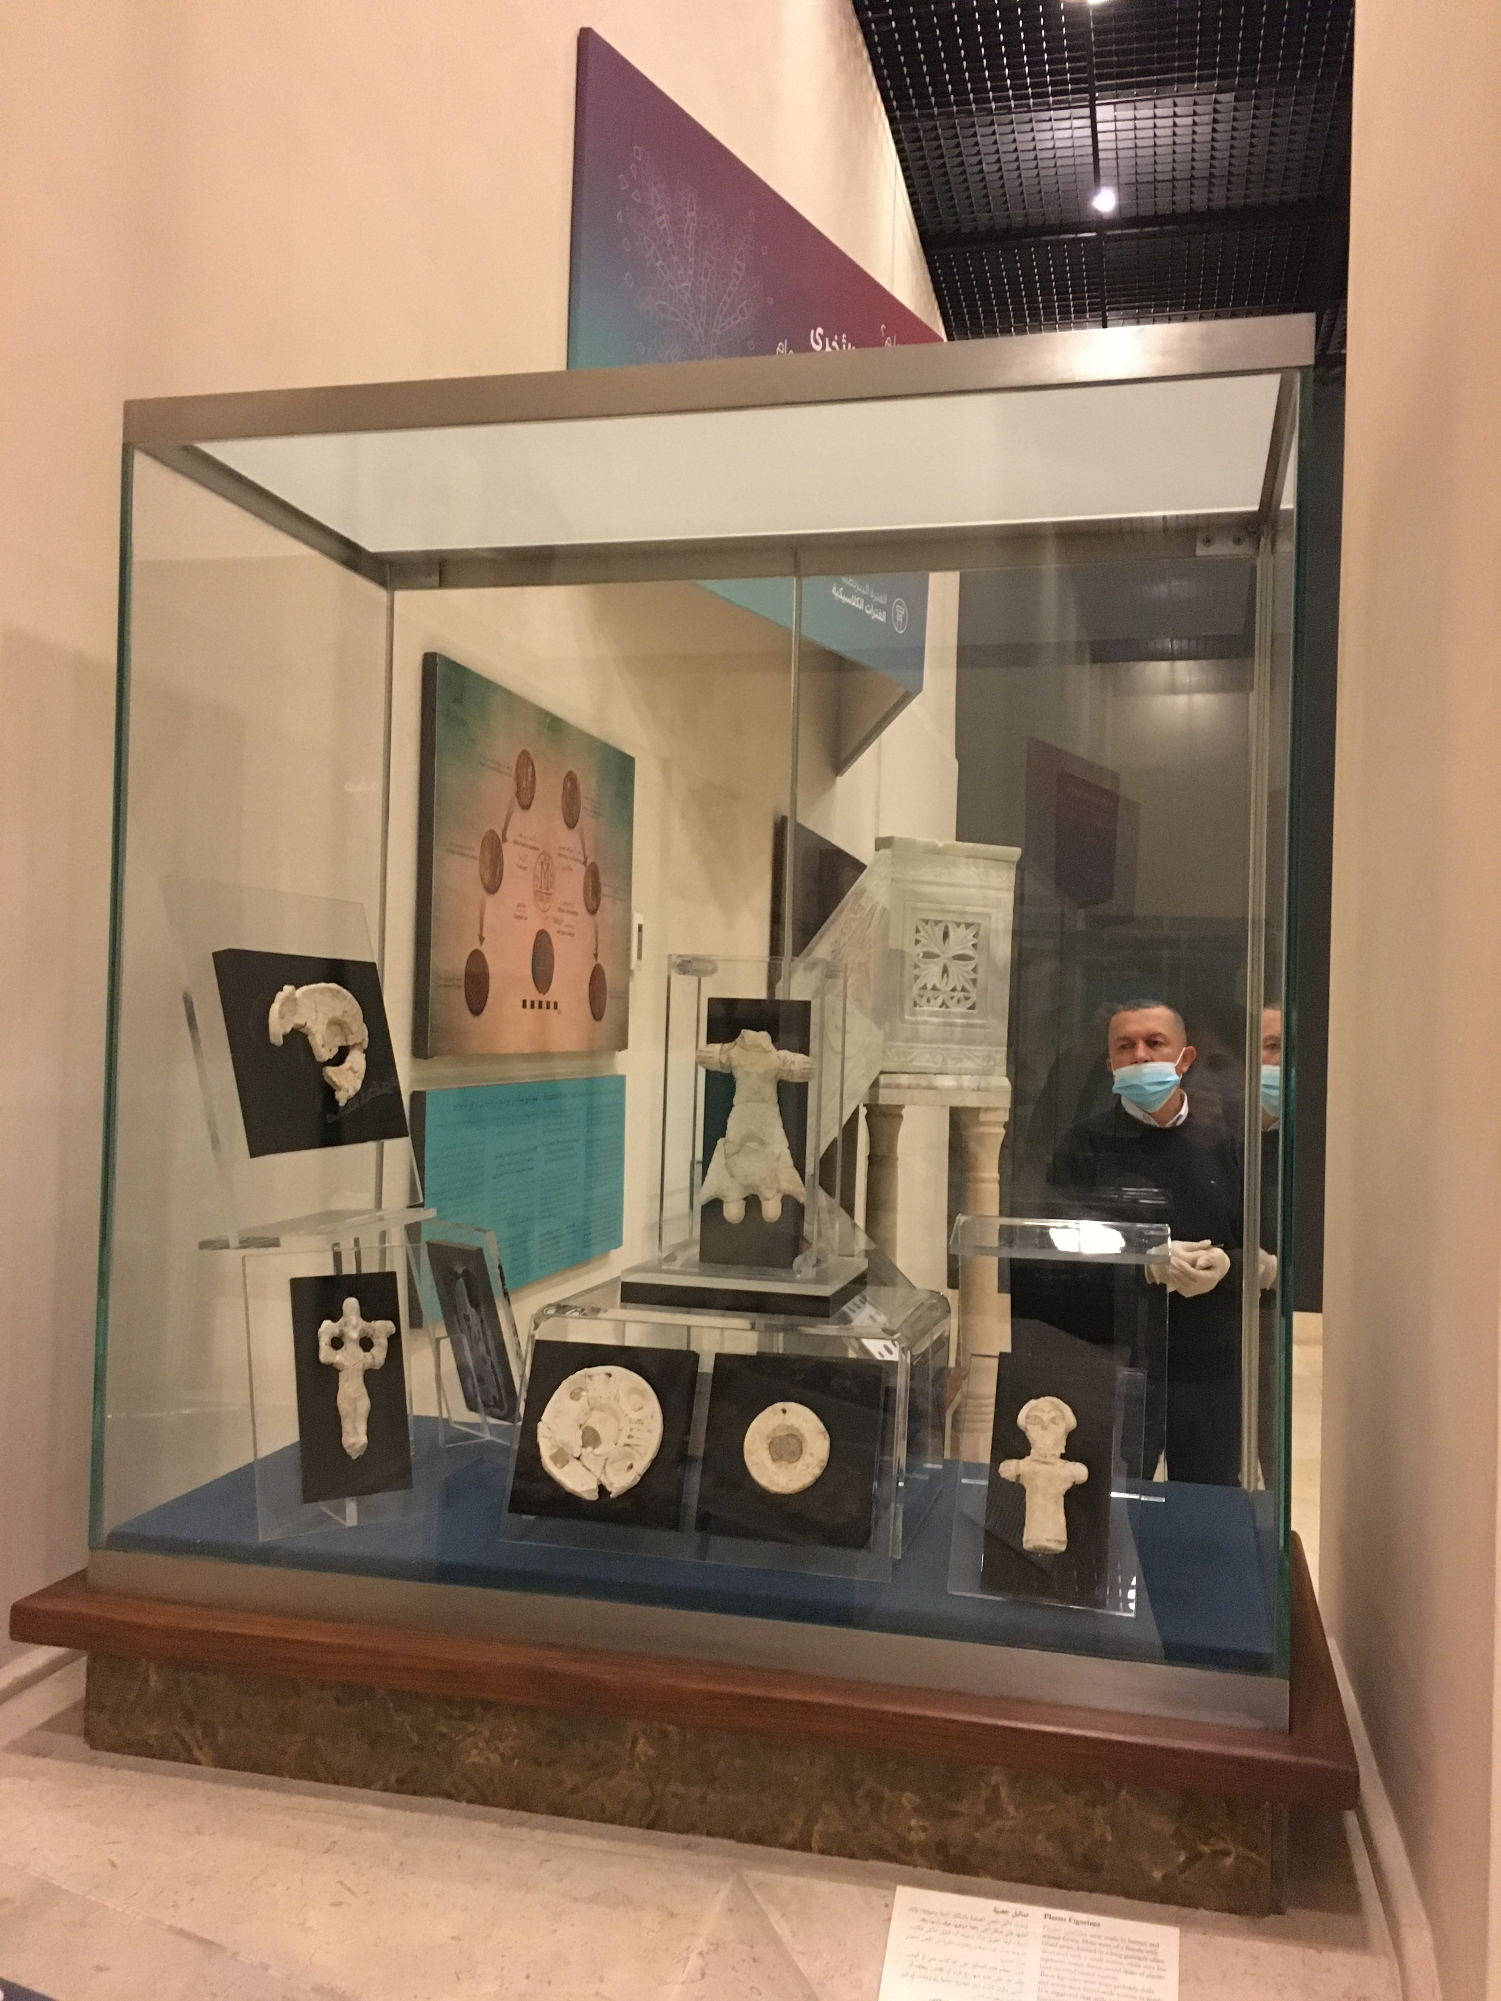

Slide 9
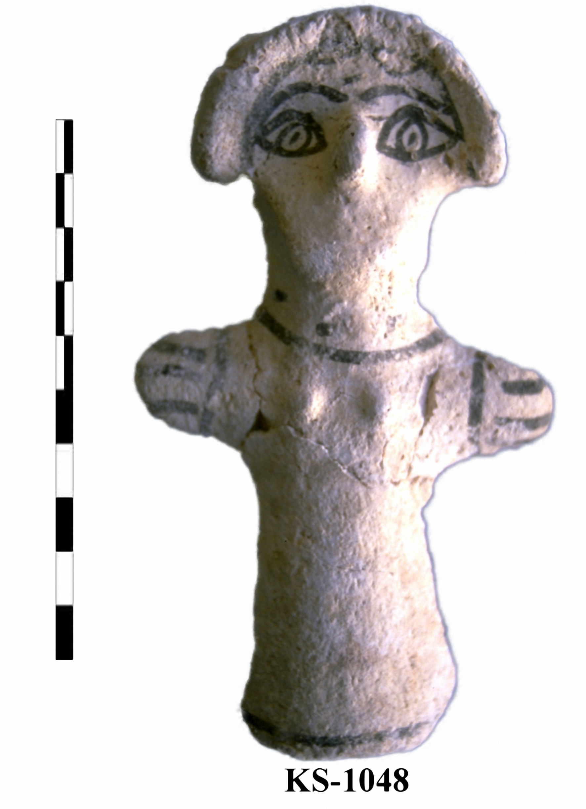
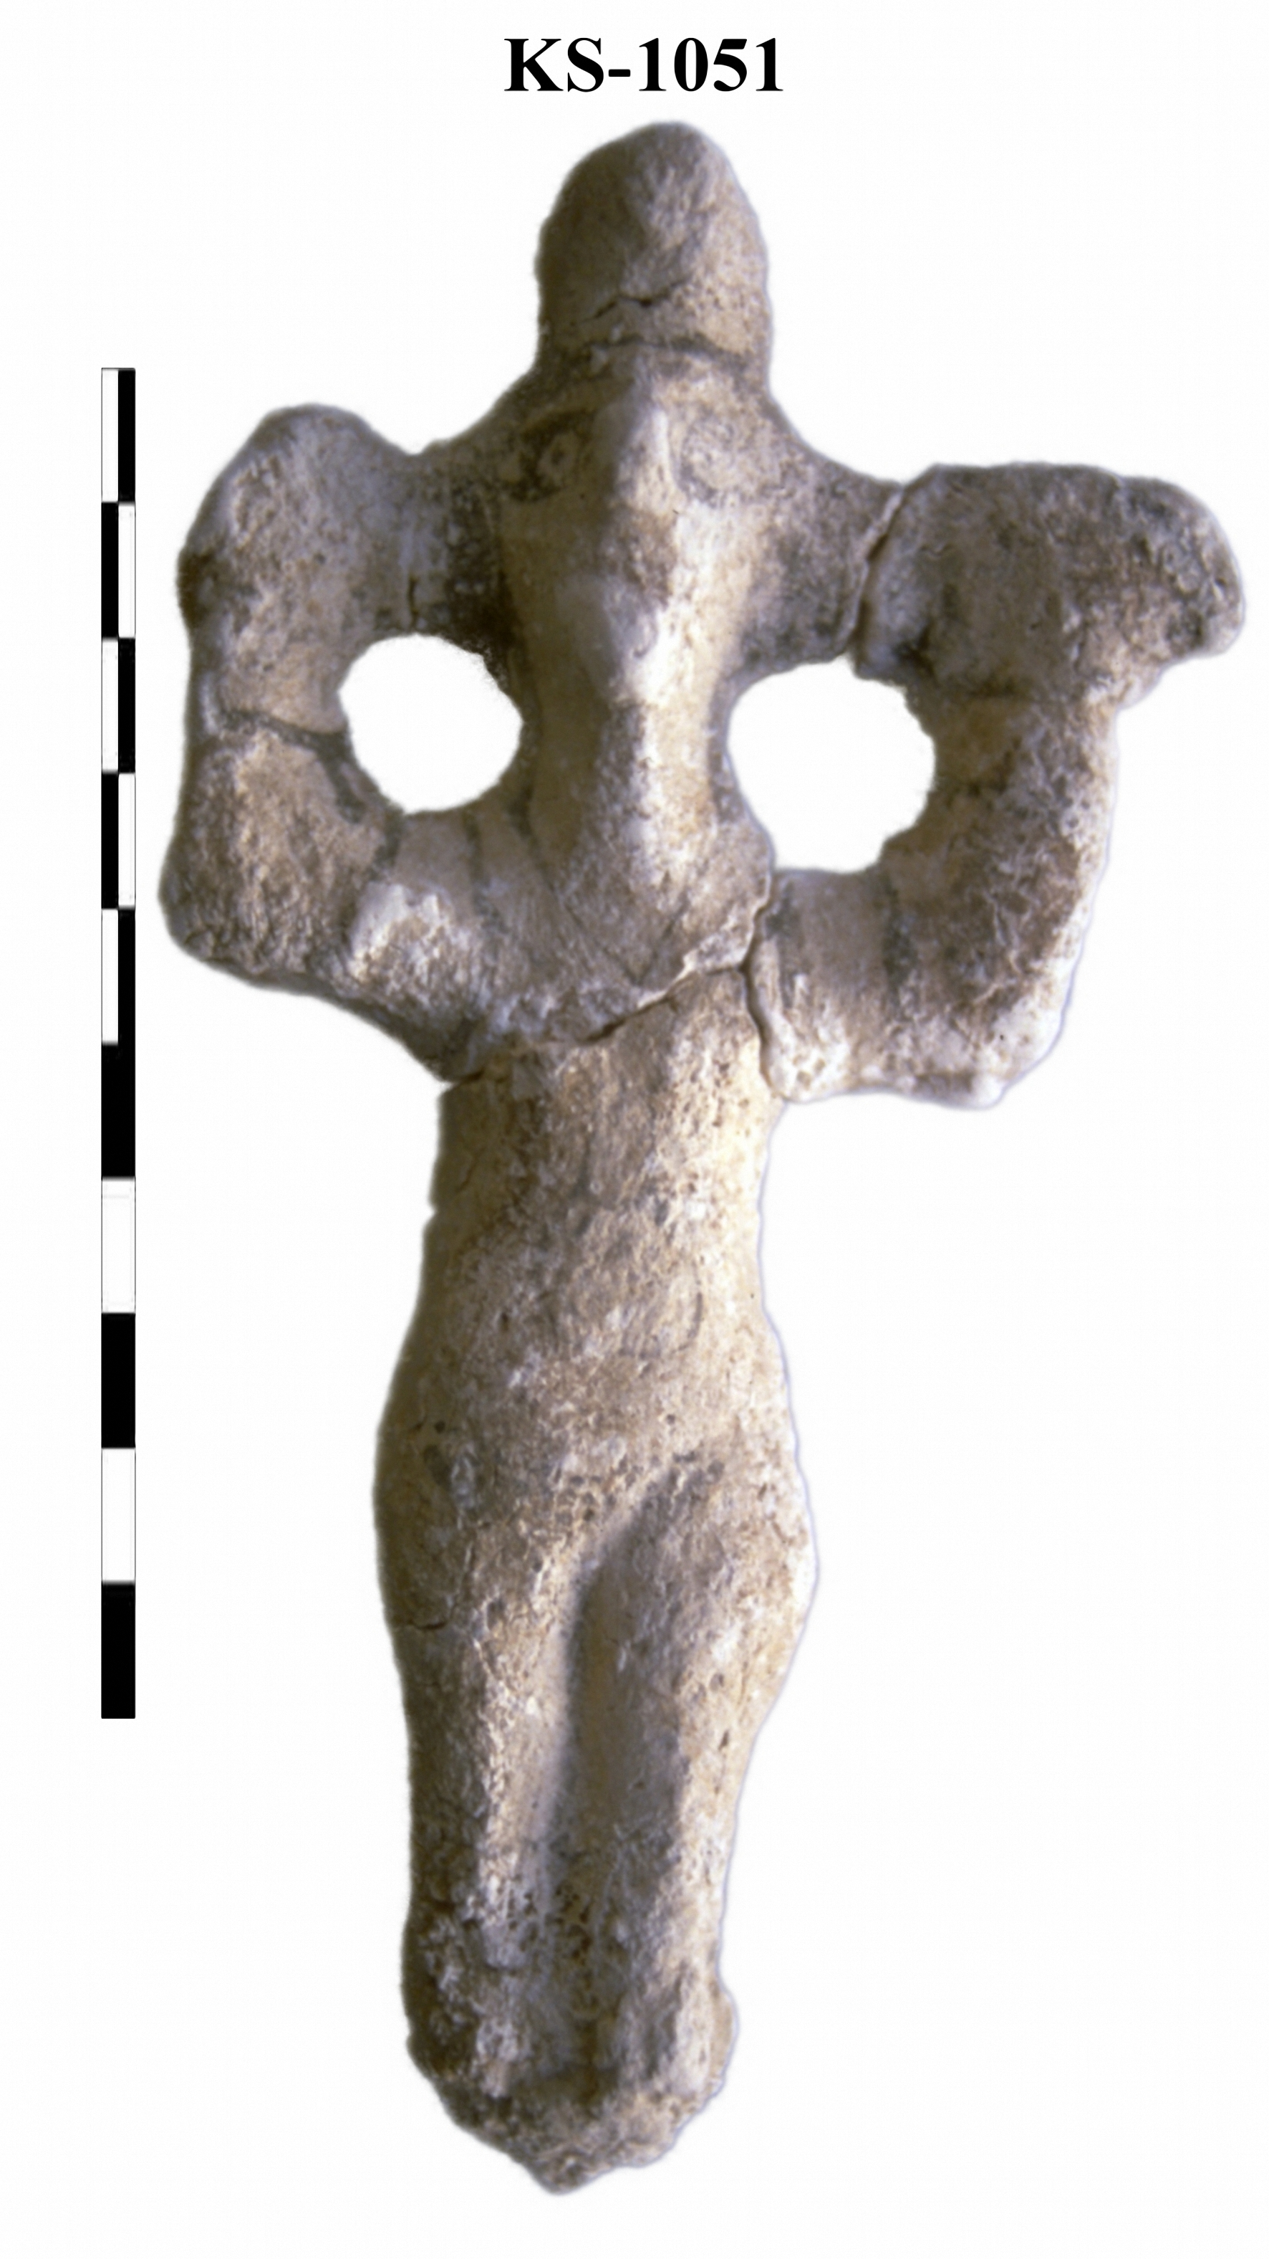
KS-0030

Slide 10
KS-1048 (~ 136x76x8 mm )
A standing short-haired (inverted crest) woman or girl with a short neck and a long protruding nose.
The wide-open eyes and eyebrows are painted in black. Also painted are the fingers, the gown’s collar and lower margin.
The figurine was found in situ just by the right hand of a possibly 10-11-year-old child buried in Tomb-099, hence this type named “Samra Doll”.

Slide 11
KS-1051 (~ 143x74x9 mm)
A female plaque figurine depicts a standing woman with her legs pressed together.
The arms are stretched to reach the braided hair on both.
The woman is wearing a short sleeved long gown that reached just above the feet and with a V-shaped collar as well as a possibly cone-shaped hat or cap.
The features are on the figurine are marked by black paint. The face shows wide open eyes and mouth thus suggesting a shouting or “lamenting” woman.
It was found in tomb of a 1-3 years old child burial.
Known as The Lamenting Woman Figurine)

Slide 12
KS-0030:
The head part of a female plaster figurine found in a 5-6 years old child burial.
It depicts a standing woman that appears to wear a head scarf painted in black lines as also her wide-open eyes and eyebrows.
Inlay mirror is in the middle off the “basket” body, which in turn is supported by the females’ upward stretched arms (the right side missing).
The fragment size, ca. 126x65x8 mm, suggests that the original size could be more than 35 cm.

Slide 13
KS-0030

Slide 14
1
2
3

Slide 15
Ca_{α}
Ca_{β}
1
2
3

Slide 16
Fe_{α}
Fe_{β}
1
2
3

Slide 17
Zn_{α}
Ni_{α}
Cu_{α}
Ti_{α}
Zn_{β}
1
2
3

Slide 18
As_{α}
As_{β}
1
2
3

Slide 19
Si_{β}
Ar_{α}
S_{β}
1
2
3

Slide 20
Ca_{α}
Fe_{α}
Ca_{β}
Fe_{β}
Ar_{α}
Cu_{α}
Si_{β}
S_{β}
Ni_{α}
As_{α}
As_{β}
Zn_{α}
Ti_{α}
Zn_{β}
1
1
2
2
3
3

Slide 21
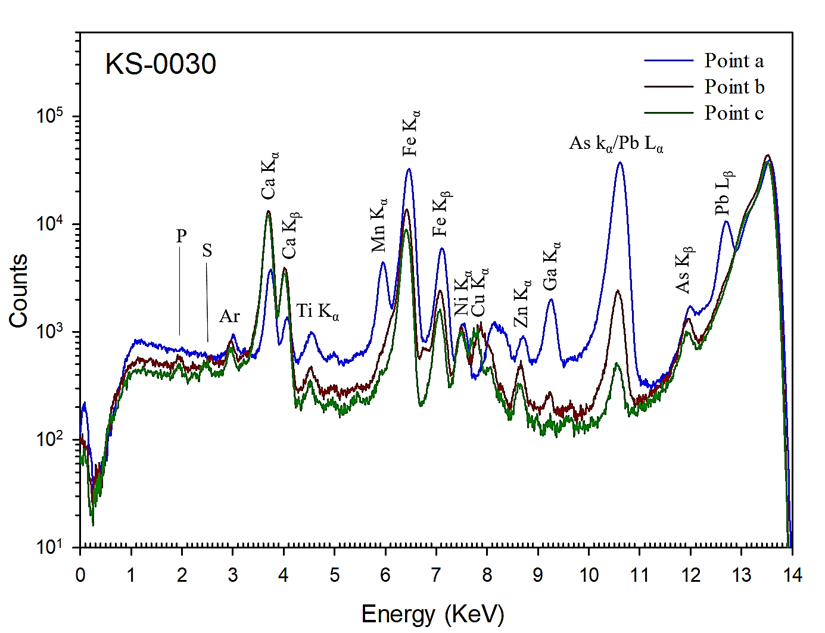
a
b
c
KS-0030

Slide 22
Mn_{α}
Mn_{β}
Sr_{α}
2
Ca_{α}
Sr_{β}
1
Ca_{β}
Cu_{α}
Ar_{α}
Fe_{α}
Br_{α}
Fe_{β}
Zn_{α}
As_{α}
Zn_{β}

Slide 23
Conclusions
The presence of Ca in high concentrations, low concentration of Si and absence of Al, exclude the existence of calcium -silicate nor calcium- aluminate.
The absence of the S, or existence in very low concentration, rule out the use of calcium sulphate, and confirms the using of only calcium carbonate CaCO₃ (Lime Plaster) as the principal constituent of the figurines body.

Slide 24
Conclusions
Calcination process
CaCO₃
Heat
CaO +
CO₂
Calcium carbonate
Calcium oxide
Quick lime
Carbon dioxide
Slaking process
CaO + H₂O
Ca(OH)₂
Calcium Hydroxide
Slaked lime
Carbonation process
Ca(OH)₂ + CO₂ CaCO₃ +H₂O

Slide 25
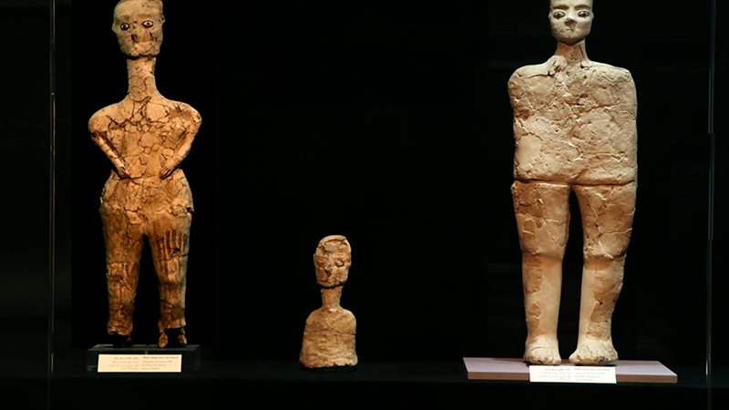
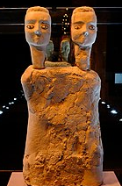
Human figurine, from Ain Ghazal, Jordan, ca.6750-6250 BCE

Slide 26
Conclusions
The spectra for the black lines didn’t show existence of P (phosphorous). This is strongly excluding the animal origin (e.g., bone) for the black colour.
Compared the SR-XRF spectrum of the unpainted body and the black lines on the body. Both spectra were almost identical. The spectra showed no marked increases in Mn content or Fe.
This excludes the using of the Fe ores (magnetite Fe₂O₃), nor Mn-based pigments for the black drawing as detected in other painted materials.
This suggests that the black drawings have been applied using wooden charcoal

Slide 27
Conclusions
The significance presence of Fe and those of Cu, K, Co, Cr, Zr, Sr and Ti, indicate to presence of other ores, and impurities in the limestone or when forming the aggregate.
No evidence of previous paintings were applied to the objects
The XRF spectra from the body and the mirror showed a higher concentration of Mn and Pb and Ga fluorescence emission lines.
In addition to the absence of Si element, this might suggest that the mirror is not a Si based object but a highly polished ma-terial containing Pb/As, Mn and Gd compo-nents.

Slide 28
Thank you

