Slide 1

MYRRHA and its driver accelerator
Adrian Fabich
19.03.2024

Slide 2
Fission generates high-level radioactive waste
Fuel
^{FP}
U²³⁵
U²³⁵
n
Minor Actinides
Actinides
n
Uranium
Fission
n
U²³⁸
Pu
Np
Am
Cm
Neutron
U²³⁸
n
^{Plutonium}
^{Neptunium}
^{Americium}
^{Curium}
^{FP}
1 ton of nuclear fuel used 4,5 year in commercial PWR reactor produces electricity for 100,000 families per year (3500 kWh/y per family)
After 4,5 years the spent nuclear fuel contains:
  94,7% of resources we can recycle (U+Pu)
  5,1% of nuclear waste with low radiotoxicity (FP’s)
  0,2% of high radiotoxicity nuclear waste
➔
Source: SCK•CEN MYRRHA Project Team

Slide 3

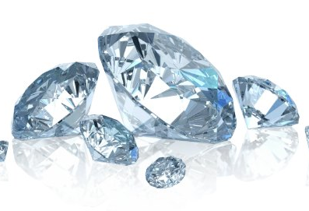
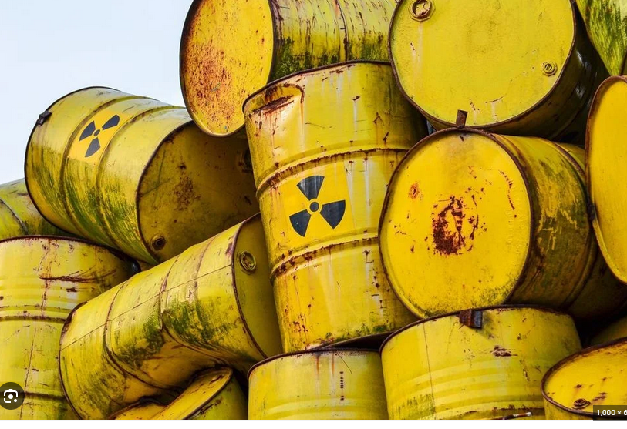
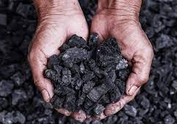
Advanced treatment of nuclear waste
Recycling of high level radioactive waste by P&T
Partitioning (P)
Transmutation (T)
VS
VS
Separate the ingredients of the spent fuel in “similar” categories we can treat in a similar way
Use intense neutron field to transmute isotopes into others, less “nasty” and producing energy (circular economy)

Slide 4


Reducing the radiotoxicity
Spent
Nuclear
Fuel
1000
Radiotoxicity
Recycling
(PUREX*)
No recycling
Advanced Recycling
(P&T_{MYRRHA})
+10 000 years
+300 000 years
Natural Uranium
1
300 years
4
* PUREX = plutonium uranium reduction extraction

Slide 5
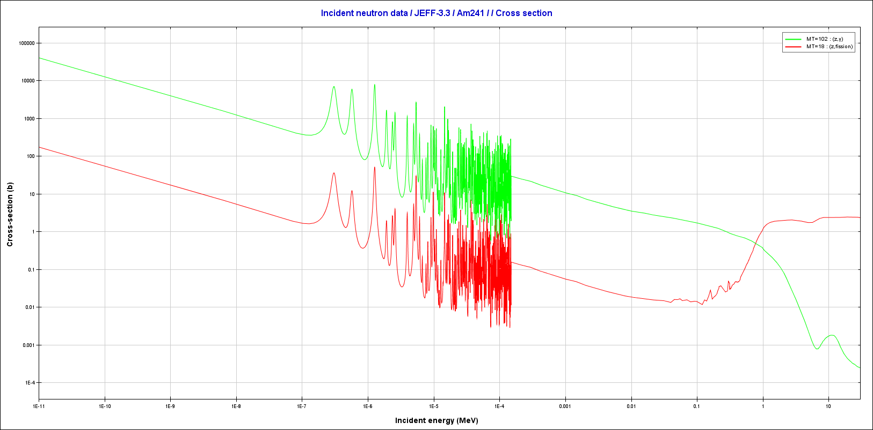
Fast neutrons for transmutation
Fission of minor actinides
Resulting in radio-isotopes of lower radiotoxicity
Cross-section for fission requires fast neutrons

Slide 6
Three options for Minor Actinide (MA) transmutation
Fission Reactor
FR
heterogeneous
FR homogeneous
ADS
Driver fuel
Blanket with MA
Fuel with MA
Blanket
Fuel with MA
Core safety parameters limit the amount of MA that can be loaded in the critical core for transmutation, leading to transmutation rates of:
  FR = 2 to 4 kg/TWh
  ADS = 35 kg/TWh (based on a 400 MW_{th} EFIT design)
EFIT = European Facility on Industrial scale Transmuter

Slide 7
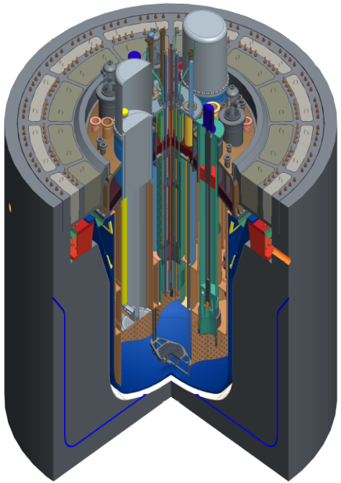
Accelerator Driven System (ADS) MYRRHA
Linear accelerator
(600 MeV)
≈360 m
42 m
Main Objectives
Transmutation demonstration
ADS at pre-industrial scale
Flexible irradiation facility
Reactor
(Sub-critical, Lead-Bismuth cooled)

Slide 8
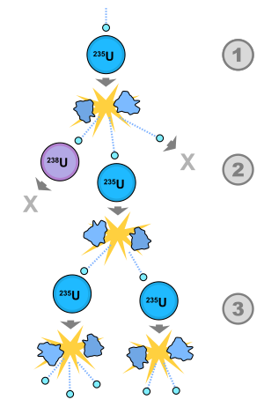
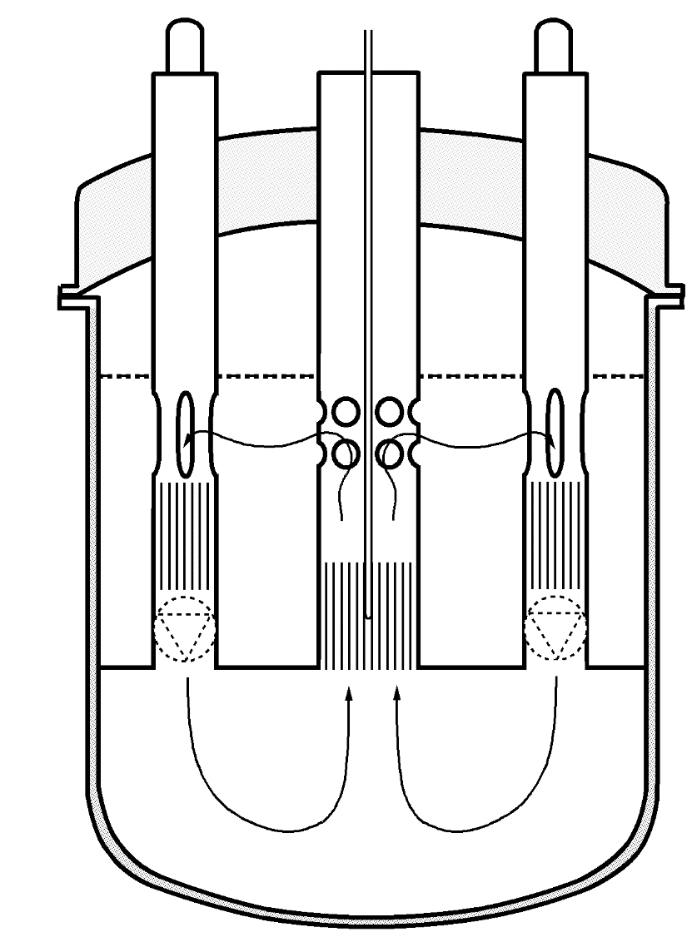
MYRRHA ADS : inherently safety
Nuclear chain reaction sustained by the accelerator beam power
In case of issues, turning off the accelerator immediately puts the reactor in a safe state as the nuclear chain reaction dies out.
Based on natural circulation of the coolant by gravity between the cold Heat Exchanger (HX) and the hot core
→ MYRRHA is inherently safe!

Slide 9

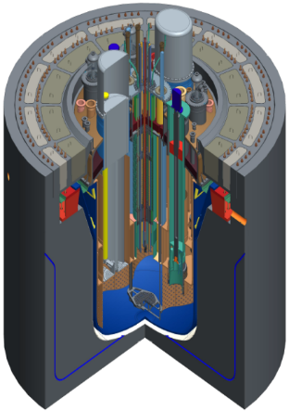
Purpose:
  ADS technology demonstrator at pre-industrial scale
  Flexible irradiation facility (Radio isotope production, reactor fuel research, …)
At SCK CEN – the Belgian nuclear research center
Pre-studies since decades
SUBCRITICAL REACTOR (~70MWth)
600 MeV Protons
4mA - CW
MTBF > 250h for beam trips over 3s
3 types of SC-cavities

Slide 10
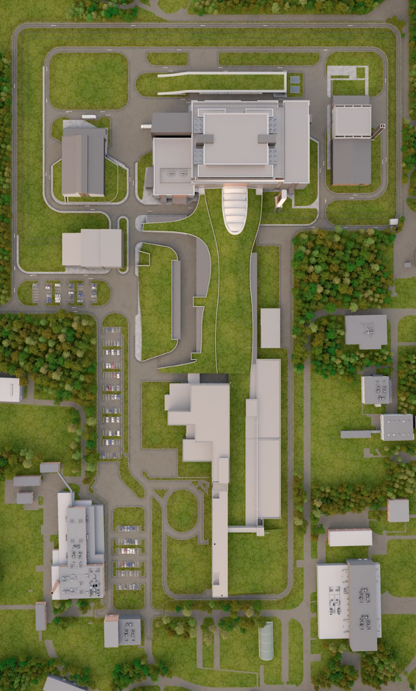

MYRRHA
7 September 2018
The Belgian Federal Government announce its decision to:
Build MYRRHA, a new large research infrastructure in Mol
Establish governmental support for promoting MYRRHA international partnership
Establish the MYRRHA international not-for-profit organization (Founded in 2022)
  Responsible for construction, development and operation of MYRRHA infrastructure
  Legal entity to welcome international Countries and Organizations in MYRRHA Consortiums

Slide 11
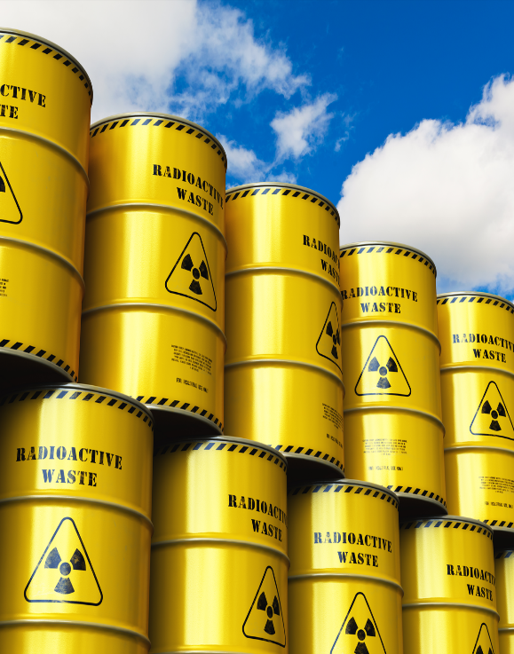
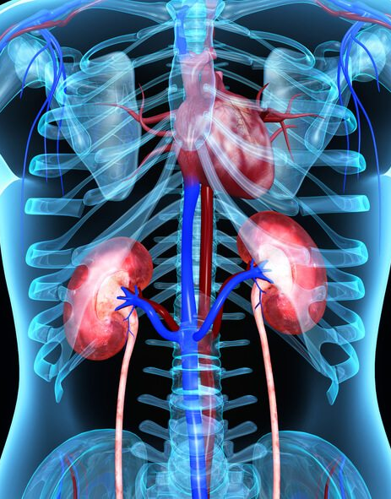
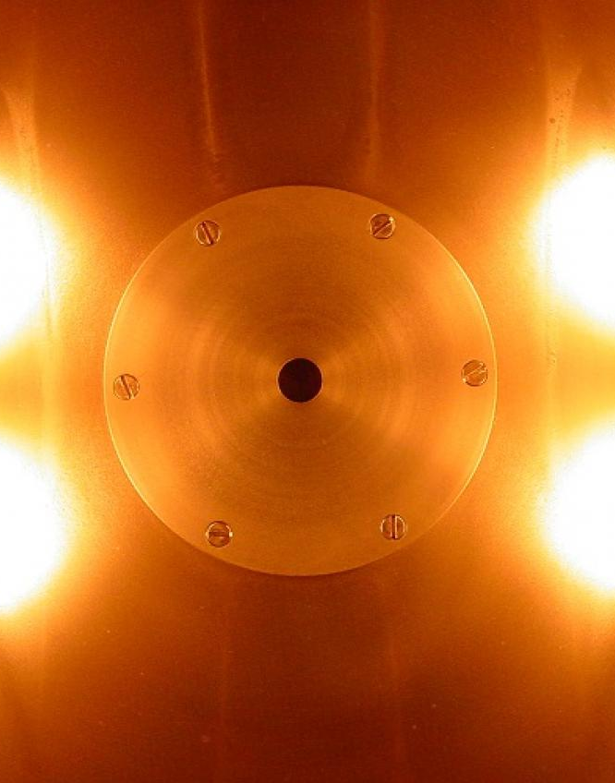
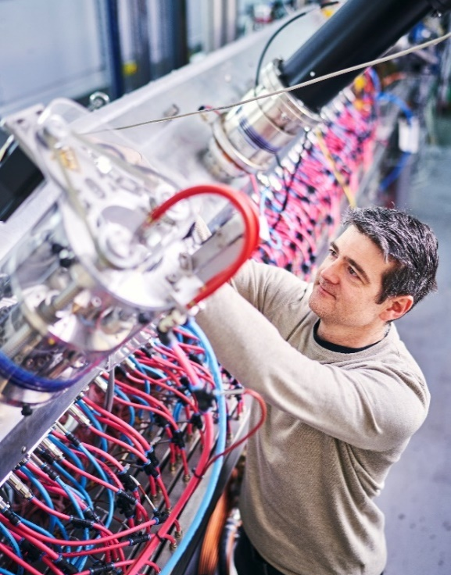
MYRRHA’s versatility
Less (toxic) nuclear waste
Production of medical radio-isotopes
New reactor concepts
Fundamental research
Transmutation reduces the final residual waste volume by a factor 100 and natural radiation level is reached after 300 years
Therapeutic radio-isotopes can fight cancer cells in a more targeted way with significant reduction of side effects for patient
A wide range of material testing by fast neutrons for development of fusion reactors as well as used in current fission reactors
Deepening understandings in Nuclear physics, atomic physics, fundamental interactions, solid state physics & nuclear medicine

Slide 12
MYRRHA, a phased approach
Phase 2 - 600 MeV
Phase 1 - 100 MeV
“MINERVA”
Application Centers
Phase 3 - Reactor

Slide 13
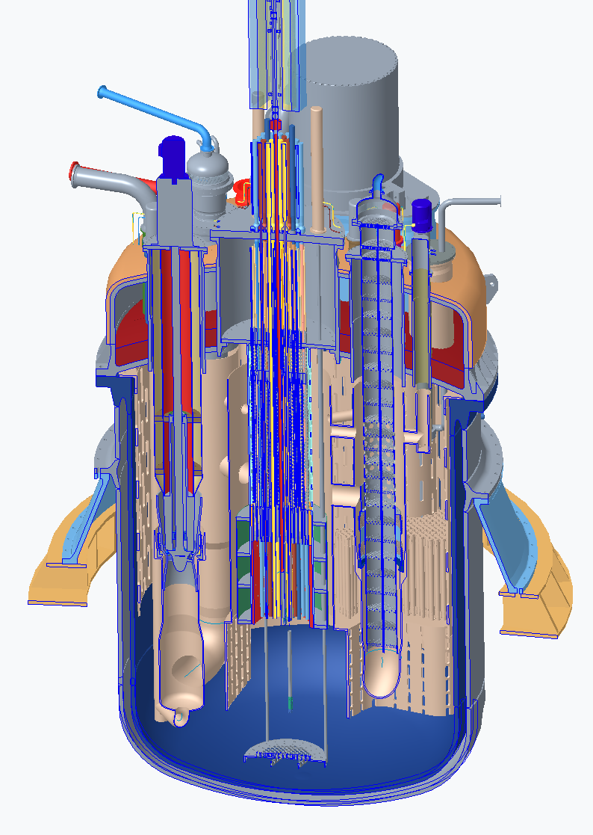
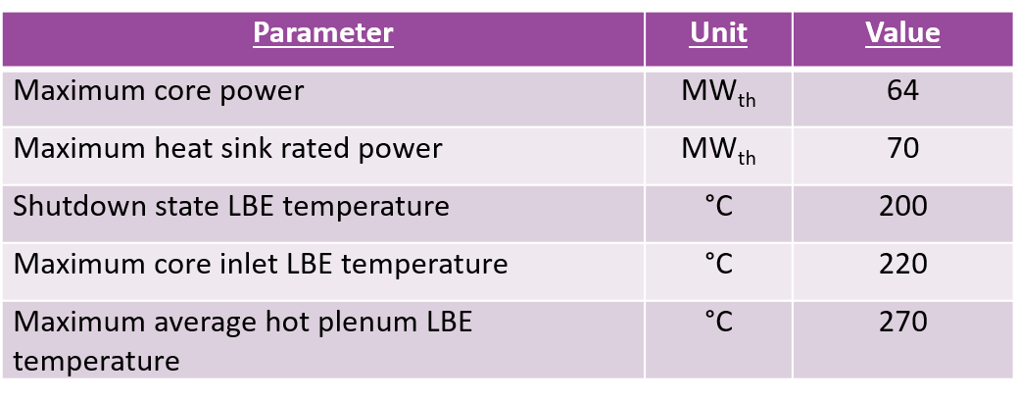
MYRRHA reactor
To be operational by 2040
Sub-critical operation (k_{eff} < 0.97)
Inherently safe
  Proton driver determines neutron flux (no chain-reaction)
  Passive decay heat removal - by natural convection

Slide 14
Resulting accelerator requirements
600 MeV protons
4mA CW
Reliability: <10 beam trips of >3 s per 90 day run
  Minimize the mechanical stresses to the reactor structure
  Maximize the uptime

Slide 15
Accelerator key design decisions
17 MeV normal conducting injector
  Parallel redundancy
Superconducting linac
  3 types of SC cavities
  Significant RF-power overhead for serial redundancy
Use of solid state amplifiers

Slide 16
MINERVA = MYRRHA phase 1 implementation
100 MeV
  1 injector
  1 SC cavity type
Test the reliability concepts (RF-fault tolerance)
Two target stations:
  ISOL system (PTF): reduced duty factor (50kW)
  Full power Facility (FPF): Fusion material research, 400 kW

Slide 17
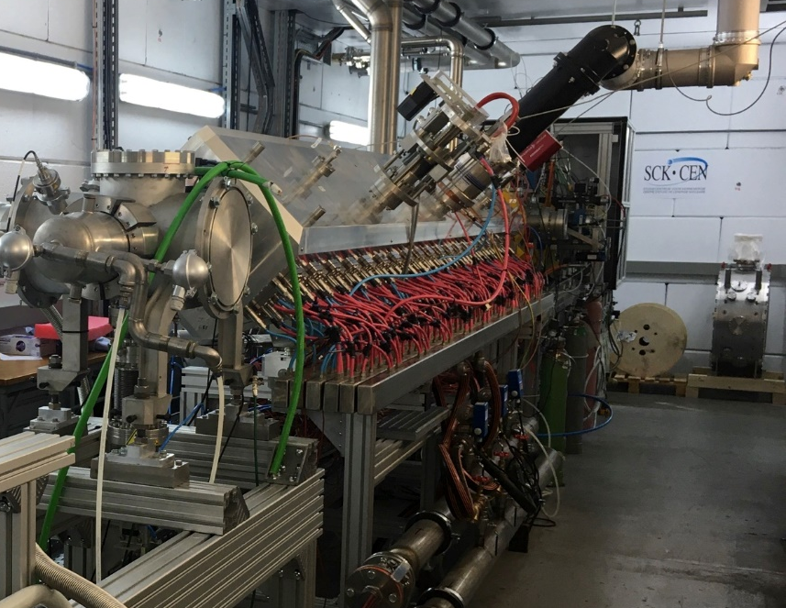
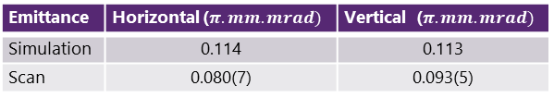
Injector
Normal conducting CH-cavities up to 17MeV, 176MHz
Experimentally validated up to exit RFQ in R&D manner
  ECR ion source, 4-rod RFQ with up to 160 kW
  Emittance measurement done
Full Beam characterization including collimation (also in stand-by inj.)
Emittance | Horizontal ($π.mm.mrad)$ | Vertical ($π.mm.mrad)$
Simulation | 0.114 | 0.113
Scan | 0.080(7) | 0.093(5)
Diagnostic & Collimation
CH-linac
Dogleg
SC-linac
Injector test stand currently being dismantled

Slide 18
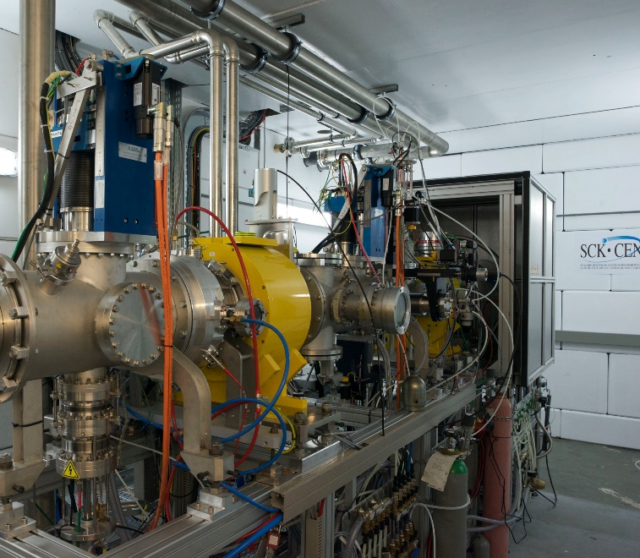
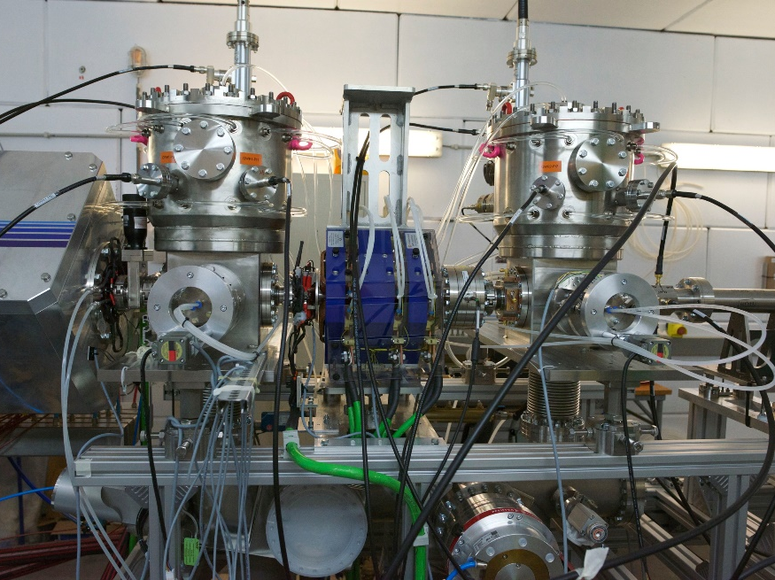
Injector Teststand
Pantechnik Monogan1000
LEBT
  2 solenoids optics
  gas injection for SCC
  2 Allison emittancemeters
  electrostatic chopper
  ACCT
4 rod RFQ
up to 160kW
Rebunching section

Slide 19
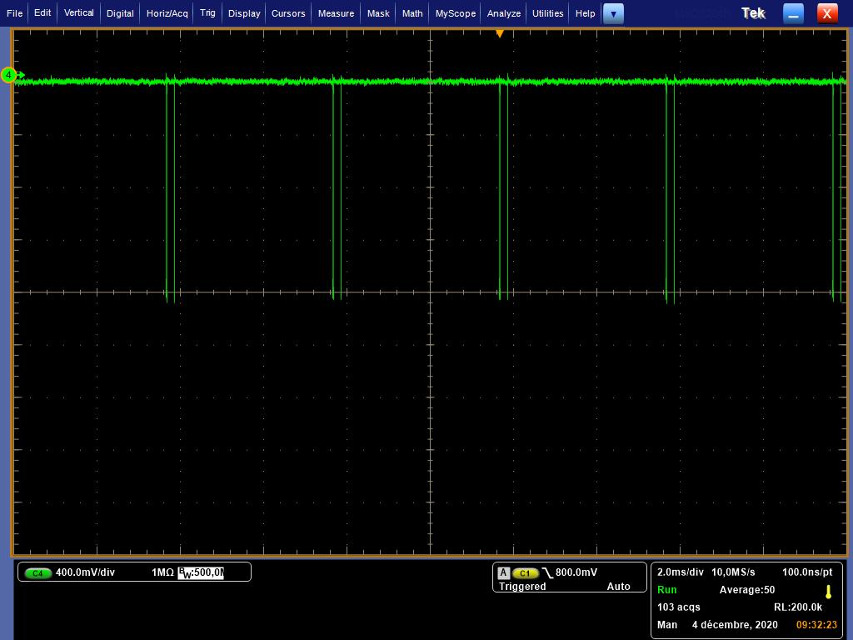
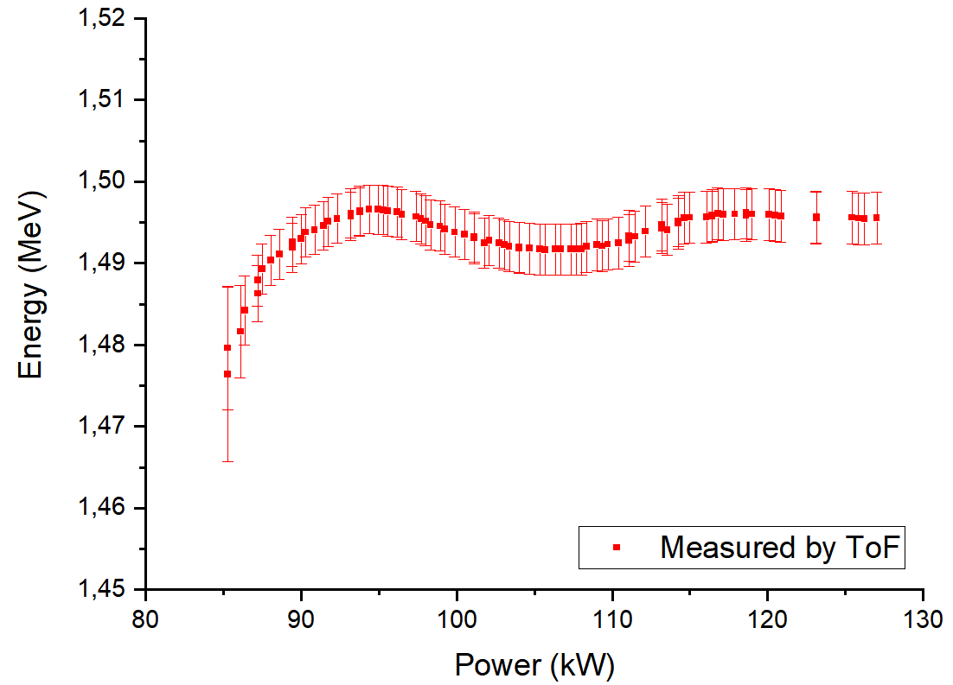
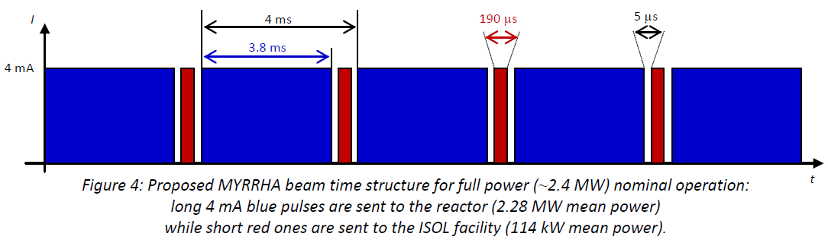
Injector Teststand
RFQ commissioned with 95% transmission in nominal conditions
Nominal energy : 1.494 ± 0.003 MeV

Slide 20
SC-linac
Optics & layout “classic high-power SC-linac-style”:
  30 cryo modules with each 2 single spoke cavities (352.2 MHz, β = 0.352)
  Warm section with doublet & diagnostic
  BPM & correctors integrated into quadrupoles
Last doublet used to match into “HEBT”
Significant RF-overhead for serial fault tolerance
Matching optimization still ongoing

Slide 21
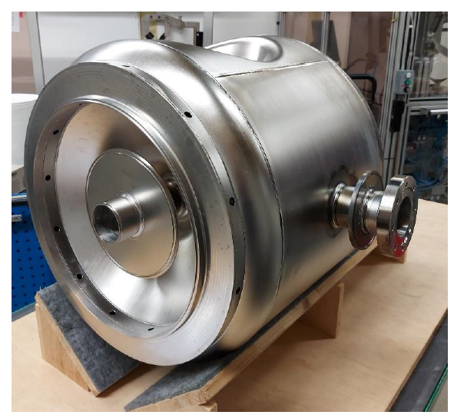
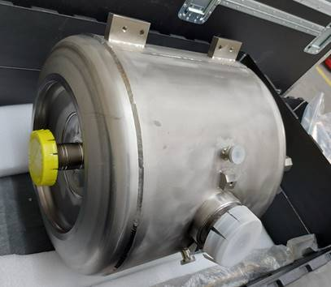
Series production of SC cavities (CAV)
cavity welded successfully
Integrated into He tank
  Leak test OK
  RF frequency after welding within tolerance
First series cavities successfully tested for E_{acc} (January/February 2024)
tested at 11 MeV/m exceeding nominal 9 MeV/m

Slide 22
Reliability
Design choices
  Linear accelerator
  Injector: parallel redundancy
  SC linac: serial redundancy
    installing RF overhead
    Fast de-tuning of SC cavities
Reliability model
  in collaboration with CERN
  using AvailSim4

Slide 23
Reliability approach
Reliability requirement: # beam trips > 3s: Max 10 per 90 days
Reliability model done together with CERN as part of the EU-funded PATRICIA collaboration
MYRRHA reliability requirements
Fault budget for individual systems, based on existing reliability data from other facilities
Identify critical sub-systems and develop fault compensation schemes

Slide 24
Top down model
MYRRHA accelerator (10)
Injectors (1)
Injector 1
(5.5){8}
Injector 2
(5.5){8}
Main LINAC (5)
[152] SRF (9.5)
Infrastructure and Services (3.6)
[58] SRF Cryo-module (0.5)
[59] Quad- doublets (5)
BI (0.25)
Electrical network (1)
Cooling plant & ventilation (0.25)
Cryo plant & distribution (0.75)
Pressurized air (0.1)
IT services (0.5)
[58] Valve box (0.2)
[58] Cryostat (0.3)
[152] Powering (2.5)
[152] Feeder, circulator, coupler (2)
[152] Cavity & tuning (2.5)
[152] LLRF (2.5)
[59] Converters (3)
Cabling and connectors (1.8)
[59] Doublet Magnets (0.2)
Controls and Timing (1)
LEBT (1)
RFQ (1)
Vacuum (0.25)
Operation & maintenance (0.2)
Non-redundant kickers and magnets (0.1)
Kickers 100 MeV (0.001)
Dipole 600 MeV (0.099)
Source (0.75)
Injector switching
(0.95) < 92% >
Dynamic compensation
(3.3) < 66% >
Quad – Matrix / Compensation <80%> (1)
Switching magnet (0.05)
Vacuum (0.25)
Non-redundant RF & Cryo (0.1)
[1] Rebuncher 100 MeV (0.1)
Source (0.75)
MEBT (1)
CH (1.5)
LEBT (1)
RFQ (1)
MEBT (1)
CH (1.5)
Vacuum (0.25)
BDS to reactor (0.2)
MYRRHA Top-Down model with fault-tolerance strategies. Numbers in brackets are fault count per 90 days (worst case to reach requirements). Numbers in square brackets are the system count. Numbers in arrow-brackets indicate the effectiveness of the respective fault-tolerance mechanism (i.e. what percentage of faults in the systems below the fault-tolerance method will be visible to operation).

Slide 25
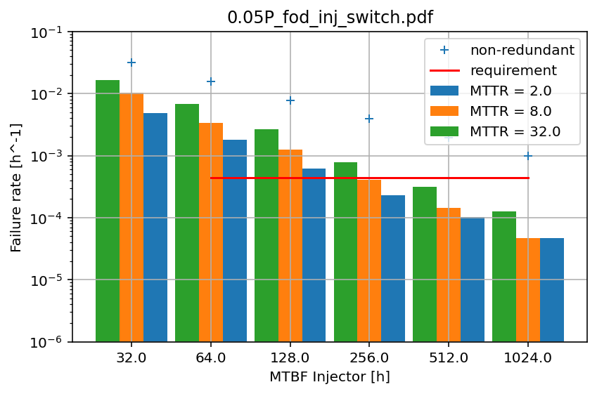
Injector reliability - AVAILSIM4 simulations
Availability of the linac simulated with Monte Carlo code (AVAILSIM4)
AVAILSIM4 result for the redundant injector strategy:
target failure rate per hour for the injector deduced from breakdown of estimated individual failure rates for all components
Failure rate/h simulated for
  different Mean Time Between Failures (MTBF)
  different Mean Time To Repair (MTTR)

Slide 26
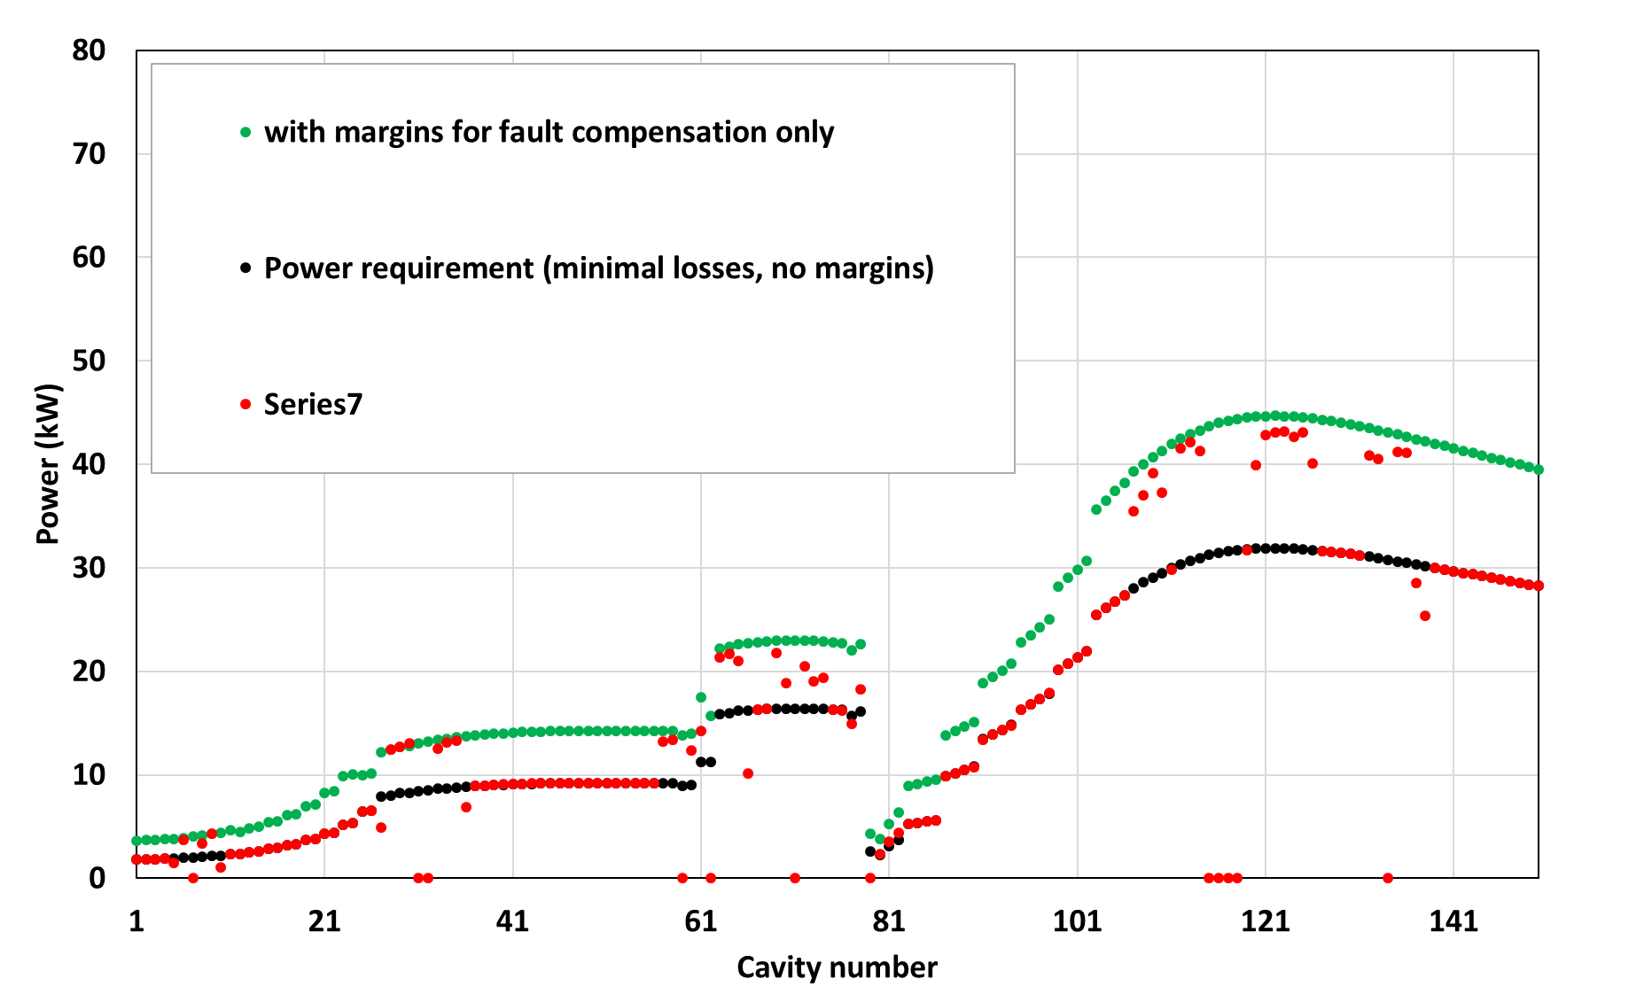
Dynamic RF-compensation
(*) 18 double spoke cavities
9 cryo modules
100 → 172 MeV
(**) 72 elliptical cavities
18 cryo modules
172 → 600 MeV
● With minimal margins for fault compensation
● With fault compensation
● Ideal from beam dynamics
MINERVA
60 single spoke cavities
30 cryo modules
17 → 100 MeV
(*)
(**)
The plot shows power requirements for all cavities from a pure beam dynamics point of view, when 4 neighboring cavities compensate 1 faulty cavity

Slide 27



















































International R&D network (1)
Universities
Research
Source: SCK CEN MYRRHA Project Team
* Acquired by Veolia

Slide 28


















International R&D network (2)
Private Sector
Beyond EU
*
Source: SCK CEN MYRRHA Project Team
* Acquired by Veolia

Slide 29
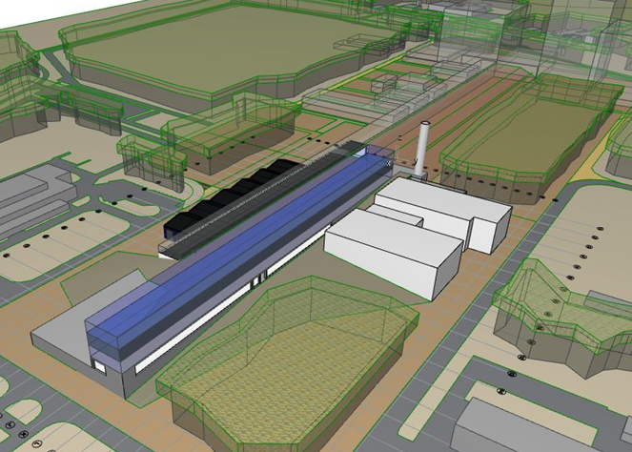
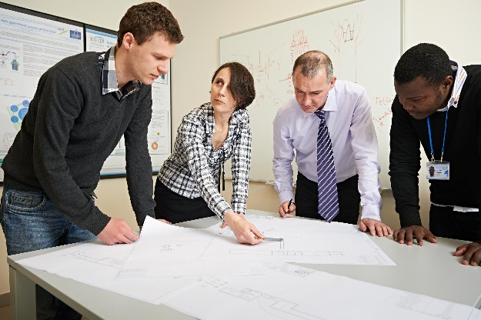

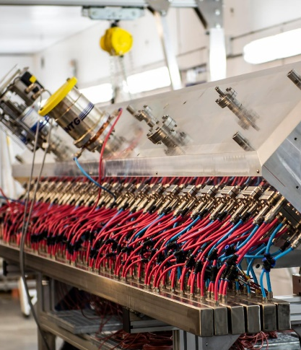
Timeline – phase 1
Nuclear licensing: approval received from authorities
2016
2020
11/2022
2024
2026
2028
Beam Commissioning
Design
Construction

Slide 30
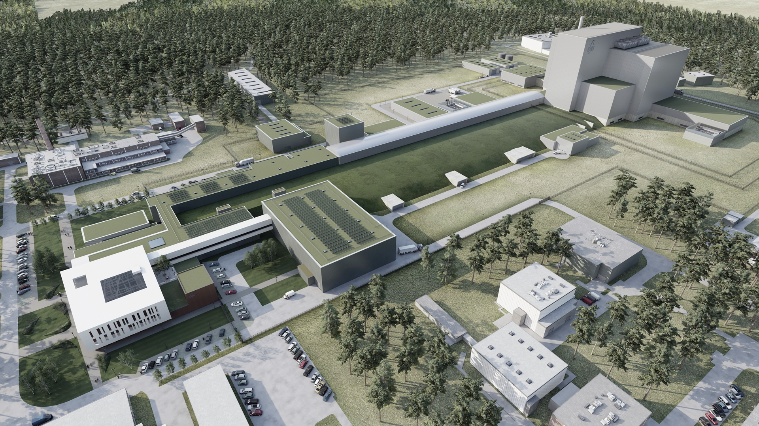
Summary
MYRRHA Phase 1 is funded and currently implemented
International not-for-profit organization established since 2022
Inviting interested parties (countries, organizations, companies) to join MYRRHA
Design consolidation of accelerator optics & components being finalized
First series components in production
Heavily relying on collaborations & industry

Slide 31
Copyright © SCK CEN
All property rights and copyright are reserved.
This presentation contains data, information and formats for dedicated use only and may not be communicated, copied, reproduced, distributed or cited without the explicit written permission of SCK CEN.
If this explicit written permission has been obtained, please reference the author, followed by ‘by courtesy of SCK CEN’.
Any infringement to this rule is illegal and entitles to claim damages from the infringer, without prejudice to any other right in case of granting a patent or registration in the field of intellectual property.
SCK CEN
Belgian Nuclear Research Centre
Studiecentrum voor Kernenergie
Centre d'Etude de l'Energie Nucléaire
Foundation of Public Utility
Stichting van Openbaar Nut
Fondation d'Utilité Publique
Registered Office:
Avenue Herrmann-Debrouxlaan 40 - 1160 BRUSSELS - Belgium
Research Centres:
Boeretang 200 - 2400 MOL - Belgium
Chemin du Cyclotron 6 - 1348 Ottignies-Louvain-la-Neuve - Belgium

